Slide 1

3 July 2023.
DRD4 – Detector R&D Collaboration on
Photodetectors and Particle ID
+ SciFi tracking + Transition Radiation
»Intro meeting with the SciFi community»
Zoom meeting
Organizers: P. Krizan and C. Joram
On beahlf of DRD4 Preparation Team

Slide 2
Material and Links
The Roadmap (248 p) https://cds.cern.ch/record/2784893?ln=en
Implementation of the ECFA Detector R&D Roadmap
https://indico.cern.ch/event/957057/page/27294-implementation-of-the-ecfa-detector-rd-roadmap
DRD 4 Implementation zone. Incl. short chronological overview: https://indico.cern.ch/event/1214407/
Older, but still interesting
ECFA Detector R&D Roadmap Symposium of Task Force 4 Photon Detectors and Particle Identification Detectors
Thursday 6 May 2021 https://indico.cern.ch/event/999817/

Slide 3
Detector R&D Collaborations in the context of the ECFA Roadmap
The Roadmap has identified detector technologies¹⁾ that need to be developed for the next generations of particle physics experiments.
To address those needs in a coordinated and efficient way, Detector R&D Collaborations are being formed.
Some similarity to the CERN R&D collaborations before the construction of LHC (still alive RD50, RD51…)
Collaborations shall form, define their work programme, define and organise their funding, define their management, report once per year to a DRD Committee at CERN. Chair: Thomas Bergauer, Vienna.
Joint R&D should increase efficiencey (avoid duplication, form partnerships) and lead to synergies (share equipment, samples, know-how).
The label ECFA Roadmap should enhance chances for extra funding from Funding Agencies. The participating groups (nationally clustered?) request funds from their FAs.
¹⁾ IMPORTANT: we are talking about technolgical (strategic) detector R&D in the fields photodetectors and Particle ID. This is different from experiment-specific developments and optimisations (adaptation of geometry, full-size prototype, industrialisation of production process, …). The latter R&D shall remain fully under the responsibility of the experiments.

Slide 4
Scintillating Fibre tracking
ECFA Roadmap panel decided to include SciFi tracking in DRD 4.
SciFi uses similar photodetectors than RICH, deals with similar signal levels, FE electronics, ligh structures
SciFi is also linked to Calorimetry (WP6). Use of organic scintillators
So far, the following institutes have expressed interest in DRD 4
  LHCb SciFi institutes Sune Jakobsen, Pascal Perret
  Mu3e, Geneva, ETH-Z Sandro Bravan, Rainer Wallny, Cristina Martin
  CERN SY-BI (Beam instrumentation) Inaki Ortega Ruiz
  GScan, Estonia (industrial) Madis Kiisk
Today, we are holding a meeting of the SciFi subteam to discuss activites and possible projects
Transition Radiation
TR is a well-established PID method and as such fits in DRD4.
Classic TR detectors are usually based on gaseous detectors (like straws, MWPC) and should be in DRD 1
It was agreed to have solid state-based TR R&D in DRD 4. So far, there are only very few groups. An intro meeting takes place tomorrow.

Slide 5
Status of DRD4 preprations
A preparation team (volunteers) has been formed (see next slide)
A collaboration structure has been defined and agreed on
Program broken down in Working Groups and Work Packages (themes)
WG = forum, social network WP = project, budget, planning…
Survey 4 clarified which group is interested in which WG and WP
Survey 4 gave first indication on (available) resources (FTE, EUR)
Question of small common fund contribution (membership fee) pending

Slide 6
  DRD4 Preparation team
  Sajan Easo, RAL, UK
  Massimiliano Fiorini, Ferrara, IT
  Roger Forty, CERN, CH
  Christian Joram, CERN, CH, Coordinator
  Peter Krizan, JSI, Ljubljana, SLO, Coordinator
  Imad Laktineh, IN2P3, Lyon, FR
  Rok Pestotnik, JSI, Ljubljana, SLO
  Alessandro Petrolini, Genova, IT
  Fulvio Tessarotto, Trieste, IT

Slide 7
Structure and naming scheme of DRD4
ECFA panel. 07 June 2024
Coordinator
WP leaders
WG convenors
Board of
Institutes
Themes DRDT 4.1 and DRDT 4.2
Theme DRDT 4.3
Theme DRDT 4.4
Enhance the timing resolution and spectral range of photon detectors
Develop RICH and imaging detectors with low mass and high timing resolution
No WP on SciFi so far.
Develop compact high performance time-of-flight detectors
Develop photosensors for extreme environments
Solid state PD
Vacuum based PD
WP 4.3.1
WP 4.4.1
WP 4.1.1
WP 4.2.1
WP 4.3.2
WP 4.4.2
Work Packages
Work Packages
WP 4.1.2
WP 4.2.2
WP 4.3.3
WP 4.4.3
WP 4.1.3
WP 4.2.3
…
…
…
…
WG 4.1
WG 4.2
WG 4.3
WG 4.4
WG 4.5
WG 4.6
Photodetector R&D
Solid state
Gaseous
Vacuum
Particle ID
RICH
DIRC
TOP
TORCH
TOF
Software
Simul
Recon
ML
…
Future
ideas,
concepts,
blue sky
…
Technologies
Radiators
Optical elements
Readout
Cooling
…
Special
SciFi
TR (Solid state based)
…
Working Groups

Slide 8
Dedicated status of (semi-)industrial partners
Industrial Partners (definition)
The Board of Institues can grant the status of “Industrial Partners” to collaborating industrial partners.
Industrial partners are not represented in the Board of Institutes.
Industrial partners do not contribute to a possible Common Collaboration Fund.
Team members of industrial partners are listed as co-authors on common publications (same rules as applicable to all other collaboration members).
Industrial partners can participate to the activities of one or several Working Groups
Industrial partners shall not directly participate to a Work Package. Indirect participation via a collaborating institute may be possible.
DRD 4 collaboration differentiates between industrial partners and institutions that have to finance themselves partly by commercial income. The latter can still become full members of the Collaboration (i.e. ”Collaborating Institutions”).
In cases where conflicts could arise with their commercial interests, e.g. when the collaboration is going to tender products which they are able to sell, the IB shall decide to not allow them to discuss and vote about these issues in the IB.

Slide 9
DRD 4, Data 28 June 2024, based on 52 returned questionnaires
Average: 1 group joins 2.56 WGs

Slide 10
DRD 4, Data 28 June 2024, based on 52 returned questionnaires
? To be checked
Average: 1 group joins 2.94 WGs
! company
! Semi-industrial

Slide 11
Strong correlation between WG 4.1 and 4.2

Slide 12
Photodetectors
Particle ID
Technological R&D
Software

Slide 13
SciFi Tracker and Transition Radiation !
Blue Sky, far future.

Slide 14
Work Packages
Some double counting ?

Slide 15
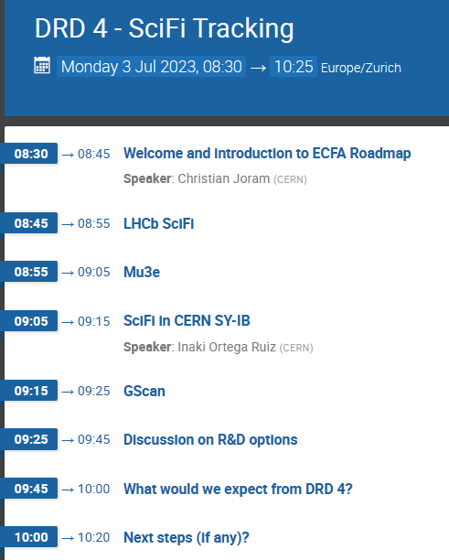
What are the foreseen developments ?
  What is experiment specific, what is ‘strategic’ ?
Are there R&D items which interest more than one group / experiments ?
What do SciFi groups expect from DRD 4 ?
Can you give a rough estimate of involved resources ?
Next steps, if any ?
Deadline for proposal submission: 31 July 2023 !

