Slide 1
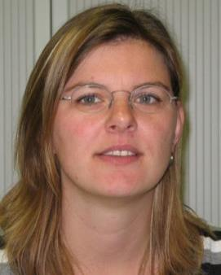
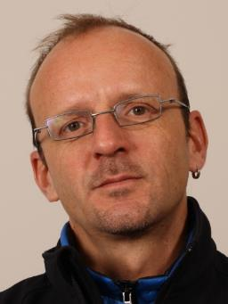
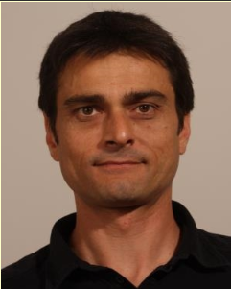
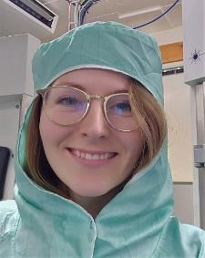
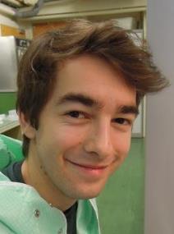
EP-DT Thin Film and Glass Service (TFG)
Students & Apprentices
Miranda van Stenis
Thomas Schneider
Jerome Noel
Thin film coating
Glass & ceramic machining
Optics Quality Control lab
Participation to fiber based detectors
See link=> https://ep-dep-dt.web.cern.ch/thin-film-glass-service
More than 50 years growing experience
Standard service
Production
R&D

Slide 2
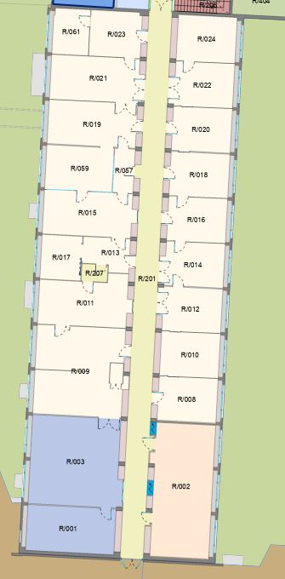
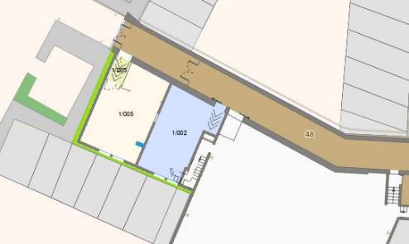
EP-DT-TFG Location
Optical QC lab
(Microscopes)
Optical QC lab
(optical spectrometer)
Clean room with 7 coating devices
Offices
Entrance area with ovens
and gluing facility
Entry
Glass and Ceramic workshop
Building 108
Building 3 R

Slide 3
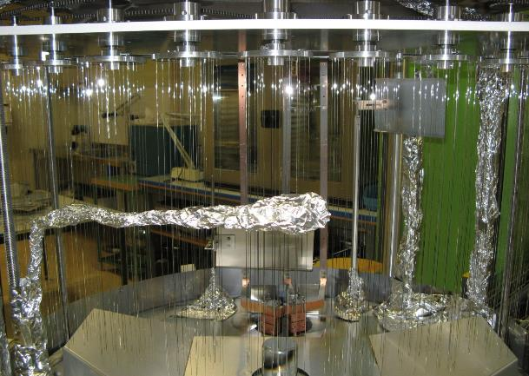
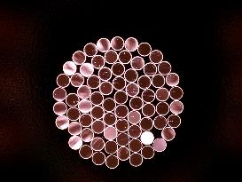
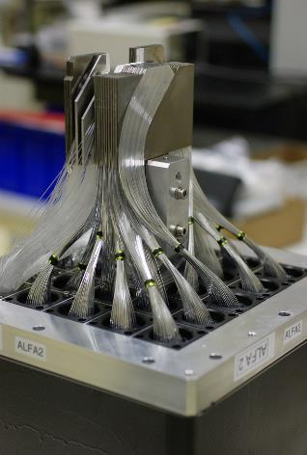
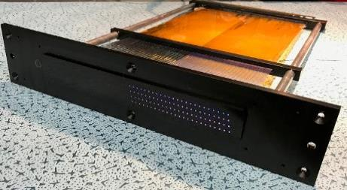
EP-DT-TFG scintillating Fiber activities
Construction and installation of ATLAS ALFA detector (initially started with lateral fibre coating)
Demonstrator construction for AX-PET
Strongly involved in LHCb SciFi development
Development and construction of 15 Fibre beam monitors for Neutino Platform (collaboration with BE-BI)
Contribution to prototype of E-cal LHCb (ongoing)
Individual fibre polishing for various detector groups (fibre–fin)
Competencies:
Optical observations
Individual fibre polishing
Fibre gluing
Fibre detector construction
Reflective (Al) lateral fibre coating
Fibre end coating
Small stock of different Fibers

Slide 4
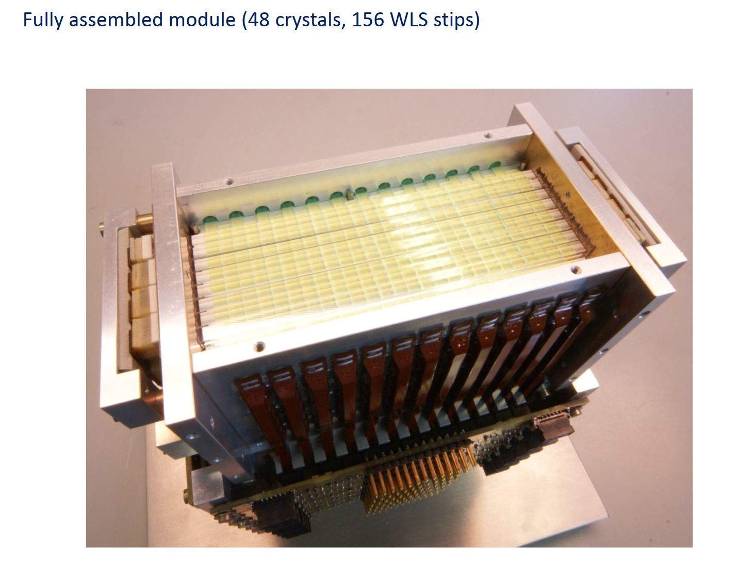
Ax-PET demonstrator construction

Slide 5
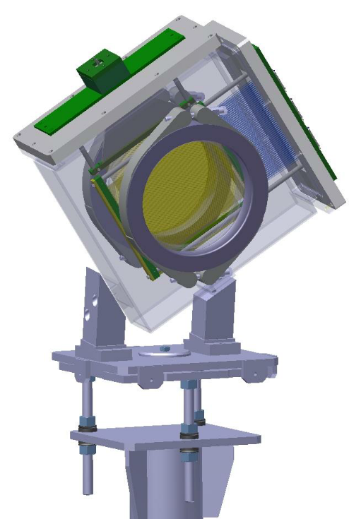
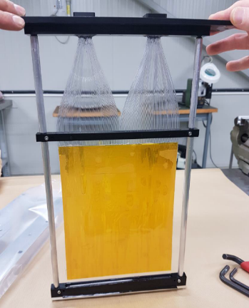
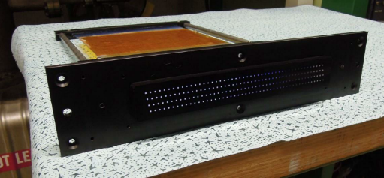
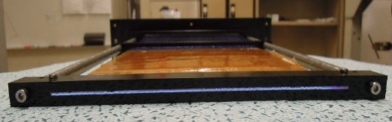
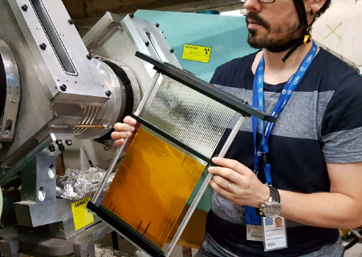
EP-DT-TFG scintillating Fiber activities
With glue!
Trigger module Beam Profile module (1-dimension)
Worked out concept for this detector
Hired TTE to work on this project
Started prototyping
Launched coating campaign for lateral AL coating
Trained TTE on different production steps
Supervised production of 15 modules
2018: Delivery for installation in Neutrino platform
2021: Coating campaign for east hall equipment
2023: Planned to equip north hall
Glued fibre!
Installation in ENH1

Slide 6

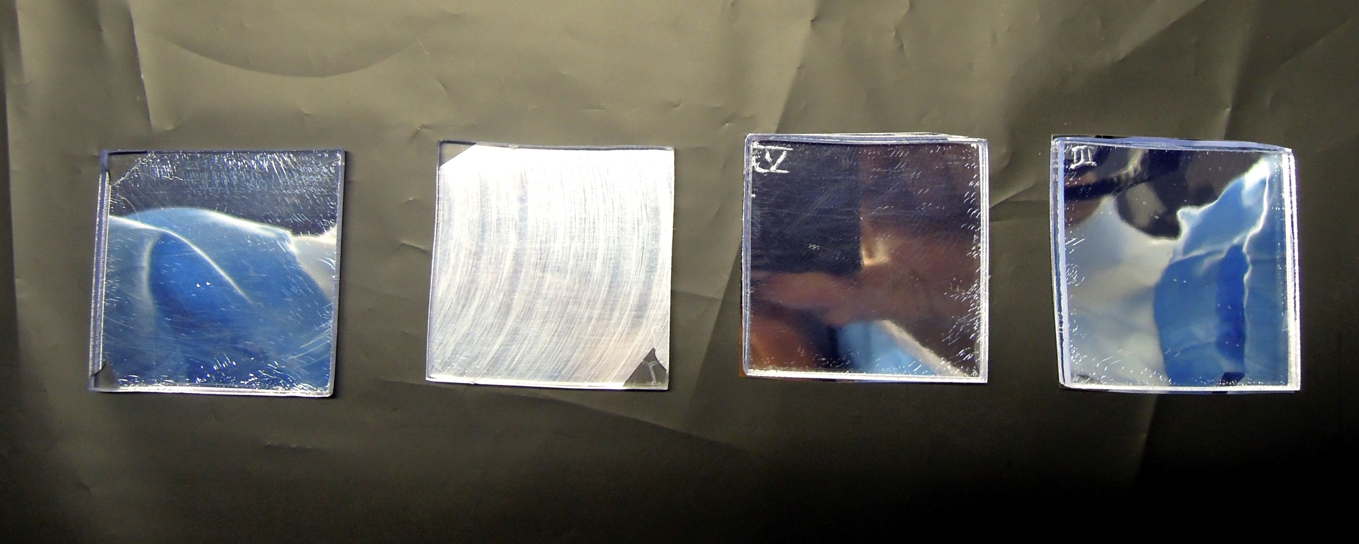
LHCB SciFi Reflector options
Machined Sci- plate with glued Al/MgF2 coated Mylar foil
Machined Sci-plate with glued 3M ESR foil
Original Sci-plate with Al coating
Machined Sci-plate with Al coating

Slide 7
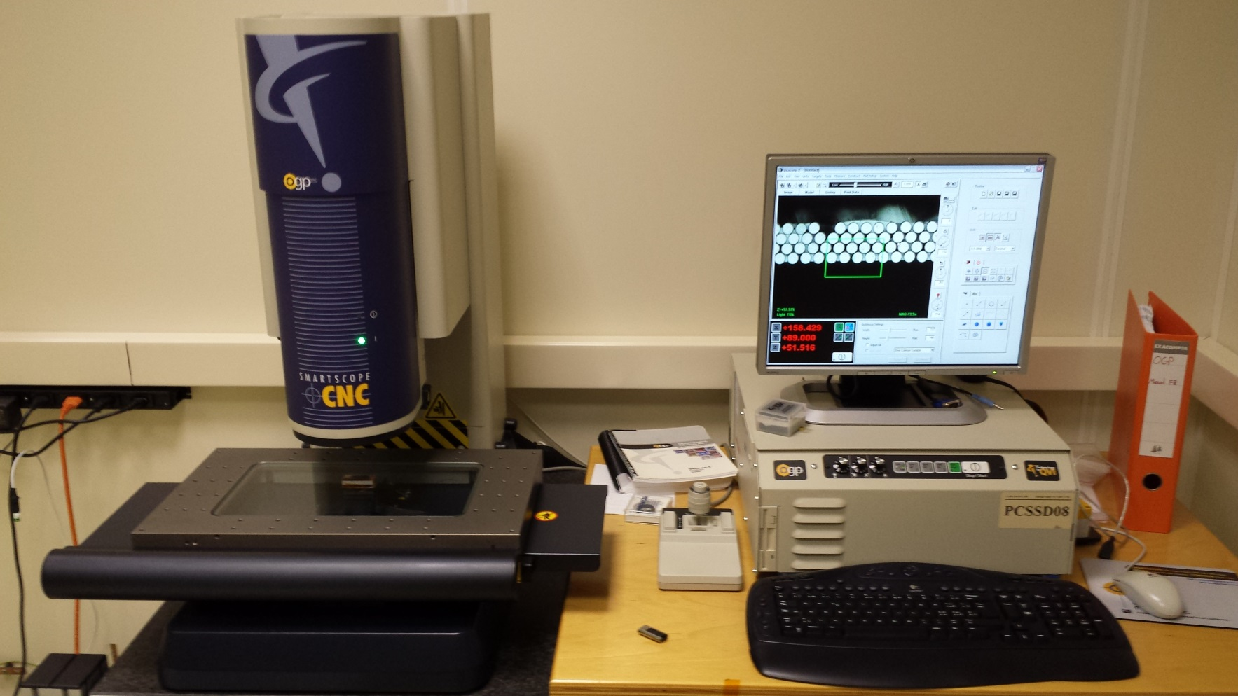
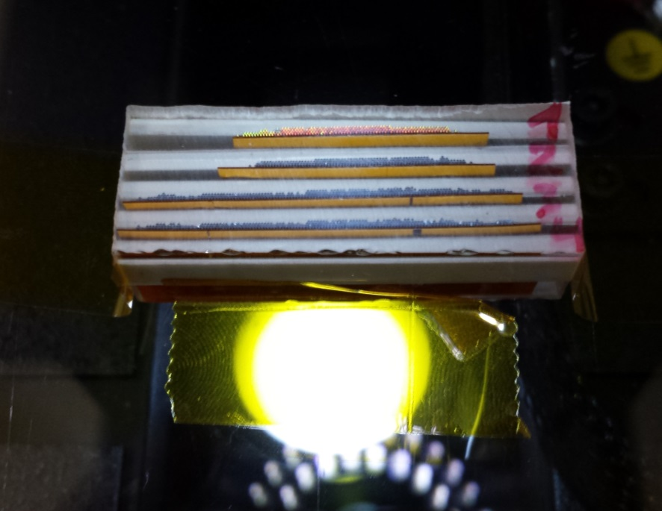
Analysis at CERN
Raphael Dumps immersed 4 samples in a Araldit 2020 bath and machined the whole block after is FULL polymerization.
This sample was then assessed using our optical OGP Coordinate Measurement Machine (prec. < 5 μm)

Slide 8
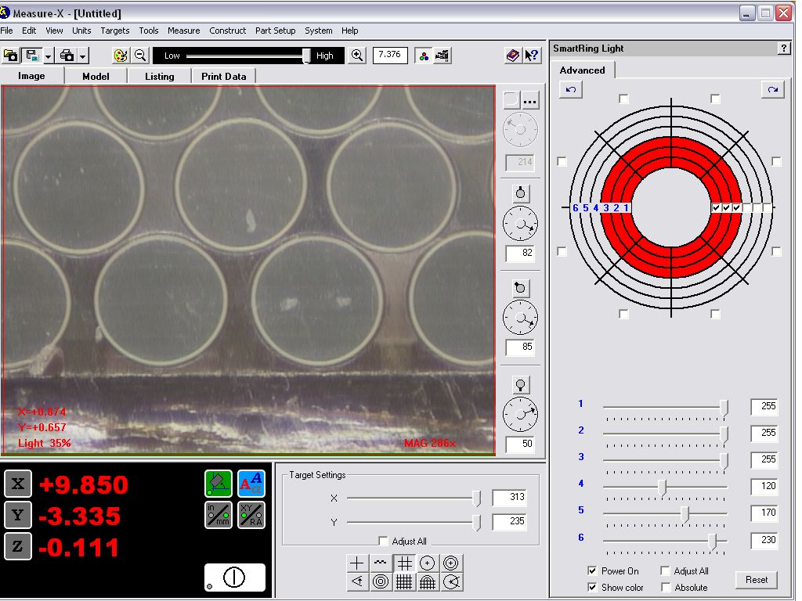

Slide 9
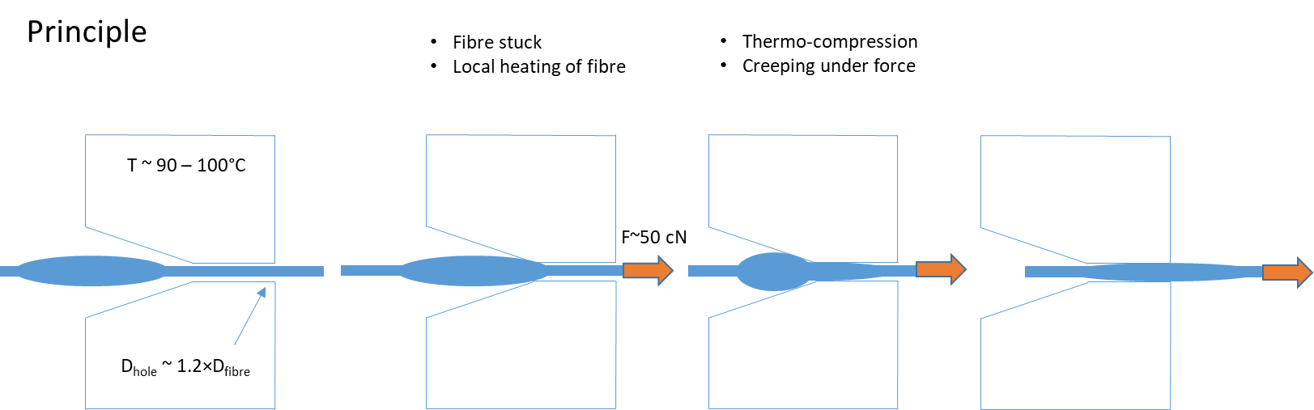
Fiber bump removal by thermo- compression

Slide 10
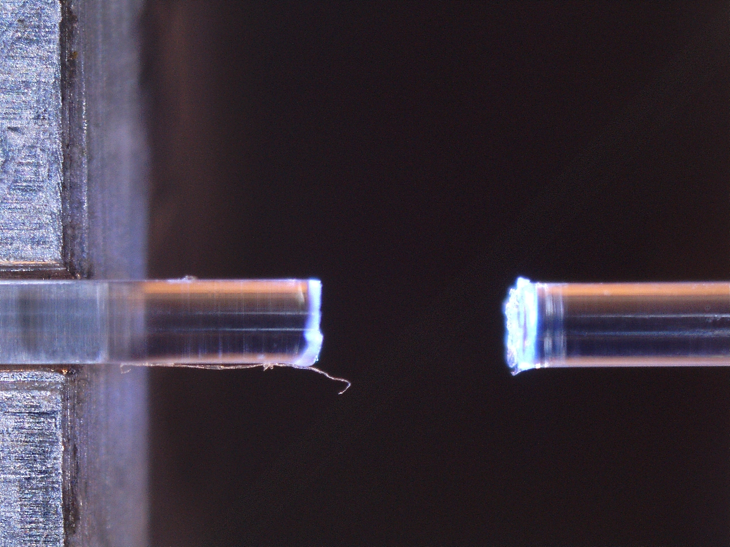
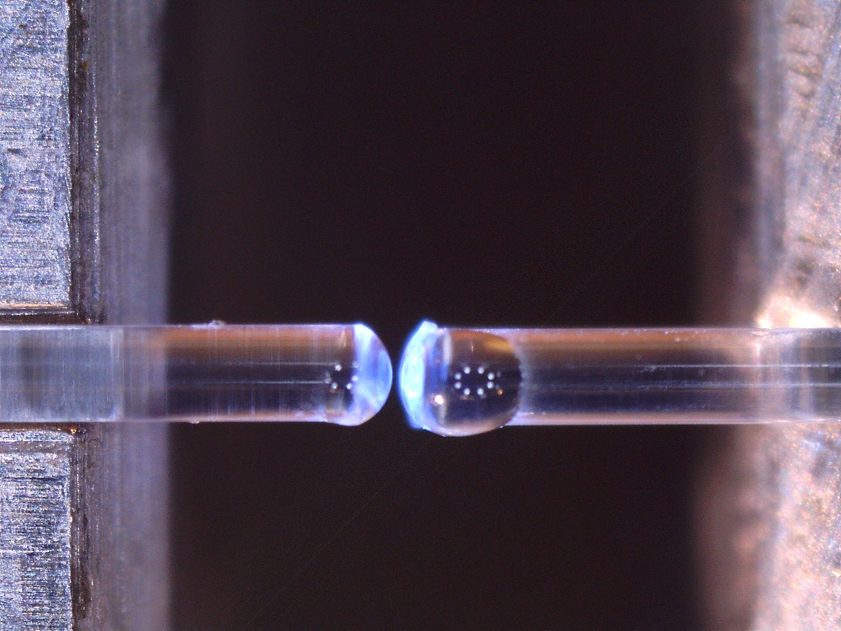
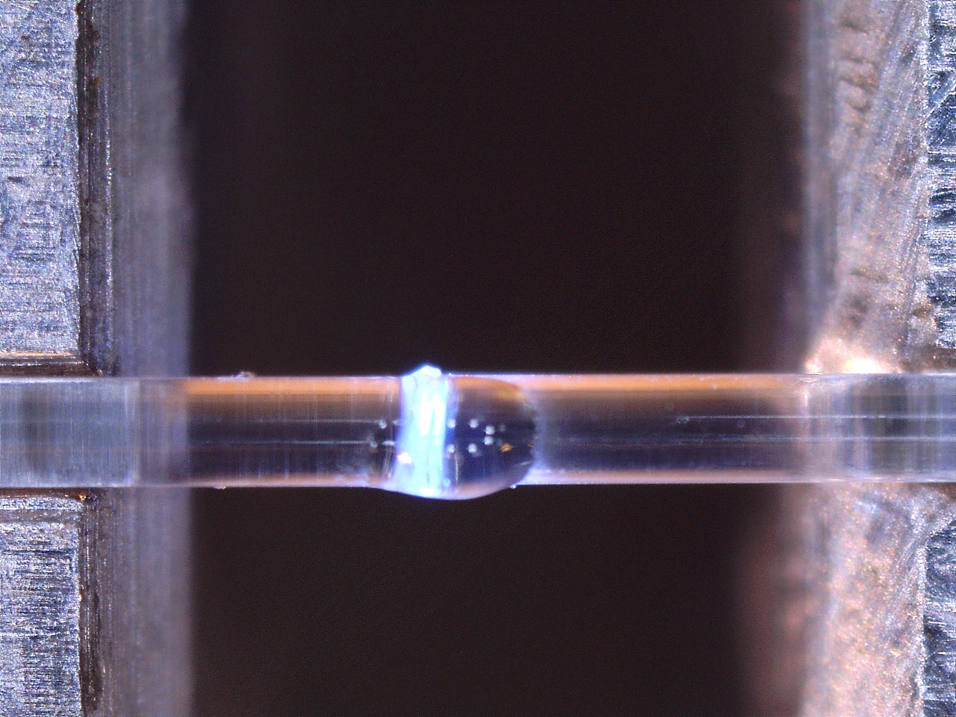
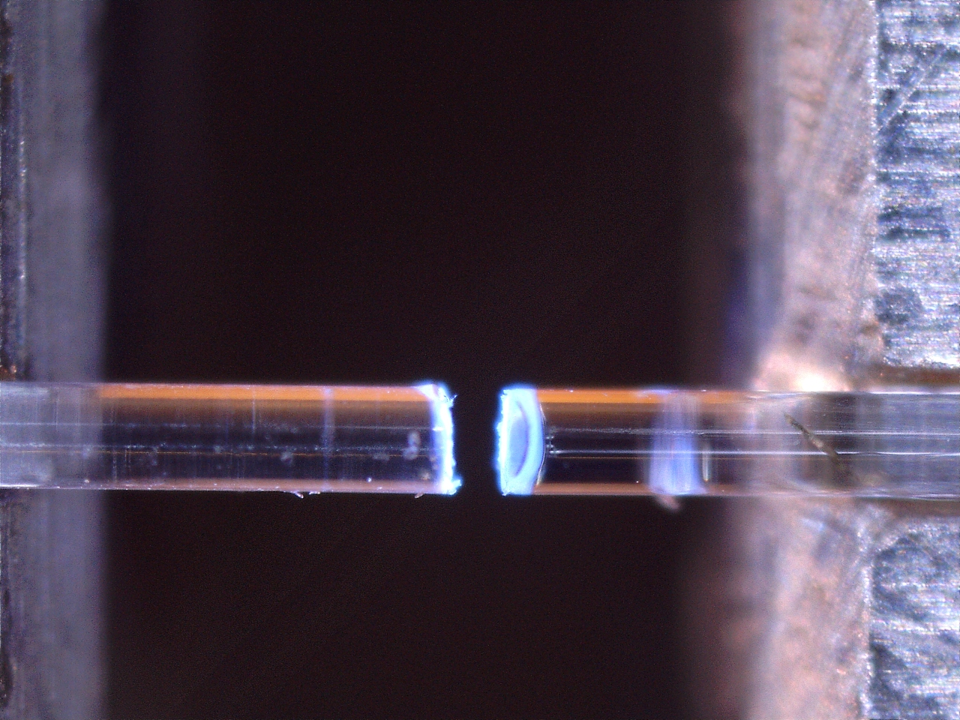
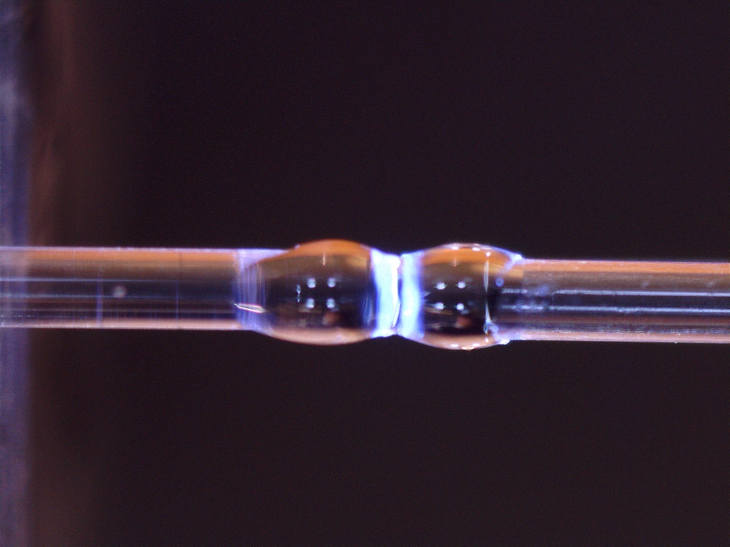
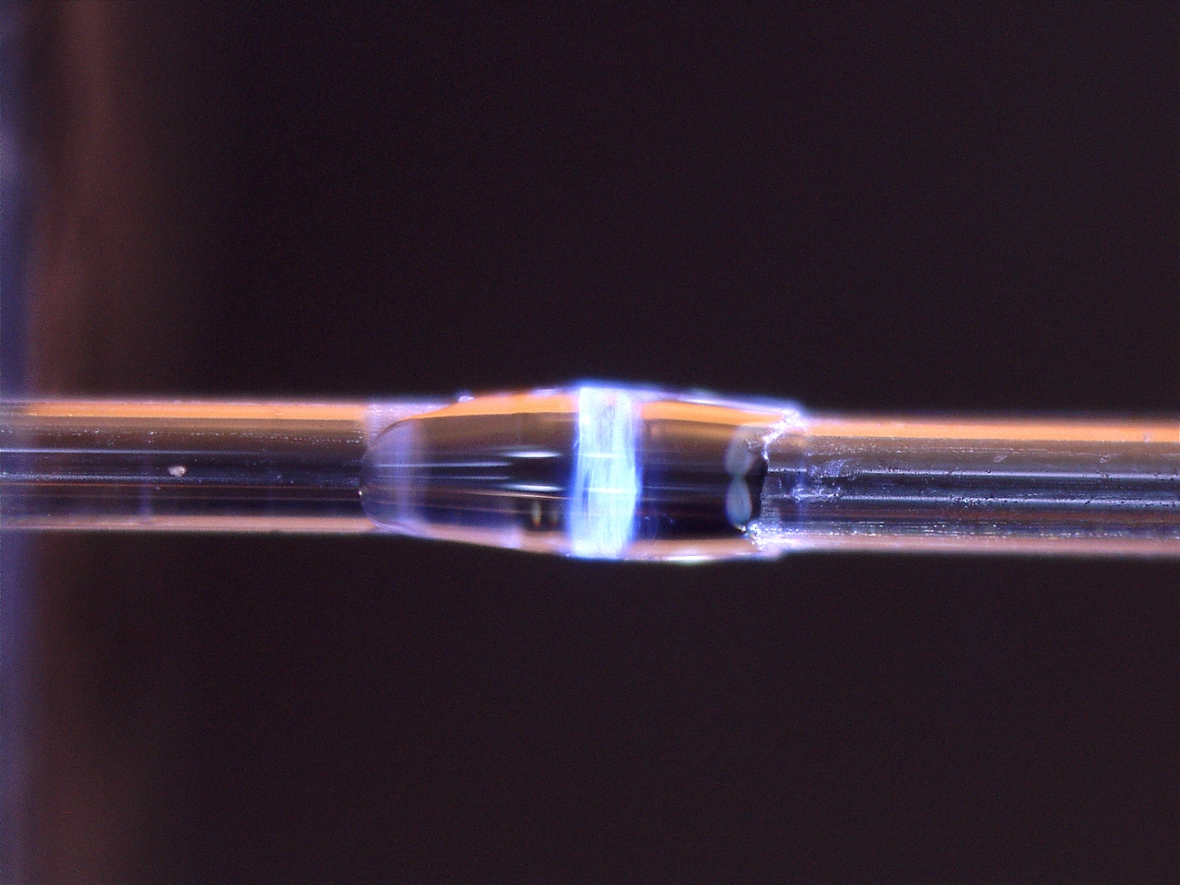
Gluing with UV glue (Loctite 4305 cyanoacrylate glue with photo-initiator)
Face to face gluing with little amount of glue
Sleeve like gluing with bigger amount of glue

Slide 11
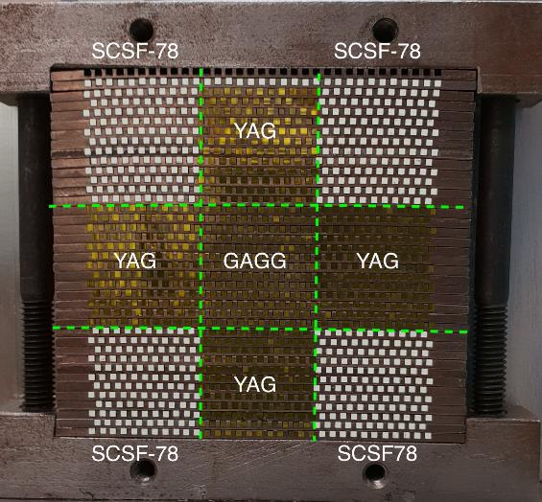
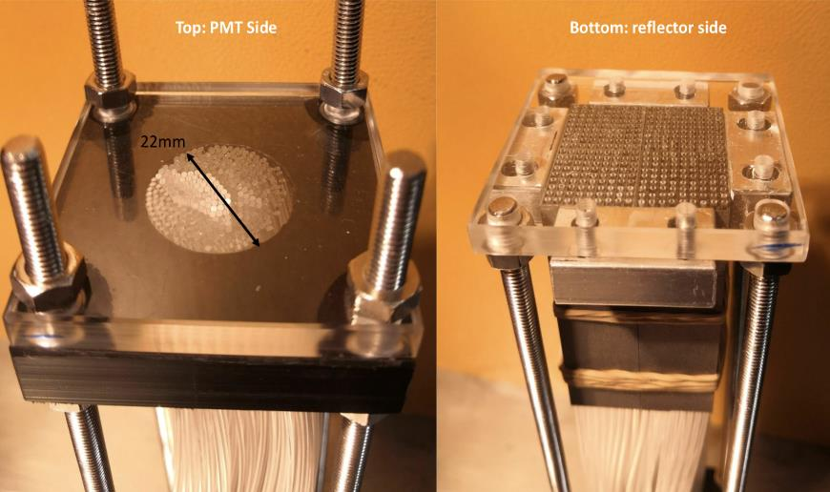
LHCb SPACAL Proto-typing
Tungsten prototype 2018
Lead polystyrene prototype 2021
One end Crystal fibres Al coating
Polishing of scintillating fibers
Assembly in the TFG clean room
Cutting/Polishing of the fibres
Study on how to bundle the fibres
Supervised student on this task

Slide 12
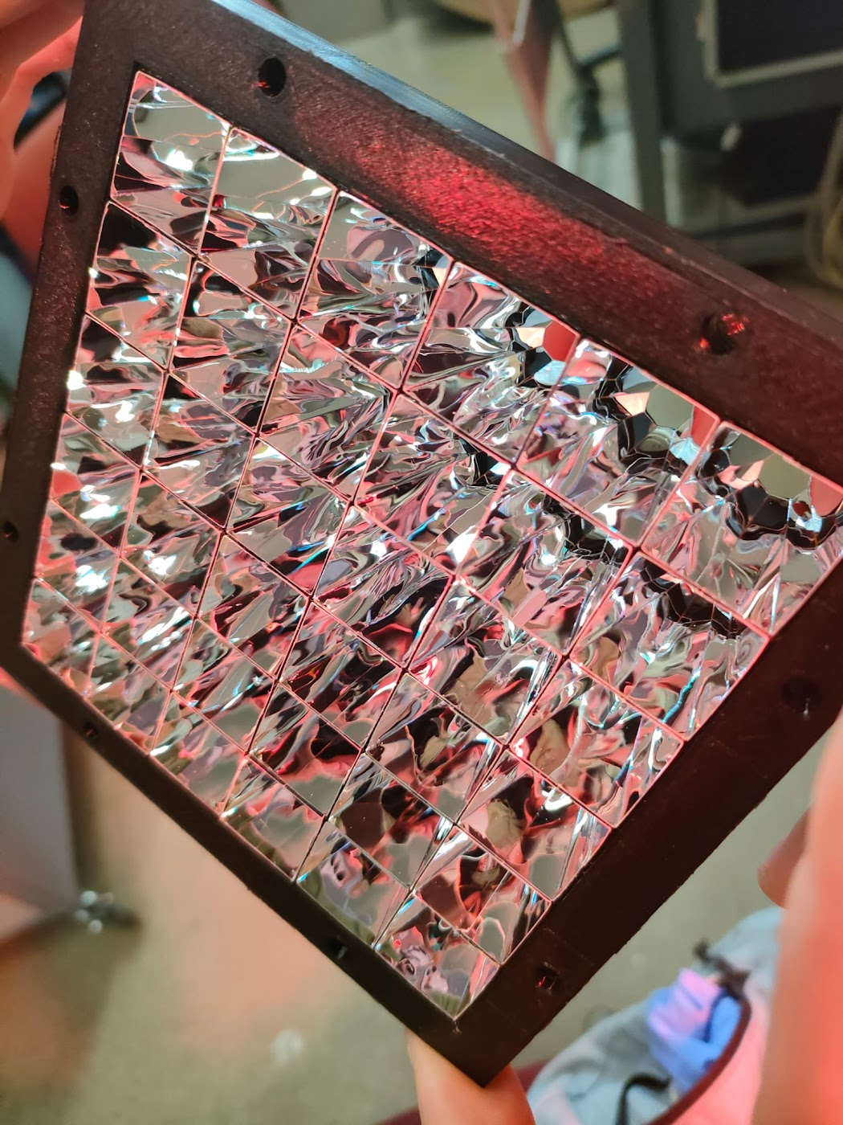
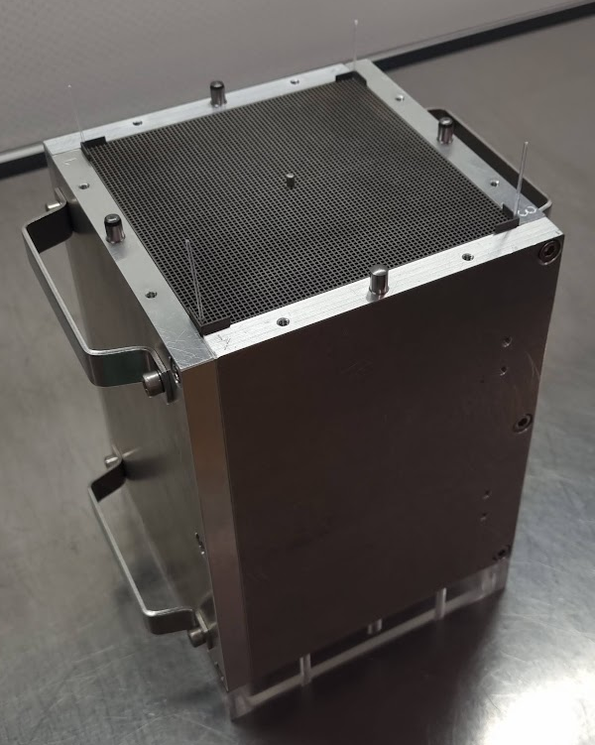
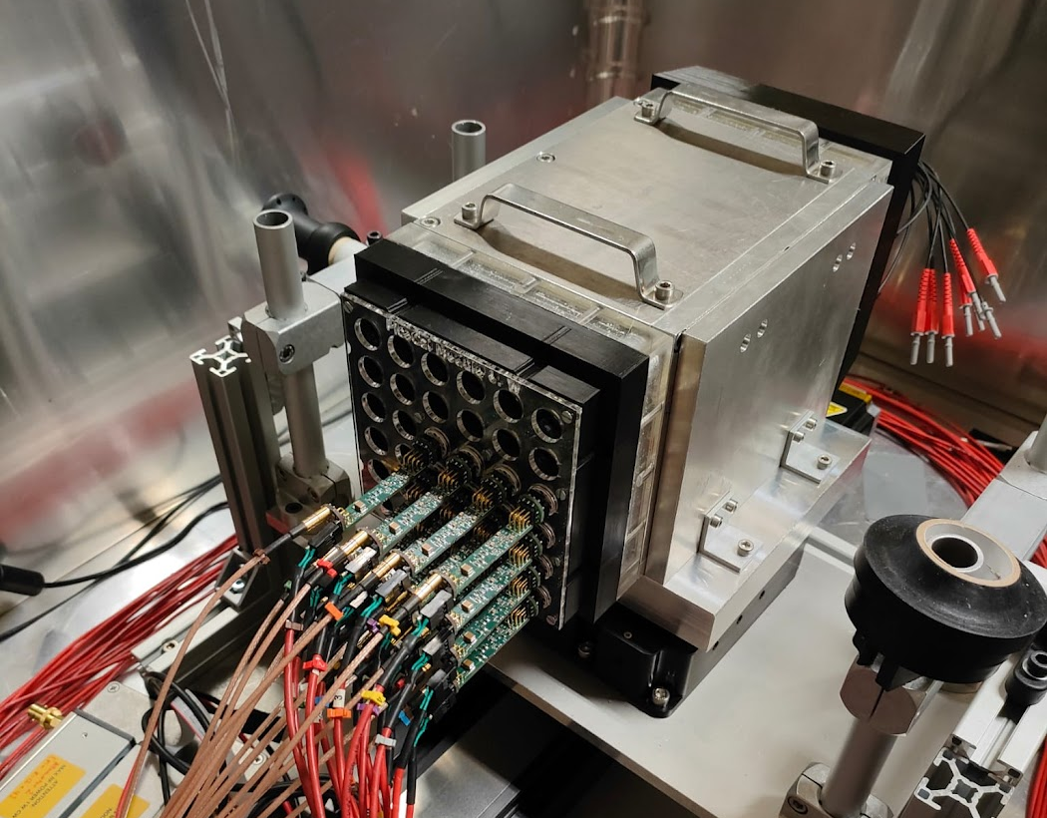
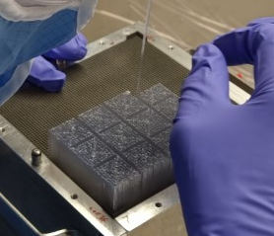
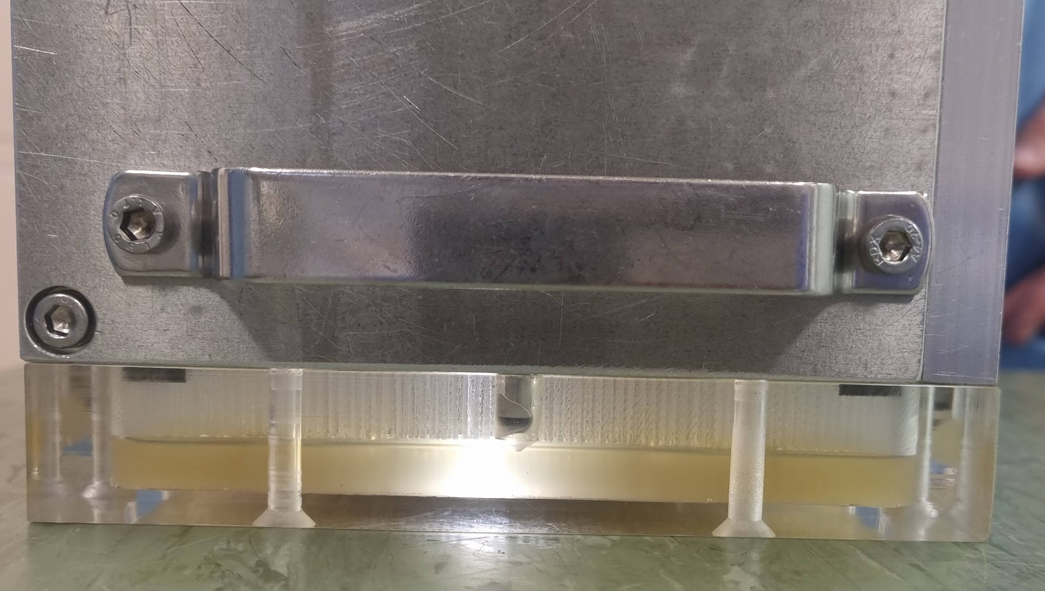
SPACAL W with organic fibers -> LHCb ECAL Module 0 (U1b)
Work performed thanks to:
Idea²
Thin film and glass lab
36 cells prototype ready to be tested:
36-cells of 2x2 cm²
Calibration system included
Kuraray polystyrene scintillating fibers SCSF-78, single cladding, square section
Fiber dimension: square, 1 mm
Pitch between fibers: 1.67 mm
Total length: 19 cm
3D printed W Abs
Radiation hard light guides
Module 0 final assembly
Alu enclosure
Poly Fiber insertion
Glueing
Notes:
this module will also address the radiation tolerance of light collection, which could be solved using reflective hollow light guide (similar to winston cones)

