Slide 1
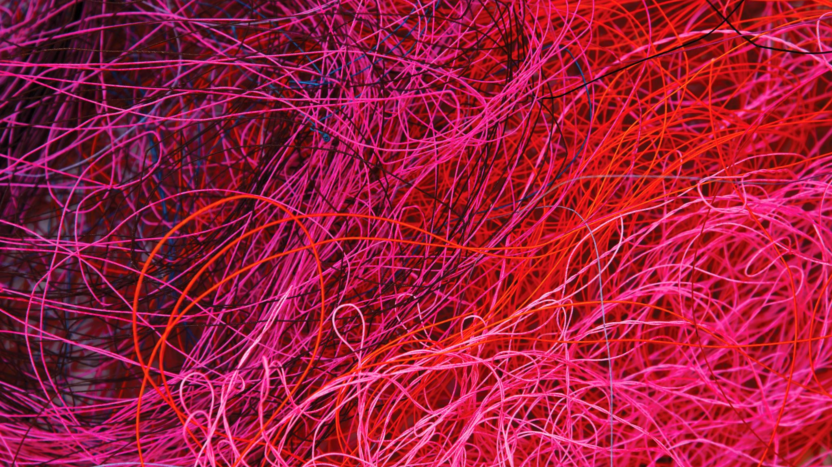
Optical Scintillating Fibres for Tracking
Blake Leverington

Slide 2
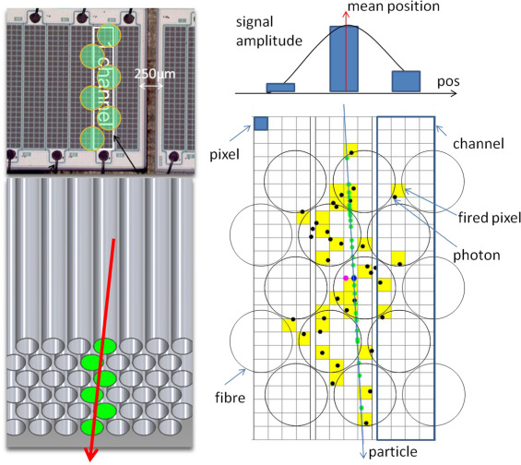
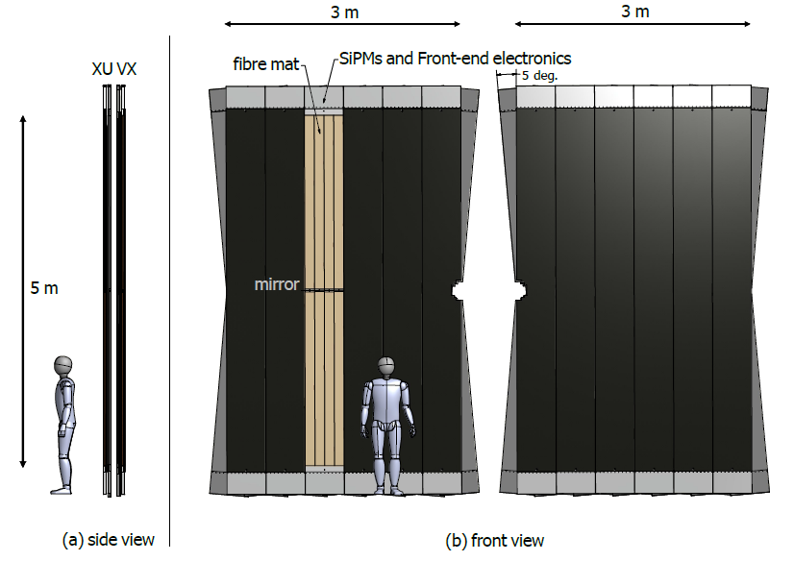

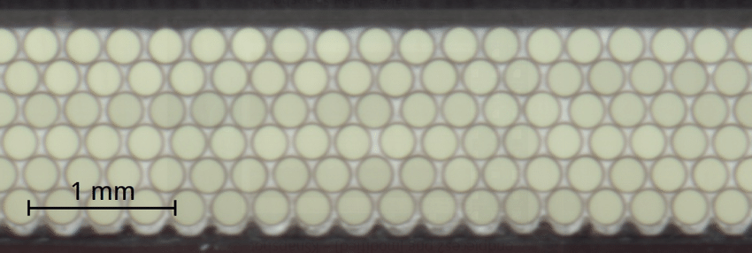
SciFi Tracker

Slide 3
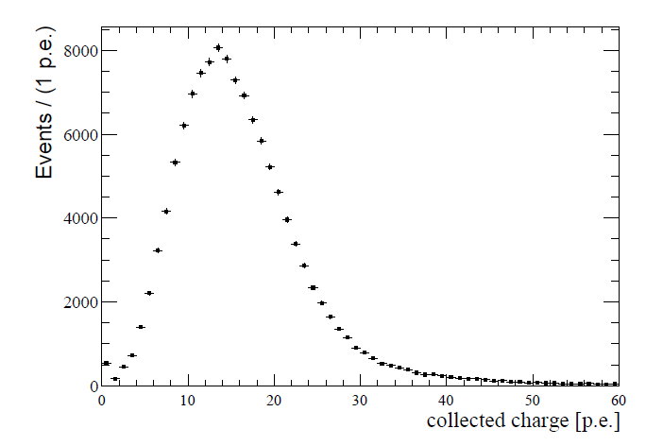
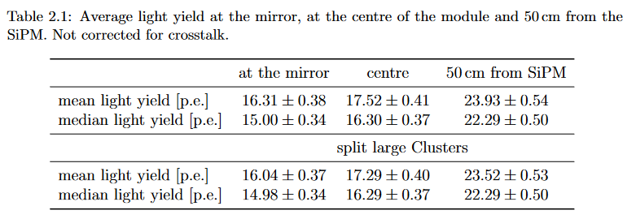
Light Yield
From 2015 test beam note – light yield at mirror

Slide 4
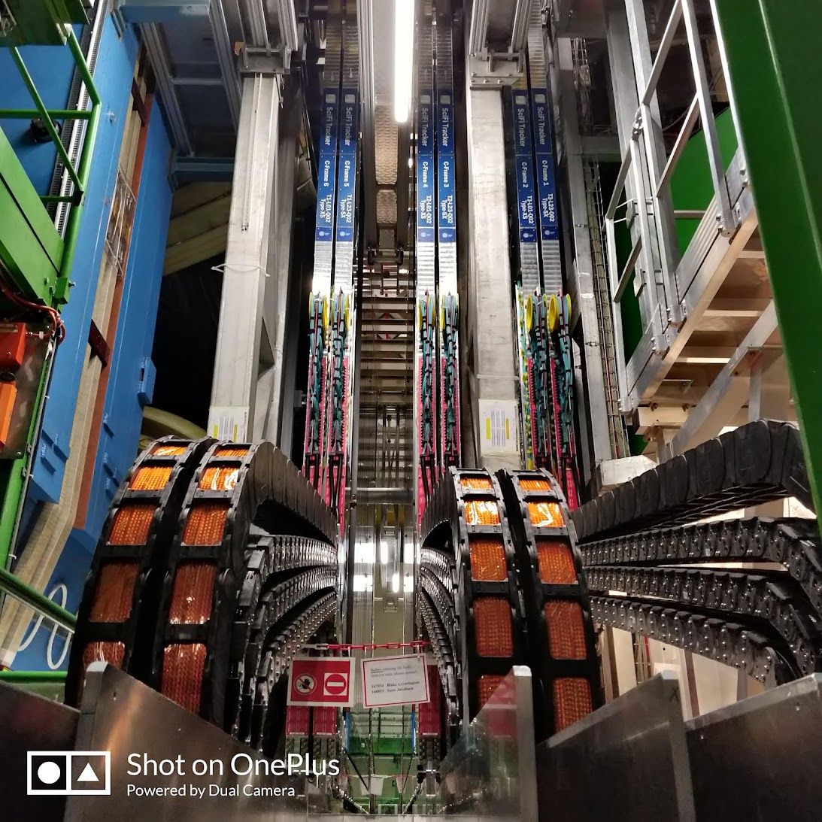
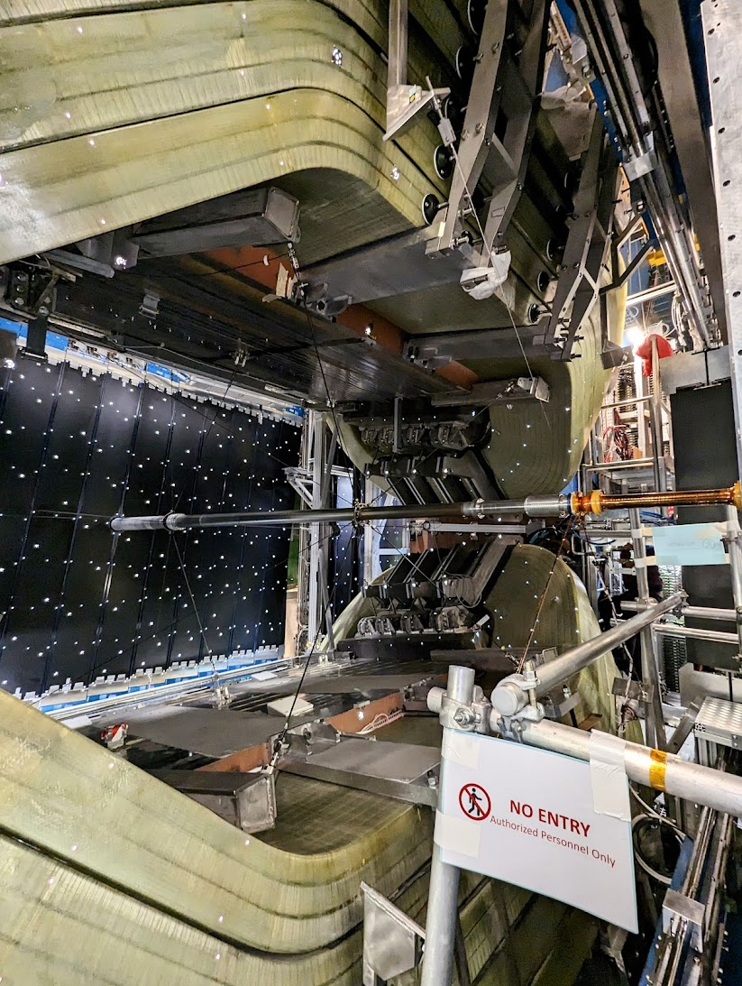
LHCb Upgrade 1 (finished April 2022)
An aligned and closed SciFi Tracker.

Slide 5
LHCb Upgrade 2
Services
Services
Services
Services
Electronics
SiPMs with Cryo Cooling
Fibre Extension
Fibres
SciFi II - A Mighty SciFi
(LS4 upgrade)
Another 5x more radiation /
(10x instantaneous luminosity)
Services
Services
Services
Services
Services
Services
Services
Services
Pixels
Services
Services
Services
Services
Services
Services
Services
Services
The fibre module in the acceptance is likely the standard fibre mat with a carbon fibre + core panel.
The detector outside the acceptance is really undefined at the moment. Not even an idea of the envelopes.
Fibre Extension
SiPMs with Cryo Cooling
Electronics
Services
Services
Services
Services

Slide 6
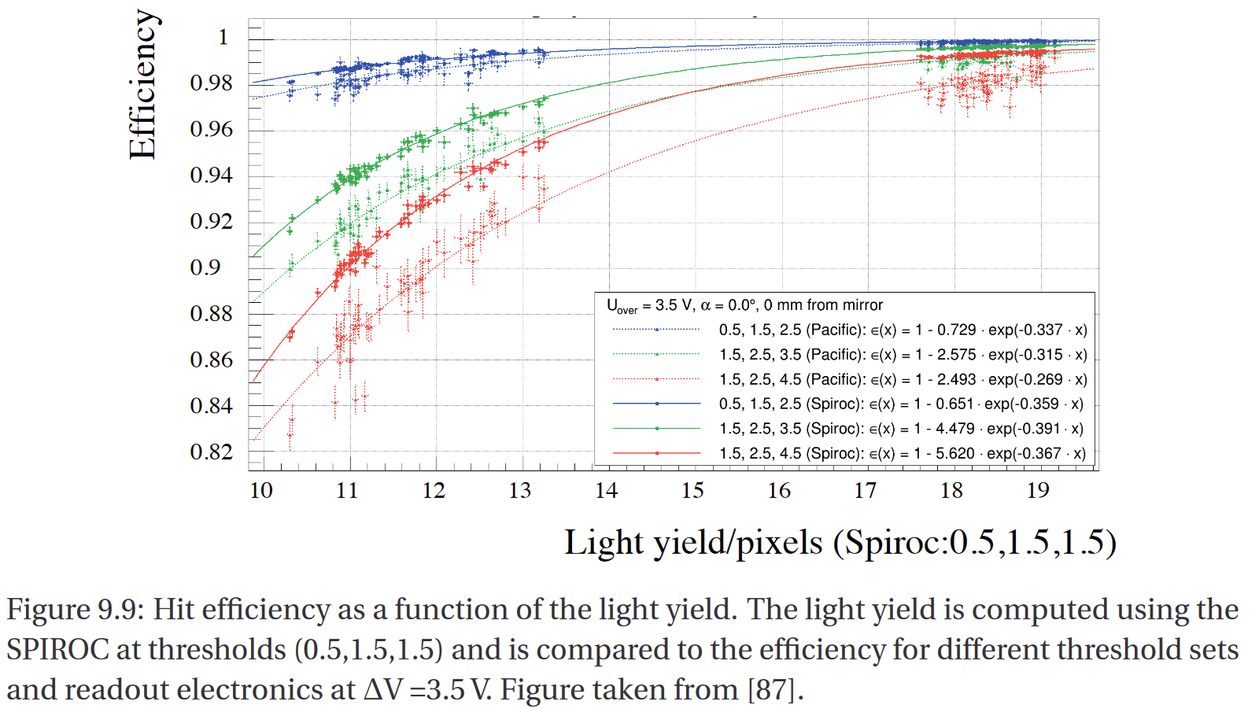
Specifications
Light Yield = Hit Efficiency
  > 16 photoelectrons wanted for >99% efficiency
Thresholds used to separate signal from SiPM Dark Noise
Timing
  Scintillation falls within 1 BXID
  ~1ns resolution possible for long fibres
https://infoscience.epfl.ch/record/256964?ln=en

Slide 7
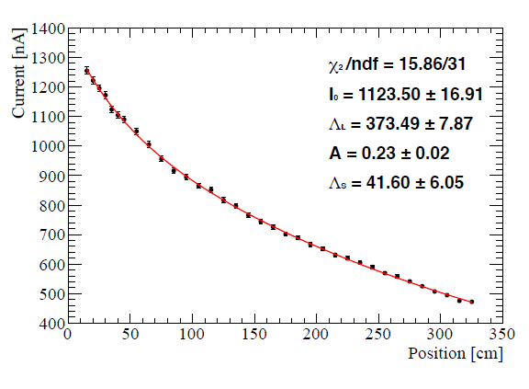
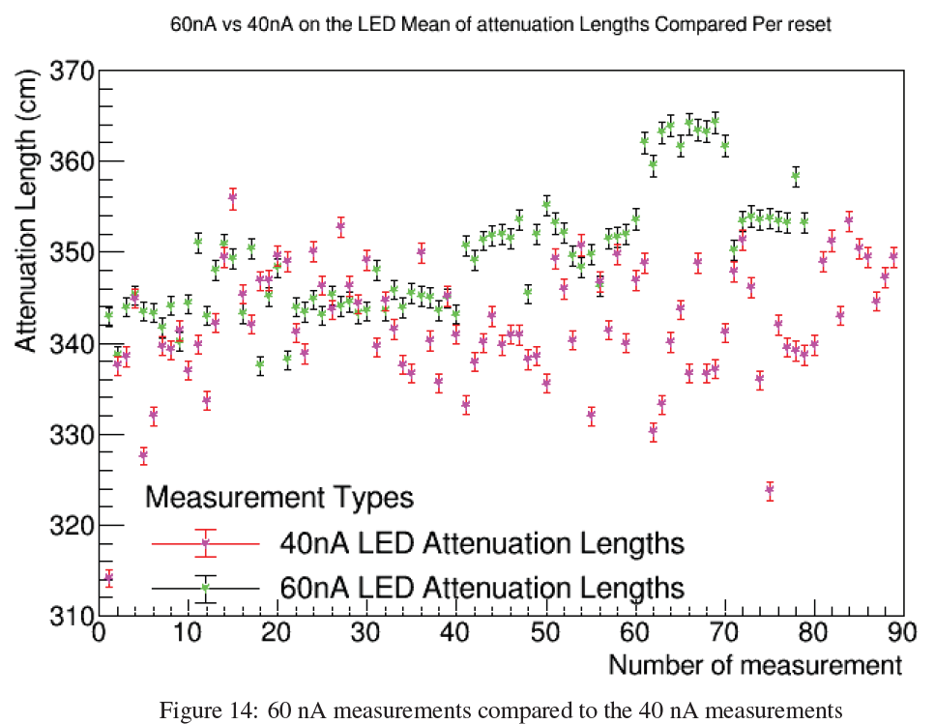
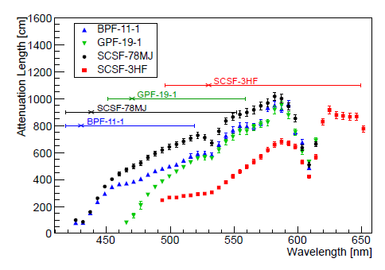
Kuraray SCSF-78MJ
2018 JINST 13 P10025
Attenuation length ~ 350 cm needed for 250 cm long fibre mats
Warning: Large variations in single measurements

Slide 8
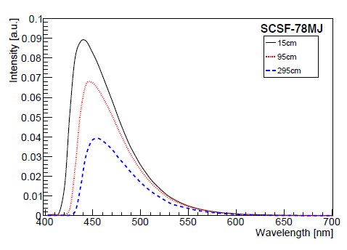
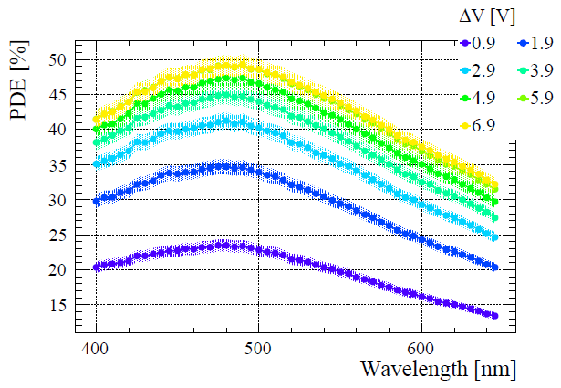
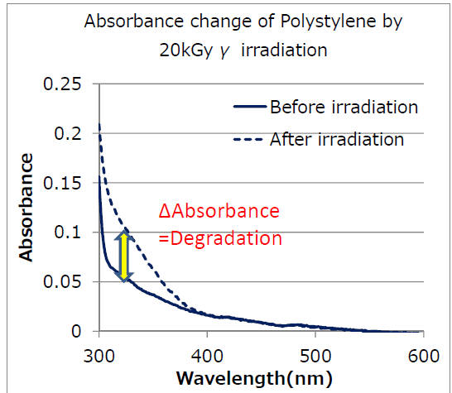
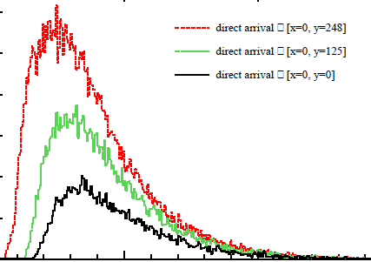
Kuraray SCSF-78MJ
2018 JINST 13 P10025
Emission spectra matches the H2017 SiPM well (3.5 V_{OV})→PDE (450nm) = 43%
Sub-450nm components absorbed quickly, and even more so from radiation damage
~40% loss of light from ionizing radiation at fibre end in SciFi
H2017 SiPM PDE

Slide 9
Towards new Fibres

Slide 10
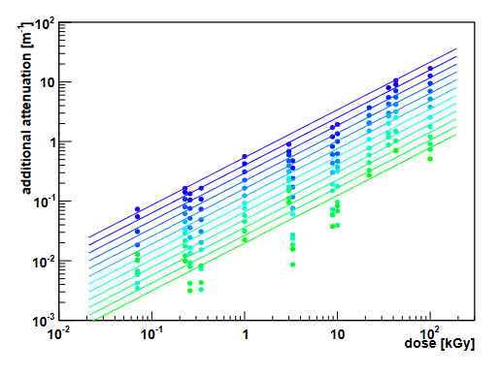
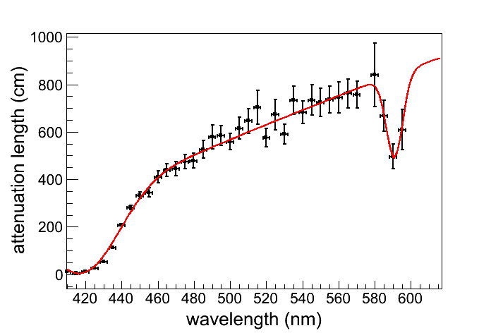
Avenues for Investigation: Fibres
Irradiated SCSF-78MJ (blue fibre)
Wanted: Fast green to red scintillator
  Radiation damage creates strong absorption in the UV-blue region in the polystyrene
  Standard 3HF has 8 ns decay time. Tau<4ns is needed to produce most of the light in the 25ns bx. (Propagation time over 2.5m + scintillation decay time)
  New (since 2014) developments in scintillators on the following 3 slides
Modifications to claddings? Coatings?
Collaborations with polymer chemists and industry needed here.
Meeting with SPACAL/ECAL in April on common interests. ECFA's strategic R&D for the DRD calorimetry
Green wavelengths less affected by radiation damage
Unirradiated SCSF-78MJ (blue fibre)
Green wavelengths less attenuated in polystyrene

Slide 11
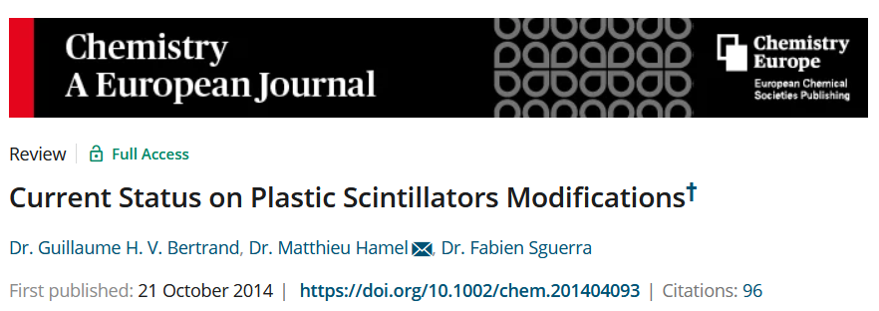
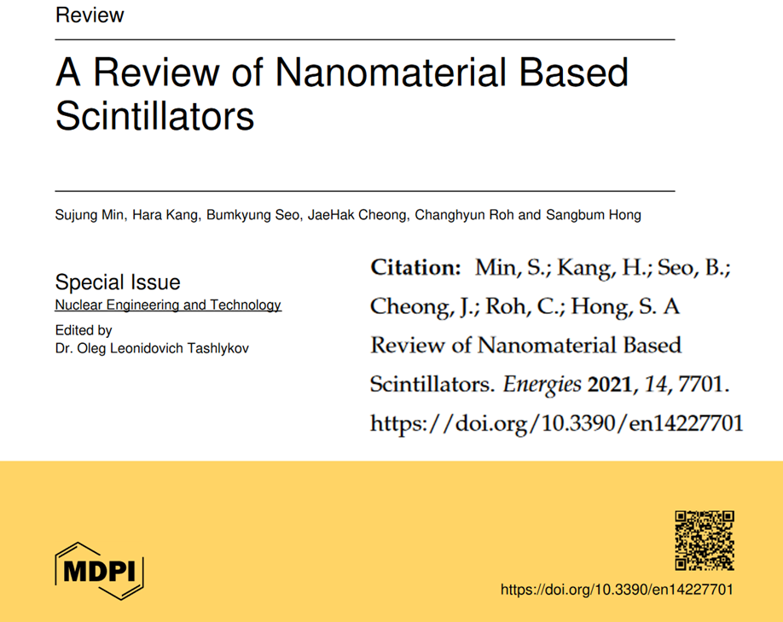



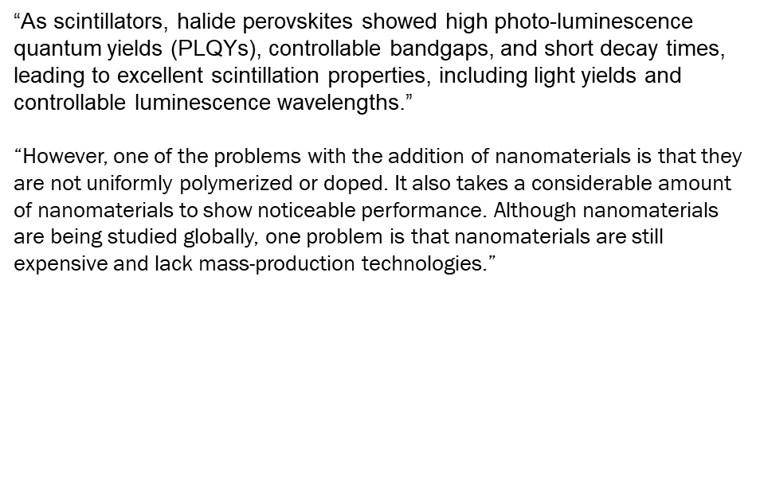
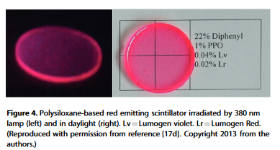
“for the replacement of 3He (neutron detectors) seem a good goal for international laboratories. Gamma spectrometry is also one of the highest challenge chemists have to achieve in the near future. “
Lots of “promising, but…”

Slide 12
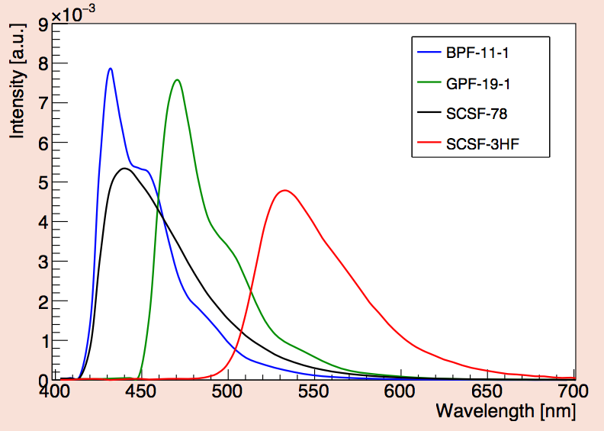
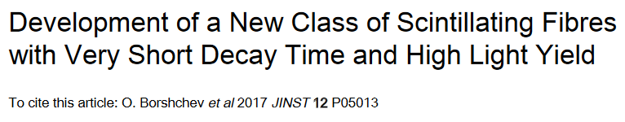
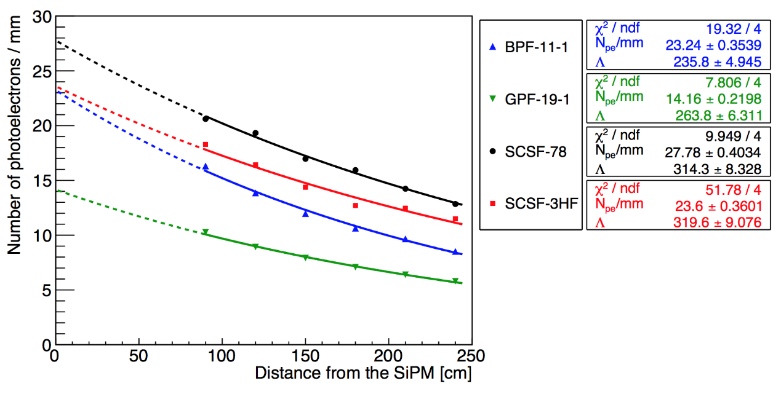
NOL fibre
Emission spectra (@ 15 cm from excitation point)
https://www.nature.com/articles/srep06549
Blue NOL fibre
Green NOL fibre
Blue standard fibre
Green standard fibre
8 iterations of NOL fibres in 2017
  Best were 50% faster than standard fibres, τ∼1ns.
  Best light yield about 15% lower than standard fibres.
Might be a material impurity problem.
  No control over the production of the materials.
  Large volumes probably impossible.
Green fibres (emission peak ∼500 nm) might be still interesting to test.
No hadron irradiation done yet!!! X-ray results are ok.
  Optimise for an irradiated detector

Slide 13
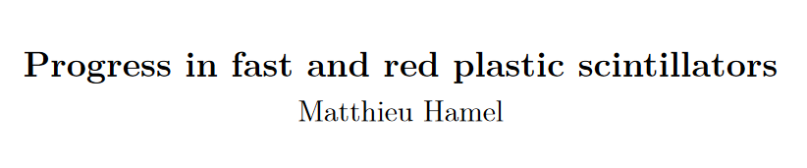
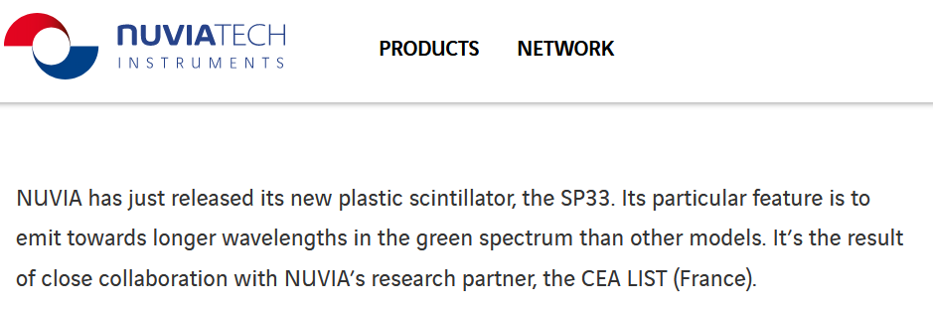
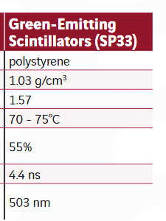
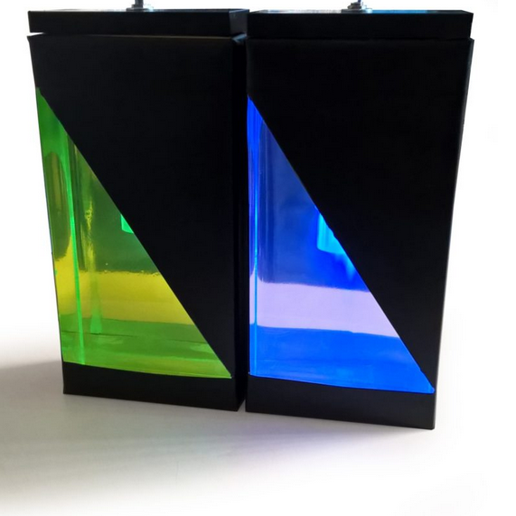
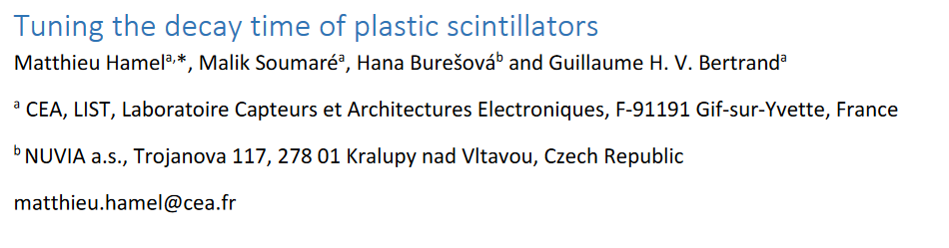
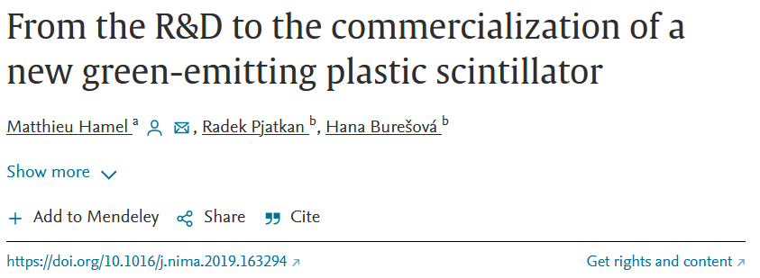
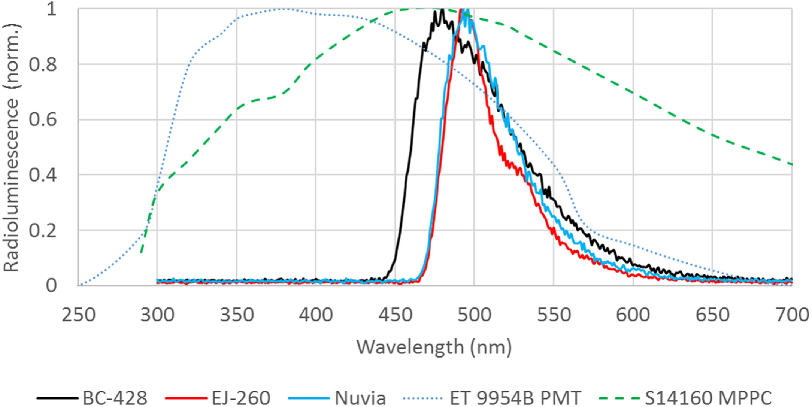
Matthieu Hamel. Progress in fast and red plastic scintillators. Chemosensors, 2022, 10 (2), pp.86. 10.3390/chemosensors10020086 cea-03582648
Anthracene
We are pursuing this as a fibre to test. Fast enough, bright like the Kuraray 78MJ.
Need real samples.

Slide 14

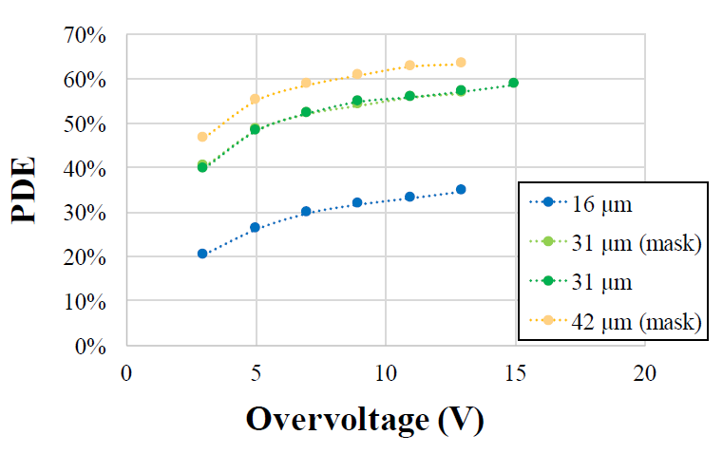
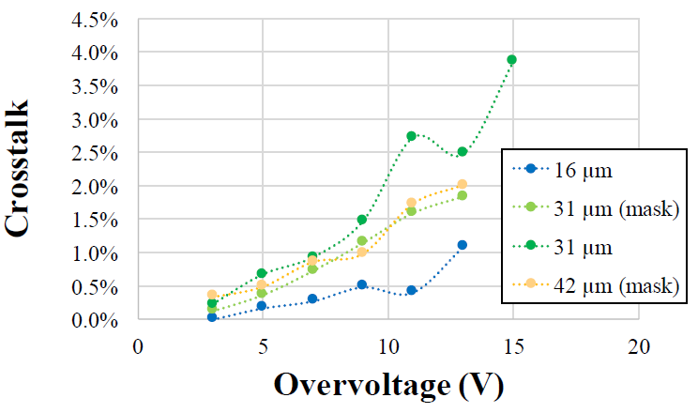
SiPM Developments
H2017: PDE_{peak}=43% @450nm
FBK2022*: PDE_{peak}=62%
*custom for LHCb. Irradiation studies will follow.
5 years of progress
Preliminary
1.45x photoelectron yield
12p.e. → 17.5p.e.
( irradiated U1 modules like new again! )
Low crosstalk means fewer dark clusters and/or lower thresholds
H2017: p_{corr}=7%
Preliminary
Plots from Carina Trippl, EPFL

Slide 15
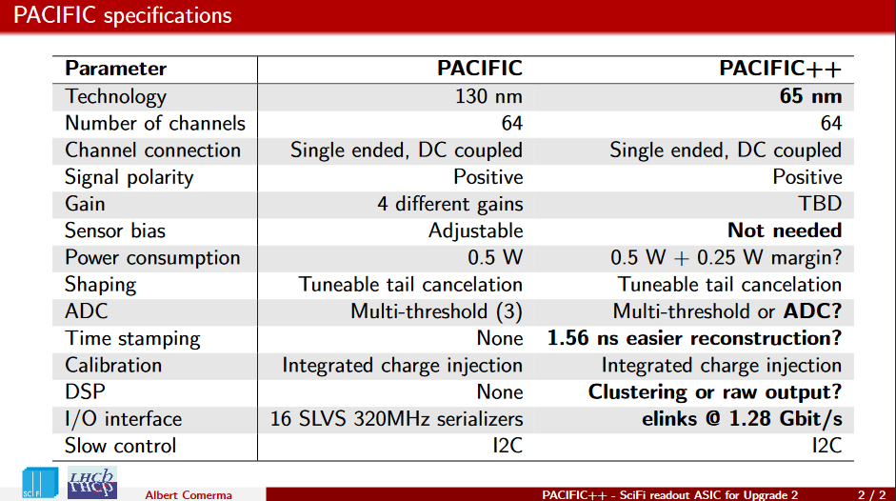
ASIC
Start to discuss the specifications and common points with other upgrade projects:
CERN
Physikalisches Institut Heidelberg
Universitat de Barcelona (RICH)
IFIC
EPFL (SiPM)
AGH (Magnet stations)
Implies no FPGAs on the Front-end

Slide 16
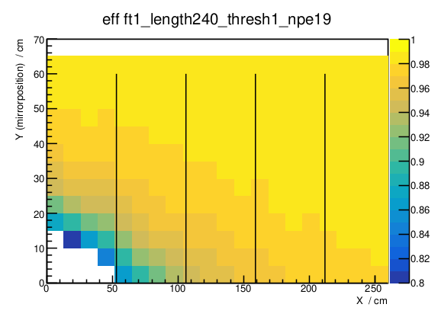
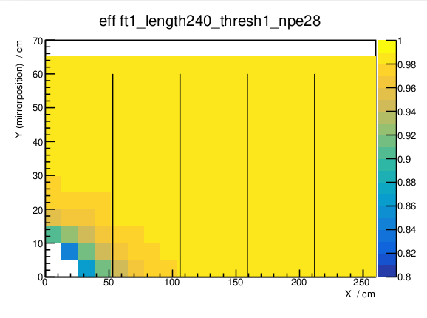
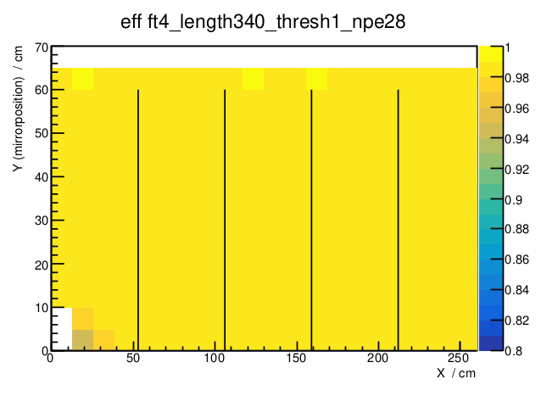
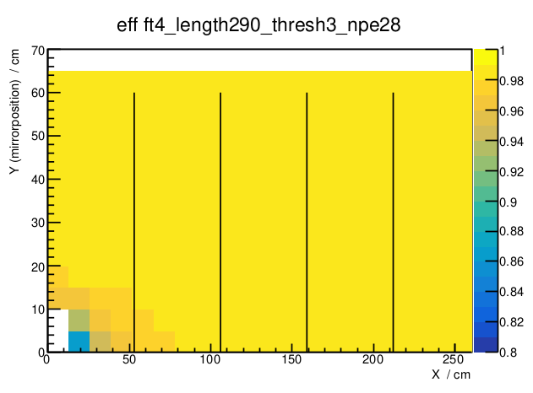
FTDR-like plot
Blue fibre
4-layer
1.5p.e thresholds
(cryo)
60%PDE (no uL)
Blue fibre
6-layer
1.5p.e thresholds
(cryo)
60%PDE (no uL)
Fast green
4-layer
1.5p.e thresholds
100cm longer
(cryo)
60%PDE (no uL)
Fast green
6-layer
4.5p.e thresholds
50cm longer
60%PDE (no uL)
(standard cooling, improved shielding needed)
I’ve made some assumptions about this green fibre. Need a real sample.
Pixel/Fibre boundary defined by tracking performance (occupancy) and affordability.

Slide 17
SPIN-OFFS

Slide 18
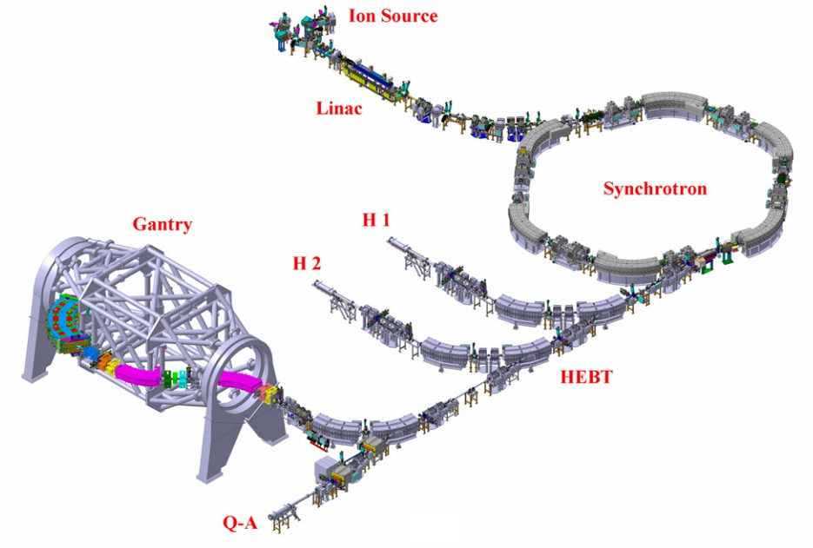
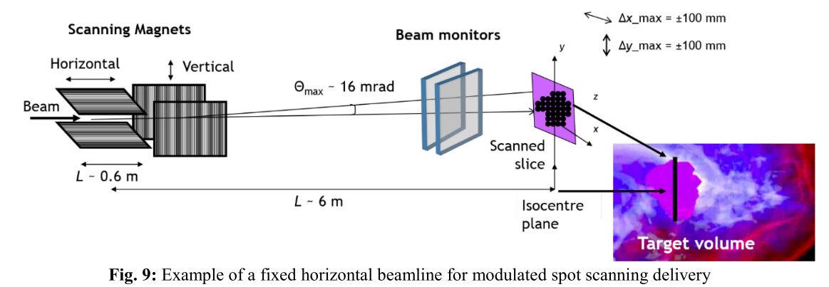
Beam-on profile detector for Heidelberg Ion Therapy (HIT)
Reference 2
Reference 3
Reference 1

Slide 19
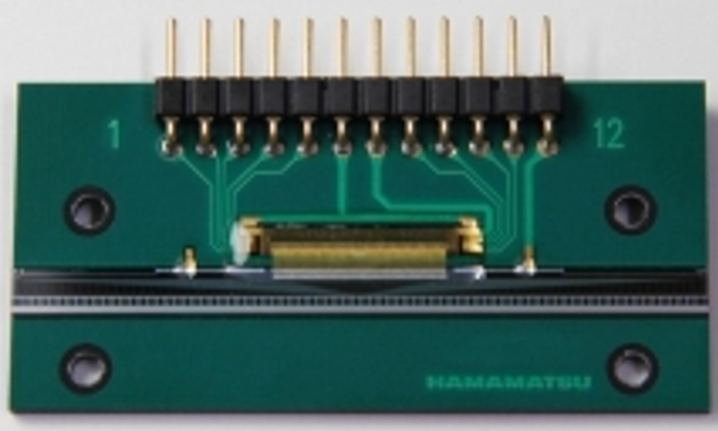
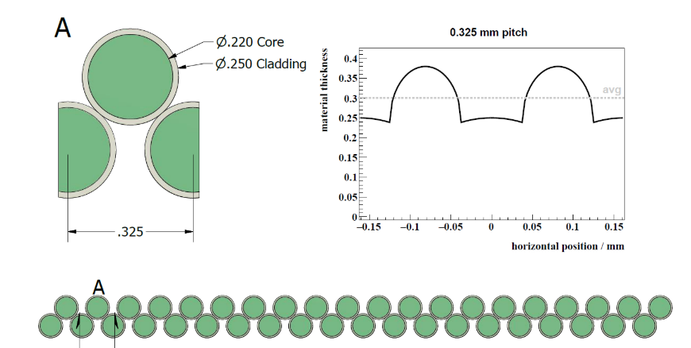
Scintillating fibre based detectors
Minimize the material: 2 layer of scintillator fibre (no epoxy 0.3 mm polyethylene have similar density with water)
Hamamatsu S11865-64 photodiode arrays with a pitch of 0.8 mm (64 channel)
Fibre : Kuraray green 3HF scintillating fibres
Version 1 : 2 arrays (128 channels)
Version 2 : 5 arrays (320 channels)
One photodiode array
Integration time: 100 μs-100 ms (adjustable)
0.8 mm

Slide 20
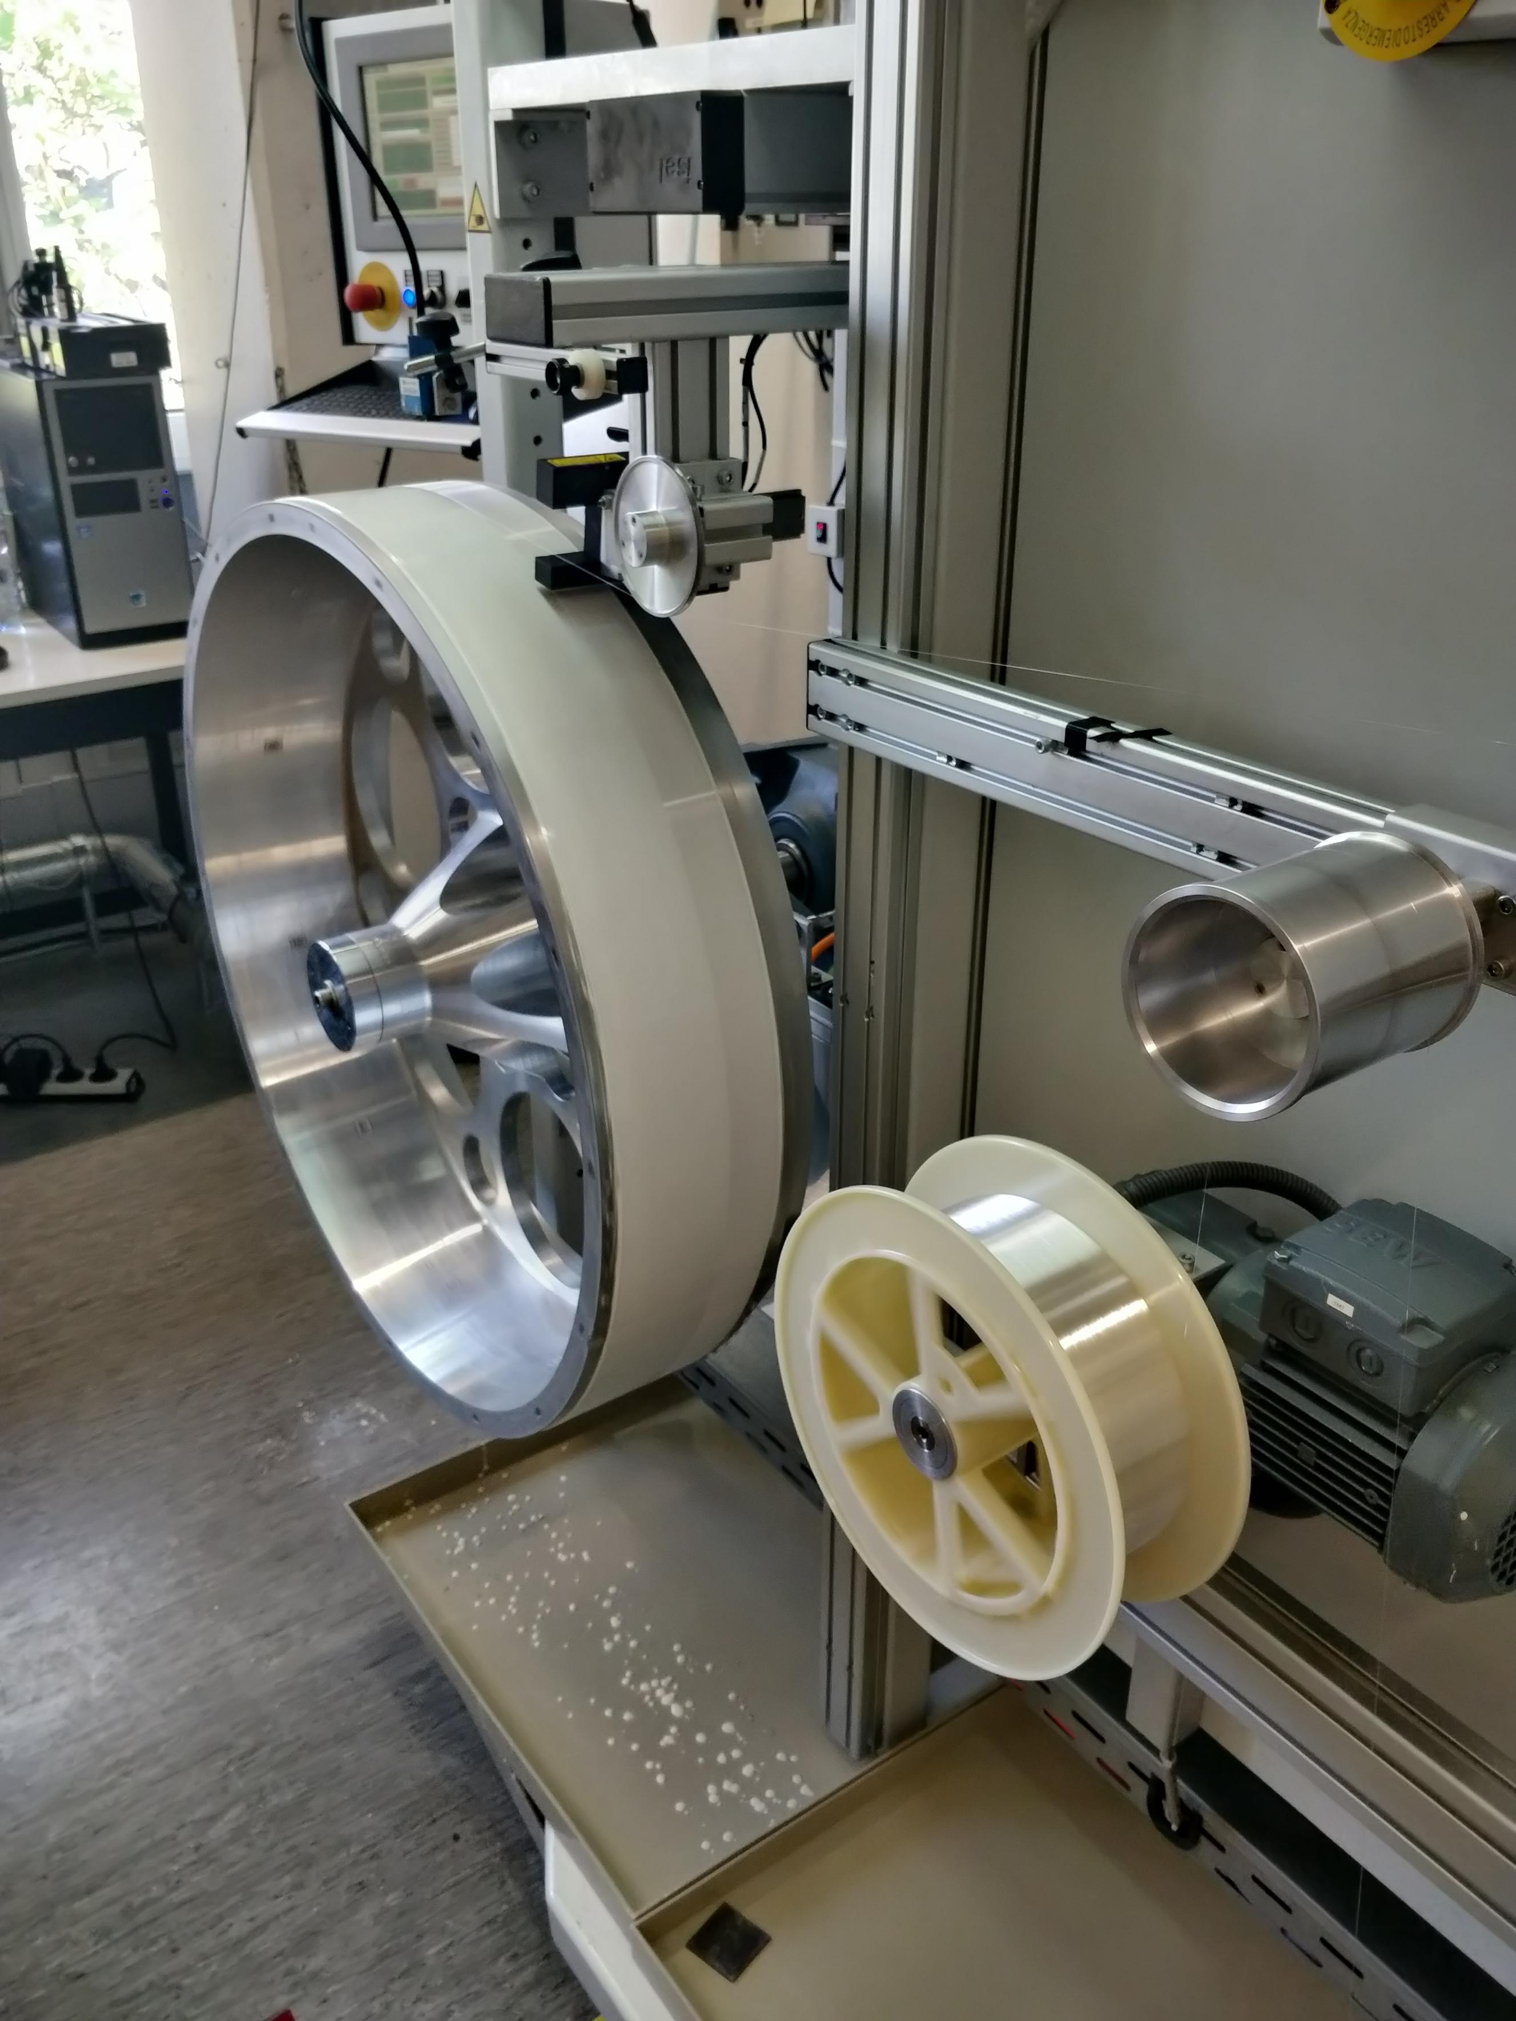
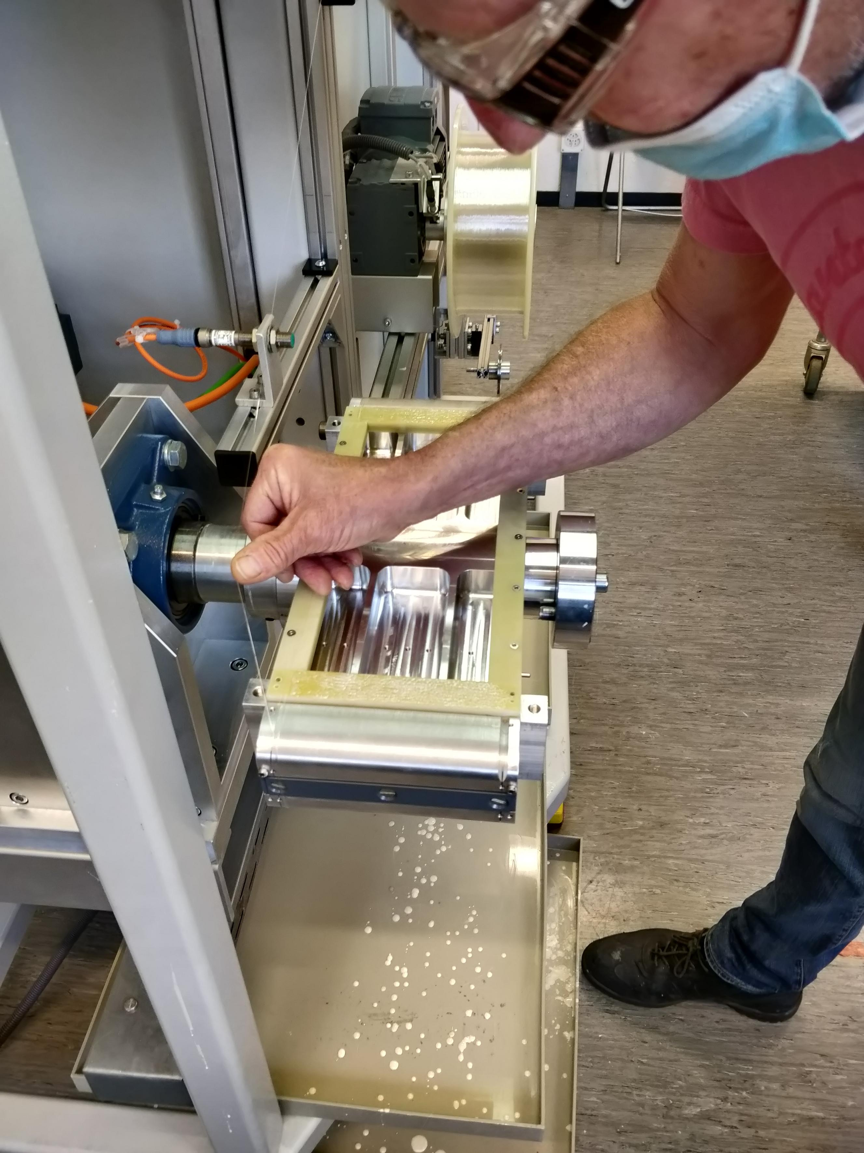
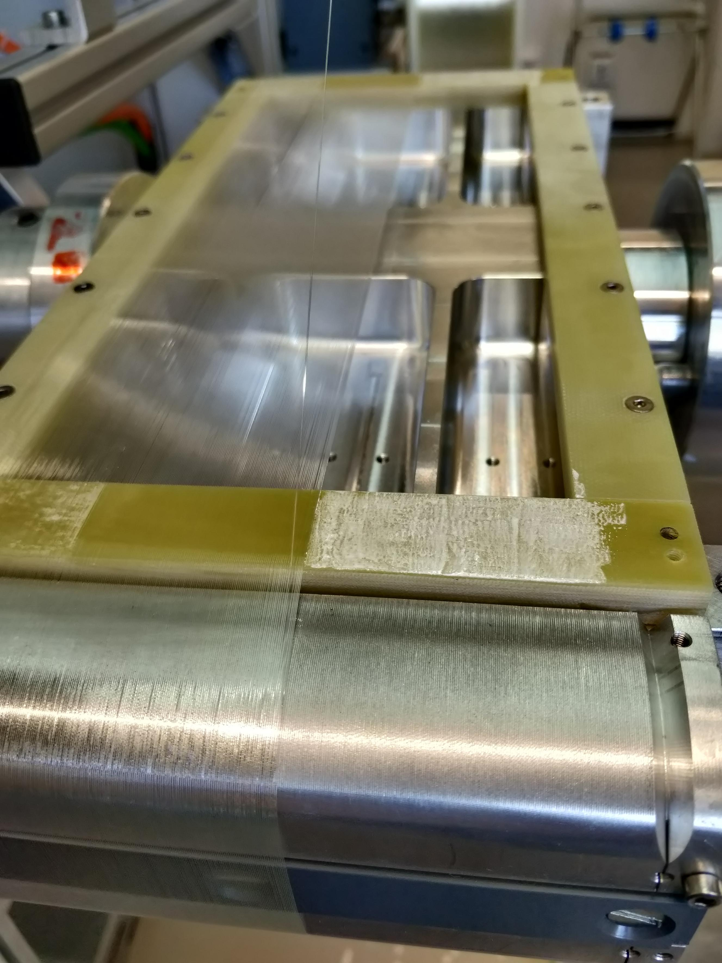
Fibre mat production
Lhcb style mats with glue. The winding machine controls tension and position.
We replace the wheel with a small hub with GFRK frames.
Two layers are wound. They are glued to the frame at each end.

Slide 21
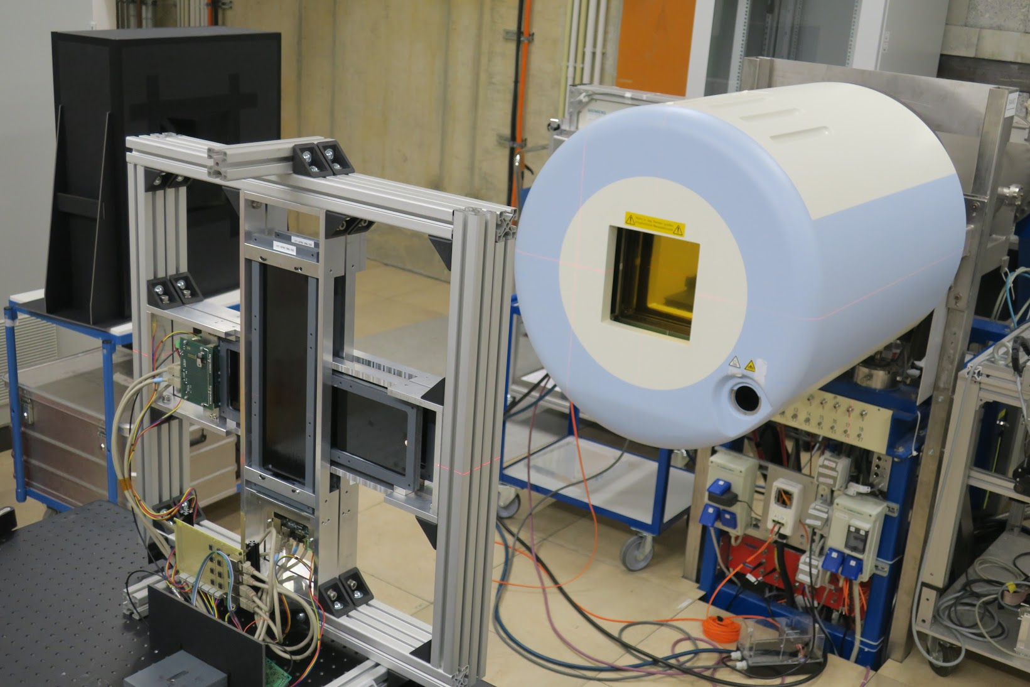
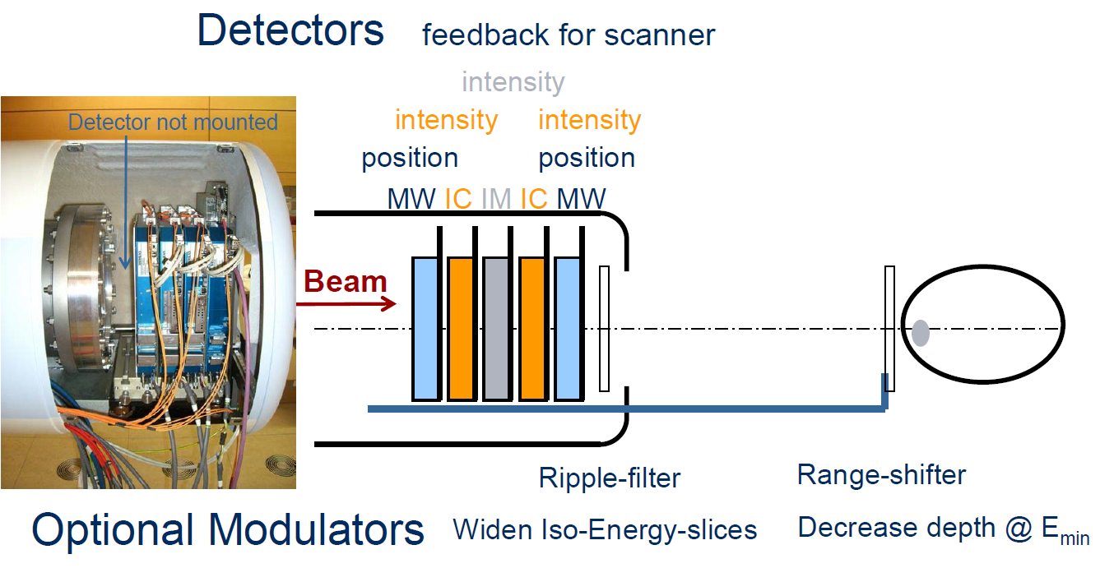
Beam Profile Monitor

Slide 22
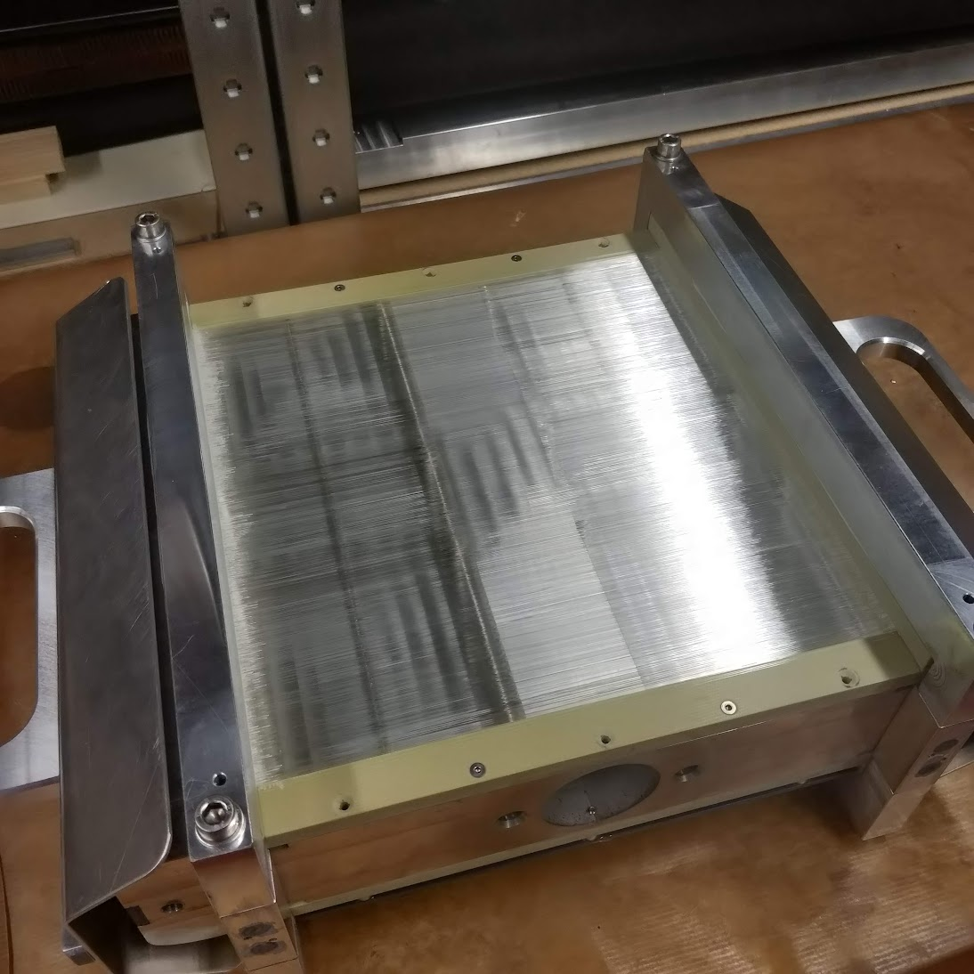
Large area, Glueless
30 cm
12cm
30 cm
30 cm

Slide 23
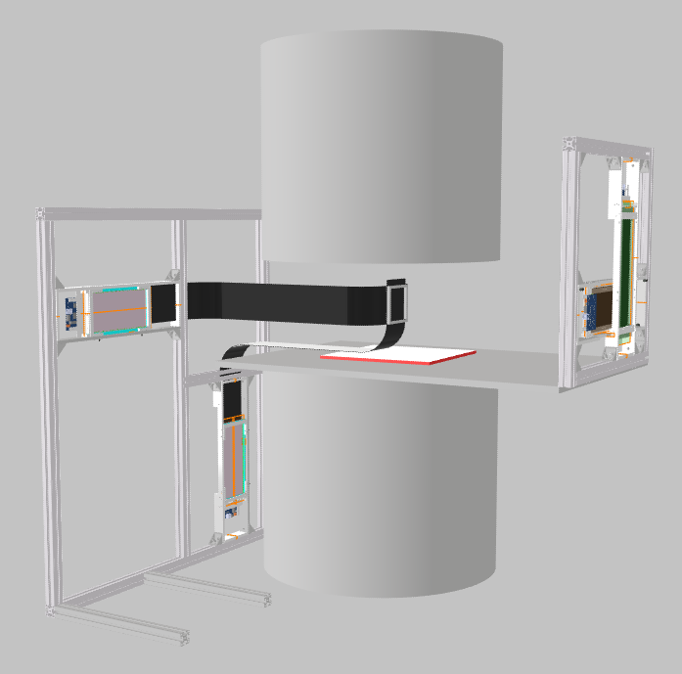

Beam Monitor in an MRI at HIT

Slide 24
SiPM
Developments

Slide 25



ΔV = +3V
Presented by Guido Haefeli, EPFL

Slide 26




Micro-lenses
GFF(50%),
GFF(82%),
Preliminary
Preliminary
Biggest return on PDE is from the Geometric Fill Factor (GFF) for large pixel devices (>40µm) where GFF>70%
But the Goal is to reach 15-20% more light with a detector GFF=72% (Estimated from Simulation)
  No benefit seen in 2nd round for large GFF(82%), but also a large variation in samples (with and without lenses).
  Will study the exit optics more (diffusion of photons from standard optical milling) → polishing?
  +32% @ ΔV=1V and +19% @ ΔV=4V benefit for GFF=50%.
  +56% in Simulation for GFF=50%.
  Less benefits seen with higher overvoltage in measurements.
  More attempts to be made
No change in cluster width seen.
Light yield of SiPMs with and without lenses. uL and flat(no uL).
SiPM with lenses under the microscope.
Plots and figures from PhD Thesis of Carina Trippl, EPFL

Slide 27
BACKUP SLIDES

Slide 28


“ It is noteworthy that important differences between the production of small-scale, craft-industrial materials and large-volume production factory may appear. More particularly, some tricks or production methods may not be shifted from the laboratory to the factory process due to costs or technical impossibilities. Herein these issues were considered at the earlier stage of the R&D process, so the laboratory chemical formulation was not changed and used as such. This scale-up was readily performed in Nuvia CZ factory, hence leading to materials with dimensions up to 12 L”

Slide 29



Timing SP33

Slide 30

Ph/MeV/ns

Slide 31


Slide 32


Slide 33


Slide 34


Slide 35

Fibre Annealing

Slide 36


Clear Fibre Extension (Mat-Mat coupling)
Fibre Mat QA with SPIROC readout
First attempt: cut an existing mat with the alignment previously glued on.
Tests optical coupling with small gap (~50 micron).
Achieved good light yield with different coupling materials:
– Using air: ≈ 75 %
– Using optical grease
(Korasilon - silicone): ≈ 82 %
Coupling is reproducible and stable.
Next steps are to test with a new clear fibre mat.
Attempt to improve the overlap of fibres.
Polishing?
Presented by Thomas Oeser, RWTH Aachen

