Slide 1
CERN Beam Instrumentation Group
--Experimental Areas--
Inaki Ortega (CERN SY-BI)
Slides for ECFA DRD4 meeting on 03 July 2023

Slide 2
What we do
We provide beam instrumentation for the secondary beams in the CERN Experimental Areas –North Area, East Area, AD&ELENA
Typical beam observables:
  Position
  Profile
  Intensity
  Particle identification
  Momentum
  Energy
Our clients are the beamline physicists, the accelerator operators, and sometimes the final users (experiments)
We have a wide variety of particle beams and use cases

Slide 3
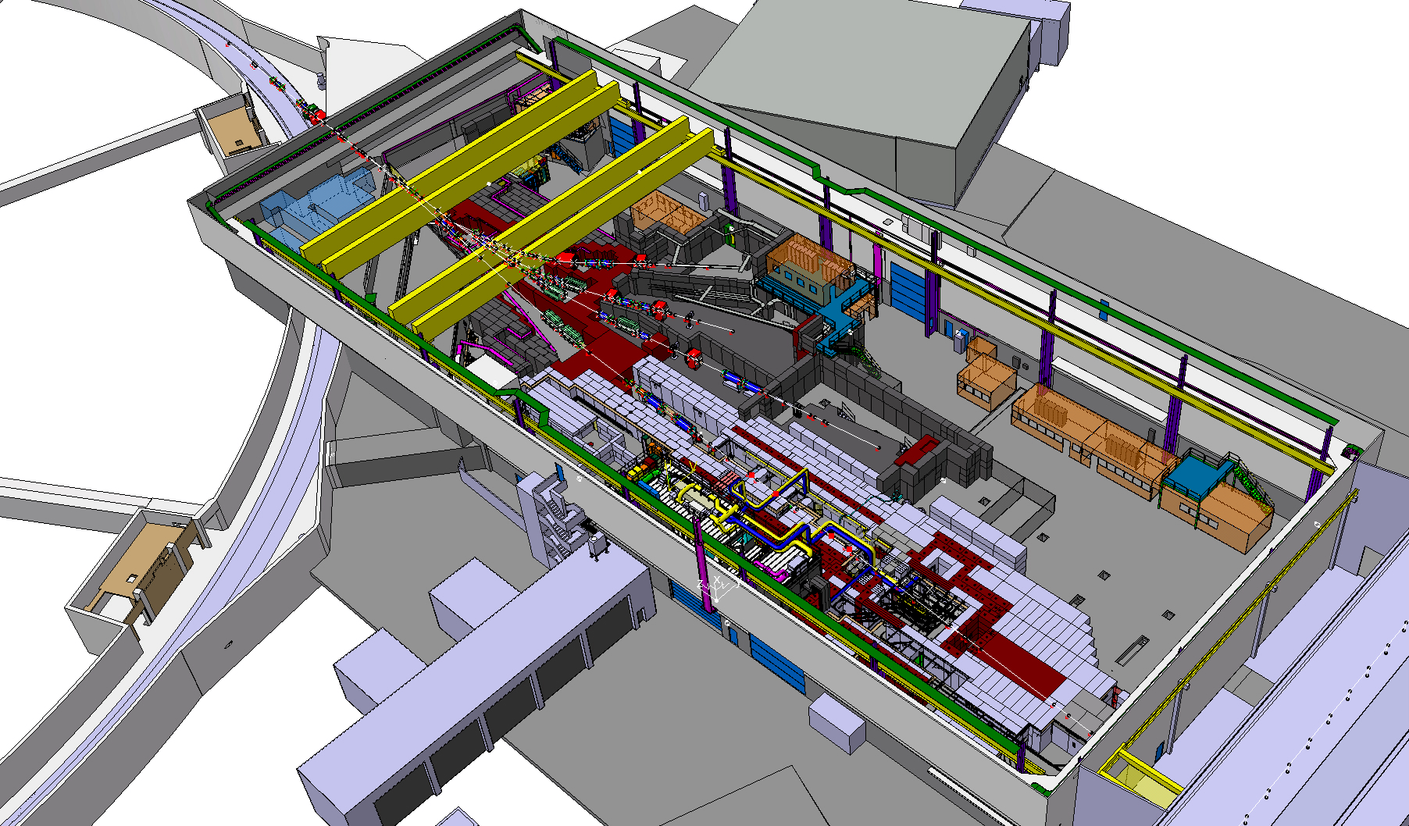
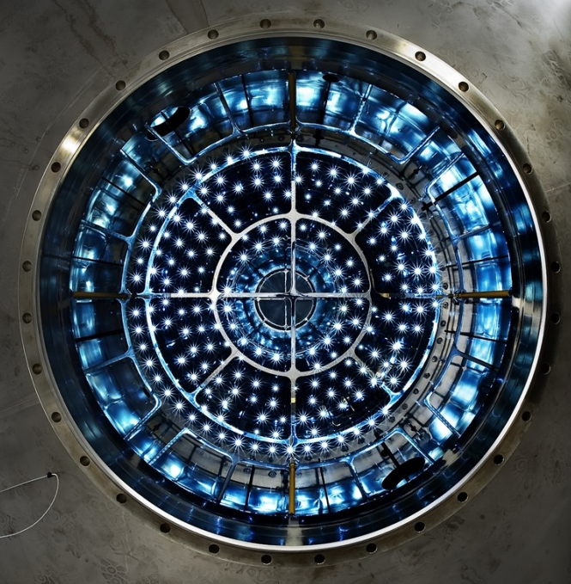
The East Area
Primary beam:
10¹¹ protons at 24 GeV/c
slowly extracted from PS in 400 ms
Secondary beams:
1 – 15 GeV/c
10³ - 10⁶ part/burst
Highly configurable
T9 & T10 Experimental areas
CLOUD experiment
IRRAD / CHARM
Notes:
The East Area receives 10^11 protons at 24 GeV/c from the PS slowly extracted over 400ms. This yields to beams tunable by the users between 1 and 15 GeV/c and intensities from 10^3 to 10^6 part/burst.
It has two experimental areas that are heavily booked all the year round.
The East Area permanently hosts the CLOUD experiment, which investigates the impact of cosmic rays in cloud formation. They have published several articles in well renowned journals, such as Nature.
The East Area also hosts the irradiation facilities IRRAD and CHARM that you probably have heard of.

Slide 4
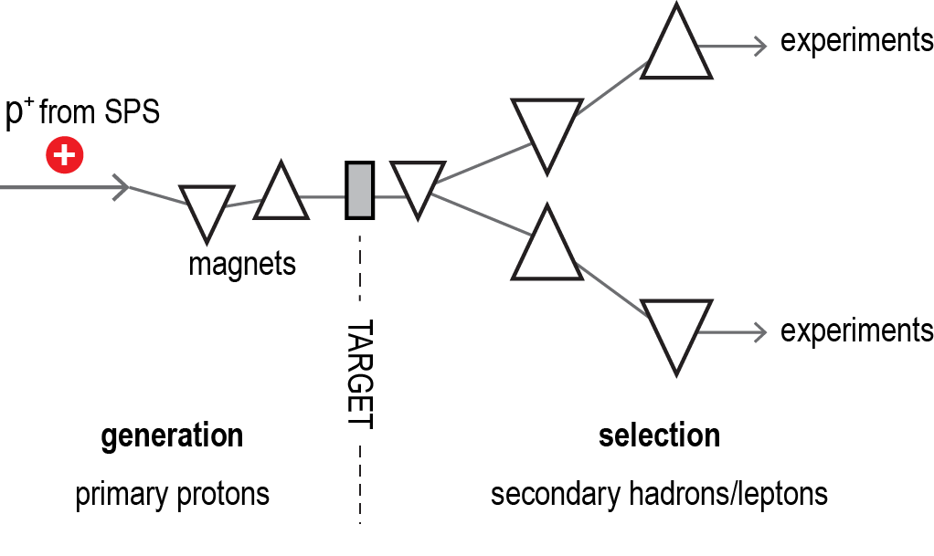
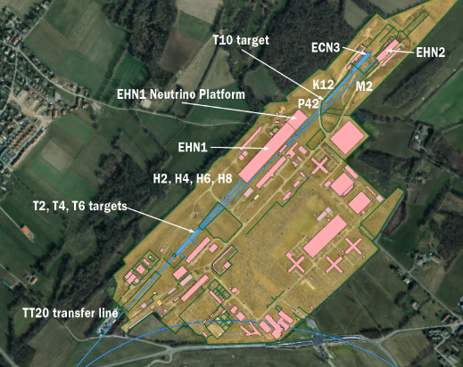
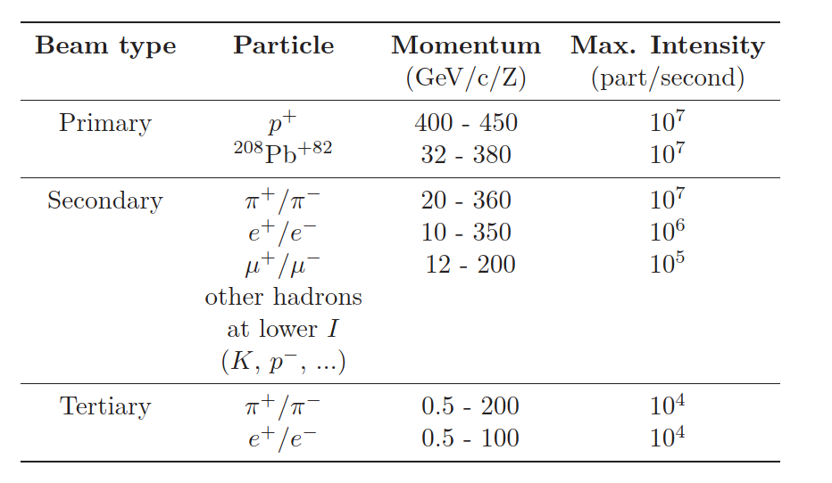
The North Area
Primary beam: 10¹³ protons/ions at 450 GeV/c from SPS, slowly extracted in 4.8 or 9.6 seconds
Notes:
The North Area receives 10^13 protons from the SPS @ 450 GeV/c, which are slow extracted during 4.8 s or 9.6 s depending on the supercycle configuration.
The NA has a unique configuration of targets and selection magnets that enable delivering beam to several secondary beam lines simultaneously.
In the table you can see the typical particles extracted, along with their energy range and maximum intensity.
In addition to secondary beams, the NA can also deliver heavy ions and attenuated beams of primary protons.
There are 4 experimental halls in the NA: EHN1 –Experimental Hall North 1-, the Neutrino Platform, which is an extension of EHN1, EHN2 and ECN3, which is underground. I will talk further about these halls in the next slide.
EHN1 has 4 beam lines, H2, H4, H6 and H8 which are general purpose and highly configurable by the users.
EHN2 has the M2 beam line, which is a high energy & high intensity muon beam line.
ECN3 has the K12 beam line, which is a high energy & high intensity kaon beam line.

Slide 5
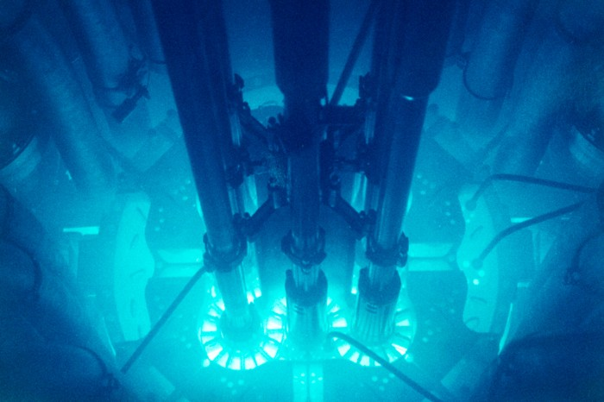
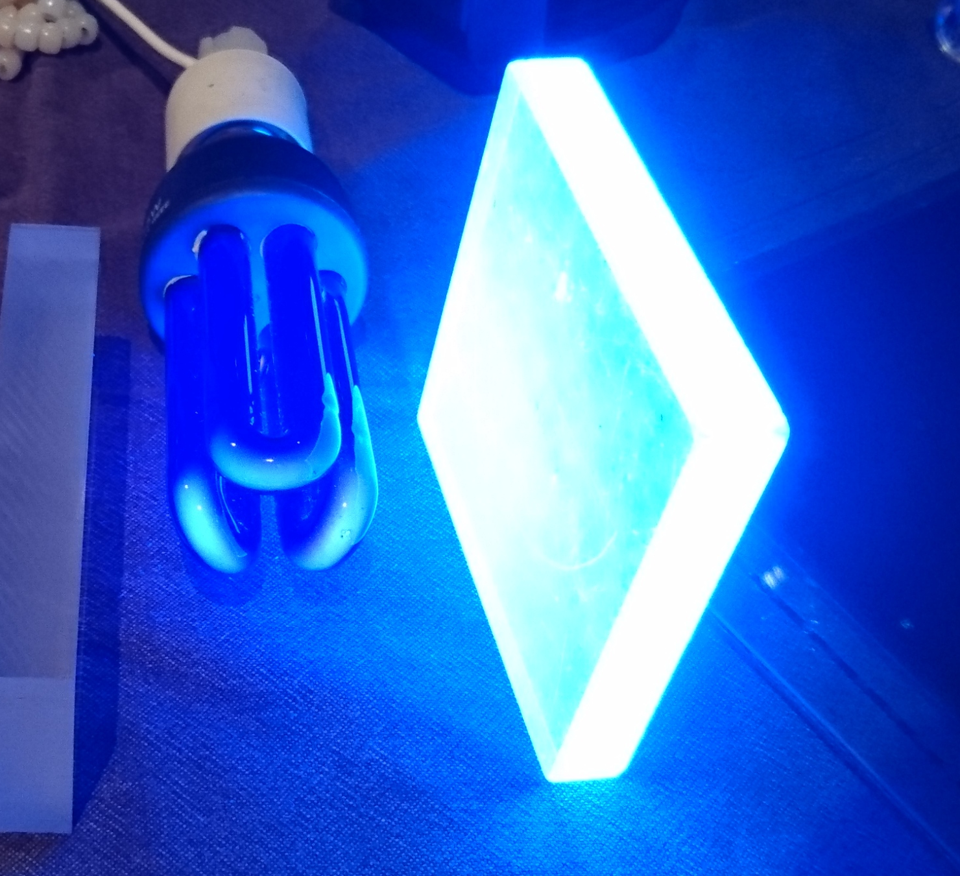
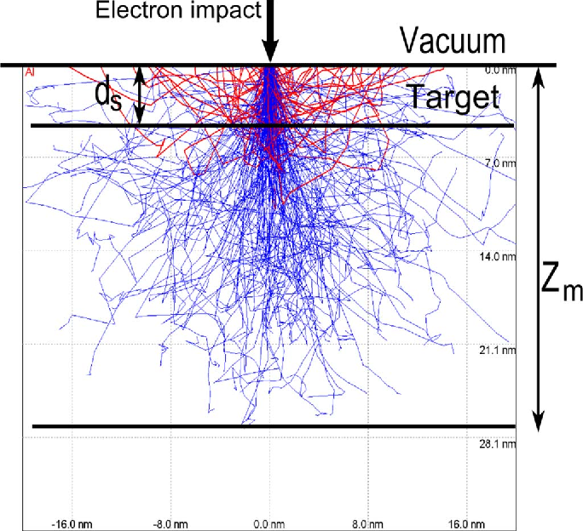
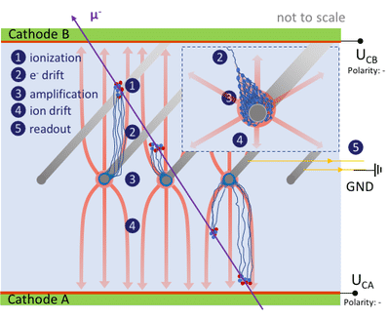
Beam instrumentation in the EA
Cherenkov detectors
Scintillators
Secondary e⁻ emission
Gaseous detectors
Notes:
The beam instrumentation in the experimental areas is, with no surprise, very different from the beam instrumentation in the circular machines. Here we don’t deal with pickups or current transformers. They would be useless with such unbunched and low intensity beams. Instead, we share more in common with the particle detectors used in physics experiments.
Our monitors can be divided in four families according to the physics principle that they exploit.
Scintillators: materials that emit light upon excitation from a charged particle. We detect that light with a suitable photodetector that is connected to readout electronics.
Gaseous detectors: a charge particle ionizes a gas under a high electric field. The created ions and electrons drift towards the cathodes and anodes and produce an avalanche when they enter the region close to the wires, where there is a huge electric field gradient. We read out the charged induced in the electrodes.
Cherenkov detectors: Cherenkov light is emitted when a particle travels faster than the speed of light in a medium. As for scintillators, we detect the Cherenkov light with a suitable photodetector.
Secondary emission detectors work on the principle that a charged particle will free some electrons as it crosses a material. By measuring the weak electric variations induced by this electron emission, we can make a signal in our particle detector.

Slide 6
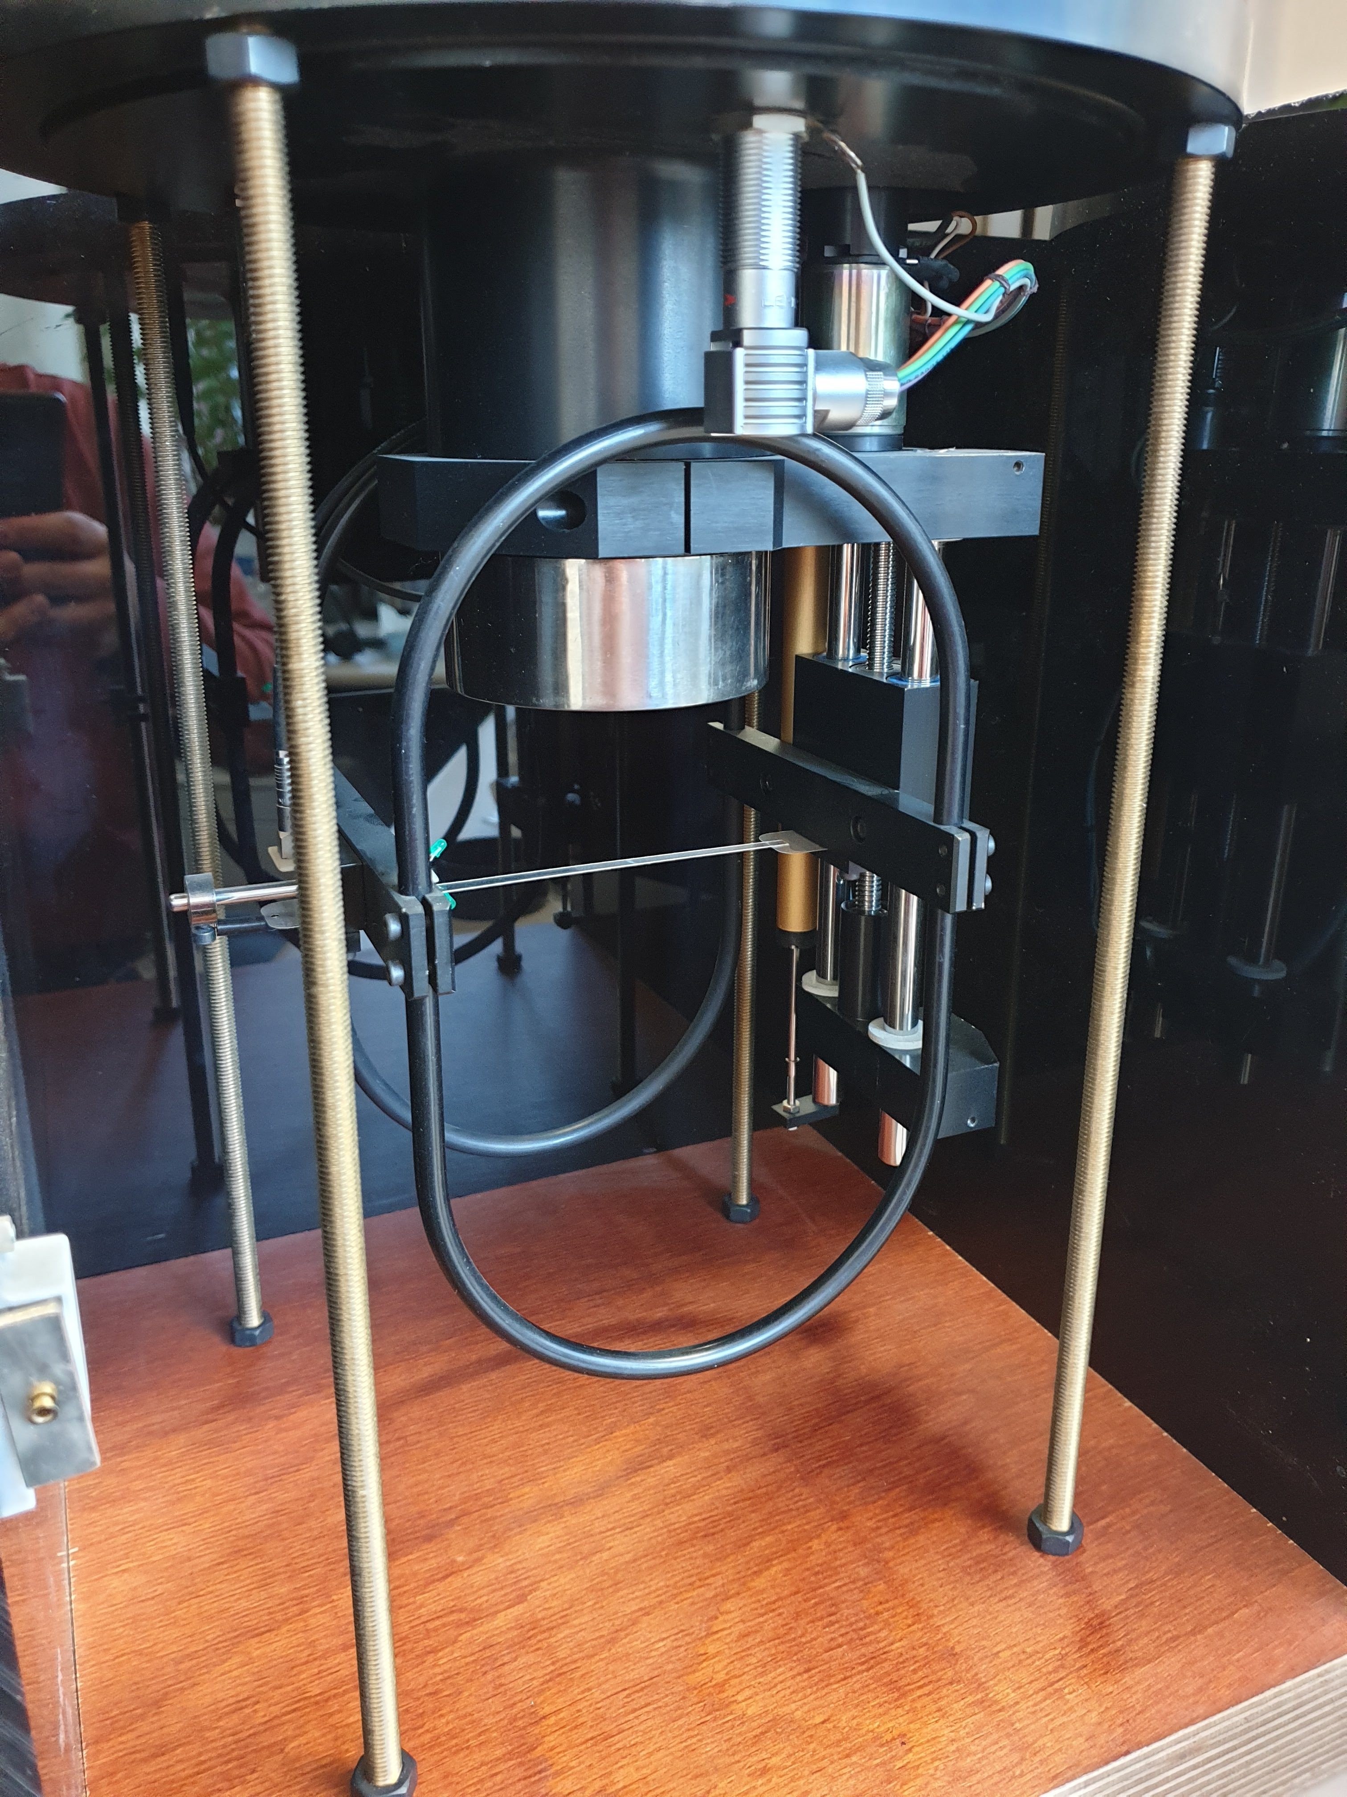
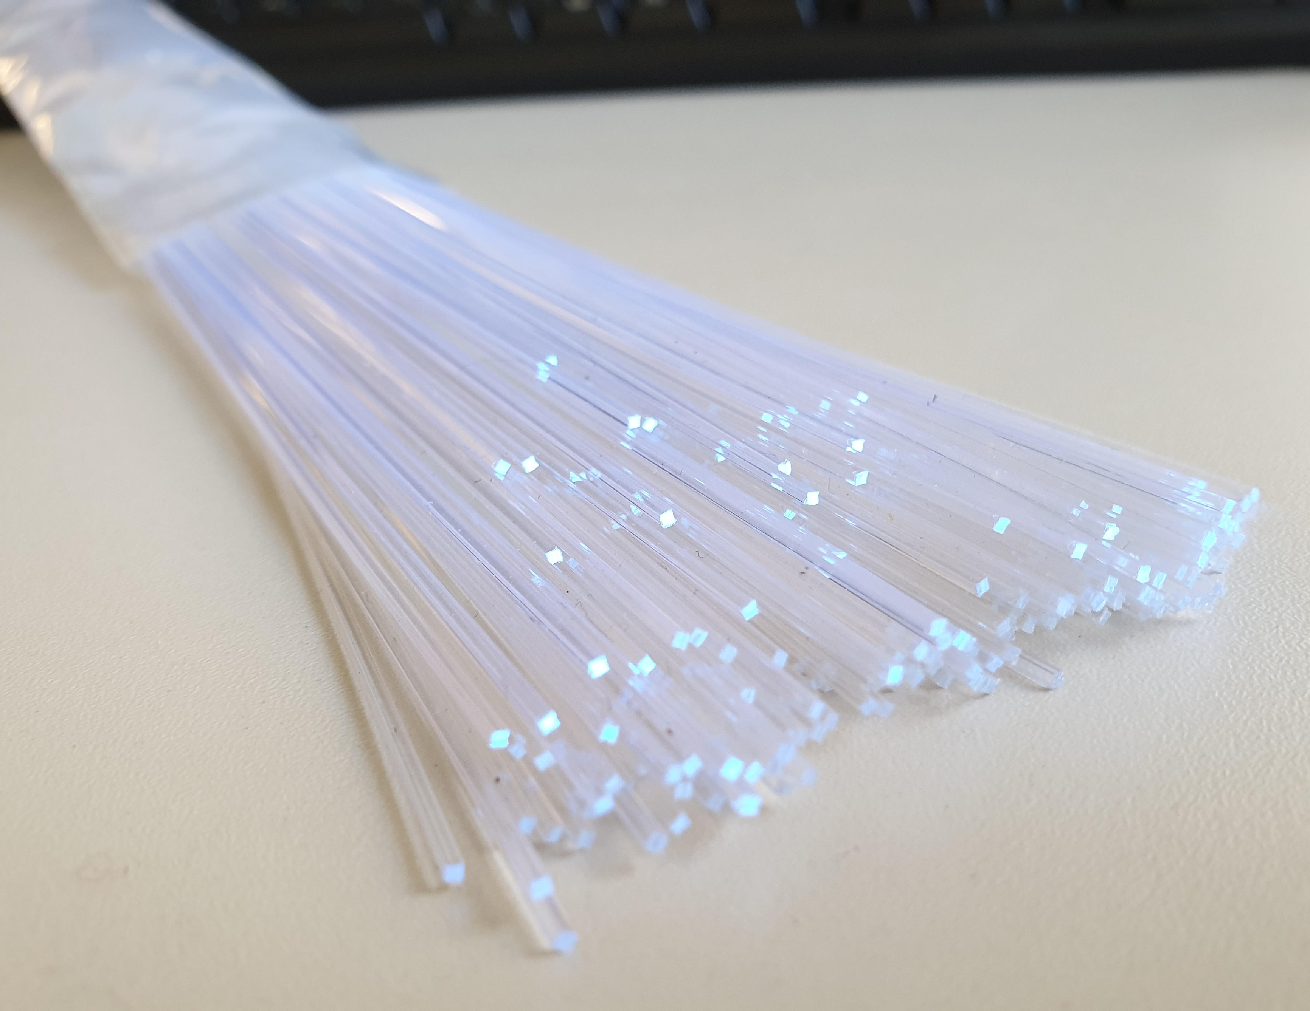
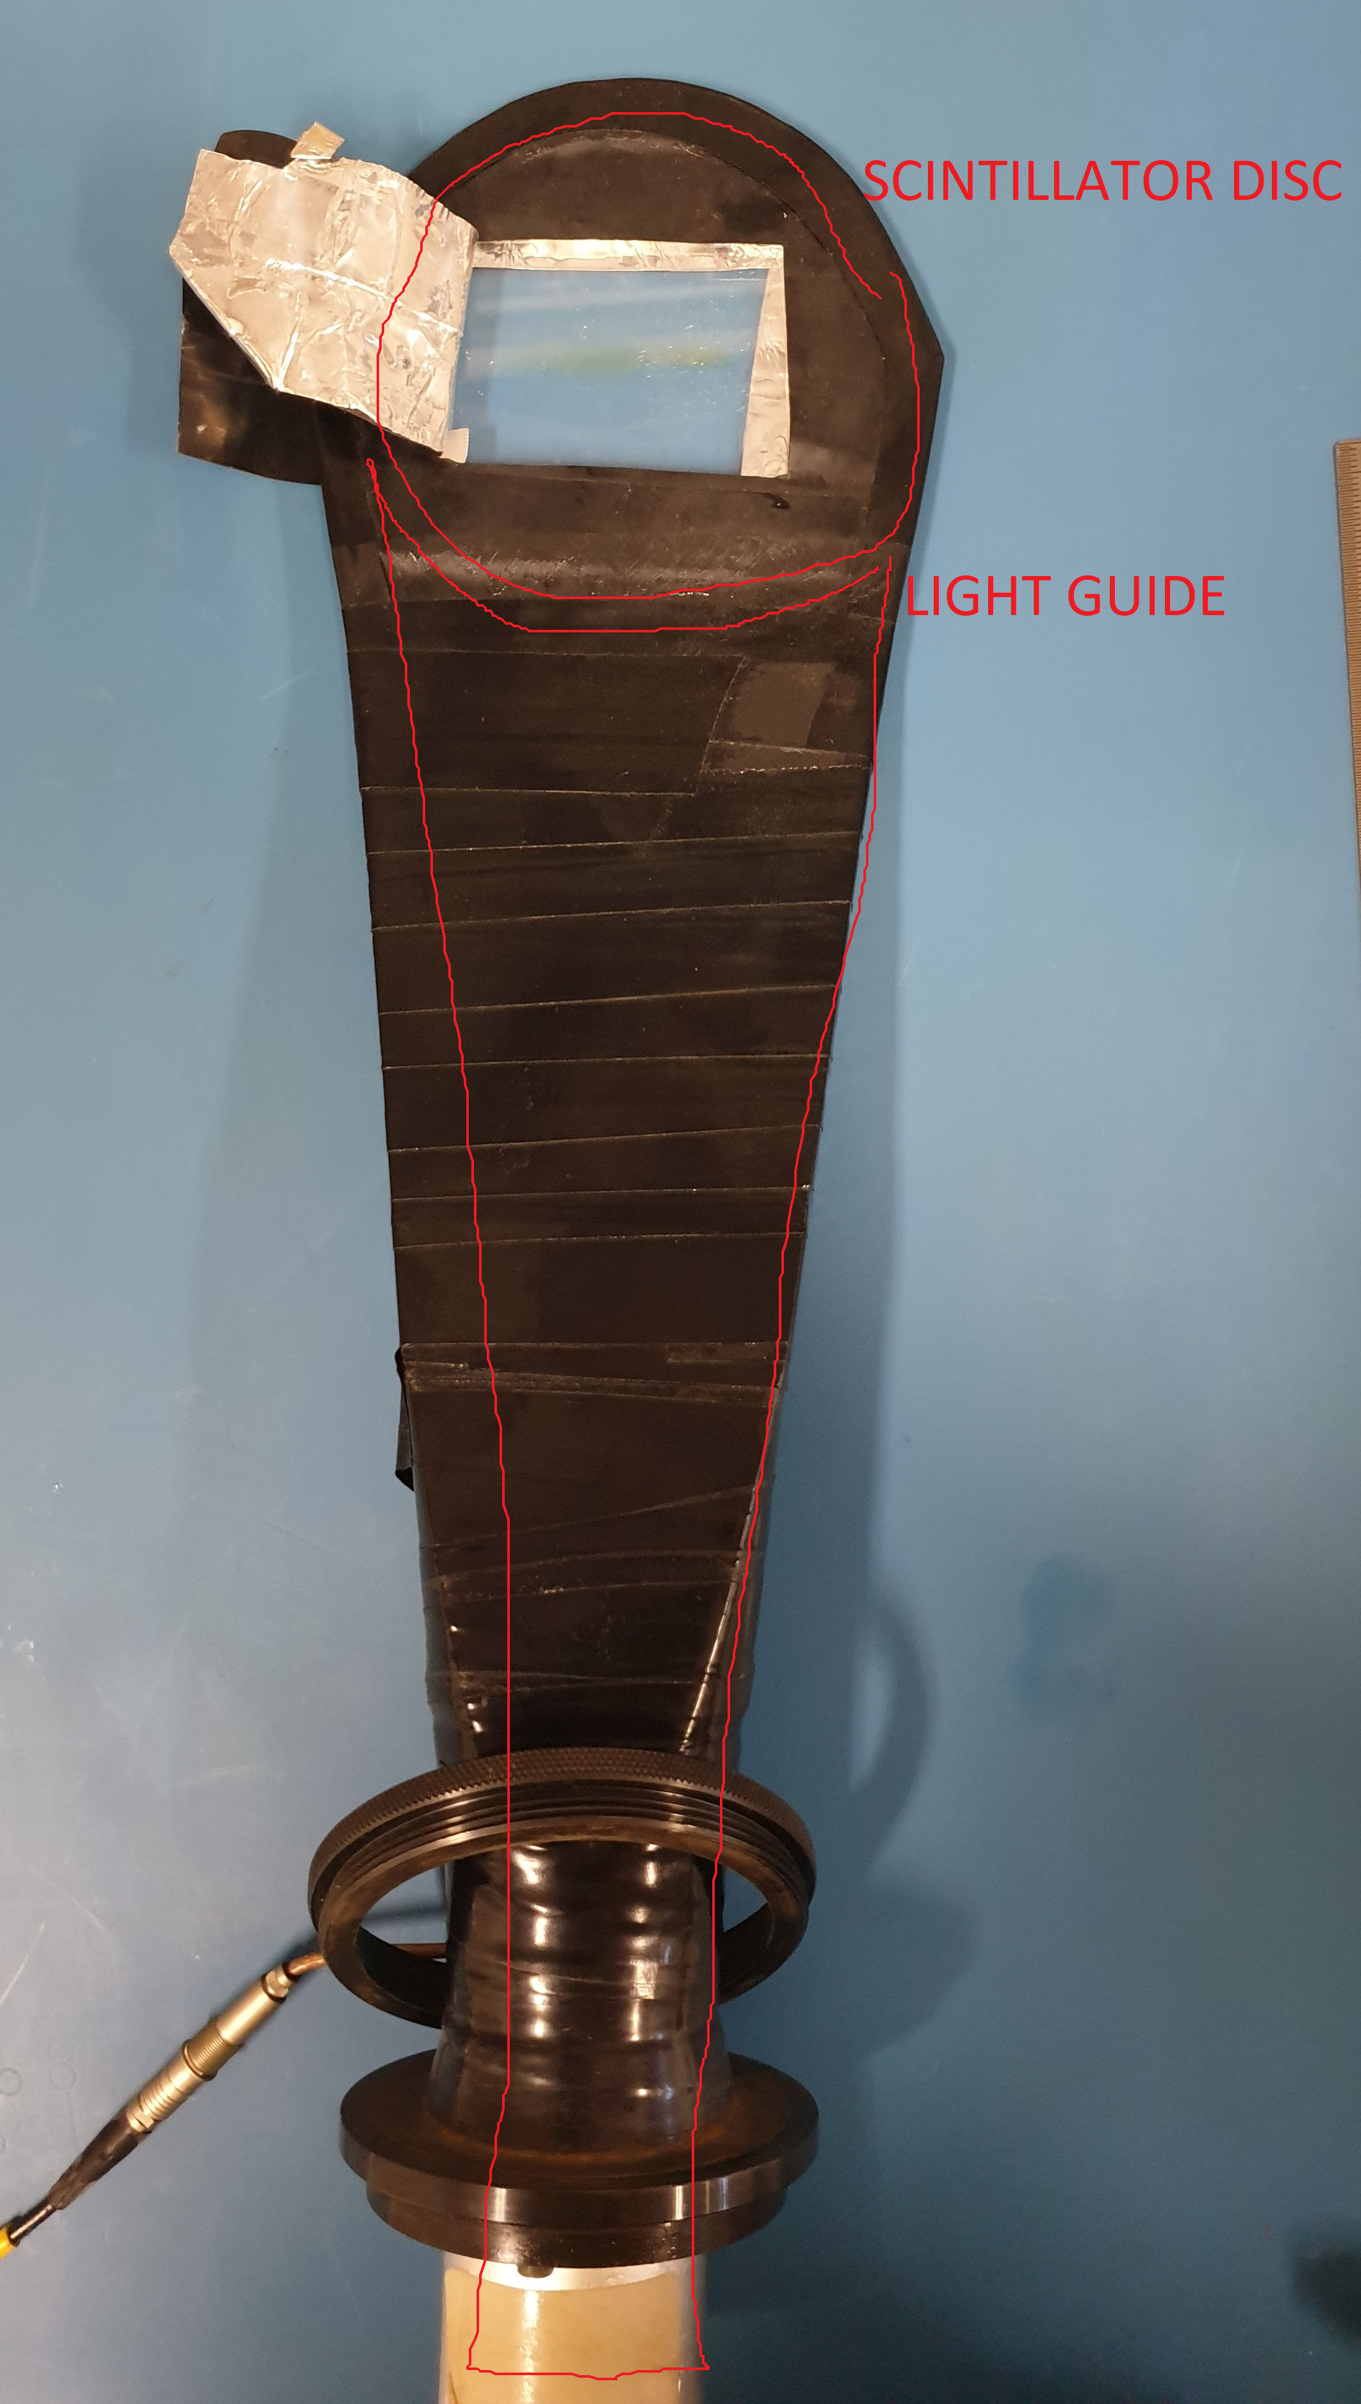
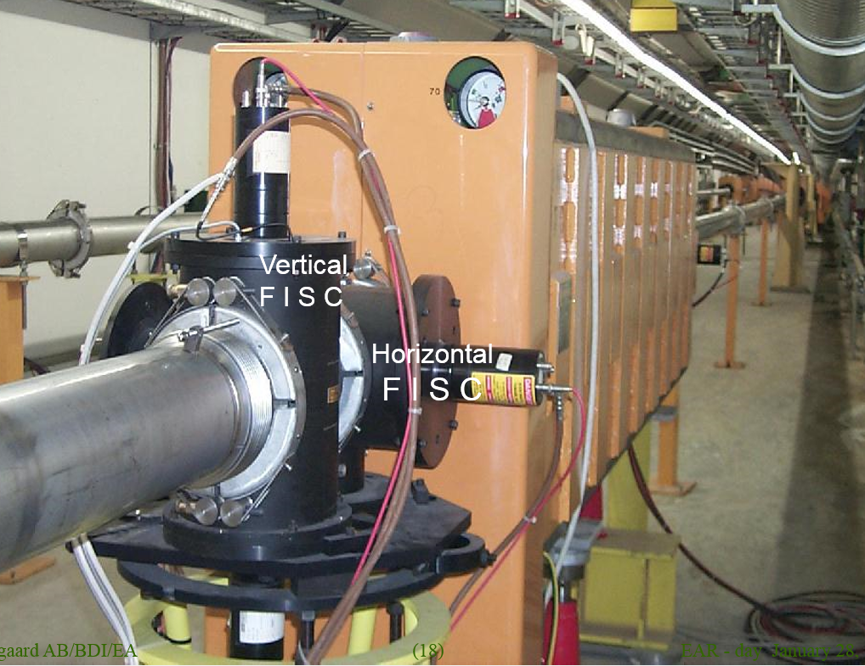
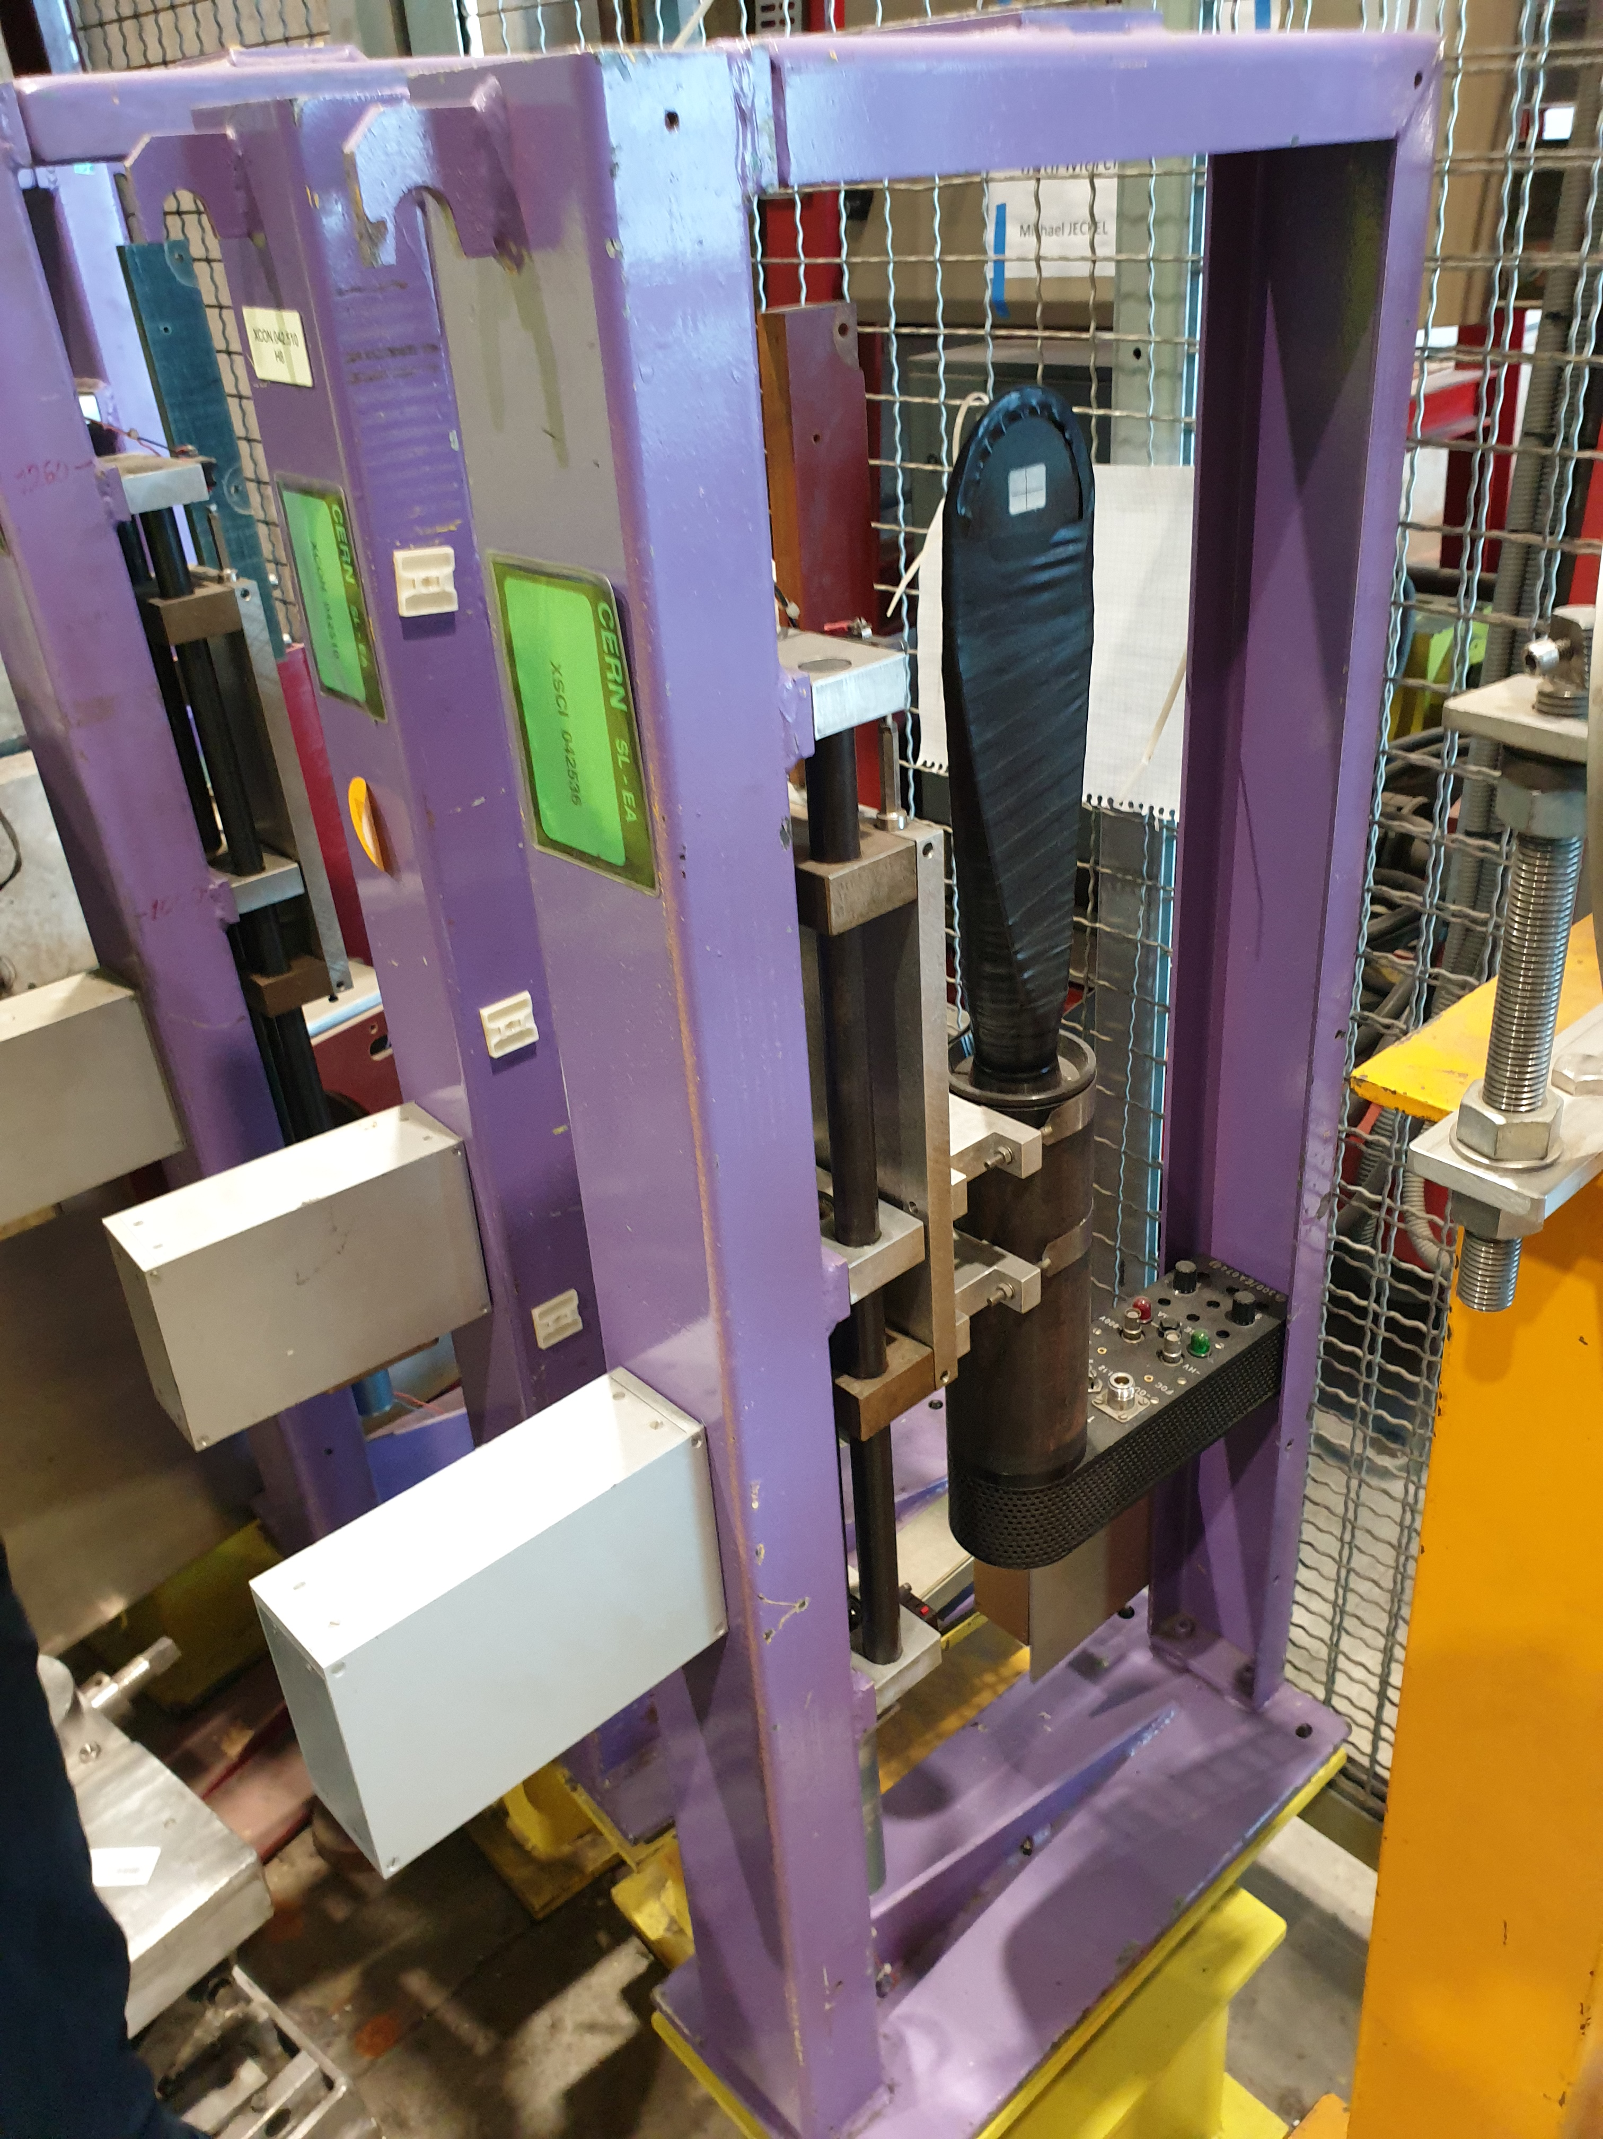
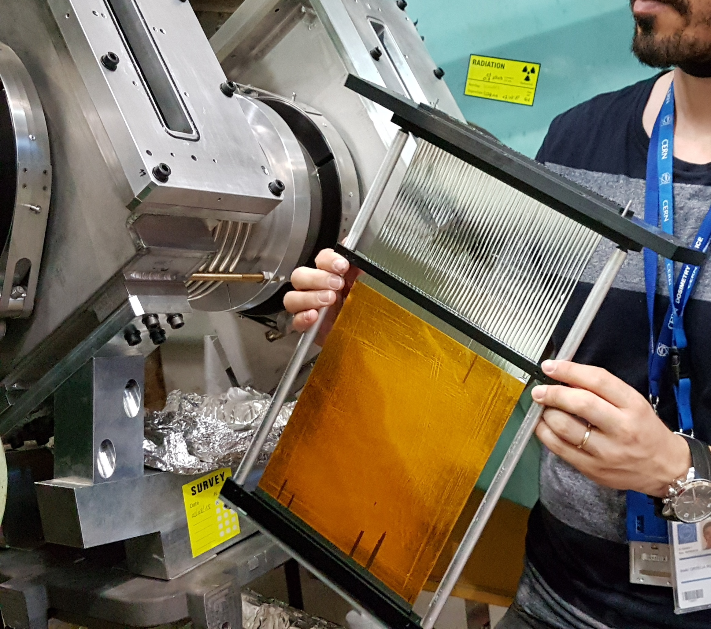
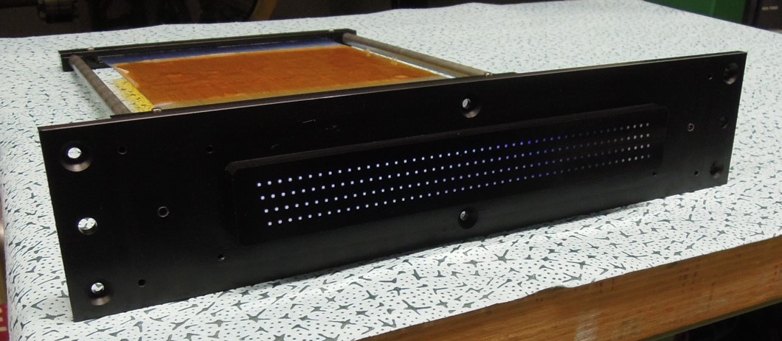
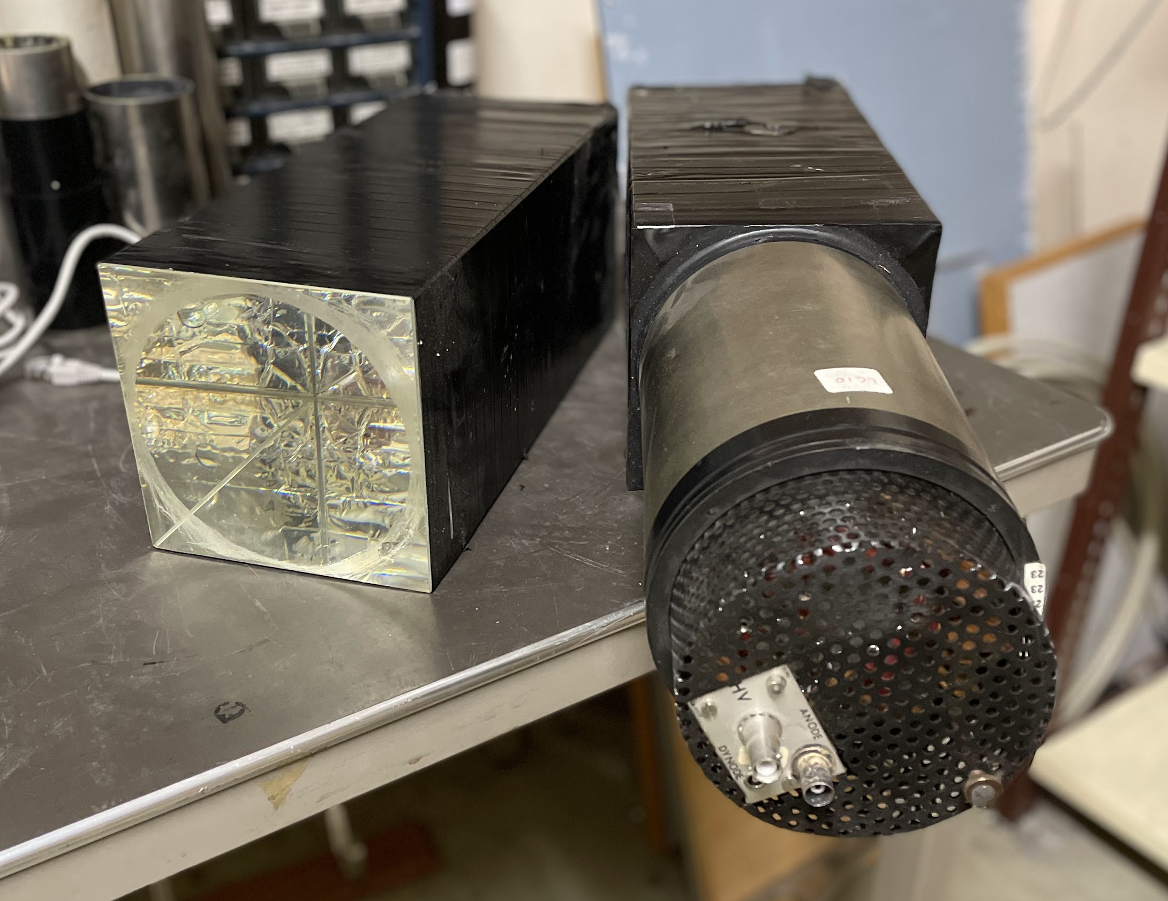
Finger scintillator scanner
(FISC)
Scintillators
Beam profile fibre monitor
(XBPF)
Scintillator paddle
(XSCI)
beam
~56 units
Lead crystal calorimeter
(XEMC)
~40 units
~20 units
~5 units
Notes:
We have 3 different monitors made of scintillators. I won’t enter into details, since we’ll talk about them in the next talk.

Slide 7
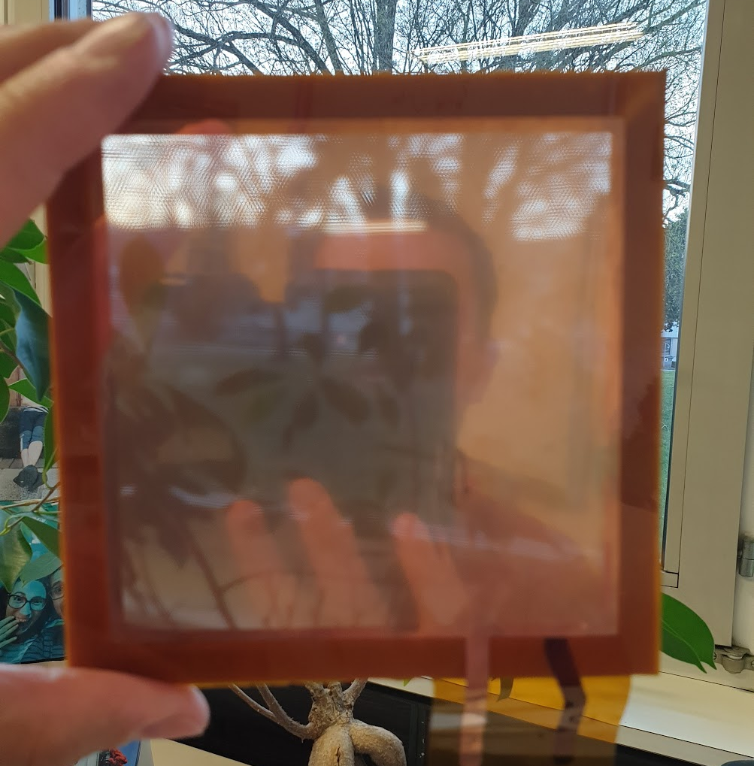
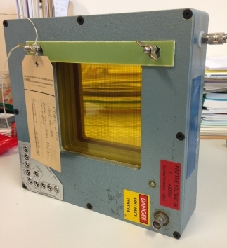
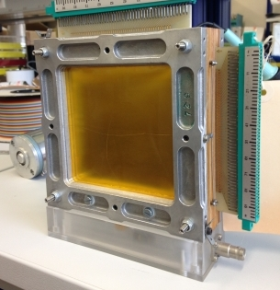
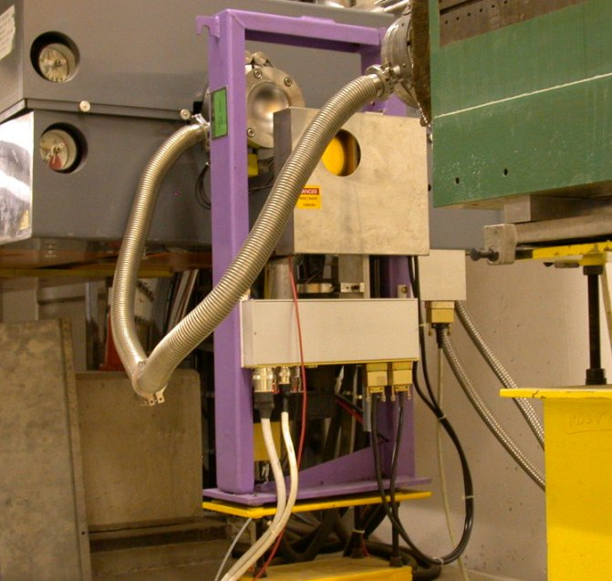
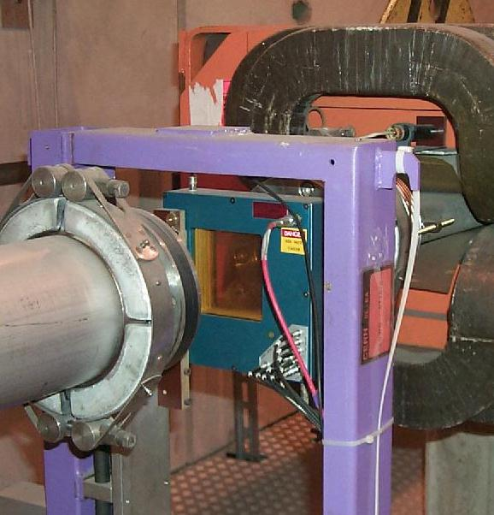
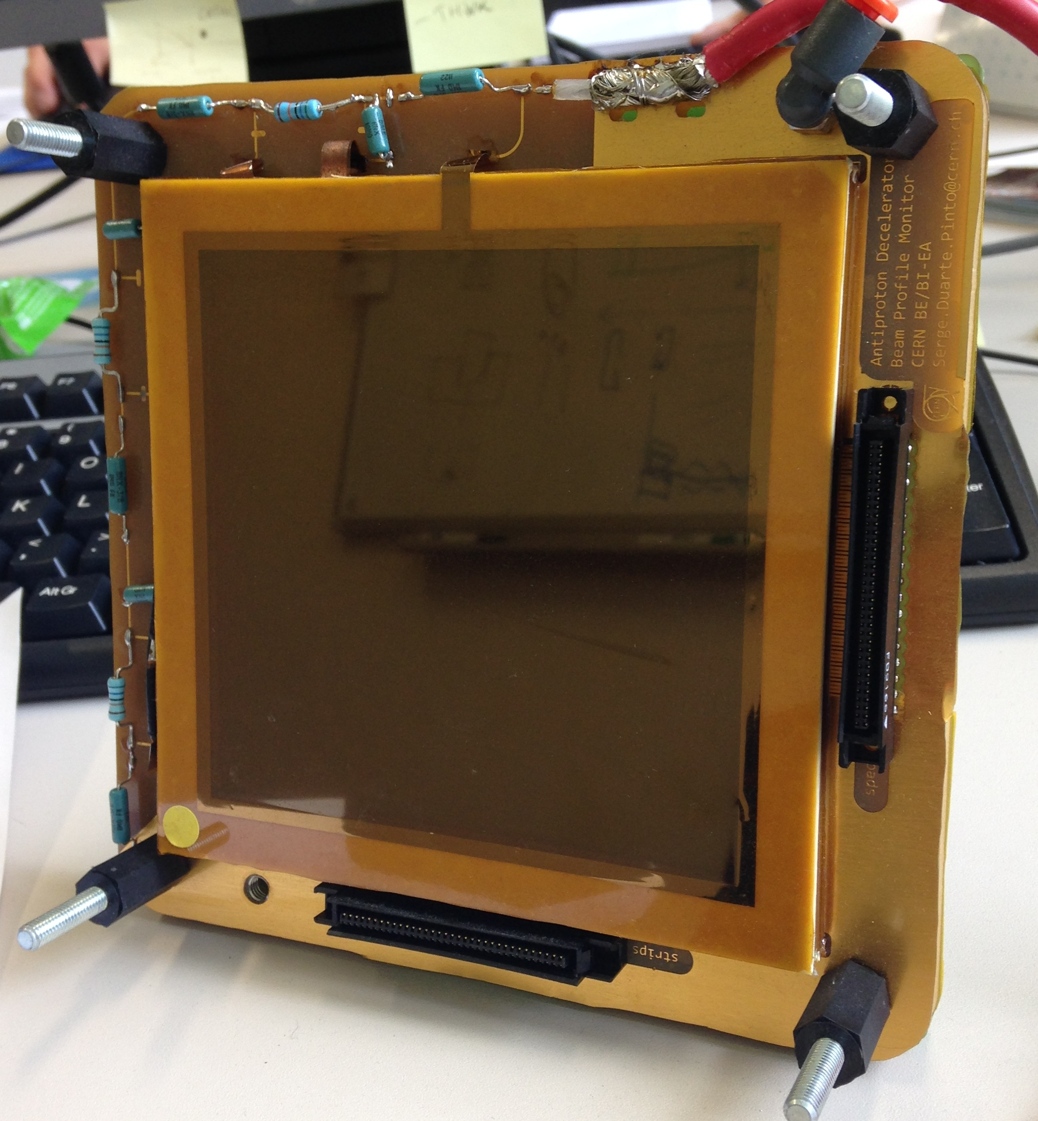
Gaseous detectors
Gas electron multiplier
(GEM)
Delay wire chamber
(DWC)
Multi-wire proportional chamber
(MWPC)
~35 units
~50 units
~6 units
Notes:
For the sake of clarity I omit another beam monitor, the ionization chamber, which is used as a counter for high intensities.

Slide 8
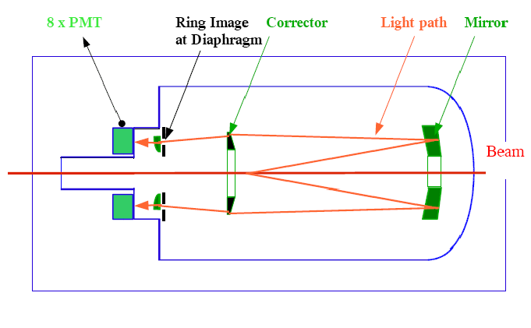
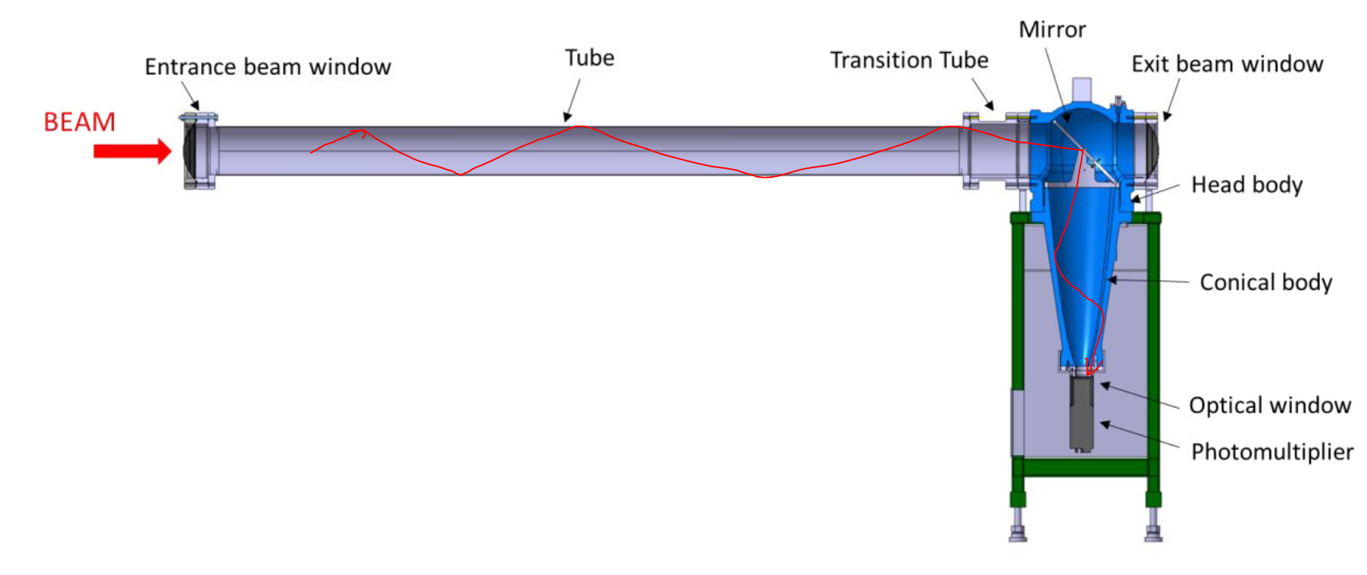
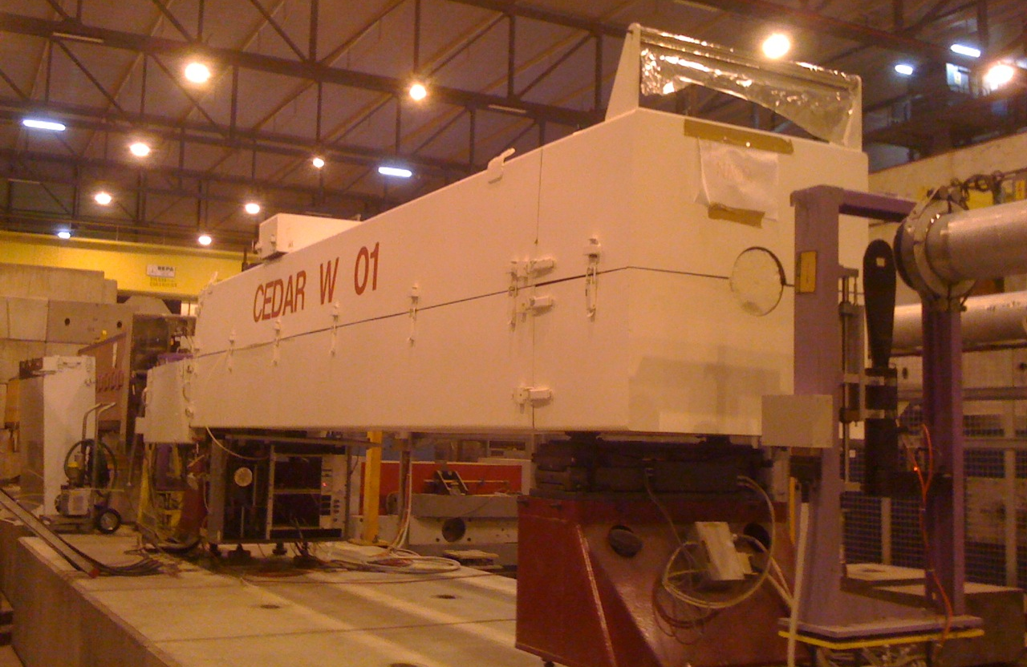
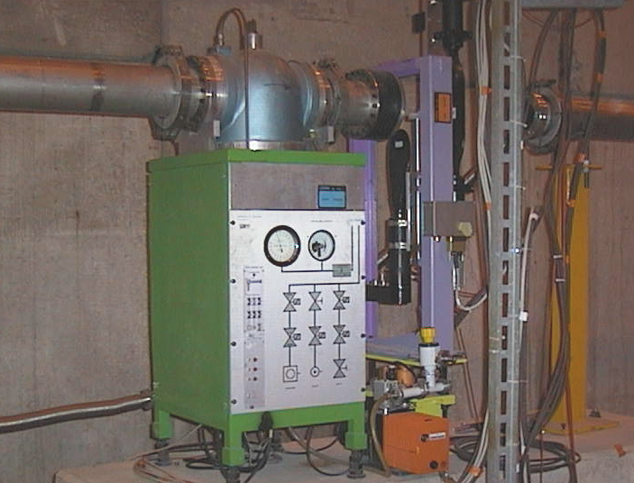
Cherenkov detectors
Cherenkov differential counter with achromatic ring focus (CEDAR)
Cherenkov threshold counter (XCET)
~16 units
~10 units
Notes:
The CEDAR name is as long as the detector

Slide 9
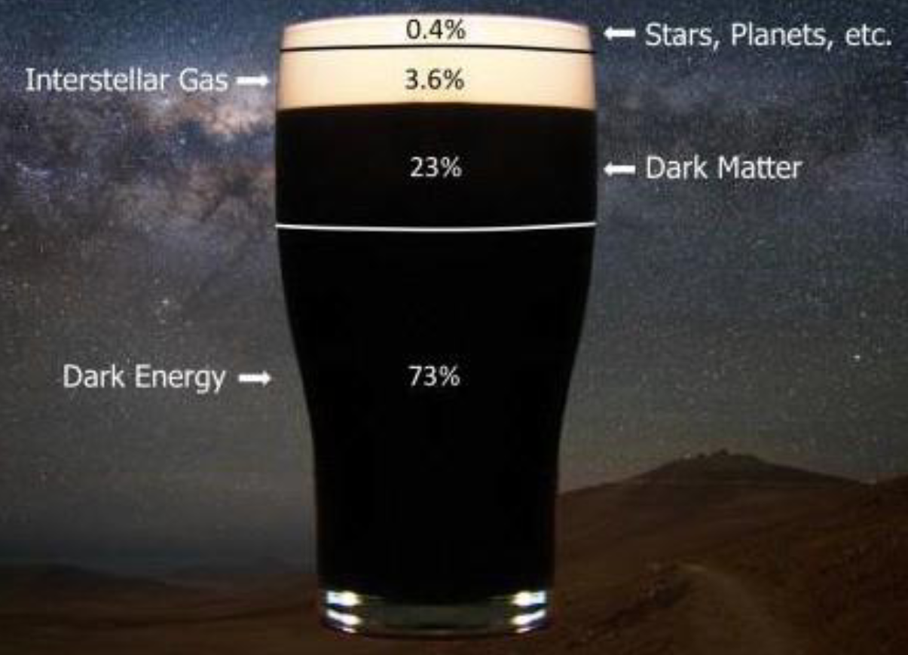
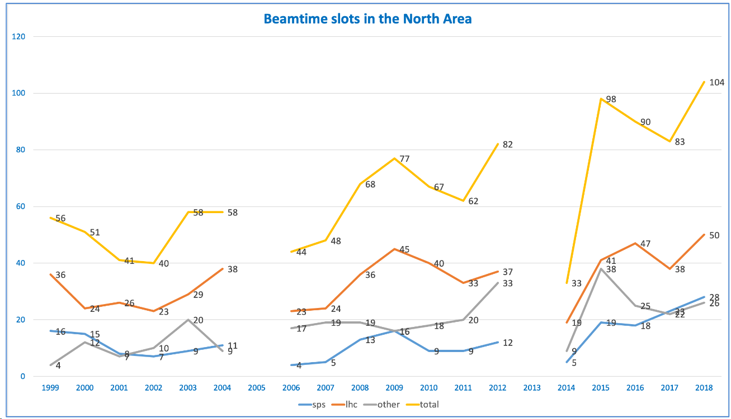
What’s the future of the North Area?
The NA is a key player in the Physics Beyond Colliders program:
low energy sector
high precision measurements
beam test facility
A unique facility in the world
And highly demanded!
The North Area dates from the 70s, and many systems need urgent consolidation -> North Area Consolidation
Large consolidation program spanned over two phases (phase 1 – 2022-208, phase 2 – 2029-2034), also covering beam instrumentation
Notes:
This pint of dark beer summarises very well our knowledge of the composition of the universe nowadays. We only know the foam. The rest remains unanswered: what’s dark matter? What’s dark energy?
During many years, we pushed the high-energy frontier looking for answers: more energy – bigger colliders like the LHC. However, the LHC has only given the Higgs boson. No other new particle or hint of new physics. The Super Symmetry (SUSY) disappointment is still fresh.
That’s the reason why the low-energy regime is becoming more and more attractive these days. The last update of the European Strategy for Particle Physics dedicated a big section to Physics Beyond Colliders, which gathers experiments looking into the low energy sector.
As it turns out, fixed target experiments are the best suited to look into the low energy sector due to their energy regime and their ability to provide high precision measurements. For this reason, many of the PBC proposals use the NA as beam source.
As I mentioned before, the importance of the NA as a test-beam facility is steadily increasing over the years for particle detector and accelerator technology R&D. With their high energy beams and versatile configuration, is a unique facility in the world. As a consequence, the NA is heavily booked all year round.

Slide 10
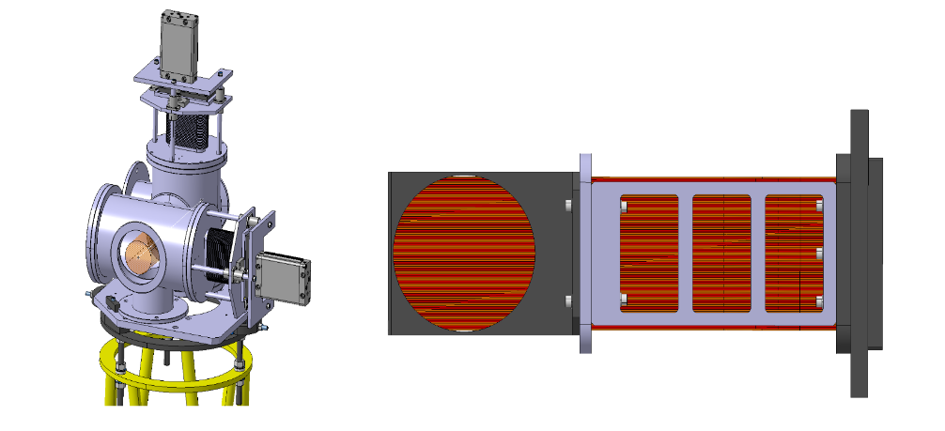
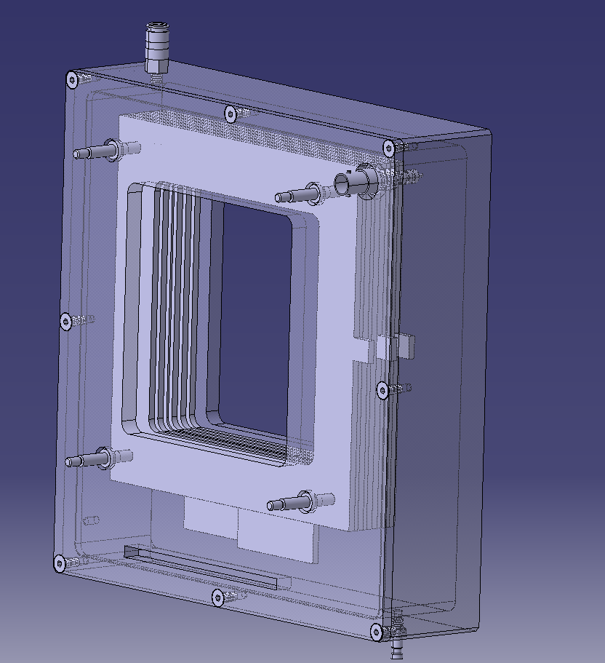
On-going North Area Consolidation-related projects
Scintillating fibre beam profile monitor (XBPF)
Already installed in the CERN Neutrino
Platform and the East Area
New NA design motorised and in a vacuum
  Redesigned detector & electronics
  Added in/out motorisation
  Reusing the FISC tank
Multi-wire Proportional Chambers
Design and production of new wire chambers
Readout Electronics
Design and production of the new generation of
Experimental Areas readout electronics

Slide 11
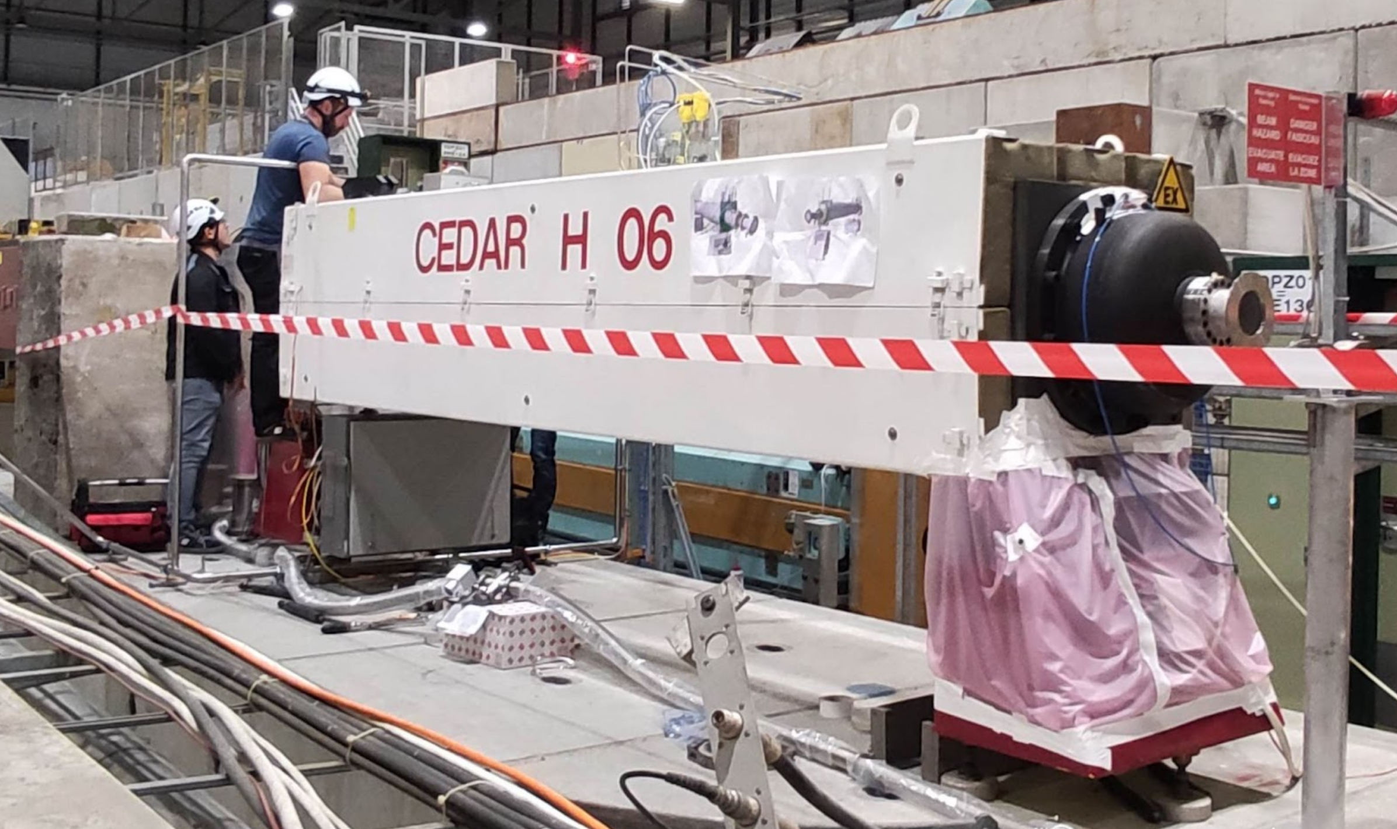
CEDAR
Goal: recover lost know-how and produce new units.
Production of a new CEDAR (mechanics + optics + gas system + control & acquisition). We are not adding new functionalities but might add a few improvements.
Timeline: prototype and test room for NA-CONS Phase 1. Bulk production in Phase 2.
Cherenkov Threshold Counter (XCET)
Same as the CEDAR: recover lost know-how and build new units.
Design of new optics, mechanics, gas system, and control & acquisition
  Timeline is waiting for confirmation from NA-CONS – phase 1 or 2?

Slide 12
Radiation-hard monitor
R&D to find a substitute for the wire chambers in the high-intensity secondary beams and high-radiation areas of TT83 and ECN3
Challenging user’s requirements:
  Beam intensity: from 10^5 to 10^11 particles/spill, slowly extracted (4.8s or 9.6s)
  1mm spatial resolution
  Material budget below 0.5% x/X₀
  Large area: 20cm x 20cm (there’s even a request for a 30cm x 30cm device!)
  In a vacuum
  Equipped with an in/out motorisation
  Radiation tolerance – 1MGy for the active area, several kGy for local components
  Measure beam divergence in specific locations. Challenging measurement –spatial resolution below 500um, individual particle detection. To be performed only on a sample of the beam.
Currently investigating different types of radiation-resistant fibres
  Silica rods & fibres (Cherenkov emitters)
  Cristal capillaries filled with liquid scintillators
  Micro-structured optical fibres filled with gaseous or liquid scintillators
  Open to new ideas!
Medical Physics
  Possible application for instrumentation for FLASH irradiation therapy. Collaborating with an Oxford team on a feasibility study of a fibre-based beam profile monitor
  The first results obtained in the CLEAR accelerator are very promising

Slide 13
NA-CONS Phase 2 – 2028-2033
Heavy-ion instrumentation
Our current instrumentation is not suited for heavy ions!
  Unreliable data
  Radiation damage
  Beam fragmentation
R&D part of NA-CONS
CEDAR and XCET readout upgrade for high-intensities
For beam intensities up to 10^9 part/s (currently around 10^7)

Slide 14
What R&D are we interested in?
Radiation-resistant detectors that could be easily scalable to make large-area beam instrumentation
Cherenkov emitters
Liquid scintillators
Gaseous scintillators
Radiation-resistant photodetectors
Coupling of light-emitting materials with photodetectors
Readout electronics for photodetectors
Please bear in mind that for beam instrumentation and high-intensity beams, in general, we do not need individual particle information -> it can be counterproductive!
Cost, ease of maintenance, and long-term availability are key drivers for us

Slide 15
What we expect from being a member of the DRD4 collaboration
Make part of the detector community
Be at the forefront of the detector technology
Learn about future projects
Learn from experts
Share expertise
Share resources
Share common goals and objectives

