Slide 1


Slide 2
Agenda meeting 17 Aug 2023
Dates and format - 70th anniversary programming
Launch 16 November
Public Event
Forum Topics
Forum Co-conveners
Updates from previous editions
Next
Notes:
Heike Riel - Heike Riel <hei@zurich.ibm.com>
Lara Jehi, no farih sorry
https://nikal.eventsair.com/6th-quantum-technology-conference/
Arunima Sarkar - Thematic Lead – Quantum Technologies - Center for the Fourth Industrial Revolution
Nir Davidson - The Peter and Carola Kleeman Professorial Chair of Optical Sciences - Dept. of Physics of Complex Systems,

Slide 3
1. Sparks! Dates and Formats
2023
16 Nov - Launch - Sparks 3rd edition - Future Quantum at SGW - 2-3 talks + performance
2024
March 6 - “Innovations at the Frontier: Technological Innovations Driving Breakthroughs in Particle Physics and Beyond” (as part of the 70th anniversary celebrations proposed by Luciano Musa TBC)
March 7 - Sparks Talks - 8 talks with Q&A + performance at SGW
March 8 - Sparks Forum - Plenary at the Globe and breakout sessions at IdeaSquare with a wrap-up session for the public at SGW

Slide 4
2. Launch
Launch Programming - 16 November 2023
19:00 - Intro by host Bruno Giussani
19:05 - Quantum 101 - Nicolle Harper author of Steampunk Quantum
19:20 - Quantum at CERN - Sofia Vallercosa
19:35 - Potential impact for society - Reeke Heijman-te Paske (Quantum Delta NL) not confirmed!
19:50 - Discussion
20:20 - Talk/ Projection by dancer Suwenchi - with VR Googles or performance
20:35 - end

Slide 5
3.Public Event
---- short film ----- ???
History of Quantum: Nobel prize winners Alain Aspect or Anton Zeilinger
How could Quantum change the world (speculative) - Talia Gershon or Ana Paula de Assis or Heike Riel from IBM
Reality check (feasible) - SUCHITRA SEBASTIAN - Cambridge or Julie Love leads Microsoft’s engagement with enterprises
Medical applications - Lara Jehi - director of quantum initiative / Cleveland Clinic or ???
Sensing - Silvia Fedi ESA Eutelsat or ???
GPS - atomic clock - Tanja Mehlstäubler - quantum sensors and clocks or Patrick Gill, Senior NPL Fellow in Time & Frequency at the National Physical Laboratory or
Knowledge sharing - Arunima- Sarkar WEF or ???
Shaking-up Structures - Anousheh Ansari or Jim Mainard - XPrize
Philosopher - Tim Maudlin or ???
---- Artist performance ---- David Quola
Notes:
Notes of discussion with Alberto
https://nikal.eventsair.com/6th-quantum-technology-conference/
Knowledge sharing should focus on access to Quantum technology, education means
WEF initiatives - Arunima Sarkar - Thematic Lead – Quantum Technologies - Center for the Fourth Industrial Revolution (kowledge sharing from private to non-profit)
Jim Mainard - X-Prize or the astronaut (Open Quantum Institute)
Philosophy of science - newtonian mechanics / what does physics means? When we do physics we only measure our interactions with nature. Human mind, experiments and knowledge

Slide 6
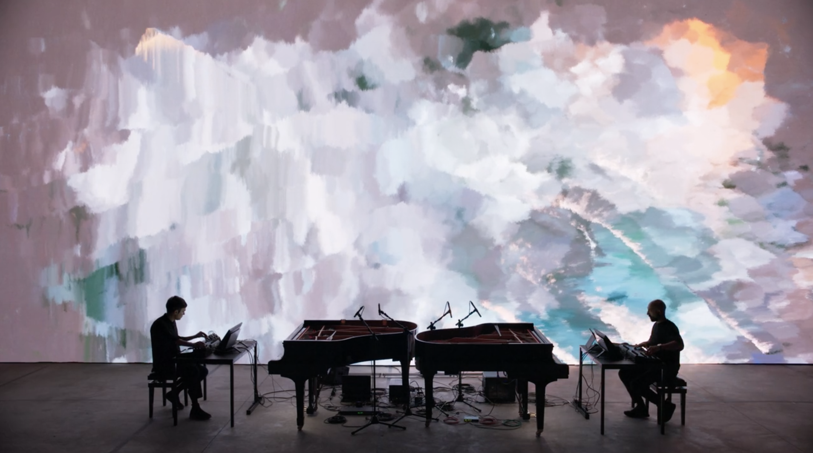
https://vimeo.com/479035458

Slide 7
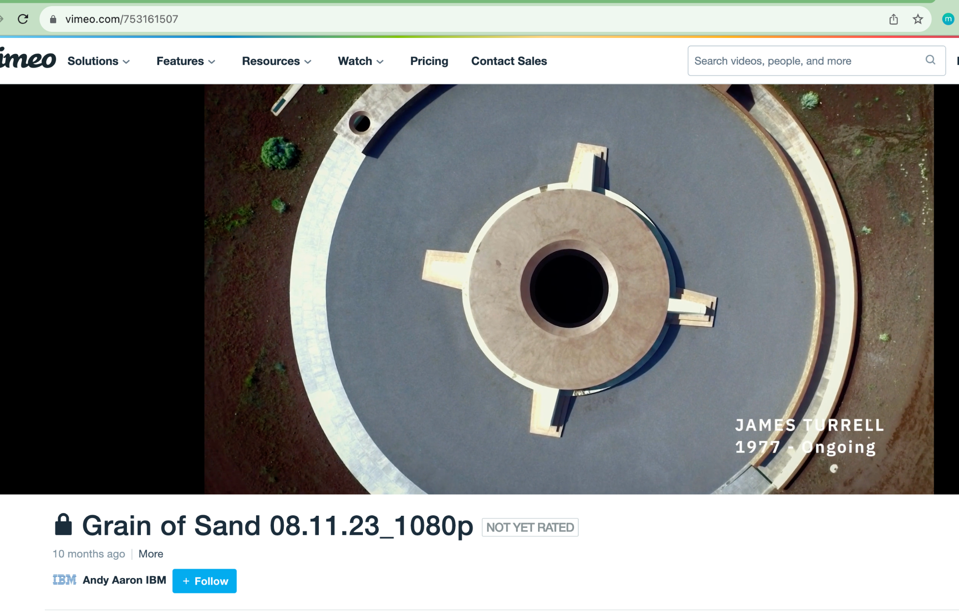
In addition
Feature film on Quantum Computing by the Director of Particle Fever Mark Levinson

Slide 8
4.Forum Topics
1 - Interpreting Reality - How will the coming quantum revolution change our understanding of reality? (physicists + philosopher) - Beatrix Hiiesmayr AND Angelo Basi
2 - Sharing Quantum - How do we ensure global knowledge sharing amongst researchers? - Tatjana Wilk, general manager of the Munich Centre for Quantum Science and Technology AND Heike Riel IBM Fellow, Senior Executive IBM Quantum Research Europe, IBM Research - Grow the Quantum Computing Ecosystem
3 - Opening Quantum - How do we ensure that users have fair access to knowledge and technology in a shared and open way? - Arunima Sarkar Thematic Lead WEF – Quantum TechnologiesCenter for the Fourth Industrial Revolution AND ?
4- Changing the game - The first true quantum computer might bestow geopolitical advantage. What frameworks need to be put into place to avoid global supremacy? - Jake Taylor or Corey Stambaugh - US National Quantum Initiative AND Reeke Heijman-te Paske from Quantum Delta NL
5 - Sensing Quantum - Quantum sensors have the potential to reduce the costs of high-tech apparatus, especially linked to health. How these applications might change our lives? How do we ensure the new tools will be used towards democratisation rather than risk increasing the societal divide? (ESA, Earth Observation community) - Tanja Mehlstäubler and/or Nancy Paul - Laboratoire Kastler Brossel in Paris and/or Yonit Hochberg - Racah Institute of Physics, Hebrew University of Jerusalem - Nir Davidson
6 - Shaking-up Structures - How will quantum computing shake up existing structures in research (small vs. large groups), industry, geopolitics (think a small country with first quantum supremacy)? How will allow us to ask a question in a new way allowing to leapfrog to a new understanding - Antoine Georges, Ph.D. Director, Center for Computational Quantum Physics, Flatiron Institute - Simons Foundations AND Jim Mainard - XPrize

Slide 9
5. Forum Co-conveners
Instead of having participants be selected by us, we will aim to have a couple of organisations co-convening each topic. At least one topic should have the involvement of one person from the CERN community
2 institutions per topic
10 names proposed by each - passed through committee
CERN invites 5
Attention to diversity and openness to format

Slide 10
6.Follow up previous events
How to follow up the interest from first and second forum editions? First edition we have the papers, but how about second edition?
Yellow Report 2nd edition: James
MLST: Follow-up Markus’ message - Dropped!
Frontiers: Drafts of 5 first articles, considering if Charlotte will sign the collection
Proposals to follow-up - Gender in tech for health research taking place in November

Slide 11
7. Next
Inviting co-conveners: template
next meetings: Sept: Tues 26 at 15:00

Slide 12
Project timeline
Phase I – Conception and initiation (12 months prior event)
  Consult committee and hierarchy about theme
  Contact potential internal stakeholders, co-curators
  Keep Partnerships and Fundraising updated with project decisions
Phase II – Definition and planning (9 months prior event)
  Refine theme and define topics with committee and/or co-curators
  Identify co-conveners and other external stakeholders
  Reflect on global format date, location, format for launch, order of Forum and Talks, etc
  Define full edition budget and liaise with PUF according to their requests
  Define prospective dates with Logistics
  Evaluate and adjust timeline
  Produce first content for brochures, allow time for copy editing
Phase III – Launch or execution (five non-holiday months before the event)
  Curation in collaboration committee
  Graphic design brief of edition
  First contact with internal teams, define briefs
  Plan website development for the edition
  Decide and plan ticketing for the public event
  Organise travel and accommodation
  Start comms across platforms

Slide 13
6. KPIs
Target audiences | Sparks events | Comments | KPIs
Potential new donors | Public event | The bigger the show the better
Local decision-makers, including Host-States | Public event and panel | Needs French
Local media | Public event and panel | Needs French
University-level students | Podcast, public event | Specially if we involve universities in the forum
HEP community (depending on topic ) | Podcast, and panel | Specially if theme is something like “energy”
CERN community | Podcast, public event and panel | Current audience of Sparks
“Interested” local communities (in science/CERN) | Podcast, public event and panel | Current audience of Sparks

