Slide 1

Quantum Computing
Lecture 2
Ahmed Abdelmotteleb
University of Warwick
ahmed.abdelmotteleb@cern.ch
CERN openlab Summer Lectures
26th of July 2023

Slide 2
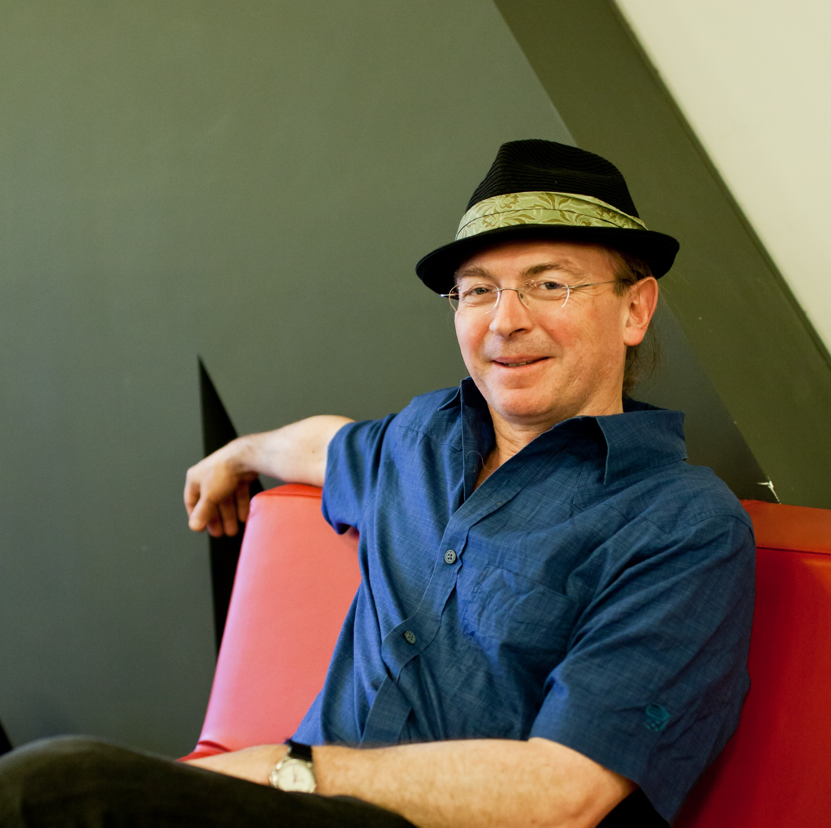
“The history of the universe is, in effect, a huge and ongoing quantum computation. The universe is a quantum computer.”
-Seth Lloyd

Slide 3
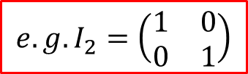
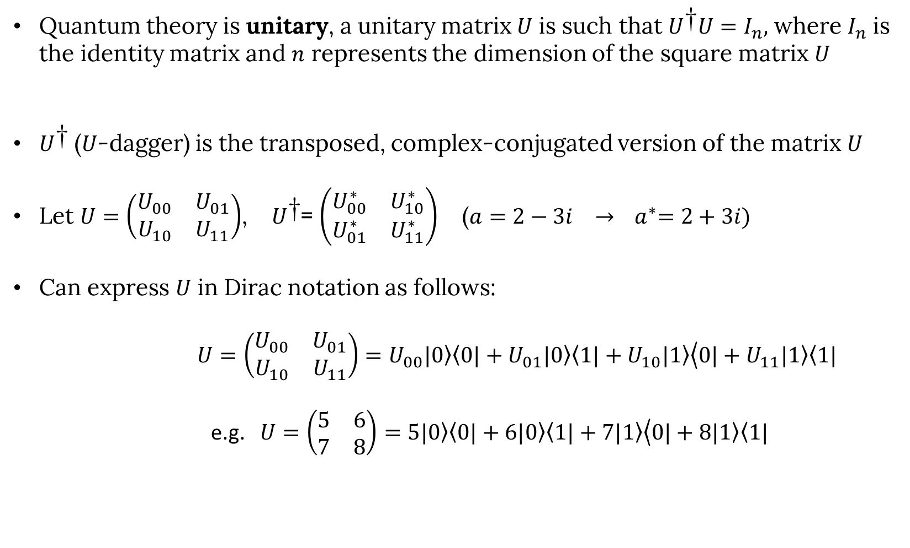
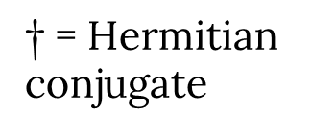
Mathematical aside 2 – Matrix Operations
Quantum theory is unitary, a unitary matrix $U$ is such that $U^{\text{†}}U=I_{n},$ where $I_{n}$ is the identity matrix and $n$ represents the dimension of the square matrix $U$
$U^{\text{†}}$ ($U$-dagger) is the transposed, complex-conjugated version of the matrix $U$
Let $U=\left(\begin{matrix}U_{00} & U_{01} \\ U_{10} & U_{11}\end{matrix}\right)$, $U^{\text{†}}$= $\left(\begin{matrix}U_{00}^{∗} & U_{10}^{∗} \\ U_{01}^{∗} & U_{11}^{∗}\end{matrix}\right)$ ($a=2−3i → { a}^{∗}=2+3i)$
Can express $U$ in Dirac notation as follows:
$U=\left(\begin{matrix}U_{00} & U_{01} \\ U_{10} & U_{11}\end{matrix}\right)=U_{00}\left.|0\right\rangle \left\langle 0|\right.+U_{01}\left.|0\right\rangle \left\langle 1\right.|$ $+ U_{10}\left.|1\right\rangle \left\langle 0|+U_{11}\left.|1\right\rangle \left\langle 1|\right.\right.$
e.g. $U=\left(\begin{matrix}5 & 6 \\ 7 & 8\end{matrix}\right)=5\left.|0\right\rangle \left\langle 0|\right.+6\left.|0\right\rangle \left\langle 1\right.|$ $+ 7\left.|1\right\rangle \left\langle 0|+8\left.|1\right\rangle \left\langle 1|\right.\right.$
$\text{†}$ = Hermitian conjugate
$$e.g. I_{2}=\left(\begin{matrix}1 & 0 \\ 0 & 1\end{matrix}\right)$$

Slide 4

Matrix Operations - continued
Recap on how to multiply two 2x2 matrix with a 2x1 matrix (2D-vector):
A = $\left(\begin{matrix}1 & 2 \\ 3 & 4\end{matrix}\right)$ B=$\left(\begin{matrix}5 \\ 6\end{matrix}\right)$
AB = $\left(\begin{matrix}1 & 2 \\ 3 & 4\end{matrix}\right)\left(\begin{matrix}5 \\ 6\end{matrix}\right)$
  = $\left(\begin{matrix}1.5+2.6 \\ 3.5+4.6\end{matrix}\right)$
  = $\left(\begin{matrix}17 \\ 39\end{matrix}\right)$

Slide 5

Gates

Slide 6
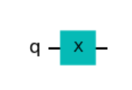
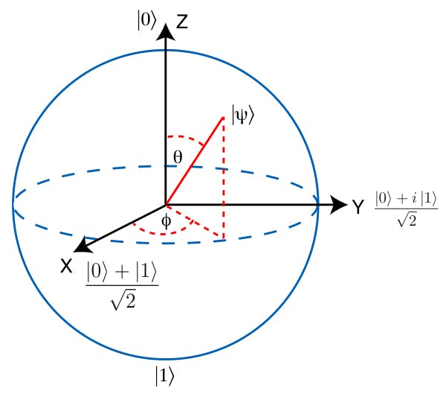
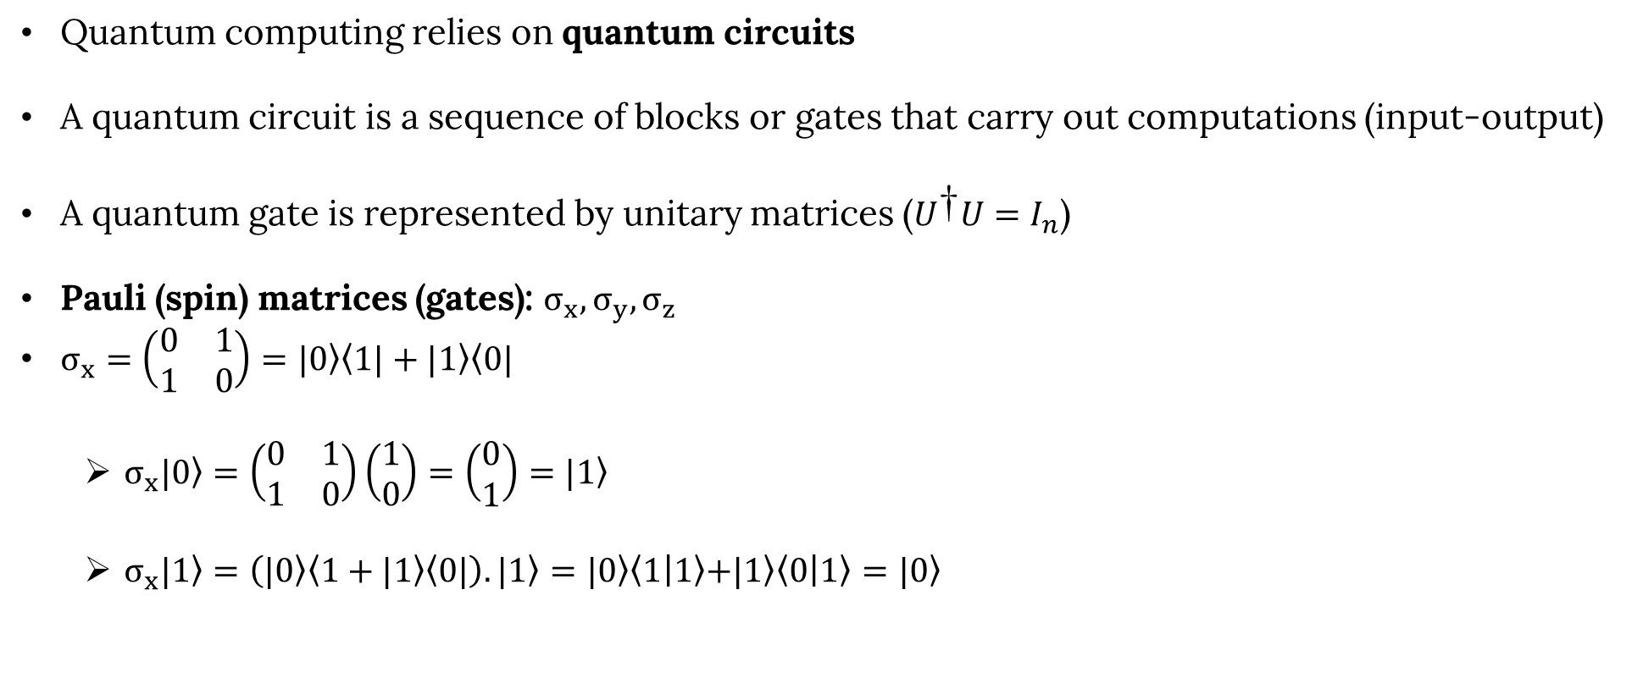
Quantum Logic Gates (qubit gates)
Quantum computing relies on quantum circuits
A quantum circuit is a sequence of blocks or gates that carry out computations (input-output)
A quantum gate is represented by unitary matrices ($U^{\text{†}}U=I_{n}$)
Pauli (spin) matrices (gates): $σ_{x},σ_{y},σ_{z}$
$σ_{x}=\left(\begin{matrix}0 & 1 \\ 1 & 0\end{matrix}\right)=\left.|0\right\rangle \left\langle 1|\right.+\left.|1\right\rangle \left\langle 0|\right.$
  $σ_{x}\left.|0\right\rangle =\left(\begin{matrix}0 & 1 \\ 1 & 0\end{matrix}\right)\left(\begin{matrix}1 \\ 0\end{matrix}\right)=\left(\begin{matrix}0 \\ 1\end{matrix}\right)=\left.|1\right\rangle$
  $σ_{x}\left.|1\right\rangle =\left(\left.|0\right\rangle \left\langle 1\right.+\left.|1\right\rangle \left\langle 0|\right.\right).\left.|1\right\rangle =\left.|0\right\rangle \left\langle 1 | 1\right\rangle \left.+|1\right\rangle \left\langle 0 | 1\right\rangle =\left.|0\right\rangle$
1
0
Bit flip (rotation about x-axis by $π$) (analogous to classic NOT gate)

Slide 7
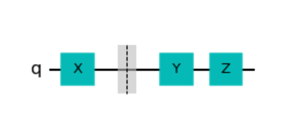


Quantum Logic Gates (qubit gates) - continued
$σ_{z}=\left(\begin{matrix}1 & 0 \\ 0 & −1\end{matrix}\right)=\left.|0\right\rangle \left\langle 0|\right.−\left.|1\right\rangle \left\langle 1|\right.$
  $σ_{z}\left.|+\right\rangle =\left(\begin{matrix}1 & 0 \\ 0 & −1\end{matrix}\right)\frac{1}{\sqrt{2}}\left(\begin{matrix}1 \\ 1\end{matrix}\right)=\frac{1}{\sqrt{2}}\left(\begin{matrix}1 \\ −1\end{matrix}\right)=\left.|−\right\rangle$ ($\left.|+\right\rangle = \frac{1}{\sqrt{2}}\left(\left.|0\right\rangle +\left.|1\right\rangle \right)$)
  $σ_{z}\left.|−\right\rangle =\left(\left.|0\right\rangle \left\langle 0|\right.−\left.|1\right\rangle \left\langle 1|\right.\right).\left(\frac{1}{\sqrt{2}}\left.|0\right\rangle −\left.|1\right\rangle \right)=\frac{1}{\sqrt{2}}\left.|0\right\rangle +\left.|1\right\rangle =\left.|+\right\rangle$
$σ_{y}=\left(\begin{matrix}0 & −i \\ i & 0\end{matrix}\right)=\left.−i|0\right\rangle \left\langle 1|\right.+i\left.|1\right\rangle \left\langle 0|\right.= iσ_{x}$. $σ_{z}$
$σ_{i}^{2}=I_{2}=\left(\begin{matrix}1 & 0 \\ 0 & 1\end{matrix}\right)$, i.e. applying the same Pauli gate twice does nothing to a state
Phase flip (rotation about z-axis by $π$)
Bit and phase flip (rotation about y-axis by $π$)

Slide 8
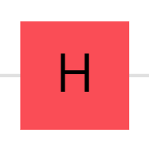
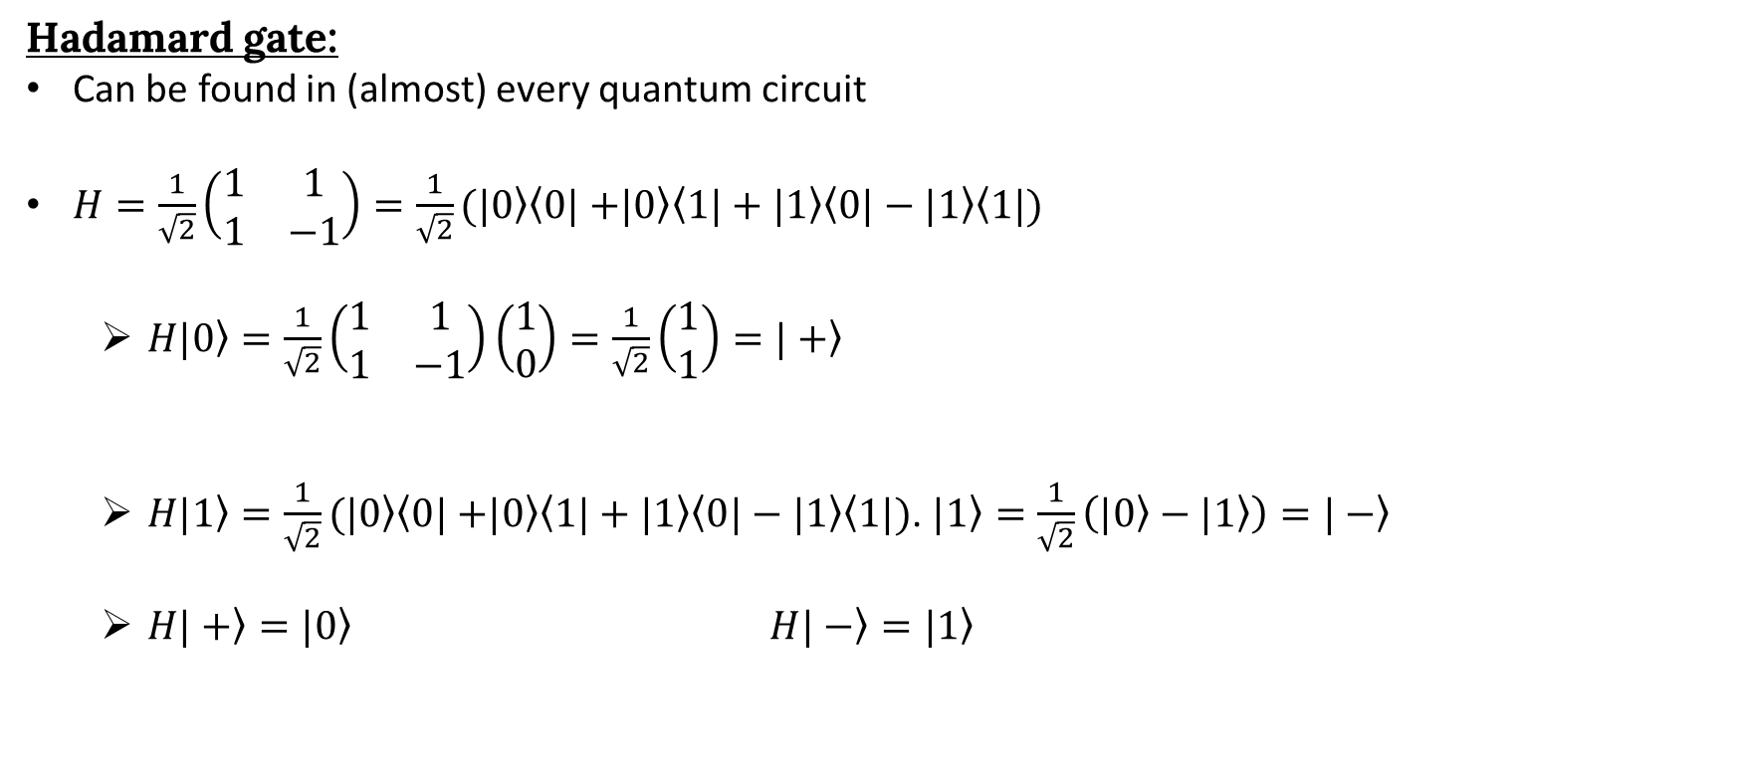
Quantum Logic Gates (qubit gates) - continued
Hadamard gate:
Can be found in (almost) every quantum circuit
$H=\frac{1}{\sqrt{2}}\left(\begin{matrix}1 & 1 \\ 1 & −1\end{matrix}\right)=\frac{1}{\sqrt{2}}(\left.|0\right\rangle \left\langle 0|+\right.\left.|0\right\rangle \left\langle 1|\right.+\left.|1\right\rangle \left\langle 0|\right.−\left.|1\right\rangle \left\langle 1|)\right.$
  $H\left.|0\right\rangle =\frac{1}{\sqrt{2}}\left(\begin{matrix}1 & 1 \\ 1 & −1\end{matrix}\right)\left(\begin{matrix}1 \\ 0\end{matrix}\right)=\frac{1}{\sqrt{2}}\left(\begin{matrix}1 \\ 1\end{matrix}\right)=\left.|+\right\rangle$
  $H\left.|1\right\rangle =\frac{1}{\sqrt{2}}(\left.|0\right\rangle \left\langle 0|+\right.\left.|0\right\rangle \left\langle 1|\right.+\left.|1\right\rangle \left\langle 0|\right.−\left.|1\right\rangle \left\langle 1|)\right.$. $\left.|1\right\rangle =\frac{1}{\sqrt{2}}\left(\left.|0\right\rangle −\left.|1\right\rangle \right)=\left.|−\right\rangle$
  $H\left.|+\right\rangle =\left.|0\right\rangle H\left.|−\right\rangle =\left.|1\right\rangle$
Creates and destroys superposition (switch between z and x bases)

Slide 9
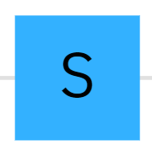

Quantum Logic Gates (qubit gates) - continued
S gate:
$S=\left(\begin{matrix}1 & 0 \\ 0 & i\end{matrix}\right)= \left.|0\right\rangle \left\langle 0|+ \right.i\left.|1\right\rangle \left\langle 1|\right.$
  $S\left.|+\right\rangle =\left.|i\right\rangle S\left.|−\right\rangle =\left.|−i\right\rangle$
$S.H$ allows us to switch between z and y bases
Adds $\frac{π}{2}$(90°) to the phase $φ$(switch between x and y bases)
https://javafxpert.github.io/grok-bloch/

Slide 10
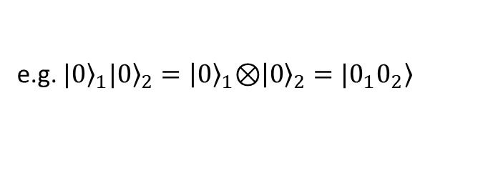
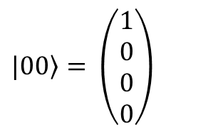
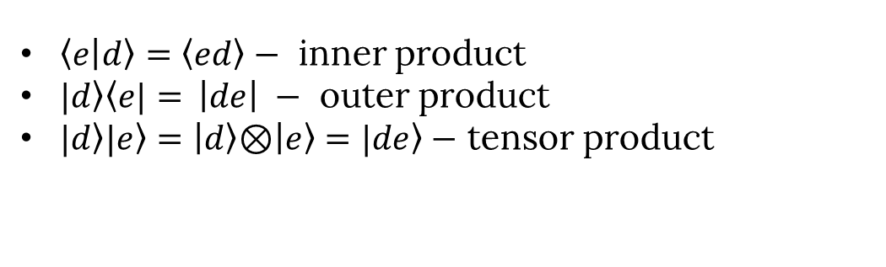
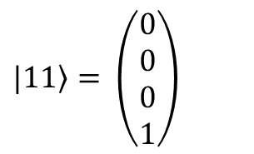
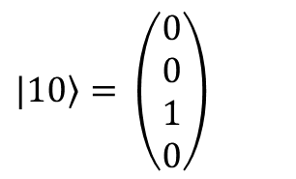
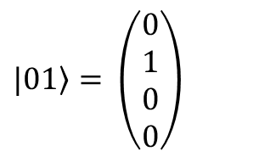
Two qubits and tensor products
$$\left.|00\right\rangle = \left(\begin{matrix}1 \\ 0 \\ 0 \\ 0\end{matrix}\right)$$
$$\left.|01\right\rangle = \left(\begin{matrix}0 \\ 1 \\ 0 \\ 0\end{matrix}\right)$$
$$\left.|10\right\rangle = \left(\begin{matrix}0 \\ 0 \\ 1 \\ 0\end{matrix}\right)$$
$$\left.|11\right\rangle = \left(\begin{matrix}0 \\ 0 \\ 0 \\ 1\end{matrix}\right)$$
$\left\langle e | d\right\rangle =\left\langle ed\right\rangle −$ inner product
$\left.|d\right\rangle \left\langle e|= \right.\left|de\right| −$ outer product
$\left.|d\right\rangle |\left.e\right\rangle =\left|\left.d\right\rangle \text{⊗}\right|\left.e\right\rangle =|\left.de\right\rangle −$ tensor product
e.g. ${\left.|0\right\rangle }_{1}|{\left.0\right\rangle }_{2}=\left|{\left.0\right\rangle }_{1}\text{⊗}\right|{\left.0\right\rangle }_{2}=|\left.0_{1}0_{2}\right\rangle$

Slide 11
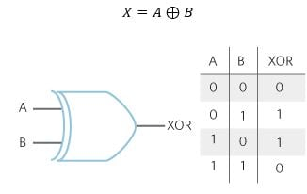
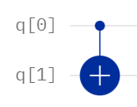
Two qubit gates
Control qubit
CNOT gate (CX):
Input |  | Output
x | y | x | x⊕y
0 | 0 | 0 | 0
0 | 1 | 0 | 1
1 | 0 | 1 | 1
1 | 1 | 1 | 0
Note that a classical XOR gate is non-reversible
However, since all quantum gates are unitary, they are, in fact, reversible
CNOT stands for Controlled-NOT. The qubit in control does not change by the gate

Slide 12
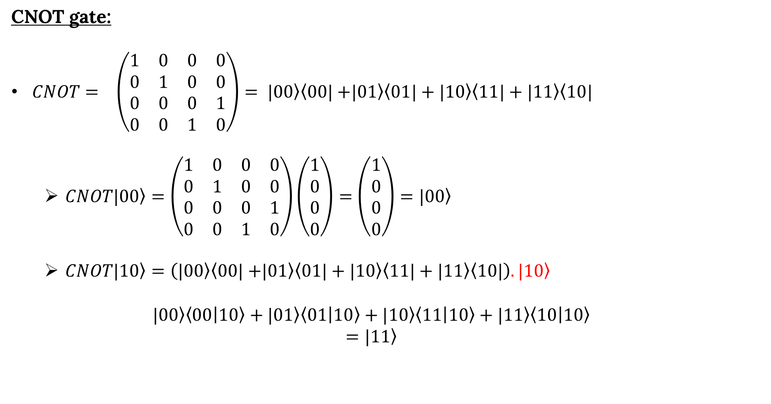
Two qubit gates - continued
CNOT gate:
$CNOT= \left(\begin{matrix}1 & 0 & 0 & 0 \\ 0 & 1 & 0 & 0 \\ 0 & 0 & 0 & 1 \\ 0 & 0 & 1 & 0\end{matrix}\right)= \left.|00\right\rangle \left\langle 00|+\right.\left.|01\right\rangle \left\langle 01|\right.+\left.|10\right\rangle \left\langle 11|\right.+\left.|11\right\rangle \left\langle 10|\right.$
  $CNOT\left.|00\right\rangle =\left(\begin{matrix}1 & 0 & 0 & 0 \\ 0 & 1 & 0 & 0 \\ 0 & 0 & 0 & 1 \\ 0 & 0 & 1 & 0\end{matrix}\right)\left(\begin{matrix}1 \\ 0 \\ 0 \\ 0\end{matrix}\right)=\left(\begin{matrix}1 \\ 0 \\ 0 \\ 0\end{matrix}\right)=\left.|00\right\rangle$
  $CNOT\left.|10\right\rangle =\left(\left.|00\right\rangle \left\langle 00|+\right.\left.|01\right\rangle \left\langle 01|\right.+\left.|10\right\rangle \left\langle 11|\right.+\left.|11\right\rangle \left\langle 10|\right.\right).\left.|10\right\rangle$
  $$|\left.00\right\rangle \left\langle 00 | 10\right\rangle +|\left.01\right\rangle \left\langle 01 | 10\right\rangle +|\left.10\right\rangle \left\langle 11 | 10\right\rangle +|\left.11\right\rangle \left\langle 10 | 10\right\rangle$$
  $$=\left.|11\right\rangle$$
00
01
10
11
00
01
10
11

Slide 13
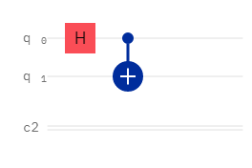
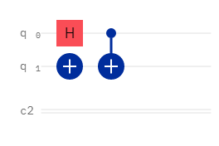
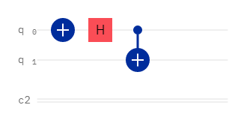
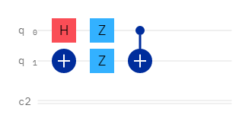

Bell states
4 states (2 qubits) that are maximally-entangled and build an orthonormal basis
$\left.|ψ^{00}\right\rangle =\frac{1}{\sqrt{2}}\left(\left.|00\right\rangle +\left.|11\right\rangle \right)$ $\left. |ψ^{01}\right\rangle =\frac{1}{\sqrt{2}}\left(\left.|01\right\rangle +\left.|10\right\rangle \right)$
$\left.|ψ^{10}\right\rangle =\frac{1}{\sqrt{2}}\left(\left.|00\right\rangle −\left.|11\right\rangle \right)$ $\left. |ψ^{11}\right\rangle =\frac{1}{\sqrt{2}}\left(\left.|01\right\rangle −\left.|10\right\rangle \right)$

Slide 14

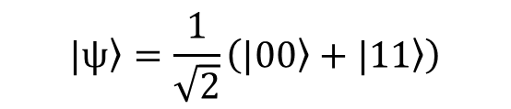
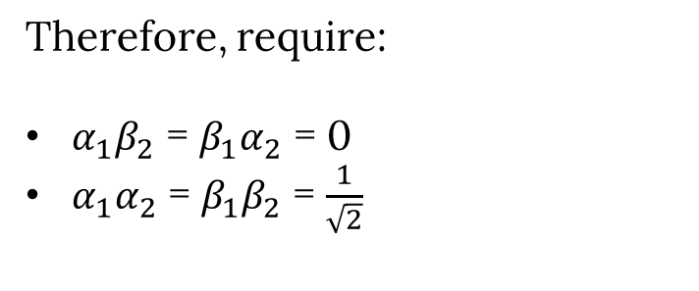
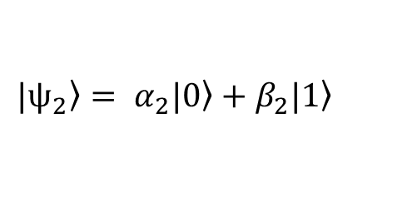
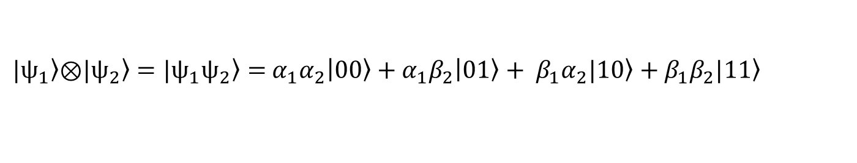
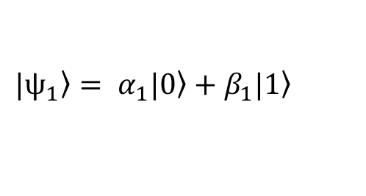

More entanglement
$$\left.|ψ\right\rangle =\frac{1}{\sqrt{2}}\left(\left.|00\right\rangle +\left.|11\right\rangle \right)$$
Global state
$$\left.|ψ_{1}\right\rangle = α_{1}|\left.0\right\rangle +β_{1}|\left.1\right\rangle$$
local state
$$\left.|ψ_{2}\right\rangle = α_{2}|\left.0\right\rangle +β_{2}|\left.1\right\rangle$$
Given the global state, what are the local states?
$\left.|ψ_{1}\right\rangle \left.\text{⊗}|ψ_{2}\right\rangle =\left.|ψ_{1}ψ_{2}\right\rangle =$ $α_{1}α_{2}\left|\left.00\right\rangle +{α_{1}β}_{2}\right|\left.01\right\rangle + β_{1}α_{2}|\left.10\right\rangle +β_{1}β_{2}|\left.11\right\rangle$
Therefore, require:
${α_{1}β}_{2}$ = $β_{1}α_{2}$ = 0
$α_{1}α_{2}$ = $β_{1}β_{2}$ = $\frac{1}{\sqrt{2}}$
$$\text{⊗}\text{ − }\text{tensor} \text{product}$$
$α_{1}=0$ or $β_{2}=0$
Contradiction!

Slide 15

More entanglement - continued
$$\left.|ψ\right\rangle =\frac{1}{\sqrt{2}}\left(\left.|00\right\rangle +\left.|10\right\rangle \right)=\frac{1}{\sqrt{2}}\left(\left.|0\right\rangle \text{⊗}\left.|0\right\rangle +\left.|1\right\rangle \text{⊗}\left.|0\right\rangle \right)=\frac{1}{\sqrt{2}}\left(\left.|0\right\rangle +\left.|1\right\rangle \right)\text{⊗}\left.|0\right\rangle$$
$$\left.|ψ\right\rangle =\frac{1}{\sqrt{2}}\left(\left.|10\right\rangle +\left.|01\right\rangle \right)= \frac{1}{\sqrt{2}}\left(\left.|1\right\rangle \text{⊗}\left.|0\right\rangle +\left.|0\right\rangle \text{⊗}\left.|1\right\rangle \right)= ?$$
We have full knowledge of the global state, but no knowledge of the local states.
Entanglement!

Slide 16


Slide 17
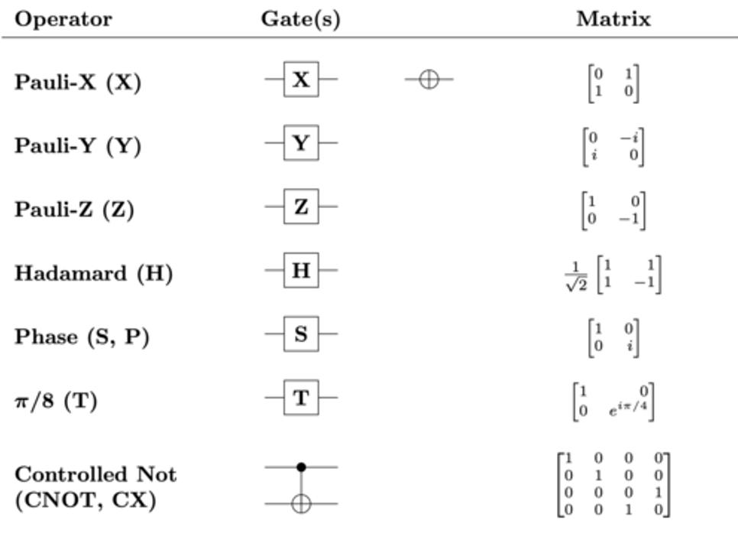
Gates summary
Pauli (spin) matrices (gates) cause spins around x,y, or z axes of a Bloch sphere (bit or phase flip)
Hadamard gates create and destroy superposition
S gate(also in combination with H gate) switches between bases
CNOT gates (2 qubit gate) help us achieve entanglement
Bell states (4 of them – 2 qubits) are maximally-entangled and build an orthonormal bases
→ help you get a Nobel prize

Slide 18
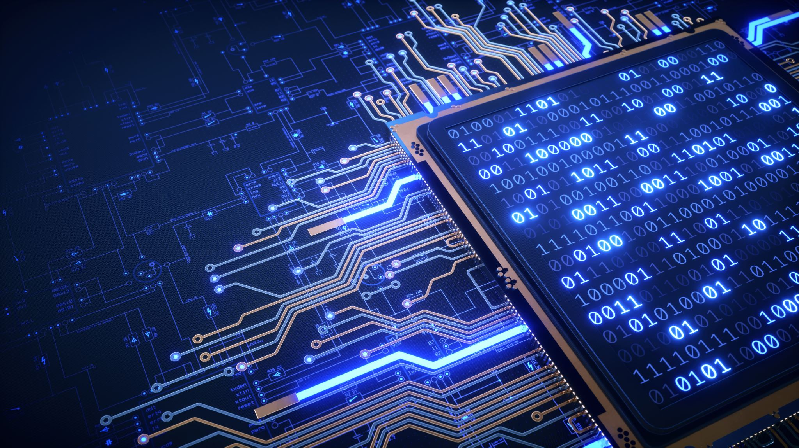
Algorithms

Slide 19
Grover’s Algorithm
An (quantum) algorithm used to search and locate a specific element in an unordered list/unsorted database
Imagine you have a list of 2 columns: name and phone number
You have a phone number, and you want to find the corresponding name using this list
Using a classical computer, you would need to use brute-forcing or some other method (not highly efficient)
With Grover’s algorithm and the superposition principle, one can exponentially decrease the time needed to find the phone number
This process happens with the help of two sub-functions called the oracle function and the amplification function
Other fun examples is solving a sudoku puzzle or polynomial root finding problems

Slide 20
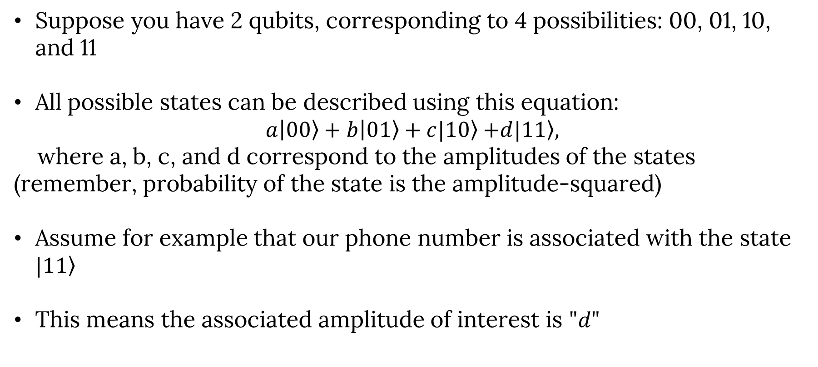
Grover’s Algorithm - continued
Suppose you have 2 qubits, corresponding to 4 possibilities: 00, 01, 10, and 11
All possible states can be described using this equation:
$a\left|\left.00\right\rangle +b\right|\left.01\right\rangle +c|\left.10\right\rangle$ $+d|\left.11\right\rangle ,$
where a, b, c, and d correspond to the amplitudes of the states (remember, probability of the state is the amplitude-squared)
Assume for example that our phone number is associated with the state $|\left.11\right\rangle$
This means the associated amplitude of interest is $"d"$

Slide 21
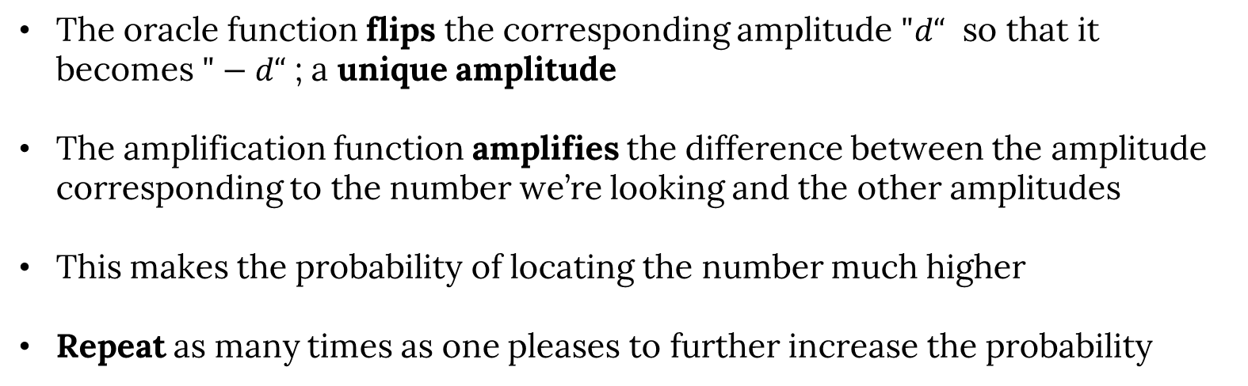
Grover’s Algorithm - continued
The oracle function flips the corresponding amplitude $"d“$ so that it becomes $"−d“$ ; a unique amplitude
The amplification function amplifies the difference between the amplitude corresponding to the number we’re looking and the other amplitudes
This makes the probability of locating the number much higher
Repeat as many times as one pleases to further increase the probability

Slide 22
Grover’s Algorithm - demo
More details/explanations can be found here (Qiskit Textbook)

Slide 23
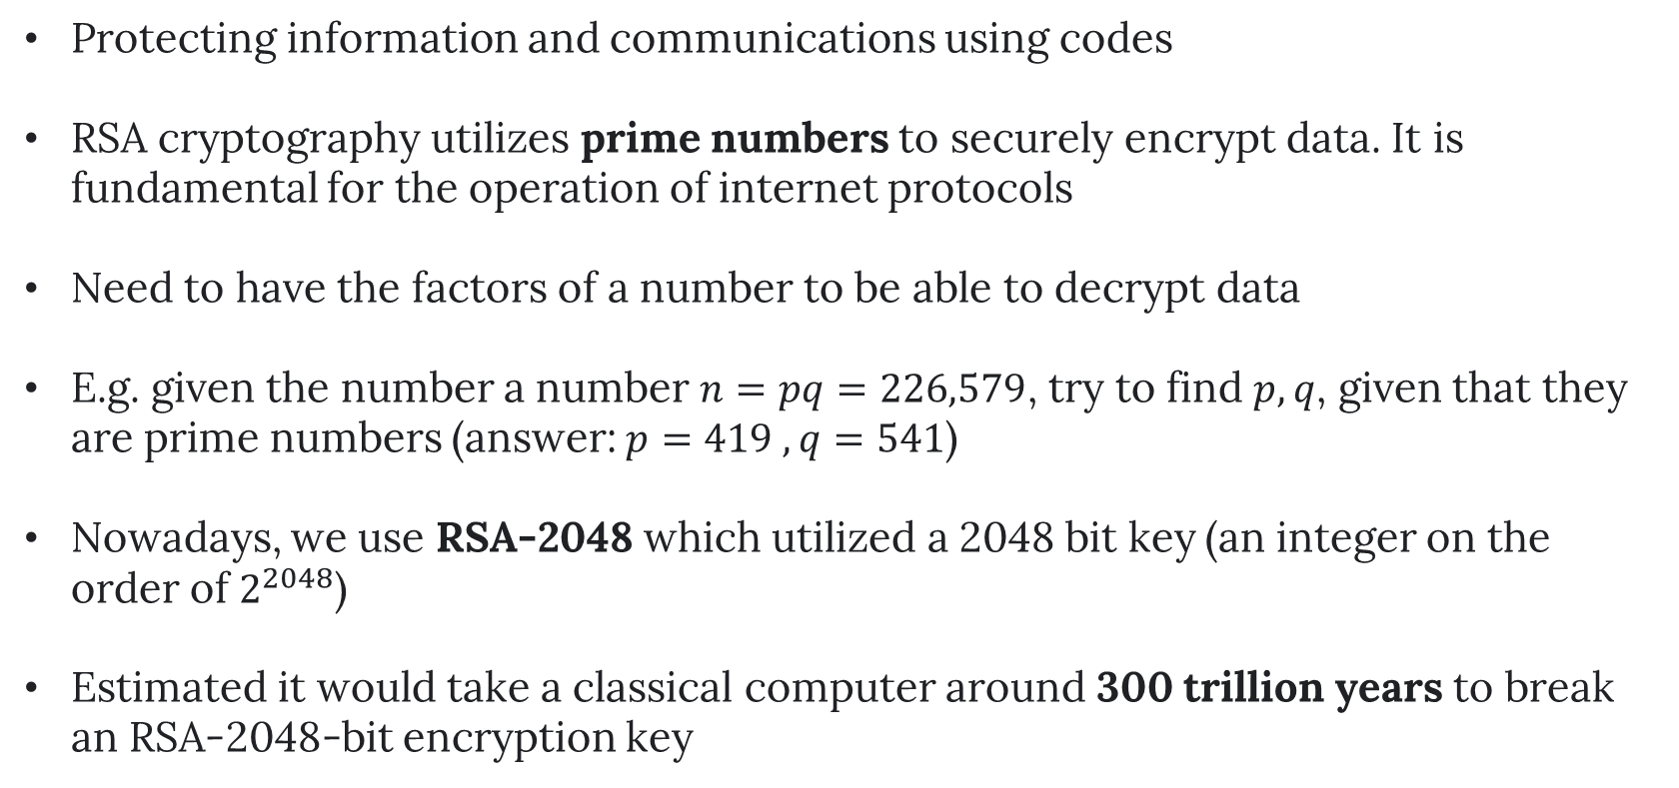
Cryptography
Protecting information and communications using codes
RSA cryptography utilizes prime numbers to securely encrypt data. It is fundamental for the operation of internet protocols
Need to have the factors of a number to be able to decrypt data
E.g. given the number a number $n=pq=226,579$, try to find $p,q$, given that they are prime numbers (answer: $p=419 , q=541$)
Nowadays, we use RSA-2048 which utilized a 2048 bit key (an integer on the order of $2^{2048}$)
Estimated it would take a classical computer around 300 trillion years to break an RSA-2048-bit encryption key

Slide 24
Example of an RSA-2048 integer
2519590847565789349402718324004839857142928212620403202777713783604366202070 7595556264018525880784406918290641249515082189298559149176184502808489120072 8449926873928072877767359714183472702618963750149718246911650776133798590957 0009733045974880842840179742910064245869181719511874612151517265463228221686 9987549182422433637259085141865462043576798423387184774447920739934236584823 8242811981638150106748104516603773060562016196762561338441436038339044149526
3443219011465754445417842402092461651572335077870774981712577246796292638635 6373289912154831438167899885040445364023527381951378636564391212010397122822
120720357

Slide 25
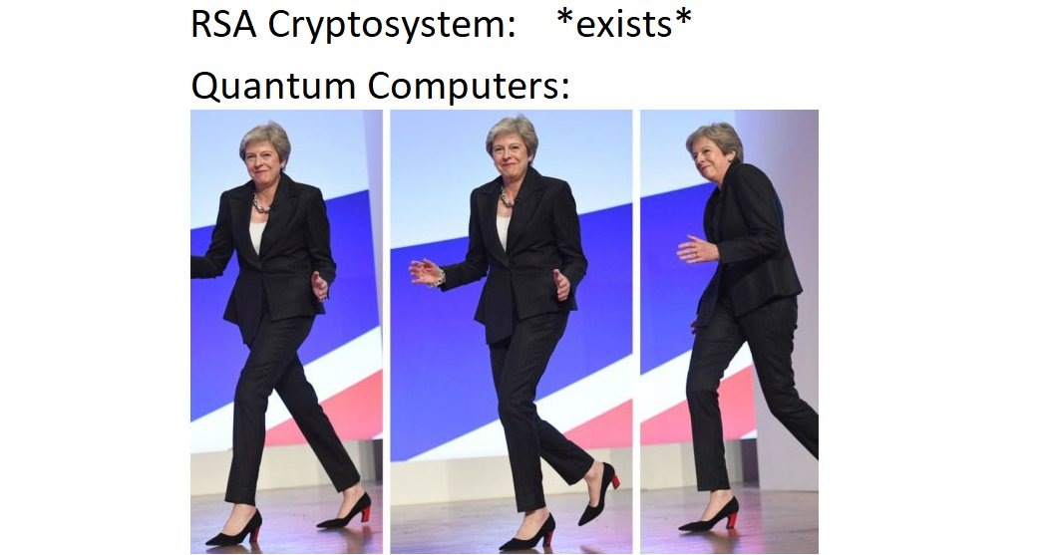

Slide 26
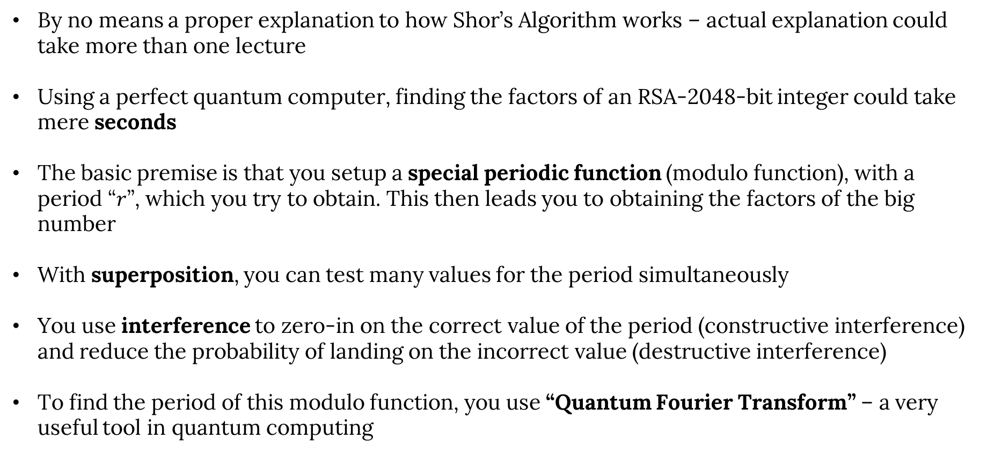
(very basic) introduction to Shor’s Algorithm
By no means a proper explanation to how Shor’s Algorithm works – actual explanation could take more than one lecture
Using a perfect quantum computer, finding the factors of an RSA-2048-bit integer could take mere seconds
The basic premise is that you setup a special periodic function (modulo function), with a period “$r$”, which you try to obtain. This then leads you to obtaining the factors of the big number
With superposition, you can test many values for the period simultaneously
You use interference to zero-in on the correct value of the period (constructive interference) and reduce the probability of landing on the incorrect value (destructive interference)
To find the period of this modulo function, you use “Quantum Fourier Transform” – a very useful tool in quantum computing

Slide 27
Quantum-safe cryptography
RSA encryption is the basis of a lot of encryption schemes used to protect many assets
Shor’s algorithm poses a threat to these kind of commonly used encryption methods
Need to have a quantum computer with millions of physical qubits to be able to do that (due to decoherence and noise)
Quantum-safe algorithms which typically rely on mathematical problems that can’t be solved easily by both classical and quantum computers already available
Algorithms that rely on geometric problems based on lattices such as CRYSTALS-Kyber and CRYSTALS-Dilithium are now recommended by NIST
Expected that industries will transition over to quantum-safe cryptographic algorithms as soon as 2024. Therefore, there is (almost) no reason to worry about quantum computers destroying the world

Slide 28
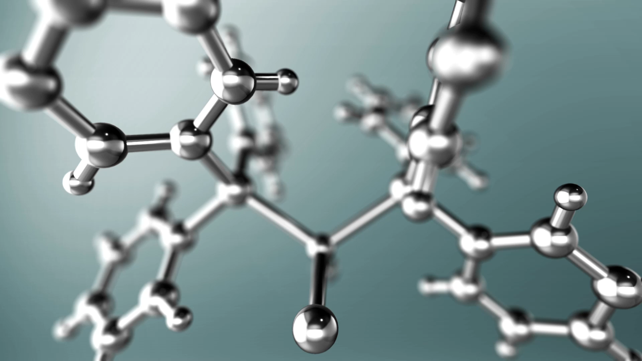
Current applications of quantum computing

Slide 29
Quantum Machine Learning (QML)
Quantum Computing
Machine Learning
QML

Slide 30
Quantum Machine Learning (QML) - continued
Machine Learning is linear algebra, and quantum computing heavily relies on linear algebra → excellent match up
QML can be used to solve Fourier Transformation, finding eigenvectors and eigenvalues, and solving linear sets of equations with an exponential speedup
Quantum Support Vector Machines (QSVM) are also one of the more popular QML techniques.
  Classical SVMs can be performed only up to a certain number of dimensions while QSVMs do not suffer from these restrictions
Quantum Optimization: try to produce best possible output by using the least possible resources.
  Superposition, entanglement and interference

Slide 31
Current applications of quantum computing
Condensed matter physics has important implications for our understanding of nature and the development of new technologies
It is also one of the main building blocks behind building computers, both classical and quantum
One of the most popular models of ferromagnetism in statistical mechanics is called the “Ising model”
Utilizes spins as its variables, and its coefficients comprise couplings and fields
Each spin configuration is assigned an energy and a corresponding Boltzmann probability
The connectivity of qubits allows researchers to simulate the dynamics of spin lattices

Slide 32
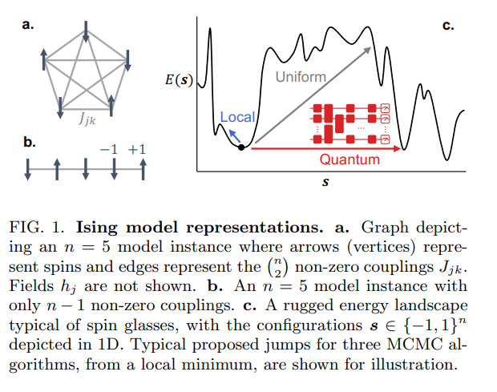
Current applications of quantum computing - continued
One of many research papers on this subject include this one from IBM Quantum
They perform Markov chain Monte Carlo (MCMC), a popular iterative sampling technique, to sample from the Boltzmann distribution of classical Ising models
A new quantum algorithm that with many current applications including ones in machine learning (Boltzmann Machines) and statistical physics (thermal averages)
Uses relatively simple quantum circuits using current hardware
Many similar efforts trying to create solutions for optimization, statistical, and machine learning problems
[arXiv:2203.12497]

Slide 33
Current applications of quantum computing - HEP
Many applications in HEP, focusing on things like track reconstruction, Lattice Electrodynamics, signal versus background separation, and finding rare processes with QML
The field of quantum computing in HEP is super recent → lots of opportunities to explore!
I am going to be biased and focus on one recent paper published by my current experiment, LHCb
Main premise is utilizing QML to identify the charge of the b hadron-jets
Proponents utilize a Variational Quantum Classifier (VQC) on LHCb data and compare it against a Deep Neural Network (DNN) model

Slide 34
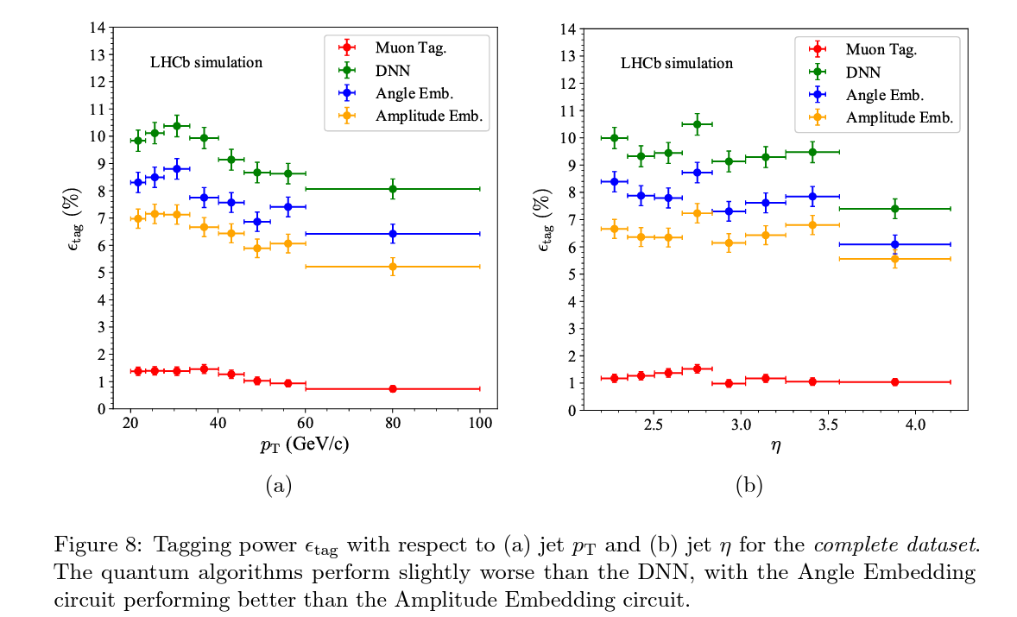
Current applications of quantum computing – HEP – continued
Measurements mapped to probabilities for different labels
Probabilities used to estimate a cost function
Cost function optimized using a classical optimizer
QML algorithms achieve performance consistent with classical methods like the DNN with low-complexity circuits and a smaller number of training events
Room for improvement, especially when using a larger number of features and utilizing better hardware
[arXiv:2202.13943]

Slide 35
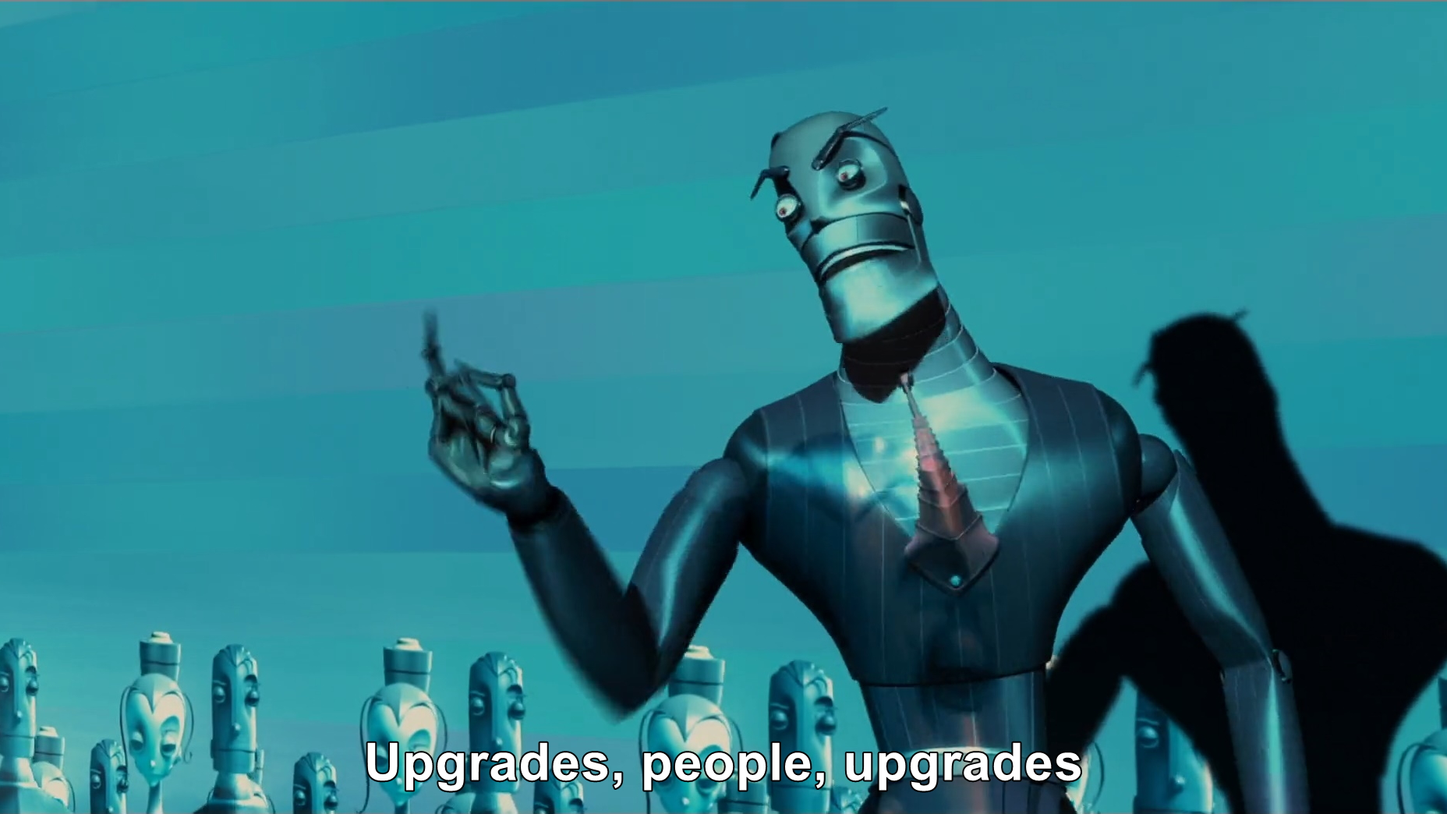
Prospects and future applications
High Energy Physics
Complex Manufacturing and Industrial Design
Logistics
Finance and financial modelling
Chemical and biological Engineering
Pharmacy and drug development
Artificial Intelligence
Cybersecurity
Material Science
… and many more!
Notes:
Manufacturing:
Designers often need several drafts when manufacturing a high-speed jet. This process ensures that they have the most efficient wing design for high speeds. It also applies to other key parts of the machine.
Quantum computing can help designers fish through the different possibilities faster.
Logistics:
Optimizing paths, best routes for every shipment (travelling salesman problem)
Finance:
Quantum cothat classic computers struggle to do.
mputing can help make more accurate simulations and predictions of market activity. They are also a lot better at Monte Carlo simulations than traditional methods. Major events can require fast-paced responses
Chemical Engineering:
With such a wide variety of chemical configurations available, it can take time to find the right one. Quantum computing can help speed up these processes.
This application is beneficial in pharmaceuticals and vaccine development. Our experience with the COVID-19 pandemic has emphasized the need for urgent solutions
AI: QML. Faster processing can lead to better AI performance

Slide 36
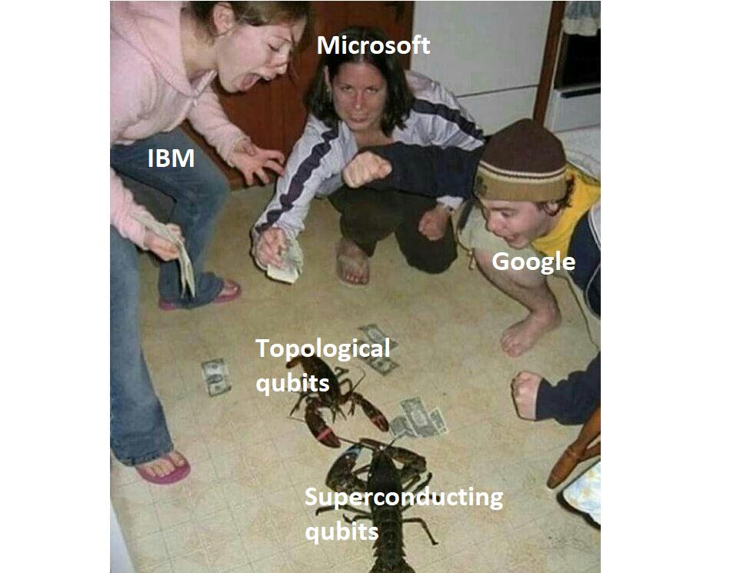
Future Predictions
IBM currently have 433 qubits – expect to reach 1,000,000 qubits in 2027
Google has 53 qubits – expect to reach 1,000,000 qubits in 2029
Google announced their first error correcting, logical qubit in February 2023
Many others are joining “the race”
When do you think quantum computers will become “useful”?
Do you think it would happen at all?

Slide 37

How can I participate?

Slide 38

CERN Quantum Technology Initiative
First workshop on Quantum Computing in HEP at CERN in 2018
Conference on Quantum Technologies in HEP last Novemeber
Established a comprehensive R&D, academic and knowledge-sharing initiative for quantum technologies
Currently focusing on:
  Quantum computing and algorithms
  Quantum theory and simulation
  Quantum sensing, metrology and materials
  Quantum communications and networks
Collaborating with universities and institutions all over the world with a lot of them being in Europe
In 2021, CERN became a quantum hub in partnership with the IBM Q-Network
Quantum Technology Initiative Journal Club – meeting on Thursdays
https://quantum.cern/

Slide 39
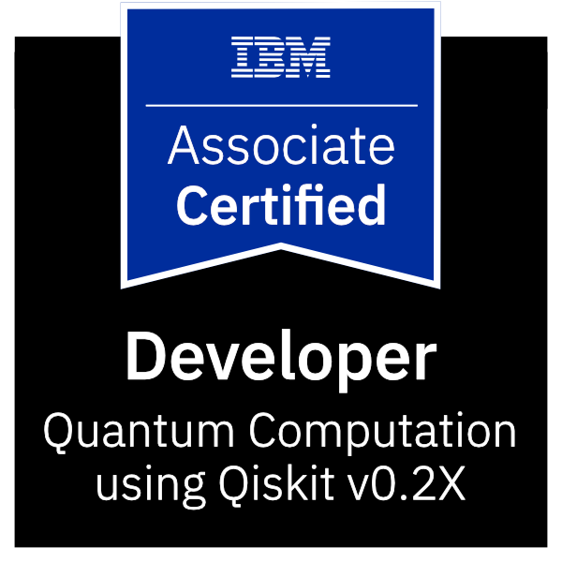
Qiskit Quantum Developer Certificate
Certification awarded for learning quantum computation using Qiskit
Demonstrates you having fundamental knowledge of quantum computing concepts
Demonstrates you being able to create and execute quantum computing programs on IBM Quantum computers and simulators
Defining, executing, and visualizing results of quantum circuits with different gates, etc.
Useful if you want to demonstrate your ability in quantum computing
https://www.ibm.com/training/certification/C0010300

Slide 40
Takeaways
Quantum computing is an emerging field that’s still far away from being useful in solving real life problems at an exponential rate
Quantum computing is basically linear algebra and complex variables (unless you’re working on developing the hardware)
Current main problems revolve around error correction and increasing number of useful qubits
When people first created the classical computer, they did not imagine how it would evolve. They probably never imagined the Internet and the horrors you can now find there
Prospects are looking okay for the time being – just need to be cautiously optimistic and not blindly follow the hype train
There are many ways you can get involved in quantum computing today!

Slide 41
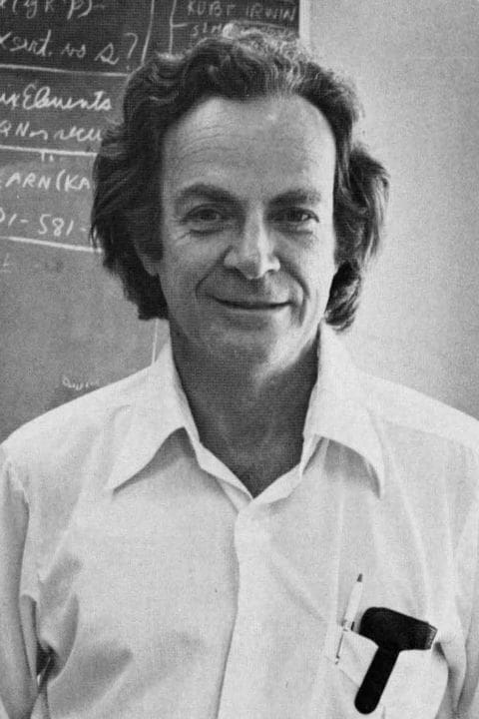
“Nature isn't classical, dammit, and if you want to make a simulation of nature, you'd better make it quantum mechanical, and by golly it's a wonderful problem, because it doesn't look so easy.”
  -Richard Feynman

Slide 42

Blooket
https://play.blooket.com

Slide 43
More resources
Introduction to Quantum Computing and Quantum Hardware (Qiskit on YouTube)
Qiskit textbook
Xanadu textbook
Quantum Machine Learning demonstrations (Pennylane)
A course on Quantum Machine Learning (Github – Pennylane)
1 Minute Qiskit (Qiskit on YouTube)
Why Did Quantum Entanglement Win the Nobel Prize in Physics? (PBS Spacetime on YouTube)
What is Quantum Safe (IBM Technology on YouTube)

Slide 44

Thank you for your attention!
https://forms.gle/5NoXyLmBANAWA88d9

Slide 45
Bonus!

Slide 46
Quantum lingo cheat sheet
Noisy Intermediate-Scale Quantum (NISQ) era: era with intermediate number of qubits (~100) that still have problems with noise/decoherence – era we are currently in
Fault tolerant computer: Less affected by noise/decoherence
Fidelity: a measure of how close the final quantum state of the real-life qubits is to the ideal case. The threshold for fault-tolerant quantum computing is over 99%
Quantum volume: a metric that measures the capabilities and error rates of a quantum computer based on the size of the successfully running circuits. It was invented by IBM
Coherence time: the length of time a quantum superposition state can survive
Transmon: a superconducting loop-shaped qubit that can be created at extremely low temperatures

Slide 47
Cracking RSA encryption with a quantum computer
Chinese scientists released a paper in Dec 2022 claiming to have cracked low-level RSA encryption using a hybrid of a quantum and classical computer
48-bit numbers using a 10-qubit quantum computer
They combine classical lattice reduction factoring techniques (Schnorr’s algorithm – not be confused with Shor’s algorithm) with a quantum approximate optimization algorithm
They calculated that it’s possible to scale their algorithm for use with 2048-bit keys using a quantum computer with only 372 qubits!
IBM already has a 433-qubit quantum computer…
Experts are saying these claims don’t add up and shouldn’t be scalable to higher qubit computer. Expect IBM to do some tests soon

