Slide 1
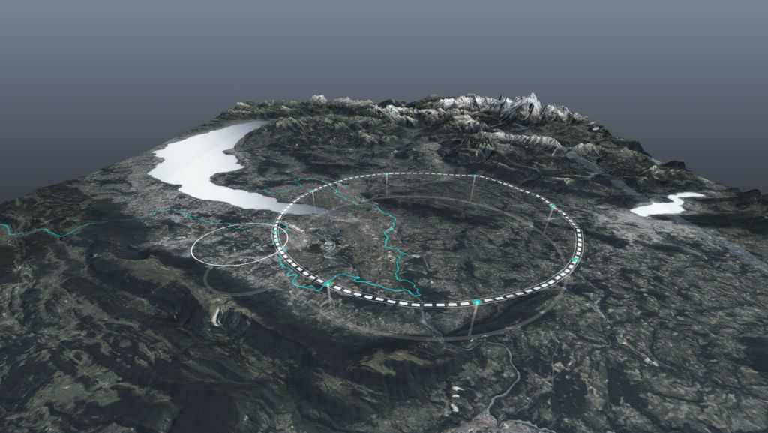










FCC Feasibility Study Status
HFM annual meeting 2023
CERN, 30 October 2023
Michael Benedikt, Frank Zimmermann, CERN
on behalf of FCC collaboration & FCCIS DS team
http://cern.ch/fcc
Work supported by the European Commission under the HORIZON 2020 projects EuroCirCol, grant agreement 654305; EASITrain, grant agreement no. 764879; iFAST, grant agreement 101004730, FCCIS, grant agreement 951754; E-JADE, contract no. 645479; EAJADE, contract number 101086276; and by the Swiss CHART program
photo: J. Wenninger

Slide 2

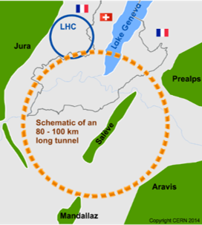
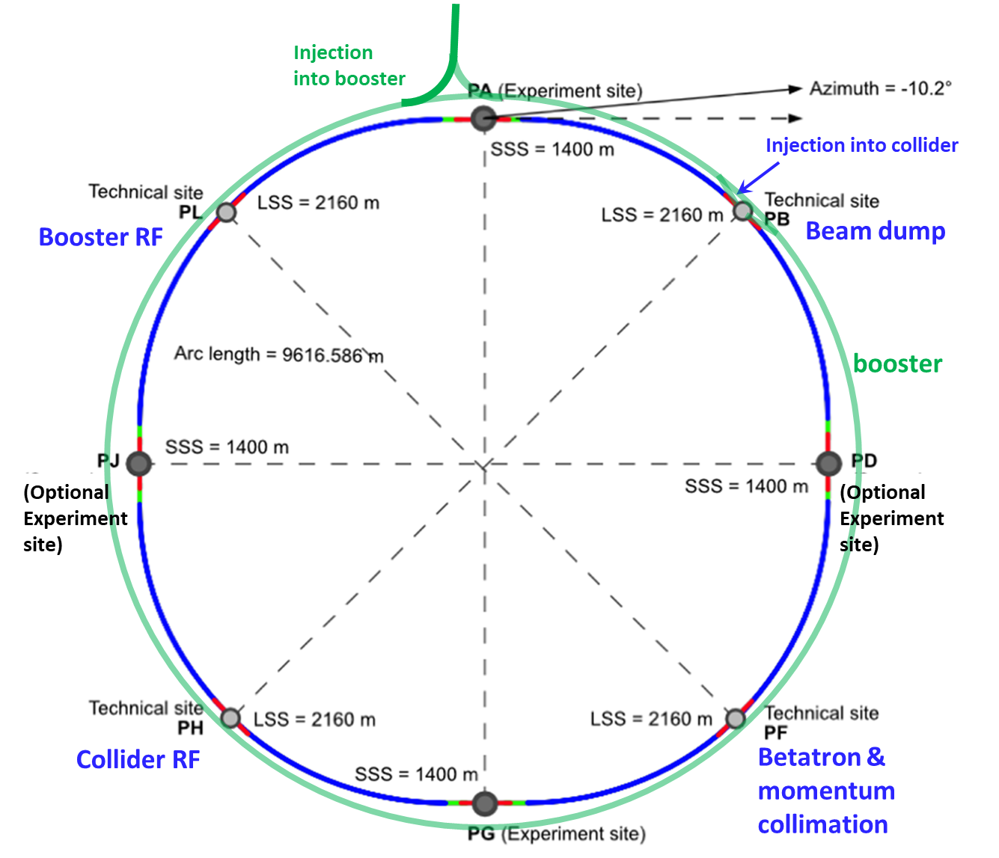
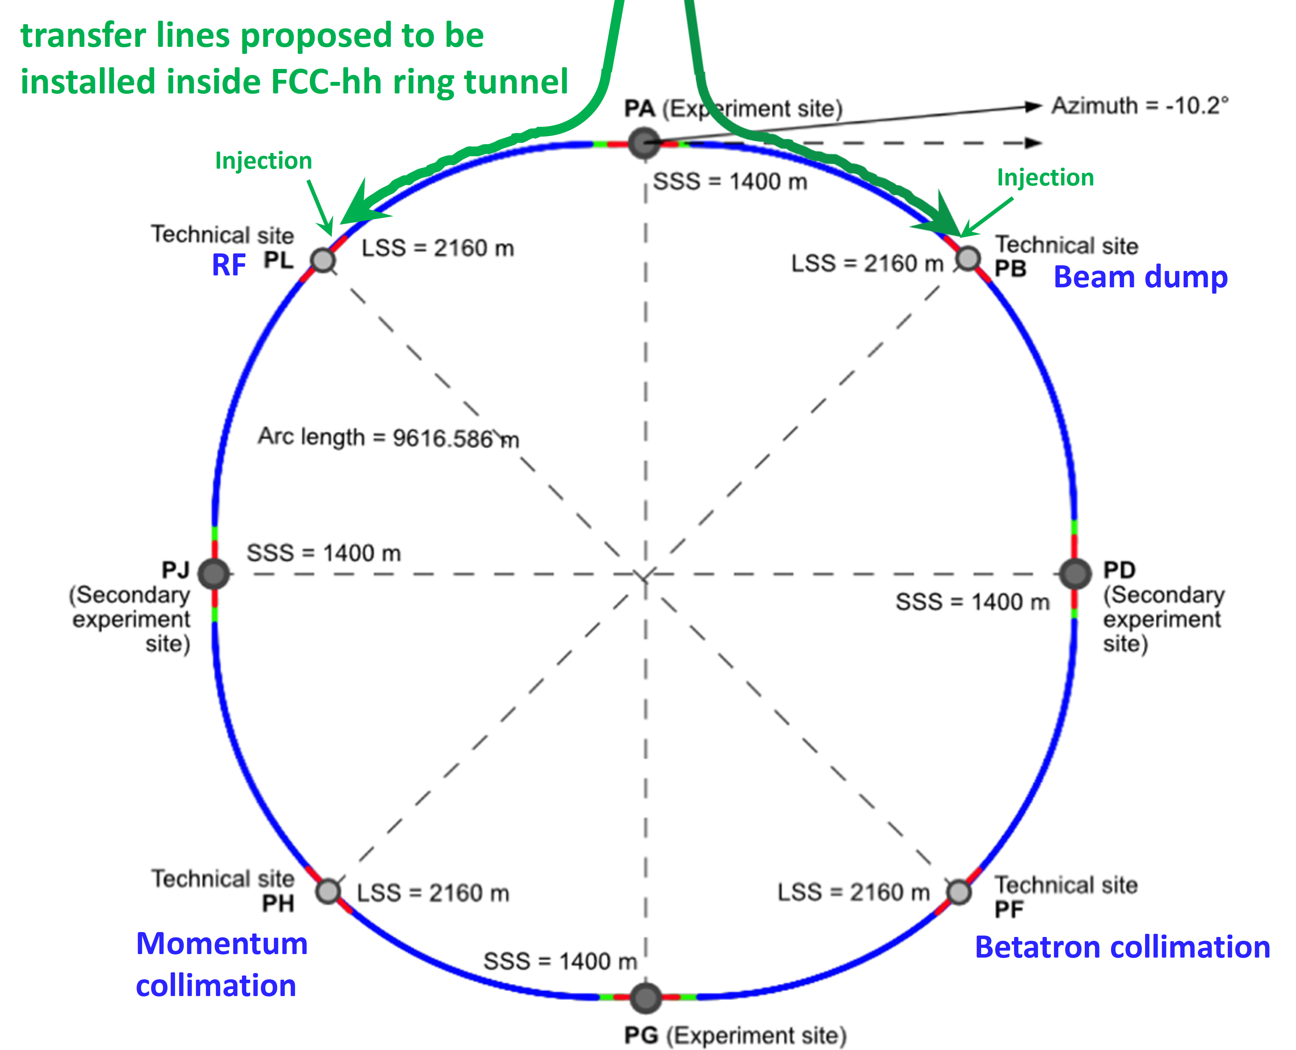
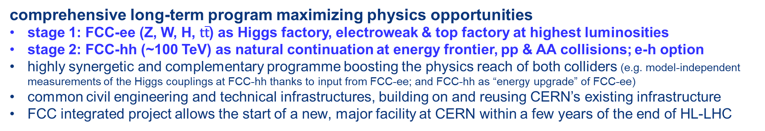
FCC integrated program
comprehensive long-term program maximizing physics opportunities
stage 1: FCC-ee (Z, W, H, $\text{t}\overline{\text{t}}$) as Higgs factory, electroweak & top factory at highest luminosities
stage 2: FCC-hh (~100 TeV) as natural continuation at energy frontier, pp & AA collisions; e-h option
highly synergetic and complementary programme boosting the physics reach of both colliders (e.g. model-independent measurements of the Higgs couplings at FCC-hh thanks to input from FCC-ee; and FCC-hh as “energy upgrade” of FCC-ee)
common civil engineering and technical infrastructures, building on and reusing CERN’s existing infrastructure
FCC integrated project allows the start of a new, major facility at CERN within a few years of the end of HL-LHC
FCC-ee
FCC-hh
2020 - 2040
2045 - 2063
2070 - 2095

Slide 3
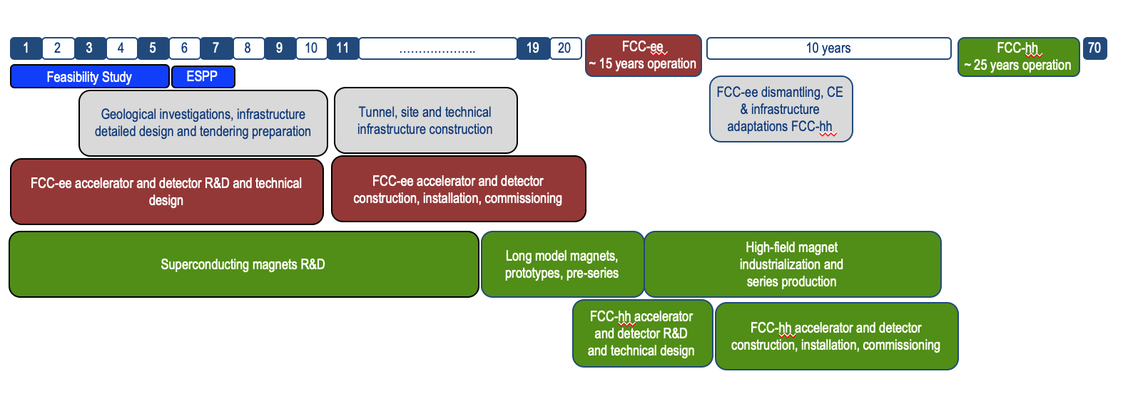
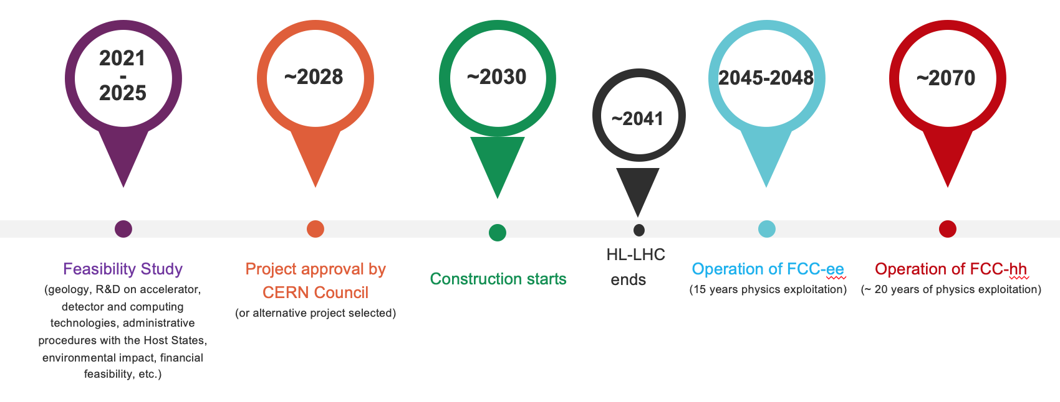
FCC timeline
Technical schedule:
FCC integrated project
Schedule takes into account:
CERN Council approval timeline
past experience in building colliders at CERN
that HL-LHC will run until ~ 2041
ANY future collider at CERN cannot
start physics operation before 2045-2048
(but construction will proceed in parallel to
HL-LHC operation)
F. Gianotti

Slide 4



European Strategy for Particle Physics
2013 Update of European Strategy for Particle Physics:
“CERN should undertake design studies for accelerator projects in a global context, with emphasis on proton-proton and electron-positron high-energy frontier machines.”
→ FCC Conceptual Design Reports (2018/19)
2020 Update of European Strategy for Particle Physics:
“Europe, together with its international partners, should investigate technical and financial feasibility of a future hadron collider at CERN with a centre-of-mass energy of at least 100 TeV and with an electron-positron Higgs and electroweak factory as a possible first stage.”
  Vol 1 Physics, Vol 2 FCC-ee, Vol 3 FCC-hh, Vol 4 HE-LHC
  CDRs published in European Physical Journal C (Vol 1) and ST (Vol 2 – 4)
  EPJ C 79, 6 (2019) 474 , EPJ ST 228, 2 (2019) 261-623 , EPJ ST 228, 4 (2019) 755-1107 , EPJ ST 228, 5 (2019) 1109-1382

Slide 5



Feasibility Study timeline and main activities/milestones
2021 | 2021 |  | 2022 |  |  |  | 2023 |  |  |  | 2024 |  |  |  | 2025
Q2 | Q3 | Q4 | Q1 | Q2 | Q3 | Q4 | Q1 | Q2 | Q3 | Q4 | Q1 | Q2 | Q3 | Q4 | Q1 | Q2 | Q3 | Q4
CDR baseline design adaptations for
new implementation scenario
FCC Week
study planning
FCC Week & Review : implementation, baseline design, organisation, communication
environmental studies, site investigation authorisation with host states, site investigations: drillings and seismics
FCCW & mid-term review:
study progress & CDR cost update
detailed design towards FSR: refine surface sites layout,
technical and cost optimisation of entire project taking into account construction and operation phases
FCC Week: technical
and cost optimisation
FCC Week
FSR progress
FS Report
Release FSR
Project review

Slide 6
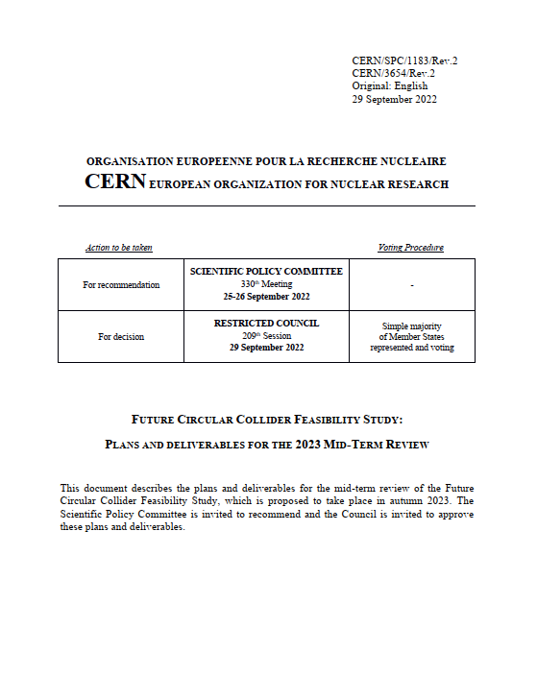
FCC FS mid-term review
Mid-term review setup and deliverables are defined in CERN/SPC/1183/Rev.2:
the scientific and technical results be reviewed by the FCC FS Scientific Advisory Committee, augmented by additional experts as needed;
the cost and financial feasibility, which will focus on the first-stage project (tunnel, technical infrastructure, FCC-ee machine and injectors), be reviewed by a committee including external experts, as proposed in CERN/3588;
SAC: review of deliverables 1, 2, 3, 4, 5, 6, 8
D1: Definition of the baseline scenario
D2: Civil engineering
D3: Processes and implementation studies with the Host States
D 4: Technical infrastructure
D5: FCC-ee accelerator
D6: FCC-hh accelerator
D7: Project cost and financial feasibility
D8: Physics, experiments and detectors
Cost Review Panel Mandate
Review the methodology and assumptions used in producing the cost estimates
Identify inaccurate or missing cost information
Check the consistency of the cost estimates with respect to applicable reference work, e.g., recent large-scale infrastructure and accelerator projects
Review the uncertainty estimates
Identify potential areas of savings and cost mitigation for future work
Advise the FCC study team on matters of cost estimation in view of preparation of the final Feasibility Study Report for end 2025

Slide 7
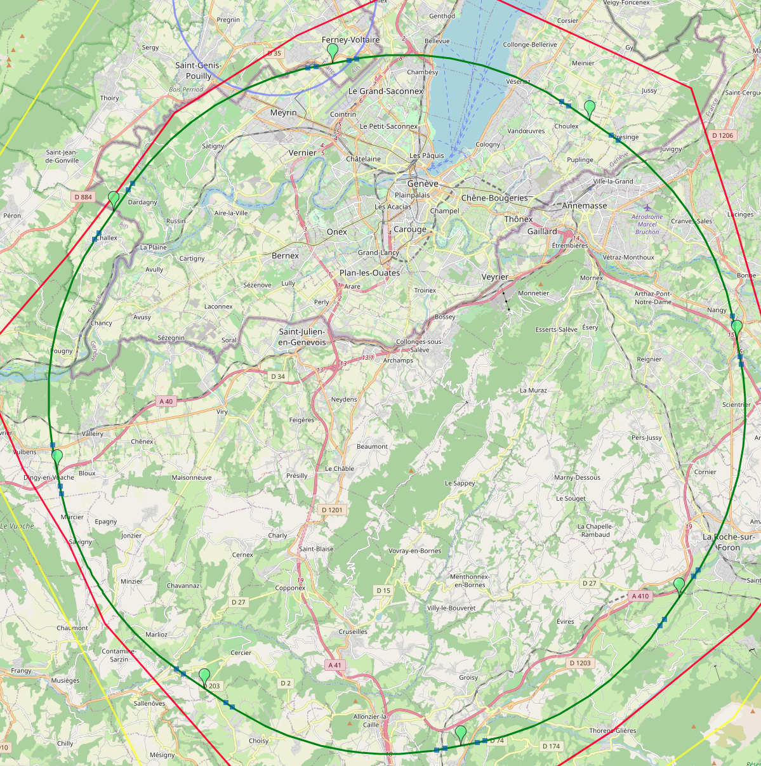
Optimized placement and layout for feasibility study
V. Mertens,
J. Gutleber
Layout chosen out of ~ 100 initial variants, based on geology and
surface constraints (land availability, access to roads, etc.), environment, (protected zones), infrastructure (water, electricity, transport), machine performance etc.
“Avoid-reduce -compensate” principle of EU and French regulations
PA: Experiment
PB: technical
PL: technical
Overall lowest-risk baseline: 90.7 km ring, 8 surface points,
Whole project now adapted to this placement
Number of surface sites | 8
Surface requirements | ~40 ha
LSS@IP (PA, PD, PG, PJ) | 1400 m
LSS@TECH (PB, PF, PH, PL) | 2032 m
Arc length | 9.6 km
Sum of arc lengths | 76.9 m
Total length | 90.7 km
PD: experiment
PJ: experiment
PF: technical
PH: technical
7
PG: experiment

Slide 8
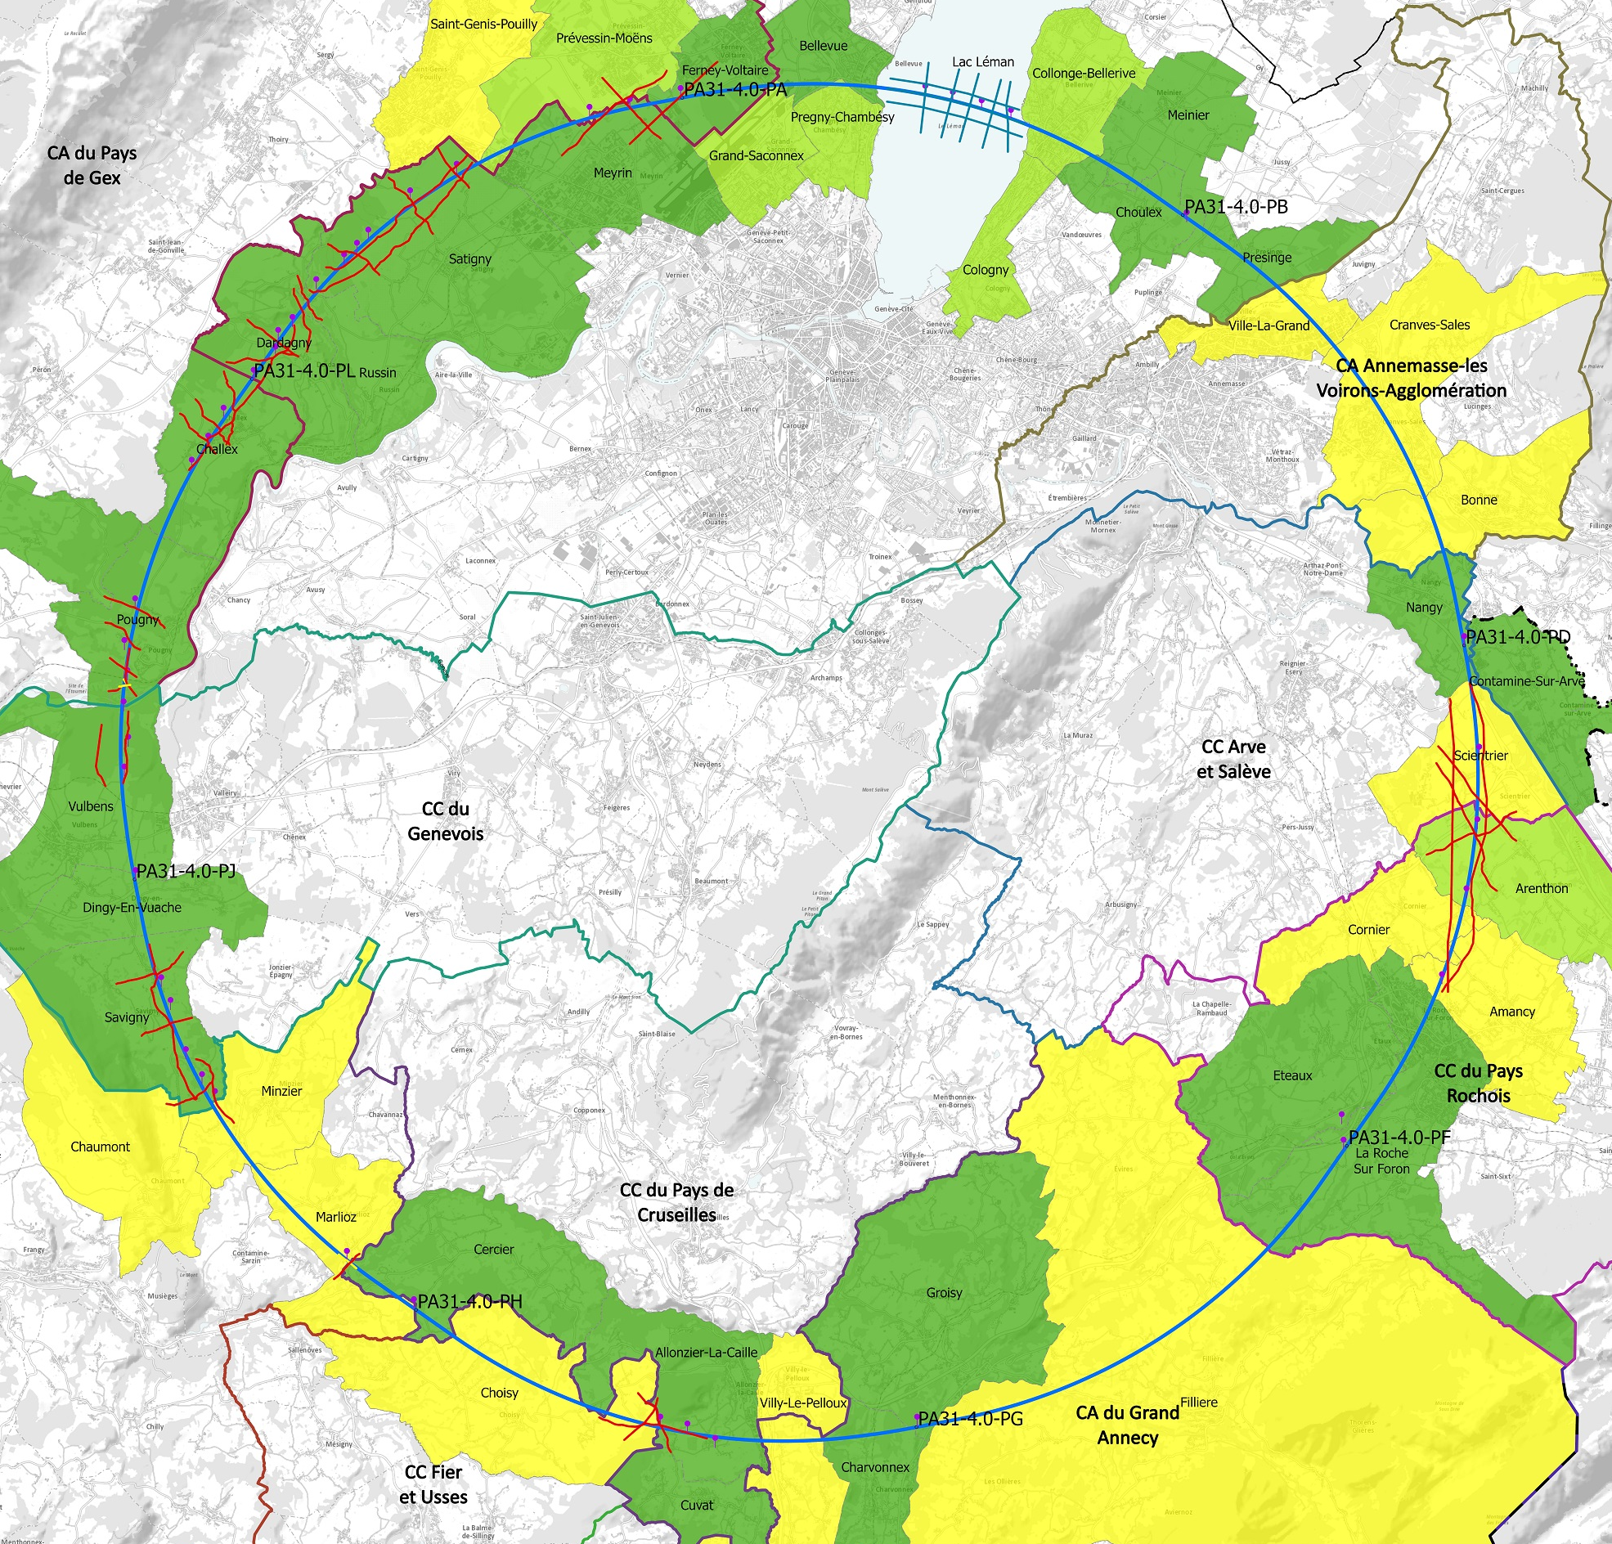
progress with implementation baseline PA31 90.7 km
Meetings with municipalities concerned
in France (31) and Switzerland (10)
PA – Ferney Voltaire (FR) – site experimental
PB – Présinge/Choulex (CH) – site technique
PD – Nangy (FR) – site experimental
PF – Roche sur Foron/Etaux (FR) – site technique
PG – Charvonnex/Groisy (FR) – site experimental
PH – Cercier (FR) – site technique
PJ – Vulbens/Dingy en Vuache (FR) site experimental
PL – Challex (FR) – site technique
status as of 1 October 2023
Individual meeting
Individual meeting planned
Collective meeting
The outstanding support of the host states is greatly appreciated and essential for the study progress!

Slide 9
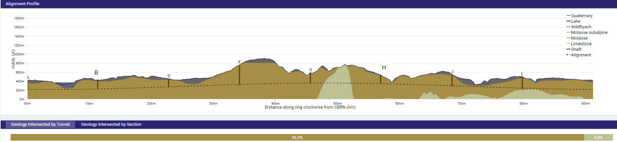
FCC tunnel implementation
Tunnel implementation summary
91 km circumference
95% in molasse geology for minimising tunnel construction risks
8 surface sites with ~5 ha area each.

Slide 10
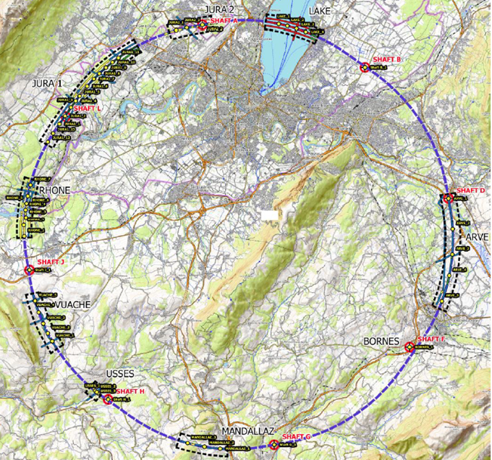
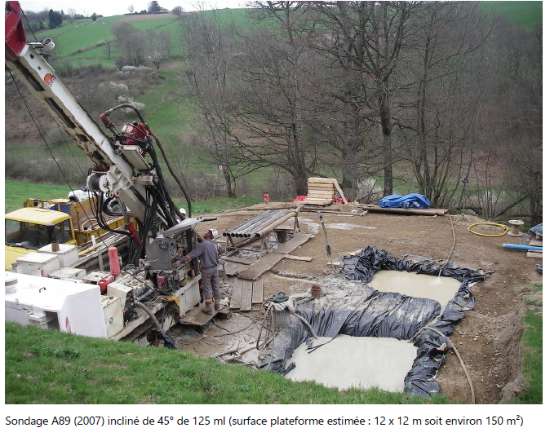
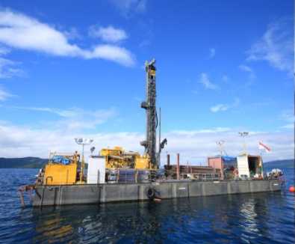
Status site investigations
Site investigations in areas with less well known geological conditions:
  Optimisation of localisation of drilling locations ongoing with site visits since end 2022.
  Alignment with FR and CH on the process for obtaining autorisation procedures. Ongoing for start of drillings in 03/2024.
Contracts Status:
  Contract for engineering services and role of Engineer during works, active since July 2022
  Site investigations tendering ongoing towards contract placement in December 2023 and mobilization from January 2024.
Drilling works on the lake

Slide 11
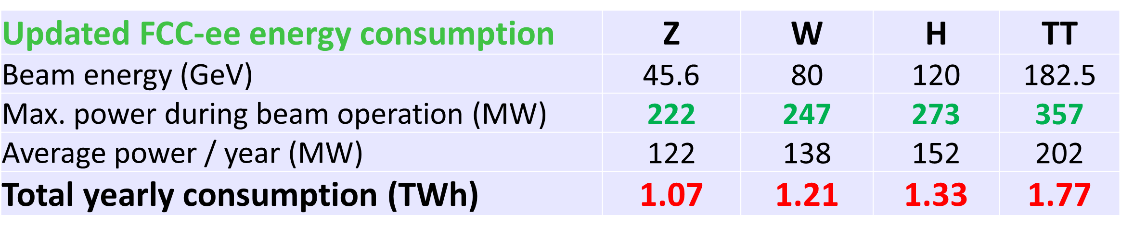
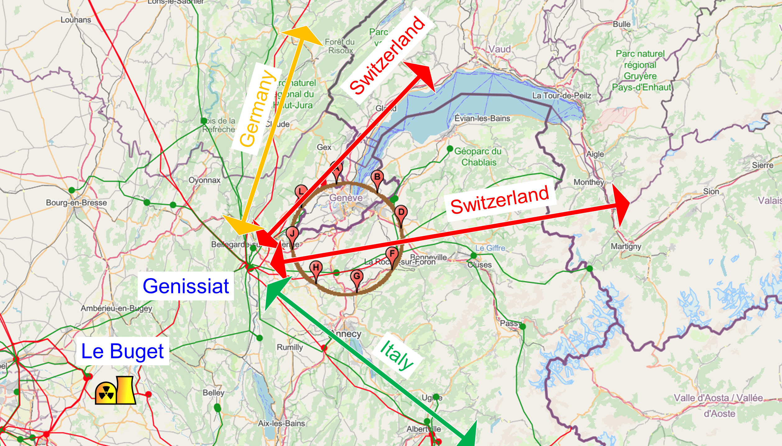
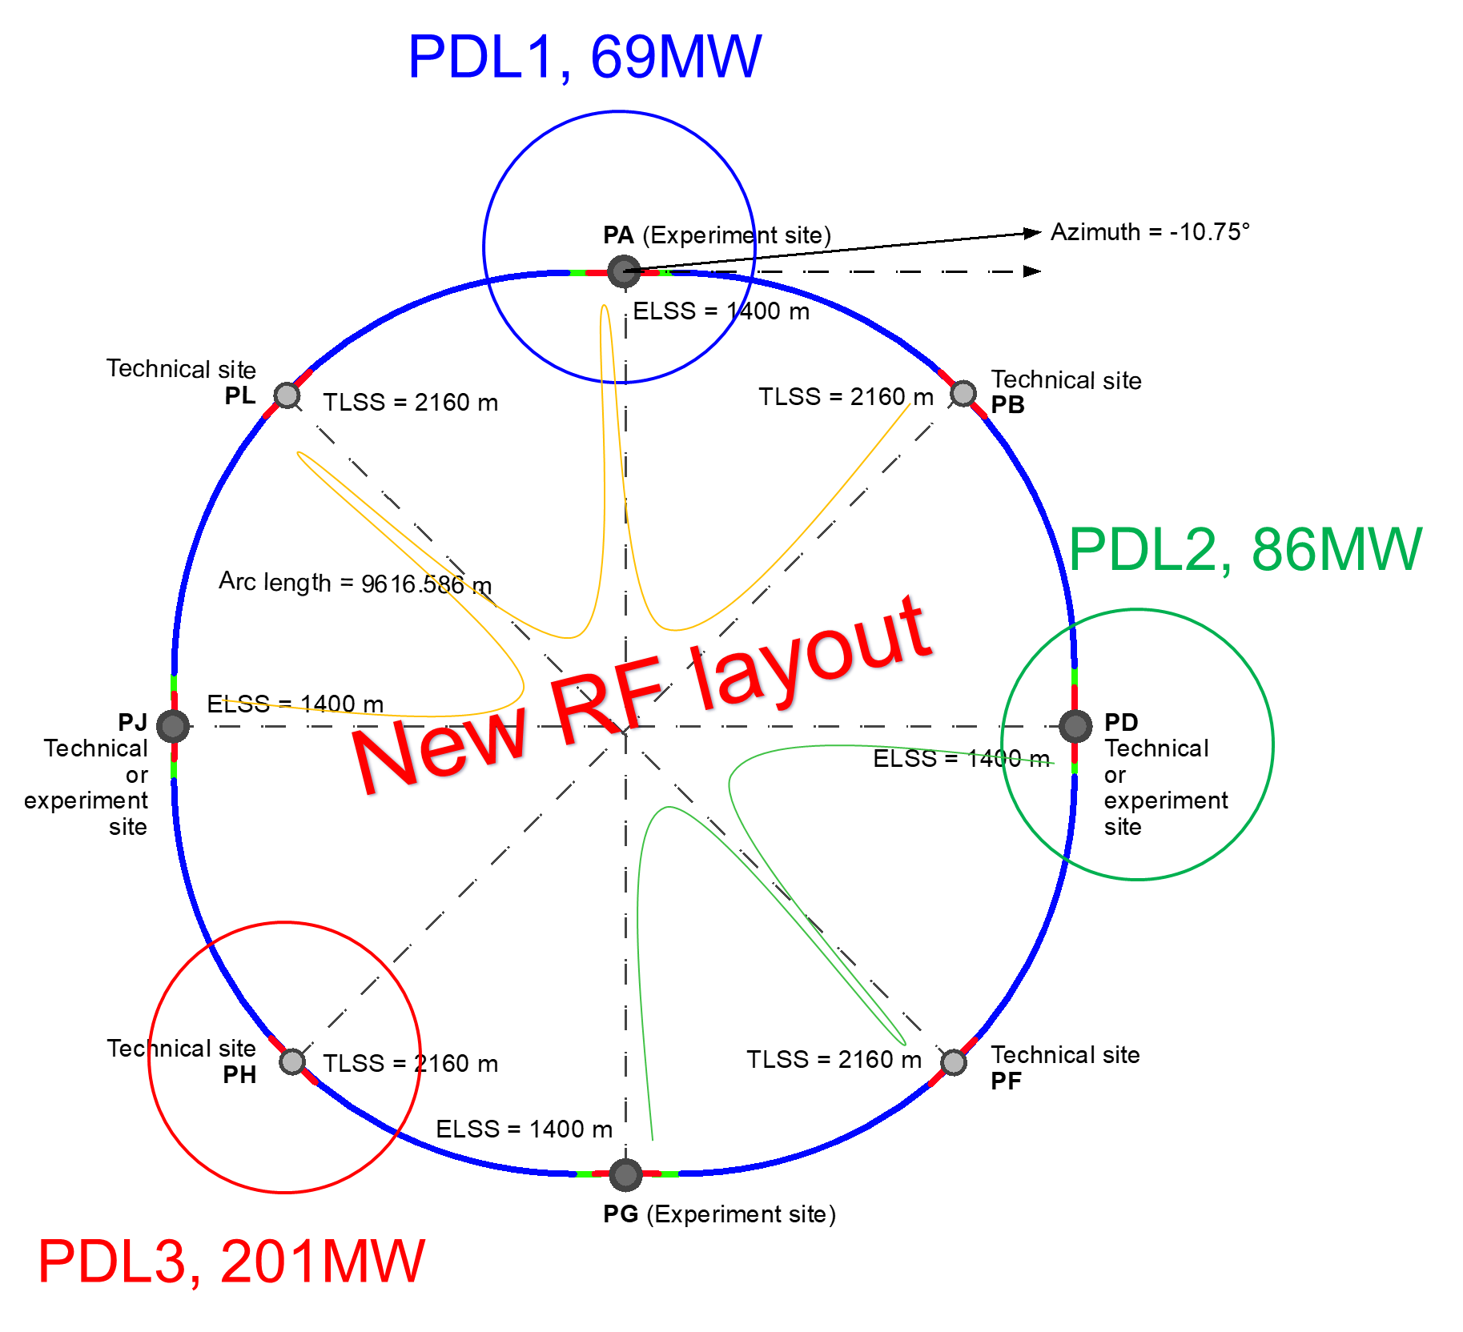

Connections to electrical grid infrastructure
Powering concept and max power load by sub-stations:
The loads could be charged on three sub-stations (optimally connected to existing regional HV grid):
Point D with a new sub-station covering PB – PD – PF – PG
Point H with a new dedicated sub-station for collider RF
Point A with existing CERN station covering PB – PL – PJ
Connection concept was studied and confirmed by RTE (French electrical grid operator)
Requested loads have no significant impact on grid
Powering concept and power rating of the three sub-stations compatible with FCC-hh

Slide 12
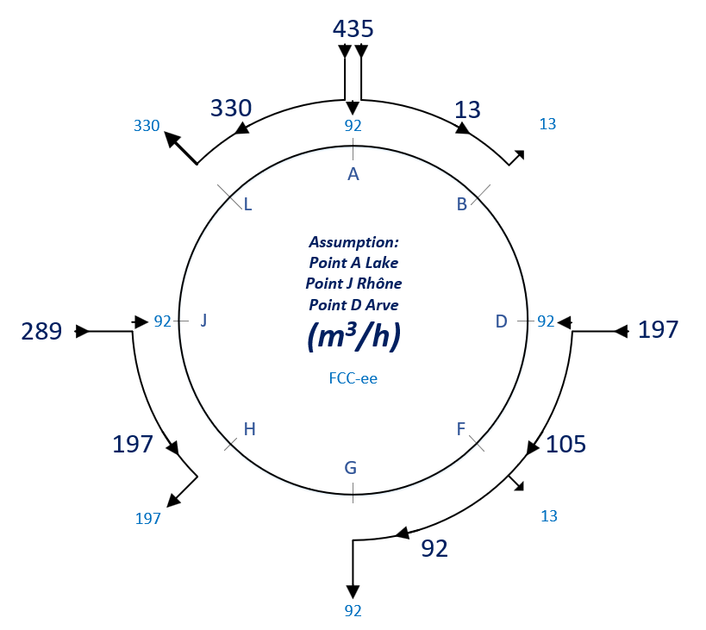
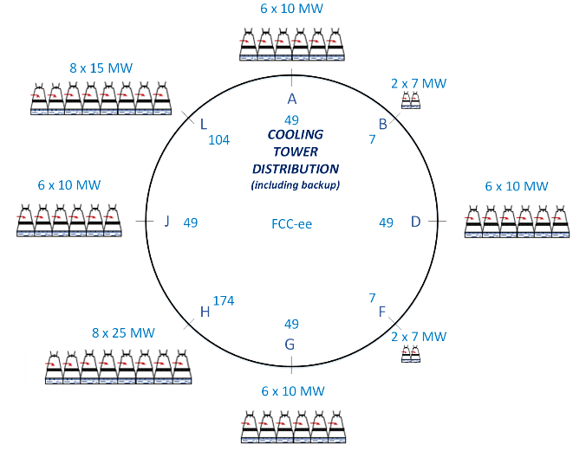
Cooling Water
Potential sources of cooling water Geneva lake (PA), Rhone (PJ) and Arve (PD).
Existing line with lake water provided by SIG to CERN LHC P8 (LHCb) sufficient for FCC-ee.
Pipework in the tunnel will connect the remaining points to points PA, PD and PJ.
Main cooling towers placed at experiment points, and RF points (PL, PH).

Slide 13
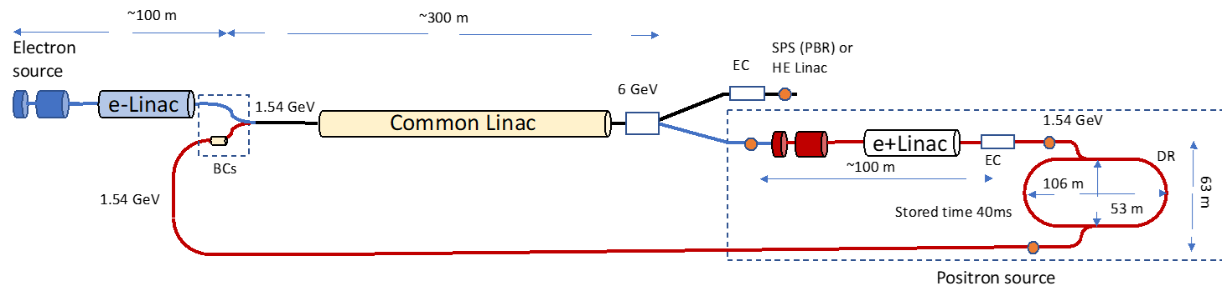
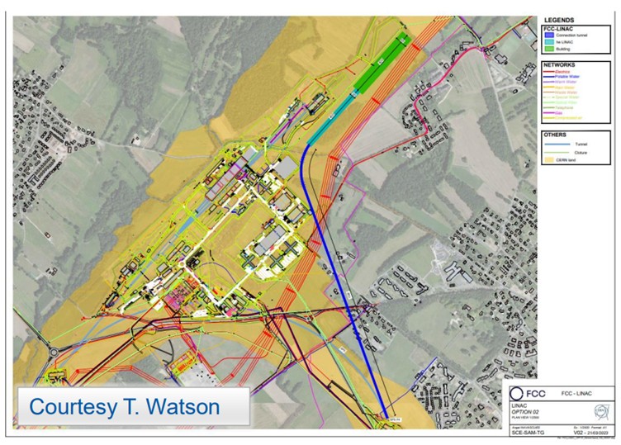
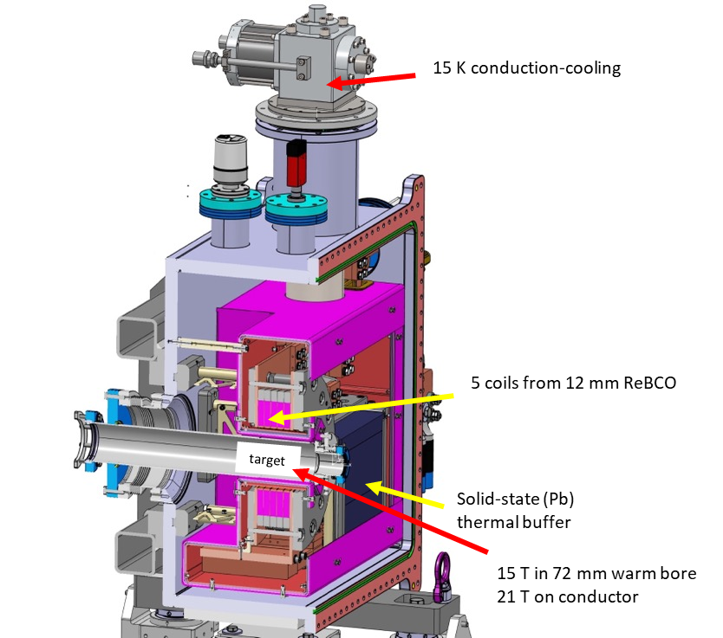
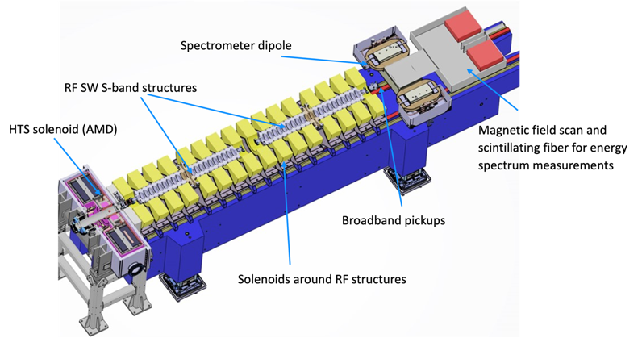
FCC-ee injector layout & implementation
P. Craievich, I. Chaikovska, A. Grudiev, C. Milardi, et al
implementation study on CERN Prevessin site
“Positron production experiment” at PSI’s SwissFEL,
beam tests from 2025/26
6 GeV linac
20 GeV linac
W. Bartmann
HTS NI target solenoid
J. Kosse, T. Michlmayr, H. Rodrigues

Slide 14
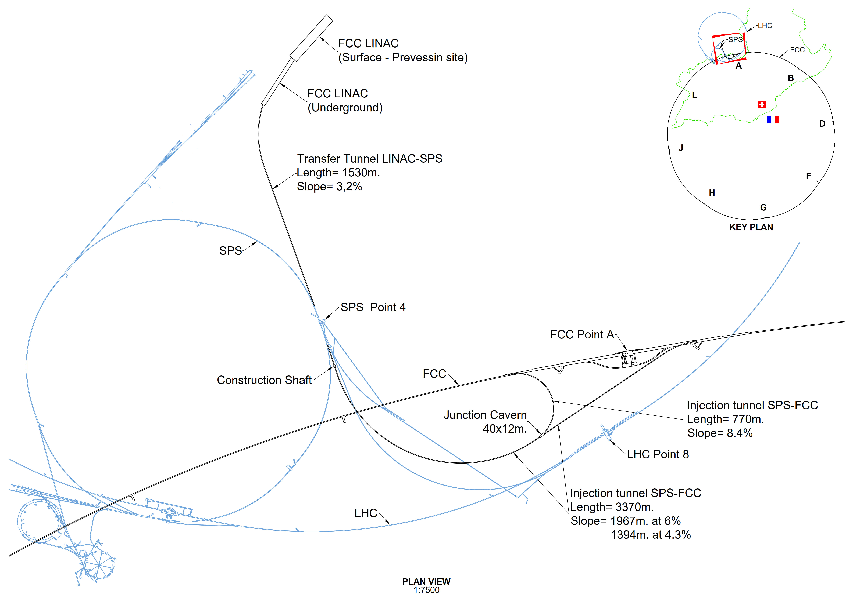
Transfer line FCC-ee (option with SPS for FCC-hh)
LINAC and Injection Tunnels
Designed to enable injection either from the HE Linac sited at Prevessin of from the SPS as pre-booster
Single tunnel with spur to enable anti-clockwise injection
Design allows re-use for FCC-hh if injector in the SPS tunnel (SC-SPS option)
  SPS Point 4 to FCC (clockwise)
  SPS Point 6 to FCC (counter-c.w.)

Slide 15
FCC-ee: main machine parameters
Parameter | Z | WW | H (ZH) | ttbar
beam energy [GeV] | 45.6 | 80 | 120 | 182.5
beam current [mA] | 1270 | 137 | 26.7 | 4.9
number bunches/beam | 11200 | 1780 | 440 | 60
bunch intensity [10¹¹] | 2.14 | 1.45 | 1.15 | 1.55
SR energy loss / turn [GeV] | 0.0394 | 0.374 | 1.89 | 10.4
total RF voltage 400/800 MHz [GV] | 0.120/0 | 1.0/0 | 2.1/0 | 2.1/9.4
long. damping time [turns] | 1158 | 215 | 64 | 18
horizontal beta* [m] | 0.11 | 0.2 | 0.24 | 1.0
vertical beta* [mm] | 0.7 | 1.0 | 1.0 | 1.6
horizontal geometric emittance [nm] | 0.71 | 2.17 | 0.71 | 1.59
vertical geom. emittance [pm] | 1.9 | 2.2 | 1.4 | 1.6
horizontal rms IP spot size [μm] | 9 | 21 | 13 | 40
vertical rms IP spot size [nm] | 36 | 47 | 40 | 51
beam-beam parameter ξ_{x} / ξ_{y} | 0.002/0.0973 | 0.013/0.128 | 0.010/0.088 | 0.073/0.134
rms bunch length with SR / BS [mm] | 5.6 / 15.5 | 3.5 / 5.4 | 3.4 / 4.7 | 1.8 / 2.2
luminosity per IP [10³⁴ cm⁻²s⁻¹] | 140 | 20 | 5.0 | 1.25
total integrated luminosity / IP / year [ab⁻¹/yr] | 17 | 2.4 | 0.6 | 0.15
beam lifetime rad Bhabha + BS [min] | 15 | 12 | 12 | 11
technical feasibility
of changing operation
sequences was assessed
(e.g. starting at ZH energy)
4 years
5 x 10¹² Z
LEP x 10⁵
2 years
> 10⁸ WW
LEP x 10⁴
3 years
2 x 10⁶ H
5 years
2 x 10⁶ tt pairs
x 10-50 improvements on all EW observables
up to x 10 improvement on Higgs coupling (model-indep.) measurements over HL-LHC
x10 Belle II statistics for b, c, τ
indirect discovery potential up to ~ 70 TeV
direct discovery potential for feebly-interacting particles over 5-100 GeV mass range
Up to 4 interaction points → robustness,
statistics, possibility of specialised detectors
to maximise physics output
F. Gianotti

Slide 16
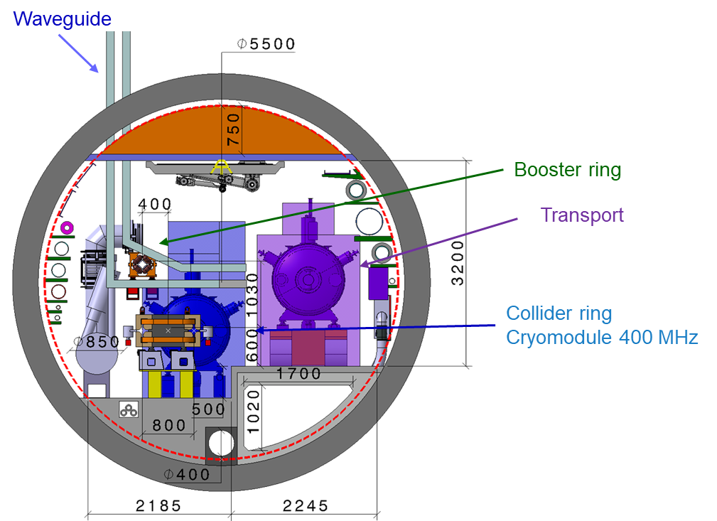
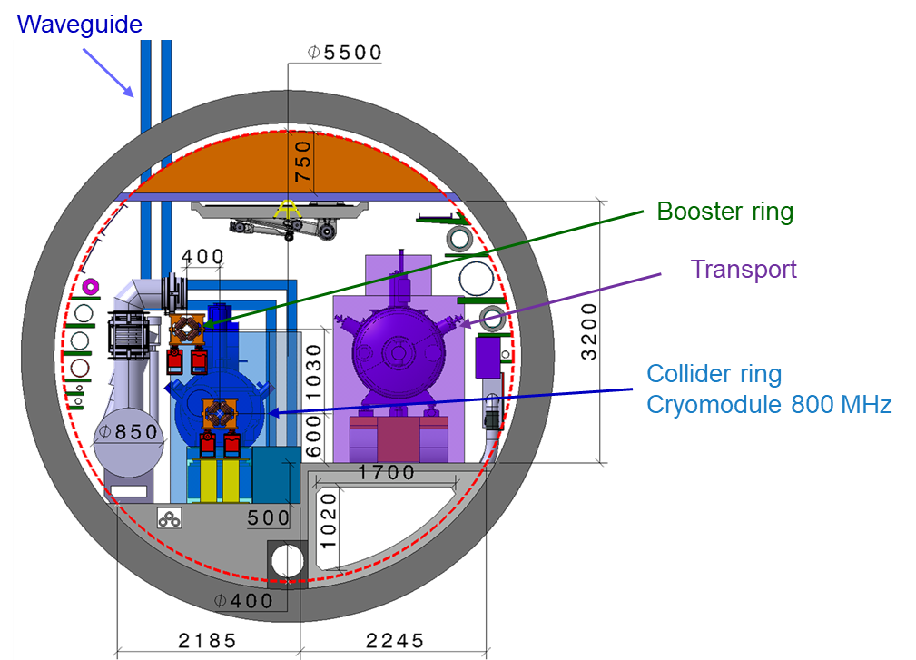
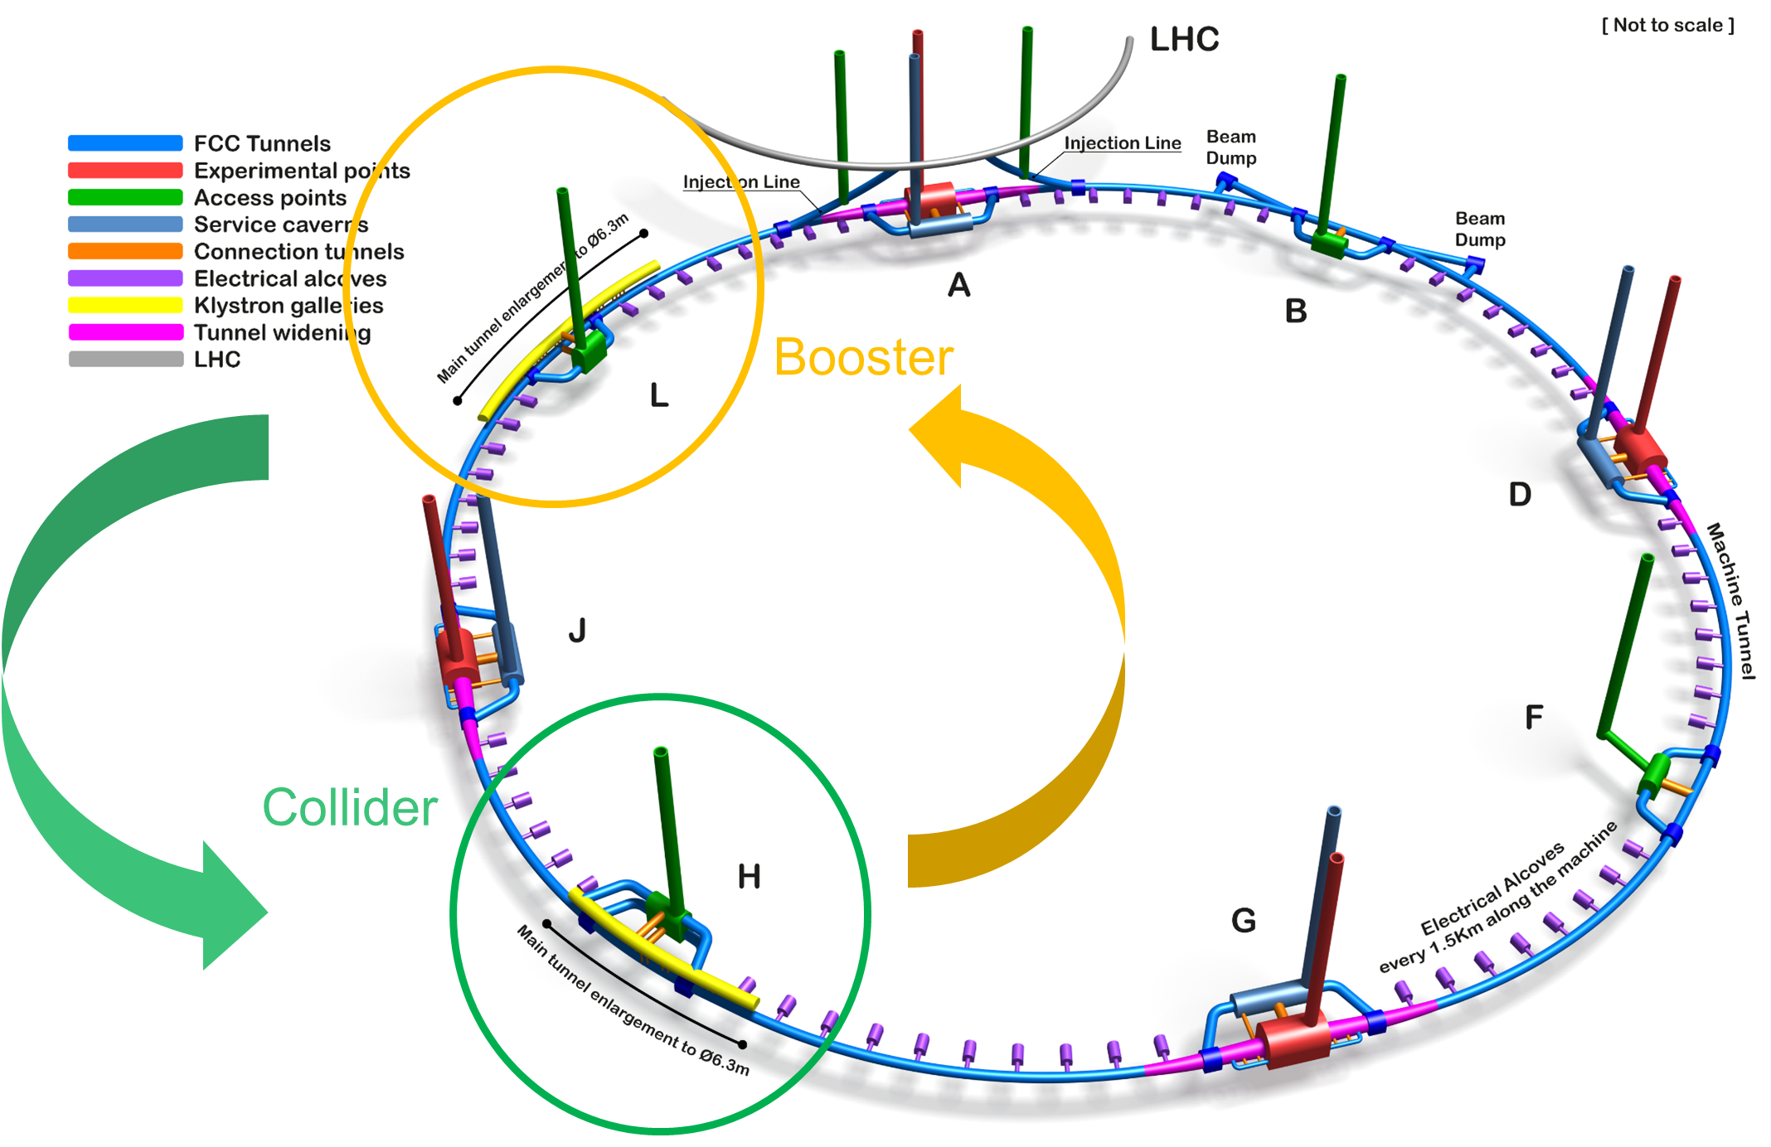
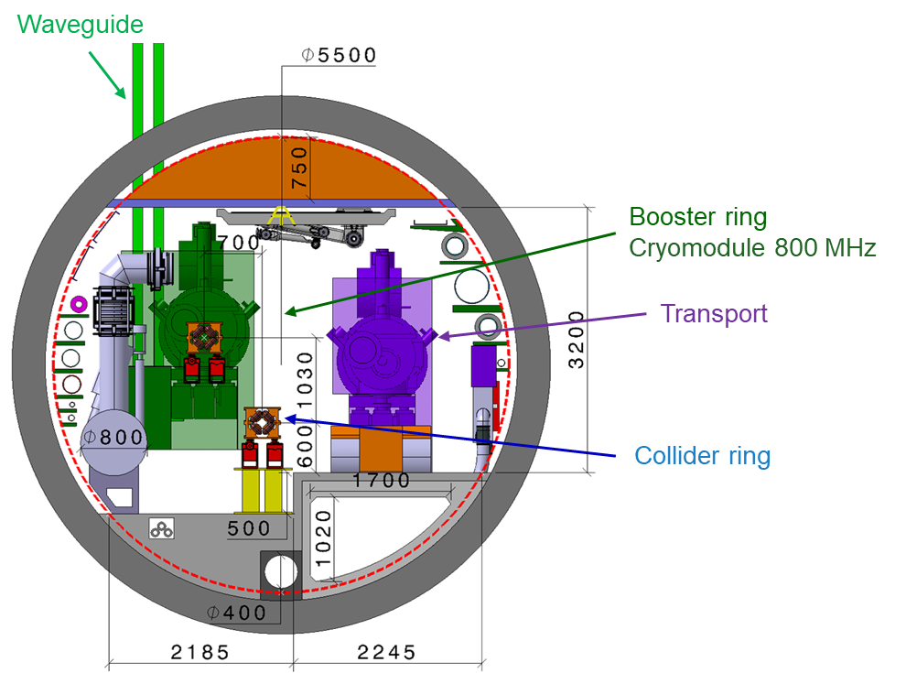
FCC-ee RF layout
RF for collider and booster in separate straight sections H and L.
fully separated technical infrastructure systems (cryogenics)
collider RF (highest power demand) in point H with optimum connection to existing 400 kV grid line and better suited surface site
Collider RF - Point H (400 and 800 MHz)
Booster RF - Point L
(800 MHz only)
J.-P. Burnet
F. Valchkova, F. Peauger

Slide 17




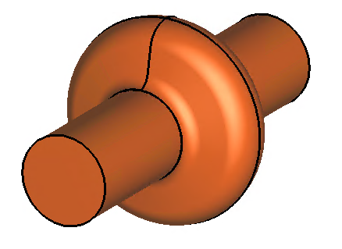
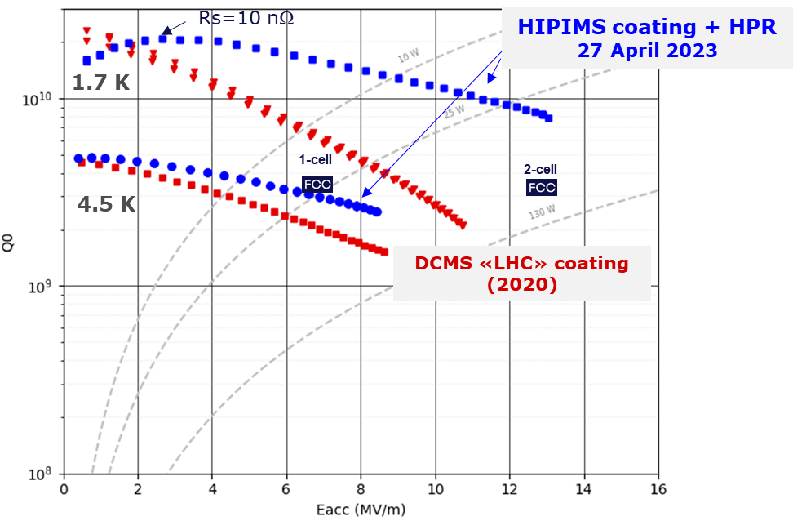
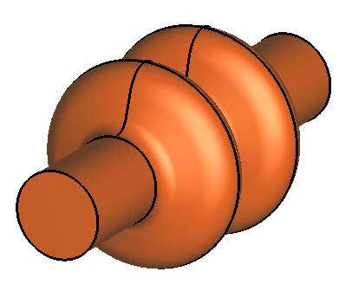
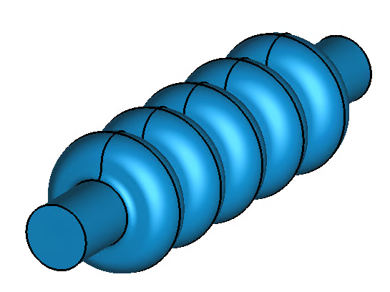
FCC-ee SRF Technology
Broad R&D collaborations on SRF
Z
low R/Q, HOM damping, powered by 1 MW RF coupler and high efficiency klystron
  1-cell
  400 MHz,
  Nb/Cu
W, H
moderate gradient and HOM damping requirements; 500 kW / cavity, allowing reuse of klystrons already installed for Z
  2-cell
  400 MHz,
  Nb/Cu
ttbar,
booster
high RF voltage and limited footprint thanks to multicell cavities and higher RF frequency; 200 kW/ cavity
  5-cell
  800 MHz,
  bulk Nb
First attempt of HiPIMS* niobium coating on a 400 MHz Cu cavity
*High-power impulse magnetron sputtering
F. Peauger, O. Brunner

Slide 18
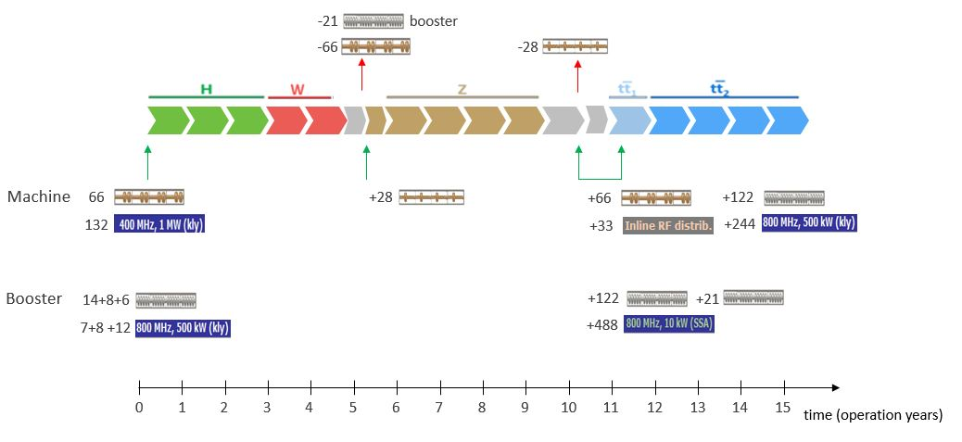
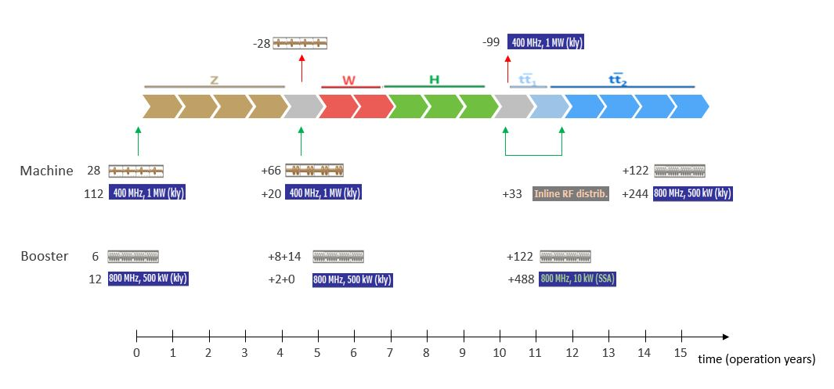
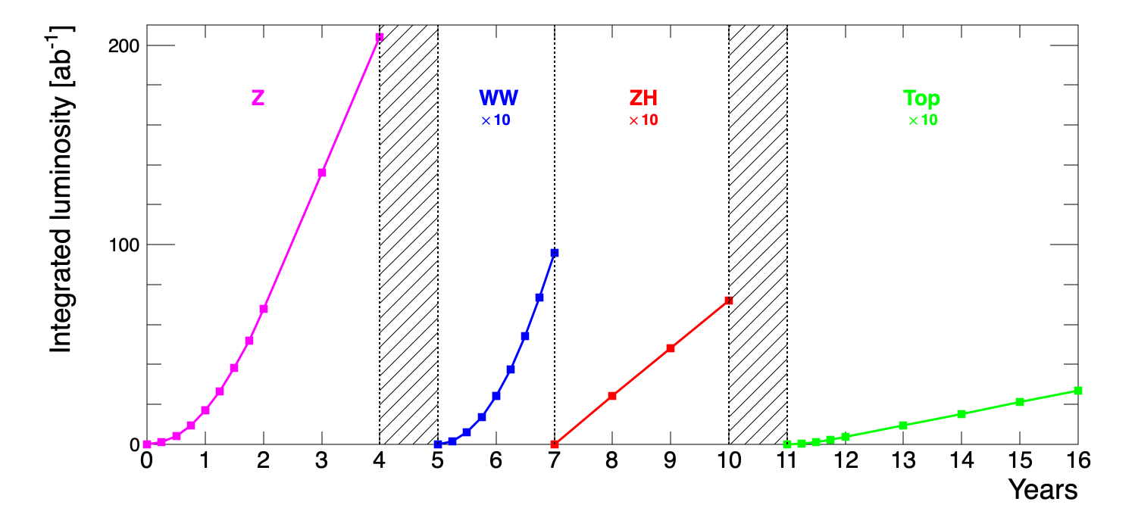
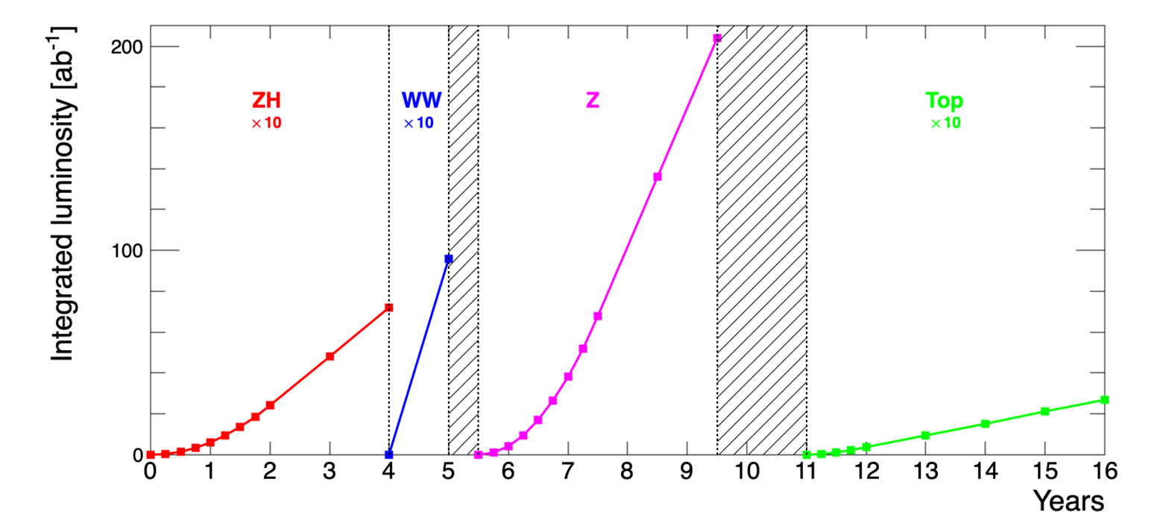
Operation sequences for FCC-ee
O. Brunner, F. Peauger
P. Janot

Slide 19
FCC-hh parameters
parameter | FCC-hh | HL-LHC | LHC
collision energy cms [TeV] | 81 - 115 | 14 | 14
dipole field [T] | 14 - 20 | 8.33 | 8.33
circumference [km] | 90.7 | 26.7 | 26.7
arc length [km] | 76.9 | 22.5
beam current [A] | 0.5 | 1.1 | 0.58
bunch intensity [10¹¹] | 1 | 2.2 | 1.15
bunch spacing [ns] | 25 | 25 | 25
synchr. rad. power / ring [kW] | 1020 - 4250 | 7.3 | 3.6
SR power / length [W/m/ap.] | 13 - 54 | 0.33 | 0.17
long. emit. damping time [h] | 0.77 – 0.26 | 12.9 | 12.9
peak luminosity [10³⁴ cm⁻²s⁻¹] | ~30 | 5 (lev.) | 1
events/bunch crossing | ~1000 | 132 | 27
stored energy/beam [GJ] | 6.1 - 8.9 | 0.7 | 0.36
With FCC-hh after FCC-ee: significantly
more time for high-field magnet R&D
aiming at highest possible energies
Formidable challenges:
high-field superconducting magnets: 14 - 20 T
power load in arcs from synchrotron radiation: 4 MW → cryogenics, vacuum
stored beam energy: ~ 9 GJ → machine protection
pile-up in the detectors: ~1000 events/xing
energy consumption: 4 TWh/year → R&D on cryo, HTS, beam current, …
Formidable physics reach, including:
Direct discovery potential up to ~ 40 TeV
Measurement of Higgs self to ~ 5% and ttH to ~ 1%
High-precision and model-indep (with FCC-ee input)
measurements of rare Higgs decays (𝛄𝛄, Z𝛄, µµ)
Final word about WIMP dark matter
F. Gianotti

Slide 20
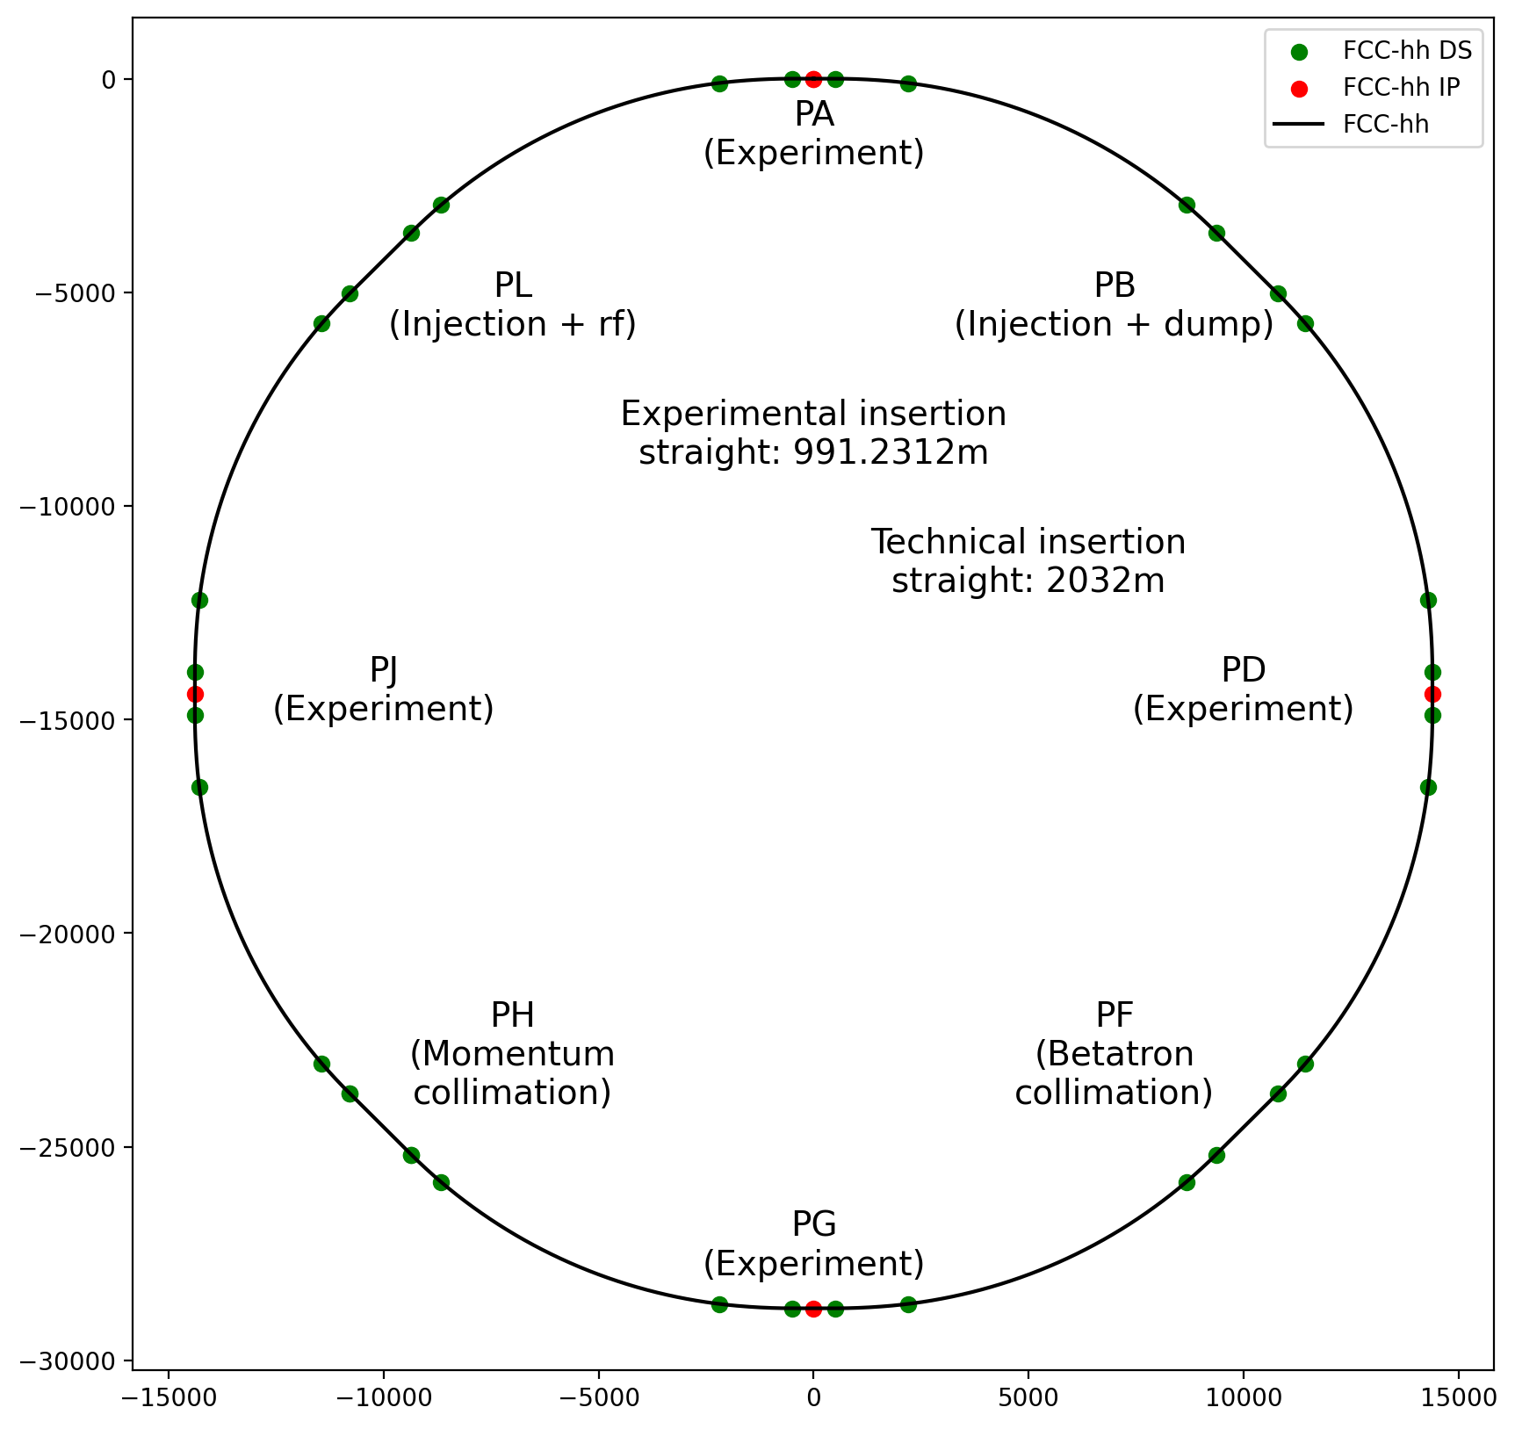
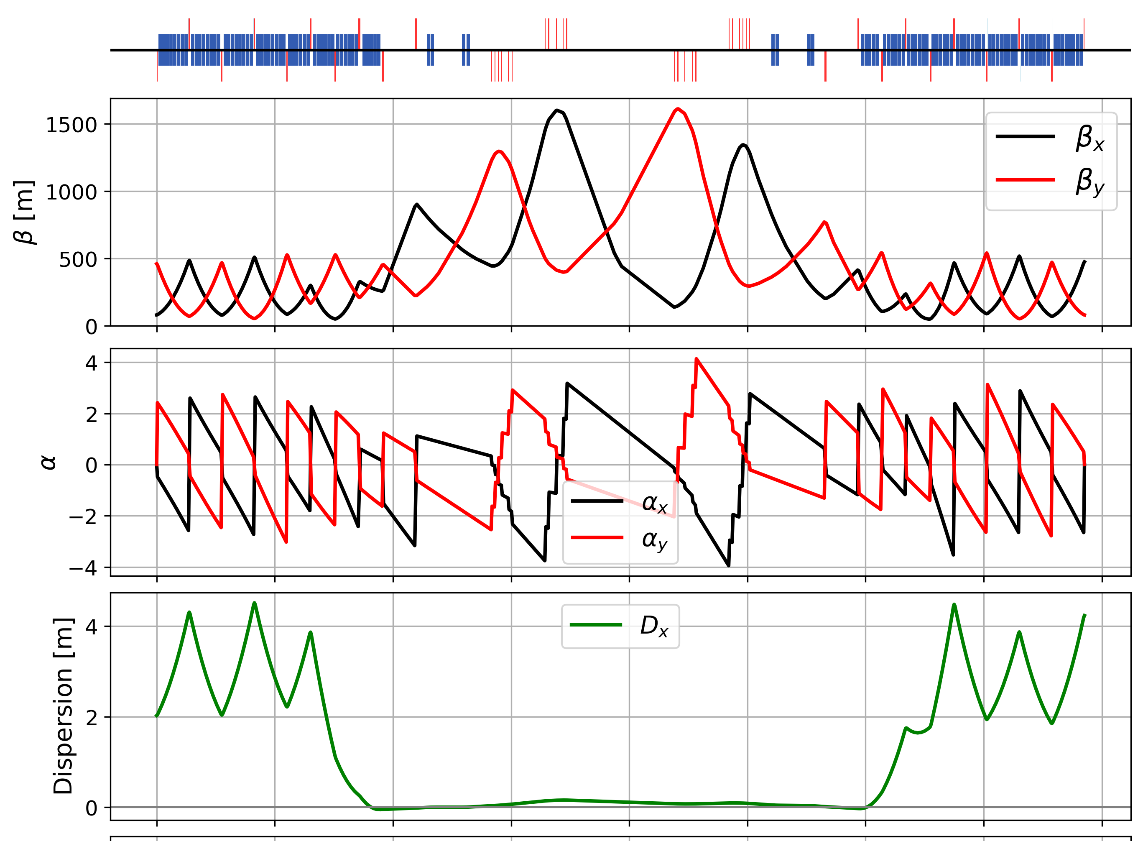
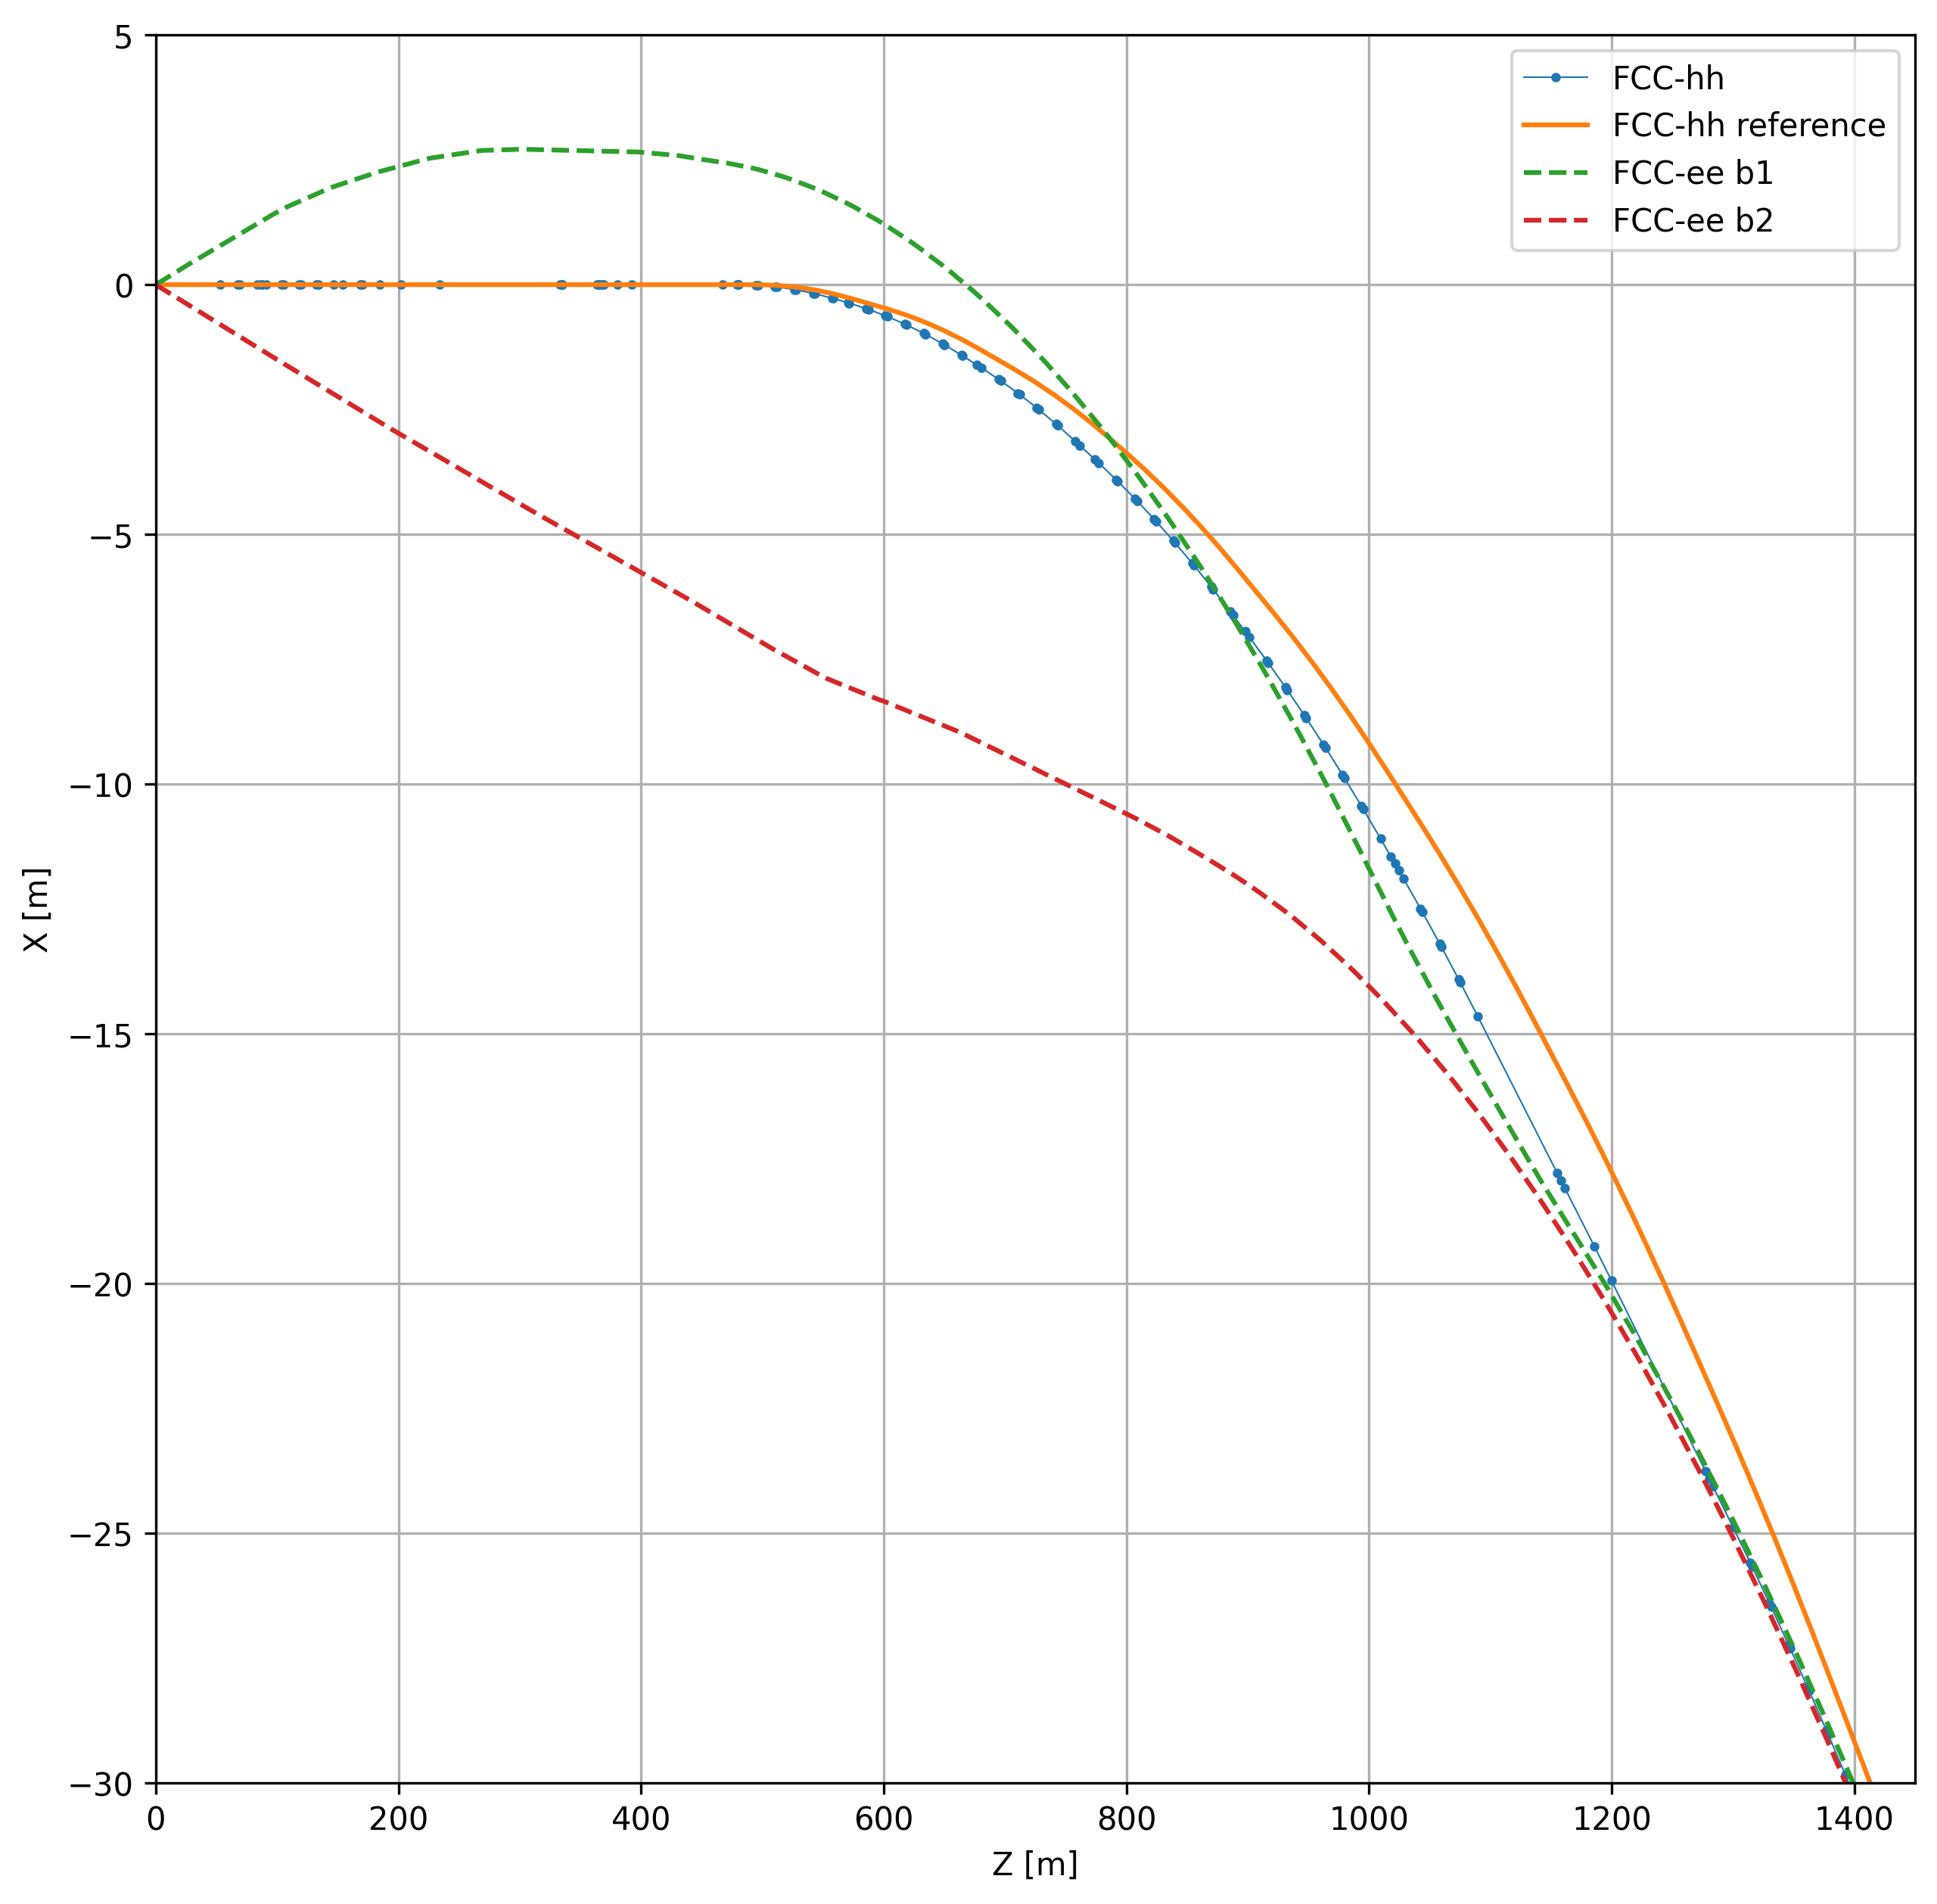
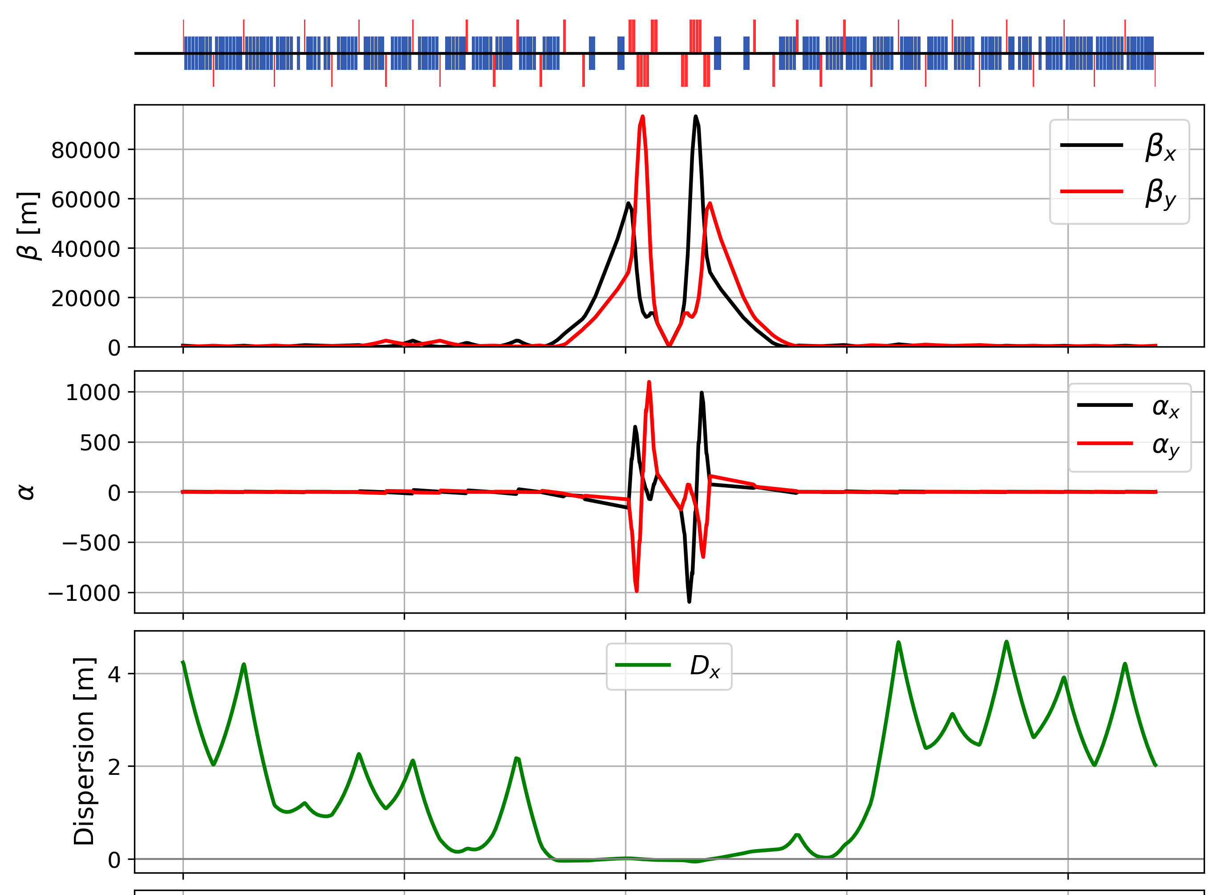
FCC-hh layout, optics work, geom. integration
betatron collimation straight
3 - beam footprint
at interaction point
ee – beam 1
from IP
IP
hh
new
hh – earlier
reference
ee – beam 2
towards IP
experimental straight
adaptation to new layout and geometry
shrink β collimation & extraction by ~30%
optics optimisation (filling factor etc.)
move hh IPs on top of ee IP to optimise tunnel and cavern widths.
M. Giovannozzi, T. Risselada, G. Perez Segurana, M. Hofer, K. Oide

Slide 21
High-field magnets for FCC-hh
A power-saving, cost-effective High-Field Magnet technology with minimum cryogen inventory
is the ambitious goal for FCC-hh HFM R&D.
FCC-hh magnet R&D requires a sustained and globally coordinated efforts by international magnet R&D programs (HFM Programme, US-MDP, nat'l programs, etc.).
Good coordination and communication among the FCC integrated program and magnet R&D programs is indispensable.
Many technologies and target parameters compete for optimum value:
  LTS today is seen as a cost-effective, rel. low risk, and potentially fast-tracked option.
  HTS as path towards FCC-hh aspirational goals (c.o.m energy, societal impact, etc., while remaining affordable).
  Technical readiness of HTS lags behind that of LTS by many years.
Need to exploit synergies with other fields and applications to help to sustain the long-term effort.

Slide 22

Status of FCC global collaboration
increasing international collaboration as a prerequisite for success
150
Institutes
32
Companies
34
Countries
EC
H2020

Slide 23
Conclusions
The first half of the FCC FS will soon be completed with the mid-term review
End October 2023: Review committee reports available to Scientific Policy Committee and Finance Committee
20 – 22 November 2023: SPC and FC review meetings on mid-term review
2 February 2024: CERN Council meeting on mid-term review
Focus so far: identifying best placement & layout and adapting entire project to new placement
Focus until end 2025: performance-risk-cost optimization considering project/operation phases and preparations for project preparatory phase
  Performance-risk-cost optimization considering construction & operation phases at system and global level
  Site investigation, surface site implementation with host states, environmental initial state, administrative processes
  Setting up for project preparatory phase: structure and resources, agreements with host states
  Setting up and strengthening R&D collaborations to advance towards technical design

