Slide 1









The Japanese High Field Magnet programs for accelerators
T. Ogitsu, M. Sugano, T. Nakamoto, K. Suzuki, M. Iio, M. Dhakarwal; KEK,
S. Awaji; Tohoku Univ., H. Oguro; Tokai Univ., N. Banno; NIMS
A. Ballarino, A. Devred, T. Bothboul, S. Hopkins; CERN,
S. Kawashima, T. Kawarada, Y. Murakami, K. Saito; Kobe Steel and JASTEC
Asami, H. Ii, H. Sakamoto, T. Kato; Furukawa Electric
N. Amemiya, Y. Sogabe, X. Luo; Kyoto U.
T. Shen, X. Wang, L.G. Fajardo, C. Myers; LBNL, C. Reis; UC Berkeley,
R. Gupta, P. Joshi, J. Schmalzle, G. Jochen, S. Joshi; BNL

Slide 2
R&D programs of High Field Magnet for Accelerator in Japan
On going (based on international collaborations)
  HTS: US-Japan collaboration framework
    KEK, Kyoto U., LBNL, BNL, UC Berkeley
  Nb3Sn: CERN-KEK collaboration
    KEK, Tohoku U., Tokai U., NIMS, JASTEC, Furukawa, CERN
Submitted Proposal
  R&D program of High Field Magnet for Accelerator
    To Science Council of Japan (Future Science Promotion 2023)

Slide 3
R&D programs of High Field Magnet for Accelerator in Japan
On going (based on international collaborations)
  HTS: US-Japan collaboration framework
    KEK, Kyoto U., LBNL, BNL, UC Berkeley
  Nb3Sn: CERN-KEK collaboration
    KEK, Tohoku U., Tokai U., NIMS, JASTEC, Furukawa, CERN
Submitted Proposal
  R&D program of High Field Magnet for Accelerator
    To Science Council of Japan (Future Science Promotion 2023)

Slide 4

Kyoto Univ.
Graduate School of Engineering Department of Electrical Engineering
Advanced Technologies on
AC-Loss and Field Quality Analysis on HTS magnets
UC Berkeley
Dept of Nuclear Engineering
Experimental material science for nuclear applications
Advanced
HTS Magnet
Technologies
for
Future
Accelerator
Sciences
BNL
Member of US-MDP
Developing Various HTS Magnets
Advanced Technologies for
HTS Magnet
LBNL
Member of US-MDP
Developing 20 T HTS Accelerator Magnets
Advanced Technologies for
High Field Accelerator Magnet
KEK
Developing HTS Magnets for High Radiation Environments
Advanced Technologies for HTS Magnet with Radiation Hardness

Slide 5


Tasks
Task1: HTS magnet technologies for high-radiation environment
Irradiation tests of organic resins
KEK, LBNL; Mechanical tests of irradiated samples
Irradiation tests of superconductors:
  KEK, LBNL and UC Berkeley; Neutron irradiation at the IMR Oarai and preform Ic test.
  LBNL and UC Berkeley; Microscopic analysis of irradiation damage.
Task 2: Stability, quench protection, and magnet safety
LBNL and Kyoto U.: Quench experiments of various spiral conductors: current sharing among coated conductors, impact of conductor length etc.).
Task 3: Measuring and modeling AC loss and field quality of HTS accelerator magnets
Kyoto U.: Advanced analyses of magnets wound with CORC wires. Fundamental study on applications of multifilament coated conductors.
KEK: Prepare field measurement of CT1.
LBNL: Field measurement of C3. Develop FEM model of C1 and C2.
BNL: Participate in the discussion.
Task 4: HTS/LTS high field hybrid accelerator dipole technology
KEK and LBNL: Non-organic insulation technology R&D for HTS and Nb₃Sn conductor.
KEK and BNL: Develop rad-hard racetrack coils that can be tested at BNL 10T test stand.
BNL: Prepare test stand, debag quench protection system. Device a detailed test program including magnetization measurement.

Slide 6
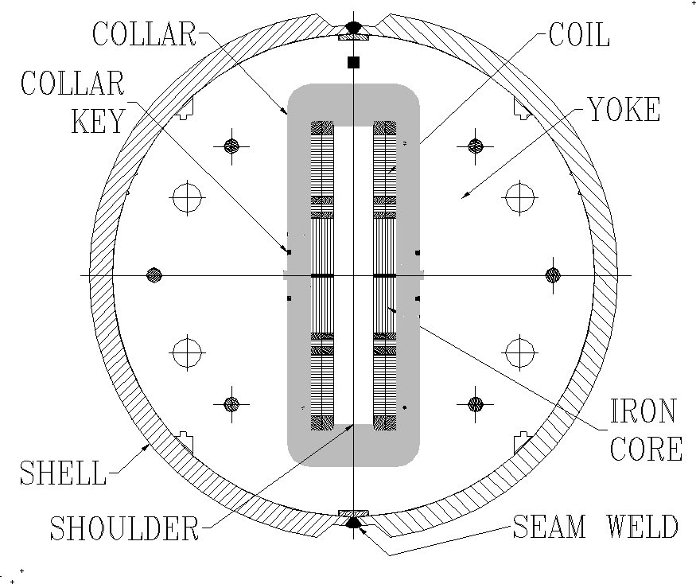
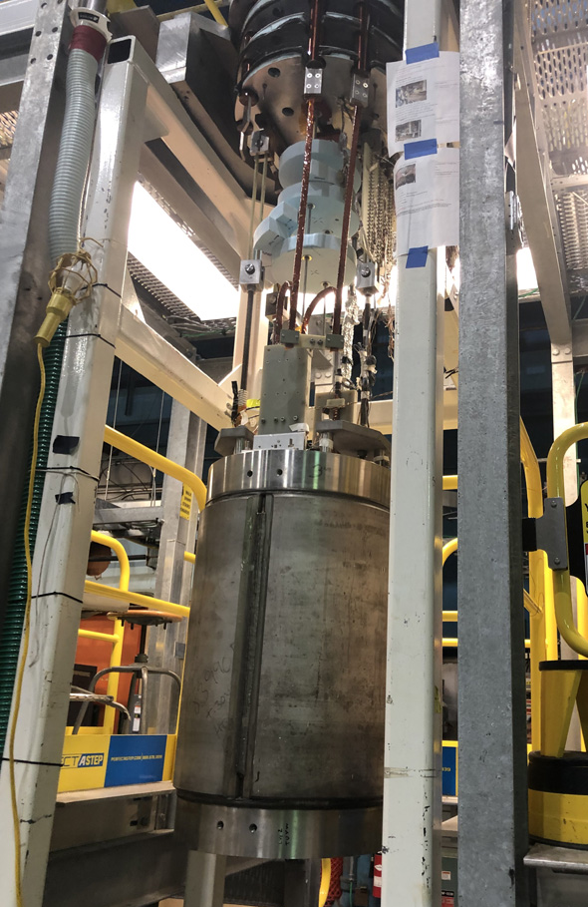
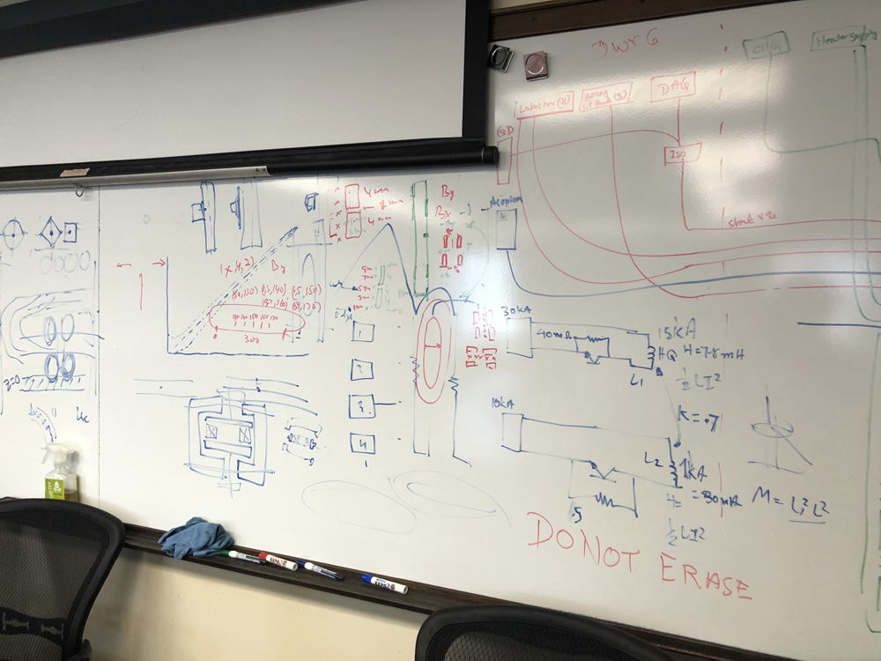
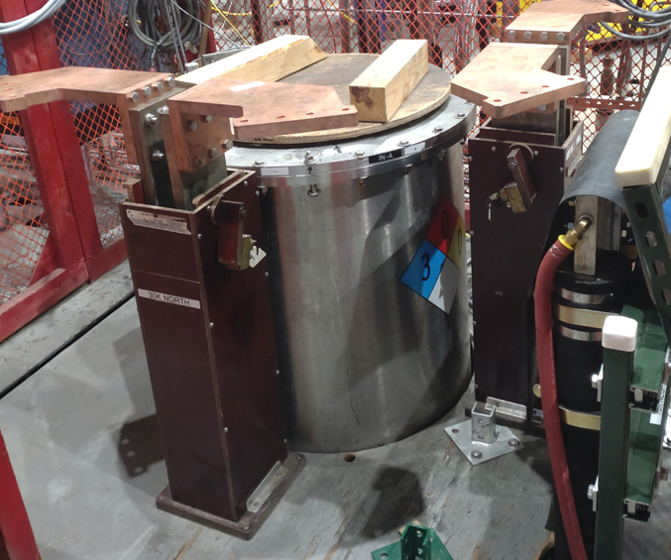
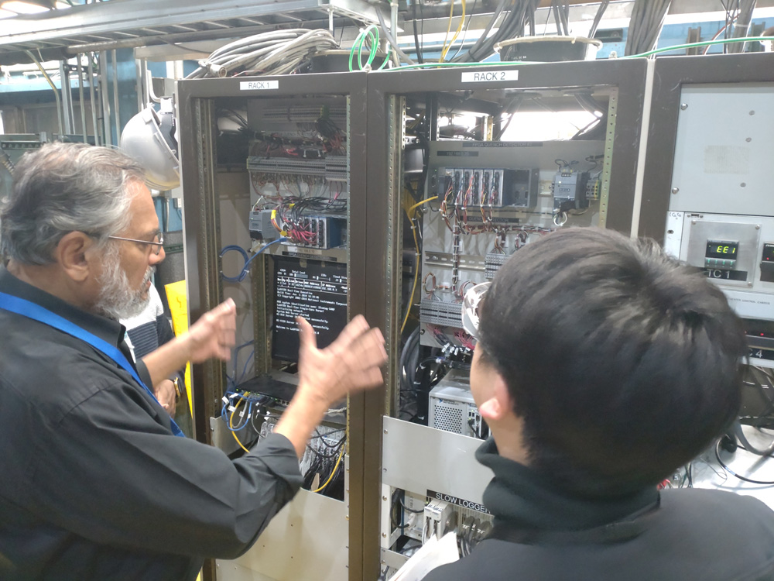
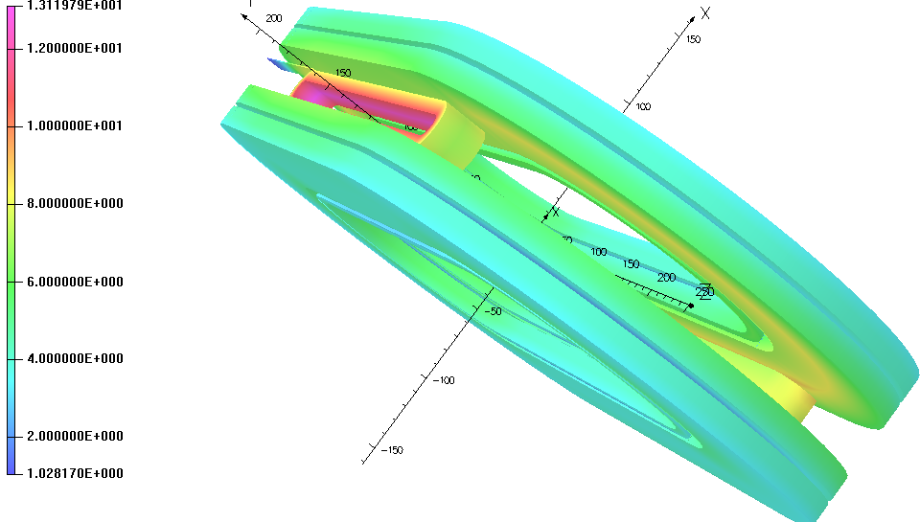
Task 4. High Field Test with Common Coil Configuration @BNL
Preparations for the test are in progress
30
KEK and BNL members discussed the details of the test plan and preparation items on site
31
30
Background
field :~10 T
335
Test plan on common coil test stand
TC measurement during cooling
Excitation test (B_{Backup}=0, 1, 5, 10 [T])
Coil magnetization measurement
Quench test (B_{Backup}=10, 7, 5, 3, 1 [T])

Slide 7

Task 1 Inorganic Insulation HTS coil
Insert coil design for the test equipment at BNL
Concerns about I_{C} degradation due to small bend radius
→EuBCO tapes (Fujikura FESC-SCH)
has good bending radius tolerance
GdBCO
Coil design parameters
Type: EuBCO, I_{C} (77K, S.F.): 201 A
Thick. of Hastelloy: 50 μm,
Thick. of Cu: 40 μm (one side)
Coil width (Avg. of meas.): 4.08 mm
Coil Thick. (Avg. of meas.): 0.16 mm
Thick. of coating: 0.026 mm (one side)
Thick. per turn: 0.31 mm (Tape+Coating+Adhesive)
Number of turns per layer: 20 turns
EuBCO
BNL Insert Coil

Slide 8
Task 1 Inorganic Insulation HTS coil
Insert coil design for the test equipment at BNL
Electrodes (Cu)
Endshoe
(Ceramic coated SS)
REBCO coil
Lead Fixtures
(Cu)
Island
(Partially ceramic coated SS)
Horseshoe
(Partially ceramic coated SS)
312.4 (6.2+300+6.2)
10
Spacers
(Ceramic coated Al)
R5.5
Supports
(Partially ceramic coated SS)

Slide 9
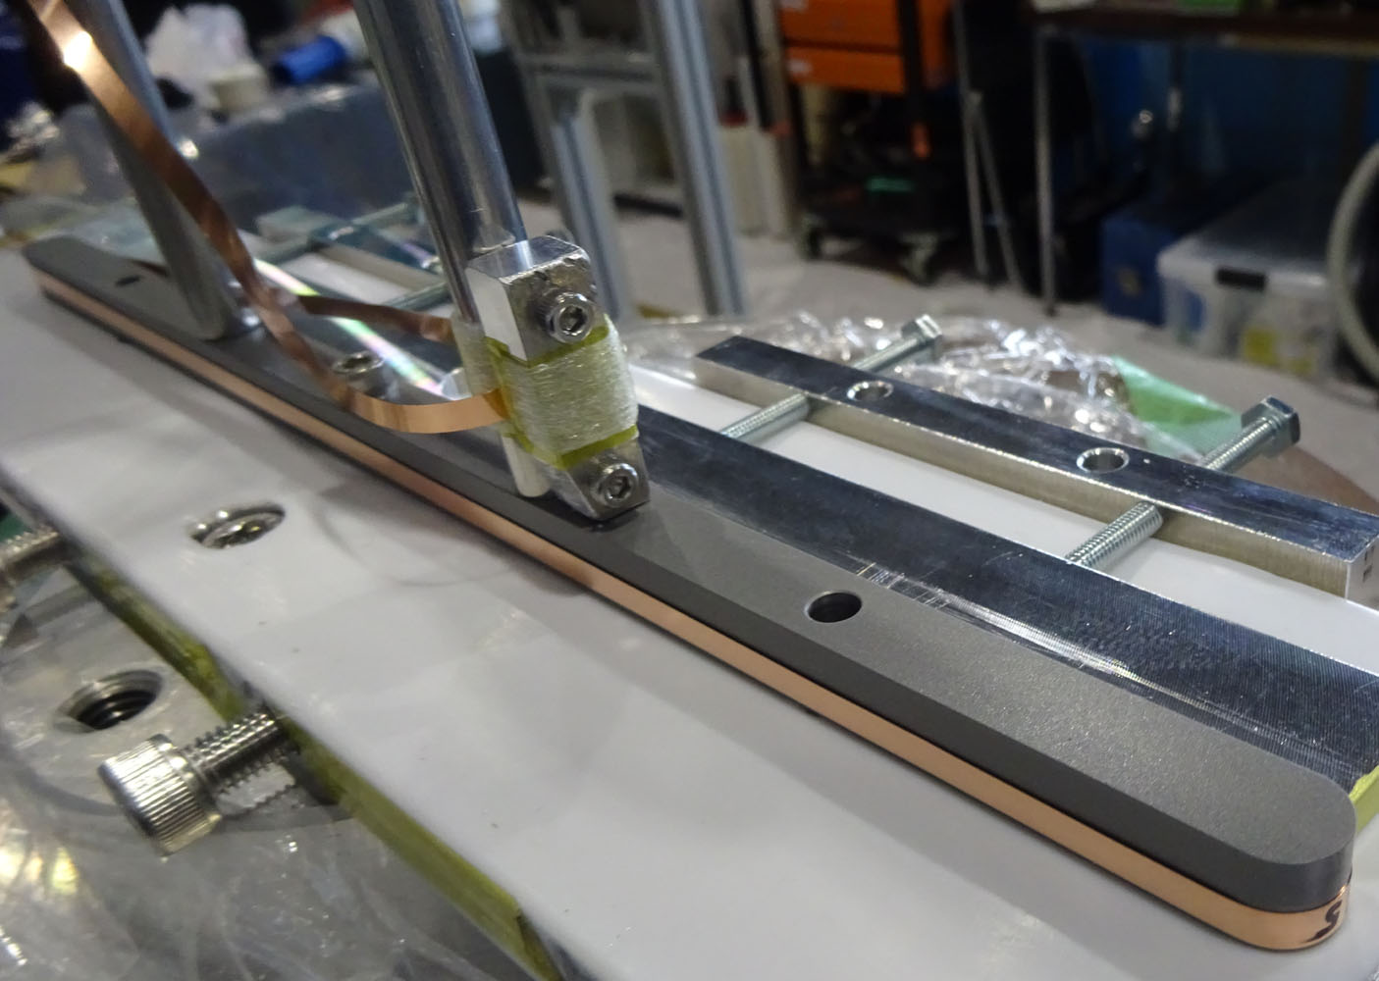
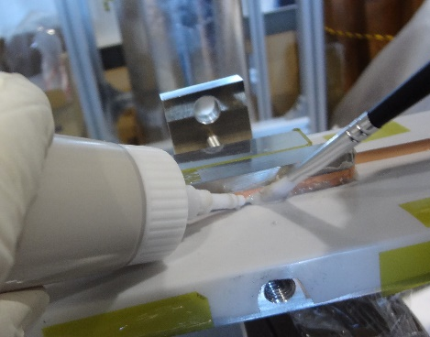
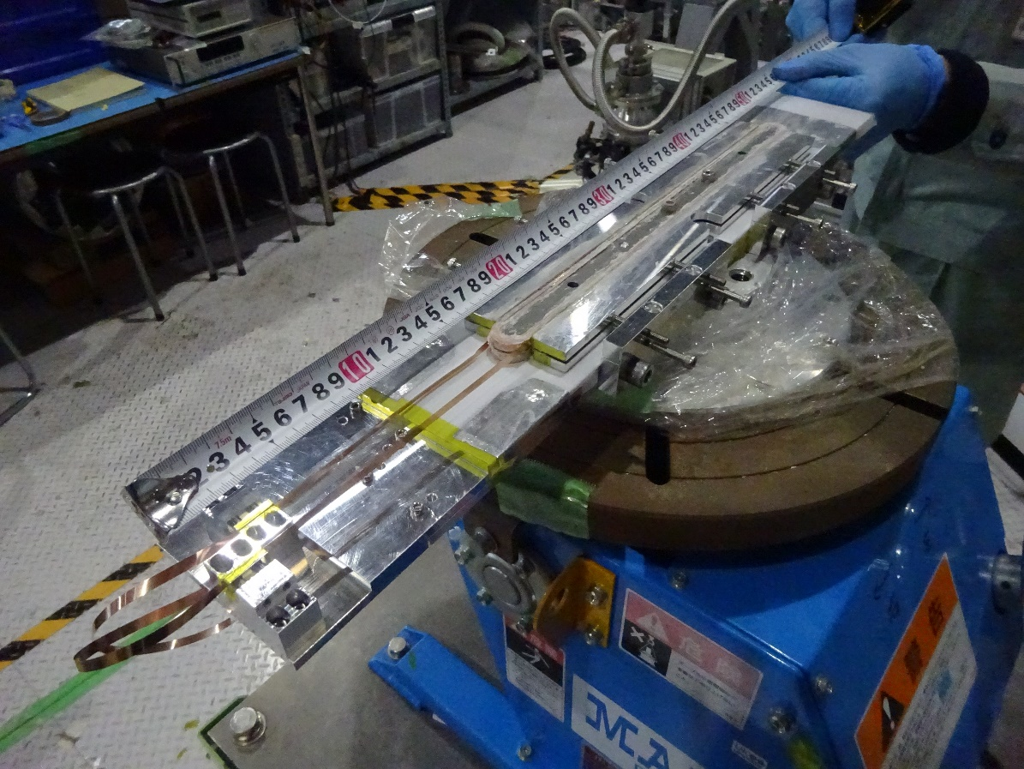
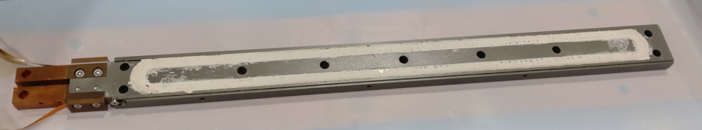
Task 1 Inorganic Insulation HTS coil
Trial winding of the insert coils with Cu tapes
Aron Ceramic Type C (Toagosei Co., Ltd)
Main Ingredients | Silica (SiO₂)
Viscosity | 70,000 mPa･s
CTE | 13x10⁻⁶ (0-600℃)
Heat Treatment | 16h at R.T. →1h at 90 ℃ →1h at 150 ℃
Purpose
Establishment of winding technology
Improvement of coil parts and winding jigs
Feedback to the actual coil design
Island
(ceramic coated SS)
Wet winding
(ceramic adhesive)
Seamless double pancake racetrack coil
Winding of actual coils winding will be performed soon.
Assembly of coil block with ceramic adhesive

Slide 10
Current status of neutron irradiation
Task 1 Neutron irradiation to HTS conductors
Publication of a paper on neutron irradiation of ReBCO
M. Iio et al., IEEE Trans. Appl. Supercond., vol. 30, no. 4, (2020) 4600505.
Activity in LBNL and UC Berkeley
Irradiated sample shipment to Berkeley: under preparation
FIB-SEM procedures for TEM lamella preparation developed
TEM access approved
NERSC Supercomputing resource access proposal underway
GdBCO conductors degrade at neutron fluences higher than 8.23 x 10²¹ [n/m²]
Irradiation of new samples is now underway at JRR3
Target fluences: 1.0 x 10²¹ [n/m²]
Conductor type: GdBCO, YBCO, EuBCO
Artificial pining: With or Without
Low-energy neutron suppression shield: With or Without

Slide 11
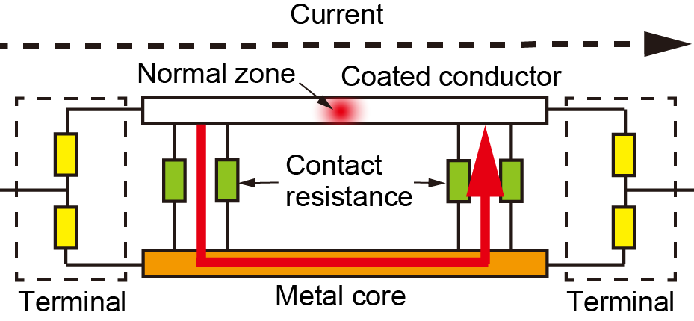
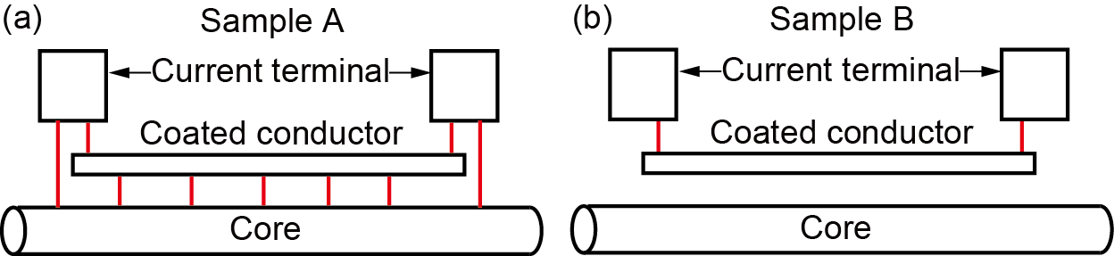
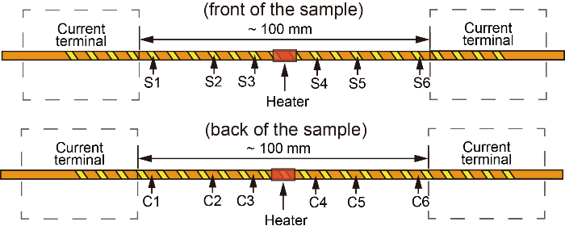
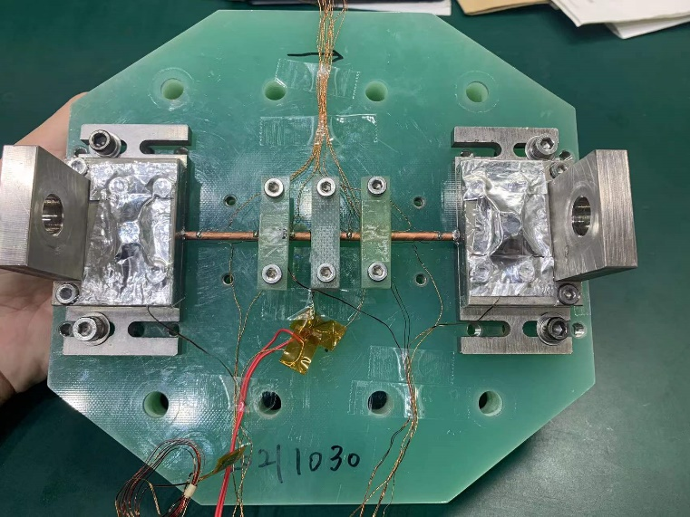
Task 2 (2022FY): Effect of metal core on quench protection of spiral coated conductors
When quench occurs in a spiral coated conductor, the current sharing by the metal core is expected to reduce Joule heating to prevent the coated conductor from burning out.
A normal zone was generated by a small heater, and, then, the coated-conductor and core voltages were measured when the sample current was 160 A at 55 K / 0.5 T (I_{c} ~ 170 A).

Slide 12
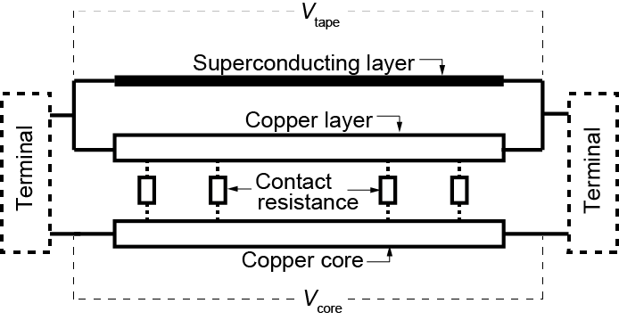
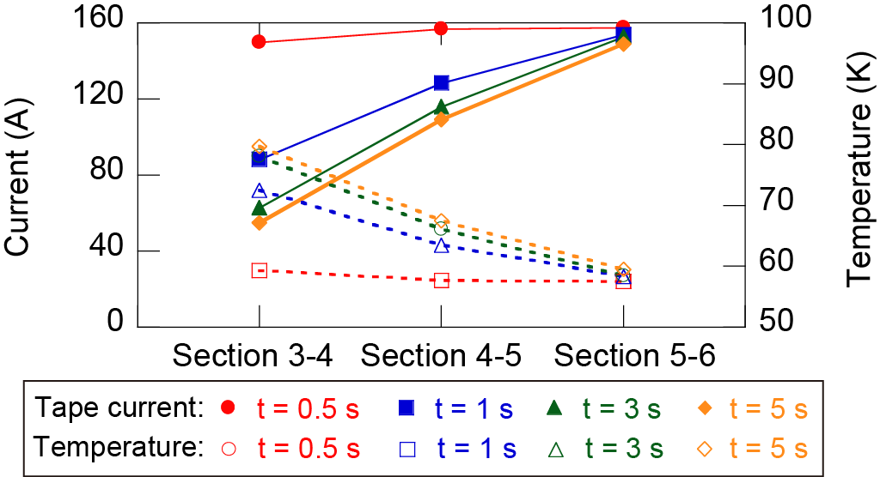
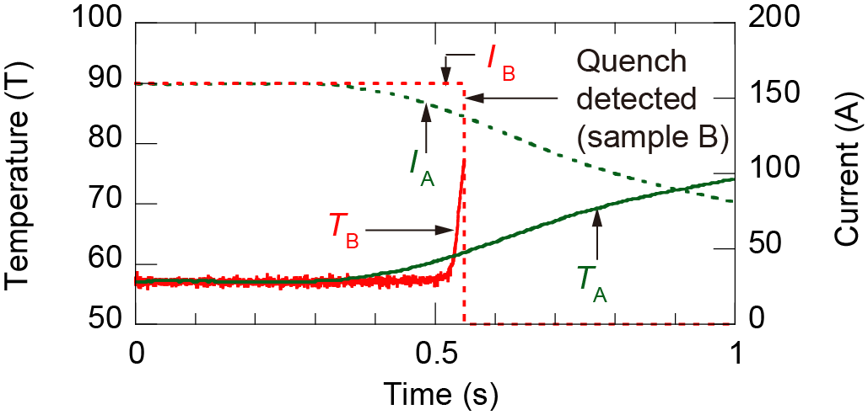
Task 2 (2022FY): Effect of metal core on quench protection of spiral coated conductors
The hot spot temperature and the currents in the coated conductor and the core were calculated by using experimental voltage data.
Comparison of current sharing and temperature in each sections
Comparison of hot-spot temperature and tape current between sample A and sample B
Current sharing between the tape and the core through the contact resistance was experimentally examined.
Current sharing was suppressing the hot-spot temperature.

Slide 13
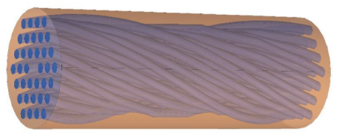
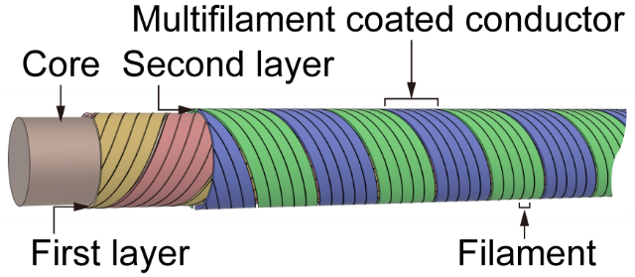
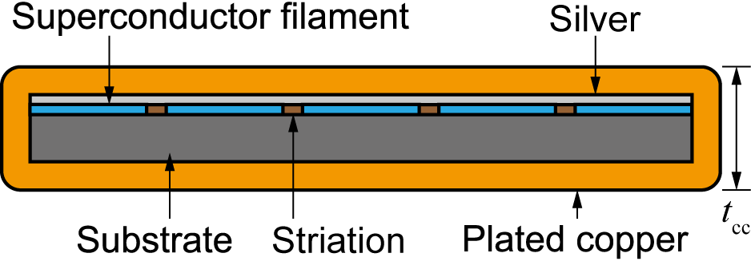
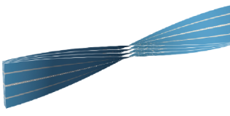
Task 3 (2022FY): SCSC cables: spiral coated conductor cable using multifilament coated conductors
Twisting round LTS wire
Winding copper-plated multifilament coated conductors spirally on a round core
SCSC cable (double “SC” cable, standing for
Spiral Copper-plated Striated Coated-conductor cable), with which shielding-current induced field can be reduced effectively
Twisting flat HTS tape

Slide 14
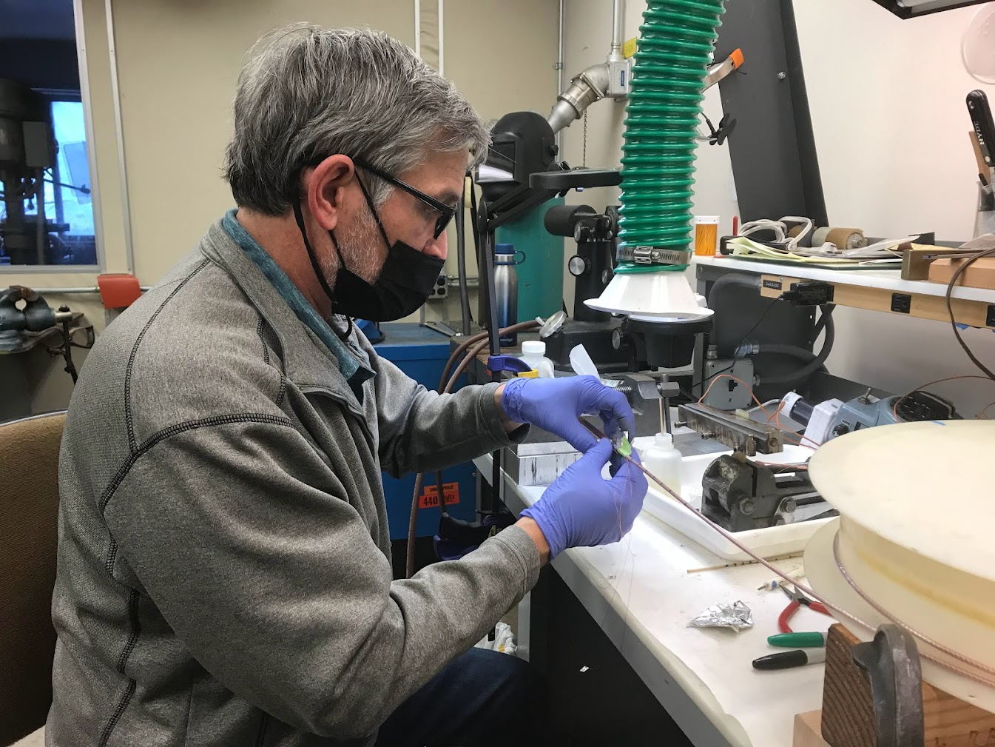
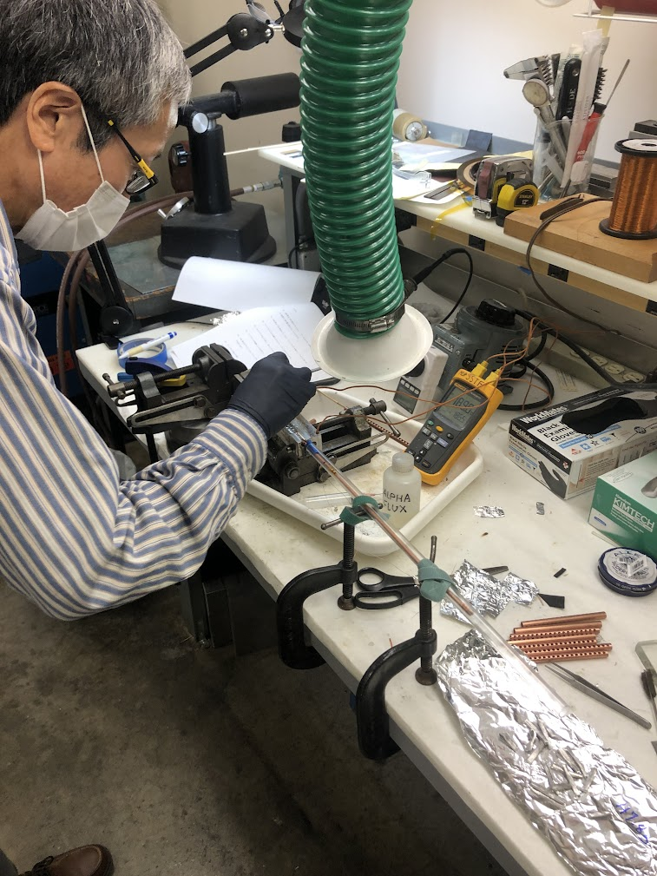
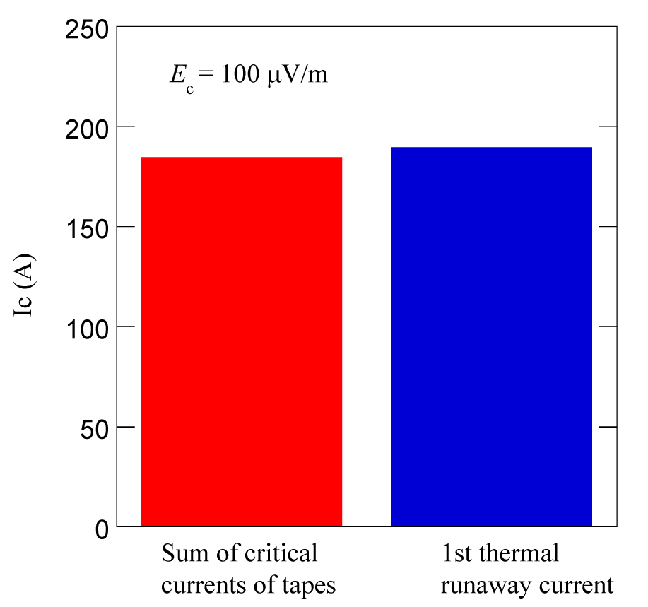
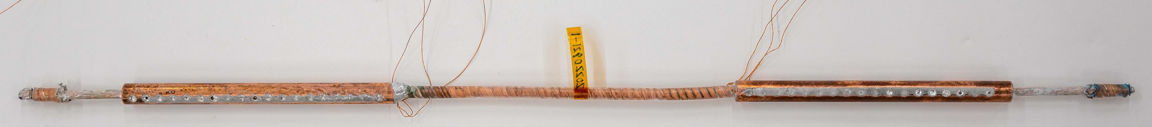
Task 3 (2022FY): Technology of fabricating terminals was transferred from LBL to KU through this Japan-US cooperation program
Hugh Higley of LBL
Naoyuki Amemiya of KU
The sample cable successfully transported current.
A sample cables with terminals, which were fabricated by Naoyuki Amemiya of KU at LBL.

Slide 15

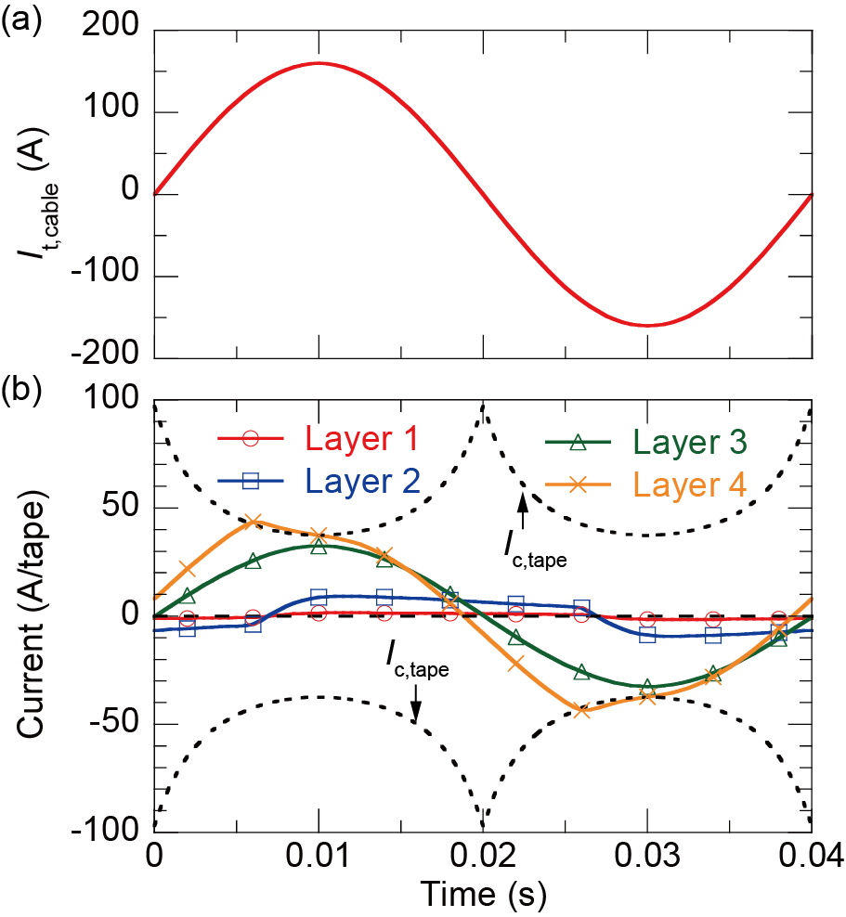
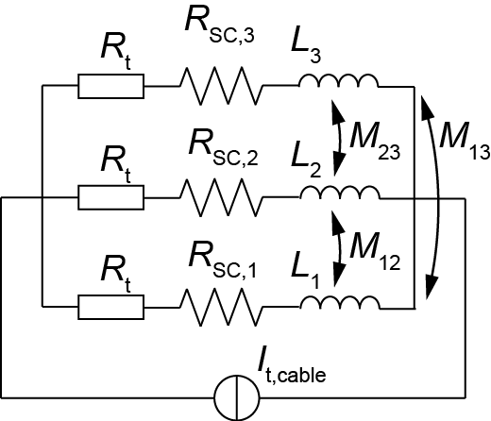
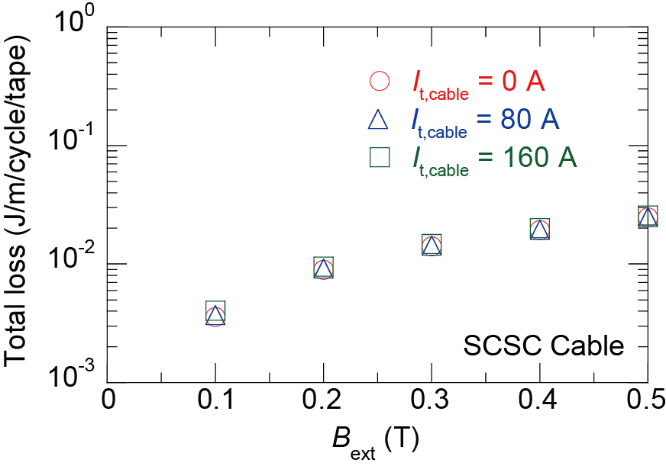
Task 3 (2022FY): Electromagnetic field analysis of spiral coated conductor cables in magnet environment
Analyses of Spiral Copper-plated Striated
Coated-conductor (SCSC) cables
carrying transport current I_{t} under
external magnetic field B_{ext} is necessary
for magnet application.
SCSC cable
Considering non-uniform current distribution among layers
The impedance imbalance of
each layer results in different
time variation of the current
in each layer (non-uniform
current distribution)
Influence of transport current
on ac loss is negligible.
Combination of circuit model for current distribution calculation and electromagnetic field analysis model
Circuit model
cable current
current in each layer
Calculated ac loss

Slide 16
Future Plan under discussion
Task1: HTS magnet technologies for high-radiation environment
Continue Irradiation tests of superconductors:
Task 2: Stability, quench protection, and magnet safety
Advanced Quench Detection?
Task 3: Measuring and modeling AC loss and field quality of HTS accelerator magnets
Continue including SCSC Cable?
Task 4: HTS/LTS high field hybrid accelerator dipole technology
Test coil based on SCSC and/or CORC Cable?

Slide 17
R&D programs of High Field Magnet for Accelerator in Japan
On going (based on international collaborations)
  HTS: US-Japan collaboration framework
    KEK, Kyoto U., LBNL, BNL, UC Berkeley
  Nb3Sn: CERN-KEK collaboration
    KEK, Tohoku U., Tokai U., NIMS, JASTEC, Furukawa, CERN
Submitted Proposal
  R&D program of High Field Magnet for Accelerator
    To Science Council of Japan (Future Science Promotion 2023)

Slide 18
Nb₃Sn conductor development program
• The first phase of Nb₃Sn conductor development program for FCC within the
CERN-KEK collaboration was conducted in 2016–2022.
• Two Japanese wire manufacturers (JASTEC, Furukawa) participated in this program.
• J_{c} improvement was the first priority.

Slide 19
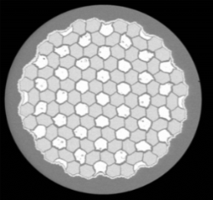
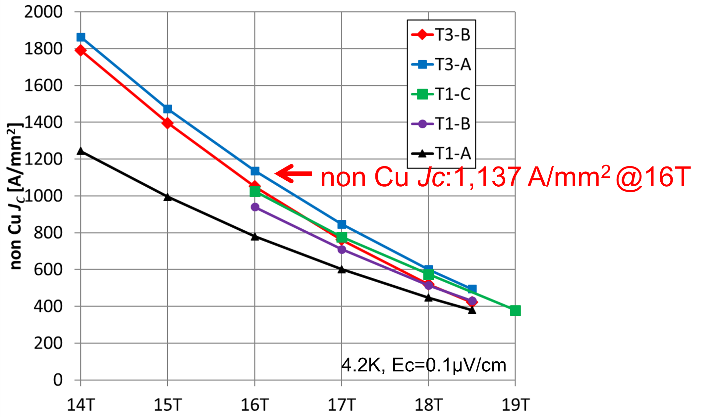
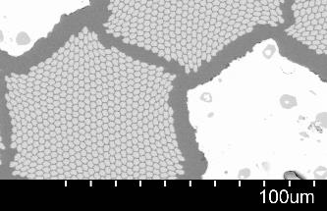
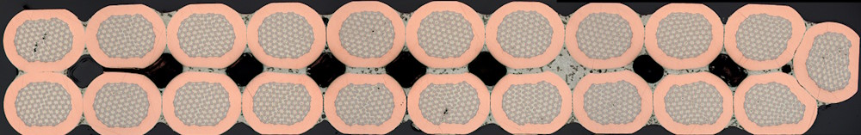
Achievement in the first phase of conductor R&D program
φ1.0 mm
Non-Cu J_{c} (A/mm²)
40%
Sn
Nb
Sn
Nb
Cross-section of DT wire by JASTEC
14
15
16
17
18
19
Magnetic field (T)
J_{c}-B curve of the JASTEC trial wires
Cross-section of Rutherford cable
made up of φ1.1 mm JASTEC wires
• Non-Cu J_{c} of distributed-Sn wires fabricated by JASTEC was improved by 40% by the
reduction in Sn diffusion distance and controlling Ti ratio. The J_{c} of 1100 A/mm² at 16 T and 4.2 K
was achieved.
• Around 3 km of DT wires with a diameter of 1.1 mm and 1.2 mm were delivered to CERN for the
cabling test.
• Drawability should be improved for longer-length production. The extracted wires from the cable
showed a stability issue.

Slide 20
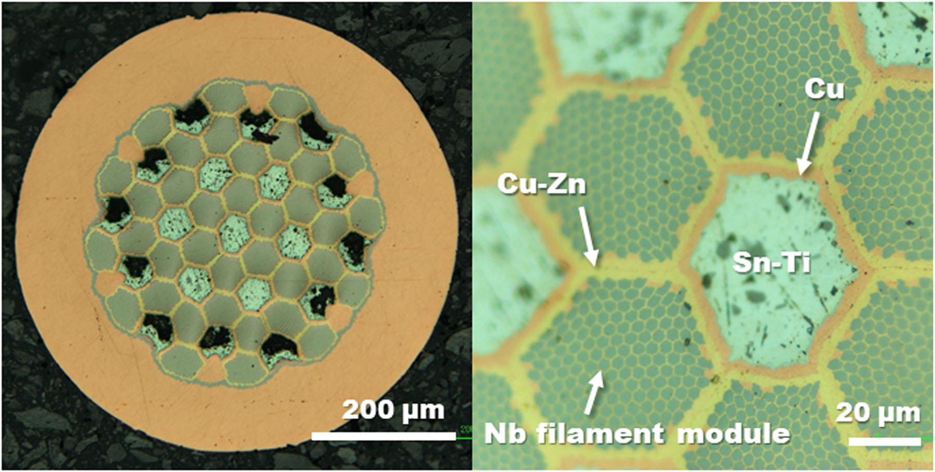
Next step for further improvement of JASTEC DT wires
Targets
1. The industrialization of the process by focusing on improved workability to achieve
longer piece length while maintaining non-Cu J_{c}~1000 A/mm² at 16 T and 4.2 K and
stability at 0.85 mm in diameter.
2. Continue R&D to further enhance performance (J_{c} and mechanical property)
towards requirements for HFM
Strategies
• Improvement of drawability
– Optimization of annealing condition of Nb
• Improvement of non-Cu J_{c} in collaboration with NIMS
– Zn addition to Cu matrix to promote Sn diffusion
– Doping of Ti to Nb instead of using Sn-Ti
– Basic R&D to understand the effectiveness of Hf doping to Nb on higher J_{c}
• Enhancement of tolerance of transverse compression stress
– Zn addition to Cu matrix
Banno et al, IEEE Trans. Appl. Supercond., 30 (2020) 6000705.

Slide 21
Characterization of mechanical properties of Nb₃Sn wires
by KEK
• KEK is addressing improvement in the tolerance of transverse compression stress
of Nb₃Sn conductors. As a first step, we started the characterization of I_{c}-transverse
compressive stress and internal strain measurement by using neutron diffraction.
– Fracture behavior of DT wires from JASTEC under transverse compression
– Verification of the strengthening effect of Cu-Nb reinforcement against transverse
compression in bronze wires from Furukawa

Slide 22
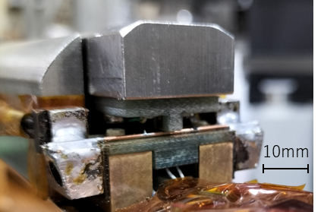
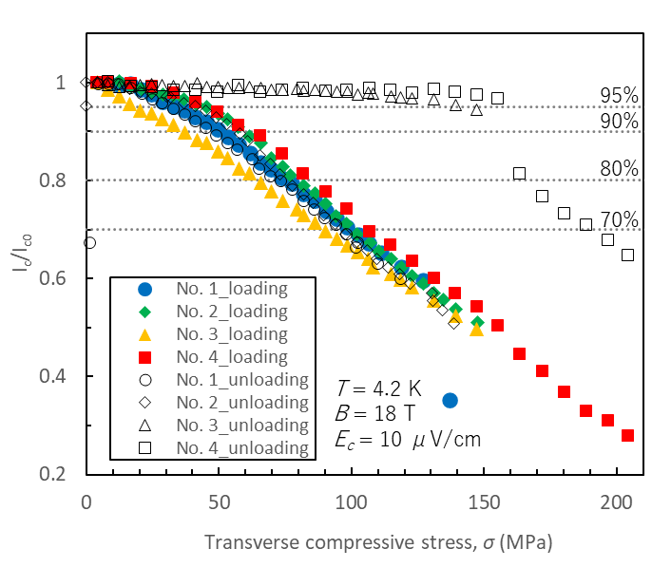
I_{c}-transverse compressive stress in JASTEC DT wire
Compressive
stress
Tolerance of transverse compressive stress was evaluated
for JASTEC DT wires with J_{c} of 1100 A/mm² at 16 T, 4.2 K .
• Lever-cam type probe in Tohoku University
• A transverse load was applied with a 3 mm-wide G10 anvil.
• Reversibility of I_{c} change was checked by loading/unloading.
• I_{c} was evaluated on the 10 μV/cm criterion at 18 T and 4.2 K.
Nb₃Sn wire
Discontinuous degradation
36±11
After unloading
• Good reproducibility among 4 samples
• Change of I_{c} after unloading
– At low stress, the I_{c} recovers to the initial
value.
– At medium stress, the I_{c} after unloading
gradually decreases with ΔI_{c}/I_{c0} < 6%.
– At high stress, discontinuous degradation
of I_{c} occurs.
52±10
73±9
99±6
With loading

Slide 23
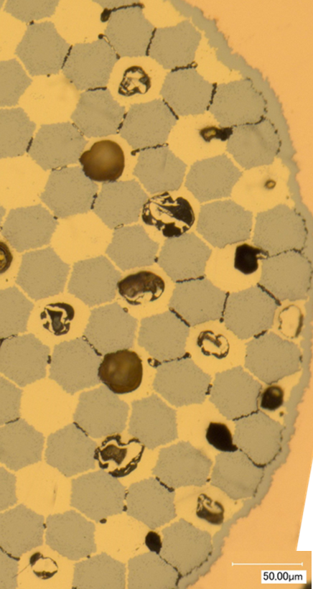
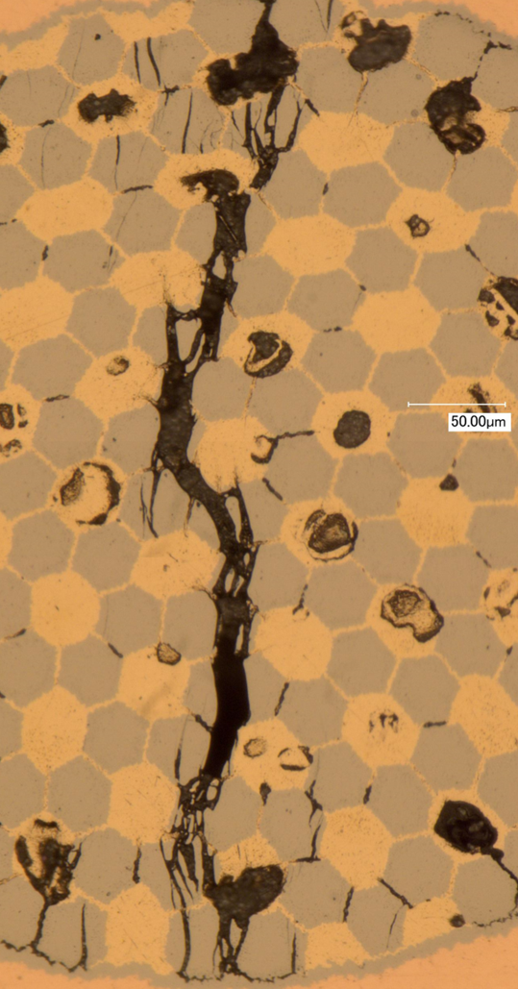
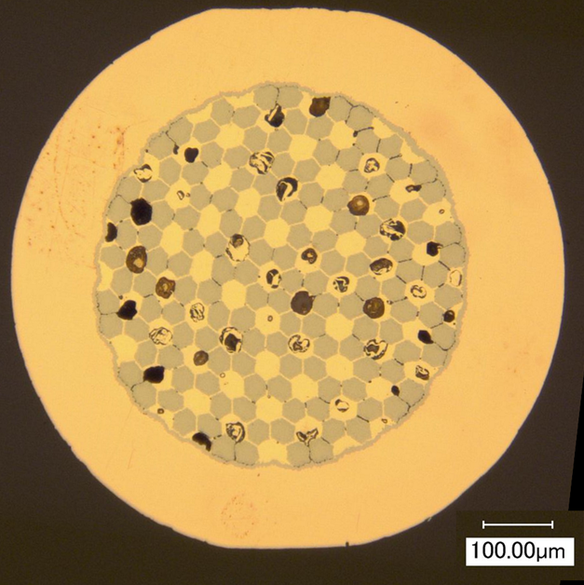
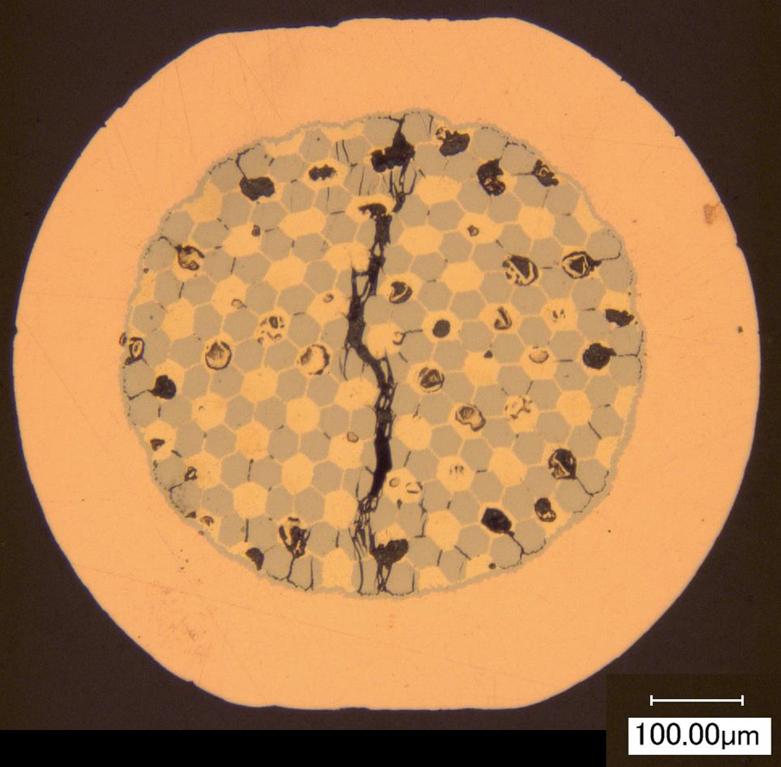
Fracture behavior by transverse compressive stress
in JASTEC DT wire
Compression
Compression
Cracks through modules
Widened inter-module gaps
(plastic deformation
of metal component)
Widened inter-module gaps
Sample No.3 in Mode II
Sample No.1 in Mode III
Mode I: Reversible I_{c} change caused
by elastic deformation of Nb₃Sn and metal
components
Mode II: Gradual I_{c} degradation caused by
plastic deformation of metal component
without cracking of Nb₃Sn modules
Mode III: Discontinuous I_{c} degradation
caused by fracture of Nb₃Sn modules

Slide 24
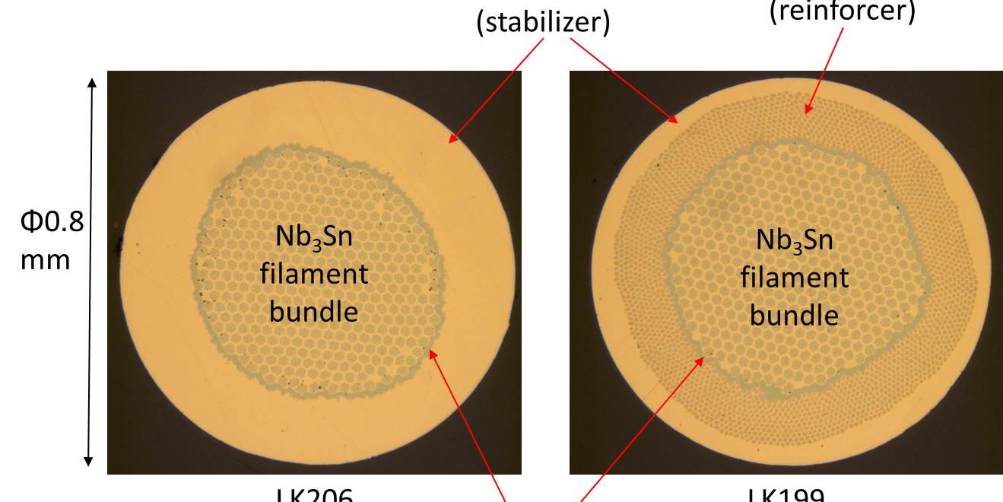
Cu-Nb reinforced Nb₃Sn wires
Stabilizing Cu
Cu-Nb reinforcement
φ0.8
mm
LK206
without reinforcement
Nb barrier
LK199
with reinforcement
• High strength bronze-routed wires were originally developed for high field solenoid
magnets by Tohoku University and Furukawa Electric
• Stabilizing Cu is partially replaced by Nb-fiber-reinforced Cu (Cu-Nb).
• High axial stress tolerance has been validated, while the reinforcement effect against
transverse compressive stress has not been fully understood.
• Neutron diffraction measurements were conducted to compare the internal strain state
of Nb₃Sn filaments under transverse compression for the wires with or without Cu-Nb
reinforcement.

Slide 25
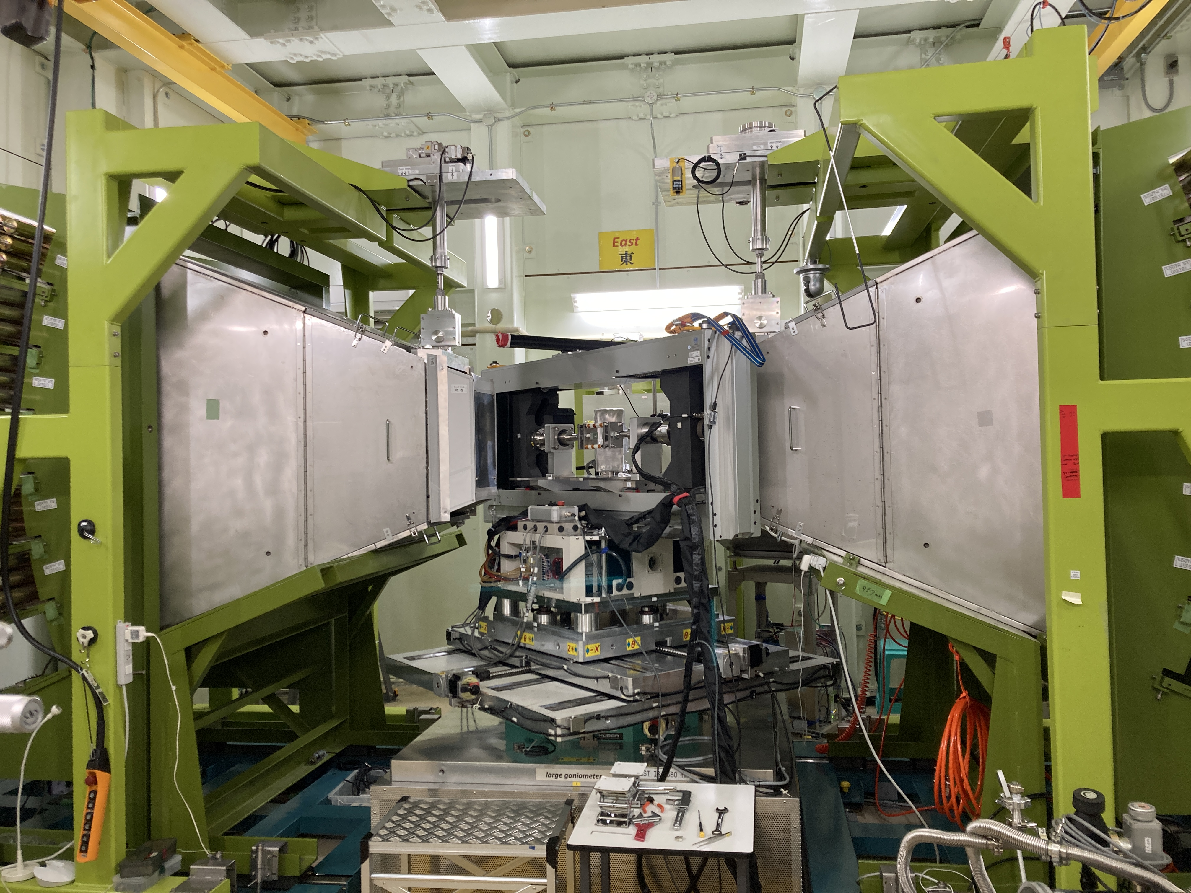
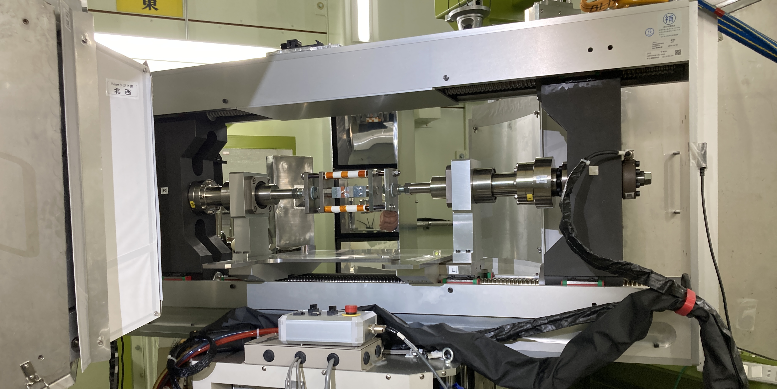
Neutron diffraction measurement under transverse stress
J-PARC/MLF BL19 (TAKUMI)
North detector
bank
South detector
bank
50 kN tensile loading frame
• Neutron diffraction measurement was conducted to evaluate the internal strain of
Nb₃Sn in a composite wire under transverse compression.
• J-PARC/MLF BL19 (TAKUMI, Engineering materials diffractometer)
– White neutron beams at 25 Hz
– 1 MW class-high-intensity neutron beams can shorten the measurement time to
obtain sufficient statistics.
– Time-of-flight (TOF) neutron diffractometer
– A loading machine with maximum load of 50 kN is installed on the goniometer.
– Diffraction patterns were taken at room temperature. Measurement at low temperature
is also possible by using a cryogenic loading frame.

Slide 26
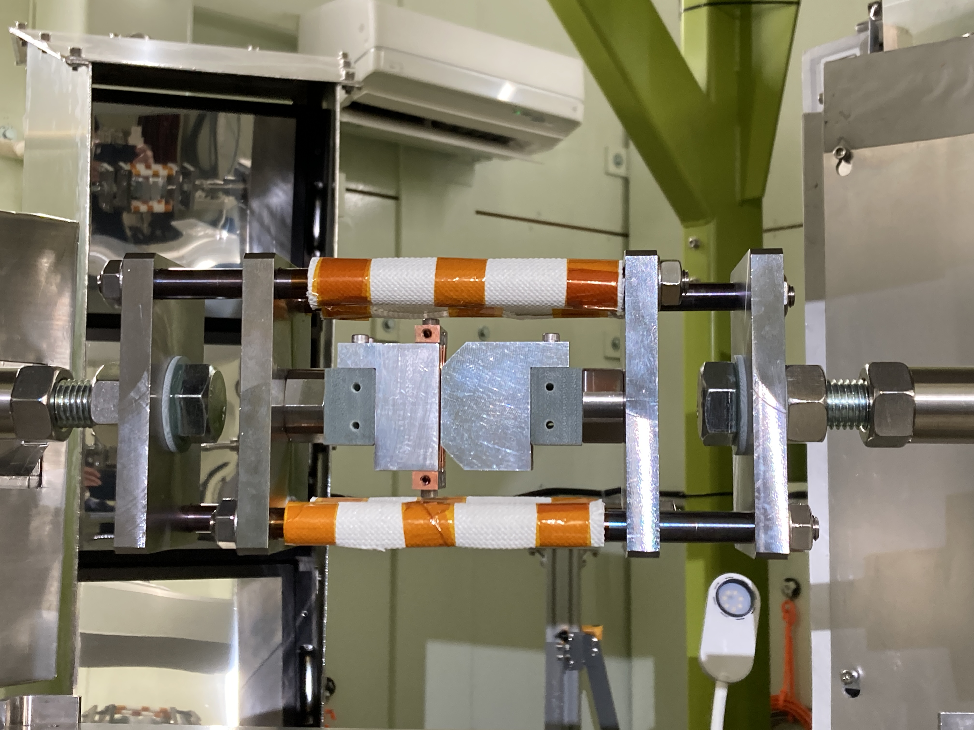
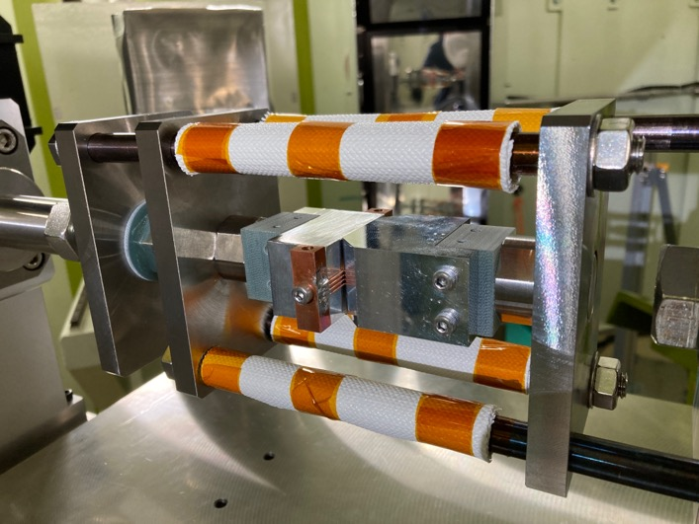
Geometry of diffraction measurement
East
Compression
Incident beam
Compressive
stress
Diffraction
beam
South
Radial Perpendicular
(RP)
North
Radial
Compressive
(RC)
Compression
Vertical configuration
East
Incident beam
Diffraction
beam
South
Axial
Compressive
stress
North
Radial
Compressive
(RC)
Compression
Horizontal configuration
• I_{c} of Nb₃Sn wires are influenced by 3-dimensional strain states.
• Combining two configurations, strain states along three orthogonal directions of Nb₃Sn
was evaluated.

Slide 27
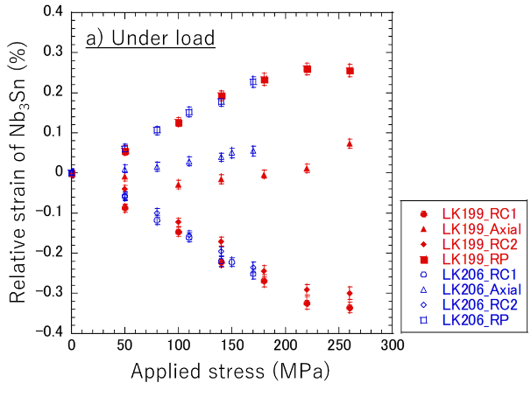
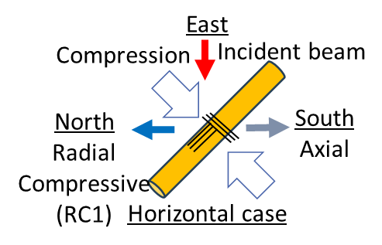
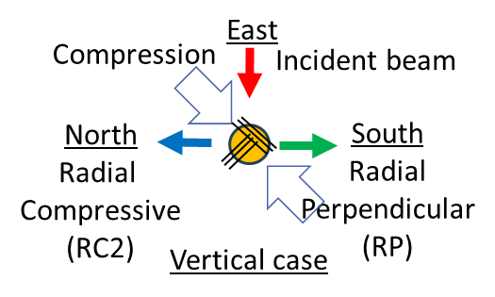
Internal strain of Nb₃Sn under transverse compression
Perpendicular to
compression axis
LK199
with Cu-Nb reinforcement
LK206 without reinforcement
Along wire length
Along
compression axis
• No significant difference was found between the wire with or without Cu-Nb
reinforcement.
• Stress analysis considering anisotropy of mechanical property of uni-directional
Nb-fiber-reinforced Cu is necessary.
• The usefulness of neutron diffraction measurement to study reinforcement mechanisms
against transverse compressive stress was verified.

Slide 28
R&D programs of High Field Magnet for Accelerator in Japan
On going (based on international collaborations)
  HTS: US-Japan collaboration framework
    KEK, Kyoto U., LBNL, BNL, UC Berkeley
  Nb3Sn: CERN-KEK collaboration
    KEK, Tohoku U., Tokai U., NIMS, JASTEC, Furukawa, CERN
Submitted Proposal
  R&D program of High Field Magnet for Accelerator
    To Science Council of Japan (Future Science Promotion 2023)

Slide 29
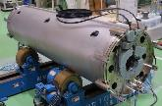
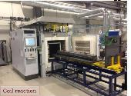
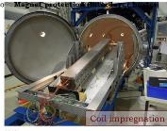
High Field Manget Development Plan
Magnet Manufacturing Technology
High Field Magnet Development
FCC D1 Design study
HL-LHC D1 Model
Advanced Conductor Development
Nb₃Sn R&D
超高精度超伝導電磁石技術
12T Manget
16-20T
4-8T
Insert Coil
High Field Magnet Design
20T High Field Magnet

Slide 30




Renovate KEK Cryogenics Science Center
Large Magnet Test stand
熱処理炉
Magnet Development
Small experiment
High Field Short sample Test stand
New Cryostat

Slide 31








High Field
Radiation Hard
SC Magnets
←COMET(5T, 10MGy)
LHC(8T, 10MGy)→
Basic R&D
HTS Radiation Hard Magnet R&D
High Field Conductor R&D
Proposal
Construct 12T magnet
With R&D insert coil aim for 16-20 T magnet
12T magnet
Magnet R&D assets
Output
Compact Muon Source
Industrial/Medical Accelerator
Science
Future Collider such as FCC
Upgrade of J-PARC
Industrial/Medical Applications
Muon Industrial application

Slide 32
Summary
On going (based on international collaborations)
  HTS: US-Japan collaboration framework
    High Field Radiation hard HTS magnet
  Nb3Sn: CERN-KEK collaboration
    High performance Nb3Sn conductor R&D (DT)
Submitted Proposal
  R&D program of High Field Magnet for Accelerator
    Continue Efforts to get real money

