Slide 2
WP3.7 - Nb3Sn ultimate performance common coil dipole demonstrator
J. García-Matos, C. Martins, F. Toral, CIEMAT
J. C. Pérez, CERN

Slide 3
Table of contents
High field magnet program at CIEMAT
ISAAC Common Coil:
  Magnetic design
  Mechanical design
Conclusions

Slide 4
High field magnet program at CIEMAT
Initial constraints for the research on high field magnets at CIEMAT:
  Some delay in starting the activity due to the workload driven by MCBXF magnets.
  The new laboratory will not be fully operational till Summer 2024: see Carla’s talk tomorrow.
Our strategy is based on the following steps:
  Model magnet using RMC coils in common coil configuration (ISAAC: Investigating Superconducting Assembly to Address Common coil mechanics).
  Research on fabrication techniques: detachable poles, react-and-wind coils.
  Prototype of a high field magnet in common coil configuration.

Slide 5
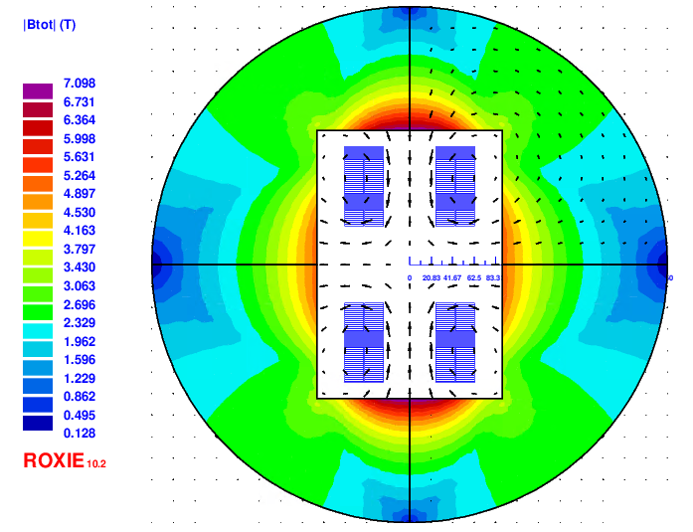
ISAAC magnetic design: goals & constraints
Main goal: learn for the 14 T model with existing coils, mostly on mechanics
  Provide 14 T in the aperture (100% load required)
  Decrease vertical Lorentz force F_{y}: low vertical preload (free horizontal movement, without friction)
  Mechanics & assembly as easy as possible
Initial base case

Slide 6
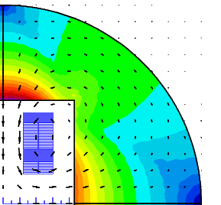
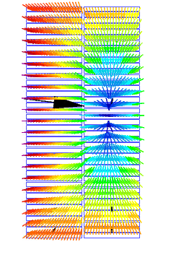
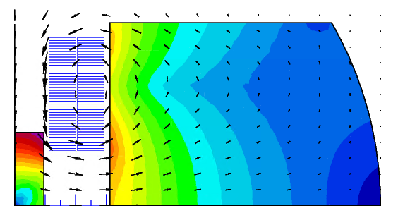
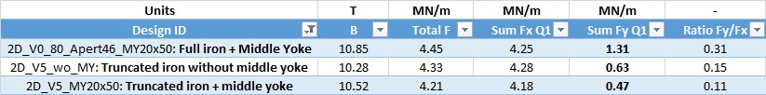
ISAAC magnetic design: decreasing F_{y}
Vertical Lorentz forces inside the coil need to be balanced: return conductors vs. iron
Yoke is used to pull the field lines in the desired direction
Yoke is truncated above the coil to provide good side support to coil
Middle yoke helps to decrease F_{y} significantly and enhances bore field
Truncated yoke

Slide 7
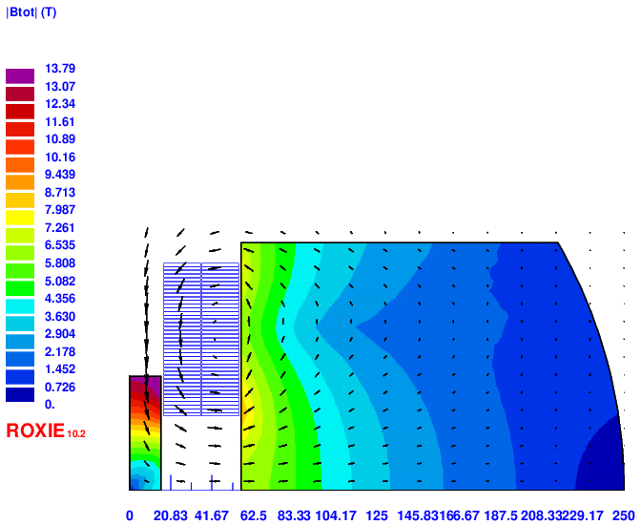
ISAAC magnetic design to provide 14T
Aperture decreased from 50 to 34 mm
Yoke very close to the coil (only 1.2 mm distance)
Intra-beam distance tuned to decrease a2
Middle yoke has a strong influence despite its assembly could be not straightforward
Protection is possible using a dump resistor according to first simulations: R_{dump} = 45 mΩ yields a hotspot temperature of 286K and 900V voltage (adiabatic simulation)
Design ID | Block | Final RMC_CC | CC | CC* | Units
Aperture | 74 | 34 | 74 | 74 | mm
Intra-beam dist. | - | 150 | 152 | 252 | mm
I_nom | 14486 | 19083 | 21353 | 20460 | A
Yoke outer radius | 246 | 250 | 246 | 246 | mm
B | 14 | 14 | 11.3 | 11.96 | T
Peak field | 16.16 | 14.8 | 14.27 | 14.51 | T
Peak Field/B | 1.154 | 1.0571 | 1.263 | 1.213 | -
Load | 99.99 | 99.99 | 100.2 | 100.36 | %
Stored energy | 1752 | 1038 | 1701 | 1733 | kJ/m
Static Self Induct. | 16.7 | 5.7 | 7.46 | 8.28 | mH/m
L*I | 242 | 109 | 159 | 169 | HA/m
Stray field (20 mm) | 1.188 | 0.44 | 0.65 | 1.56 | T
Sum Fx Q1 | 5.1 | 6.636 | 5.79 | 6.53 | MN/m
Sum Fy Q1 | -4.3 | 0.474 | 3.02 | 0.73 | MN/m
Final RMC_CC

Slide 8
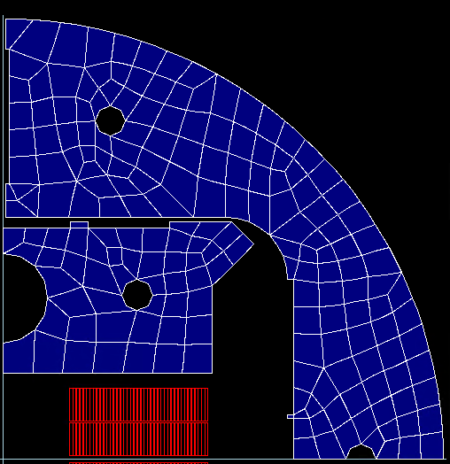
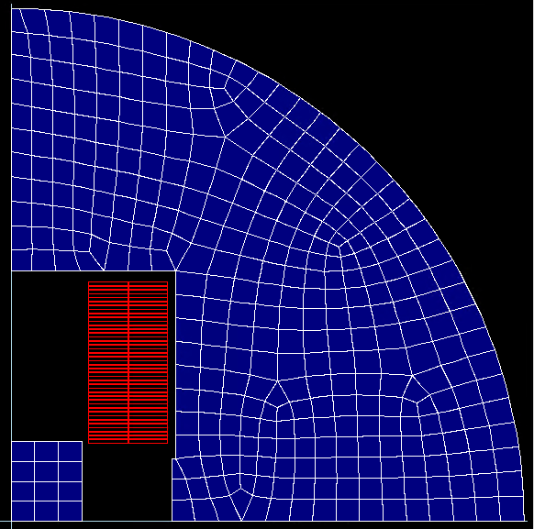
Block vs. common coil
Same aperture, 100% load line, same yoke outer radius
Same energy but half inductance in CC: easier to protect.
Slightly larger horizontal forces but large repulsive vertical forces.
More current required in CC: less field but two apertures.
Block
Common coil

Slide 9
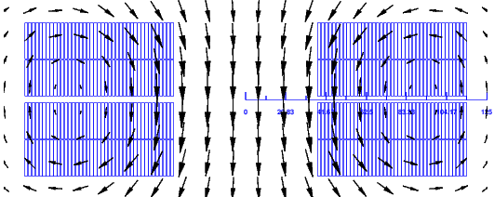
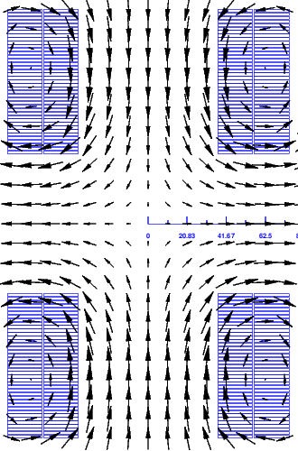
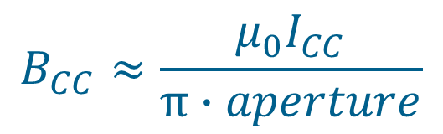

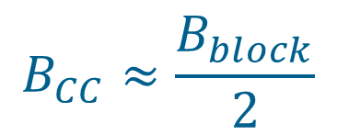

Block vs. common coil
Using the same coils and aperture, common coil field is about half the block coil field
φ
φ/2
For
$$I_{CC}=I_{block}$$
φ/2
φ/2
$$B_{CC}≈\frac{B_{block}}{2}$$
$$B_{CC}≈\frac{μ_{0}I_{CC}}{π∙aperture}$$
$$B_{block}≈\frac{{2μ}_{0}I_{block}}{π∙aperture}$$
φ/2

Slide 10
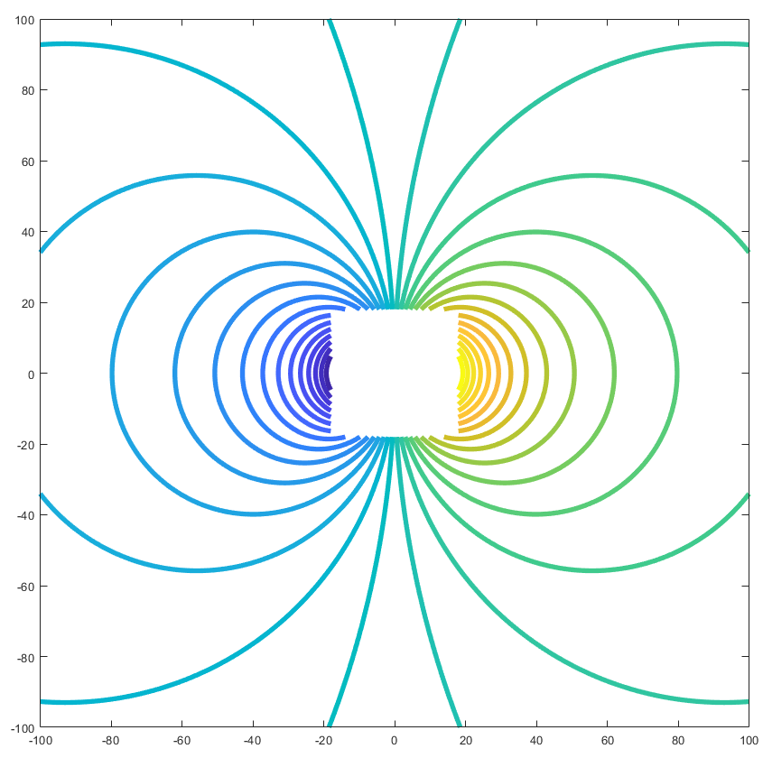
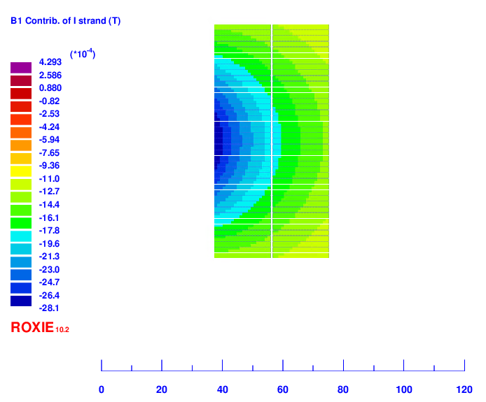
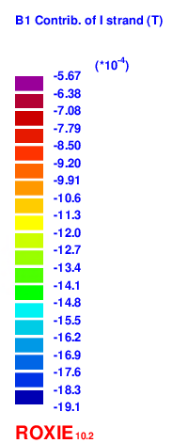
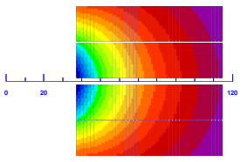

Block vs. common coil
Isolines for the dipole field contribution of a current line depending on its location
In this particular case, the far cables of the block configuration are not efficient

Slide 11
Magnetic design: field quality vs coil position
ISAAC magnet aperture: 34 mm
A horizontal displacement of 0.5 mm:
  decreases field about 1%
  multipoles variation below 0.5 units unless a2 (1.5 units)
mm | T | units | units | units | units | units | units | units | units | %
Displ. X | Aperture field | b3 | b5 | b7 | b9 | a2 | a4 | a6 | a8 | % B
0 | 13.99 | 297.1 | 0.7 | 2.2 | -0.5 | 3.0 | -25.7 | -1.5 | 1.4 | 0
0.5 | 13.86 | 297.0 | 1.1 | 2.2 | -0.5 | 1.5 | -25.9 | -1.6 | 1.5 | -0.97
1 | 13.73 | 296.8 | 1.4 | 2.2 | -0.5 | -0.0 | -26.2 | -1.6 | 1.5 | -1.92
1.5 | 13.60 | 296.5 | 1.8 | 2.2 | -0.5 | -1.5 | -26.5 | -1.6 | 1.5 | -2.87

Slide 12
Table of contents
High field magnet program at CIEMAT
ISAAC Common Coil:
  Magnetic design
  Mechanical design
Conclusions

Slide 13
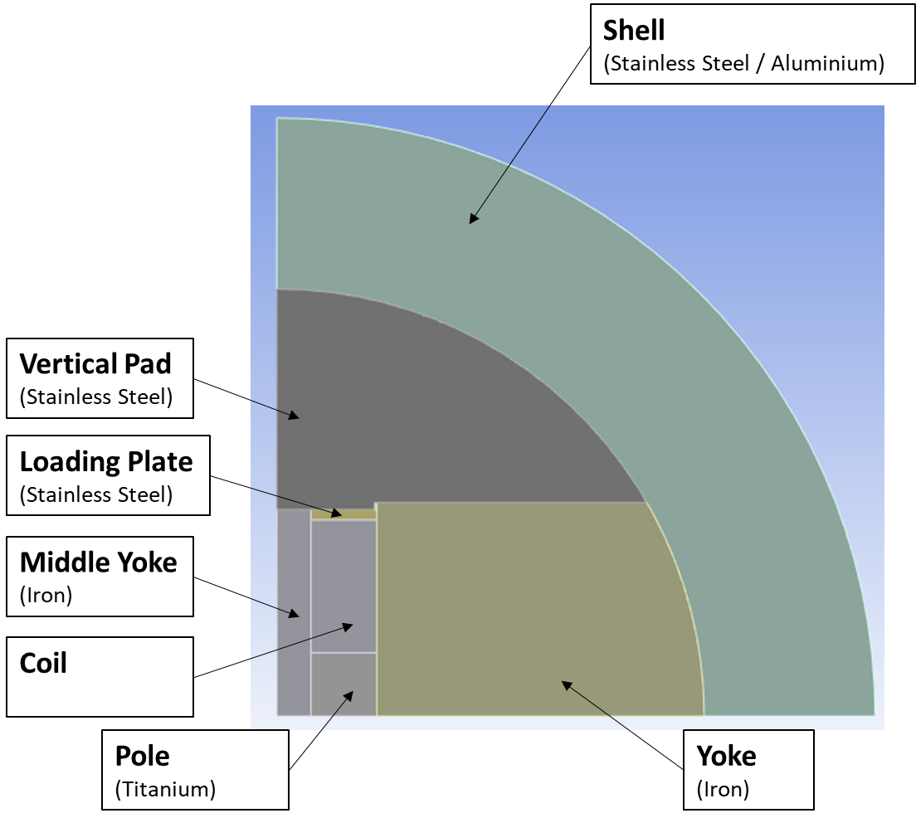
Mechanical design: layout
Main features:
Parts in contact (without prestress) at room temperature
Stainless steel vertical pad
Cooling (from 295.15K to 1.9K)
Electromagnetic Forces

Slide 14
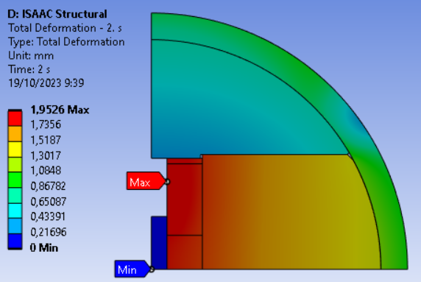
Mechanical design: goals
Aluminium Shell similar to SMC CERN block configuration
  Outer yoke radius: 250 mm
  Shell thickness: 29 mm
Goal: Coil displacement below 1mm (after cooling)
in order to:
Reduce the possibility of sudden coil movements
Aperture field over 13.7T
First simulation shows a horizontal displacement of coil close to 2 mm!!

Slide 15
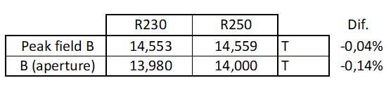
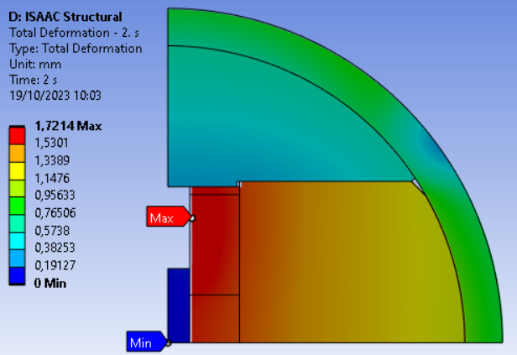
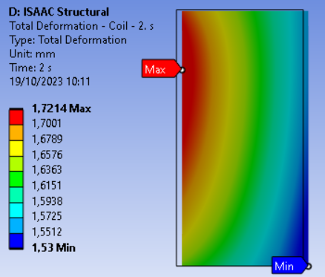
Mechanical design: first iterations
Final RMC_CC
Aluminium shell inner radius from 250mm to 230mm:
  Very similar magnetic field (14T => 13.98T)
  Coil displacement reduced (1,95mm => 1,72mm)
Increasing the thickness or using a stainless steel shell complicate considerably the magnet fabrication without a significant reduction of coil movement

Slide 16
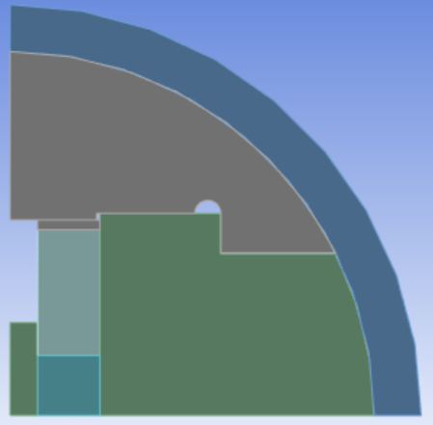
Mechanical design: stiff support structure
Let’s explore the use of yoke as support structure
Upper part is made in stainless steel: it may help to contain the large Lorentz horizontal force
Aluminium shell also contributes to hold the forces
The coil would lose contact with this part during cooling down: it could move horizontally without friction
Assembly with bladder and keys is not modeled yet
Slight preload just to keep contact between parts

Slide 17
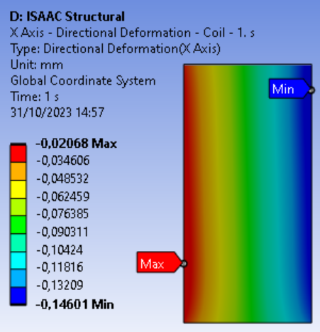
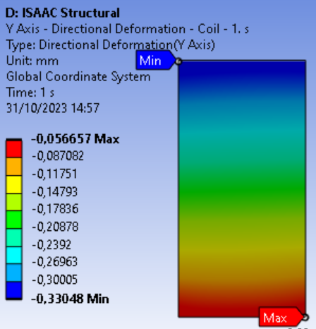
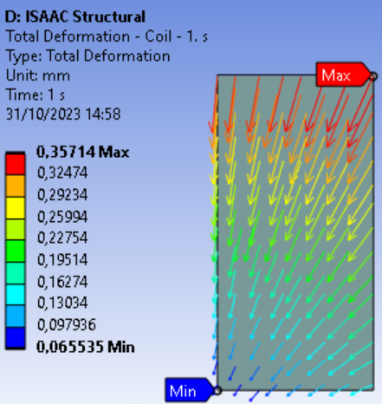
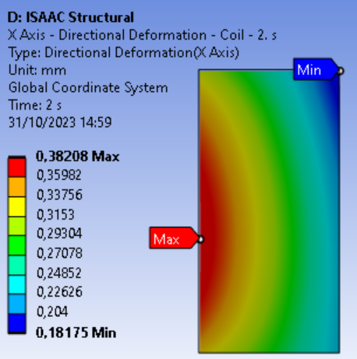
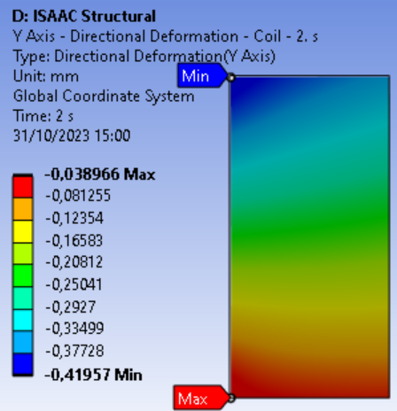
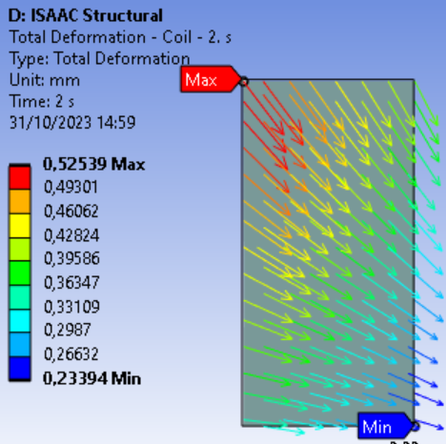
Mechanical design: coil displacement
Horizontal coil displacement below 0.5 mm
COOLING
X displacement
Y displacement
Total displacement
COOLING + EM

Slide 18
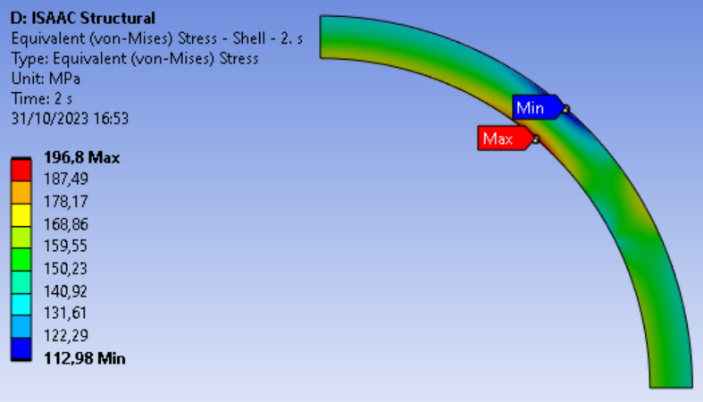
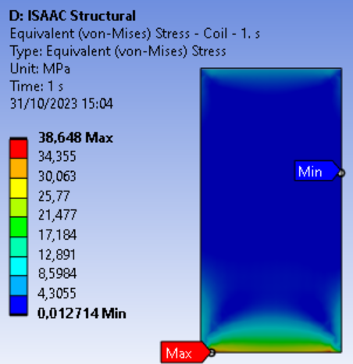
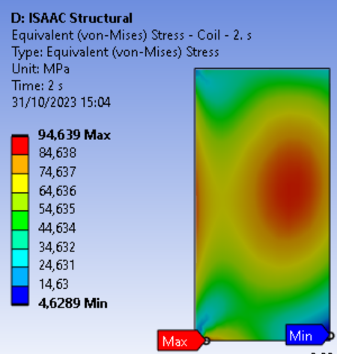
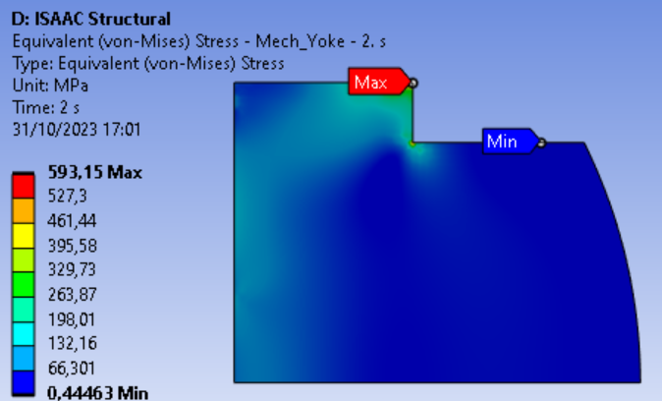
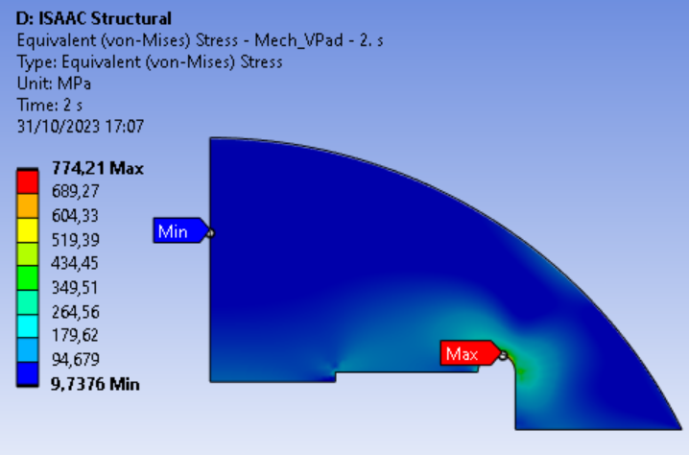
Mechanical design: stress distribution
Coil stress below 95 MPa!!
No significant problems for the structural parts.
Detailed design is ongoing.
COOLING
COOLING + EM

Slide 19
Conclusions
The first stage of CIEMAT HFM program is the study of common coil mechanics using existing RMC coils
The strategy is to let the coils moving horizontally, due to the low impact on field quality: low coil stresses at any load condition
A promising design based on the use of yoke as support structure is being analysed in detail
Next step is the engineering design: drawings and fabrication of parts
In parallel, the electromagnetic design of a 14 T demonstrator magnet with 50 mm aperture will be done, based on existing strands

