Slide 1
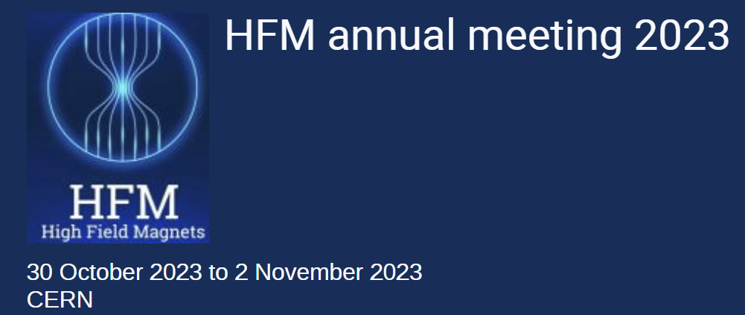
WP4.5 - Quench detection, protection and diagnostic methods for Nb₃Sn and HTS high-field magnets - CERN
Mariusz Wozniak
1st November 2023

Slide 2
Quench Protection – Goals and increasing complexity
Quench protection: managing the release of the stored magnetic energy in a way that prevents/mitigates any potential damage to the magnet, its circuitry, and surrounding components.
With increasing magnetic field, quench protection becomes more important and more complex:
Nb-Ti -> voltages and temperature (in most cases)
Nb₃Sn -> voltages, temperatures, and conductor level stresses
HTS -> voltages, temperatures, conductor level stress and often superconductor level stress and for NI coils, a potential for a force density redistribution
Quench protection should be an integral part of the design of a superconducting magnet, affecting the design of the conductor (e.g. Cu/SC ratio, insulation) and coil, the choice of operating current, etc.
Proper quench protection analysis of high-field magnets requires advanced computer tools, and is a multidisciplinary team effort!

Slide 3
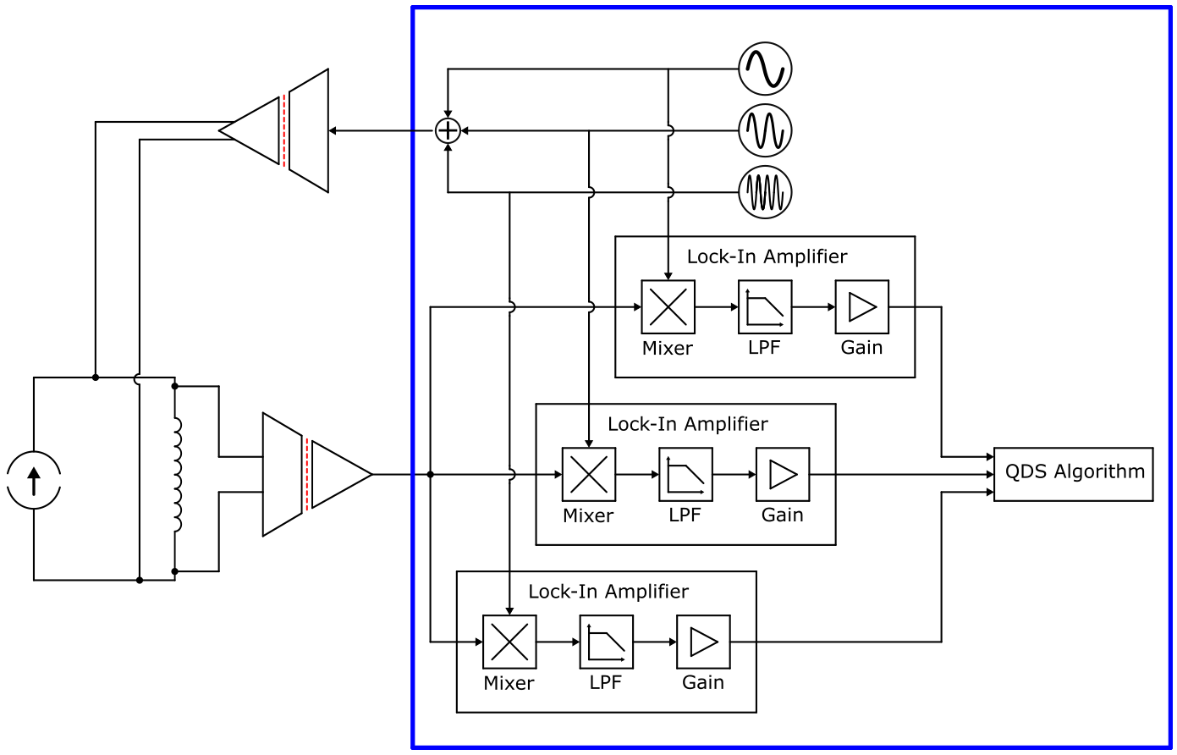
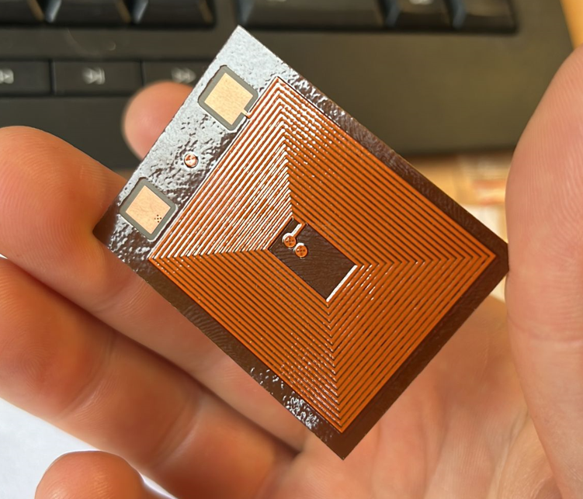
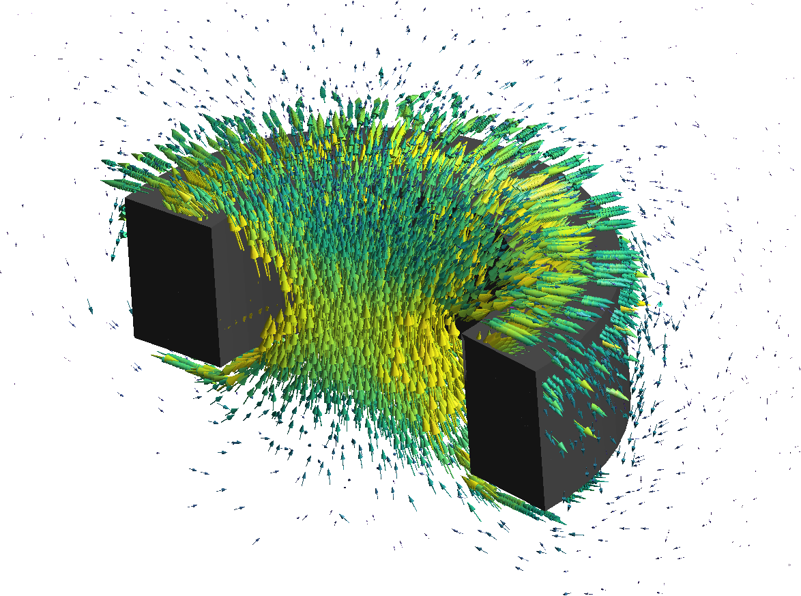

Outline
Detection Technology
Quench Detection Through Electrical Stimuli
E-CLIQ (External CLIQ) Development Progress
S-CLIQ (Secondary CLIQ) Simulations
ESC (Energy Shift with Coupling) Concept
CD (Capacitive Discharge) Protection for HTS
EE (Energy Extraction) with energy recuperation
Protection Technology
12T VE Quench Simulation study
New tool for 2D FE quench simulations
AC loss LTS – 3D
AC loss LTS – 2D reduced order
3D FE Simulations of HTS pancakes
3D FE Simulations - High Performance Computing
2D FD Simulations of HTS pancakes stacks
3D CCT Quench Co-simulations
Material properties in Simulations
Transient Simulations

Slide 4
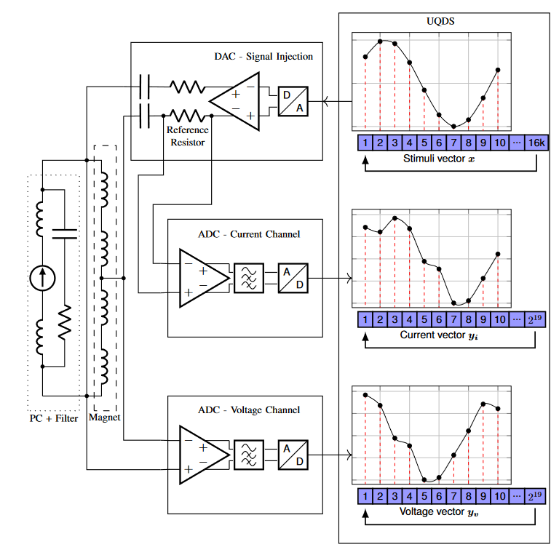
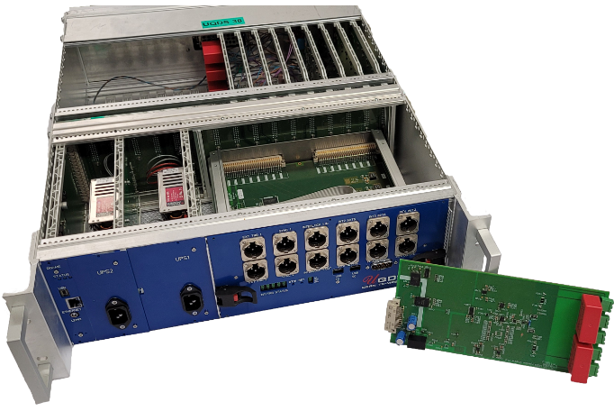
Quench Detection Through Electrical Stimuli
Concept:
QD and electrical quality assurance based on magnet’s response to electrical stimuli signal.
Current Status:
Successfully measured impedance of powered superconducting magnet circuit.
Measured 5 Quenching magnet (SMC).
Upcoming Tasks
Analyze quench data and look for Quench precursors/indicators.
Upgrade measurement hardware for better low noise performance.
Perform more quench measurements – possibly on different magnets.
WP4.5-T1-D5
Courtesy of Magnus Christensen

Slide 5
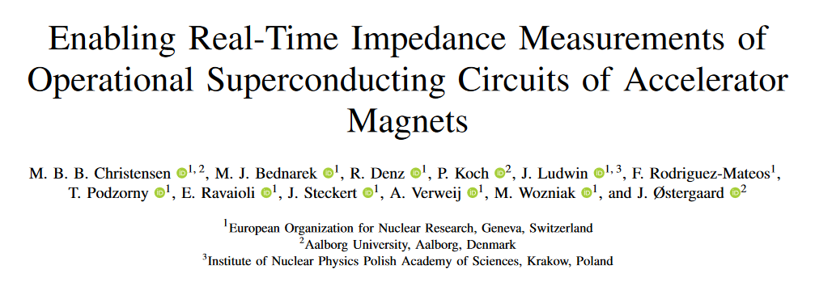
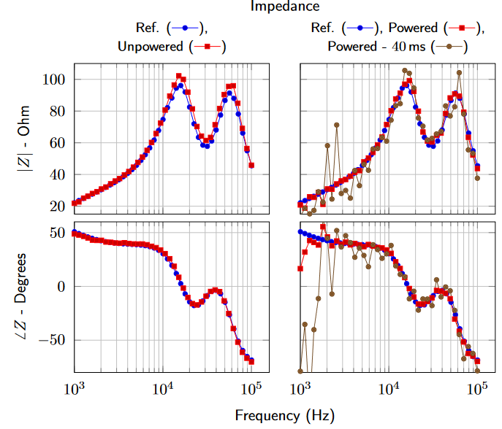
Quench Detection Through
Electrical Stimuli
Key Results:
We tested the system on a D2 prototype magnet
The magnet was measured when unpowered and powered (50 A)
Impedance estimate based on 1.28 S (2¹⁹ samples) of data acquisition.
Results show good correspondence between the powered, unpowered, and reference measurements.
Impedance estimates based on shorter measurement windows need additional work
Publication in proceedings of MT28 under review
WP4.5-T1-D5
Courtesy of Magnus Christensen

Slide 6
Outline
Detection Technology
Quench Detection Through Electrical Stimuli
E-CLIQ (External CLIQ) Development Progress
S-CLIQ (Secondary CLIQ) Simulations
ESC (Energy Shift with Coupling) Concept
CD (Capacitive Discharge) Protection for HTS
EE (Energy Extraction) with energy recuperation
Protection Technology
12T VE Quench Simulation study
New tool for 2D FE quench simulations
AC loss LTS – 3D
AC loss LTS – 2D reduced order
3D FE Simulations of HTS pancakes
3D FE Simulations - High Performance Computing
2D FD Simulations of HTS pancakes stacks
3D CCT Quench Co-simulations
Material properties in Simulations
Transient Simulations

Slide 7
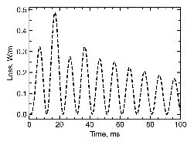
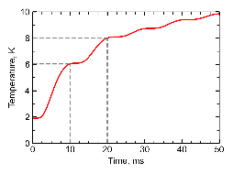
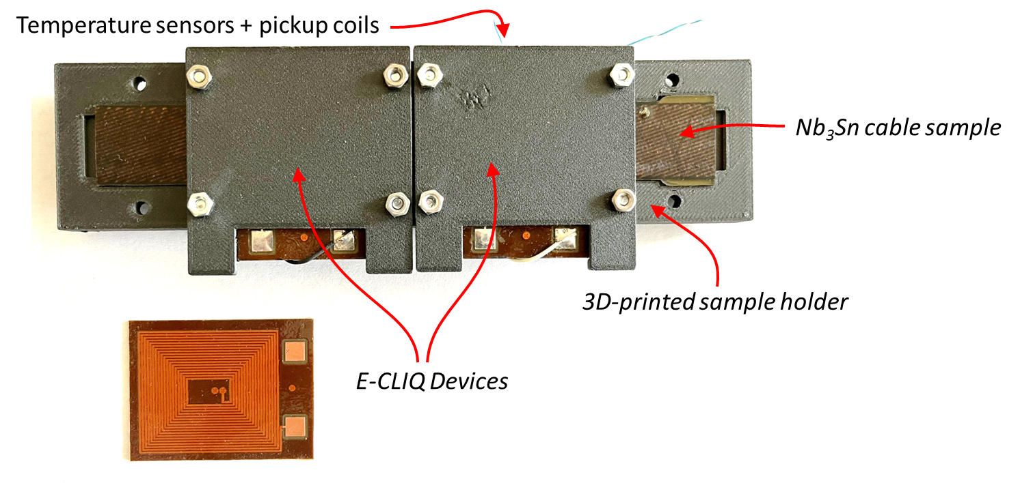
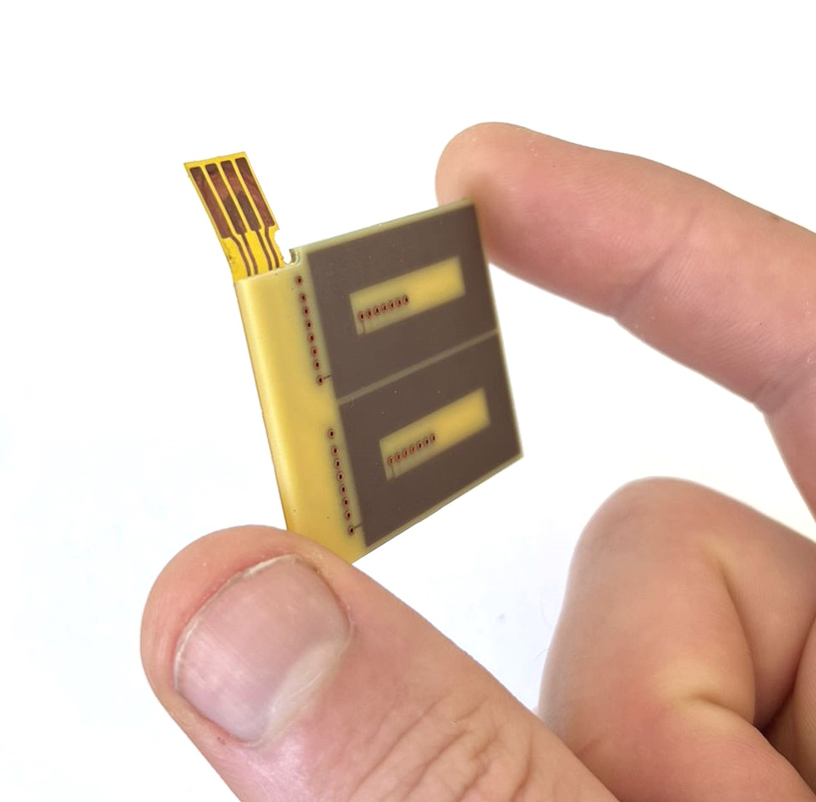
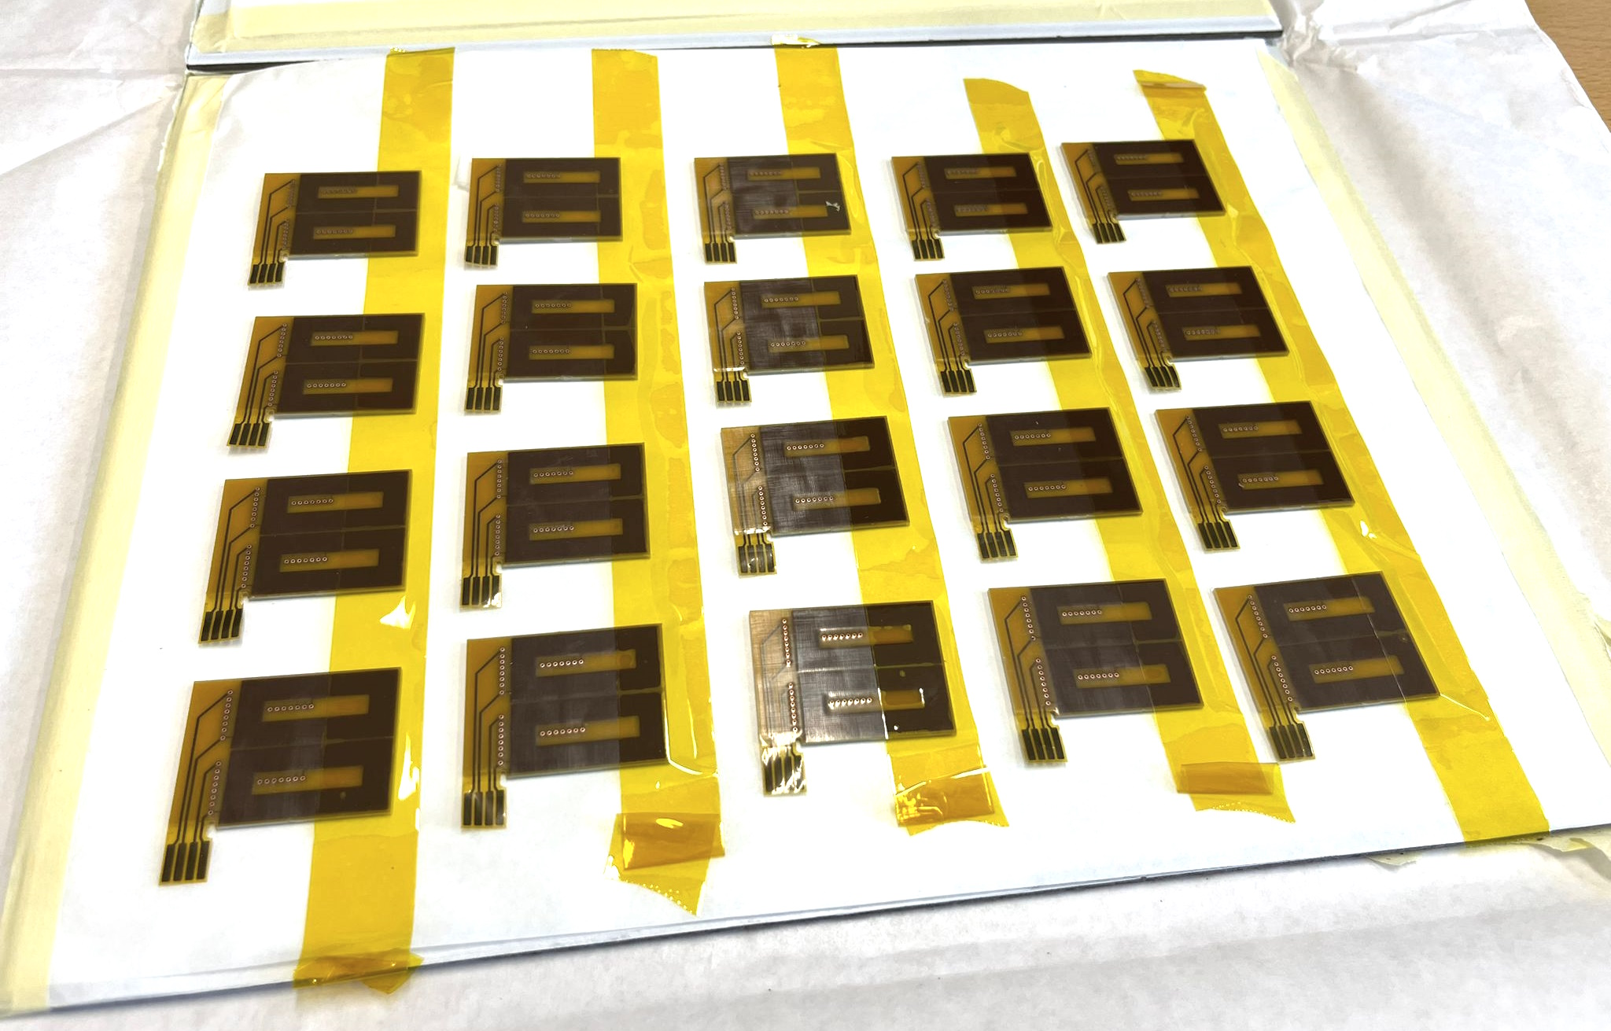
External CLIQ (E-CLIQ)
New developments:
Further matured modeling tools to design and predict the behavior of the E-CLIQ coils and the expected loss in the conductor.
E-CLIQ demonstration test on a Nb₃Sn cable sample preparation.
Test will be performed in GHe in cryolab.
New E-CLIQ coils designed and produced for test in combination with a SMC. Integration discussions in progress.
Expected temperature increase using the calculated loss.
New E-CLIQ coils
Setup for test in cryolab.
WP4.5-T4-D2
WP4.5-T5-D5
Courtesy of Tim Mulder

Slide 8

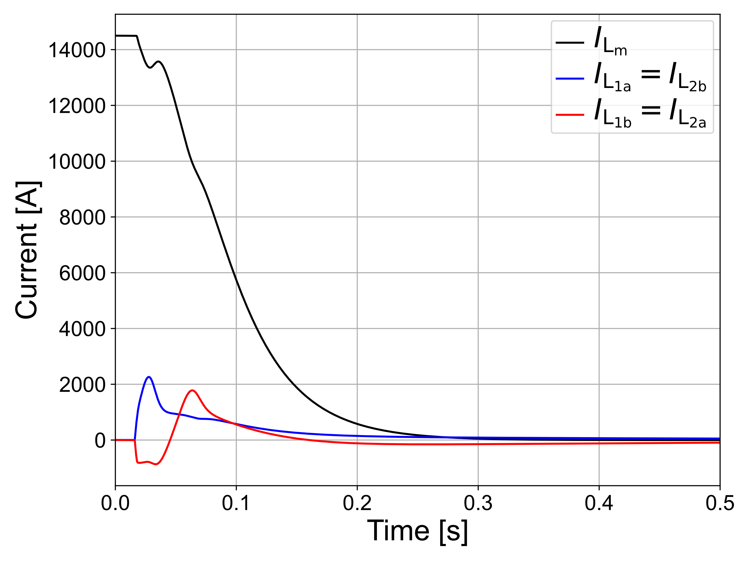
Secondary CLIQ (S-CLIQ)
As fast as CLIQ or faster
Extracts part of the magnet energy
Electrically insulated from coil
Easier redundancy
[1] M. Mentink and E. Ravaioli, SuST, 2020
auxiliary coil 1
magnet
coils
auxiliary coil 2
WP4.5-T4-D3
Courtesy of Emmanuele Ravaioli

Slide 9
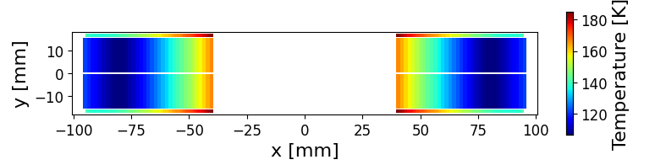
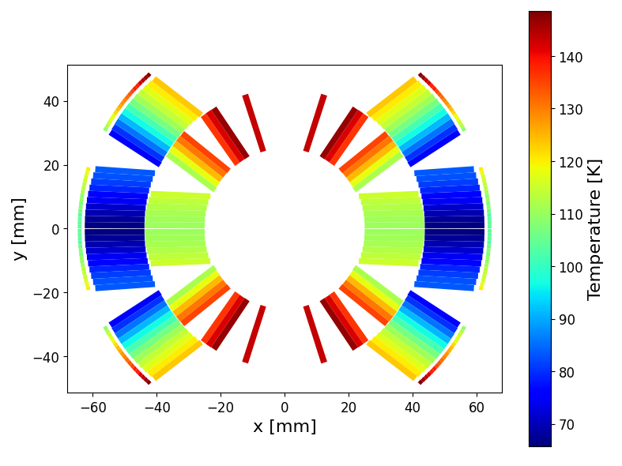
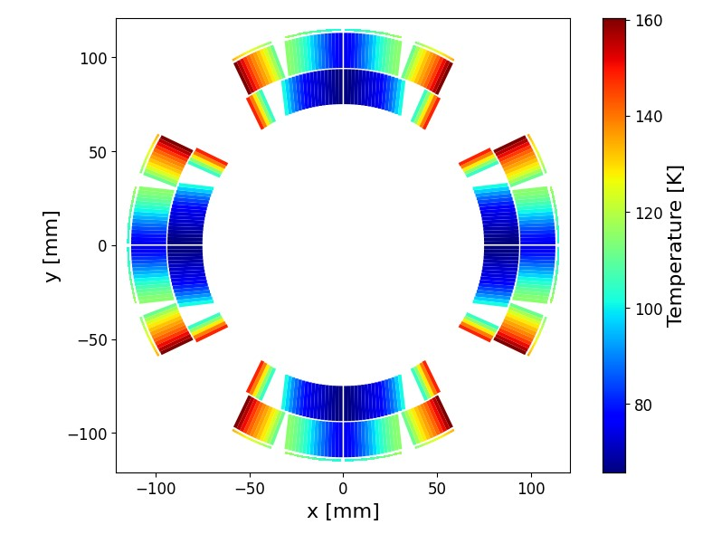

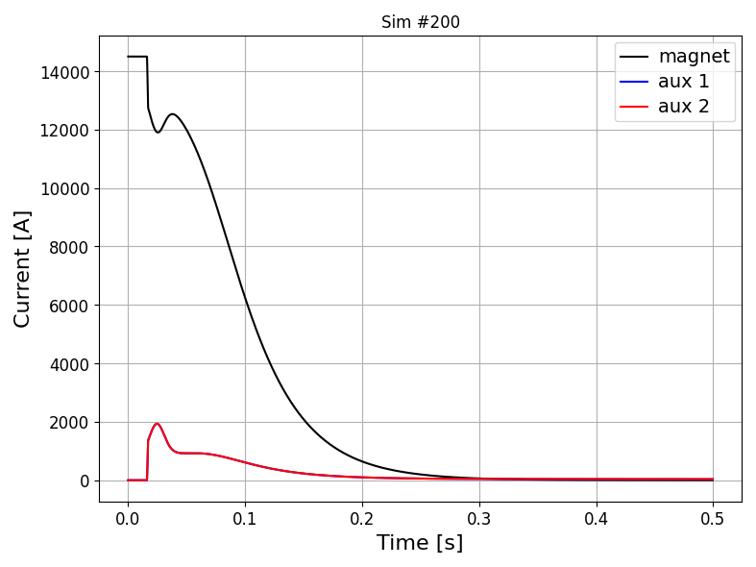
ESC (Energy Shift with Coupling)
As fast as CLIQ or faster
Extracts part of the magnet energy
Sudden current drop → lower ohmic loss
Electrically insulated from coil
Easier redundancy
https://indico.cern.ch/event/1321217/
auxiliary coil 1
magnet
coils
auxiliary coil 2
WP4.5-T4-D9
Courtesy of Emmanuele Ravaioli

Slide 10
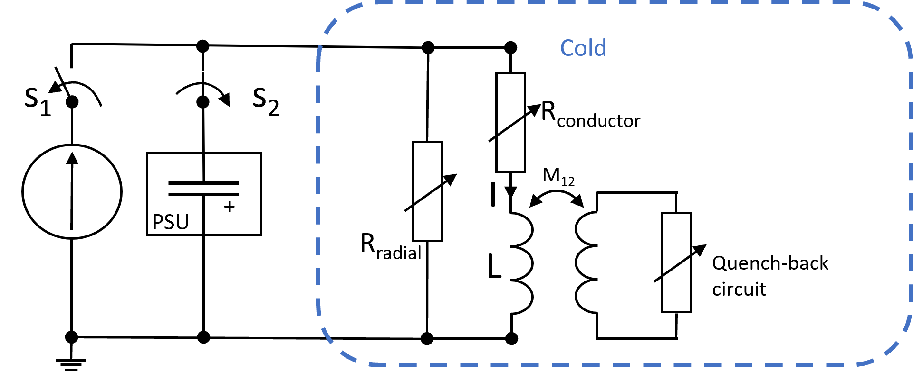
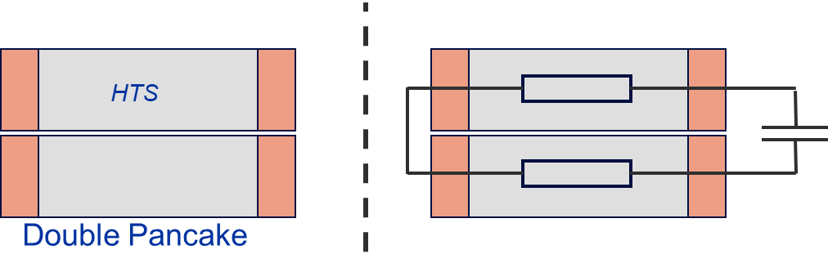
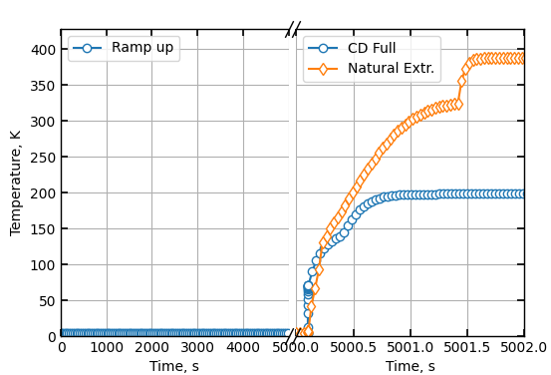
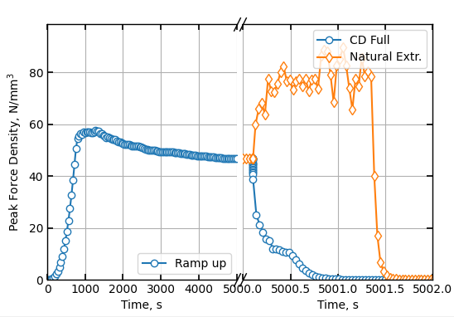
Capacitor Discharge Quench Protection
for Stacks of HTS NI Pancake Coils
Quench Protection Concept:
Upon quench detection, a charged capacitor bank is discharged into the NI coils.
High current pulse generates heat in the turn-to-turn resistive connections.
Fast, potentially very effective, no additional internal components required.
Reduction in hot-spot temperature
Reduction in peak radial force density
Quench
WP4.5-T5-D6
Courtesy of Tim Mulder

Slide 11
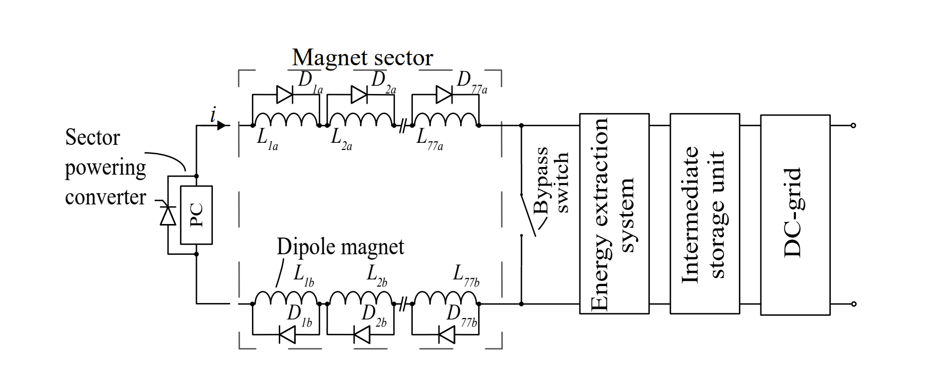
Energy extraction (EE) with energy recuperation
A new idea from the recent years proposed an implementation of energy recuperation function in energy extraction (EE) systems
Principle
  1st step: In case of quench or trip, the magnetic stored energy from SC circuit is saved in the storage unit (battery/capacitor) instead of being dumped as thermal losses in a resistor
  2nd step: The energy from the storage unit is injected in the network grid or used as a DC source
A study on the following aspects is foreseen in the coming years:
  Profitability of such functionality
  Intermediate storage and technology selection
  Reliability and circuit protection
  Design and mock-up manufacturing
In the light of future and bigger accelerators construction involving huge amount of stored energy, such recuperation function becomes a must.
WP4.5-T4-D8
Courtesy of Bozhidar Panev

Slide 12
Outline
Detection Technology
Quench Detection Through Electrical Stimuli
E-CLIQ (External CLIQ) Development Progress
S-CLIQ (Secondary CLIQ) Simulations
ESC (Energy Shift with Coupling) Concept
CD (Capacitive Discharge) Protection for HTS
EE (Energy Extraction) with energy recuperation
Protection Technology
12T VE Quench Simulation study
New tool for 2D FE quench simulations
AC loss LTS – 3D
AC loss LTS – 2D reduced order
3D FE Simulations of HTS pancakes
3D FE Simulations - High Performance Computing
2D FD Simulations of HTS pancakes stacks
3D CCT Quench Co-simulations
Material properties in Simulations
Transient Simulations

Slide 13
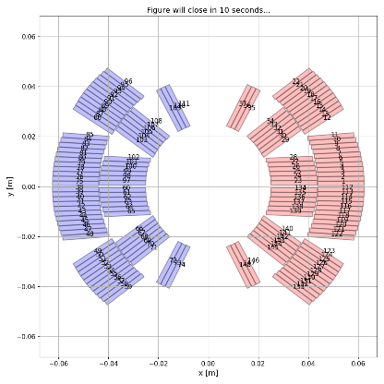

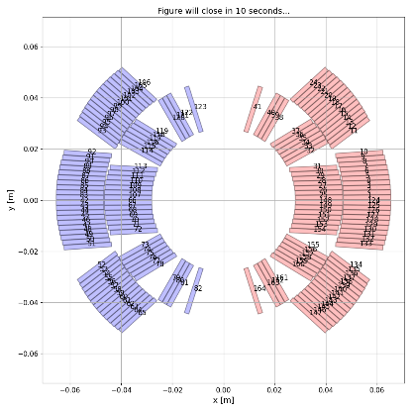
12T VE Quench Protection studies – initial review
We have parametric quench protection software. Looking at many options is relatively low effort for us.
Thanks for great collaboration to the 12 T VE magnet team.
50 mm, 5 blocks
50 mm, 6 blocks
56 mm, 6 blocks
Magnet designs
Courtesy of
L. Fiscarelli
WP4.5-T5-D1
WP4.5-T5-D10

Slide 14
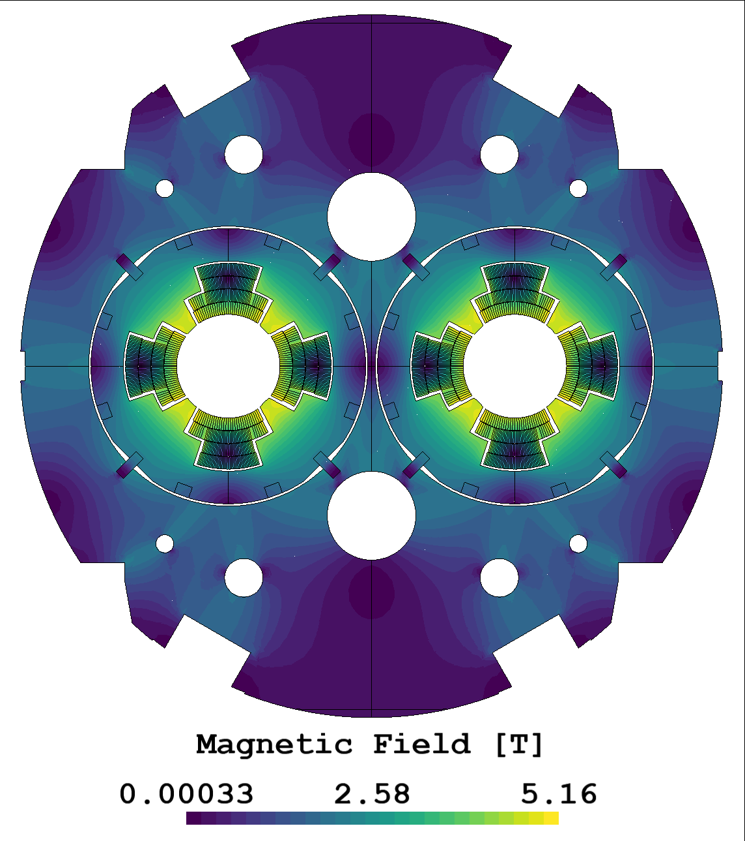

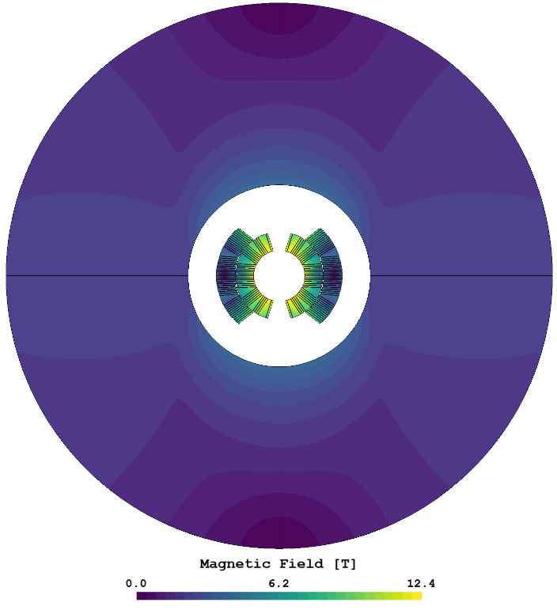
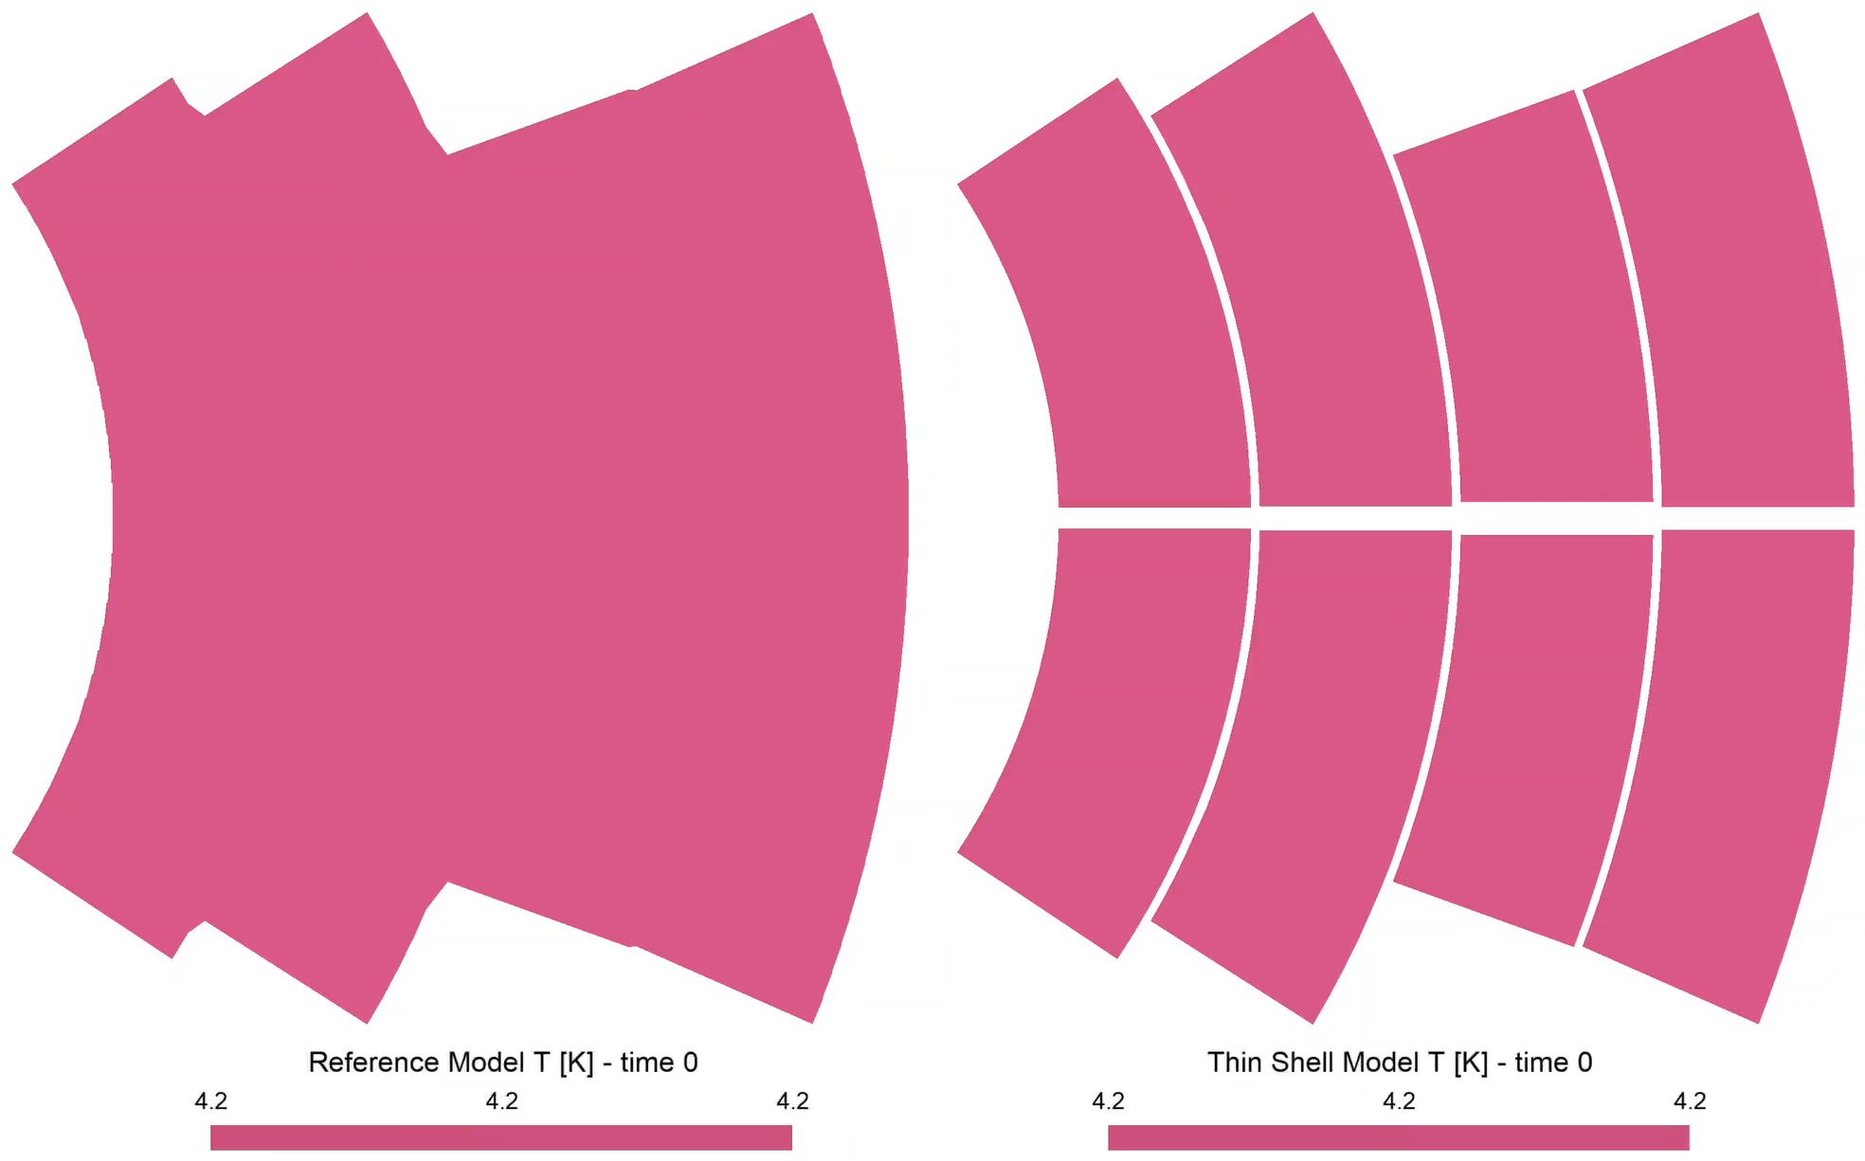
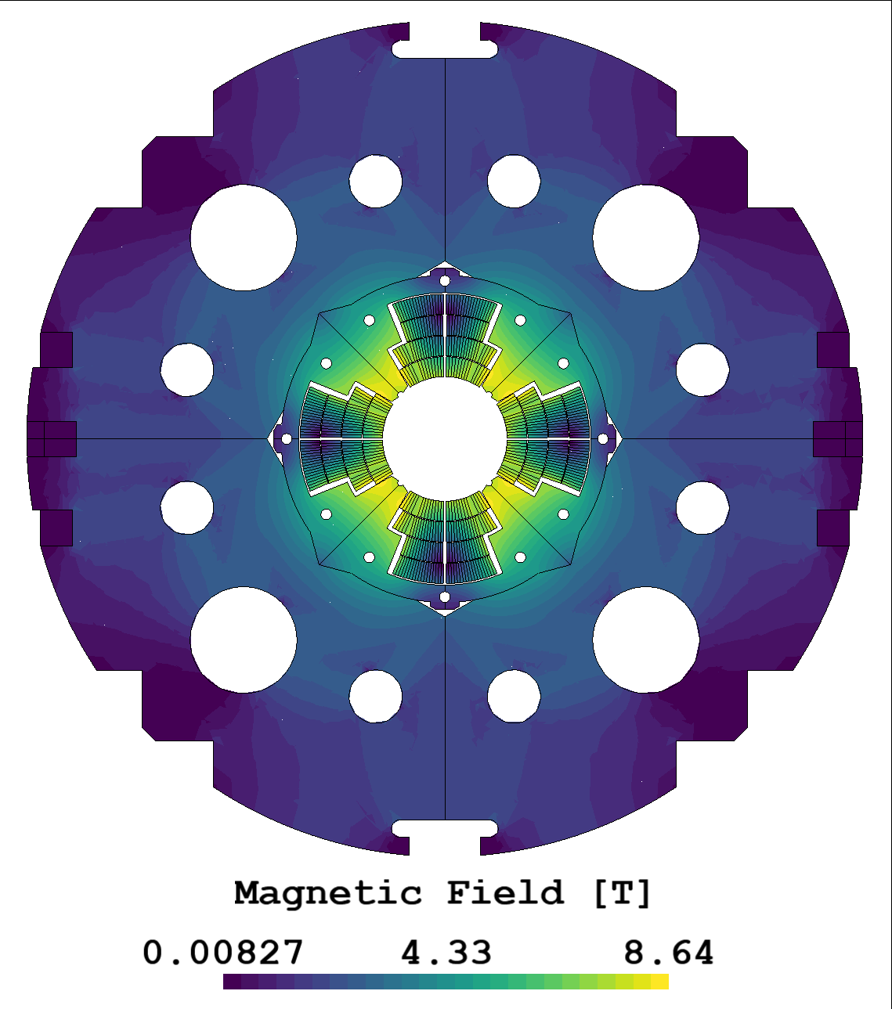
FiQuS Multipole magnets magnetic and thermal simulations
Robust 12 T VE
(MQXF cable with 6 blocks)
MQY
Magnet design
Courtesy of
L. Fiscarelli
MQXA
13’143 DoFs
77’380 DoFs
10 times shorter solution time!
MQXA:
Nb-Ti / Cu cables
Cu wedges
Kapton insulations
WP4.5-T5-D9
Courtesy of E. Schnaubelt & A. Vitrano

Slide 15
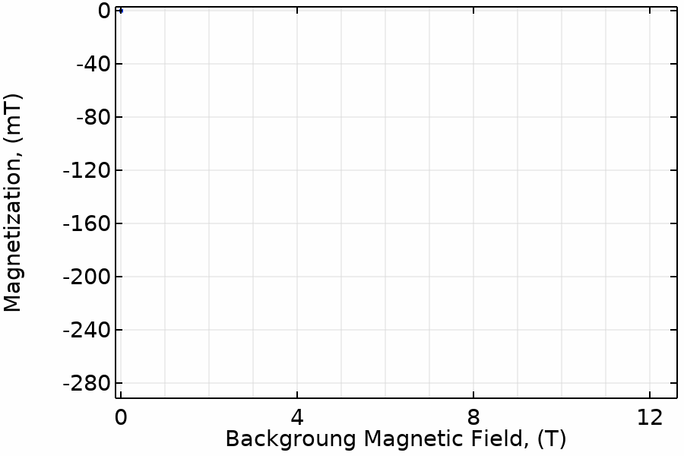
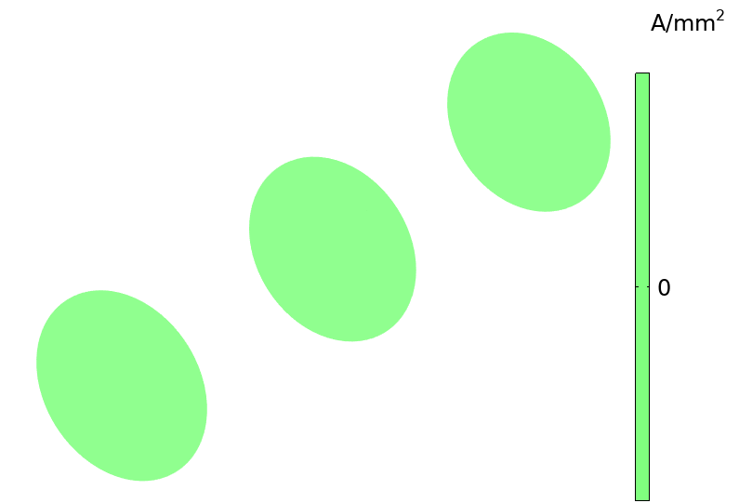
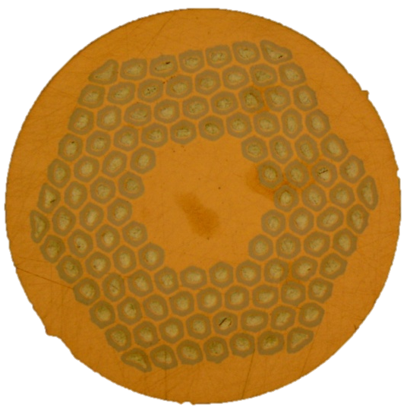
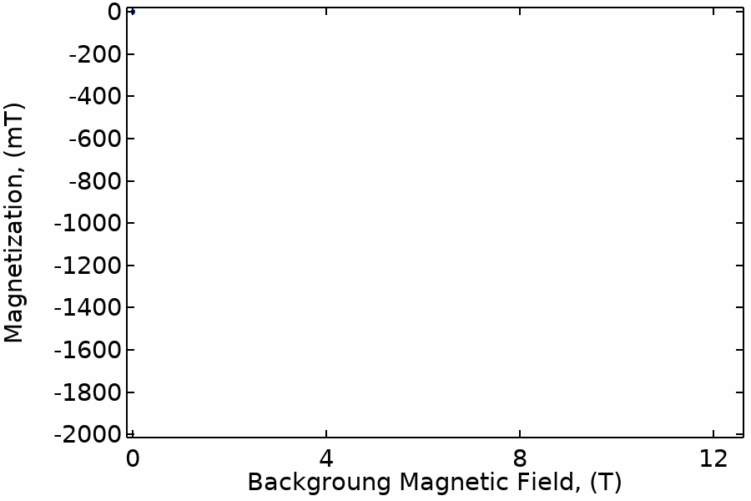
A 3D FEM thermo-electro-magnetic model to simulate twisted composite superconductors in transient regimes
Animation of the of the currents in the whole wire 5 T/min
5 T/min
An example:
Current distribution and Magnetization
in a MQXF Nb₃Sn wire exposed to an increasing background field at 1.9 K
5000 T/min
Animation of the of the currents in the whole wire, 5000 T/min
WP4.5-T5-D4
Courtesy of Bernardo Bordini
15

Slide 16
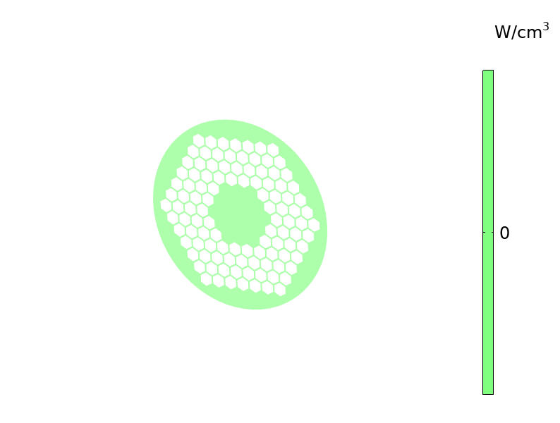
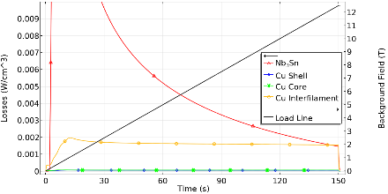
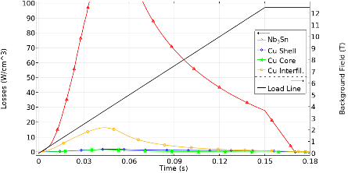
A 3D FEM thermo-electro-magnetic model to simulate twisted composite superconductors in transient regimes
5 T/min
An example:
Copper Current distribution (animations on the right) and Overall Losses (plots on the left) in a MQXF Nb₃Sn wire exposed to an increasing background field at 1.9 K
5 T/min
5000 T/min
5000 T/min
5000 T/min
WP4.5-T5-D4
Courtesy of Bernardo Bordini
16

Slide 17
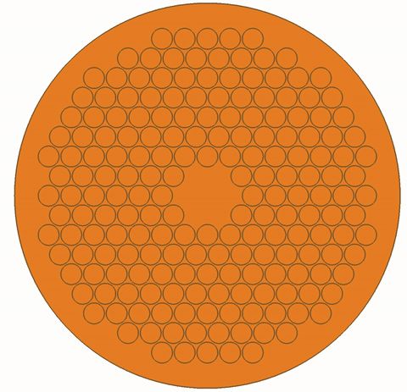
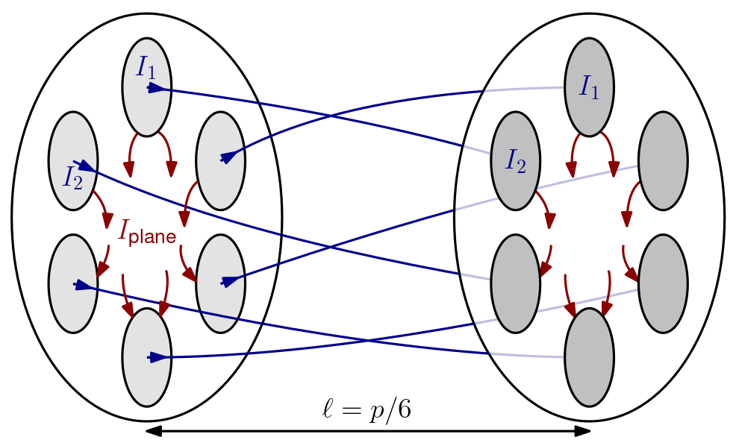
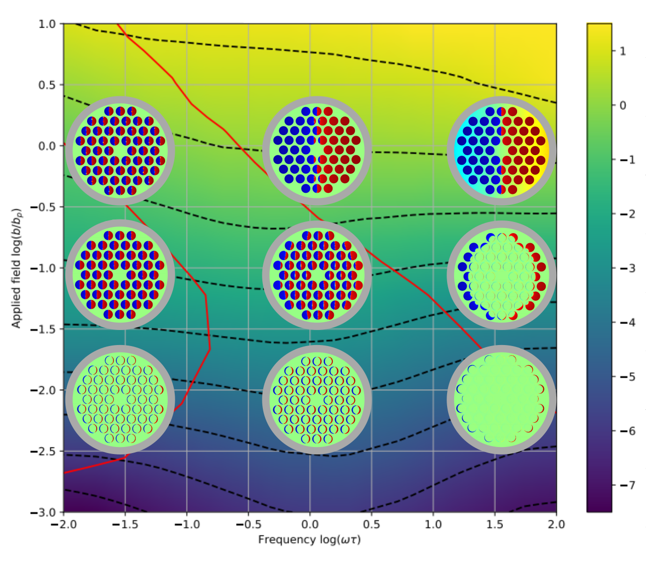
Reduced Order Modelling of Composite Wires and Cables
Objective: describe the response of composite superconductors in view of their homogenization,
  AC loss, magnetization, inductance.
We propose a 2D model:
  One problem with in-plane currents,
  One problem with out-of-plane currents,
  Coupling via circuit equations.
Example - AC loss w.r.t. field and frequency:
WP4.5-T5-D4
Courtesy of J. Dular, F. Magnus

Slide 18
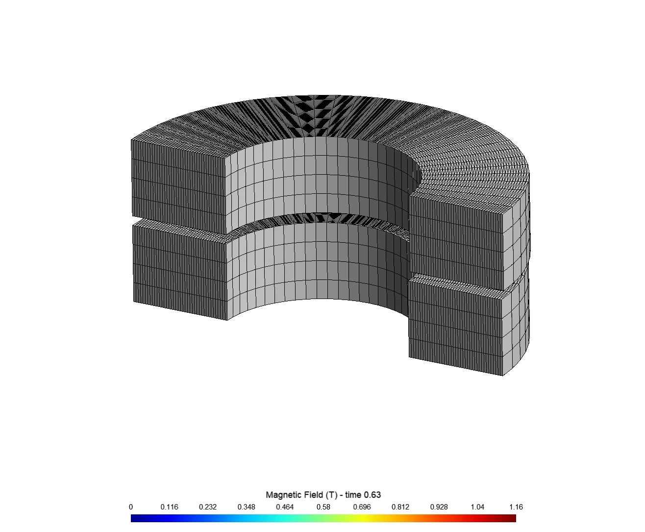
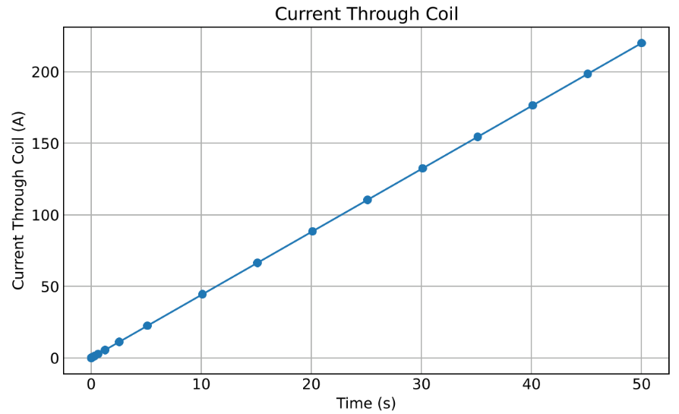
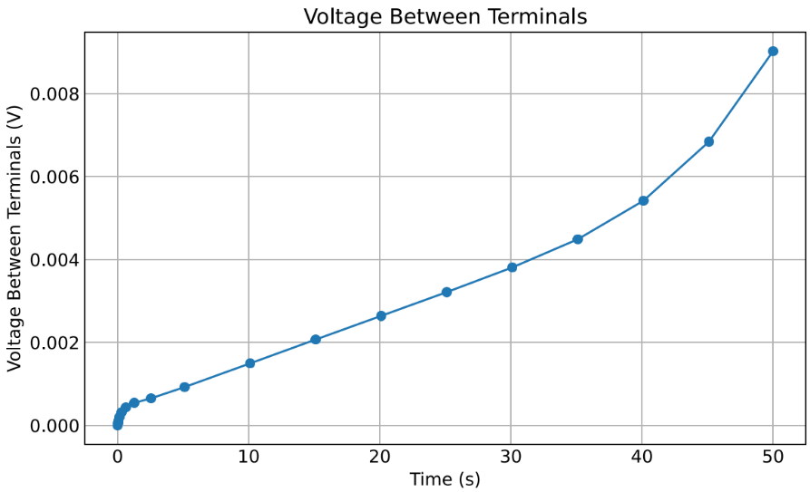
3D FE Simulations of HTS No-Insulation Pancake Coils
Coupled 3D magneto-thermal models resolving all turns
  Using specialized thin shell approximations
40 turns double pancake
with linear current ramp
Fully non-linear and anisotropic material relations
E. Schnaubelt et al., “Magneto-Thermal Thin Shell Approximation for 3D Finite Element Analysis of No-Insulation Coils”. In: arXiv:2310.03138
WP4.5-T5-D6
Courtesy of Sina Atalay

Slide 19
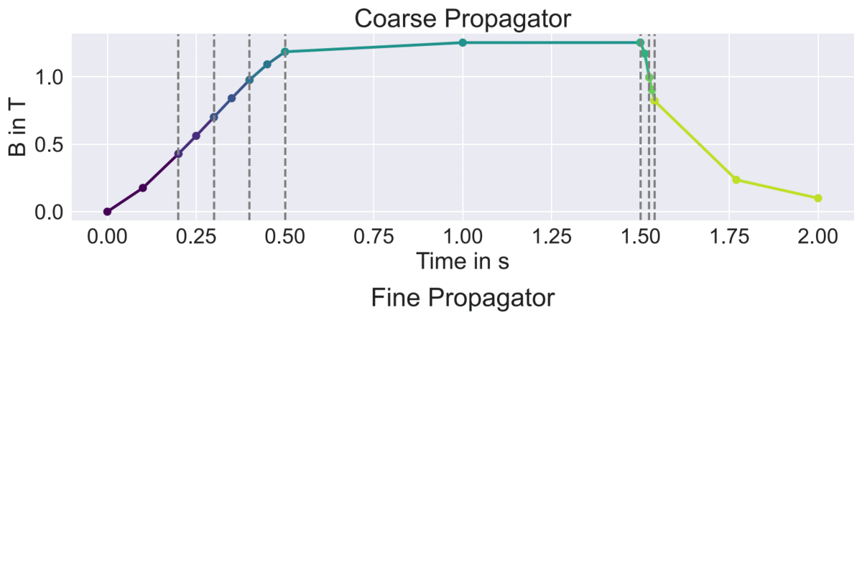
HPC Methods for Parallel FE Simulations
Parallelization in Time
  Parallelization in Space in progress
Parallel-in-time integration of central field of no-insulation HTS pancake coil
E. Schnaubelt et al., “Parallel-in-Time Integration of Transients in Superconducting Accelerator Magnets”. In: 93rd Annual Meeting of the International Association of Applied Mathematics and Mechanics (GAMM 2023). Dresden, May 30, 2023.
WP4.5-T5-D6
Courtesy of Erik Schnaubelt

Slide 20
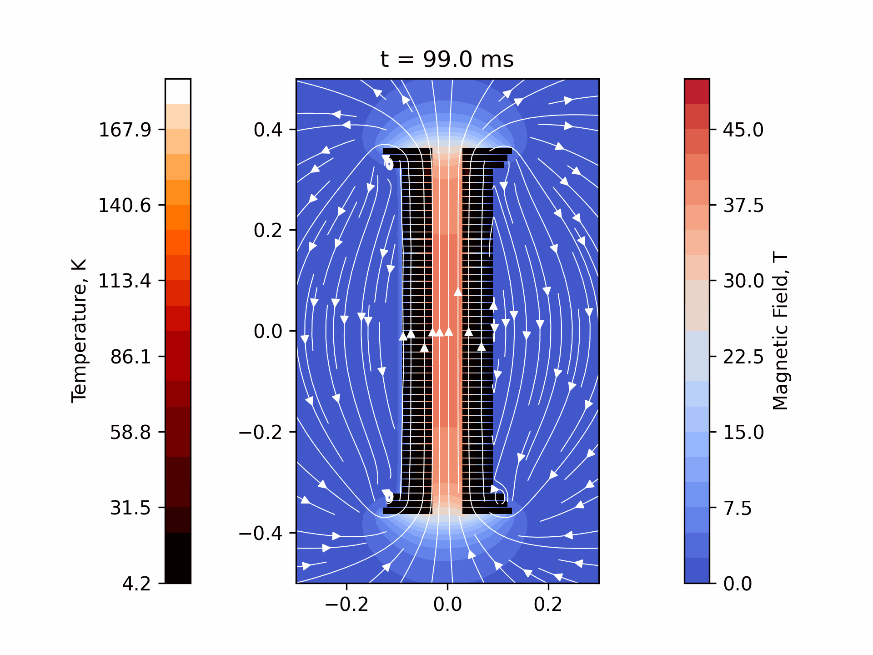
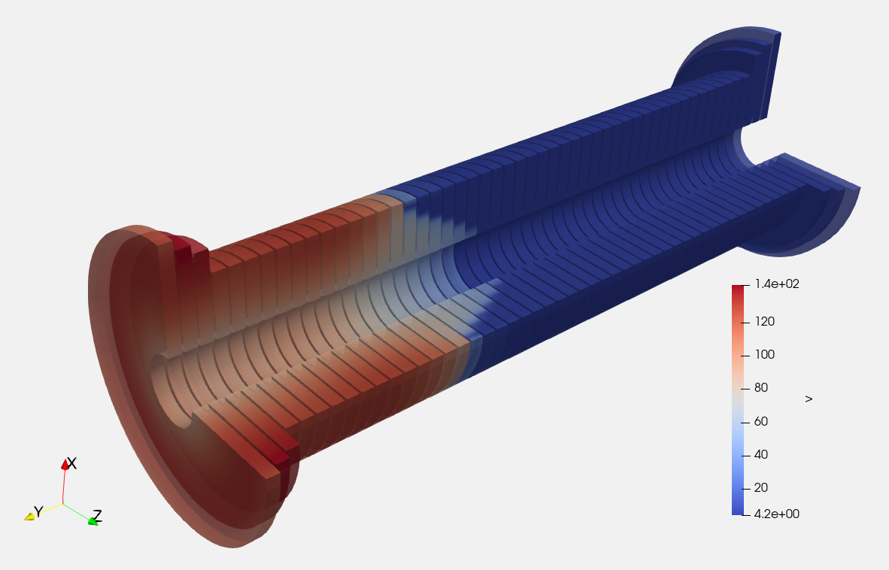
NICQS : No-Insulation HTS Coil Quench Simulator
2D-Simulation of NI-Pancake coils
Designed for the thermo-electromagnetic simulation of stacks of NI pancake coils.
New developments:
Accepts multiple pancake geometries using different conductor layouts on different circuits in one simulation.
Quench back in surround rings is possible.
Screening currents and its corresponding AC loss are fully included.
Force density can be exported for analysis in COMSOL / other software.
Used to test various quench protection strategies for stacks of NI pancake coils.
40 T NI HTS Solenoid
WP4.5-T5-D6
Courtesy of Tim Mulder
20

Slide 21
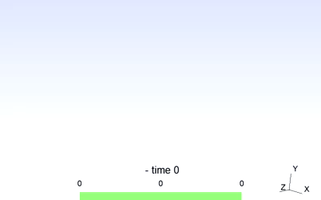
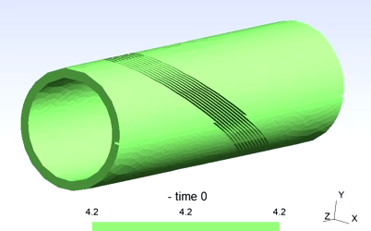
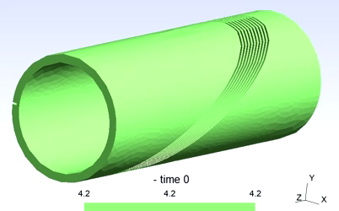
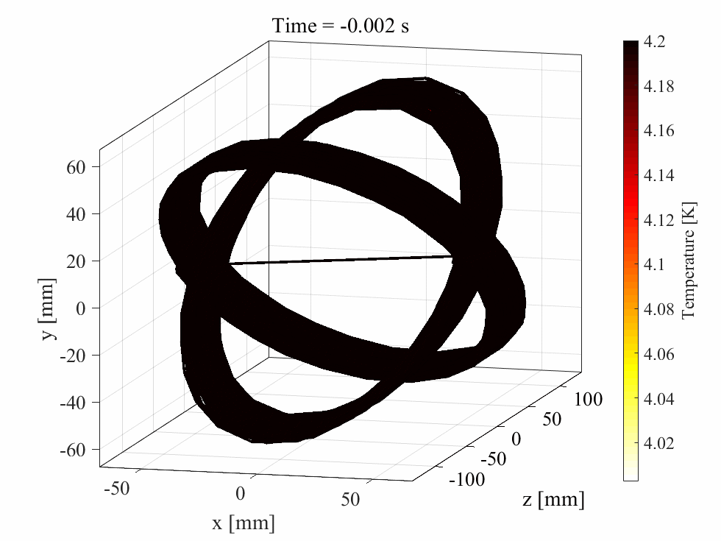
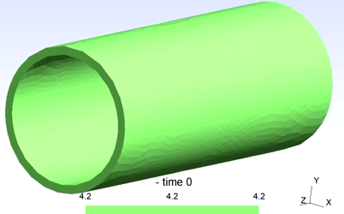
CCT magnets quench simulation in 3D
Co-simulation approach used
Iteration #1
Iteration #N
Eddy currents
Formers and Shell
Temperature
Formers and Shell
Temperature
Windings
Outer former
Outer former
Inner former
Inner former
Shell
Shell
WP4.5-T5-D13

Slide 22





STEAM-material-library
to .dll
BBQ
SIGMA
wrapper
STEAM-materials python package¹ used in:
PyBBQ
NICQS
to .mex
STEAM_MatPro MatLab-mex class² used in:
LEDET
One single C source
CERNGetDP
Material functions used in FiQuS through CERNGetDP³
One single source assures that the material property functions are always the same in all simulation tools.
Most common materials for superconducting magnet design are already included.
Analytical derivatives of selected material functions available.
Properties are available to everybody via the steam git repository.
Supported Materials
Ag
AgMg
Al
BeCu
Brass
BSCCO
Cu
G10
Hastelloy
Properties
He
Iron (BH)
Kapton
Nb₃Sn
NbTi
Steel(Stainless Steel)
Stycast
More to come…
Volumetric heat capacity
thermal conductivity
Resistivity
Jc: Critical Current density $(LTS \& HTS)$
https://steam-material-library.docs.cern.ch/
¹Pypi steam-material-library
³STEAM_MatPro MatLab class
³CERNGetDP interface
WP4.5-T5-D9
WP4.5-T5-D11
Courtesy of Georgia Zachou

Slide 23
Summary
WP4.5 focuses on quench protection, and should work together with magnet designers, builders and testers.
We already have several excellent collaborations in place between WP4.5 and other HFM work packages and other projects, like the Muon collider study.
We are ready and motivated to join up with more magnet teams/groups by:
  helping you to choose among the various quench protection technologies
  providing simulations and assessing the results (advantages and disadvantages)
  (co-)analysing the protection-related test results, to validate and further improve our models.
Let’s try to work together on an integrated conductor–magnet–quench protection design. How hard can it be?

