Slide 1


IFAST WP8 meeting #19
20th July 2023
Ernesto De Matteis & Co

Slide 2
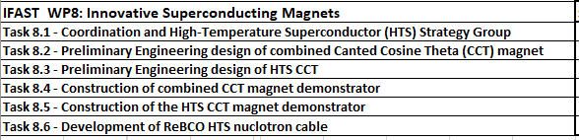
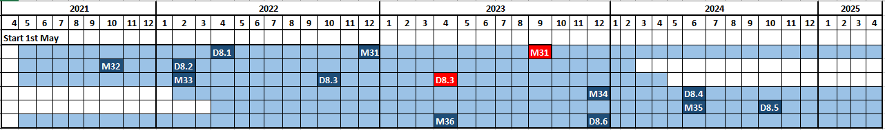

IFAST WP8 Gantt & Deliverables and Milestones
https://ifast-project.eu/wp8-innovative-superconducting-magnets
Milestones:
  M31 (09/2023): Construction readiness of combined CCT demonstrator
  M34 (12/2023): Construction of the formers for combined CCT winding
  M35 (06/2024): Test of mock-up coils with dummy cable - (Report on test and assessment of CI)
Deliverables:
  D8.4 (06/2024): Construction of combined CCT demonstrator
  D8.5 (10/2024): Construction of HTS CCT demonstrator
IFAST WP8 meeting #19 - 20th July 2023

Slide 3

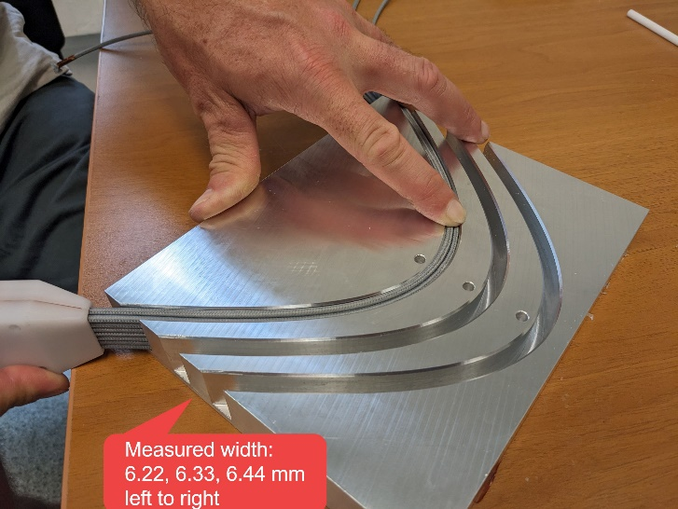
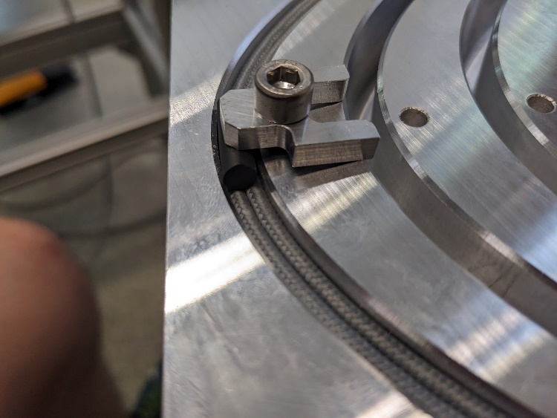
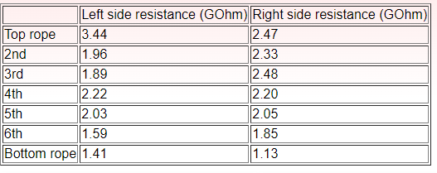
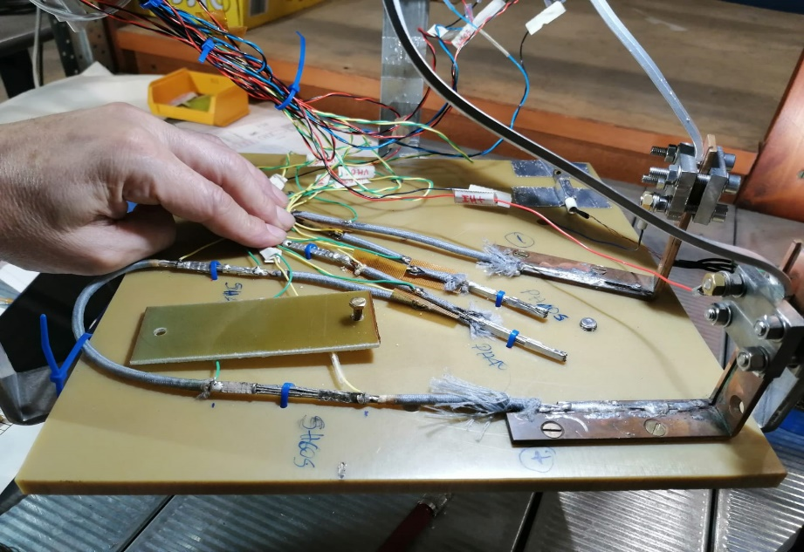
Task 8.4 - Construction of combined CCT magnet demonstrator
Conductor – NbTi Rope (6+1):
  The insulation (dry) test at Wigner → ok at 1 kV
Final rope production with double polyester braid (99% coverage factor) → Texcavi in September;
Splice test at LASA (done yesterday) in LHe:
  Praying (#4) and shaking (#2) hands configurations;
  Current limited to max 350 A (busbar and PS limits);
  One praying hand without soldering → 400 nΩ
  All the rest are well below 10 nΩ;

Slide 4
Task 8.4 - Construction of combined CCT magnet demonstrator
Definition of the final model of the demonstrator (dedicated meetings in the previous days):
CAD design by Daniel Barna (Wigner RCP);
Groove aspect ratio: 6.5 mm (wide) and 22.2 mm (high);
Design adapted to the raw Al-Br tubes;
  First layer tube – ID: 78 mm, OD: 132 mm, and L: 2000 mm;
  Second layer tube – ID: 127 mm, OD: 183 mm, and L: 2000 mm;
External tube thickness to be verified (mechanical simulation by INFN);
Definition of the Impregnation tooling: spice box impregnated with the magnet;
Winding and impregnation setup (CIEMAT):
Updates?
Test of the final magnet (Uppsala):
Integration of the external support of the magnet with the test bench insert (to be discussed);
M31 milestone about the construction readiness of the demonstrator (September 2023)→ open points?

Slide 5

Task 8.5 - Construction of the HTS CCT magnet demonstrator
Conductor – HTS tape:
  Good news from CERN procurement (3 offers received);
  Faraday Factory selected as a tradeoff between tape performance and price (41 CHF/m);
  For the moment the order is 2.5 km of tape (within October/November 2023), we hope to integrate it with other 0.5/1 km;
R&D activities for the former and cabling definition:
Julio and Daniel updates?
Company survey for the former test;
Test facilities for the demonstrator (INFN-LASA):
LASA started to define the updates of the actual test facilities (4.2 K → 10 – 50 K)→ magnet will be tested at 20 K (as preliminary engineering design);
Magnet will be tested in conduction cooling mode (refrigerator at GHe, 20 K)→ customization of the cooling contact with the magnet;
Open points: splice definition and test → INFN (LASA) is available for organizing the test;

