Slide 1
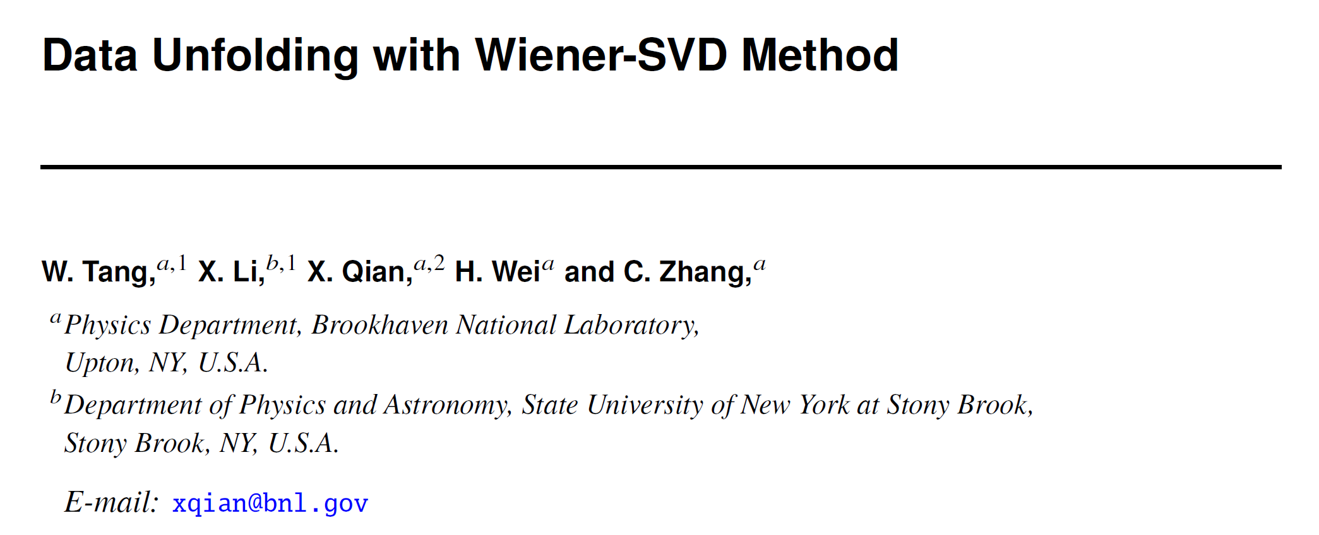
and Model Validation
JINST 12 P10002, arXiv:1705.03568
https://github.com/BNLIF/Wiener-SVD-Unfolding

Slide 2
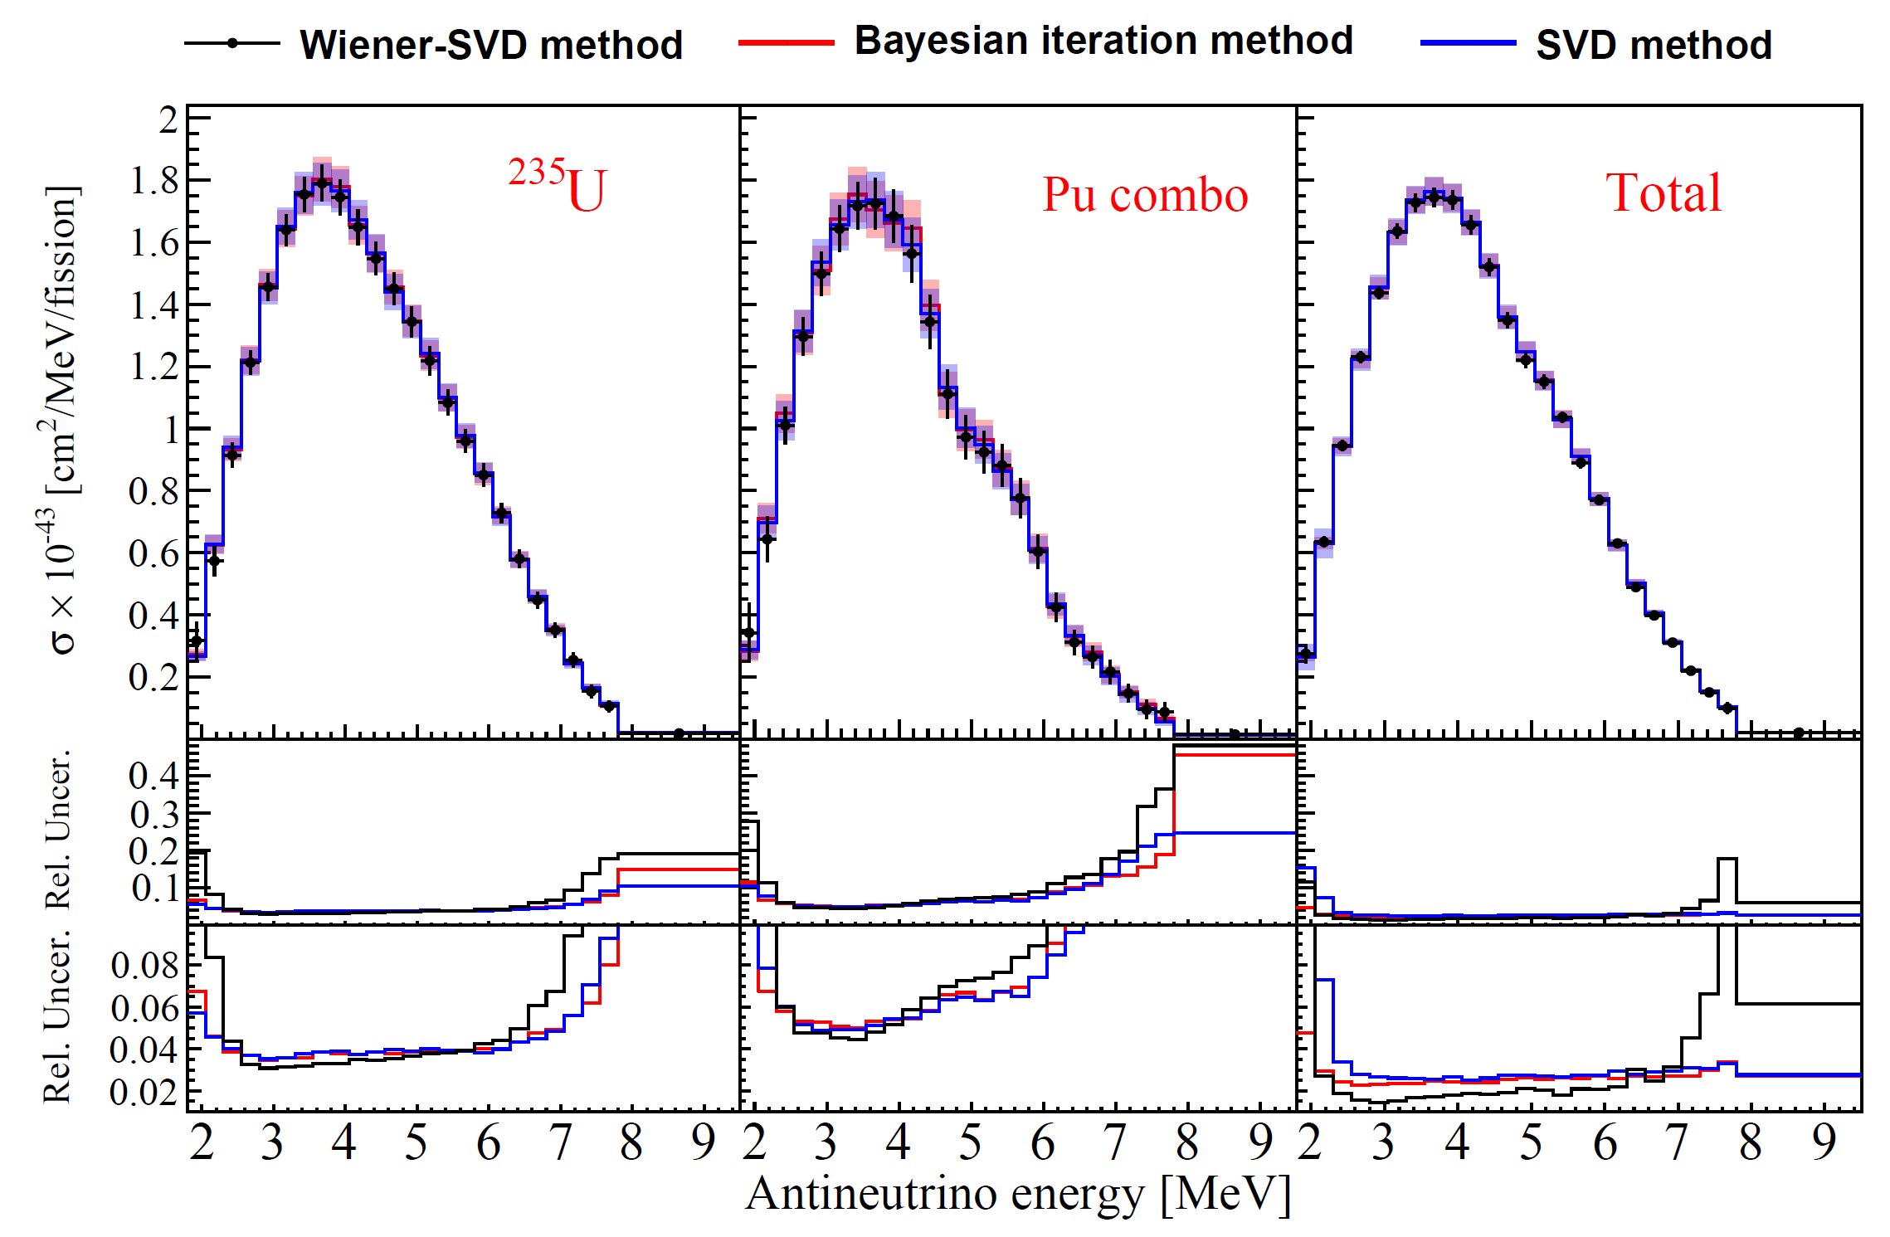
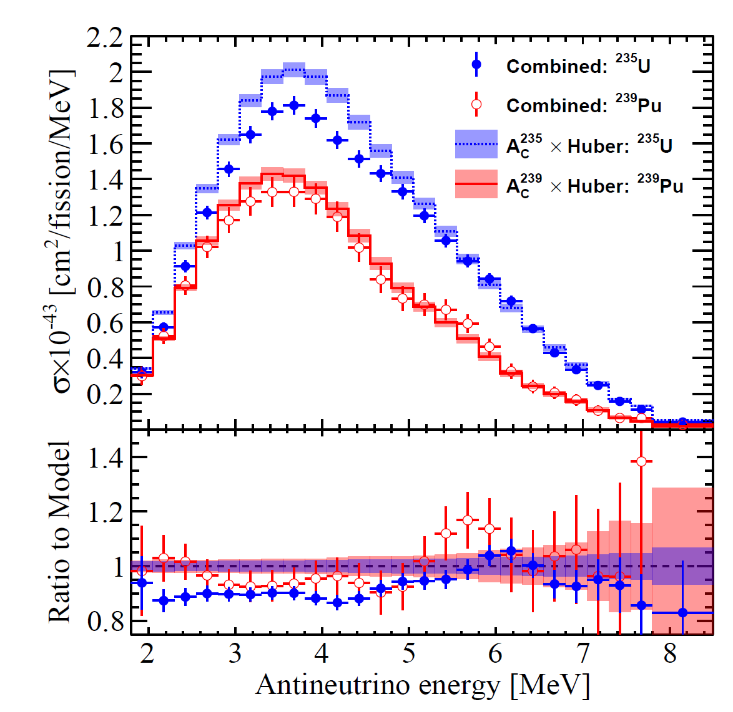
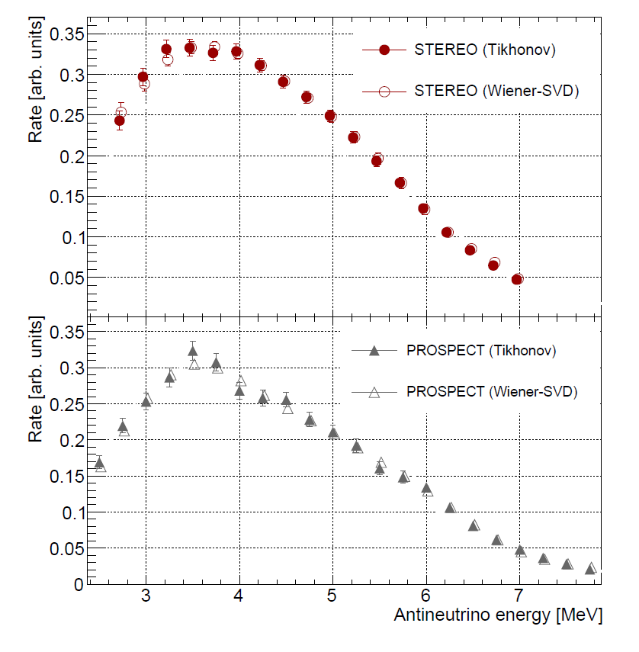



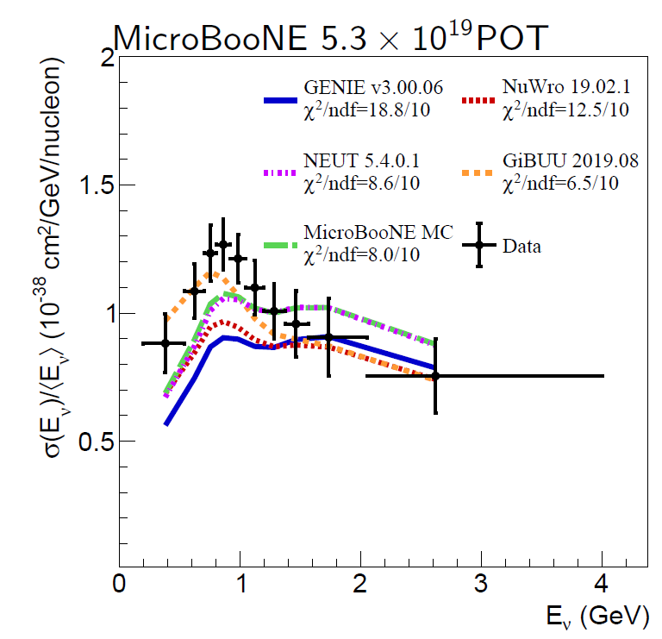
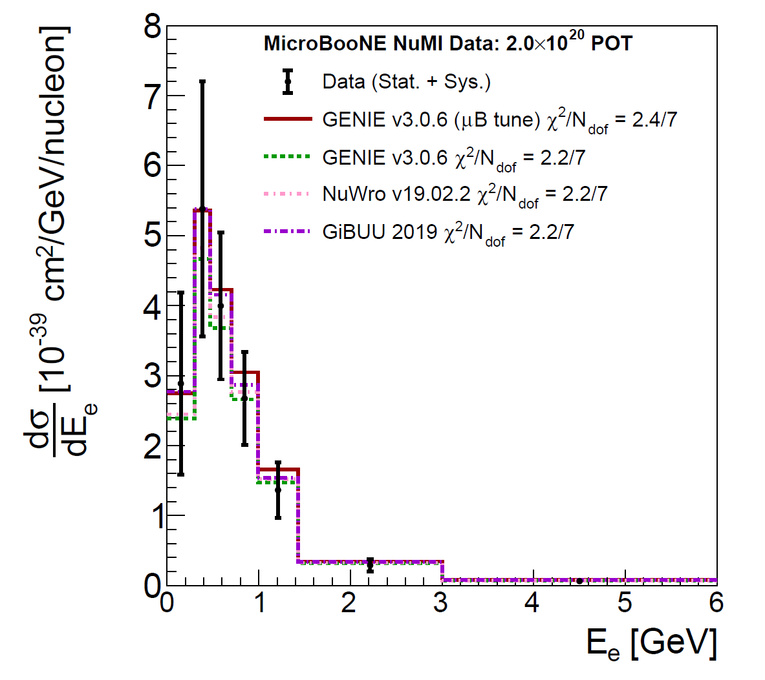
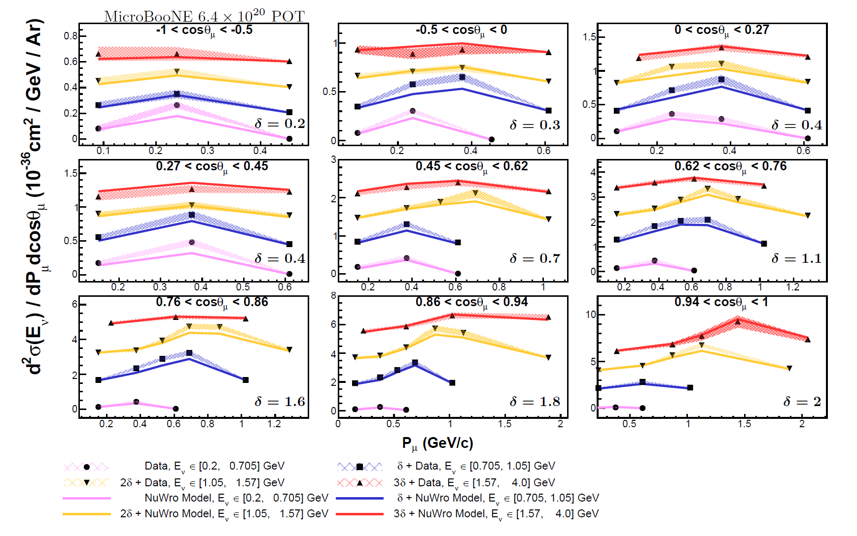

CPC 45 073001, arXiv:2102.04614
PRL 128, 081801, arXiv:2106.12251
PRL 128, 081802, arXiv:2107.03371
PRD 105 L051102
arXiv:2109.06832
PRL 128, 151801
arXiv:2110.14023
arXiv:2307.06413

Slide 3
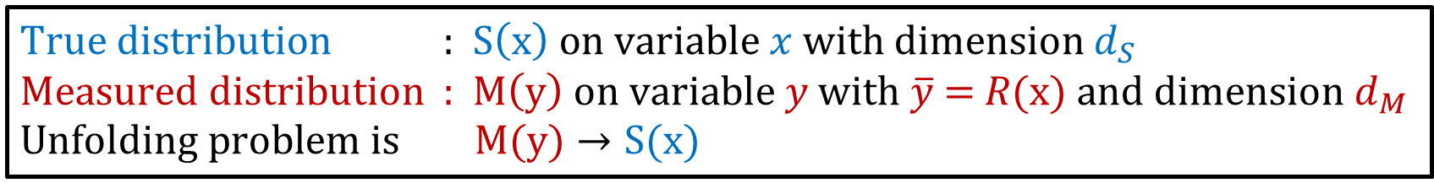
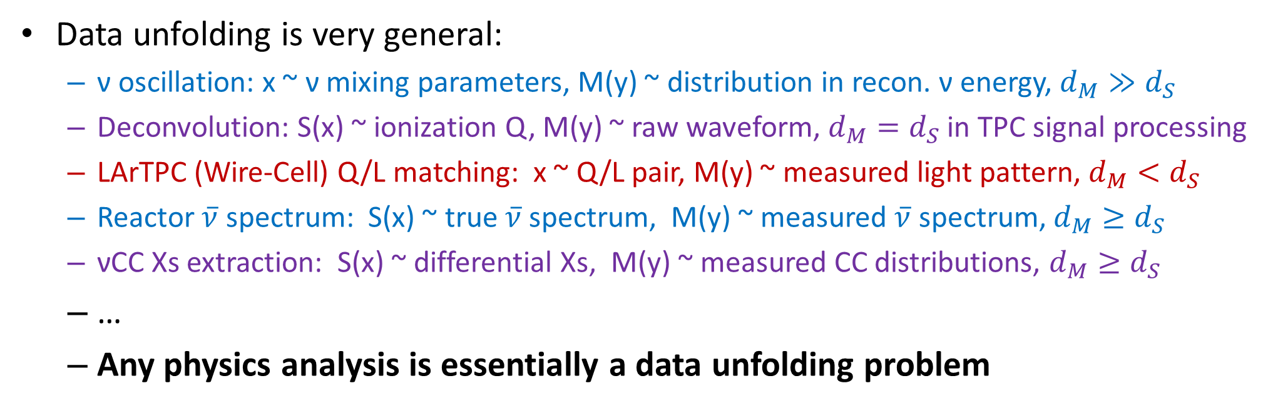
Introduction to Data Unfolding Problem
$\text{T}\text{rue} \text{distribution} \text{:} \text{S}\left(x\right) on variable x$ with dimension $d_{S}$
$\text{Measur}\text{ed} \text{distribution}\text{ : }\text{M}\left(y\right) on variable y with \overline{y}\text{ =} R(x)$ and dimension $d_{M}$
$$\text{Unfolding} \text{problem} \text{is} \text{M}(y)→S(x)$$
Data unfolding is very general:
  ν oscillation: x ~ ν mixing parameters, M(y) ~ distribution in recon. ν energy, $d_{M}≫d_{S}$
  Deconvolution: S(x) ~ ionization Q, M(y) ~ raw waveform, $d_{M}=d_{S}$ in TPC signal processing
  LArTPC (Wire-Cell) Q/L matching: x ~ Q/L pair, M(y) ~ measured light pattern, $d_{M}<d_{S}$
  Reactor $\overline{ν}$ spectrum: S(x) ~ true $\overline{ν}$ spectrum, M(y) ~ measured $\overline{ν}$ spectrum, $d_{M}≥d_{S}$
  νCC Xs extraction: S(x) ~ differential Xs, M(y) ~ measured CC distributions, $d_{M}≥d_{S}$
  …
  Any physics analysis is essentially a data unfolding problem

Slide 4
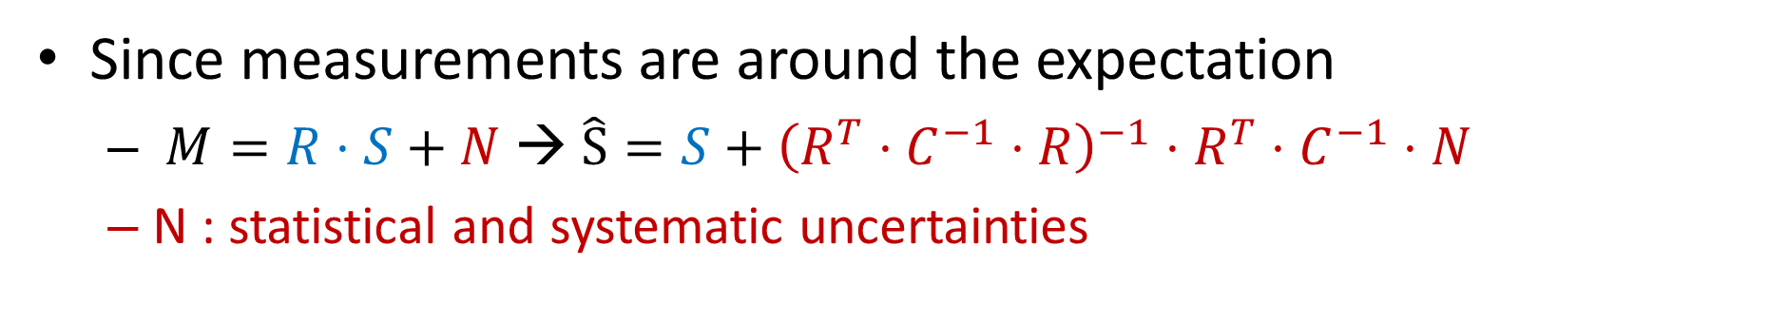
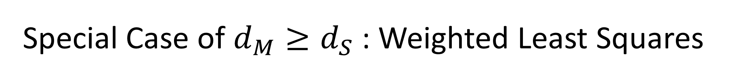
Special Case of $d_{M}≥d_{S}$ : Weighted Least Squares
A. C. Aitken Proc. R. Soc. Edinburgh 55, 42 (1935)
Since measurements are around the expectation
  $M=R⋅S+N$ → $\hat{S}=S+{\left(R^{T}⋅C^{−1}⋅R\right)}^{−1}⋅R^{T}⋅C^{−1}⋅N$
  N : statistical and systematic uncertainties
Large fluctuations → Regularization (e.g. Wiener-SVD) is needed for intuitive results

Slide 5
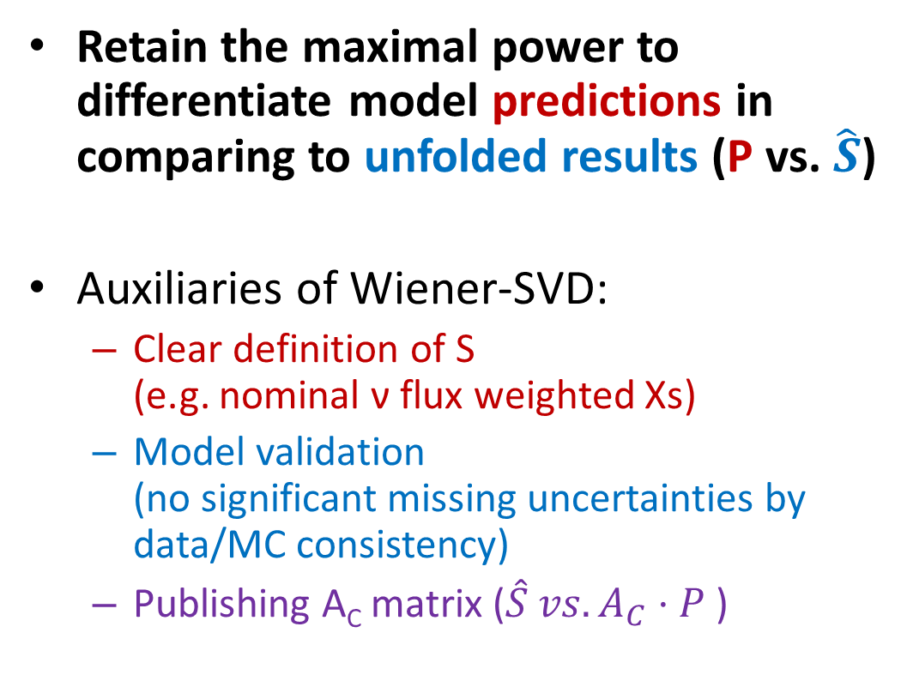
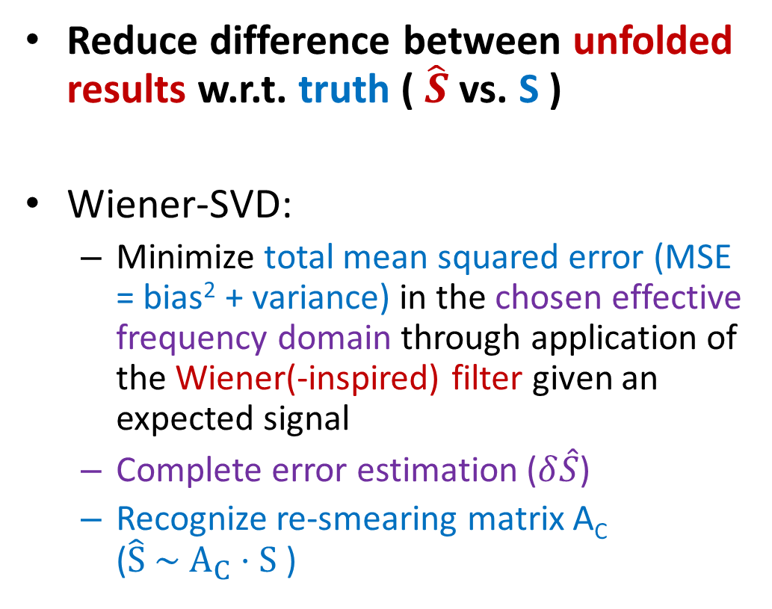
Overview: Goals of Data Unfolding
Reduce difference between unfolded results w.r.t. truth ( $\hat{S}$ vs. S )
Wiener-SVD:
  Minimize total mean squared error (MSE = bias² + variance) in the chosen effective frequency domain through application of the Wiener(-inspired) filter given an expected signal
  Complete error estimation ($δ\hat{S}$)
  Recognize re-smearing matrix A_{C} ($\hat{S} \sim A_{C}⋅S$ )
Retain the maximal power to differentiate model predictions in comparing to unfolded results (P vs. $\hat{S}$)
Auxiliaries of Wiener-SVD:
  Clear definition of S
  (e.g. nominal ν flux weighted Xs)
  Model validation
  (no significant missing uncertainties by data/MC consistency)
  Publishing A_{C} matrix ($\hat{S} vs. A_{C}⋅P$)

Slide 6
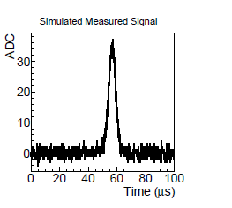
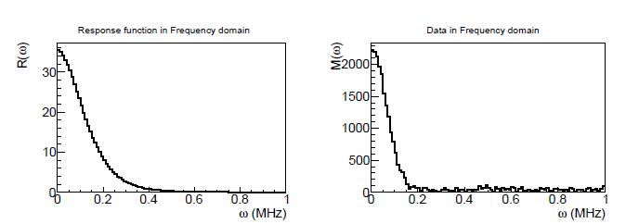
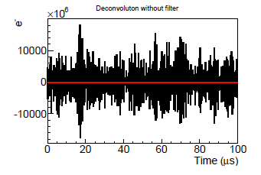

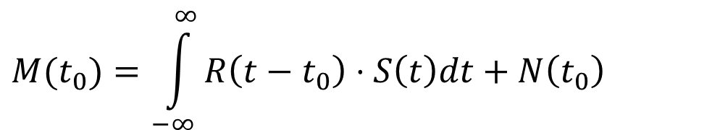
History of Wiener-SVD unfolding
Wiener-SVD was inspired by LArTPC signal processing
  B. Baller JINST 12 P07010
  Apply (Fast) Fourier Transformation: S$\left(ω\right)=\frac{M\left(ω\right)}{R\left(ω\right)}−$ $\frac{N\left(ω\right)}{R\left(ω\right)}$
$$M(t_{0})=\int_{−∞}^{∞}{R\left(t−t_{0}\right)⋅S\left(t\right)dt+N\left(t_{0}\right)}$$
R(ω)
M(ω)

Slide 7
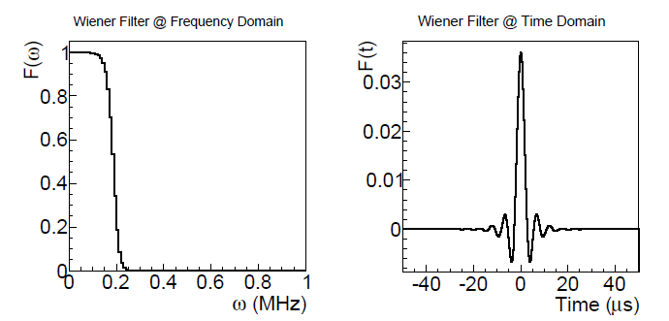
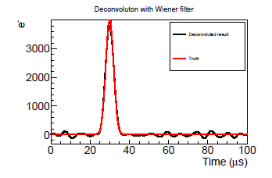

Software (Wiener) Filter
To suppress the noise at the high frequency, a software filter is generally needed
One form of the filter is the Wiener filter
using expectations of signal and noise
$$F(ω)=\frac{\overline{S^{2}\left(ω\right)}}{\overline{S^{2}\left(ω\right)}+\overline{N^{2}\left(ω\right)}}$$
F(ω)
F(t)
Detector response is replaced by the filter (smearing) function!

Slide 8


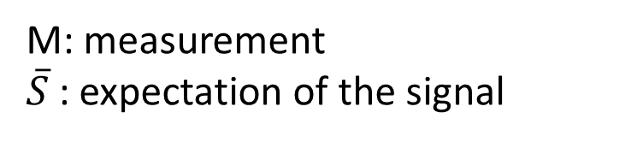
Meaning of Wiener filter
Wiener filter was determined by minimizing the expectation of
M: measurement
$\overline{S}$: expectation of the signal
$$E\left[{\left(F\left(ω\right)⋅M\left(ω\right)−\overline{S\left(ω\right)}\right)}^{2}\right] \\ =E\left[{\left(F\left(ω\right)⋅\left(\overline{S}(ω)+N(ω)\right)−\overline{S\left(ω\right)}\right)}^{2}\right]$$
Wiener filter is by construction to minimize the total
mean squared error (MSE = bias² + variance) in the frequency domain
S
FFT to frequency domain
Inverse FFT
How to find a (frequency) ‘domain’ to maximize separating signal and noise?
=
+
Apply Wiener Filter
M
N
$$\hat{S}$$

Slide 9
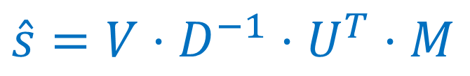
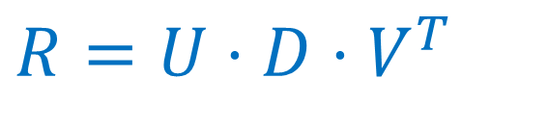

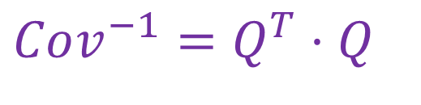
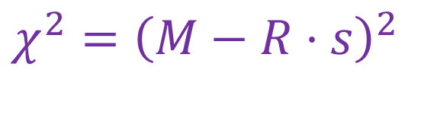
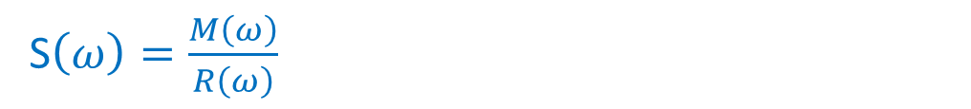
SVD Unfolding
Start with general chisquare formalism with the covariance matrix
Whitening of the chisquare
SVD decomposition of R
m is the measured counts
r is the smearing matrix,
s is true distribution to be extracted
Cov is the covariance matrix taking into account all uncertainties
$$M=Q⋅m \\ R=Q⋅r$$
$$Cov^{−1}=Q^{T}⋅Q$$
$$χ^{2}={\left(M−R⋅s\right)}^{2}$$
$$R=U⋅D⋅V^{T}$$
$$\hat{s}=V⋅D^{−1}⋅U^{T}⋅M$$
S$\left(ω\right)=\frac{M\left(ω\right)}{R\left(ω\right)}$
Effective frequency domain determined by Cov (uncertainties) and R (response)
Frequency domain

Slide 10
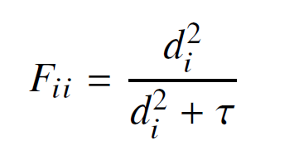
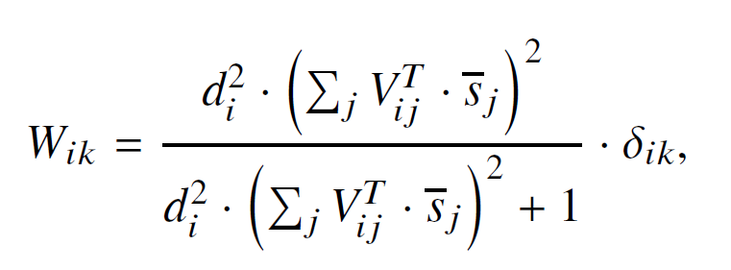
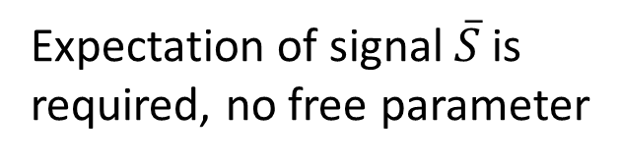
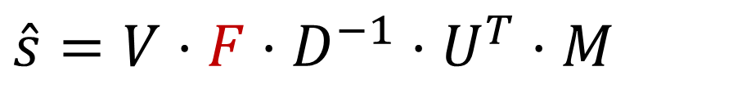
Wiener-SVD Unfolding
$$\hat{s}=V⋅F⋅D^{−1}⋅U^{T}⋅M$$
Tikhonov regularization
Wiener regularization
Regularization strength τ to be varied for optimization
Expectation of signal $\overline{S}$is required, no free parameter

Slide 11

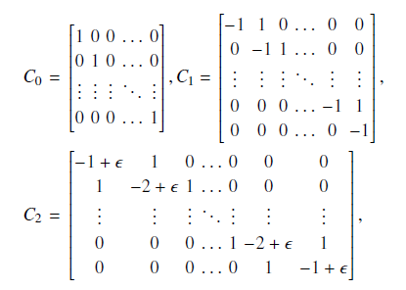
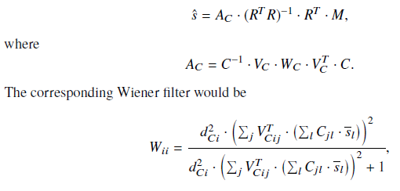
Generalized Wiener SVD Approaches
Instead of using amplitude of s, we can use 1st or 2nd derivative of s
Different C gives different effective frequency domain, in which has different signal/noise separations!
S
FFT to frequency domain
Inverse FFT
How to find an effective ‘domain’ to maximize separating signal and noise?
=
+
Apply Wiener Filter
M
N
$$\hat{S}$$

Slide 12
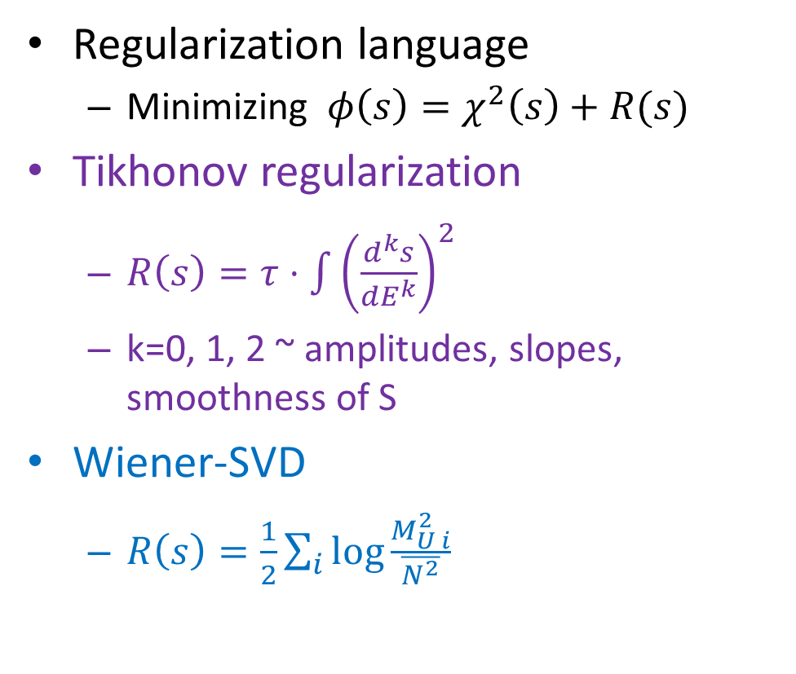
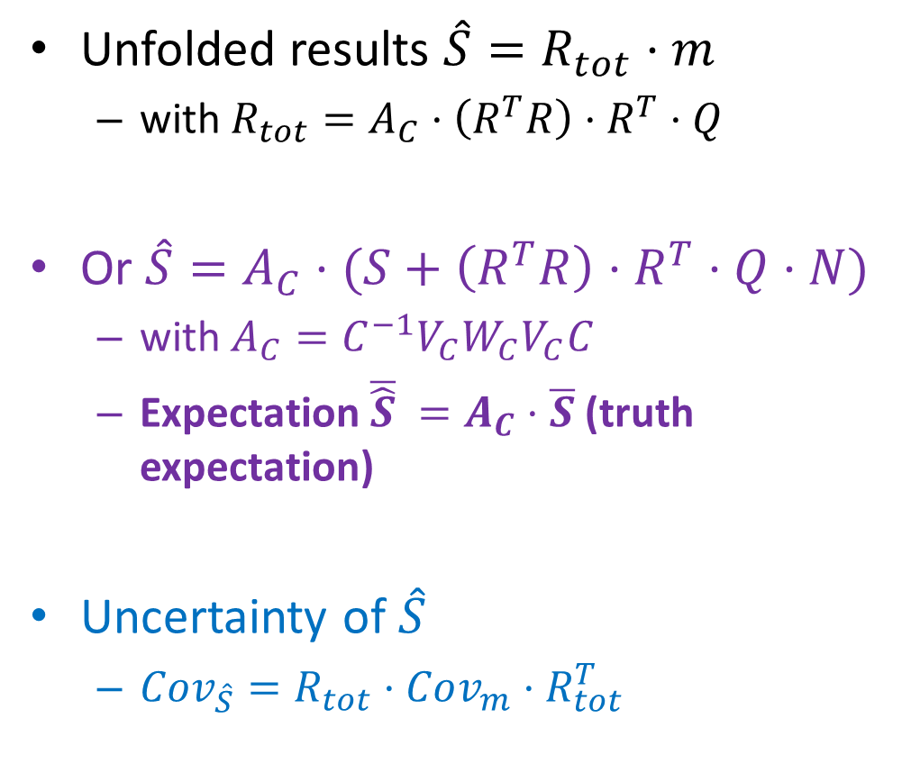
Wiener-SVD: Uncertainties and Regularization
Unfolded results $\hat{S}=R_{tot}⋅m$
  with $R_{tot}=A_{C}⋅\left(R^{T}R\right)⋅R^{T}⋅Q$
Or $\hat{S}=A_{C}⋅(S+\left(R^{T}R\right)⋅R^{T}⋅Q⋅N)$
  with $A_{C}=C^{−1}V_{C}W_{C}V_{C}C$
  Expectation $\overline{\hat{S}} =A_{C}⋅\overline{S}$ (truth expectation)
Uncertainty of $\hat{S}$
  $Cov_{\hat{S}}=R_{tot}⋅Cov_{m}⋅R_{tot}^{T}$
Regularization language
  Minimizing $φ\left(s\right)=χ^{2}\left(s\right)+R(s)$
Tikhonov regularization
  $R\left(s\right)=τ⋅$ ${\int{\left(\frac{d^{k}s}{dE^{k}}\right)}}^{2}$
  k=0, 1, 2 ~ amplitudes, slopes, smoothness of S
Wiener-SVD
  $R\left(s\right)=\frac{1}{2}\sum_{i}{\log{\frac{M_{U i}^{2}}{\overline{N^{2}}}}}$
Signal in the effective frequency domain
Noise in the effective frequency domain

Slide 13
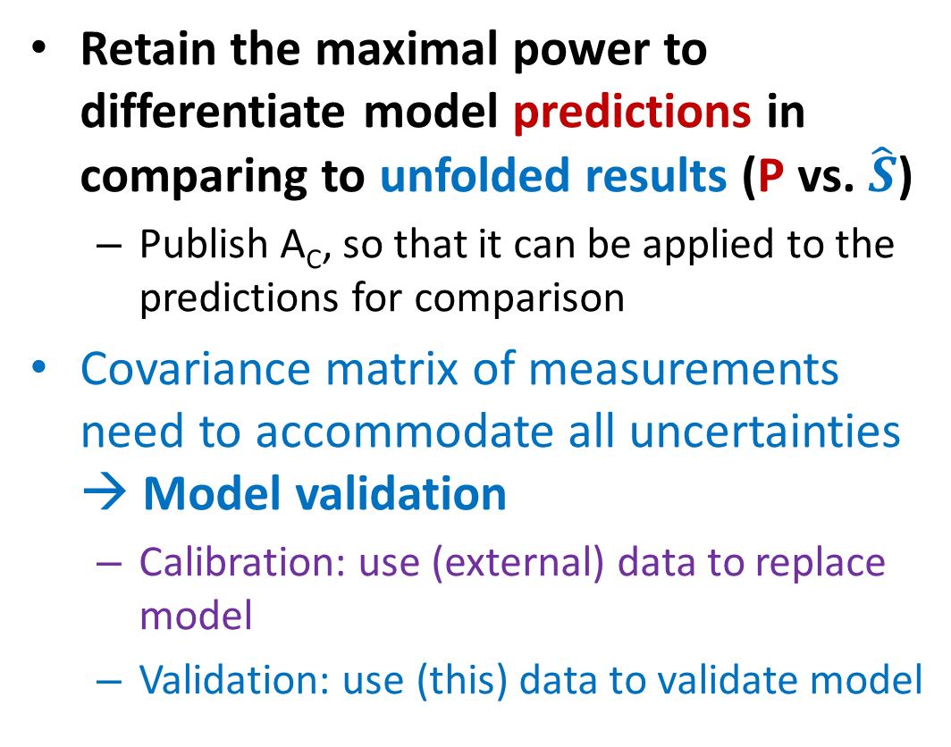
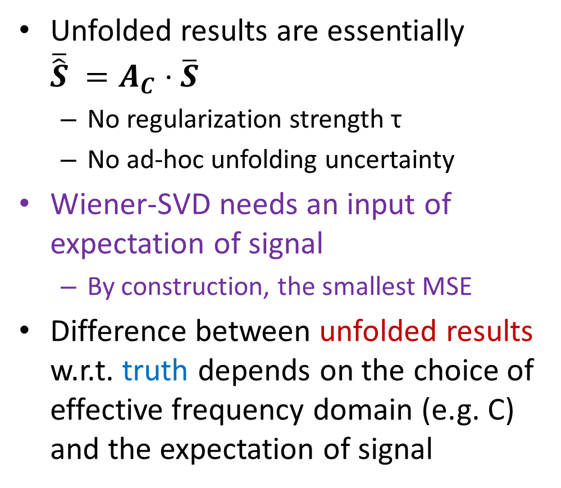
Key Take-away Points of Wiener-SVD
Unfolded results are essentially
$\overline{\hat{S}} =A_{C}⋅\overline{S}$
  No regularization strength τ
  No ad-hoc unfolding uncertainty
Wiener-SVD needs an input of expectation of signal
  By construction, the smallest MSE
Difference between unfolded results w.r.t. truth depends on the choice of effective frequency domain (e.g. C)
and the expectation of signal
Retain the maximal power to differentiate model predictions in comparing to unfolded results (P vs. $\hat{S}$)
  Publish A_{C}, so that it can be applied to the predictions for comparison
Covariance matrix of measurements need to accommodate all uncertainties → Model validation
  Calibration: use (external) data to replace model
  Validation: use (this) data to validate model

Slide 14
Application: Cross Section Extraction Procedure (I)
Case study: extraction of total ν_{μ}CC cross section as neutrino energy
Measurements
ν_{μ}CC cross section
Detector response matrix
Selection efficiency
ν_{μ} Neutrino Flux
background

Slide 15
Cross Section Extraction Procedure (II)
Can be directly calculated with existing Monte Carlo simulations
A constant for each reco. energy j bin related to POT, T, and nominal flux
Nominal flux averaged cross section in the truth energy bin j
for pros, also see discussions in L. Koch and S. Dolan PhysRevD.102.113012
This choice is crucial in simplifying the uncertainty calculation and comparisons with model calculations

Slide 16
Cross Section Extraction Procedure (III)
Some of the major uncertainties
  Flux uncertainties: reweighting from universes → impacts on F and B and then to M
  Xs uncertainties: reweighting from universes → impacts on σ and B and then to M (different from before, since we are extract Xs here), suppressed in Xs extraction
  Detector uncertainties: bootstrapping method based on dedicated DetVar/CV simulation → impacts on D and ε and then to M, also on B
All the derivations are exact with no approximations

Slide 17
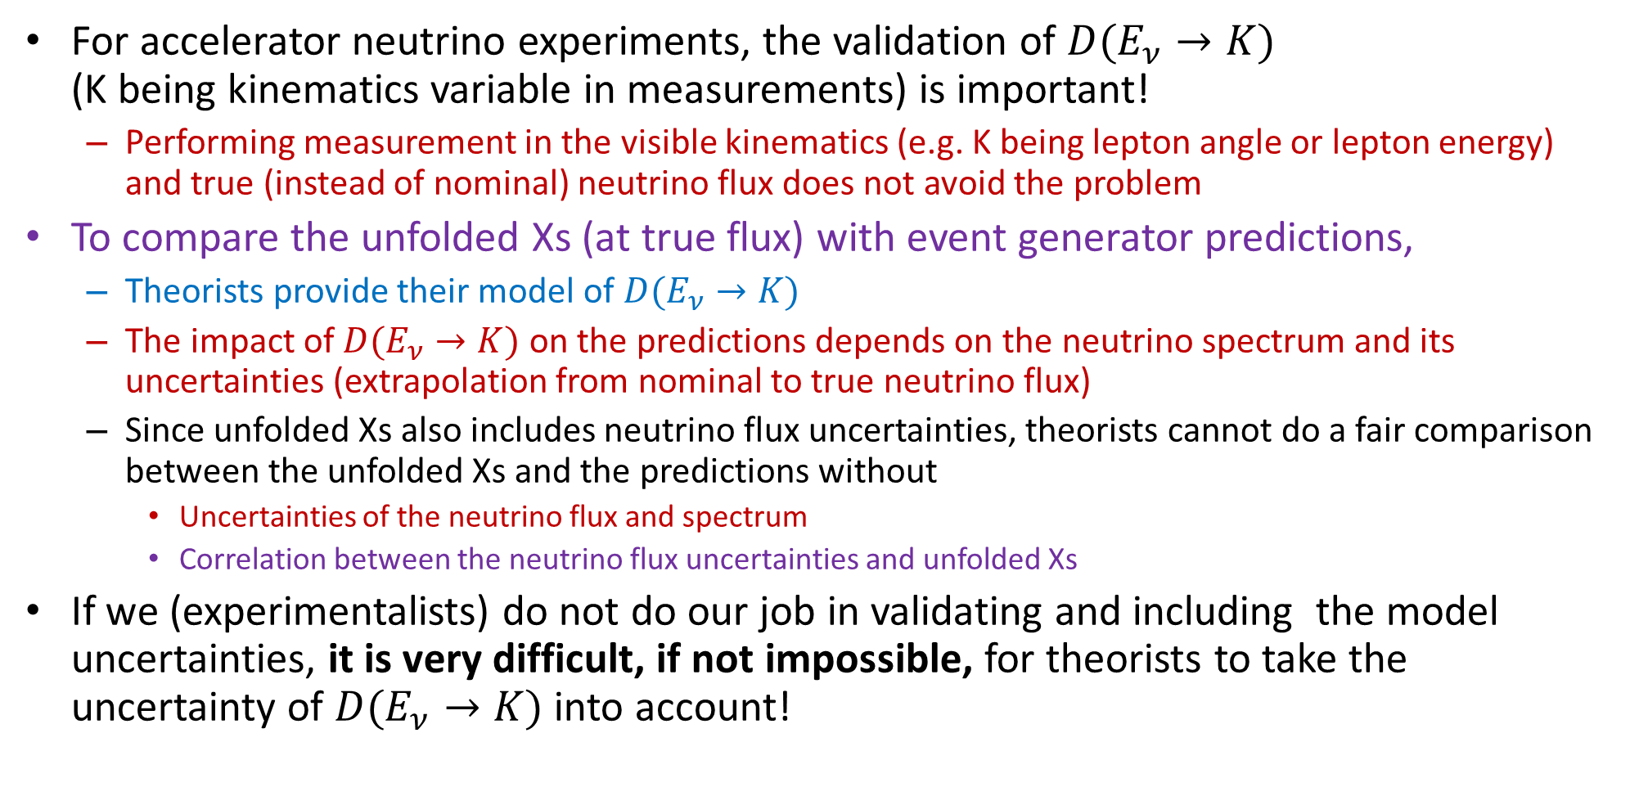
Model Validation
For accelerator neutrino experiments, the validation of $D(E_{ν}→K)$
(K being kinematics variable in measurements) is important!
  Performing measurement in the visible kinematics (e.g. K being lepton angle or lepton energy) and true (instead of nominal) neutrino flux does not avoid the problem
To compare the unfolded Xs (at true flux) with event generator predictions,
  Theorists provide their model of $D(E_{ν}→K)$
  The impact of $D(E_{ν}→K)$ on the predictions depends on the neutrino spectrum and its uncertainties (extrapolation from nominal to true neutrino flux)
  Since unfolded Xs also includes neutrino flux uncertainties, theorists cannot do a fair comparison between the unfolded Xs and the predictions without
    Uncertainties of the neutrino flux and spectrum
    Correlation between the neutrino flux uncertainties and unfolded Xs
If we (experimentalists) do not do our job in validating and including the model uncertainties, it is very difficult, if not impossible, for theorists to take the uncertainty of $D(E_{ν}→K)$ into account!

Slide 18

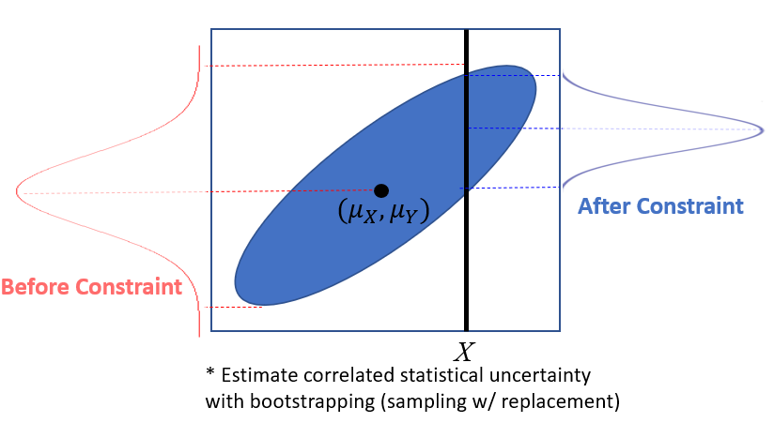
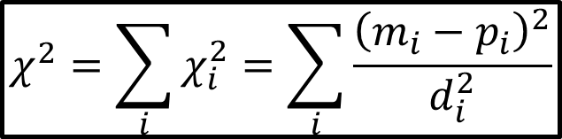
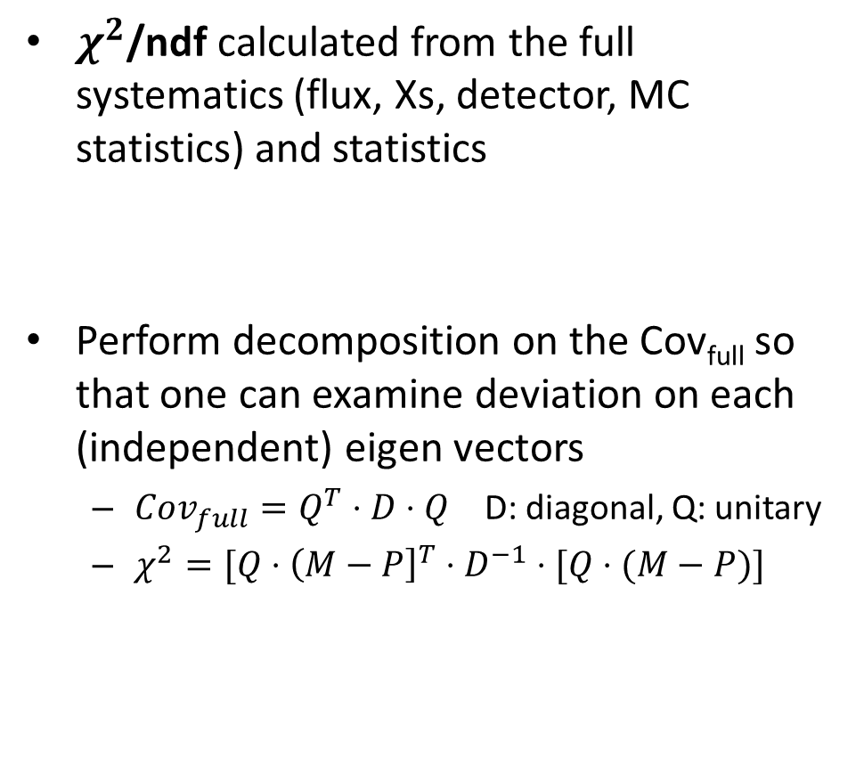
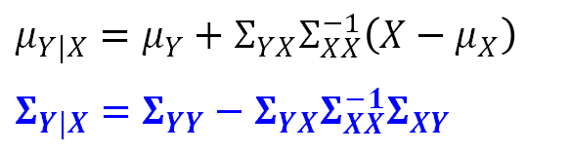
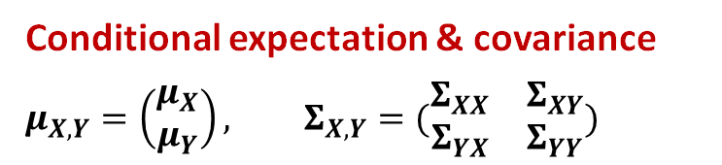
Model Validation Tools: Goodness-of-Fit Tests
Global/Local GoF Tests
Conditional Constraining Procedure
$χ^{2}$/ndf calculated from the full systematics (flux, Xs, detector, MC statistics) and statistics
Perform decomposition on the Cov_{full} so that one can examine deviation on each (independent) eigen vectors
  $Cov_{full}=Q^{T}⋅D⋅Q$ D: diagonal, Q: unitary
  $χ^{2}=[Q⋅{\left(M−P\right]}^{T}⋅D^{−1}⋅[Q⋅(M−P)]$
Conditional expectation & covariance
$$μ_{X,Y}=\left(\begin{matrix}μ_{X} \\ μ_{Y}\end{matrix}\right), Σ_{X,Y}=(\begin{matrix}Σ_{XX} & Σ_{XY} \\ Σ_{YX} & Σ_{YY}\end{matrix})$$
$$μ_{Y|X}=μ_{Y}+Σ_{YX}Σ_{XX}^{−1}\left(X−μ_{X}\right)$$
$$Σ_{Y|X}=Σ_{YY}−Σ_{YX}Σ_{XX}^{−1}Σ_{XY}$$
$$χ^{2}=\sum_{i}{χ_{i}^{2}}=\sum_{i}{\frac{{\left(m_{i}−p_{i}\right)}^{2}}{d_{i}^{2}}}$$

Slide 19
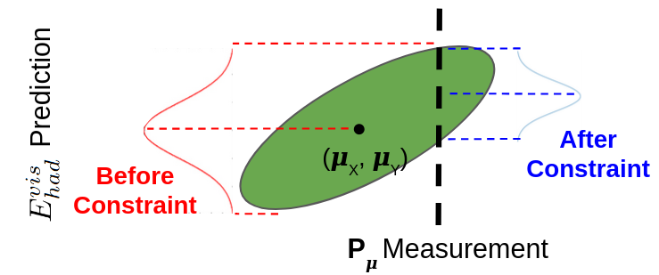
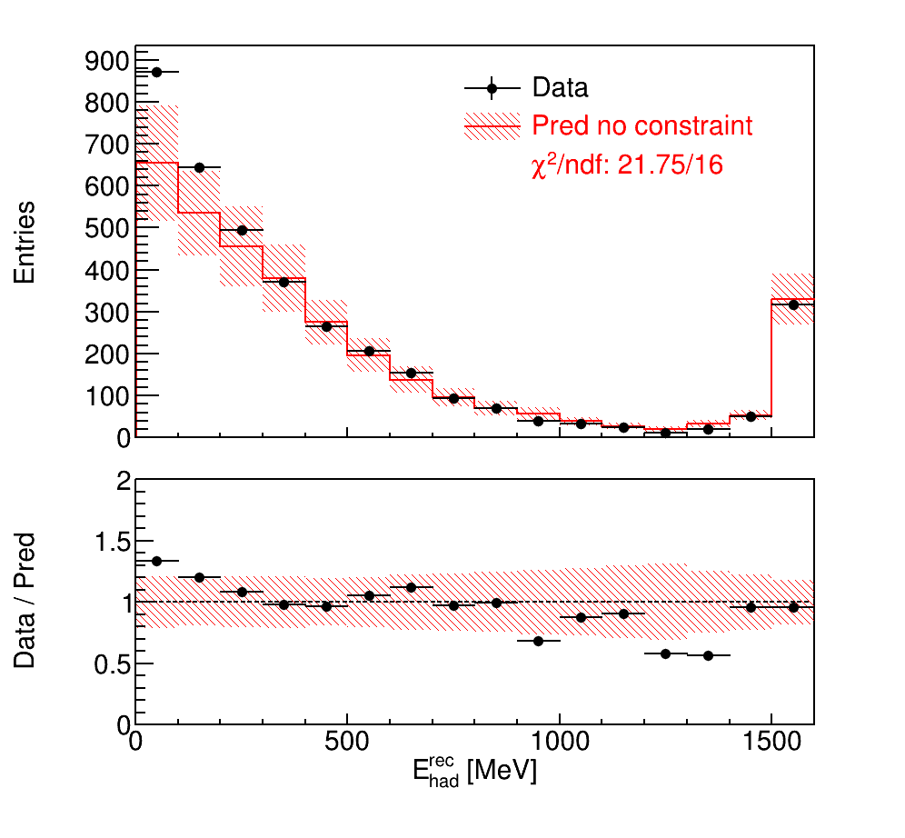
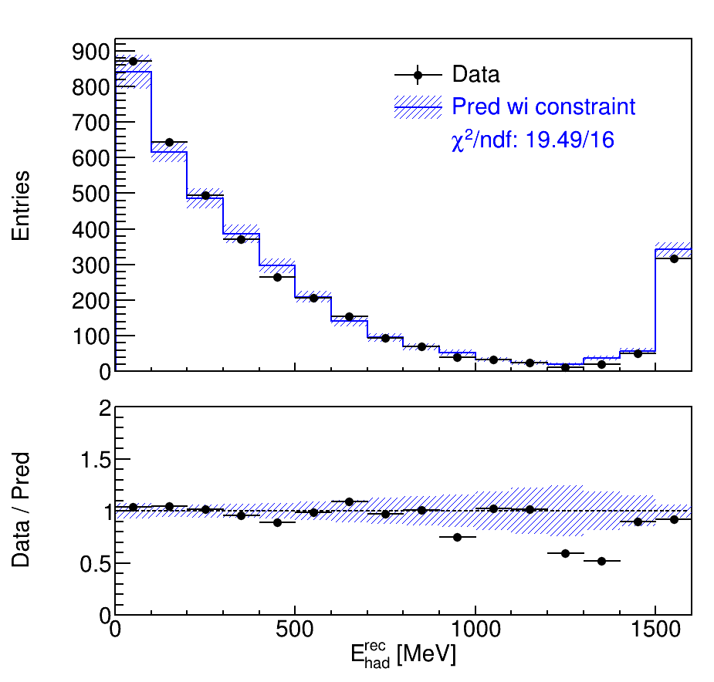
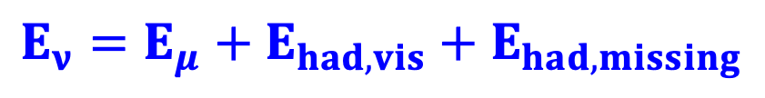
Model Validation: M($E_{had}^{rec}$) vs. $μ$($E_{had}^{rec}$ | ${E_{ν}, E}_{μ}^{rec}$)
New method to validate modeling of neutrino energy
reconstruction given separated lepton and hadronic
energy measurements
in LArTPC
Neutrino flux modeling
Measurement of muon kinematics
$$E_{ν}={E_{μ}+E}_{had,vis}+E_{had,missing}$$
Before Constraint
After Constraint
Overflow
FC
Also see N. Nayak’s talk on Wednesday
Excess at low hadronic
energy indicates
mis-modeling of
missing energy?
Measured muon kinematics are used to constrain the overall model (flux, cross section, etc.) for hadronic energy
Notes:
In order to extract the energy-dependent cross section, it is important to validate the modeling of the neutrino energy, which is of course crucial in any neutrino oscillation measurements. Given the separated lepton and hadronic energy measurements in LArTPC, MicroBooNE invented a new method to validate the modeling of the undetected missing hadronic energy.
This validation procedure compares the measurement of visible hadronic energy with the prediction constrained by apriori neutrino flux modeling and the actual measurement of muon kinematics. Given the energy conservation, this comparison allow us to examine the modeling of the missing hadronic energy, which in turn validate the modeling of neutrino energy.
Before applying the constraint of muon kinematics measurement, the data show an excess at low hadronic energy, which may suggest a mismodeling of the missing hadronic energy.
After applying the constraints, excellent data/MC agreement is observed. There is also a significant reduction in the overall systematic uncertainties from 20% to 5%.
This exercise, supported by the fake data studies, demonstrates the modeling of missing hadronic energy in MicroBooNE simulation is sufficient in describing data. This indirect validation procedure can be used together with the direct validation procedure of DUNE-PRISM to achieve maximal power in measuring and validating the neutrino energy modeling in DUNE.

Slide 20
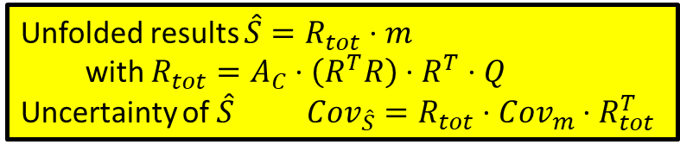

Summary
Wiener-SVD, by construction, gives
the smallest MSE
  No regularization strength τ
  No ad-hoc unfolding uncertainty
The quality of Wiener-SVD unfolding depends on the choice of effective frequency domain and the input signal expectation
Retain the maximal power to differentiate model predictions in comparing to unfolded results
  Clear definition of S (e.g. nominal ν flux weighted Xs)
  Model validation (no significant missing uncertainties by data/MC comparison)
  Publishing A_{C} matrix ($\hat{S} vs. A_{C}⋅P$)
Unfolded results $\hat{S}=R_{tot}⋅m$
  with $R_{tot}=A_{C}⋅\left(R^{T}R\right)⋅R^{T}⋅Q$
Uncertainty of $\hat{S} Cov_{\hat{S}}=R_{tot}⋅Cov_{m}⋅R_{tot}^{T}$

Slide 21
Acknowledgement
Thank London Cooper-Troendle, Ben Bogard, Lee Hagaman, Matt Toups and others for their help in preparing this talk

Slide 23
Summary of different Apporaches
Linear Algebra is a very powerful tool in experimental data analysis
  Least square approach:
  Iterative approach:
Applications | Selected Examples
Signal Processing | MicroBooNE TPC and Daya Bay PMT waveform analysis
Data unfolding | EXO-200, Wiener-SVD
Event Reconstruction | Wire-Cell 3D imaging, MicroBooNE ν selection
Applications | Selected Examples
Numerical solutions | Coordinate Descent, BCGSTAB
Data unfolding | ML-EM (Bayesian unfold) in NEXT, ν Xs
Reducing bias | Iterative Least Weighted Squares
Approx. NL fit | Trajectory & dQ/dx fit in LArTPC

Slide 24



Issue of Extracting Xs at Real Flux with FDS
Comparisons between Xs prediction and extraction
Incorrect: Not considering the neutrino flux uncertainty in making predictions
Flawed: Ignore correlation of flux uncertainty between prediction and Xs
  Theorists need to learn how to use the reported neutrino flux uncertainties to extrapolate to real flux
Correct: Consider correlations
  No experiment report such correlation so far
Incorrect
Flawed
Correct
Expected $χ^{2}$ Distribution
$$\log_{10}{(χ^{2})}$$

Slide 25


Sensitivity of Model Validation and Xs Extraction
MicroBooNE in Progress
FDS with either different event generators or artificially creation all support the expectation that the model validation is more sensitive to mismodeling than the Xs extraction
Conclusion holds for (signal-only) Xs-only systematics and works for other systematic uncertainties (flux, detector …)

Slide 26
Outcome of “pre-data” interaction model fake data tests
Interaction model systematics are inadequate
Interaction model systematics are adequate
Matt Toups
Indication of a potential for bias in the cross section extraction from an unknown source, not necessarily due to the interaction model (possible Type-I error, mitigated if extracting cross sections a function of “directly observable” quantities)
Both methods would have specific concerns about bias in the cross section extraction
Full systematics are inadequate
Outcome of “post-data” model validation tests
Indication of a potential for bias due to the interaction model that the data itself indicates is only realized as a subdominant effect in the cross section extraction
(possible Type-II error)
Both methods would not have specific concerns about bias in the cross section extraction
Full systematics are adequate

Slide 27


https://arxiv.org/abs/2212.11107
~730 pages of review

Slide 28

About the Role of Event Generator, Model Uncertainties and QCD in the non-perturbative region

