Slide 1



Free Air-Cooling Solution for the Data Centers
Laurent Roy (LHCb Experiment) – ESSRI – 29 Sept 2022
Acknowledgments: Francesco Sborzacchi (LHCb)
Heinrich Schindler (LHCb)
Niko Neufeld (LHCb)
Edvard Andreassen (ALICE)
Andre Augustinus (ALICE)
Olof Barring (Cern / IT Dep.)

Slide 2
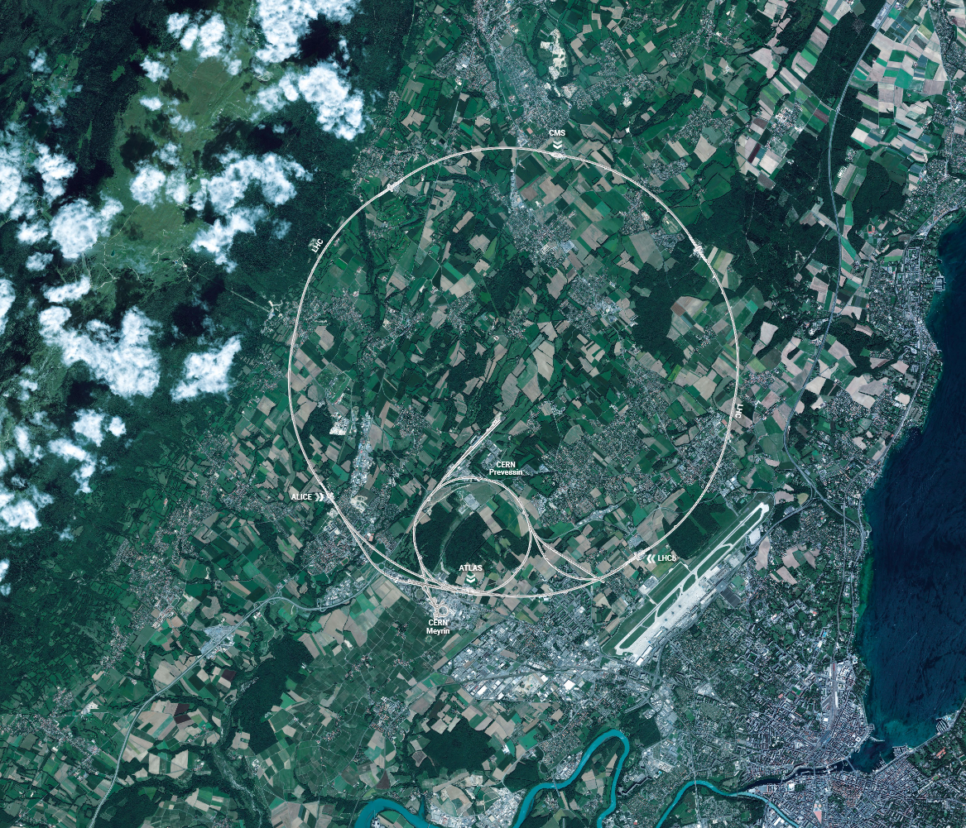
Location of new Data Centers at CERN
LHCb and ALICE: two of the four large LHC Experiments
→ Data Centres recently put in Operation
Prevessin Computer Centre (PCC)
→ Under construction
PCC
ALICE
LHCB

Slide 3
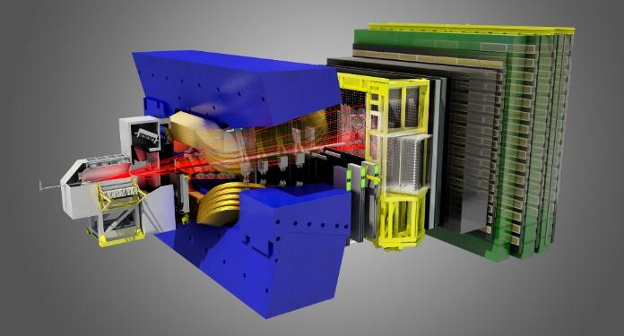
More computing power needs
LHCb Detector
LHCb example
Major update of sub-detectors and their electronics in LS2 (end in March 2022)
Removal of the ‘hardware trigger’ (FPGAs)
Much more data for DAQ & Trigger (~ x80)
Larger event rate (1 Mhz to 40 Mhz)
Larger event size (50 KB to ~100 KB)
More computing power needed = more servers
40 Mhz
Hardware trigger
1 Mhz
DAQ
Filter units :
High Level Trigger
20 Khz
CERN long term storage
Offline physic analysis

Slide 4
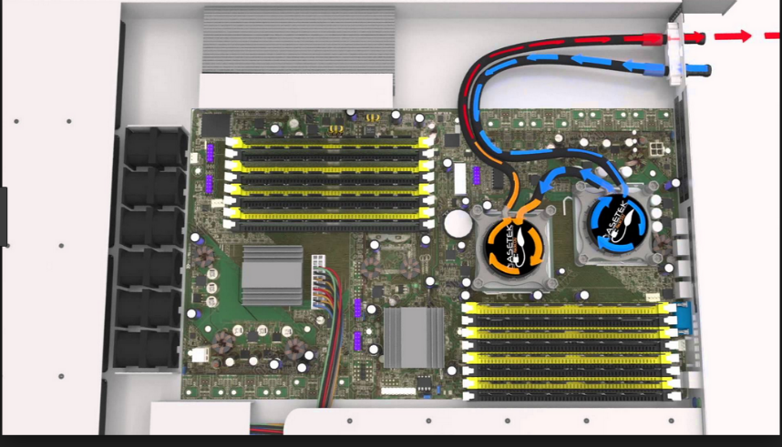
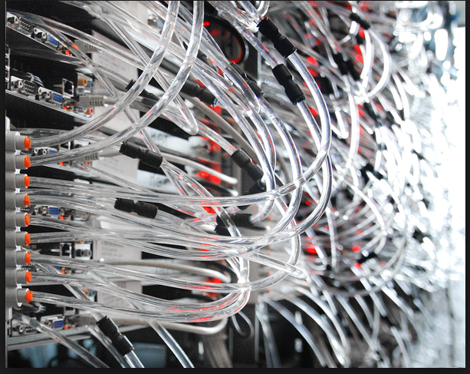
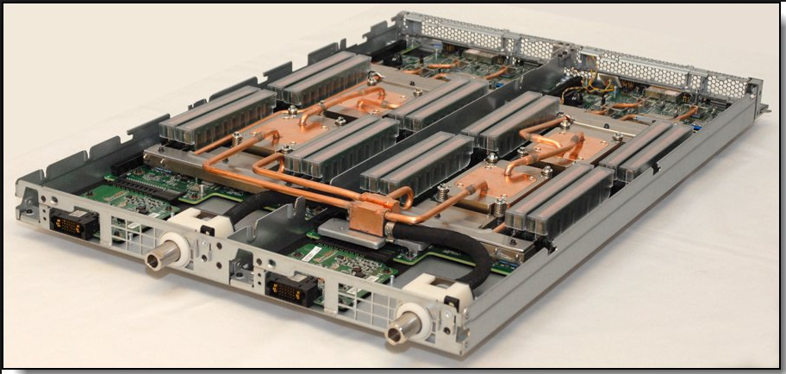
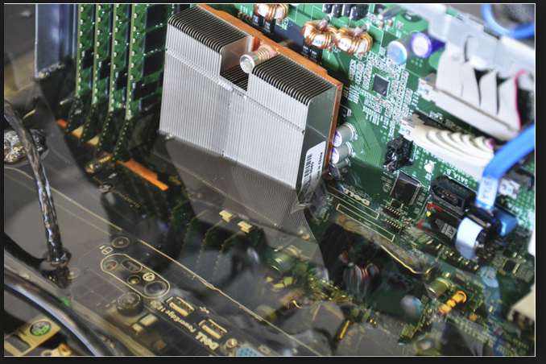
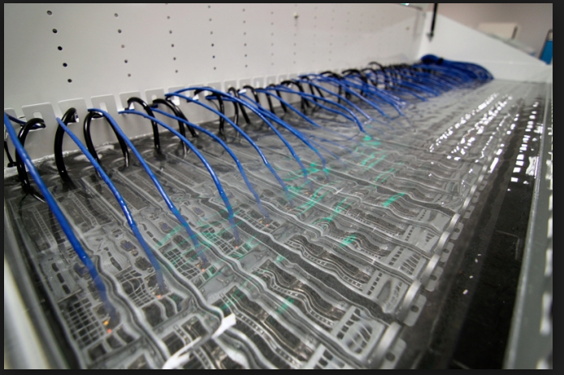
Different cooling systems for servers studied
Direct Contact Liquid Cooling
water (pb with leaks…)
pipes management (in addition of power + IT cables)
Pumps on CPU
Fans
Immersion Cooling
special coolant (no electrical conduction)
a good solution for very ‘high densities’
> 40kW/rack

Slide 5
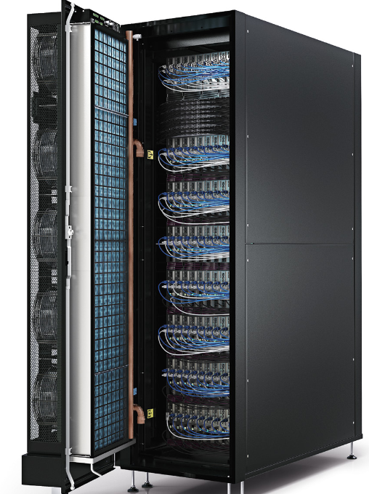
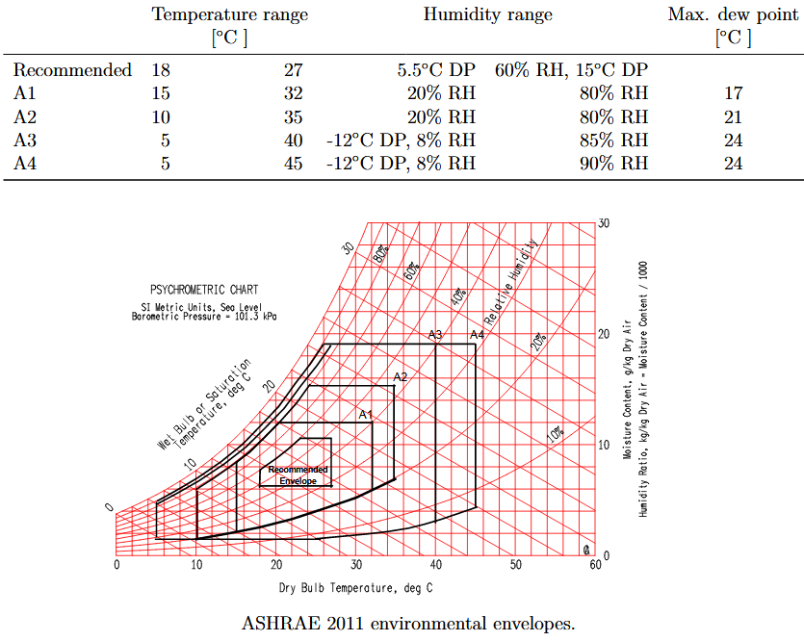
Different cooling systems studied
Water passive or active (with fans) doors mounted on the rear of racks
For the three technologies the use of dry coolers or evaporative towers + pumps are needed
The new servers generation can run with higher air inlet temperatures (30-45 °C) than in the past (20-25 °C).
ASHRAE (American Society of Heating, Refrigerating and Air Conditioning Engineers)
recommends a maximum of 27 °C (low consumption, risk of failure very low).
But have also defined environmental envelopes (Class A1, A2, A3, A4)
The manufactures use the Class to defined their specs.
Many servers are today ‘ASHRAE Class A3 and A4 compliant’
But to take in consideration: 1) can be more expensive
2) a server consume a little extra electricity at higher temperatures

Slide 6
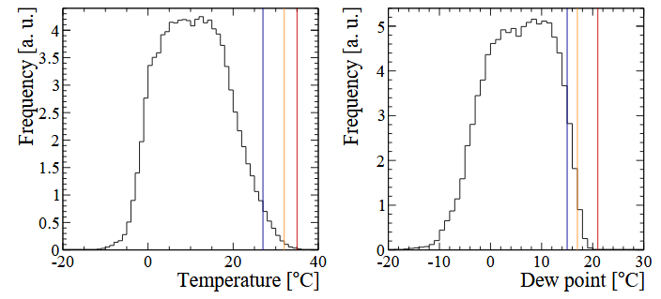
Geneva outside AIR conditions
A1, A2
A1, A2
Distribution for 1 year
Always in the A2 envelope
Compatible with ‘Direct Free AIR cooling’
Compatible with ‘Indirect Free AIR cooling’ (with additional adiabatic cooling for summer)
→ advantages with ‘Indirect’ solution: Air filtration easier, better control of the air temperature inlet.

Slide 7
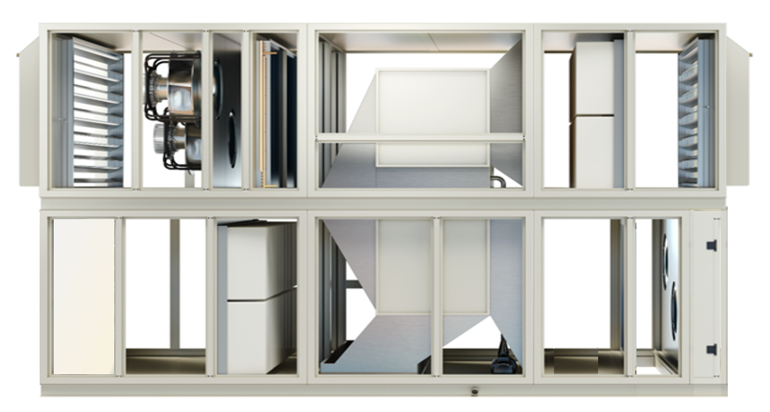
Indirect Free Air-Cooling principle
If ‘outside Fans’ not enough, water is sprinkled on the heat exchangers
when outside air T > ~ 20 °C
‘Outside’ Fans running 0-20% - 70%
Return Air
AIR/AIR Heat exchanger
Supply Air
~40°C
~ 27°C
‘Inside loop’: Fans running according DC Load

Slide 8
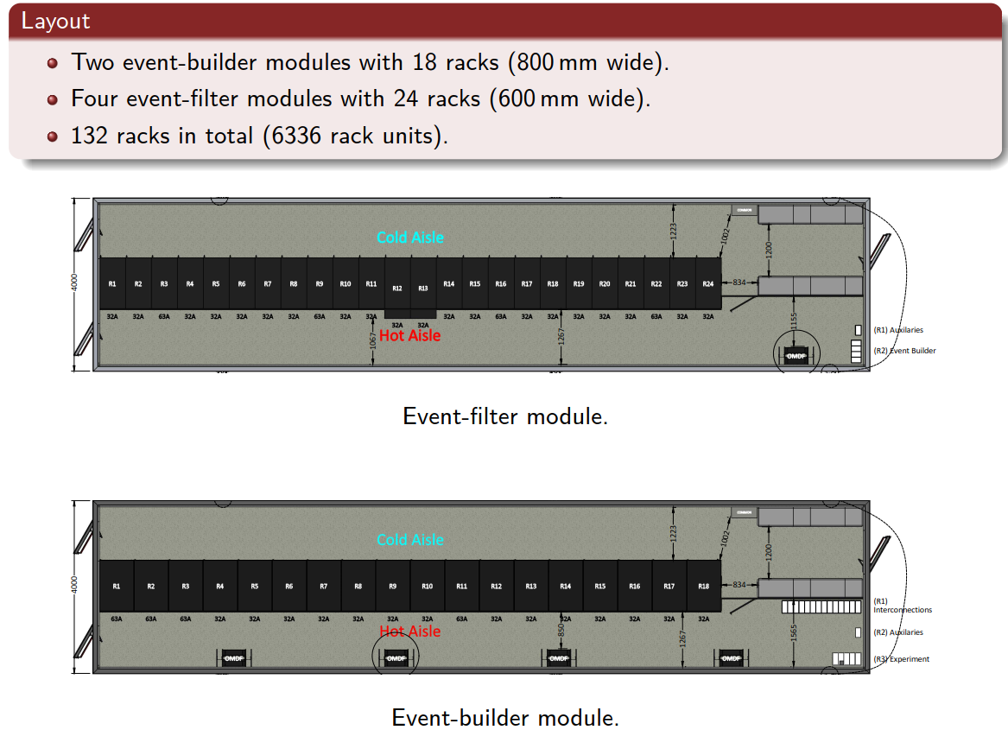
The needs
We went for ‘Modular Data Centres’
1 row of racks, Cold aisle, Hot aisle
LHCb: 7 Modules
6 IT: 18m x 4m x 6,5m height
1 Power + Water : 18m x 3,5m x 3m height
Up to ~ 20kW/rack (85%)
Up to ~ 40kW/rack (15%)
Design for a total power of 2 MW
2 full redundant Power supplies
(2 transformers 3.15 MVA, 2 main switchboards, 2 secondary switchboards, 2 PDU per rack)
ALICE: 5 Modules
18 racks (~128 servers) / IT Module

Slide 9
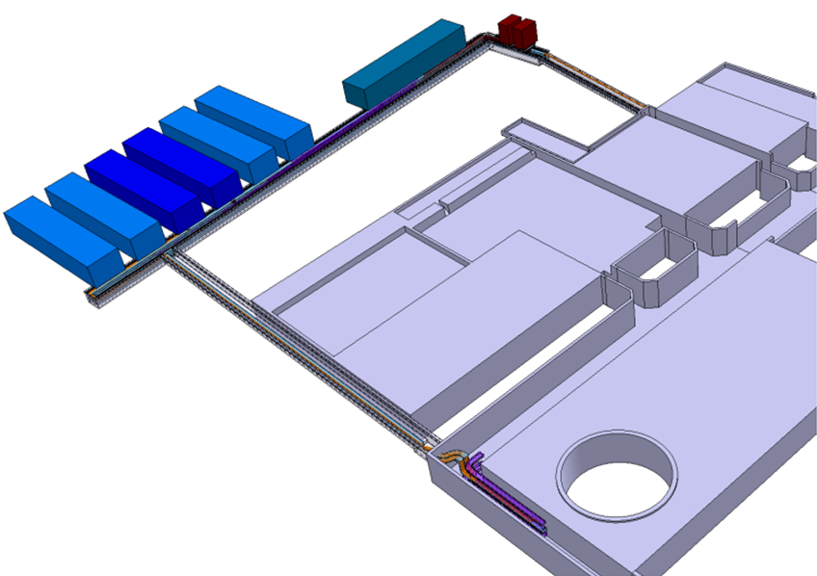
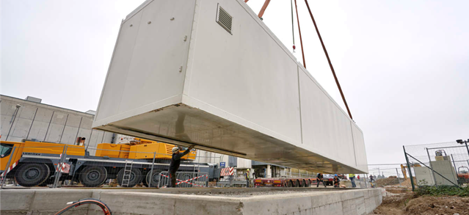
Installation
1
2
Power module
Several manufactures on the market of Modular Centers:
DELL, HP, Schneider….
Delivery possible in few steps → investment staggered
Preparation and tests in factory → fast deployment
The bidders selected was ‘Automation’ company (BE)
A common tender Alice + LHCb (12 Modules)
Deliveries / Experiments need:
First 3 LHCb Modules: Nov 2018 (phase 1)
First 3 ALICE Modules: Dec 2018
2 additional LHCb Modules: March 2019 (phase 2)
2 last LHCb Modules: Nov 2019 (phase 3)
2 additional ALICE Modules: Dec 2019
3
IT6
IT1
LHCb site

Slide 10
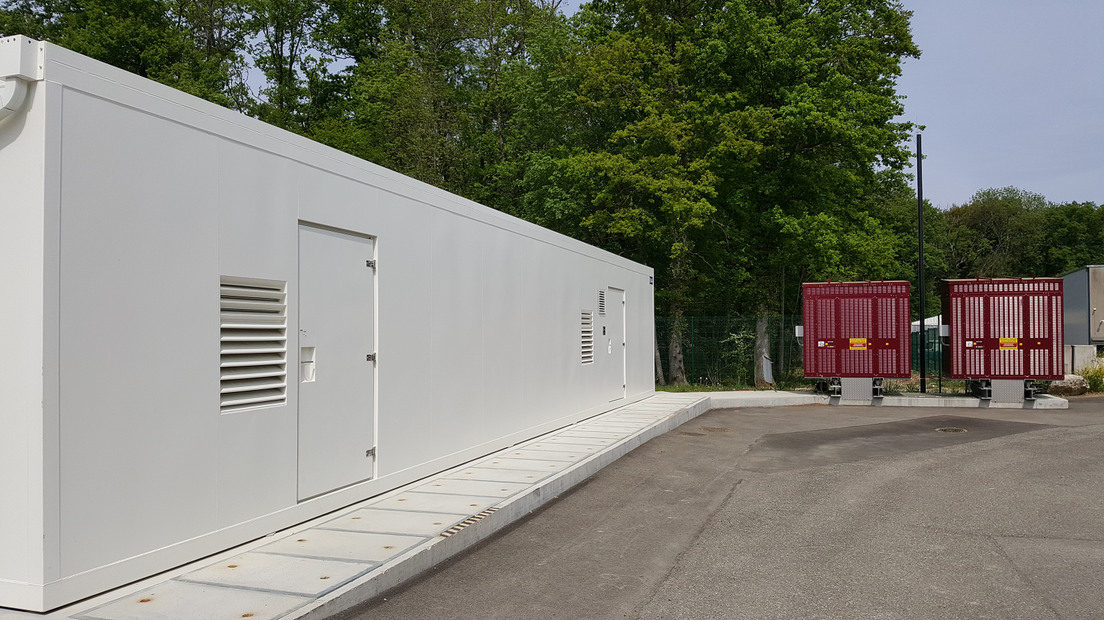
Transformers & Power module

Slide 11
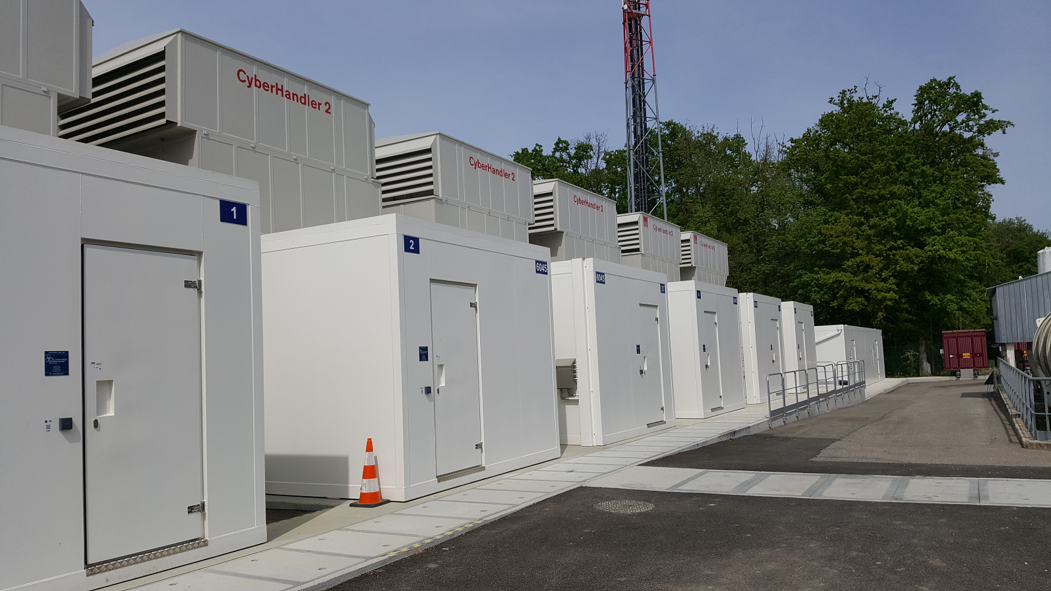
LHCb site

Slide 12
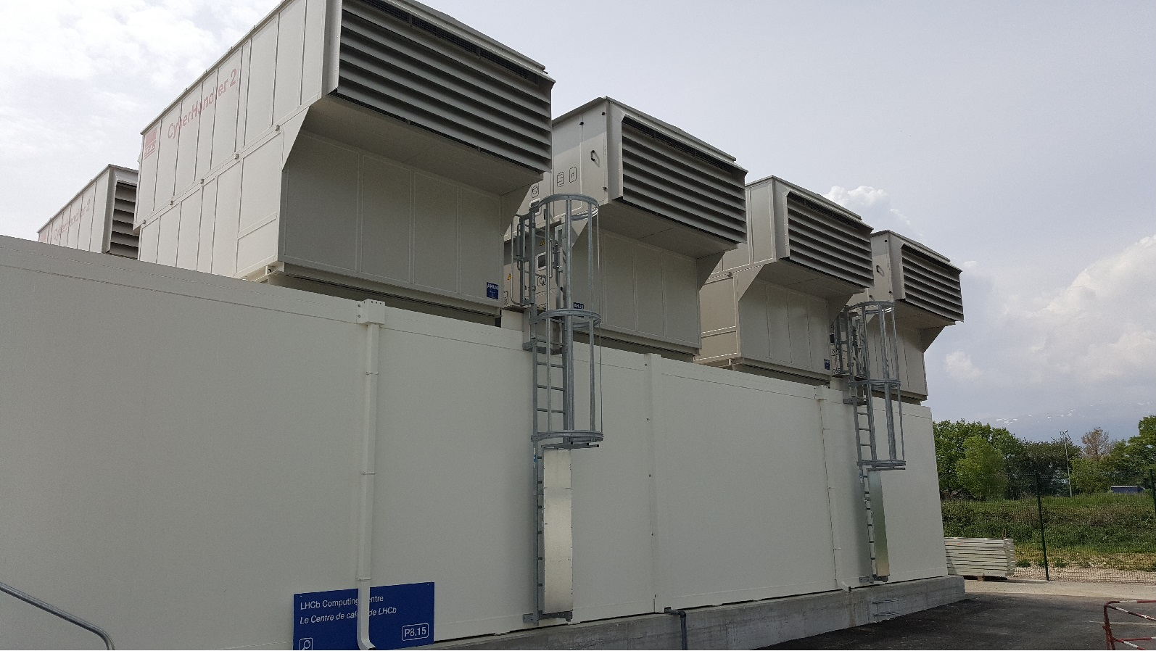
Air Handler Units
Up to 125 kW each

Slide 13
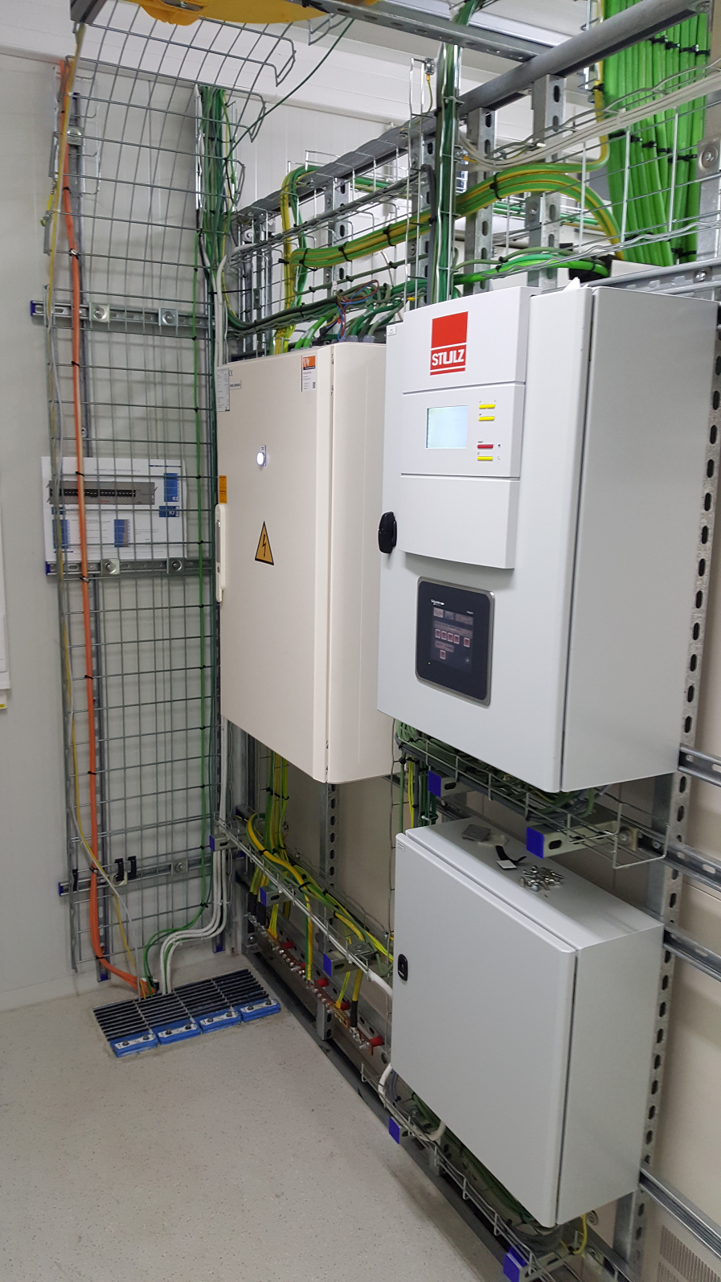
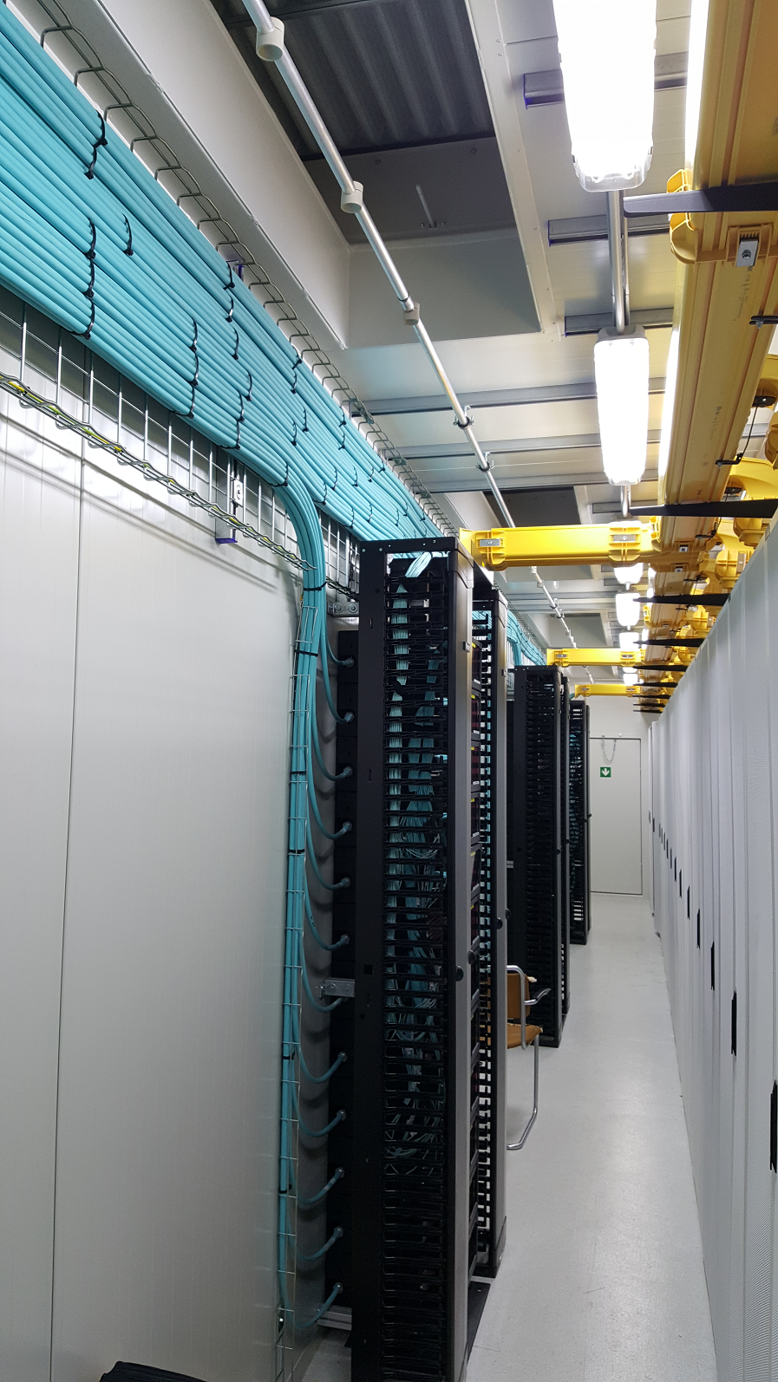
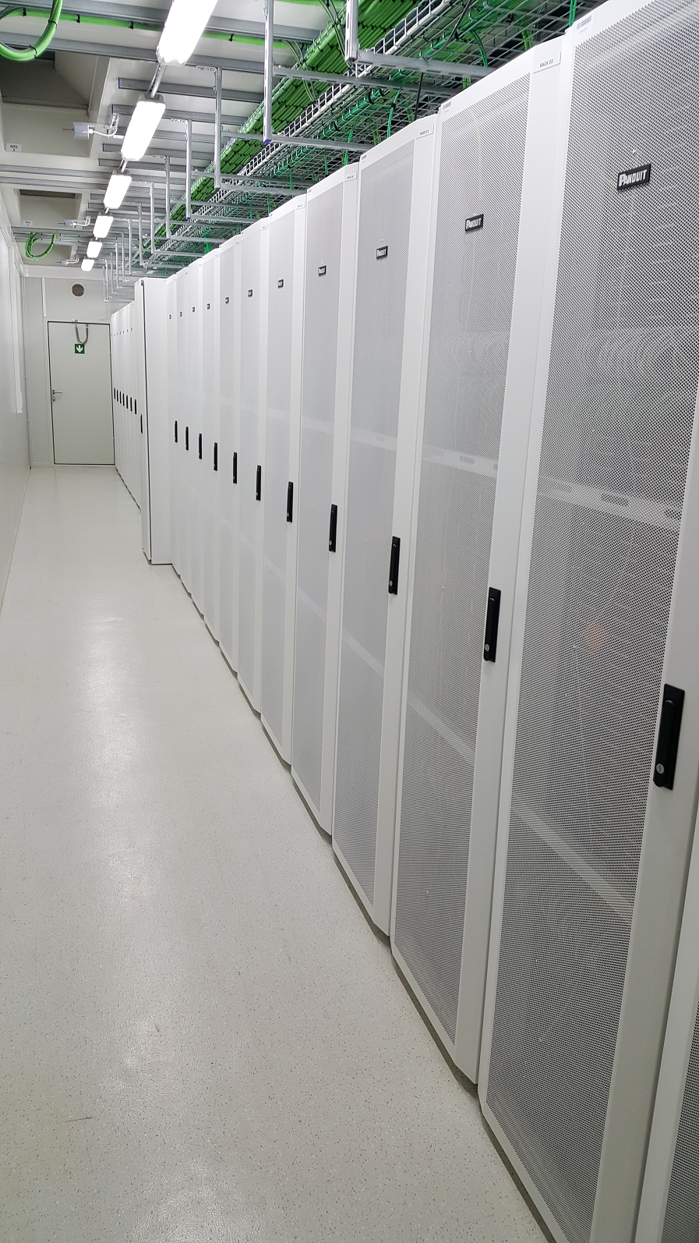
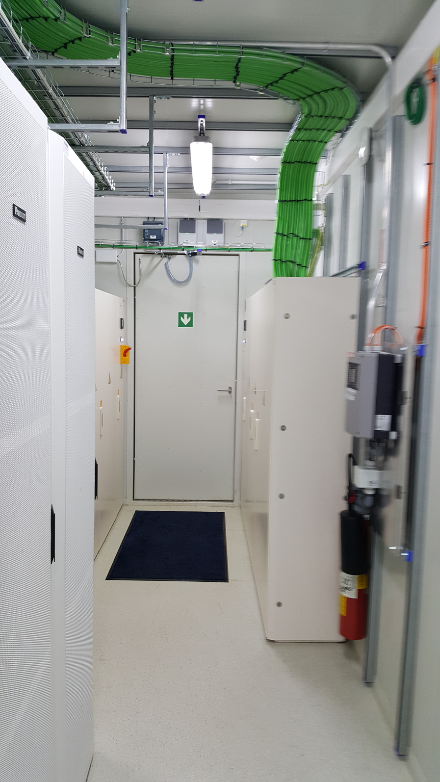
Inside the IT modules
2 secondary switchboards
Smoke detection
Air Unit Controller
19000 fibers come from LHCb Experiment (250m)
‘Cold’ aisle

Slide 14
ALICE site

Slide 15
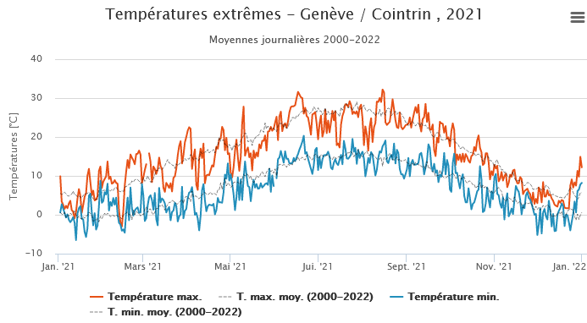
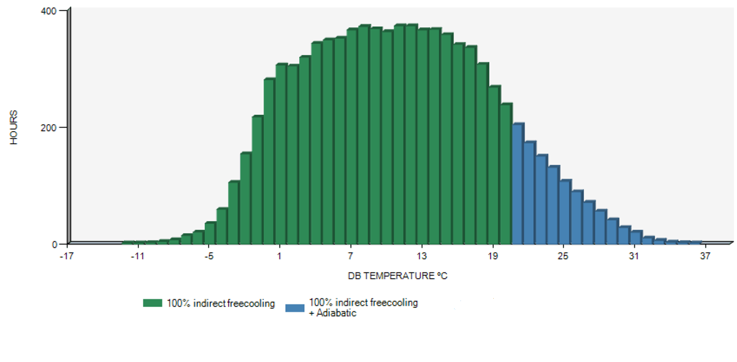
Temperatures in Geneva
For a full year, the outside air is below 20 °C most of the time
→ ‘Dry mode’ (without water) is the most used
Additional Adiabatic cooling (water used)
20°C

Slide 16
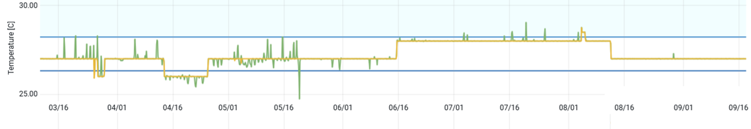
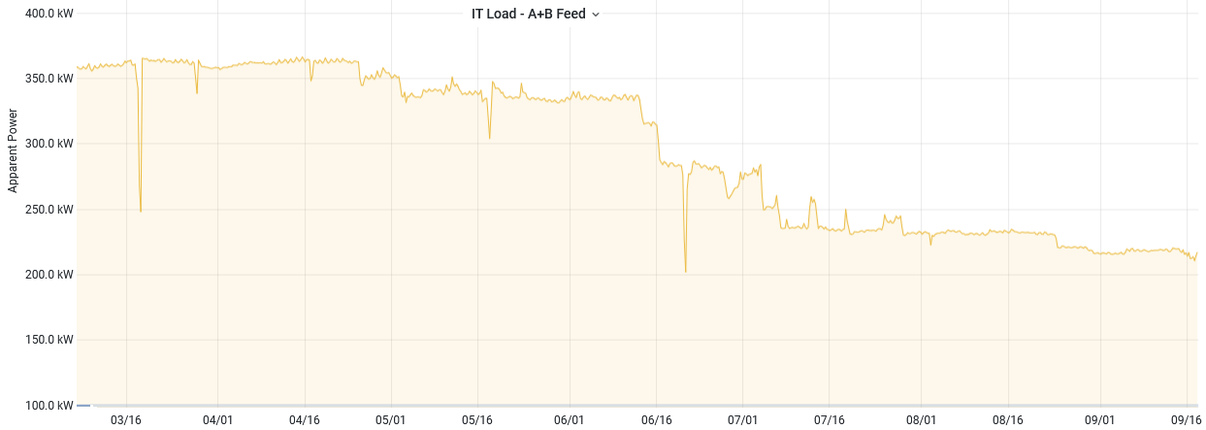
Temperature stability
Ex: air supply in IT2 module in 2022
Manual set point (26,27,28 °C)
Temperatures relatively stables (+/-1°C) , independently of the load
IT2 module
2022

Slide 17
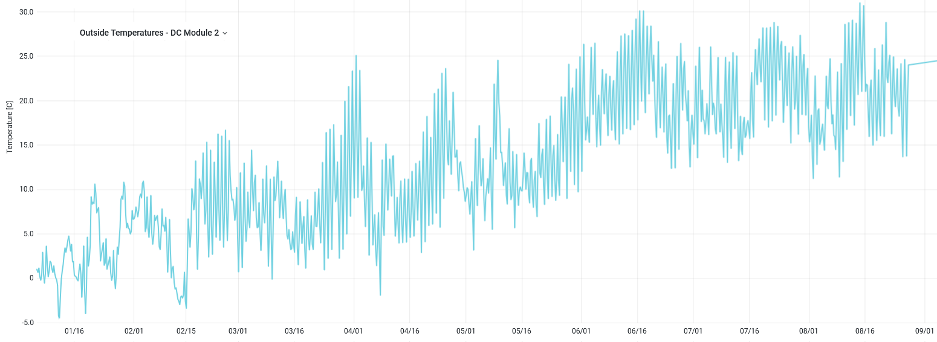
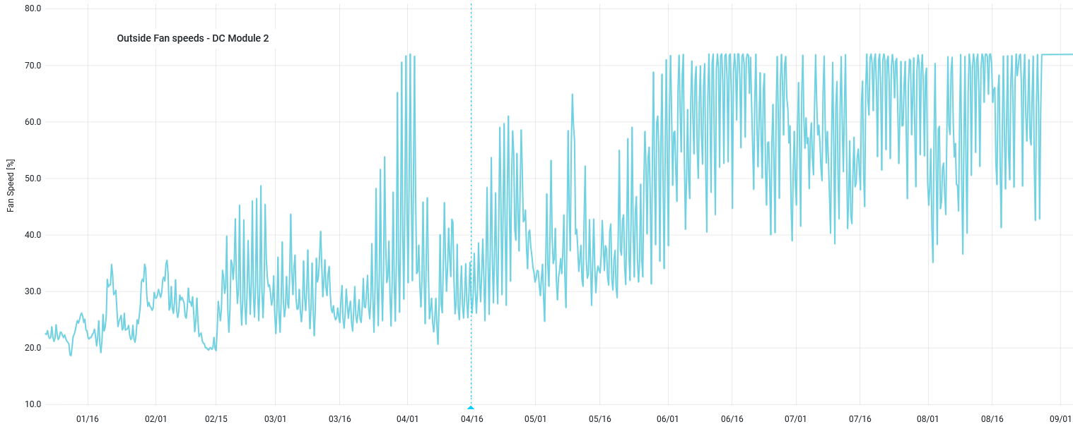
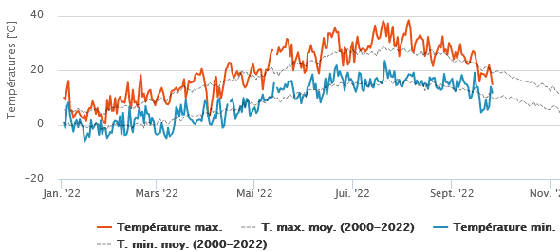
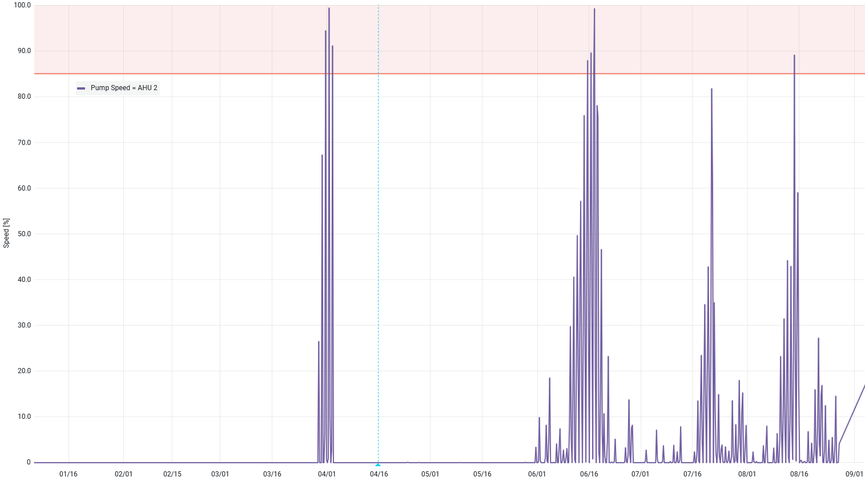
Trends
Outside Temperature
Average per day (max: 30°C)
Period: Jan - Sept 2022
Exceptionally hot during summer
Ex: IT2 module
% Outside Fan Speed
Maxi set to 70%
Fans speed + water pumps at the maximum only punctually
% Water pumps speed

Slide 18
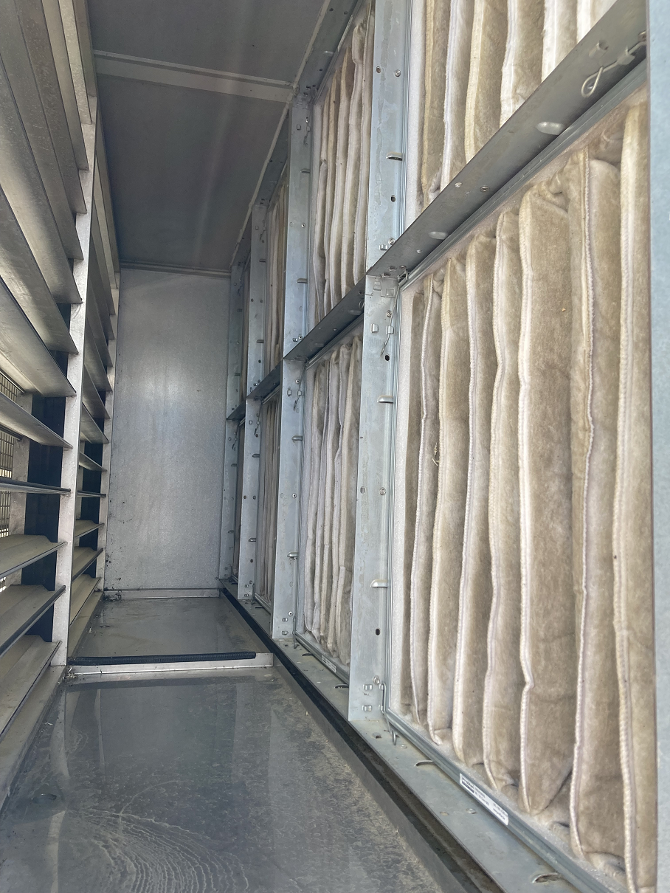
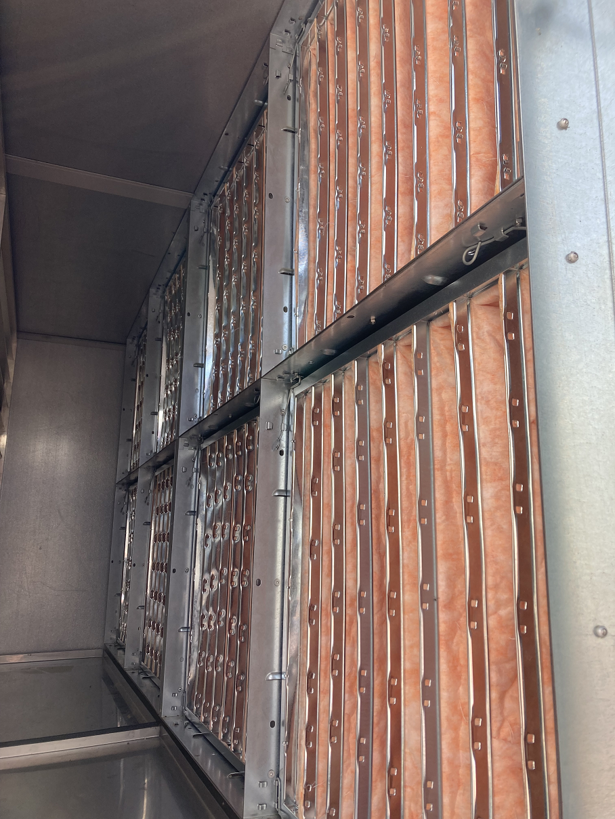
Regulation
Goal → have a 27 °C inlet server temperature, as stable as possible
Independently of Outside temperature, humidity & Load of servers
Parameters for each AHU:
Outside fan speeds
minimum 20%, high speeds clog more quickly the air filters
Inside fan speeds
adjusted to have a good delta T temperature for the best Air/Air exchanger efficiency
Water pumps speeds (in Summer mode)
enough to well cover the heat exchanger but not too high (energy consumption)
Influence of the air filters status
regular maintenance needed
→ better knowledges after 2 years of operation but the ‘tuning’ is still on going to reach the ideal operating point in term of Energy efficiency.
Air filters improvement
Page 18

Slide 19
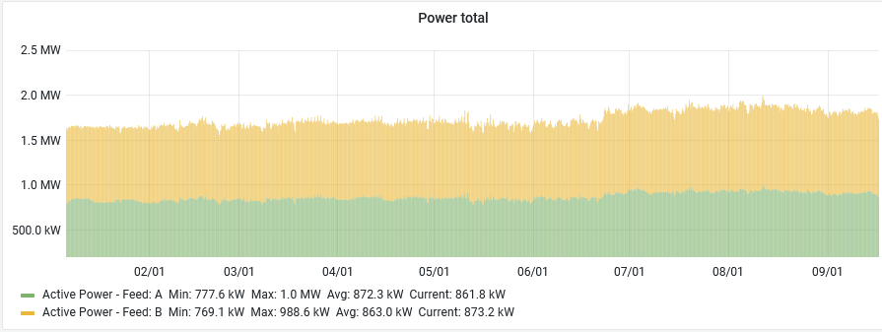
Data Center Total Power
~ 1.6 - 1.9 MW

Slide 20
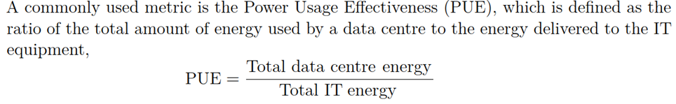
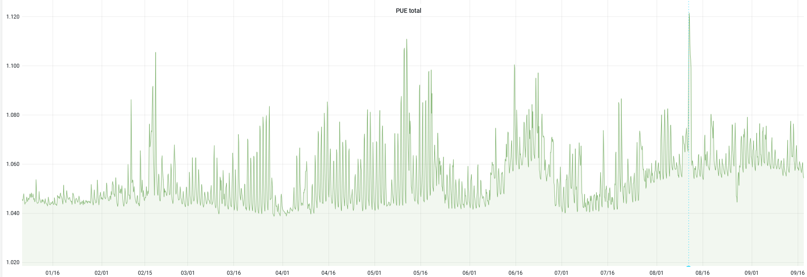
PUE
Average PUE: 1.055
(Jan.2022-now)
(Trend: average each 3 hours)
AHU maintenance
2022

Slide 21
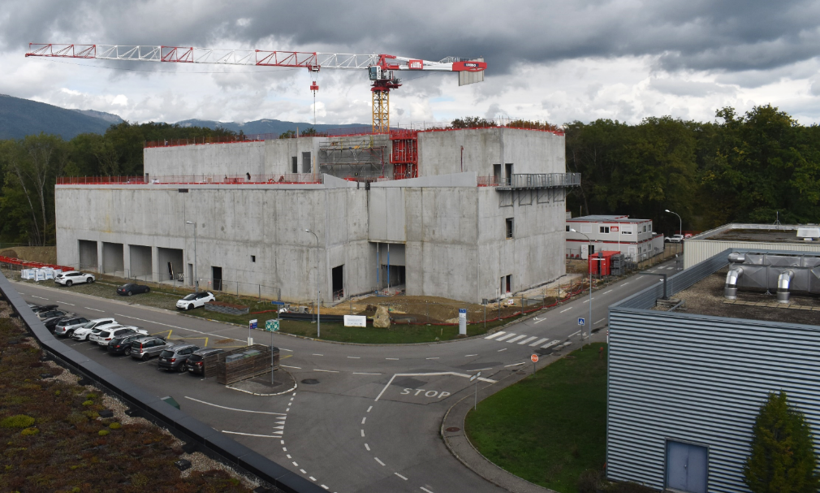
Prevessin Data Center
Under construction: operational end of 2023
Initial capacity, top floor: 4 MW
According to the needs:
2 lower floors up to a total of 12 MW
3 Phases deployment ( Oct. 2023 / 2025 /2030)
Very efficient cooling system
Power Usage Effectiveness (PUE) contractual < 1.15
CERN objective ~ 1.10
26/09/2022

Slide 22
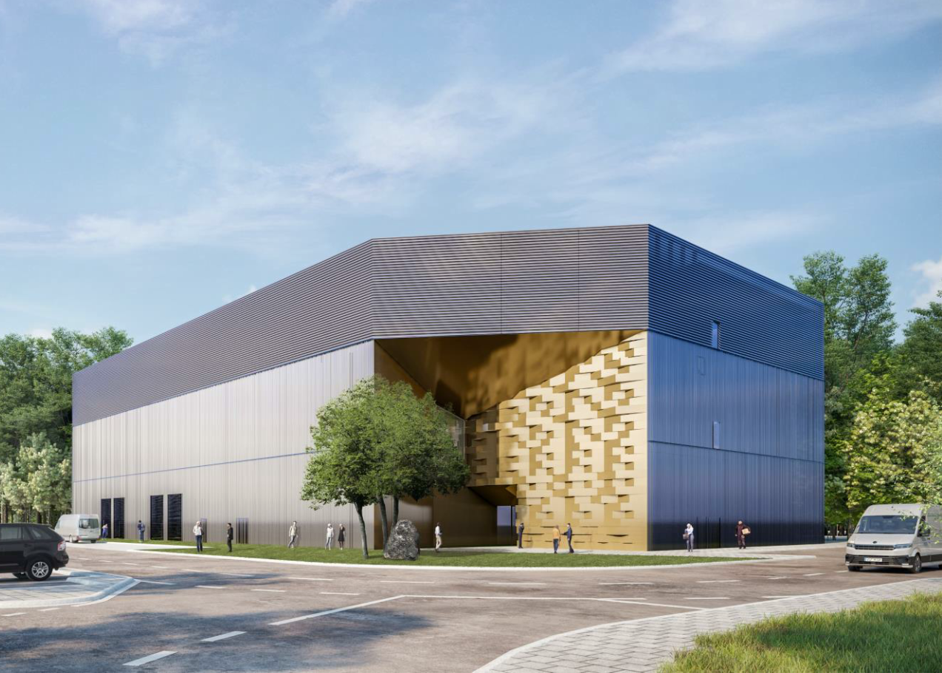
Prevessin Data Center
Occupied ground area: 2250 m2
Height: 19,15 m
Total surfaces: 6400 m2
Power per IT Rack: 20-25 kW
A heat recovery system is foreseen
up to 3 MW to heat the entire site
Vegetation will cover half the roof

Slide 23
Conclusion
ALICE and LHCb Experiments had need to increase significantly their computing facilities for the next years.
Considering the energy efficiency, modular Data Centers with indirect free air cooling have been adopted.
The two computing facilities have been delivered at CERN in time and without extra cost.
By using the outside air, the cooling efficiency has been drastically reduced to compare with the previous Data Centers underground.
The PUE is well below the 1.10 foreseen. Traditional DC (using expansion cooling) have their PUE from ~ 1.30 to 1.50.
The recent heat wave of summer 2022 (40°C peak) did not cause problems for the cooling system.
A new Data Center up to 12 MW is in construction at CERN, same approach: to have a high energy efficiency by using outside air but also by recovering part of the heat in winter.
END

