Slide 2


Are you ready?
Take a seat, the session will start shortly…

Slide 3
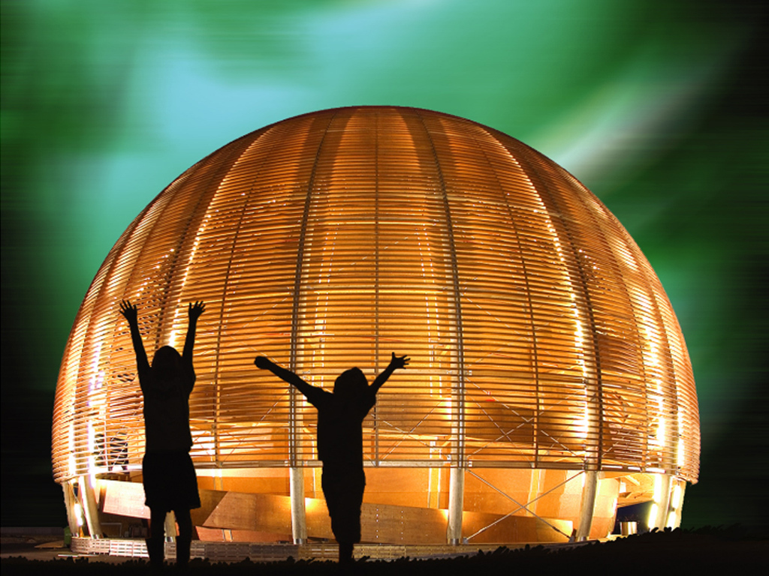
Welcome @ CERN
1 August 2023
© CERN Photo
Notes:
Good morning and welcome aboard!

Slide 4
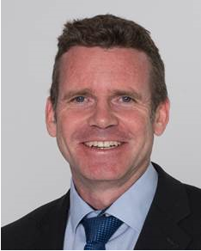
Bienvenue
Welcome
James PURVIS
Chef du département des ressources humaines
Head, Human Resources Department
Link to video on Indico
Notes:
Rocio
**************

Slide 5
Welcome Bienvenue
Kyriaki FAKOURELI
HR-LD
Erwin MOSSELMANS
HR-LD
Rocio
ALOT
HR-TA
Notes:
Rocio

Slide 6
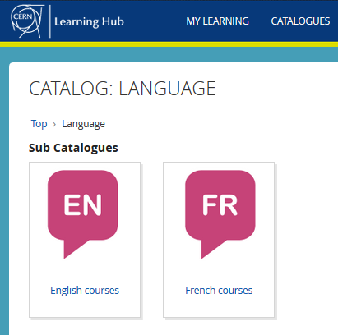


Logistics - language
Tandem
link
Find a partner
to practice speaking
each other’s language
Different levels, different formulas
classroom on site
virtual classroom (online)
blended (mix)
self-study with online platform
→ cern.ch/learninghub
Notes:
Rocio
*************
Au CERN, nous avons 2 langues officielles : l’anglais et le francais.
Qui maitrise bien ces 2 langues ?
Aujourd’hui, nous utiliserons principalement l’anglais, mais n’hesitez pas d’intervenir en francais si vous le souhaitez !
CERN has 2 official languages : English and French. Today, we will use mainly English, as from experience we know that not everyone understands French … yet !.
To learn English or French, there are classroom courses organised on the site, which are also open for spouses. You find the details on the CERN learning hub.
The enrolments open from the 7th November and the classes start in January 2023. 7th speaking platform.
And you can also create the opportunities yourself with the tandem website. The aim of the website is to facilitate finding a partner (not to bike together but) to meet and learn by practicing on a voluntary basis each other’s language, not limited to English and French !

Slide 7

Logistics - slides
Available at any time
direct link : https://indico.cern.ch/category/10150/
Notes:
Erwin
*************
The slides are available on Indico, which is an event management software tool created at CERN.
Later today, you will receive an email with the link to the slides.

Slide 8
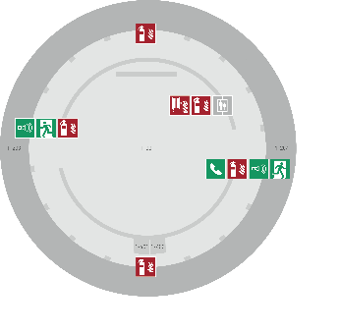
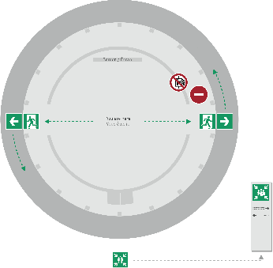
Emergency Procedure d’Urgence
When the alarm sounds
Lorsque le signal d’évacuation retentit
Evacuate immediately
Évacuez immédiatement
Don’t use the lift
N’utilisez pas l’ascenseur
Follow the signs
Suivez le balisage
Go to assembly point
Rendez-vous au point de rassemblement
74444
Escape routes
Voies d’évacuation
Fire hose
Lance d’incendie
Extinguisher
Extincteur
Assembly point
Point de rassemblement
Notes:
Erwin
**************
Welcome on board !
When you take a flight, you always get the emergency demonstration
When the alarm goes off (sound), everybody leaves immediately the room, using one of the 2 exits – never the lift.
We come together in front of the green panel “Assembly Point”.
Safety is important at CERN – there is a whole unit in charge of Health, Safety and Environment, which is directly attached to the DG.

Slide 9
Programme of the morning
08.45 Welcome by James Purvis, Head HR Department
08.55 Quiz – Part 1 : CERN as organization
09.20 Group photo, coffee break and networking
09.55 Quiz – Part 2 : Daily life at CERN
10.30 Meet colleagues from your department
Transfer to department
11.00 Welcome in your department
Notes:
Rocio
************

Slide 10


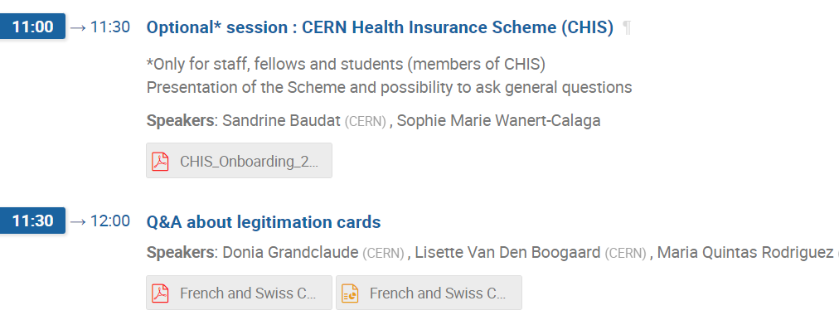
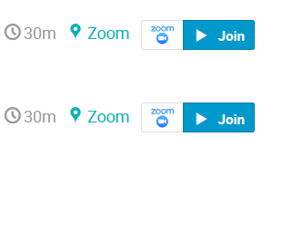
Programme Wednesday 2 August
Notes:
Rocio
******************
Programme continues tomorrow with 2 short presentations and the possibility to ask questions about legitimation cards and about the CERN Health Insurance Scheme, for those who are covered by it : staff, fellows and students.

Slide 11

Ready to learn
more about CERN
via a quiz ?
Notes:
Erwin
**********

Slide 12
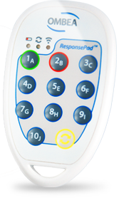
Quiz – voting clickers
Team work !
One clicker for 2 or 3 people
Get together !
Notes:
Erwin
************************
For the quiz, you will work in small teams of 2 to 3 people.
So please, make your team and
Is everyone in a team with 2 or 3 people ? Hands-up if you aren’t.
Does every team has one clicker ? Hands-up if youhaven’t.
OK, we are now ready to start.

Slide 13
How to answer
Question with only one correct answer
  Click on the number of your choice – blinks green
  Mistake ? Just enter your new choice – blinks green
Question with several correct answers
  Click on the different numbers of your choice
  Blinks green on every entry
  Mistake ? Reset response by pressing on a button
    an impossible answer (eg. 10) – blinks red
  Now enter all your answers again
Notes:
Erwin
************************
For a question with only one correct answer , you click on the number of your choice and that is all.
Your answer is automatically sent, you can see it with the green LED blinking once.
Some questions will have several several correct answers
Click one by one on the numbers of your choice, each time you select an additional answer, the LED will blink once green
Mistake ?
For questions with only one correct answer, it is easy : just enter your new choice, it overrides your previous answer.
For questions with multiple correct answers, you can reset your response by pressing on a button
an impossible answer, for example 10
These actions are accompagnied with a red blink.
This erases everything you answered. You can now start again to enter all your answers.
Before we start with the real quiz, let’s practice !

Slide 14
Test 1 : We are now in…
Building number
CERN’s Main Auditorium
Globe of Science and Innovation
ATLAS Visitor Center
Universe of Particles
Ideasquare
500
80
3162
80
3179
Only 1 answer is correct
Notes:
Florence
*****************
Where are we now ?
This is an answer with only 1 answer – you can not be physically at 2 places at the same time, even if you work at CERN ☺
The correct answer is B.
All the other places exist at CERN.
The Main Auditorium is in CERN’s Main Building. It is a the biggest auditorium at CERN, with almost 400 seats.
The Atlas Visitor Center is just behind the Globe.
It is one of the dedicated visit points for people who visit CERN and take on a guided tour.
Atlas is one of the experiments of LHC, the Large Hadron Collider.
The Universe of Particles is the exhibition which is on the ground floor of the Globe. It was sponsored by Rolex.
Ideasquare exists : it’s purpose is to bring together people to generate new ideas and work on conceptual prototypes in an open environment.
Not all buildings at CERN have names, but all buildings have a number (click).
If you find a logic behind the numbering, you’re surely will be nominated for the next Nobel prize in Mathematics.
But the good thing is that building numbers are unique : if there is a building 1, than there is only one building which has this number.

Slide 15
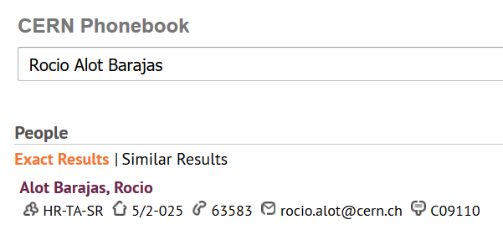


Building 5,
2nd floor
office 025
R = ground floor (rez de chaussee)
S = basement (sous-sol)
Notes:
Florence
*************
In the CERN Phonebook, you can find out where people have their office.
For example, me/Rocio has her office in building 5, on the 2nd floor, and the office number is 25, on the side of the corridor with oneven numbers, and which are going up from 1 on one side of the building to the highest number on the other side of the building.

Slide 16
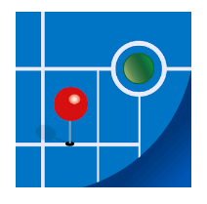
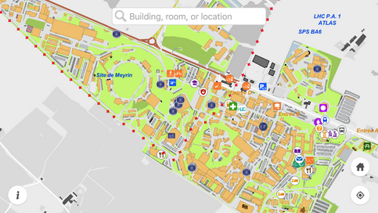
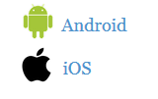
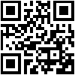
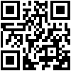
MapCERN
Notes:
Florence
************************
And there is an application which you can install on your smartphone.
The app is called MapCERN and is available for Android and iOS.
You can do a quick search, it covers all places at CERN and works offline.

Slide 17
Test 2 : The Globe …
Palais de l’equilibre
Represents an atom
100% wooden structure
Donation of Swiss government
Several correct answers !
Notes:
Rocio
*********************
Let us now look at how you answer a question with more than one correct answer : you enter all the letters which are correct.
The Globe of Science and Innovation :
In French, its name is Palais de l’equilibre
Represents an atom, because of its shape
Only wood was used for its construction
CERN did not pay for this building, it was the Swiss government who donated it to CERN
If you made a mistake, you can correct by pressing 10, which is an impossible answer.
This resets completely your answer.
You will then need to enter all your choices again.
Correct answers are C and D

Slide 18
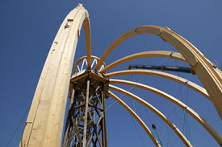
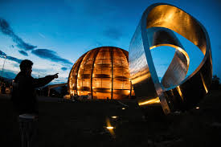
© CERN Photo
https://visit.cern/globe/history-globe
© CERN Photo
Notes:
Rocio
************************
The Globe is building with a history similar to the Eiffel tower.
Built for a national exhibition in Switzerland in 2002, which lasted 6 months, it was located near the lake of Neuchatel and called at that time the Palais de l’equilibre.
This name is however no longer used.
At the end of the exhibition, it was dismantled and the Swiss Governement offered to re-build it on the CERN site.
The building technique is quite unique : they start with top crown, which is on a temporary platform. Once all the beams are put in circle, the platform is dismantled : the crown holds everything together.
The shape of the building represents the planet Earth (outer layer to protect the building against Sun and other elements, just like the atmosphere does).
The Globe has become a landmark in the Geneva area.
If you want to know more about it, here is a link :
https://visit.cern/globe/history-globe

Slide 19

CERN as an international organization
Quiz – part 1
Notes:
Rocio
************************
Ready to start with the real quiz ?
We first have a few questions about CERN as an international organisation.

Slide 20
CERN members of personnel
How many ?
~ 2 660
~ 3 560
~ 11 900
~ 16 950
Only 1 answer is correct
Notes:
Florence
************************
How many members of personnel ?

Slide 21






CERN MoP
~16 950
Contractors
> 4 500
Employed MPE
~ 3 560
Associated MPA
~ 13 400
Staff
~ 2 660
Fellows
~ 900
Users
~ 11 900
Associates
~ 950
Students
~ 540
Notes:
Florence
************
Stats 2022 : https://cds.cern.ch/record/2858688?
************************
If you answered 2 660, then you probably only took into account the staff members.
But on top of the staff, we also had 900 fellows on 31.12.2022.
As from this year, CERN does not offer any fellow contracts anymore, but recruits now Graduates in 3 different programs : Origin (Early career professionals), Quest (Experienced Project Graduates, and Research Fellowships.
The staff members and fellows together are the employed members of the personnel or MPE.
CERN is their employer.
But besides these more than 3 4560 people, there are also many more who have a contract with CERN, although it is not an employment contract :
First of all, we have more than 11 900 users, who are working in scientific collaborations
And also almost 950 associates
And more than 500 students
All together approximately 13 400 people who have a contract of association with CERN.
Both MPE and MPA are considered MoP, and you are a member of that big family of almost 17 000 people.
How many people on the CERN site on an average day ?
Not all users are present at CERN every day. Note also that there is also personnel from contractors which can be working on the CERN site : there are more than 4 500 such people with an active registration, and some of them come here every day while others come only for the duration of a specific intervention.
Presence on CERN site :
before COVID : average of 7200 people on a normal weekday (of which 1800 contractors)
now (May 2022) : average of 6500 people (including 1500 contractors)
(Source : data presented at ED by Katy Foraz).

Slide 22
Main financial sponsor of CERN?
European Commission
United Nations (UNO)
CERN Member States
France and Switzerland
Only 1 answer is correct
Notes:
Erwin
*****************
Who is or are the main financial sponsors of CERN ?
The correct answer is indeed C, the CERN member states (click -> next)

Slide 23
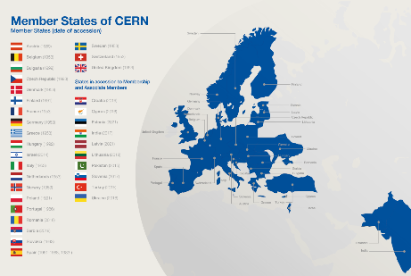
Revenues 2022
Member State contributions 84 %
Associate Member State contributions 2 %
Special contributions 3.7%
(to HL-LHC, specific experiments, from EU)
Other 10 %
(e.g. knowledge transfer, donations, …)
Principle =
proportional to Gross National Income
→ equal effort for every country
Notes:
Erwin
************************
Sources :
- https://cds.cern.ch/record/2799098?ln=en (budget 2022)
- https://cds.cern.ch/record/2790156 (map member states)
The CERN member states are indeed providing 84 % of CERN’s budget. (click)
There are today 23 Member states – originally when CERN was founded, there were only 12 countries. (click)
In order to have a fair sharing of the cost, the contributions are calculated as a certain percentage of the National Income.
And were does the remaining 16% comes from ?
Well, CERN also has associated member states, who pay a reduced contribution compared to the members states. This amounts to 2% of the budget.
The remaining 14% of the budget come a variety of sources : special contributions from certain countries or institutes, participation of the European Commission, income from knowledge transfer activities, donations to CERN, …)

Slide 24
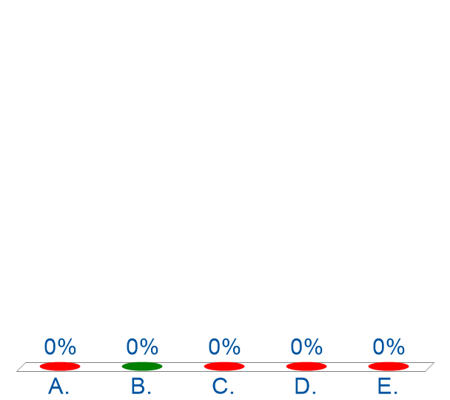
CERN’s final budget 2023
~ 136 000 KCHF
~ 1 360 MCHF
~ 1 360 M€
~ 1 360 k₤
Not yet known
Only 1 answer is correct
Notes:
************************
- https://cds.cern.ch/record/2799098?ln=en (budget 2022)
The correct answer is indeed 140 million Swiss francs, B.

Slide 25
Budget 2023
Official Currency : CHF
Units
1 kCHF = 1000 CHF = 10³ = one thousand
1 MCHF = 1 000 000 CHF = 10⁶ = one million
1 360 MCHF = 1.36 * 10⁹ = 1.36 billion (1.36 milliard)
Style guide
https://translation-council-support-group.web.cern.ch/style-guides
Notes:
************************
CERN has a Medium term plan : The MTP describes CERN’s scientific and financial strategy for the next five years along with a longer-term view over ten years. This plan is updated annually and also includes a precise budget for the following year. This budget is voted by the Council in the year before. So E was not correct.
CERN has its seat in Geneva, Switzerland, only the Swiss franc is udes as its official currency. So you could disregard the answers C and who were expressed in other European currencies.
You will very often see kCHF and MCHF, so it is worth to explain it
The correct answer is B : 1405 million Swiss francs, which is 1.4 billion Swiss francs
4. We have at CERN a styleguide for how to write in CERN publications
https://translation-council-support-group.web.cern.ch/style-guides
Applied here :
Use space as 1000 separator (comma might be misleading)
Up to 4 figures : no space or comma

Slide 26
Fabiola Gianotti is currently …
In Forbes’ top 100 of influential women
Spokesperson ATLAS
Nobel prize laureate
1st female Director General of CERN
CERN’s future DG
Only 1 answer is correct
Notes:
Rocio
************************
https://www.forbes.com/profile/fabiola-gianotti/

Slide 27
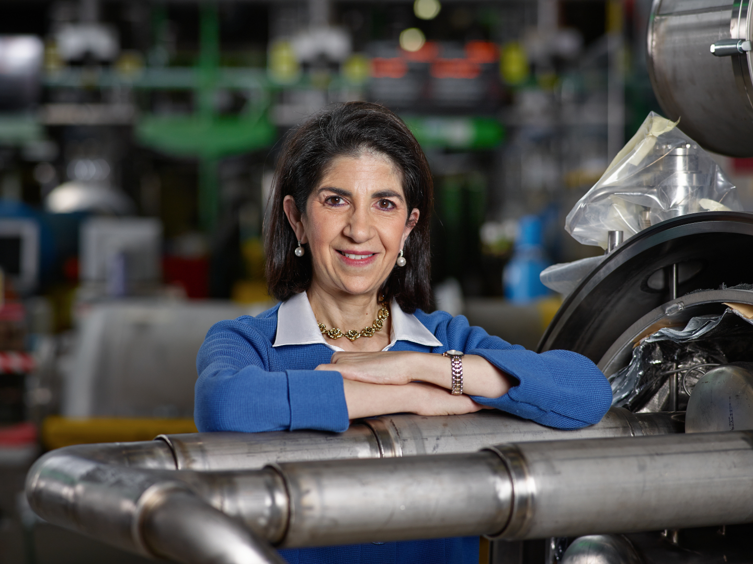
Link to biography
© CERN Photo, 2015
Notes:
Rocio
************************
https://press.cern/biographies/fabiola-gianotti-born-1960-Italian
Fabiola Gianotti is indeed CERN’s 1st female Director General, since 1st January 2016. Like all DG’s, she has a mandate of 5 years. In some exceptional cases in the past, this has been extended, but usually we have a new DG every 5 years.
From 2009 to 2013, she was spokesperson for the ATLAS experiment, and had the task of presenting the results on the search for the Higgs boson in a seminar at CERN on 4 July 2012. This discovery led to the Nobel prize for Higgs and Englert.
Gianotti has been awarded several prizes, but not the Nobel prize.
In 2013, she was included among the “Top 100 most influential women” by Forbes magazine, and today she continues to figure in their top 100 of Power Women.
https://www.forbes.com/profile/fabiola-gianotti/?list=power-women

Slide 28
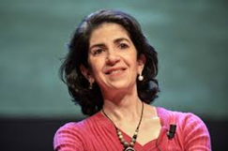
Director General
Health, Safety & Environment
Internal Audit
Legal Service
UNIT
Translation, Minutes & Council support
Accelerators & Technology
Beams
Technology
Finance & Human Resources
International Relations
Research & Computing
Engineering
Finance & Administrative Processes
Industry, Procurement & Knowledge Transfer
Human Resources
Site & Civil Engineering
Experimental Physics
Theory
Information Technology
AcceleratorSystems
Diplomatic & Stakeholder Relations
Education, Communication & Outreach
Science Gateway Operations
Sector
Department
Group

Slide 29
DG
HSE
Fabiola Gianotti
Benoit Delille
UNIT
ATS
BE
TE
FHR
IR
RCS
EN
FAP
IPT
HR
SCE
EP
TH
IT
SY
Sector
Mike Lamont
Raphael Bello
Charlotte Warakaulle
Joachim Mnich
Rhodri Jones
Florian Sonneman
Manfred Krammer
Department
J. Miguel Jiménez
Christopher Hartley
Gian Giudice
Katy Foraz
James Purvis
Enrica Porcari
Brennan Goddard
Mar Capeans

Slide 30
Sector
Director
Department
Department Head
DAO
DPO
DSO
DTO
…
Group
Group
Group
Group Leader
Section
Section
Section
Section Leader
Notes:
Florence
************
The size of a Department can be from less than 100 people to several hundreds of people.
A Department has usually several groups.
And groups can in turn be composed of several sections.

Slide 31
Physics Nobel prizes for CERN
How many ?
0
3
4
5
6
8
Only 1 answer is correct
Notes:
Erwin
****************
The correct answer is 0 : CERN is not eligible for a Nobel prize in Physics.
A Nobel prize for Physics can be awarded only to a person and on top, that person must still be alive.
However, CERN can be associated very easily with a number of Nobel prize winners.

Slide 32
Working at CERN when Nobel prize
1992 : Georges Charpak
1988 : Carlo Rubbia & Simon van der Meer
1984 : Jack Steinberger (with Lederman and Schwartz)
Working at CERN after Nobel prize
1952 : Felix Bloch
1976 : Sam Ting
Nobel prize thanks to discoveries at CERN
2013 : Peter Higgs & Francois Englert
Notes:
Erwin
************************
https://public-archive.web.cern.ch/public-archive/en/About/Nobels-en.html
https://www.nobelprize.org/nobel_prizes/facts/
3 prizes for people who were working at CERN when they received the Nobel prize
1992 : Georges Charpak
1988 : Carlo Rubbia & Simon van der Meer
1984 : Jack Steinberger (with Lederman and Schwartz)
+ 2 Nobel prize winners who worked at CERN
1952 : Felix Bloch, became CERN DG in 1954
1976 : Sam Ting, still works here at CERN on AMS (alpha magnetic spectrometer which is installed on ISS, the International Space Station)
+ 2 Nobel prize winners thanks to discoveries at CERN
2013 : Higgs and Englert

Slide 33
Welcome to HR-PXE colleagues
Opportunity to ask questions during coffee break
Collective induction session by type of contract
  Graduates (Origin, Quest, …)
  Tech & Admin students in the 2nd week
  Doctoral students
Individually contacted by HRA : Staff
Notes:
Florence
**************

Slide 34


Slide 35
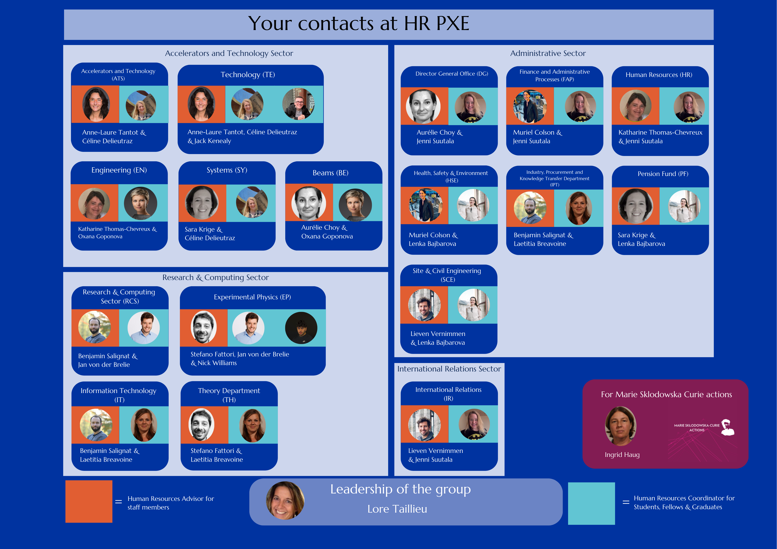

Slide 36
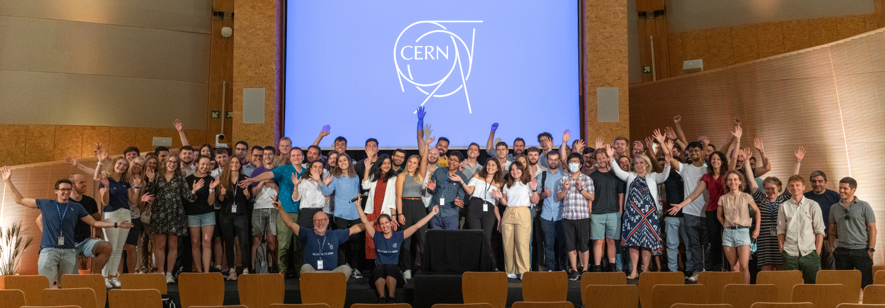
Time for a group photo !
© CERN Photo
Notes:
Rocio
***************

Slide 37



30
MINUTES
BREAK TIME

Slide 38
Are you ready?
Take a seat, the session will start shortly…

Slide 39
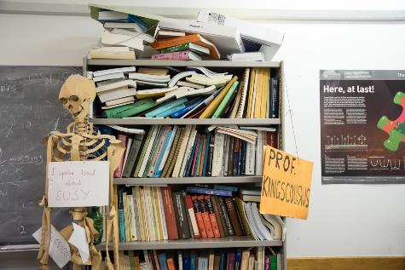
Daily life at CERN
Quiz part 2
Notes:
Rocio
************************
We have some questions for you, which will be helpful for your daily life at CERN.

Slide 40
CERN infrastructure covers …
625 ha of land
700+ buildings
30 km of roads
One site in France + one site in Switzerland
Several correct answers !
Notes:
Rocio
************************

Slide 41
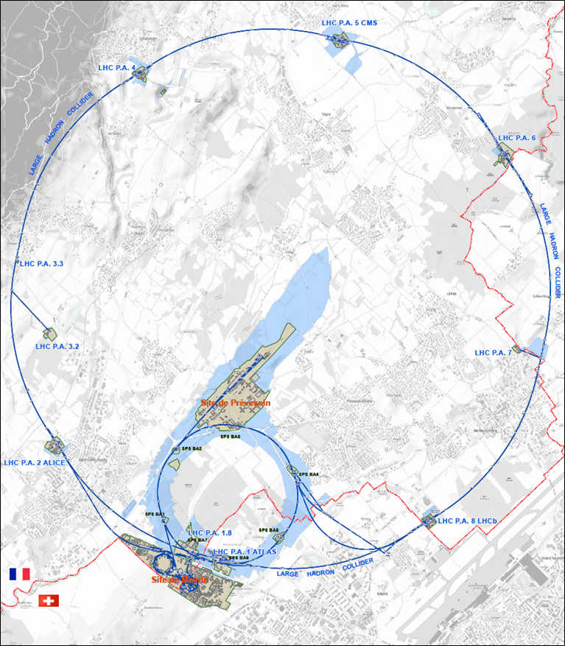




625 ha
515 ha
fenced : 220
110 ha
… 700+ buildings
accounting for
500.000 m²
5 900 parking spots
101 ha
green
spaces
30 km roads
Notes:
Rocio
************************
Source : https://indico.cern.ch/event/669690/contributions/2740056/attachments/1553507/2441980/Mobility_IoT.pptx
CERN is indeed composed of 2 major sites : Meyrin in Switzerland and Prevessin in France. But there are many more smaller CERN sites, especially in France.
CERN has all in all 625 hectares of land, of which 1/3 is fenced. The majority is on the French territory.
There are more than 700 buildings, for a variety of purposes and built in different periods in a variety of styles. Office space as well as parking space are sometimes difficult to find !
There are also 30 km of roads, and normal traffic rules applies. And there is control and sanctions : if you park your car on the footpath, the sidewalk, your car might be towed away.
There also green spaces, especially on the Prevessin site. Some people have the luck to see through their window deers coming out of the wood or a flock of sheep grazing in the prairie next to their office.

Slide 42
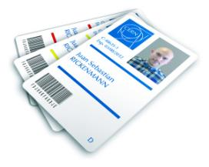
CERN access card
Visitors badge
Validity :
2 working days
CERN access card
Building 55
Working days
from 7:30 to 18:30, non stop
Also
vehicle registration
biometrics registration
https://sce-dep.web.cern.ch/security/access
Notes:
Erwin
****************************
If you hurry to get your CERN access card, you might find yourself queuing.
Avoid
Mondays
1st working day of the month
7:30 to 9

Slide 43




Gates | Days
Meyrin A | Mon-Fri | 6-22 |  | 7-19
Porte Jura Bldg 33 |  | 24/24
Meyrin B (Main entrance) |  | 24/24
Meyrin C | Mon-Fri | 6-22 |  | 7-19
Meyrin D (goods only) | Mon-Fri |  |  |  | 08-12 13-16
Meyrin E | Mon-Fri | In : 7-9.30 Out : 16.30-20
Intersites tunnel (restrictions) | Mon-Fri |  |  | 7-18
Prevessin Main entrance |  | 24/24 |  |  | 08-12 13-16
Prevessin Route du Maroc |  | 24/24
Prevessin Moulin des Ponts |  | 24/24
Notes:
Erwin
************************
There are 7 gates at the Meyrin site, and 3 gates at the Prevessin site.
The Main gates in Meyrin and Prevessin are open 24 hours a day, for pedestrians, bikes and motorized vehicles.
In Meyrin, on top of the main gate, there are 4 other gates for pedestrians, with are open only on workdays and for certain periods. 3 of them are also open for bycicles. With a car, you can get in on workdays during certain hours through 3 other gates.
Meyrin 2 gates with restrictions : entrance D is for goods only, and the intersites tunnel can only be used with a car and being on duty. It can not be used to get to your workplace nor to go home.

Slide 44
In restaurants at CERN, I pay
In cash, only in CHF
In cash, only in Euros
With the chip of my access card
In cash or by credit card,
in CHF or in Euros
Only 1 answer is correct
Notes:
Florence
************************

Slide 45

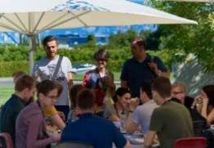
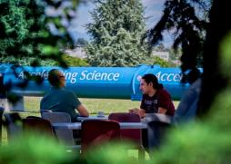
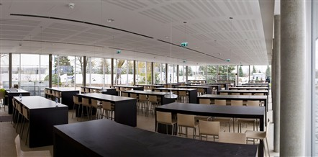
Restaurants
2 in Meyrin (resto 1 & 2)
1 in Prevessin (resto 3)
Cafeteria (snacks)
Building 13, 30, 40, 54, …
Click for more info
© CERN Photo
Notes:
Florence
************************
There are 3 restaurants on the site. There are always several menus, including a vegetarian.
You can find menus and opening hours in the CERN directory.
There are also microwave ovens, when you heat the food you bring along yourself.
There are also some cafeterias, which often have a reduced offer, and shorter opening hours.
From 15 June to 15 September : discount for students for a meal. Need a badge, can be obtained from your secretariat.
(see announcement https://home.cern/news/announcement/cern/restaurants-offer-student-discount-over-summer

Slide 46
For transport on/between CERN sites, I can …
use the bike I rent from CERN
rent a car and ask to be reimbursed
use a car belonging to CERN
use CERN’s car sharing service
use my own car/bicycle
use my brand new Harley Davidson
use the CERN shuttle service
Several correct answers !
Notes:
Erwin
************************
To drive a CERN car (3 and 4) requires CERN Driving authorisation :

Slide 47
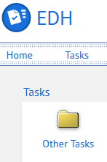
CERN Car
Requires
CERN driving authorization :
Valid driving licence
OK Department Head
Private vehicle
Not requiring registration
  Bike, “trottinette”
Requiring registration
  Must be registered in member state or EU country
  “Tourist” cars only
  Not allowed :
  Scooter, moto, lorry, bus, …
Notes:
Erwin

Slide 48
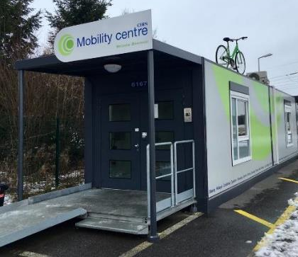
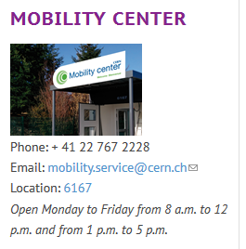
CERN Mobility Centre
Located next to Entrance A
Services offered
Bike rental
Car rental
Car sharing
Bike sharing
Shuttles
….
https://sce-dep.web.cern.ch/campus-life/mobility
Notes:
Erwin

Slide 49


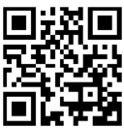
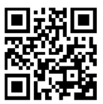
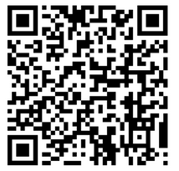
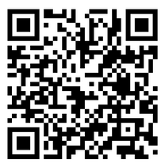
Mobility apps
Car sharing
glide.io
login with CERN SSO
Bike sharing
www.mobility-parc.net/
login with CERN SSO
Notes:
Erwin
For professional use, not for personal use
Car sharing
Max. 4 hours
Driving authorization is required + complete the Safety at CERN online course
If stay on the CERN site – no mission order required, outside CERN site : mission required
Pick-up and return to the same station
Bike Sharing
CERN site and to Prevessin allowed
Normal and e-bikes
50 ebikes all year round + 50 more during Summer
Pick-up and drop off in the another station allowed
Note : you should first complete the online course Road Traffic – Bike riding (and Safety at CERN)
(and wait for one night that the information is propagated and that you can logon to the app)
Link e-learning = https://lms.cern.ch/ekp/servlet/ekp?PX=N&TEACHREVIEW=N&CID=EKP000040487&TX=FORMAT1&LANGUAGE_TAG=en&DECORATEPAGE=N

Slide 50
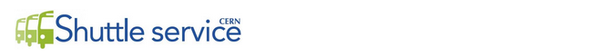
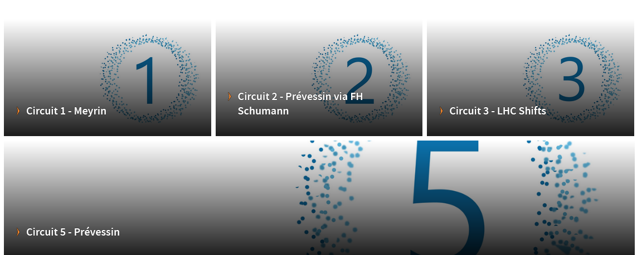
https://sce-dep.web.cern.ch/cern-shuttle-service
Notes:
Erwin
********************
Line 4 is temporarily suspended

Slide 51
In case of a road accident on the CERN site, I call …
Geneva police
CERN Service desk 77777
CERN Emergency 74444
My supervisor
My mother
Several correct answers !
Notes:
Rocio
************************
Can someone tell me what do you expect as a result from calling your mother ?
Answer A is not correct : the Geneva police cannot enter on any of the CERN sites without the explicit authorisation of CERN, which is given by the Host State Relation Service.
Answer B, the CERN help desk, will help you, but they will help you with anything. (-> next slide)

Slide 52
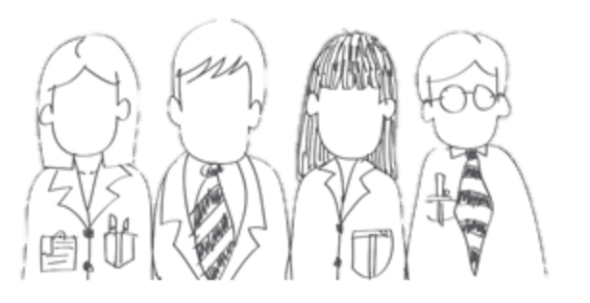

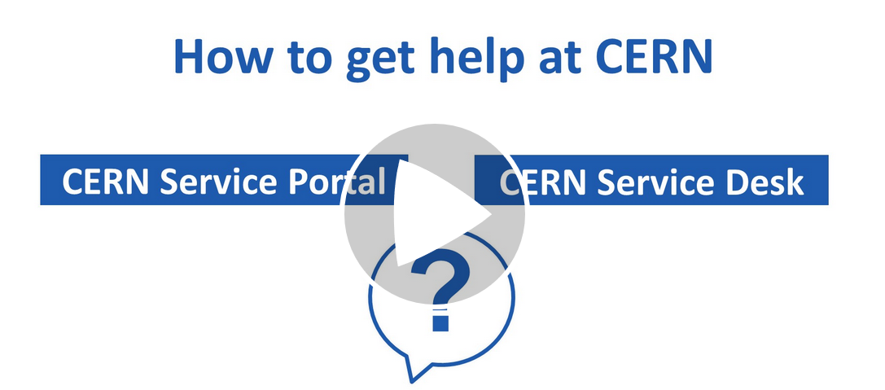




CERN Service Desk
Phone: +41 22 76 77777
Email: service-desk@cern.ch
Monday to Friday
from 7.30 to 18:30
( Geneva time )
CERN Service Portal
Services
Service overview in a glance
Online forms
Report an incident, submit a request
Knowledge articles
Find your answer!
Feedback
Your feedback matters!
https://cern.ch/service-portal
Notes:
Rocio
***************
The CERN service desk will help you with any request, and especially if you do not know which service to contact. They will make sure that your question gets to the right person, and that you get a reply.
Your request will generate a ticket for an efficient follow-up, and you will be informed by mail.
You can contact them by phone or by sending an e-mail.
The CERN service portal, accessible from the directory or from the link below, allows you to search for a service, find out what they offer and make an online request. There are also Knowledge Base articles where you find answers to the most frequent questions.

Slide 53
Accident on site – different cases
In all cases
Inform supervisor
In case of
Injury
Environmental hazard
Disruption traffic
3rd party involved
CERN Fire & Rescue 74444
(+ 41 22 767 44 44)
+
Internal accident report (EDH)
+
European Union Car Accident form
Notes:
Florence
************************
The correct answer in all cases is to call your supervisor (D) and in some cases (C), the CERN Fire and rescue service, through the number 74444.
Why always your supervisor ?
Internal accident report :
- needs to be signed by your supervisor, so for that reason he must be informed immediately.
- also used to report near-misses -> can be used to avoid further accidents
In certain cases, the CERN Fire and rescue need to be called.
We recommend to add the full number in your mobile phone
+41 22 767 44 44, so you can also call them if you are not connected to the CERN telephone network.
https://admin-eguide.web.cern.ch/node/352
2.2.1 Accident on the CERN site
In the event of injury, disruption to the flow of traffic or involvement of a third party:
The CERN Fire Brigade will go to the scene of the accident, take the appropriate measures required by the circumstances and draw up a call-out report.
The local Gendarmerie/Police will intervene only if so requested by CERN (Relations with the Host States Service or CERN Fire Brigade).
The driver(s) of the vehicle(s) (or, if not possible, the Fire Brigade) must complete a European car accident form (a blue form known as the "Constat européen d'accident automobile"), which must be signed by the parties involved. A copy of page 1 of the form must be sent to the Legal Service and to the CERN's Insurance Manager. If the injured party is a member of the personnel or a family member who is a member of the CERN Health Insurance Scheme, the procedure set out in paragraph 3 must also be followed.
In all other cases, and if the vehicle suffers material damage:
The member of the personnel must draw up a report to which he must attach, where possible, a statement by a witness (the European car accident form may be used). This report (or a copy of the European car accident form) must be sent to the CERN's Insurance Manager together with a statement by the Head of Department or his designated representative, certifying that the journey was made on official duty, or a copy of the official travel form if applicable.

Slide 54
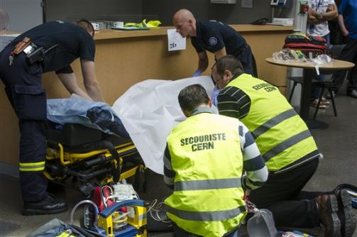
CERN Fire and Rescue Service
assisted by local First Aiders
Find out who
are closest to
your office / usual work places
© CERN Photo
Notes:
Rocio
************************
CERN’s Fire and Rescue Service is a team of more than 50 qualified fire-fighters and paramedics. They are available 24h/day, all year long.
They are assisted by more than 150 First Aiders, who are trained volunteers.

Slide 55
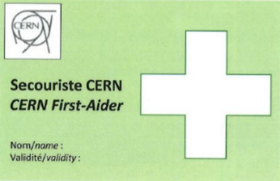
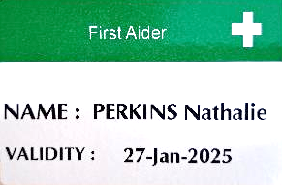
First Aider door sticker
Your safety contacts : http://safety.cern.ch/FirstAid.html
Notes:
Rocio
************************
You can find the first aiders in your building in this link.
And you also spot the green stickers on the doors, indicating that there is a qualified CERN first-aider in that office
Training available for all All personnel working at CERN : First Aid - Life-Saving Actions (Covid-19)
https://lms.cern.ch/ekp/servlet/FORMAT1?CID=EKP000043535&LANGUAGE_TAG=en

Slide 56
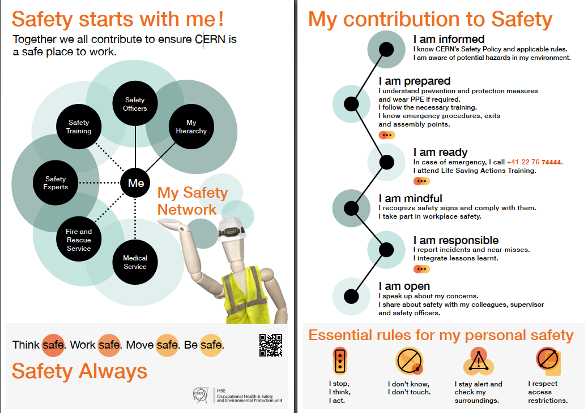
Click on the picture to download the flyer
Notes:
Rocio

Slide 57

or click on this slide

Slide 58
CERN Staff Association …
is one of the unions to defend your rights
an association, only open for staff members
oversees the CERN Clubs
runs a Crèche and a School on the CERN site
was the previous name of CERN Alumni
Several correct answers !
Notes:
Florence
************************
A is not completely wrong : the Staff Association is not one of the unions, but the only one.
It is open for all personnel, not only staff members but also for fellows, students, associates.
There are more than 50 clubs at CERN, which you can join..
On the CERN site there are indeed children from 4 months to 6 years who go the Creche or the CERN School.
The Staff Association oversees the operation of the Clubs and manages the School.

Slide 59


Defends all personnel
on a collective and on an individual basis
Become member : Website
Network of people who work(ed) at CERN
Become member : Website
Notes:
Florence
************************
The Staff association defends your rights, they organize regularly public meetings to inform you. The also have a website, and you can become a member by paying a fee.
CERN Alumni is an initiative launched in 2017.
It brings together people who have worked at CERN and those who work today at CERN. As such, you can be a member as from today. Membership is free.

Slide 60
Allowed Dress Code
Casual
Smart casual
Business casual
Business formal
All of the above
Only 1 answer is correct !
Notes:
Erwin
************************
How difficult was it this morning to decide how to dress for your first day ?

Slide 61
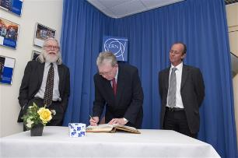
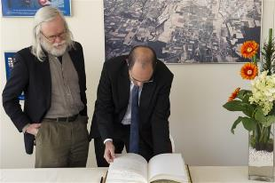
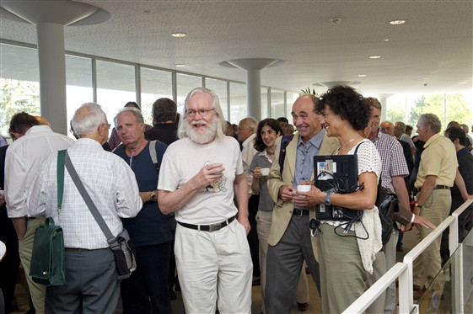
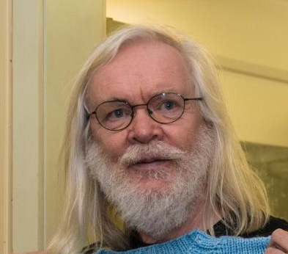
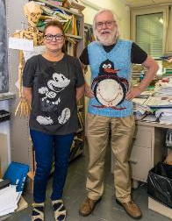
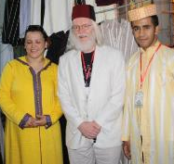
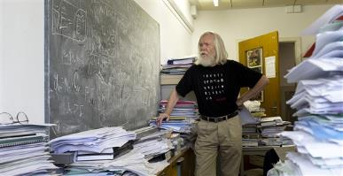
© CERN Photo
Notes:
Erwin
************************
This is John Ellis, a British theoretical physicist.
Employed by CERN, he has been department head of the Theory department, and an advocate for geographical enlargement of CERN.
You can see him
At an official ceremony to sign an agreement, dressed business formal, in a suit and tie
In his office, amongst his papers, casual with pants and a black T-shirt
At another official ceremony, smart casual or business casual, with a shirt and jacket, but no tie
At a Physics School in Morocco, in local traditional clothes, including the fez
Again in his office, with a Finnish teacher who knitted him a pullover with his famous penguin diagram
In 2011, at the coffee break of the colloquium in honor for his 65th birthday
Conclusion:
CERN is very casual
CERN is very tolerant
Recommendations :
Dress according to the situation
Nothing offending other people – T-shirts with text/images

Slide 62
CERN code of conduct
clear rules how to behave in specific situations
guide for ethical procurement
how to post on social media
standards to behave according to CERN values
not applicable to me
Only 1 answer is correct !
Notes:
Florence
************************

Slide 63

Code of Conduct
https://cern.ch/codeofconduct
https://cern.ch/cerns-values
with a 2’ video for each value
Code for ethical procurement
Social media guidelines
Anti-harassment policy
Anti-fraud policy
Conflict of interest policy
Diversity policy
Notes:
Florence
*****************
CERN's values are commitment, professionalism, creativity, diversity and integrity. Taken together they provide the basis for respect: respect for others, respect for the Organization and respect for its mission, and underpin the CERN Code of Conduct.

Slide 64
Tools for working remotely
Which tools have you already used?
Vidyo
MS Teams
Zoom
Cisco WebEx
Skype for Business
Mattermost
CERN Phone
Other
None of the above
Several answers possible !
Notes:
Rocio

Slide 65



CERN tools
Phone (audio only) : CERNphone
  Mobile client (iOS and Android)
  Desktop client (Windows, macOS, Linux)
Videocalls and videoconferencing cern.zoom – FAQ
Messaging – individual and public/private ”channels”
integration with Zoom
dedicated channel New @ CERN
Notes:
Rocio
****************
A call is usually more efficient than an email,
So we encourage you to reach out to colleagues, programme cordinators or supervisor, and we give you different options to do so:
If you go for a voice call, we are using CERNPhone
You can access the CERN phone book to find any employee working at cern, and dial her or his number.
For video conference, we use now Zoom on a CERN specific instance cern.zoom (with SSO)
For messaging, you can use Mattermost. You can invite someone for a instant Zoom call from

Slide 66


Newcomers website
https://hr.web.cern.ch/joining-cern
Notes:
Erwin
************************
On the HR website, you will find the Welcome to CERN pages.
You have already looked at the pages “Before I arrive”, but there is more information for you to discover now under “My first week” and later on under “life@CERN”

Slide 67



Many questions, answers are …
  Your departmental secretariat
  Your supervisor, your colleagues
  Specific question for personal situation?
  → Make appointment with the expert services
  Pension Fund, Health Insurance, Installation Service, Housing Service, Social Service, …
  HR Website > Welcome > my first week
Notes:
Erwin
************************
CERN is a big and complex organisation, with more than 60 years of history. Enough to have certain traditions, a certain way to do things, a certain culture.
You will certainly have many questions …
But where to find the answers ?
The departmental secretariat is an important info point about your rights and obligations, and it is close to you. You will meet them later today.
Your supervisor and colleagues will also be able to answer certain of your questions.
On the HR website, there is also the Welcome site with a dedicated section “My first week”
If you have specific questions related to you personal situation, there are expert services at your disposal. You’ll find their contact details on the Welcome pages.
We encourage you to make an appointment with them, why not do it later today ?
The quiz will also be an opportunity for you learn about the how and why of certain things.

Slide 68

Public meetings
Click for past and future events (agenda, slides, recordings)
Directorate every 3 months
Highlights of Council Week and other recent news.
Staff Association every month
Latest information on priorities and current issues
HR ad hoc
Focus on one topic (eg. flexibility)
Notes:
Erwin
**************

Slide 69


Recap from quiz - recommended
Download CERN map on your smartphone
Enter full number Fire and rescue service in your phone
Find out who are closest first-aiders
+ 41 22 76 74444
Notes:
Rocio
************************

Slide 70
Onboarding continues with …
Welcome session in your department
Meet the experts (online – Zoom)
  CERN Health Insurance (CHIS) Wednesday 2 August, 11.00 – 11.30
  Legitimation cards Wednesday 2 August, 11.30 – 12.00
Collective induction session or Individual contact by HRA
More short sessions with experts (online – Zoom)
  Computer security* Monday 14 August, 13.30 - 14.00
  Library and Open Science* Tuesday 26 Sept, 13.30 - 14.00
  Pension Fund* Monday 25 Sept, 13.30 - 14.00
Connecting the dots* Wed 27 September, 13.30 -17.30
Visit* of CERN installations – register via Indico
Spouse* welcome session Tuesday 26 September, 16.00 – 18.00
Part of
Welcome session
see Indico
* You will be invited
* You need to register
Notes:
Rocio
****************************
Induction sessions by type of contract :
Staff members will be contacted individually by their HRA (Human Resources Coordinator) .
Connecting the dots: you will have the opportunity to learn more about physics and accelerators, meet representatives from several CERN Services and CERN Clubs and network with other newcomers. You will receive an invitation and you will have to choose in which session you will enroll.
Visit of CERN installations open for newcomers and their families

Slide 71
End of session in the Globe
Notes:
Erwin

Slide 72

Users
If first day : go to Users’ Office
Notes:
Erwin
****************

Slide 73
Meet your new colleagues !
Go to the flag of your Department/Unit.
Introduce yourself to your colleagues
Meet with your DAO
  in Globe
  on Zoom
  in their office (use CERN Map for directions)
Notes:
Erwin
************************
Organise yourself as a group so everyone gets there in time
Don’t be afraid to ask for help
Don’t be afraid to offer help

Slide 74


Thanks !
Notes:
Erwin

Slide 75
Meeting points
Dept​ | Place​ | Time​ | Remarks​
ATS​ | 30/6-023 | 11:00​ | Help each other to get there ! With CERN Map​
BE​ | Zoom​ | 14:00​ | DAO meets at flag at 10.30​
DG​ | 42/R-023 | 11:00​ | Help each other to get there ! With CERN Map​
EN​ | Globe​ | 10:30​ | DAO meets at flag​
EP​ | Globe​​ | 10:30​ | DAO meets at flag​
FAP​ | Globe​ | 10:30​ | DAO meets at flag​
HR​ | Globe​​ | 10:30​ | DAO meets at flag​
HSE​ | Globe​​ | 10:30​ | DAO meets at flag​
IPT​ | 5/3-026​ | 11.00​ | Help each other to get there ! With CERN Map​
IR​ | Globe​ | 10:30​ | DAO meets at flag​
IT​ | 31/S-023​ | 11:00​ | Help each other to get there ! With CERN Map​
PF​ | Globe​​ | 10:30​ | DAO meets at flag​
RCS​ | Globe​ | 10:30​ | Together with EP​
SCE​ | Globe​ | 10:30​ | DAO meets at flag​
SY​ | Zoom​ | 14:00​ | DAO meets at flag at 10.30​
TE​ | Globe​ | 10:30​ | DAO/GAO meets at flag​
TH​ | 4/2-004 | 11:00​ | Help each other to get there ! With CERN Map
Notes:
Erwin

Slide 76

Notes:
All the best !

