Slide 1


TRUSTroke WP2 Review
Luca BARBIERI, Antonio BOIANO, Mattia BRAMBILLA, Bernardo CAMAJORI TEDESCHINI, Michele CARMINATI, Stefano LONGARI, Usevalad MILASHEUSKI, Monica NICOLI, Alessandro REDONDI
CERN, Geneve, 28-29/09/2023

Slide 2
WP2 Task 2.2
T2.2: FL network architecture and protocols (Leader: POLIMI; CERN, CNR); M3-M36
- definition of an efficient, robust and secure network architecture (to be delivered in D2.2 and D2.6).
- definition of communication protocols to support the FL processes
- identification of key communication requirements
- analysis of the traffic generated by different FL architectures (centralized vs decentralized)
- development of the control-plane (e.g., authentication of nodes) and data-plane protocols (e.g., ML model uploads and downloads) for the FL platform

Slide 3




FLux: Goals and motivations
Understand the impact of communications protocol performance is key to design efficient FL systems.
Goals:
Creation of framework to emulate a Federated Learning network
Benchmark FL framework
Benchmark communication protocols (e.g. FedComm[1])
[1] G. Cleland, D. Wu, R. Ullah and B. Varghese, "FedComm: Understanding Communication Protocols for Edge-based Federated Learning," in 2022 IEEE/ACM 15th International Conference on Utility and Cloud Computing (UCC), Vancouver, WA, USA, 2022 pp. 71-81.

Slide 4
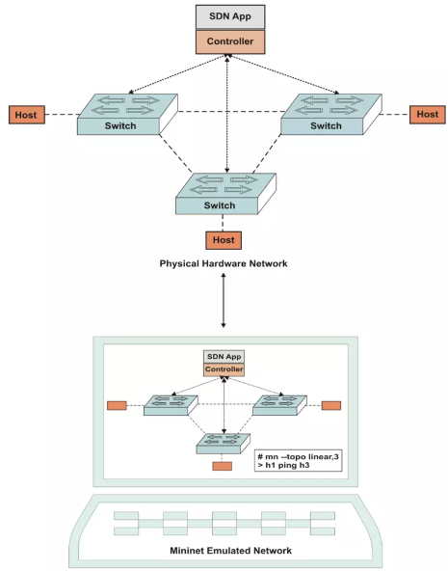

Mininet and Containernet
Mininet:
Virtual test bed and development Environment for SDN
Test complex network topology without a physical network
Run real code as Linux kernel, network stack and User Space code
Containernet add Docker support to mininet which enables support for CPU and RAM limitation per host

Slide 5



Flower a case-study: Test setup
10 Rounds
5 Clients
3 Comm. protocol compared (Stream gRPC, Request/Response gRPC, REST)
X 5

Slide 6
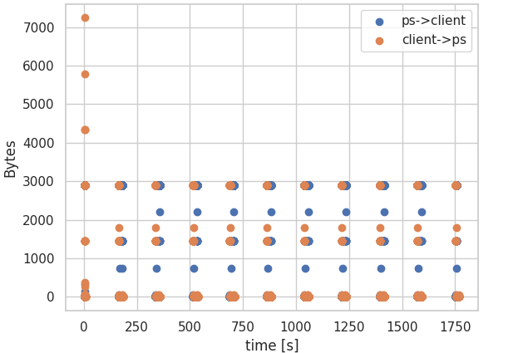
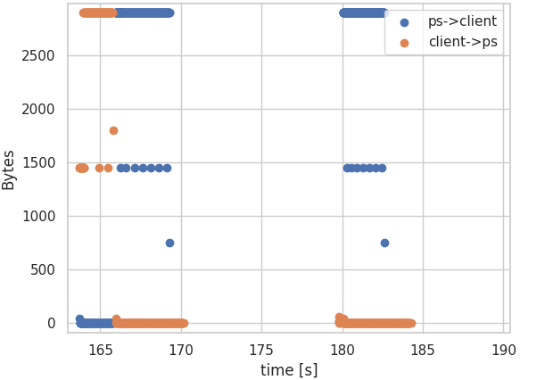
Flower a case-study: Communication rounds

Slide 7
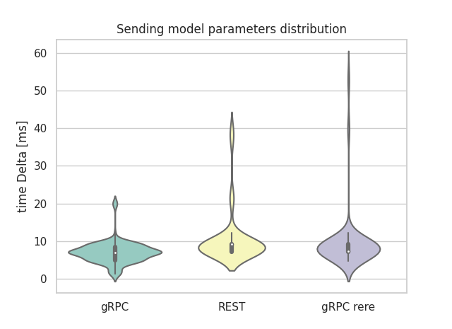
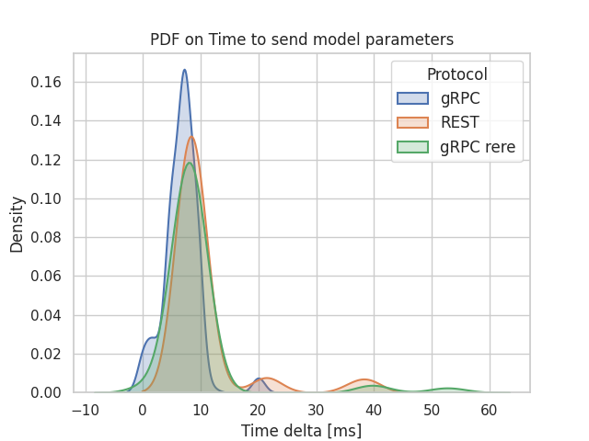
Flower a case-study: Comm. time distribution

Slide 8
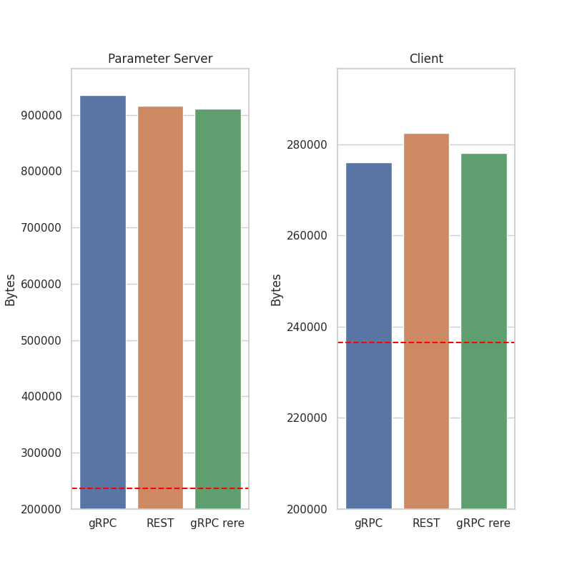
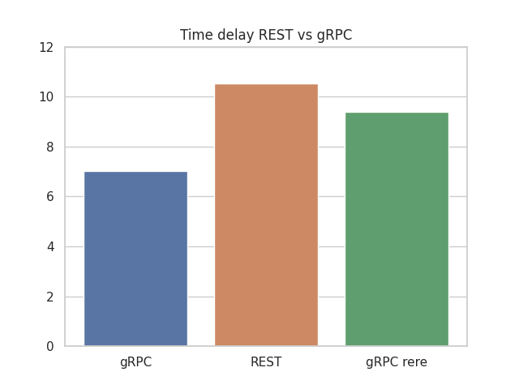
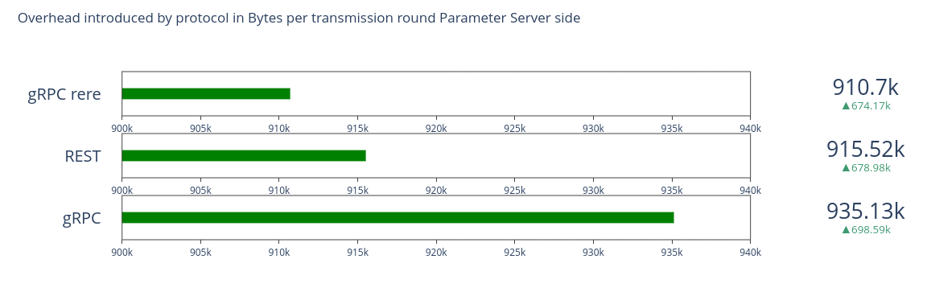
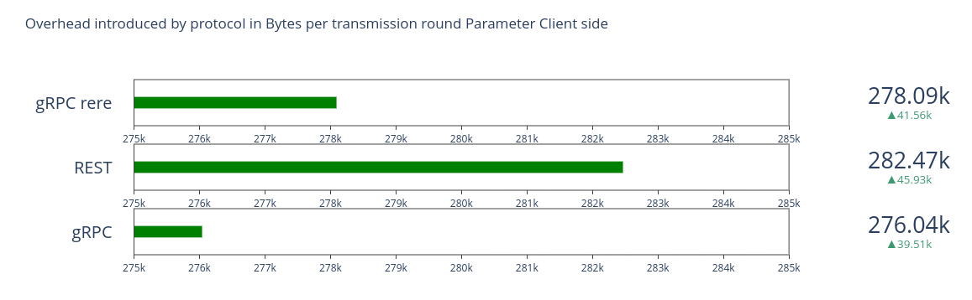
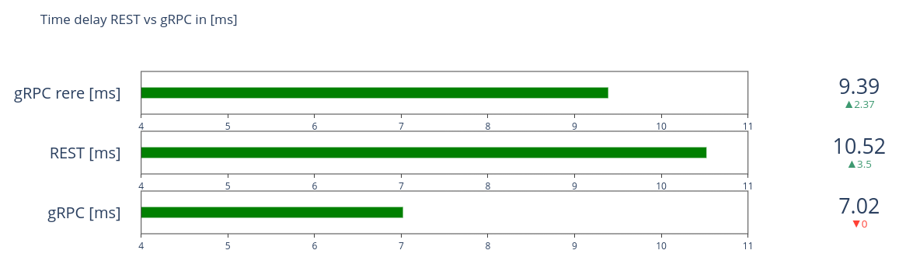
Flower a case-study: Protocol overhead
Protocol Overhead in Bytes

Slide 9
Conclusions
Brief Presentation of FLux
Example of a possible benchmark with KPI extraction from FLOWER framework ​
Future Directions:
  Create a solid benchmark of different FL frameworks and communication protocols as a function of:
    Network topology
    ML Model size
    CPU and RAM constraints
    Network stress
​

Slide 10
WP2 Task 2.3
T2.3: FL algorithms and optimization (Leader: CNR; POLIMI, CERN); M3-M36
- analysis of the federation algorithms and their optimization
- different FL designs (centralized, decentralized, synch/asynch)
- verification using synthetic and public datasets and initially delivered (D2.1)
- optimization based on the finalised AI models (T4.4)
- transferred to T2.1 for integration with the FL network infrastructure
- possible support of re-training of the AI models on new patient data or clinical sites, when available.

Slide 11
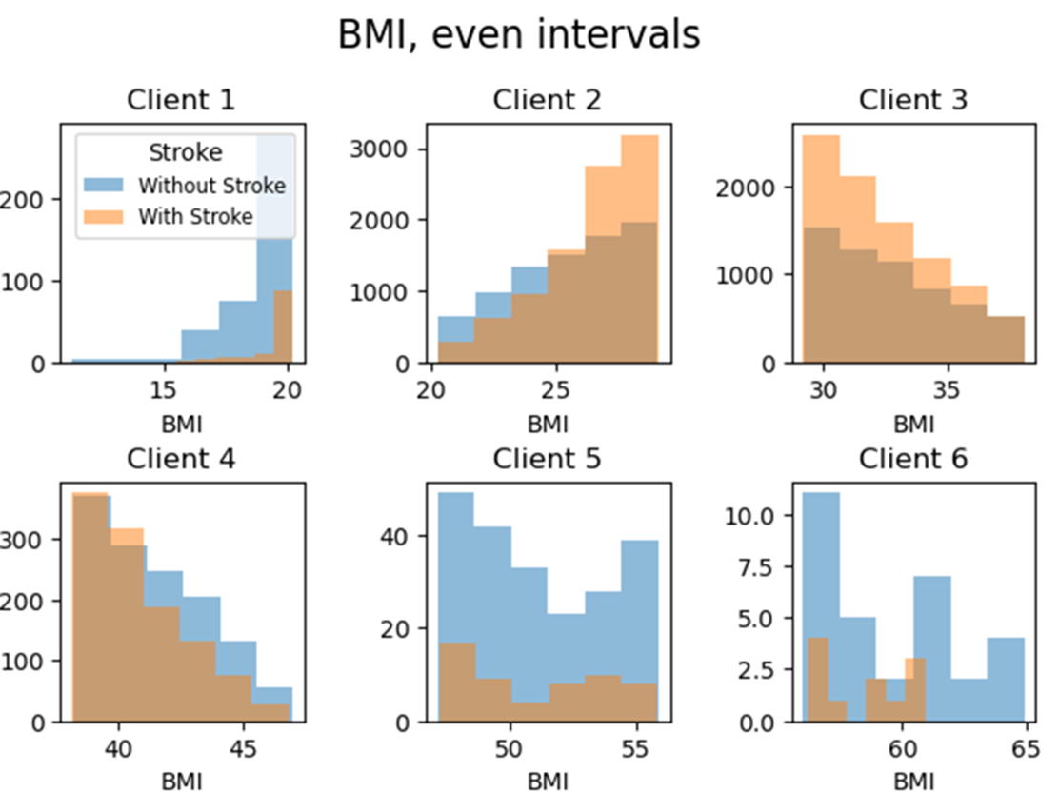
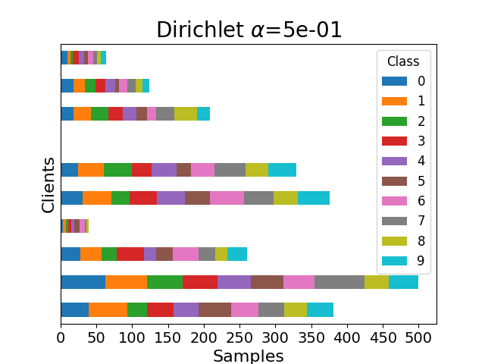
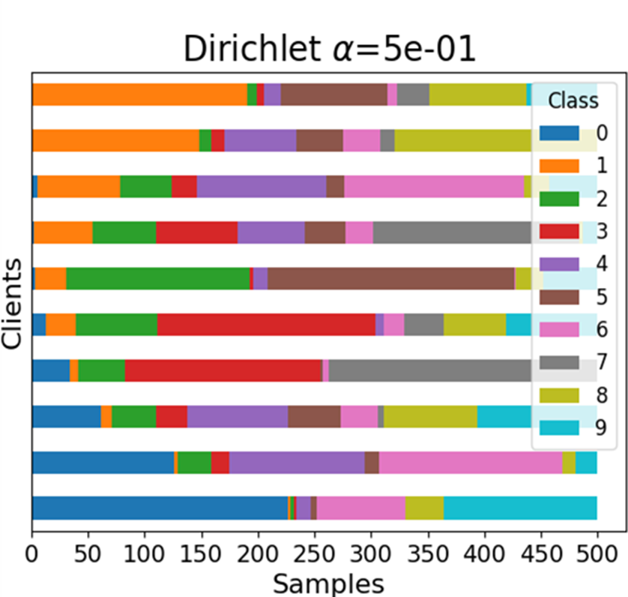

FL algorithms and impact of heterogeneous data distribution
We are investigating FL algorithm performances on real data (as much as possible close to the Trustroke usecase) and the impact of data heterogeneity
Heterogeneity
Quantity based
Label based
Feature based

Slide 12
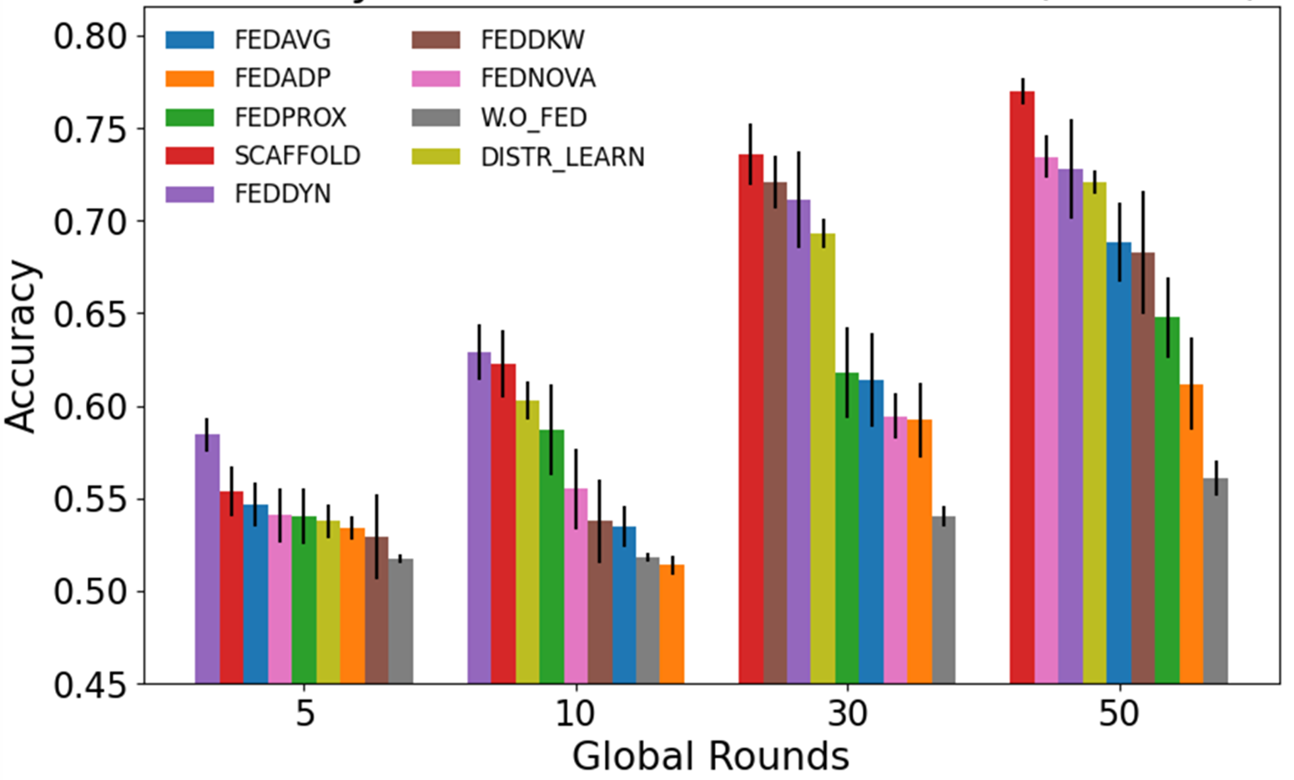
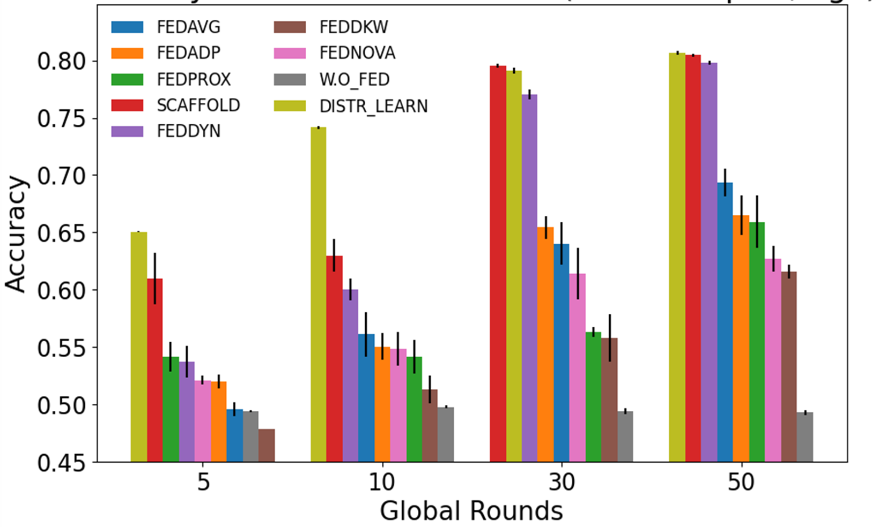
Preliminary validation of FL algorithms
We made a first assessment on a number of FL algorithms from the literature analyzing varying levels of hetereogenity
HETEROGENOUS SAMPLES
HETEROGENEOUS LABELS

Slide 13
Task 2.3 discussion
Development of ad-hoc validation and/or benchmarking strategies suited for the data to be used during the project. It would be useful to have information on the data that will be made available.
Expand the assessment to other medical datasets (now using only the stroke dataset publicly available via Kaggle).
Studying FL algorithms for heterogeneous AI models (e.g., vertical FL scenarios).
Extensions of the FL platform to support multiple (related) medical tasks (e.g., predictions of the CEPs).

Slide 14
WP2 Task 2.4
T2.4: Security and privacy design (Leader: POLIMI; CERN, CNR); M3-M36
- implementation of both security and privacy by design principles both for the PS and the medical nodes
- development of methodology for threat modelling, risk assessment and risk treatment
- study of state-ot-the-art and black and glass-box testing methodologies (to de described in D2.3)
- testing and verification of FL platform robustness against several attacks (to de delivered in D2.7).

Slide 15

State of the art security measures
State-of-the-Art cybersecurity measures identification and deployment
Solid methodology of threat modelling, risk assessment, and risk treatment.
Secure Authentication: Verify participants
Multifactor Authentication, Certificated-based Authentication
Access Controls: Limit data and model access
DAC, MAC, RBAC, ABAC
Model Versioning: Ensure model integrity
DVC, MLFlow
Monitoring and Auditing: Detect and respond to anomalies
Intrusion Detection and Prevention systems, Testing frameworks
Secure Network Architectures: Partitioning and resiliency
Firewall, VPN, Load Balancing, Proxy
Encryption: Protect data in transit and at rest
SSL/TLS, HTTPS, AES 256

Slide 16
A taxonomy of the adversarial attacks
Membership Inference
Feature Inference
Model Inversion
Label Flipping
Class Representation
Data Privacy
GAN Reconstruction
Watermarking
Perturbations
Data Poisoning
Model Performance
Targeted
(Back Doors)
Training Rule Manipulation
Training Rule Manipulation
Untargeted
(Degradation)
Gradient Manipulation
Model Poisoning
Gradient Manipulation

Slide 17
A taxonomy of defences against adversarial attacks
Local DP
Regularization
Differential Privacy (DP)
Data Privacy
Central DP
Robust Aggregation
Adaptive Mechanisms
Model Performance
Similarity Assessment
Outlier Detection
Metric Assessment

Slide 18
Discussion

Slide 19
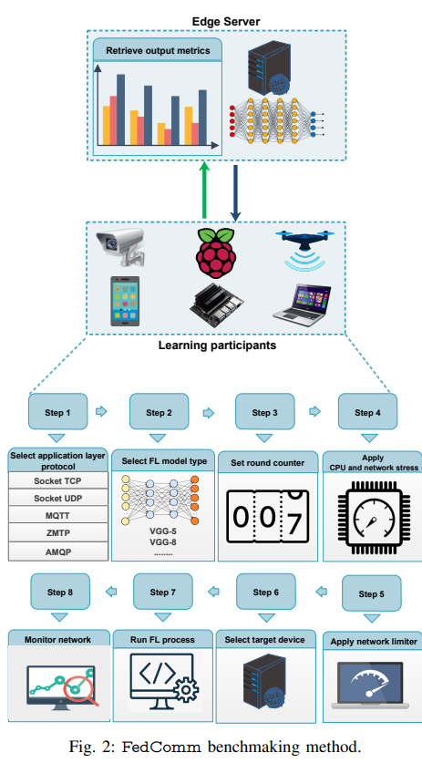
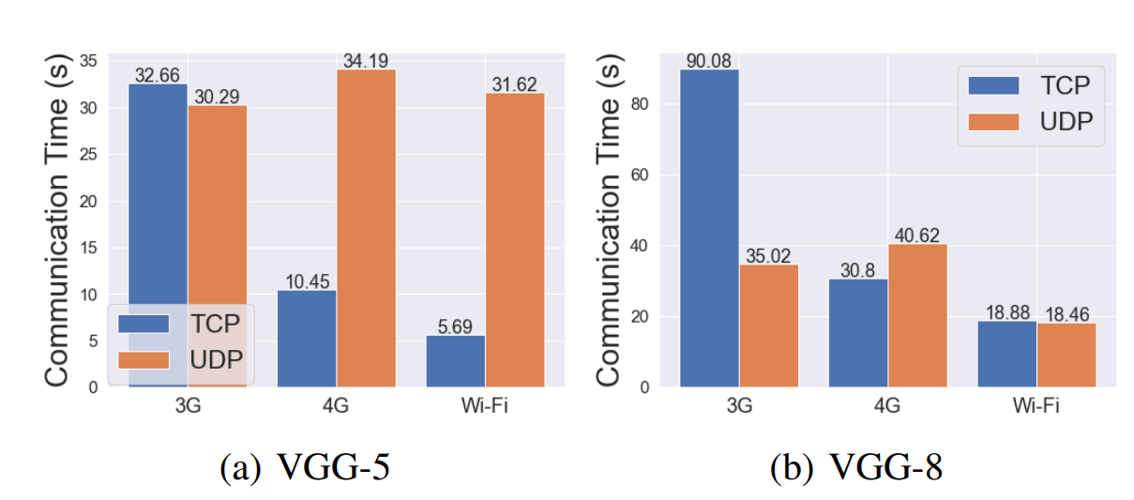
State of the art
FedComm, a benchmarking methodology that evaluates the performance of Message Queue Telemetry Transport (MQTT), Advanced Message Queuing Protocol (AMQP), ZeroMQ Message Transport Protocol (ZMTP), TCP, and UDP protocols

