Slide 1

TRUSTroke
Meeting 28.9.2023
HORIZON-HLTH-2022-STAYHLTH-01-04
WP Nº 2 –
T2.3,T2.5
Federated infrastructure
CERN, CNR, POLIMI
L. Barbieri, B. Camajori Tedeschini, S. Kianoush, M. Nicoli, D. Santos, S. Savazzi, L. Serio

Slide 2

WP2: T2.3
T2.3 FL algorithms and optimization (Leader: CNR; POLIMI, CERN); M3-M36
- analysis of the federation algorithms and their optimization
- different FL designs (centralized, decentralized, synch/asynch)
- verification using synthetic and public datasets and initially delivered (D2.1)
- optimization based on the finalised AI models (T4.4)
- transferred to T2.1 for integration with the FL network infrastructure
- possible support of re-training of the AI models on new patient data or clinical sites, when available.
R&D is required to optimise the learning process, discriminate relevant updates from irrelevant ones, learn new features without losing previously acquired knowledge.

Slide 3
Progress report WP2: T2.3
T2.3 FL algorithms and optimization (Leader: CNR; POLIMI, CERN); M3-M36
- analysis of the federation algorithms for deep neural networks (Federated Averaging w/o proximal term, Federated ADP, weighted consensus tools)
evaluation of the robustness of FL under several data heterogeneity assumptions (labels, features)
- planned: comparison of different FL architectures (centralized, decentralized, synch/asynch)
- verification of the algorithms using synthetic and public datasets

Slide 4
WP2: T2.5
T2.5 Design of the FL Platform-as-a-Service (Leader: CNR; CERN, POLIMI, EUT); M6-M36
- application of PaaS and modular design principles to FL processes based on the algorithms defined in T2.3.
- enable the management of configurable, secure, and trusted FL processes (integration of T2.4/T2.2).
- application-level interface between the medical nodes and the PS into the FL infrastructure.
PaaS functions and interfaces are initially validated (D2.5) then optimised in R1 and R2 releases.
Notes:
Goal is to apply platform as a service design principles to implement modular platform which could be configurable enough to deploy and test different setups.

Slide 5
Progress report WP2: T2.5
T2.5 Design of the FL Platform-as-a-Service (Leader: CNR; CERN, POLIMI, EUT); M6-M36
- starting on november
planned management of configurable and trusted FL processes will be possibly based on an industry-standard publish-subscribe network protocol (i.e., MQTT or variants),
initial version of the platform, modular design (to be delivered M16 as initial R1 pre-release)
requirements on application interface
- align with the IEEE P2805.4 working group

Slide 6
Tentative roadmap (year 1)
Development of selected
FL algorithms (T2.3)
Preparation of D2.1
T2.2 Network
Feedback from testing; Updated algorithms w. new datasets (if any)
D2.1 Fundamental Algorithms
Review literature
T2.5
May ‘23
Oct ‘23
Nov.‘23
Febr ‘24
April ‘24
July ‘23
Dec ‘23
March ‘24
May ‘24
T2.3
Testing of the pre-release R1 via remote connections + AI models from WP4
Collection of the minimal requirements to implement PaaS services (minimal/required functions)
Implementation of PaaS services for R1 pre-release (preparation of D2.4 due M16)
Testing of the algorithms on initial platform (R1 pre-release/testing on localhost connections)
Notes:
We might need to update the algorithms based on positive or negative feedback from initial testing

Slide 7
T2.3 Evaluation plan
OUTCOME:
- Design, development/implementation of federated learning algorithms and their verification on synthetic and public stroke datasets.
- Develop fundamental guidelines to choose the most suitable algorithm based on the targeted CEP (requires a policy for algorithm benchmarking).
- Algorithms transferred to T2.5 for implementation in the FL platform of T2.1.
M12 | Algorithms implementation (at least 2 federation strategies implemented), evaluation of learning accuracy/performance Benchmarking tests | Performance of AI algorithms using synthetic/pub datasets. Number of hospitals joining the federated network Robustness (benchmarking tests and resilience of the algorithms against data heterogeneity)
M16 | (re-)evaluation of algorithms as integrated with platform-as-a-service (PaaS) tools (T2.5) | .
M24 | Evaluation of algorithms on retrospective patients | .
M36 | Algorithms evaluation and benchmarking based on prospective data and release R2 | Nº of patient recruited for a complete test of the platform
Risks
FL algorithms and generated global models inaccurate or unsatisfactory generalisation | Identify and select the most promising algorithms that are less sensitive to local model mismatches and local data imbalances, to avoid issues with global model learning. | Perform optimization and algorithm selection within T2.5 and using the initial release of the platform R1.
Notes:
An initial version of the same platform has been also tested with geo distributed devices.

Slide 8
T2.5 Evaluation plan
OUTCOME:
- Management of configurable FL processes (interaction with T2.4).
- Application-level interface between the medical nodes and the PS into the FL infrastructure based on the architecture and protocols defined in T2.3
- PaaS functions and interfaces are initially validated (D2.5) then optimised in R1 and R2 releases.
M16 | PaaS functions evaluated, at least 3 hospitals joining the federation, communication latency/quality assessed. | Number of hospitals joining the federated network (1-10) Configuration time (20-30min) Supported model size (250MB) Comm. quality (FL round success rate 99%)
M24 | Evaluation of the connectivity functions in the first release (R1) of the FL platform, tests on retrospective patients | Number of hospitals joining the federated network (1-10) Configuration time (20-30min) Supported model size (250MB) Comm. quality (FL round success rate 99%)
M36 | Evaluation of the platform functions finalized in the TRUSTroke network release (R2). | Number of hospitals joining the federated network (1-10) Configuration time (20-30min) Supported model size (250MB) Comm. quality (FL round success rate 99%)
Risks
FL platform networking functions delayed | Networking functions of the FL platform tested on medical nodes and parameter server in advance to reduce troubleshooting time to deliver the global model. | Extra time for local training and communication with the server
Notes:
An initial version of the same platform has been also tested with geo distributed devices.

Slide 9



FL algorithm benchmarking proposed procedure
INPUTS TO FL ENVIRONMENT
# of hospitals joining the federation (3,5,10)
datasets used: pub. synthetic data used for FL benchmaring (MNIST, CIFAR, pub. stroke dataset)
data partitioned across hospitals/clients; 3 different heterogeneity types:
  sample imbalance (skewness)
  feature imbalance
  label space imbalance (only MNIST, CIFAR)
Heterogeneity level parametrized via standard Dirichlet distribution: high/medium/low heterogeneity scenarios
PERFORMANCE ASSESSMENT
Performance: global vs local model accuracy
  for varying FL algorithms
  Varying data heterogeneity (sample/feature/label)
Performance comparison with classical distributed machine learning (requires data anonymization)
Global vs local model analysis
Overhead (# of bits/parameters exchanged over the network)
Parameter
Server
FL algorithms
Notes:
An initial version of the same platform has been also tested with geo distributed devices.

Slide 10
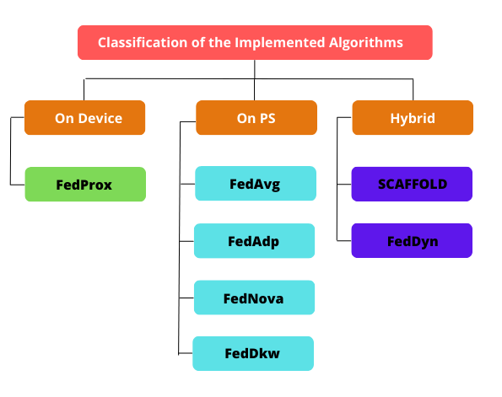
FL algorithms
on-device, on-PS and hybrid algorithms.
key seps performed on the PS during aggregation phase
key steps performed on the local client during update phase
key steps performed during aggregation and update phases on both the PS and the clients
prox term penalizes large divergence of the local models
average of the model parameters
control variates to keep the global gradient on the consistent track towards global minima
exponential weighting of the angles between the gradients
regularizing local models correct the global update
average of the normalized
gradients
weighting inversely proportional to KL Divergence
Notes:
An initial version of the same platform has been also tested with geo distributed devices.

Slide 11
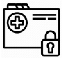


Minimal client-server interface
UPDATE STAGE Server (or Client) initialization both supported
(publish) MQTT topic: client_weights_topic = “Name_of_federation" + 'client_weights'
'model_layer{}'.format(k)
'device’
'samples’
'training_end’
+ algorithm dependent parameters
+ configurable timestamp (round)
Client (learner i)
Broker
learner_XX.py
(local models
published by the broker)
(subscribe) MQTT topic: “Name_of_federation" + 'client_weights'
learner_XX.py
PS for federation “Name_of_federation"
Notes:
An initial version of the same platform has been also tested with geo distributed devices.

Slide 12
Minimal client-server interface
AGGREGATION STAGE
(global model published by the broker)
(subscribe) MQTT topic: “Name_of_federation" + ‘server_weights’ + str(i)
Client (learner i)
Broker
(publish) MQTT topic: “Name_of_federation" + ‘server_weights’ + str(i)
'global_model_layer{}'.format(k)
‘global_epoch’
'training_end’
+ algorithm dependent parameters
+ configurable timestamp (round)
learner_XX.py
learner_XX.py
PS for federation “Name_of_federation"
Global model for active federation “Name_of_federation"
Notes:
An initial version of the same platform has been also tested with geo distributed devices.

Slide 13
Algorithms currently supported
PS_server_XX.py
@CERN
Supported FL algorthms
'FedAvg', 'Classes.Fl_Algorithms.FedAvg', 'FEDAVG',
'FedAdp', 'Classes.Fl_Algorithms.FedAdp', 'FEDADP',
'FedProx', 'Classes.Fl_Algorithms.FedProx', 'FEDPROX',
'Scaffold', 'Classes.Fl_Algorithms.Scaffold', 'SCAFFOLD',
'FedDyn', 'Classes.Fl_Algorithms.FedDyn', 'FEDDYN',
'FedDkw', 'Classes.Fl_Algorithms.FedDkw', 'FEDDKW',
'FedNova', 'Classes.Fl_Algorithms.FedNova', 'FEDNOVA’
‘C-FedAvg’ ‘Consensus', ‘CONSENSUS] (Decentralized FedAvg without PS)
Network
- MQTT v3.11 support
Architectures
Synch and asynch operation
Decentralized (parameter server less)
Optional
Support to actor-critic federated reinforcement learning processes
Tracking of energy consumption (real time carbon tracking)
MQTT
broker
learner_XX.py
learner_XX.py
learner_XX.py
Notes:
An initial version of the same platform has been also tested with geo distributed devices.

Slide 14
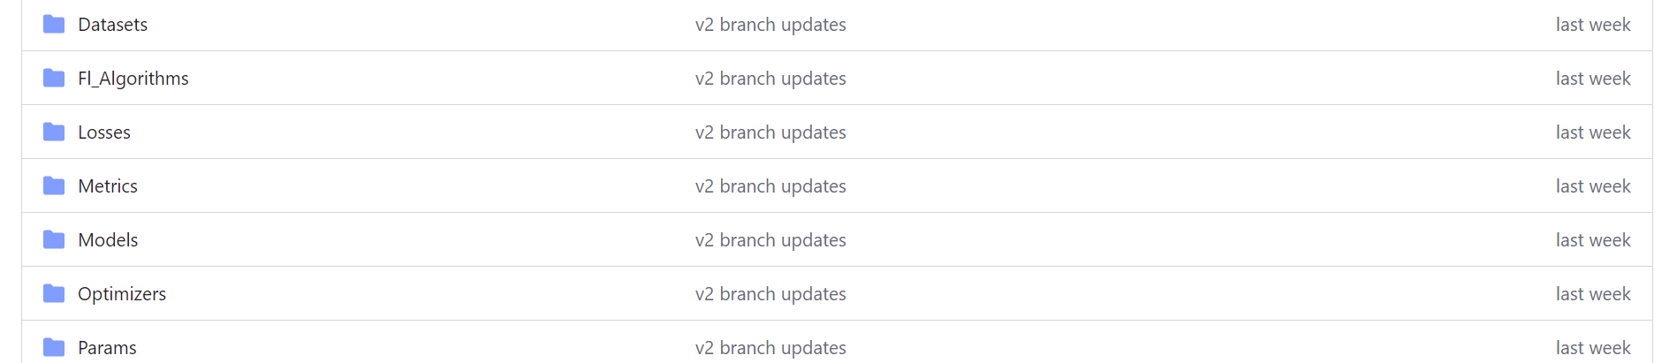
Algorithm development
https://github.com/labRadioVision/FL_platform (private repo)
Notes:
Few words on the platform which will be used to design and test the algorithms and will be transferred to T2.1
The initial repo is available at this link. Myself Bernado sanaz, luca and Usevalad (finalizing now his master degree thesis on FL) have full access now, please let me know who is interested in joining this.
The platform supports many functions now and is designed to be as modular as possible (considering the different algorithms). Just a short presentation of the platform.

