Slide 1


TRUSTroke
Webinar 29.9.2023
HORIZON-HLTH-2022-STAYHLTH-01-04
Networking basics
Alessandro E. C. Redondi

Slide 2
Agenda
Basics on networking and the Internet
Transferring data among computers
Federated learning under the communication perspective
Securing a public network infrastructure: Virtual Private Networks

Slide 3



What is the Internet
The global Interconnection of networks
Hosts (PC, laptop, smartphones, Web servers) connected to the Internet can send and receive data to other hosts using a public infrastructure.
Data is carried by packets which are forwarded along a network path formed by one or more links joined by network elements such as routers or switches.

Slide 4











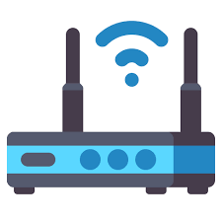

What is the Internet
Cellular Network
IoT network
Server farm
LAN/WLAN

Slide 5




Internet Protocol
Each device connected to the Internet has an address (IP address)
Packets exchanged in the Internet are known as Internet Protocol (IP) Packets. Each packet carries its source and destination IP address (just like a mail letter) plus some data.
Public routers read the destination address of IP packets and forward them to other routers closer and closer the the final destination
Sometimes, packets may be lost!
188.184.9.235
From: 131.175.18.10
To: 188.184.9.235
?
Destination | Next Hop
188.184.X.X | A
A
C
B

Slide 6

What is the Internet
Cellular Network
IoT network
Server farm
LAN/WLAN

Slide 7






Adding reliability
Two main options are available for transmitting IP packets between computers:
  Unreliable / Best effort delivery (UDP)
  Reliable delivery (TCP)
UDP
  Minimal overhead, fast and quick transfer
  Packets may be lost
  Main uses: real-time/latency-critical, loss-tolerant app (e.g., audio/video streaming)
TCP
  Reliable. Packet reception is guaranteed (in order of transmission).
  Important communication & resource overhead
  Main uses: file transfer, web browsing, mail…

Slide 8
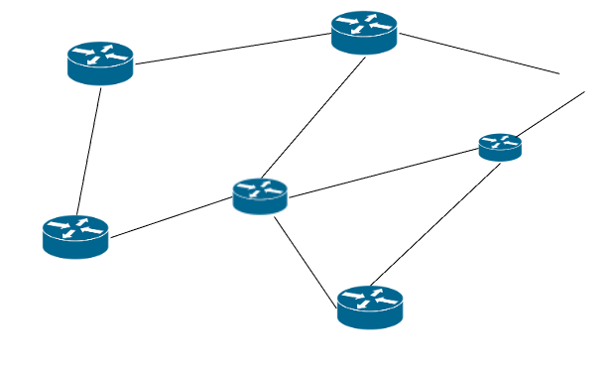
Communication paradigm
Client/server (HTTP)
  Communication is point to point: client asks, server replies
Pub/Sub (MQTT)
  Communication is point to multipoint via an intermediate broker: publisher sends update, subscribers are notified.
Request
Response
Client
Server
/sometopic
Broker
Subscribers client
/sometopic
/sometopic
/sometopic
Publisher client

Slide 9
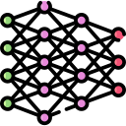
Federated learning under the comm. perspective
What to transfer:
  Local and global models (potentially very large in size)
How to transfer:
  Reliably (with TCP)? What about timing constraints?
  Can we tolerate losing some model params in favour of a more timely process (with UDP)?
  Client/server or pub/sub?
Federated learning is not only transferring models (e.g., the data plane)…
  Nodes joining/leaving the infrastructure
  Deciding how frequently performing updates
  Disseminating working parameters (e.g., changing the unit of a specific feature)
  In other words: the control plane!

Slide 10






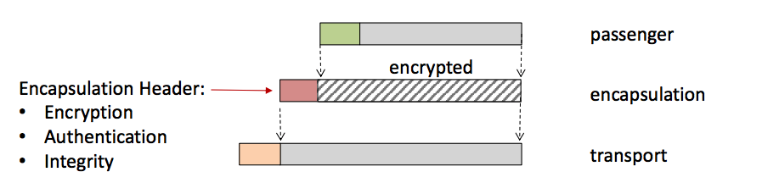
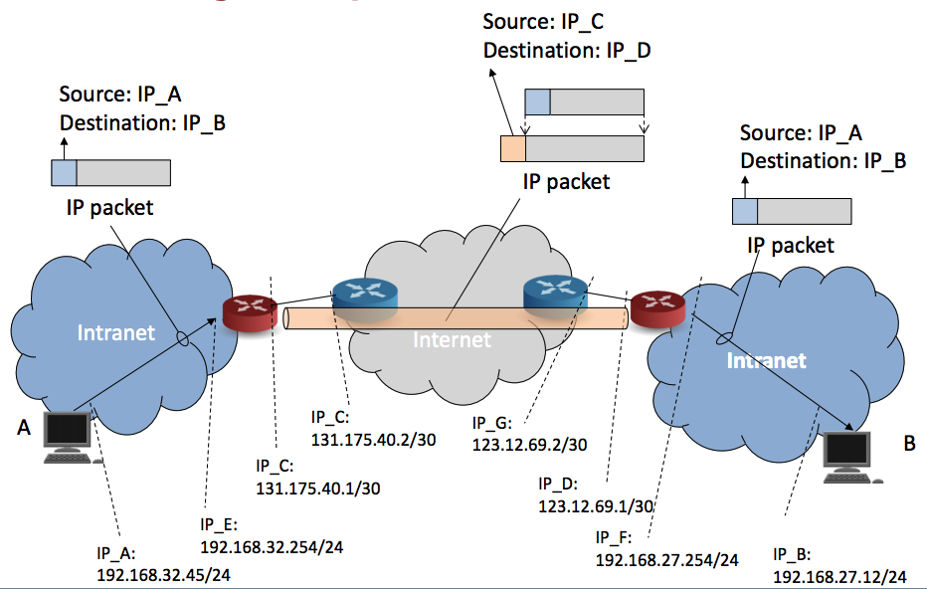
Securing a public network: VPN
How can we create a trusted and secure local network among the partners?
  Dedicated links – costly
  Virtual Private Networks
Virtual Private Networks
  Virtual tunnels are created among the partners
  Partner’s devices gets new IP addresses: they all belong to the same local network
  All traffic flowing in the tunnels is encrypted (IPSec)
  Authentication, Integrity and Confidentiality are provided

Slide 11
Task T2.2 objectives
Benchmarking FL frameworks from the communication perspective
Identify the best set of communication primitives for the project needs
Implement the data and control plan for the Trustroke FL platform
Propose new techniques for communication-efficient FL

