Slide 1


TRUSTroke
Webinar 28.9.2023
HORIZON-HLTH-2022-STAYHLTH-01-04
Federated Learning
theory and applications
Stefano Savazzi

Slide 2

Outline
Federated Learning (FL)
  Classical machine learning vs Federated Learning
  Cross-silo vs cross-device federations
  Vertical/horizontal FL
Challenges in Federated Learning
  Global model generalization
  Data heterogeneity
  Centralized and decentralized FL
FL network for TRUSTroke
  FL algorithms
  TRUSTroke network
  IEEE P2805.4: protocols for FL
FEDERATED LEARNING: THEORY AND APPLICATIONS
  28/09/2023, CERN, Geneve

Slide 3
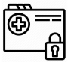

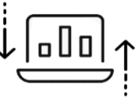
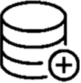
Classical machine learning vs Federated Learning
Network
Client
Data center
Classical machine learning:
1) data are disclosed by clients and shared with a data center
FEDERATED LEARNING: THEORY AND APPLICATIONS
  28/09/2023, CERN, Geneve

Slide 4
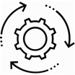
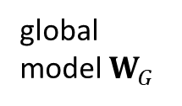
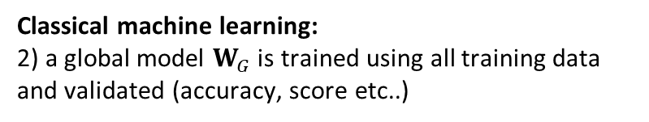
Classical machine learning vs Federated Learning
Data center
global model $W_{G}$
Classical machine learning:
2) a global model $W_{G}$ is trained using all training data and validated (accuracy, score etc..)
FEDERATED LEARNING: THEORY AND APPLICATIONS
  28/09/2023, CERN, Geneve

Slide 5
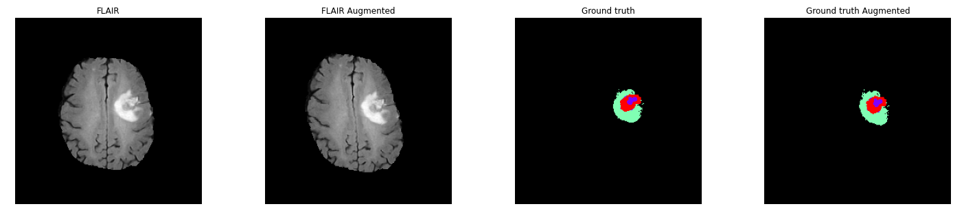
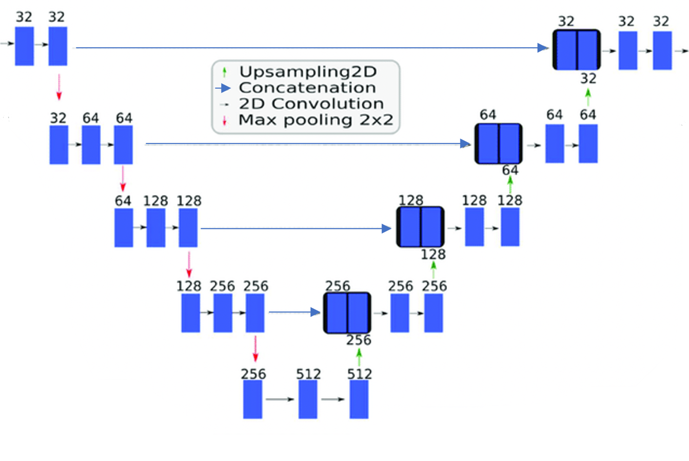
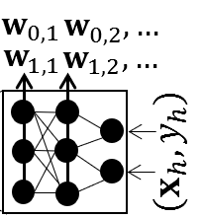
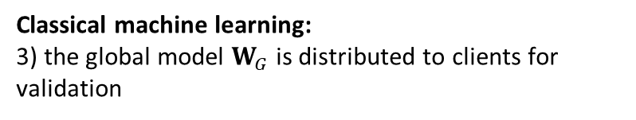

Classical machine learning vs Federated Learning
Model example (brain tumor segmentation)
Model: U-Net 2D
Brain tumor segmentation system
Network
240 x 240 x 1/4
240 x 240 x 2/4
$$W_{G}$$
global model $W_{G}$
Classical machine learning:
3) the global model $W_{G}$ is distributed to clients for validation
FEDERATED LEARNING: THEORY AND APPLICATIONS
  28/09/2023, CERN, Geneve

Slide 6


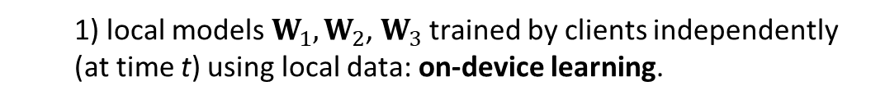

Classical machine learning vs Federated Learning
(local)
Data center
$$W_{2}(t)$$
Federated learning
$$W_{1}(t)$$
Client (learner 1)
$$W_{3}(t)$$
Parameter
Server
Classical machine learning
  1) local models $W_{1},W_{2}$, $W_{3}$trained by clients independently (at time t) using local data: on-device learning.
FEDERATED LEARNING: THEORY AND APPLICATIONS
  28/09/2023, CERN, Geneve

Slide 7

Classical machine learning vs Federated Learning
Federated learning
Parameter
Server (PS)
Classical machine learning
  1) local models are sent to a Parameter Server. Data is kept on each individual client and never transferred.
FEDERATED LEARNING: THEORY AND APPLICATIONS
  28/09/2023, CERN, Geneve

Slide 8
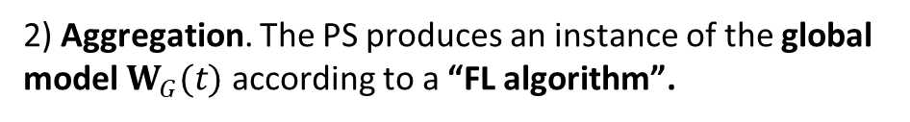
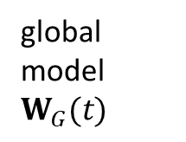
Classical machine learning vs Federated Learning
Federated learning
PS
global model $W_{G}(t)$
Classical machine learning
FL algorithm
2) Aggregation. The PS produces an instance of the global model $W_{G}(t)$ according to a “FL algorithm”.
FEDERATED LEARNING: THEORY AND APPLICATIONS
  28/09/2023, CERN, Geneve

Slide 9
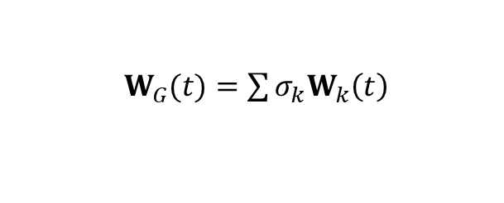
Classical machine learning vs Federated Learning
Federated learning
PS
global model $W_{G}(t)$
Classical machine learning
$W_{G}(t)=\sum{σ_{k}W_{k}\left(t\right)}$
2) Aggregation. Federated Averaging example
“Federated optimization: Distributed machine learning for on-device intelligence,” http://arxiv.org/abs/1610.02527.
FEDERATED LEARNING: THEORY AND APPLICATIONS
  28/09/2023, CERN, Geneve

Slide 10
Classical machine learning vs Federated Learning
Federated learning
global model $W_{G}(t)$
Classical machine learning
2) Aggregation. Global model is distributed to clients
FEDERATED LEARNING: THEORY AND APPLICATIONS
  28/09/2023, CERN, Geneve

Slide 11


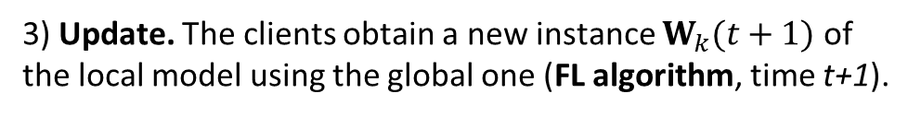

Classical machine learning vs Federated Learning
+
$W_{2}(t+1)$
+
+
Federated learning
$W_{1}(t+1)$
$W_{2}(t+1)$
Classical machine learning
3) Update. The clients obtain a new instance $W_{k}(t+1)$ of the local model using the global one (FL algorithm, time t+1).
FEDERATED LEARNING: THEORY AND APPLICATIONS
  28/09/2023, CERN, Geneve

Slide 12
Classical machine learning vs Federated Learning
Federated learning
Classical machine learning
3) Update. The updated model is sent to the PS.
Aggregation and update form a FL round. Repeated until a certain level of accuracy is met.
FEDERATED LEARNING: THEORY AND APPLICATIONS
  28/09/2023, CERN, Geneve

Slide 13
Federated Learning
Federated approach: collaborative training of a machine learning model across clients with distinct data sets
On device learning. Local machine learning trained by each client/device independently
Local models are sent to a Parameter Server
Aggregation and update phases are repeated for some rounds
Data is kept on each individual node and never shared
Adv./Motivations:
Address privacy and data governance shortcomings
Efficiency: model updates rather than full dataset exchange.
Scalability: FL well scales to large numbers of clients
Generalization: leveraging diverse data sources, reducing the risk of overfitting to a specific dataset.
Limitations:
Poisoning/inversion and c. attacks
Data harmonization required.
Generalization unsatisfactory Local model overfitting local data
Performance penalties compared with classical ML (where all data is shared)
“Advanced and Open Problems in Federated Learning,” https://arxiv.org/abs/1912.04977
FEDERATED LEARNING: THEORY AND APPLICATIONS
  28/09/2023, CERN, Geneve

Slide 14
Cross-silo vs cross device federations
Cross-silo federations
small number of parties (<50) holding a large amount of data and computational power
critical privacy concerns, data cannot be shared directly
each party trains a local model on their own data and only shares the model updates
applications: healthcare, fraudulent financial transactions
Cross-device federations
large number of parties (>50-1M), relatively small amount of data, limited communication, computational power/capacity/energy (mobile)
data ownership concerns, IPR protection, data cannot be shared due to limited connectivity
each party trains a subset of the local model and shares the updates
applications: IoT, Industry 5.0
TRUSTroke
FEDERATED LEARNING: THEORY AND APPLICATIONS
  28/09/2023, CERN, Geneve

Slide 15
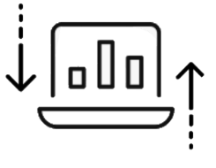
Horizontal federation
«feature space» example
«sample space»
FL network
1) Gender/age
2) Hypertension
3) Heart Disease
…
4) Smoking Status
5) Average Glucose Level
6) BMI
…
1) Gender/age
2) Hypertension
3) Heart Disease
…
4) Smoking Status
5) Average Glucose Level
6) BMI
…
Patient A
Patient B
Parameter
Server
1) Gender/age
2) Hypertension
3) Heart Disease
…
4) Smoking Status
5) Average Glucose Level
6) BMI
…
1) Gender/age
2) Hypertension
3) Heart Disease
…
4) Smoking Status
5) Average Glucose Level
6) BMI
…
Patient C
Patient D
Hospital data share the same feature space but different sample space
FEDERATED LEARNING: THEORY AND APPLICATIONS
  28/09/2023, CERN, Geneve

Slide 16

Vertical federation
Patient A
1) Gender/age
2) Hypertension
3) Heart Disease
…
Patient B
1) Gender/age
2) Hypertension
3) Heart Disease
…
FL network
Patient C
1) Gender/age
2) Hypertension
3) Heart Disease
…
Patient D
1) Gender/age
2) Hypertension
3) Heart Disease
…
(model
fragment)
Parameter
Server
Patient A
4) Smoking Status
5) Average Glucose Level
6) BMI
…
Patient B
4) Smoking Status
5) Average Glucose Level
6) BMI
…
Patient C
4) Smoking Status
5) Average Glucose Level
6) BMI
…
Patient D
4) Smoking Status
5) Average Glucose Level
6) BMI
…
Data share the same sample space but different feature space (hybrid solutions H/V also apply)
FEDERATED LEARNING: THEORY AND APPLICATIONS
  28/09/2023, CERN, Geneve

Slide 17
Federated Learning: challenges and main concepts
Main challenges:
Global model generalization
Handling data heterogeneity (adaptive weighting)
Client-server architecture limitations (decentralized FL)
Communication (learning over networks with limited performance)
Cybersecurity (data/model/learning poisoning, model inversion attacks)
FEDERATED LEARNING: THEORY AND APPLICATIONS
  28/09/2023, CERN, Geneve

Slide 18
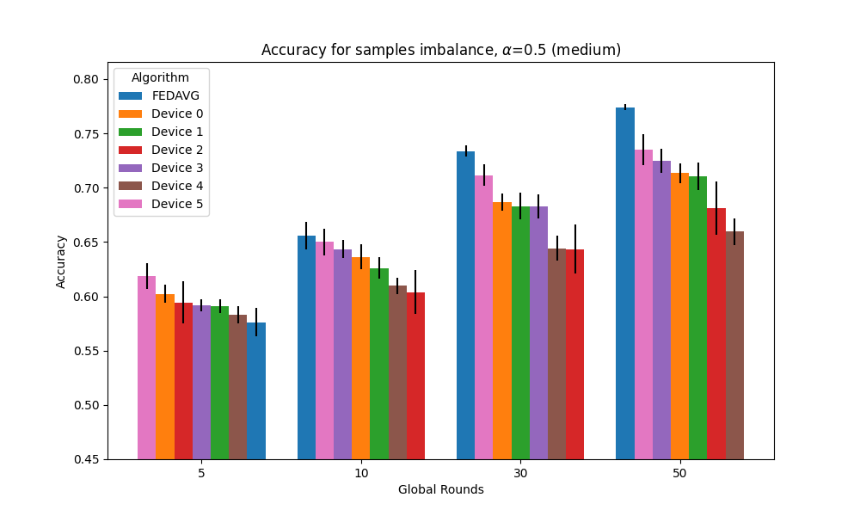
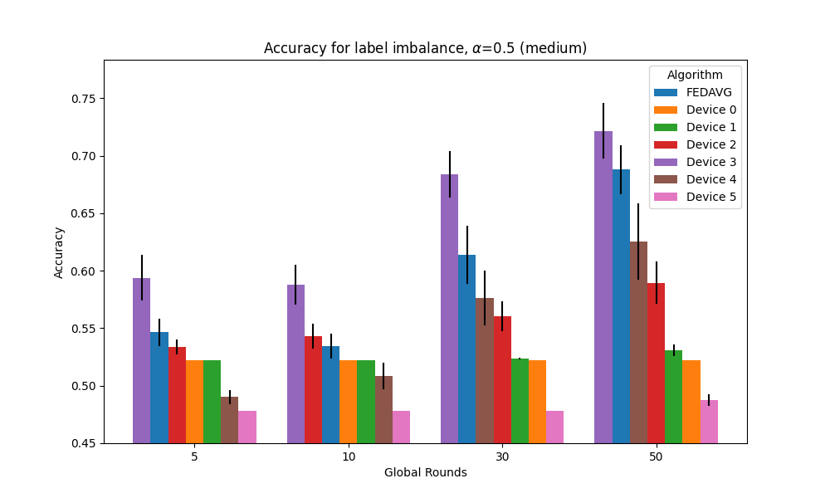
Global model generalization, an example
Pub. stroke simplified dataset: 11 clinical features considered for predicting stroke events
FL
FL
Hospital (0)
FL
FL
Hospital (1)
FL global model
(FEDAVG)
Data heterogeneity responsible of unsatisfactory generalisation (algorithm optimization needed)
Hospital (2)
Global model “generalization”:
Few-shot learning capability: global model ability to adapt to unseen data
Meta-learning capability: fast adaptation to new problems to solve
Hospital (3)
FL
Hospital (3)
Hosp. 3
Hospital (4)
Hospital (5)
FEDERATED LEARNING: THEORY AND APPLICATIONS
  28/09/2023, CERN, Geneve

Slide 19
Federated Learning: challenges and main concepts
Main challenges:
Global model generalization
Handling data heterogeneity (adaptive weighting)
Client-server architecture limitations (decentralized FL)
Communication (learning over networks with limited performance)
Cybersecurity (data/model/learning poisoning, model inversion attacks)
FEDERATED LEARNING: THEORY AND APPLICATIONS
  28/09/2023, CERN, Geneve

Slide 20


Data heterogeneity: adaptive weighting
high-quality data
low-quality data
(data and/or feature skew)
Client 1
Client 2
$W_{1}(t)$
$W_{2}(t)$
Large patient population
All clinical variables
Large size/distribution
Limited patient population
Subset of clinical variables
Missing (large) data
Small size/distribution
Temporal misalignments
global model
Heterogeneous FL environment: data differ in terms of distribution, size, quality, or other factors
Also referred to as non-independent-identically distributed (non-iid)
FEDERATED LEARNING: THEORY AND APPLICATIONS
  28/09/2023, CERN, Geneve

Slide 21



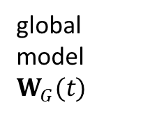
Data heterogeneity: adaptive weighting
high-quality data
low-quality data
(data and/or feature skew)
Client 1
Client 2
$W_{1}(t)$
$$σ_{G,1}$$
$$σ_{G,2}$$
$W_{2}(t)$
global model $W_{G}(t)$
$W_{G}(t)=σ_{G,1}(t\text{)} W_{1}\left(t\right)+σ_{G,2}(t\text{)}W_{2}\left(t\right)$
Clients with low quality data contribute to the global model
Problem: how to combine local models and quantify their contributions to the global model
Solution: adaptive optimization of the weights $σ_{G,1},σ_{G,2}$ : Federated Adaptive Weighting
“Fast-Convergent Federated Learning with Adaptive Weighting” https://arxiv.org/abs/2012.00661
FEDERATED LEARNING: THEORY AND APPLICATIONS
  28/09/2023, CERN, Geneve

Slide 22
Federated Learning: challenges and main concepts
Main challenges:
Global model generalization
Handling data heterogeneity, non-iidness (adaptive weighting)
Client-server architecture limitations (decentralized FL)
Communication (learning over networks with limited performance)
Cybersecurity (data/model/learning poisoning, model inversion attacks)
FEDERATED LEARNING: THEORY AND APPLICATIONS
  28/09/2023, CERN, Geneve

Slide 23

Centralized and decentralized architectures
Centralized Federated Learning (Parameter Server (PS)
Decentralized Federated Learning (Parameter Server-less)
Local
model
Local
model
Parameter
Server
Parameter
Server
Federated learning with cooperating devices: A consensus approach for massive IoT networks, https://arxiv.org/pdf/1912.13163.pdf
FEDERATED LEARNING: THEORY AND APPLICATIONS
  28/09/2023, CERN, Geneve

Slide 24
Main algorithms for FL: an introduction
Algorithms with key steps performed on the Parameter Server during aggregation phase:
  FEDAVG - Federated Averaging
  FedADP - Federated Adaptive Weighting: uses weighted average consensus, robust to data heterogeneity
  FedNOVA - addresses imbalanced in computational capabilities of the client
  FedDkw - requires knowledge of the client data distribution … cybersec. critical!
Algorthms with key steps performed on the local client during update phase (require some specific adaptations on the client):
  FedProx - Federated Learning with proximal term
  CFA - Consensus-driven Federated Averaging: applies linear and weighted average consensus (no use of the PS)
Hybrid algorithms with key steps performed during aggregation and update phases on both the PS and the clients:
  Scaffold: 1) adjusts the direction of the local model update; 2) apply adaptive weighting (on the PS) of local updates
  FedDyn: Federated Dynamic Regularizer: applies dynamic regularization of the local model and adaptive weighting on the PS
"Scaffold: Stochastic controlled averaging for federated learning." ICML. https://arxiv.org/abs/1910.06378
FEDERATED LEARNING: THEORY AND APPLICATIONS
  28/09/2023, CERN, Geneve

Slide 25



Federated Learning Network for TRUSTroke
AI model #1 trained on
VHIR client
AI models to address one or more CEPs. Clients train multiple AI models (multiple tasks)
Node-FL AI models
(to answer CEPs)
Data management toolbox
Clinical End Points (CEPs) needed for predicting progression of stroke:
✔ CEP1: What is the individualised prediction of clinical response to acute reperfusion treatment and stroke severity at discharge as measured with NIHSS score21?
✔ CEP2: What is the probability of early supported discharge (1 week after the event)?
✔ CEP3: What is the probability of poor mobility, incomplete recovery and unfavourable long-term outcomes?
✔ CEP4: What is the probability of unplanned hospital readmission (at 30 days)?
✔ CEP5: What is the personalised risk of stroke recurrence (at 3 and 12 months?
AI model #1 trained on
KUL client
Node-FL AI models
(to answer CEPs)
Data management toolbox
AI model #2 trained on
KUL client
Data management toolbox
Node-FL AI models
(to answer CEPs)
AI model #2 trained on
GEM client
FEDERATED LEARNING: THEORY AND APPLICATIONS
  28/09/2023, CERN, Geneve

Slide 26
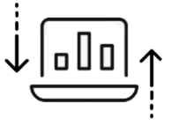
Federated Learning Network for TRUSTroke
Example: 3 local models
Node-FL AI models
(to answer CEPs)
Modular interface
(PaaS principles)
Data management toolbox
Problem: learning many models in FL environment
Networking
Node-FL AI models
(to answer CEPs)
Data management toolbox
Parameter Server (PS)
Data management toolbox
Node-FL AI models
(to answer CEPs)
FEDERATED LEARNING: THEORY AND APPLICATIONS
  28/09/2023, CERN, Geneve

Slide 27
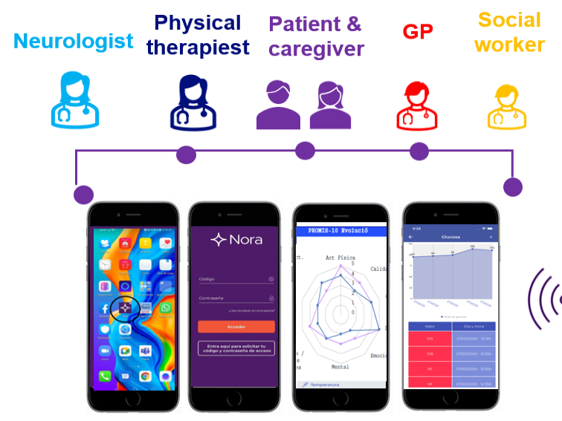



Federated Learning Network for TRUSTroke
Node-FL AI models
(to answer CEPs)
Data management toolbox
Global models distributed to medical nodes
FL algorithms
Node-FL AI models
(to answer CEPs)
Data management toolbox
Parameter Server (PS)
Global-FL AI models (to answer CEPs)
Data management toolbox
Node-FL AI models
(to answer CEPs)
validation + acceptance
FEDERATED LEARNING: THEORY AND APPLICATIONS
  28/09/2023, CERN, Geneve

Slide 28
IEEE P2805.4: WG Standard for FL Collaboration Protocols
Purpose: define an edge collaboration mode for federated learning across different edge node types and to be used as a reference by developers of edge computing nodes, edge device manufacturers, and federated learning frameworks
Applications
➢ Healthcare networks, Industrial processes, Fin. Transactions (FFT)
Communication Protocols for Federated Learning
➢ HTTP/HTTPS, WebSocket, gRPC, MQTT, CoAP
Algorithms for Model Training and Optimization in Federated Learning
➢ FedAvg, FedSGD, FedADP, FedNova, FedCom
GDPR, CCPA, and ISO/IEC 27001 Compliance
➢ GDPR, CCPA, and ISO/IEC 27001 are data privacy protection laws/regulations/standard
FEDERATED LEARNING: THEORY AND APPLICATIONS
  28/09/2023, CERN, Geneve

Slide 29
Further readings
Rieke, N., Hancox, J., Li, W. et al. The future of digital health with federated learning. npj Digit. Med. 3, 119 (2020). https://doi.org/10.1038/s41746-020-00323-1
Ashish Rauniyar et al. “Federated Learning for Medical Applications: A Taxonomy, Current Trends, Challenges and Future Research Directions” https://arxiv.org/pdf/2208.03392.pdf
Dinh C. Nguyen, Quoc-Viet Pham, Pubudu N. Pathirana, Ming Ding, Aruna Seneviratne, Zihuai Lin, Octavia Dobre, and Won-Joo Hwang, Federated Learning for Smart Healthcare: A Survey. ACM Comput. Surv. https://arxiv.org/abs/2111.08834
Selected papers
B. C. Tedeschini, S. Savazzi, R. Stoklasa, L. Barbieri, I. Stathopoulos, M. Nicoli, L. Serio "Decentralized Federated Learning for Healthcare Networks: A Case Study on Tumor Segmentation," IEEE Access, vol. 10, pp. 8693-8708, 2022
S. Savazzi, M. Nicoli, M. Bennis, S. Kianoush and L. Barbieri, “Opportunities of Federated Learning in Connected, Cooperative and Automated Industrial Systems,” IEEE Communications Magazine, vol. 59, no. 2, pp. 16-21, February 2021
S. Savazzi, V. Rampa, S. Kianoush and M. Bennis, "An Energy and Carbon Footprint Analysis of Distributed and Federated Learning,“ IEEE Transactions on Green Communications and Networking, vol. 7, no. 1, pp. 248-264, March 2023
FEDERATED LEARNING: THEORY AND APPLICATIONS
  28/09/2023, CERN, Geneve

