Slide 1
Runners explained
P. LEWANDOWSKI
July 5th, 2023

Slide 2

Outline
Runner principles
Our Windows runners
Our Linux runners
What do runners run (.gitlab-ci.yml)
How does it come together
What’s in the runner
What has changed
Additional resources

Slide 3
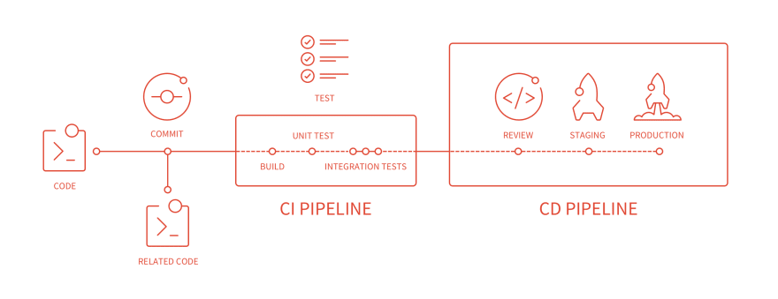
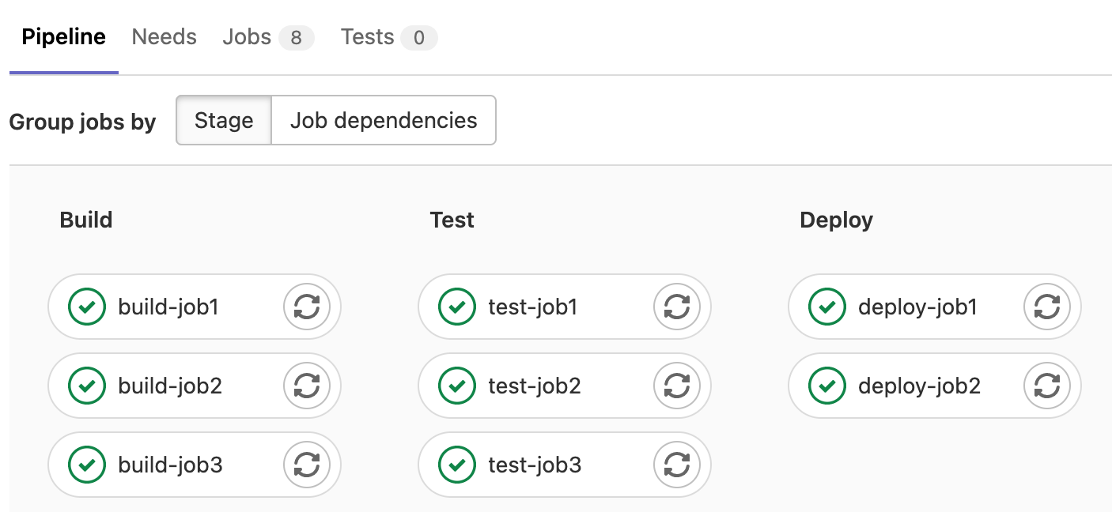
1. Runner principles
Notes:
By default, jobs are run in parallel. If sequence needed → define stages
Pipeline: all jobs triggered for one event

Slide 4
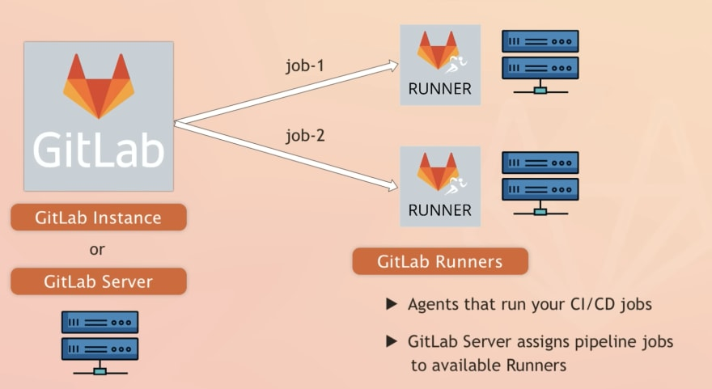
1. Runner principles

Slide 5
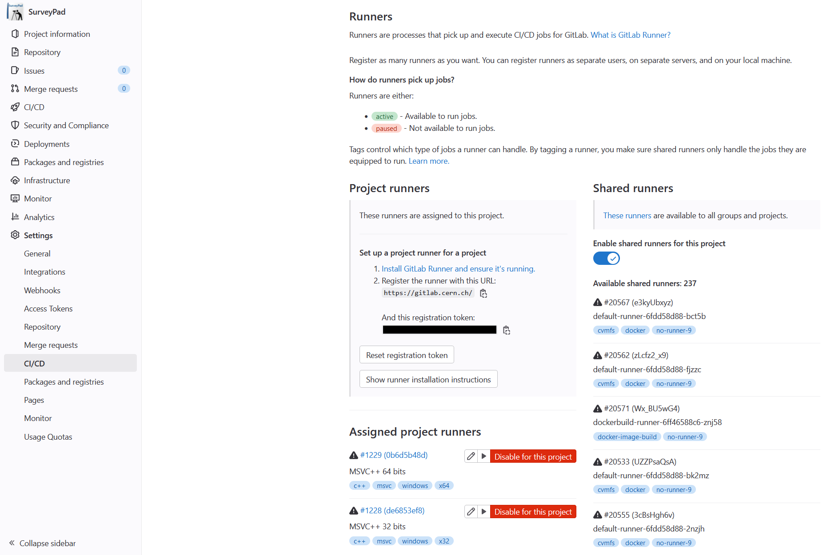
2. Our Windows runners

Slide 6
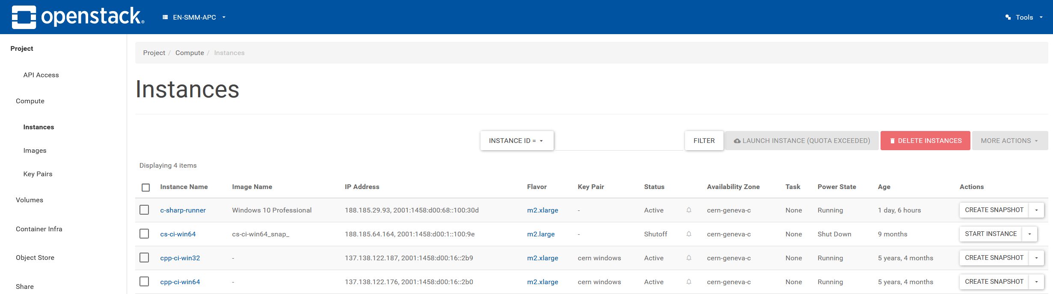
2. Our Windows runners

Slide 7
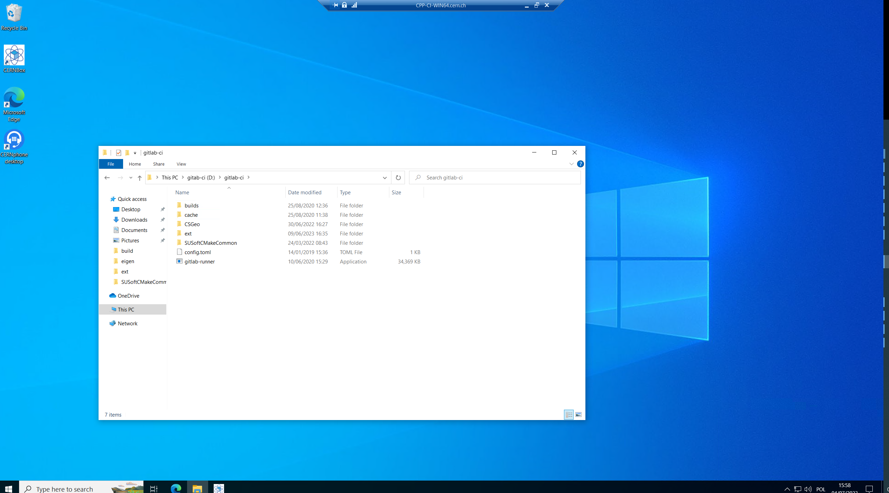
2. Our Windows runners
Notes:
Show it in RDP

Slide 8
3. Our Linux runners
How a Docker image can be created with GitLab CI (example): https://gitlab.cern.ch/gitlabci-examples/build_docker_image
How we create our own Docker images based on the example: https://gitlab.cern.ch/apc/common/docker-image-susoft-cpp
Dockerfile – it is a text document that contains all the commands a user could call on the command line to assemble an image. This means that it contains all the required dependencies and setup-steps one might need to run the target application on the image.
Notes:
kaniko is a tool to build container images from a Dockerfile, inside a container or Kubernetes cluster.

Slide 9
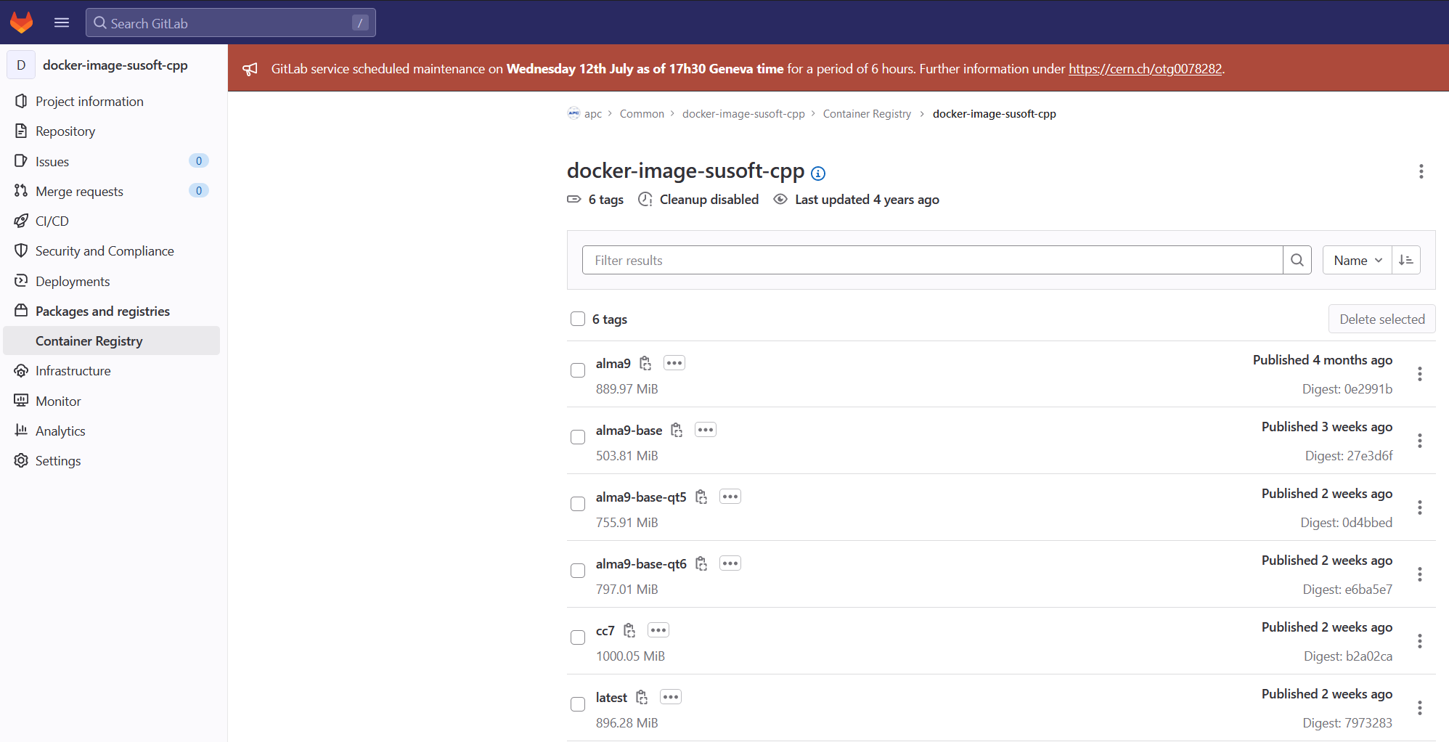
3. Our Linux runners
Notes:
kaniko is a tool to build container images from a Dockerfile, inside a container or Kubernetes cluster.

Slide 10
4. What do runners run (.gitlab-ci.yml)
We need a base GitLab .yml file with a scripts that are shared https://gitlab.cern.ch/apc/common/gitlab-ci-utils/-/blob/master/ci/scripts/gitlab-ci-susoft.yml
  This file defines how a generic pipeline should look like
  It defines jobs for both Windows and Linux (that are separate!)
This base class is included and (sometimes) extended by .yml files of the repository, e.g.:
  LGC extends build_and_test jobs for both Windows and Linux https://gitlab.cern.ch/apc/susofts/processing/LGC2/-/blob/master/.gitlab-ci.yml

Slide 11

5. How does it come together
OpenStack
Windows Runner
Windows Runner
GitLab
GitLab Server
Image Builder
.yml script base
docker-image-susoft-cpp
gitlab-ci-utils

Slide 12
5. How does it come together - Windows
OpenStack
Gitlab Server gets notified
It chooses one of the available registered runners to run the pipeline
Runners run the .gitlab-ci.yml that in our case mostly includes gitlab-ci-utils scripts and proceeds with running all the jobs
Windows Runner
Windows Runner
GitLab
.yml script base
GitLab Server
gitlab-ci-utils

Slide 13
5. How does it come together - Linux
GitLab
GitLab Server
Gitlab Server gets notified
It pulls the previously built image from docker-image-susoft-cpp
It starts the container that in our case mostly includes gitlab-ci-utils scripts and proceeds with running all the jobs
Image Builder
.yml script base
docker-image-susoft-cpp
gitlab-ci-utils
Docker container

Slide 14
6. What’s in the runner
What dependencies are installed:
Windows – what is installed manually
Linux - https://gitlab.cern.ch/apc/common/docker-image-susoft-cpp/-/blob/master/Dockerfile-cc7
What .yml scripts are used:
Windows - Repository scripts + (most likely) gitlab-ci-utils scripts
Linux - Repository scripts + (most likely) gitlab-ci-utils scripts
Where was SUSoftCMakeCommon before:
Windows - Installed on runner manually
Linux – pulled each time (master branch of the repository) in before_script

Slide 15
7. What has changed
SUSoftCMakeCommon is not manually installed on Windows anymore, neither the repository is pulled automatically on Linux on Docker image build
Now SUSoftCMakeCommon is part of every SUSoft repository, added as a submodule
I changed the Docker image builder to allow building multiple images, instead of always overwriting the latest one (and forcing all repositories to use it)
I plan to apply this change to all repositories (even legacy ones like Rabot, CSGeo)

Slide 16
7. What has changed - usage
To update SUSoftCMakeCommon there is no need to manually change files in Windows runners and there is no need to rebuild the Docker image for Linux from scratch
Every repository can dynamically use whatever version of SUSoftCMakeCommon they want
Every repository can use any Docker image they want (and changes can be done on per-repository basis)
From now on, when somebody checks out to a specific commit they directly see what was the SUSoftCMakeCommon and the dependecies that were used to compile the code
The situation where different SUSoftCMakeCommon was running on Windows and Linux is no longer possible since it will be coming from the repository submodule

Slide 17
8. Additional resources
https://docs.gitlab.com/ee/ci/
Presentation of a previous APC member: https://indico.cern.ch/event/767698/attachments/1740085/2815397/Gitlab_CI.pdf

Slide 18


