Slide 1
BB, wire compensations and instabilities MDs
G. Sterbini, X. Buffat and L. Giacomel on behalf of the Beam-Beam and Instabilities team
Thanks to many colleagues, in particular P. Bélanger, C. Droin, I. Efthymiopoulos, S. Fartoukh, S. Kostoglou, M. Hostettler, S. Redaelli, C. E. Montanari and M. Giovannozzi.
11 July 2023, https://indico.cern.ch/event/1304705/

Slide 2
3 MD2 requests
MD9603 (12 h) - BB limit at reduced crossing angle
MD10363 (12 h) - Wire Compensation during β* levelling
MD9405 (4 h) - Instability Growth Rate at Injection 2023

Slide 3
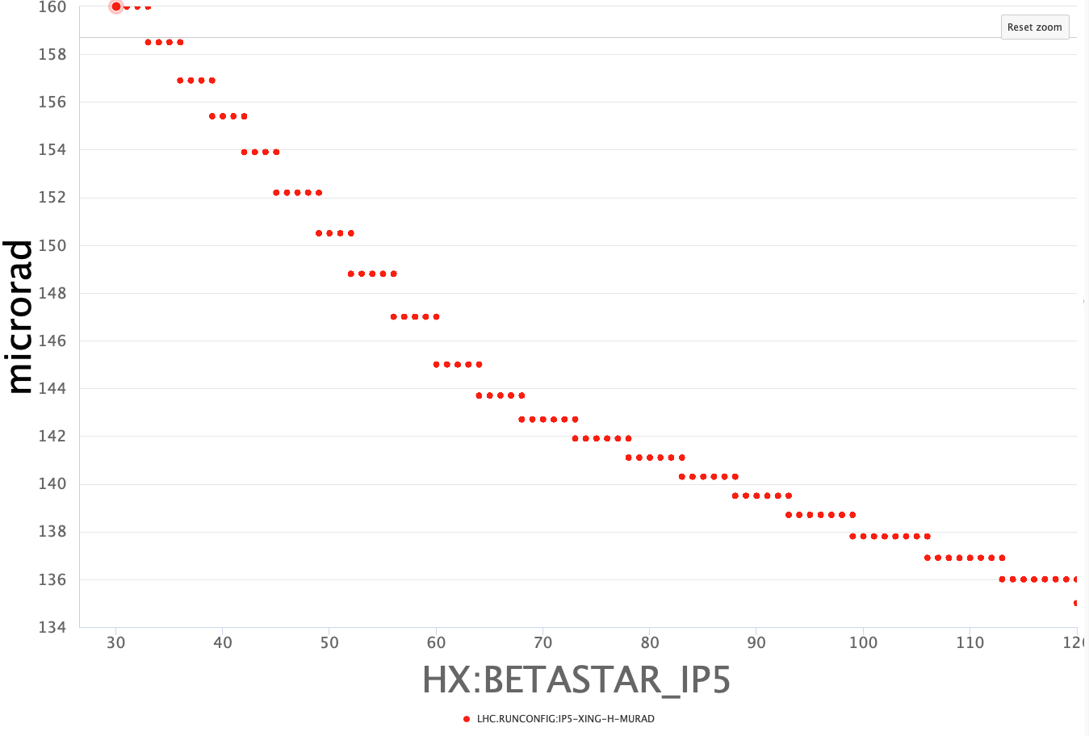
1. MD9603 (12 h): aggressive θ_{X}(β*) to explore the BB limit
Q: Is there margin to close the crossing angle at IP1/5?
MD benefits:
  Valuable input for the 2024 configuration
  opening the way to reduce the β* (performance)
  reduce the triplet irradiation (triplet lifetime)
We request a 12 h MD to make up to 3 θ_{X}(β*) scans at β*=120, 60 and 30 cm (3 trains at top energy) from 135, 145 and 160 urad to (max) 120 urad. We are planning for 2 fills. Tune scans optimization will be performed systematically.
θ_{X} [urad]
3 trains of 48 b distributed to have collision in IP1/5, IP2 and IP8. We would like to have the maximum allowed intensity (e.g. 1.8e11 ppb?) and the smallest emittances (e.g. 2 um at the start of levelling). Luminosity signals are needed (BBB lumi and pile up at ~60 in IP1/5).
β∗ [m]
To reduce the crossing angle we maintain the TCT at constant gap moving the jaws to follow the reduction of the crossing angle (TCT interlock limit of the jaws has to be updated correspondingly). Ideally we would like to measure the octupole reversal and, at θ_{X}(β*=30cm), we propose to use also the B2 wire compensation.

Slide 4
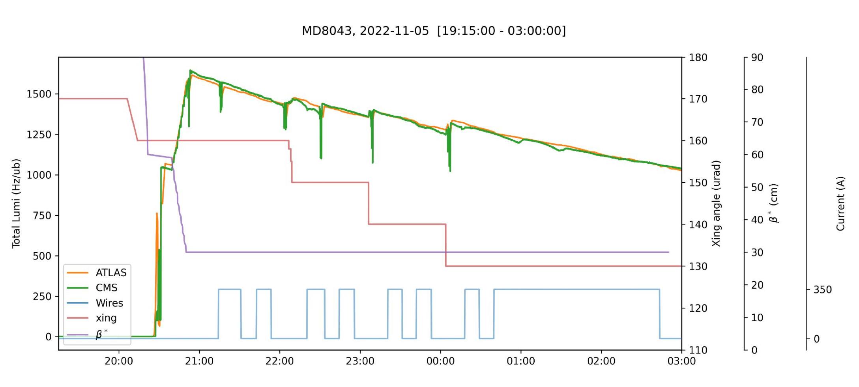
2. MD10363 (12 h): Wire compensation and β* leveling
Last year we tested the wire compensation during crossing angle anti-leveling at constant β*.
MD benefit:
  Test a fully-fledged orchestration β* + θ_{X} + TCT at constant normalized gaps + BBLR (using the last 4 steps of β*, < 40 cm, 8 h)
  Complete the diffusion studies on the vertical plane (at the end of the MD, 4 h)
Minimum 3 trains distributed to have collision in IP1/5. We would like to have the maximum allowed intensity (e.g. 1.8e11 ppb?) and the smallest emittances (e.g. 2 um at the start of levelling). Luminosity signals are needed (BBB lumi and pile up at ~60 in IP1/5).
The tune-feedforward correction is in place (ATS-index independent and taking into account the beam-wire distance) but the details for their operational deployment still need to be agreed.

Slide 5
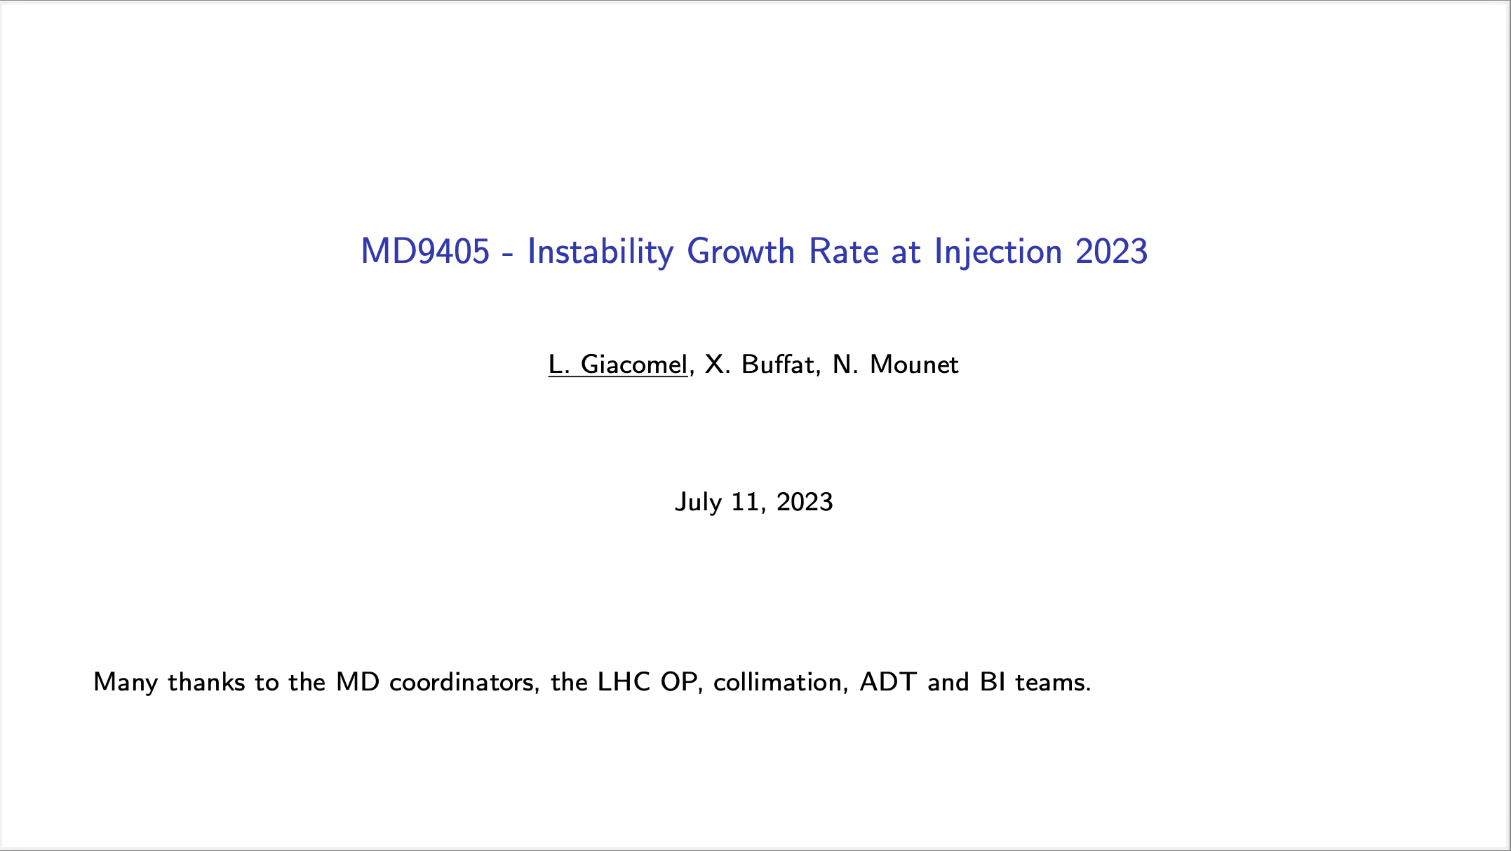

Slide 6
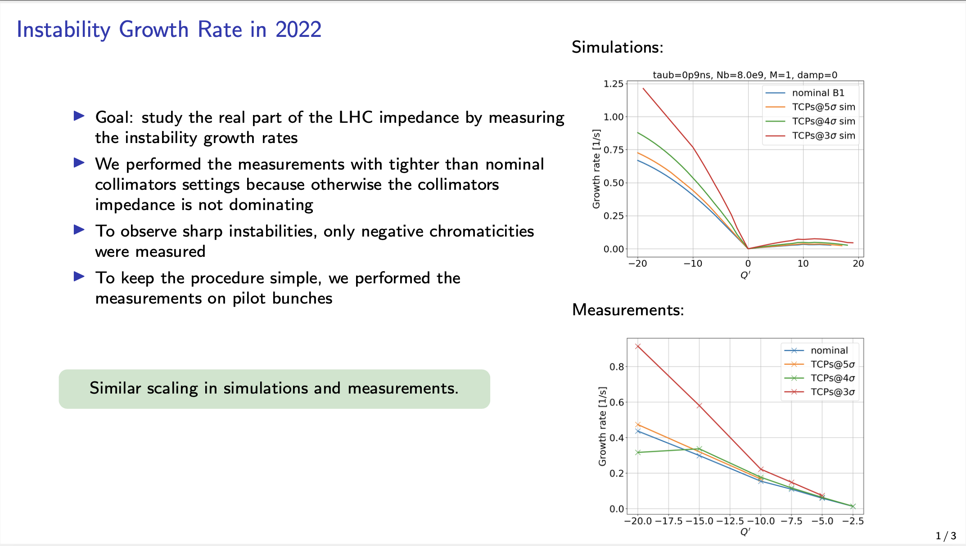

Slide 7
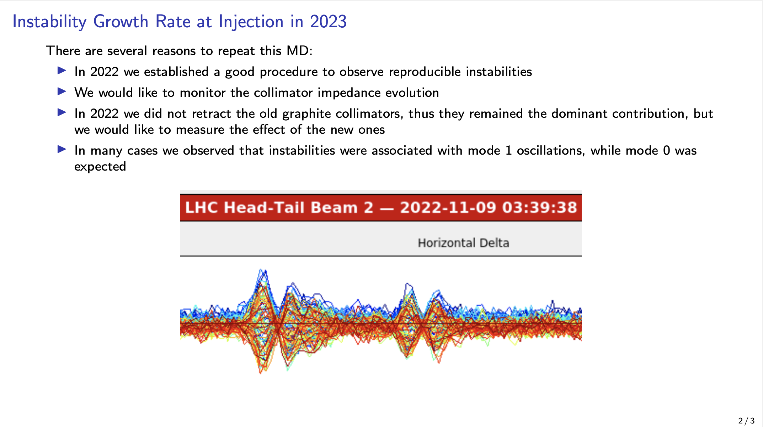

Slide 8
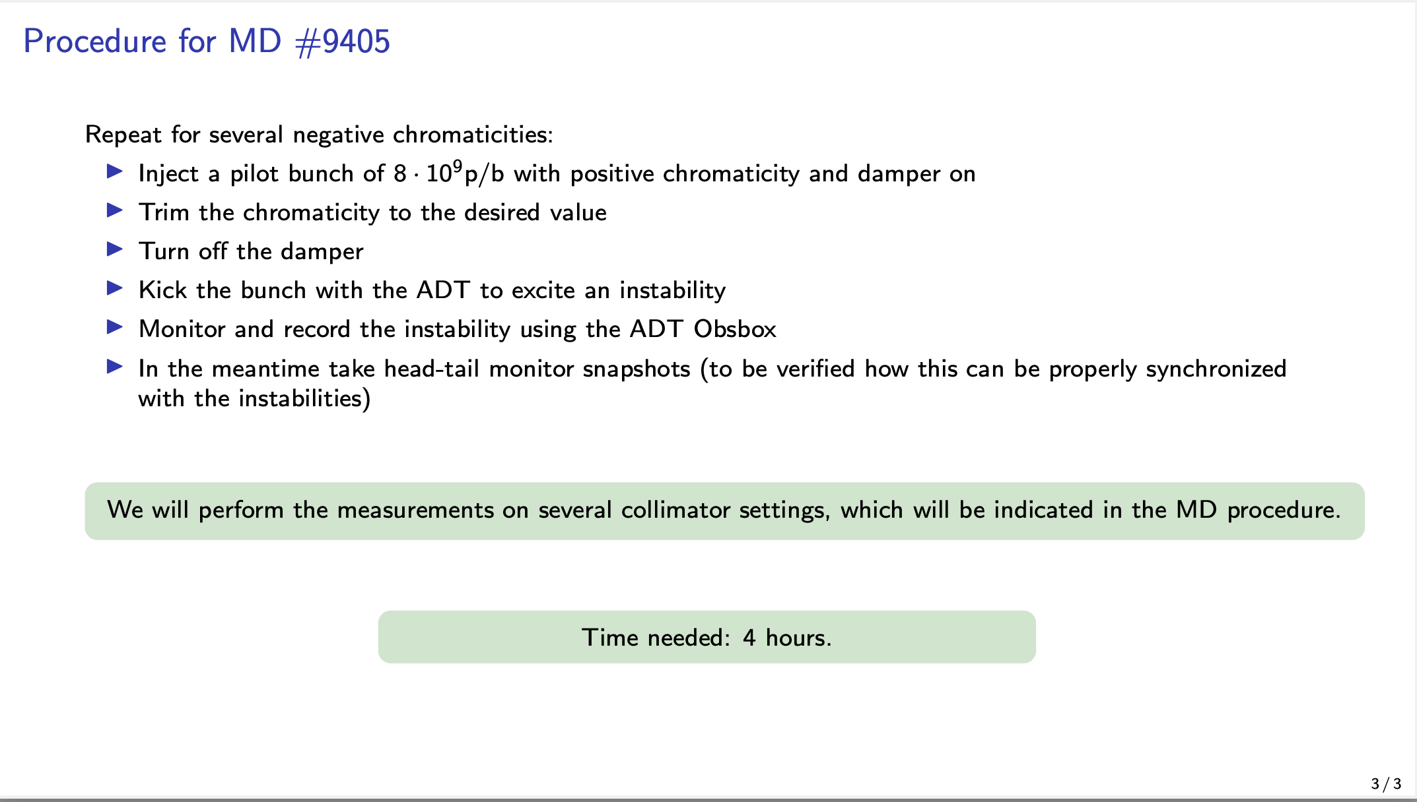

Slide 9
Thank you for your attention.

Slide 11
Backup

Slide 12
Short overview of the 2022 MDs
3 MDs and 13 hours allocated in 2022
→ Thanks to the MD Team, MPP and the OP/OMC/COLL help and support!
MD 6823: UPS ADT Noise at 450 GeV (July 1st, FMD 4/4)
MD 8043: Beam-beam wire compensation (Nov 5th, MD Block 2)
MD 7983: UPS ADT Noise at 6.8 TeV (combined with MD 8043, MD Block 2)

Slide 13
MD 8043: BB wire compensation (I)
During this MD (8 h) only the B2 wires were available (faulty B1 wire).
MD aim: wire potential with high intensity bunches (1.4e11 ppb, β*=30 cm)
→ reduced crossing
Courtesy of P. Bélanger

Slide 14
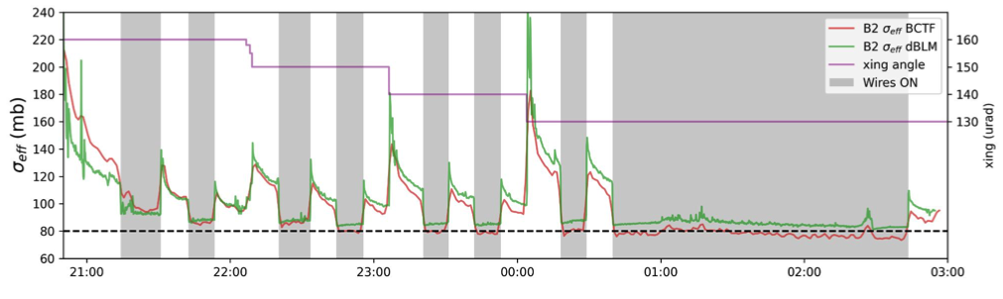
MD 8043: BB wire compensation (II)
Very clear effect of the xing angle reduction and of the compensation.
Our main obsevable is the σ_{eff} (losses normalized to the luminosity).
We used also the dBLM (together with the FBCT)
→ dBLM measurement show much higher time resolution
Courtesy of P. Bélanger

Slide 15
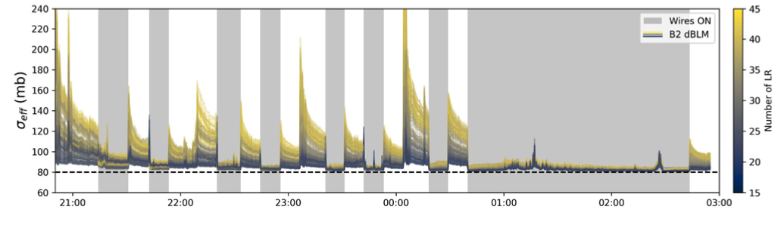
MD 8043: BB wire compensation (III)
1. Very clear signature of the BBLR effect (more LR → larger σ_{eff}).
2. The collimation team (C.E. Montanari, M. Giovannozzi,…) showed that the diffusion of the high amplitude particle is greatly reduced with the compensation on (it was barely measurable).
COMPENSATION MEASUREMENT
DIFFUSION MEASUREMENT
Courtesy of P. Bélanger

