Slide 2
OP MD requests
J. Wenninger, M. Hostettler

Slide 3
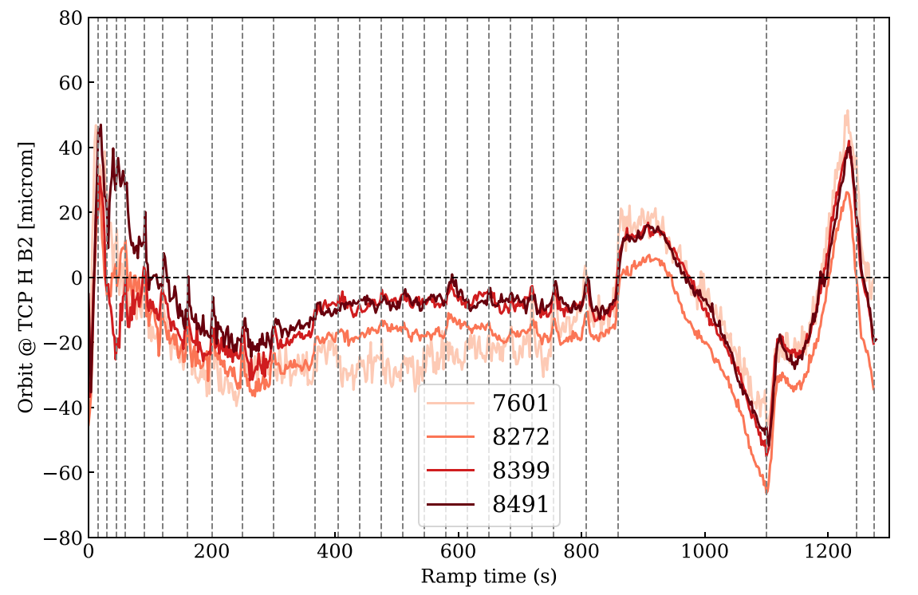
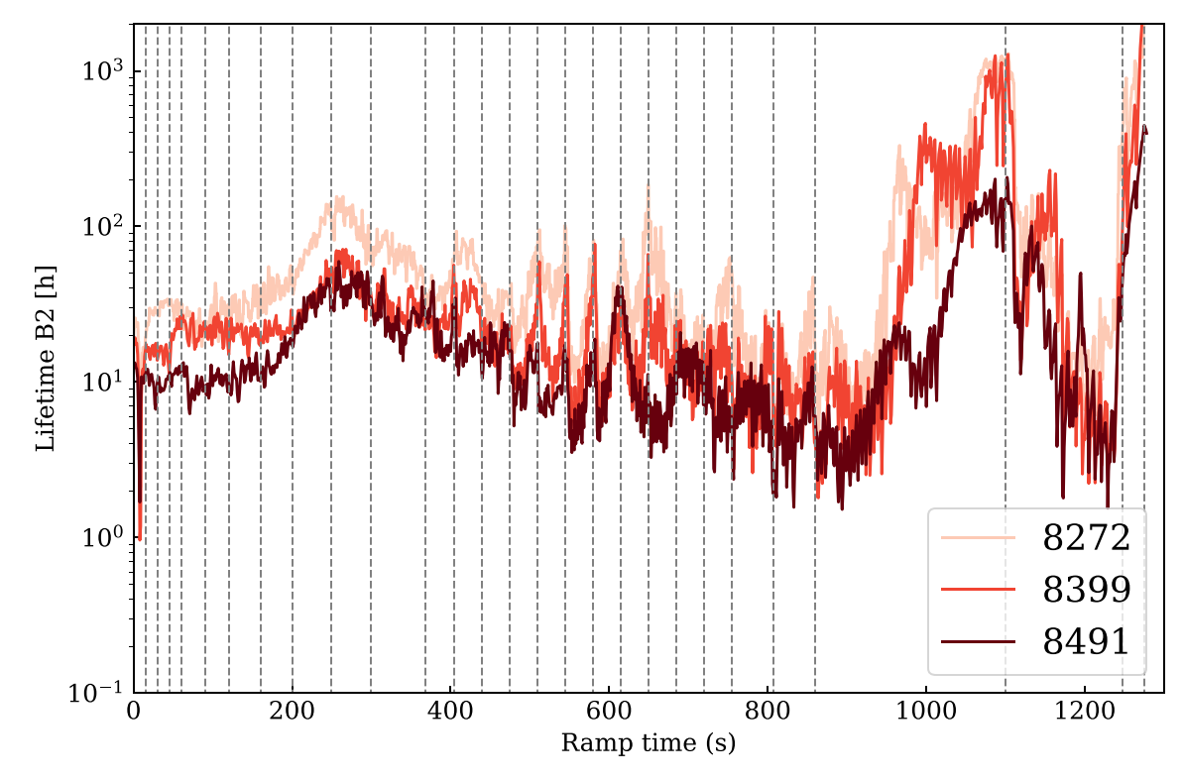
MD request #10386 - residual orbit excursion in the ramp
Residual horizontal orbit excursions are present in the ramp while the vertical plane is stable at 10-20 microns.
Spikes are visible at matched points. They are due to the parabolic rounding applied to feed-forward corrections.
A large non-corrected structure is present in the last 1/3 of the ramp: it correlates with the B2 lifetime structures.
  The structures can be explained by TF errors of the separation dipoles.
Merit: eliminating such orbit spikes will remove some of the lifetime dips in the ramp (and squeeze).
Life structures due to beta-beating introduced by optics interpolations requite other measures.
Details were presented at the LBOC of January 17th 2023.
Vertical dashed lines: matched points

Slide 4
MD request #10386
Some of the horizontal orbit spikes are due to the parabolic rounding applied to feed-forward trims in the ramp.
This MD will test of a modified way to incorporate feed-forward corrections into the ramp, by-passing the parabolic rounding.
Preparation and execution:
The initial settings will be constructed from the current low-beta ramp.
2-3 consecutive ramps are required to be able to feed-forward correction to consecutive ramps.
The cycle will be made with one nominal bunch per beam.
Total time estimate: 6 hours.

Slide 5
MD request # 10423
The ATLAS BCM is well known in operation for the number of beam aborts.
Recently 4 consecutive cycles have been aborted by the BCM with a particular filling scheme that had one single train colliding in ATLAS and CMS. Two 2022 MDs with the same train configuration were aborted before the filling scheme was changed.
It cannot be excluded that those dumps were due to tiny UFOs, in which case such filling schemes would be UFO enhancers (in ATLAS), or the issue is in the BCM algorithm.
The aim of the MD is to reproduce such dumps and observe the beams and signals in close collaboration with ATLAS.
Conditions:
A filling scheme with one long train per beam, with all bunches colliding in ATLAS and CMS.
Inject, ramp, squeeze and collide. Observe.

