Slide 1
Automatic TCDI alignment MD
F.M. Velotti, C. Bracco, Y. Dutheil, G. Trad

Slide 2
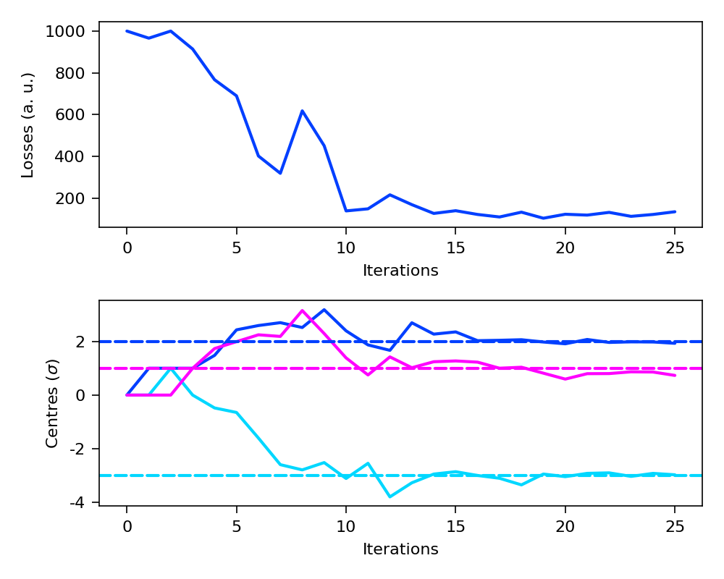
Motivation
TCDI alignment takes very long time → 6-7h in a very good day
Only goal is to find the center of collimator jaws – already automated but still needed ~15 shots per collimator (using today’s method)
We can easily speed it up by using numerical optimizers!
  ~20 iterations for 3 TCDIs → ~1h for both lines
  Still to test different algorithms
Need 8h with single PILOT on single TL in “inject and dump” (using MKD knob) – no matter which TI
  Ideally would use a bit of time before the MD during other MDs with single bunches to test TCDI movement (without intercepting the beam!)

Slide 3
Procedure
Measure PILOT emittance in the SPS
Prepare TL and LHC for TCDI alignment procedure (usual masking of interlocks)
Verify Gy/p calibration of TCDIL for the TL under study
  If calibration different from last year for first 2 TCDI, repeat calibration
Set all TCDILs at 3 sigma gap
  Verify that most of the beam still makes it to the end of the line
Change TCDIL centres by a few mm
Launch numerical optimizer to find back nominal TCDI centres
Solve eventual bugs in the SW/procedure
Repeat with different TCDI apertures (2, 3, 4 sigma) and different algorithms

