Slide 1
Crystal collimation studies
M. D’Andrea on behalf of the LHC Collimation Team
11 July 2023 – LHC Studies Working Group – MD2 Preparation

Slide 2
MD #10503
Characterization of B1H crystal collimator

Slide 3
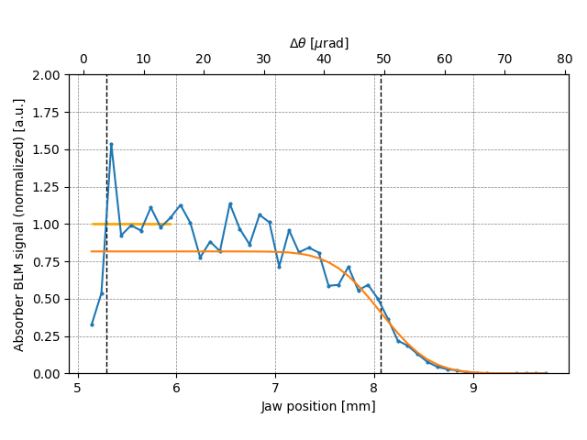
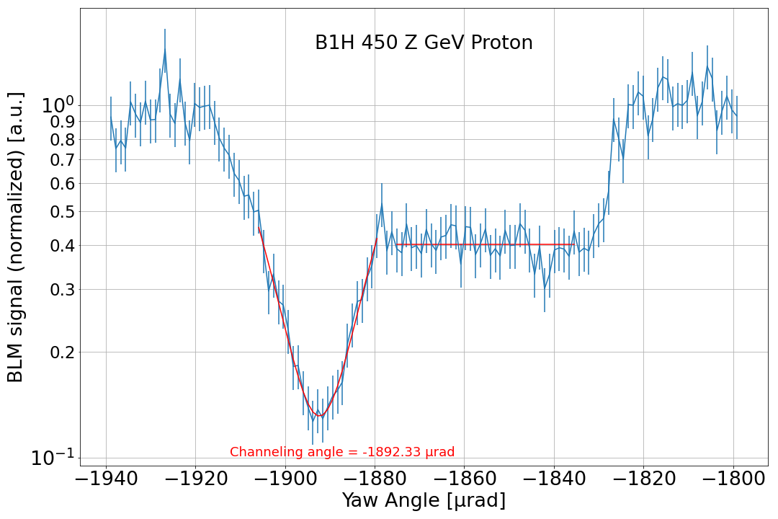
Motivation
B1H crystal collimator re-installed during TS1 after solving a hardware issue identified during startup commissioning
First very quick checks performed at injection energy: crystal behaves as expected
Angular scan of crystal
Linear scan of absorber
Courtesy of R. Cai
Important to perform same checks at top energy in preparation for operation in 2023 Pb ion run
  Establish reference position for linear alignment and orientation for optimal channeling
  Confirm crystal parameters and no unexpected issues

Slide 4
Beam requirements and plan
Up to 30 pilot bunches for both beams, respecting setup beam flag
Plan:
  Ramp to 6.8 TeV
  ͏Beam based alignment of B1H crystal collimator → reference linear position at top energy
  Retraction of TCPs and TCSGs upstream of crystal
  ͏Angular scan of crystal collimator → reference orientation at top energy
  ͏Linear scan of absorber → crystal bending angle and multiturn channeling efficiency
  ͏Loss maps → preliminary cleaning assessment
During angular and linear scans, ADT used to excite 3 pilot bunches at the same time
Same procedure as previous crystal tests (e.g. MD3327, MD7007)
Estimated time: 6 hours

Slide 5
MD #9943
Measurement of dechanneling population
with crystal collimators

Slide 6
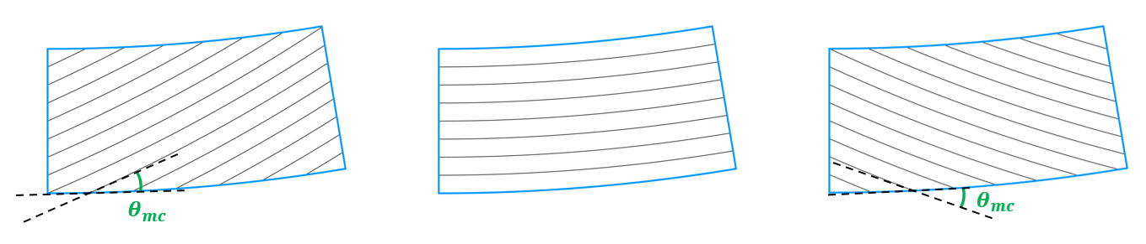
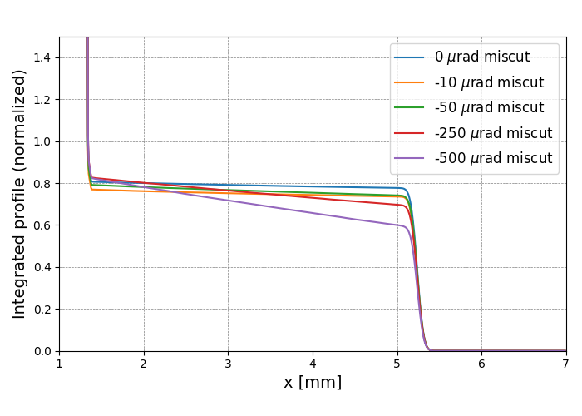

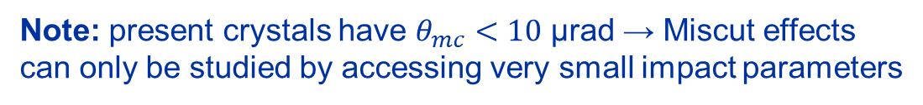


Motivation
Miscut angle: mis-orientation of crystalline planes with respect to lateral face, may arise in manufacture
$$θ_{mc}>0$$
$$θ_{mc}=0$$
$$θ_{mc}<0$$
Beam
Channeled particles experience different effective deflections depending on impact parameter
  For negative miscut angle: larger percentage of particles in the “dechanneling” region
Goals of the MD:
Intermediate deflections (“dechanneling”)
Measure dechanneling population via linear scans
Compare results for different beam excitations → different impact parameters
Assess impact of miscut effects for collimation purposes
Gather data for benchmark of simulation tools and better definition of tolerances
Full deflection
Note: present crystals have $θ_{mc}<10$ µrad → Miscut effects can only be studied by accessing very small impact parameters

Slide 7
Beam requirements and plan
More efficient if performed after MD10503 (optimal linear and angular alignment already found)
Up to 30 pilot bunches for both beams, respecting setup beam flag
Plan:
  Ramp to 6.8 TeV
  ͏Setup for optimal channeling with all crystals (profiting from previously established references)
  Retraction of TCPs and TCSGs upstream of crystal
  ͏Multiple linear scans of absorber with different ADT excitation gains
  Possibly refill and ramp a second time if more data required
During linear scans, ADT used to excite 3 pilot bunches at the same time
Estimated time: 6 hours

Slide 8
Thank you for your attention!

