Slide 1
Construction noise assessments and mitigation proposals during asbestos remediation works in B60
Jordan MINIER
21/07/2023
EDMS 2917544

Slide 2
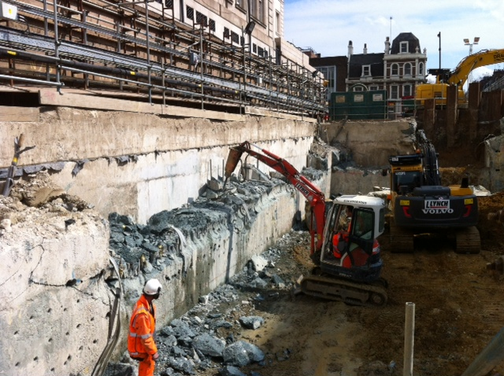
Construction noise definitions
Airborne noise: Airborne noise is transmitted through the air and atmosphere (blue waves).
Structure borne noise: results from an impact on, or a vibration against, a part of a building fabric resulting in sound being radiated from an adjacent vibrating surface.
  Exemple: hand-held drill or breaker (red waves).
Construction noise assessments and mitigation proposals during asbestos remediation works in B60
Notes:
Bruit aerien -> onde se deplace dans l’ air
Bruit solidien -> onde se deplace dans un solide (beton, sol).

Slide 3
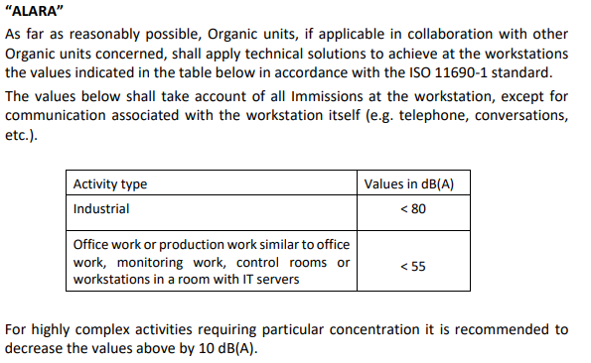
CERN’s ’’noise at work’’ criteria
GSI-SH-4 Protection of workers against noise extracts:
Noise criteria
Noise transmission | Criteria
Structure borne noise (in receptor room) | 55 dBA
Airborne noise (at receptor facade) | 80 dBA with closed windows
Note: Following facade insultation can be considered
- 10 dBA with opened windows
- 25 dBA with closed windows

Slide 4
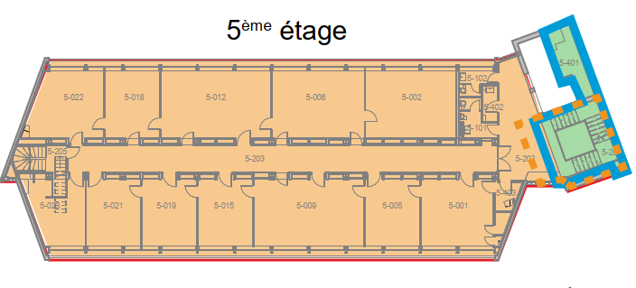
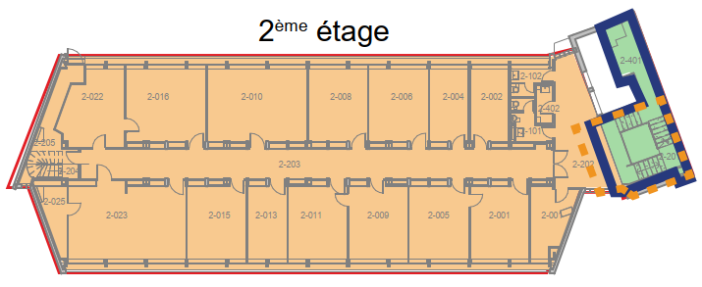
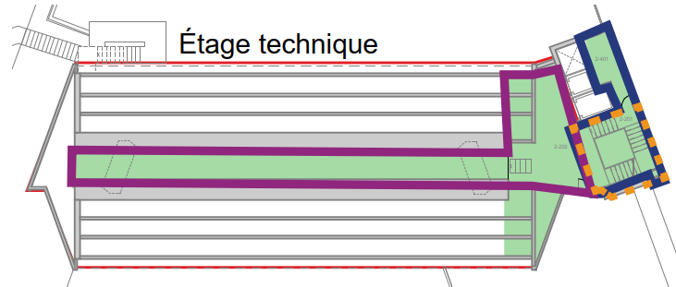
Works programme
Hours of work:
7am-12am
1pm-5:30pm
Activities | Description | Location | Duration (weeks) | Dates
1 | Option A - asbestos remediation in office aera (floors 2 to 6) with slab conservation. Option B - asbestos remediation in office aera (floors 2 to 6) without slab conservation. | Office area | 5 | From 10/07 to 11/08
2 | Asbestos remediation in technical room (1/2 impair floors) | North staircase | 2 | From 14/08 to 22/09
3 | Asbestos remediation in technical floor | R+2 | 2
4 | Asbestos remediation in technical room (1/2 pair floors ) | North staircase | 1
5 | Asbestos remediation in north staircase |  | 1
Note 1: Some slight variation in the activity programme can be expected.
Note 2: Air Handling Unit (AHU) will be operating 24/7 at the B60 façades to control asbestos dispersion. Numbers of AHU will decrease at the end of Activity 1.
Activity 1
Activity 2
Activity 3
Activity 4
Activity 5

Slide 5
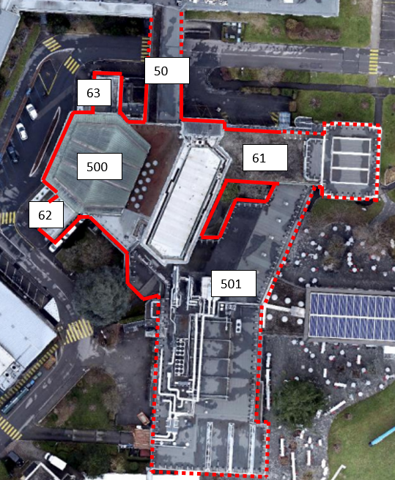
Structure borne noise (SBN) predictions
Structure borne noise (SBN) will impact any building structurally connected to B60: B500, B61, B62, B63 et B50.
This disturbance could not be forecasted for the following reasons:
pre-vibration survey was not possible due to asbestos presence.
works programme includes the use of vibrating tools at all storeys at the same time to minimise works duration.
SBN impact planning
Activity | Description | Duration (weeks) | SBN impact
1 | Option A - asbestos remediation in office aera (floors 2 to 6) with slab conservation. Option B - asbestos remediation in office aera (floors 2 to 6) without slab conservation. | 5 | Yes
2 | Asbestos remediation in technical room (1/2 impair floors) | 2 | Yes
3 | Asbestos remediation in technical floor | 2 | No
4 | Asbestos remediation in technical room (1/2 pair floors ) | 1 | Yes
5 | Asbestos remediation in north staircase | 1 | No
Notes:
Difficulte a quantifier le bruit solidien

Slide 6
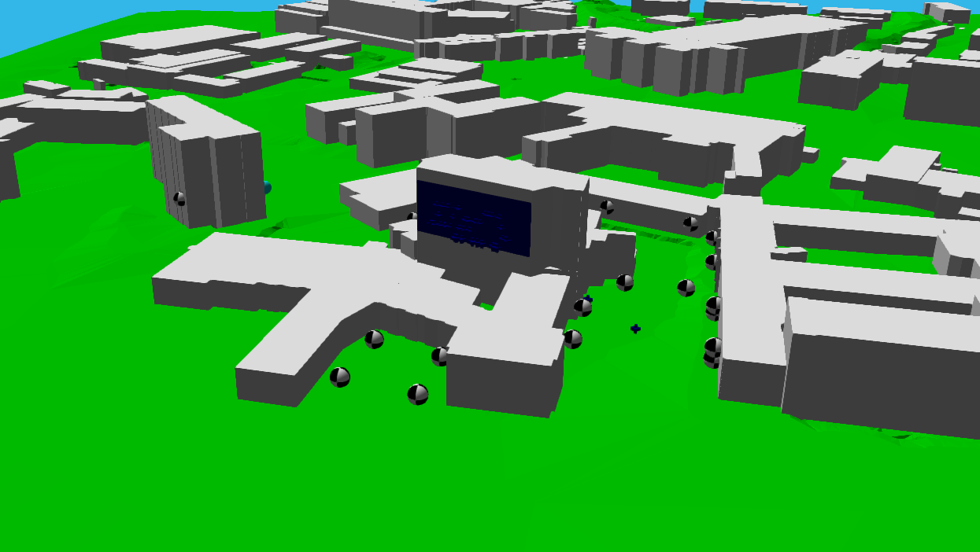
Airborne noise predictions
The ‘’Directive sur le bruit de chantier’’ from OFEV requires that a construction noise assessment is carried out.
To do so, 3D noise model has been used to predict noise levels associated with the construction activities.
The software sums the noise levels calculated from each noise source at each receptor location.
Plant noise levels are taken from:
Datasheets provided by manufacturer
On-site measurement.
BS 5228 Code of practice for noise and vibration control construction and open sites database.
Noise propagation
Notes:
Office fédéral de l'environnement OFEV

Slide 7
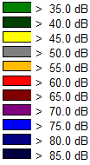
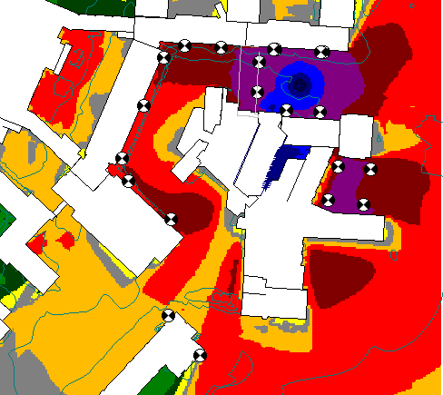
Activity 1 – Asbestos remediation in office area
→ From 10/07 to 11/08 (5 weeks)
52
53
Building | Max noise levels (with closed windows) 8 hours average – dBA
B53 | 46.5
B50 | 50
B52 | 43
B2 | 40
B510 | 40.5
B38 | 31.5
B61 | 49.5
Cantine (Terrasse) | 68 (Terrasse)
2
61
510
Note 1: SBN not included in noise levels results.
Note 2: ALARA criteria : 55 dBA + 25 dBA = 80 dBA at facade.
38

Slide 8
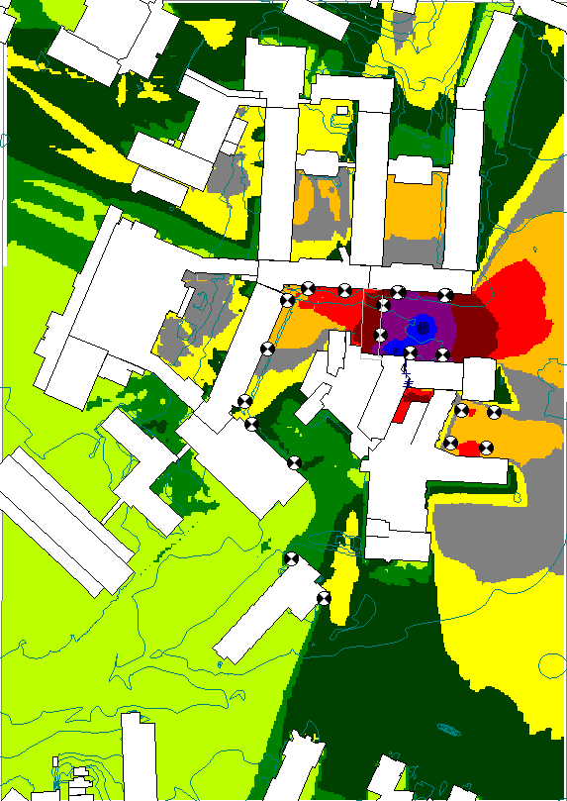
Activity 2-5 – Asbestos remediation in north staircase and R+2
→ From 14/08 to 22/09 (6 weeks)
52
53
Bâtiment | Max noise levels (with closed windows) 8 hours average – dBA
B53 | 44
B50 | 46.5
B52 | 40
B2 | 32
B510 | 20
B38 | 11
B61 | 48.5
Cantine (Terrasse) | 56 (Terrasse)
2
61
510
38
Note 1: SBN not included in noise levels results.
Note 2: ALARA criteria : 55 dBA + 25 dBA = 80 dBA at facade.

Slide 9
Observations and results
For buildings connected to B60, structure borne noise might exceed ALARA criteria for a 8 week duration.
For other buildings, airborne noise will never exceed ALARA criteria with closed windows.
Delivery area is the main noise source. Unfortunately due to asbestos restrictions, this area needs to remain near the construction area.

Slide 10
Control measures during asbestos remediation works
Asbsestos remediation works to be undertaken during holiday period to limit noise impact.
Contractors to be made aware of the environmental constraints of the site and follow the necessary procedures to minimise noise. Task Briefings will be carried out to ensure all operatives are fully aware of the need to keep noise to a minimum:
  No radios or music systems are permitted on site, this extends to include any in-cabin music systems present on any vehicles attending site.
  Drop heights for materials will be minimised wherever possible.
  Site traffic will be instructed to switch engines off and not to leave engines idling.
A continuous liaison between project team and neighbours will be in place through batiment60@cern.ch. If a direct complaint is received, the site supervisor will check if remedial action can be taken on site.
Attended noise measurements may also be taken as the work progresses.

Slide 11
Recommandations
B60 abestos remediation works will generate noise.
The construction noise assessment has permitted to state the followings:
    For buildings connected to B60, structure borne noise might exceed ALARA noise level (55 dBA) during a 8 weeks period
    → Prioritise teleworking during this period.
    For other buildings, airborne noise will not exceed ALARA limits with closed windows
    → Keep windows closed during this period and prefer night ventilation.
Project team and HSE noise specialist remain available throughout the construction duration and regular update will be given. → Contact batiment60@cern.ch in case of disturbance.
Reminder:
B60 construction works noise impact are closely assessed and monitored.
For next construction stages, methodologies will be reviewed to minimise impacts which are likely to be less significant.
Notes:
Impact pour les bâtiments du B500, B61, B62, B63 et B50
Suivi strict du chantier avec le maitre d’œuvre pour assurer une bonne acceptabilité du chantier

