Slide 1
ecsite 2024

Slide 2
Role of SC & SM in society
Traditional roles
Education, inspiration
Conservation
New roles
Open up to communities
Youth work (is not science education)
Core of community
Contributing to societal change
Research
…

Slide 3
Colombia
Youngsters collecting fossils: > 2000
Exhibition
Museum in community
Now inspiring local youth

Slide 4
Universcience
Private companies as sponsors
  Past: wanting PR and visibility
  Now: wanting co-design
  Resistance inside institution
    Concern greenwashing
    Values
    Employees reluctant to collab
    Lists of companies with strong ESG commitments
      (Environment, Social, Governance)

Slide 5
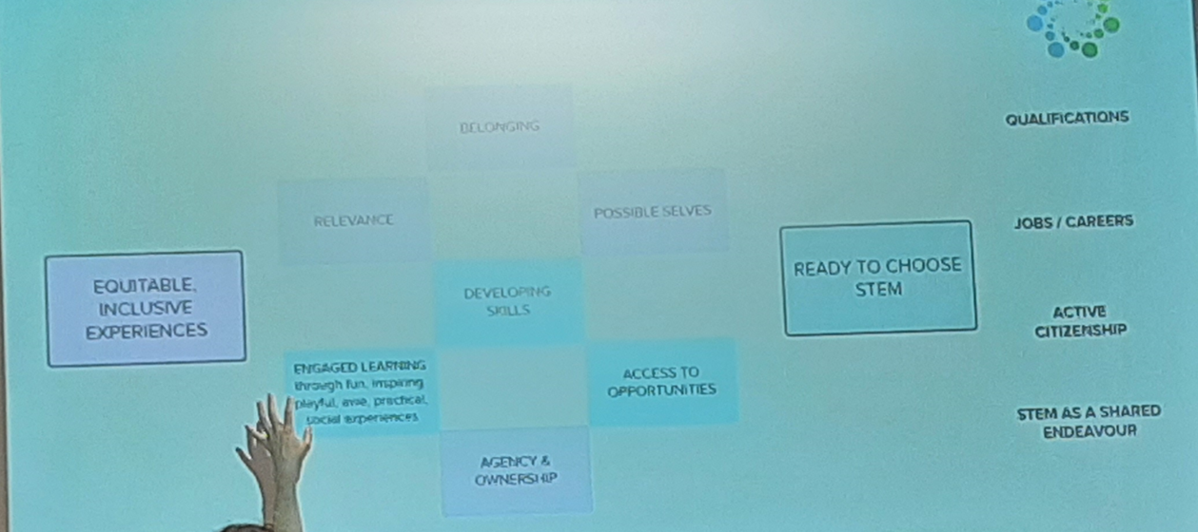
Unite different goals companies and SC&SM

Slide 6
Museum of the Future
Dubai
Opened 2 y ago
Already working on complete renewal
Estimate time of life of exhibition at 5 y

Slide 7
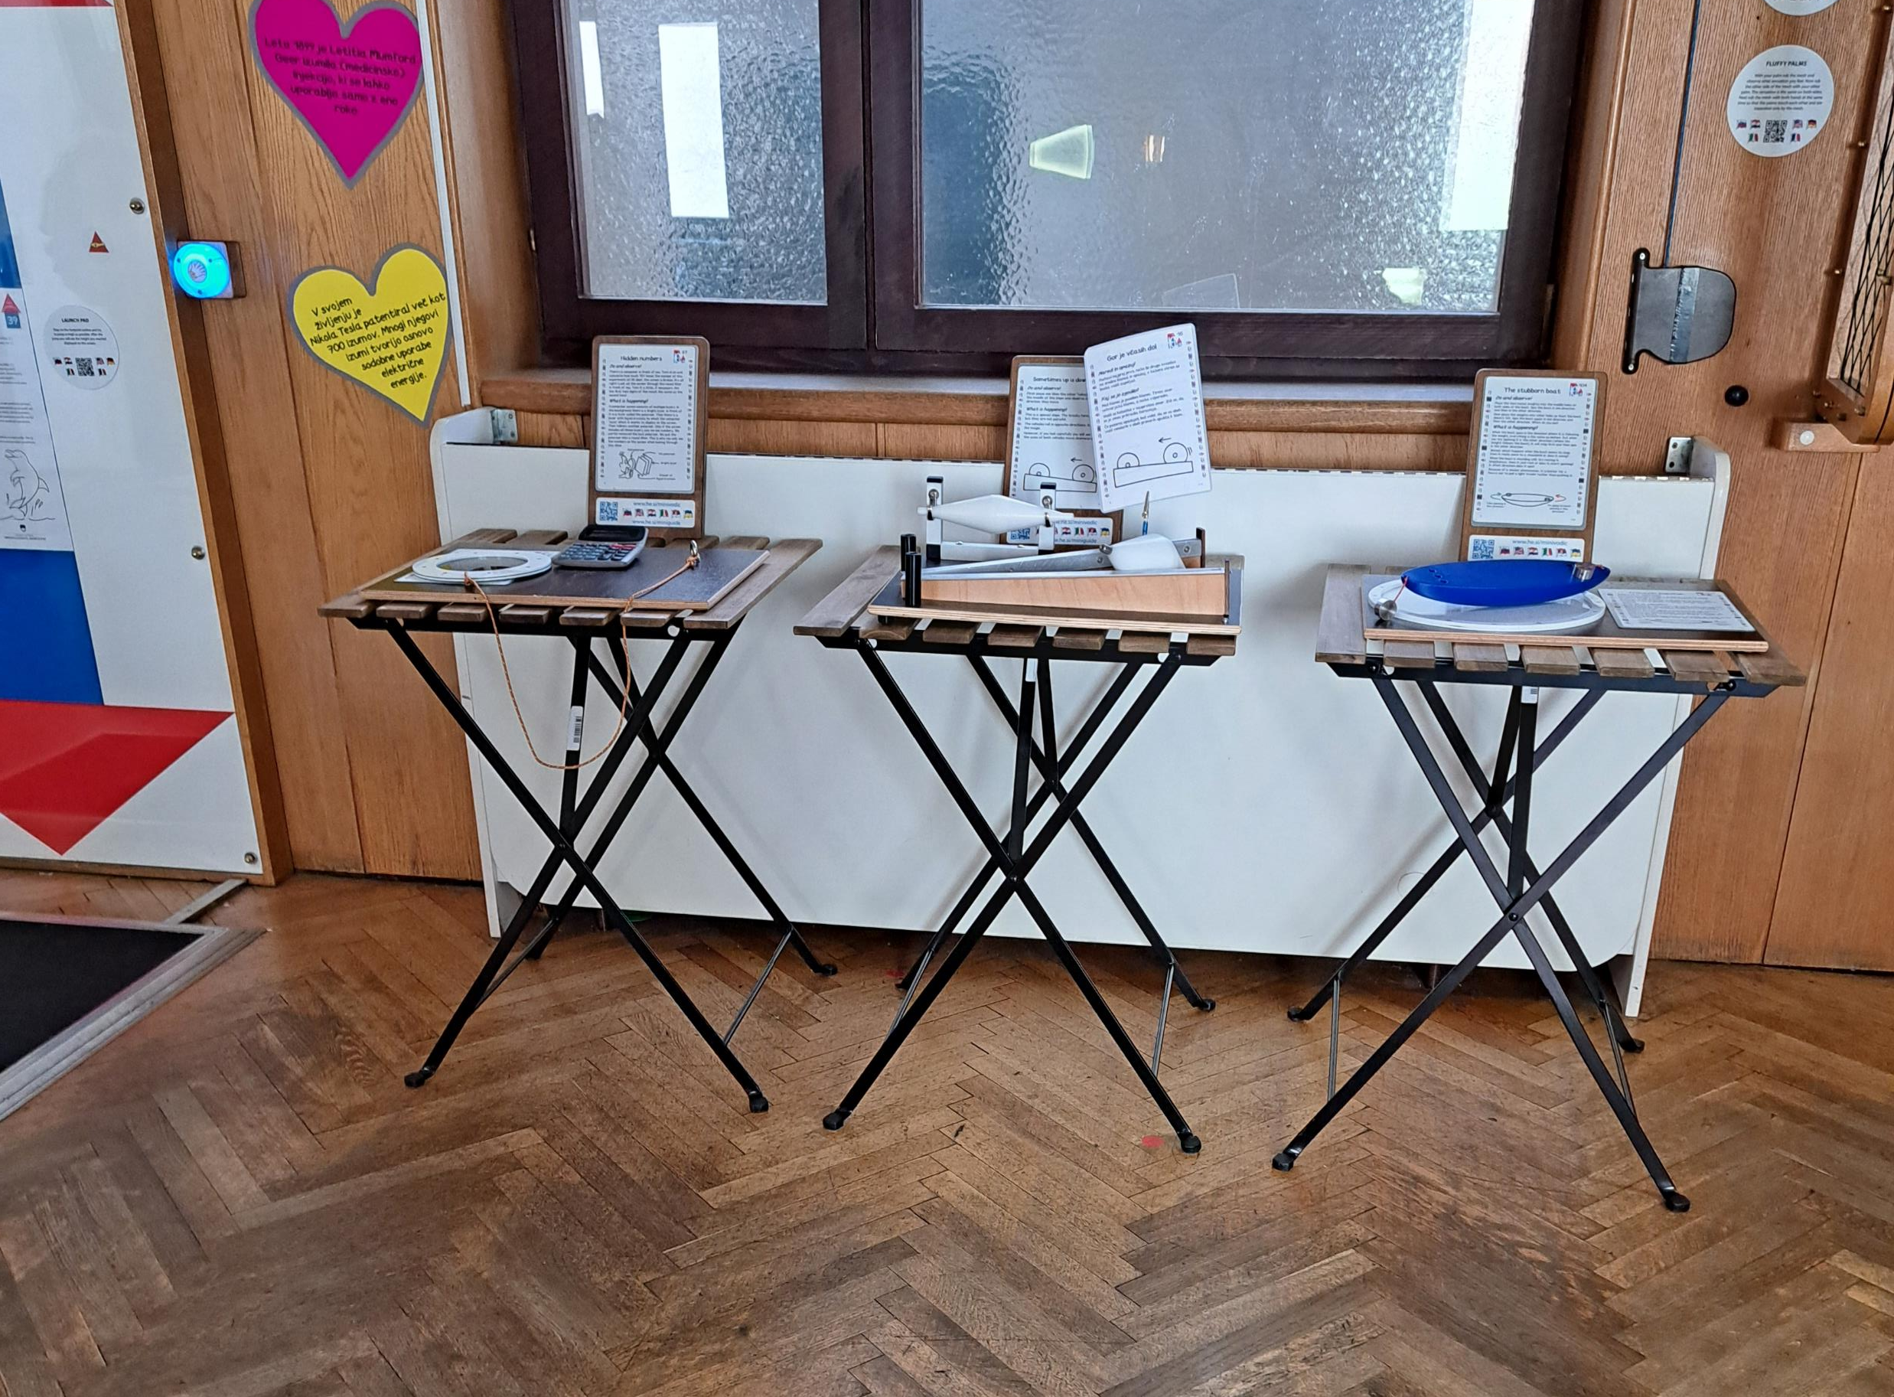
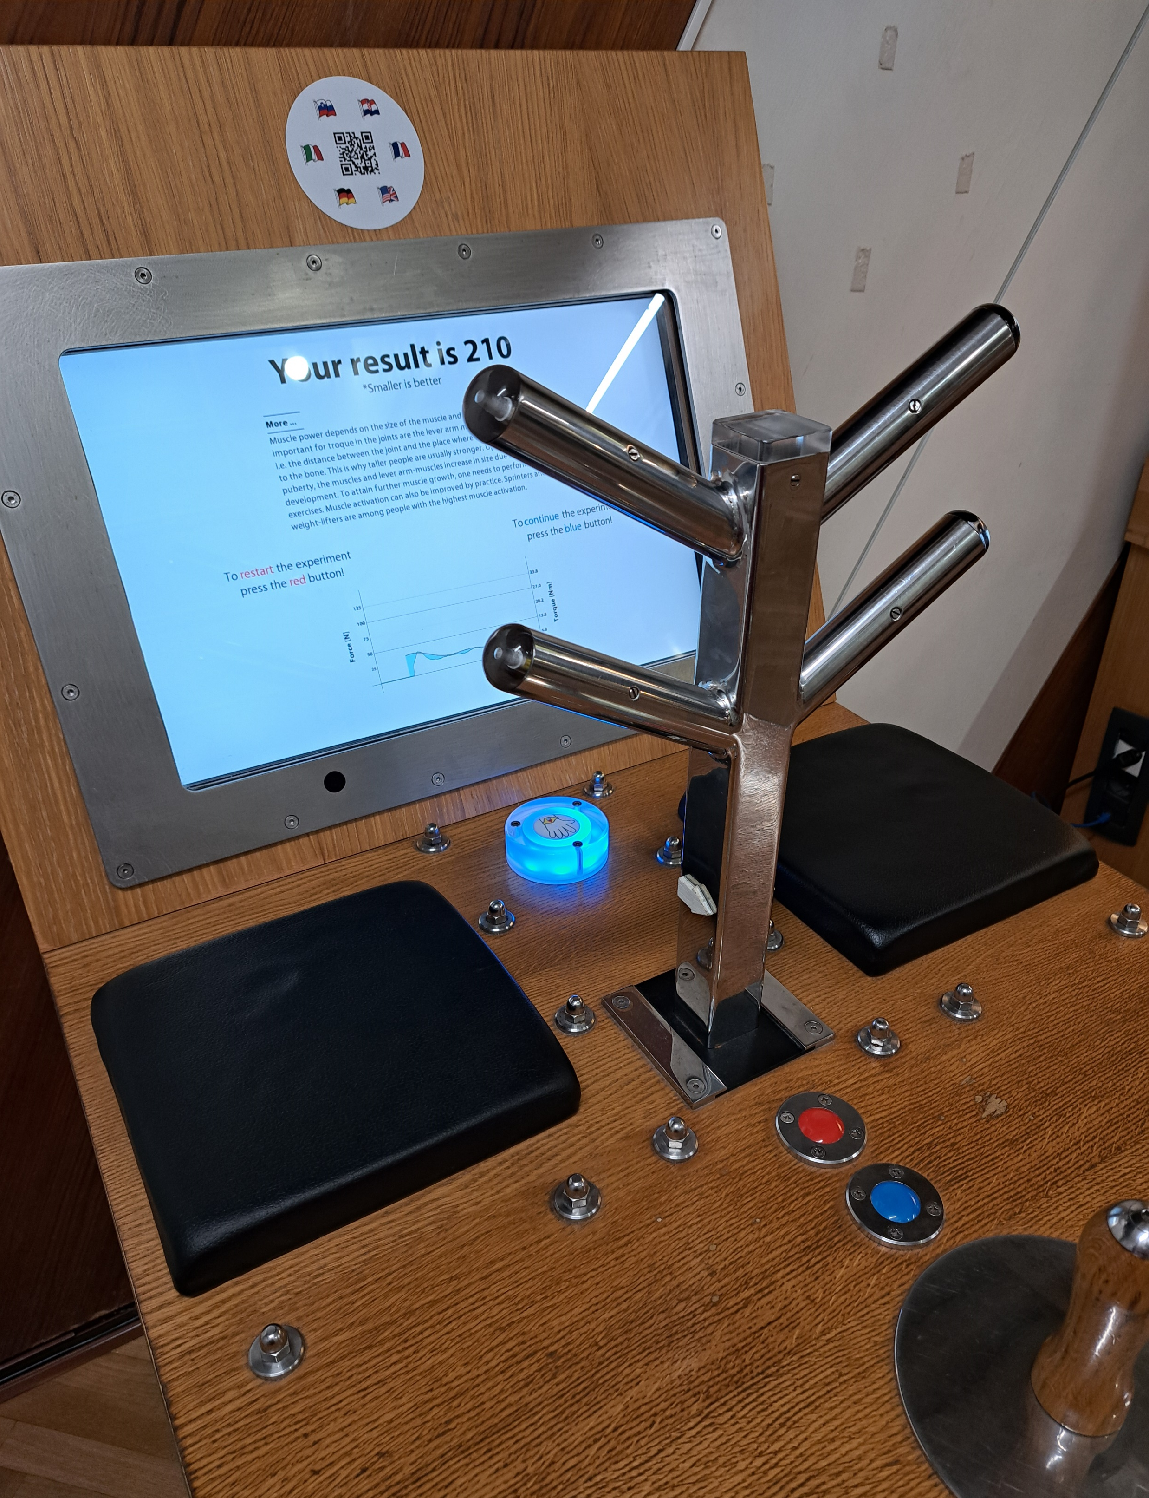
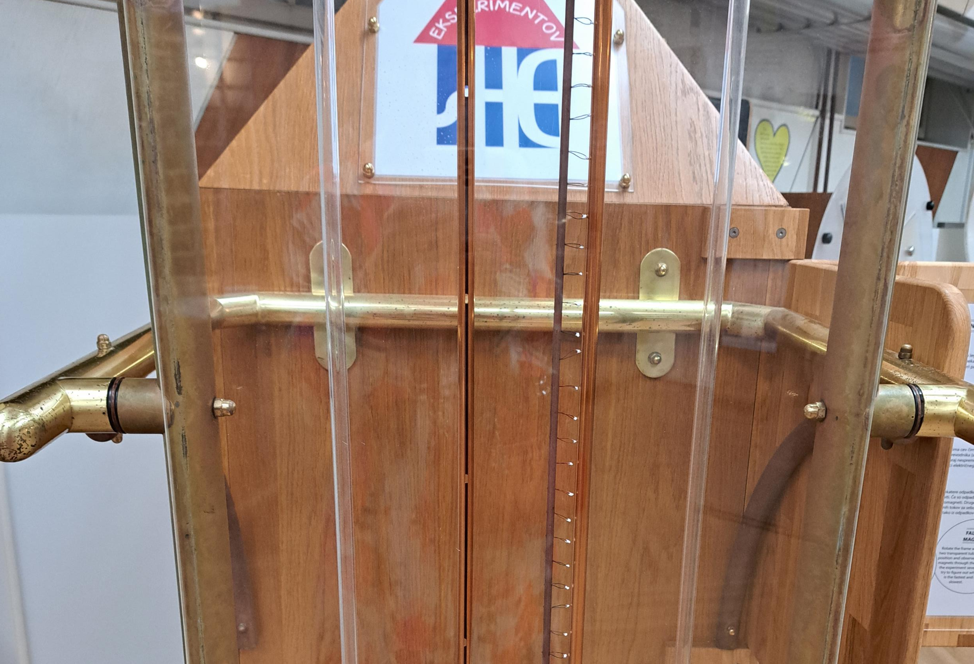
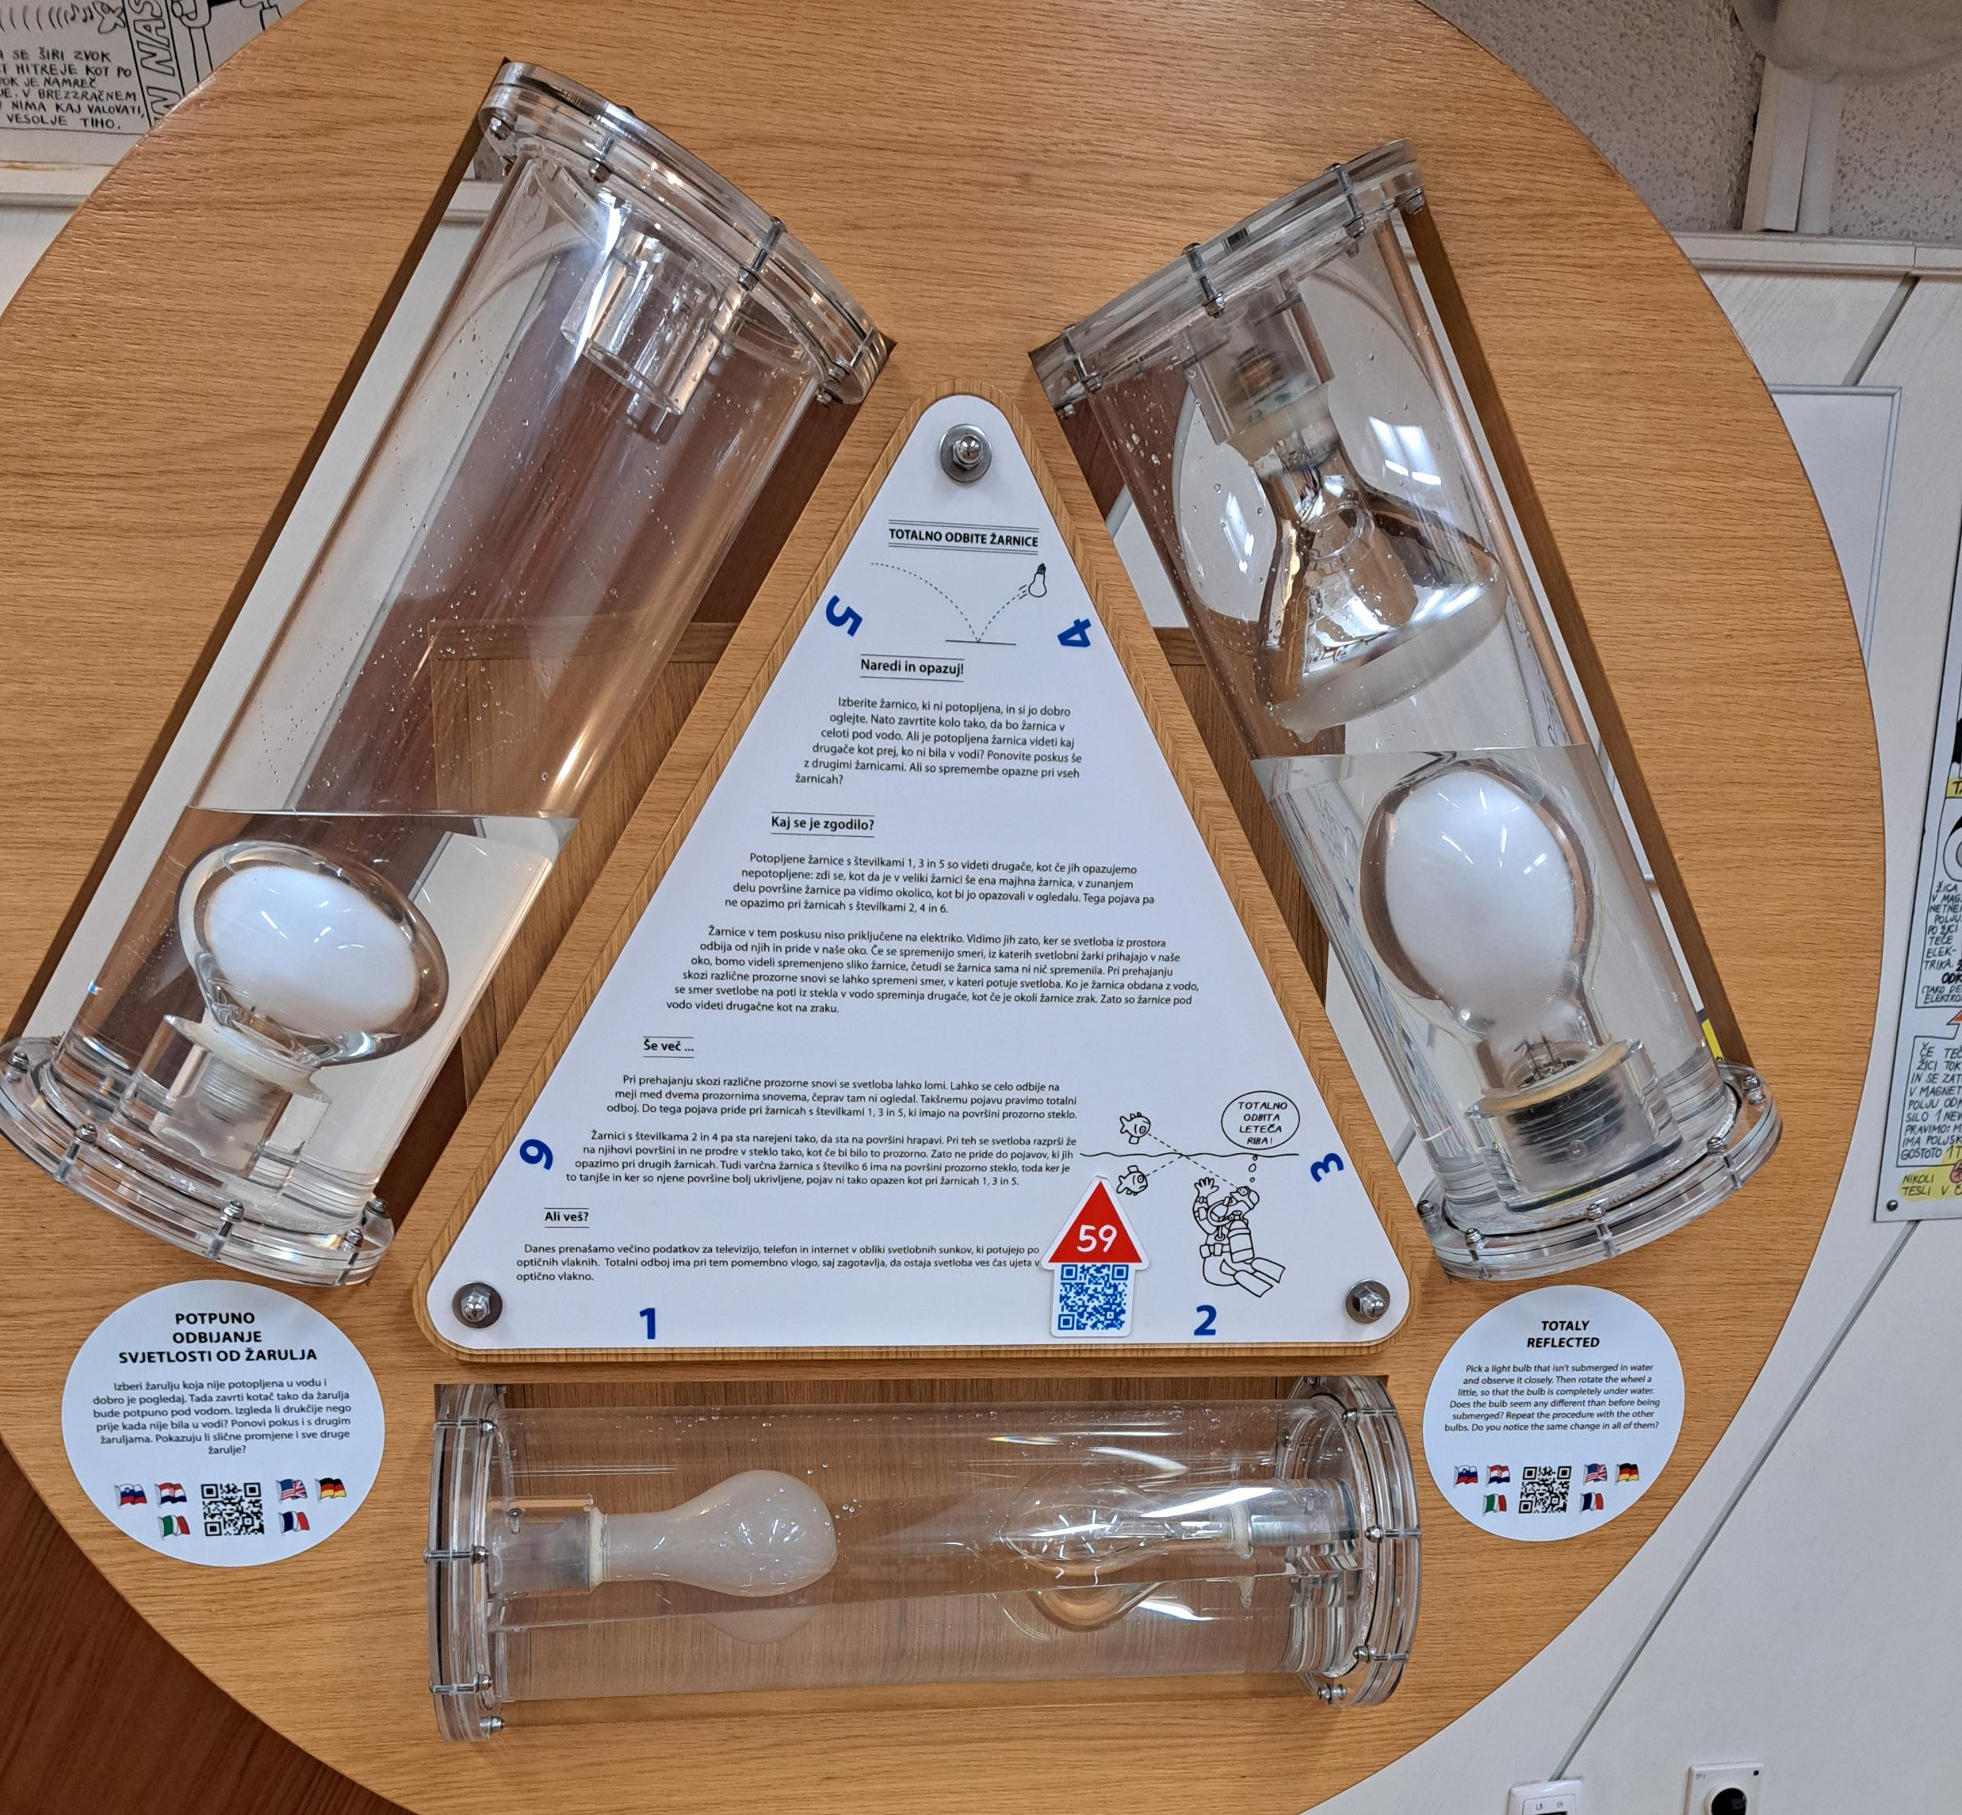
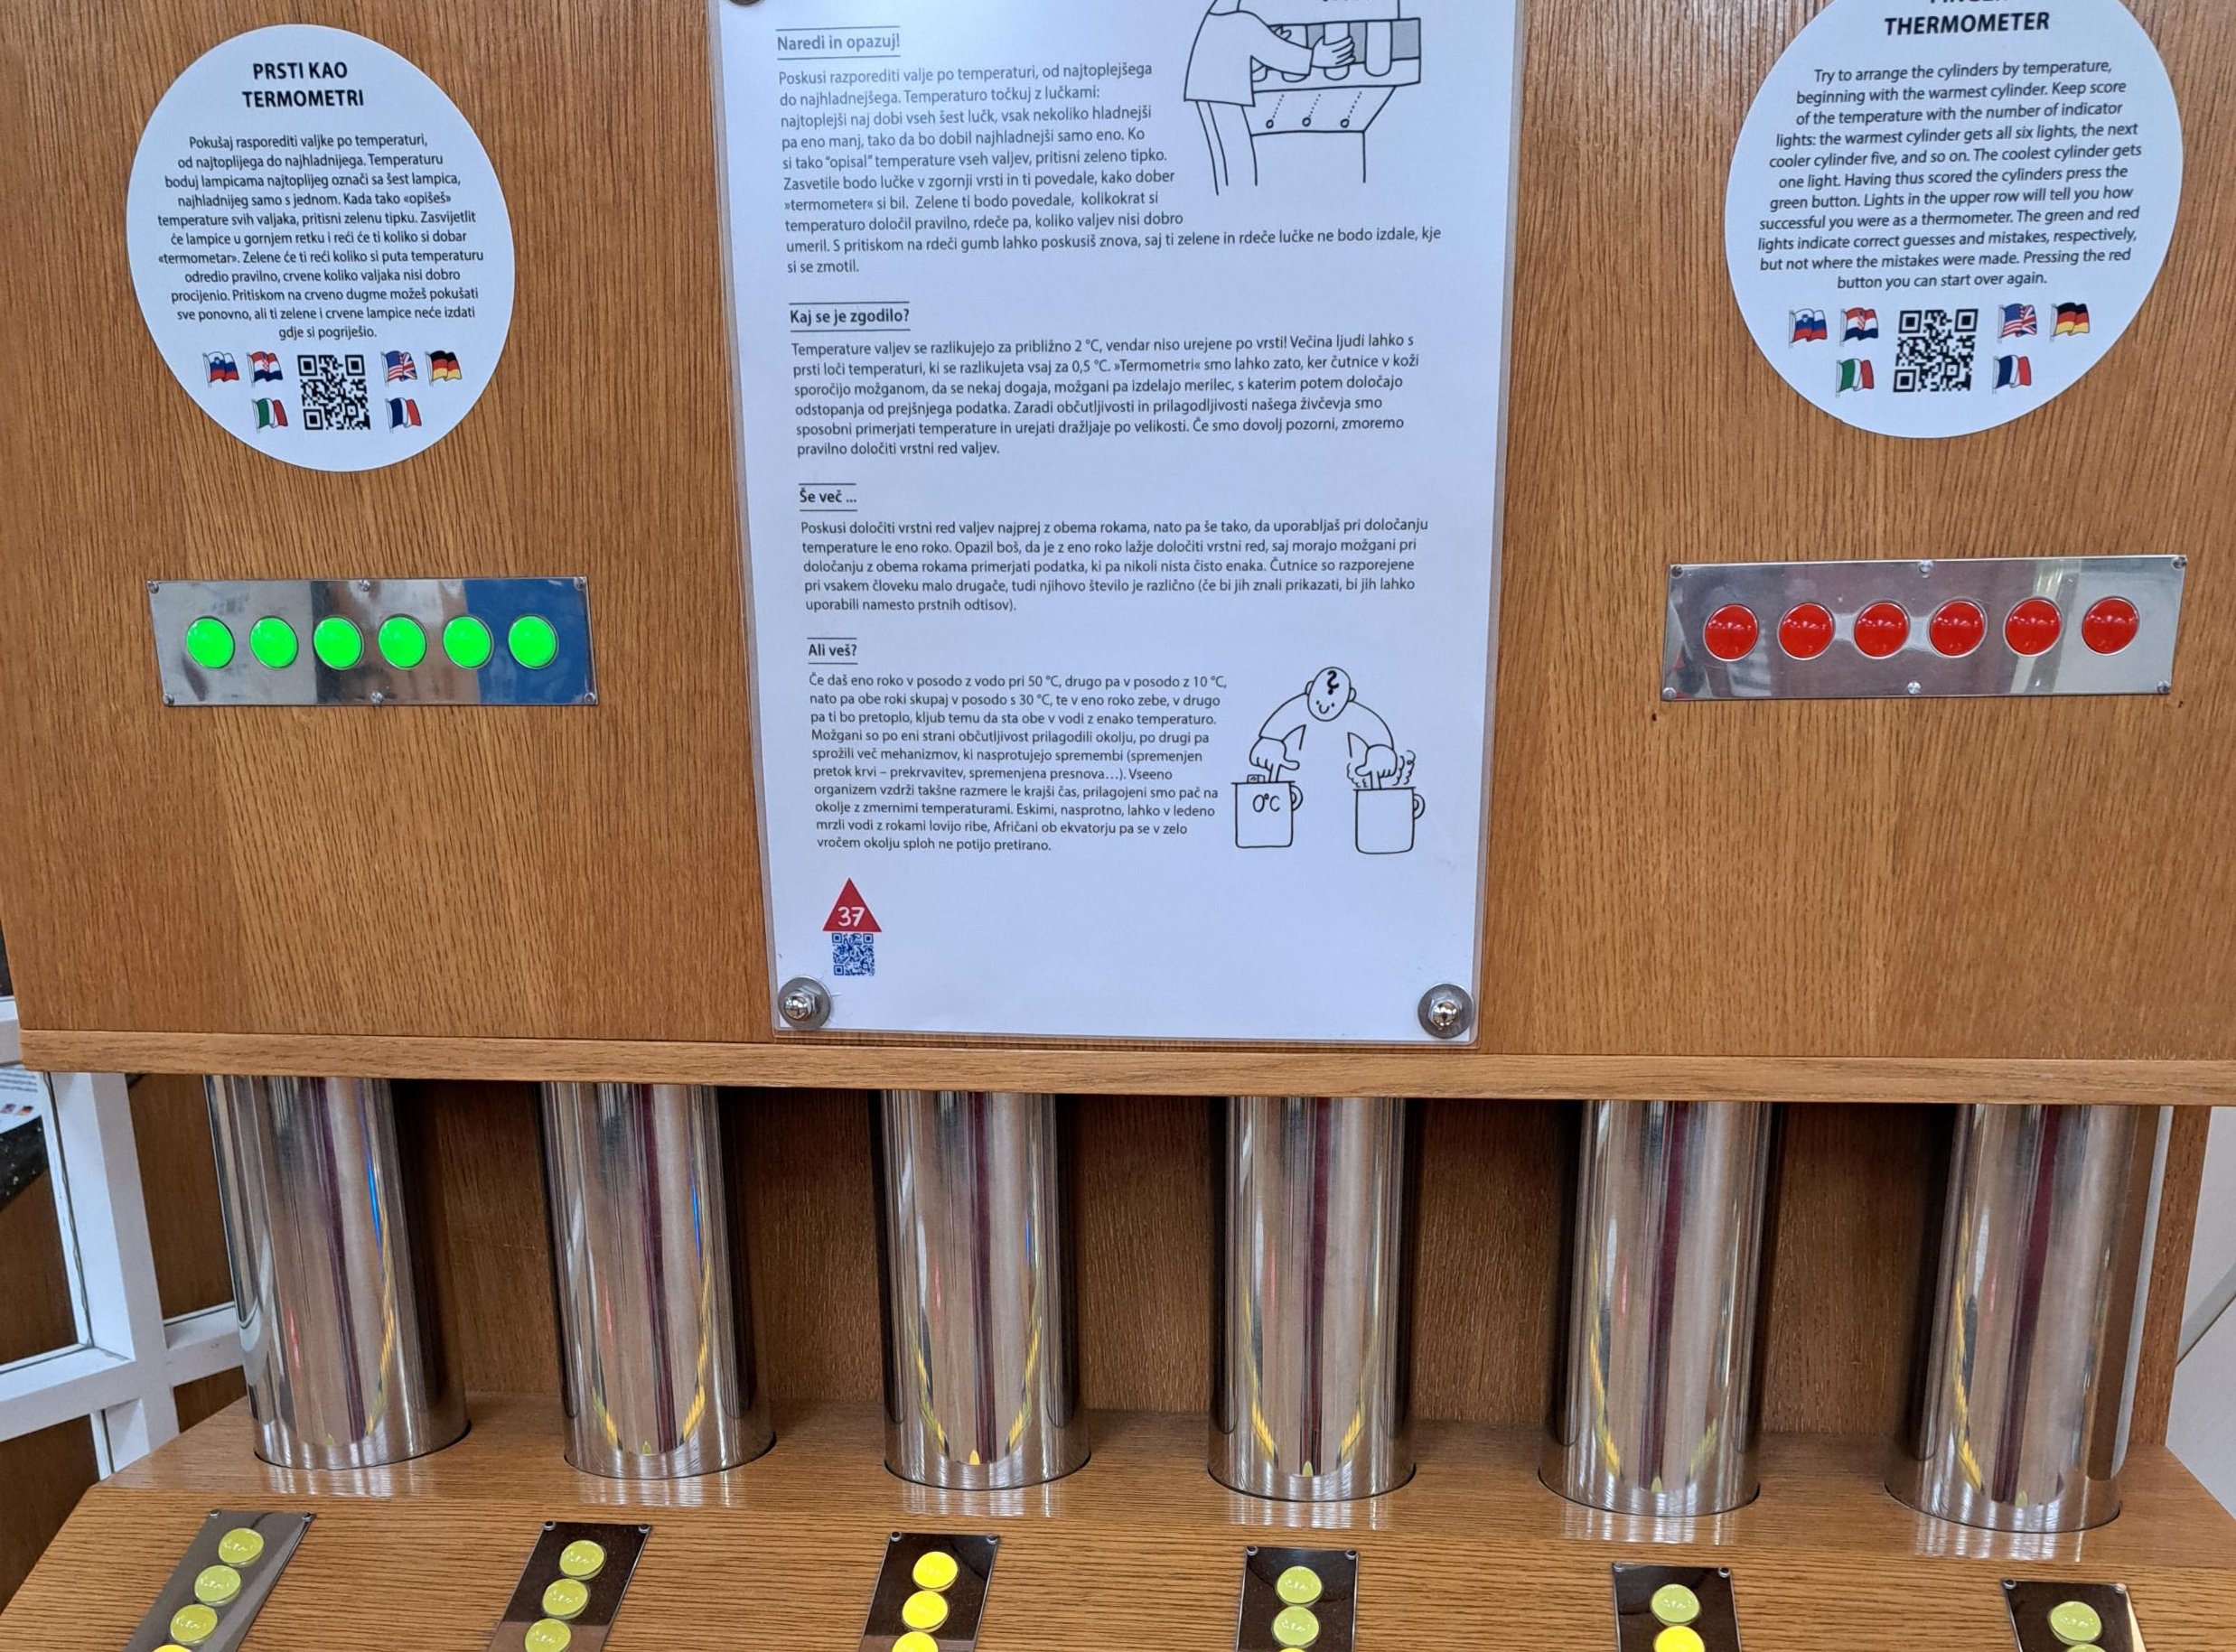
House of experiments: possibilities on limited budget
Everything build in house
Slovenian instruction + EN summary
QR code to 6 languages
  https://vodic.he.si/#37

Slide 8
Hugh Herr(Prof. MIT)
Disability as opportunity

Slide 9
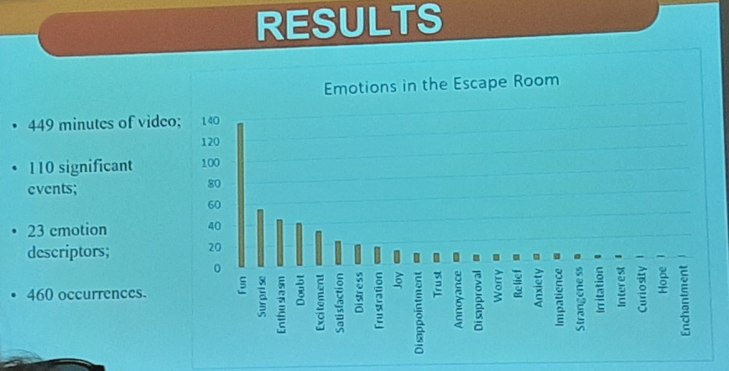
Evaluation: emotions

Slide 10
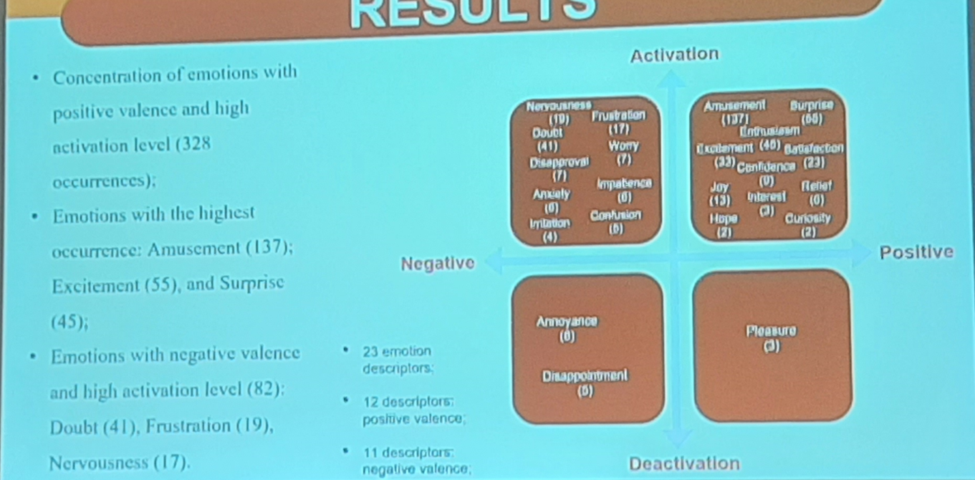

Slide 11
Potential suppliers for exhibition furniture

