Slide 1
AN ECSITE’ING EVENT
Interesting elements
Candice TROCSON
June 13, 2024

Slide 2
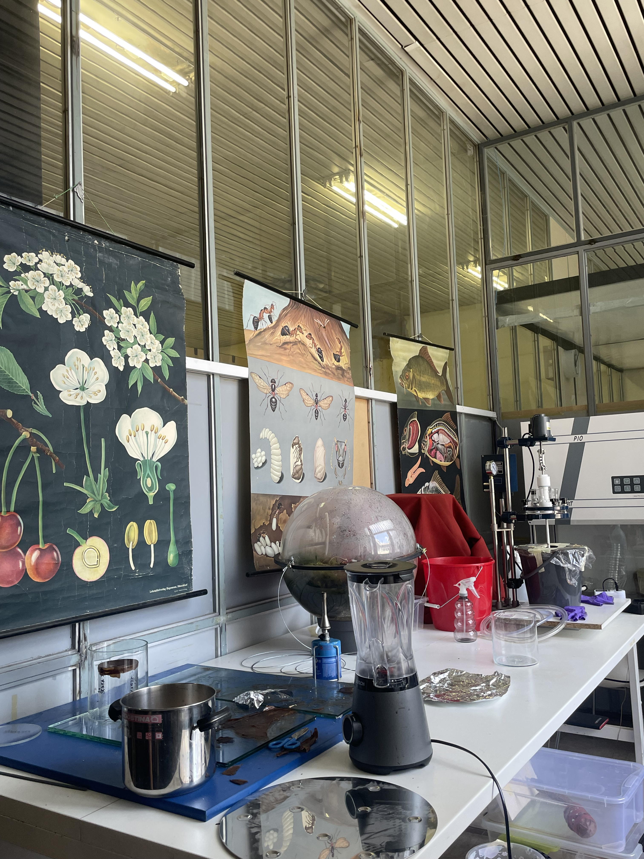
Artful alliances: How to enrich art and science collaborations to deepen engagement
  Discovery of the Kersnikova Institute
  Discovery of the Universcience / Scenocosme
  Key Points :
  Main topic this year ( conference MIT/Artist)
  Interdisciplinarity to break codes and innovate

Slide 3
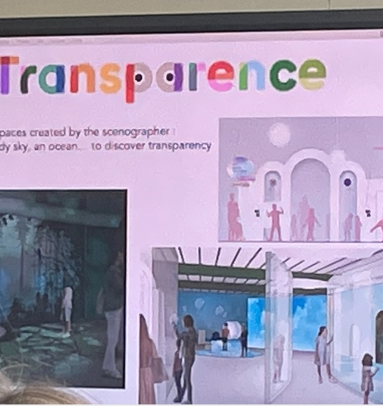
Artful alliances: How to enrich art and science collaborations to deepen engagement
  Discovery of the Kersnikova Institute
  Discovery of the Universcience / Scenocosme
  Key Points :
  Main topic this year ( conference MIT/Artist)
  Interdisciplinarity to break codes and innovate

Slide 4
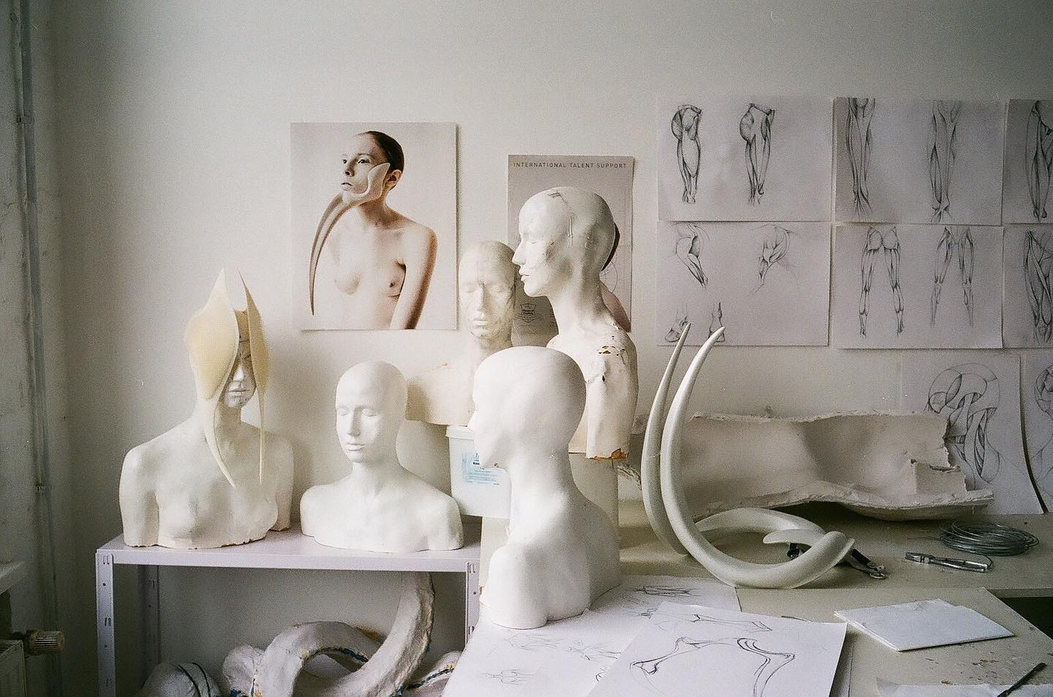

Artful alliances: How to enrich art and science collaborations to deepen engagement
  Discovery of the Kersnikova Institute
  Discovery of the Universcience / Scenocosme
  Key Points :
  Main topic this year ( conference MIT/Artist)
  Interdisciplinarity to break codes and innovate

Slide 5
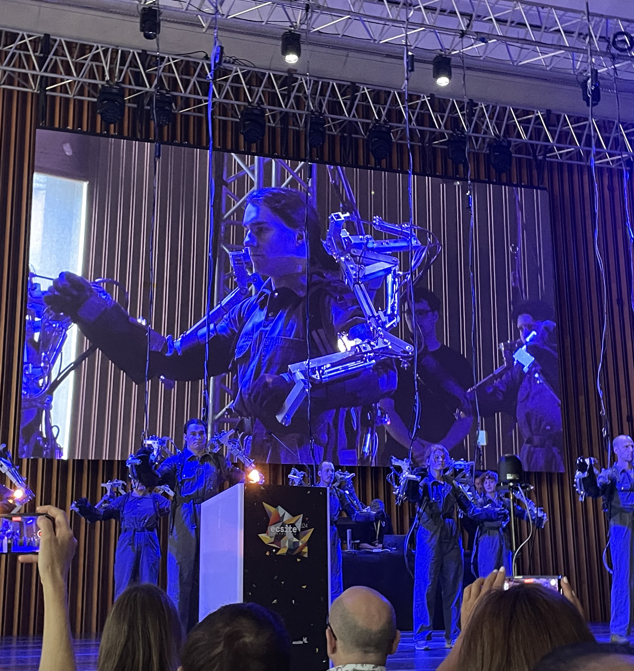
Artful alliances: How to enrich art and science collaborations to deepen engagement
  Discovery of the Kersnikova Institute
  Discovery of the Universcience / Scenocosme
  Key Points :
  Main topic this year ( conference MIT/Artist)
  Interdisciplinarity to break codes and innovate

Slide 6
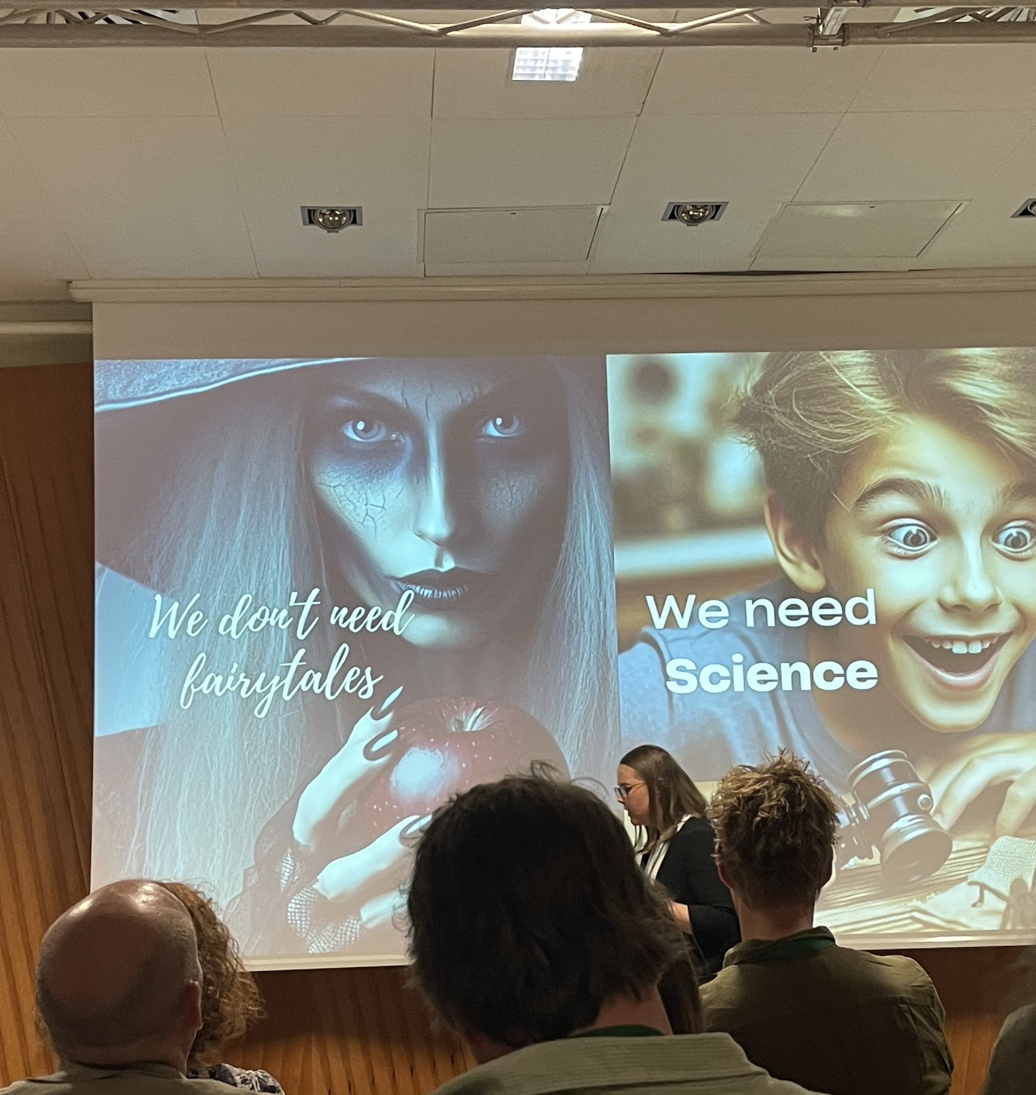
On trial : Storytelling through scenography in science centers
  Debate / Jugement by The Supreme Court of the ECSITE Conference :
  Whether storytelling through scenography in science centers should be sent to jail ?
  Key Points :
  A fun way to create a debate but it really demonstrated the importance of scenography AND storytelling to facilitate the understanding of information.
  Winning with just this image

Slide 7
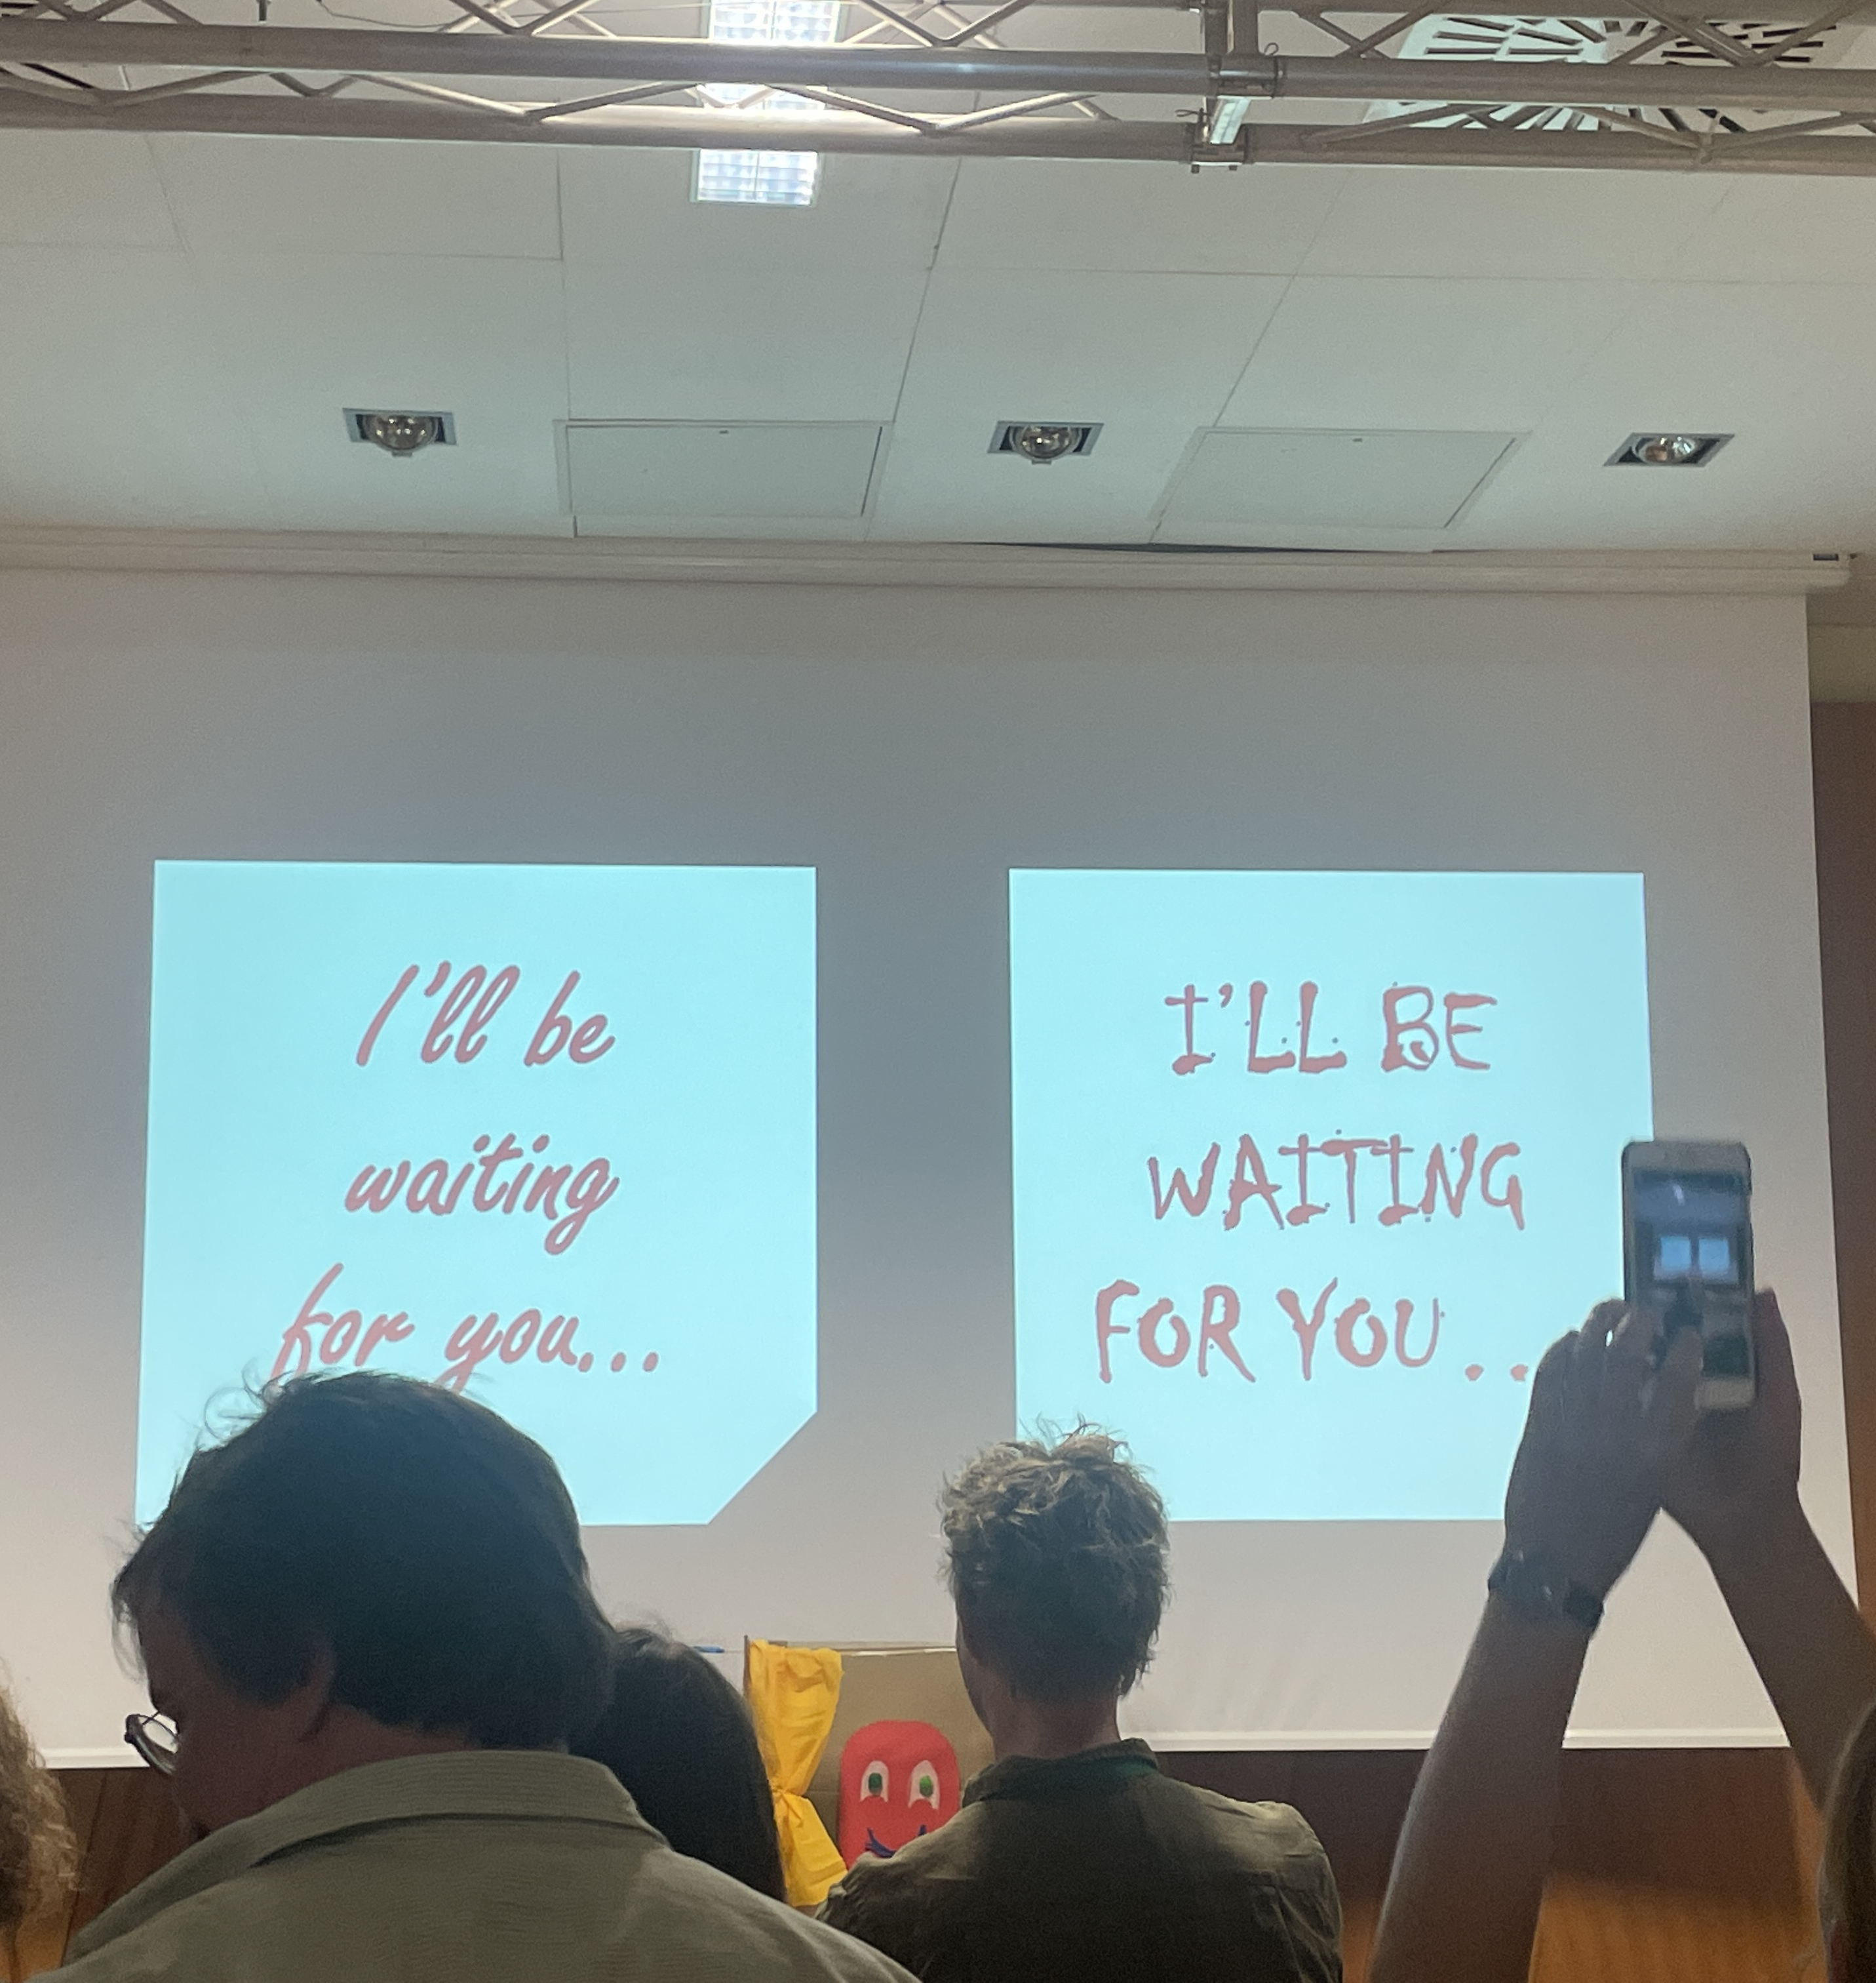
On trial : Storytelling through scenography in science centers
  Debate / Jugement by The Supreme Court of the ECSITE Conference :
  Whether storytelling through scenography in science centers should be sent to jail ?
  Key Points :
  A fun way to create a debate but it really demonstrated the importance of scenography AND storytelling to facilitate the understanding of information.
  Winning with just this image

Slide 8
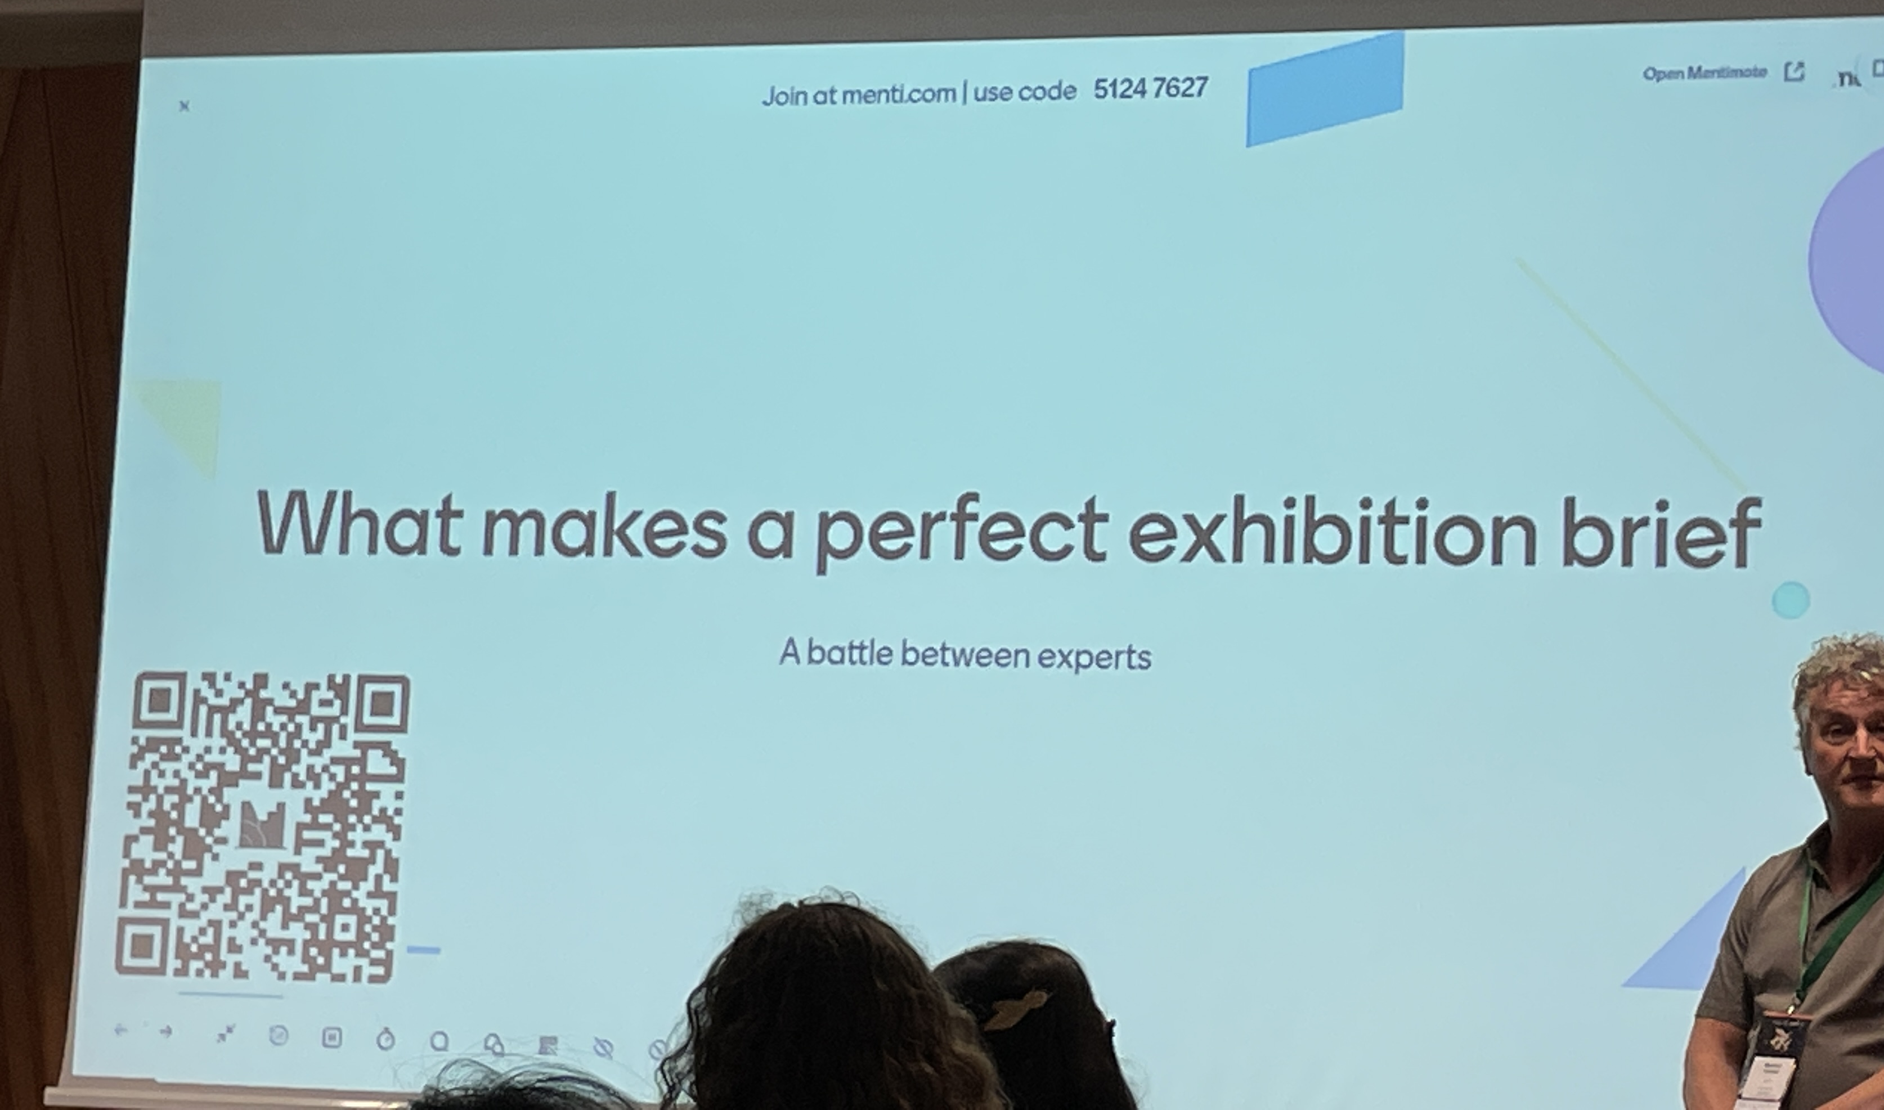
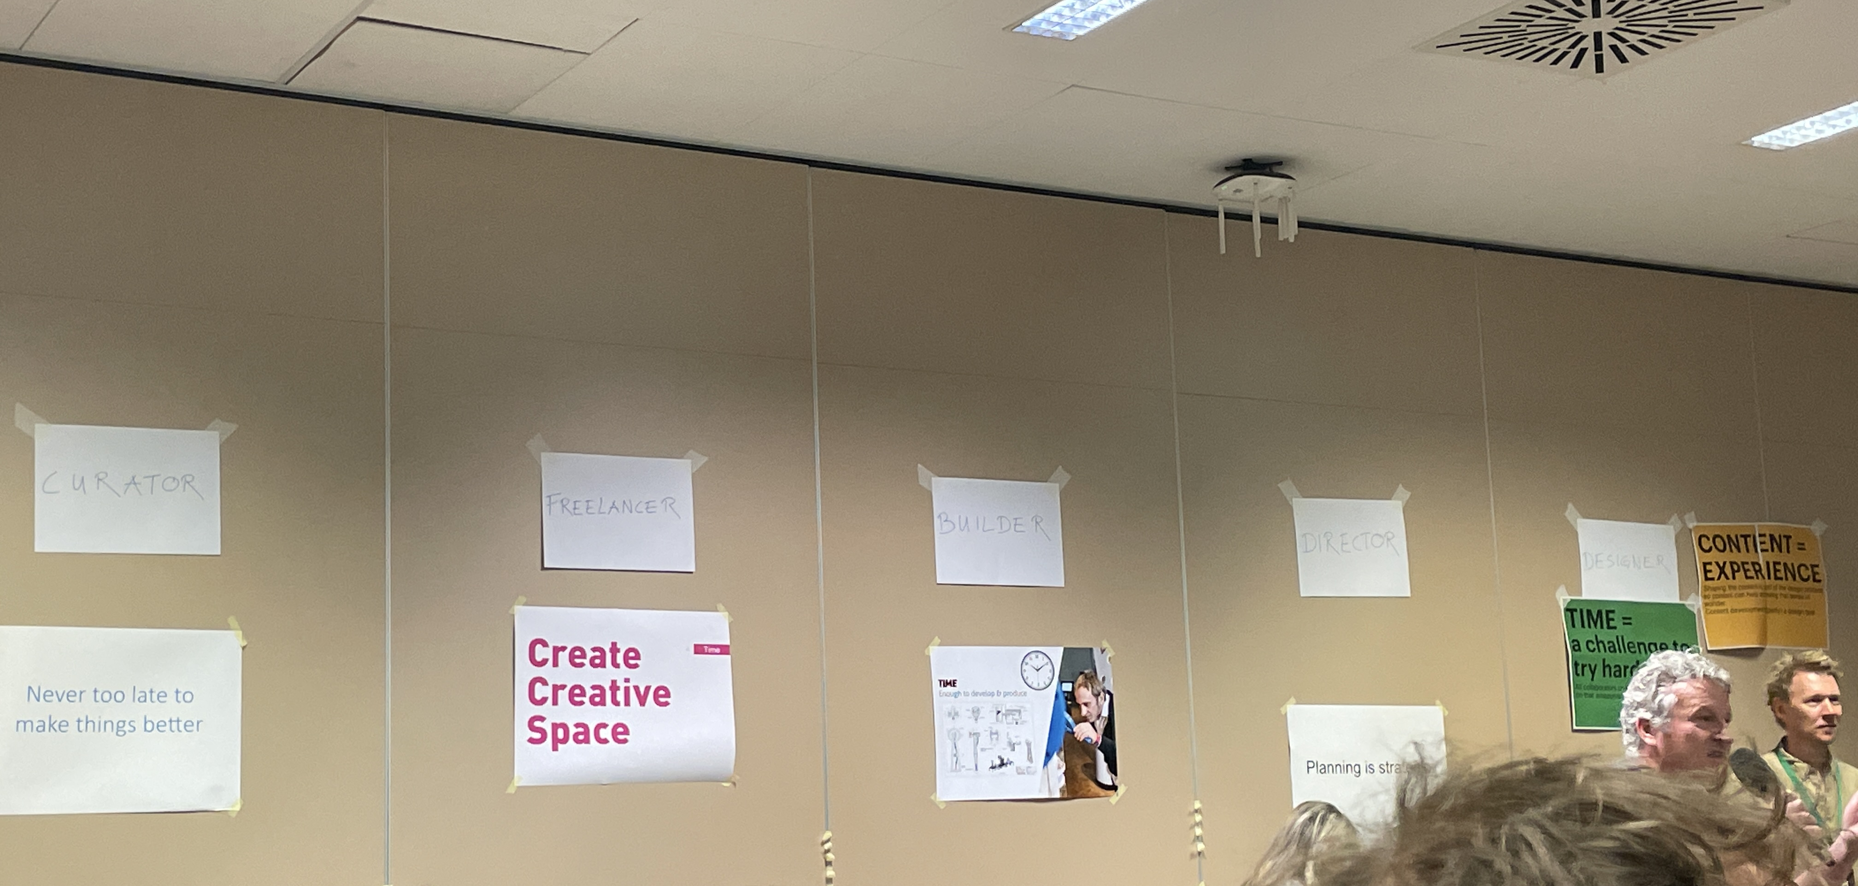
What makes a good exhibition brief? A battle between experts
  Discussion (or battle in the ring) between client, curator, designer, manufacturer and director to gather best practices in writing design briefs.
  Key Points :
  Better understand each person's vision of their role, and improve listening and understanding

Slide 9
What makes a good exhibition brief? A battle between experts
  Discussion (or battle in the ring) between client, curator, designer, manufacturer and director to gather best practices in writing design briefs.
  Key Points :
  Better understand each person's vision of their role, and improve listening and understanding

Slide 10
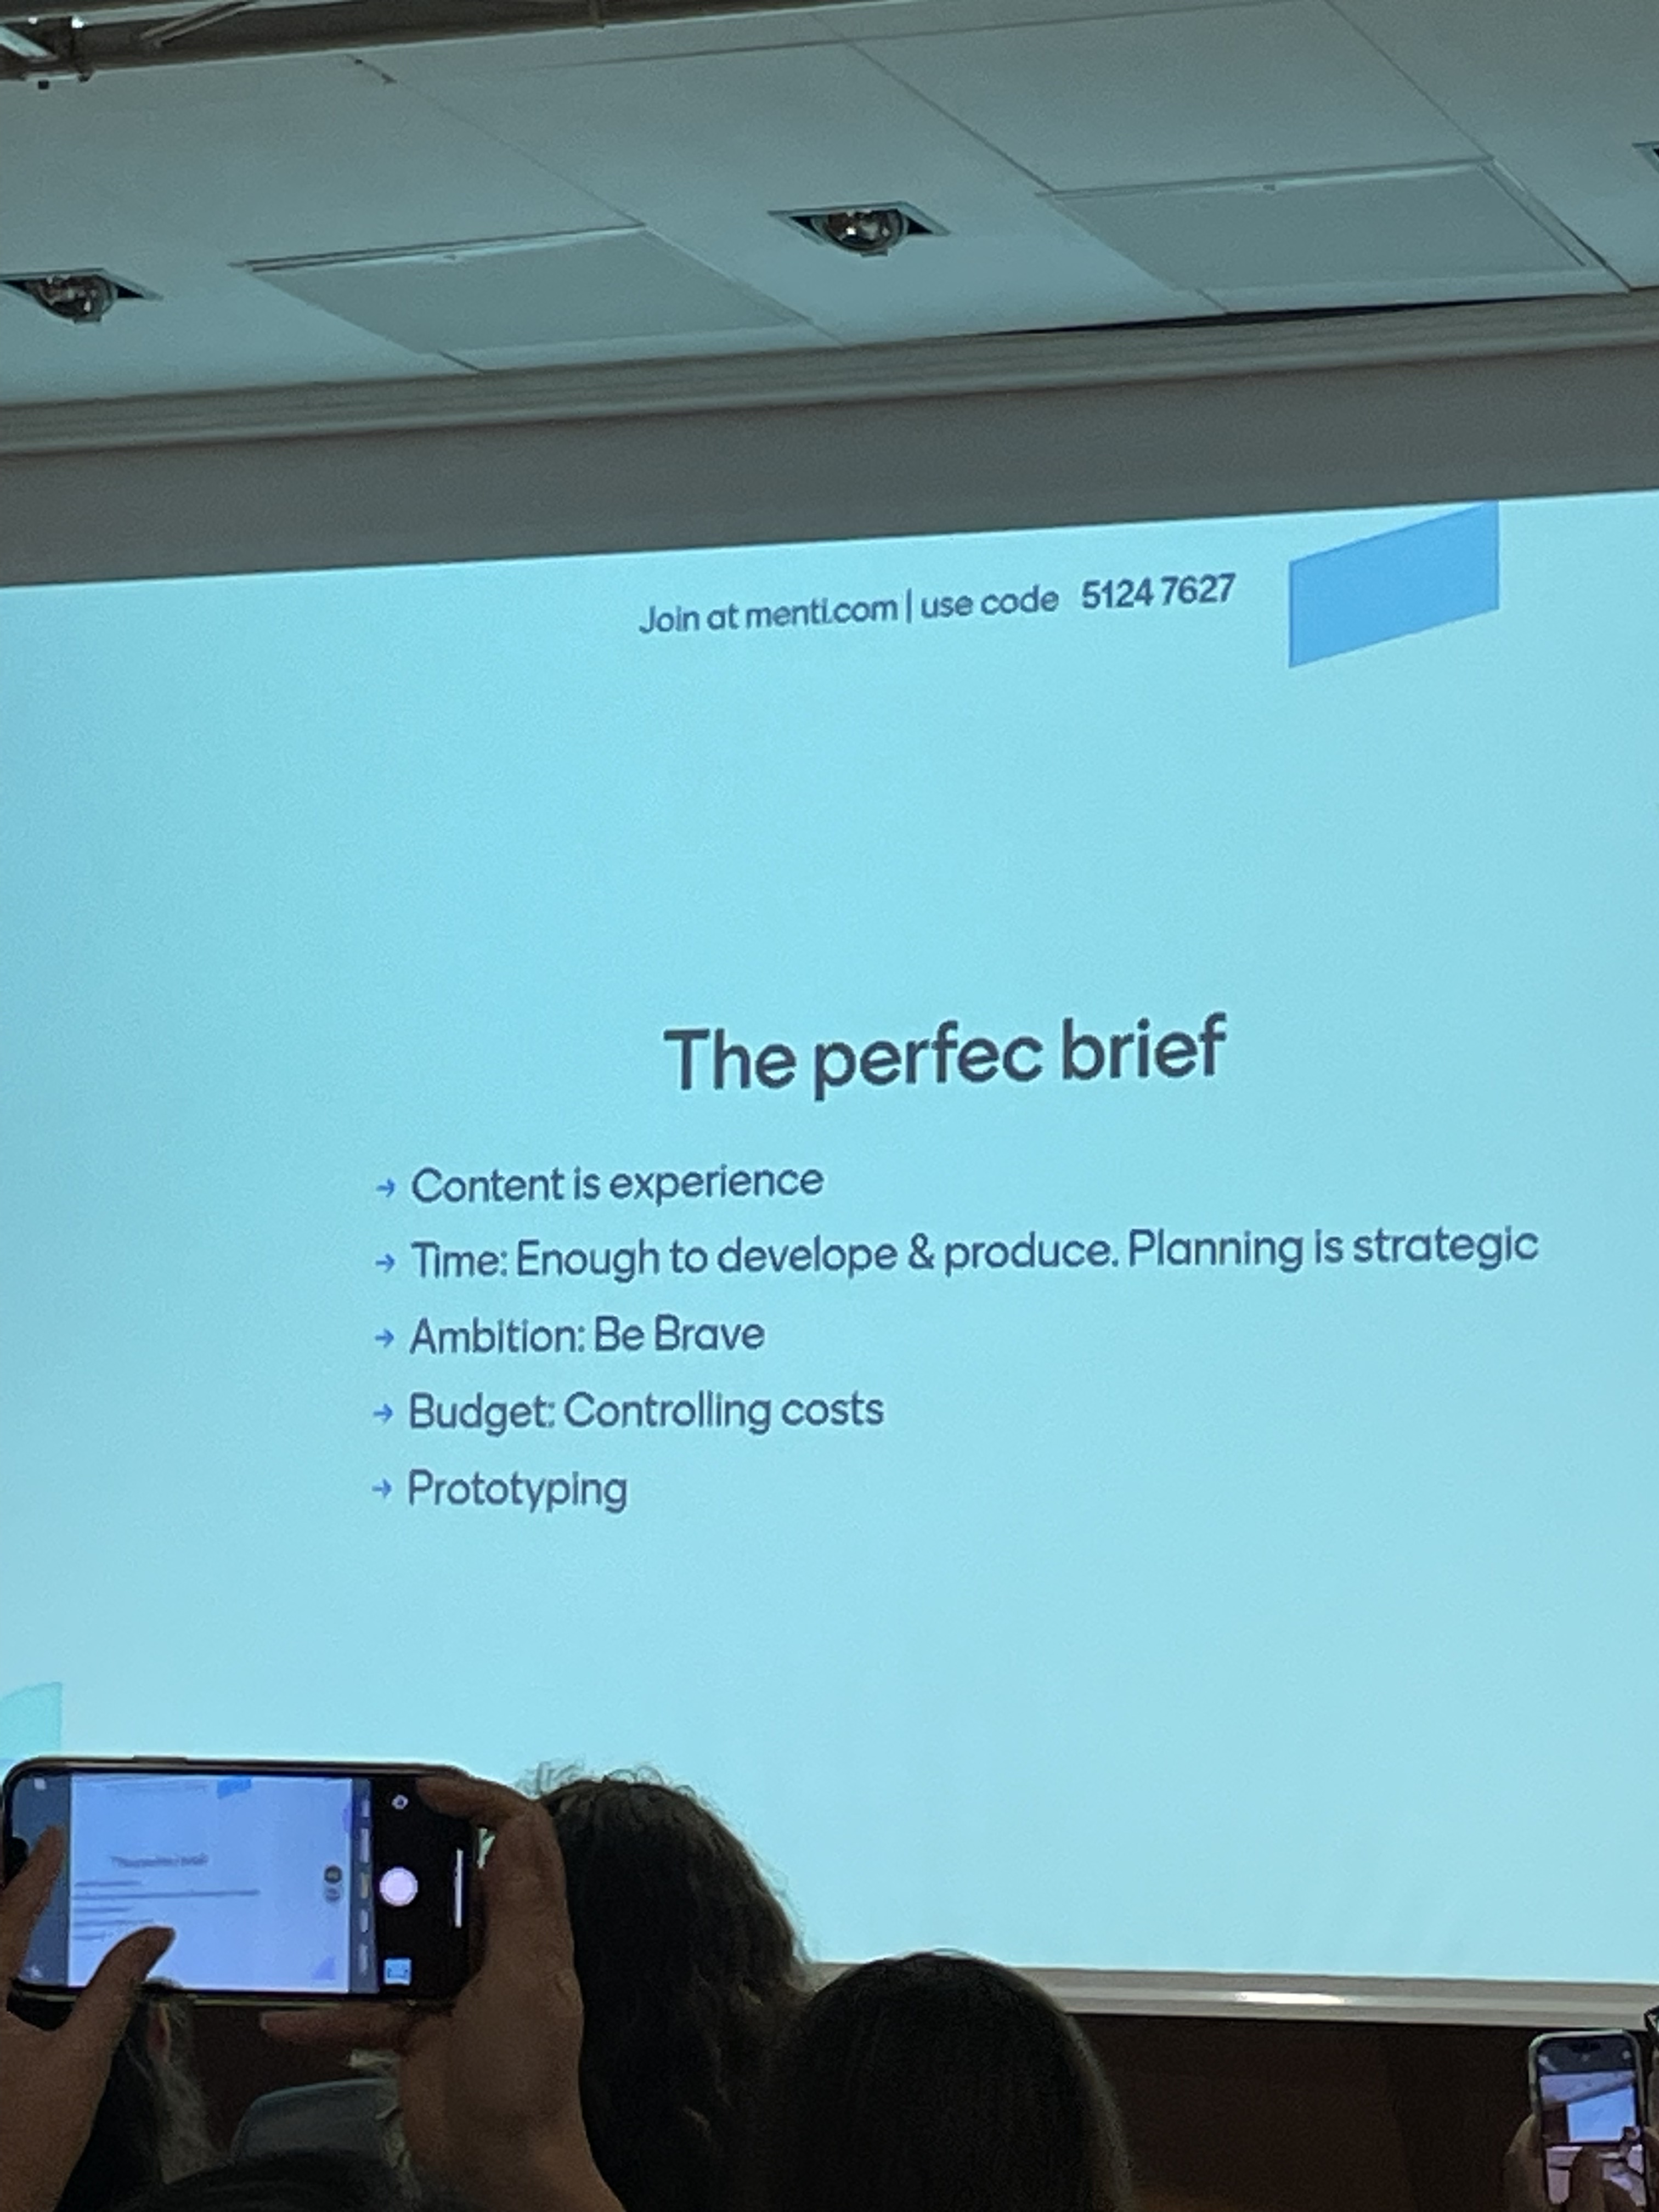
What makes a good exhibition brief? A battle between experts
  Discussion (or battle in the ring) between client, curator, designer, manufacturer and director to gather best practices in writing design briefs.
  Key Points :
  Better understand each person's vision of their role, and improve listening and understanding
Collaboration

Slide 11
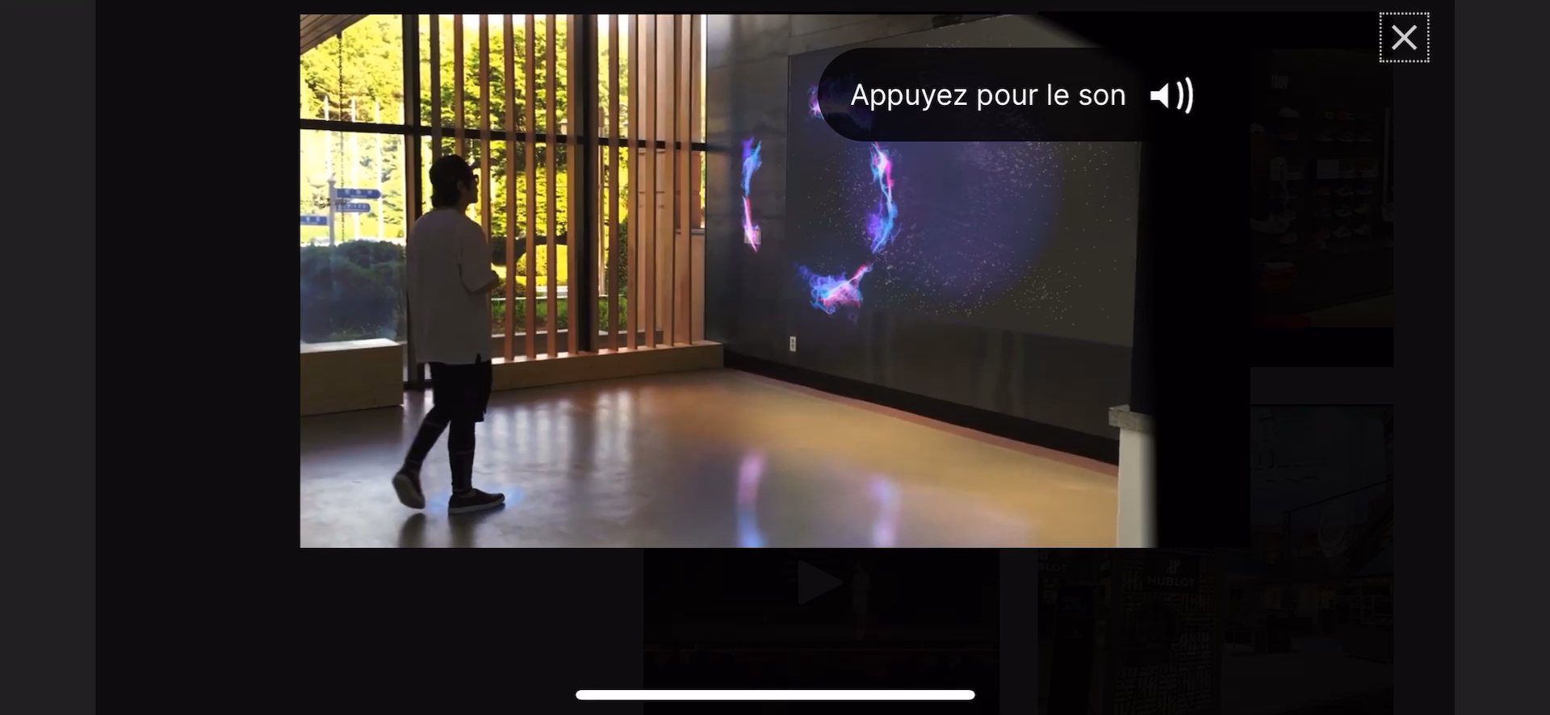
Discovery
  Hologram company in the Netherlands: Novaline
  Design/concept/construction company: Trias
  Ecological scenography company: Ciao&Hallo

Slide 12
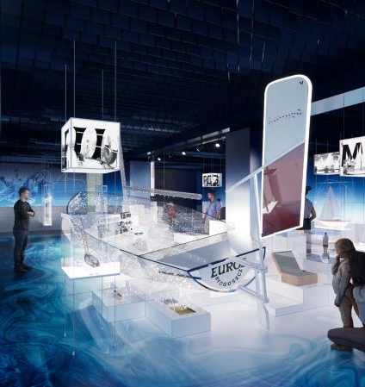
Discovery
  Hologram company in the Netherlands: Novaline
  Design/concept/construction company: Trias
  Ecological scenography company: Ciao&Hallo

Slide 13
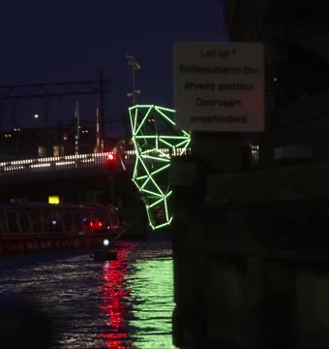
Discovery
  Hologram company in the Netherlands: Novaline
  Design/concept/construction company: Trias
  Ecological scenography company: Ciao&Hallo

Slide 14

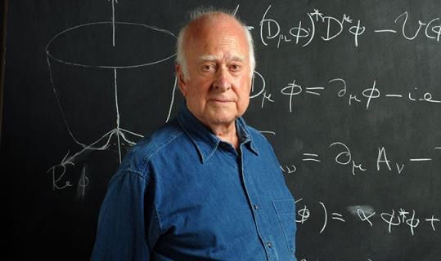
Project ?
  Jean-Christophe DENIS, from the University of Edinburgh, proposes to bring our two institutions closer together through an exhibition/project based on Peter Higgs (professor at the University).

Slide 15
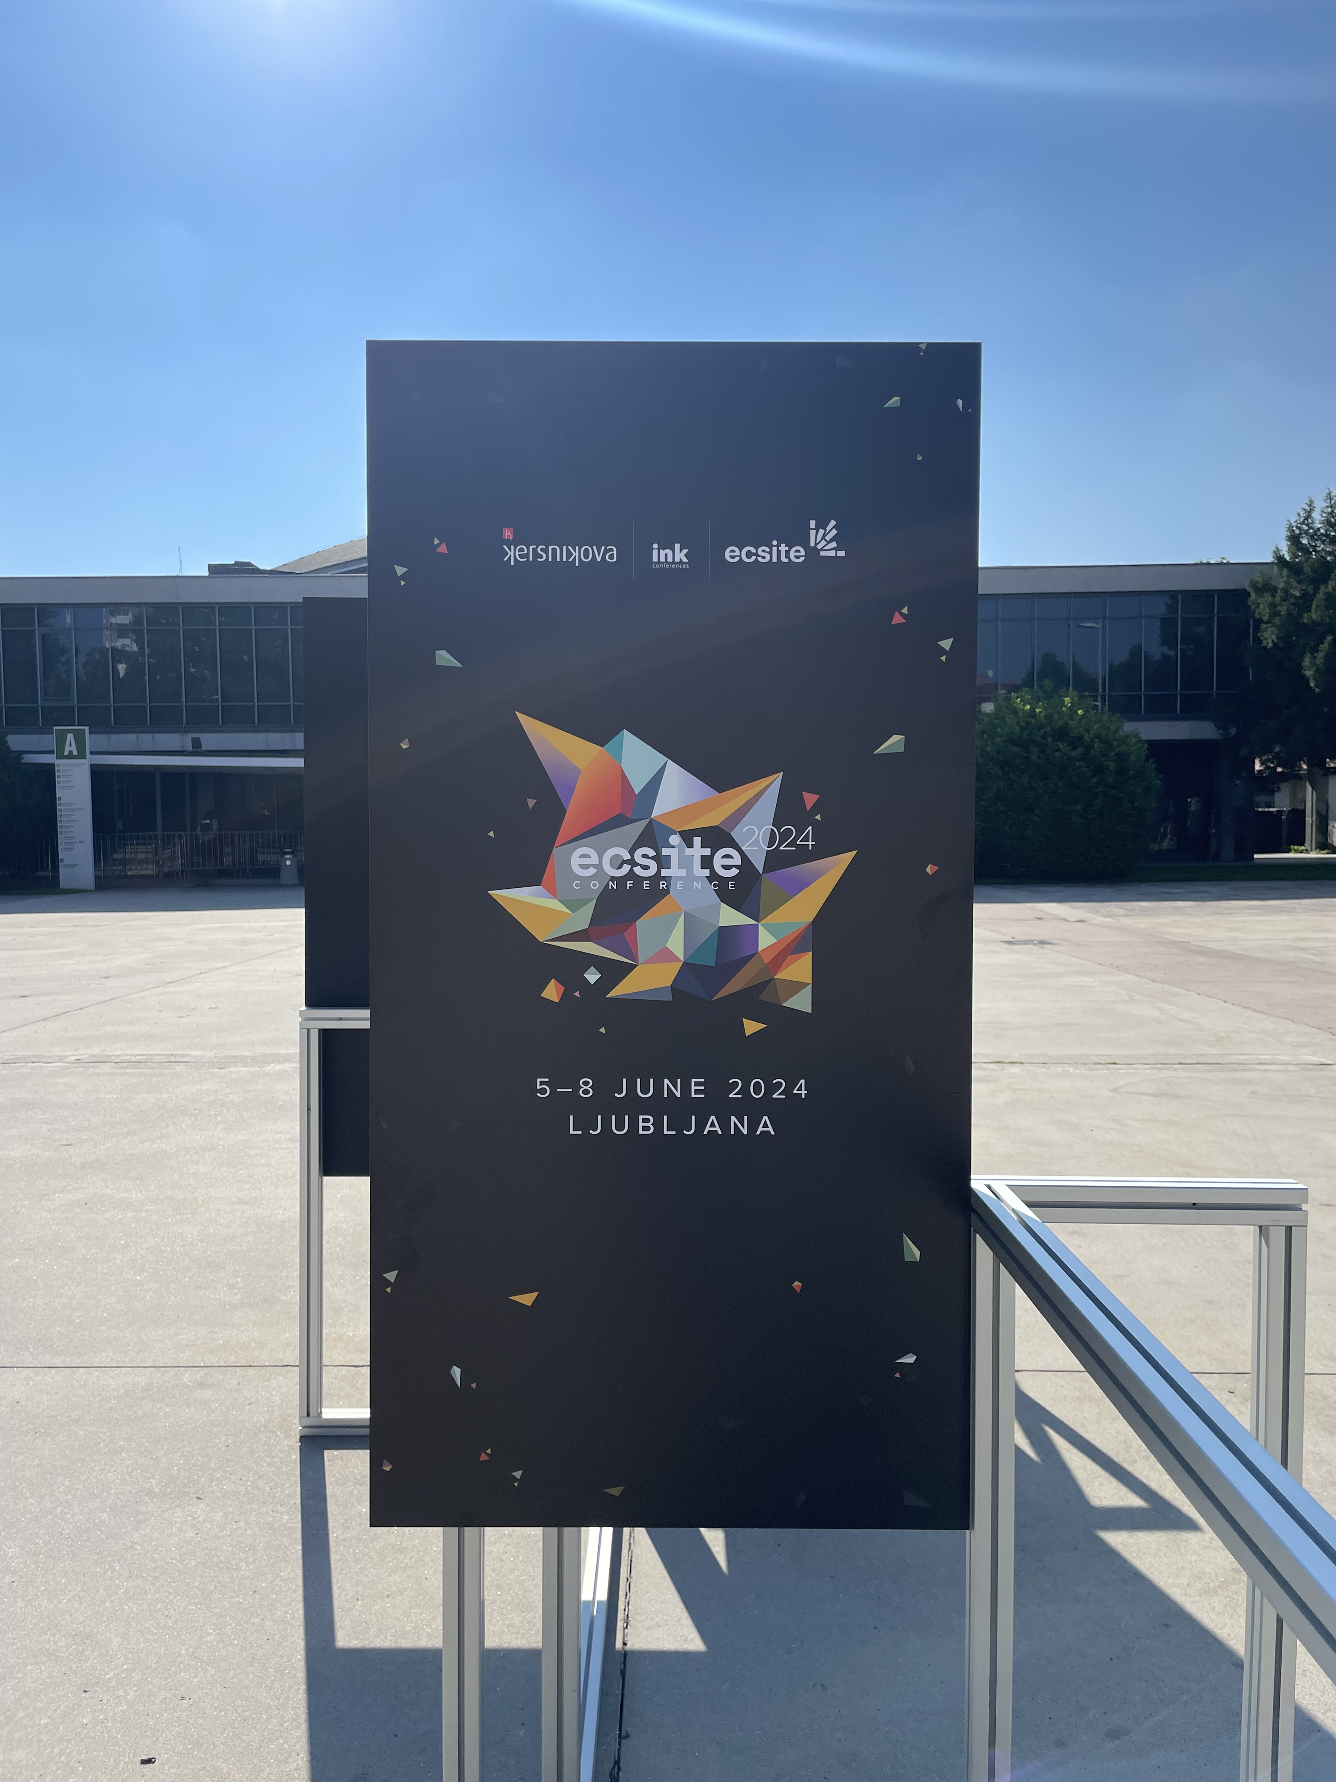
5 points that seem to be desires/needs for all these professionals:
  Have FUN in exhibition
  Importance of scenography to translate the subject / give meaning / atmosphere
  The important role of IA
  Take advantage of what the public wants/needs
  Art and science: developing links

