Slide 1

Sensitivity Reach Dependence on
Detector Parameters
Doojin Kim (doojin.kim@tamu.edu)
DAMSA@PIP2-BD Progress Reports
September 5th, 2023

Slide 2








Baseline Design and Cuts
$θ_{det}=0.5$ rad
Polyurethane
moderator
Decay chamber
(vacuum vessel)
W-dump is assumed thick enough (i.e., radius) not to affect the fiducial photon flux.
Backgrounds are assumed to be $\sim {10}^{8}$ per year, irrespective of angular coverage and energy cuts.
1-year exposure ($3×{10}^{22}$ POTs) is assumed.
W dump
100 MHz-pulsed
$p$ beam
$1.09$m
ECAL
$E_{cut}=15$ MeV
$0.8$m
$0.2$m
${∆L}_{det}$= 1 m

Slide 3
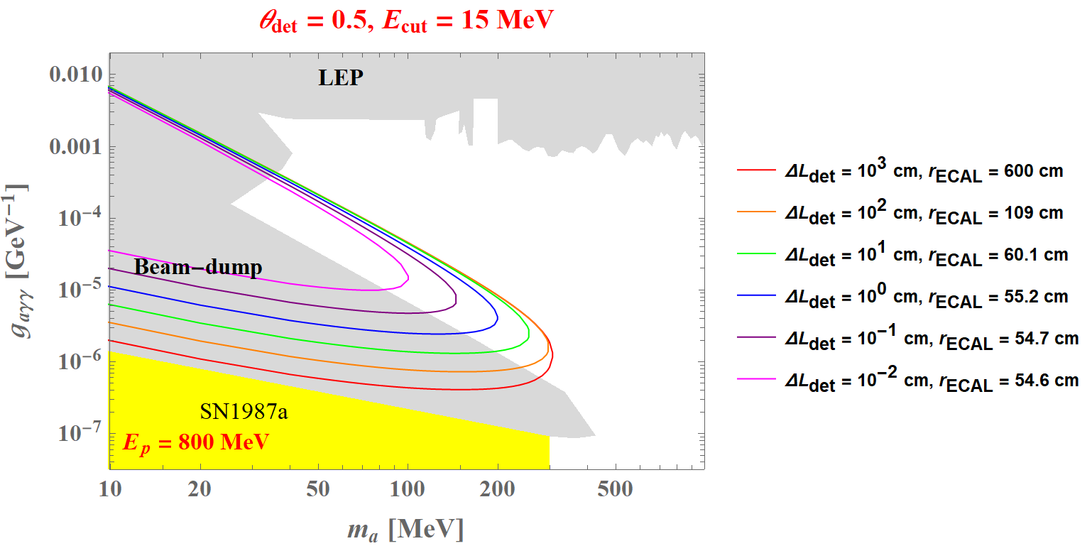
Decay Chamber Length Variations

Slide 4
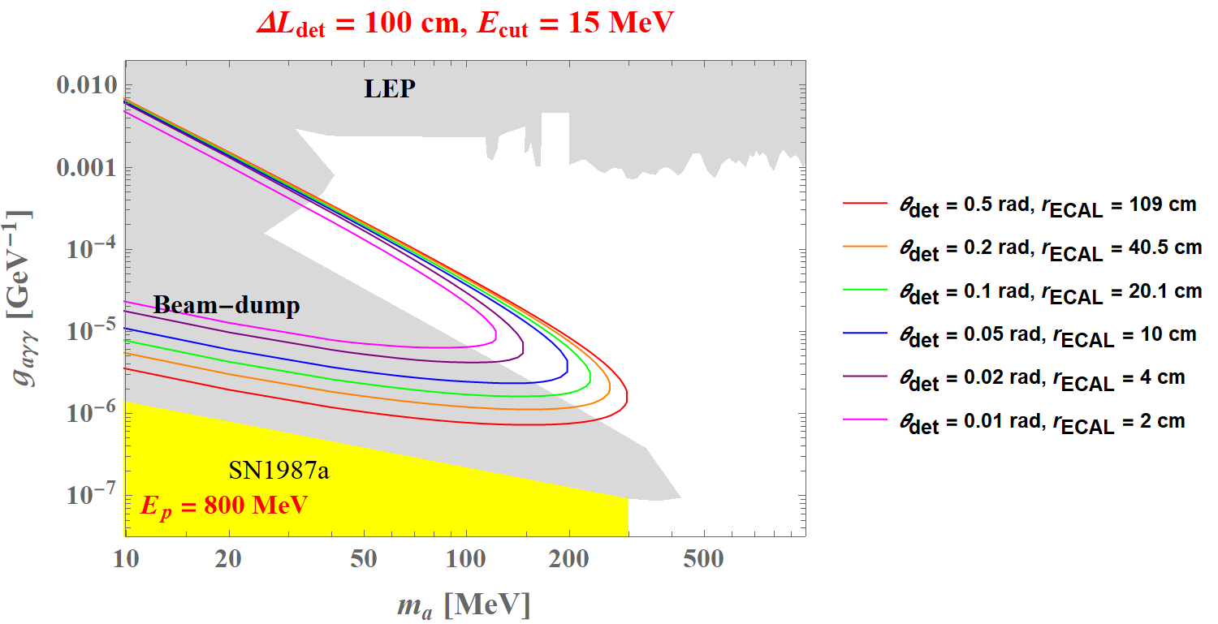
Angular Coverage Variations

Slide 5
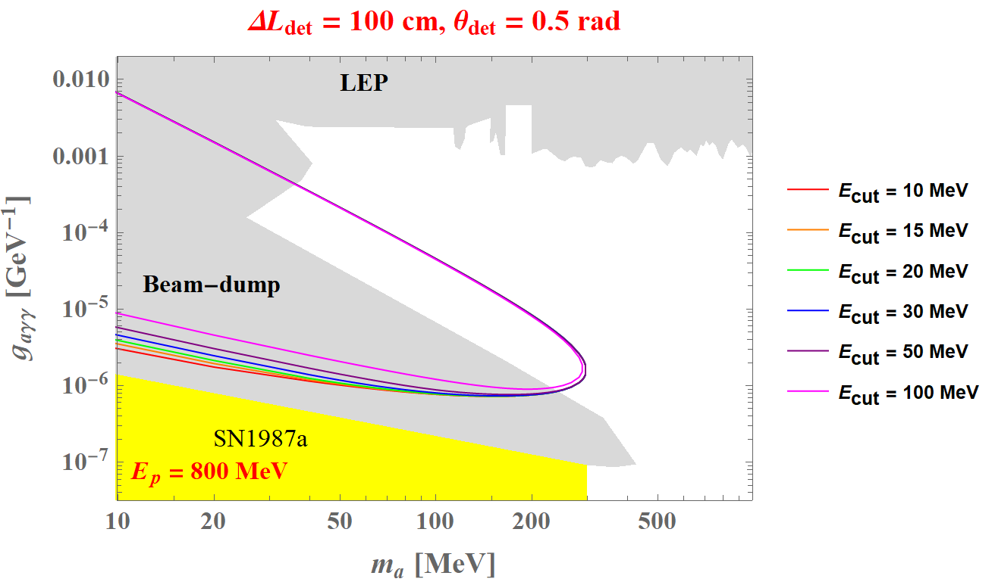
Energy Cut Variations

Slide 6
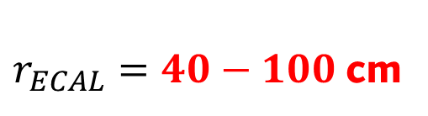
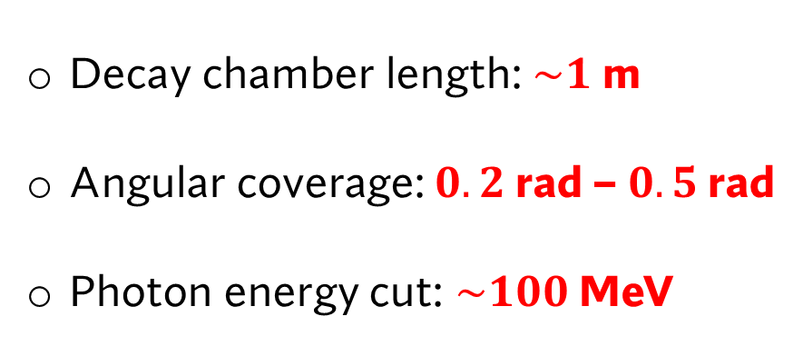
Conclusions: Design and Search Strategy Proposal
Decay chamber length: $\sim 1$ m
Angular coverage: $0.2$ rad – $0.5$ rad
Photon energy cut: $\sim 100$MeV
$r_{ECAL}=40−100$cm

Slide 7
Back-up

Slide 8





Search for ALPs Interacting with Photons
$$γ$$
$$a$$
$$g_{aγγ }$$
$$γ$$

Slide 9







ALP Search in DAMSA at PIP2-BD
$$π^{0}$$
$$γ$$
Dump
Detector
$$γ$$
p beam
$$γ$$
$$e$$
$$γ$$
$$a$$
$$γ$$
$$N$$
$$N$$
…
Meson decays
E&M showers
…
ALP production by
Primakoff process
ALP detection by
its decay to two photons
Production of photons
DAMSA: Dump-produced Aboriginal Matter Searches at an Accelerator

