Slide 1
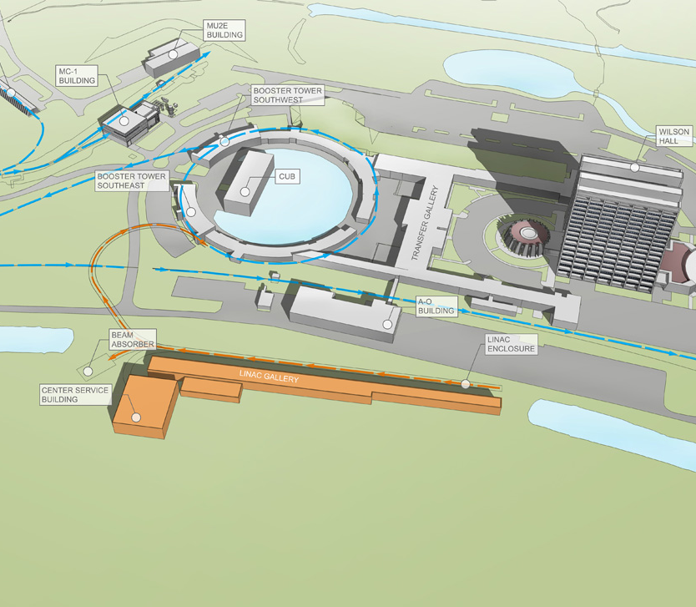
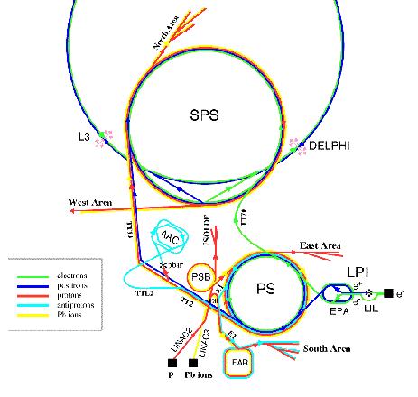
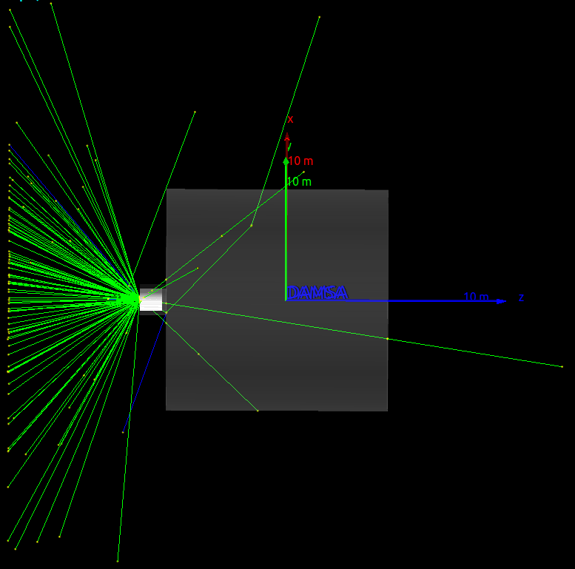
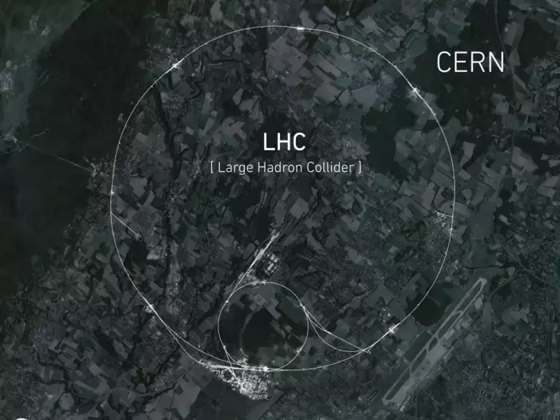
DAMSA
800 MeV, 120 GeV and 450 GeV
DAMSA visual
Jacob Bogenschuetz

Slide 2
Content
Data Collection Positions
Particle Flux photons, pions, rho, eta and kaons | Particles Exiting Dump | Neutron/Neutrino Distribution | Detector / background analysis
For 800 MeV, 450 GeV, 120 GeV

Slide 3

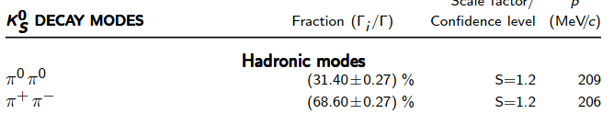
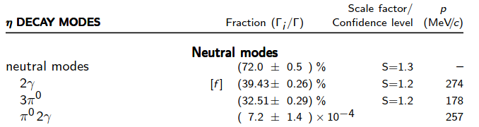
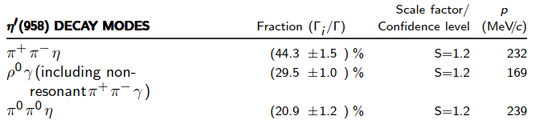
Particle decays of Interest
Particle Data Group: https://pdg.lbl.gov/2002/contents_tables.html

Slide 4
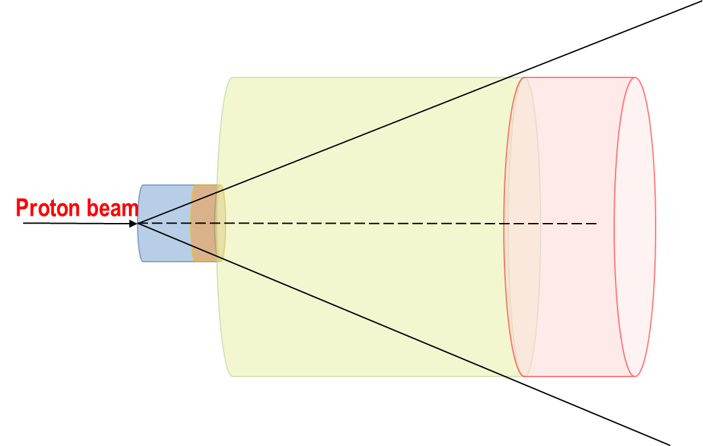
Target Flux

Slide 5
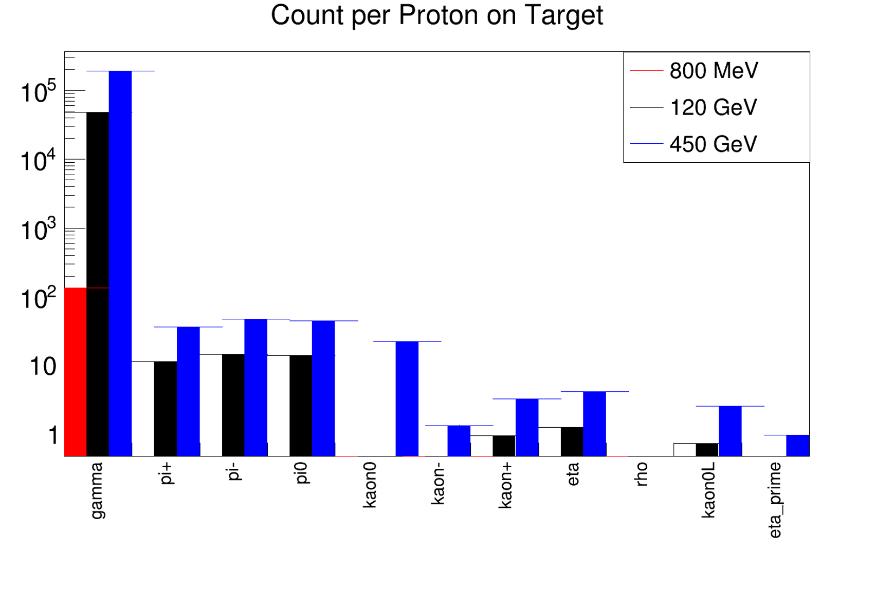
TargetFlux - Compare
photons, pi^0, pi+, pi-, rho, eta and all kaons
POT 1e4
POT 1e2
POT 1e1

Slide 6
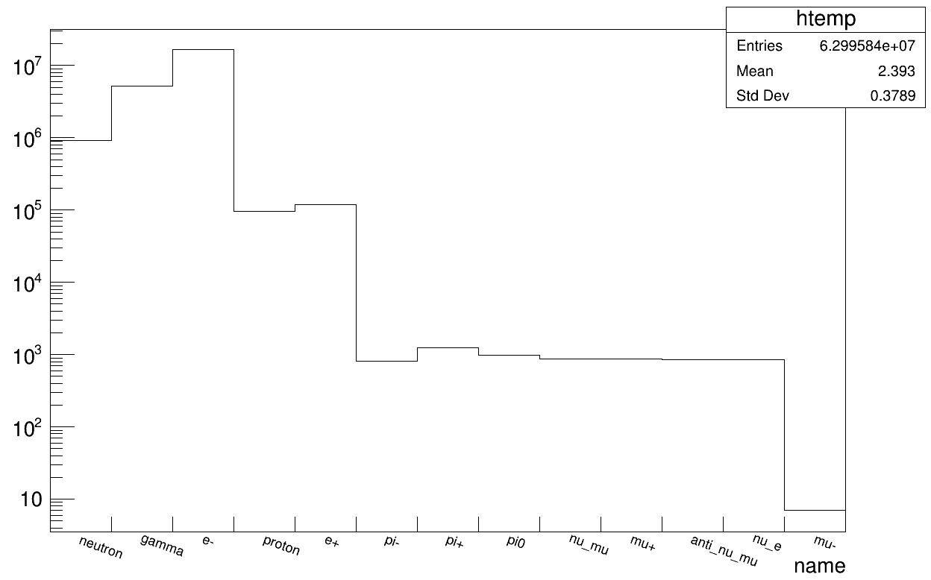
TargetFlux - Compare
photons, pi^0, pi+, pi-, rho, eta and all kaons
800 MeV POT1e4

Slide 7
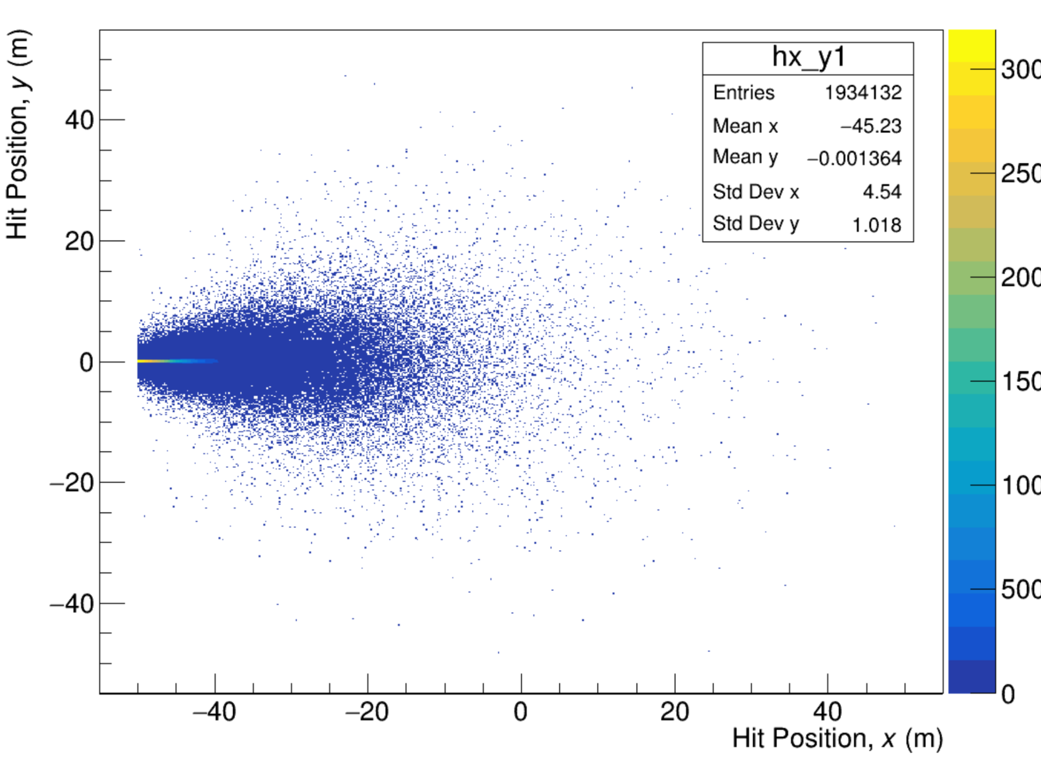
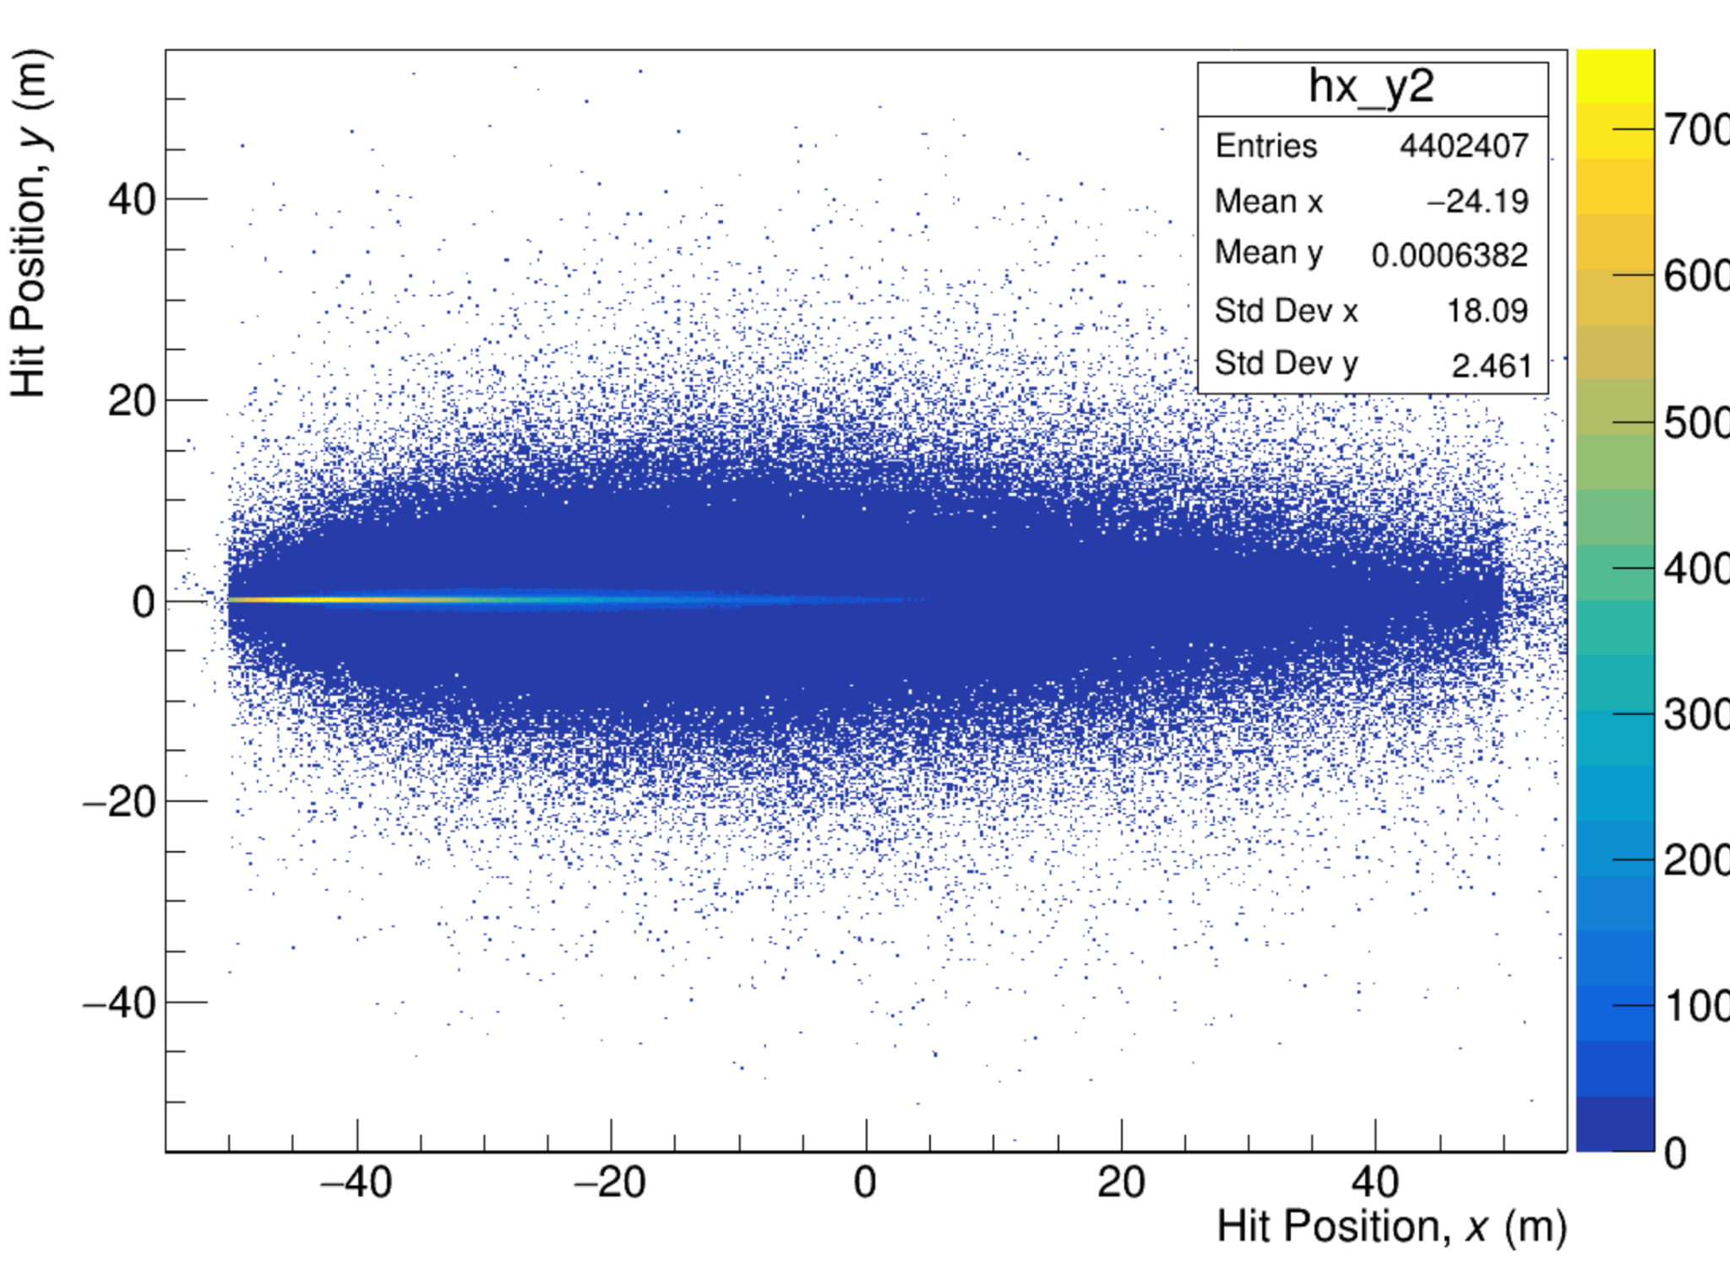
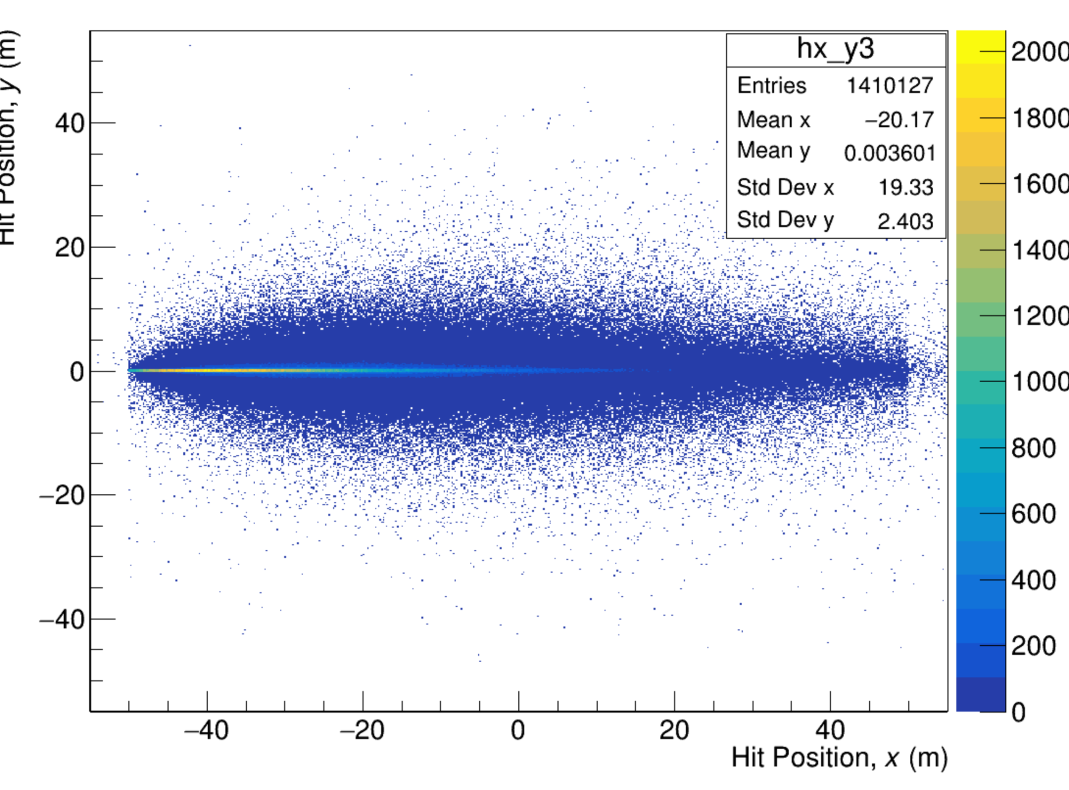
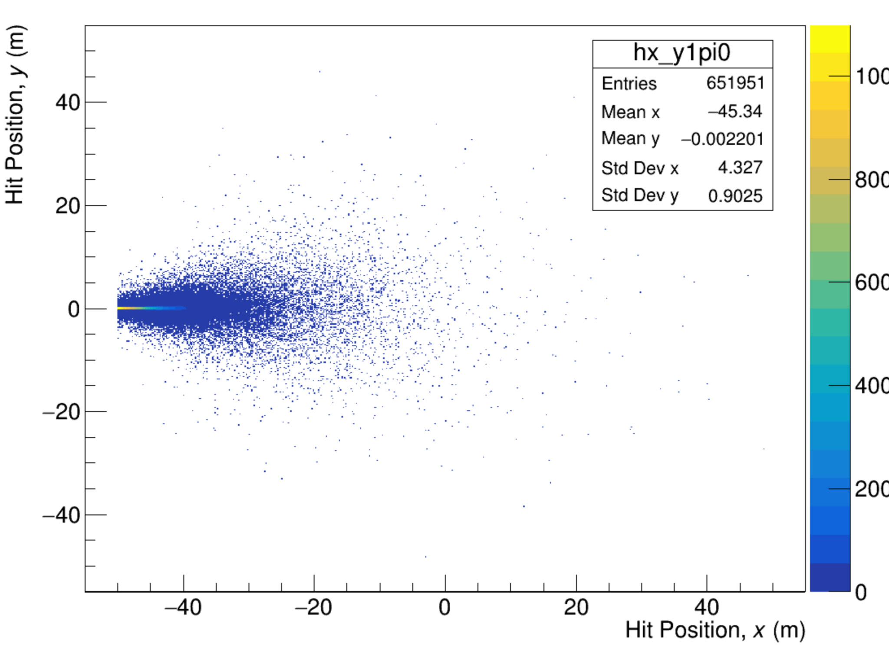
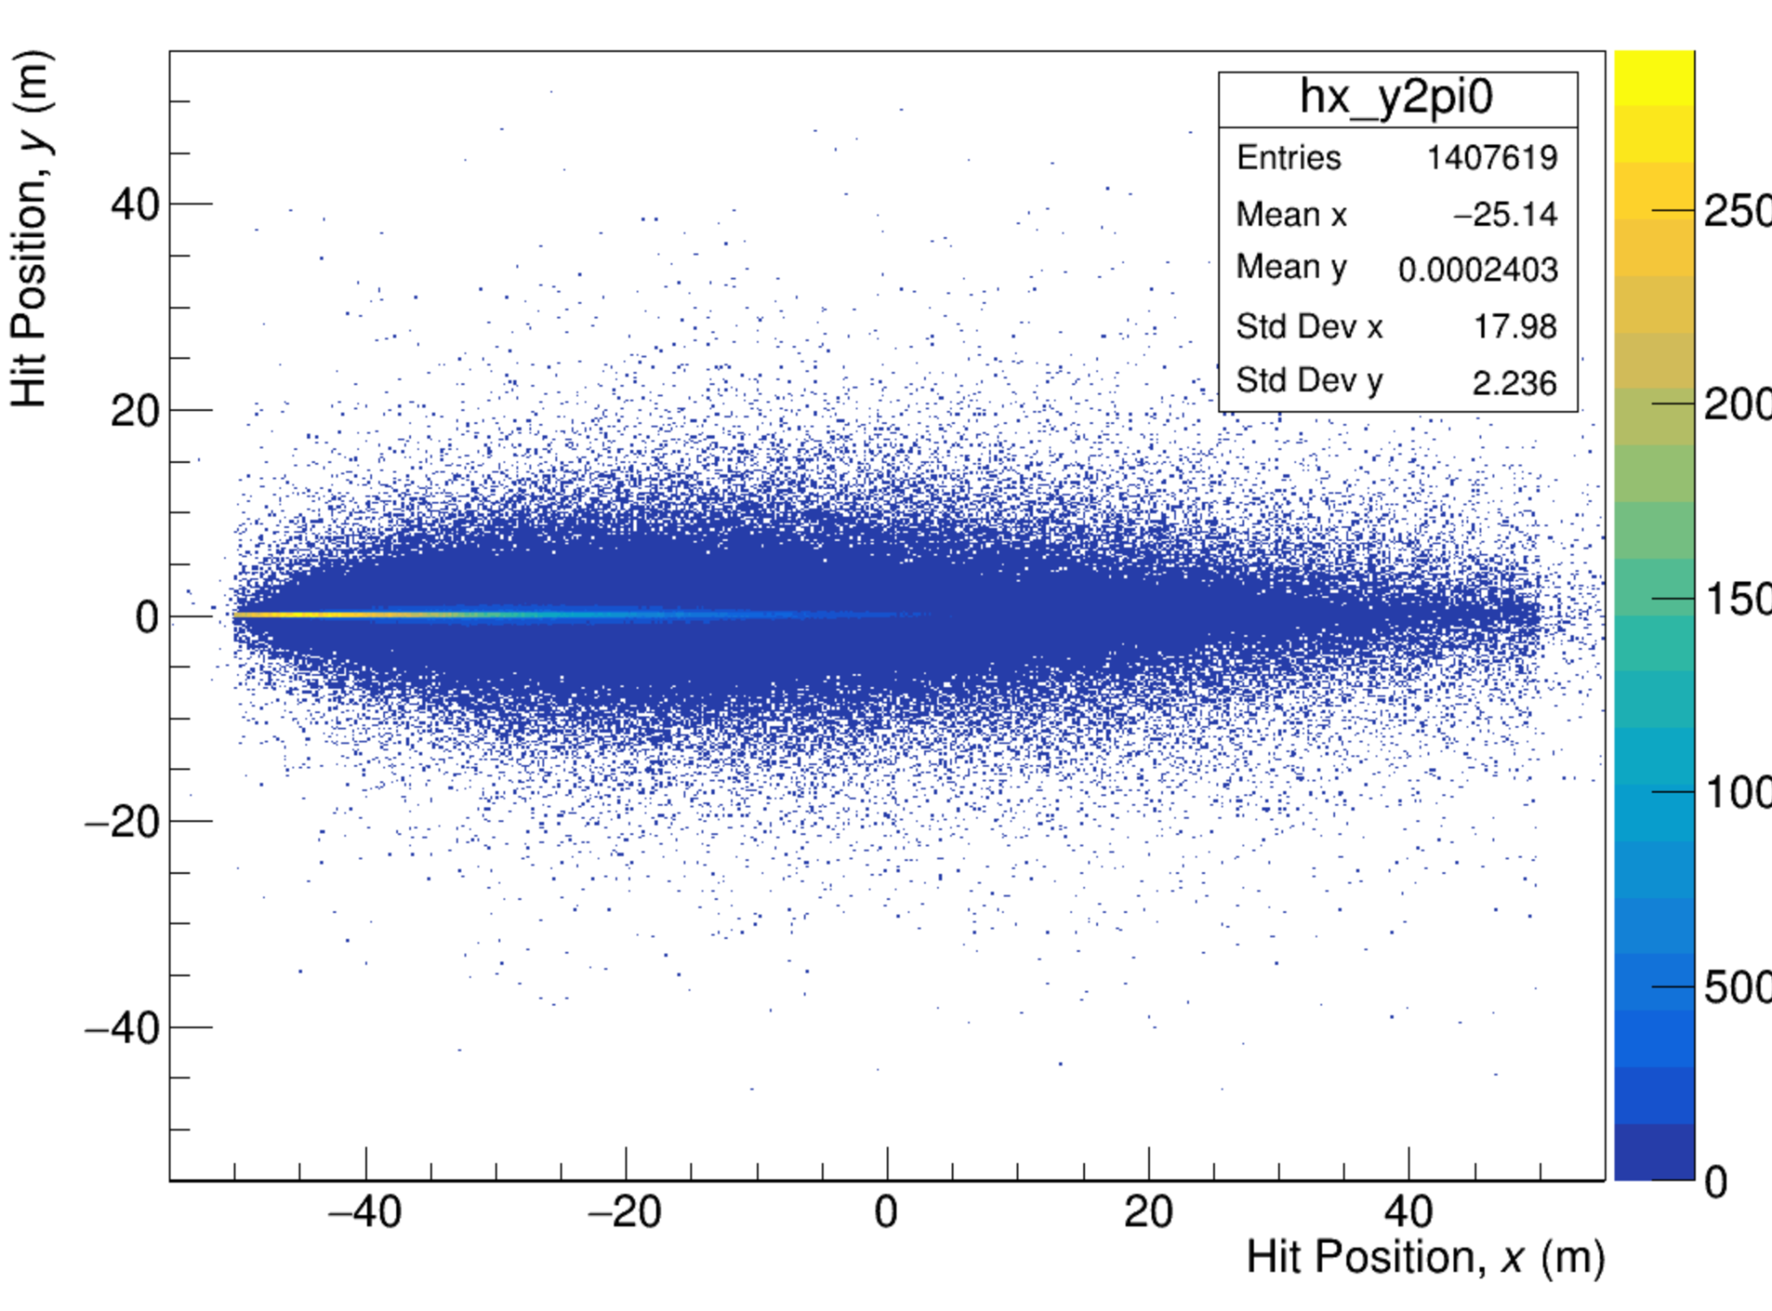
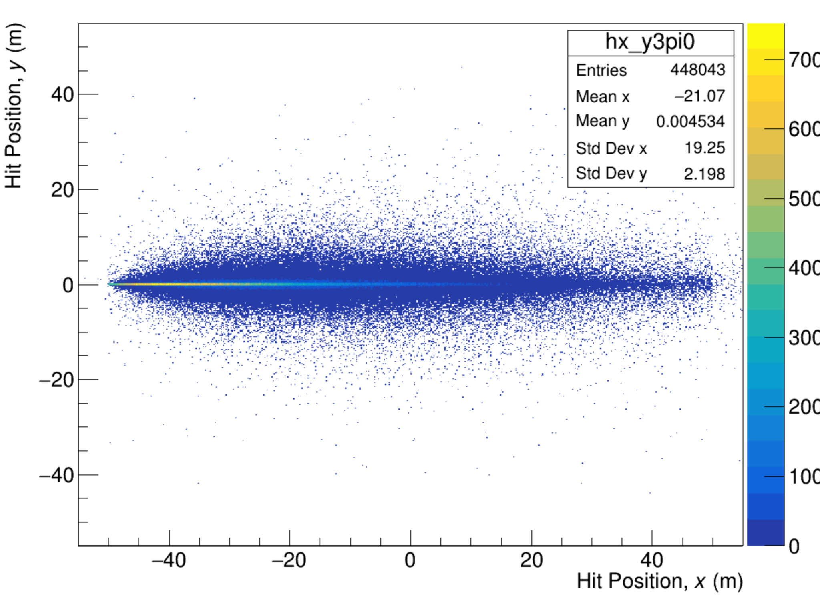
per Proton on Target - All / Pi0

Slide 8
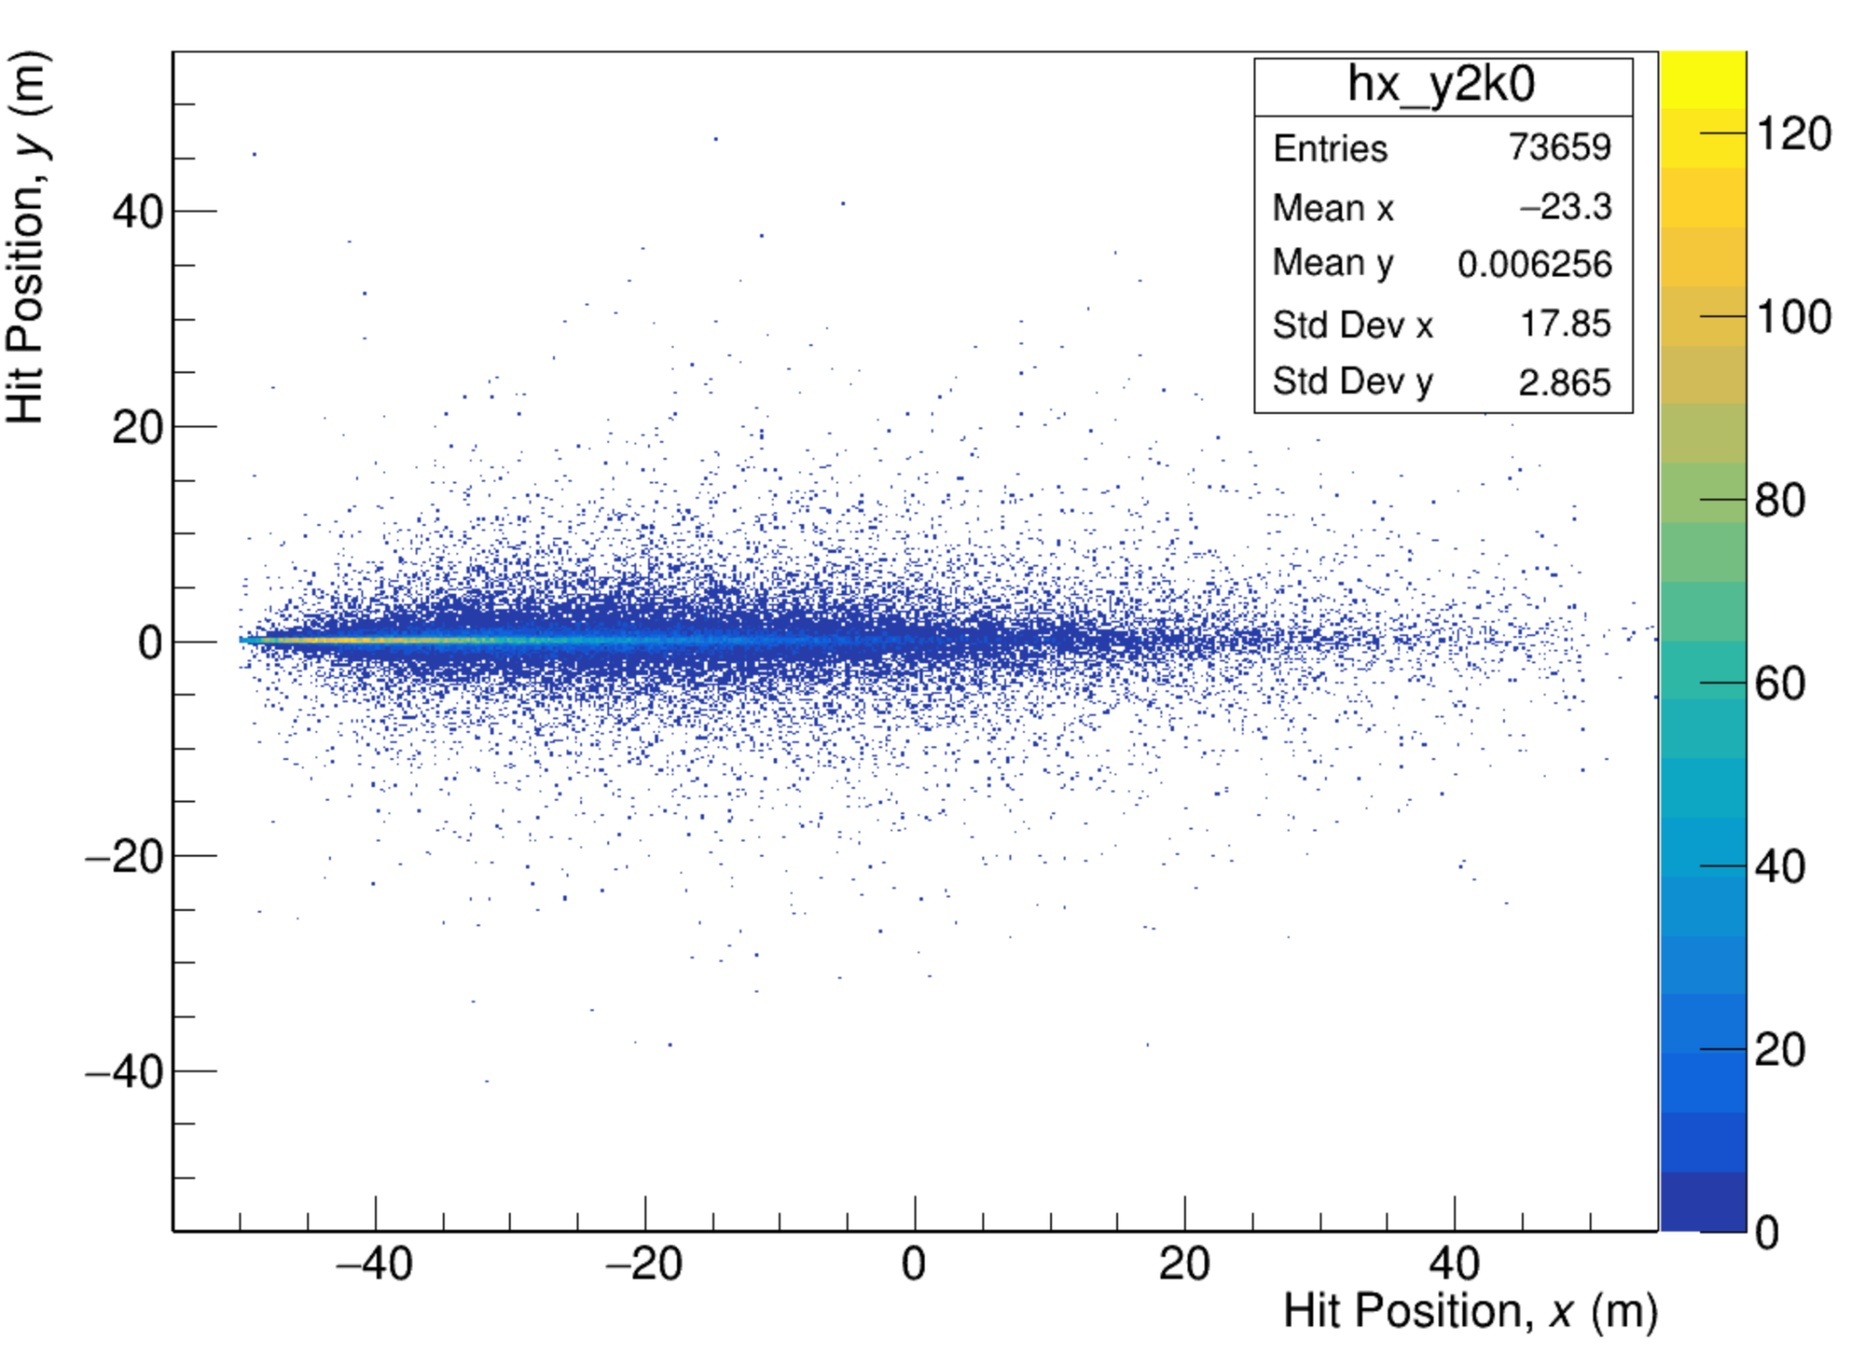
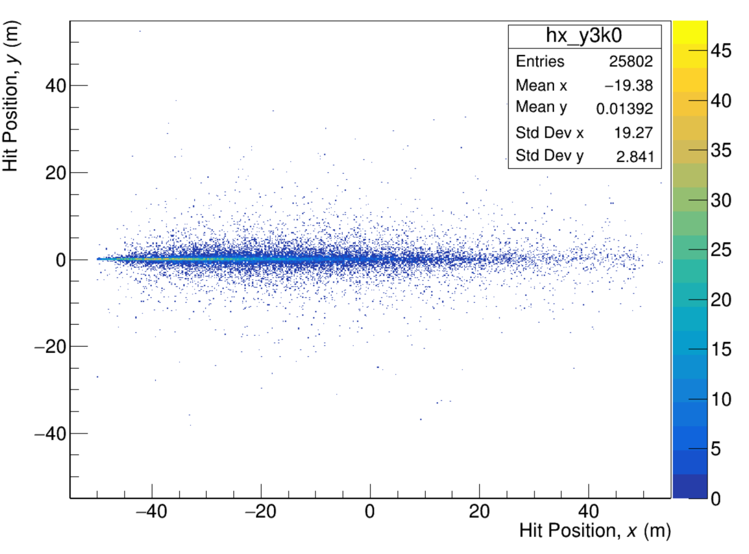
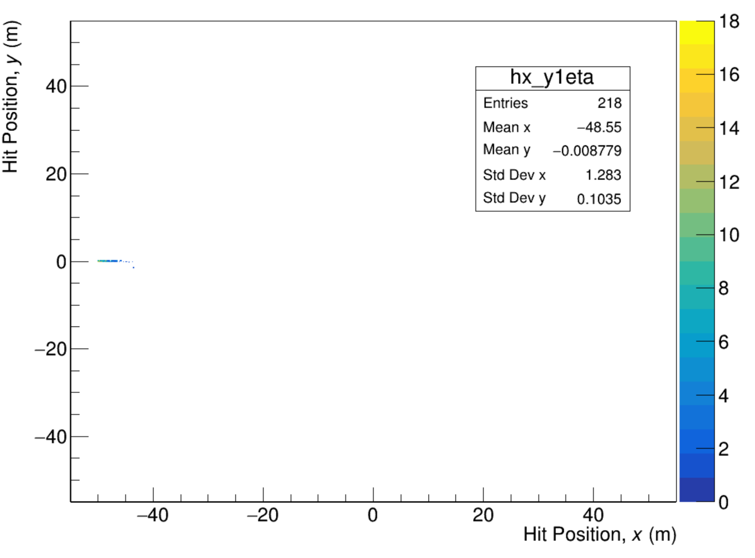
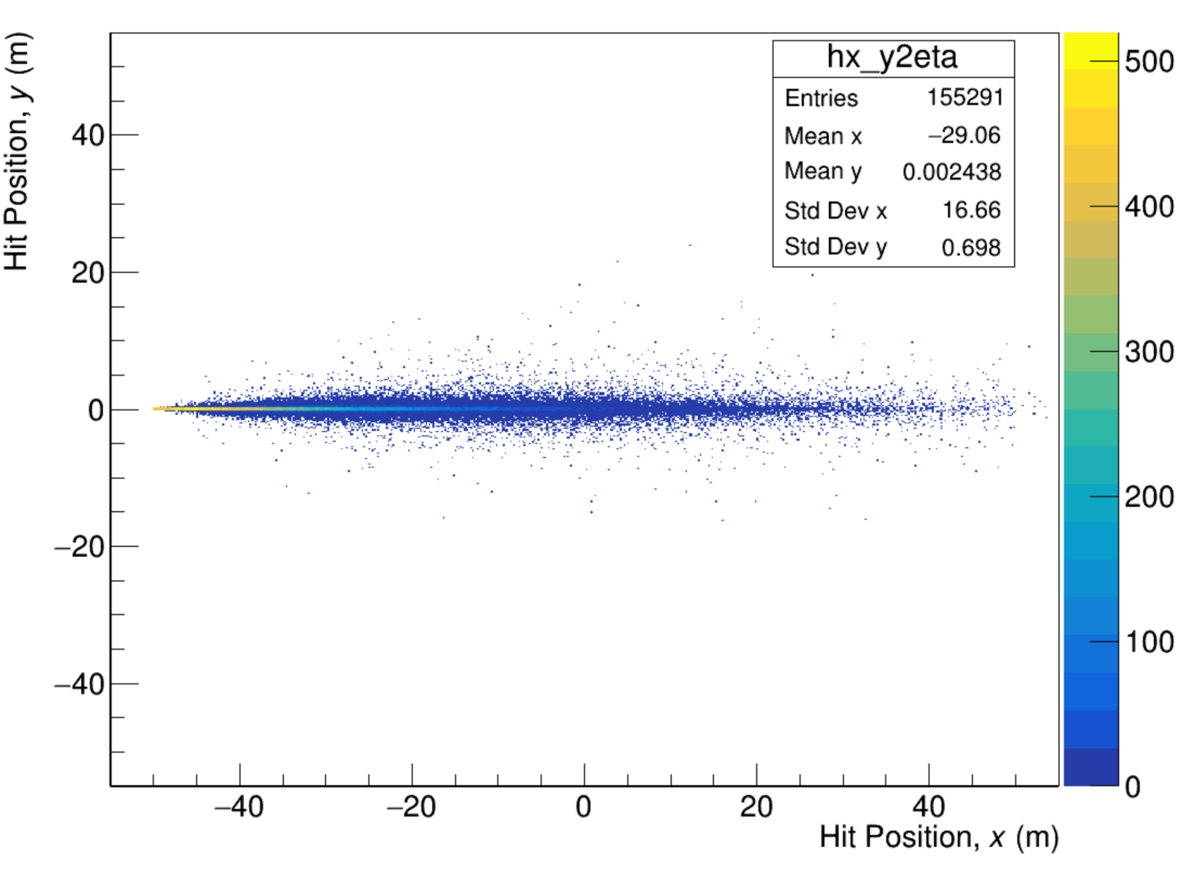
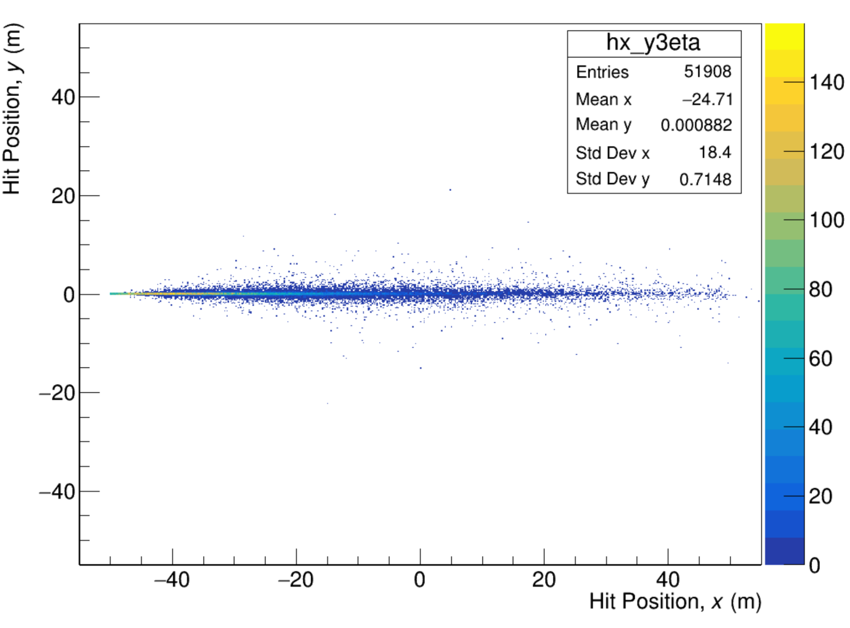
per Proton on Target - k0 / eta

Slide 9
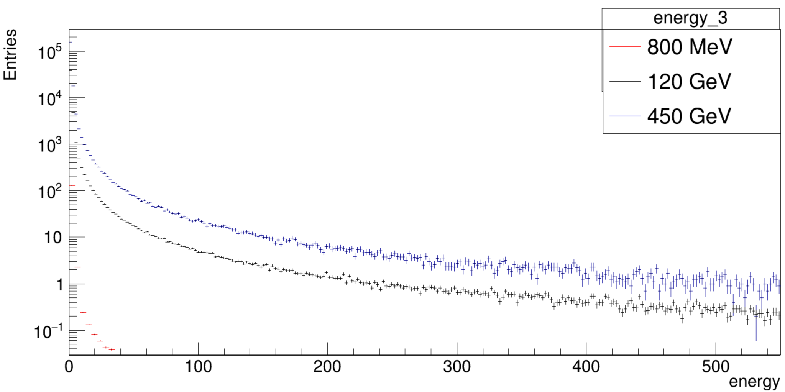
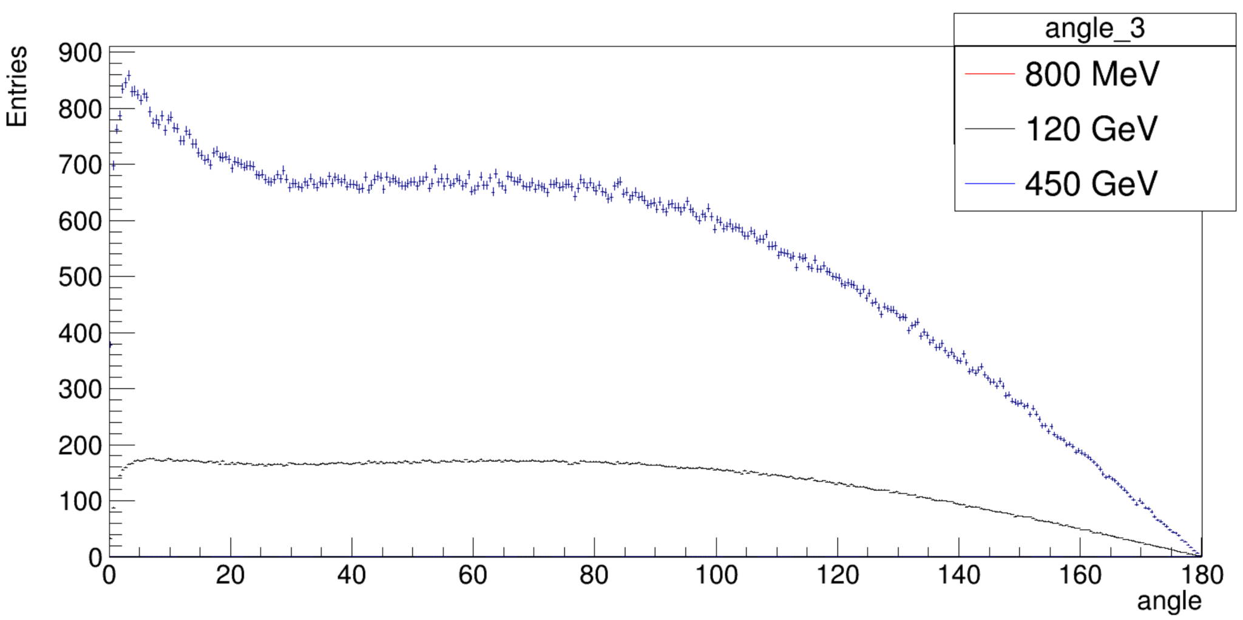
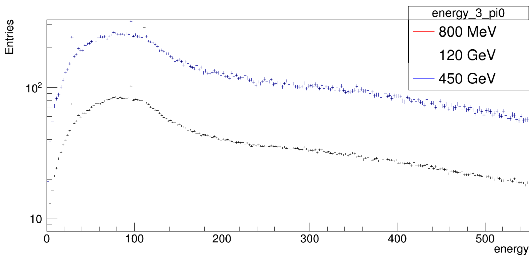
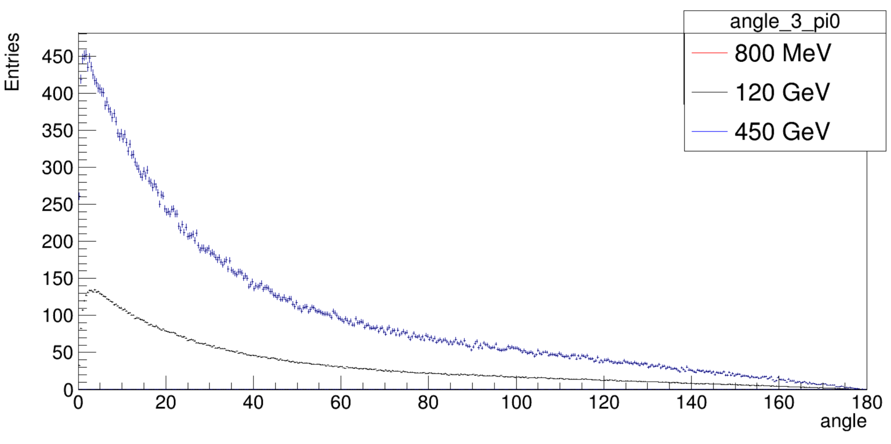
per Proton on Target - All / Pi0

Slide 10
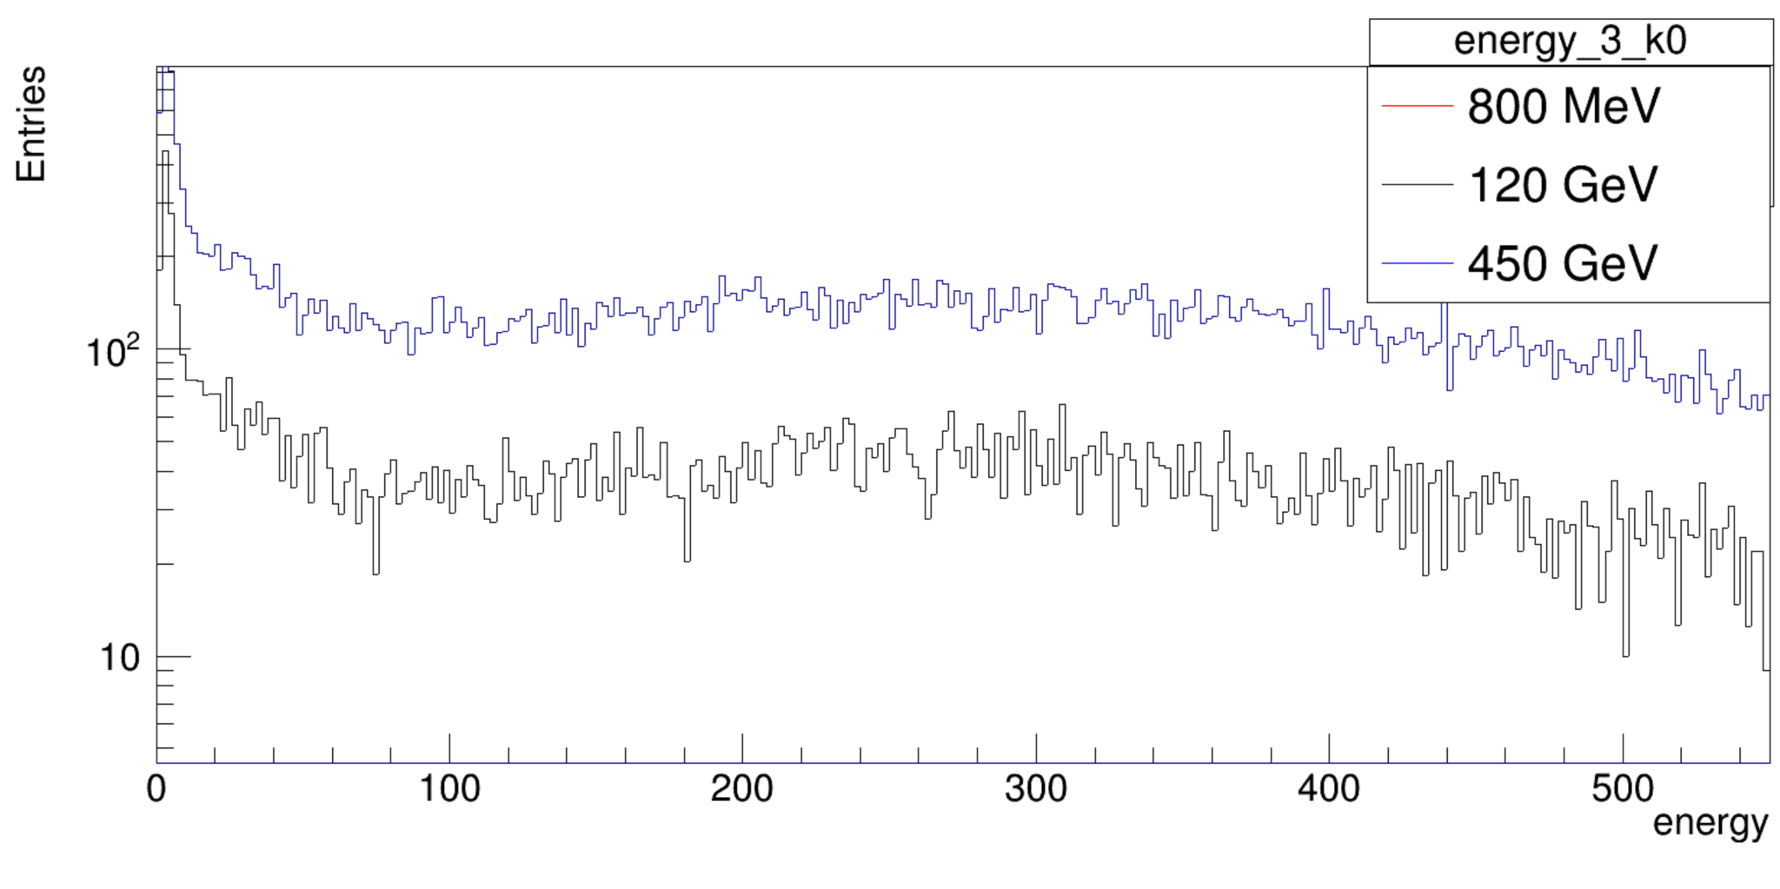
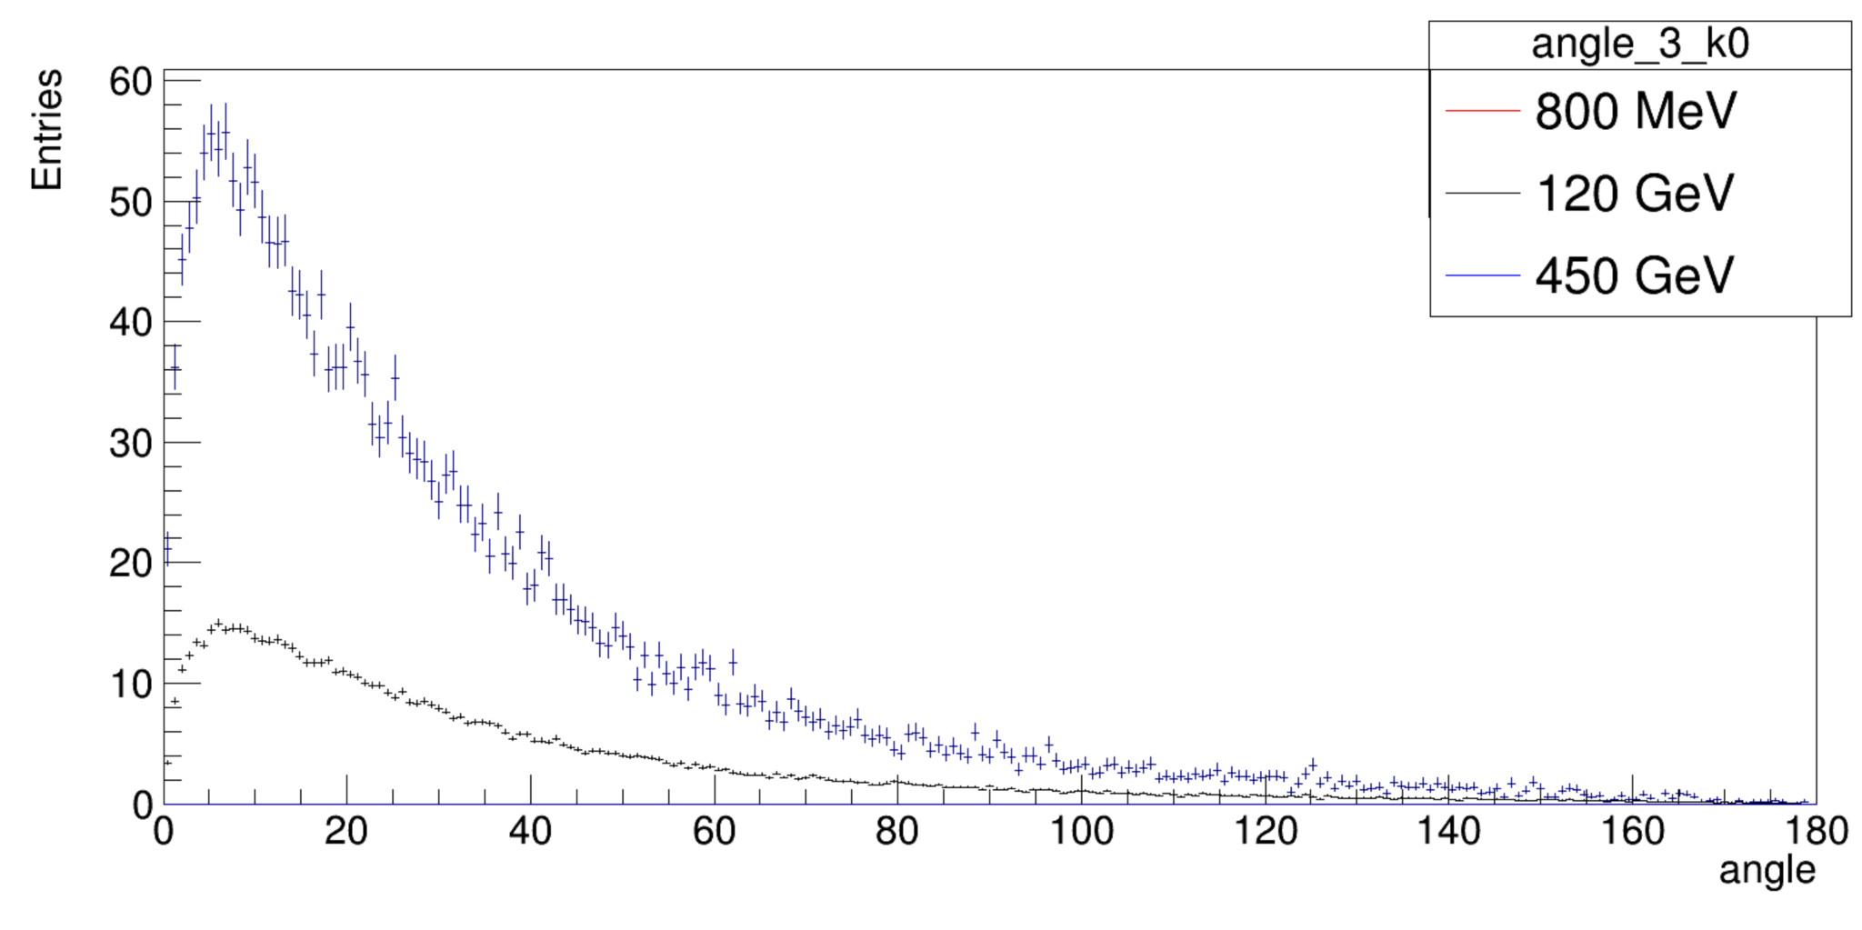
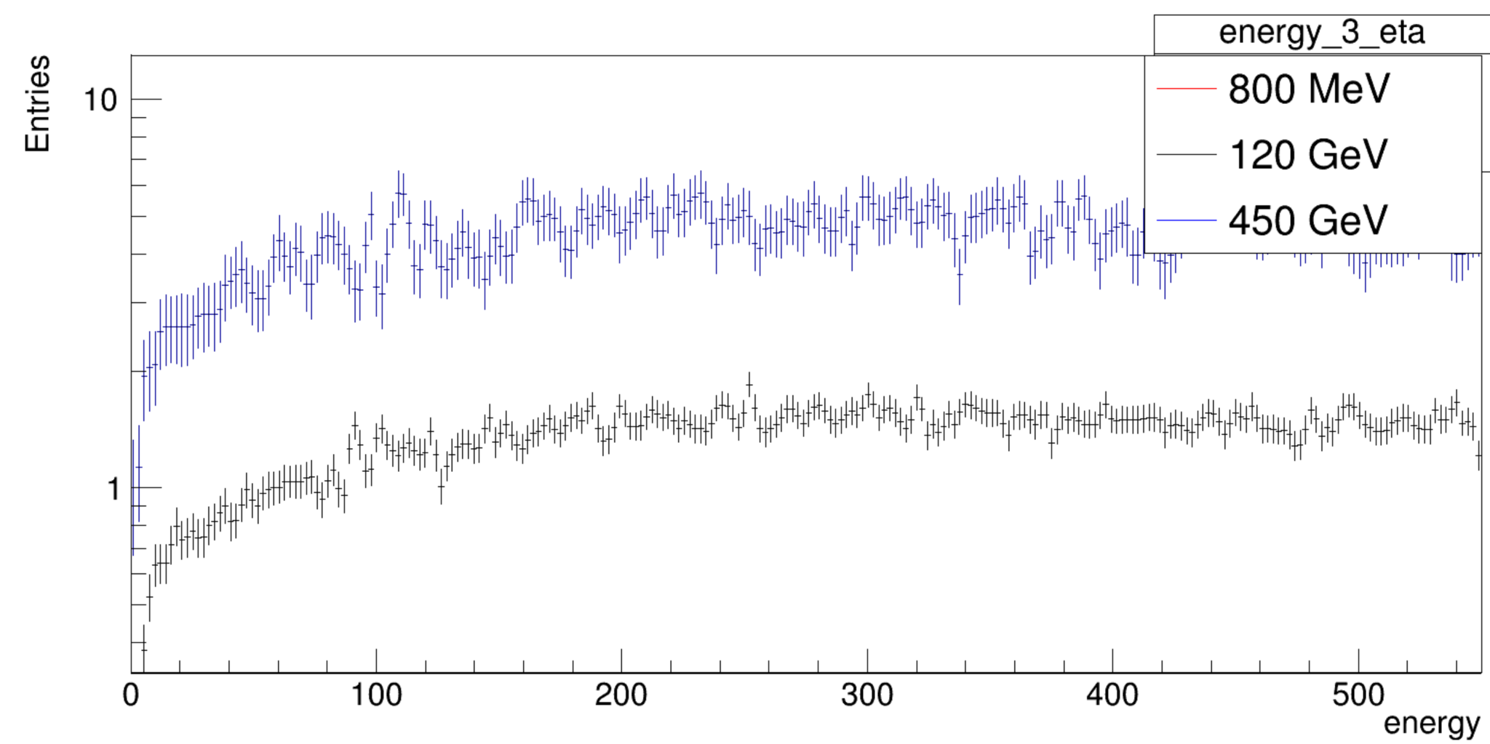
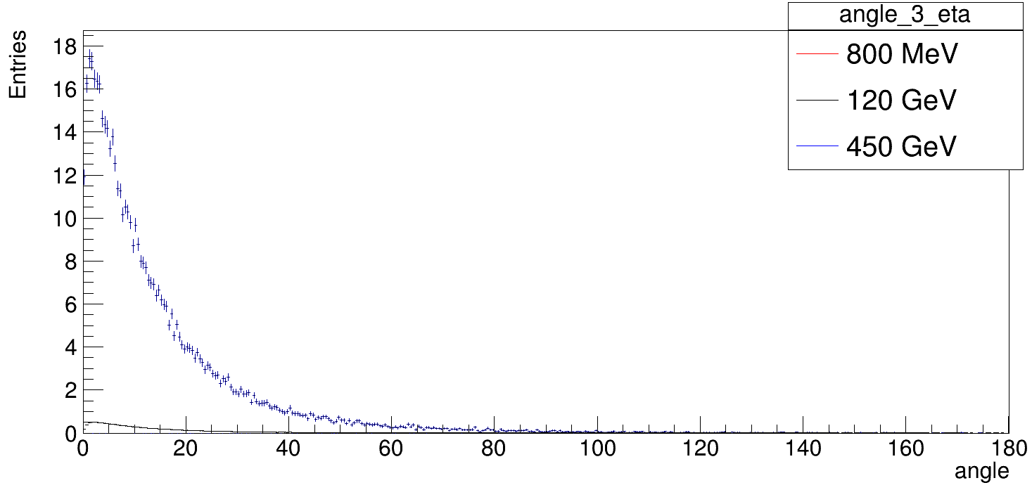
per Proton on Target - k0 / eta

Slide 11
Particles Exiting the Dump

Slide 12
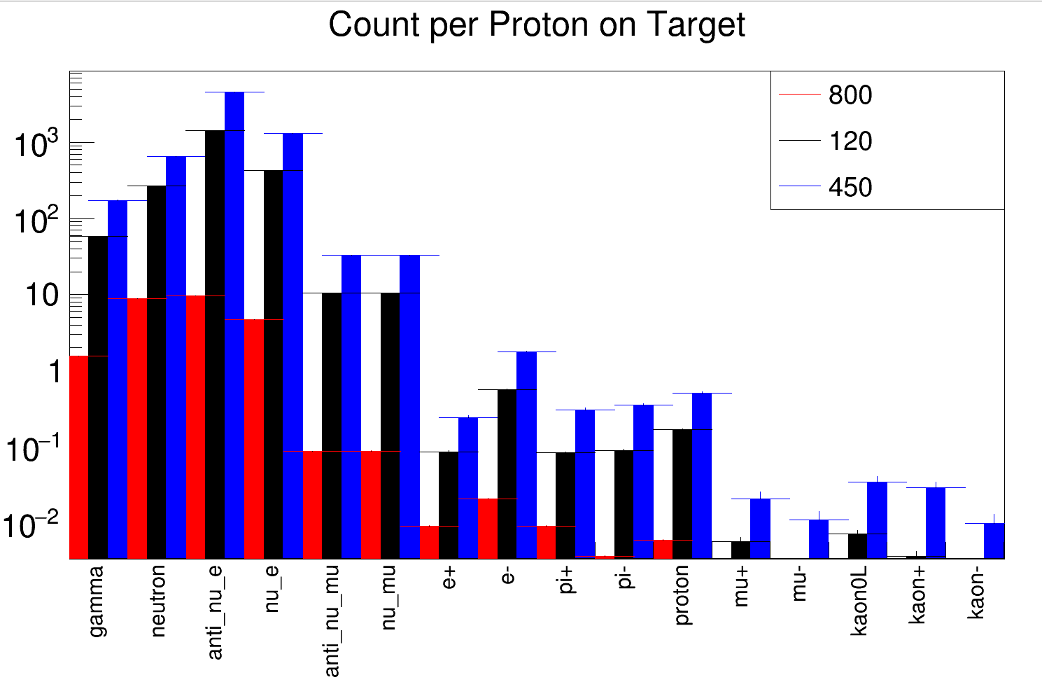
Dump Count - Cylindrical
MeV
Gev
Gev

Slide 13
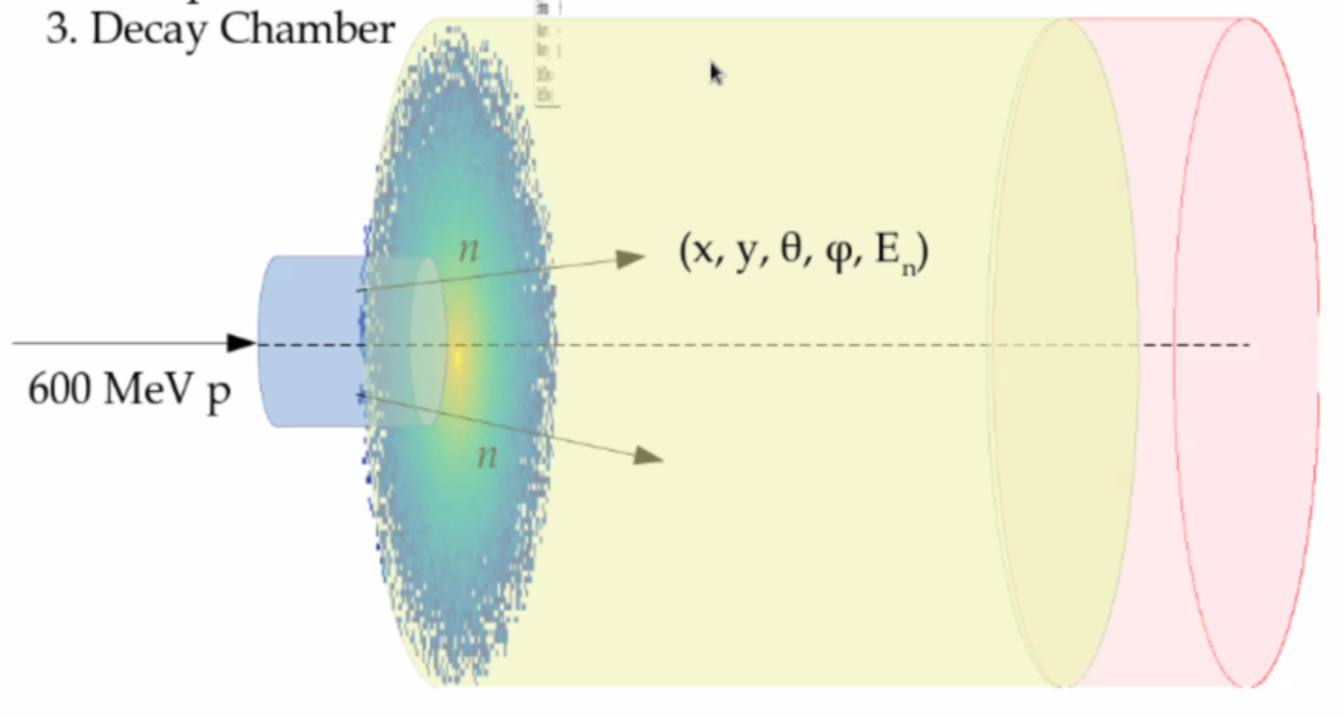
Neutrino Distribution

Slide 14
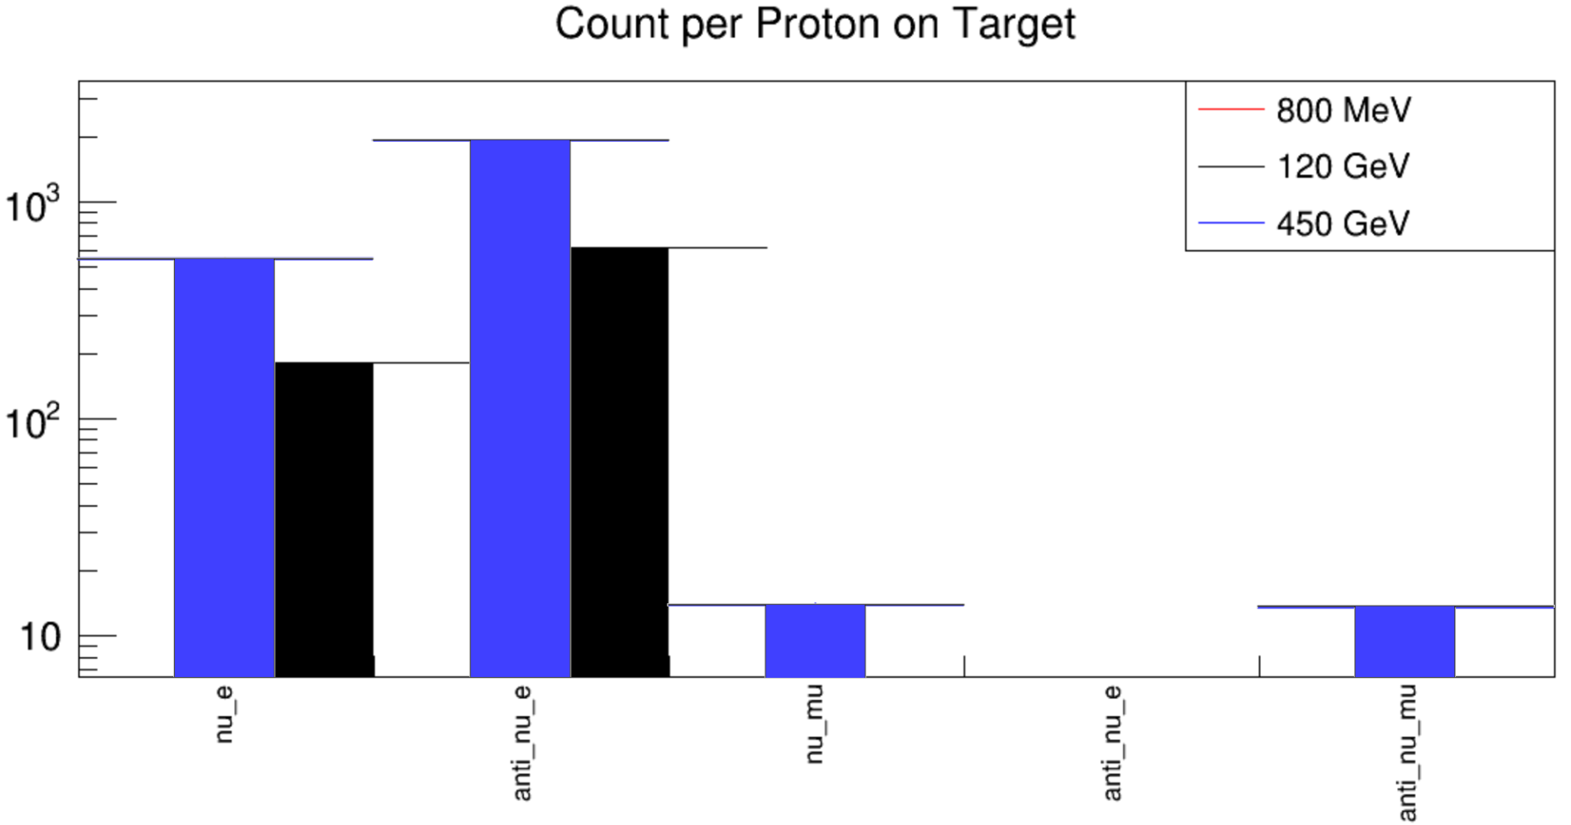
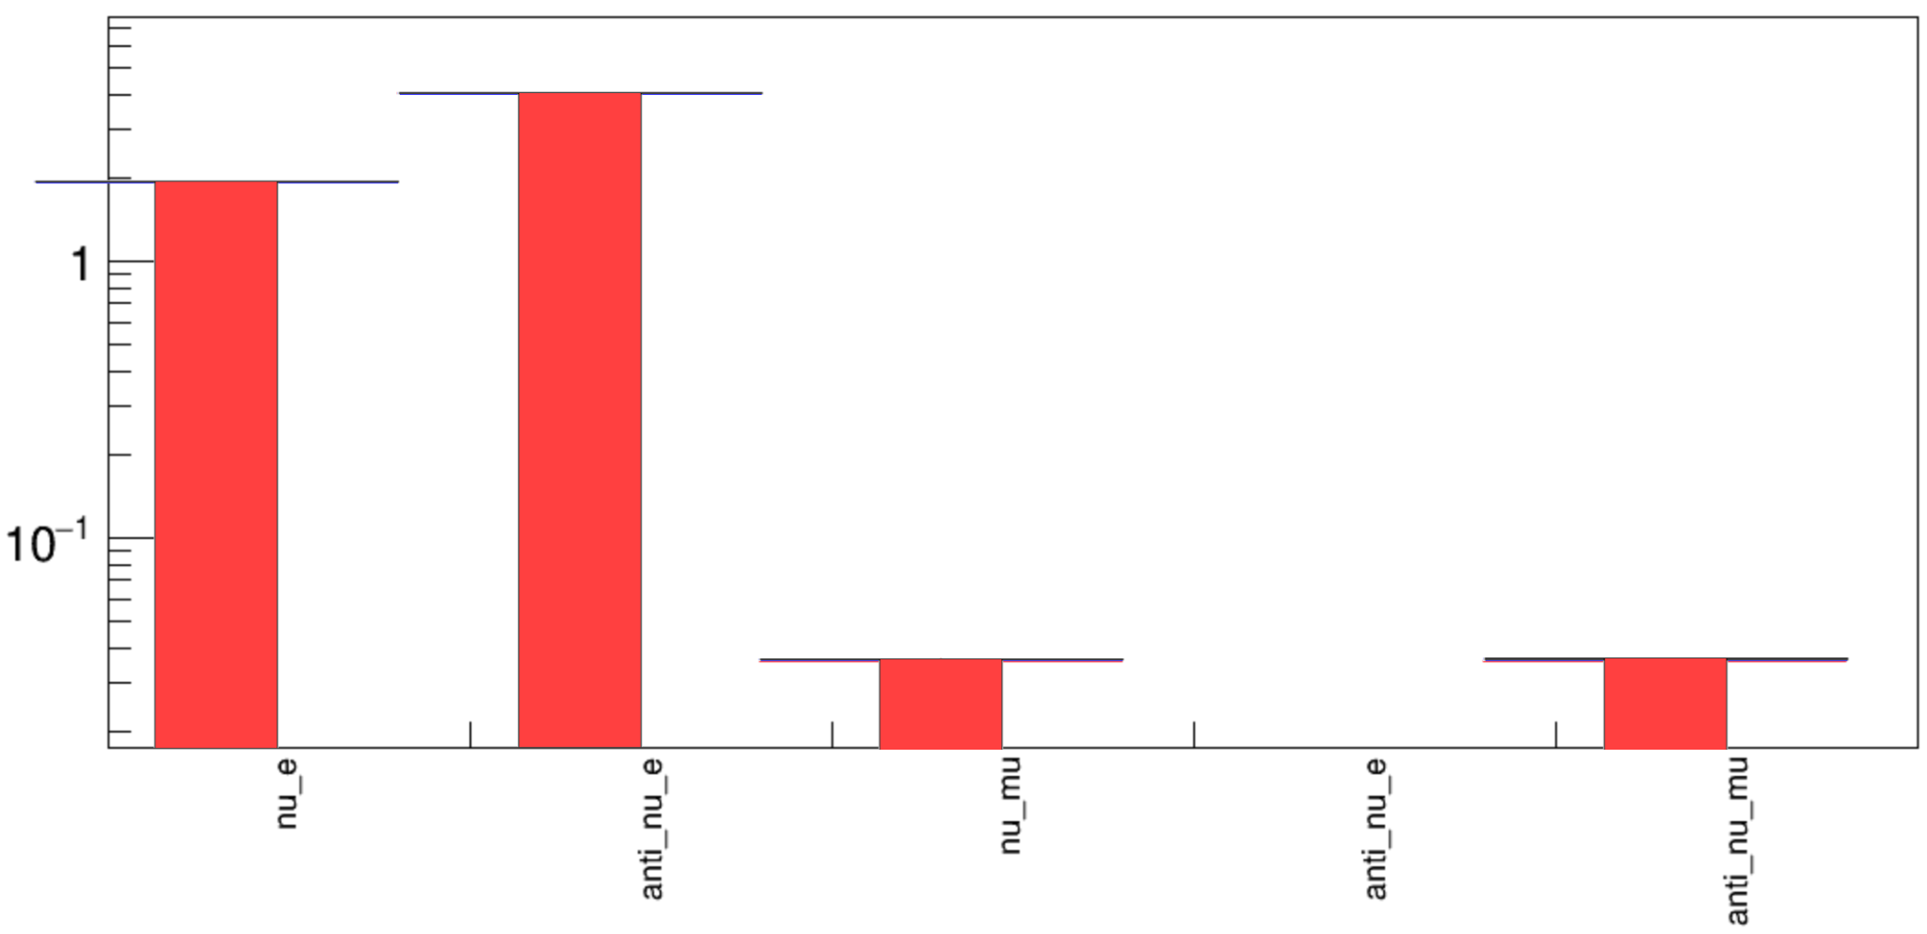
Neutrino per POT

Slide 15
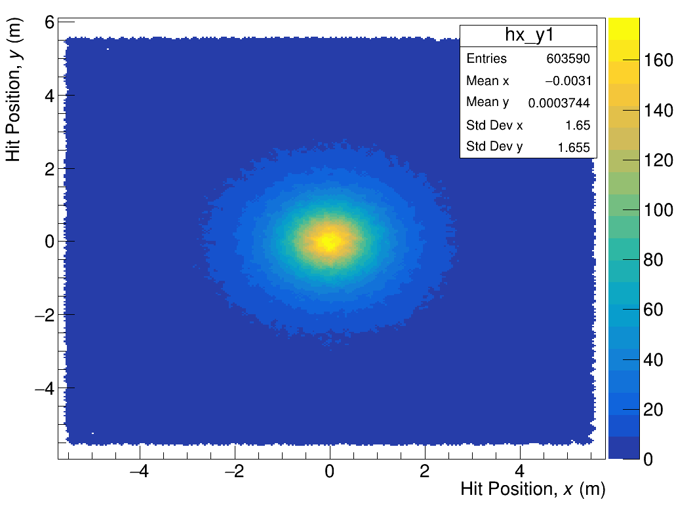
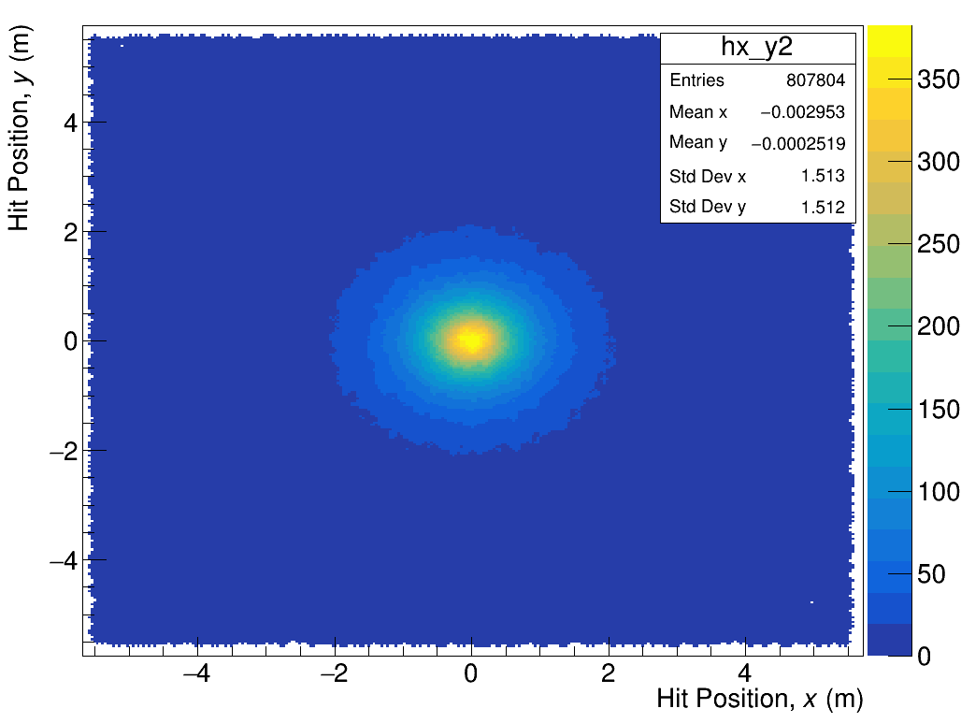
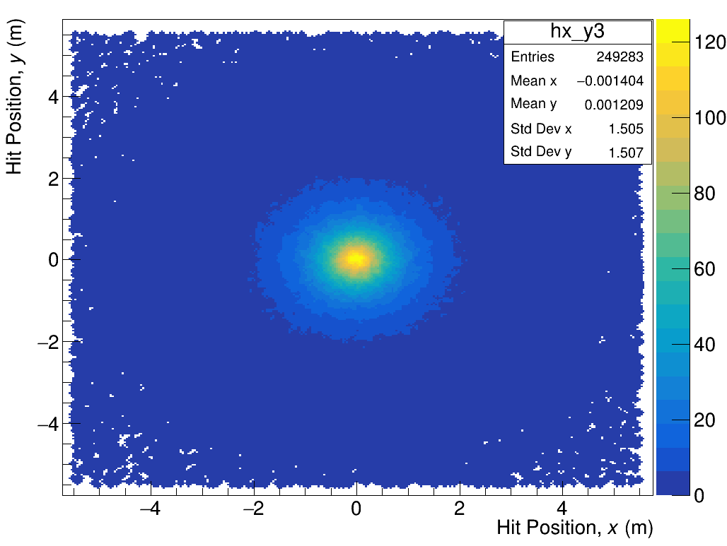
Neutrino 2D Distribution
Binning 550,550
 | 800 MeV POT 1e5 | 120 GeV POT 1e3 | 450 GeV POT 1e2
All

Slide 16
Neutron Distribution

Slide 17
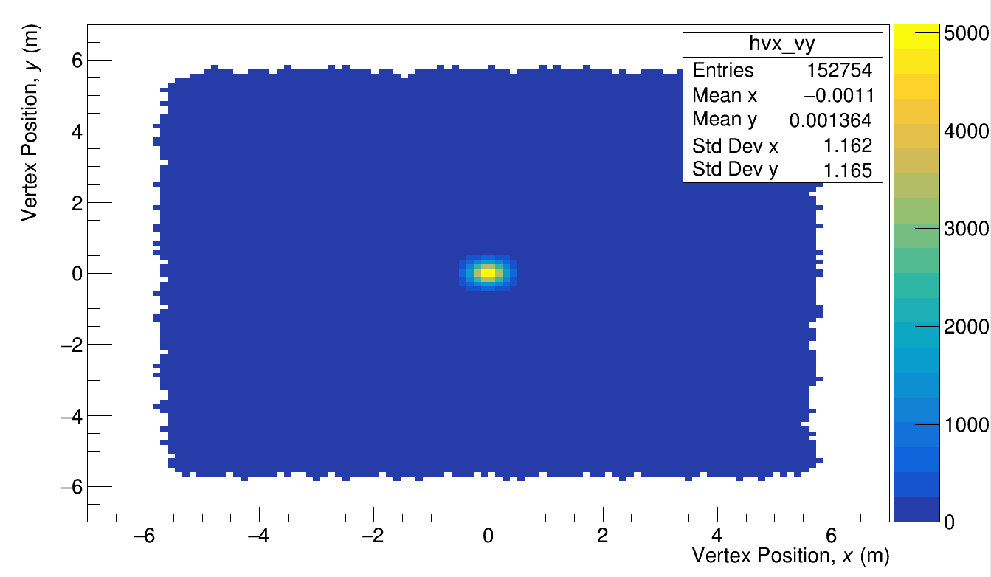
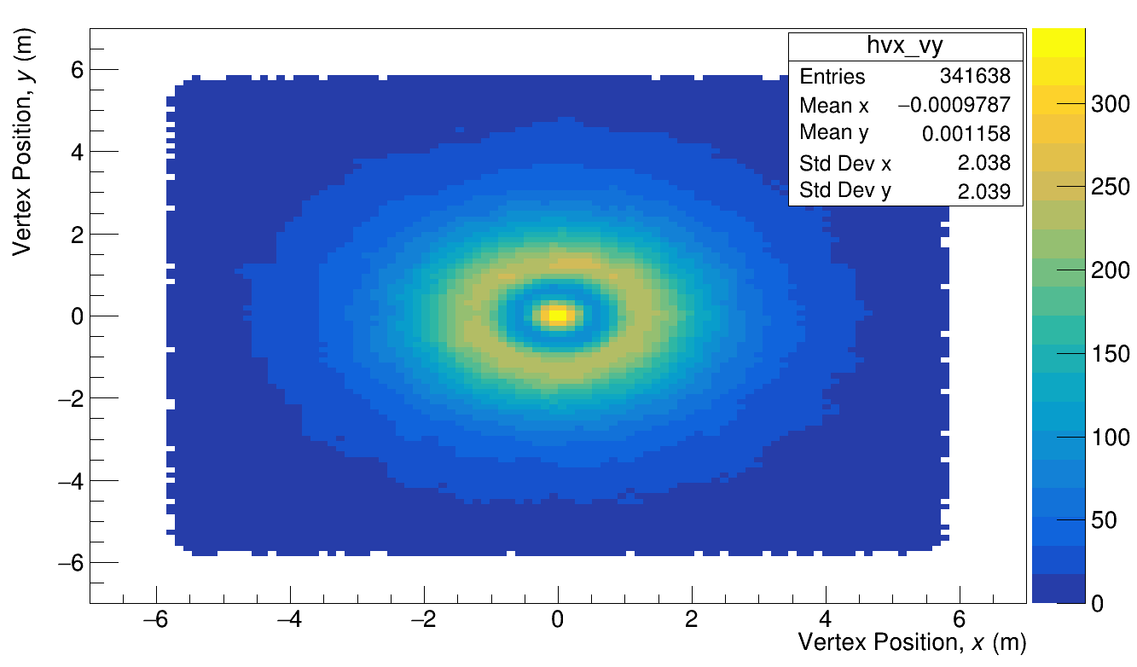
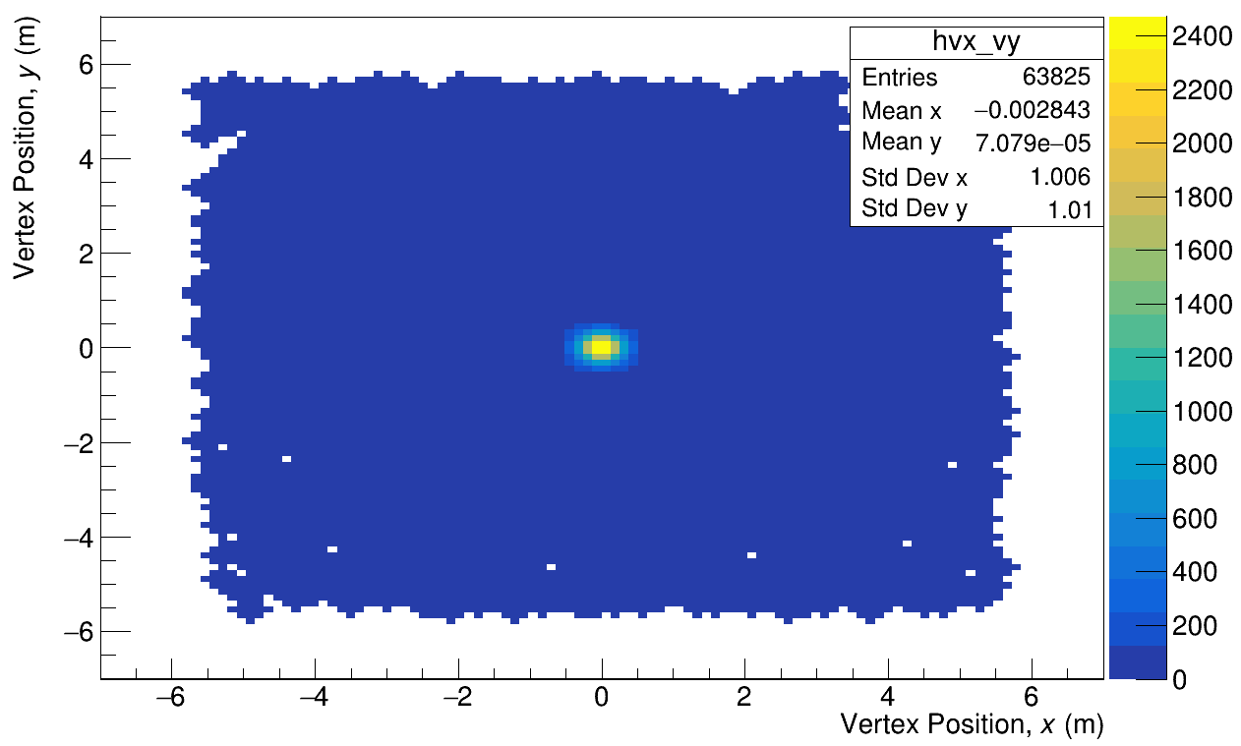
Neutron 2D Distribution
800 MeV POT 1e8
120 GeV
POT 1e5
450 GeV
POT 1e4

Slide 18
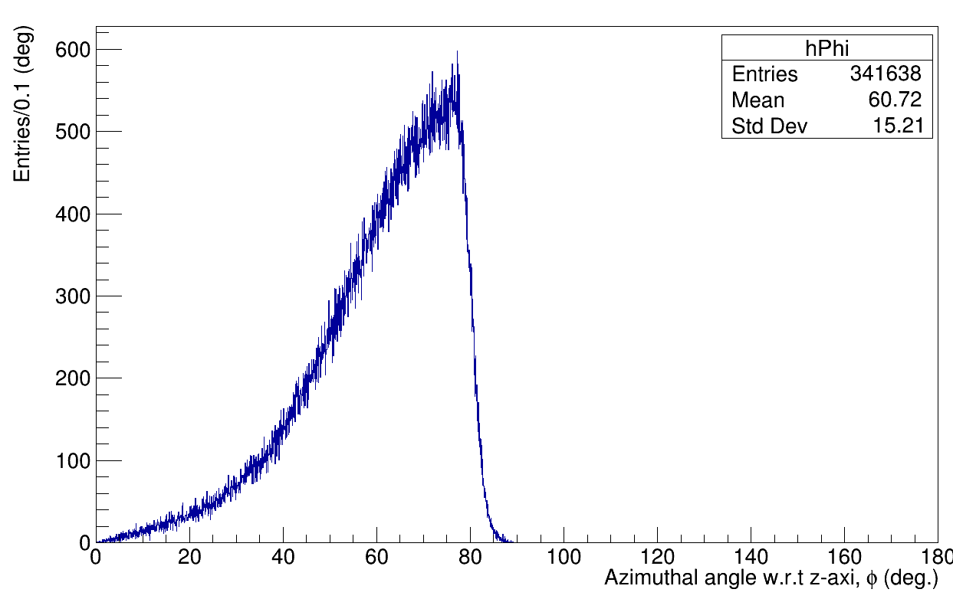
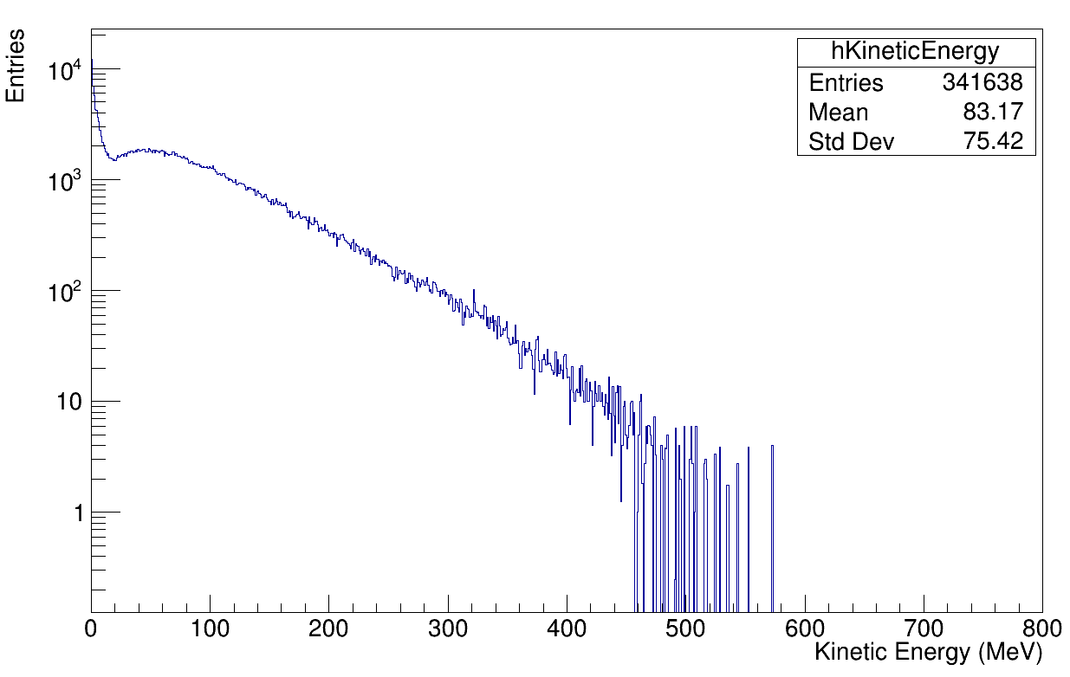
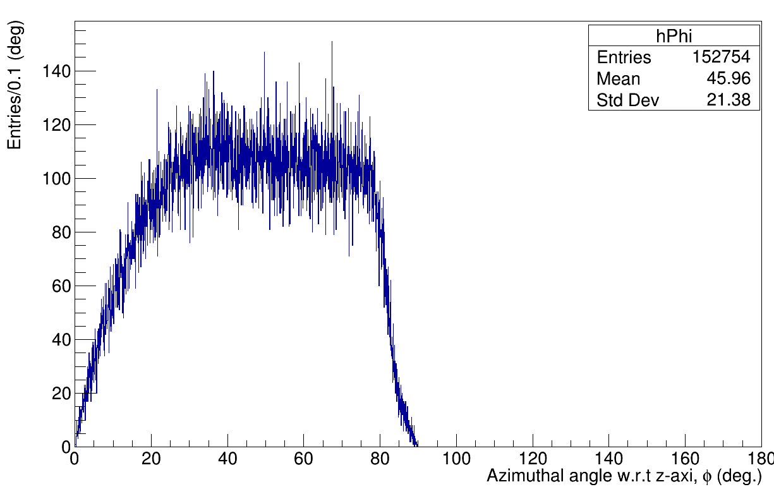
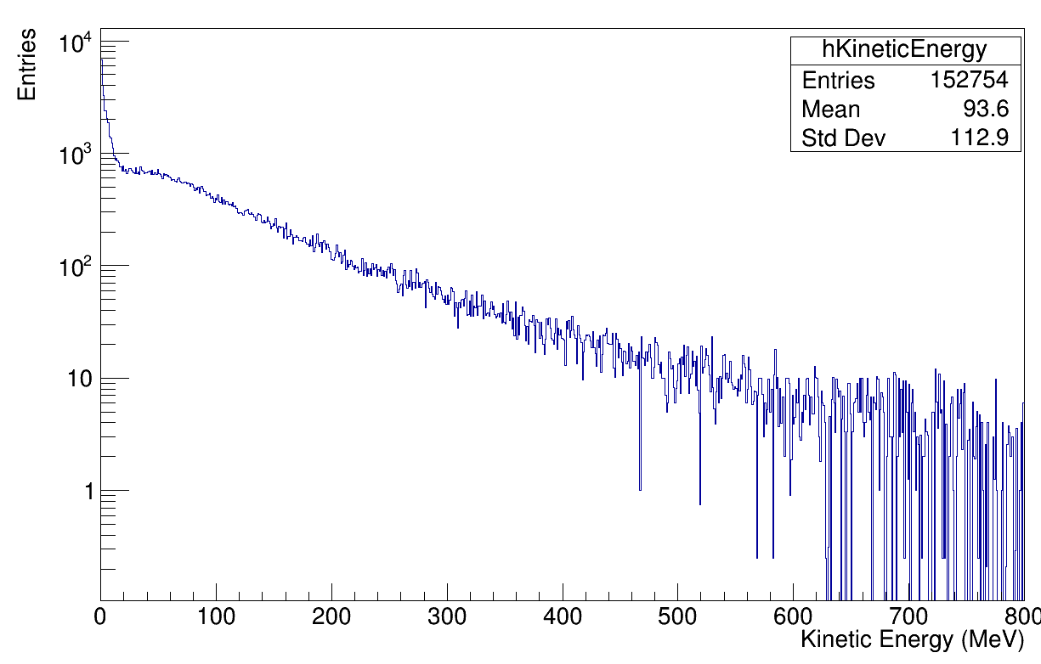
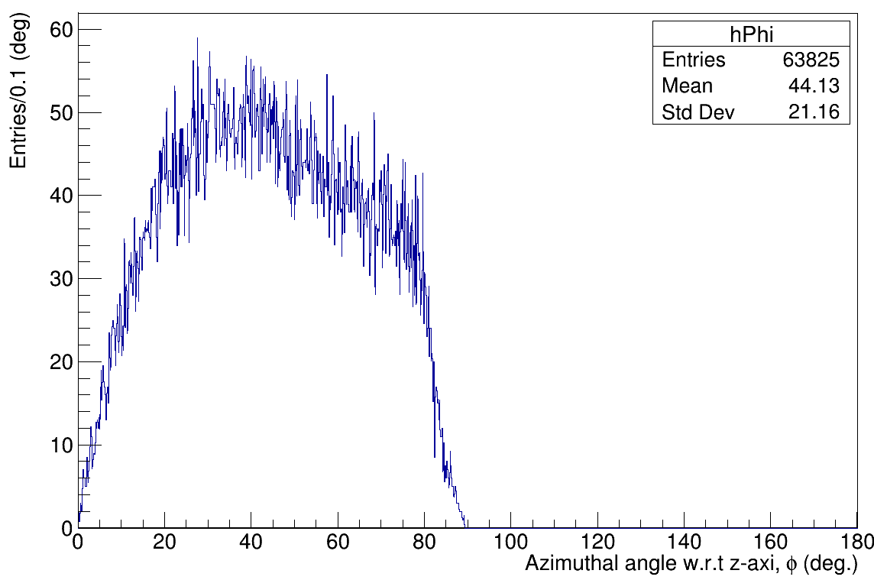
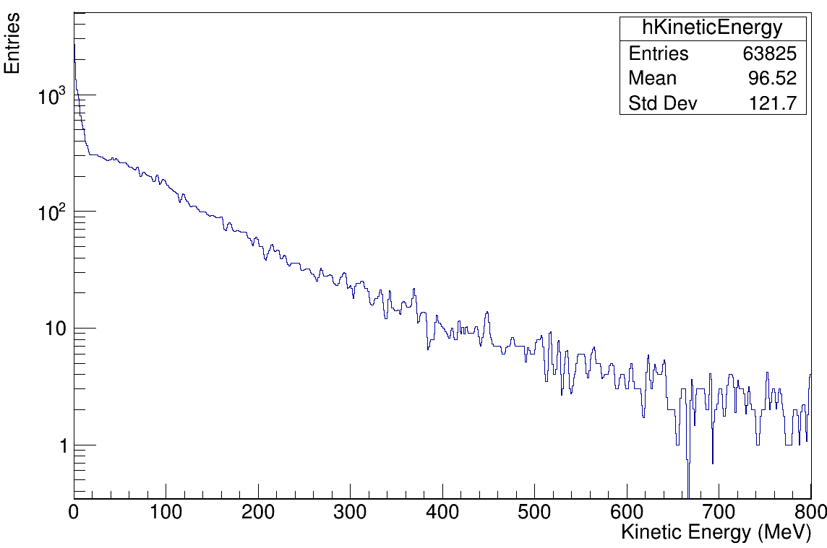
Neutron 2D Distribution
800 MeV
120 GeV
450 GeV

Slide 19
Decay Volume/
Photon accidentals

Slide 20
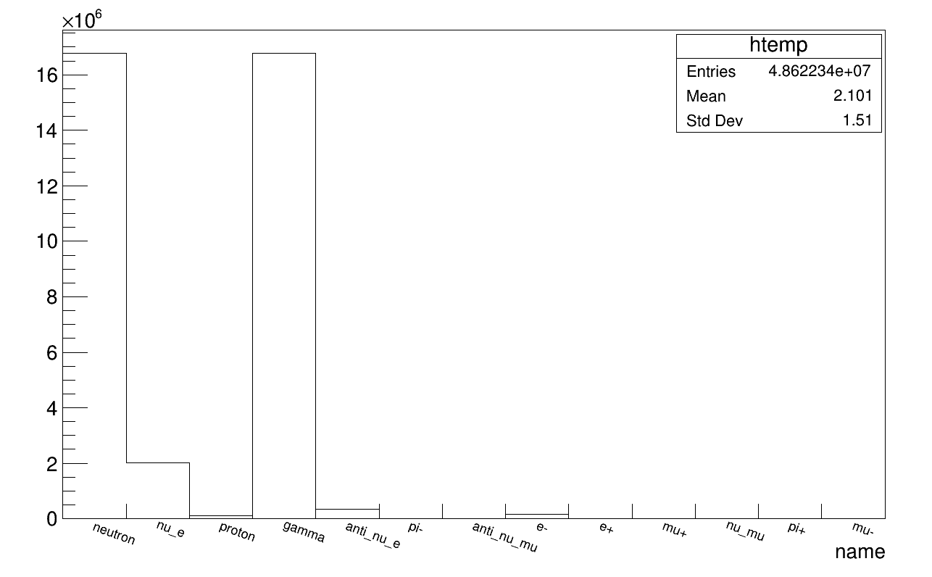
Particles - 800 MeV - POT1e10

Slide 21
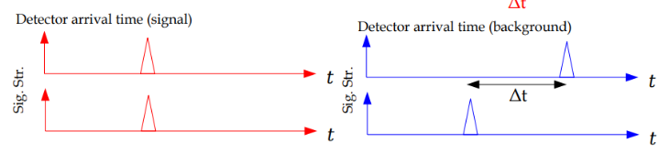
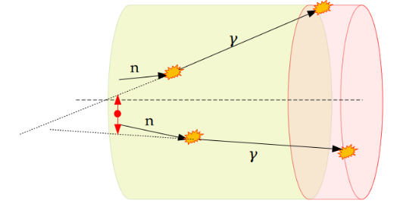
Background Considerations
ΔTOA / DCA / Back-Tracing / Fiducial Volume
Back-Tracing
cut
Fid. Vol. Cut
Notes:
dt and dist account for ainglular

Slide 22
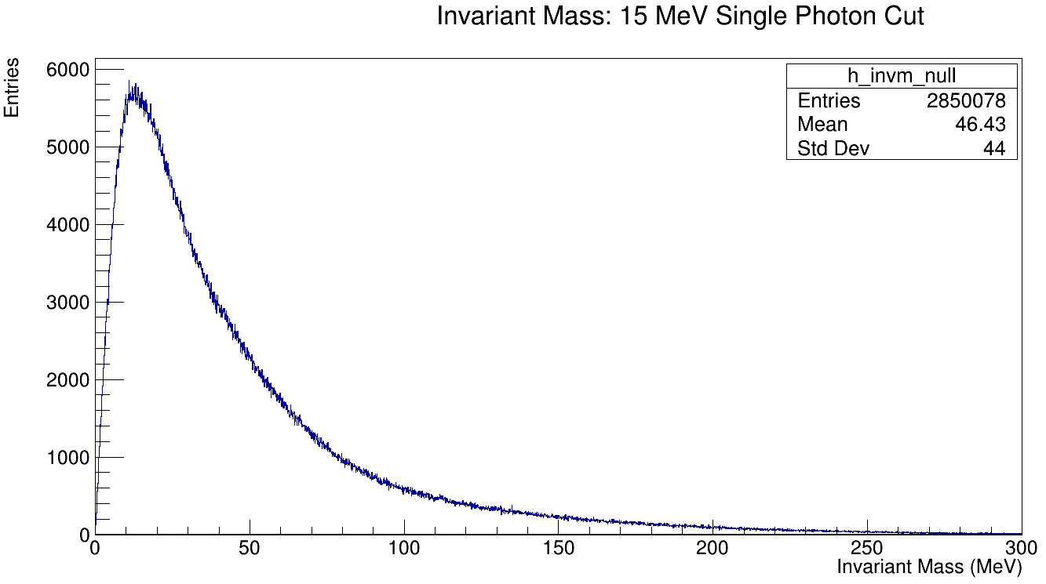
Accidental Photons - 800 MeV

Slide 23
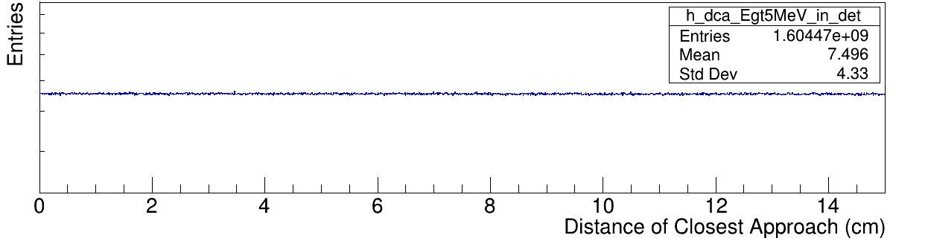

DCA / ΔTOA

Slide 24

ΔTOA Selection Efficiency
15 MeV cut ɣ
Δt cut (ns) | 800MeV N_{2𝜸 ,cut}/N_{2𝜸} | σ₈₀₀ | 120GeV N_{2𝜸 ,cut}/N_{2𝜸} | σ₁₂₀ | 450GeV N_{2𝜸 ,cut}/N_{2𝜸} | σ₄₅₀
<10 | 5.14x10⁻¹ | 1.02x10⁻³
<5 | 3.00x10⁻¹ | 1.23x10⁻³
<2 | 1.56x10⁻¹ | 1.61x10⁻³
<1 | 8.49x10⁻² | 2.11x10⁻³
<0.5 | 4.42x10⁻² | 2.29x10⁻³
<0.1 | 9.34x10⁻³ | 6.16x10⁻³

Slide 25

DCA Selection Efficiency
15 MeV cut ɣ
DCA (cm) | 800MeV N_{2𝜸 ,cut}/N_{2𝜸} | σ₈₀₀ | 120GeV N_{2𝜸 ,cut}/N_{2𝜸} | σ₁₂₀ | 450GeV N_{2𝜸 ,cut}/N_{2𝜸} | σ₄₅₀
<10 | 2.92x10⁻² | 3.52x10⁻³
<5 | 1.46x10⁻² | 4.93x10⁻³
<2 | 5.89x10⁻³ | 8.84x10⁻³
<1 | 2.96x10⁻³ | 1.09x10⁻²
<0.5 | 1.55x10⁻³ | 1.50x10⁻²
<0.1 | 3.93x10⁻⁴ | 2.99x10⁻²

Slide 26
-Benchmark Beam Parameters -
Beam Energy (E_{beam}): 800 MeV
Beam Current (I_{beam}): 2 mA
Beam Power (P_{beam}): 1.6 MW
Protons-on-Target Per Year: 3.93 x 10²³
Sequential Cuts | 800 MeV | 120 GeV | 450 GeV
Protons per pulse | 8.00x 10⁷
Beam induced Neutrons from dump | 2.74x 10⁵
Beam induced Neutrinos from dump | 1.92x 10⁸
Neutron induced photons on detector | 4.53x 10¹
n𝜸 after 15 MeV threshold cut | 1.91x 10⁰
TOA < 40 ns | 8.12x 10⁻¹
Photon Pairs | ~0
Independent Cuts | Efficiency 800 MeV | Efficiency 120 GeV | Efficiency 450 GeV
DCA < 1cm | 2.96x10⁻³
ΔTOA < 0.1 ns | 9.34x10⁻³
Fiducial Volume Cut | 2.06x10⁻²
Back Tracing Cut | 3.14x10⁻²

Slide 27
END

Slide 28
Particle Flux in Dump - Backup Slides

Slide 29


Raw data - TargetFlux - All particles
800 MeV POT1e4
120 GeV POT1e2
450 GeV POT1e1

Slide 30
Particles Exiting Dump - Backup Slides

Slide 31

Particles Exiting the Dump 800 MeV

Slide 32

Particles Exiting the Dump 120 GeV

Slide 33

Particles Exiting the Dump 450 GeV

Slide 34
Neutrino Distribution - Backup Slides

Slide 35






Neutrino 2D Distribution
Binning 550,550
 | 800 MeV POT 1e5 | 120 GeV POT 1e3 | 450 GeV POT 1e2
nu_e
anti_nu_e

Slide 36






Neutrino 2D Distribution
Binning 55,55
 | 800 MeV POT 1e5 | 120 GeV POT 1e3 | 450 GeV POT 1e2
nu_mu
anti_nu_mu

Slide 37


Neutrino 2D Distribution

Slide 38
Neutron / Neutron count per POT
-incident on upstream decay volume wall-
Particle | 800 MeV | 120 GeV | 450 GeV
Neutron | 3.42x10⁻³ | 1.53x10⁰ | 6.38x10⁰
All Neutrinos | 2.40x10⁰ | 8.08x10² | 2.49x10³
nu_e | 1.92x10⁰ | 1.81x10² | 5.53x10²
anti_nu_e | 4.04x10⁻¹ | 6.18x10² | 1.91x10³
nu_mu | 3.57x10⁻² | 4.52x10⁰ | 1.37x10¹
anti_nu_mu | 3.56x10⁻² | 4.55x10⁰ | 13.43x10¹

Slide 39
VacuumChamberSim - Backup Slides

Slide 40


Single Photon Energy Spectra - VacuumChamberSim - 800 MeV

Slide 41


Slide 42





If backtracking, feduction, DCA<1cm, dt<.1ns
1e11 E_{photon} > 15MeV
1e10 If E_{photon} > 15MeV (Large cut >95%)
1e10 14< E_{photon} < 15 if(i=20) break;
1e11 E_{photon} > 10MeV

