Slide 1
The Future of High Energy Physics: A New Generation, A New Vision
Accelerator Technologies
Emilio A. Nanni
Aspen Center for Physics
3/28/2024

Slide 2
Outline
Major Systems and Components of Accelerator Facilities
  Particle Sources
  Energy Gain
  Steering
Colliders of Tomorrow
  Linear
  Circular

Slide 3

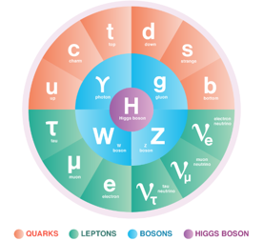
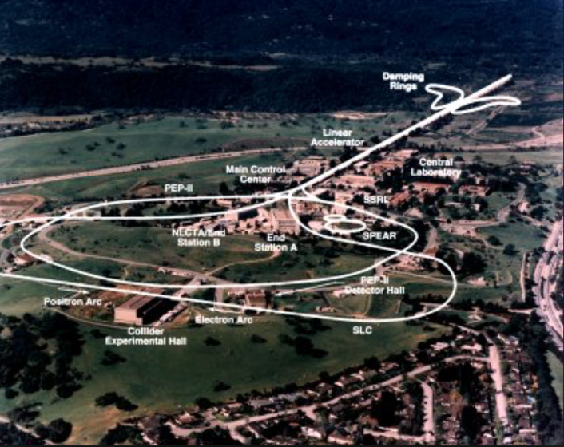
Accelerators Drive Discovery for High Energy Physics
Experimental validation of the Standard Model of Particle Physics
What determines the performance of an accelerator? How do accelerators work across different scales in size and energy?
27 km LHC @ CERN
SLAC “2 Mile” Accelerator / Collider

Slide 4

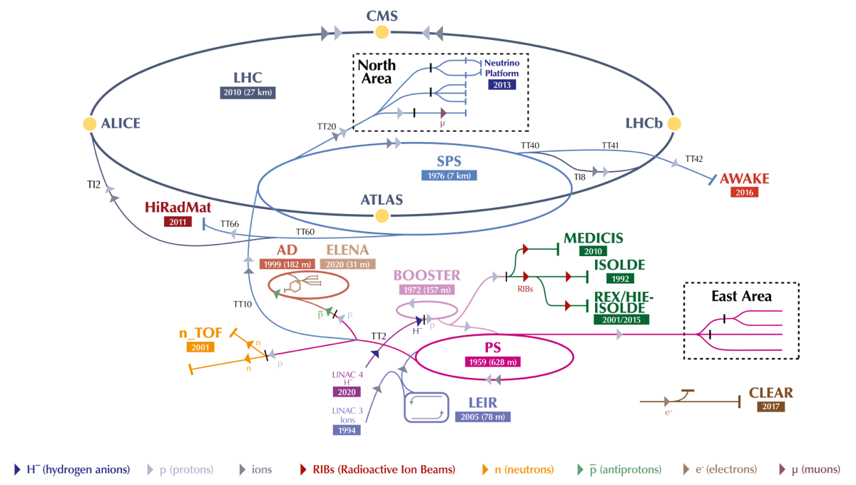
CERN Accelerator Complex
6500 GeV
450 GeV
2 GeV
0.16 GeV
25 GeV
Notes:
The accelerator complex at CERN is a succession of machines that accelerate particles to increasingly higher energies. Each machine boosts the energy of a beam of particles before injecting it into the next machine in the sequence. In the Large Hadron Collider (LHC) – the last element in this chain – particle beams are accelerated up to the record energy of 6.5 TeV per beam.
Linear accelerator 4 (Linac4) became the source of proton beams for the CERN accelerator complex in 2020. It accelerates negative hydrogen ions (H-, consisting of a hydrogen atom with an additional electron) to 160 MeV to prepare them to enter the Proton Synchrotron Booster (PSB). The ions are stripped of their two electrons during injection from Linac4 into the PSB, leaving only protons. These are accelerated to 2 GeV for injection into the Proton Synchrotron (PS), which pushes the beam up to 26 GeV. Protons are then sent to the Super Proton Synchrotron (SPS), where they are accelerated up to 450 GeV.
The protons are finally transferred to the two beam pipes of the LHC. The beam in one pipe circulates clockwise while the beam in the other pipe circulates anticlockwise. It takes 4 minutes and 20 seconds to fill each LHC ring, and 20 minutes for the protons to reach their maximum energy of 6.5 TeV. Beams circulate for many hours inside the LHC beam pipes under normal operating conditions. The two beams are brought into collision inside four detectors – ALICE, ATLAS, CMS and LHCb – where the total energy at the collision point is equal to 13 TeV.
Protons are not the only particles accelerated in the LHC. Lead ions for the LHC start from a source of vaporised lead and enter Linac3 before being collected and accelerated in the Low Energy Ion Ring (LEIR). They then follow the same route to maximum energy as the protons.
https://home.cern/science/accelerators/accelerator-complex#:~:text=The%20LHC%20is%20the%20last,Image%3A%20CERN)

Slide 5
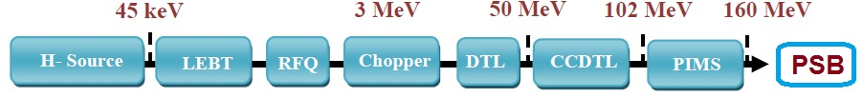
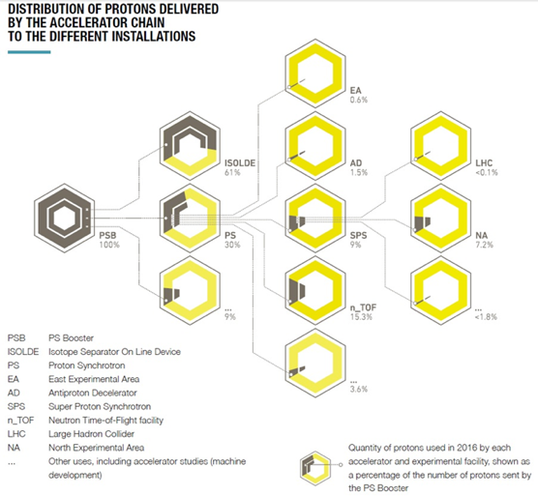
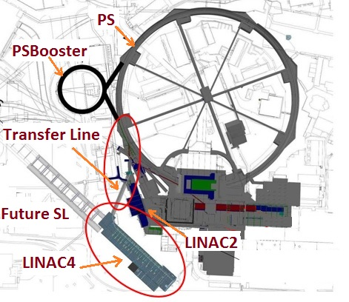
Particle Source for LHC
Linac4
Notes:
https://www.lhc-closer.es/taking_a_closer_look_at_lhc/0.proton_source
Inaugurated in May 2017 after two decades of design and construction, Linac 4 was connected to the next link in the accelerator chain, the Proton Synchrotron Booster (PSB), in 2019 at the start of Long Shutdown 2 and already operated for physics last year. The 86-metre-long accelerator is the first step in the LHC accelerator chain, replacing the long-serving Linac2 as the source of all proton beams for CERN's experiments (more in CERN Courier).

Slide 6
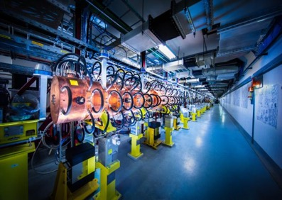
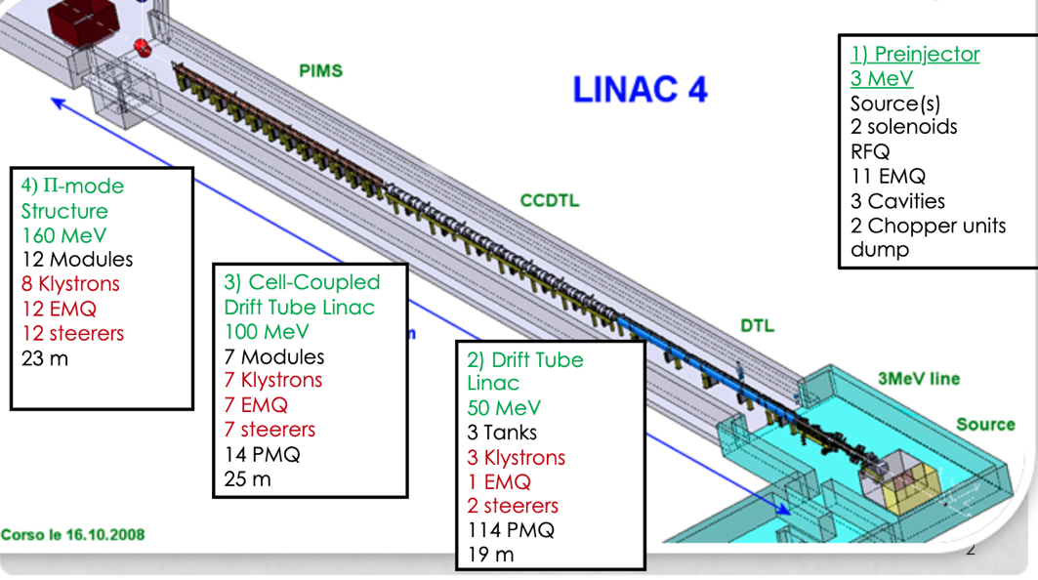
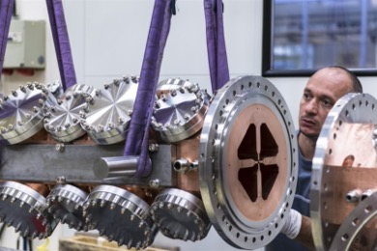
The Proton Source: Linear Accelerator 4 (Linac4)
Linac4 Radio Frequency Quadrupole
Notes:
Linear accelerator 4 (Linac4) is designed to boost negative hydrogen ions to high energies. It became the source of proton beams for the Large Hadron Collider (LHC) in 2020.
Linac4 accelerates negative hydrogen ions (H⁻, consisting of a hydrogen atom with an additional electron) to 160 MeV to prepare them to enter the Proton Synchrotron Booster, which is part of the LHC injection chain. Negative hydrogen ions are pulsed through the accelerator for 400 microseconds at a time.
Linear accelerators use radiofrequency cavities to charge cylindrical conductors. The ions pass through the conductors, which are alternately charged positive or negative. The conductors behind them push particles and the conductors ahead of them pull, causing the particles to accelerate. Quadrupole magnets ensure the hydrogen ions remain in a tight beam.
The machine comprises a H- ion source and four types of accelerating structure: the particles are accelerated in several stages, first to 3 MeV by a radio-frequency quadrupole (RFQ), then to 50 MeV by drift tube linacs (DTLs), then to 100 MeV by coupled-cavity drift tube linacs (CCDTLs), and finally to 160 MeV by Pi-mode structures (PIMS). Linac4’s hardware also includes an equipment called a chopper line. Its role is to cut up the beam at the same frequency as that of the PS Booster.
The ions are stripped of their two electrons during injection from Linac4 into the Proton Synchrotron Booster to leave only protons. This allows more particles to accumulate in the synchrotron, simplifies injection, reduces beam loss at injection and gives a more brilliant beam.
Linac4 is 86 metres long and located 12 metres below ground. Beams began to be produced in 2013 and the milestone energy of 160 MeV was reached in 2016, after the commissioning of all the accelerating structures. During the long shutdown 2019–20, it replaced Linac2, which had previously accelerated protons to 50 MeV. The Linac4 is a key element in the project to increase the luminosity of the LHC during the next decade.
https://indico.fnal.gov/event/50492/contributions/221697/attachments/146688/187454/LINAC4_at_PIP-IIworkshop_v3.pdf

Slide 7
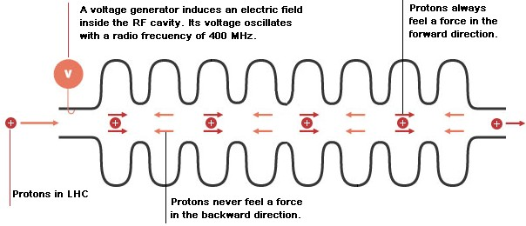
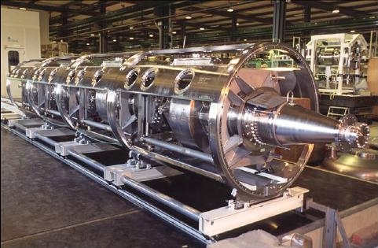
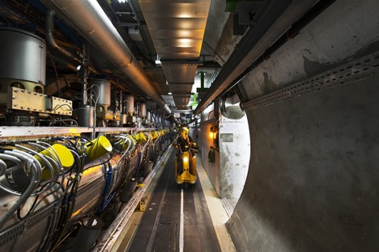
LHC Cryomodule
The LHC uses eight cavities per beam, each delivering 2 MV (an accelerating field of 5 MV/m) at 400 MHz. The cavities operate at 4.5 K — the LHC magnets use superfluid helium at 1.9 K.
Notes:
To accelerate particles, the accelerators are fitted with metallic chambers containing an electromagnetic field known as radiofrequency (RF) cavities. Charged particles injected into this field receive an electrical impulse that accelerates them.
Assembly of cavities for the HIE-ISOLDE accelerator (Image: Maximilien Brice/CERN)In the Large Hadron Collider (LHC), 16 RF cavities are housed in four cylindrical refrigerators called cryomodules, which enable them to work in a superconducting state.
Each cavity is driven by a high-power klystron, which is a tube containing electron beams. The electron beams are intensity-modulated to a frequency of 400 MHz, or 400 million oscillations per second. A rectangular pipe of conducting metal called a waveguide directs energy to the cavity. The cavity’s shape has been specifically designed to achieve resonance and the build up in intensity of the electromagnetic waves. Each cavity can reach a maximum voltage of 2 megavolts (MV), corresponding to 16 MV per beam.
One of the module containing the accelerating cavities for the LHC (Image: Maximilien Brice/CERN)The LHC’s RF cavities bring the 450 GeV energy of the particles (1 GeV = 1 billion electronvolts) to 6.5 TeV (1 TeV = 1 million million electronvolts) - more than 14 times their injection energy. The maximum energy is reached in around 20 minutes with the bunches having passed through the RF cavities more than 10 million times.
The field in an RF cavity is made to oscillate (switch direction) at a given frequency, so timing the arrival of particles is important. In the LHC, each RF cavity is tuned to oscillate at 400 MHz. When the beam has reached the required energy, an ideally timed proton with exactly the right energy will not be accelerated. By contrast, protons with slightly different energies arriving earlier or later will be accelerated or decelerated so that they stay close to the desired energy. In this way, the particle beam is sorted into packs of protons called "bunches".
Assembly of two crab cavities for the High-Luminosity LHC (Image: Julien Ordan/CERN)Aside from these accelerating cavities, CERN is developing “crab” cavities for the LHC’s successor, the High-Luminosity LHC. The purpose of these crab cavities is to give a transverse momentum to steer the particles as they approach the collision point.
https://home.web.cern.ch/science/engineering/accelerating-radiofrequency-cavities

Slide 8
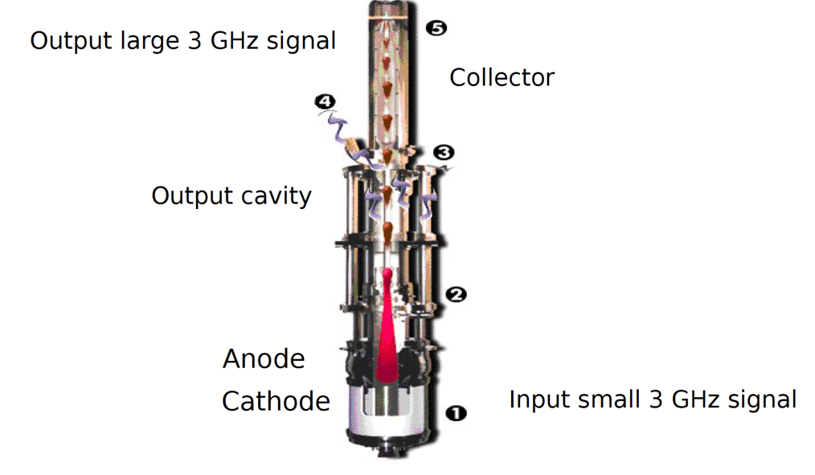
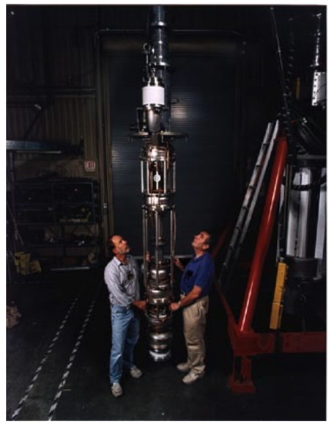
RF Sources Power the Accelerator
RF Source (Klystron)
400 MHz, 500 kW LHC Klystron

Slide 9
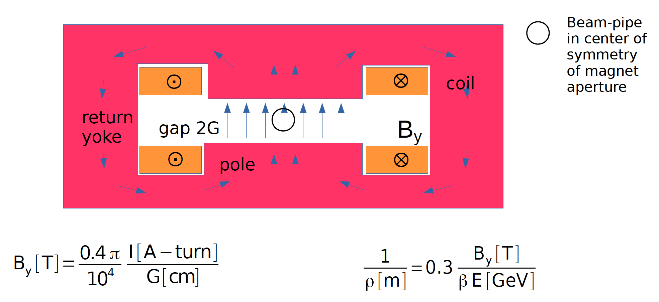
Magnets Guide and Transport the Beam

Slide 10
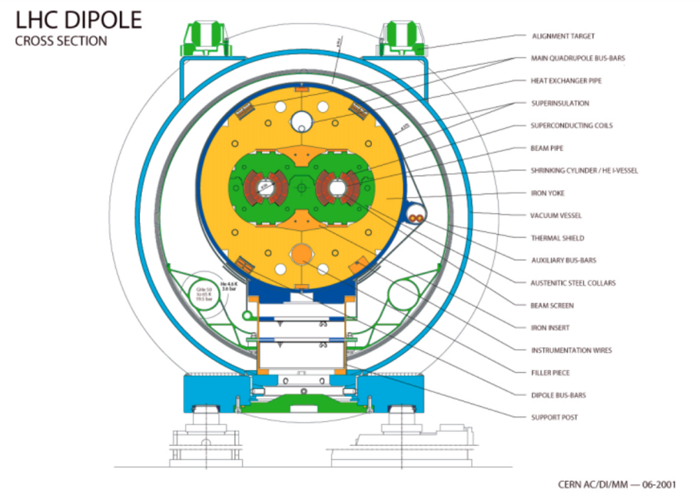
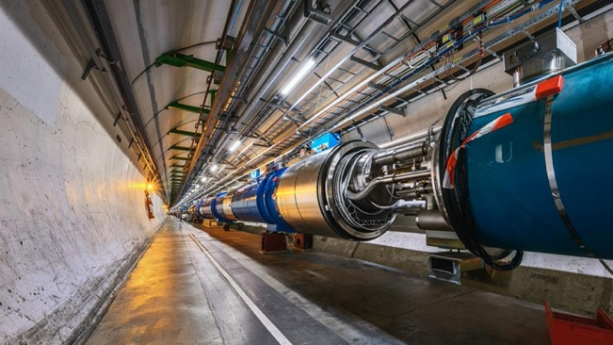
LHC Superconducting Magnets
LHC Dipole in Tunnel
8.3 T
Notes:
The LHC has a total of 1232 dipoles, magnets which bend the particles’ trajectories, and 474 quadrupoles, which squeeze the bunches. All these magnets are superconducting, i.e. they operate at a temperature of -271°C, are 15 metres long and weigh up to 28 tonnes. So moving them around is no trivial matter.

Slide 11
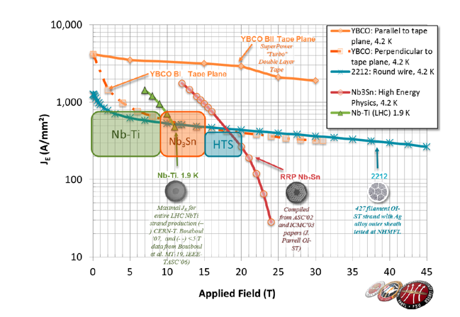
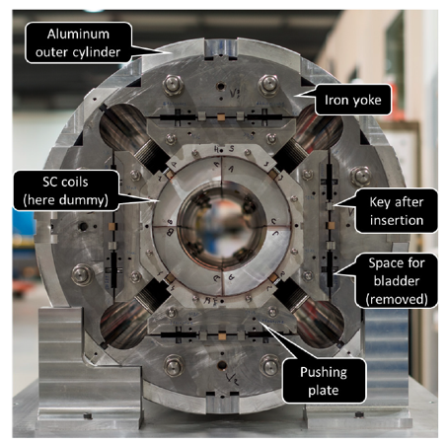
Path Forward for Superconducting Magnets
Magnet performance will determine energy reach of future colliders
FCC-hh baseline at 16 T
HL-LHC will also benefit from higher fields
Superconducting Wire Performance
HL-LHC Nb3Sn IT Quad
Existing quads
70 mm aperture
200 T/m gradient
Proposed for upgrade
At least 120 mm aperture (now 150 mm)
200 T/m gradient
Field 70% higher at pole face
Notes:
DOI: 10.1142/S1793626819300093
HL-LHC Proposal: b*=55 cm b*=15 cm
•Just like classical optics
•Small, intense focusbig, powerful lens
•Small b*huge bat focusing quad

Slide 12
Outline
Major Systems and Components of Accelerator Facilities
  Particle Sources
  Energy Gain
  Steering
Colliders of Tomorrow
  Linear
  Circular

Slide 13
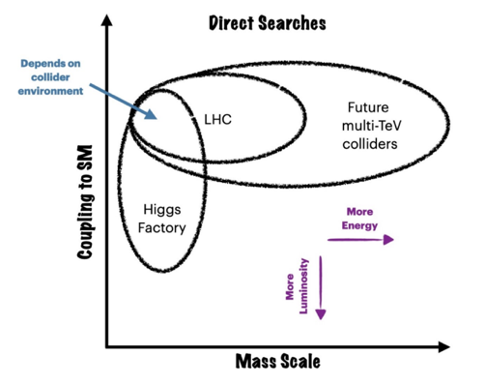
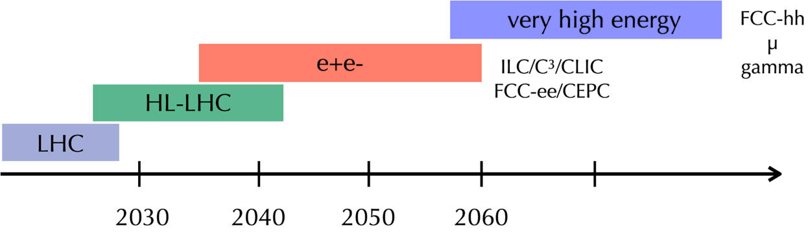

What’s Next for the Energy Frontier?
Many options in consideration beyond HL-LHC
Precision studies with Higgs Factories
Discovery physics on the >TeV scale
Reina, P5 Town Hall
C. Vernieri

Slide 14
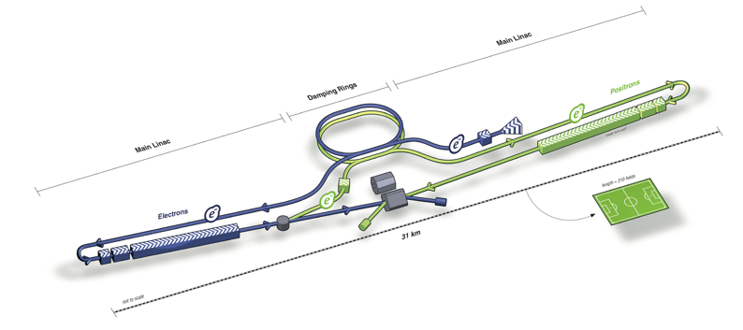
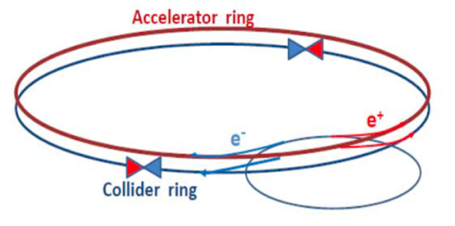
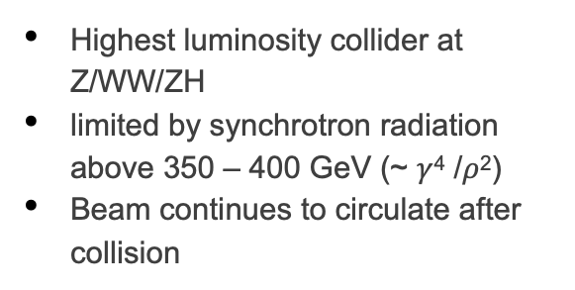
Linear vs. Circular
Linear e⁺e⁻ colliders: ILC, C³, CLIC
Reach higher energies (~TeV), and can use polarized beams
Relatively low radiation
Collisions in bunch trains
Circular e⁺e⁻ colliders: FCC-ee, CEPC
Highest luminosity collider at Z/WW/ZH
limited by synchrotron radiation above 350 – 400 GeV (~ $γ$⁴ /$ρ$²)
Beam continues to circulate after collision

Slide 15
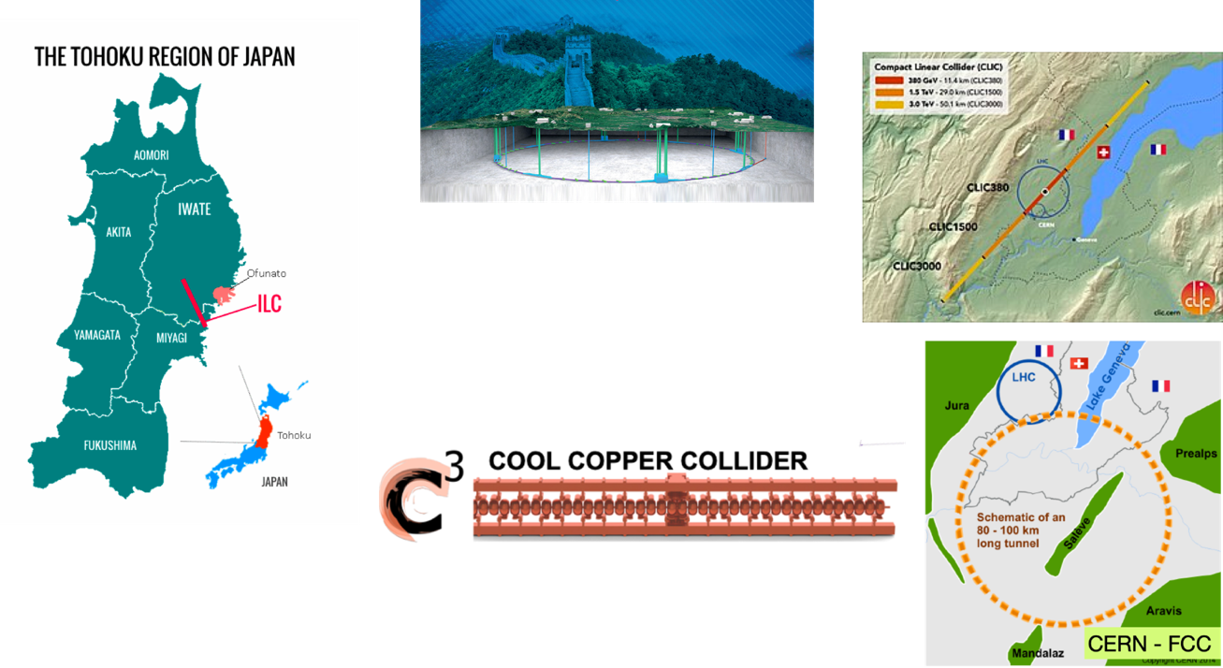


Higgs Factory Proposals
CLIC 380/1000/3000 GeV
CEPC
240 GeV
FCC-ee
240/365 GeV
ILC
250/500 GeV
250/550 GeV
… > TeV

Slide 16
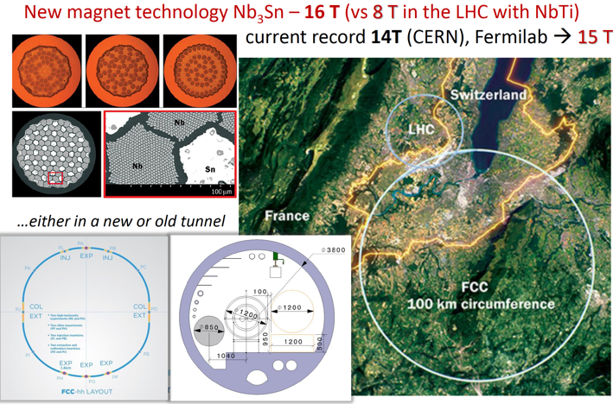
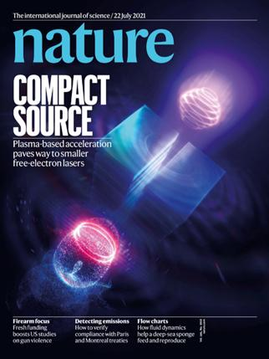
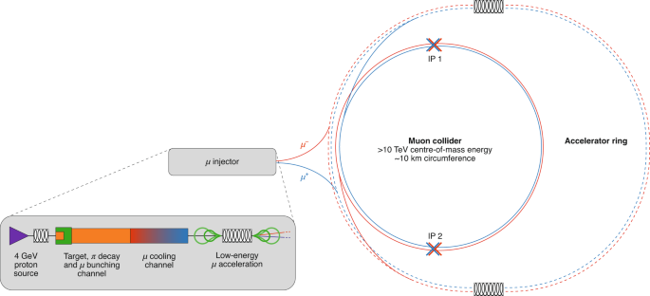
Future Muon, Wakefield and hh Colliders
Wakefield
Muon Collider
FCC-hh
16

Slide 17
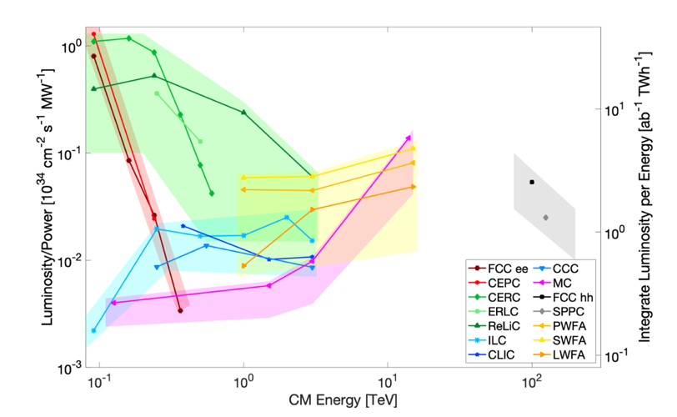
Landscape of High Energy Colliders
Snowmass Implementation Task Force comparisons of machine concepts
Future studies focusing on physics potential for operation AND construction
https://arxiv.org/pdf/2208.06030.pdf

Slide 18

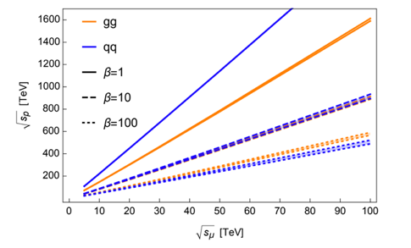
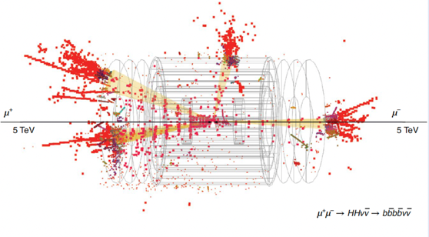
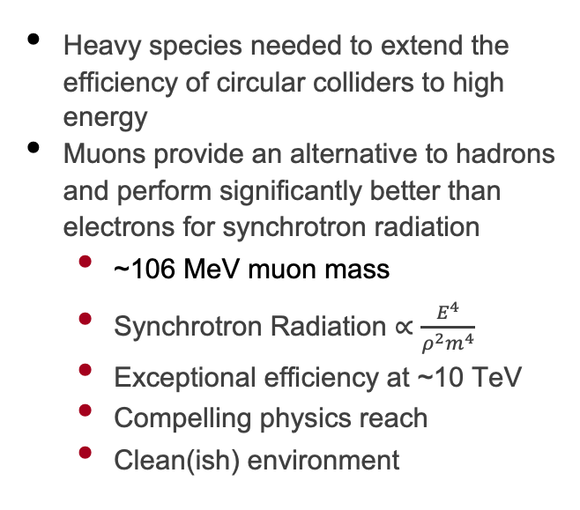
Pushing the Limits of the Energy Frontier
Sustainability Plays an Increasing Critical Role as CoM Approaches and Exceeds 10 TeV
Heavy species needed to extend the efficiency of circular colliders to high energy
Muons provide an alternative to hadrons and perform significantly better than electrons for synchrotron radiation
  ~106 MeV muon mass
  Synchrotron Radiation $∝\frac{E^{4}}{ρ^{2}m^{4}}$
  Exceptional efficiency at ~10 TeV
  Compelling physics reach
  Clean(ish) environment
Meade, P5 Town Hall
https://arxiv.org/pdf/2209.01318.pdf
Nature Physics | VOL 17 | March 2021 | 289–292
https://indico.bnl.gov/event/18372/contributions/75211/attachments/47021/79728/P5HighEnergy.pdf

Slide 19
Outline
Major Systems and Components of Accelerator Facilities
  Particle Sources
  Energy Gain
  Steering
Colliders of Tomorrow
  Linear
  Circular

Slide 20
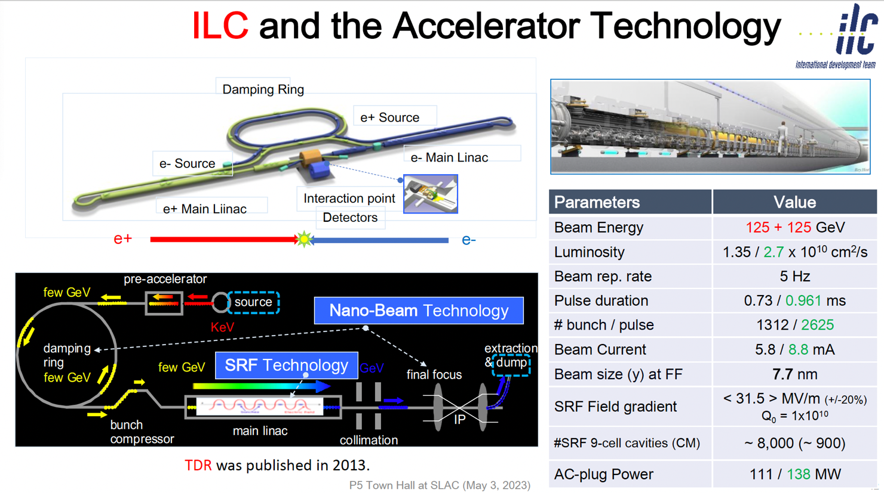
International Linear Collider
~20 km

Slide 21
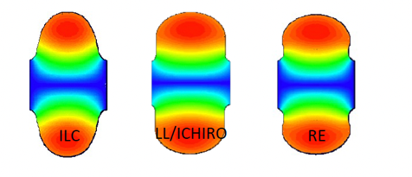
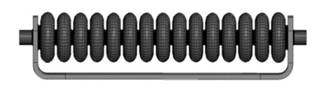
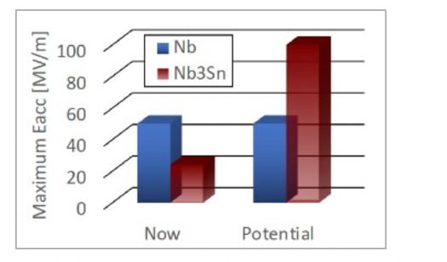
SRF technology for ILC-250 beyond present limits
Advanced shape standing wave SRF cavities – Low Loss (LL), ICHIRO,
Reentrant (RE) – increase peak quench magnetic field by 10-20%, potentially bringing accelerating gradient limit to ≲ 60 MV/m
Traveling wave (TW) SRF offers better cryogenic efficiency and higher accelerating gradient up to ~ 70 MV/m – possible application: ILC energy upgrade, HELEN collider, ACE at Fermilab
Advanced SRF materials – Nb3Sn cavities can potentially reach ~ 90 MV/m

Slide 22
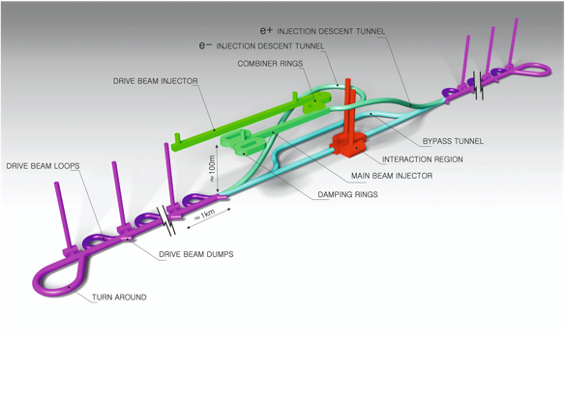
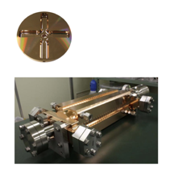
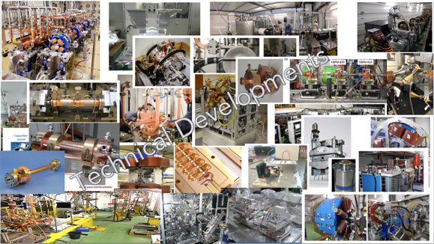
The Compact Linear Collider (CLIC)
  Timeline: Electron-positron linear collider at CERN for the era beyond HL-LHC
  Compact: Novel and unique two-beam accelerating technique with high-gradient room temperature RF cavities (~20’500 structures at 380 GeV), ~11km in its initial phase
  Expandable: Staged programme with collision energies from 380 GeV (Higgs/top) up to 3 TeV (Energy Frontier)
  CDR in 2012 with focus on 3 TeV. Updated project overview documents in 2018 (Project Implementation Plan) with focus 380 GeV for Higgs and top.
  Recent talks (with more references): eeFACT1 and eeFACT2
Accelerating structure prototype for CLIC: 12 GHz (L~25 cm)
The CLIC accelerator studies are mature:
Optimised design for cost and power
Many tests in CTF3, FELs, light-sources and test-stands
Technical developments of “all” key elements

Slide 23
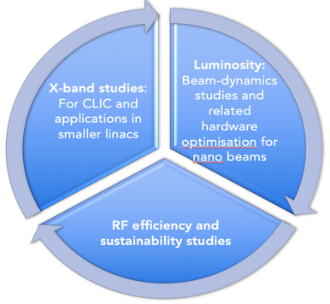
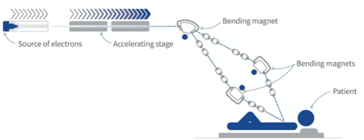
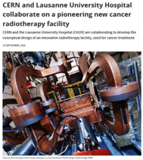
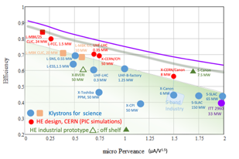
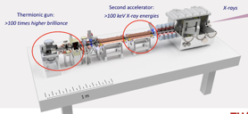
On-going CLIC studies towards next ESPP update
Project Readiness Report as a step toward a TDR
Assuming ESPP in ~ 2026, Project Approval ~ 2028, Project (tunnel) construction can start in ~ 2030.
Optimizing the luminosity at 380 GeV – already implemented for Snowmass paper, further work to provide margins will continue.
      Luminosity margins and increases:
    Initial estimates of static and dynamic degradations from damping ring to IP gave: 1.5 x 10³⁴ cm⁻² s⁻¹
    Simulations taking into accord static and dynamic effects with corrective algorithms give 2.8 on average, and 90% of the machines above 2.3 x 10³⁴ cm⁻² s⁻¹ (this is the value currently used)
The X-band technology readiness for the 380 GeV CLIC initial phase - more and more driven by use in small compact accelerators
Improving the power efficiency for both the initial phase and at high energies, including more general sustainability studies
Power estimate bottom up (concentrating on 380 GeV systems)
Very large reductions since the CDR, better estimates of nominal settings, much more optimised drive-beam complex and more efficient klystrons, injectors more optimized, main target damping ring RF significantly reduced, recent L-band klystron studies
Energy consumption ~0.6 TWh yearly, CERN is currently (when running) at 1.2 TWh (~90% in accelerators
Notes:
LAST CLIC SLIDE
Connection to C3
Emittance, Stability, Injector, Compact, High Gradient

Slide 24

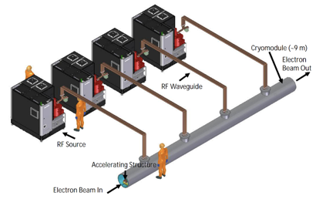
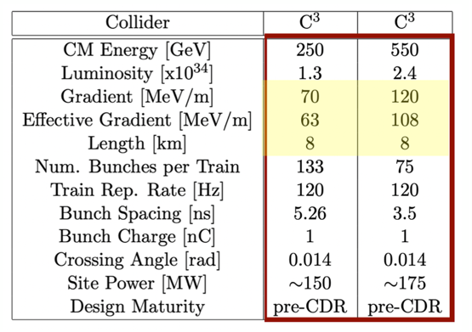
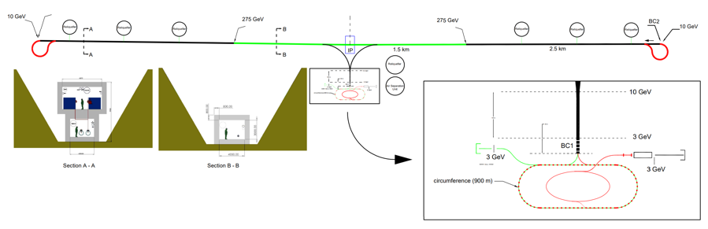
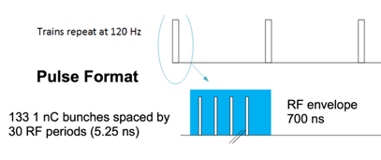
Accelerator Complex
8 km footprint for 250/550 GeV CoM ⟹ 70/120 MeV/m
Large portions of accelerator complex compatible between LC technologies
Beam delivery / IP modified from ILC (1.5 km for 550 GeV CoM), compatible w/ ILC-like detector
Damping rings and injectors to be optimized with CLIC as baseline
C³ Main Linac Cryomodule
9 m (600 MeV/ 1 GeV)
C³ Parameters
C³ - 8 km Footprint for 250/550 GeV (to scale)
Snowmass

Slide 25

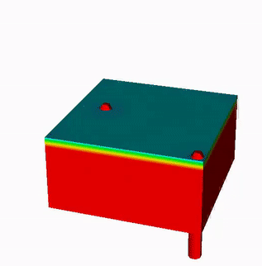
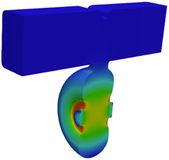










Alignment and Vibrations
Two-Phase Fluid Simulations
System level optimization essential for achieving performance
RF Structure Optimization
Vibration Measurements and Analysis
3.55 mm iris radius
2.0=E_{max}/E_{acc}
1.23=H_{coup}/H_{wall}
K. Shoele
Electric Field
Precision Short and Long Range Alignment
Magnetic Field
Z. George, V. Borzenets, A. Dhar, D. Palmer
H. Van Der Graaf
M. Shumail, Z. Li
Main Linac Beam Dynamics
Alignment Parameters | Units | Value
Raft Components | μm | 5
Short Range (~10m) | μm | 30
Long Range (>200m) | μm | 1000
Structure Vert. Vibration | μm | 9
Quad Vert. Vibration | nm | 15
BPM Resolution | μm | 0.1
BPM-Quad Alignment | μm | 2
100 nm resolution
Approved effort to test cold
White (C³), Schulte (CLIC)
https://arxiv.org/pdf/2307.07981.pdf

Slide 26
Outline
Major Systems and Components of Accelerator Facilities
  Particle Sources
  Energy Gain
  Steering
Colliders of Tomorrow
  Linear
  Circular

Slide 27





FCC integrated program
comprehensive long-term program maximizing physics opportunities
stage 1: FCC-ee (Z, W, H, $\text{t}\overline{\text{t}}$) as Higgs factory, electroweak & top factory at highest luminosities
stage 2: FCC-hh (~100 TeV) as natural continuation at energy frontier, w pp & AA collisions; also eh option
highly synergetic and complementary programme boosting the physics reach of both colliders (e.g. model-independent measurements of the Higgs couplings at FCC-hh thanks to input from FCC-ee; and FCC-hh as “energy upgrade” of FCC-ee)
common civil engineering and technical infrastructures, building on and reusing CERN’s existing infrastructure
FCC integrated project allows the start of a new, major facility at CERN within a few years of the end of HL-LHC
FCC-ee
FCC-hh
2020 - 2040
2045 - 2060
2070 - 2095
a similar two-stage project CEPC/SPPC is under study in China

Slide 28










FCC-ee accelerator R&D - examples
efficient RF power sources
(400 & 800 MHz)
efficient SC cavities
Slotted Waveguide Elliptical cavity (SWELL) for high beam current & for high gradient, seamless by nature – links to past work at ANL (Liu & Nassiri, PRAB 13, 012001)
I. Syratchev
400 MHz 1- & 2-cell Nb/Cu, 4.5 K
high efficiency klystrons
& scalable solid-state amplifiers
FPC & HOM coupler, cryomodule,
thin-film coatings
I. Syratchev
under study: CCT HTS quad’s & sext’s for arcs
reduce energy consumption by O(50 MW)
energy efficient twin aperture arc dipoles
M. Koratzinos,
B. Auchmann
A. Milanese

Slide 29





Stage 2: FCC-hh: highest collision energies
$\sim$order of magnitude performance increase in both energy & luminosity wrt LHC
$\sim$100 TeV cm collision energy (vs 14 TeV for LHC)
20 ab⁻¹ per experiment over 25 years of operation (vs 3 ab⁻¹ for LHC)
similar performance increase as from Tevatron to LHC
key technology: high-field magnets
from
LHC technology
8.3 T NbTi dipole
via
HL-LHC technology
12 T Nb₃Sn quadrupole
FNAL dipole demonstrator
4-layer cosϑ
14.5 T Nb₃Sn in 2019
HTS technology
Hybrid Nb-Ti/HTS
A. Zlobin

Slide 30

Muon Collider Concept
Leading concept for Muon Collider is a proton driven target for muon production followed by 6D cooling to reduce the beam emittance
Alternative concept – positron driven muon production
ArXiv: 1808.01858
Challenges:
  Muon cooling for proton driven source
  High flux positron source

Slide 31

Muon Cooling

Slide 32



Target Parameters for Muon Collider from Snowmass 2021
Accelerator R&D areas:
  High power proton driver
  Short lifetime of muons in injector (~microsec)
  Cooling to reduce emittance
  Injection and acceleration
  Mitigating radiation
arXiv:2203.08033
Notes:
https://arxiv.org/pdf/2203.08033.pdf

Slide 33





Wakefield Accelerator Technologies
Structure Wakefield Accelerators @
Argonne, SLAC, and LBNL are the stewards of SWFA, PWFA, and LWFA technology in the US, with university participation.
Beam Driven Plasma @
Laser Driven Plasma @
Key advantages:
Ultra-large gradients (1-100 GeV/m)
Ultra-short bunches (suppress beamstrahlung)
Notes:
Show capillary

Slide 34
Conclusions
Accelerators are powerful tools for scientific discovery
A great variety of parameters are achievable – species, power, wavelength, repetition rate
Technology is evolving rapidly to enable new capabilities
Ultimately accelerator technology will set the limits of collider performance
Exciting time with great options for the community
Questions?

Slide 35
Acknowledgements & References
Eric Prebys & Vladimir Shiltsev CMS Data School Talks from 2022/2020
Michael Fazio
US Particle Accelerator School
  https://uspas.fnal.gov/index.shtml
  https://people.nscl.msu.edu/~lund/uspas/ap_2021/
  https://sites.google.com/view/uspas-2020-winter-fundamentals/course-syllabus
Alesini, David. "Linear Accelerator Technology." CERN Yellow Reports: School Proceedings 1 (2018): 79-79.
Kain arXiv:1608.02449v1 Beam Dynamics and Beam Losses – Circular Machines
P5 Proponents for Colliders – SLAC Town Hall
Many more references on slides and in speaker notes

Slide 36


Particle (Electron) Sources
Electrons emitted by providing enough free energy to overcome binding energy
Thermionic, field and/or photo emission
Need electric fields to accelerate particles away from the surface
DC Gun
RF Gun

Slide 37

Particle (Ion) Sources
Ionize gas and accelerate
Set desired ionization by stripping or adding electrons
Select ionization with magnets
Schematic of CERN’s LINAC4 source

Slide 38




Real Particle Sources
RF Electron Gun
CERN Hydrogen Ion Source
DC Electron Gun
Emitter heated to 1000 ºC
Notes:
http://lhc-closer.es/taking_a_closer_look_at_lhc/0.linac4/idioma/en_GB
The process is as follows: the ion source is fed with hydrogen gas. A discharge plasma is formed and a strong electric field strips away an electron from each hydogen atom, producing H⁺.
The positively charged protons (H⁺) from the plasma are attracted towards a cathode surface (metal surface with Caesium). The deposition of Caesium reduces the work function of the cathode, making it a more efficient donor of electrons to the positively charged hydrogen ions, thus enhancing H⁻ ion production
Because of its negative charge, the H⁻ ion will move away from the negative surface.
The H⁻ ions are extracted from the ion source in 400 μs long pulses to form a beam which is then passed through a small magnet to remove any free electrons.
The H⁻ ions leave the ion source with an energy of 45 keV and across 86 m line (Radio Frequency Quadrupole, Chopper line, an Alvarez Drift Tube Linac (DTL), a Cell-Coupled Drift Tube Linac (CCDTL) and a Pi-mode structure (PIMS), will be finally adquiring 160 MeV.

Slide 39

RF Linear Accelerator Increases Beam Energy
Electromagnetic wave accelerates particles to higher energy
Linear accelerator is common for injection into a circular machine
Higher beam quality; used to bunch, focus and compress beam
Electrons at APS

Slide 40

Fabrication of RF Accelerators
(a) OFHC forged copper; (b) realization of cells
by lathes; (c) single cells machined and ready to be stacked; (d) cells piled up before brazing; (e) the structure in a vacuum or hydrogen furnace; (f) the brazed structure.

Slide 41



Axial Electric Field Increases Kinetic Energy

Slide 42


Circuit Model for Powering Accelerators
High quality factor increases energy gain for fixed power

Slide 43


RF Cavities in Linac4
Linac4 Drift Tube Linac
Linac4 Radio Frequency Quadrupole

Slide 44


Superconducting Magnets
Dipole Field Produced by SC Tape
Notes:
https://indico.cern.ch/event/55044/attachments/979806/1392579/LHC_lumUP_Magnets_Rossi.pdf

Slide 45






The Next Steps: Staging
A proof-of-principle demonstration of staging was performed at LBNL in 2016.
BELLA is well-positioned to demonstrate GeV-scale staging with the existing facility.
100 MeV-scale of LWFA Accelerators
S. Steinke et al. Nature (2016)
GeV-scale staging schematic
AWA plans a 0.5-GeV demo followed by a 3-GeV fully-featured module.
Ask to P5: Upgrade AWA facility for 0.5 GeV demonstrator.
SWFA Staging Experiment
C. Jing et al NIM A (2018)
SWFA 0.5 GeV Staging Demo
C. Jing and G. Ha, JINST (2022)
FACET-II can study beam transport in and out of a single stage.
Future Request: Facility for demonstrating two or more PWFA stages.
Note to P5: PWFA Staging experiment may be possible at C³ Demo facility.
Beam matching with plasma ramps
R. Ariniello et al. PRAB (2019)
Laser-gated multistage plasma accelerator
A. Knetsch et al. arXiv:2210.02263
45
Notes:
Staging is one thing that highlights difference in tech. stringing structures together is required to reach high energies

Slide 46











FCC-ee SRF system
Z
low R/Q, HOM damping, powered by 1 MW RF coupler and high efficiency klystron
F. Peauger,
O. Brunner
5-cell cavity development (2018), successful collaboration with JLAB
  1-cell
  400 MHz,
  Nb/Cu
W, H
moderate gradient and HOM damping requirements; 500 kW / cavity, allowing reuse of klystrons already installed for Z
  2-cell
  400 MHz,
  Nb/Cu
ttbar,
booster
high RF voltage and limited footprint thanks to multicell cavities and higher RF frequency; 200 kW/ cavity
  5-cell
  800 MHz,
  bulk Nb
F. Marhauser
Promising R&D towards ultra-high Q₀. Collaboration with FNAL
First attempt of HiPIMS* niobium coating on a 400 MHz Cu cavity
*High-power impulse magnetron sputtering

Slide 47

The Next Steps
Challenges
Staging
Repetition Rate
Positron Acc.
Energy Recovery
Beam Delivery Syst.
Laser-Plasma Linear Collider
arXiv 2203.08366
Some of the next steps in the R&D path are achievable at existing facilities, while others are not.
Notes:
Explain layout of accelerator and commenalities

Slide 48







European Efforts
Europe is moving ahead with major Wakefield Accelerator projects, such as AWAKE at CERN, and EuPRAXIA User Facility at INFN, which is on ESFRI Roadmap.
New ideas like Hybrid PWFA Boosted Higgs Factory will be covered in an Integrated Design Study.
Support from P5 is critical for keeping pace with our European Partners!
AWAKE: Proton-driven PWFA for experiment at CERN aims to generate O(100) GeV electrons for Dark Sector searches.
Plasma Collider Boosted Higgs Factory, B. Foster et al. arXiv:2303.10150
EuPRAXIA Plasma Accelerator User Facility at INFN
Notes:
WRE

Slide 49

Electromagnetic Fields Used to Accelerate Particles
Phase of electromagnetic wave needs to be controlled to match the particles velocity
Standing Wave - fields in cavity alternate polarity in cavities and oscillate
Traveling Wave – fields propagate with a phase velocity that matches particle velocity
Standing Wave
Traveling
Wave

