Slide 1
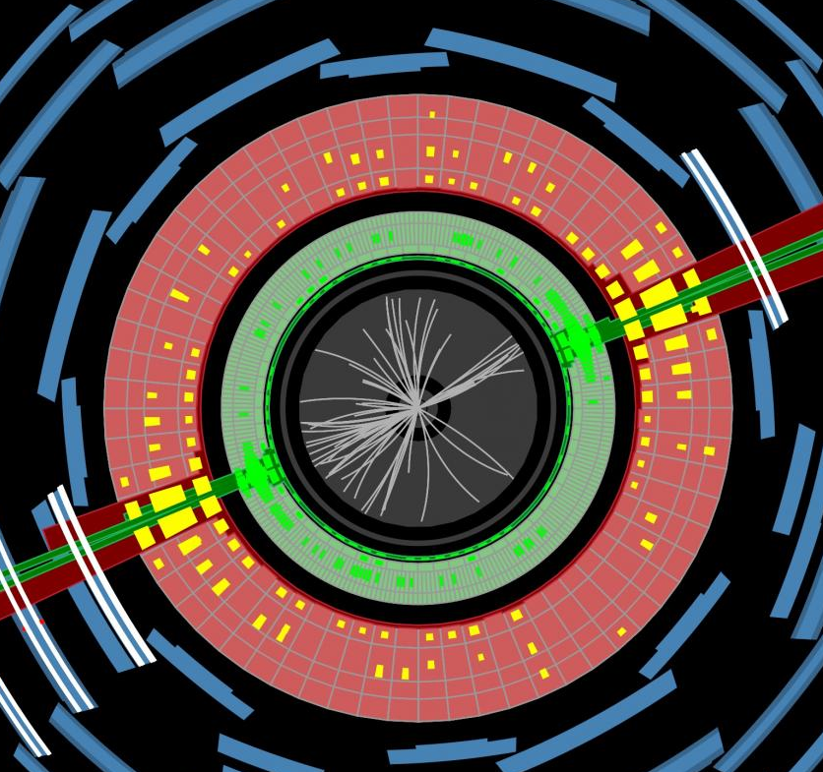

Chacal, Wits, South Africa
22/1/2023
Jon Butterworth, UCL Physics & Astronomy
Reinterpretation of Measurements for BSM
Contur in Action

Slide 2

Off the map…?

Slide 4
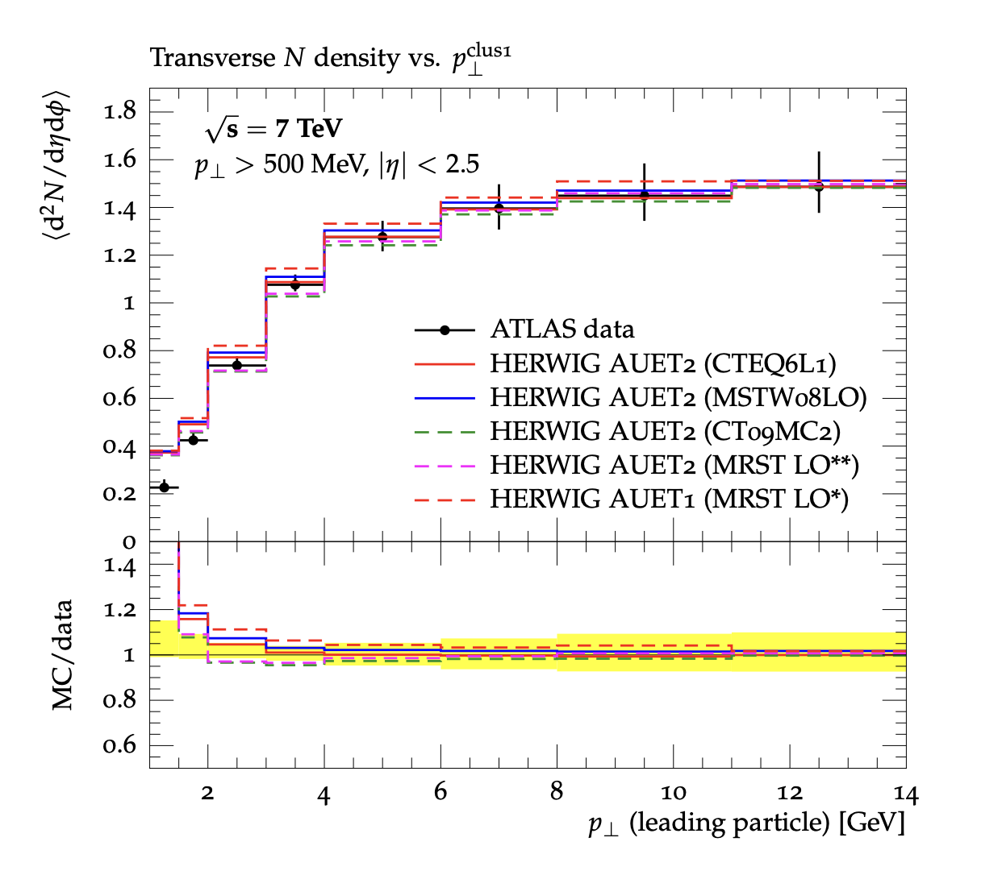
Introducing Rivet
Robust Independent Validation of Experiment and Theory arXiv:1003.0694, arXiv:1912.05451
Direct legacy from HERA (1990s, HZTOOL)
Developed by MCnet for tuning and validation of new MC event generators
  e.g. What does the underlying event look like in 7 TeV pp collisions?
Library of measurements of final state particles produced in collisions, and variables derived from them
Buckley et al, Bierlich et al
From ATL-PHYS-PUB-2011-008

Slide 5
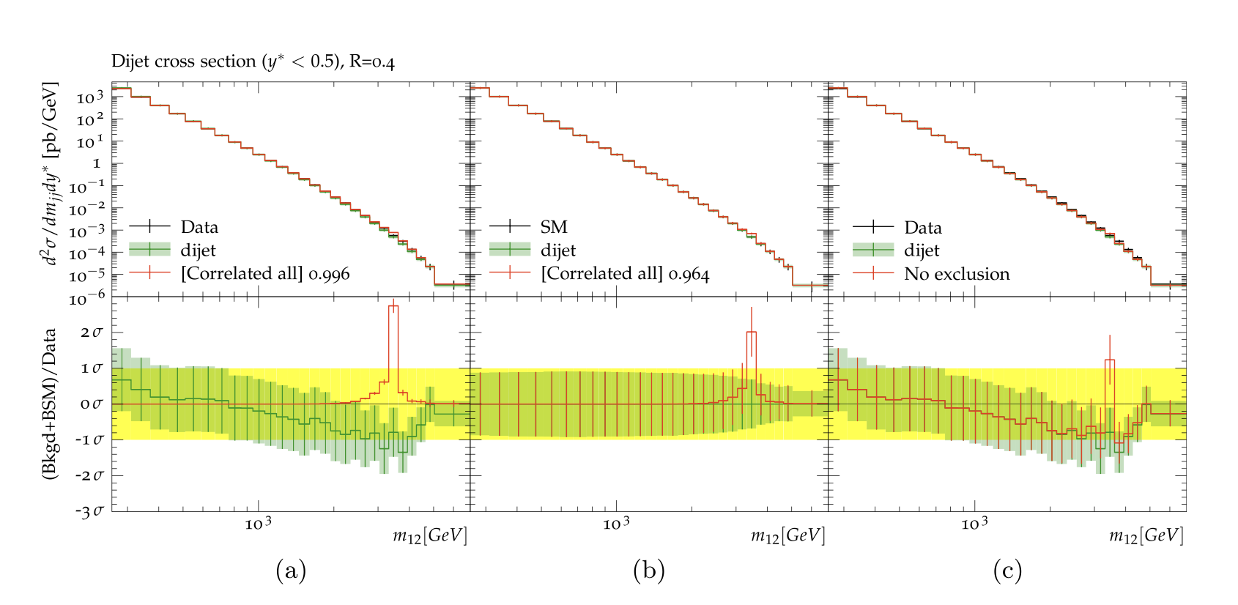
Introducing Contur
Constraints On New Theories Using Rivet arXiv:1605.05296, arXiv:2102.04377
Extend the power of Rivet beyond the Standard Model
Signal-injection of final-state particles from Beyond-the-SM physics events on to the measured cross sections in Rivet
From Altakach, JMB, Ježo, Klasen, Schienbein arXiv:2111.15406
Increasingly precise measurements and calculations together extend the reach
JMB, Grellscheid, Krämer, Sarrazin, Yallup; Buckley et al

Slide 6
Recent Developments
New interface between Rivet+Contur and Madgraph
  Could already drive a MG scan using Contur machinery (as with Herwig)
  Can now access Rivet+Contur from within the MG UI and use MG scanning machinery
Wider selection of SM predictions, move to using these only
  no more assumption that the data ≡ SM.
Use of correlation matrices, more Rivet analyses, other minor improvements (Contur 2.4)
(See Yoran’s talk this afternoon for more.)

Slide 7
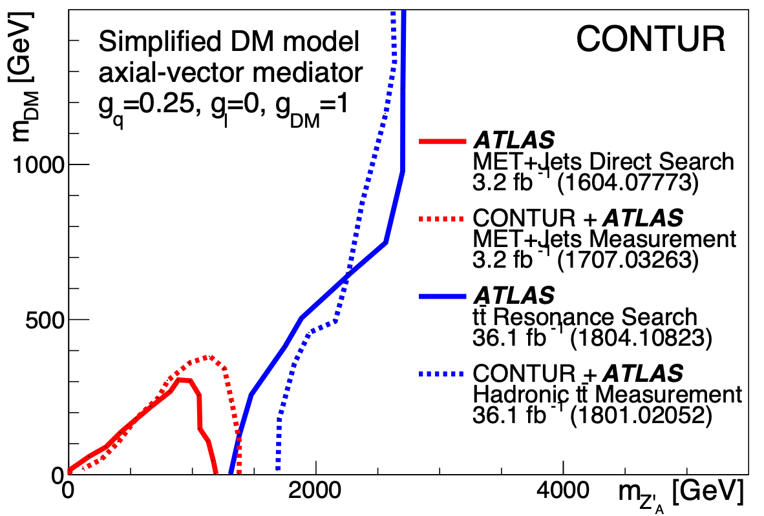
Unleashing the power of high luminosity LHC data
(example case studies)
A heavy scalar triplet and the W mass
Composite Dark Matter
Vector-like Quarks
The future?
Louie Corpe

Slide 8
A Heavy Scalar Triplet and the W mass
Motivation
  The W mass: CDF and custodial symmetry
  The Type II Seesaw model
  Bringing them together
Method
  Rivet, Contur and, the LHC measurement library and SM predictions
Results and conclusions
JMB, Julian Heeck, Sihyun Jeon, Olivier Mattelaer, Richard Ruiz
Phys.Rev.D 107 (2023) 7, 075020
2210.13496 [hep-ph]

Slide 9

Motivation

Slide 10
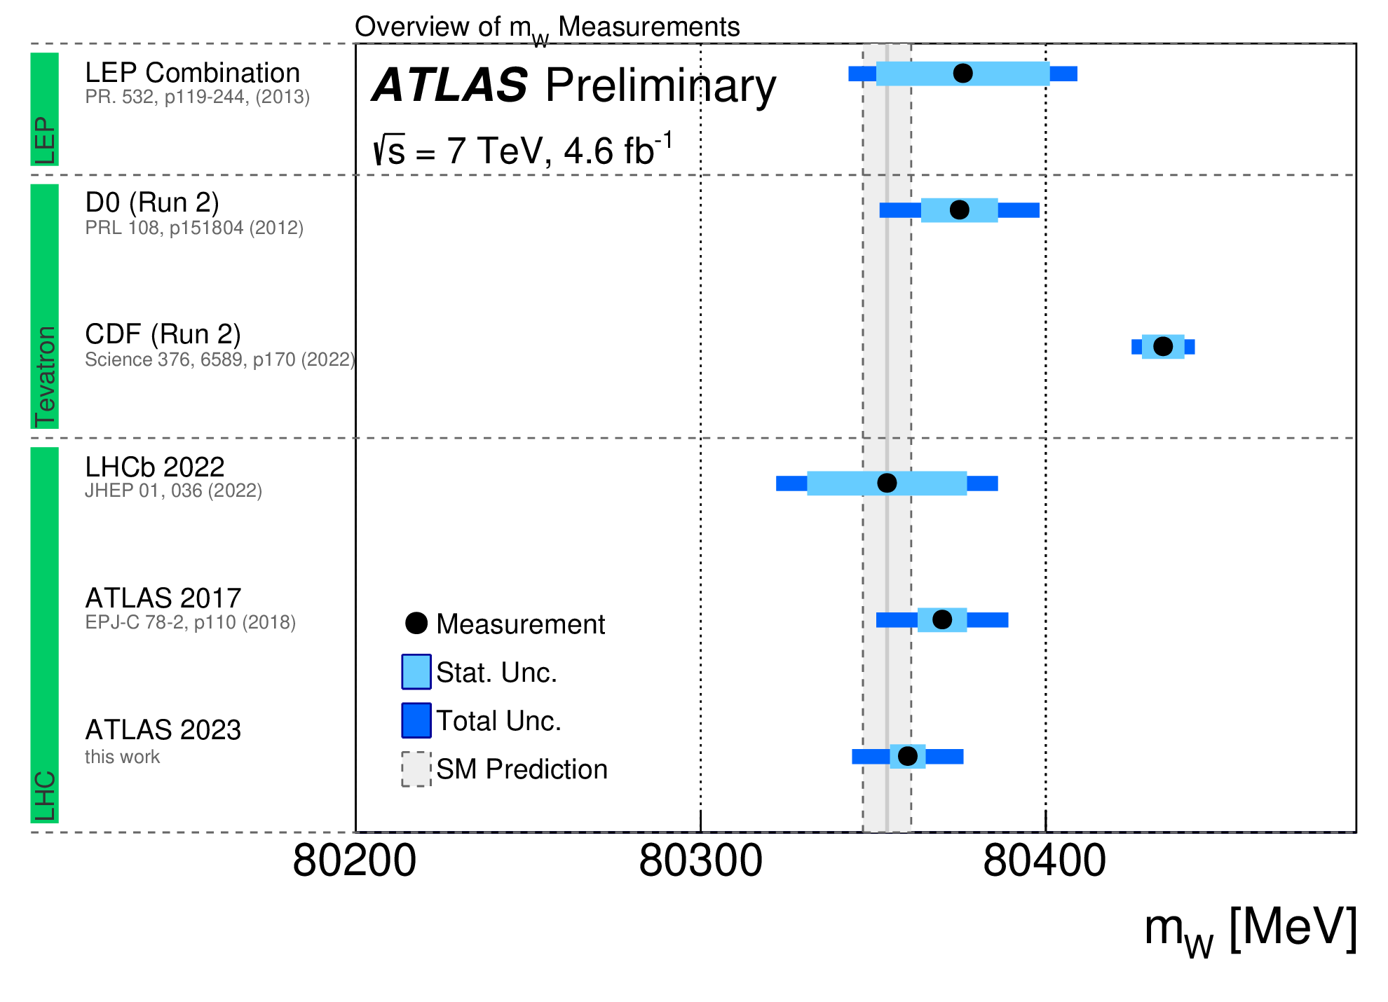
The W mass
ATLAS-CONF-2023-004

Slide 11
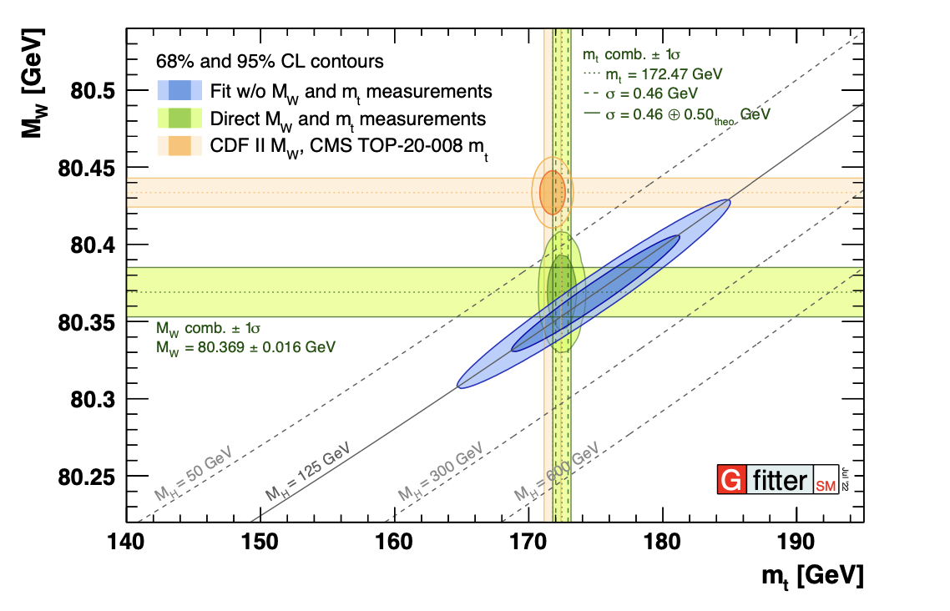
The W mass

Slide 12

Custodial Symmetry
Residual SU(2) symmetry after spontaneous symmetry breaking
  Invariance under rotations among (W¹, W², W³) i.e. M(W^{+/-}) = M(W³)
  After mixing with U(1):
  Obviously must be broken (but only slightly!) if CDF are even approximately right
  Many BSM models build in ρ₀ = 1
  But not all…

Slide 13
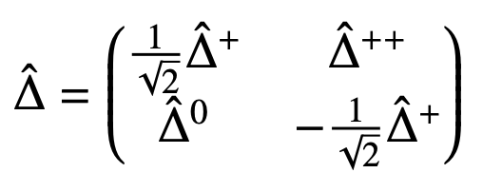
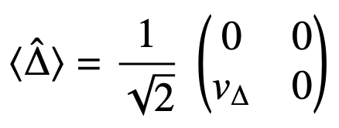
Type II Seesaw Model
Add a complex scalar triplet with a vev to the SM
Introduces Majorana mass terms for neutrinos
Direct connection between neutrino oscillation parameters and Yukawa couplings implies correlations between collider signatures (D decays to leptons) and neutrino sector
Breaks custodial symmetry at tree level… 🙂
… but reduces ρ₀ , and thus M_{W} 😞

Slide 14
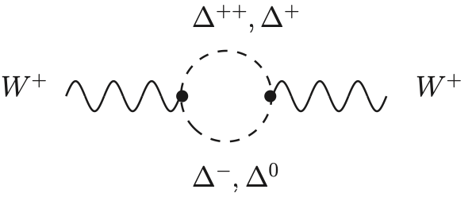
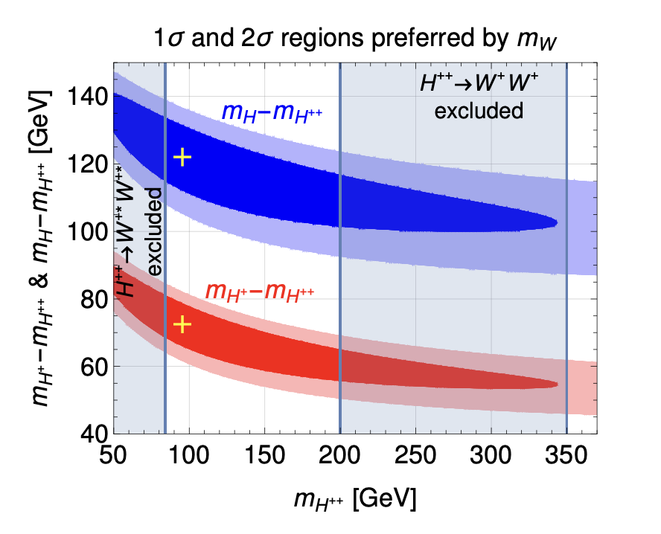
Two problems solved?
Low vev (≲ 1 GeV) means the tree-level effect is small
One-loop contributions can be large and opposite in sign
Low Yukawa couplings/vev evades many searches
  Y << 1, MeV < v∆ < GeV
A CDF-like shift in M_{W} implies upper bounds on mass states
J Heeck, Phys.Rev.D 106 (2022) 1, 015004 2204.10274

Slide 15

Method
The LHC measurement “library”

Slide 16
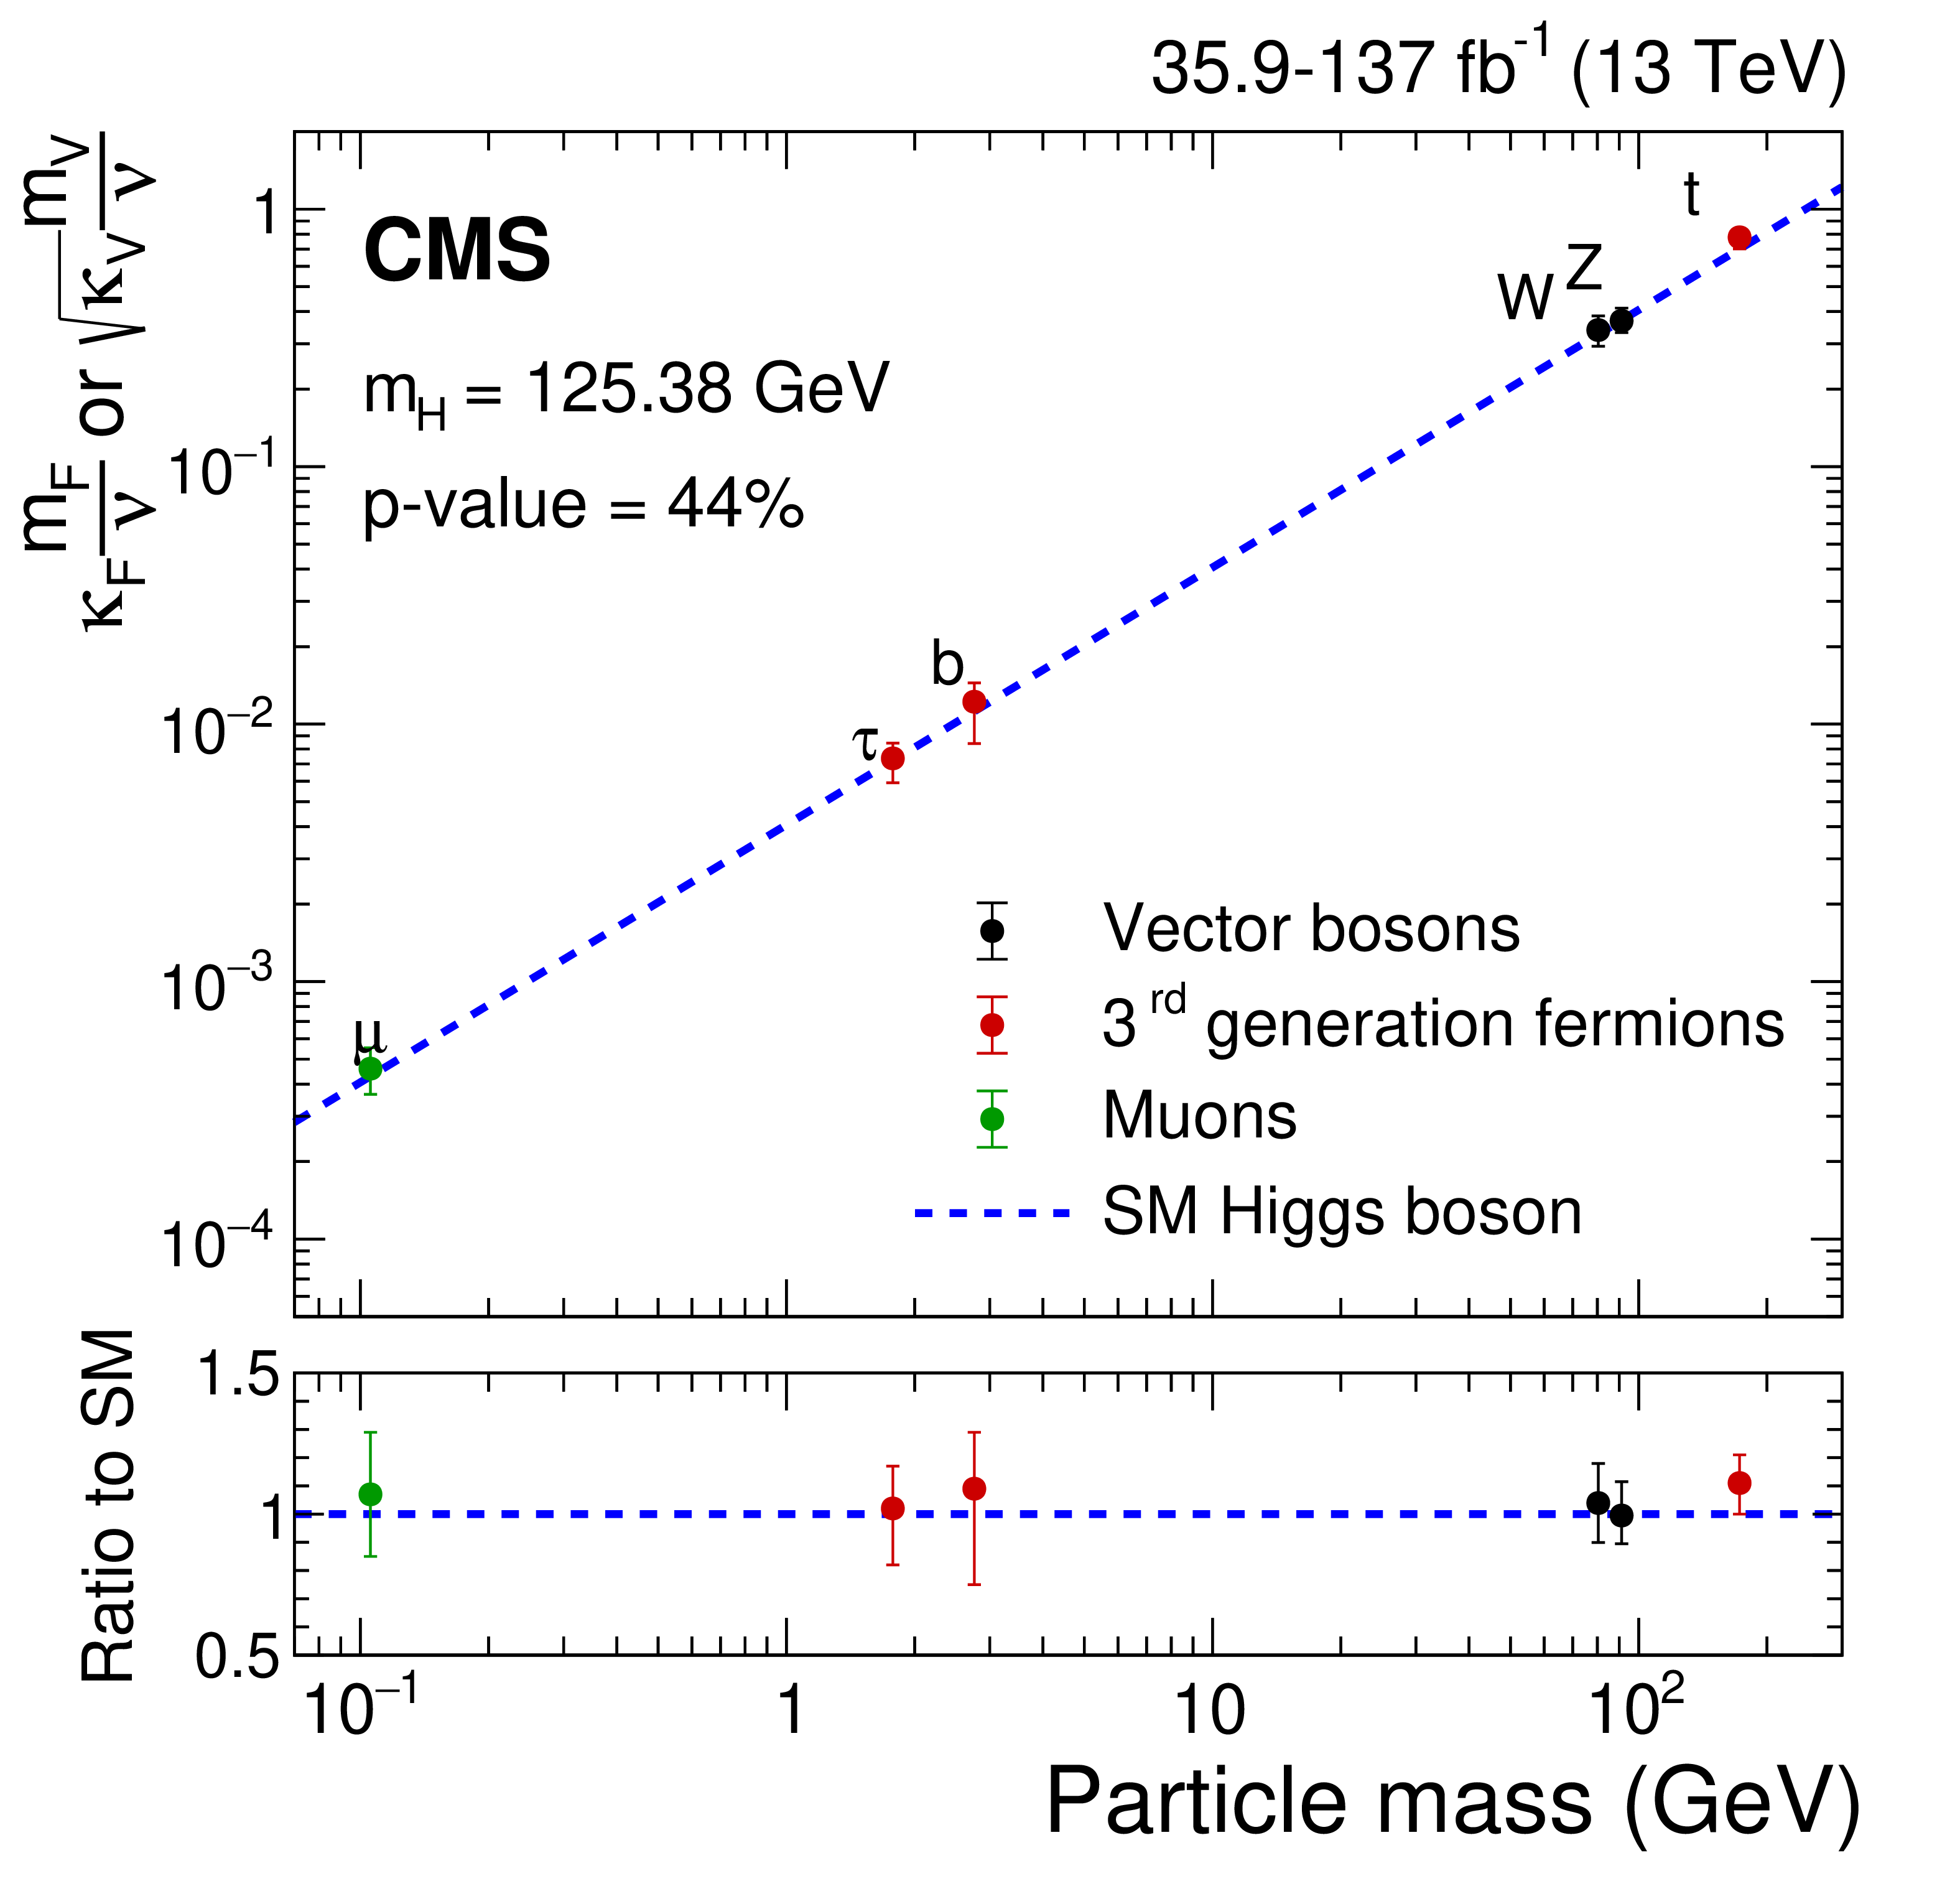
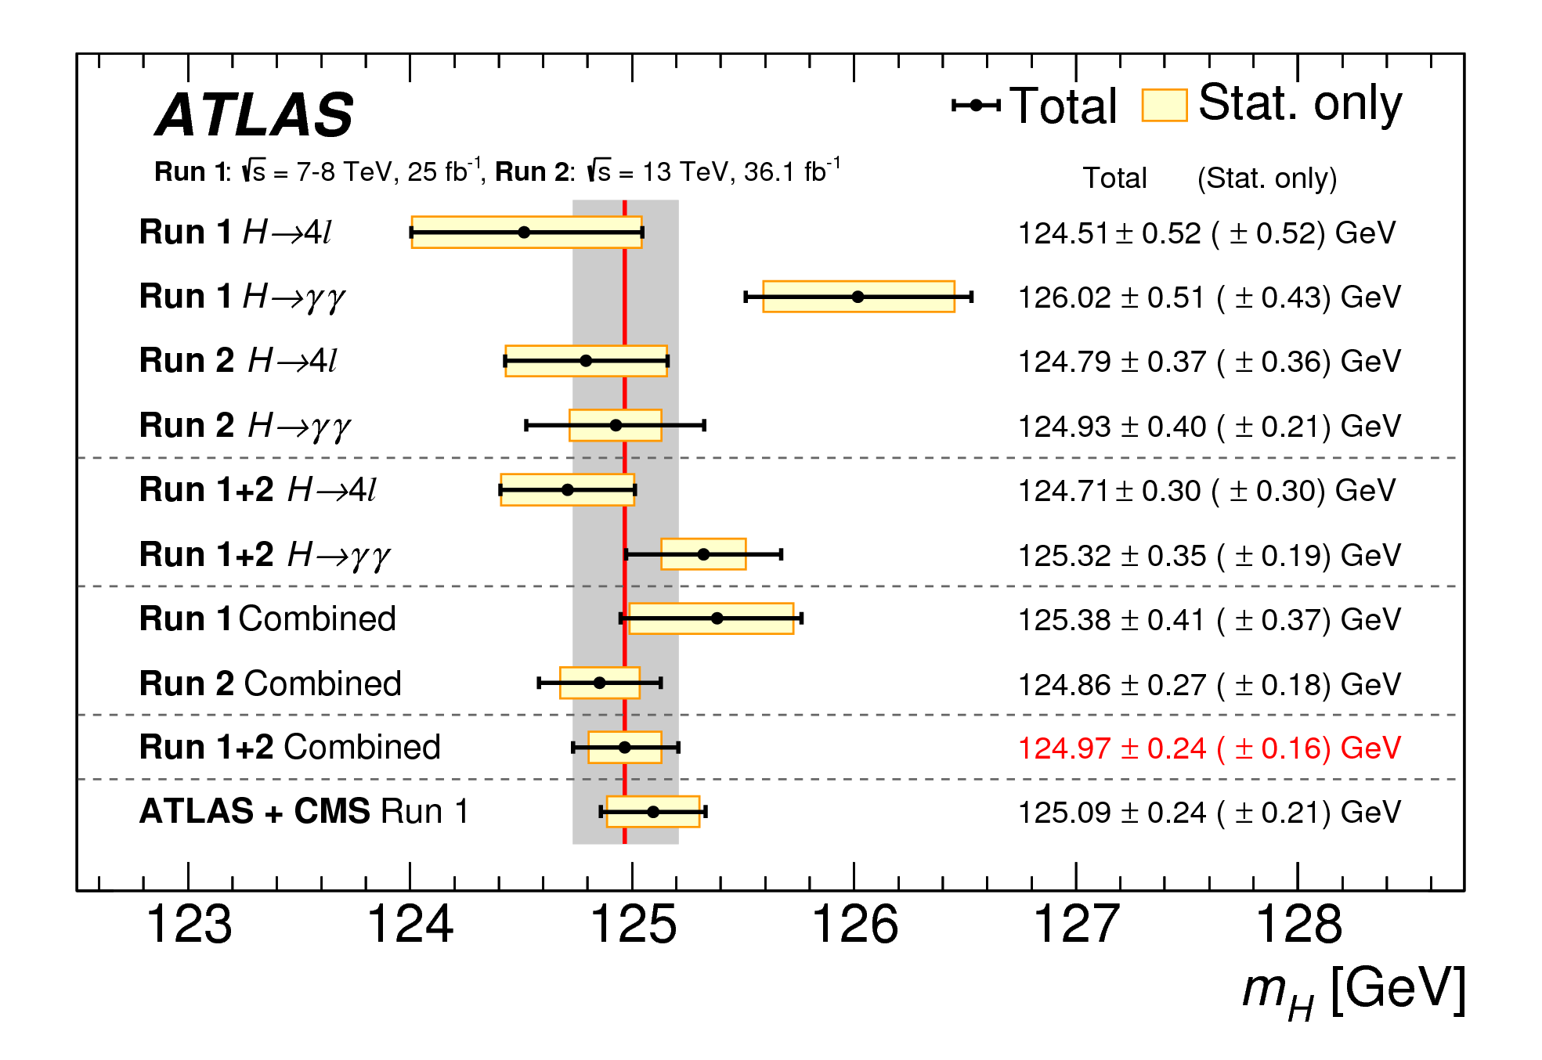

Slide 17
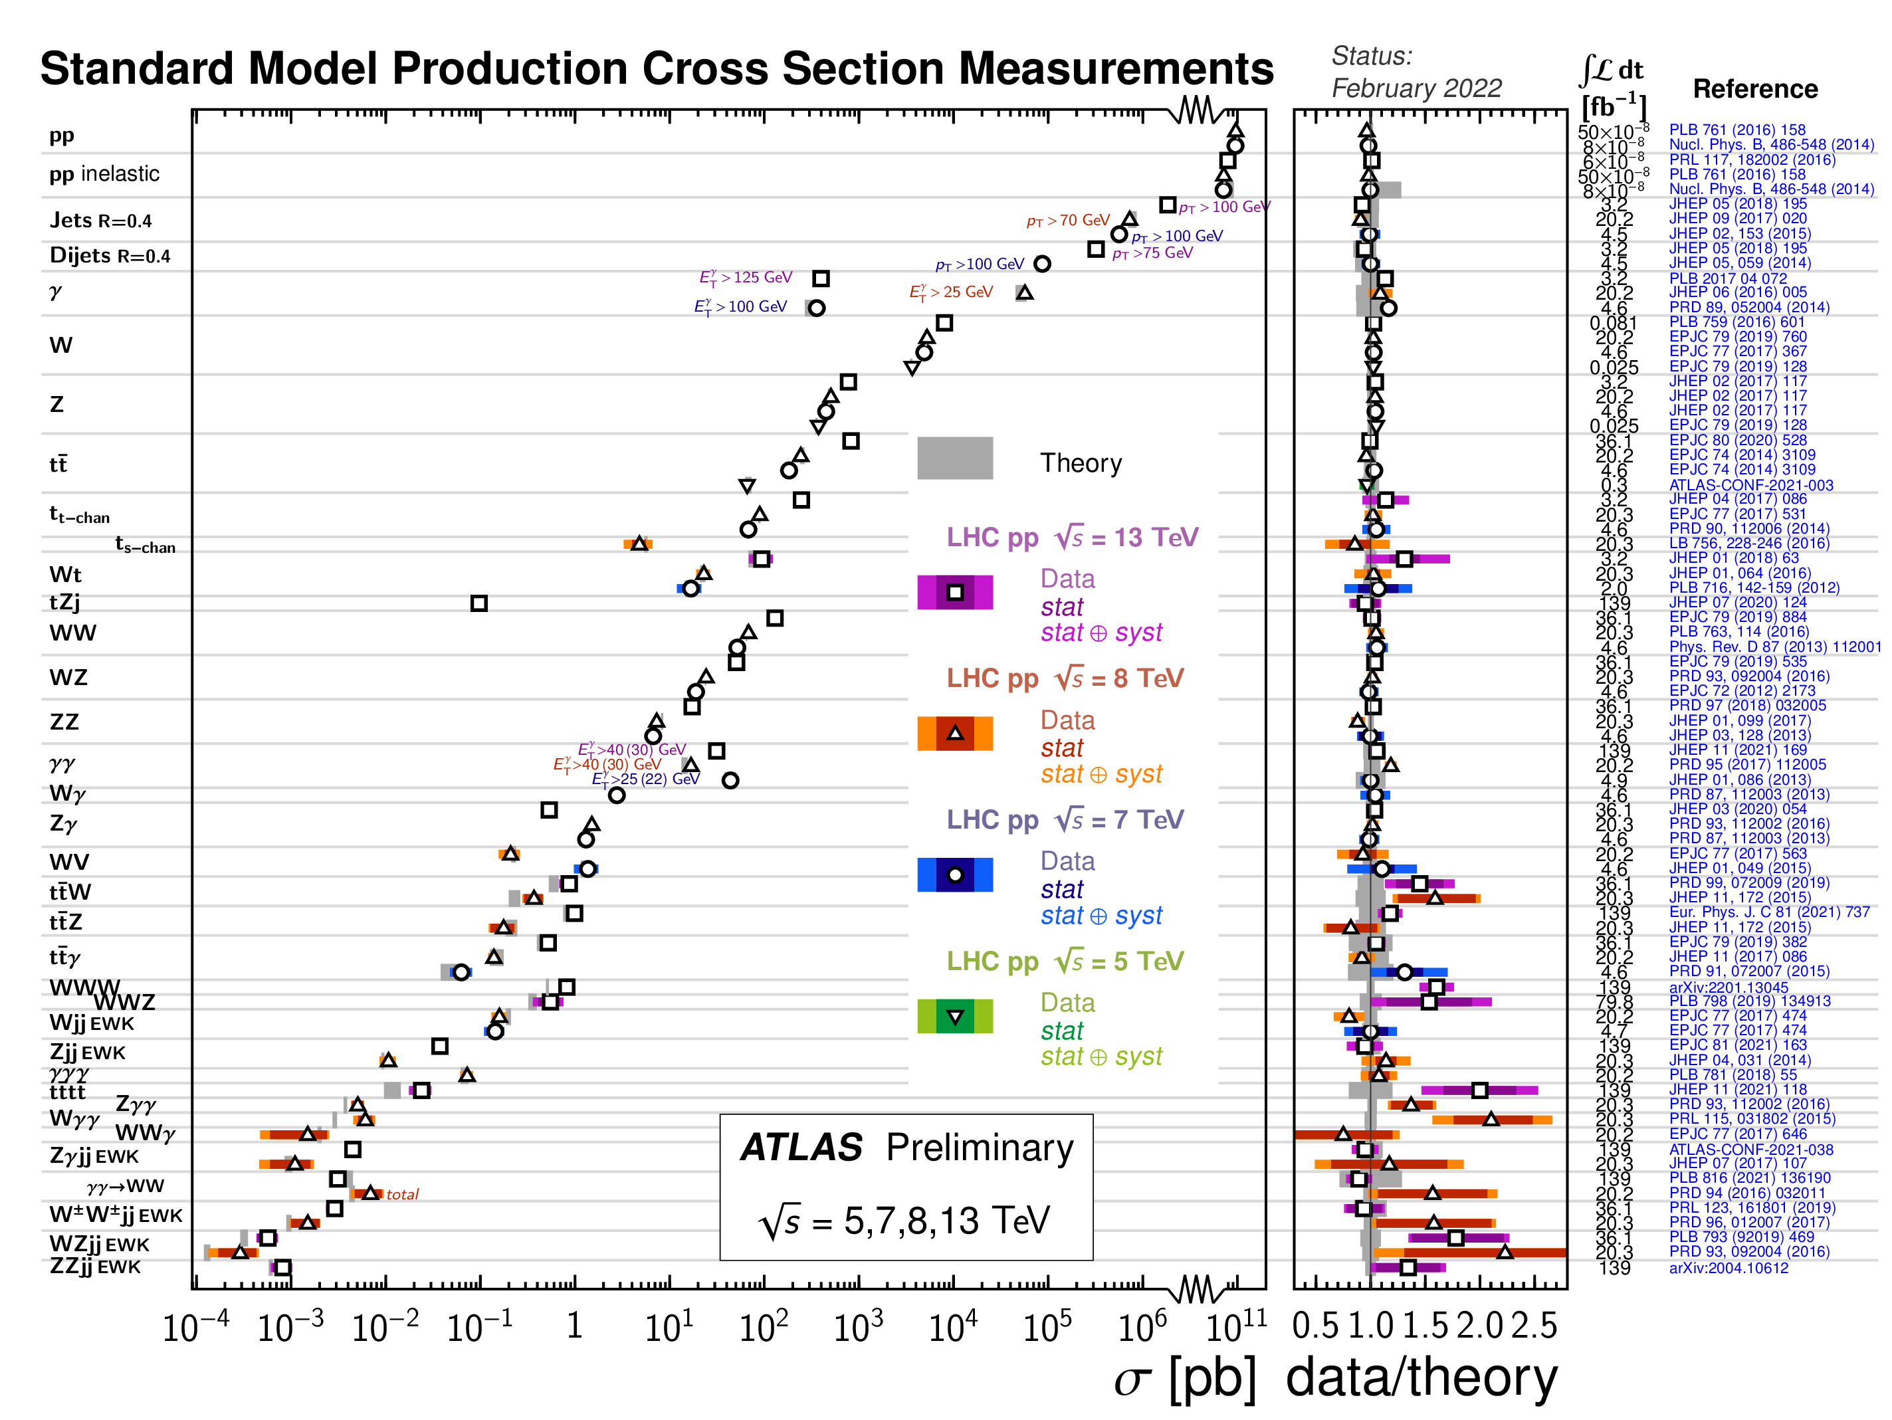

Slide 18
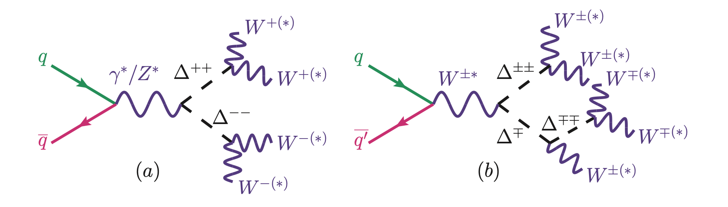
Analysis
Feynrules¹ → UFO → Madgraph → Pythia → Rivet → Contur (over 130 LHC measurement papers)
vev = 1 GeV
  High enough that Δ decays are prompt. At very low values (~0.1 MeV for M_{Δ++} = 200 GeV) may not be true
  Little effect on collider phenomenology otherwise
¹ Pich, Santamaria, Bernabeu, Phys. Lett. B 148 (1984) 229–233.

Slide 19
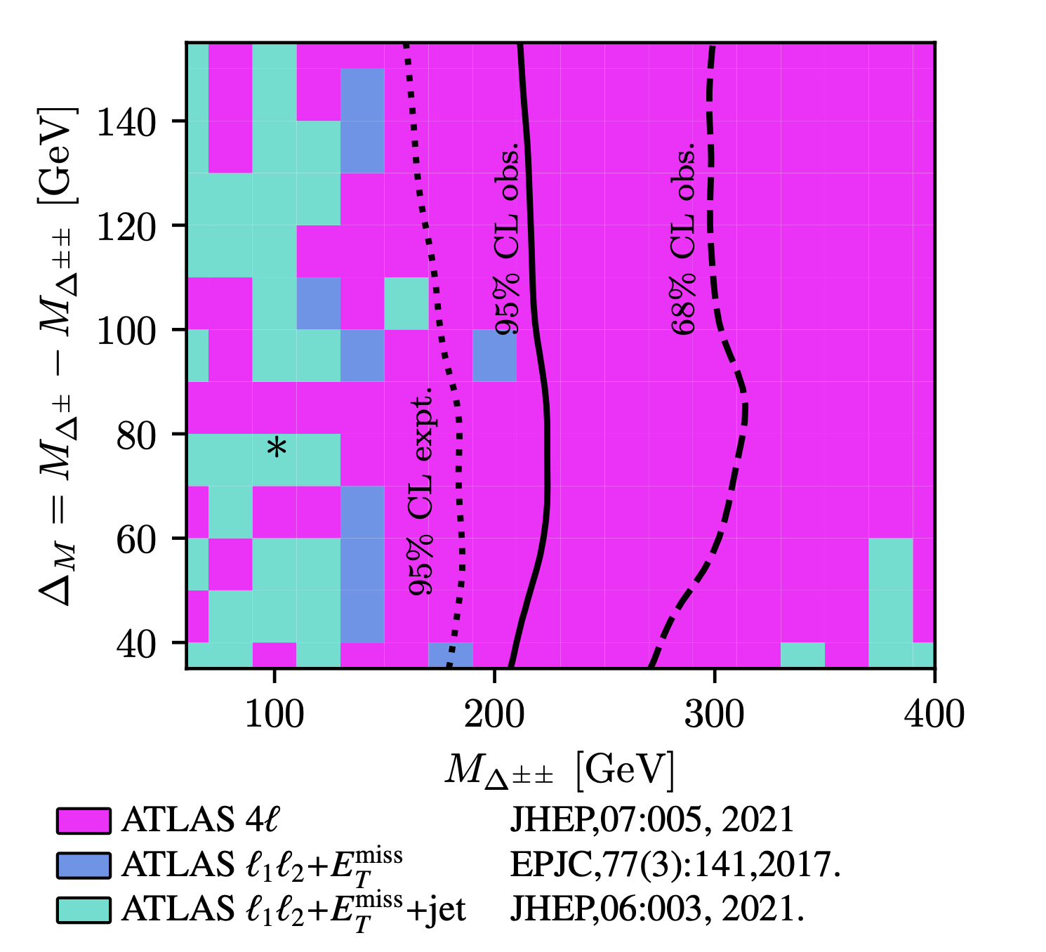
Analysis
The (M∆±±,∆M) parameter space overlaid with the 95% (solid) and 68% (long-dash) exclusion limits as obtained from MGaMC + Contur.
Values to the left of the lines are excluded.
Also shown is the 95% expected exclusion (dotted).
The colour-shading scheme indicates which SM measurement provides the dominant exclusion.
The black asterisk indicates the best fit value from Heeck (2022)
All possible final states were scanned

Slide 20
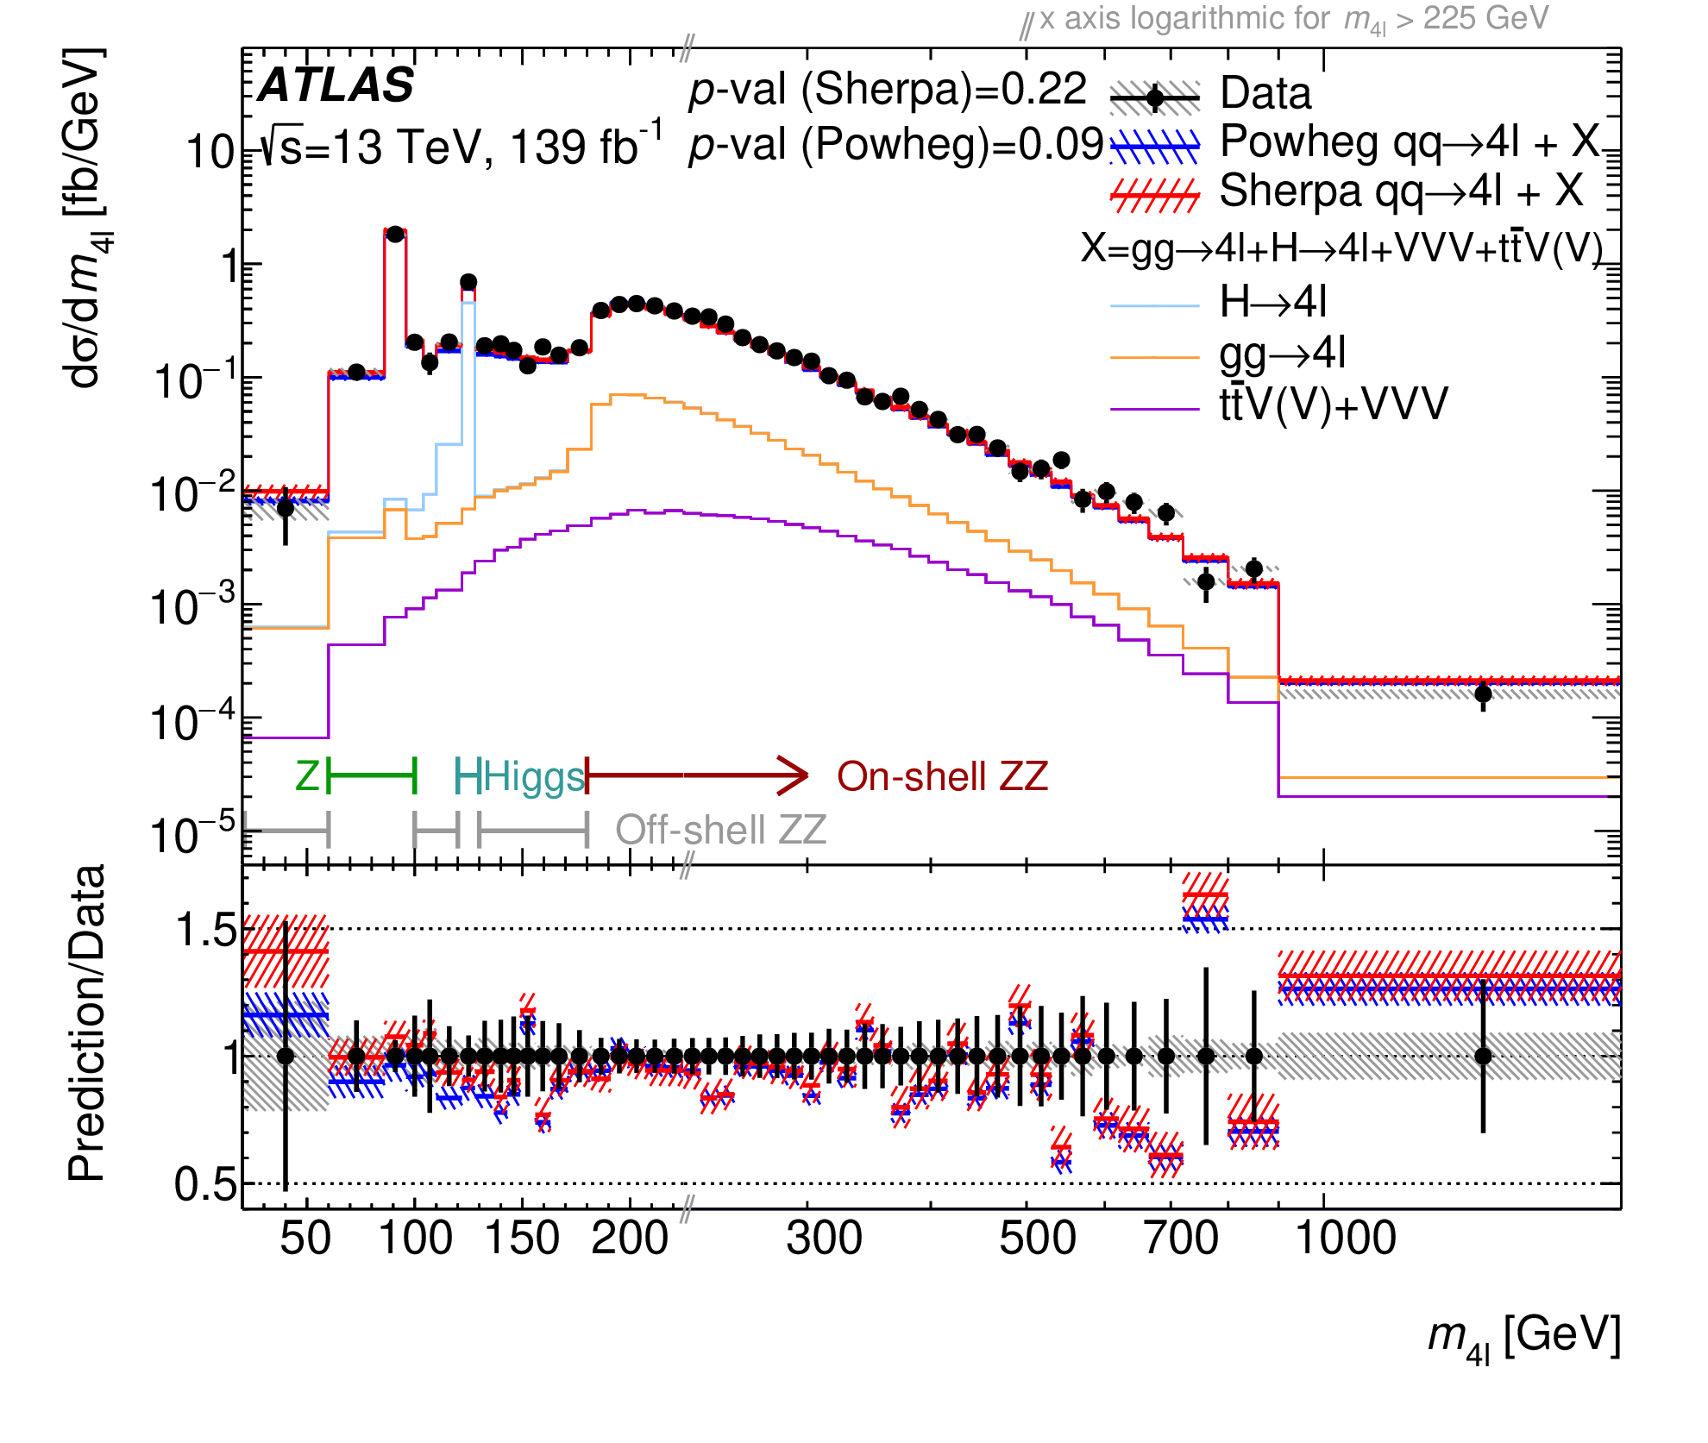
arXiv:2103.01918, JHEP 07 (2021) 005

Slide 21
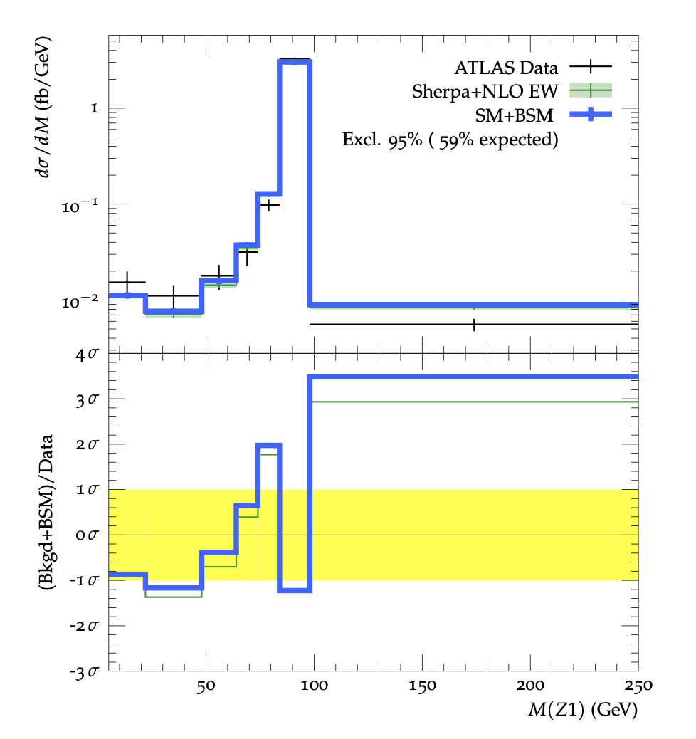
Example of Impact
Upper panel: Representative differential cross section as a function of the highest-mass dilepton pair in 4-lepton measurements used in this study showing:
ATLAS data (crosses) JHEP 07 (2021) 005
Predicted SM yields (green) Sherpa, SciPost Phys. 7 (3) (2019) 034
Predicted SM+BSM yields for (M∆±± , M∆± ) = (180 GeV, 255 GeV) (blue).
Lower panel: bin-by-bin significance of expected theory yields relative to data with combined data and theory uncertainties (band).

Slide 22

Conclusion
Previously “unconstrained” best fit point is actually already excluded by LHC measurements, for promptly-decaying Δ⁺⁺
Still a worth looking for in LLP searches, but not otherwise

Slide 23
Composite Dark Matter Models
What if Dark Matter is a composite particle arising from e.g. an SU(4) symmetry which confines at some scale Λ_{dark}?
Lead to bound states ”dark” mesons and baryons.
  Kribs et al. arXiv:1809.10183
Dark fermions transform under electroweak part of the Standard Model: communication with SM
There are no direct searches for this model by ATLAS or CMS:
instead to constrain this model using the bank of existing LHC measurements using Contur
Dynamics of the theory depend a lot on 𝜂=𝑚(𝜋_{𝐷})/𝑚(𝜌_{𝐷})
JMB, Corpe, Kong, Kulkarni, Thomas. arXiv:2105.08494

Slide 24
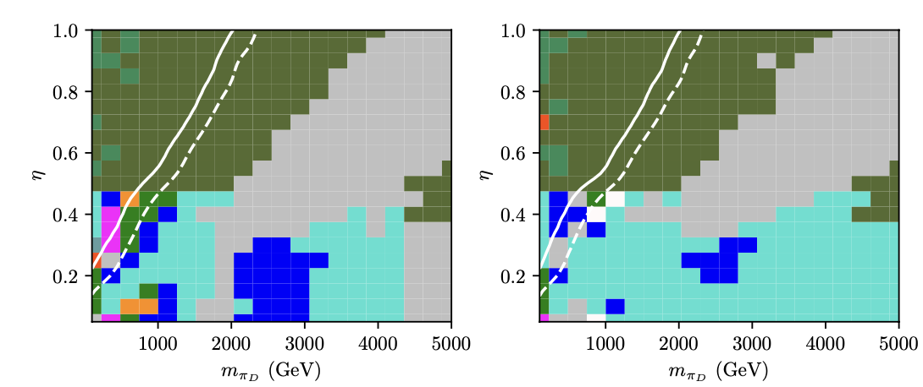
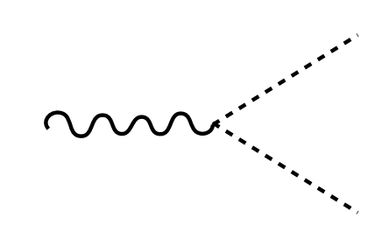
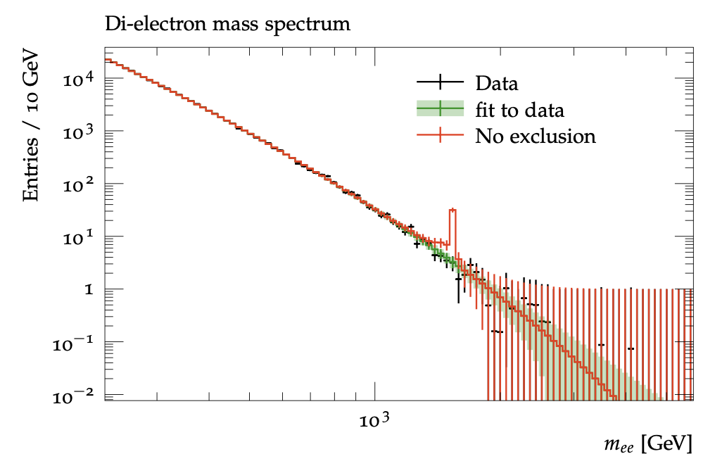
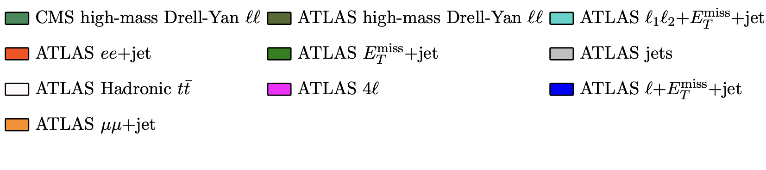





Composite Dark Matter Models
Left-handed model
ρ⁰D, ρ⁺D, ρ⁻D
Right-handed model
ρ⁰D only
$$p$$
$$l^{±}$$
$$ρ_{D}^{0},ρ_{D}^{±}$$
$$p$$
$$l^{±}$$
JMB, Corpe, Kong, Kulkarni, Thomas. arXiv:2105.08494

Slide 25
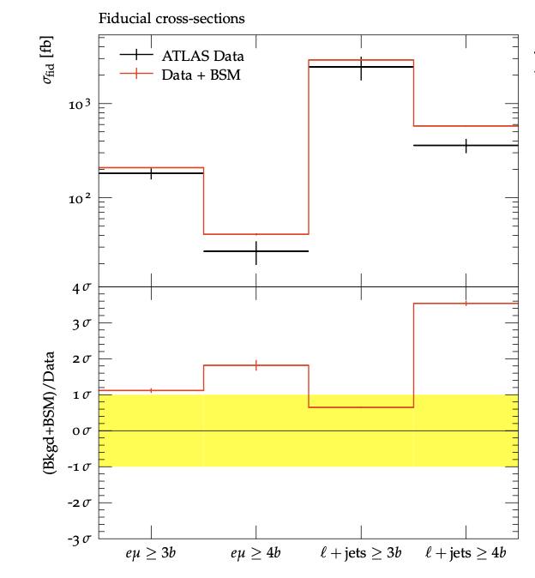
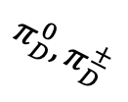
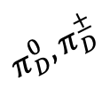



Composite Dark Matter Models
Left-handed model
ρ⁰D, ρ⁺D, ρ⁻D
Right-handed model
ρ⁰D only
$$p$$
$$π_{D}^{0},π_{D}^{±}$$
$$ρ_{D}^{0},ρ_{D}^{±}$$
$$π_{D}^{0},π_{D}^{±}$$
$$p$$
JMB, Corpe, Kong, Kulkarni, Thomas. arXiv:2105.08494

Slide 26
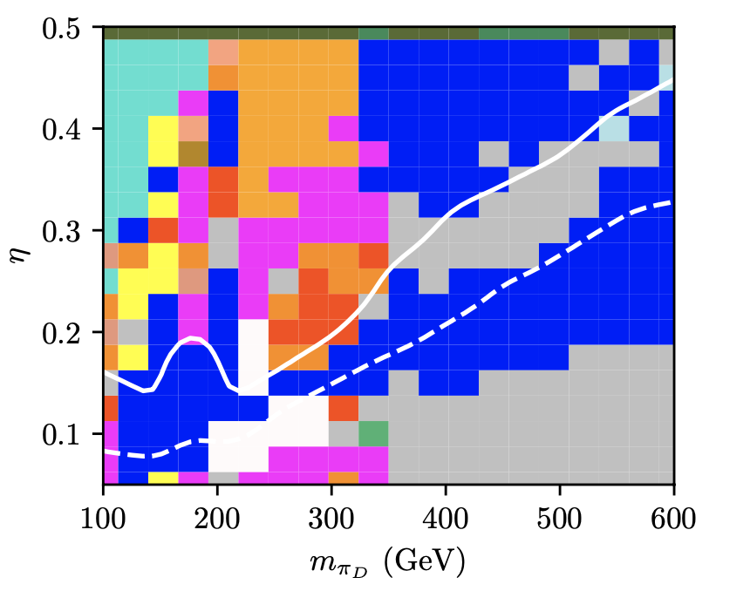
Composite Dark Matter Models
Large areas excluded:
  When pion mass is close to Higgs mass, H→gg analysis contributes
  Boosted hadron ”top” measurements contribute when pion mass ~200 GeV: Pions decay to tb and are boost from heavy r.
  Other sensitivity from Z-pole dileptons, and lepton+missing energy (Z, top, W production in decay chains)
Left-handed model
ρ⁰D, ρ⁺D, ρ⁻D
JMB, Corpe, Kong, Kulkarni, Thomas. arXiv:2105.08494

Slide 27
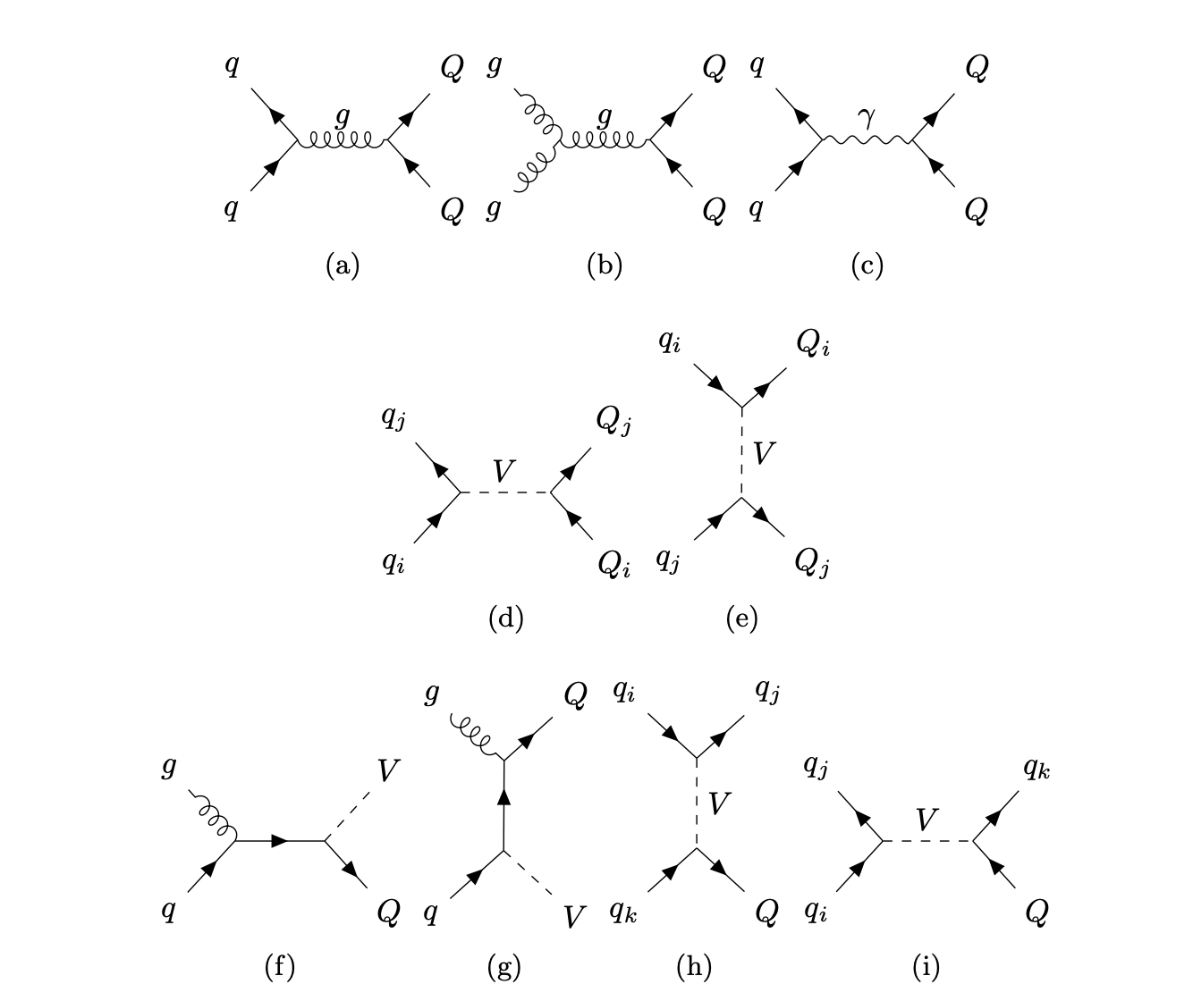
Vector-like Quarks
Very common extension to SM, general model by Buchkremer et al (arXiv:1305.4172). Introduces up to four quark partners, B, T, X, Y.
  Usual strong couplings to SM
  Evade bounds from Higgs because they are vectors
  B, T interact with with W, Z, H with modfied weak couplings
  X, Y interact with W (only) similarly
Three sets of parameters (in additon to masses)
  𝜅: absolute coupling of VLQs to SM quarks
  𝜁i: relative coupling of VLQs to i^{th} generation
  𝜉v: relative coupling of B,T to V in {W, H, Z}
Buckley, JMB, Corpe, Huang, Sun arXiv:2006.07172

Slide 28
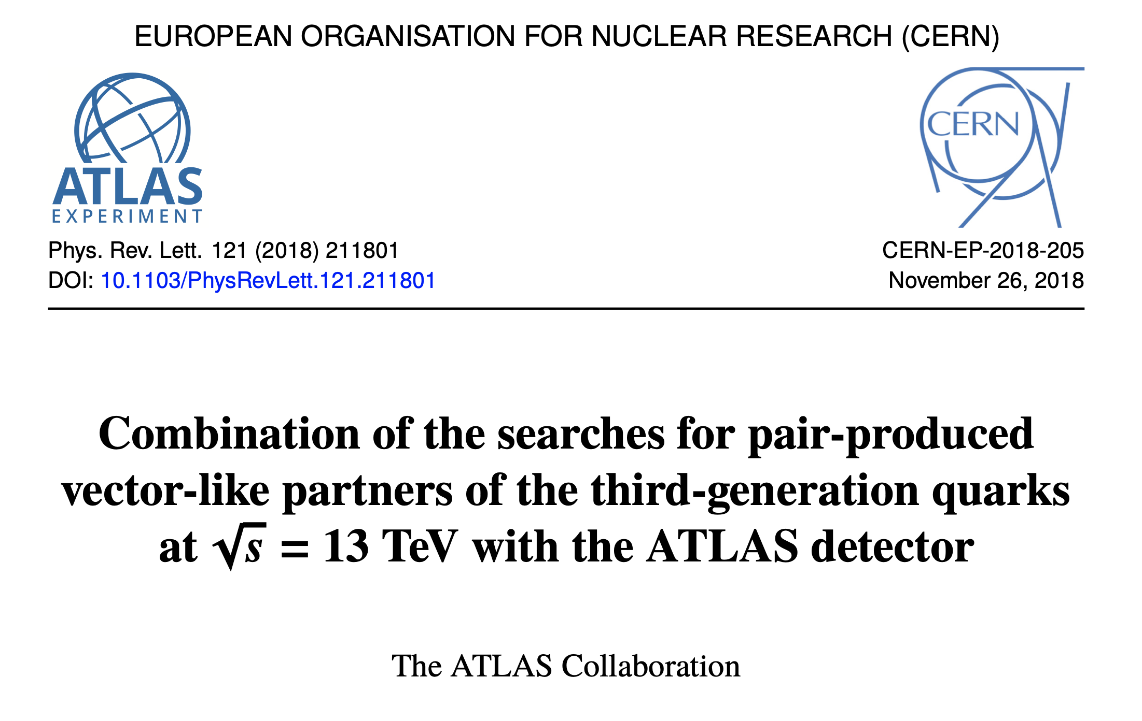
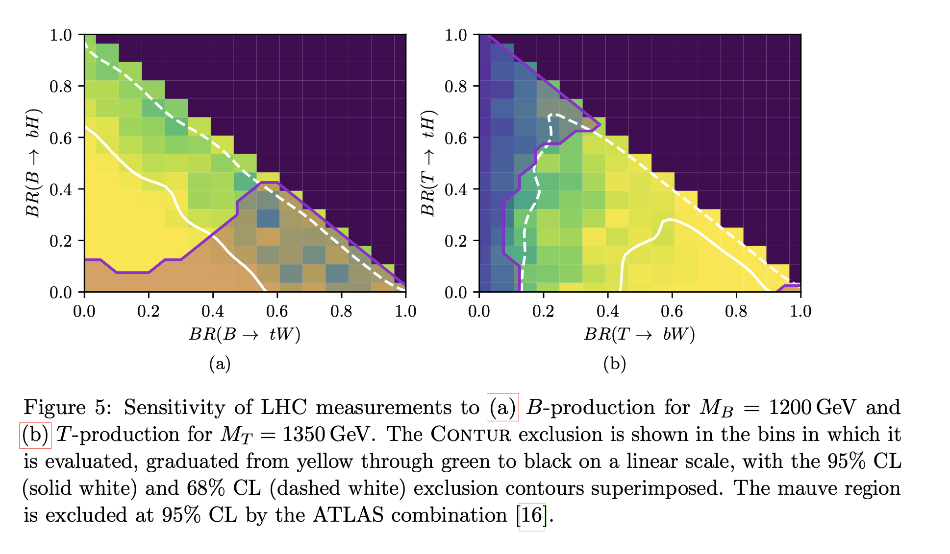
Vector-like Quarks
Compare to (quite limited) direct searches: ATLAS limits from arXiv:1808.02343
Assumes 3rd generation coupling only, and X, Y are decoupled.
Only include pair production
Buckley, JMB, Corpe, Huang, Sun arXiv:2006.07172

Slide 29
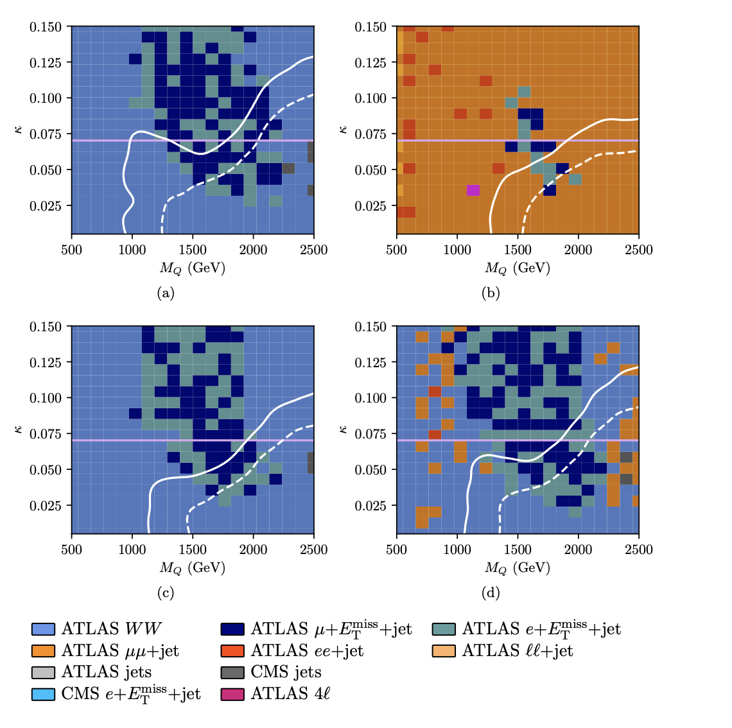
Vector-like Quarks
Coupling to 1st generation.
Region above line excluded by non-collider constraints
No LHC search analyses exist
Measurements exclude most of the plane.
Single VLQ production very important at highest masses
Buckley, JMB, Corpe, Huang, Sun arXiv:2006.07172

Slide 30
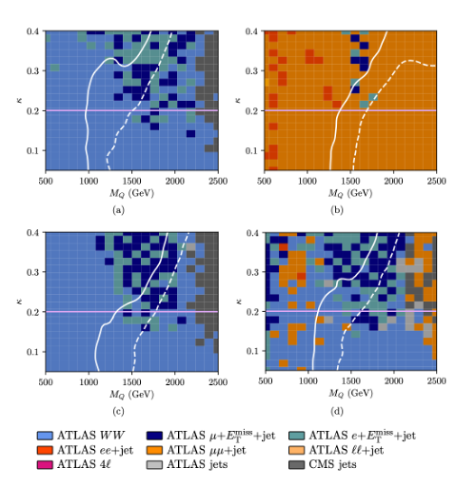
Vector-like Quarks
Coupling to 2nd generation.
Region above line excluded by non-collider constraints
No LHC search analyses exist
Measurements exclude significant part of the plane.
Single VLQ production again very important at highest masses
Buckley, JMB, Corpe, Huang, Sun arXiv:2006.07172

Slide 31
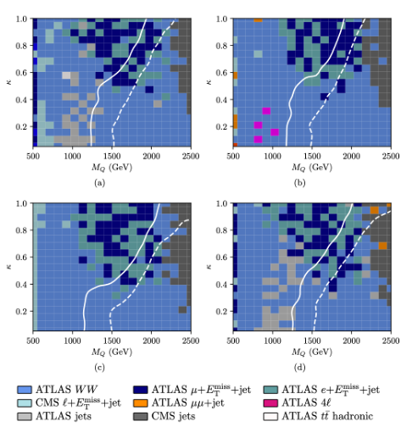
Vector-like Quarks
Coupling to 3rd generation.
No exclusion from non-collider, but there are several LHC searches
Measurements also exclude significant part of the plane.
Single VLQ production still significant at highest masses
Buckley, JMB, Corpe, Huang, Sun arXiv:2006.07172

Slide 32
Vector-like Quarks
Addendum: During journal review for this paper, it was pointed put that we’d missed some of the most compelling scenarios, and should instead consider:
  B, T singlets
  BT, XT, TY doublets
  BYX, BTY triplets
… for each generational coupling scenario and for four different decay branching benchmarks to W, Z, H.
i.e. 7 x 3 x 4 two dimensional parameter scans
Hmm. A challenge for Contur?
Buckley, JMB, Corpe, Huang, Sun arXiv:2006.07172

Slide 33


Vector-like Quarks

Slide 34
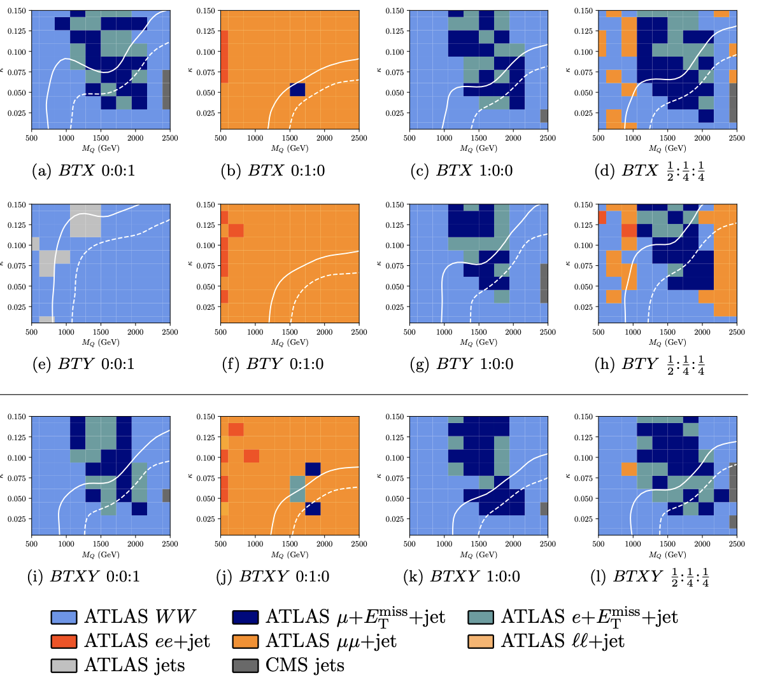
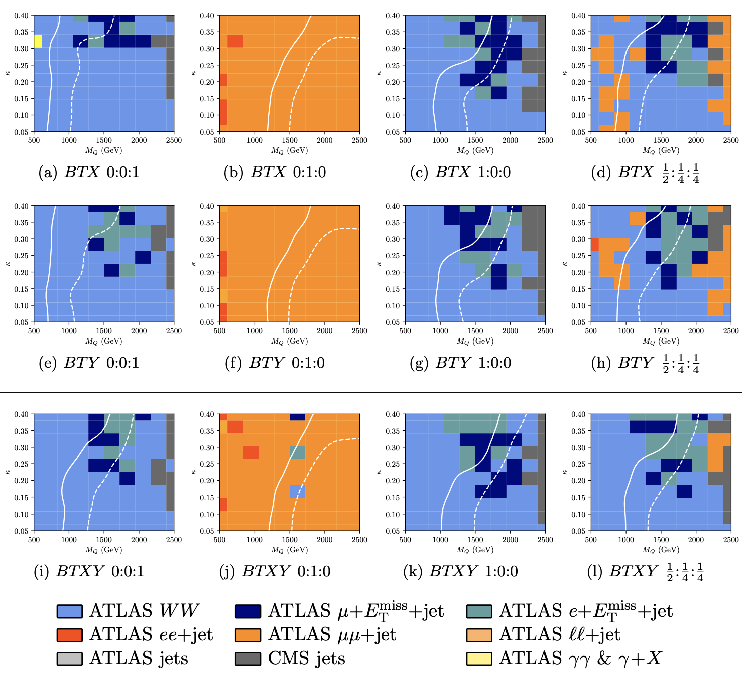
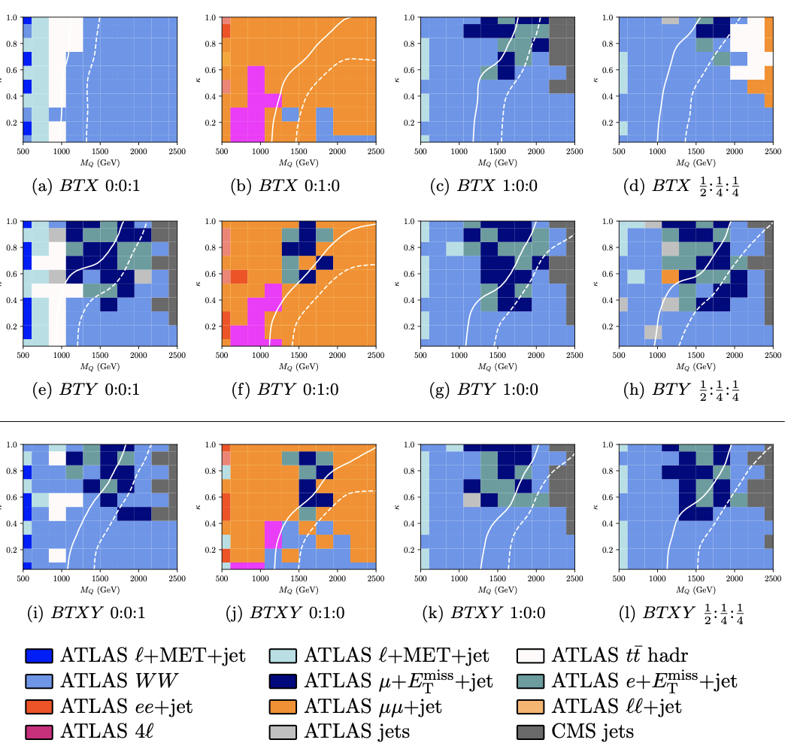
Vector-like Quarks
1st Generation 2nd Generation 3rd Generation
Buckley, JMB, Corpe, Huang, Sun arXiv:2006.07172

Slide 35
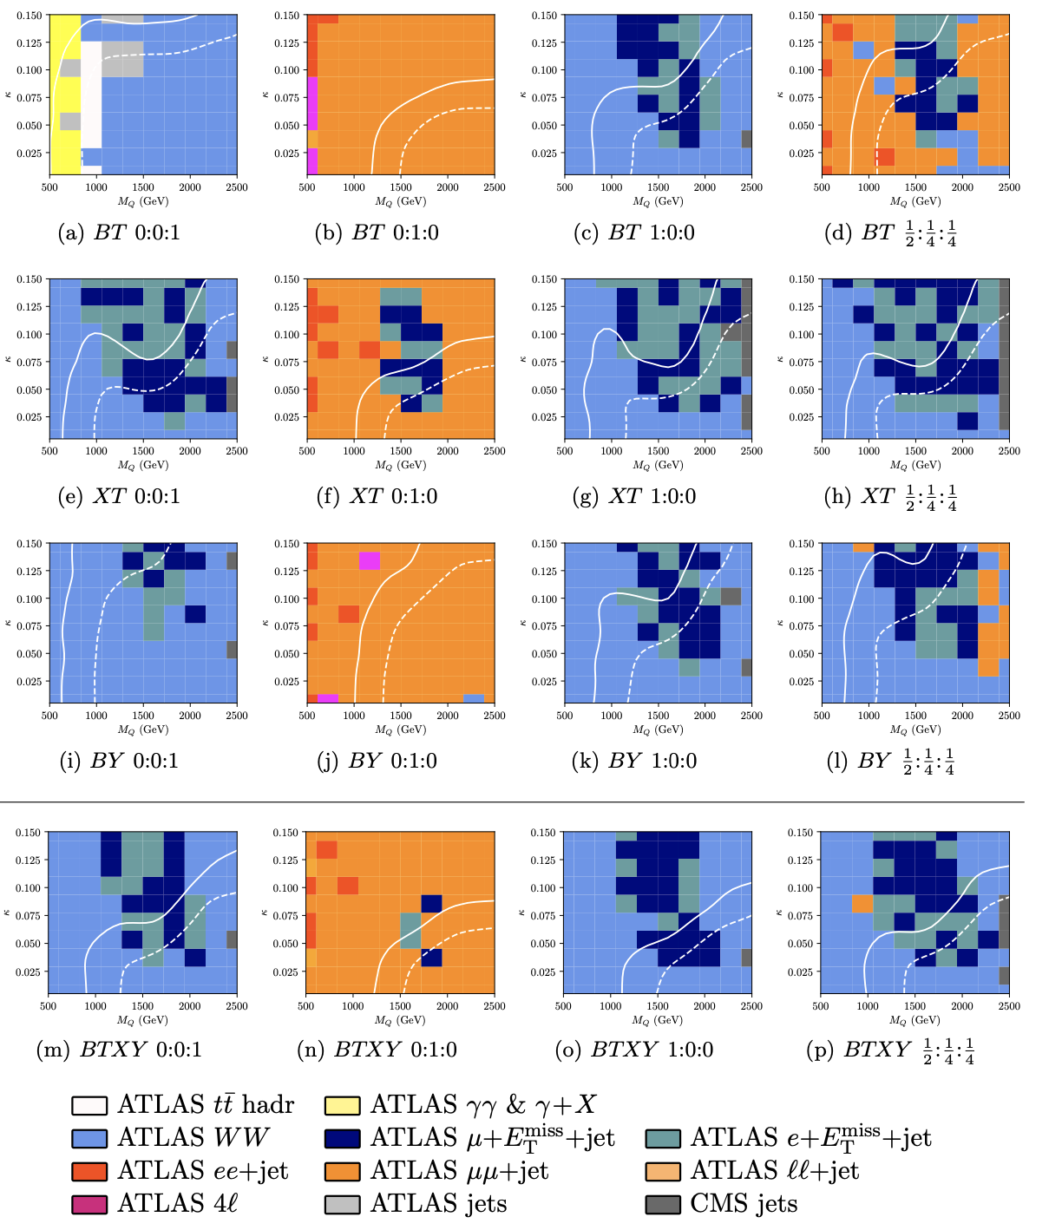
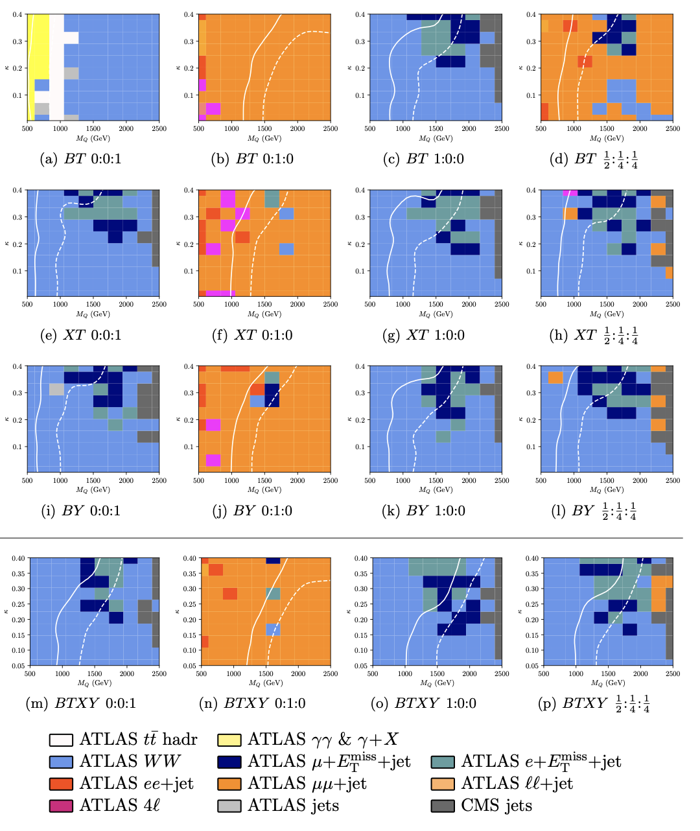
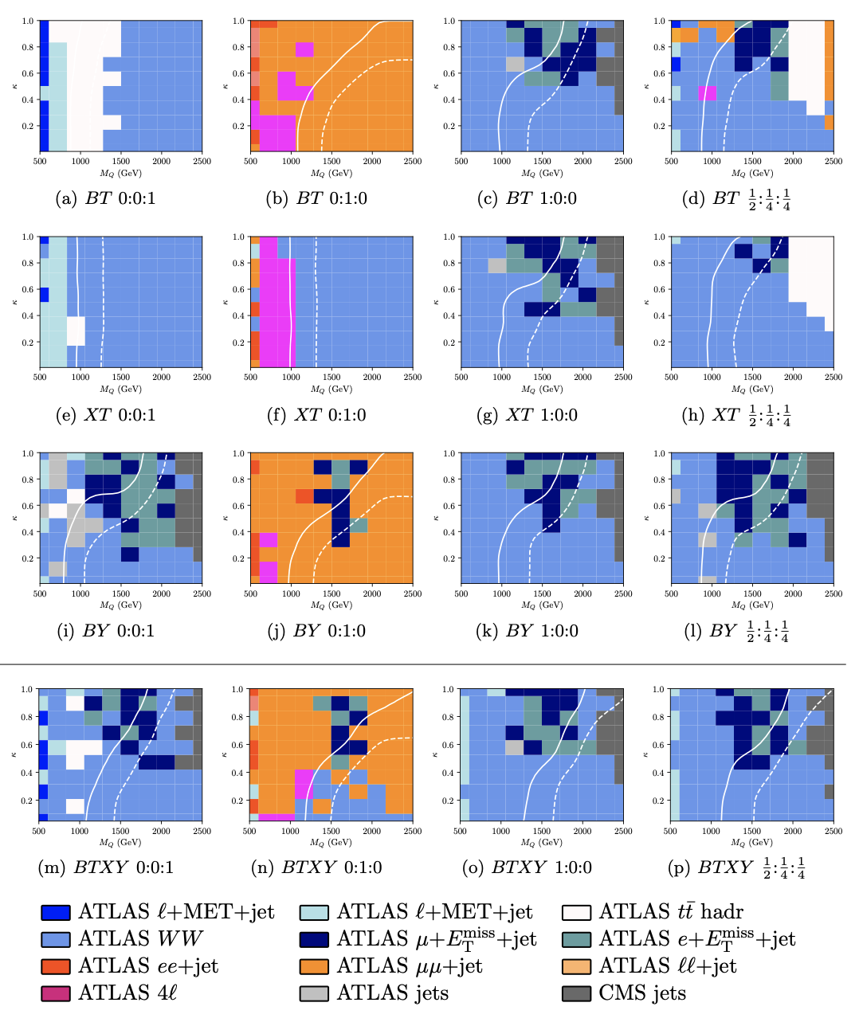
Vector-like Quarks
1st Generation 2nd Generation 3rd Generation
Buckley, JMB, Corpe, Huang, Sun arXiv:2006.07172

Slide 36
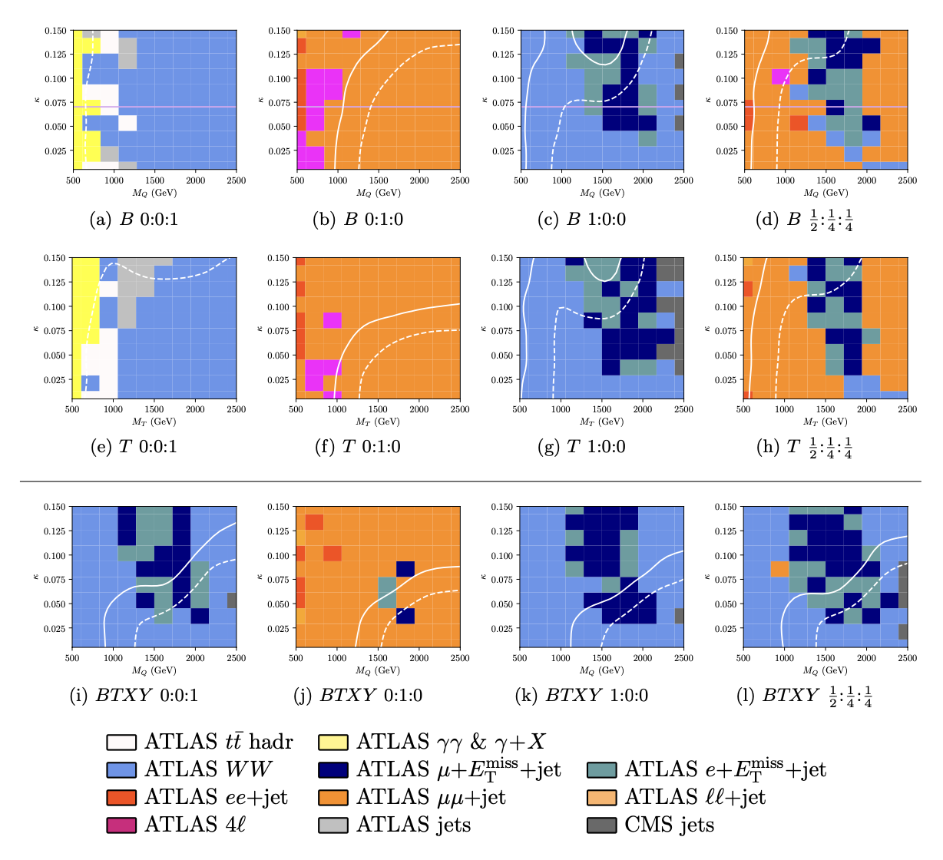
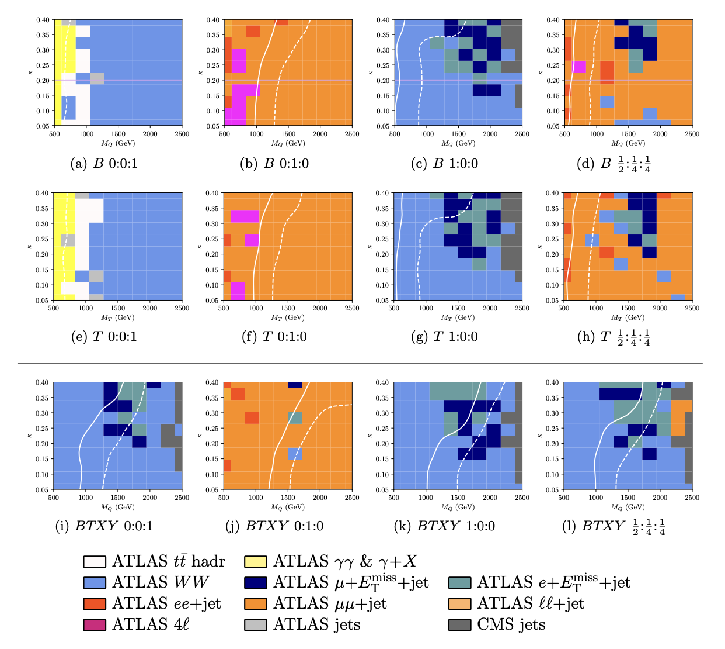
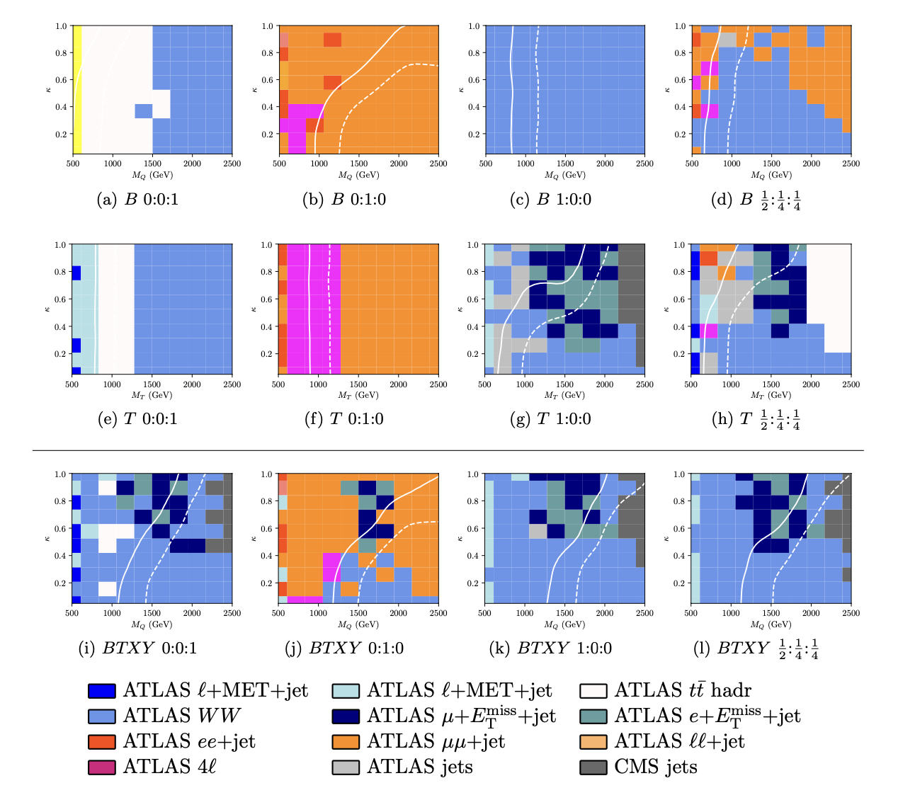
Vector-like Quarks
1st Generation 2nd Generation 3rd Generation
Buckley, JMB, Corpe, Huang, Sun arXiv:2006.07172

Slide 37
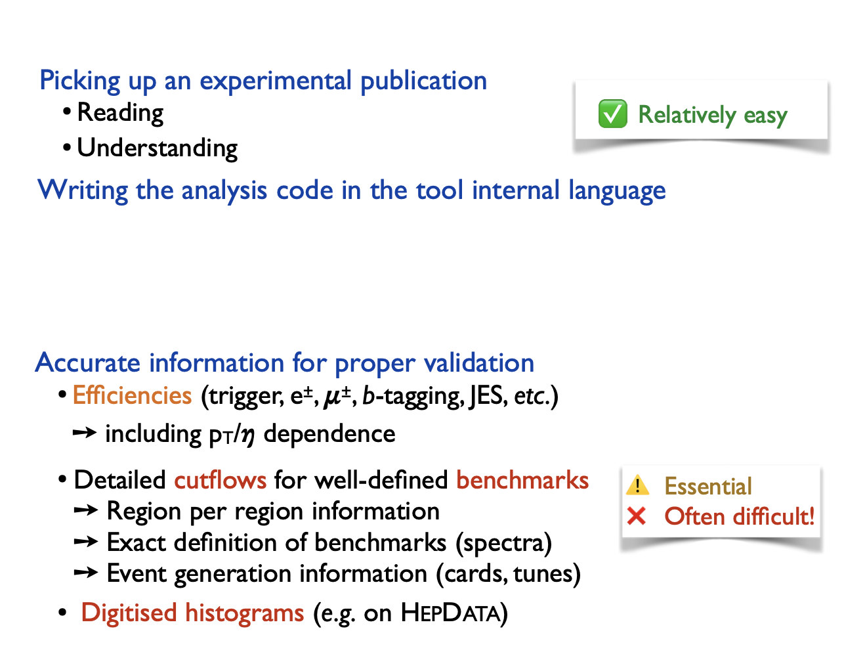
Summary
From Benjamin
In many cases, best to let the experimentalists do this once-and-for-all) → particle-level measurements

Slide 38
Summary
Contur (and the software stack it sits on) provides a very efficient way of extracting additional BSM information from “SM” measurements (if they are made properly – see previous lectures!)

Slide 39
Once you have the BSM HepMC file…
mkdir /Work
cd /Work
rivet -a $CONTUR_RA13TeV /Events/chacal2024_events_vnoweights.hepmc.gz
contur Rivet.yoda
contur-rivetplots --cls 0.3 -–nomultip
Then copy the ANALYSIS directory to somewhere visible outside of docker, and view ANALYSIS/plots/index.html in your browser.

