Slide 1
Working plan - Overview
Catarina Serafim
13/07/2023

Slide 2
Overview
CuBe2 irradiated – this pair had poor results in the LES testing.
  At the moment, we think that carbon contamination from irradiation may be causing the difficulties in the conditioning.
  When testing the electrodes in the LES, carbon has been expelled from the cathode to the anode.
  Both cathode and anode must go trough plasma treatment before high pulsing tests again in the LES.
  First trial with plasma cleaning was been made on the cathode. (images in the last 2 slides)
  CuBe2 not-irradiated – good results in the LES (110Mv/v). SEM analysis has been made. Ready to go to machining if needed.
  SS316 irradiated – Machining and cleaning completed. Ready to go to irradiation.
  SS316 non-irradiated – LES completed. Very good results (120 mV/m). SEM to be done.
Next in the LES3
Next in the LES2

Slide 3
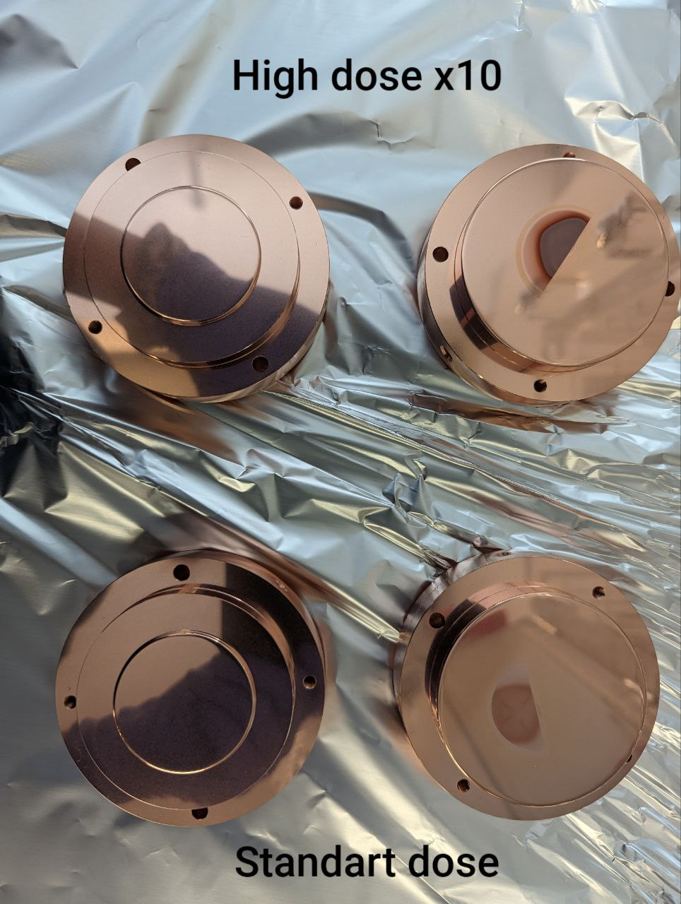
Overview
Cu-OFE standard dose irradiated
Cu-OFE high dose irradiated
Standard dose
Bad results in the LES.
SEM to be done to confirm the presence of Carbon.
For now we will see for the results of CuBe2 and the affect of the plasma cleaning to understand if this treatment can be applied in these electrodes.
High dose x10

Slide 4
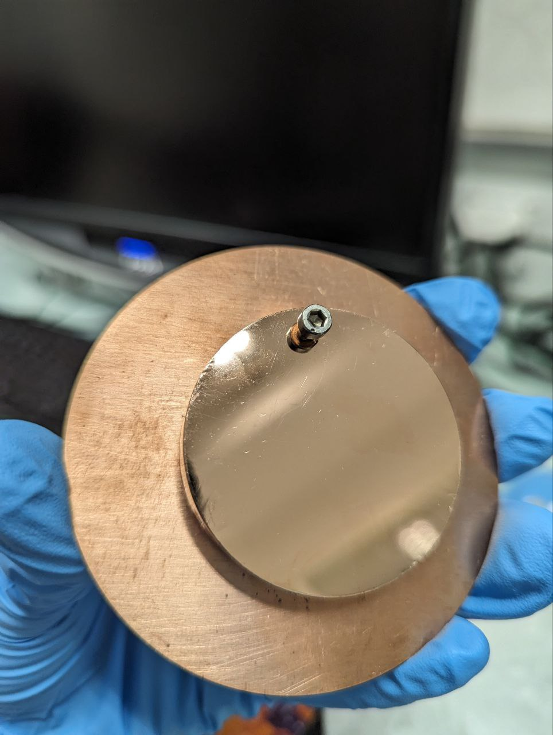
For irradiation
Irradiation probably to begin at the end of August. Current date: 28th of August.
To be irradiated:
  SS316 cathode (the one that was re-machined and we want to re-try LES) – Standard dose.
  Cu sample with high dose for the purpose of
  continuing the analysis of blistering.
Cu sample almost prepared – 50 mm diameter sample,
diamond machined exposed to heat treatment and
15 microns electropolished.

Slide 5
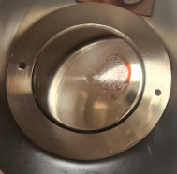
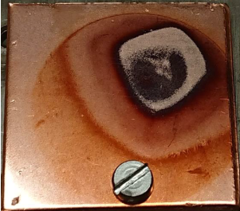
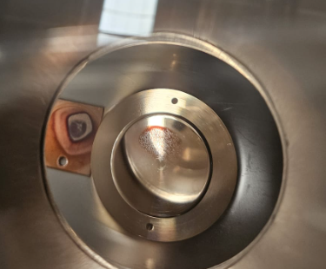
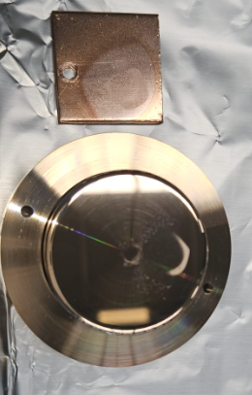
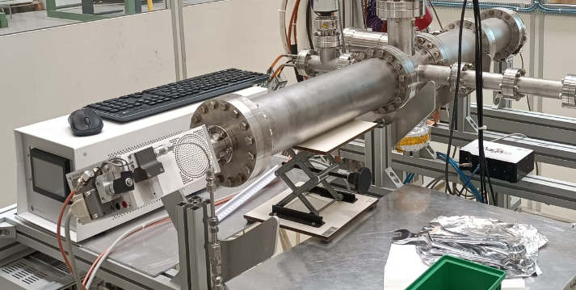
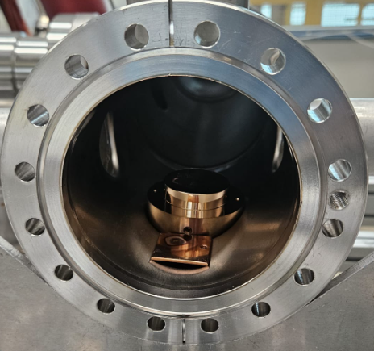
12/07/2023
Plasma cleaning of H- irradiated CuBe cathode and reference Cu sample irradiated (in LINAC?)
Plasma treatment parameters
Plasma source: ibss alumina tube 300W prototype, φ = 0.147 in
p = 4E-3 mbar, pure oxygen (pressure)
P_{rf} = 50 W (pl.source rf power)
L = 610 mm ± 10 mm (distance samples - plasma source); D_{ch} = 100 mm
a-C dth/dt in these conditions = 0.015 nm/s (removal rate)
Plasma ion energy in these conditions : 35 eV (measured by RFEA)
Treatment duration = 1h 15 min (nominally 68 nm of a-C)
Before O₂ plasma cleaning
viewport
System in 181
After O₂ plasma cleaning
Plasma source

Slide 6
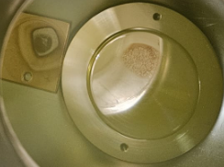
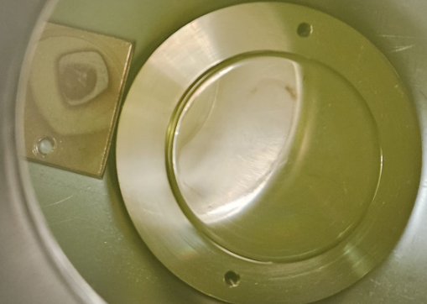
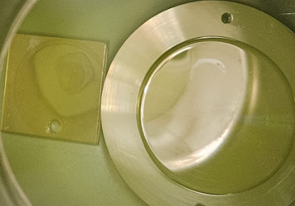
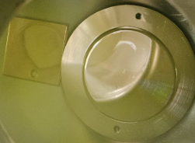
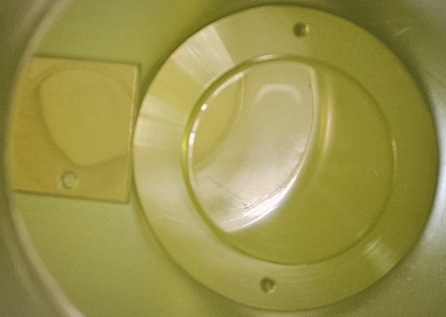
Pictures during exposure to O₂ plasma
Starting time: 10:00
Time 10:21
Time 10:35
Remarks :
Removal is visible → most probably the brownish stains were really carbon layers;
Carbon layers on the two samples might have different thickness : ~ 60 nm on the Cu sample (FIB measured), ~ 20 nm on the CuBe cathode (estimated from the time employed to remove it based on visual inspection);
No significant (visible by eyes) changes in the last 10 minutes of the treatment
Not all the stains were removed by the plasma treatment → XPS investigation planned
Time 11:55
Ending time: 11:15

