Slide 1
General information
Frank Zimmermann
170th FCC-ee Optics Design Meeting & 41st FCCIS WP2.2 Meeting, 20 July 202

Slide 2
Minutes and actions from the 169th meeting
comment: larger beam pipe should yield a poorer BPM resolution
action: prepare a list of bunch & beam parameters and BPM requirements for different scenarios
mid-term deliverable reports advancing well
a few items missing; D5.1 should be completed next week
EAJADE planning and possibilities

Slide 3

EAJADE
EAJADE (Europe–America–Japan Accelerator Development and Exchange programme) is a training, education and staff exchange network in the field of accelerator research for high-energy elementary particle physics (HEP). More precisely, it is a “Marie Sklodowska-Curie Action” in the framework of the European Union’s “Horizon Europe” programme, focusing on staff exchange between (and within) Europe and other world regions.
The recent update of the European Strategy for Particle Physics emphasizes the need for a “Higgs factory” — a high-energy lepton collider able to scrutinize the Higgs boson and its interactions with other elementary particles and to use it as a window towards potential “new physics”. … Four Higgs factory proposals are being considered: CEPC, CLIC, FCC-ee, ILC …. The exchanges proposed in EAJADE cover primarily FCC-ee, CLIC and ILC where there are large European communities, even though there is overlap with the technical challenges that also need to be addressed with CEPC and a much more limited European participation in CEPC studies.
..
EAJADE will provide the funding for the European side of this scientific exchange and is complemented by the efforts of and collaborations with partners in other world regions or industry where the seconded are hosted. In particular, EAJADE aims at harnessing the expertise and the infrastructures available in particular in Japan and in North America (USA and Canada) for the purposes of accelerator R&D, with a view towards developing Higgs factory collider project studies.

Slide 4
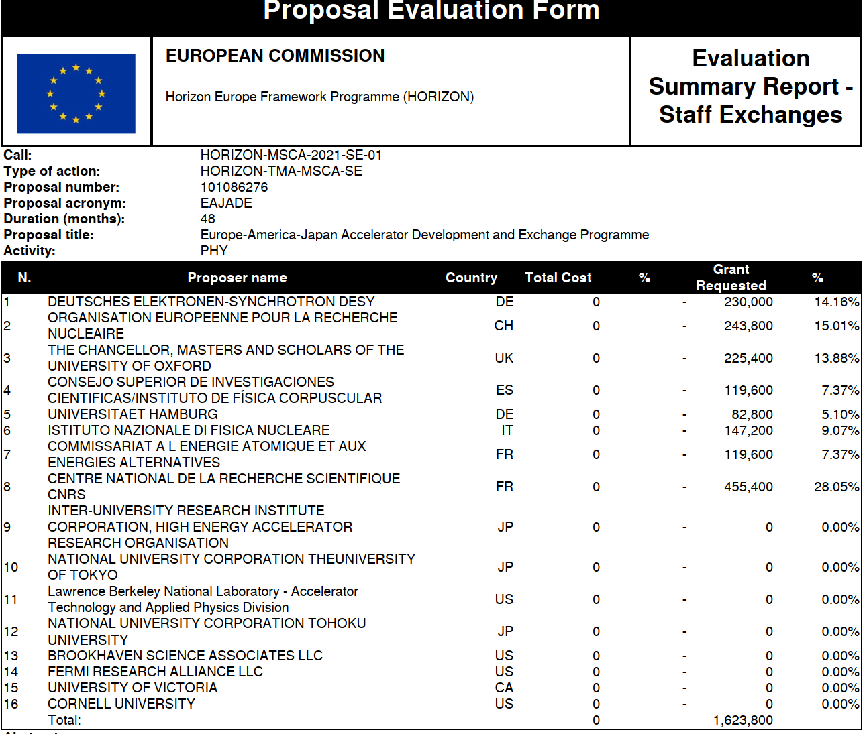
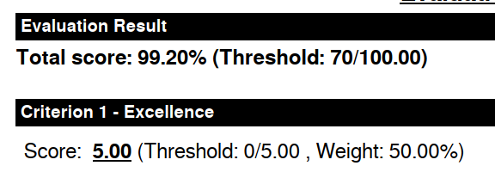



also involving
SuperKEKB
this talk
most important
contribution
to SuperKEKB
Start date: 1 March 2023
+SLAC National Accelerator Lab

Slide 5
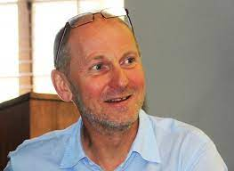
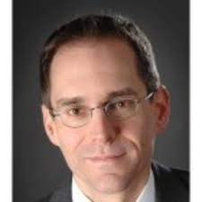
KEK is represented by Tadashi Koseki
Addt’l KEK contacts:
Katsumasa Ikematsu and Makoto Tobiyama
Beneficiaries
and corresponding members of the Consortium Board
Institution | PI
CEA | Enrico Cenni
CERN | Frank Zimmermann / Steinar Stapnes
CNRS | Philip Bambade / Angeles Faus-Golfe
DESY | Karsten Buesser
U Hamburg | Marc Wenskat
CSIC / IFIC | Juan Fuster
INFN | Laura Monaco
(Oxford) | (Phil Burrows)
Science Coordinator: Steinar Stapnes - CERN
Project Manager: Thomas Schörner DESY

Slide 6
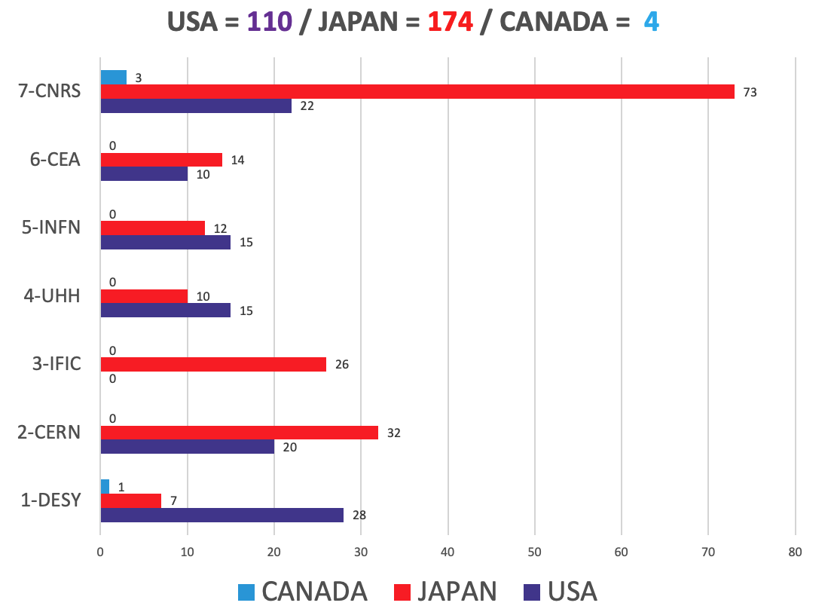
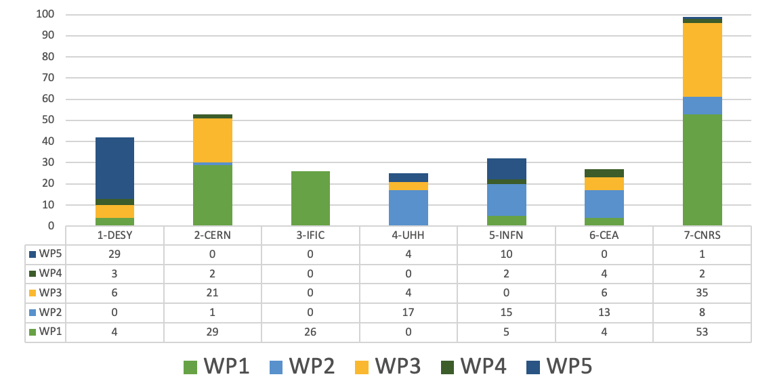
Overview of Travel Situation (person-months)
Thomas Schörner, Natalia Potylitsina-Kube
relevant for SuperKEKB - let’s take a look

Slide 7
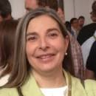
WP1 R&D&I at currently operating state-of-the-art accelerator facilities
Task 1.1 Future electron-positron linear collider studies
(CERN, CEA, CNRS, CSIC/IFIC, UOXF, 88 person-months)
Task 1.2 Future electron-positron circular collider studies
(CERN, CEA, CNRS, DESY, INFN, UOXF, 30 person-months)
Task 1.3 Positron production for next generation electron-positron colliders
(CNRS, CERN, 19 person-months)
Task 1.4 R&D on Energy Recovery Linacs (CNRS, 6 person-months)
Description of relevant deliverables:
1.3 SuperKEKBLumLossRep (month 24, task 1.2): Report on SuperKEKB luminosity performance and optimisation, beam loss
induced background and Machine Detector Interface issues – CNRS
1.5 SuperKEKBOpticsRep (month 36, task 1.2): Report on SuperKEKB beam optics tuning with crab-waist, collective effects and
beam lifetime issues – CNRS
1.6 PosProdRep (month 42, task 1.3): Overview report on positron production performance at SuperKEKB and requirements for
future colliders including polarized positrons - CNRS
1.7 BeamDynRep (month 48, tasks 1.1 and 1.2): Report on beam dynamics R&D at currently operating accelerators and remaining
issues for future e+e- colliders, both linear and circular - CNRS
WP1 coordinator
A. Faus-Golfe (CNRS)

Slide 8
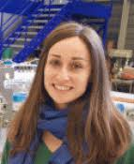
WP3 Special technologies, devices and systems performance
Task 3.1: Final focus and interaction point, collimation and magnets, luminosity devices and MDI studies
(CERN, CNRS, DESY, UOXF, KEK, BNL, SLAC, FNAL, 40 person-months)
Task 3.2: Beam dynamics, start-to-end simulations, polarisation/polarimetry studies including hardware concepts
(CERN, CNRS, DESY, KEK, BNL, SLAC, UVIC, 34 person-months)
WP3 coordinator
N. Fuster (IFIC)
Description of deliverables:
3.1 OptParHiggsRep (month 36, task 3.2): Optimized parameters for Higgs factories including polarization studies - CERN
3.2 LumiPerfFCCRep (month 42, task 3.1): Report on luminosity performance and margins for the Higgs factory proposals - CERN

Slide 9
WP1 "R&D&I at currently operating state-of-the-art accelerator facilities
Task 1.2 Future electron-positron circular collider studies (CERN, CEA, CNRS, DESY, INFN, UOXF, 30 person-months): SuperKEKB is a state-of-the-art facility operated at KEK which is particularly well suited to study some of the main issues and challenges for future circular colliders, especially the FCC-ee Higgs factory under consideration at CERN. The main topics to be addressed are:
luminosity monitoring and extraction of beam parameters at interaction point (IP) [Gawas, Salvsen, Sai],
feedback control of IP beam offsets [Salvesen],
monitoring of final focus magnet vibration with benchmarking of simulation and evaluation of luminosity impact [Salvesen, Sai]
beam optics tuning with very low β_{y}* and crab-waist collision scheme [Keintzel, Sai, Salvesen, Tomas]
impact of collective effects on performance [Kisciny, Buffat, Migliorati (INFN)],
benchmarking of linear and non-linear optics [Keintzel, Tomas],
beam lifetime [Kisciny],
evaluation of beam-induced background in interaction region and mitigation via collimation [Andre],
machine-detector interfacing [Andre, Broggi, Boscolo (INFN)]
in square brackets: possible CERN (or FCC partner) participants

Slide 10
WP3 "Special technologies, devices and systems performance"
Task 3.1: Final Focus and interaction point, collimation and magnets, luminosity devices and MDI studies (CERN, CNRS, DESY, UOXF, KEK, BNL, SLAC, FNAL, 44 months): this task will cover studies and hardware development for circular and linear colliders, covering the devices critical for providing high luminosity collisions. Key devices are alignment and stability systems, final focus magnets, collimation, instrumentation and diagnostics, luminosity monitors, and more. Collaboration among groups involved in SuperKEKB, ATF2/3 and Higgs Factory and EiC studies where these challenges are studies and/or devices used and optimized.
Deliverable 3.2 LumiPerfFCCRep (month 42, task 3.1): Report on luminosity performance and margins for the Higgs factory proposal.
Task 3.2: Beam dynamics, start-to-end simulations, polarization/polarimetry studies including hardware concepts (CERN, CNRS, KEK, BNL, SLAC, UVIC, 30 months): Start-to-end simulations and parameters optimization studies of the Higgs factory complexes, including polarization and polarimetry and luminosity measurements. These studies aim to define the performance goals for the collider options, including key parameters as polarization parameters and luminosity, including estimating the expected measurement accuracy for these. Collaboration among groups in SuperKEKB, ATF2/3 and Higgs factory and EiC studies where these challenges are studied and/or devices used and optimized.
Deliverable 3.1 OptParHiggsRep (month 36 task 3.2): Optimized parameters for Higgs factories including polarization studies.

Slide 11
Last name | First name | Home institution | Home country | Home Sector (academic/industry) | Receiving institution | Receiving country | Receiving Sector (academic/industry)2 | Duration [months] in TOTAL 53 | Status | Topic | WP | WP number | Comment
Abramov |  | CERN | CHE | academic | BNL | USA | academic | 3 | Ph.D. student or fellow | (EIC) IR magnet development and collimation | Special technologies, devices and system integration | 3 | FCC
BI expert? |  | CERN | CHE | academic | BNL | USA | academic | 3 | Ph.D. student or fellow | (EIC) polarisation/polarimetry | Special technologies, devices and system integration | 3 | FCC
Bruce? |  | CERN | CHE | academic | BNL | USA | academic | 1 | Staff | (EIC) IR magnet development and collimation | Special technologies, devices and system integration | 3 | FCC
Keintzel |  | CERN | CHE | academic | BNL | USA | academic | 1 | Staff | (EIC) polarisation/polarimetry | Special technologies, devices and system integration | 3 | FCC
OMC team members |  | CERN | CHE | academic | FNAL | USA | academic | 6 | Ph.D. student or fellow | (IOTA and US Future Collider Studies) beam dynamics, prec. optics correction & polaris. | Special technologies, devices and system integration | 3 | FCC
Keintzel, Sai, Gawas |  | CERN | CHE | academic | KEK | JP | academic | 6 | Ph.D. student or fellow or staff | (SuperKEKB) beam optics control with extremely small beta* | R&D&I at currently operating state-of-the-art facilities | 1 | FCC
Broggi, Salvesen, Kisciny, Andre |  | CERN | CHE | academic | KEK | JP | academic | 5 | Ph.D. student | (SuperKEKB) machine detector interface, background control, & collimation | R&D&I at currently operating state-of-the-art facilities | 3 | FCC
Tomas |  | CERN | CHE | academic | KEK | JP | academic | 1 | Staff | (SuperKEKB) machine detector interface, background control, & collimation | R&D&I at currently operating state-of-the-art facilities | 3 | FCC
Zimmermann |  | CERN | CHE | academic | KEK | JP | academic | 1 | Staff | (SuperKEKB) beam optics and collective effects | R&D&I at currently operating state-of-the-art facilities | 1 | FCC
RF student and/or MDI student |  | CERN | CHE | academic | SLAC | USA | academic | 4 | Ph.D. student | (LCLS-II) SRF operation, collective effects and/or machine-detector interface | R&D&I at currently operating state-of-the-art facilities | 1 | FCC
? |  | CERN | CHE | academic | SLAC | USA | academic | 1 | Staff | (LCLS-II) beam dynamics | R&D&I at currently operating state-of-the-art facilities | 1 | ?
CERN FCC plan for EAJADE
- preliminary

Slide 12
Possible themes for secondments to SuperKEKB:
Optics corrections and beam based alignment – Candidate collaborators: J. Keintzel, R. Tomas, S. Sai; KEK contact: Y. Ohnishi
IP feedback and luminosity tuning – Candidate collaborators: J. Salvesen, V. Gawas; KEK contact: Y. Ohnishi, M. Tobiyama?; other contacts: A. Fisher, J. Dusatko / SLAC
Collimation and collimation design - Candidate collaborators: G. Broggi; KEK contact: T. Ishibashi
Sudden beam loss studies - Candidate collaborators?: L. Mether?; KEK contacts: H. Ikeda, T. Abe
Impedance modeling and impedance effects - Candidate collaborators: M. Migliorati / INFN ; KEK contacts: D. Zhou, T. Ishibashi
Beam-beam theories and simulations - Candidate collaborators: X. Buffat, P. Kicsiny, et al.; KEK contacts: D. Zhou, K. Ohmi
New IR optics design for SuperKEKB major upgrade in the 2030s – Candidate collaborators: P. Raimondi / SLAC or CERN optics experts; KEK contact: D. Zhou
New QCS magnets 2030s – Candidate collaborators: M. Koratzinos / PSI, et al.; KEK contact: X. Wang?
Polarized e-beam – Candidate collaborator: J. Keintzel; KEK contact: ?
MDI background studies – Candidate collaborator: K. Andre; KEK contact: H. Nakayama

Slide 13
possible/proposed secondees and topics:
Peter Kisciny (1 month in total, fall 2023 or winter 23/34), xsuite beam-beam code benchmarking against BBSS and real SuperKEKB;
KEK contacts: Demin Zhou, Kazuhito Ohmi
Rogelio Tomas and Jacqueline Keintzel (1 month in total, December 23 or February/April ‘24): turn-by-turn BPM data analysis and beam-based alignment – could Rogelio visit after the next ARC meeting?
KEK contact: Yukiyoshi Ohnishi
John “Jack” Salvesen (1 month in total): IP feedback - to be synchronized with SLAC expert visit
Giacomo Broggi ? (1 month): collimation – tbc
Kevin Andre ? (1 month) : SR background studies - tbc
Mauro Migliorati / INFN (KEK short term fellow, 2 weeks) in spring 2024
Andrey Abramov? to BNL (1 month): collimation - tbc , BNL contact: Angelika Drees ?

Slide 14
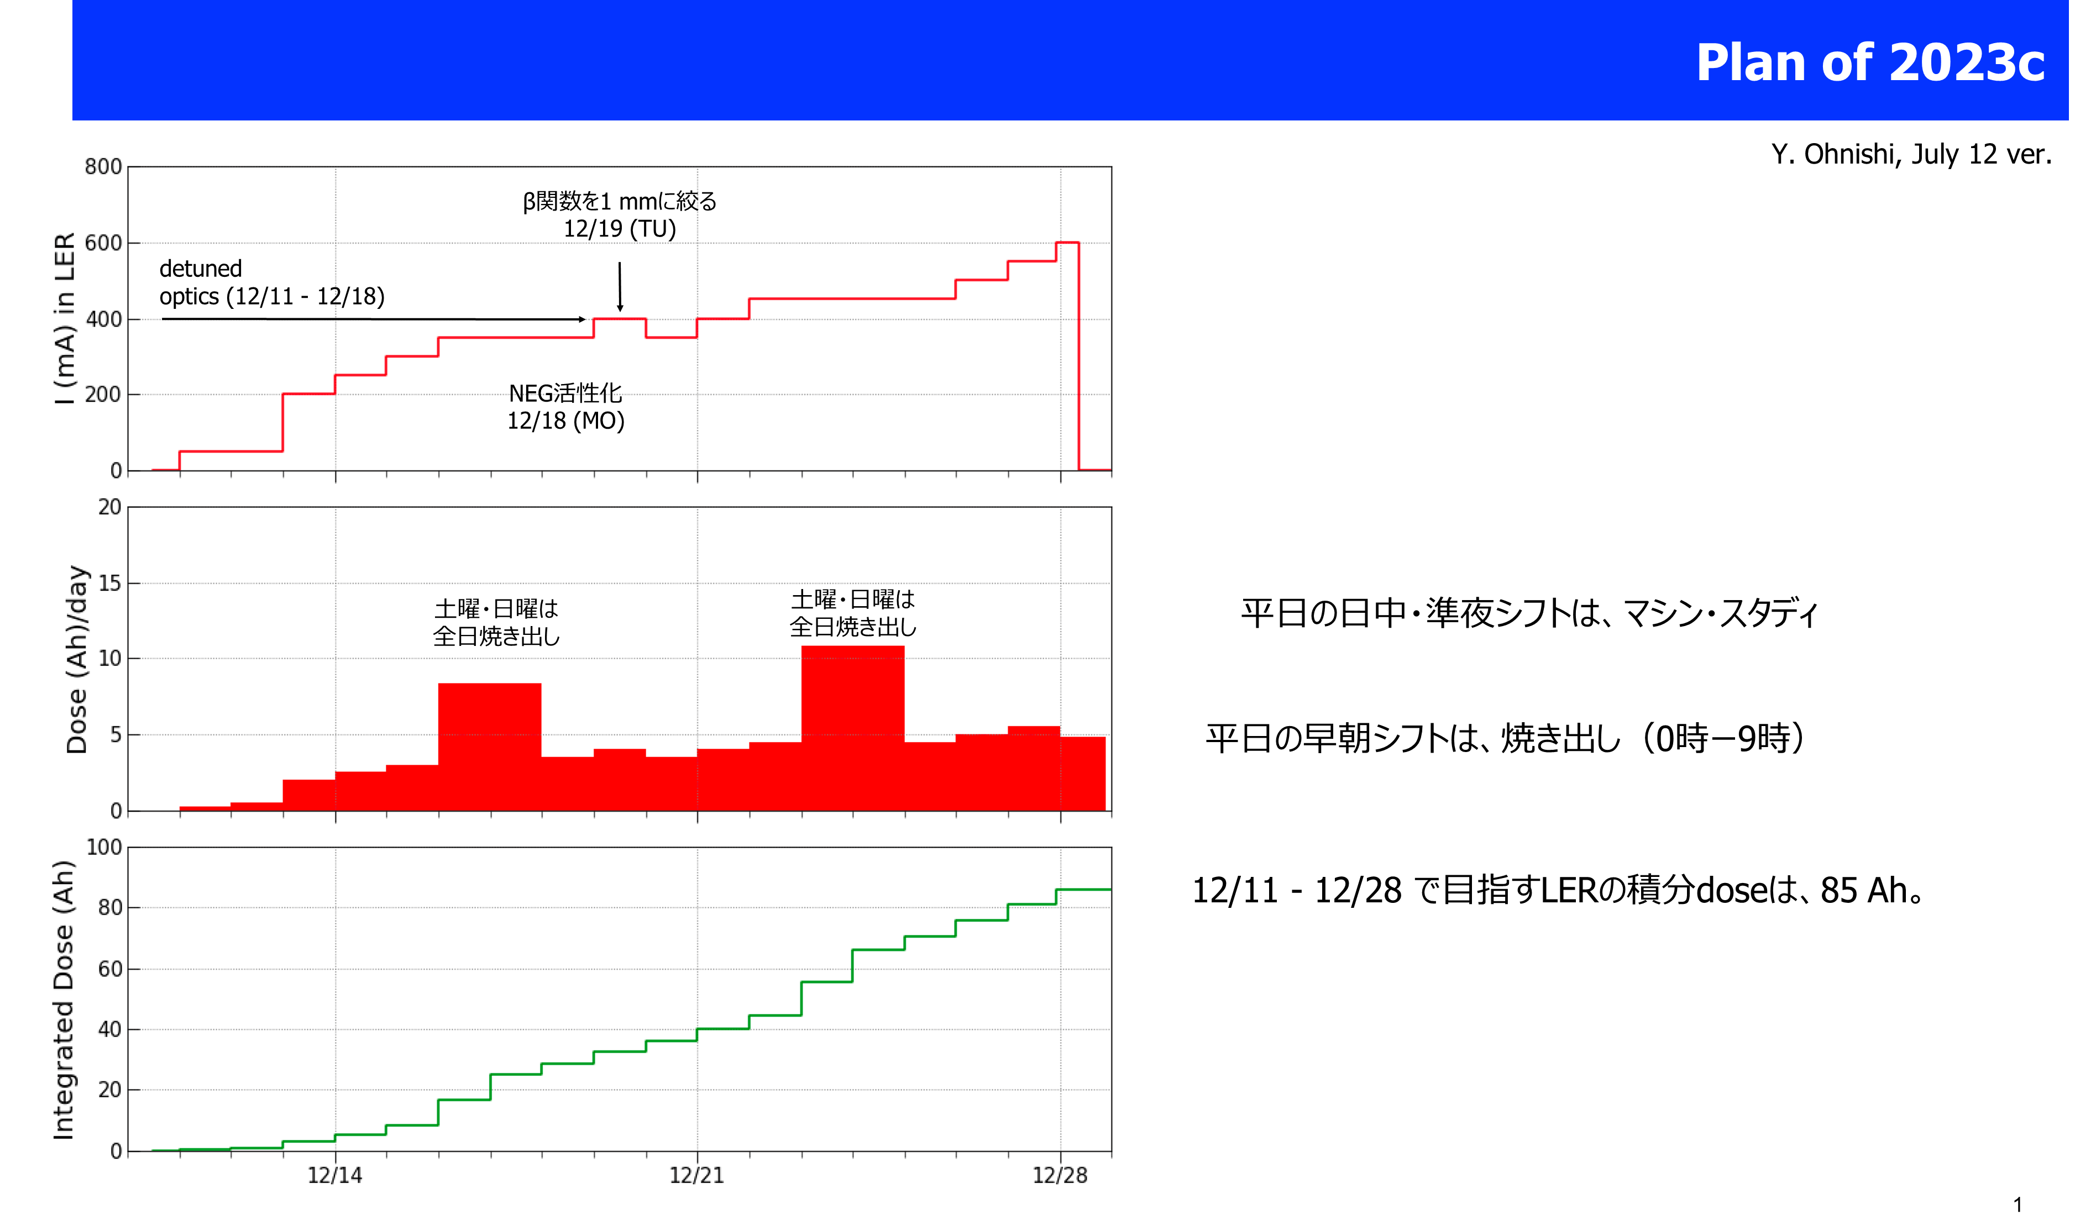
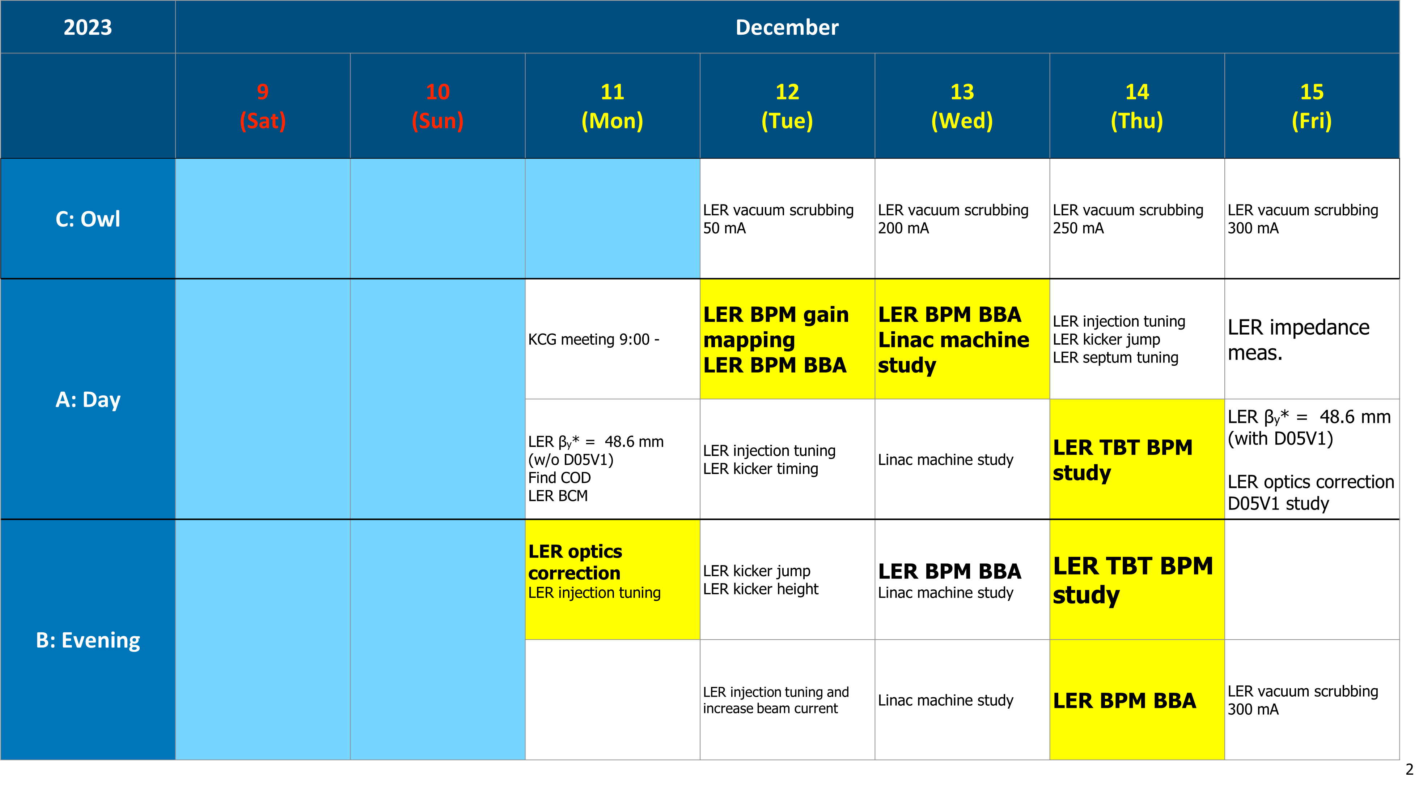
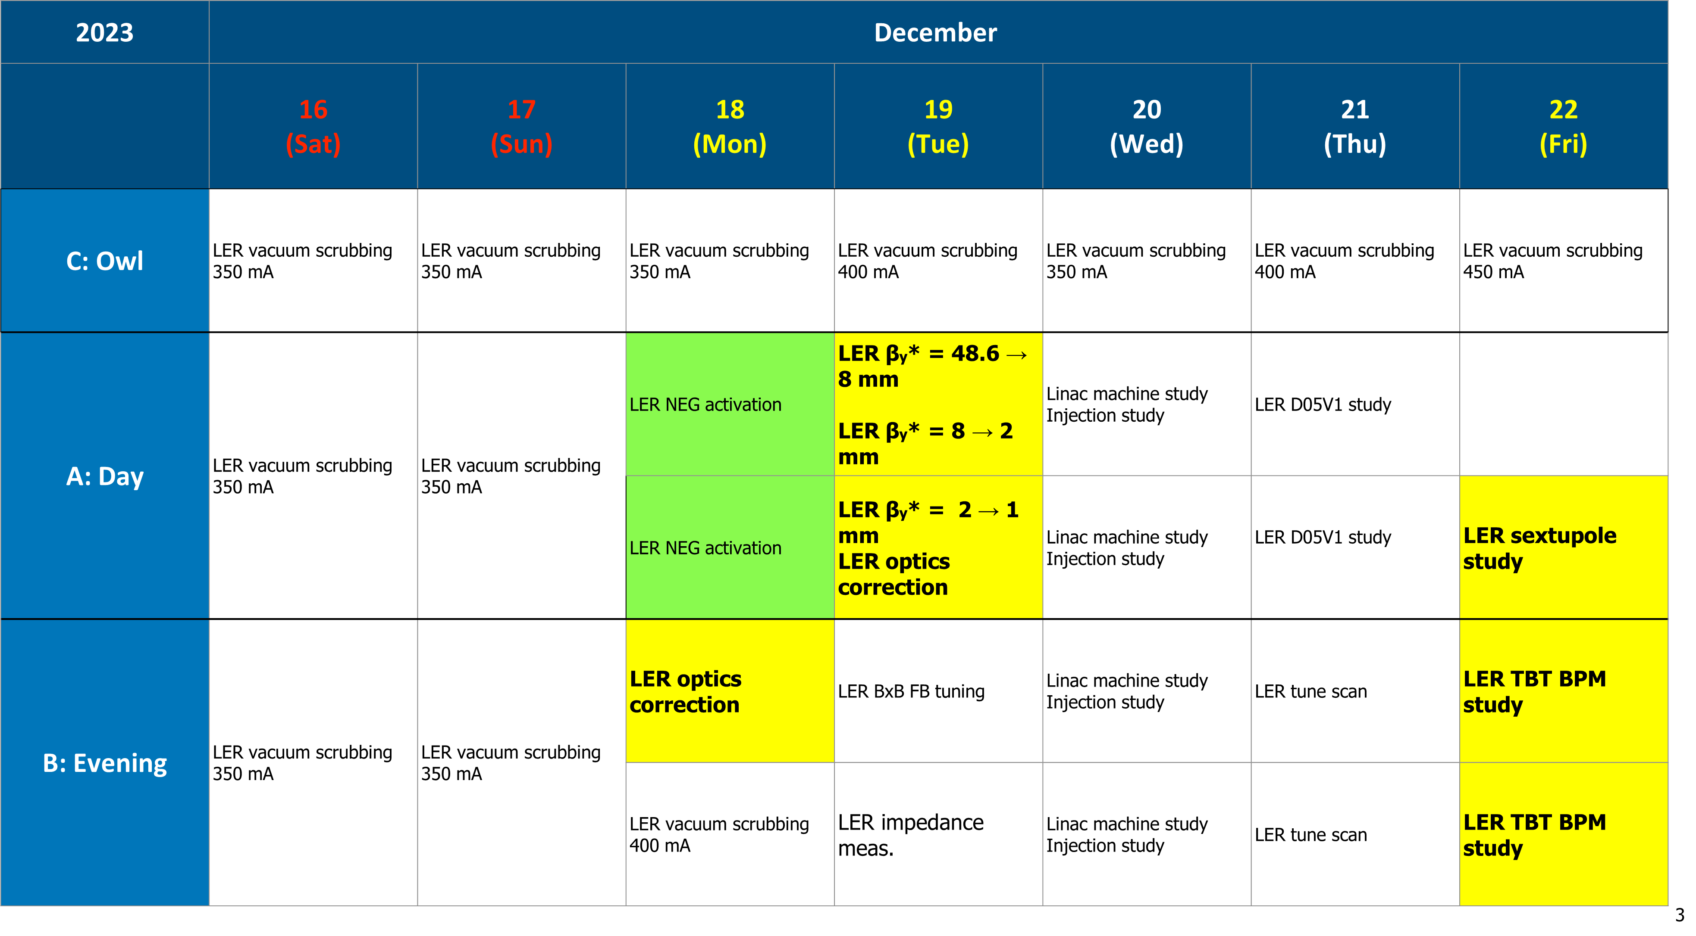
Y. Ohnishi
N. Iida
General SuperKEKB Schedule till Summer 2023
End 2023
・LINAC 10/02（月）– 12/28（木）：25Hz運転調整
・DR, MR-BT 11/27（月）開始2週間調整 – 12/28
・SuperKEKB MR 12/11（月）– 12/28
・PF ring 11/07（火）– 12/28 ：11/10（金）よりユーザー運転開始
・PF-AR 11/14（火）– 12/28
• 2023年度第3期（2024a）運転案
・LINAC, DR, MR-BT 01/15（月）– 03/31（日）：50Hz運転調整
・SuperKEKB MR 01/29（月）– 03/31（日）
・PF ring 02/05（月）– 03/25（月）
・PF-AR 02/12（月）– 03/18（月）
• 2024年度第1期（2024b）運転案
・LINAC, DR, MR-BT 04/01（月）– 07/12（金）
・SuperKEKB MR 04/01（月）– 06/30（日）
・PF ring 05/06（月）– 07/08（月）
・PF-AR 05/13（月）– 07/01（月）

