Slide 1




First Studies on IP Feedback
20/07/2023 Transfer of Status
John P T Salvesen
170th FCC-ee Optics Design Meeting & 41st FCCIS WP2.2 Meeting
FCCIS: 'This project has received funding from the European Union's Horizon 2020 research and innovation programme under the European Union's Horizon 2020 research and innovation programme under grant agreement No 951754.'

Slide 2
Outline
20/07/2023 Transfer of Status
John P T Salvesen
Introduction
Beam-beam Interaction Simulations
  GUINEA-PIG
Simulation Results
  Primary Signal: Beam Deflection
  Secondary Signal: Beamstrahlung Photons
Crab Waist Modelling
Luminosity Enhancement
Conclusions

Slide 3
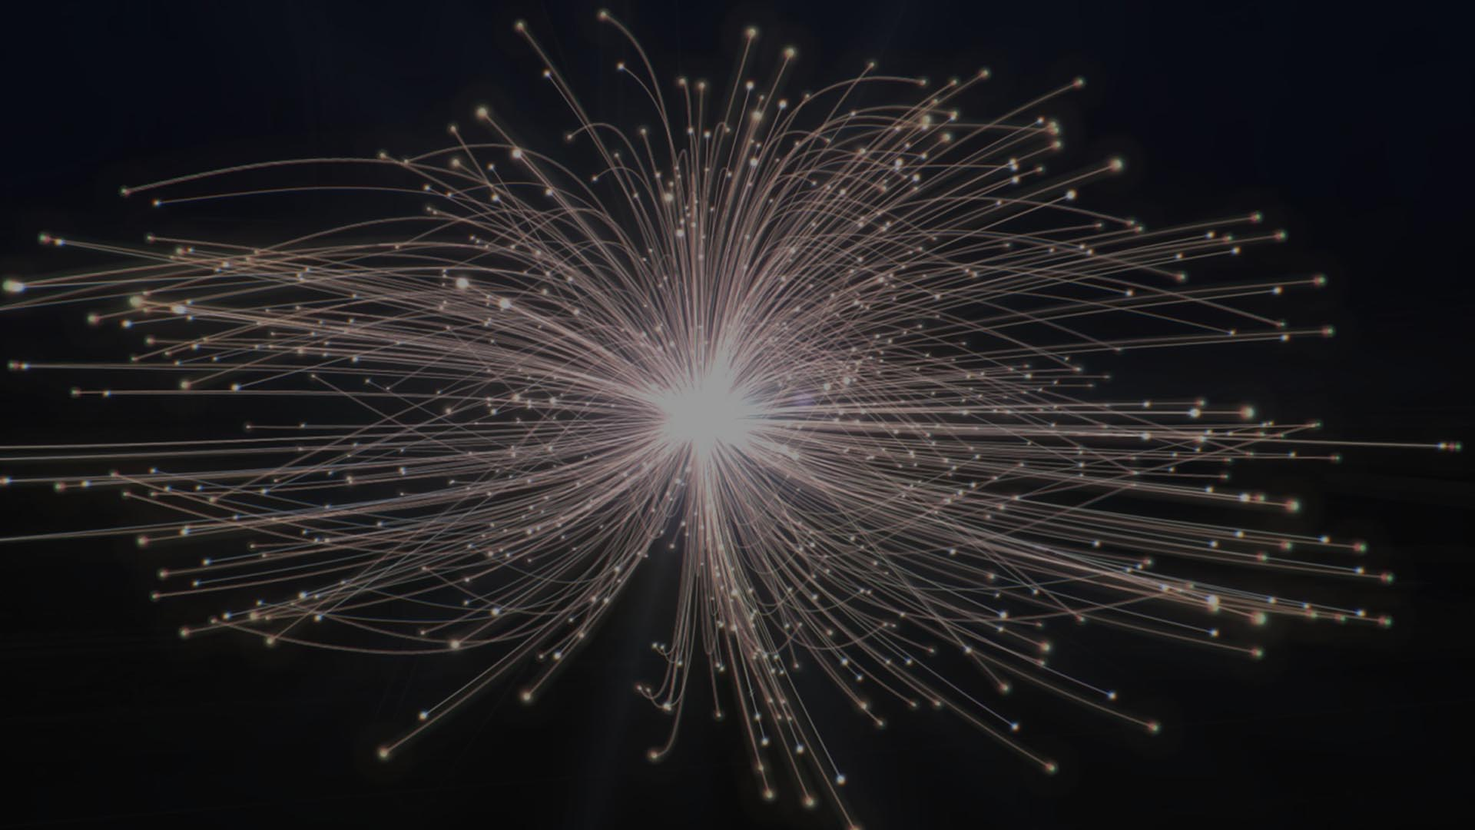
Introduction
20/07/2023 Transfer of Status
John P T Salvesen

Slide 4
Introduction
20/07/2023 Transfer of Status
John P T Salvesen
Who Am I
Aim: Design of an Interaction Point Collision Feedback System for FCCee
Initial studies into beam-beam effects with a strong-strong beam model have been undertaken
Really fits more into “Task 2.3: Interaction region and machine detector interface design”, but heavy optics input requirements
John Salvesen (Jack)
Doctoral Student in BE-ABP-LAF
DPhil Candidate at University of Oxford
CERN Supervisor: Frank Zimmermann
University Supervisor: Phil Burrows

Slide 5
Beam-beam Interaction Simulations
20/07/2023 Transfer of Status
John P T Salvesen

Slide 6
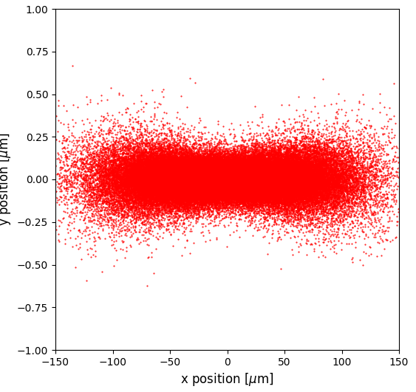
Strong-Strong simulation with GUINEA PIG
20/07/2023 Transfer of Status
John P T Salvesen
Strong-Strong model for colliding beams
  Solves Poisson’s Equation on a 3D mesh
Including:
  Beamstrahlung
  Production of coherent and incoherent pairs
Limitations
Single bunch crossings
No downstream bunch tracking (yet)
Using GUINEA-PIG++² (C++ Version)
An example bunch used in GUINEA-PIG
100,000 macroparticles shown

Slide 7
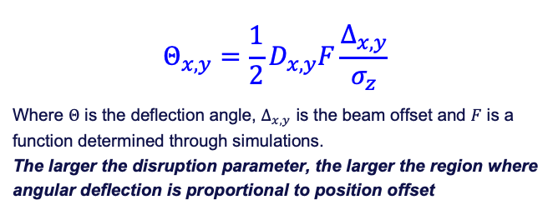
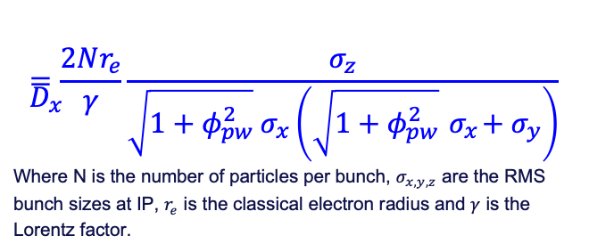
Beam-beam Effects
20/07/2023 Transfer of Status
John P T Salvesen
The collision area is much shorter than the bunch length due to the crossing angle.
Several key effects at play :
  The hourglass effect (focusing)
  Dynamic Beta (beta dependance on beam-beam)
  Loss of dynamic aperture (chaotic motion)
  Emittance blowup
Strength of beam-beam effects quantified by the Disruption Factor
  Large disruption parameters in y throughout
The Disruption Factor- adjusted for x
$$D_{x}=\frac{2Nr_{e}}{γ}\frac{σ_{z}}{{\sqrt{1+φ_{pw}^{2}} σ}_{x}\left(\sqrt{1+φ_{pw}^{2}}{ σ}_{x}+σ_{y}\right)}$$
Where N is the number of particles per bunch, $σ_{x,y,z}$ are the RMS bunch sizes at IP, $r_{e}$ is the classical electron radius and $γ$ is the Lorentz factor.
Beam-beam deflection
$$Θ_{x,y}=\frac{1}{2}D_{x,y}F\frac{Δ_{x,y}}{σ_{z}}$$
Where $Θ$ is the deflection angle, $Δ_{x,y}$ is the beam offset and $F$ is a function determined through simulations.
The larger the disruption parameter, the larger the region where angular deflection is proportional to position offset
Parameter | Z | WW | ZH | tt
D_{x} | 0.0038 | 0.0040 | 0.0025 | 0.0020
D_{y} | 0.9241 | 1.8747 | 0.8801 | 1.5715

Slide 8
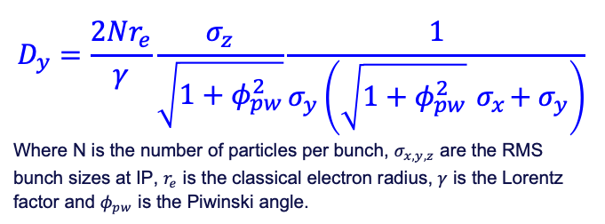
Beam-beam Effects
20/07/2023 Transfer of Status
John P T Salvesen
The collision area is much shorter than the bunch length due to the crossing angle.
Several key effects at play :
  The hourglass effect (focusing)
  Dynamic Beta (beta dependance on beam-beam)
  Loss of dynamic aperture (chaotic motion)
  Emittance blowup
Strength of beam-beam effects quantified by the Disruption Factor
  Large disruption parameters in y throughout
The Disruption Factor- Adjusted for y
$$D_{y}=\frac{2Nr_{e}}{γ}\frac{σ_{z}}{\sqrt{1+φ_{pw}^{2}}}\frac{1}{σ_{y}\left(\sqrt{1+φ_{pw}^{2}}{ σ}_{x}+σ_{y}\right)}$$
Where N is the number of particles per bunch, $σ_{x,y,z}$ are the RMS bunch sizes at IP, $r_{e}$ is the classical electron radius, $γ$ is the Lorentz factor and $φ_{pw}$ is the Piwinski angle.
Beam-beam deflection
$$Θ_{x,y}=\frac{1}{2}D_{x,y}F\frac{Δ_{x,y}}{σ_{z}}$$
Where $Θ$ is the deflection angle, $Δ_{x,y}$ is the beam offset and $F$ is a function determined through simulations.
The larger the disruption parameter, the larger the region where angular deflection is proportional to position offset
Parameter | Z | WW | ZH | tt
D_{x} | 0.0038 | 0.0040 | 0.0025 | 0.0020
D_{y} | 0.9241 | 1.8747 | 0.8801 | 1.5715

Slide 9
Deflection Scans
20/07/2023 Transfer of Status
John P T Salvesen

Slide 10
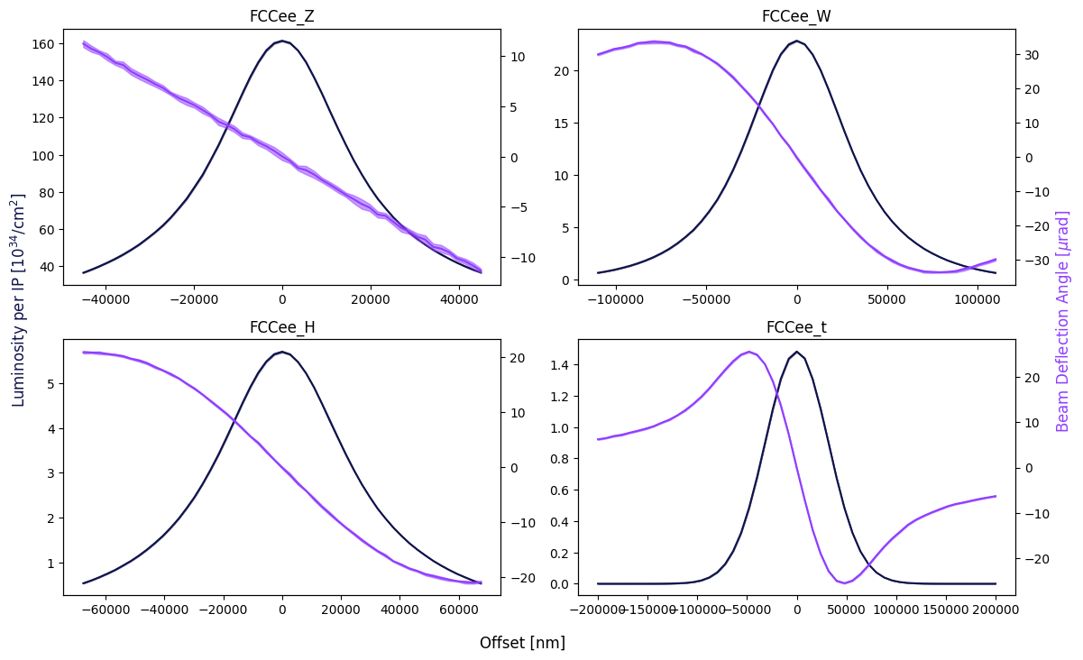
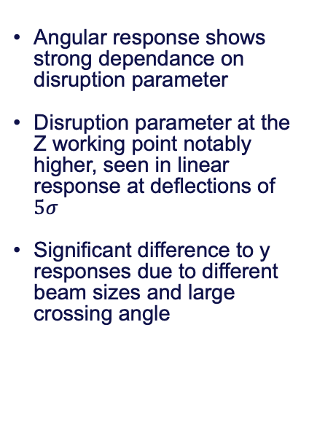
Primary Signal: Beam Deflection
20/07/2023 Transfer of Status
John P T Salvesen
Angular Response at IP
(x offset)
Angular response shows strong dependance on disruption parameter
Disruption parameter at the Z working point notably higher, seen in linear response at deflections of $5σ$
Significant difference to y responses due to different beam sizes and large crossing angle

Slide 11
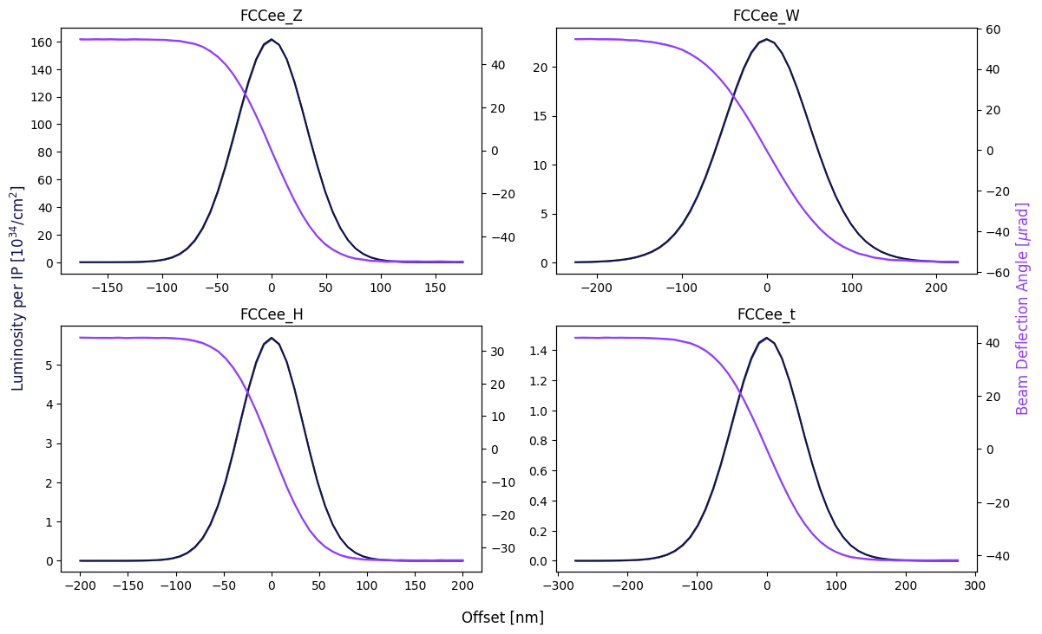
Primary Signal: Beam Deflection
20/07/2023 Transfer of Status
John P T Salvesen
Angular Response at IP
(y offset)
All working points show similar behavior
Large disruption parameters in all cases
Potential for significant instability at these disruption parameters (especially Z)
All curves expected to return to 0 angle for high enough deflection

Slide 12
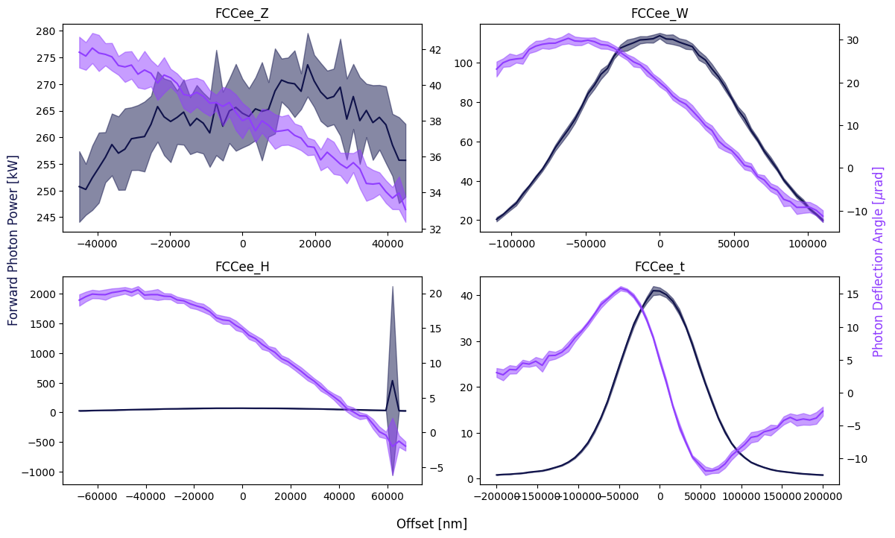
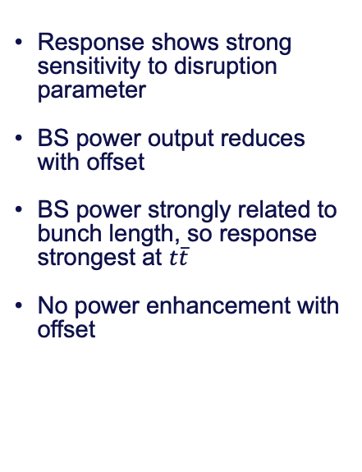
Secondary Signal: Beamstrahlung Photons
20/07/2023 Transfer of Status
John P T Salvesen
IP Beamstrahlung Emission
(x offset, x angle)
Response shows strong sensitivity to disruption parameter
BS power output reduces with offset
BS power strongly related to bunch length, so response strongest at $t\overline{t}$
No power enhancement with offset

Slide 13
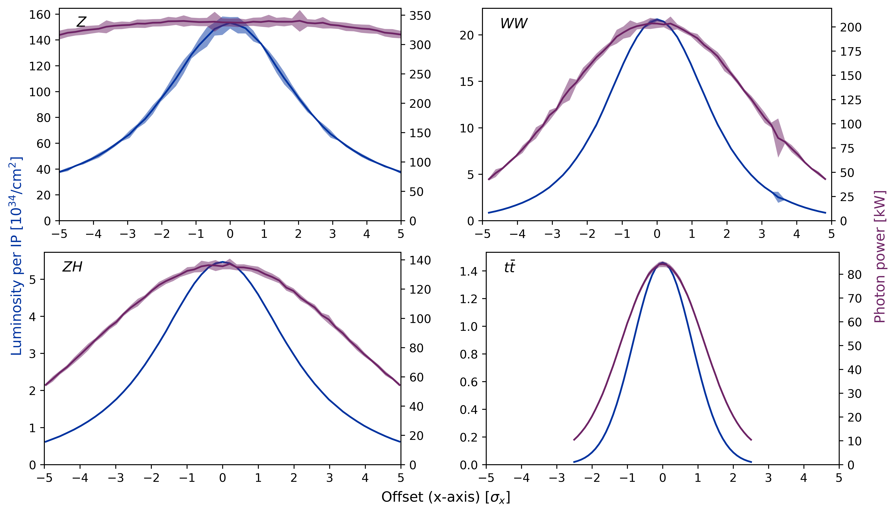
Secondary Signal: Beamstrahlung Photons
20/07/2023 Transfer of Status
John P T Salvesen
IP Beamstrahlung Emission
(x offset, x angle)
Previous scans (FCC week)
Power here is total per IP, not directional
Data shown post filtering
Now no longer using filtering process, but need grid resizing for x

Slide 14
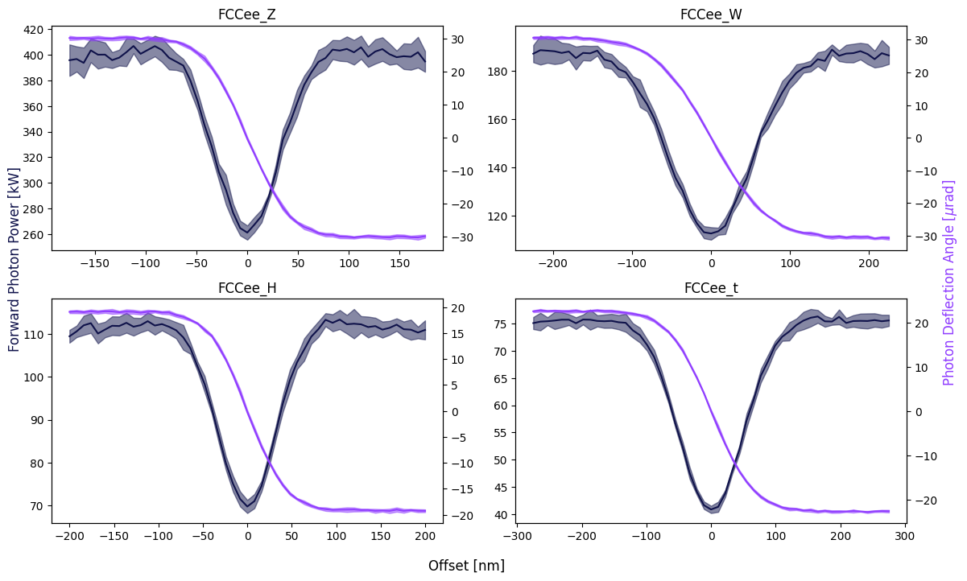
Secondary Signal: Beamstrahlung Photons
20/07/2023 Transfer of Status
John P T Salvesen
IP Beamstrahlung Emission
(y offset, y angle)
All working points show similar behavior
Offsets close to 0 cause significant enhancement in BS power
Power enhanced as beams see the full charge/field of opposing beam
Power output is expected to return to 0 with significant offset

Slide 15
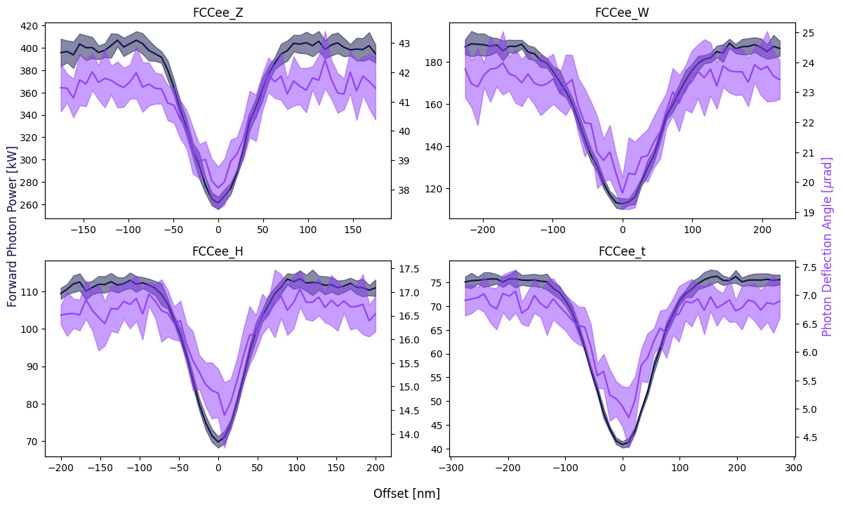
Secondary Signal: Beamstrahlung Photons
20/07/2023 Transfer of Status
John P T Salvesen
IP Beamstrahlung Emission
(y offset, x angle)
While just noise is seen in the y angle with x offset, there is a trend in x angle with y offset
The x angle is linked to the power output, and as such varies in line with the BS power

Slide 16
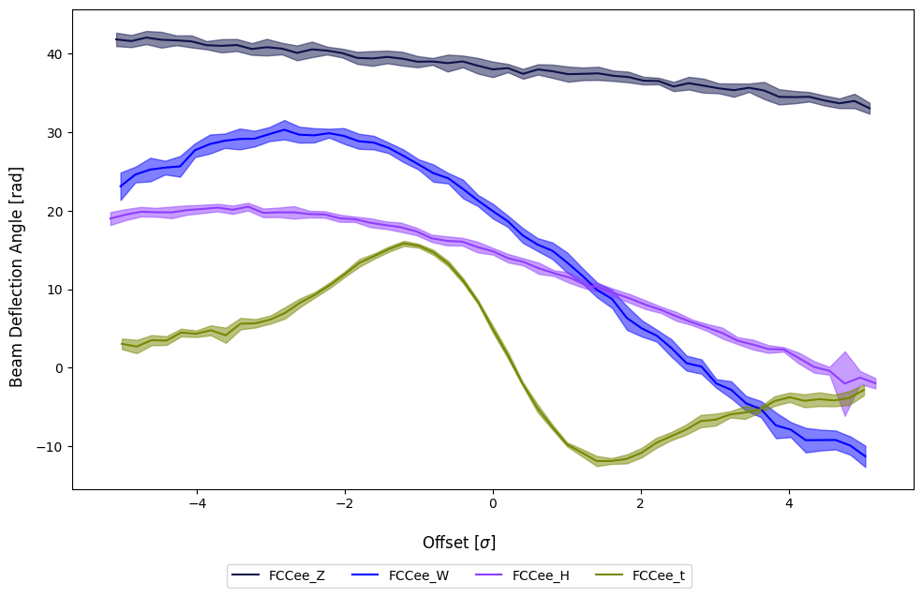
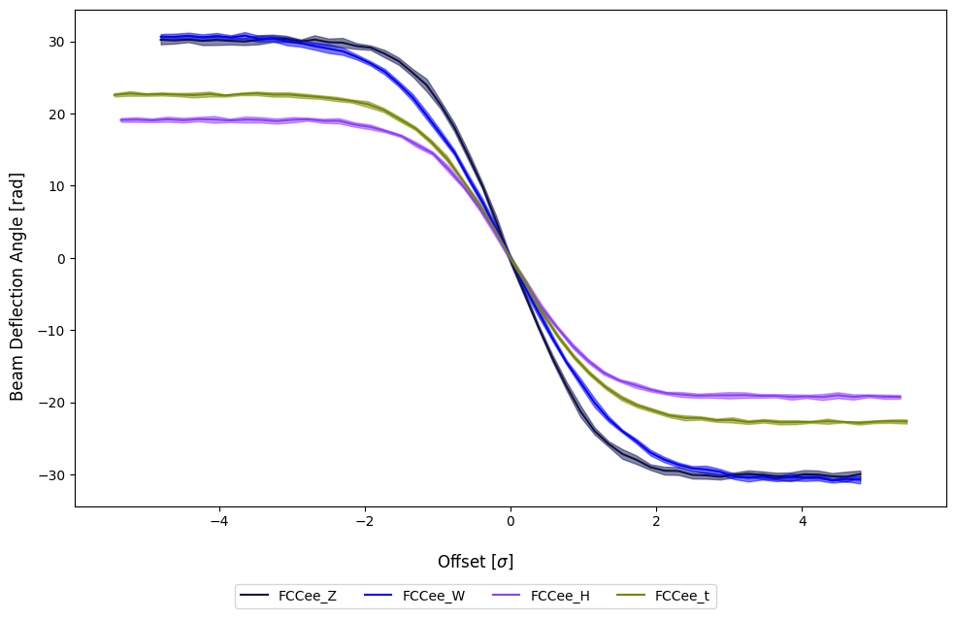
Secondary Signal: Beamstrahlung Photons
20/07/2023 Transfer of Status
John P T Salvesen
N.B. From previous angle scans, offsets in y centre on 0, while there is a ‘centre of mass’ to the photon offset, dependent on the beam energy
Left: x offsets, x angles
Right: y offsets, y angles

Slide 17
Crab Waist Modelling
20/07/2023 Transfer of Status
John P T Salvesen

Slide 18

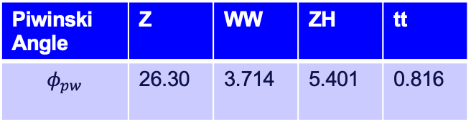
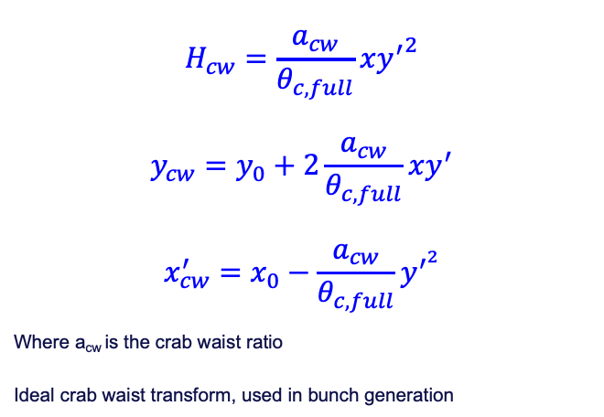
Crab Waist Modelling
20/07/2023 Transfer of Status
John P T Salvesen
Crab Waist Transform
$$H_{cw}=\frac{a_{cw}}{θ_{c, full}}x{y^{′}}^{2}$$
$$y_{cw}=y_{0}+2\frac{a_{cw}}{θ_{c, full}}xy^{′}$$
$$x_{cw}^{′}=x_{0}−\frac{a_{cw}}{θ_{c, full}}y^{′^{2}}$$
Where a_{cw} is the crab waist ratio
Ideal crab waist transform, used in bunch generation
Crab waist transform applied to ideal Gaussian Beams
Transform applied ‘ideally’- not tracked through magnets but applied as mathematical transform
Impact quantified by Piwinski angle
Piwinski Angle | Z | WW | ZH | tt
$$φ_{pw}$$ | 26.30 | 3.714 | 5.401 | 0.816
Piwinski Angle
$$φ_{pw}=\frac{θ_{c, full}}{2}\frac{σ_{z}}{σ_{x}}$$

Slide 19
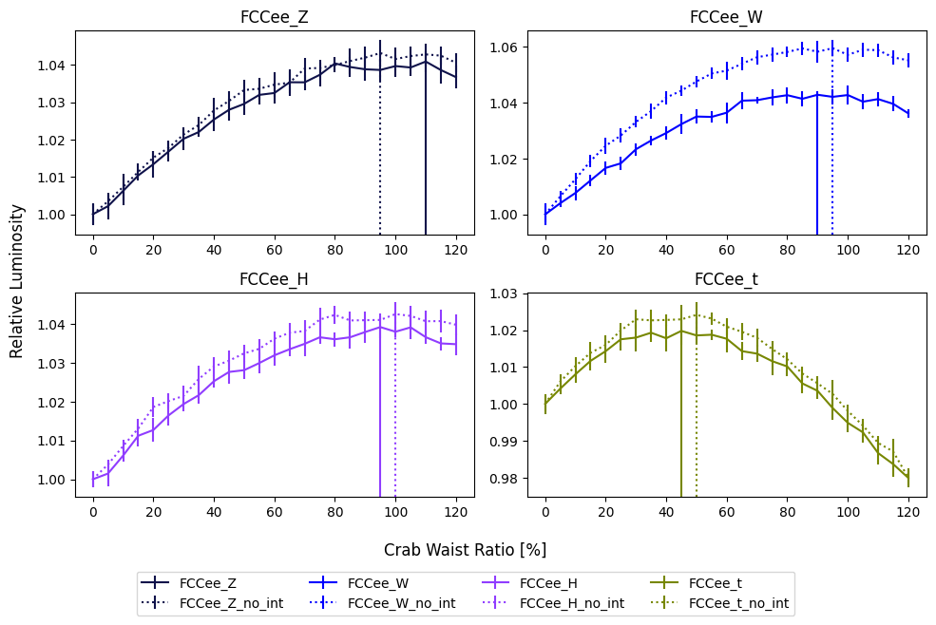
Luminosity Maximisation with Crab Waist
20/07/2023 Transfer of Status
John P T Salvesen
Scans in Crab Waist %
Applied as ideal transform to Gaussian bunch

Slide 20
Luminosity Enhancement
20/07/2023 Transfer of Status
John P T Salvesen

Slide 21
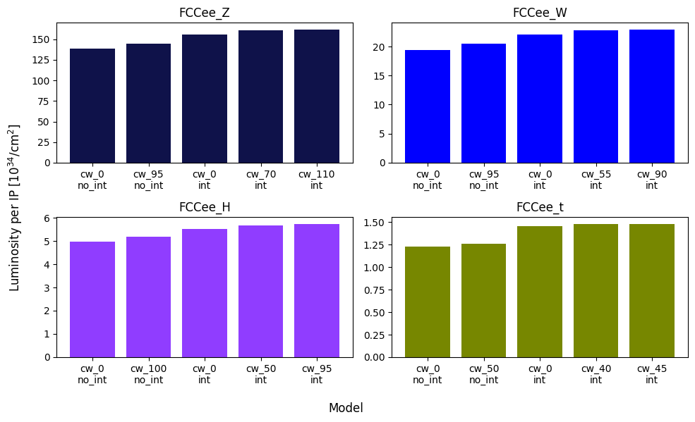
20/07/2023 Transfer of Status
John P T Salvesen
Luminosity Enhancement
Both Crab Waist and Strong-Strong beam effects cause luminosity enhancement
N.B. results here are all comparisons for ideal case, no machine errors yet simulated

Slide 22
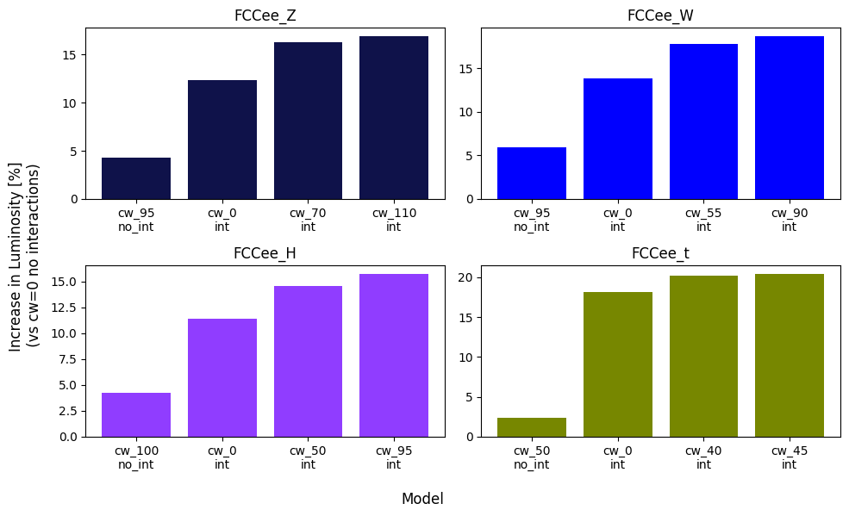
20/07/2023 Transfer of Status
John P T Salvesen
Luminosity Enhancement
Both Crab Waist and Strong-Strong beam effects cause luminosity enhancement
N.B. results here are all comparisons for ideal case, no machine errors yet simulated

Slide 23
Conclusions
20/07/2023 Transfer of Status
John P T Salvesen

Slide 24
Conclusion and Future Plans
20/07/2023 Transfer of Status
John P T Salvesen
Conclusions
Next Stages
Angular deflection shows strong linearity for small offsets, before becoming strongly non-linear.
  This is encouraging for the use of downstream BPMs to measure IP offset.
BS radiation shows strong dependence on offset. It may be possible to use a Beamstrahlung monitor to measure beam properties at IP.
  The high power output BS radiation poses a serious technical challenge to such a monitor.
  More realistic bunch models
      Downstream Bunch Tracking
        Multi-turn tracking
        Ground motion model
        BPM locations

Slide 25
Thank you for your attention.
20/07/2023 Transfer of Status
John P T Salvesen
25

Slide 26
Appendices
20/07/2023 Transfer of Status
John P T Salvesen

Slide 27
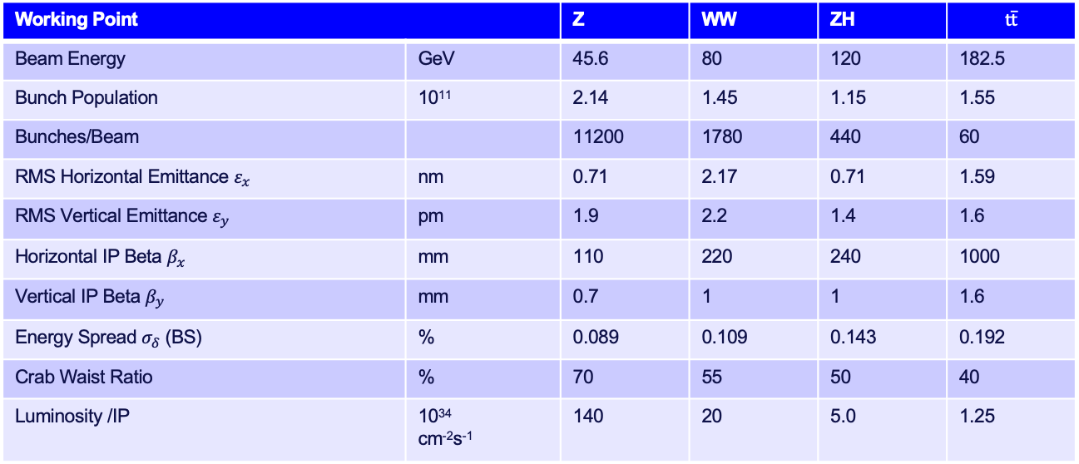
Parameters Used
20/07/2023 Transfer of Status
John P T Salvesen
Working Point |  | Z | WW | ZH | $$\text{t}\overline{\text{t}}$$
Beam Energy | GeV | 45.6 | 80 | 120 | 182.5
Bunch Population | 10¹¹ | 2.14 | 1.45 | 1.15 | 1.55
Bunches/Beam |  | 11200 | 1780 | 440 | 60
RMS Horizontal Emittance $ε_{x}$ | nm | 0.71 | 2.17 | 0.71 | 1.59
RMS Vertical Emittance $ε_{y}$ | pm | 1.9 | 2.2 | 1.4 | 1.6
Horizontal IP Beta $β_{x}$ | mm | 110 | 220 | 240 | 1000
Vertical IP Beta $β_{y}$ | mm | 0.7 | 1 | 1 | 1.6
Energy Spread $σ_{δ}$ (BS) | % | 0.089 | 0.109 | 0.143 | 0.192
Crab Waist Ratio | % | 70 | 55 | 50 | 40
Luminosity /IP | 10³⁴ cm⁻²s⁻¹ | 140 | 20 | 5.0 | 1.25
Machine parameters used throughout
Assuming layout PA31-3.0, with 4IPs

Slide 28
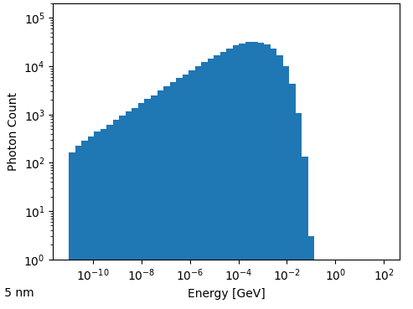
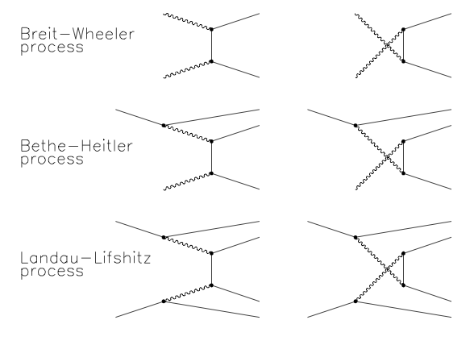

Radiation Emission
20/07/2023 Transfer of Status
John P T Salvesen
Photon Radiation
Synchrotron/ Bremsstrahlung radiation is emitted as the beams are bent into the IP
  Mostly Stopped by collimators
  K Andre Studies not included here
Beamstrahlung constitutes the bulk of the radiation power
Pair Production
Pairs are produced coherently by BS photons in strong EM beam fields and incoherently from colliding photons
Other
Hadronic jets are also produced at IP
1. D. Schulte, Beam-beam simulations with GUINEA-PIG. No. CERN-PS-99-014-LP. 1999.
Top: Beamstrahlung power spectrum at the $t\overline{t}$ working point
Bottom: Incoherent Pair production processes used in GUINEA-PIG¹

Slide 29
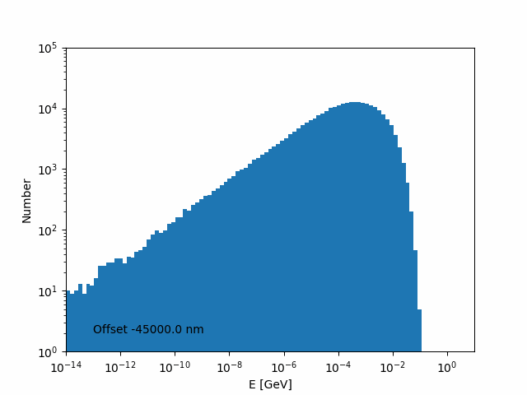
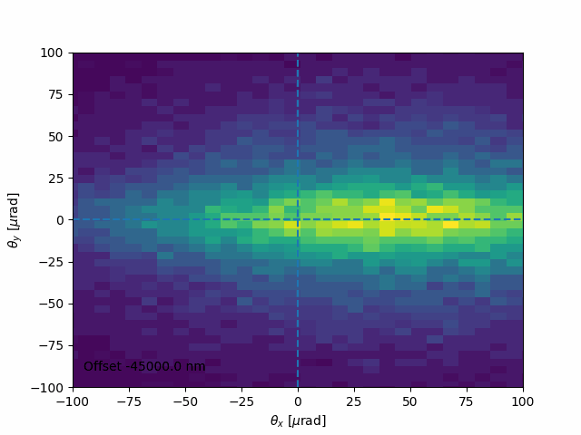
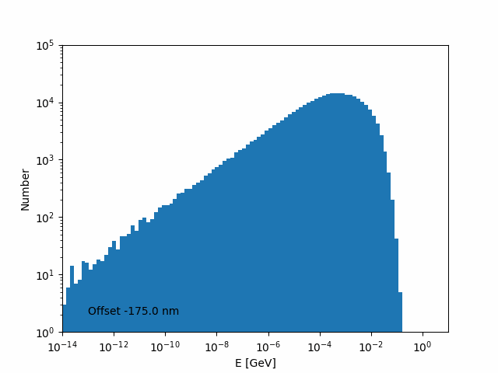
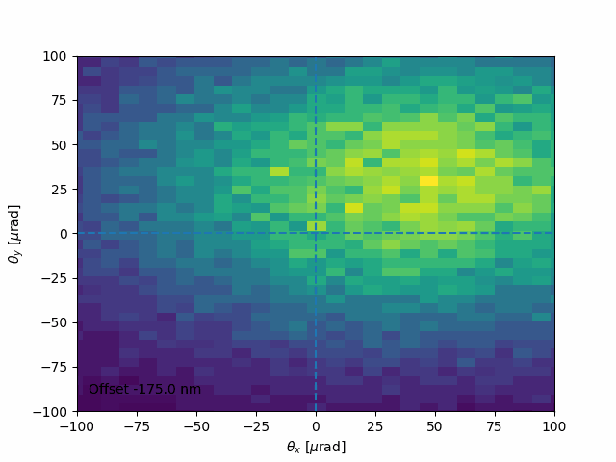
Photon Scans:
20/07/2023 Transfer of Status
John P T Salvesen
Working Point: Z
Top: x offset
Bottom: y offset

Slide 30
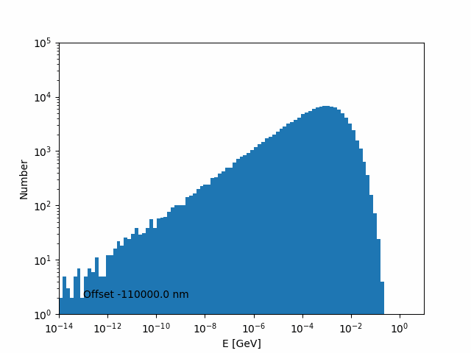
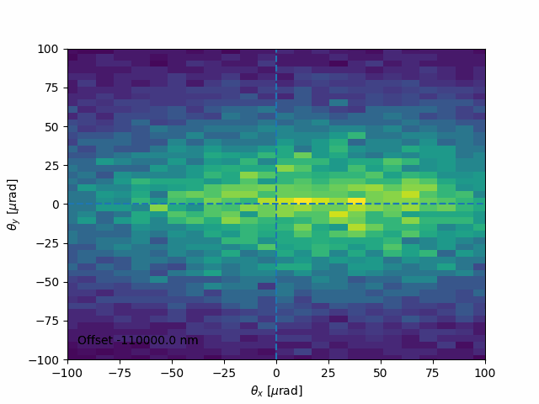
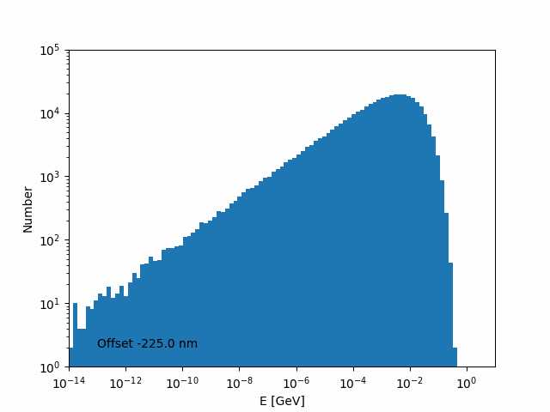
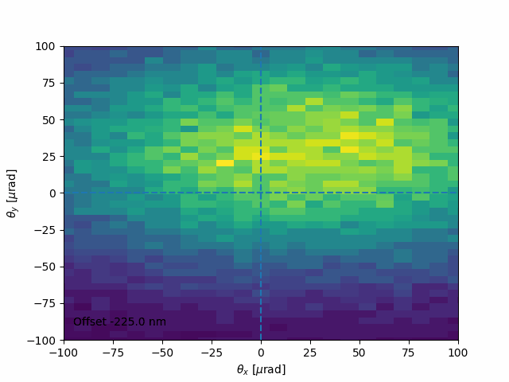
Photon Scans:
20/07/2023 Transfer of Status
John P T Salvesen
Working Point: WW
Top: x offset
Bottom: y offset

Slide 31
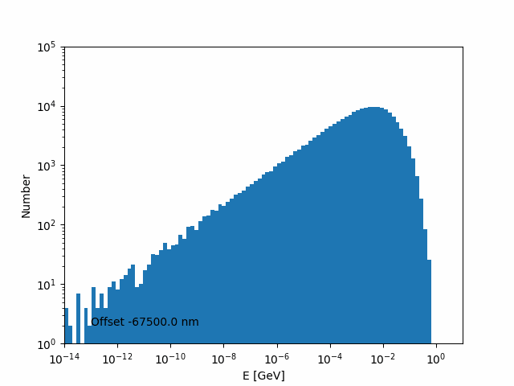
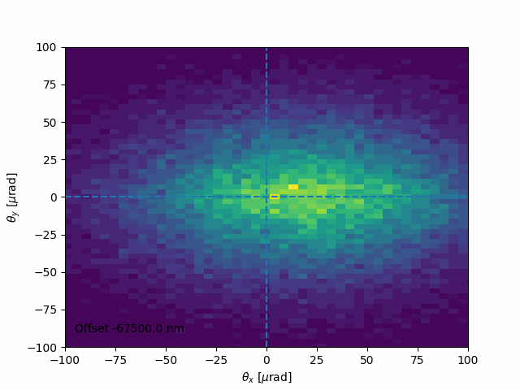
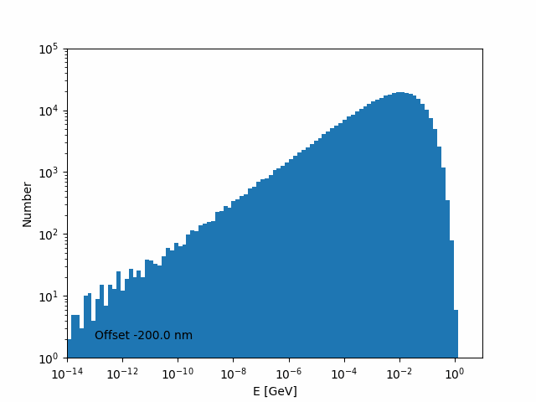
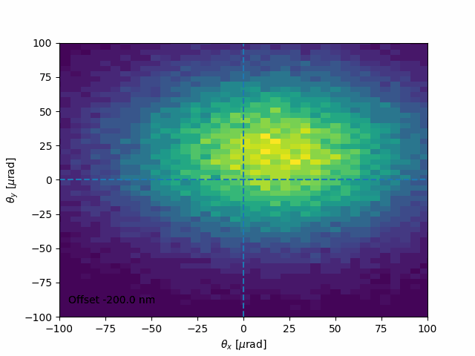
Photon Scans:
20/07/2023 Transfer of Status
John P T Salvesen
Working Point: ZH
Top: x offset
Bottom: y offset

Slide 32
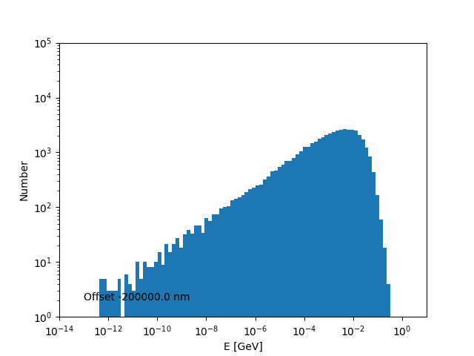
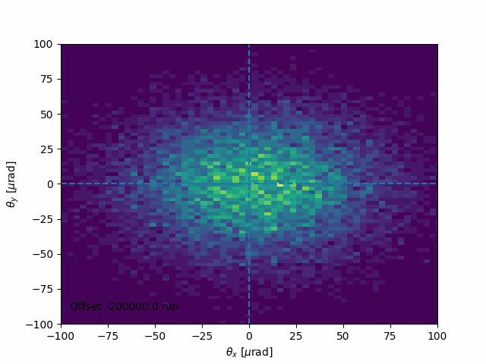
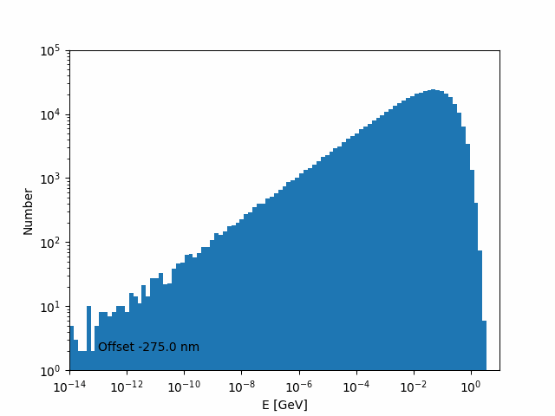
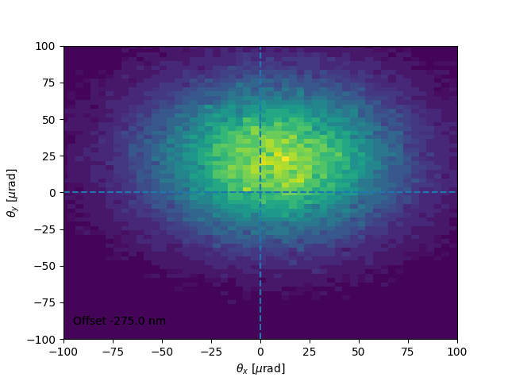
Photon Scans:
20/07/2023 Transfer of Status
John P T Salvesen
Working Point: tt
Top: x offset
Bottom: y offset

