Slide 1
X-Box Update
14.06.2023

Slide 2
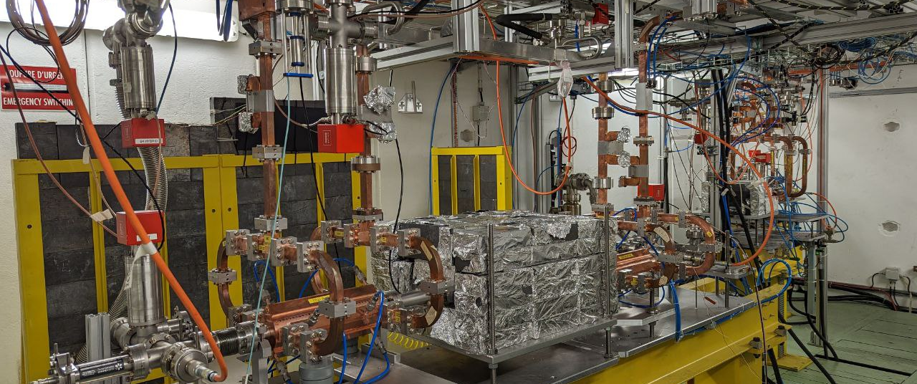
X-Box 2: TD31 N3 N4

Slide 3
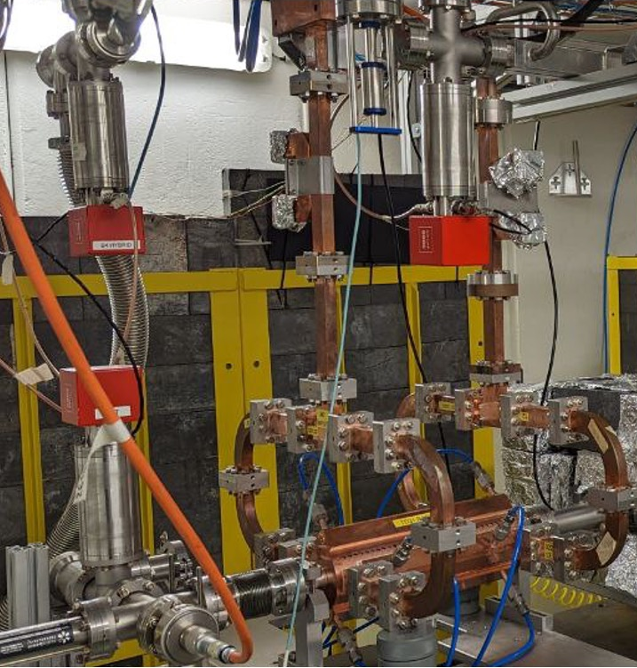
X-Box 2 TD31 N3 N4: Structure A
Restarted 05.06.2023
After general blackout, we restarted on Friday 7th
Currently stuck at 45 MW

Slide 4
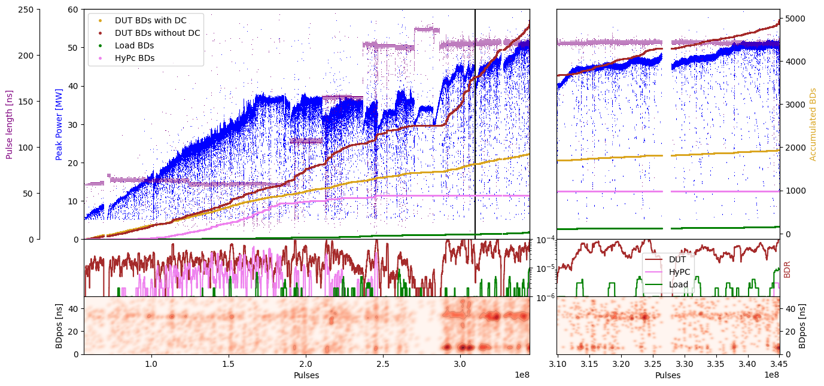
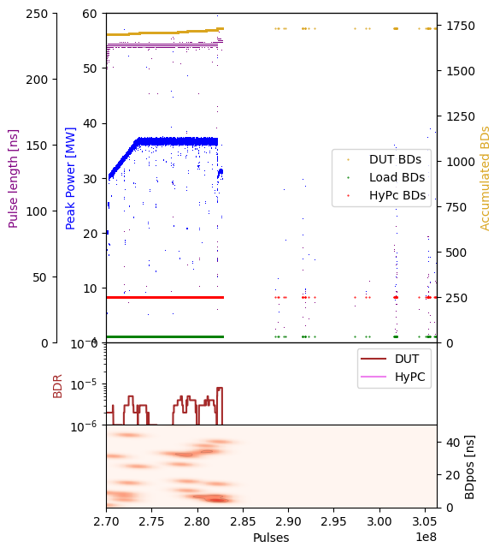
X-Box 2: TD31 N3 N4 Structure A – Peak Power

Slide 5
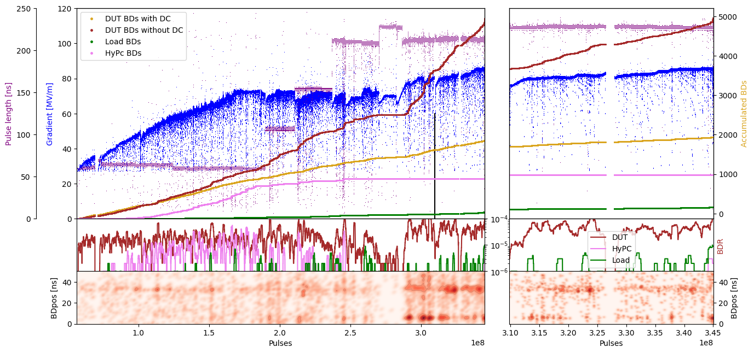
X-Box 2: TD31 N3 N4 Structure A – Gradient

Slide 6
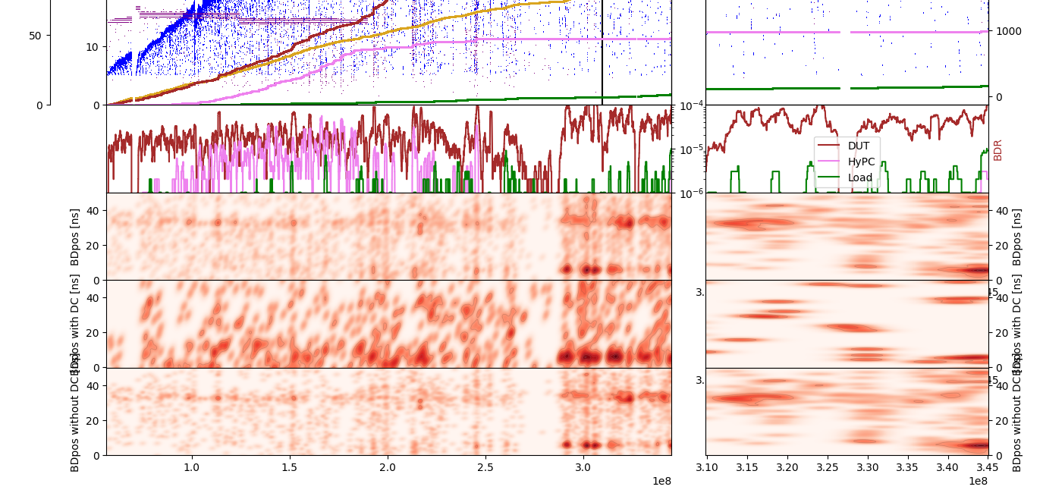
X-Box 2: TD31 N3 N4 Structure A – Pos

Slide 7
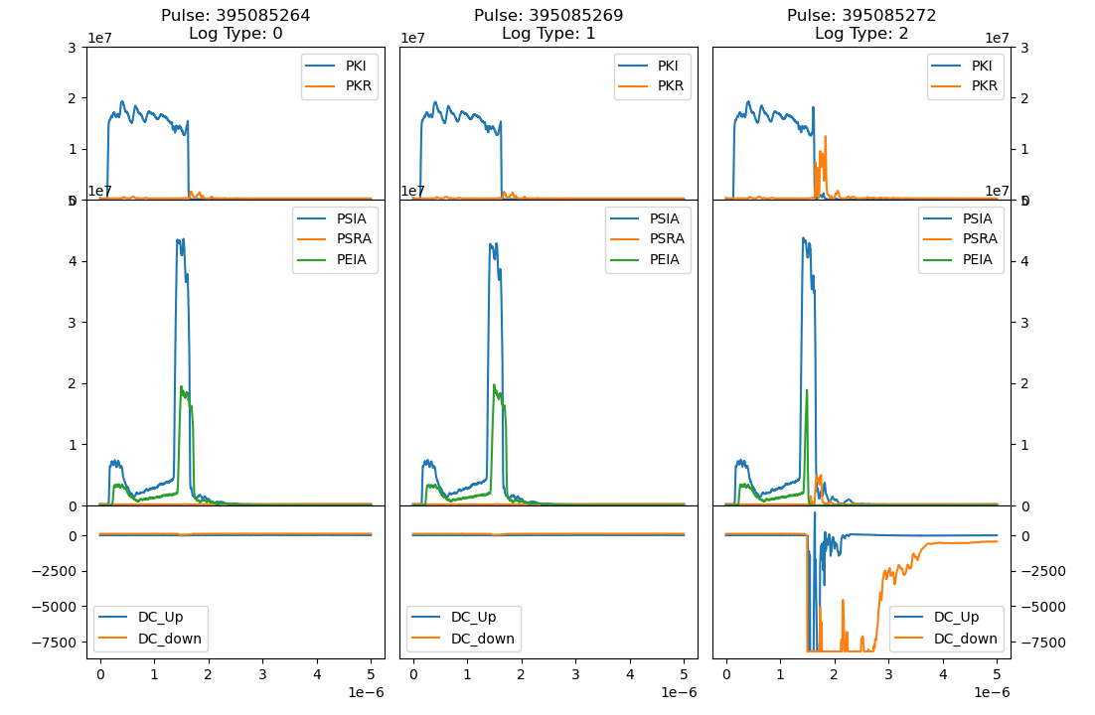
X-Box 2: 07 July 2023 Pulse 395085264

Slide 8
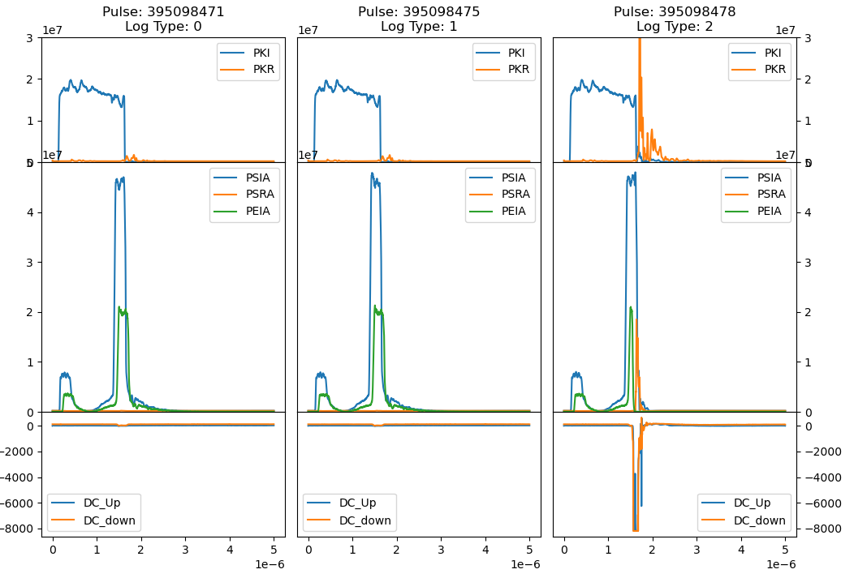
X-Box 2: 07 July 2023 Pulse 395098471

Slide 9
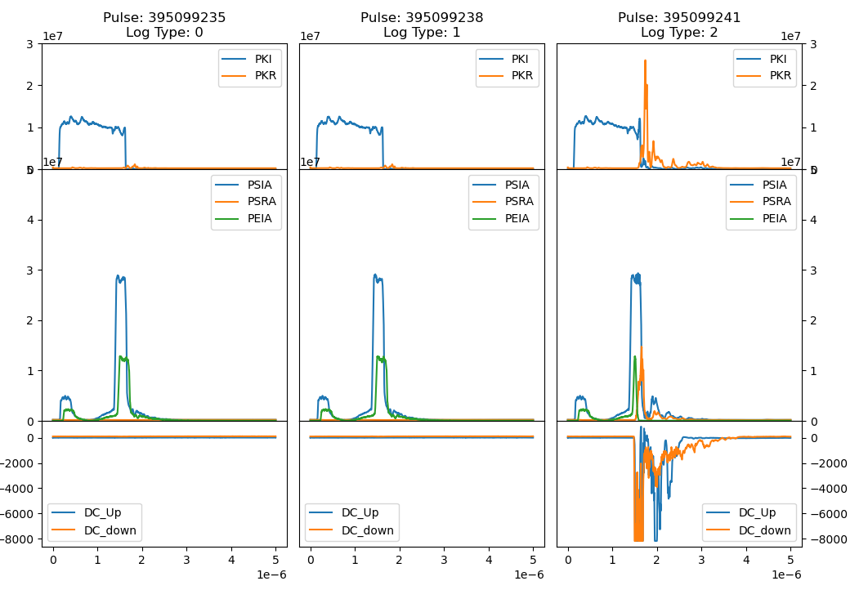
X-Box 2: 07 July 2023 Pulse 395099235

Slide 10
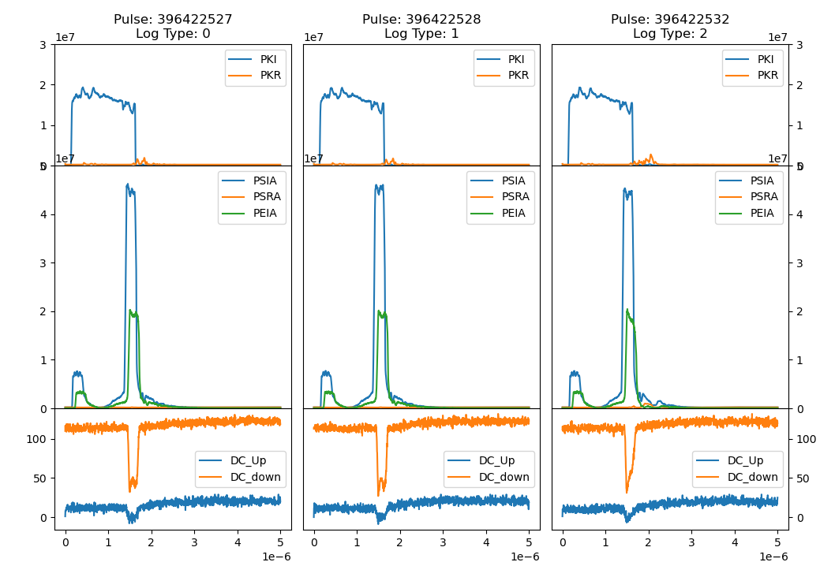
X-Box 2: 08 July 2023 Pulse 396422527

Slide 11
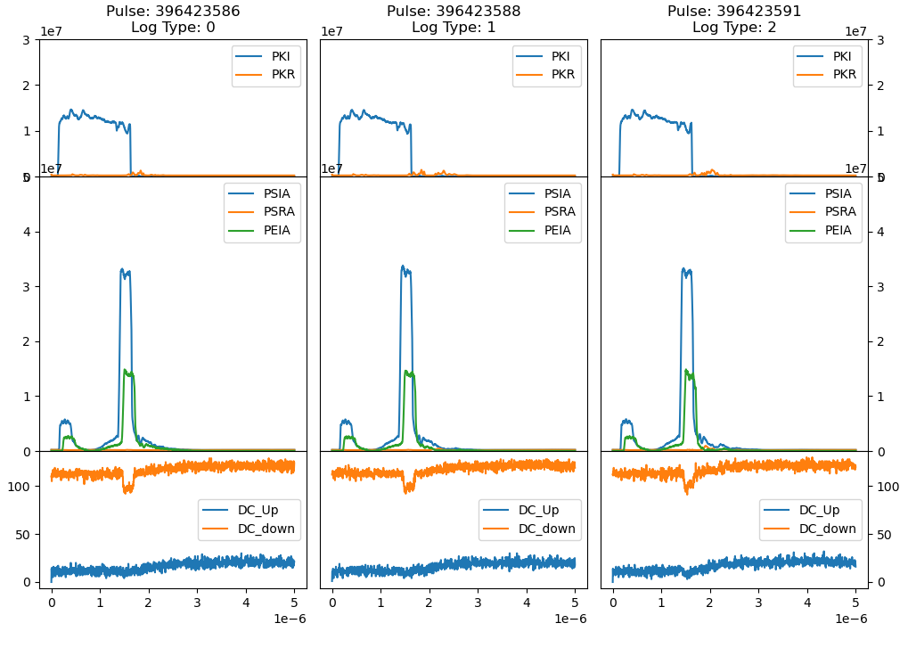
X-Box 2: 08 July 2023 Pulse 396423586

Slide 12
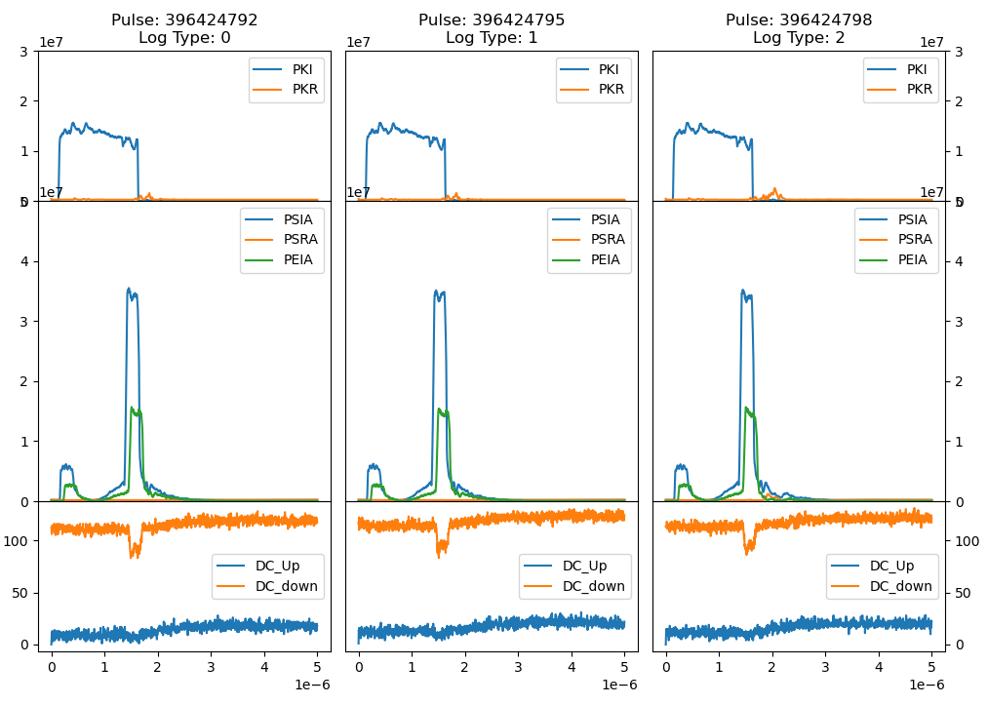
X-Box 2: 08 July 2023 Pulse 396424792

Slide 13
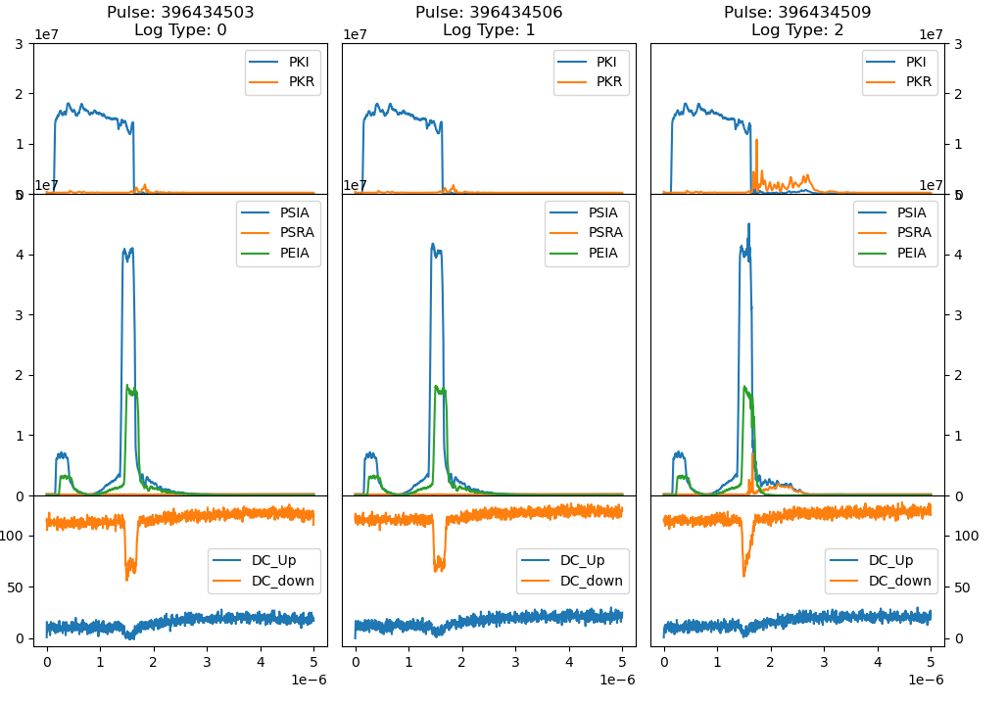
X-Box 2: 08 July 2023 Pulse 395099235

Slide 14
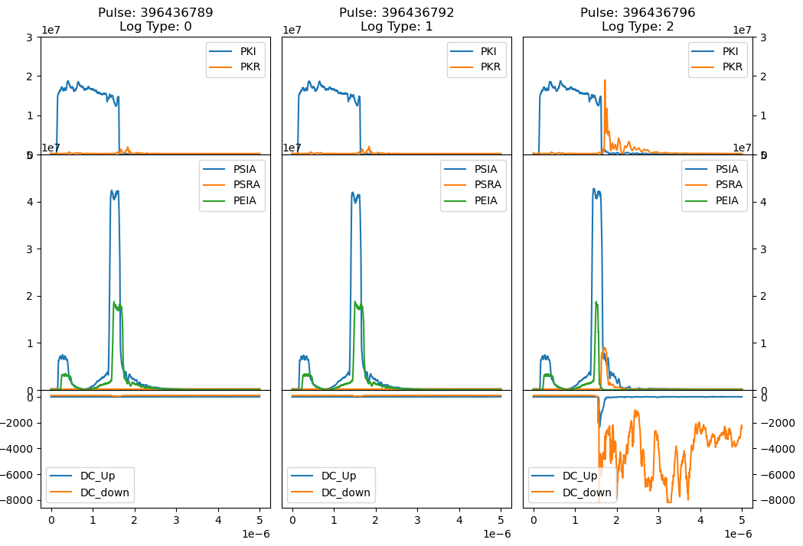
X-Box 2: 08 July 2023 Pulse 396436789

Slide 15
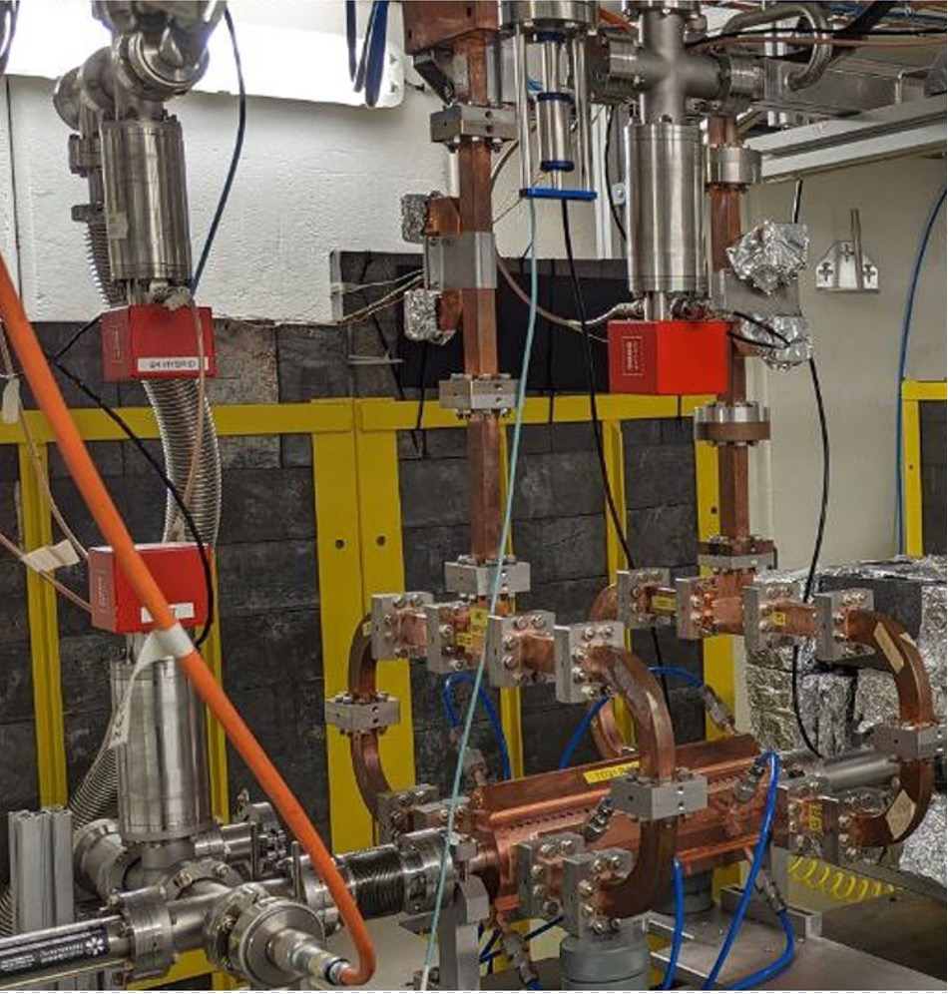
X-Box 2 TD31 N3 N4: Structure B
Restarted 11.07.2023

Slide 16
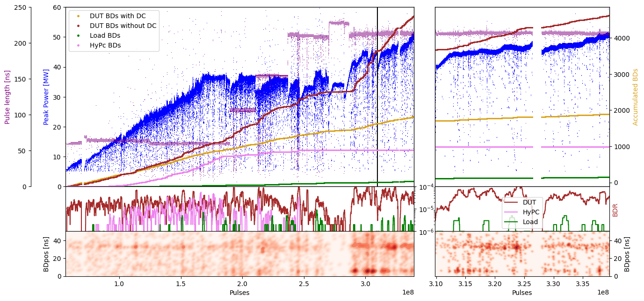
X-Box 2: TD31 N3 N4 Structure B – Peak Power

Slide 17
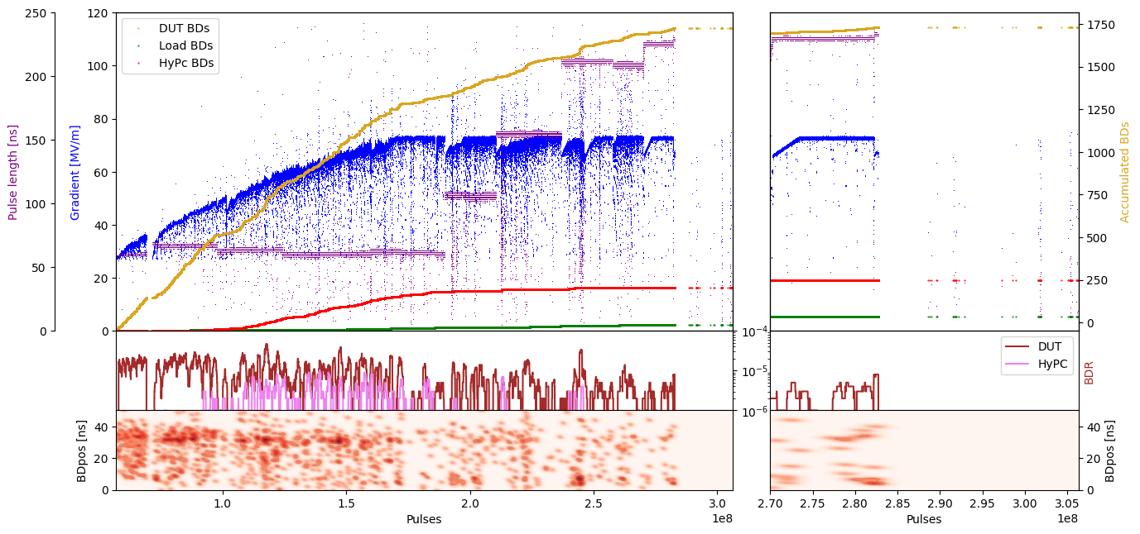
X-Box 2: TD31 N3 N4 Structure B – Gradient

Slide 18
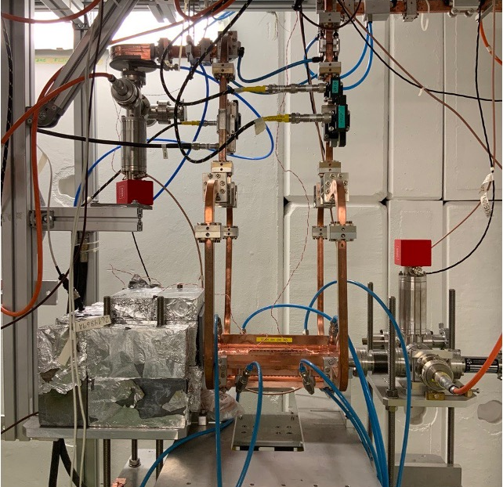
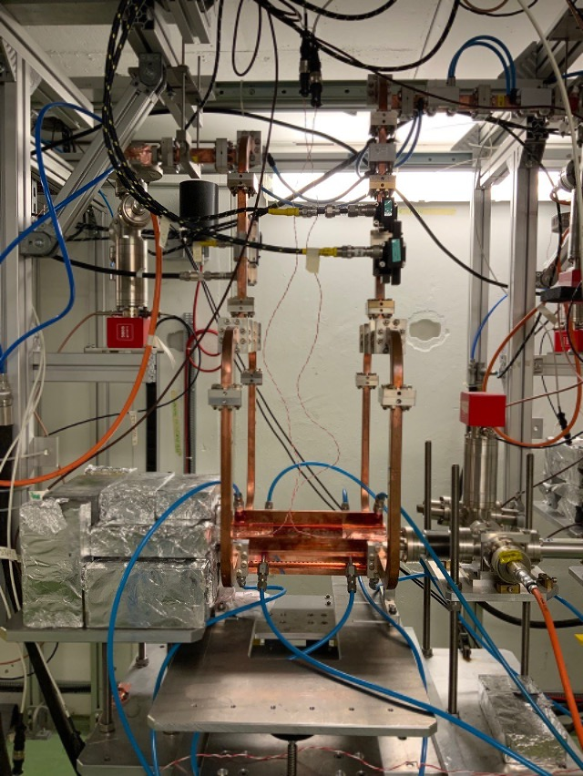
X-Box 3: TD31

Slide 19
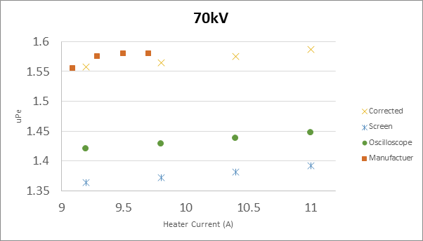
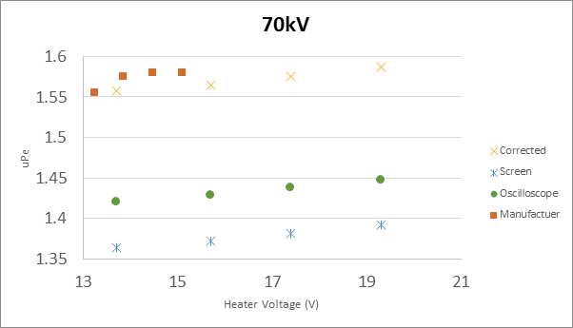
High Efficiency Klystron ER37117 TUBE1
Measurement campaign
Measurements at 70kV (CANON configuration)
Sweep up to current value of 11A, saturation point not found
Calculated uPe differs from Canon value by an 8.4%

Slide 20
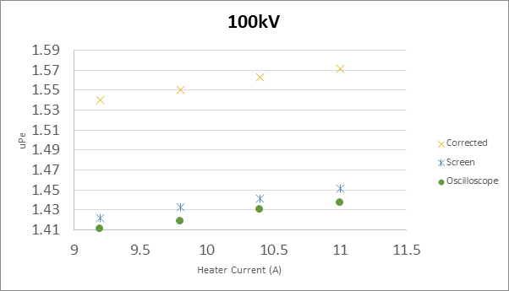
High Efficiency Klystron ER37117 TUBE1
Measurement campaign
Measurements at 100kV
Sweep up to current value of 11A, saturation point not found

Slide 21
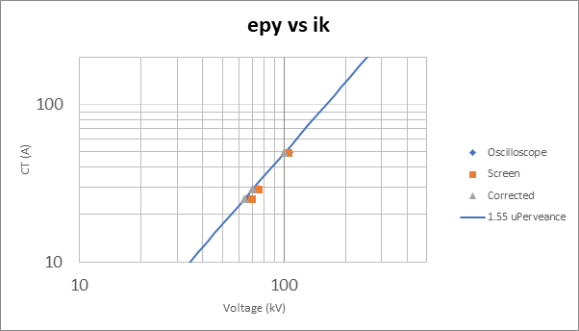
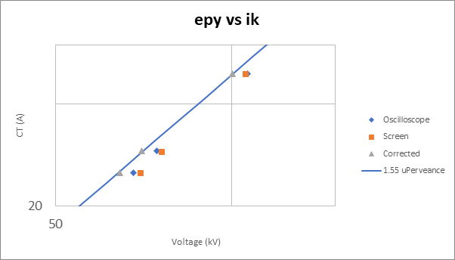
High Efficiency Klystron ER37117 TUBE1
Measurement campaign
Klystron output: voltage vs current curves

Slide 22
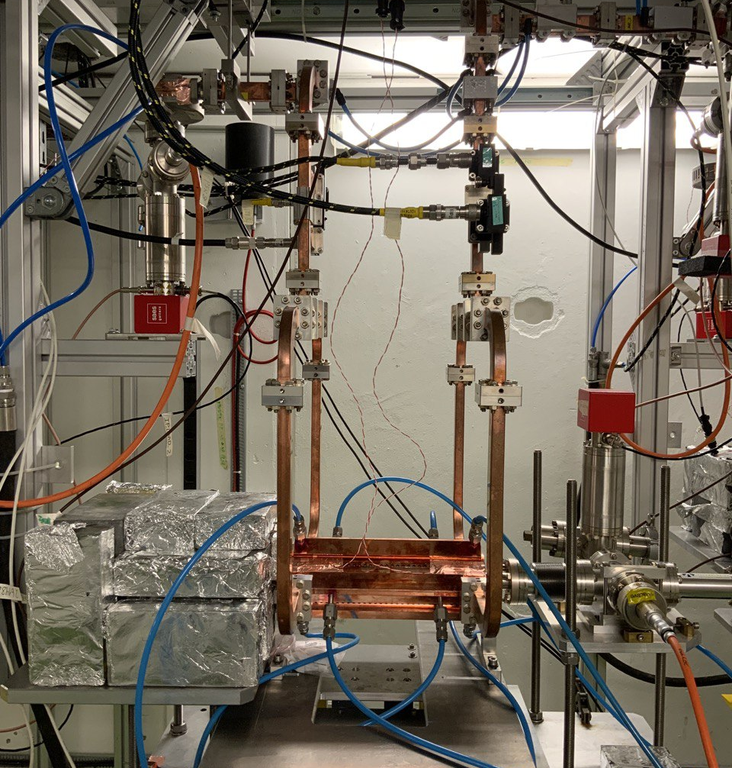
X-Box 3 Line 1: TD31 N1
Shut down

Slide 23
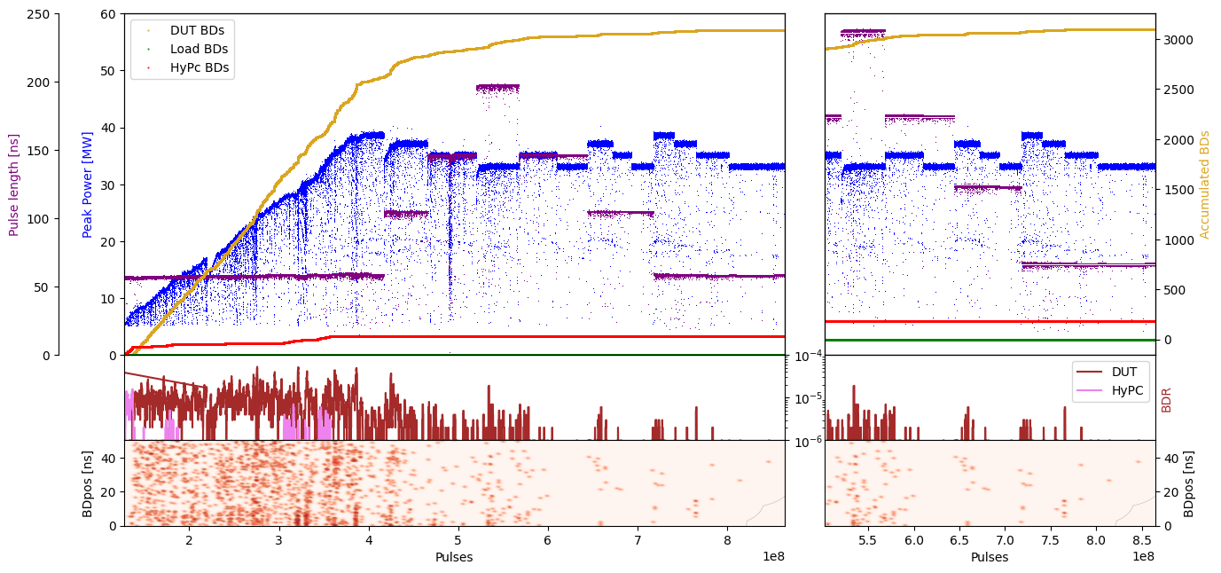
X-Box 3 Line 1: TD31 N1 – Peak Power

Slide 24
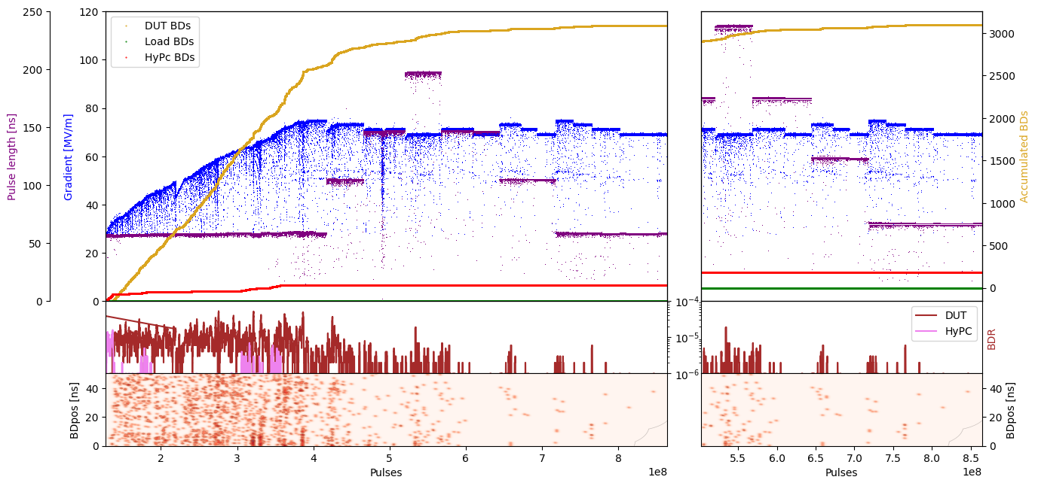
X-Box 3 Line 1: TD31 N1 – Gradient

Slide 25
X-Box 3 Line 2: TD31 N2
Shut down

Slide 26
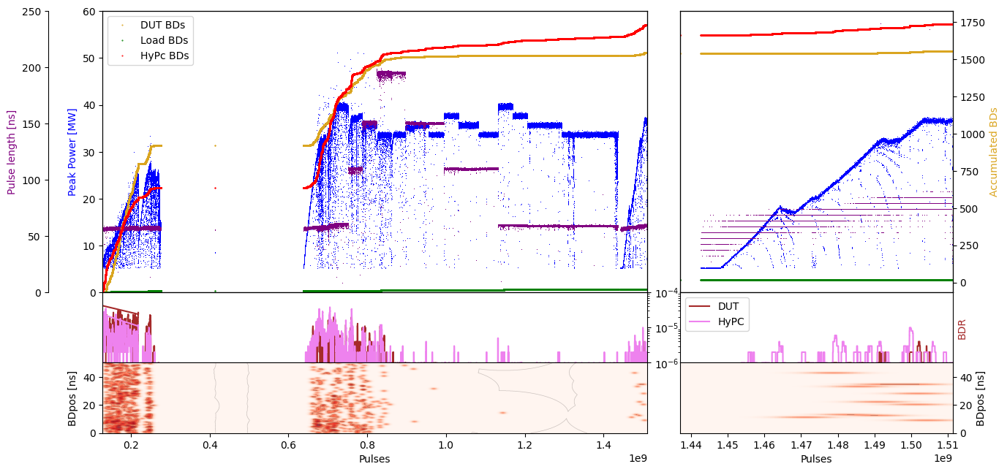
X-Box 3 Line 1: TD31 N2 – Peak Power

Slide 27
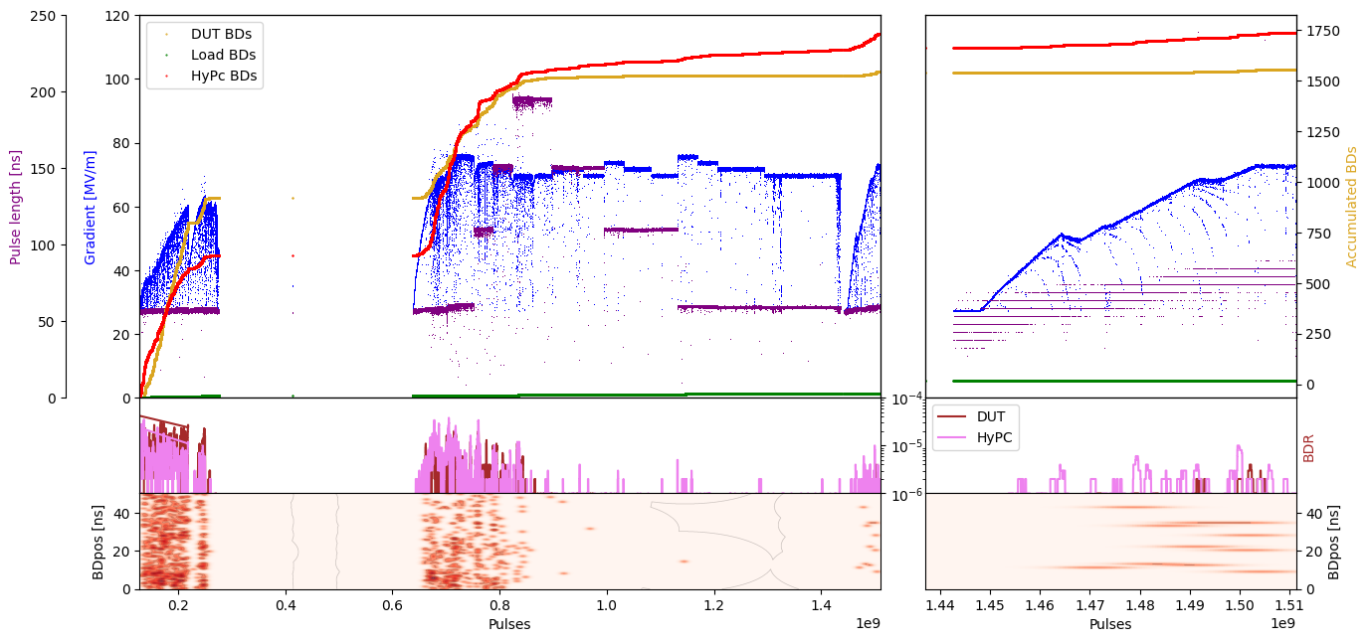
X-Box 3 Line 1: TD31 N2 – Gradient

