Slide 1

CERN support units for
critical WLCG services
WLCG Operations Coordination meeting
13th July 2023
Maarten Litmaath
v1.0

Slide 2
Recap from September 2021
WLCG critical services Twiki page:
  Each service name now links to instructions on how to open a ticket for the corresponding service
    Mostly via GGUS, in some cases via SNow
    For SNow, a dedicated form is used to have relevant experts notified directly
  Those instructions are grouped together on a dedicated new page:
    https://twiki.cern.ch/twiki/bin/view/LCG/WLCGggusSNow
  That page has been replicated into a SNow Knowledge Base article:
    https://cern.service-now.com/service-portal/?id=kb_article&n=KB0007528
    It will be updated manually when needed
    The Twiki source is versioned, the KB article does not support versioning
  The instructions are thus available from 2 independent domains
  For CERN services also the corresponding SNow Functional Elements and/or Service Elements are listed
    That information is for the IT Department groups providing the services

Slide 3
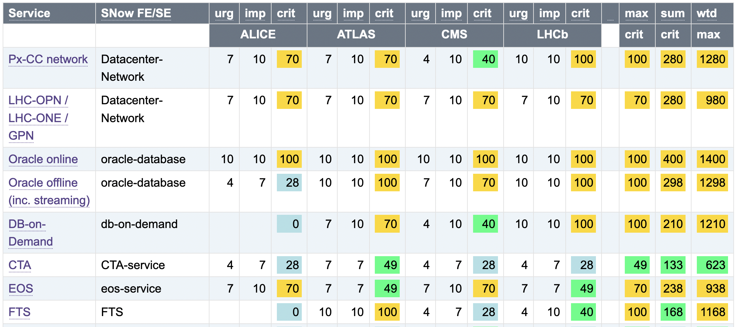
Critical services at CERN
…

Slide 4
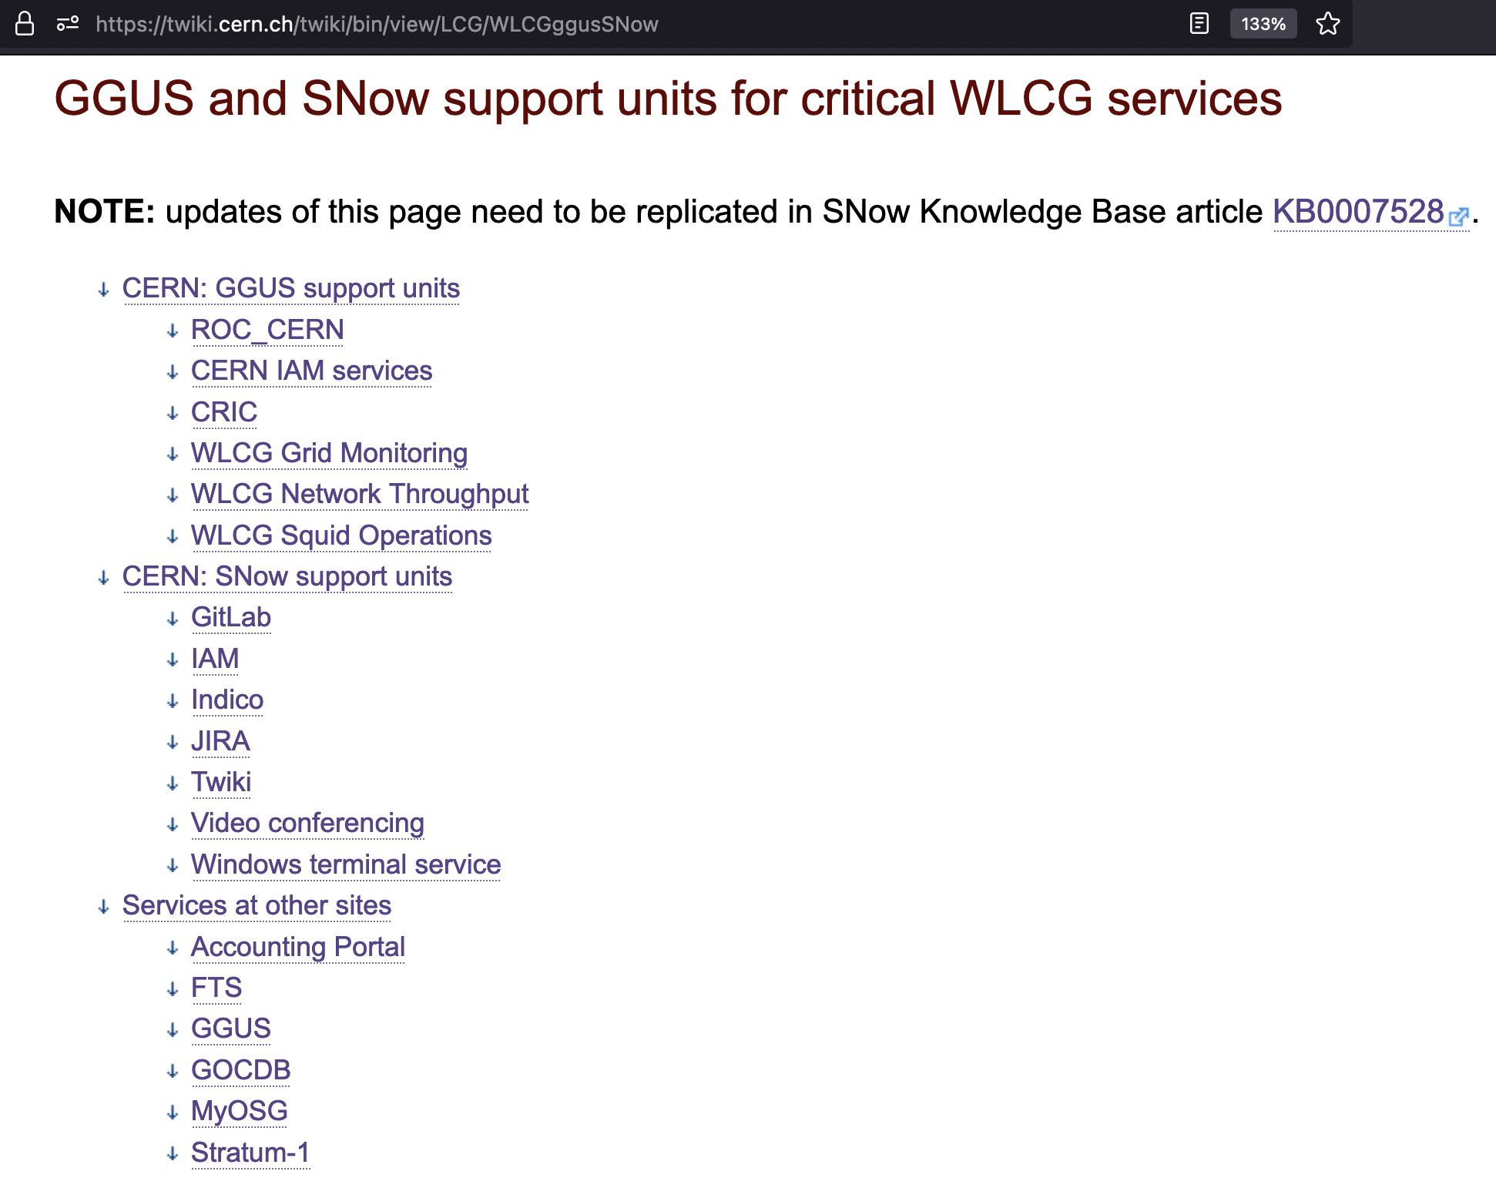

Slide 5
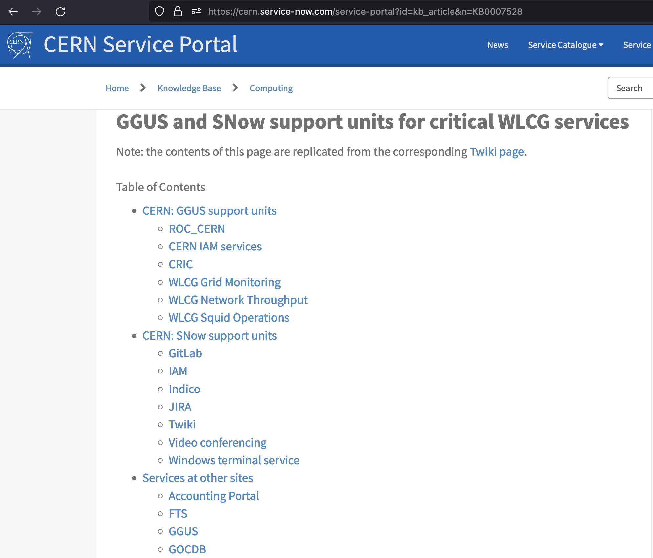

Slide 6
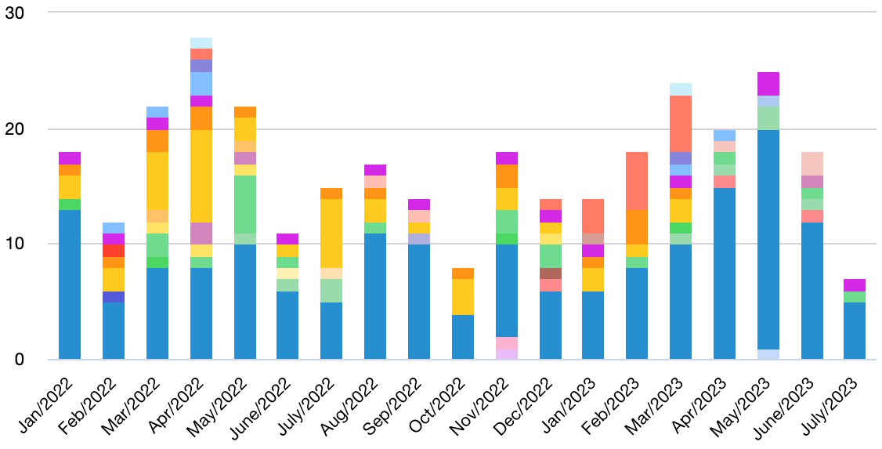
The new WLCG Helpdesk
Plans for the new WLCG Helpdesk were presented in the GDB meeting on 21 June
The integration of the CERN SNow support units has recently started getting looked into
A concern was raised about costs vs. benefits of this approach
  On average ~15
  tickets per month
  in the last 1.5 years
  Can a lot of effort
  for implemention
  and maintenance
  be defended?
    Upgrades vs.
    compatibility…

Slide 7
Interface considerations
The Helpdesk-SNow interface may fail from time to time
  This has happened a number of times for GGUS in the past years
  Recent examples are documented in this (open!) ticket: GGUS:162634
  The fallout can be very annoying – the other side did not receive the latest ticket update message and therefore did not react…
Various causes
  Bugs
  Configuration mistakes
  Design flaws / limitations
  Incomplete / inconsistent testing of upgrades on either side

Slide 8
Alternative proposal
What if we used only SNow for all the CERN support units?
  We would avoid the described:
    Implementation and maintenance efforts
    Synchronization issues
  We could finally target the support units behind ROC_CERN directly
    Send a ticket directly to the relevant team
    That feature has been requested before, but was declined so far
It would imply that people need to have a CERN account and use that for interacting with SNow
  Would that be a problem?
  They could log in using their home institute credentials via eduGAIN
  Which would also be the way to log into the new WLCG Helpdesk!
Discussion…

