Slide 1

Progress on R&D at INFN-Pisa
F. Bosi
on behalf of the INFN Pisa mechanical studies group

Slide 2
OUTLOOK
Light structure for CEPC
Light structure for Belle 2 DMAPS VTX Upgrade
Conclusions

Slide 3
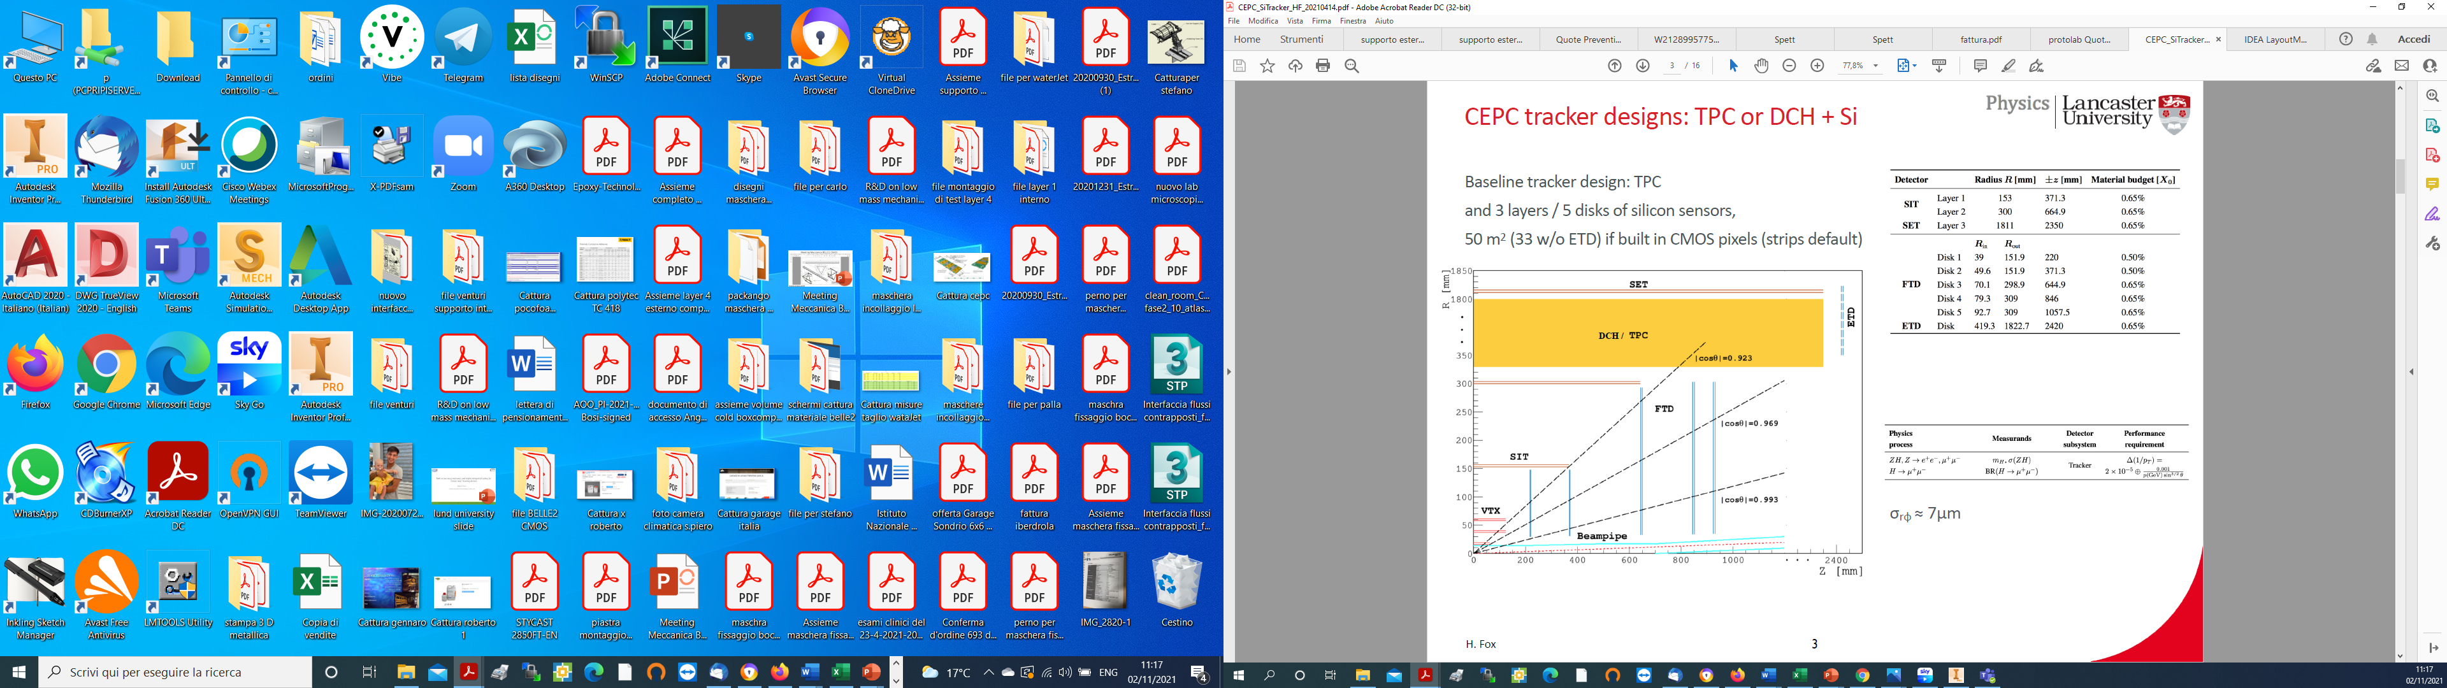
CEPC Baseline layout
CepC Tracker
INFN Focus

Slide 4
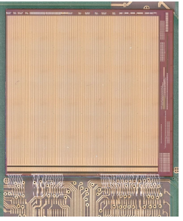
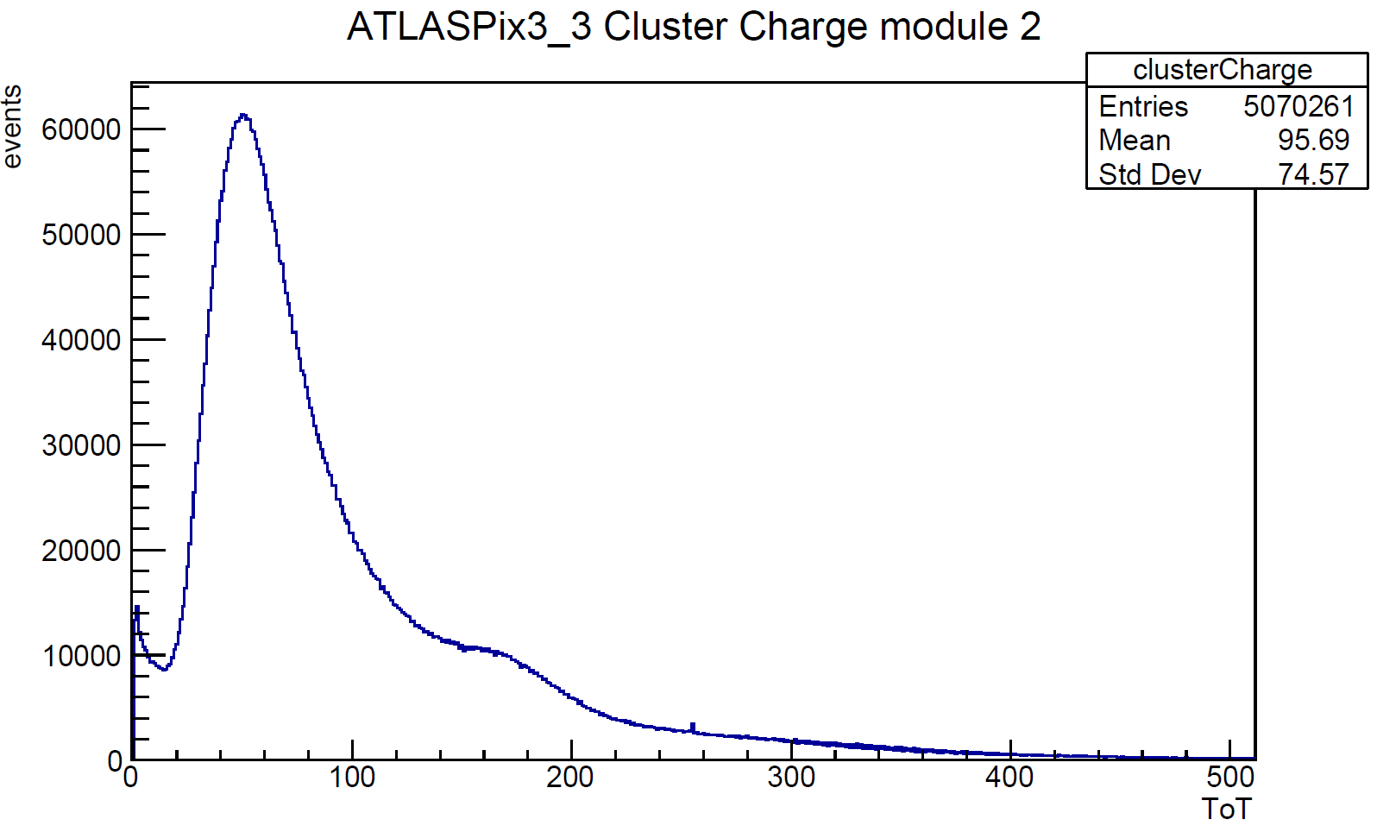
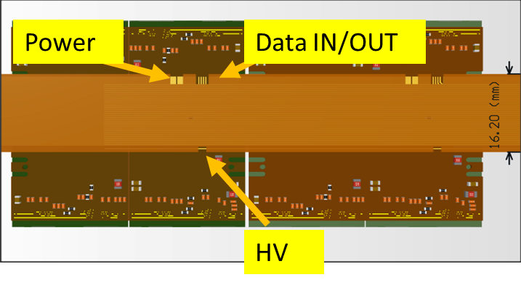
AtlasPix3
DETECTOR
Total thickness 372 µm
Total copper 36 µm
Based on ATLASPIX3 R&D
  50 x 150 µm2
  Up to 1.28 Gb/s downlink
  TSI 180 nm process
  132 columns of 372 pixels
Active length (r-phi x z)
  18.6 mm x 19.8 mm
Module is made of 2x2 chips
Power goal 100 mW/cm² (175 now)
Module tested on beam (DESY)
Y)
4 chip module
Attilio Andreazza Group
INFN Milano
Collaboration: INFN, IHEP, KIT, Liverpool
stave

Slide 5
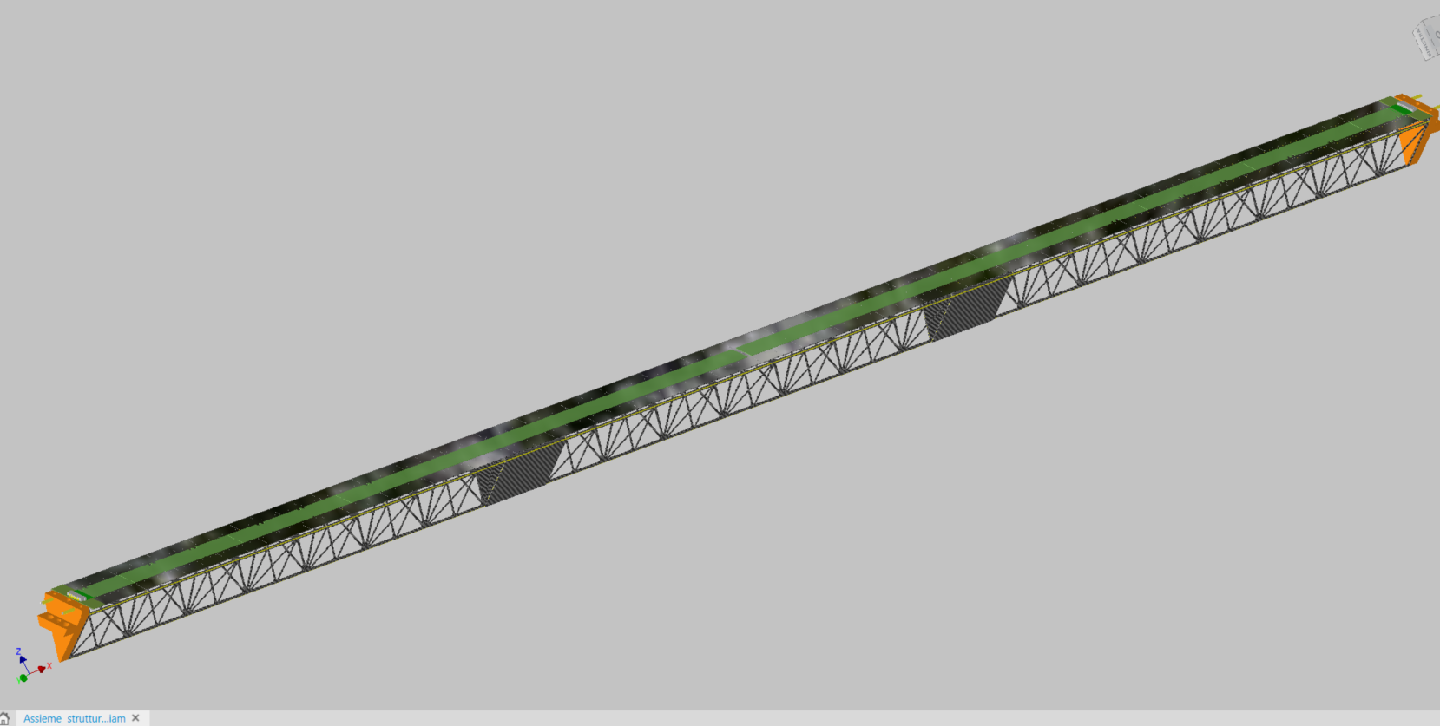
Long Stave for the Outer Tracker of the CEPC Experiment
Three Single Truss Structure put together to form the Long Stave
1332 mm
Union Plate
Single Truss Structure

Slide 6
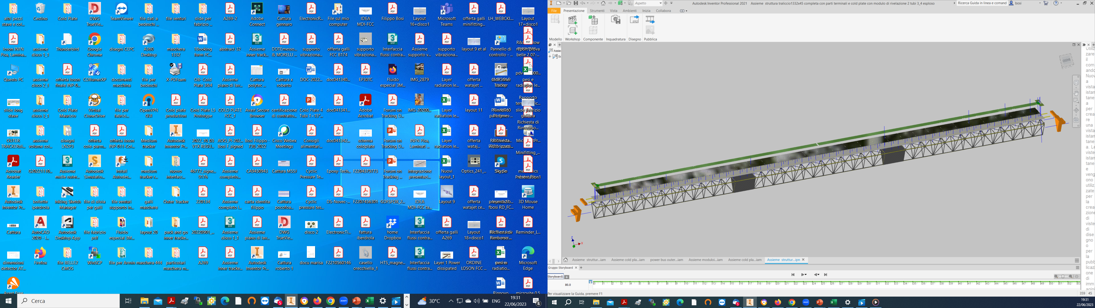
Long Stave Exploded View
Electronic plate and Bus Foil
Pixel detectors
Cold Plate
Truss Structure
Terminal Part Cold Plate
Terminal Part Truss
1332 mm
Union Plate
Single Truss Structure

Slide 7
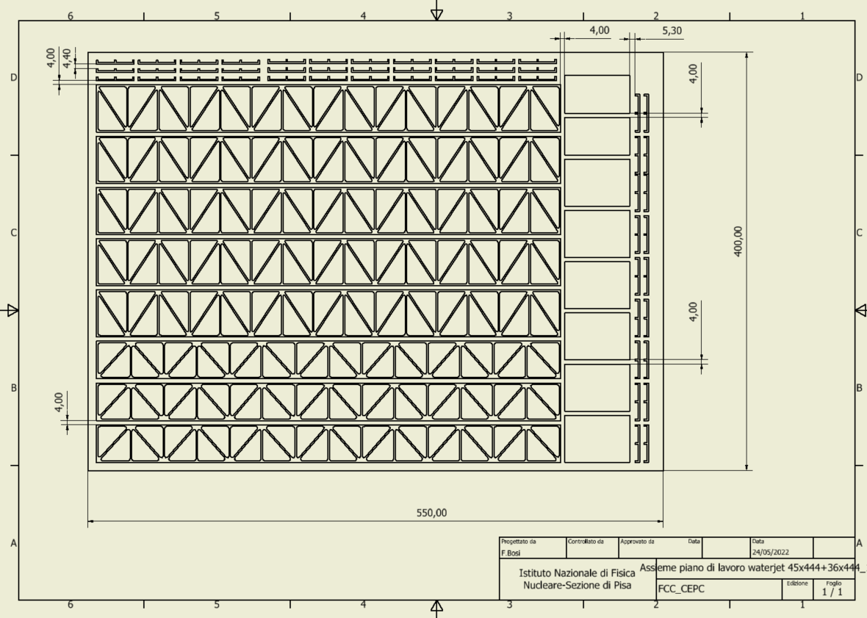
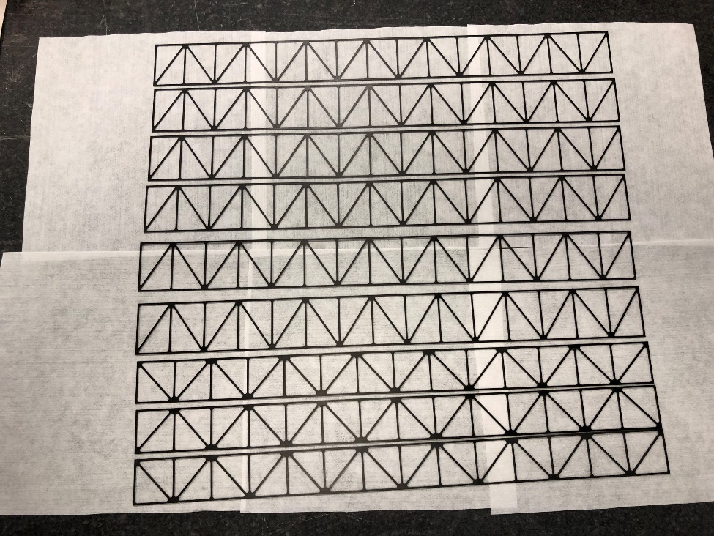
SINGLE SHORT TRUSS STRUCTURE
LAMINATED FOIL
Th=0.5 mm of 550x460 mm²
Carbon Fiber MJ46
Single truss structure realized by WataJet Company
Special process waterjet technology (precision 50 µm)

Slide 8
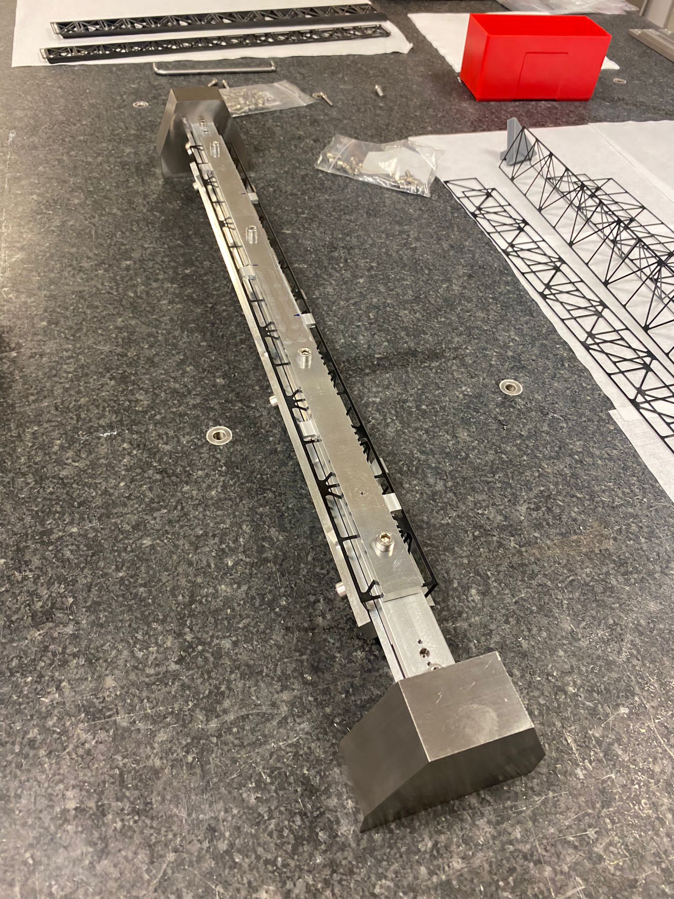
End piece truss structure
Single truss structure
Single truss structure mask assembled and glued on the mask
Short Mask
Single truss structure mask assembled and glued on the mask

Slide 9
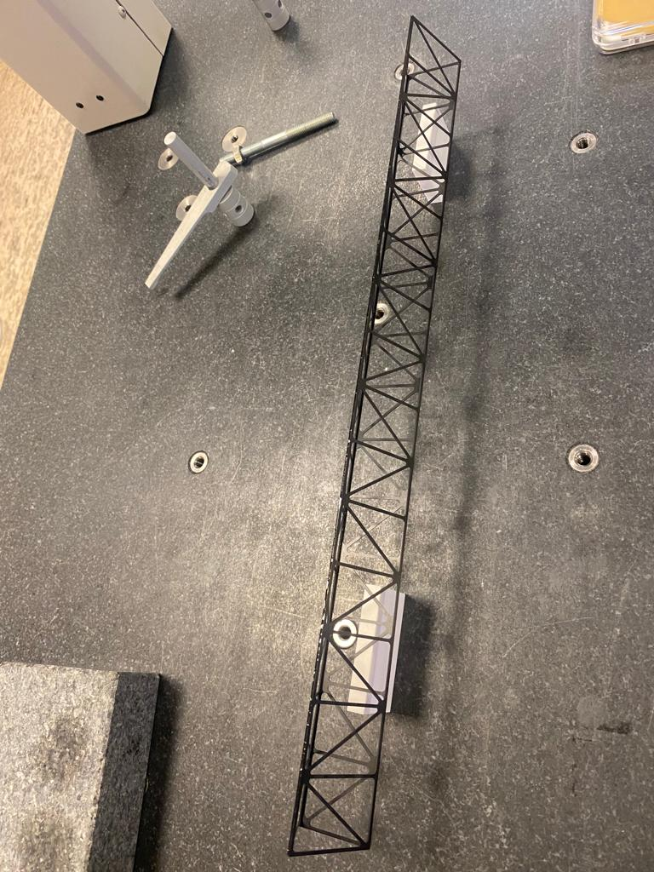
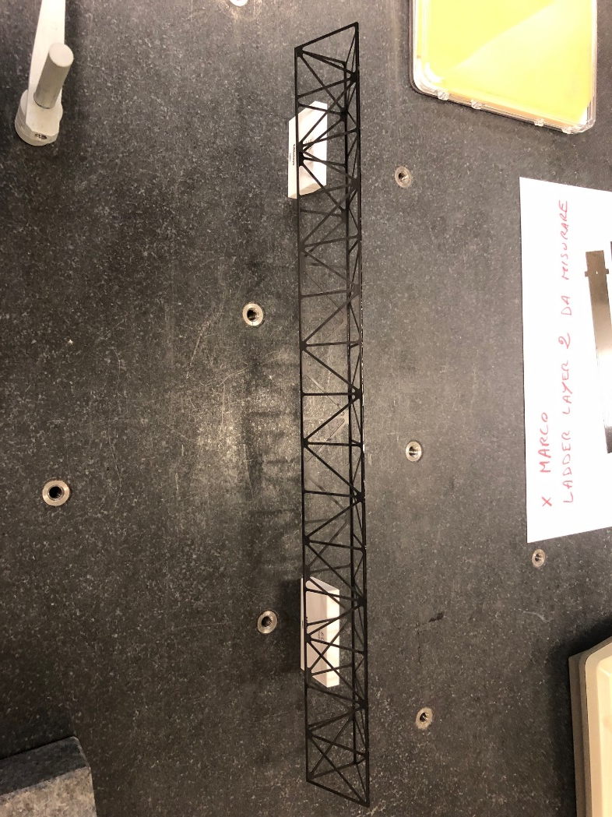
SINGLE SHORT TRUSS STRUCTURE BY SHORT MASK
Single truss structure realized
444 mm
glueing with Araldite 2011 and Cyanacrlilate
Until now three truss structures realized

Slide 10
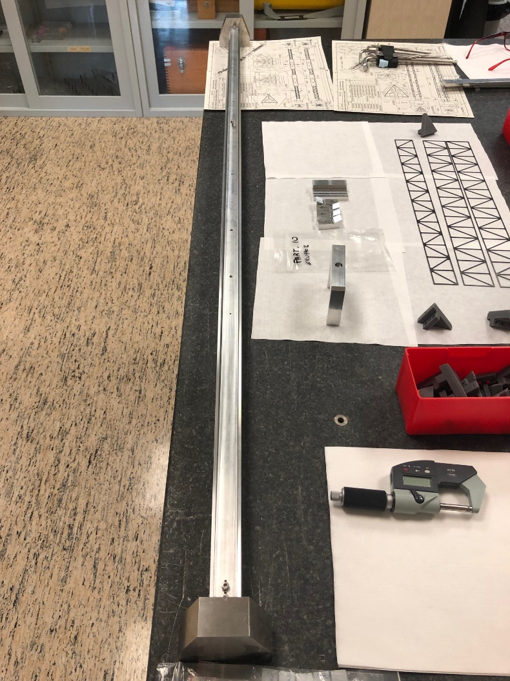
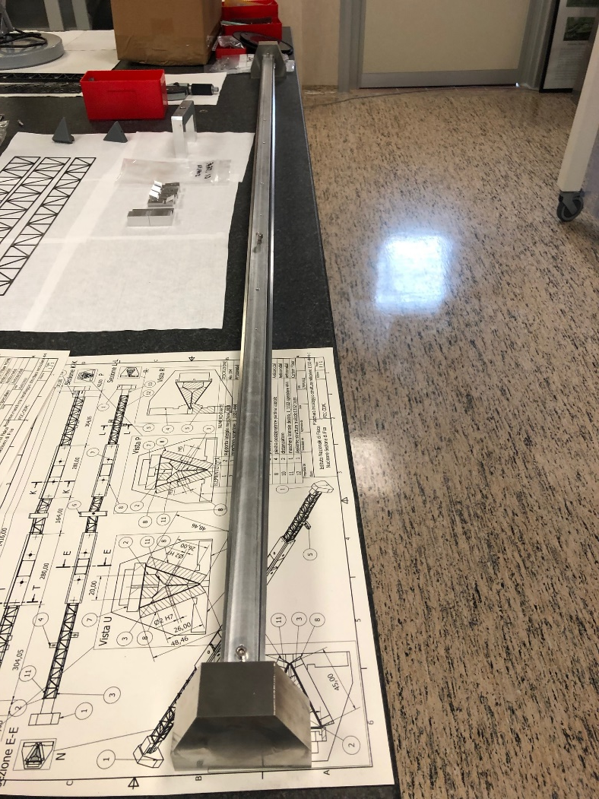
SINGLE LONG TRUSS STRUCTURE BY LONG MASK
Long Stave 1332 mm
One sample realized until now

Slide 11
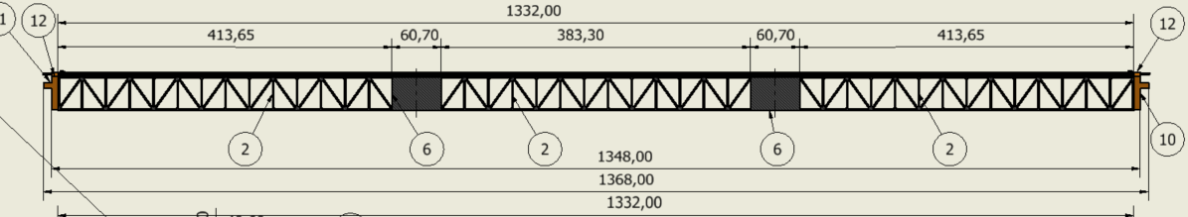
Experimental test for the sagitta value of Super Weight Load
Test for sagitta realized on the CNN measuring machine
P= 200 g
P= 200 g
450
450
Sagitta measured at the center and at the point where applied the load

Slide 12
Experimental test for the sagitta value of the real Weight
Equivalent weight uniformily distribuited of the detector + electronic + Power Bus + Cold Plate= 164,85 g
Test for sagitta realized on the CNN measuring machine
Sagitta measured at the center of the truss

Slide 13
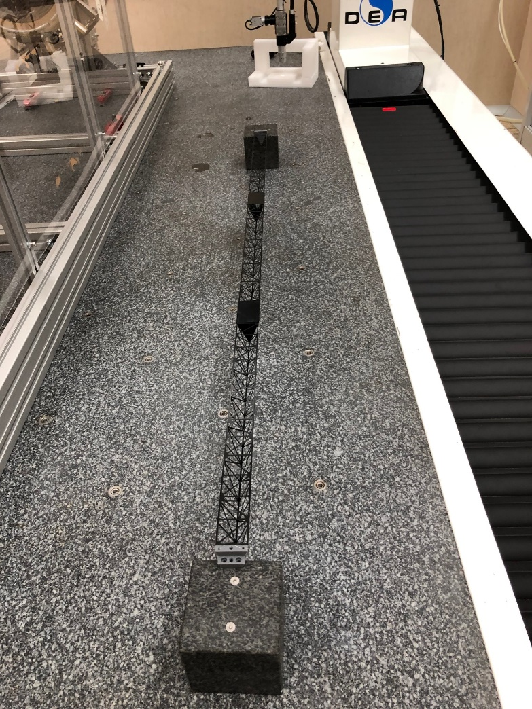
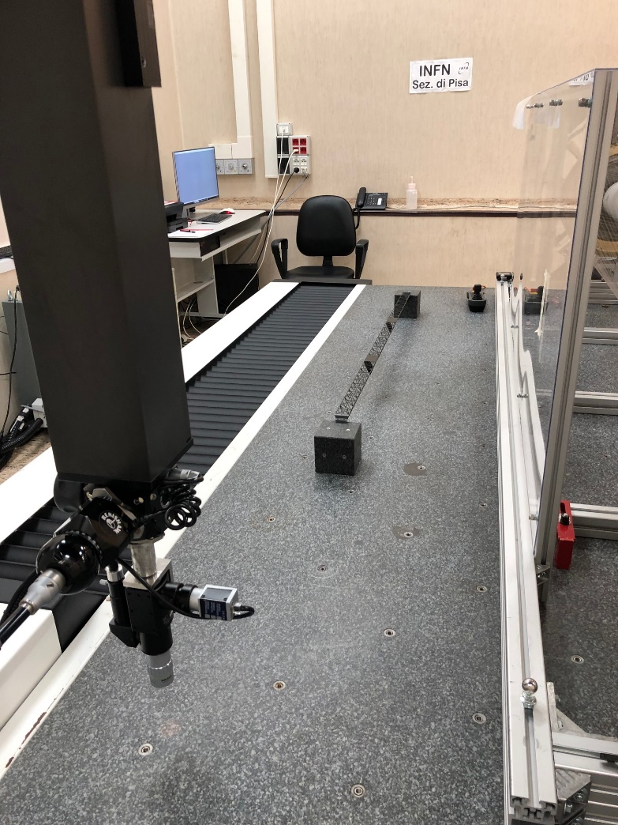
Truss Structure under Measuring Machine
Truss Structure positioned under the 3D CNN Measuring Machine Hexagon DEA GHIBLI
Volume measured 3500x1500x1800 mm³
Precision X,Y,Z axis 4,5 micron

Slide 14
RESULTS
Super Weight Test
Concentrated load 200 g at 450 mm from each edge
Sagitta at 450 mm from the edge = 800micron
Sagitta at the center of the structure = 900 micron
(Some difference with the simulation value attributable to a non conformal CFRP material: to be optimized)
Real Weight Test
Uniformily load distributed of 164,85 g
Sagitta at 450 mm from the edge =210 micron
Sagitta at the center of the structure = 280 micron

Slide 15
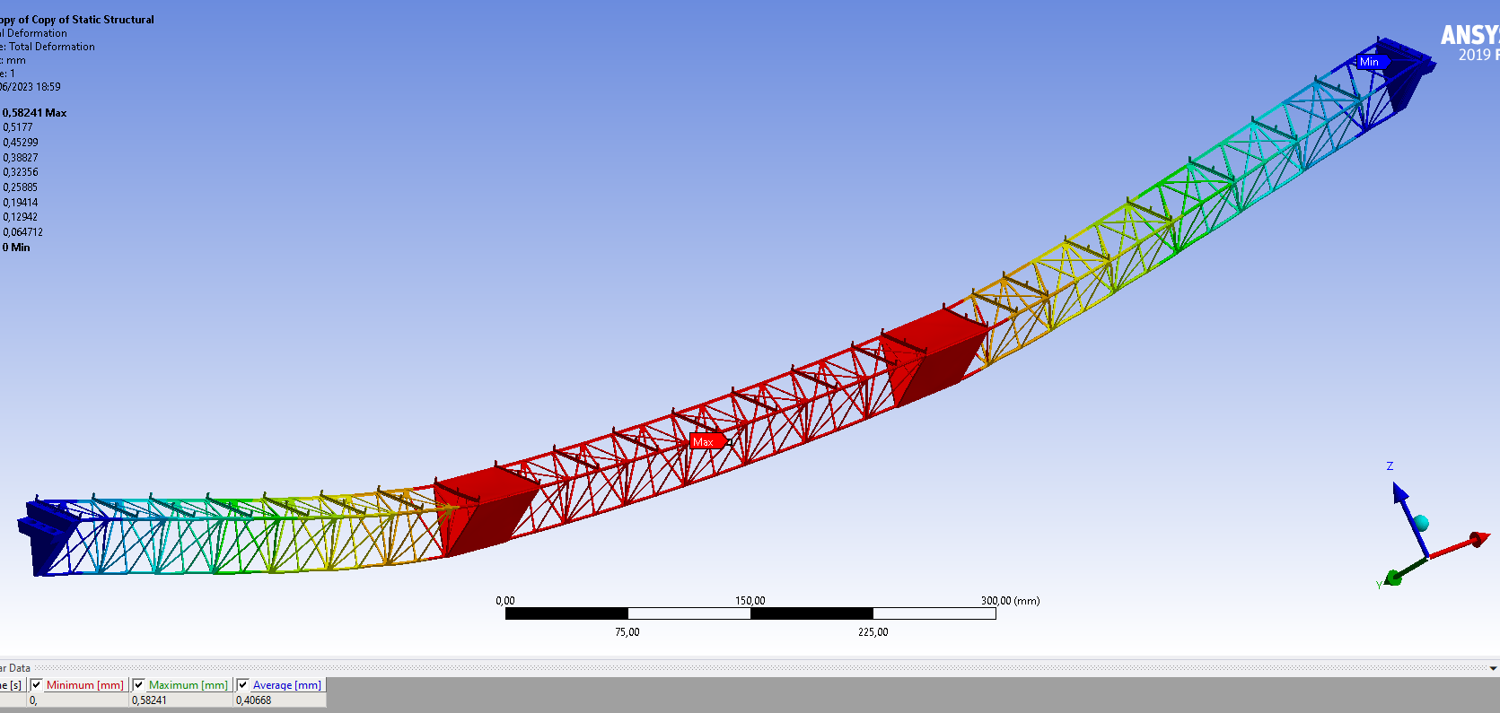
Static Simulation at 0°
200 g
200 g
Max sagitta = 582 micron with superweight load of 200 g

Slide 16
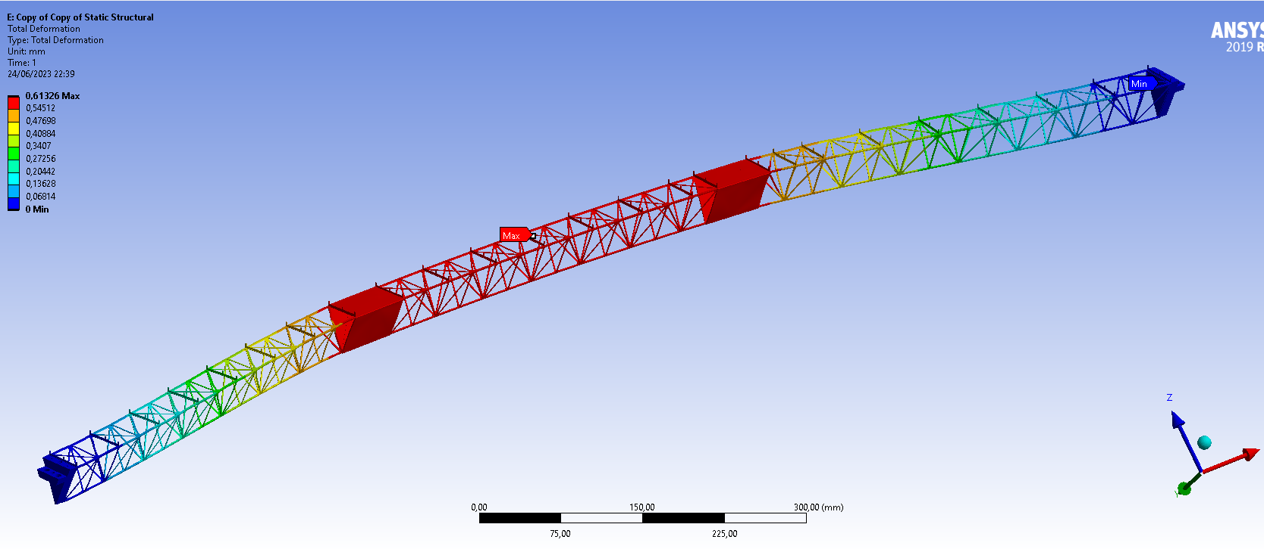
Static Simulation at 90 °
Max sagitta = 613 micron with superweight load of 200 g (shear)
200 g
200g

Slide 17
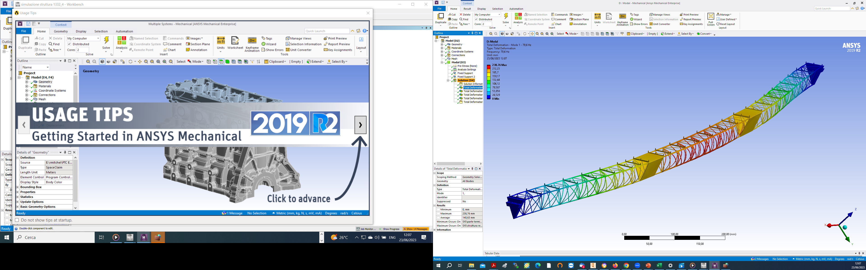
Vibrational Simulation
First Frequency of resonance = 79,6 Hz
Second frequency of resonance = 81,4 Hz
Third Frequency of resonance = 166,6 Hz

Slide 18
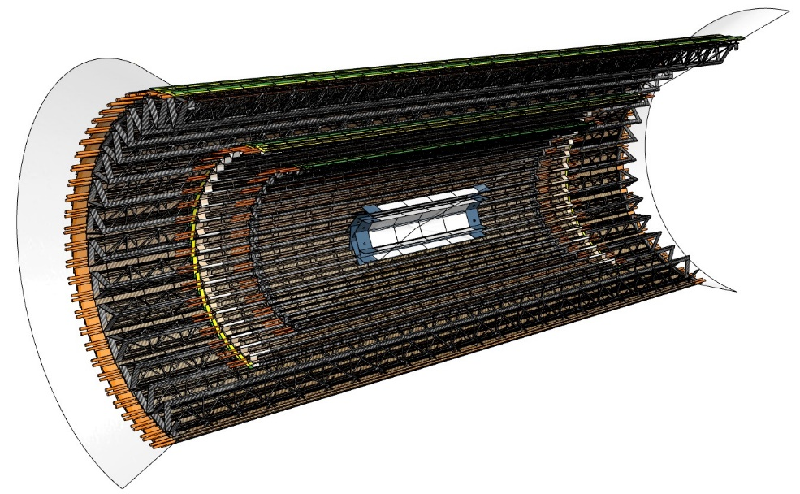
The DMAPS Upgrade of the Belle II Vertex Detector
FEA simulations
The SuperKEKB collider is planning a major upgrade of the I.R. to reach the design luminosity.
All-layer monolithic vertex detector upgrade (VTX) to be installed in LS2 in ~2028:
  More performant and resilient against higher machine backgrounds
  Defined target spec’s in terms of material budget, spatial resolution and integration time window
  Baseline chip technology TJ180 nm, evolving from TJ-Monopix2:
  OBELIX: First steps towards a Belle II CMOS sensor, submission in 2024
Realization of prototypes of inner/outer layers ongoing, submitted to the mechanical, thermal and electrical characterization.
In the finalization phase the CDR of the Belle II Upgrade.

Slide 19
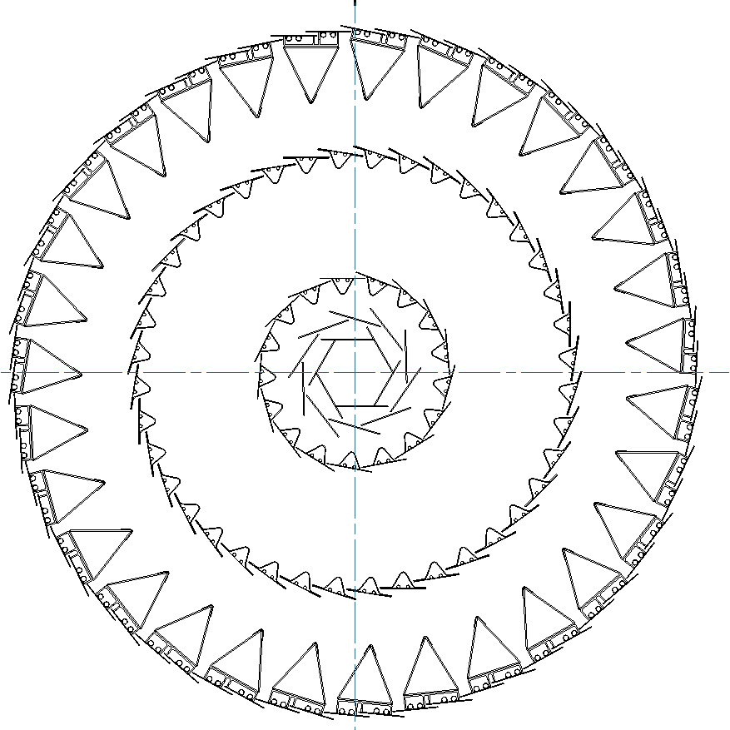
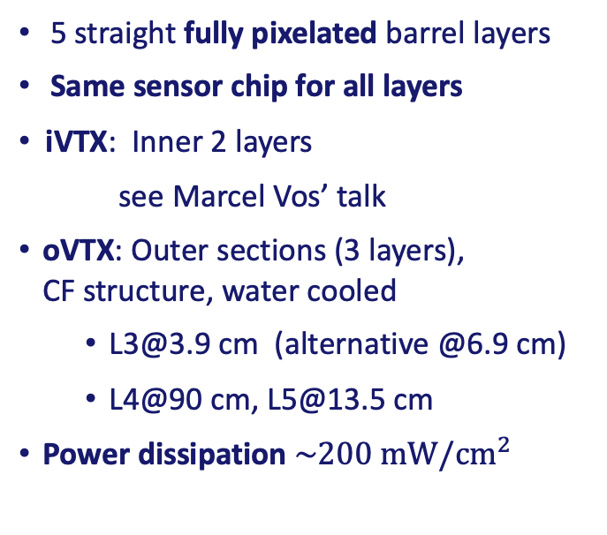
VTX Baseline Concept
Low material budget (~50 μm thin sensors):
0.1% X0 (L1-2), 0.3-0.5% X0 (L3-4), 0.8% X0 (L5)
Requirements:
  Radiation levels for L1 (r=1.4 cm)
    TID: ~100 Mrad
    NIEL: ~5∗10^14 n_eq/cm²
  Hit-rate up to 120 MHz/cm^2
  Resolution < 15 um
  Fast integration time 50-100 ns
  Operation simplicity and
  reduced services
Depleted monolithic
active CMOS pixel sensors
  Chip size: 2x3 cm²
  Moderate pixel pitch 33 μm²
5 straight fully pixelated barrel layers
Same sensor chip for all layers
iVTX: Inner 2 layers
see Marcel Vos’ talk
oVTX: Outer sections (3 layers),
CF structure, water cooled
  L3@3.9 cm (alternative @6.9 cm)
  L4@90 cm, L5@13.5 cm
Power dissipation $\sim 200 mW/{cm}^{2}$
Outer VTX

Slide 20
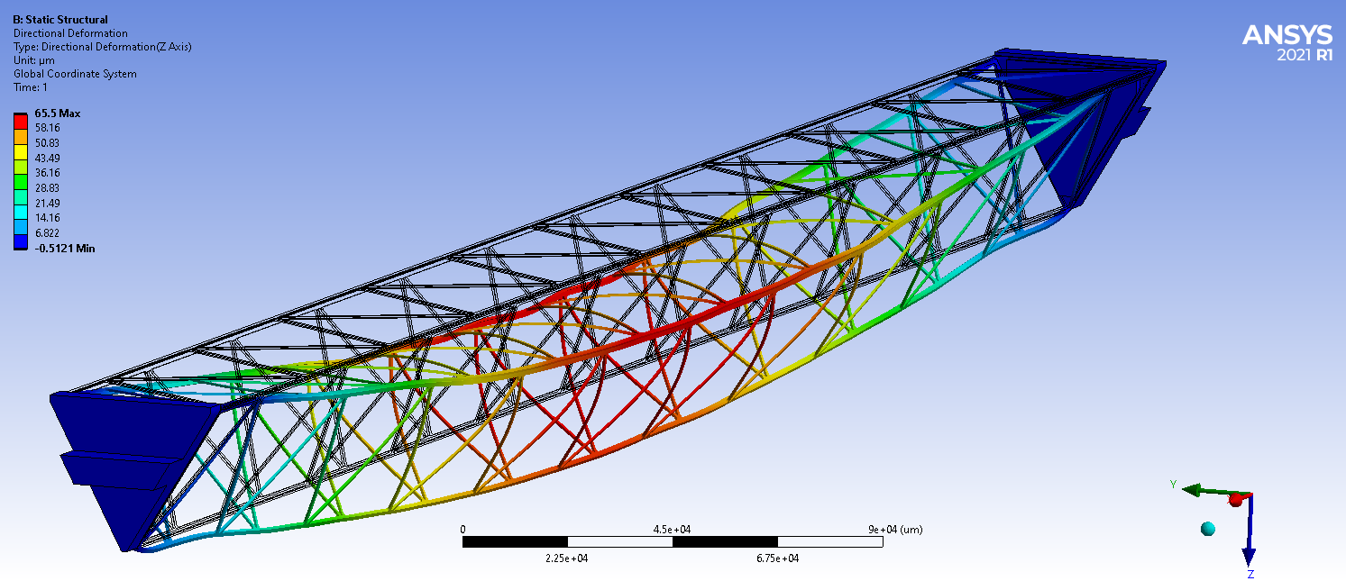
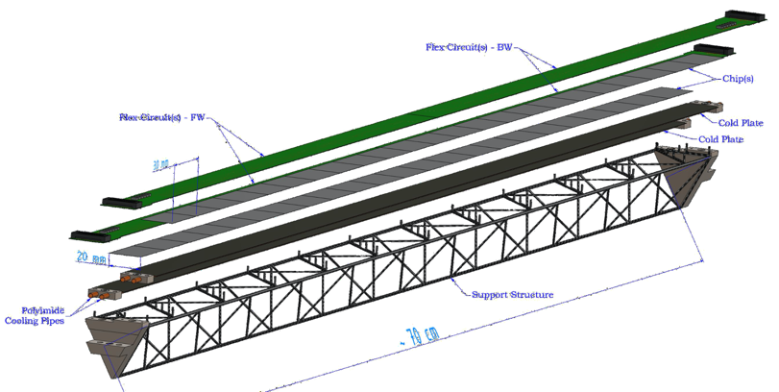
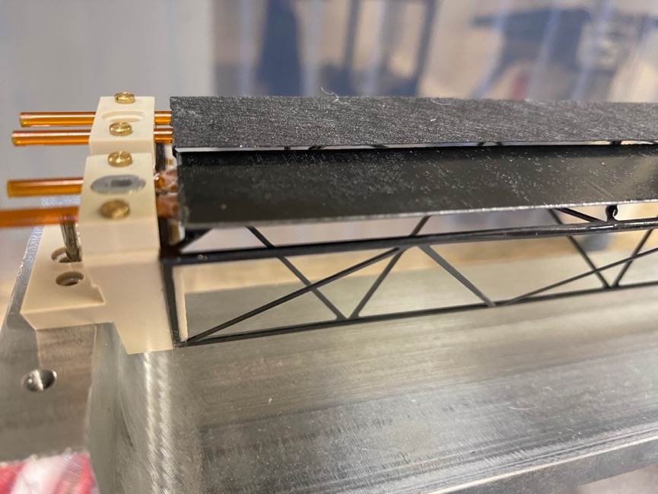
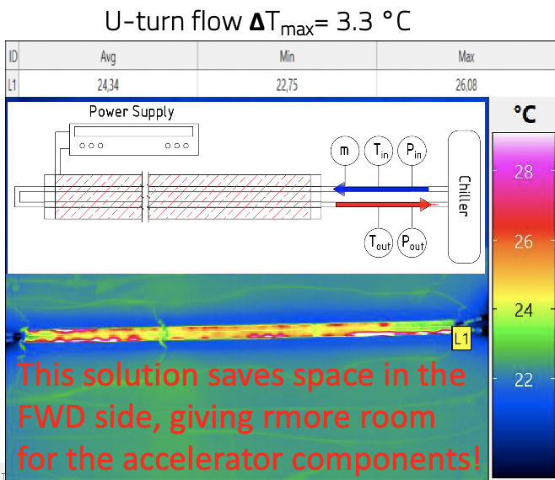
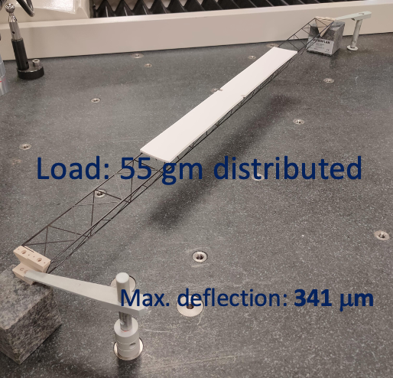
oVTX Thermo-mechanics
Ladder structure design inspired by ALICE ITS2, composed of:
CF support structure (truss), cold-plate with pipes for
liquid coolant circulation (neg. pressure),
Chip and Flex circuit for power&signal
glued on top
FEA simulations
Detail of a L5 ladder prototype
L5 ladder: 70 cm long
Performed mechanical characterization of the L5 prototype:
Distortion: measurements of sagitta (~340 um)
Vibration: 1st resonance frequency ~250 Hz (>>earthquake f.)
Thermal characterization:
Used Kapton heaters, inlet ( T=10ºC) and outlet on one side
Uniform temperature along the ladder ΔT max=3.3 ºC

Slide 21
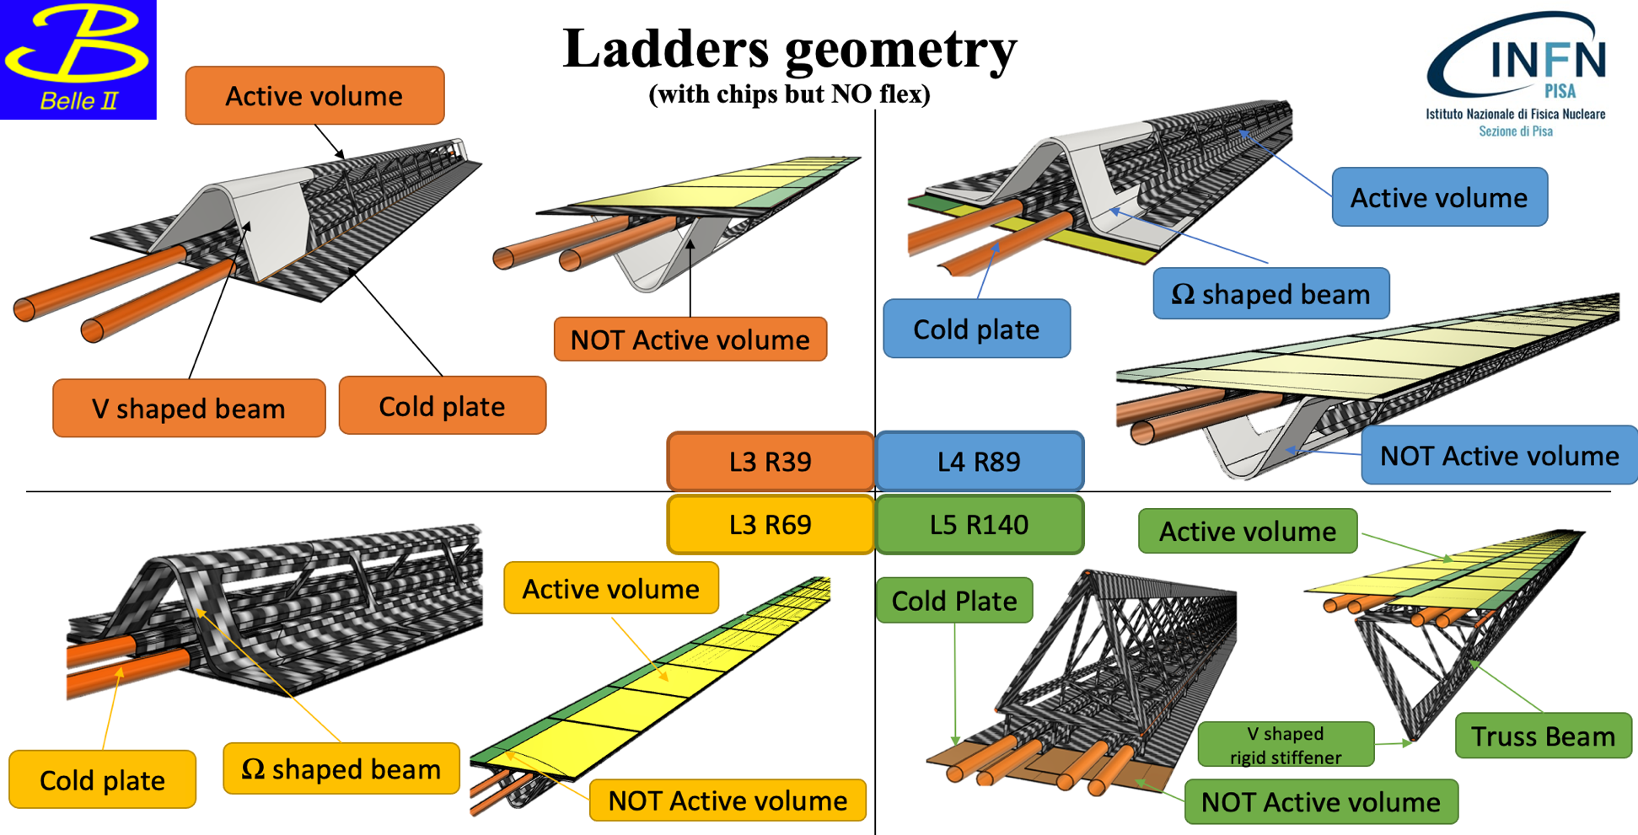
oVTX Ladders Geometry
FEA simulations

Slide 22
Thanks for the attention

