Slide 1







Task 4.3 - Common Tools for Irradiation Facilities QC: Data Management, Traceability, Dosimetry and
Activation Measurements
P. Garosi, B. Gkotse, F. Ravotti, on behalf of Task 4.3
18 March 2024

Slide 2
Outline
Task Objectives & Management
Activities Status
  Objective 1: IDM Updates & Generalization
  Objective 2: Integrated system for induced activation measurements and RFID tagging
  Objective 3: Common NIEL dosimetry calibration set for cross-comparison of irradiation facilities
Timeline
Conclusion

Slide 3
Task 4.3 Objectives
Generalize the IRRAD facility Data Manager (IDM) system to include new facilities and improve its features (usability, sharing of irradiation experiment results and operational data, etc.)
Design and develop a prototype for an integrated system to manage induced activation (APEX-gamma, etc.) and traceability data for irradiated objects (CAEN DigiWaste) based on IDM
Produce a common dosimetry calibration set for cross-comparing irradiation facilities by evaluating, with dedicated dosimeter structures, the Non-Ionizing Energy Loss (NIEL) of their particle beam
18 Mar 2024

Slide 4
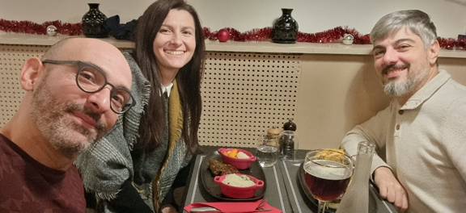

Task 4.3 Management
Blerina Gkotse moved from CERN to the University of Madison, Wisconsin (USA) as of 2024:
  CERN User (EP-DT) collaborating in common R&D activities
Paola Garosi (CAEN) is the new Task 4.3 leader!
#3 task meetings during the last year:
  https://indico.cern.ch/category/13502/
18 Mar 2024

Slide 5
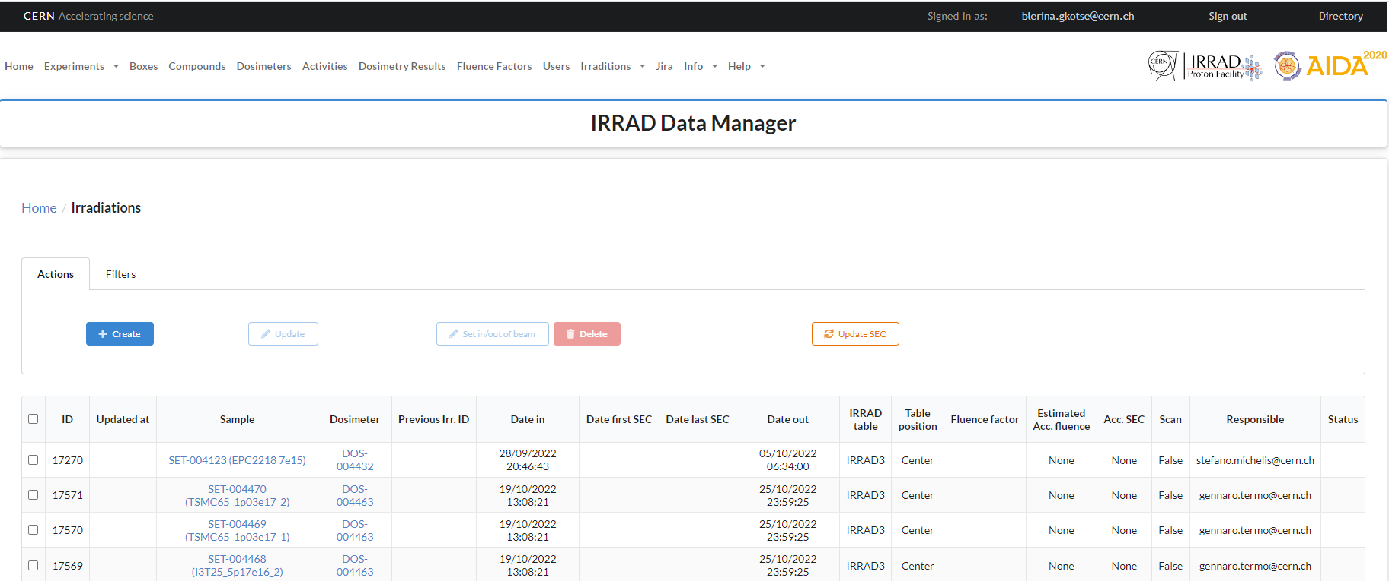
IRRAD Data Manager (IDM) Updates
Objective 1
  For irradiation run 2024, new version of IDM deployed implementing the recommendations gathered during the usability session:
    SMTP server changes for e-mail notifications
    Making IDM settings more configurable
    etc.

Slide 6
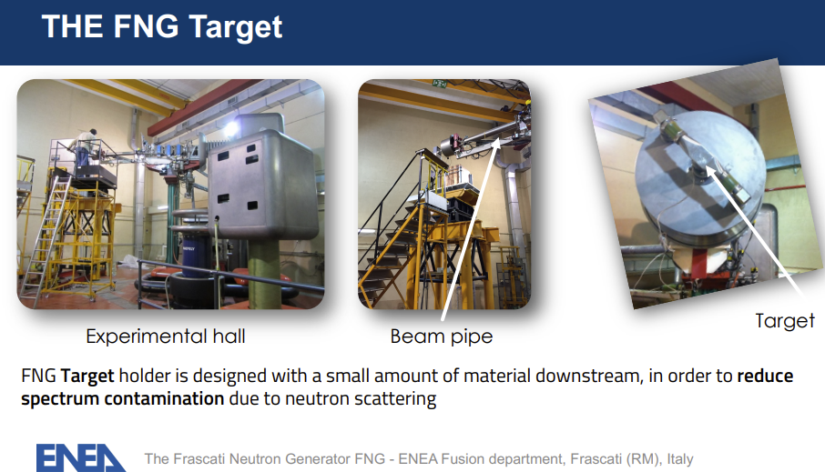
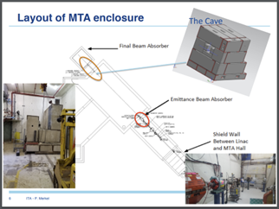
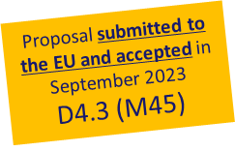
IDM Generalisation
Objective 1
  Change of target facility for D4.3
<< While the extension of IDM to CERN-GIF++ is completed, the departure of the senior staff leading the AIDAinnova task at ENEA-FNG in Rome (who moved to a new position at the beginning of 2023), as well as of his post-doc working on the technical development, de facto stopped the software deployment work ongoing at ENEA-FNG required to fully achieve the future D4.3.
Since the contribution of ENEA-FNG to D4.3 (…) aims to prove that IDM can be generalized and employed in facility infrastructures other than the CERN one, for the purposes of D4.3, we propose the change of the target facility for the software deployment from ENEA-FNG to the Fermilab-ITA proton irradiation facility in the USA where the deployment of an extended version of the original IDM tool is currently ongoing with the support of the CERN team involved in Task 4.3. The proposed change of target facility infrastructure does not change the scope of the work and still demonstrate the technical feasibility of the task originally foreseen in D4.3. >>

Slide 7
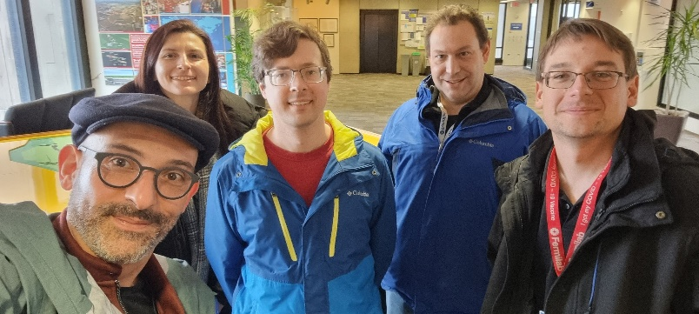
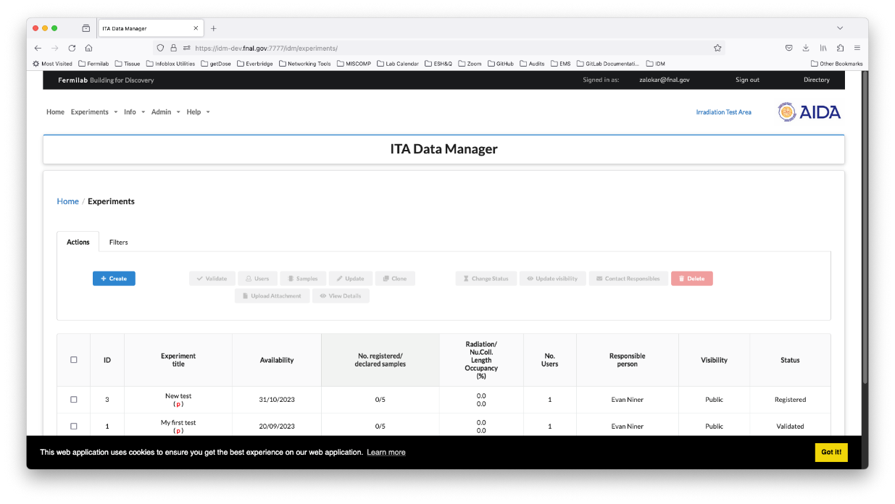

ITA Data Manager @ FNAL
Objective 1
  Cloning and adapting IDM according to ITA requirements (based on the work of MS13):
    a prototype version already exist
  Meeting @ FNAL on 08/03/24 to discuss technical issues, advancement, support:
    IT system updates, warnings to users while registering experiments, etc.
  Discussion started about possibility to test CAEN DigiWaste platform also @ FNAL ?
Screenshots of ITA data manager prototype @ FNAL (© M. Zalokar, E. Niner)
D4.3 (M45)

Slide 8
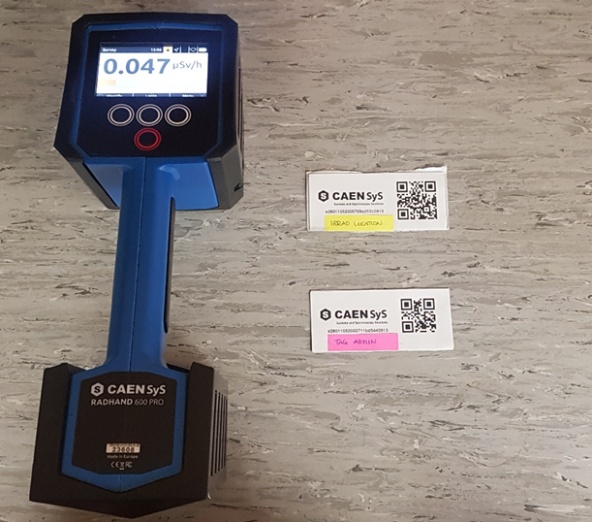
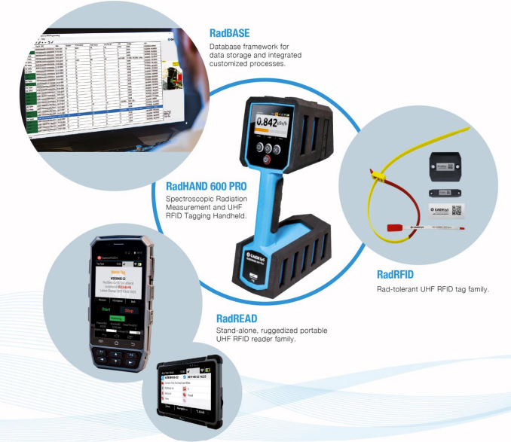
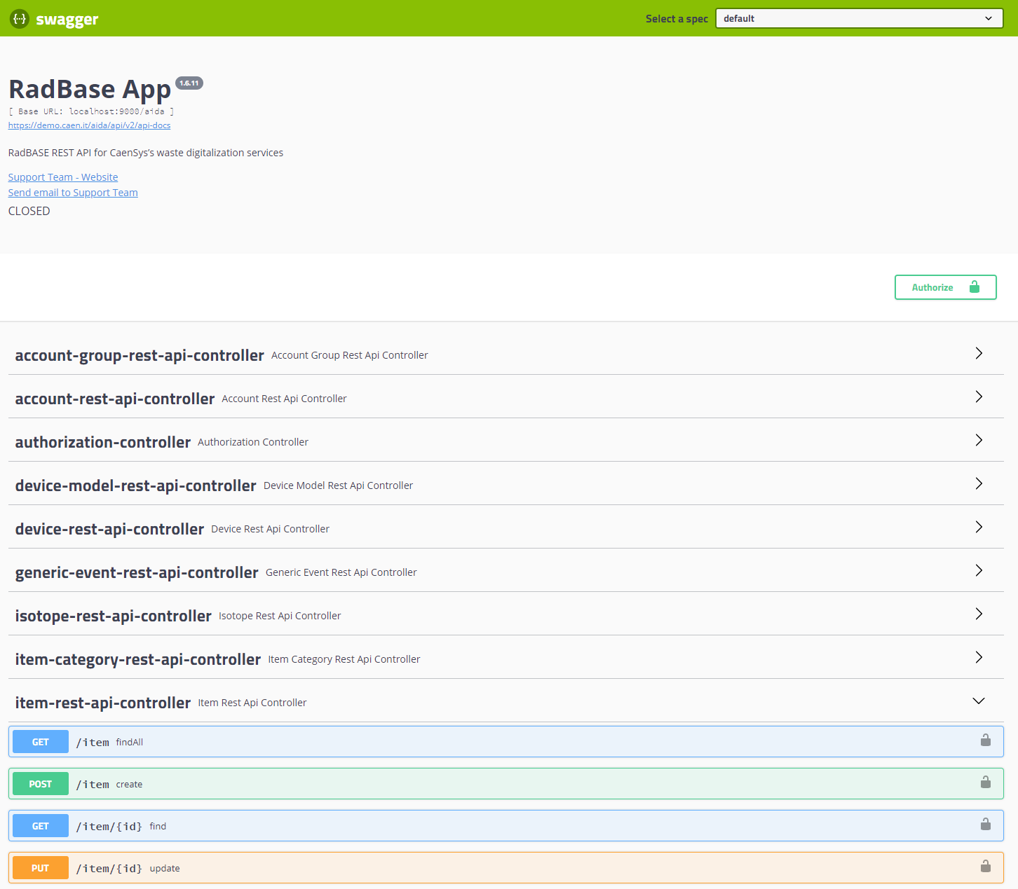
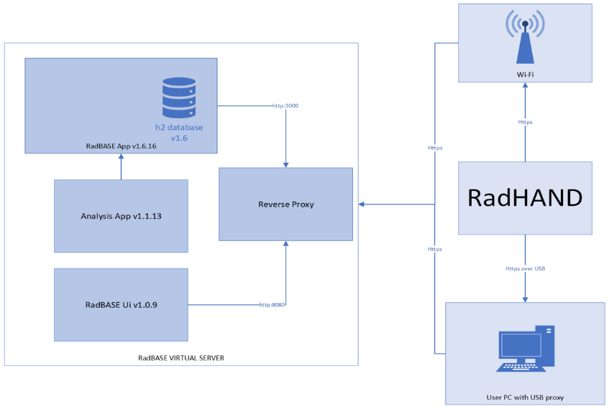
Spectrometry & Traceability Data Aggregation
Objective 2
CAEN RadHAND device delivered at CERN
RadBASE interface configured, and workflow tested for IRRAD
DigiWaste platform

Slide 9
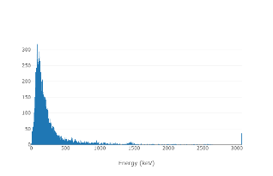
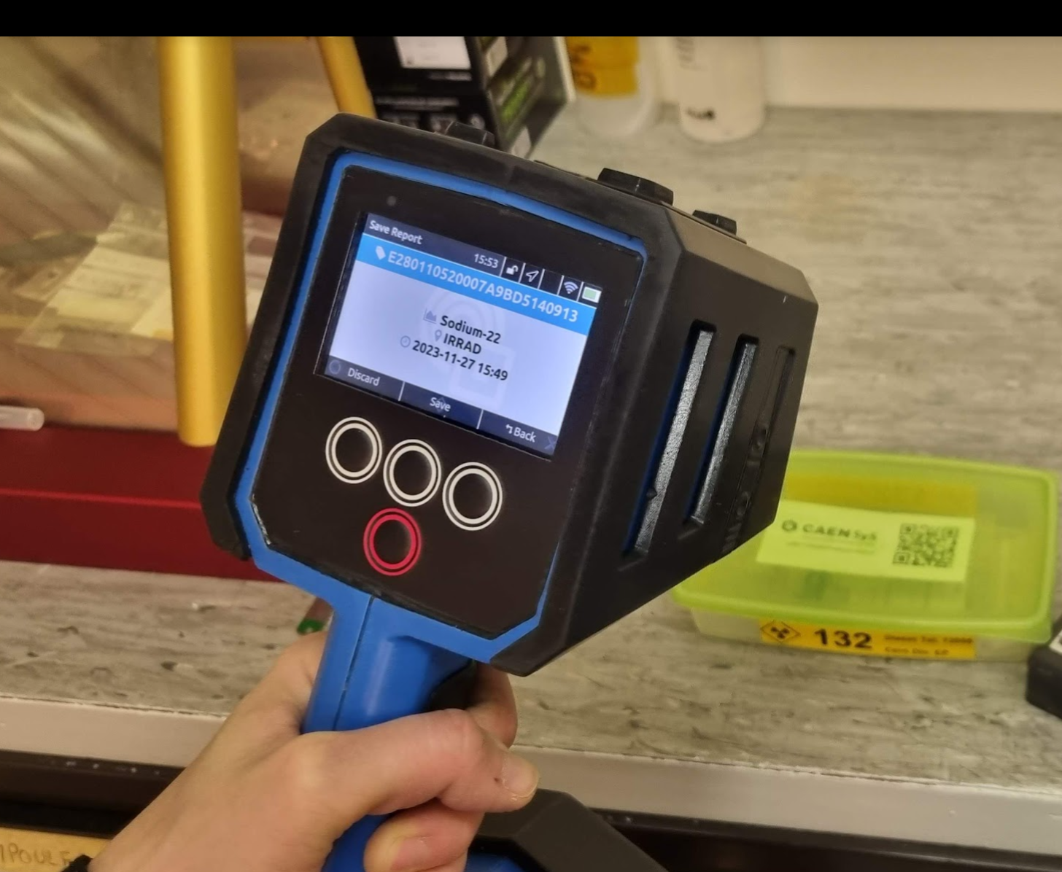
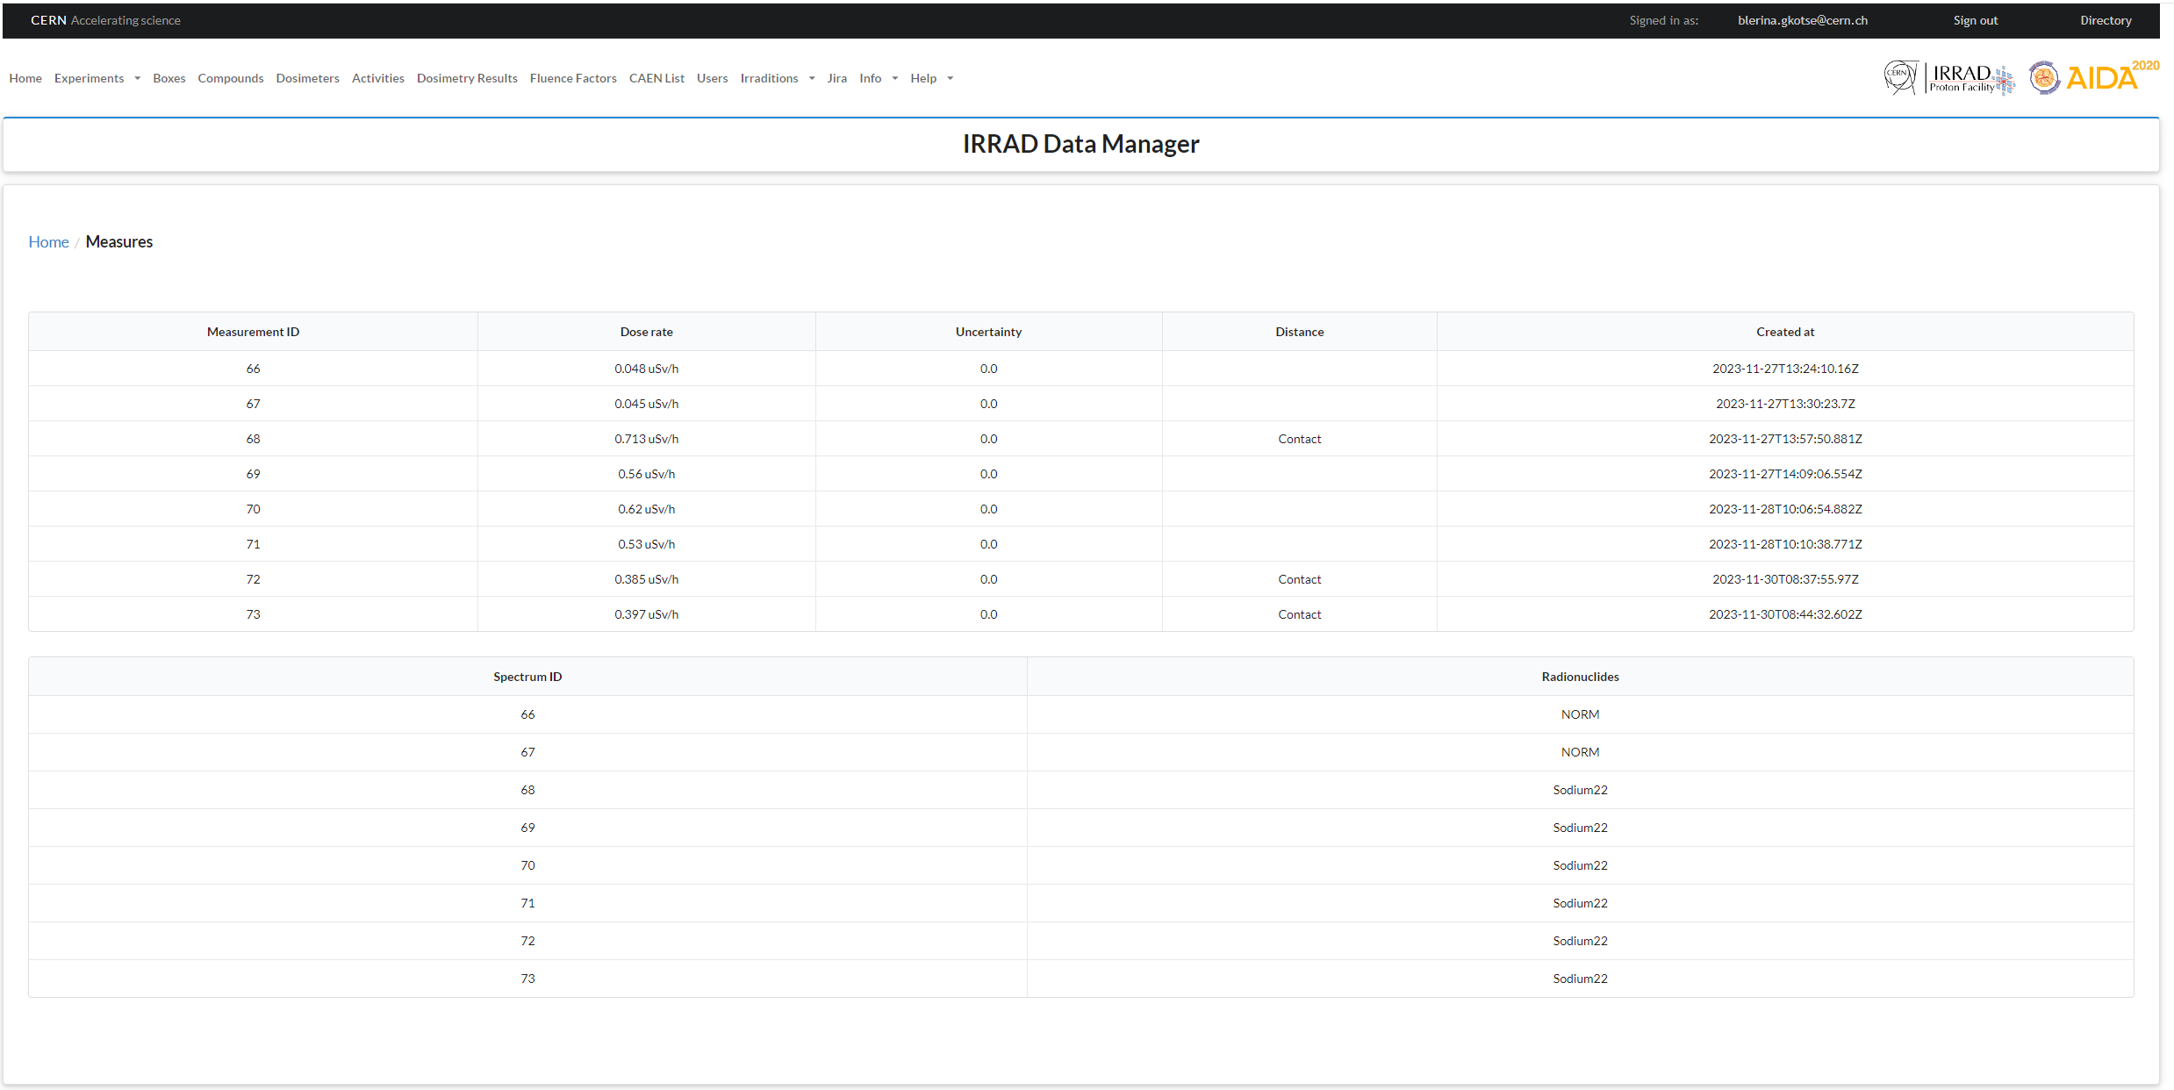
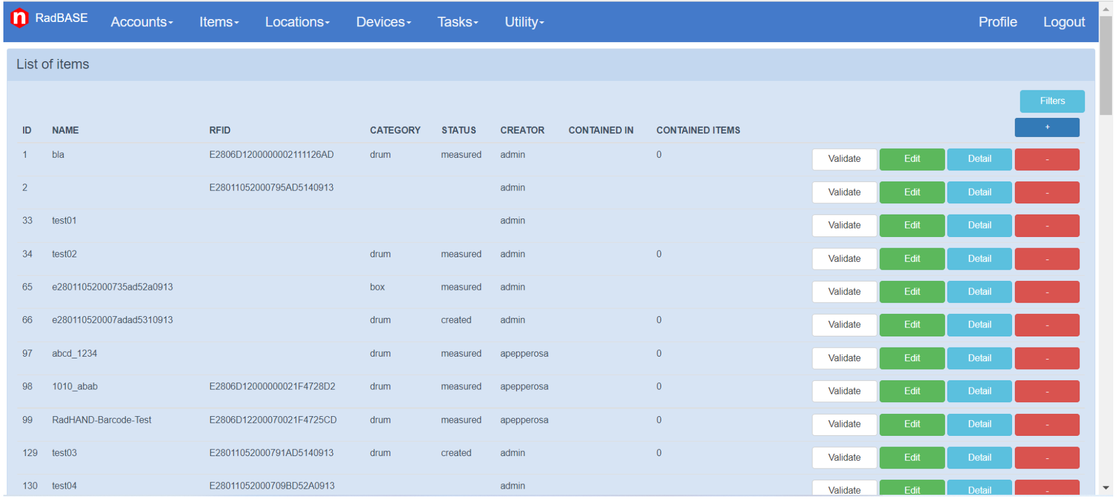
Spectrometry & Traceability Data Aggregation
Objective 2
New integrated system RFID-based is being tested at IRRAD
  RadHAND device used with RFID tags tested within AIDAinnova (slide 11)
Complete workflow tested using the RadHAND device:
  Data acquired with RadHAND integrated in IDM using CAEN API
Operation also shown in WP2 promotional video recorded in Nov. 2023
RadHAND measurements integrated in IDM

Slide 10
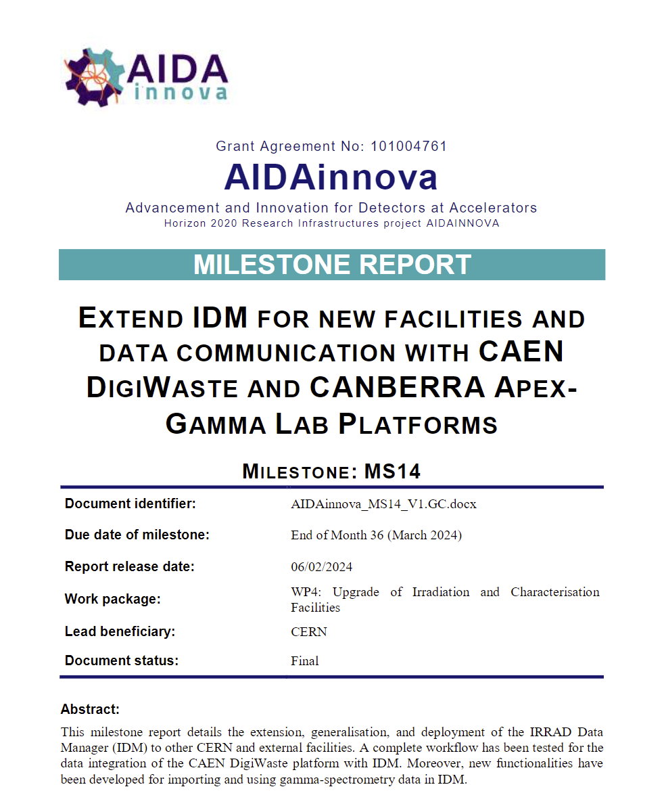

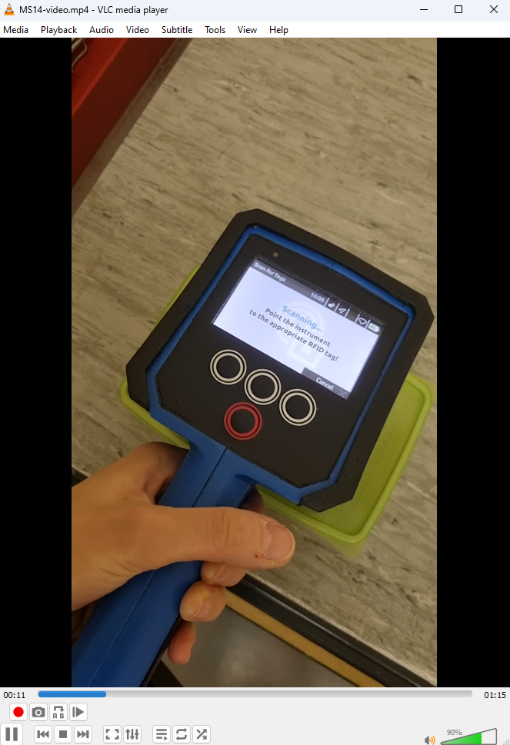
IDM Generalisation
Objective 2
Milestone MS14 completed and released
Available in Zenodo: https://zenodo.org/records/10809780
(including demo video!)
MS14

Slide 11
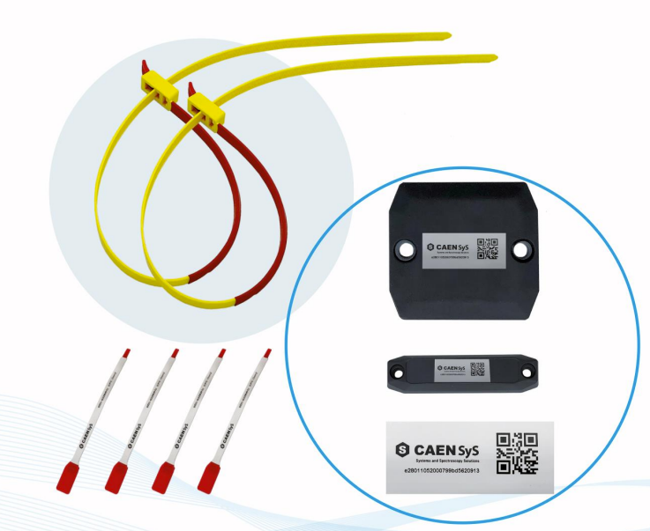
Test of RFIDs for Samples Tagging
Objective 2
Investigating the suitability of RFIDs to be used in radiation environment:
  one model chosen at the beginning of the project (size, packaging, etc.)
  photons: bibliography data exist
  protons at IRRAD (AIDAinnova):
    Report (also in Zenodo): https://edms.cern.ch/document/2680300/
  neutrons at ENEA-FNG (AIDAinnova) funded by RADNEXT TA:
    Report (also in Zenodo): https://edms.cern.ch/document/2884302/
  mixed-field at CERN: planned in 2024
Summary of these investigations to be compiled in form of MS report by M42
MS15 (M42)

Slide 12
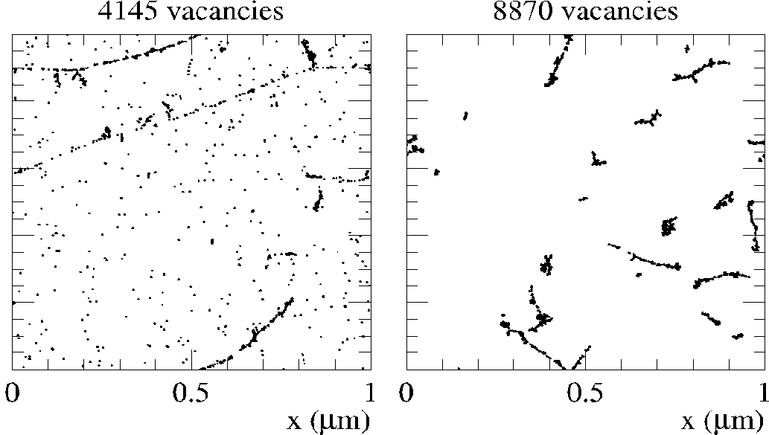
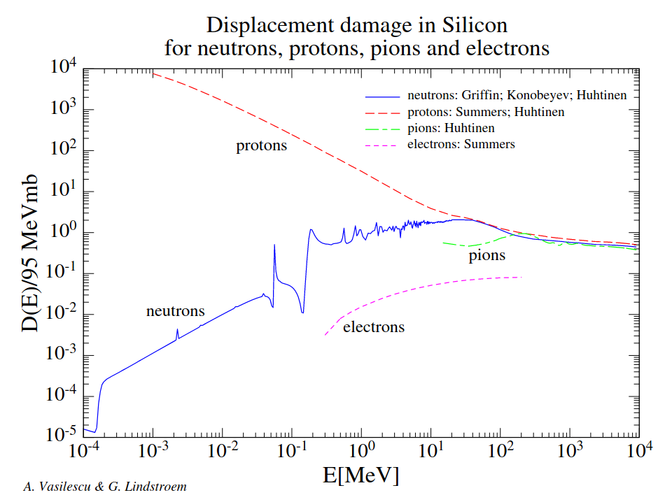
NIEL
(Non-Ionizing Energy Loss)
Objective 3
NIEL is a physical quantity describing the non-ionizing energy loss as the particle travels through the medium
NIEL can be used to predict the radiation damage and therefore to predict the lifetime of the detectors and components necessary for measurements
NIEL is usually expressed as an equivalent to NIEL of 1 MeV neutrons
NIEL is used by most of the LHC experiments
V. Subert
(PhD, synergy with EP-R&D)
NIEL for Silicon was determined from various sources 20 years ago by A. Vasilescu and G. Linstrom¹⁻⁵ (RD-48 data).
NIEL does not distinguish in point defects/ cluster defects, NIEL violation has been reported. ⁶⁻⁷->need to revisit NIEL
RD-48 data
Data from A. Vasilescu (INPE Bucharest) and G. Lindström (Univ. of Hamburg)
P.J. Griffin et al., SAND92-0094 (Sandia Natl. Lab.93), priv. comm. 1996: E = 1.025E-10 - 1.995E+01 MeV
Konobeyev, Alexander Yu., et al. “Nuclear Data to Study Damage in Materials under Irradiation by Nucleons with Energies up to 25 GeV.” Journal of Nuclear Science and Technology, vol. 39, no. sup2, Aug. 2002, pp. 1236–39. Taylor and Francis+NEJM, https://doi.org/10.1080/00223131.2002.10875327.
Huhtinen, M., and P. A. Aarnio. “Pion Induced Displacement Damage in Silicon Devices.” Nuclear Instruments and Methods in Physics Research Section A: Accelerators, Spectrometers, Detectors and Associated Equipment, vol. 335, no. 3, Nov. 1993, pp. 580–82. ScienceDirect, https://doi.org/10.1016/0168-9002(93)91246-J.
Summers, G. P., E. A. Burke, P. Shapiro, et al. “Damage Correlations in Semiconductors Exposed to Gamma, Electron and Proton Radiations.” IEEE Transactions on Nuclear Science, vol. 40, no. 6, Dec. 1993, pp. 1372–79. IEEE Xplore, https://doi.org/10.1109/23.273529.
Huhtinen, M. “Simulation of Non-Ionising Energy Loss and Defect Formation in Silicon.” Nuclear Instruments and Methods in Physics Research Section A: Accelerators, Spectrometers, Detectors and Associated Equipment, vol. 491, no. 1, Sept. 2002, pp. 194–215. ScienceDirect, https://doi.org/10.1016/S0168-9002(02)01227-5.
Gurimskaya, Yana, et al. “Radiation Damage in P-Type EPI Silicon Pad Diodes Irradiated with Protons and Neutrons.” Nuclear Instruments and Methods in Physics Research Section A: Accelerators, Spectrometers, Detectors and Associated Equipment, vol. 958, Apr. 2020, p. 162221. ScienceDirect,
12

Slide 13
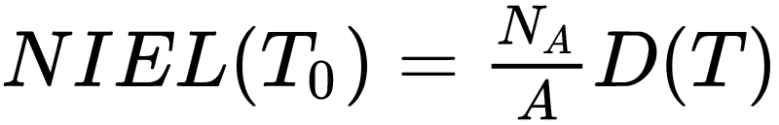
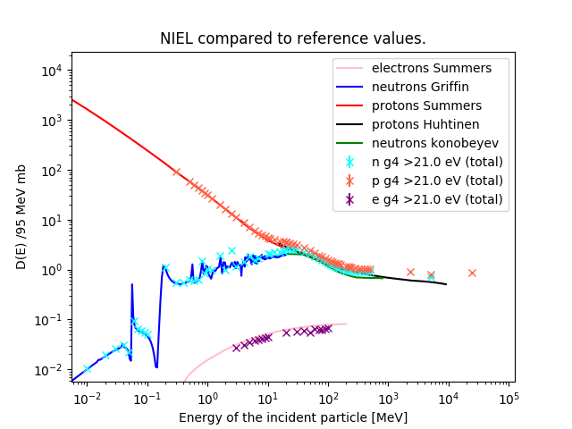
NIEL
(Non-Ionizing Energy Loss)
Objective 3
T₀: energy of incident particle
T: energy transferred to the recoil atom
(dσ/dT): differential partial cross section for a particle with energy T₀ to create a recoil atom with energy T in the i-th reaction
Q(T): partition factor giving the fraction of T that is going into further displacements
N_{A} : Avogadro number
A : atomic mass of target atom
Displacement damage function
MeV cm²/g
MeV mb
NIEL curves in literature with Geant4 and FLUKA simulations successfully reproduced
Algorithm for identifying clustered versus point defect damage implemented
Agreement with qualitative analysis reached
The tuning of the parameters (number of neighbours to be considered cluster, threshold energy for recoil production in Silicon) ongoing: benchmarking with the measurements data
RD-48 data
Geant4
^{1,2,3,4,5}
New Geant4
Simulations vs
RD-48 data

Slide 14
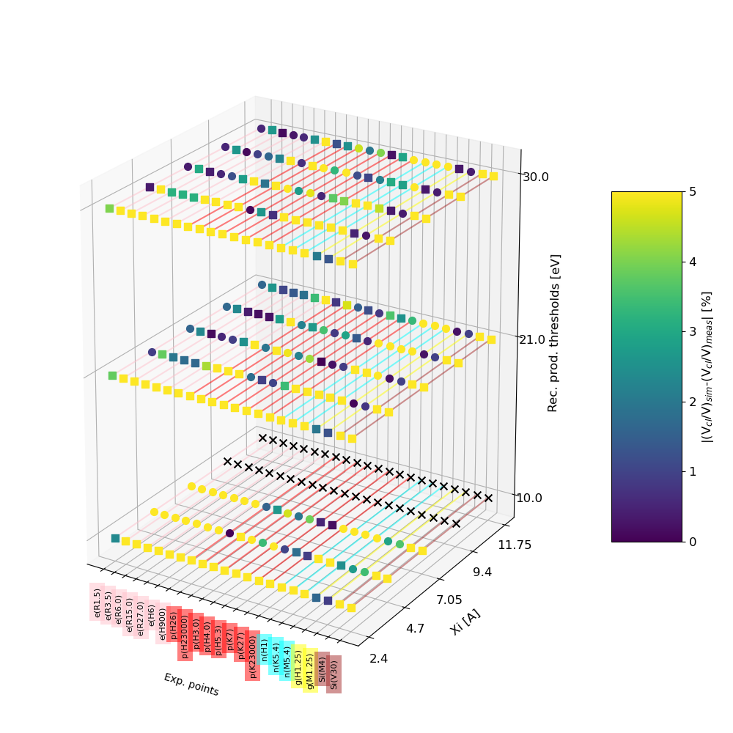
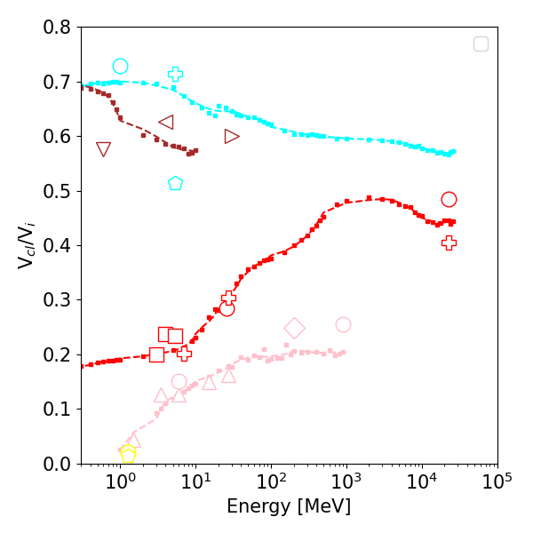
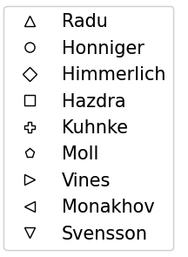
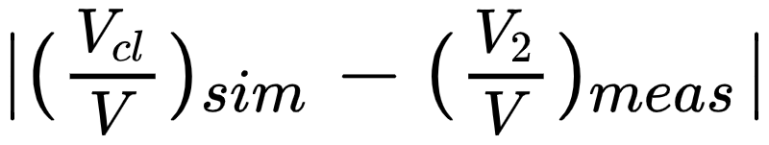
Parameter tuning and meas. benchmarking
Objective 3
X: axis measurement points
Y axis: nearest neighbor parameter in A
Z: recoil threshold production cutoff
Yellow shows the settings for which the simulation and measurements does not agree by > 5 %
We look for a row that is dark along the X-axis: good candidate for parameter tuning.
Cubes: Simulation predict higher fraction of clusters/isolated then measurements
Spheres: Simulation predict lower fraction of clusters/isolated then measurements
Measurements compilation from:
M.Kuhnke et al., Defect generation in crystalline silicon irradiated with high energy particles, https://www.sciencedirect.com/science/article/pii/S0168583X01008862,
L.Vines: Effect of spatial defect distribution on the electrical behavior of prominent vacancy point defects in swift-ion implanted Si, https://journals.aps.org/prb/pdf/10.1103/PhysRevB.79.075206
E.V.Monakhov: Ion mass effect on vacancy-related deep levels in Si induced by ion implantation, https://journals.aps.org/prb/pdf/10.1103/PhysRevB.65.245201
B.G. Svensson: Point defects in MeV ion-implanted silicon studied by deep level transient spectroscopy, https://www.sciencedirect.com/science/article/abs/pii/0168583X95007024
M.Moll: Radiation Damage in Silicon Particle Detectors: microscopic defects and macroscopic properties, PhD thesis
P. Hazdra: Defect distribution in MeV proton irradiated silicon measured by high-voltage current transient spectroscopy, 2002, https://www.sciencedirect.com/science/article/pii/S0168583X01011612
F. Honniger: Radiation Damage in Silicon - Defect Analysis and Detector Properties, 2007, https://inspirehep.net/files/f1ccf3f290d0ec203961dbdcd962701a
R. Radu: Bulk radiation damage in Silicon: from point defects to clusters, PhD thesis 2015
A.Himmerlic, private communication, CERN

Slide 15
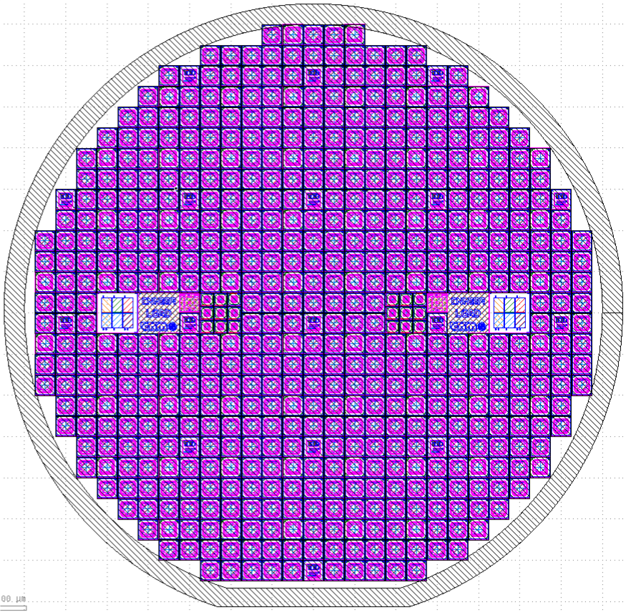
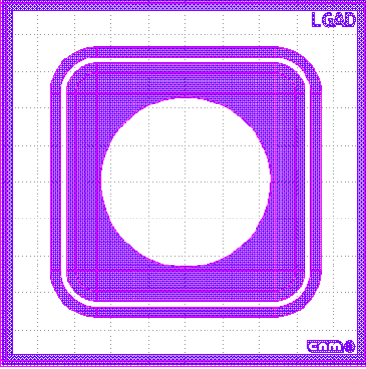
Sensors for NIEL measurements
Objective 3
NIEL sensors
  Produce a set of identical sensors that will be used to
    (a) study more profoundly the NIEL Hypothesis in dependence of particle type and energy
      Measurement of damage parameters: Diode (leakage, depletion, E-Field) and material (defect spectroscopy)
    (b) inter-compare radiation facilities in terms of their ‘hardness factors’
      Measurement of leakage current after exposure and specified annealing [alpha-value]
A set of Silicon Sensors (n-in-p) are in production at CNM, Barcelona
simple mask: 8 mask levels
600 devices of 5x5 mm² per wafer (150 mm)
10 wafers in production
  2 wafers will go to Ljubljana reactor
  2 wafers will go to CERN IRRAD
  6 wafers for in-depth NIEL studies
Status: In production since beginning of 2024
  33% of processing steps done
D4.2 (M42)

Slide 16
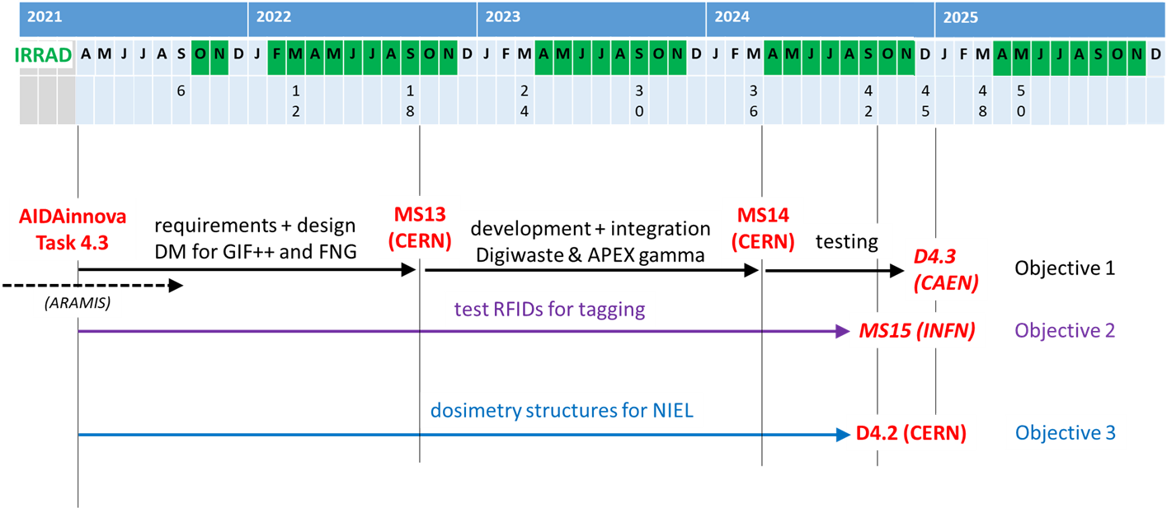
Timeline
requirements + design DM new facilities
Spectrometry data model (ARAMIS report)

Slide 17
Conclusion
Objective 1 – Generalisation of IDM
  IDM specifications for deployment to new facilities finalised (MS13)
  Deployment @ GIF⁺⁺ finalized
  Deployment @ FNAL ongoing (D4.3)
Objective 2 – Integrated system for induced activation data management and traceability
  APEX-gamma DB communication with IDM and proton fluence computation (MS14)
  CAEN RadHAND / RadBASE API → IDM integration tested (MS14)
  Irradiation campaigns for CAEN RFID tags performed in IRRAD (protons) and ENEA-FNG (neutrons) while other tests are being planned (MS15)
Objective 3 – Common dosimetry calibration set for cross-comparison of irradiation facilities by NIEL evaluation
  Geant4 and FLUKA simulations for NIEL curves successfully reproduced and algorithm for identifying clustered vs point defect damage implemented
  Benchmarking simulations with measurements data is ongoing
  Production of silicon sensors is ongoing (D4.2)

