Slide 1
AIDAinnova (7.2)
MRPCs for fast timing at high incident flux of charged particles
Muon tomography: Low power, minimal gas use, excellent time resolution
Name of the legal entity | Type | Country | Main contact person
INFN, Bologna | Institute | Italy | Gilda Scioli
Picotech SAS | Company | France | Crispin Williams
LIP-Coimbra | Institute | Portugal | Alberto Blanco
University of Clermont Ferrand | University | France | Cristina Carloganu
EUROPEAN MEMBERS
Tsinghua University | University | China | Yi Wang
Shenzhen Institute of Advanced Technology, Chinese Academy of Sciences | Institute | China | Zheng Liu
Seoul National University Bundang Hospital | Institute | South Korea | Do-Won Kim
Gangneung-Wonju National University | University | South Korea | Yongwook Baek
Benemérita Universidad Autónoma de Puebla | University | Mexico | Cecilia Uribe Estrada
EXTERNAL MEMBERS

Slide 2

Grant Agreement No: 101004761
AIDAinnova
Advancement and Innovation for Detectors at Accelerators
Horizon 2020 Research Infrastructures project AIDAINNOVA
deliverable report
Characterisation of small size MRPC prototypes for fast timing and high rates
Deliverable: D7.2
Many thanks to Yongwook Baek and Jinsook Kim for this report

Slide 3
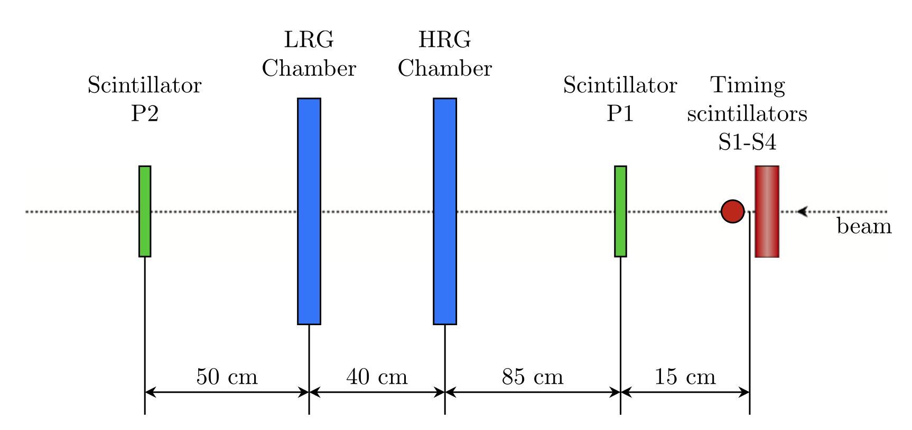
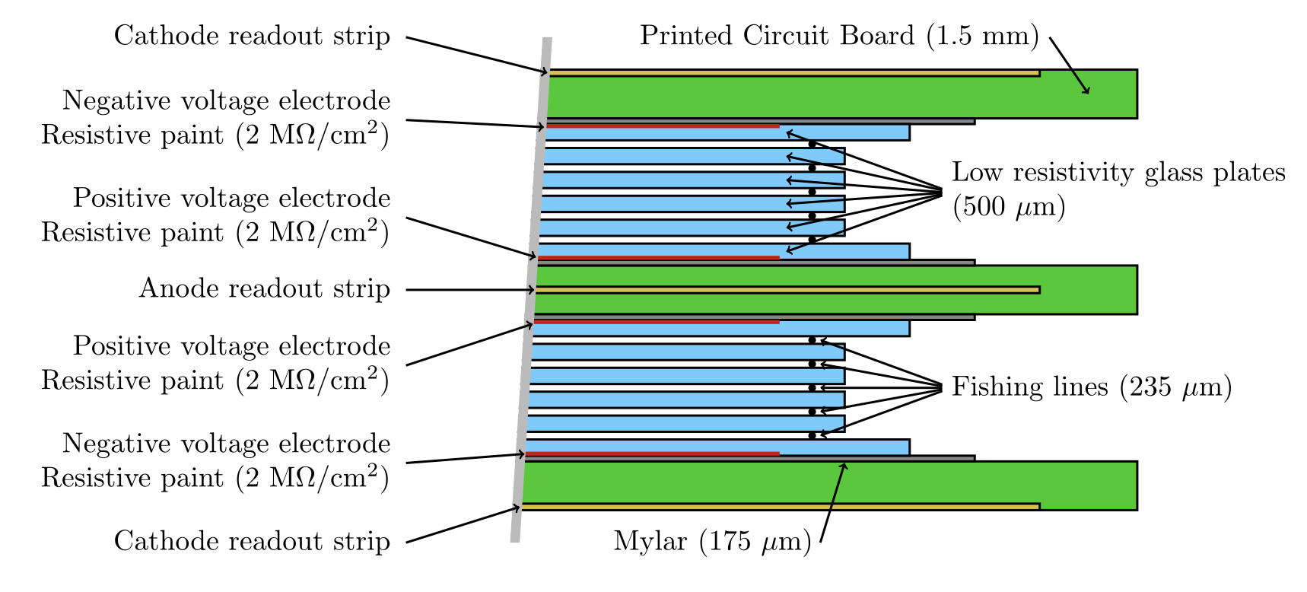
Beam test :
  T10 line at PS CERN
  Two MRPC tested :
    8-gap (2 stacks of 4-gaps) chamber (HRG)
      standard float glass, thickness 400μm
      gap size 250 μm
      nylon fishing lines as spacers
    10-gap (2 stacks of 5 gaps) chamber (LRG)
      Low resistive glass (10⁹ Ωcm), thickness 500μm
      gap size 235 μm
      ceramic coated fishing lines as spacers
  Two mixtures of gas tested :
    98% C₂F₄H₂ and 2% SF₆
    100% HFO-1234ze

Slide 4
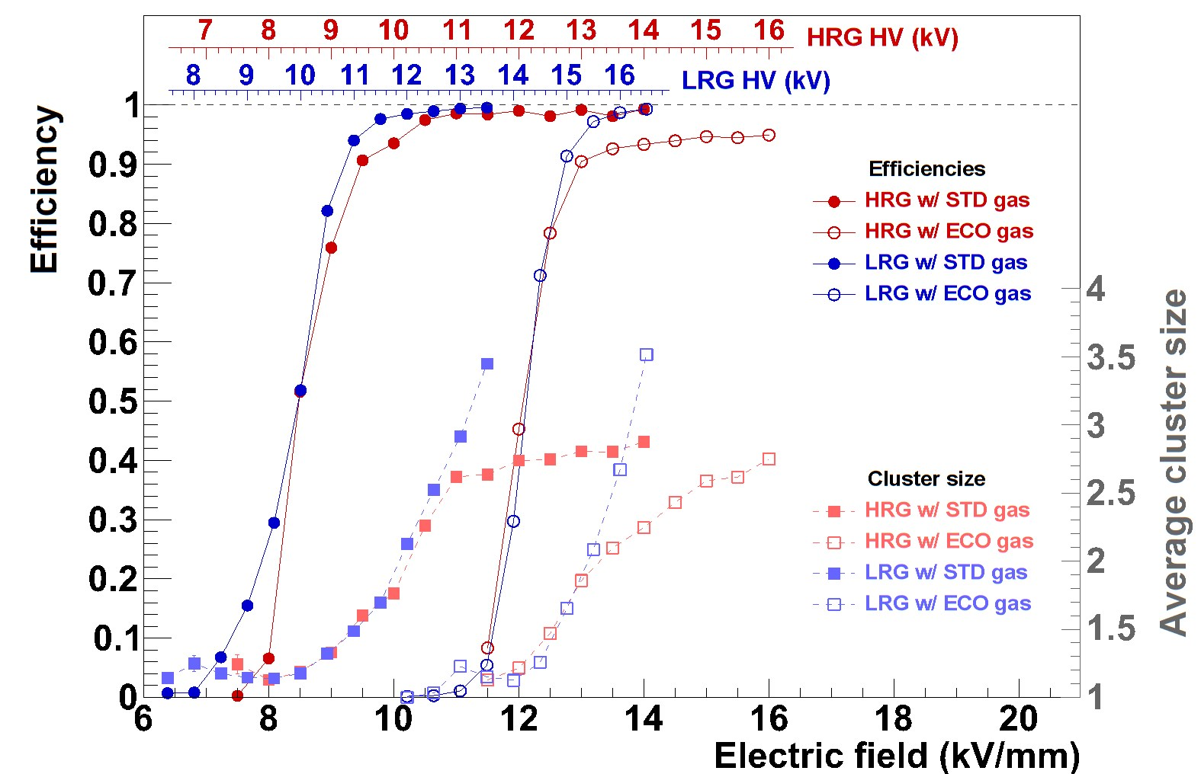
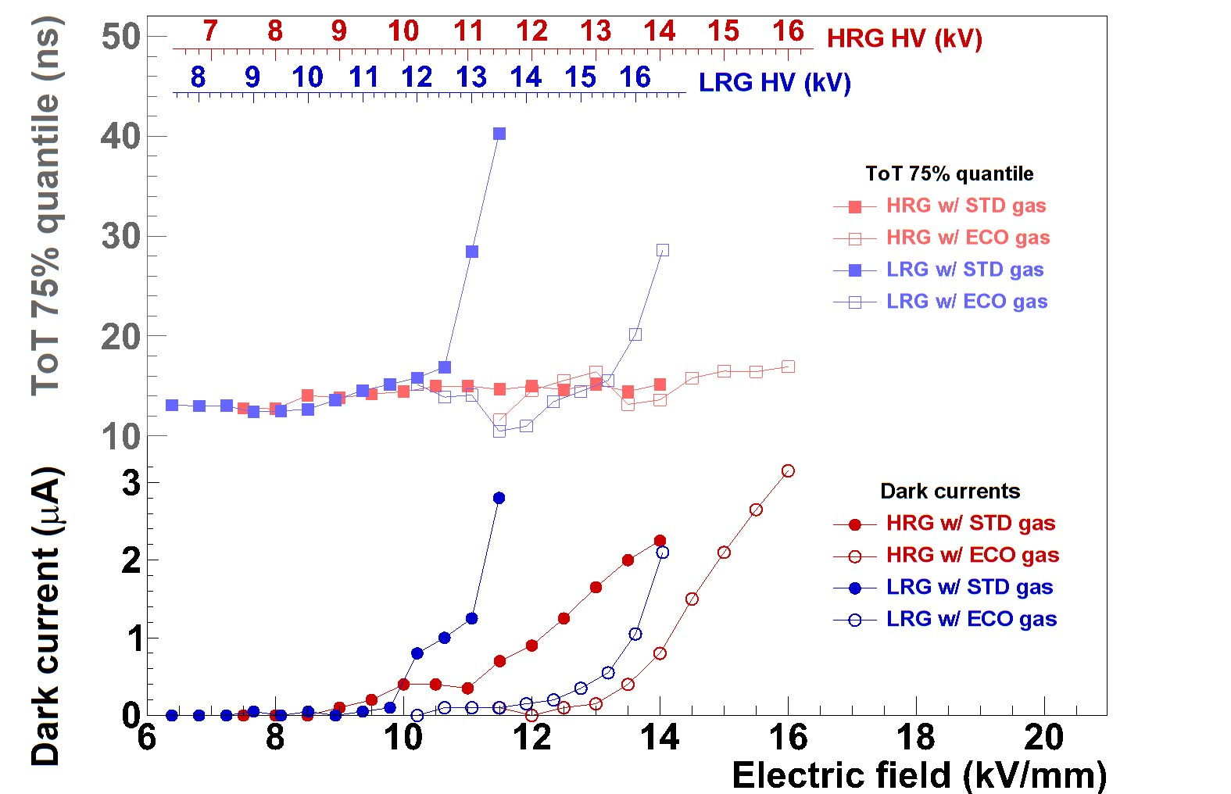
Efficiency/Multiplicity
In the case of ecological gas, the voltage needs to be increased by 4 kV to reach the efficiency plateau … also current starts to rise quicker when on efficiency plateau

Slide 5
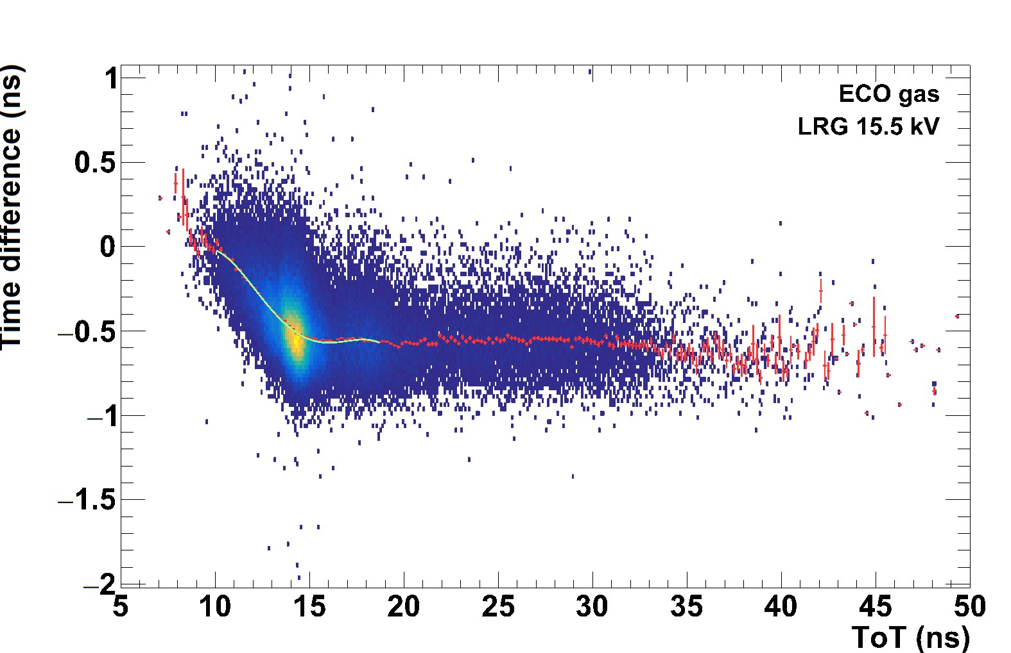
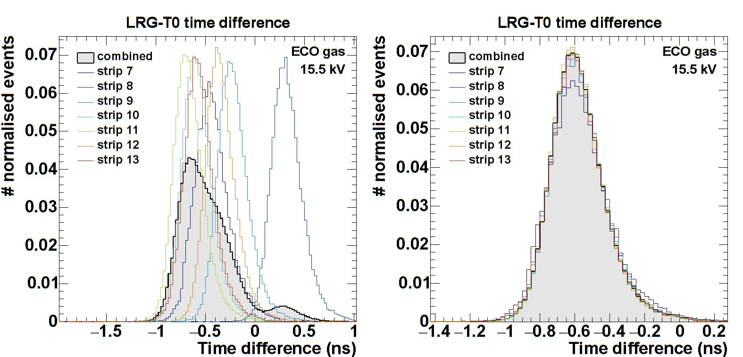
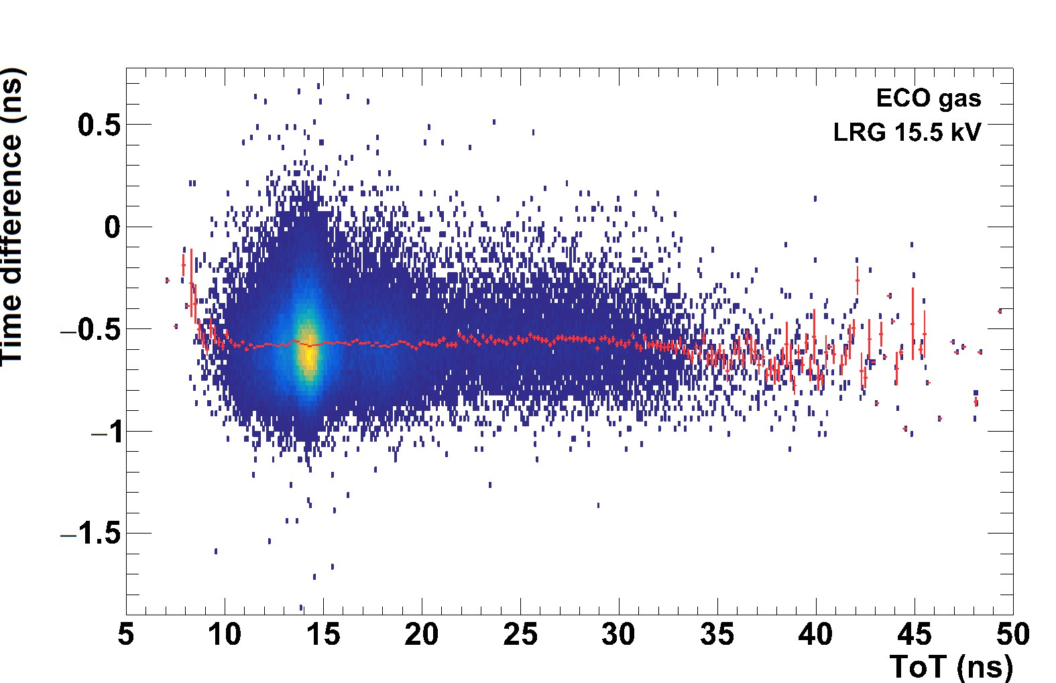
Calibration for channels
Time-off set correction
Time-slewing correction

Slide 6
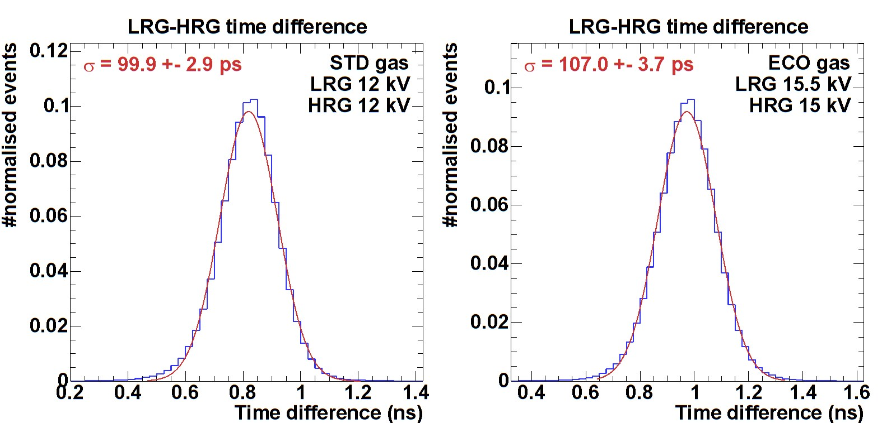
Timing
Use the difference between the two chambers to estimate their timing resolution (CFD was not operating properly)
Standard gas :
  σ = 100 ps
  => 70 ps per chamber
Eco gas :
  σ = 107 ps
  => 76 ps per chamber

Slide 7
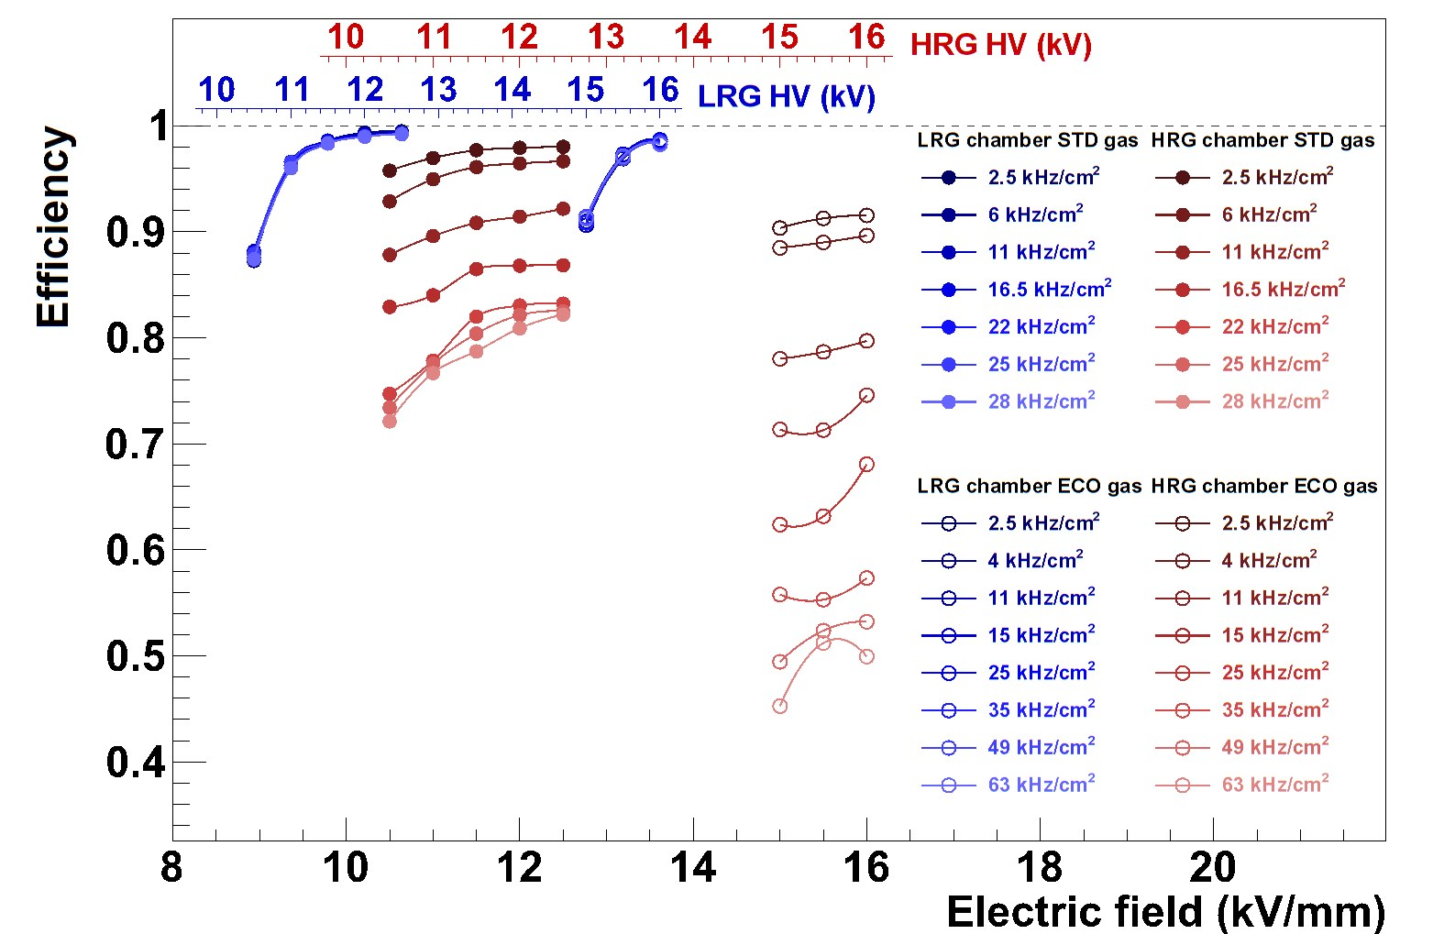
Efficiency vs. Rate
Beam: 7 GeV pions
Beam profile : 1.3 cm FWHM
Rates :
  up to 28 kHz/cm2 for standard gas
  up to 63 kHz/cm2 for eco gas
Rate has no effect on LRG chamber (as expected)

Slide 8
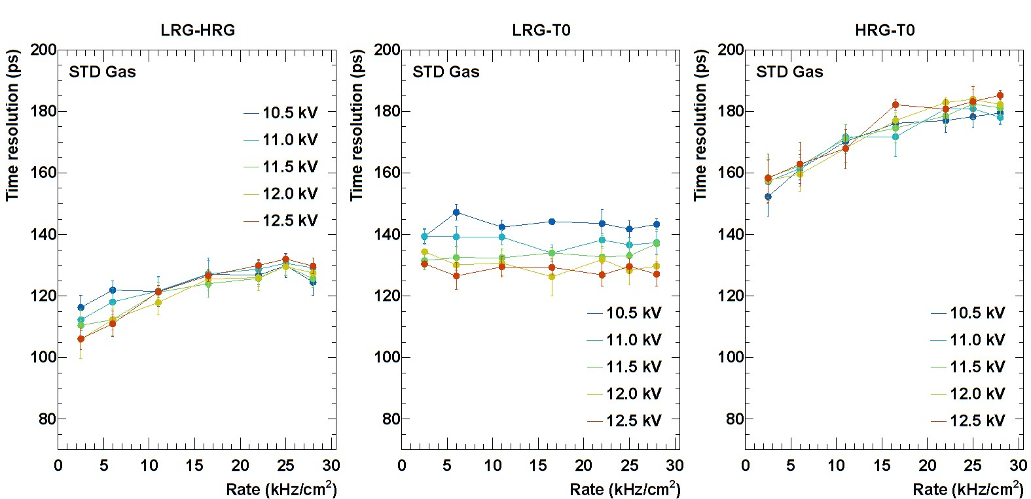
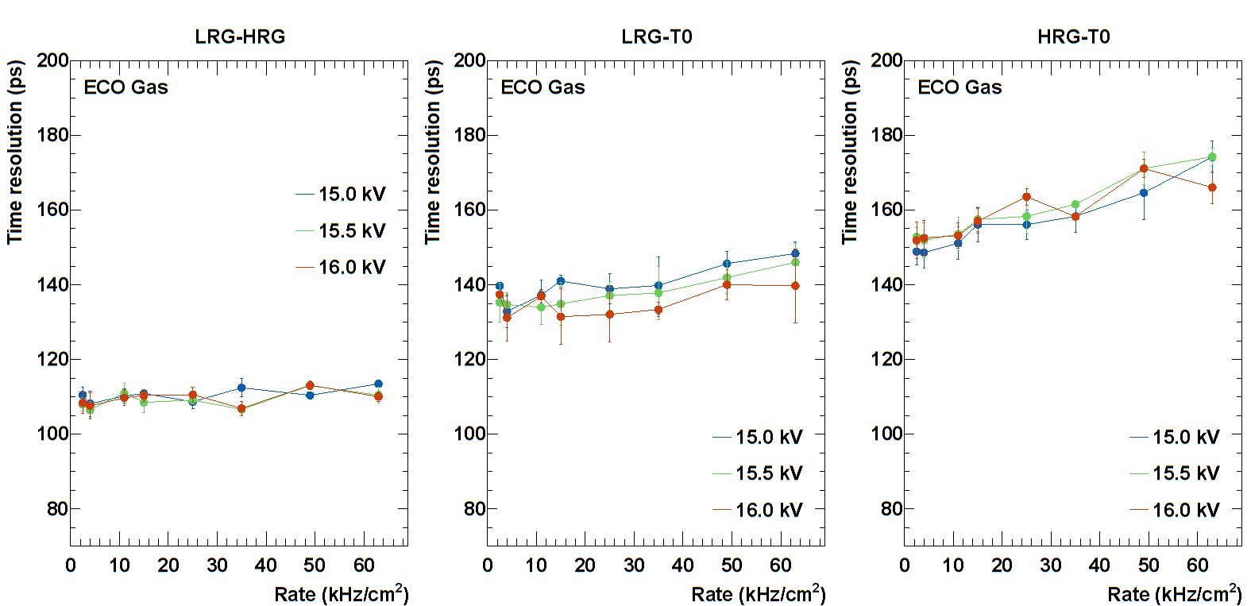
Time resolution vs. Rate
STD gas
Overall, similar results were obtained for both gases
ECO gas

Slide 9
Conclusion
HRG vs. LRG
  A distinct difference in the rate capability at high rate flux
Ecological gas vs. Standard gas
  No conspicuous difference in efficiency and timing performance
A realistic test on the rate capability needs to be carried out in the further test by irradiating the larger detector area instead of a focused beam on a small spot.

Slide 10
Some words on the picoTDC development
INFN Bologna

Slide 11

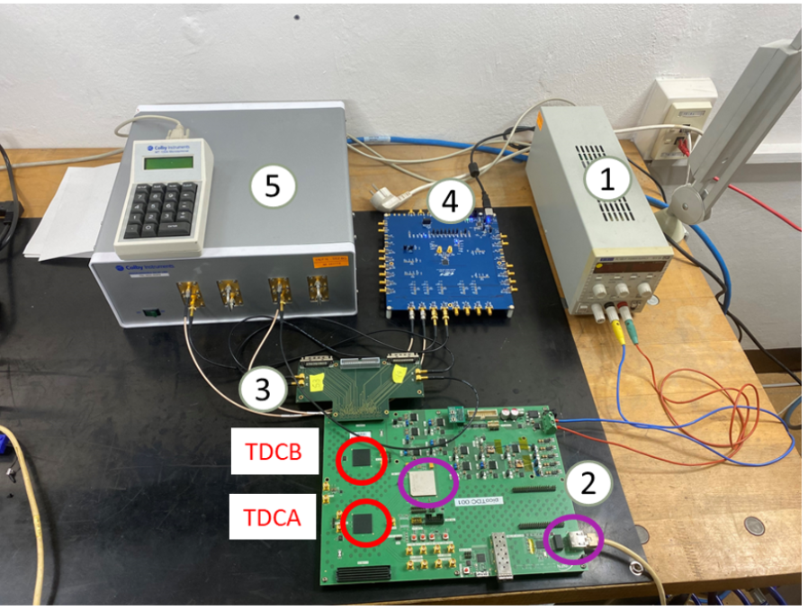
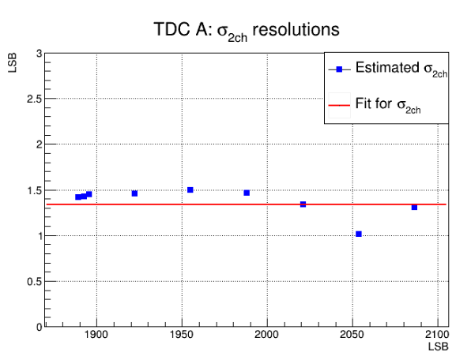
Update on picoTDC card (128 channels)
Firmware suite fully developed for PolarFire FPGA
I2C programming of picoTDC
Data acquisition via Ethernet (IPBUS)
Resolution tests using calibrated delayed line (EM) (0 – 600 ps)
σ_{2ch} ≅ 1.34 LSB
σ_{1ch} ≅ 0.95 LSB
Note :
LSB is 3 ps
σ_{2ch} (TDC bins)
1. power supply (12 V)
2. picoTDC board with 2 picoTDC
3. FMC adapter card (includes VHDCI connectors getting inputs from ALICE TOF FEA cards)
4. SiLab low-jitter clock (used to pulse at 30 KHz)
5. Electromagnetic trombone (Colby XT-200)
Delay (TDC bins)

Slide 12
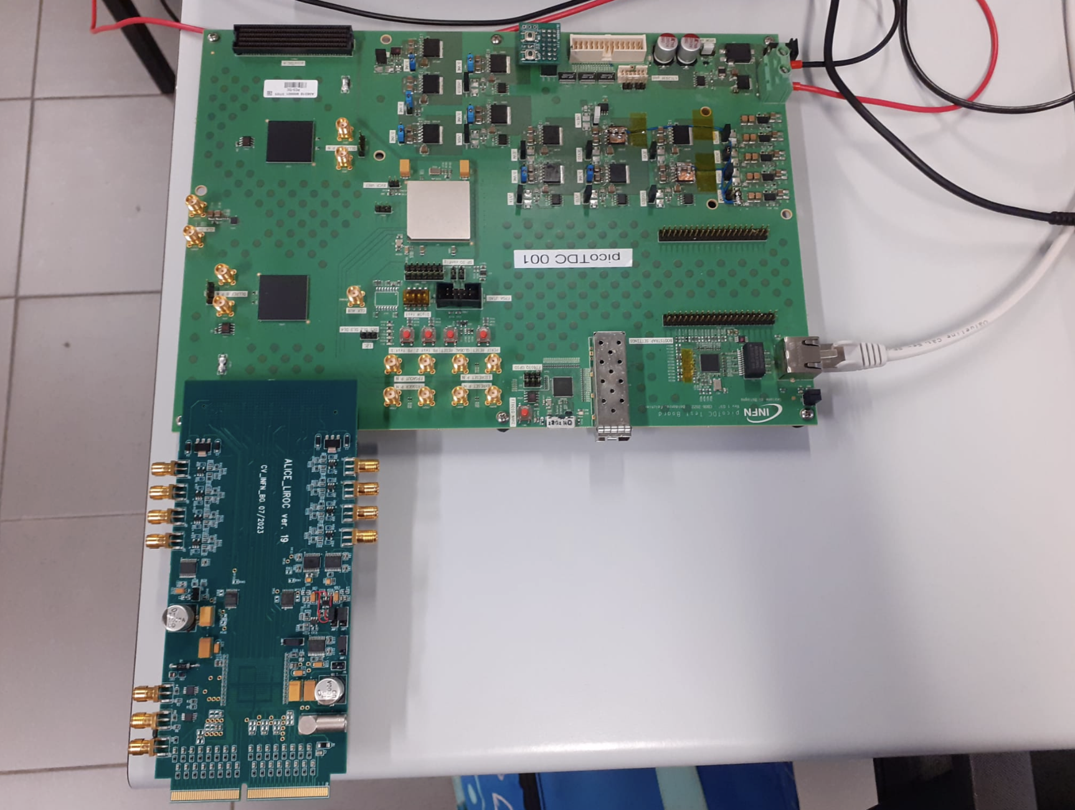
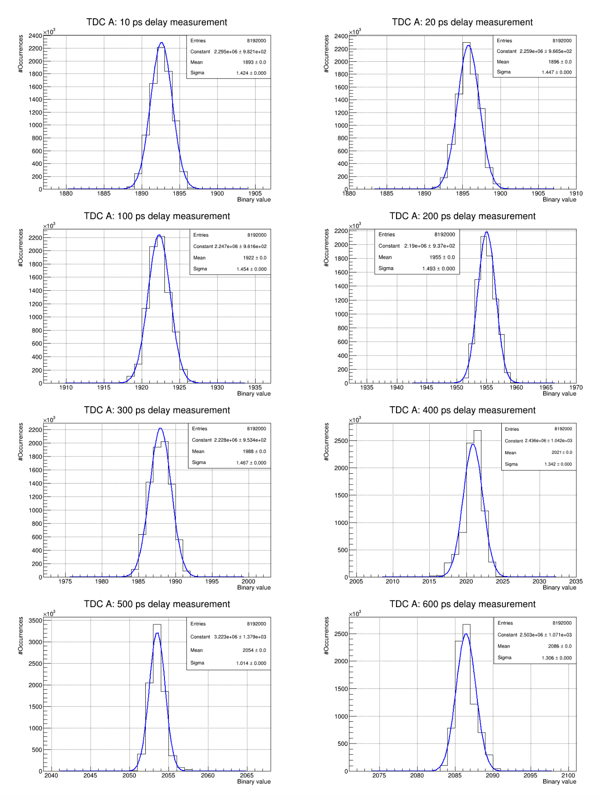
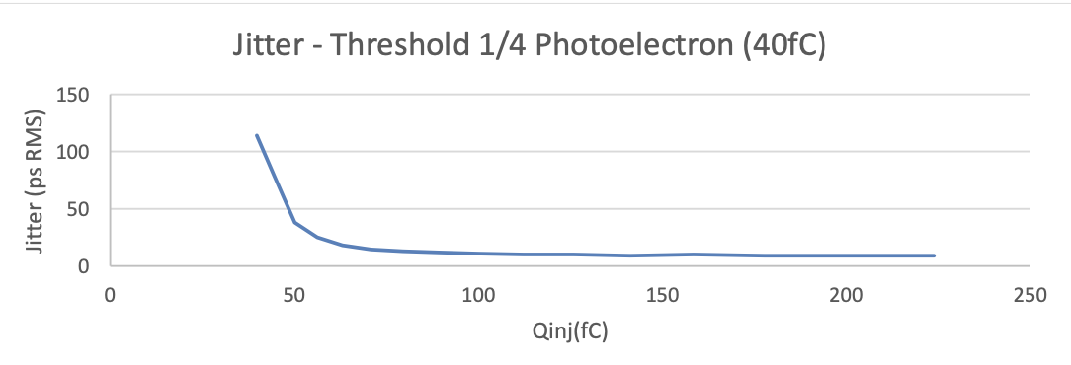
Delay line measurements with picoTDC Board
Additional custom card: FMC adapter for Weeroc LIROC
LIROC is an ASIC (preamp+disc) optimized for SiPM
64 channels naturally “coupled” with picoTDC
8 discriminated output available on ext. connectors
I2C programming of LIROC via picoTDC Board
The cards will be used for test beams at CERN both on MRPC
(from NINO FEA) and SiPM (from LIROC)

Slide 13
Thank you for your attention

Slide 14
Backup

Slide 15
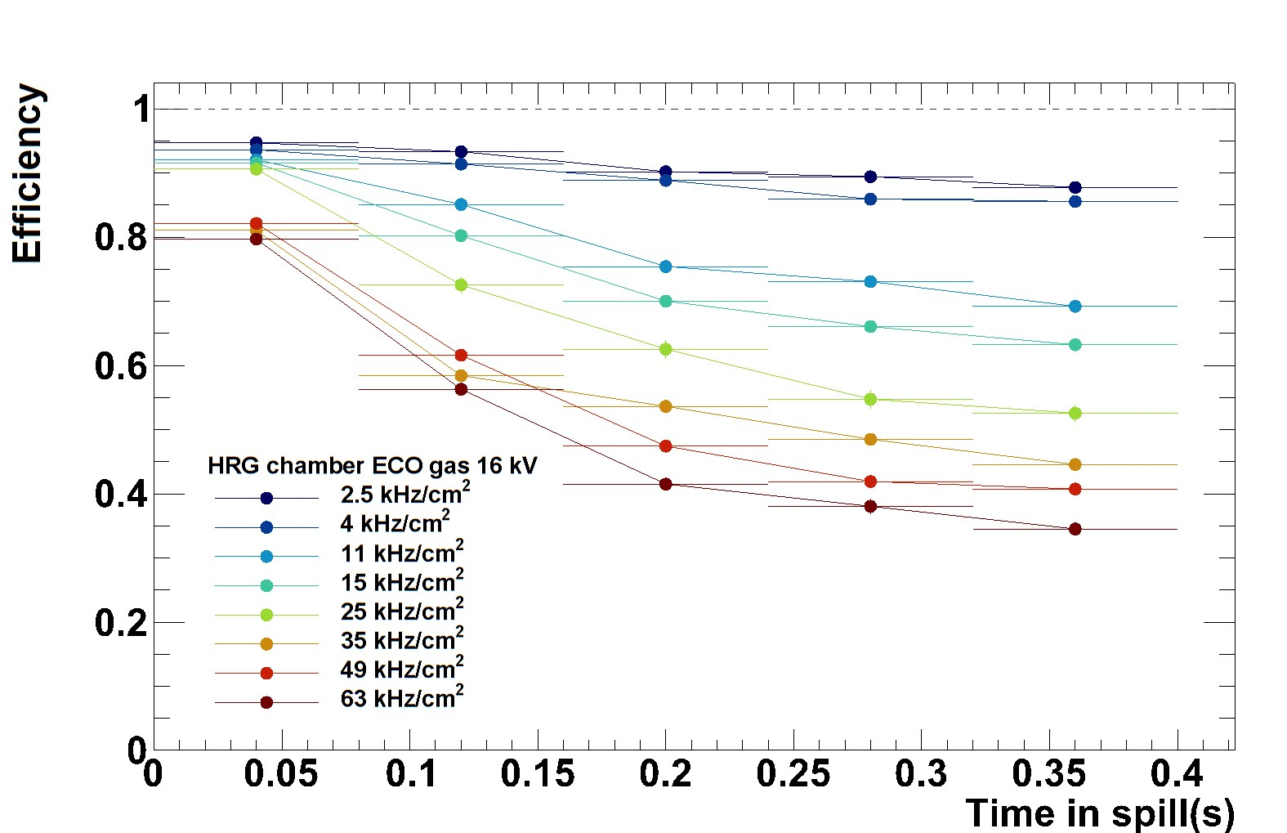
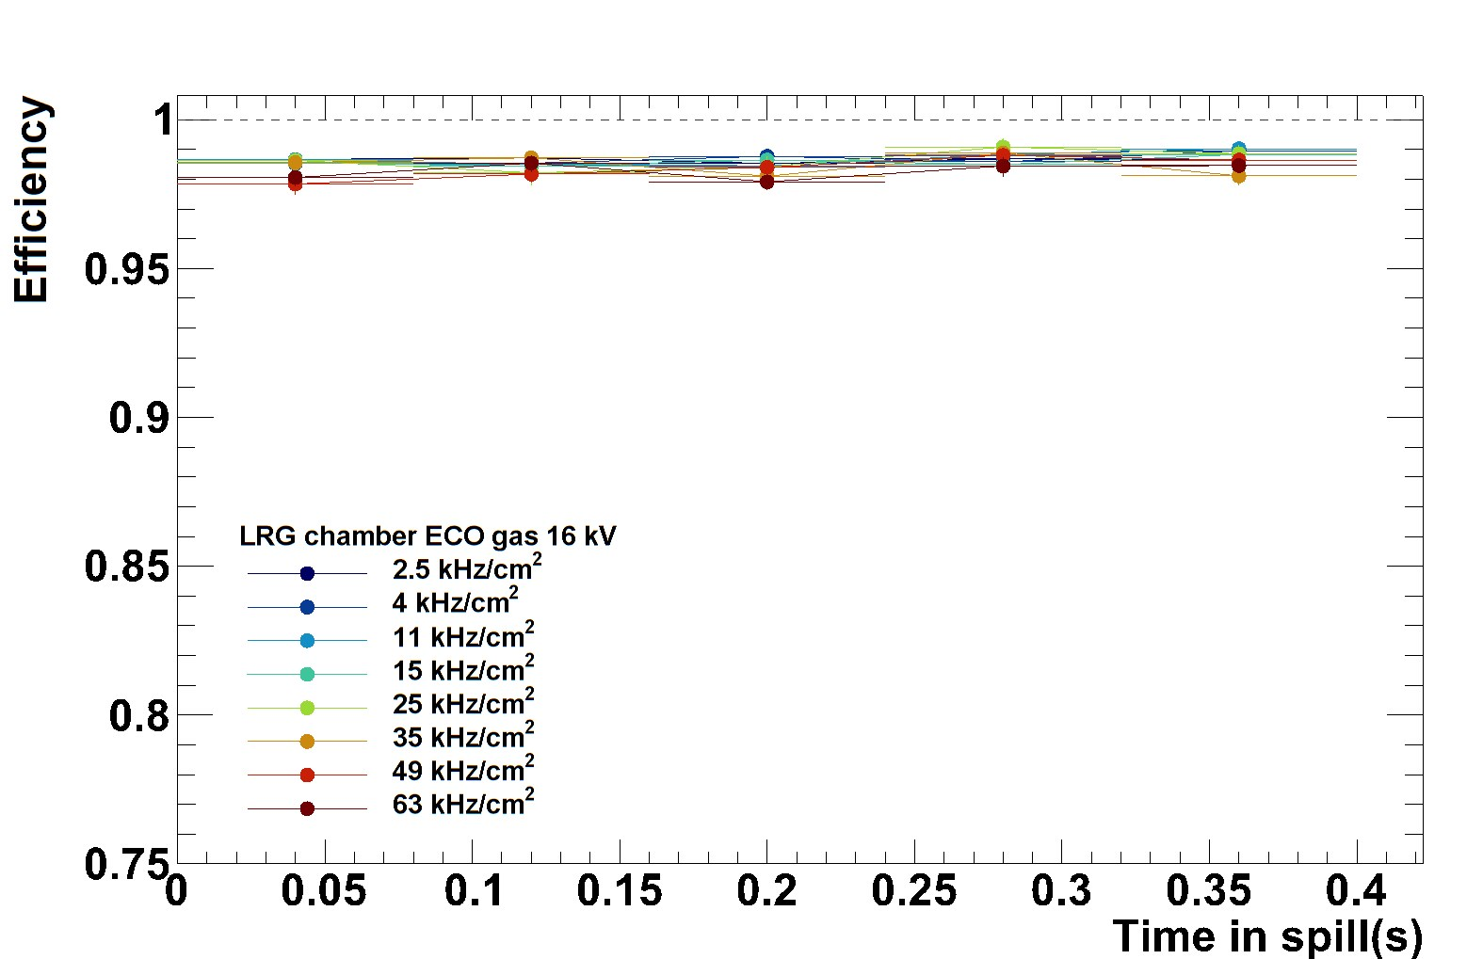
Efficiency in a beam spill
HRG
LRG

Slide 16
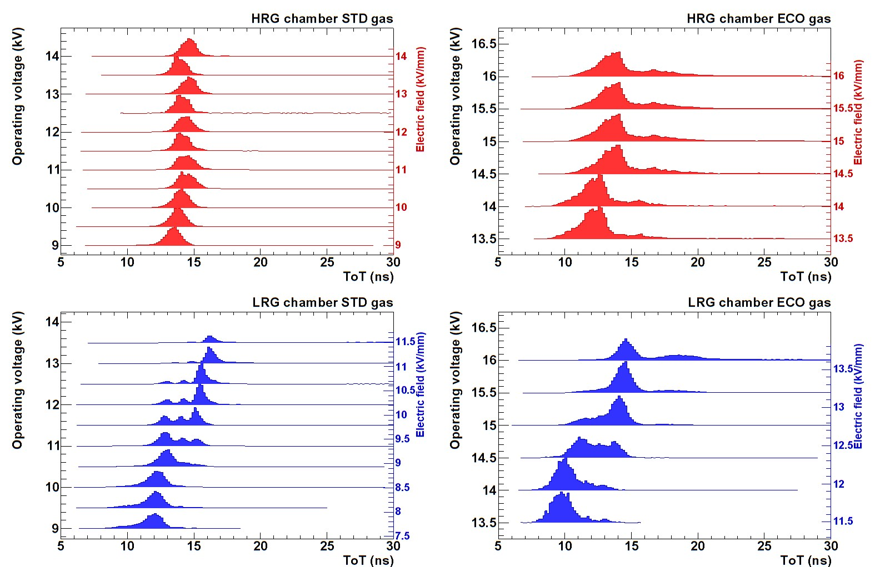
ToT distribution

