Slide 1
New vis
(and some GUI) features 2023
Scheduled for Geant4 11.2
These are summary slides for the plenary session
Please come to the vis parallel session this afternoon
for a full report and discussion

Slide 2
Contents
G4debug—a new output stream
A new scene tree—available to any viewer when using the Qt GUI
/vis/open (without parameters)
  Choose driver at run time
  /vis/open (with parameters), e.g., /vis/open OGL, works as before
New off-screen drivers with ToolsSG (TSG) and Vtk
  Output to file—choice of formats
  Any size—choose large size to get high resolution
News

Slide 3
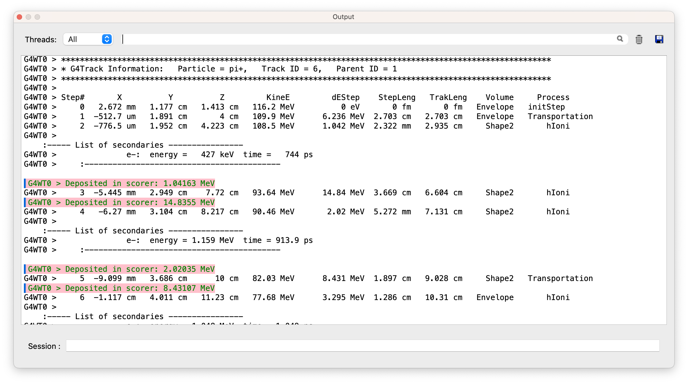
G4debug example using Qt GUI
In B1::SteppingAction::UserSteppingAction after testing for the scoring volume:
G4debug << "Deposited in scorer: ”
<< step->GetTotalEnergyDeposit()/CLHEP::MeV << " MeV" << G4endl;
To show occasional debug
line in a mass of other
output, run with:
/tracking/verbose 2
/gun/particle proton
/gun/energy 1 GeV
/run/beamOn
The Qt GUI intercepts this
Output stream and highlights
it, making it easy to pick out
the debug line.
(Other sessions, e.g., tcsh,
simply direct to std::cout.)

Slide 4
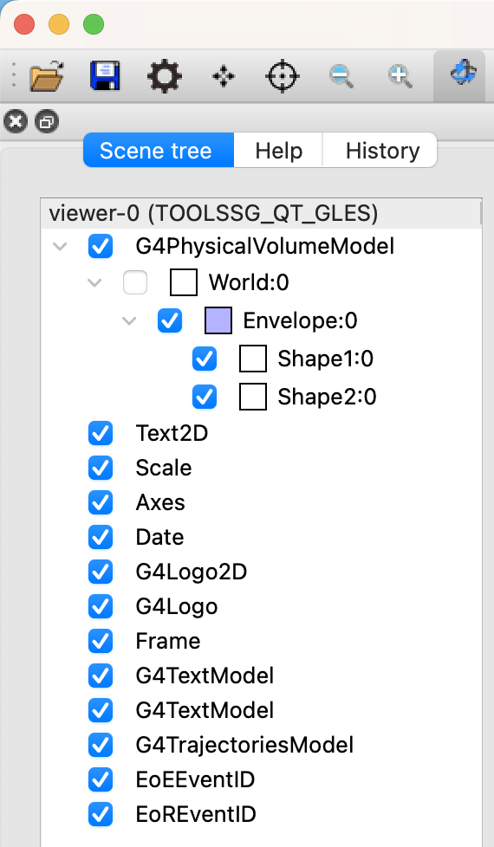
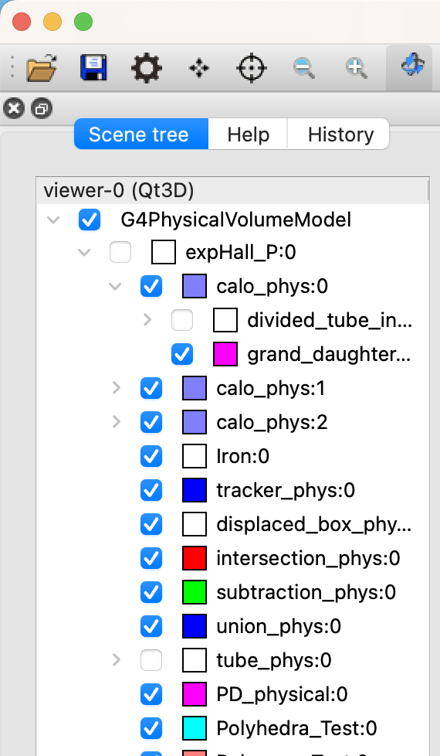
A new scene tree
Available to any viewer when using the Qt GUI
  Including non-Qt viewers, off-screen and file-writing viewers
  A unique scene tree is held by each viewer and made available to the Qt GUI
  The Qt GUI renders it to an interactive tree and notifies the interactions to the viewer
Features
  Hover to get dump of touchable
  Click on blue check box to make invisible/visible
  Click on chevron to hide/expose list of daughters in the scene tree
  Double click on small square box to change colour
  Right-click to get menu of actions

Slide 5
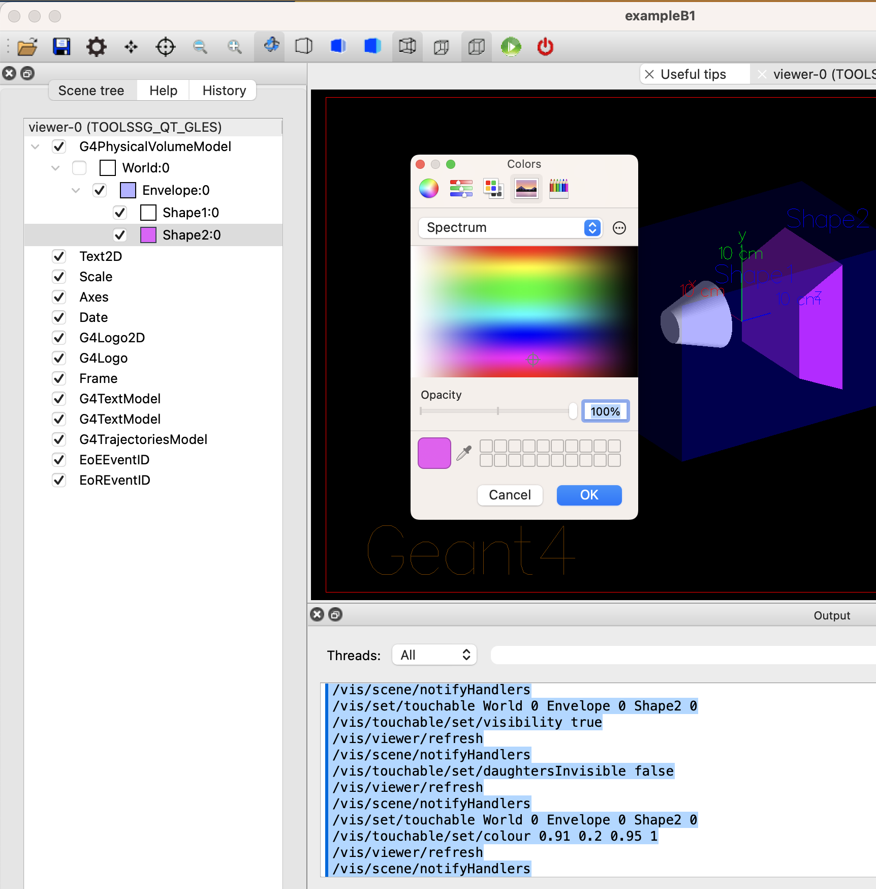
New scene tree
(contd)
Double click on small square box
to change colour

Slide 6
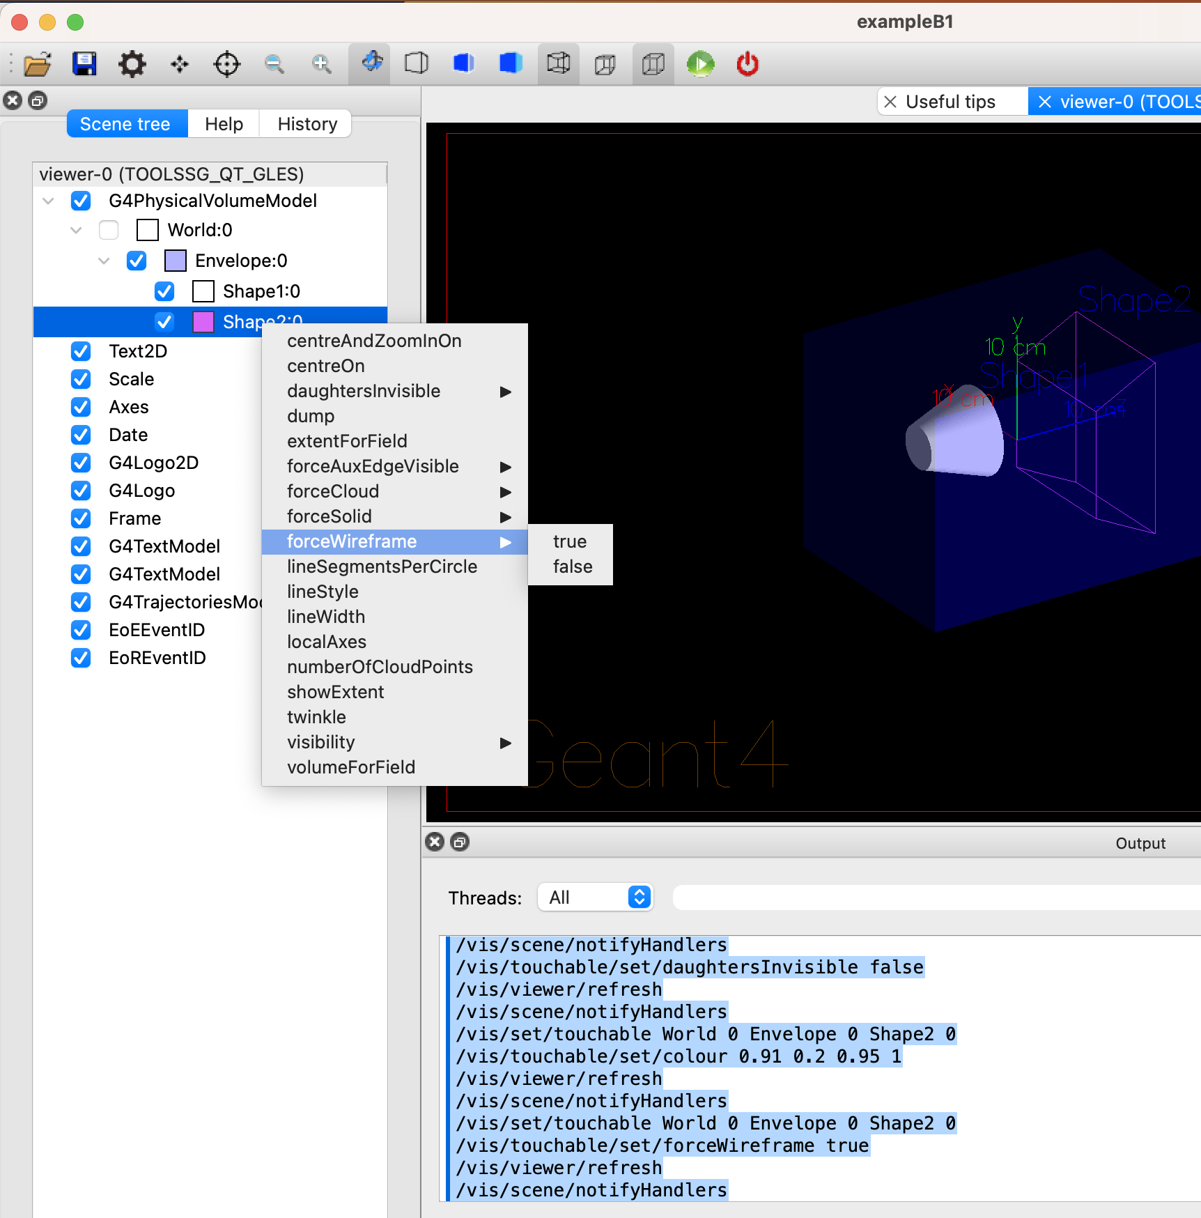
New scene tree
(contd)
Right-click to get menu of actions

Slide 7
/vis/open (without parameters)
This will be the recommended way of opening a viewer
  Examples B1 and B2 have been changed
  We plan to change all tests and examples for 11.2
  A new constructor in all main programs:
  G4VisExecutive(argc, argv)
  All /vis/open OGL commands stripped of parameters in all vis.mac files
Existing behaviour is preserved
  The default default is OGL
  You can still use the old constructor: G4VisExective()
  You can still use /vis/open OGL
The default can be changed at run time (without having to edit vis.mac!)
  By programmed argument
  By environment variable
  By entry in a file in your home directory, ~/.g4session
Otherwise according to batch/interactive and build flags

Slide 8
New or improved and retired vis drivers
New in Geant4 11.0 and further developed for 11.1 and 11.2
  Qt3D (John Allison): limited functionality but nice
  ToolsSG (TSG) (Guy Barrand): working nicely
    Most features of the OpenGL drivers
    Also supports plotting
    Full-screen driver, TOOLSSG_OFFSCREEN—always built, default in batch mode
  Open Inventor Qt (OIQt) (Fred Jones): Also very nice, requires users
    Includes “bookmarking” and “navigation”
  Vtk (Stewart Boogert, Laurie Nevay): Improved multi-featured version on the way
    Interactive cutting and clipping
    Export to GLTF (modern 3D object transfer protocol), interface to other packages
    Export to web – scene can be rendered and manipulated in a webpage, “fantastic for manuals and documentation”
    Off-screen rendering
Retired (removed) in Geant4 11.1
  HepRep/Wired (HepRepFile/HepRApp is retained)
  VRML1 (VRML2 is retained)
  The “network” drivers (those that communicate with their browser via BSD sockets”
    VRML2 (VRMK2FILE is retained)
    DAWN (DAWNFILE is retained)

Slide 11





Why VTK?
Development supported by
Best in class scientific rendering
KitWare world leading opensource scientific computing company (cf. Cmake)
Trusted in medical applications, high end engineering, non-HEP scientific visualisation
Large user community
Stable and documented API in C++
1000s of C++ examples to base visualization code on
Started in December 1993 (pre-dates Geant4)
Works exceptionally well for Geant4!

Slide 12
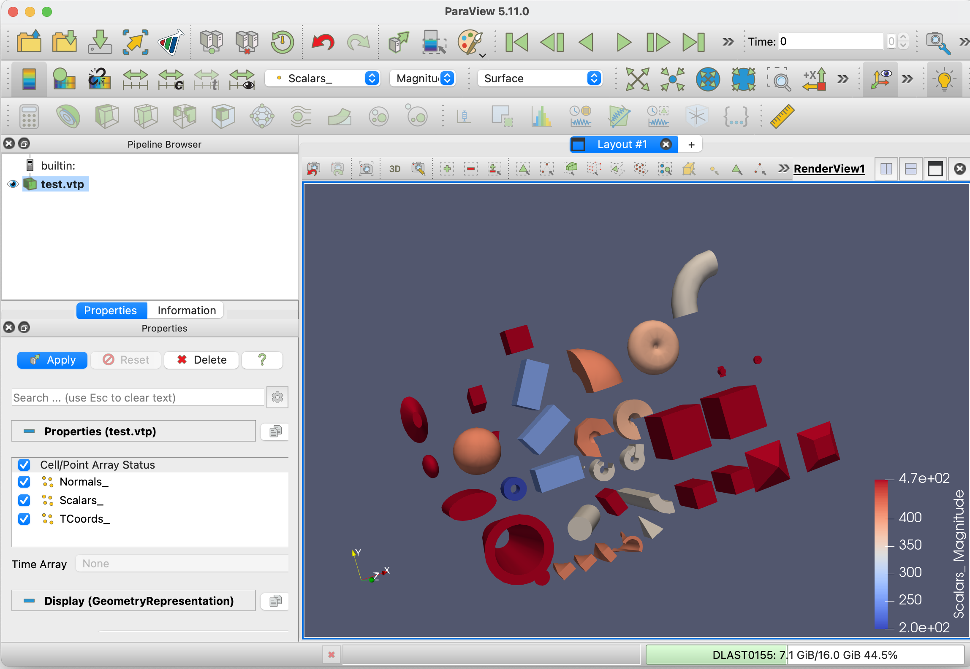

Vtk exports
Vtk → OBJ/GLTF → Powerpoint
Export to almost all possible 3D file formats
  VTU/VTP (vtk.js web model)
  OBJ (convert to GLTF/USD web mode)
  VRML
  PLY
Export screen grabs
  PS
  JPEG
  TIFF
  PNG
  BMP
Offscreen rendering and 3D conversion etc
Vtk → VTP/VTP → Paraview

Slide 13
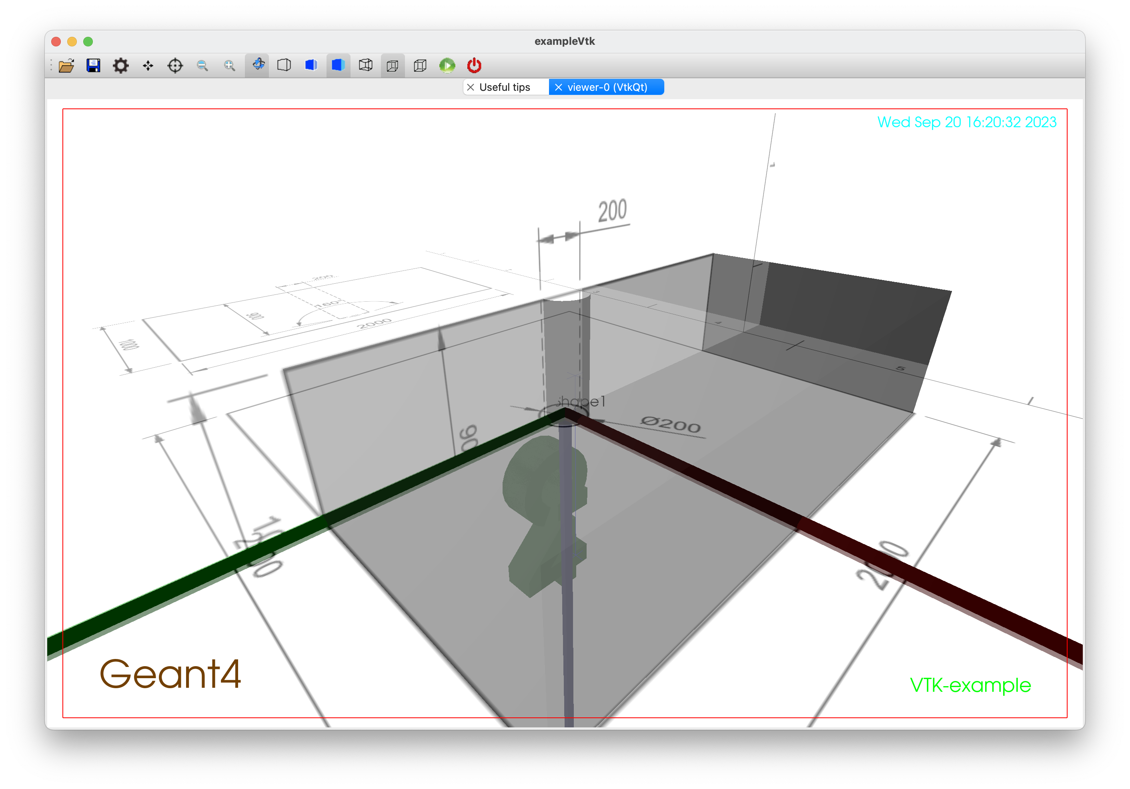
Vtk “side-loaders”
Load data to augment modelling process
  2D image or 3D data
  DICOM
  Multiphysics data
Example is CAD 2D images
  exported as PDF->PNG
  Side loaded in to VTK
Need to put into generic vis not just VTK

Slide 14
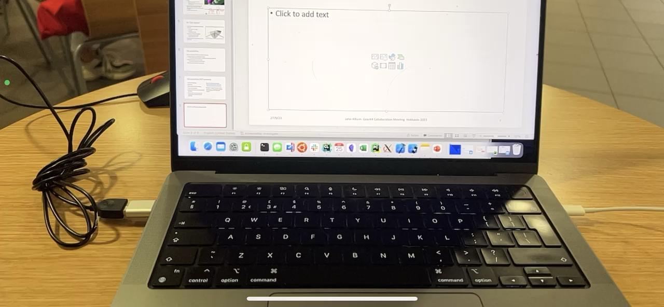
GLTF in iPhone RealityKit
Vtk → OBJ/GLTF → iPhone App (RealityKit)

Slide 15
Vtk possibilities (HEP outreach)
Complex lighting
Shadows
Physically based rendering
Ray tracing Ospray
OpenXR simple to enable (VR/AR for free)
Vtk for iOS and Android and Javascript so mobile version possible.
Each of these (non-critical improvements) each will take ~40 hours work to implement
Boogert happy to support keen post-doc or PhD student wanted to develop an HEP outreach project

Slide 16
For more details, come to the vis parallel session at 1400.
G4 vis is an object-oriented multi-driver system. The core vis system converts the G4 scene (geometry, trajectories, etc.) into G4 graphics primitives. A driver renders the primitives and brings additional features, such as clipping, volume rendering, file export, etc.
You can choose your driver, even have different drivers in the same interactive session, and multiple views of the G4 scene.
Graphics is an ever-changing scene. It’s hard to keep up. We want to exploit modern features to keep Geant4 looking smart and performant. In particular we are looking for people to take on the work of continuing development of the Vtk driver (under Stewart’s supervision). We could do with someone with experience of Qt C++.
Come and join—even if part time—this fun and challenging working group.
Thankyou

