Slide 1

The next generation projects
in Deep Underground Laboratories
30 June 2011 - 2 July 2011,
Zaragoza, Spain
Neutrino mass in Europe
Andrea Giuliani
CSNSM, CNRS/IN2P3
France

Slide 2
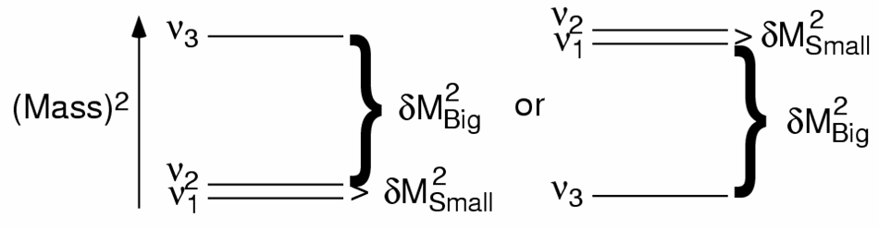
What ν oscillations don’t tell us
①
absolute neutrino mass scale
②
neutrino mass hierarchy
direct
inverted
Hierarchy could be identified in a few years (θ₁₃ looks “big”…)
③
DIRAC or MAJORANA nature of neutrinos
ν ≠ ν
ν ≡ ν

Slide 3
Cosmology, single and double β decay
Cosmology, single and double β decay measure different combinations
of the neutrino mass eigenvalues, constraining the neutrino mass scale
In a standard three active neutrino scenario:
cosmology
simple sum
pure kinematical effect
3
Σ ≡
Σ M_{i}
i=1
1/2
3
β decay
incoherent sum
real neutrino
⟨M_{β}⟩ ≡
Σ M_{i}² |U_{ei}|²
i=1
3
double β decay
coherent sum
virtual neutrino
Majorana phases
⟨M_{ββ}⟩ ≡
|Σ M_{i} |U_{ei}|² e^{iα} |
i
i=1

Slide 4
Decay modes for Double Beta Decay
2ν Double Beta Decay
allowed by the Standard Model
already observed – τ ≥ 10¹⁹ y
①
(A,Z) → (A,Z+2) + 2e⁻ + 2ν_{e}
②
neutrinoless Double Beta Decay (0ν-DBD)
never observed (except a discussed claim)
τ > 10²⁵ y
(A,Z) → (A,Z+2) + 2e⁻
Processe ② would imply new physics beyond the Standard Model
violation of total lepton number conservation

Slide 5
The mass mechanism
how 0ν-DBD is connected to neutrino mixing matrix and masses
in case of process induced by light ν exchange (mass mechanism)
neutrinoless
Double Beta Decay
rate
Phase
space
Nuclear
matrix elements
Effective
Majorana mass
1/τ = G(Q,Z) |M_{nucl}|²⟨M_{ββ}⟩ ²
⟨M_{ββ}⟩ = ||U_{e1} | ²M₁ + e^{iα1} | U_{e2} | ²M₂ + e^{iα2} |U_{e3} | ²M₃ |

Slide 6
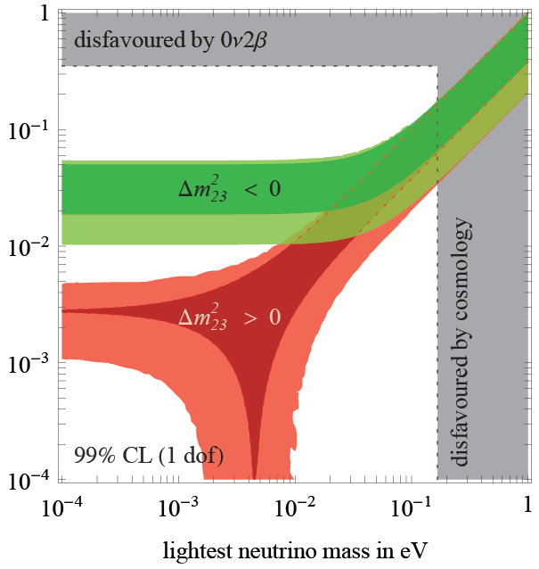

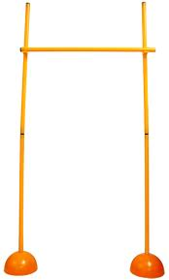
Three hurdles to leap over
⟨M_{ββ}⟩
[eV]
100-1000 counts/y/ton
400 meV
Klapdor’s claim
95% c.l.
0.5-5 counts/y/ton
20 meV
0.1-1 counts/y/(100 ton)
1 meV

Slide 7
The sensitivity
sensitivity F: lifetime corresponding to the minimum detectable number
of events over background at a given confidence level
b: specific background coefficient
[counts/(keV kg y)]
live time
energy resolution
source mass
F ∝ (MT / bΔE)^{1/2}
If (b ΔE X exposure) < 1, then the background can be considered ~0
F ∝ MT
The order of magnitude of the target bakground is
≤ 1 counts / y ton to explore inverted hierarchy

Slide 8
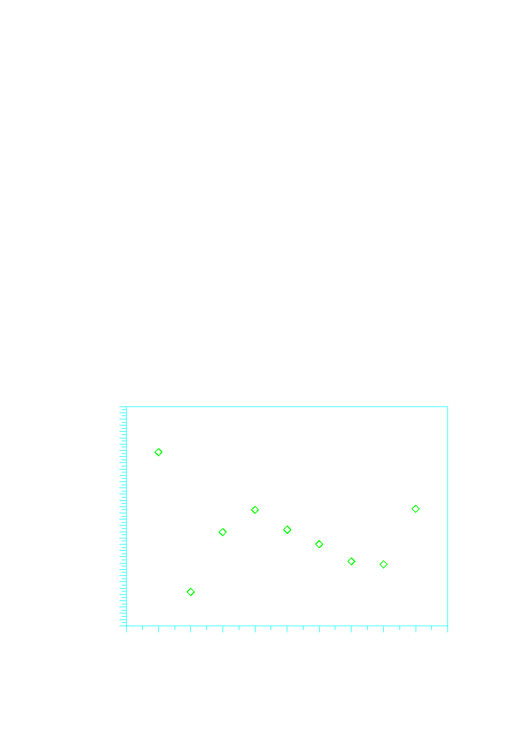
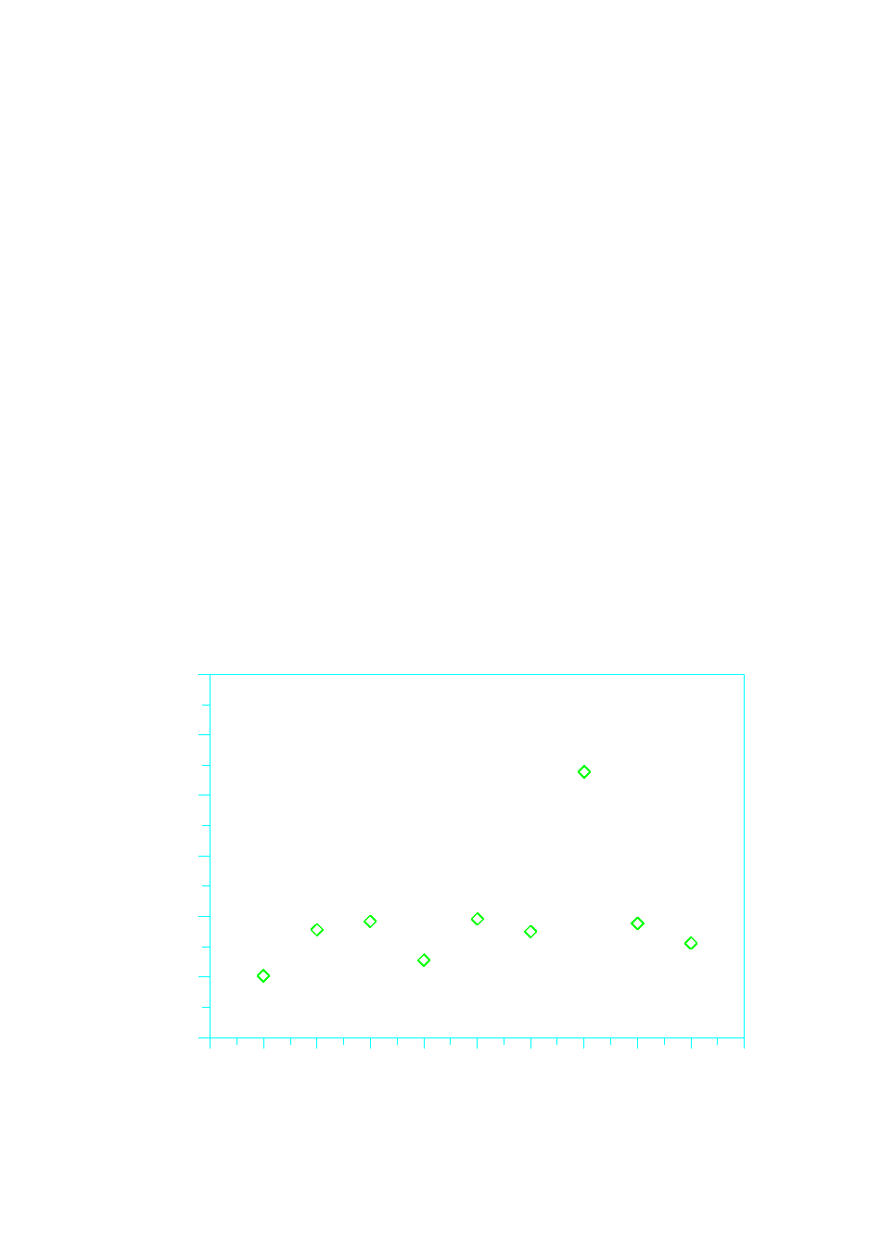
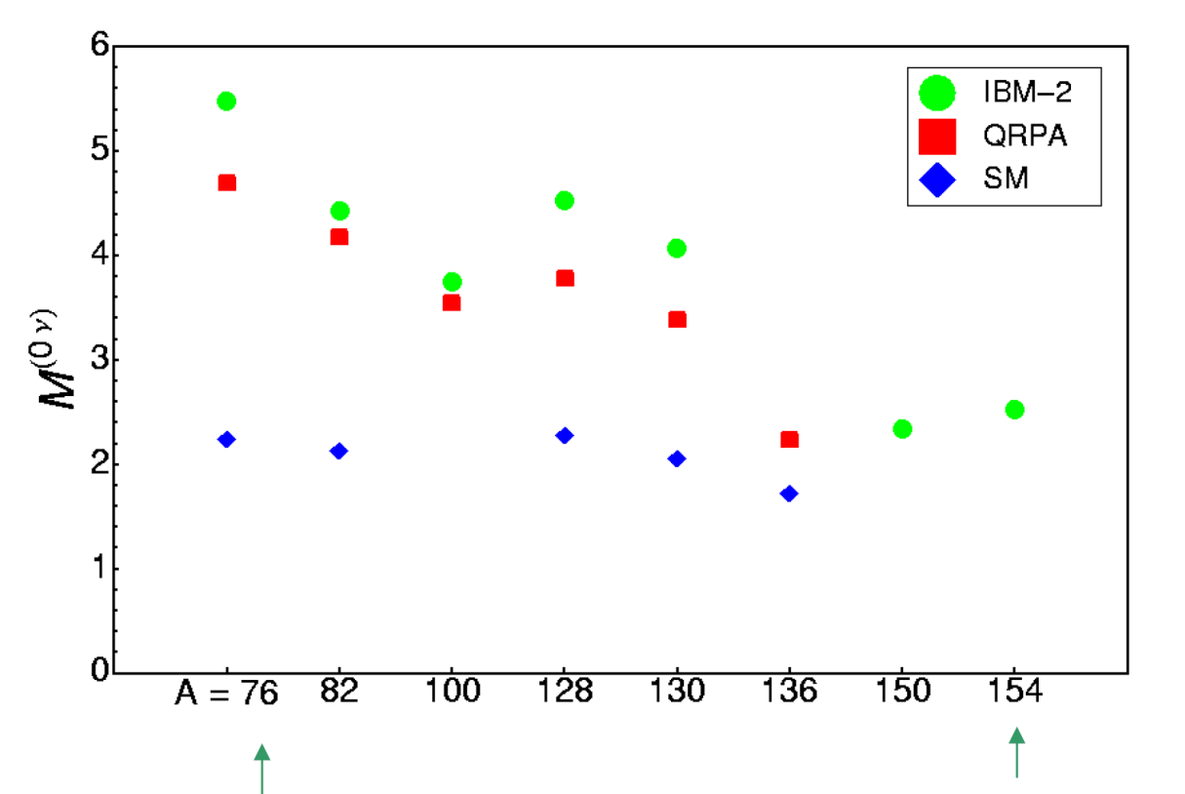
Choice of the nuclide
Transition energy (MeV)
Isotopic abundance (%)
5
40
4
20
3
2
0
Nuclear Matrix Element
⁴⁸Ca
⁷⁶Ge
⁸²Se
⁹⁶Zr
¹⁰⁰Mo
¹¹⁶Cd
¹³⁰Te
¹³⁶Xe
¹⁵⁰Nd
⁴⁸Ca
⁷⁶Ge
⁸²Se
⁹⁶Zr
¹⁰⁰Mo
¹¹⁶Cd
¹³⁰Te
¹³⁶Xe
¹⁵⁰Nd
No super-favoured isotope !
Sign of convergence!

Slide 9
Class 1 experiments
e⁻
e⁻
High energy resolution («1%)
No tracking capability
Source ≡ Detector
Easy to approach the ton scale
Easy to reject 2ν DBD background
GERDA – ⁷⁶Ge
Array of enriched Ge diodes operated in liquid argon
First phase: 18 Kg; second phase: 40 Kg - LNGS
Proved energy resolution: 0.16 % FWHM
CUORE – ¹³⁰Te
Array of low temperature natural TeO₂ calorimeters operated at 10 mK
First step: 200 Kg (2014) – LNGS – it can take advantage from Cuoricino experience
Proved energy resolution: 0.25 % FWHM
LUCIFER / scintillating bolometers – ⁸²Se – ¹¹⁶Cd – ¹⁰⁰Mo
Array of scintillating bolometers operated at 10 mK (ZnSe or CdWO₄ or ZnMoO₄)
First step: ~ 10 Kg (2014) – LNGS – essentially R&D project to fully test the principle
Proved energy resolution: 0.3 - 1 % FWHM
e⁻
detector
source
e⁻
detector
Low energy resolution (≥1%)
Tracking / topology capability
Source ≠ Detector
Easy to get tracking capability
Easy to approach zero background
(with the exception of
2ν DBD component)

Slide 10
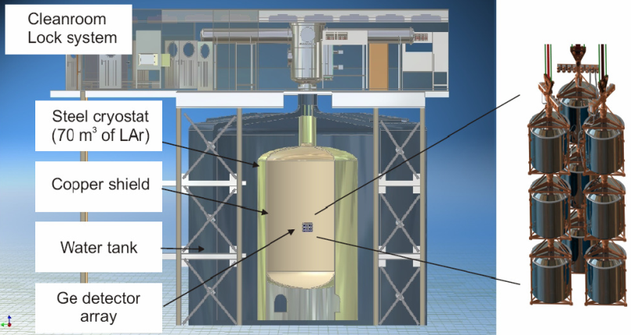
CLASS 1
GERDA – phase 1
Technique/location: bare enriched Ge diodes in liquid argon – LNGS (Italy)
Source: Ge - 17.66 kg – ⁷⁶Ge enriched at 86% - 1.2x10²⁶ nuclides
Sensitivity: designed to scrutinize Klapdor’s claim in ~1 year data taking
Timeline: GERDA phase 1 is working now with normal Ge diodes for debugging
Background target: 0.01 counts/(keV y kg)
Background contribution from ⁴²Ar higher than expected
→ now improved, insertion of enriched detector is ongoing

Slide 11
CLASS 1
GERDA – phase 1
⁴²Ar contamination
⁴²Ar is present in natural Ar due to cosmogenic production
Decay scheme
Considered in the proposal and contribution evaluated (30 μBq/kg)
However: 1) natural concentration underestimated
2) migration of the charged daughter ions due to detector
E field → higher concentration close to detector
Measures: 1) introduction of a mini-shroud to shield the detectors
2) change of detector field configuration
The problem is mitigated
⁴²Ar (33 yr, Qβ= 600 keV) ⁴²K (12.36 h, Qβ = 3.52 MeV)
Eγ = 1.524 MeV,…

Slide 12
CLASS 1
GERDA – phase 1 – ⁴²Ar
w/o mini-shroud
with mini-shroud
R8
“cosmogenic detector”
R1
R9
R3
“E-field free”
w/o
mini-shroud
encapsulation
R2
R5
R4
R10
R7
R11
R12
R6

Slide 13
CLASS 1
GERDA – phase 1 – status
Detector commissioning with non-enriched detectors started in summer 2010
12 commissioning runs with different detectors, read-out schemes, E-field configurations
(best resolution: ΔE_{FWHM}=3.6 keV at 2.6 MeV)
Background with non-enriched detectors currently at 0.05 cts/(keV kg year). Goal for Phase I: 0.01 cts/(keV kg year).
Deployment of first string with enriched detectors: this week
After summer: development of the remaining enriched detectors
Phase I soon will study background with enriched detectors
⇒ start of Phase I physics run

Slide 14
CLASS 1
GERDA – phase 2 and 3
2·10²⁷ (90 % CL)
<24 - 41 meV
2·10²⁶ (90 % CL)
<75 - 129 meV
3·10²⁵ (90 % CL)
assuming
|M^{0ν}|=2.99-8.99
[Smol&Grab PRC’10]
and 86% enrichment
GERDA
Phase II/
Majorana
Demonst.
KK
GERDA
Phase III/
Majorana
(no event in ROI)
GERDA
Phase I
required for ‘background free’ exp. with ΔE~3.3 keV (FWHM):
O(10⁻³)
O(10⁻⁴)
counts/(kg·y·keV)
Background requirement for GERDA/Majorana:
⇒Background reduction by factor 10² - 10³ required w.r. to precursor exps.

Slide 15
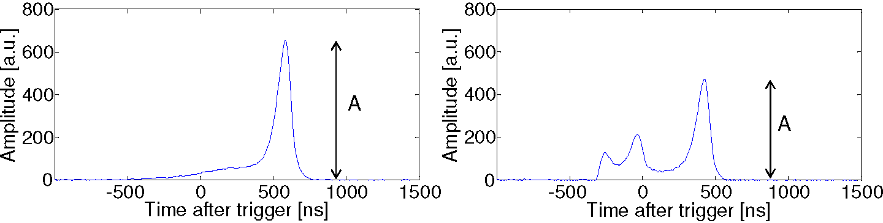
CLASS 1
GERDA – elements for phase 2
Production of prototypes with depleted germanium at CANBERRA has been successful
Production of detector for phase 2 in 2012 (30 additional kg)
Pulse shape discrimination with p-type BEGe detectors
Single site event
Multi site event
Possible instrumentation of Liquid argon

Slide 16
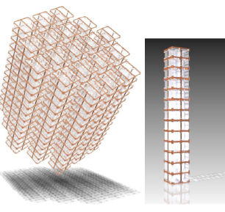
CLASS 1
CUORE
Technique/location: natural TeO₂ bolometers at 10 mK– LNGS (Italy)
⇒ evolution of Cuoricino
Source: TeO₂ – 741 kg with natural tellurium - 9.5x10²⁶ nuclides of ¹³⁰Te
Sensitivity: 35 – 82 meV (with target background ~ 10⁻² counts/(keV kg y))
Timeline: first CUORE tower in 2011 – data taking with full apparatus in 2014
CUORE-0 under commissioning
Structure of the detector
Detector in the custom fridge

Slide 17
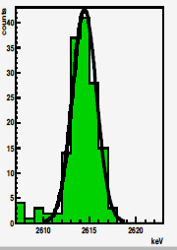
CLASS 1
CUORE - status
The production of the crystals in SICCAS (Shanghai) is going on smoothly
The crystals are tested as bolometers in CUORE configuration by sampling.
Excellent results are routinely obtained in:
- Bolometric performance
- Radiopurity
3.1 keV FWHM at 2.6 MeV
The CUORE assembly line is ready and will be used this summer to assemble CUORE-0
The first base temperature test of the CUORE cryostat is foreseen for 2012
Only concern for background comes from alpha surface radioactivity in Copper ⇒ Cleaning procedure are well established – a background of the order of 5x10⁻² was measured in a dedicated test in hall A – this number will be lower in CUORE just for geometry

Slide 18
CLASS 1
LUCIFER / scintillating bolometers
Technique/location: scintillating bolometers containing high Q-value candidates
(⁸²Se, ¹⁰⁰Mo, ¹¹⁶Cd) ⇒ high phase space, beyond natural gamma radioactivity
Site: for LUCIFER, LNGS is the most natural location; possibility of a scintillating bolometer section in EURECA (Modane extension)
Source: ZnSe, ZnMoO₄, CdWO₄ single crystals
Sensitivity: for LUCIFER, 10 kg enriched Se is feasible with present funding corresponding to ~100 meV (with target background ~ 10⁻³ counts/(keV kg y))
Timeline: LUCIFER ready to take data within 2015 – main difficulty: quality and reproducibility of the crystals ⇒ enrichment, purification, crystal growth chain
Basic idea: Alphas emit a different amount of light with respect to beta/gamma of the same energy (normally lower → α QF < 1, but not in all cases).
Alpha background can be fully rejected in a region where it dominates

Slide 19
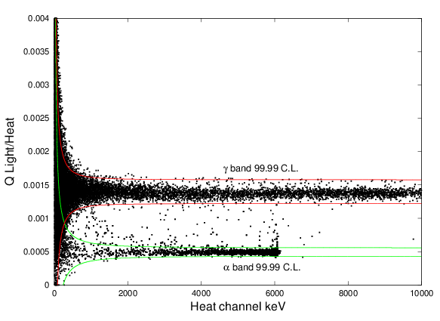
CLASS 1
Scintillating bolometers
The Molybdenum way is very promising, based on ZnMoO₄ crystals
Search is active also with CaMoO₄ crystals (AMORE experiment)
Excellent alpha / beta separation in a ZnMoO₄ prototype operated at CSNSM Orsay

Slide 20
Class 2 experiments
e⁻
e⁻
High energy resolution («1%)
No tracking capability
Source ≡ Detector
NEXT – ¹³⁶Xe
High pressure gas TPC
Total mass: 100 kg
Aims at energy resolution down to 1% FWHM exploiting electroluminesce in high field region
NEXT-10, a 10kg prototype, should provide data in CANFRANC in 2013
COBRA - ¹¹⁶Cd competing candidate – 9 ββ isotopes
Array of ¹¹⁶Cd enriched CdZnTe of semiconductor detectors at room temperatures
Small scale prototype at LNGS
Proved energy resolution: 1.9% FWHM
Pixellization can provide tracking capability
Easy to approach the ton scale
Easy to reject 2ν DBD background
e⁻
detector
source
e⁻
detector
Low energy resolution (≥1%)
Tracking / topology capability
Source ≠ Detector
Easy to get tracking capability
Easy to approach zero background
(with the exception of
2ν DBD component)

Slide 21
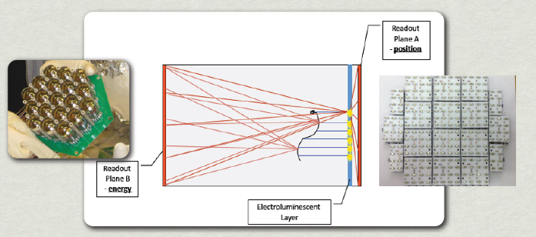
CLASS 2
NEXT
Technique/location: High pressure (~10 bar) gaseous Xe TPC in Canfranc
Source: ¹³⁶Xe - 100 Kg of enriched Xe in Canfranc
Sensitivity: target background ~ 2x10⁻⁴ counts/(keV kg y) – target energy resolution: 1% FWHM at the Q-value ⇒ ~60 meV with 1 (ton x y) exposure
Timeline: complete NEXT1 (1 kg prototypes) in 2011 – start construction larger systems in 2012 – complete construction final detector in 2013 –depleted Xenon run in 2014
Basic idea: exploit electroluminescence in Xenon to get high energy resolution and tracking
Cathode: energy measurement with PMTs
Anode: position measurement with SiPMs

Slide 22
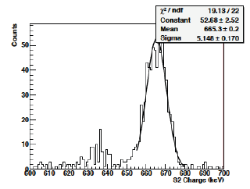
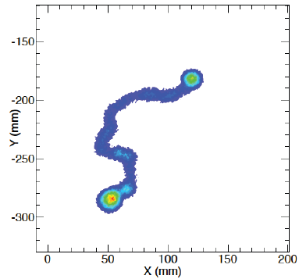
CLASS 2
NEXT
Energy resolution
Topology
¹³⁷Cs line measured in LBNL prototype ⇒ 1.8% FWHM
corresponding to <1% at Q-value
Simulation of DBD event

Slide 23
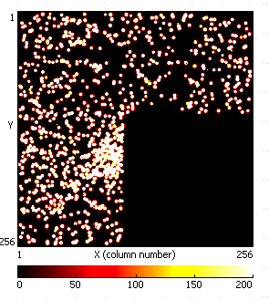
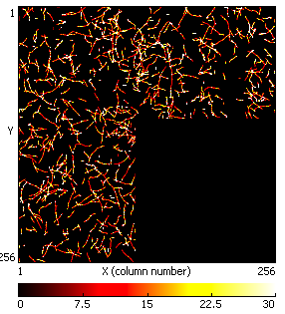
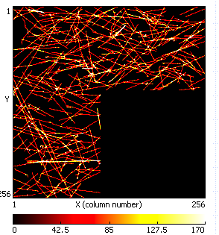
CLASS 2
COBRA
Technique/location: CdZnTe crystals operated as semiconductor detectors - LNGS
Source: nine DBD candidates, but focus on ¹¹⁶Cd – the crystals are small (typically 1 cm side cubes) and the detector is operated with high granularity
Status: present background at the Q-value: 5 counts/(keV kg y) but massive reduction is expected thanks to pixellization (solid state TPC) which allows particle identification.
⇒ Upgrade of 64 element array in LNGS – pulse shape and multipixel
Preselected samples
256x256 pixels, 55μm
Alphas
Electrons
Muons

Slide 24
Class 3 experiments
e⁻
e⁻
High energy resolution («1%)
No tracking capability
SUPERNEMO - ⁸²Se or ¹⁵⁰Nd
Modules with source foils, tracking (drift chamber in Geiger mode) and calorimetric (low Z scintillator) sections
Magnetic field for charge sign
Possible configuration: 20 modules with 5 kg source for each module ⇒ 100 Kg in Modane extension
Energy resolution: 4 % FWHM
it can take advantage of NEMO3 experience
Source ≡ Detector
Easy to approach the ton scale
Easy to reject 2ν DBD background
e⁻
detector
source
e⁻
detector
Low energy resolution ≥1%)
Tracking capability
Source ≠ Detector
Easy to get tracking capability
Easy to approach zero background
(with the exception of
2ν DBD component)

Slide 25
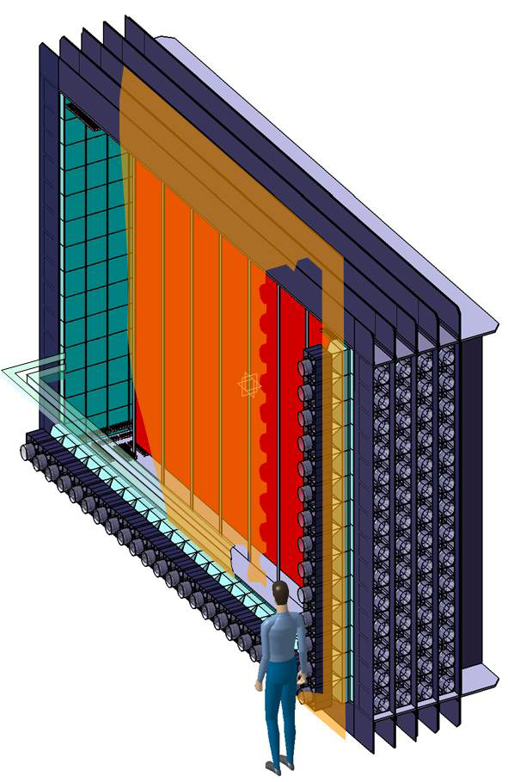
CLASS 3
SuperNEMO
Technique/location:
tracking Geiger cells+ plastic scintillator – Modane (France) – evolution of NEMO-3
Source: choice flexibility (⁸²Se, ¹⁵⁰Nd, ⁴⁸Ca)
⇒ options (assuming 100 kg of materials):
- 7x10²⁶ ⁸²Se nuclides (baseline)
2.5x10²⁶ ¹⁵⁰Nd nuclides (it depends on the possibility of laser isotope separation – now revival at CEA)
It is in the form of a thin foil (~40 mg/cm²)
Sensitivity: 53 – 145 meV (for ⁸²Se)
Status/Timeline: demonstrator module in 2014 (~7 kg)
After that, construction of 20 modules estimated in 2 years

Slide 26
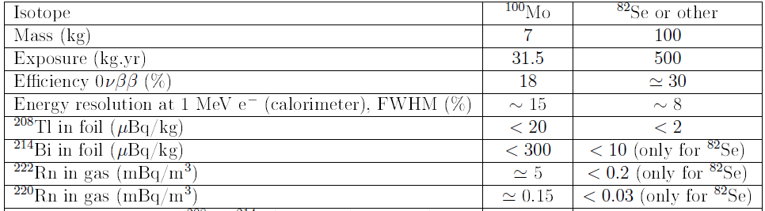
CLASS 3
SuperNEMO - challenges
Improvements wrt NEMO3
Demonstrated
This target contamination corresponds to 1 event /(100 kg y) in the ROI
(same level expected from 2ν DBD)
Crucial: process of purification of Se and subsequent diagnostic
BiPo3 in in Canfranc ⇒ start data taking at the end of 2011

Slide 27
CLASS 3
SuperNEMO - features
Unique in its capability to reconstruct electron tracks
Very useful to identify
the 0ν DBD mechanism
and exotic processes
BUT it is not easy to achieve 1 ton sensitive mass (importance of ¹⁵⁰Nd option)

Slide 28
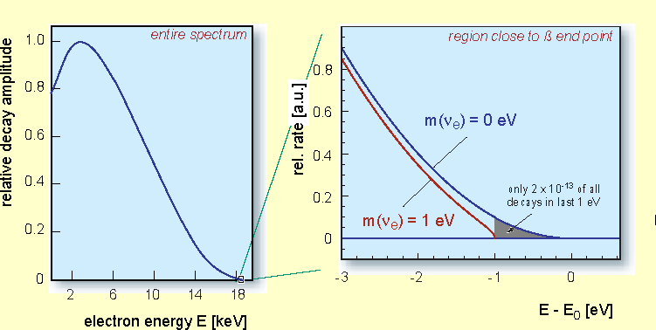
Direct measurement of ν mass
A beta spectrum is modified by a finite ν mass close to the end-point Q
Tritium
as an example
E – Q [eV]

Slide 29
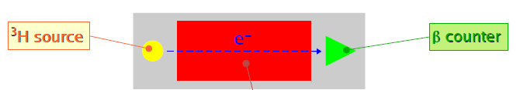
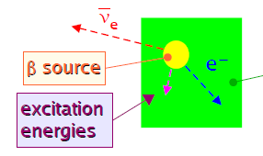
Approaches

source separate from detector (the source is T - Q=18.6 keV)
KATRIN
measurement of the electron energy out of the source
Karlsruhe
selection of the electrons by an electrostatic spectrometer
and magnetic adiabatic collimation
future planned sensitivity: ∼ 0.2 eV

source ≡ detector (the source is ¹⁸⁷Re - Q=2.5 keV)
determine all the “visible” energy of the decay with a high resolution low energy “nuclear” detector
cryogenic microcalorimeters
present achieved sensitivity: ∼ 10 eV
MARE
Milano,
Genoa
future planned sensitivity: under study

Slide 30
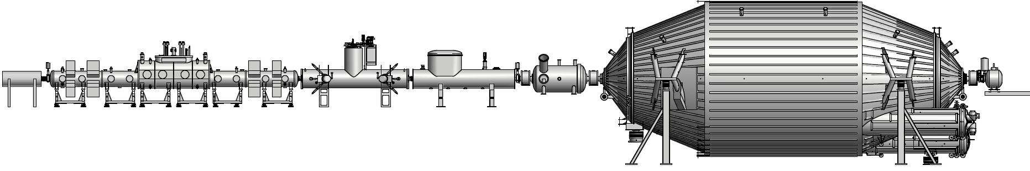
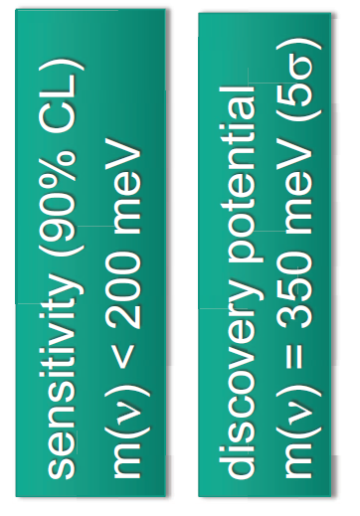
KATRIN status
Tritium bearing components
Spectrometer and detector
Tritium close cycle operational in 2011 (40 g of T)
Windowless T gaseous source: presently demonstrator (main system: 2013)
T retention system: early 2012
Pre-spectrometer: validating and refining the design
Main spectrometer: electrode installed – start commissioning in early 2012
(issue: background induced by ^{219.220}Rn alpha decays)
Focal plane system: commissioning in early 2012
Sensitivity to sterile neutrino: in 3+1 scenario,
3σ detection by kink in beta spectrum if |U_{es}|²> 0.055
Start data taking: 2013/2014

Slide 31
MARE status
Precursors (MANU, MIBETA)
Single element
Array of 10 elements
Statistics: N = 10⁶ events
σ(⟨M_{β}⟩)
∼
20 eV
Semiconductors
MARE-1 – commissioning in Milan – ΔE ~ 10 – 30 eV – τ_{R} ~ 100 μs
σ(⟨M_{β}⟩)
∼
2 eV
Transition Edge Sensors
Semiconductors
Arrays of 300 elements
Statistics: N = 10¹⁰ events
MARE-2 –R&D in Genoa – ΔE ~ 5 - 10 eV – τ_{R} ~ 1 – 10 μs
Transition Edge Sensors
Magnetic calorimeters
Kinetic Inductance Det.
σ(⟨M_{β}⟩)
∼
0.2 eV
Arrays of 50000 elementi
Statistics: N = 10¹³ events
Alternative to ¹⁸⁷Re : ¹⁶³Ho EC source to be implanted in the detector
Sensitivity to ~1 keV sterile neutrinos

Slide 32
Conclusions
In the next five years in Europe:
3 / 4 projects in DBD could approach the inverted
hierarchy region
Technology to explore inverted hierarchy region
should be established soon
KATRIN will take data
Rich R&D program in various sectors could provide new
solutions to increase the sensitivity

