Slide 1
Underground Experimental Program
in Korea
Sun Kee Kim
Seoul National Unversity
ASPERA workshop, Zaragoza

Slide 2
Outline
Y2L (YangYang Underground Laboratory)
KIMS (Korea Invisible Mass Search)
  Dark matter search with CsI(Tl) crystals
  Double beta decay search activities
AMoRE (Advanced Molybdenum based Rare process Experiment)
  Development of CaMoO4 crystals
  Development of cryogenic detector with the CaMoO4 crystal
  Prospects

Slide 3
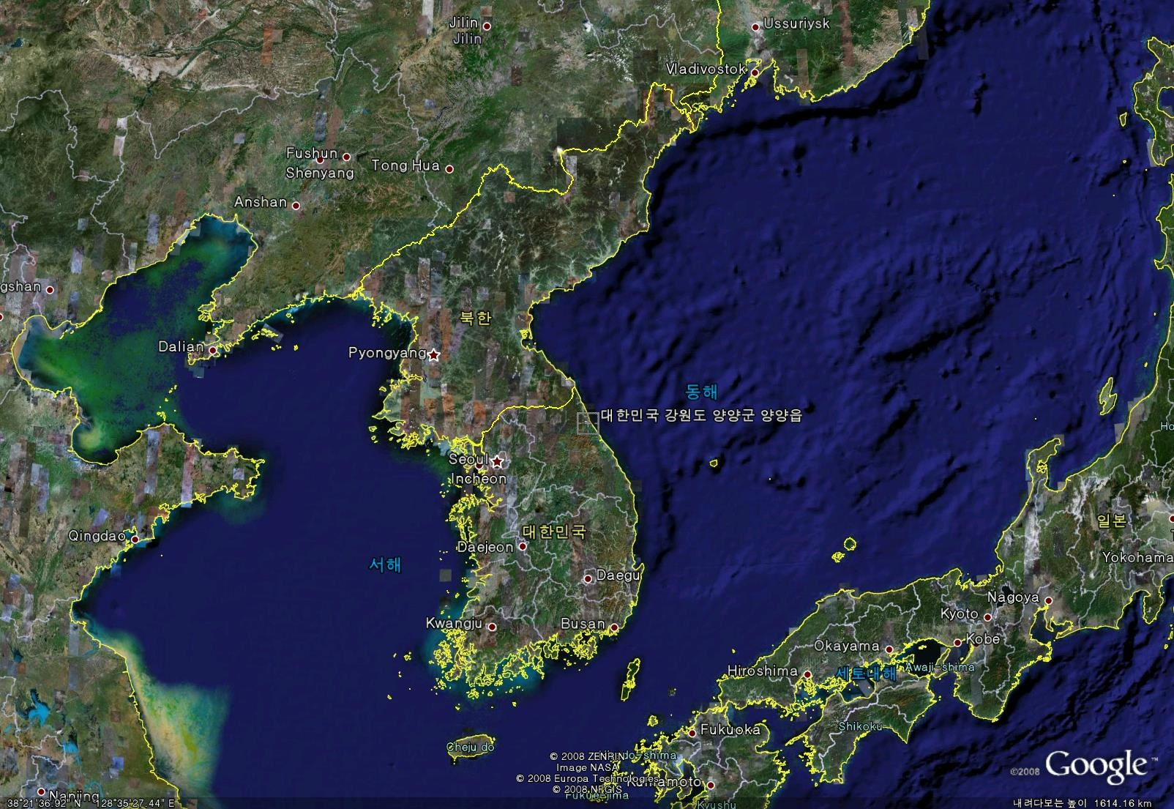
Yangyang Underground Laboratory(Y2L)

Slide 4

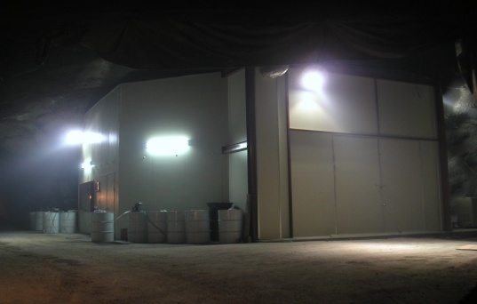
Yangyang Underground Laboratory
Yangyang Pumped Storage Power Plant
(Upper Dam)
Korea Middleland Power Co.
→ Korea Hydro and Nuclear Power Co.
700m
(Power Plant)
(Lower Dam)
Vertical depth : 700 m / Access to the lab by car (~2km)
Constructed in 2003

Slide 5
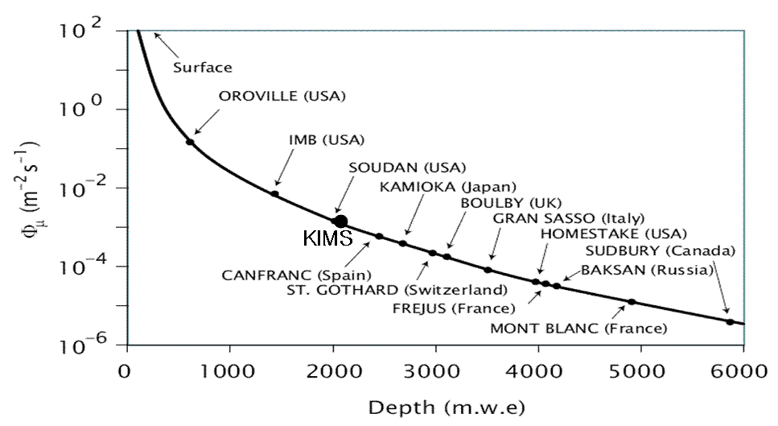
Environment Parameters in Y2L
Depth | Minimum 700 m
Temperature | 20 ~ 25 ºC
Humidity | 35 ~ 60 %
Rock contents | ²³⁸U less than 0.5 ppm ²³²Th 5.6 +- 2.6 ppm ⁴⁰K 270 ppm
Muon flux | 2.7 x 10⁻⁷ /cm²/s
Neutron flux | 8 x10⁻⁷ /cm²/s
²²²Rn in air | 1~2 pCi/liter

Slide 6
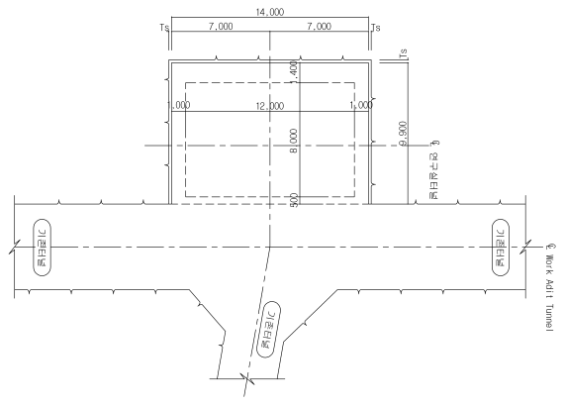
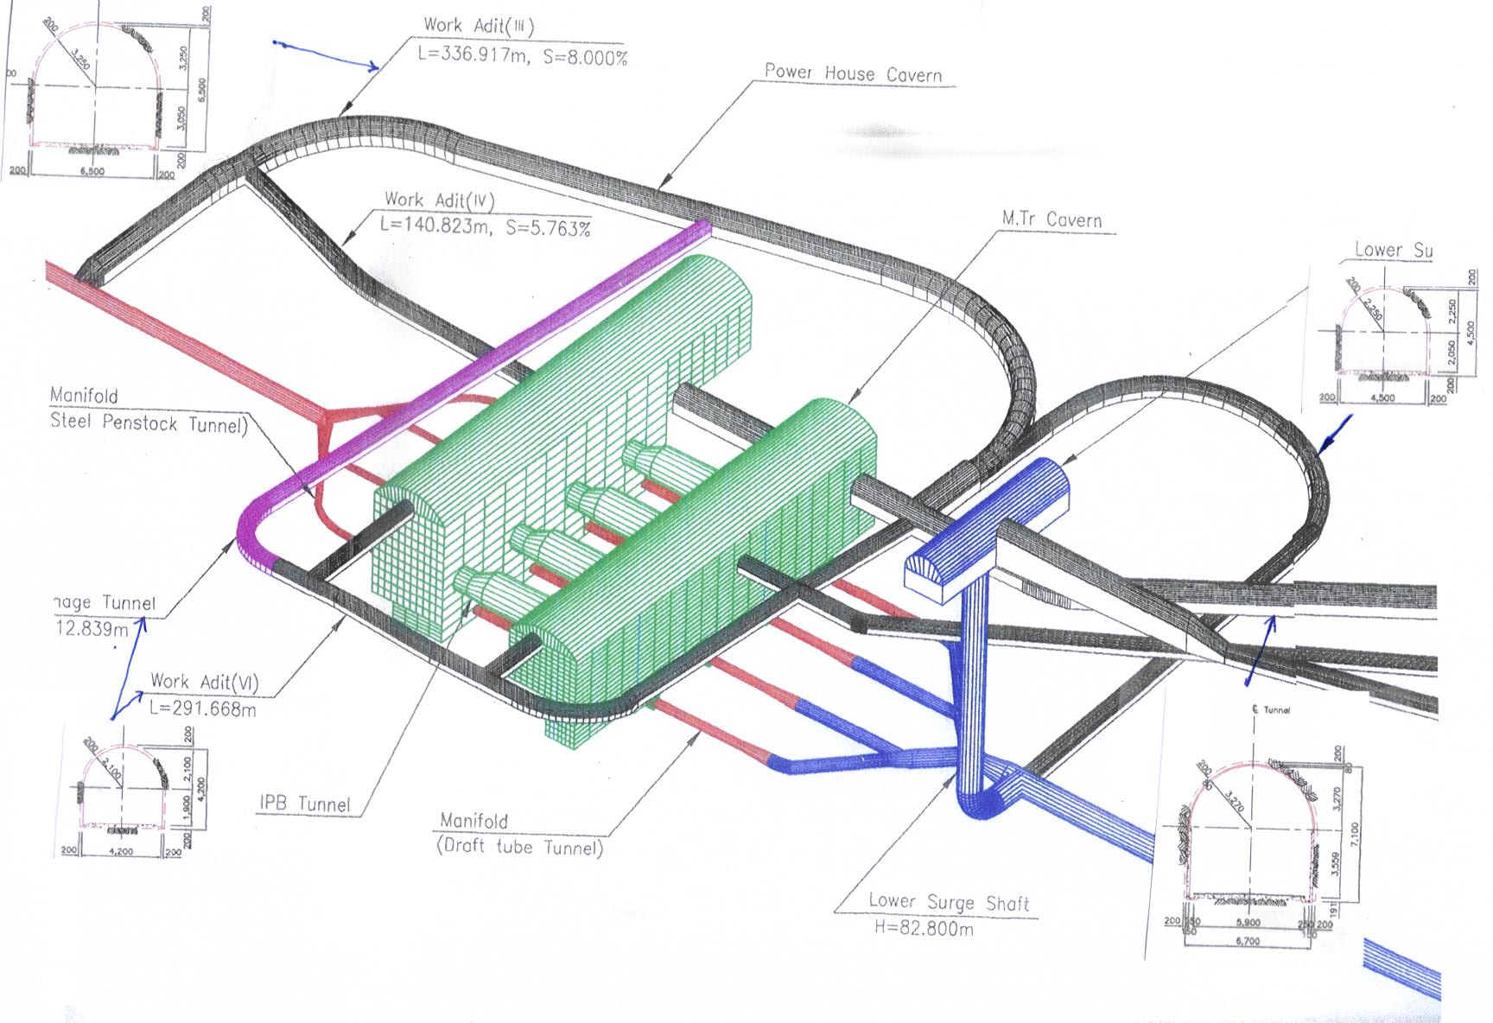
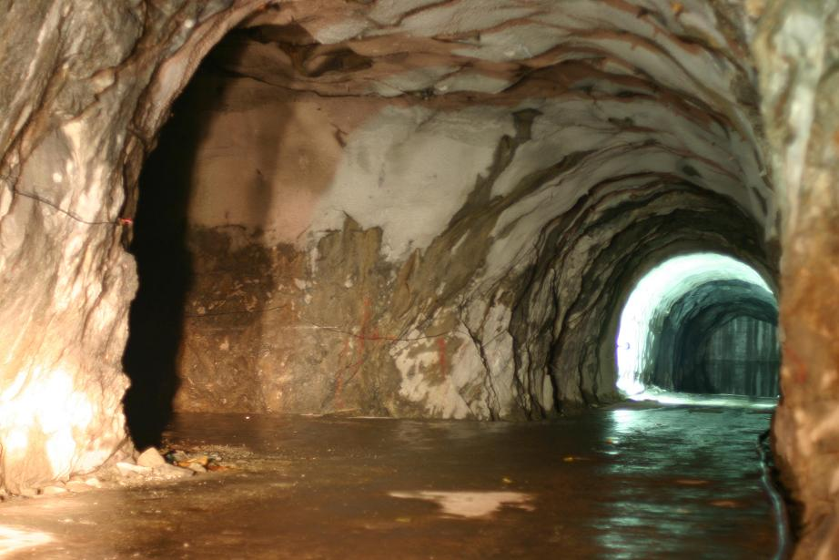

Underground Lab. Space
New Lab. Space
under discussion
with KHNPC
Current Lab. ~ 100m²

Slide 7
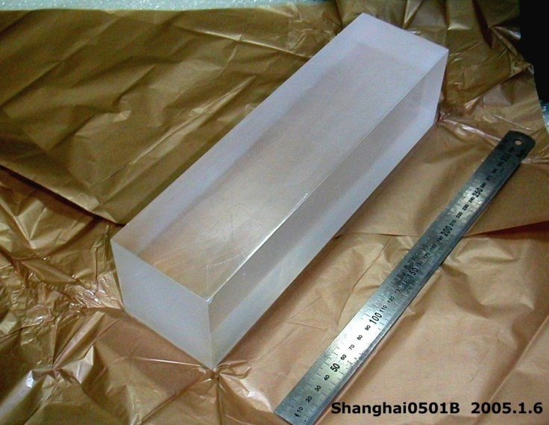
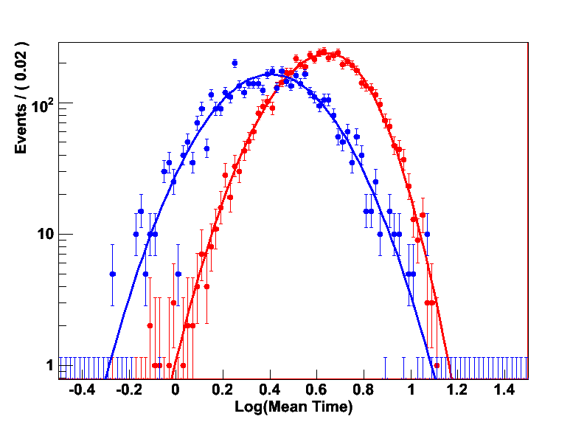
KIMS(Korea Invisible Mass Search)
WIMP search with CsI(Tl) Crystals
Easy to get large mass with an affordable cost
➔ Good for AM study
High light yield ~60,000/MeV
Pulse shape discrimination
➔ Moderate background rejection
Easy fabrication and handling
Cs-133, I-127 (SI cross section ~ A²)
Both Cs-133, I-127 are sensitive to SD interaction
electron recoil
nuclear recoil
Isotope | J | Abun | <Sp> | <Sn>
¹³³Cs | 7/2 | 100% | -0.370 | 0.003
¹²⁷I | 5/2 | 100% | 0.309 | 0.075
⁷³Ge | 9/2 | 7.8% | 0.03 | 0.38
¹²⁹Xe | 1/2 | 26% | 0.028 | 0.359
¹³¹Xe | 3/2 | 21% | -0.009 | -0.227

Slide 8
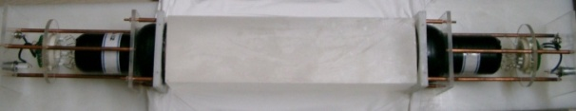
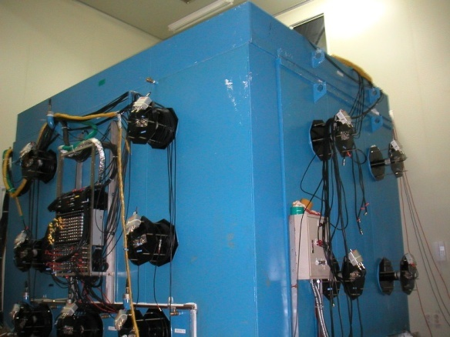
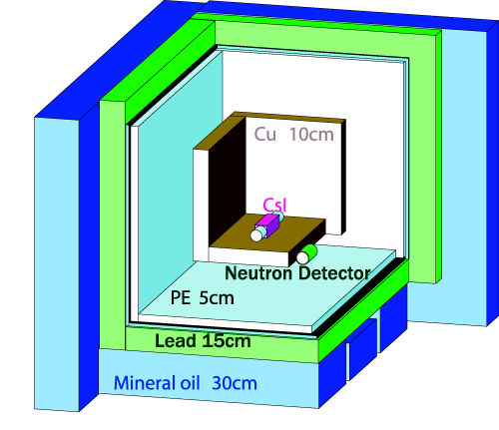
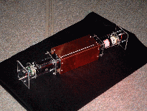
KIMS(Korea Invisible Mass Search)
DM search experiment with CsI crystal
CsI(Tl) Crystal 8x8x30 cm³ (8.7 kg)
3” PMT (9269QA) : Quartz window, RbCs photo cathode
~5 Photo-electron/keV

Slide 9
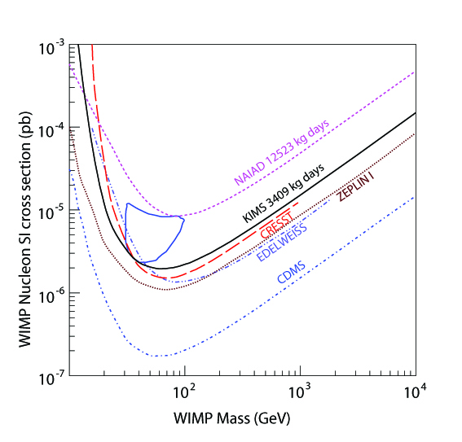
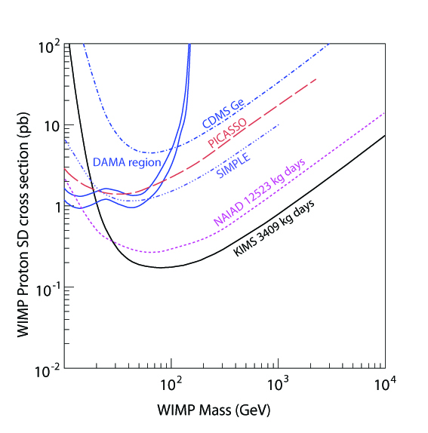
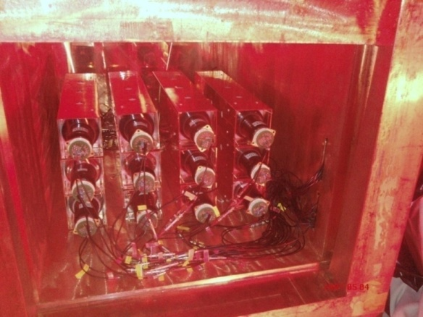
PRL 99, 091301 (2007)
4 crystals, ~ 2months
Data taking with 12 crystals
12 crystals(104.4kg) running (from 2008)
Stable data taking for more than a year
Unique experiment to test DAMA annual modulation

Slide 10
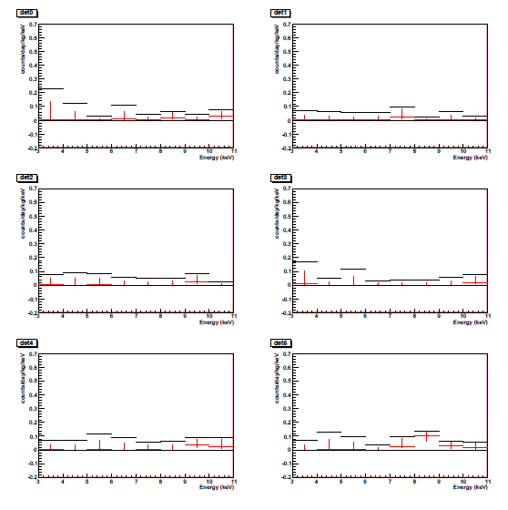
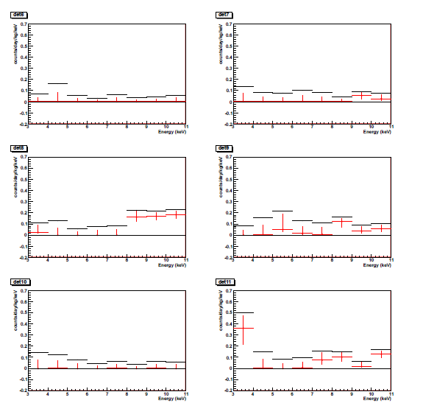
New result on WIMP search (PSD analysis) - Preliminary
NR events rate for det0 to det12
Counts/day/kg/keV
Determined from
Bayesian method
90% limit
68% interval
~ 1 year data
3-11 keV

Slide 11
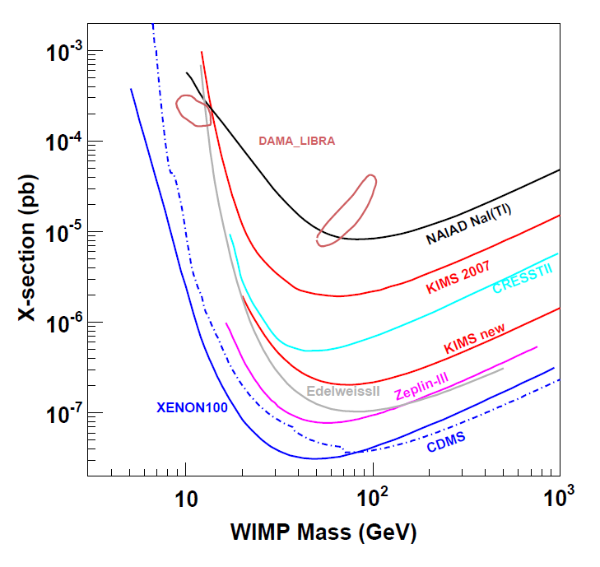
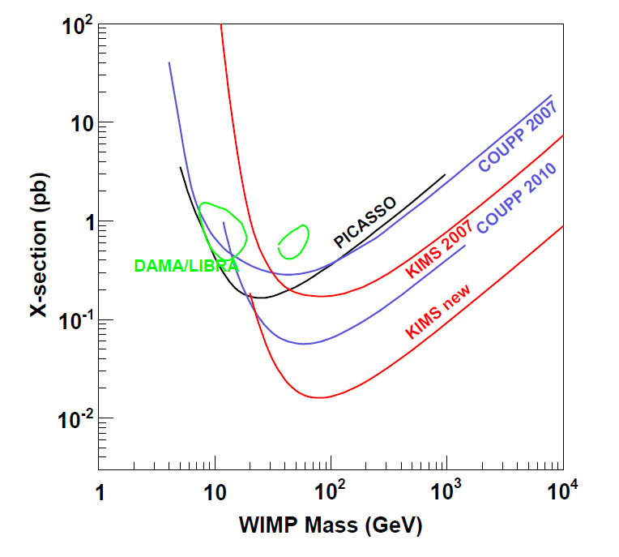
New result on WIMP search (PSD analysis) - Preliminary
~ 1 year data, Total exposure: 32793 kg days
SI
SD
AM analysis after full 2 year data collection : ~ end of Aug.

Slide 12
DBD Searches at KIMS
Passive targets : HPGe + CsI(Tl) [Nuclear Physics A 793 (2007)]
  ⁶⁴Zn EC+β⁺ decay
  ¹²⁴Sn ββ to excited states of ¹²⁴Te
  ¹¹²Sn EC+β⁺ decay
Active targets
  ¹²⁴Sn 0νββ : Sn loaded Liquid scintillator
  [Astropart. Phys. 31,412 (2009)]
  ⁸⁴Sr EC+β⁺ decay : SrCl₂ crystal
  ⁹²Mo EC+β⁺ decay : Ca^{nat}MoO₄ crystal
  ¹⁰⁰Mo 0νββ decay : Ca¹⁰⁰MoO₄ crystal → AMoRE

Slide 13
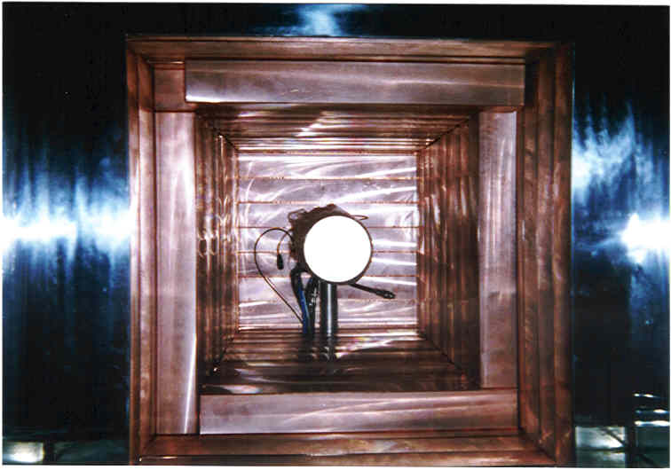
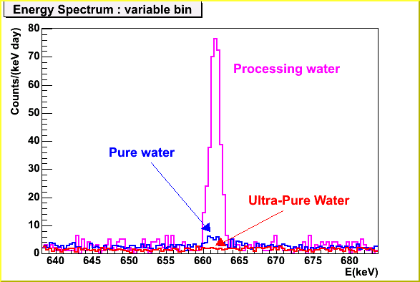
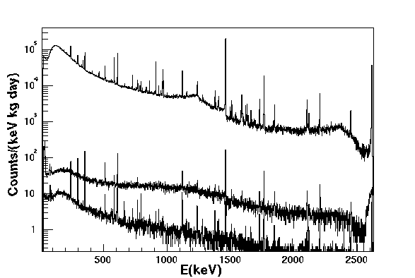
HPGe at Y2L
HPGe : 100% efficiency
Shielding : 5 cm OFHC Cu +
15 cm Pb +N2 gas flowing
Low background measurement,
Double beta decay search
Normal Water
Pure water
Ultra pure
NIMA 552(2005) 456

Slide 14
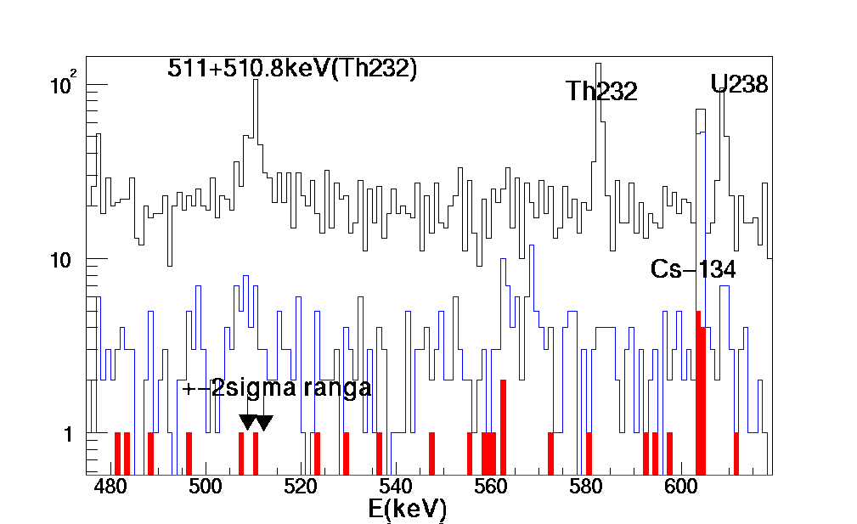
Zn-64 EC+β⁺ decay
511keV γ
CsI
7.5x7.5x8
HPGe + Zn(8x8x1cm, 457g)+CsI(Tl) crystal
100% of HPGe
350m underground
10cm low background lead,
10cm copper and N2 flowing
Calibration by Na22 (β+ radioactive source)
Efficiency calculation by Geant4; 3%
1 week data;
Coincidence cut with 2 sigma range ; 1 event
2x10²⁰ year by 95% CL
H.J.Kim et al., Nucl. Phys. A 793 (2007)
(1.1x10¹⁹ y) Positve evidence by I.BIKIT et.al,
App. Radio. Isot. 46, 455, 1995
<= 25% HPGe + NaI(Tl) with 350g Zn at surface with shielding.
Zn
511keV γ
HPGe

Slide 15
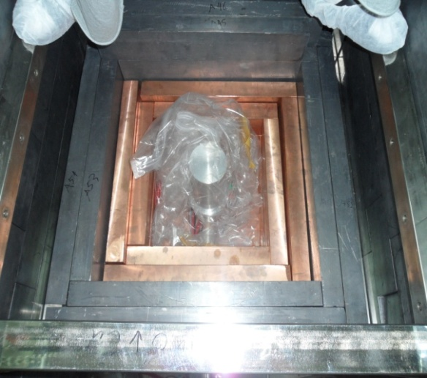
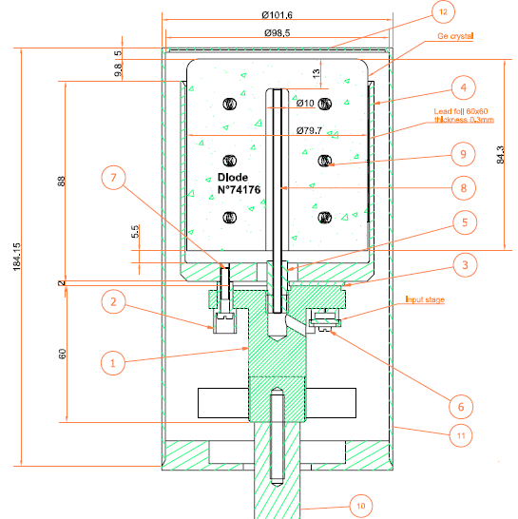
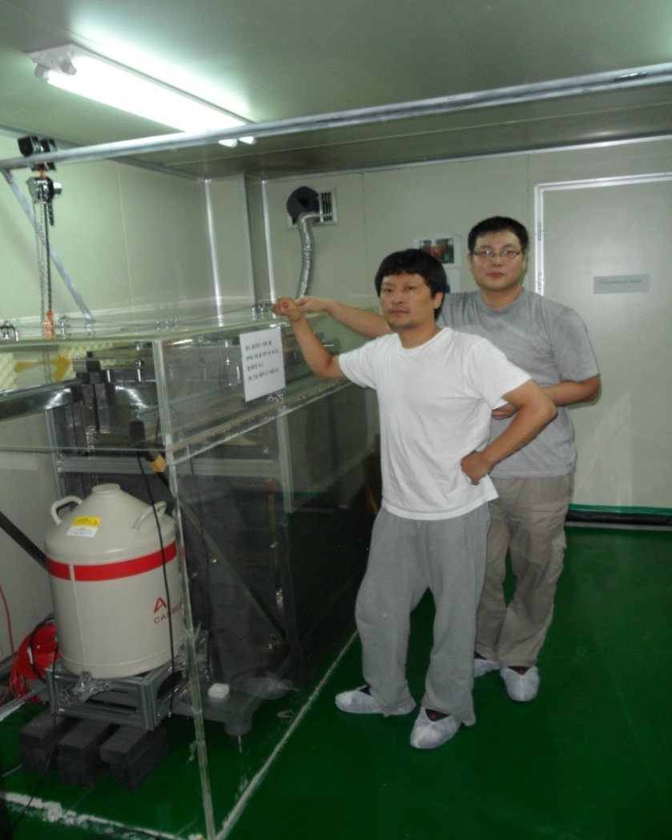
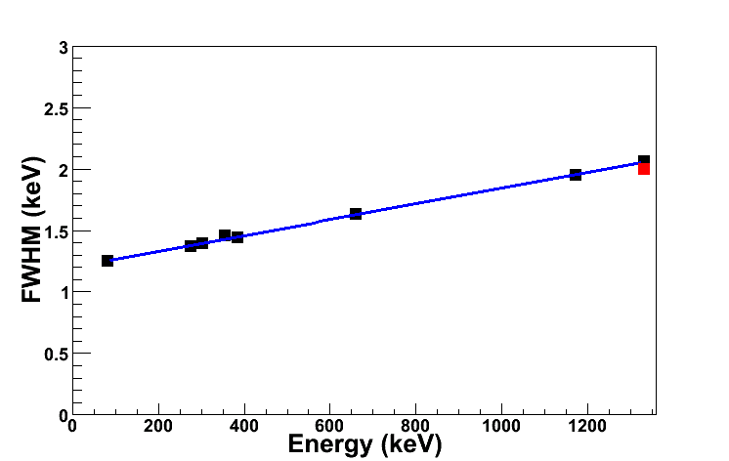
New HPGe detector at Y2L
Will be used for
- Measurement of internal background
- DBD search with beta+
~527 cc
~2.8kg
Co60/Cs137/Ba133
Energy Resolution

Slide 16
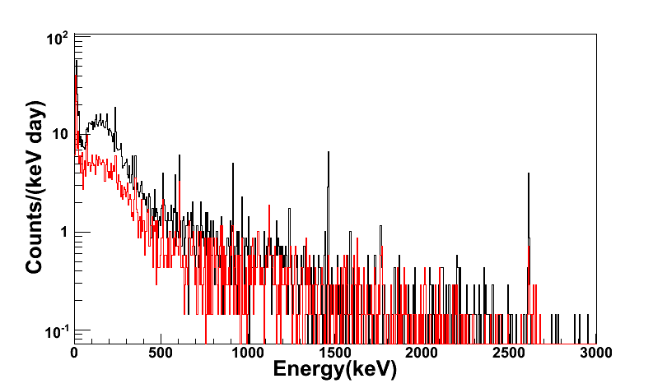
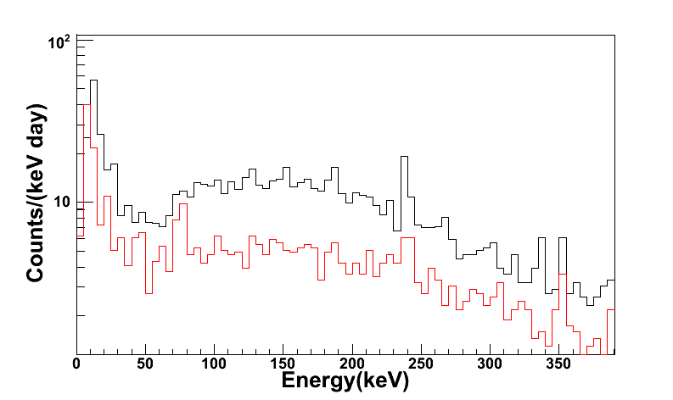
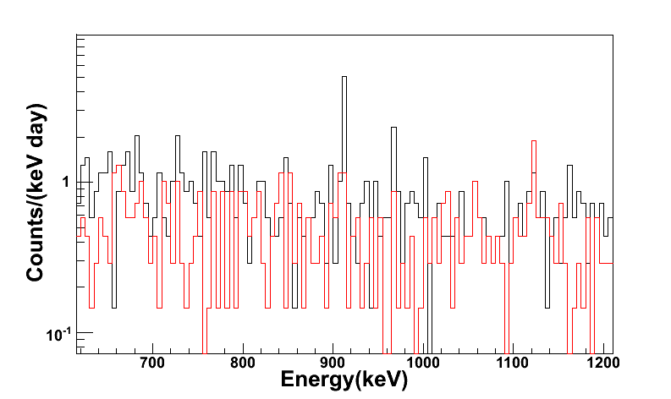
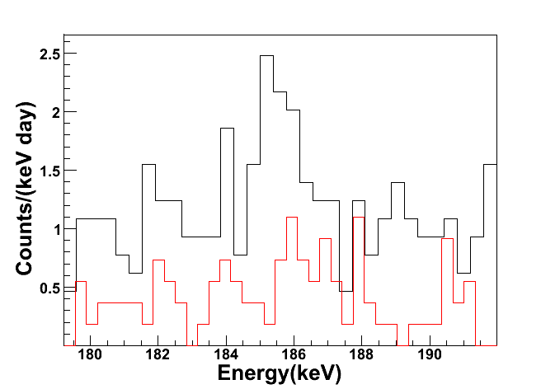
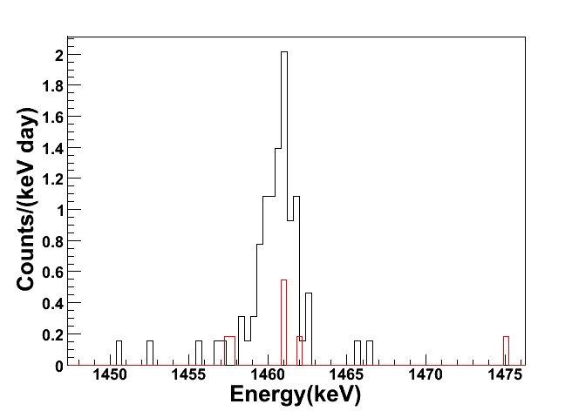
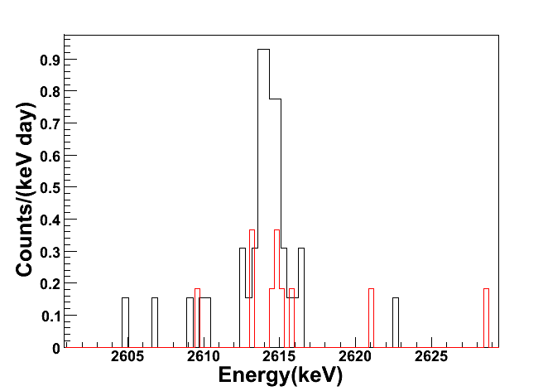
New HPGe detector at Y2L
Black Line : ORTEC ➔0.0119 Hz
Red Line : Canberra➔0.0060 Hz
P1
1.86evt/bin
P1
5.08evt/bin
P2
Energy resolution
P2
0.219evt/bin
0.431evt/bin
Ra226
K40
Tl208

Slide 17
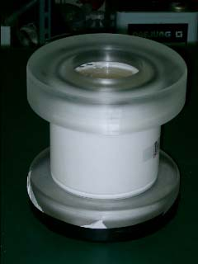
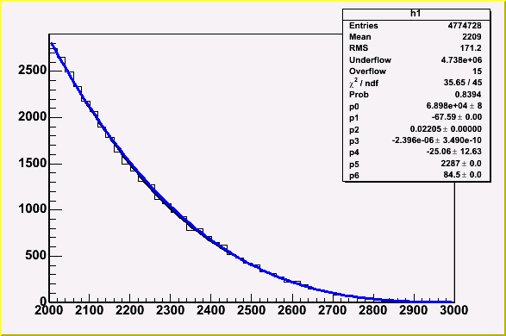
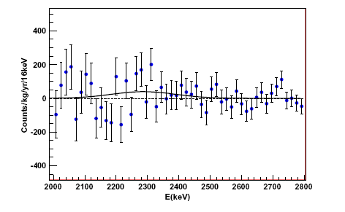
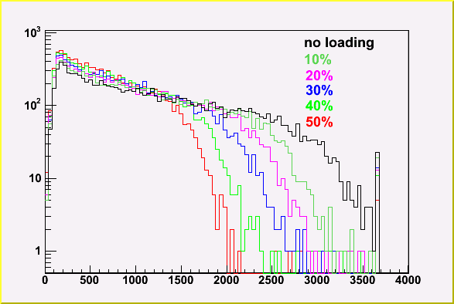
0ν bb search with Sn-loaded LSC
Double beta decay search with ¹²⁴Sn
Q = 2287 keV
5% of natural abundance
1.1 liter 33% Tin-loaded Liquid scintillator
9 Month data at Y2L inside of Pb shielding
Astropart. Phys. 31 (2009) 412
TetraButhyl Tin + LSC (50%->Sn 20%)
2287keV
T_{1/2} > 2.0x10¹⁹ yr at 90% C.L
Previous limit:
T_{1/2} > 2.4x10¹⁷ yr at 90% C.L

Slide 18
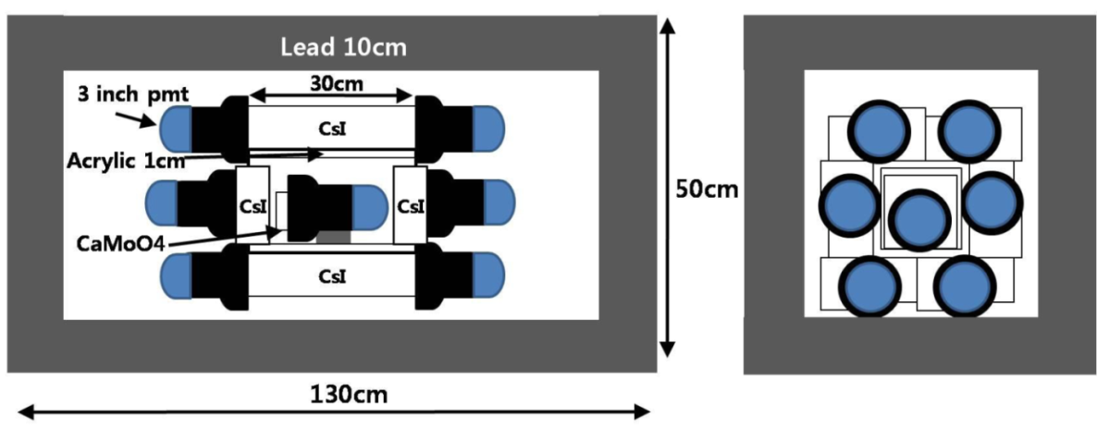
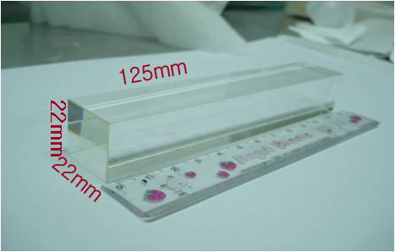
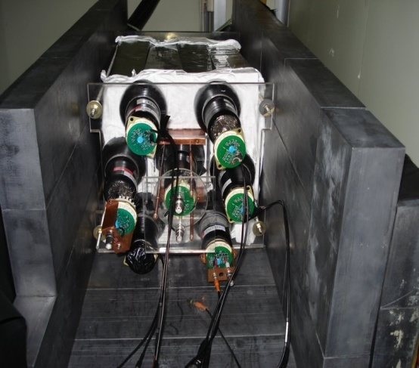
EC/β⁺ decay of ⁹²Mo
(A, Z) + e⁻ -> (A, Z-2 ) + e⁺ + 628keV(Q-value)
e⁺ stops in active(CaMoO₄) Crystal.
back to back 511 keV gammas at CsI(Tl)
Abundance = ⁹²Mo: 14.84%, ¹⁰⁰Mo: 9.63%
4pi coverage by CsI(Tl) crystal (not high radiopurity)
CaMoO4 crystal :
2.2x2.2x6cm (2) : 255g

Slide 19
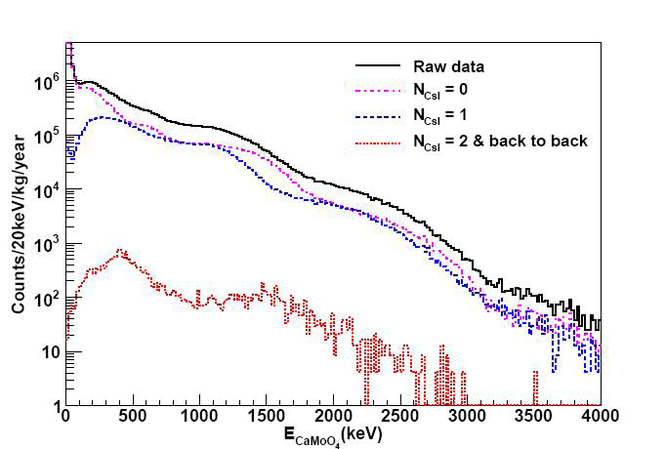
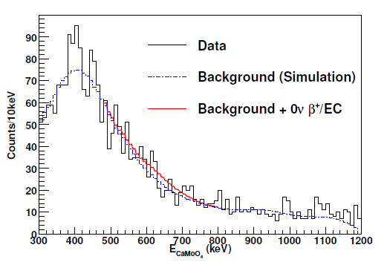
Mo-92 EC
627 keV for 0+/EC
8 ± 33.4 events
44.1 events at 90 % confidence level
> 2.3×10²⁰ years at 90 % confidence level
> 1.9x10²⁰ years by Barabash et al.,

Slide 20
CaMoO₄ for 0νββ
CaMoO₄
DBD for Mo-100 (3034 keV), Ca-48(4272 keV)
high energy → less background
Mo-100 enrichment >90% not so difficult
for Mo-100 search, Ca-48 needs to be depleted
Scintillator
  At room temp; 10-20% of CsI(Tl) at 20º
  Decay time ; 16 μ sec
  LY increases at lower temp. (almost the same as CsI(Tl) )
  Wavelength; 450-650ns-> RbCs PMT or APD
  Pulse Shape Discrimination
Can be used as cryogenic detector
  Debye temperature: 438 K ( Ge : 360 K, Si: 625 K)
  Combining with Scintillation detection : NR, alpha/gamma separation
  Good dark matter detector as well
Energy
¹⁰⁰Tc
¹⁰⁰Mo
Q_{ββ}
¹⁰⁰Ru
Z
Z
Z+1
Z+2

Slide 21
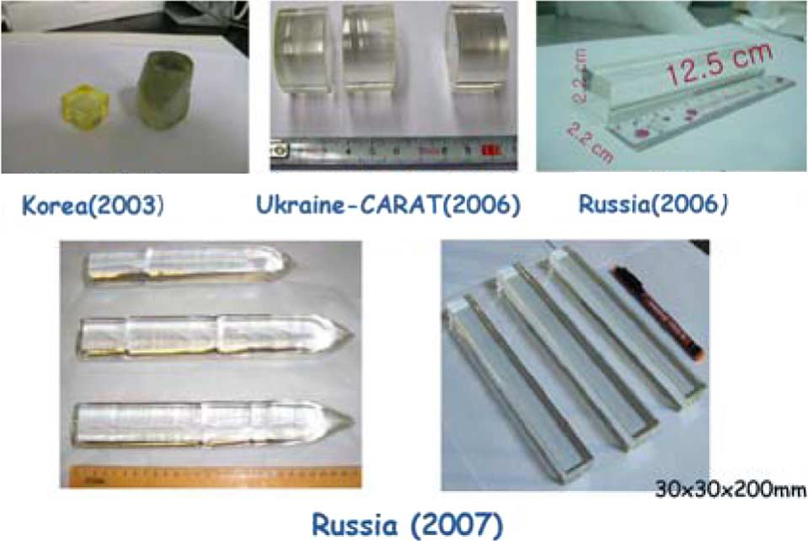
CaMoO₄ crystal development

Slide 22
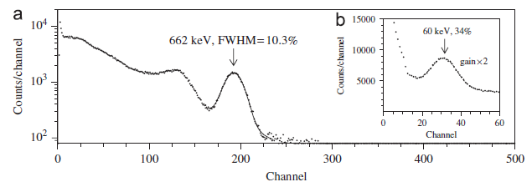
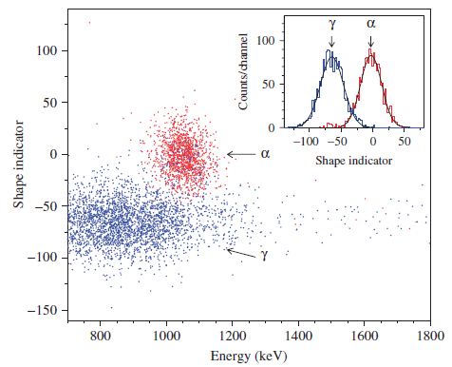
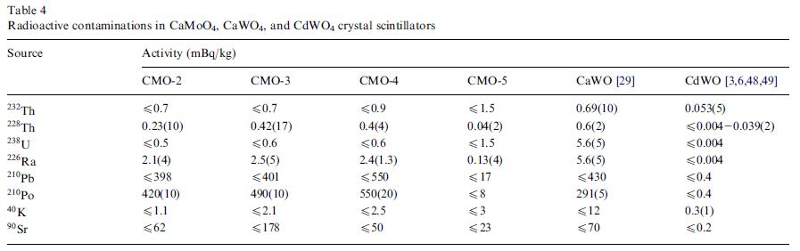
Crystal Characteristics

Slide 23
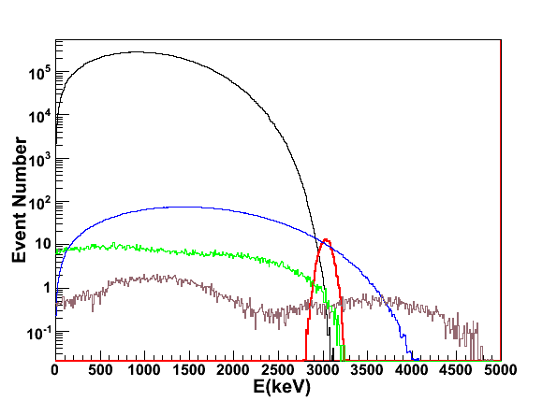

Enrichment & Depletion
Mo-100 enrichemeinet : 96.1%
Ca-48 depletion < 0.001% (Nantural abundance is 0.187%)
Depleted Ca : ~ 30 kg available
➔ Good for 100 kg CaMooO4 crystals

Slide 24
⁴⁸Ca Enrichment/Depletion at KAERI
(Korea Atomic Energy Research Institute)
ALSIS (Advanced Laser Stable Isotope Separation)
- Features : Isotope-Selective Optical Pumping (ISOP)
followed by Non-selective Resonant Photoionization (RPI)
- ISOP gives good isotope-selectivity and non-selective RPI high yield.
+
+
+
+
+
+
+
+
(-) Charge collector
+
+
+
+
+
+
+
+
+
+
+
+
+
+
+
+
+
+
+
+
+
+
Atomic vapor
RPI
target isotope
ISOP
other isotope
+
target isotope ion

Slide 25
⁴⁸Ca Enrichment/Depletion at KAERI
Special features of ALSIS
- Isotope-selective optical pumping
followed by resonant photo-ionization
- Ideal for ⁴⁸Ca Production
- Fiber-based lasers : most advanced, maintenance-free
Engineering Demonstration (2010~2012)
- Production capability : 1kg/yr
Production Demonstration for (2013 – 2014)
- Production capability : 5 kg/yr

Slide 26
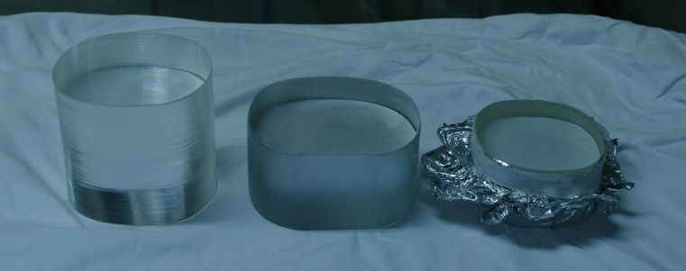
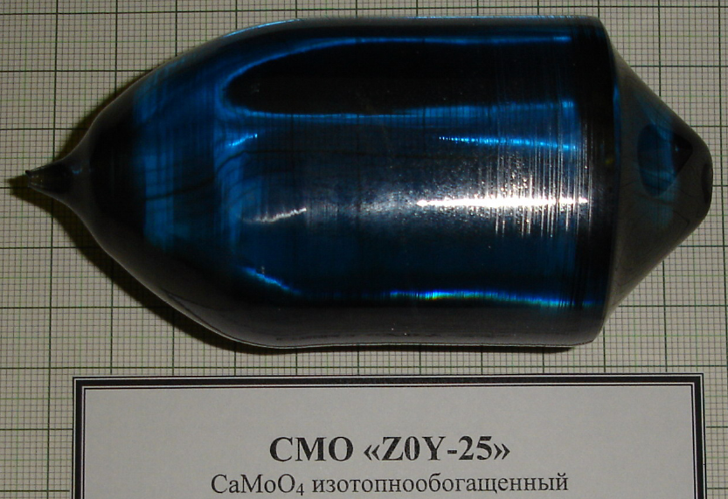
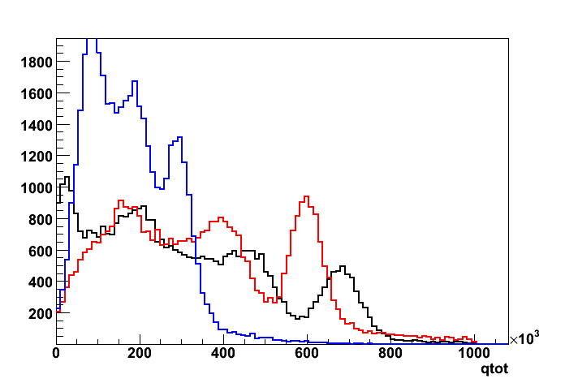

⁴⁰Ca¹⁰⁰MoO₄
First ⁴⁰Ca¹⁰⁰MoO₄ crystal
after big bang
SB28
CMO-3
S35
D44 mmxL51mm~300g
Cs-137 source
3 crystals with enriched
material ~ 845g
Being tested at Y2L
SB28
Resolution : 30% (FWHM)
Mean : 2.88 x 10⁵
S35
Resolution : 16% (FWHM)
Mean : 5.97 x 10⁵
CMO_3
Resolution : 16% (FWHM)
Mean : 6.79 x 10⁵

Slide 27



Preliminary data analysis
²¹⁴Po : 1.93-MeV
²¹⁶Po : 1.62-MeV
²²⁰Rn : 1.44-MeV
Tagtime of ²¹⁴Po
Mean time : 243 μs
Half-life : 169 μs
β−α decay
²¹⁴Bi → ²¹⁴Po → ²¹⁰Pb
α-decay of ²¹⁴Po
Half life : 164 μs

Slide 28

BG spectrum of SB28 with 47 days data
β−α decay in ²³⁸U
²¹⁴Bi (Q-value : 3.27-MeV) → ²¹⁴Po (Q-value : 7.83-MeV)→ ²¹⁰Pb
α−α decay in ²³²Th
²²⁰Rn (Q-value : 6.41-MeV) → ²¹⁶Po (Q-value : 6.91-MeV)→ ²¹²Pb
±1 sigma of energy cut was used to analyze the internal background.
Preliminary
²¹⁶Po : 1.61-MeV, 21 events ≈ 0.026mBq/kg
²¹⁴Po : 1.93-MeV, 34 events ≈ 0.043mBq/kg
²²⁰Rn : 1.45-MeV
²¹⁴Bi (Q-value : 3.27-MeV)

Slide 29

BG spectrum of S35 with 87 days data
β−α decay in ²³⁸U
²¹⁴Bi (Q-value : 3.27-MeV) → ²¹⁴Po (Q-value : 7.83-MeV)→ ²¹⁰Pb
α−α decay in ²³²Th
²²⁰Rn (Q-value : 6.41-MeV) → ²¹⁶Po (Q-value : 6.91-MeV)→ ²¹²Pb
²¹⁰Po : 1.13-MeV
Preliminary
²¹⁶Po : 1.61-MeV, 363 events ≈ 0.19 mBq/kg
²¹⁴Po : 1.93-MeV, 3134 events ≈ 1.63 mBq/kg
²²⁰Rn : 1.45-MeV
²¹⁴Bi (Q-value : 3.27-MeV)

Slide 30



Cryogenic Detector
Energy absorption ➔ Heat (Temperature)
α, β, γ, etc.
Thermometer
Absorber
Thermal link
Heat sink < 100 mK
Choice of thermometers
Thermistors (doped Ge, Si)
TES (Transition Edge Sensor)
MMC (Metallic Magnetic Calorimeter )
STJ, KID etc.
Example

Slide 31



Metallic Magnetic Calorimeter (MMC)
Field coil
Magnetic material (Au:Er) in dc SQUID
Au:Er(10~1000ppm)
  paramagnetic system
  metallic host: fast thermalization ( ~ 1ms)
  Can control heat capacity by magnetic field
junctions
g = 6.8
5 mT → Δε = 1.5 μeV
1 keV → 10⁹ spin flips
Fast
Wide working temperature
Absorber friendly
Notes:
31

Slide 32




Experimental setup at KRISS with MMC
to measure temperature changes
~ 500 μm thick brass
crystal size
~ 1 cm × 0.7 cm × 0.6 cm
base temperature : 13 ~ 100 mK
32

Slide 33


Performance of CMO+MMC
Astropart. Phys.34, 732, 2011
5.5 MeV alpha
FWHM = 11.2 keV
high energy resolution
suitable to search for Mo-100 0νββ
Emission line of Mo : 18keV
42 keV
60keV gamma
FWHM = 1.7 keV
low energy thresold
suitable to search for WIMP

Slide 34

New sensor for large heat capacity
Meander is made in U. of Heidelberg.
2.5 x 2.5 x 0.07 mm³ gold foil
C = 0.6 nJ/K at 20 mK
60 cm³ CMO
C = 0.17 nJ/K at 10 mK
1.4 nJ/K at 20 mK

Slide 35


CaMoO4 DBD Sensitivity
100 kg CaMoO4 Cryogenic detector
Mo-100~ 50 kg
0.5% FWHM →15 keV FWHM
Efficiency ~ 0.8
5 years, 100 kg ⁴⁰Ca¹⁰⁰MoO₄
3 x10²⁶ years ~ 50 meV
Werner Rodejohann, Int. J. M. Phys., 2011

Slide 36

Dark matter sensitivity of CaMoO₄ cryogenic experiment
E_{th}=10 keV
(5 and 100 kg year)
CaMoO₄
CDMS 2008
SuperCDMS 25kg
XENON10 2007
Bottino et al
XENON100 6000 kgd
E_{th}=1 keV
(5 and 100 kg year)
CMSSM, Ellis et al
Trotta et al
Ellis et al
CMSSM, Markov chain Trotta et al
Effective MSSM, Bottino et al
by S. Scopel

Slide 37

Toward a full scale experiment
Crystal size: ~ 60 cm³, 250 g
Crystal size: 0.6 cm³
Energy resolution
<1 % @ 3 MeV
➔
Energy resolution
2keV (60keV)
11 keV (5.5MeV)
Additional light sensor
Time constant of phonon signal
Efficiency ~ 0.8
Si or Ge
TES/MMC/NTD
CaMoO₄
60 cm³ CMO
C = 0.17 nJ/K at 10 mK
1.4 nJ/K at 20 mK
Phonon sensor (MMC)

Slide 38


4cm x 4 cm
Toward the full scale experiment!
5ms/div

Slide 39


AMoRE Collaboration
KIMS(Korea Invisible Mass Search) collaboration
Seoul National University: H.C.Bhang, J.H.Choi, S.C.Kim, S.K.Kim, J.H.Lee, M.J.Lee, S.J.Lee, S.S.Myung
Sejong University: U.G.Kang, Y.D.Kim, J.I. Lee
Kyungpook National University: H.J.Kim, J.H.So, S.C.Yang
Yonsei University: M.J.Hwang, Y.J.Kwon
Ewha Womans University: I.S.Hahn
Korea Research Institute of Standard Sciences : Y.H.Kim, K.B.Lee, M. Lee
Institute of High Energy Physics J.Li
Tsinghua University : Y.Li, Q.Yue
4 countries
8 institutions
68 collaborators
Korea (39)
Seoul National University : H.Bhang, S.Choi, M.J.Kim, S.K.Kim, M.J.Lee, S.S.Myung, S.Olsen, Y. Sato, K.Tanida, S.C.Kim, J.Choi, S.J.Lee, J.H.Lee, J.K.Lee, H.Kang, H.K.Kang, Y.Oh, S.J.Kim, E.H.Kim, K.Tshoo, D.K.Kim, X.Li, J.Li, H.S.Lee (24)
Sejong University : Y.D.Kim, E.-J.Jeon, K. Ma, J.I.Lee, W.Kang, J.Hwa (5)
Kyungpook national University : H.J.Kim, J.So, Gul Rooh, Y.S.Hwang(4)
KRISS : Y.H.Kim, M.K.Lee, H.S.Park, J.H.Kim, J.M.Lee, K.B.Lee (6)
Russia (16)
ITEP(Institute for Theoretical and Experimental Physics) : V.Kornoukhov, P. Ploz, N.Khanbekov (3)
Baksan National Observatory : A.Ganggapshev, A.Gezhaev, V.Gurentsov, V.Kuzminov, V.Kazalov, O.Mineev, S.Panasenko, S.Ratkevich, A.Verensnikova, S.Yakimenko, N.Yershov, K.Efendiev, Y.Gabriljuk (13)
Ukraine(11)
INR(Institute for Nuclear Research) : F.Danevich, V.Tretyak, V.Kobychev, A.Nikolaiko, D.Poda, R.Boiko, R.Podviianiuk, S.Nagorny, O.Polischuk, V.Kudovbenko, D.Chernyak(11)
China(2)
Tsinghua University : Y.Li, Q.Yue(2)

Slide 40
SUMMARY
Y2L
  In operation since 2003
  Expansion of the laboratory space in discussion
KIMS
  data taking with 100 kg CsI(Tl)
  PSD analysis is done
  AM analysis will be done for two full year data
AMoRE
  Large volume CaMoO4 crystals with enriched material developed
  Pilot experiment of ~ 1 kg with scintillation technique + CsI(Tl) active veto is in preparation
  Development of cryogenic CaMoO4 detector
  100kg CaMoO4 cryogenic detector: achievable goal
    ~3 x 10²⁶ yrs (~ 0.05 eV)
  Included in the National Research Facility Road Map

Slide 41
Thank you for your attention !

