Slide 1
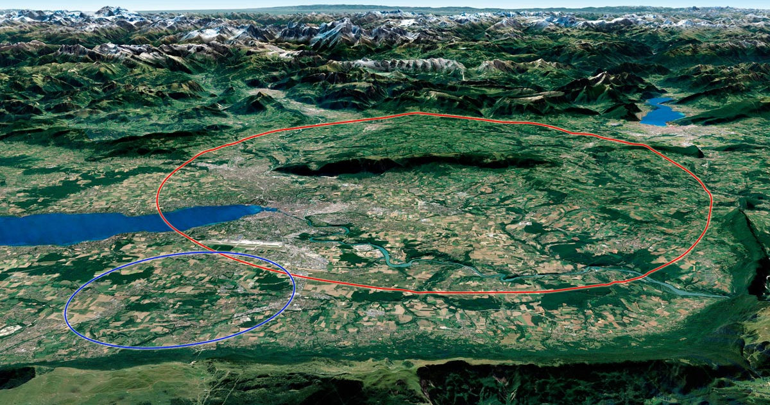
Future Circular Collider
Local Communication & Environment studies
20 January 2023
J. Gutleber (CERN)

Slide 2
Future Circular Collider
Territorial dialogue & Environment studies
20 January 2023
J. Gutleber (CERN)

Slide 3
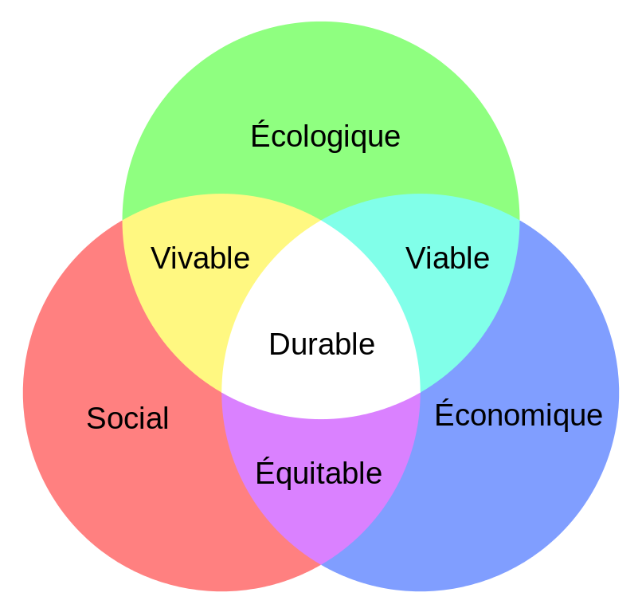
Term: “Environment”
Embraces everything into which the project is “embedded”
Includes “natural” and “artificial” elements
Applicable legal frameworks require an interpretation in the “large sense”
  Unordered set of exemplary topics:
  climate, soil, water, air, energy, subsurface, natural resources, biodiversity, habitats, patrimony and heritage, landscape, human environment, traffic and mobility, public health, technical infrastructures and risks, nuisances, waste, different types of radiation (light, magnetic, ionising), demography, economy, education.

Slide 4
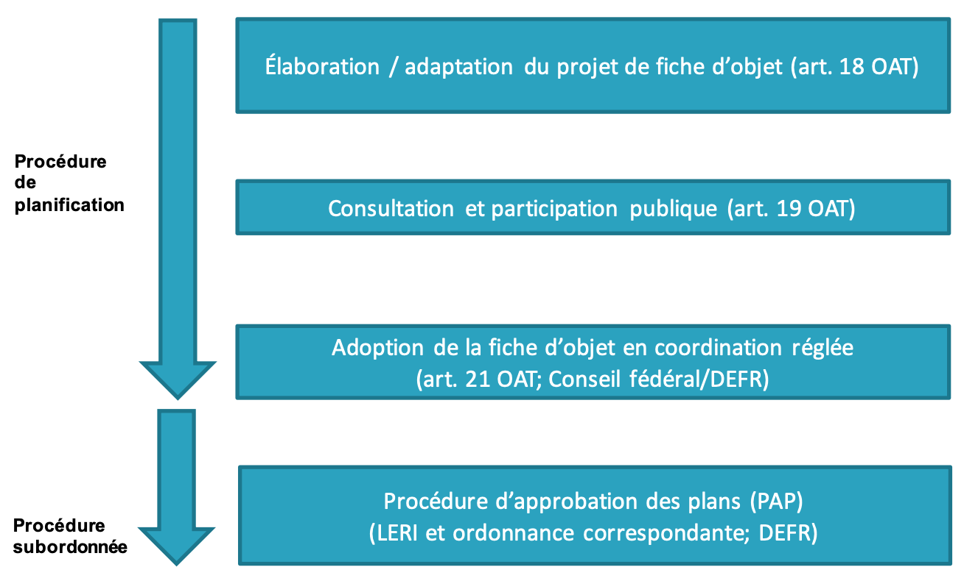
Motivation: project authorisation process
Switzerland
Development of a so called “plan sectoriel” to establish a legal framework to provide planning security for CERN’s future projects.
2 step authorisation process:
France
To be further developed. Large scale projects are typically authorised via a so called “procedure unique” based on an “environmental evaluation” that encompasses a diversity of topics.
Usually it is put in place with a particular law (similar to the “Sektorplan”) to be voted in the national assembly.

Slide 5
France/Switzerland: commonalities & differences
Differences
Project scope definition
Materials and methods for the analysis
Limits and threshold values
Scope of the topics to be assessed
Possibilities for improvement and compensation actions
Formalisms of processes
Decision and arbitration bodies
Types, number and levels of notified bodies
Default perimeter of the stakeholder engagement (from national to local, from institutional to private)
> Differences have significant impact potential on the authorisation process duration.
Commonalities
Requirement for public engagement and dialogue throughout the entire process.
Requirements for
Analysis of the initial state of the environment
Assessment of territorial evolution with and without the project
Presentation of variants and versions
Application of the Avoid-Reduce-Compensate approach in the project and project element design
Environmental impact assessment of the specific plans in the project location.
Socio-economic impact generation

Slide 6
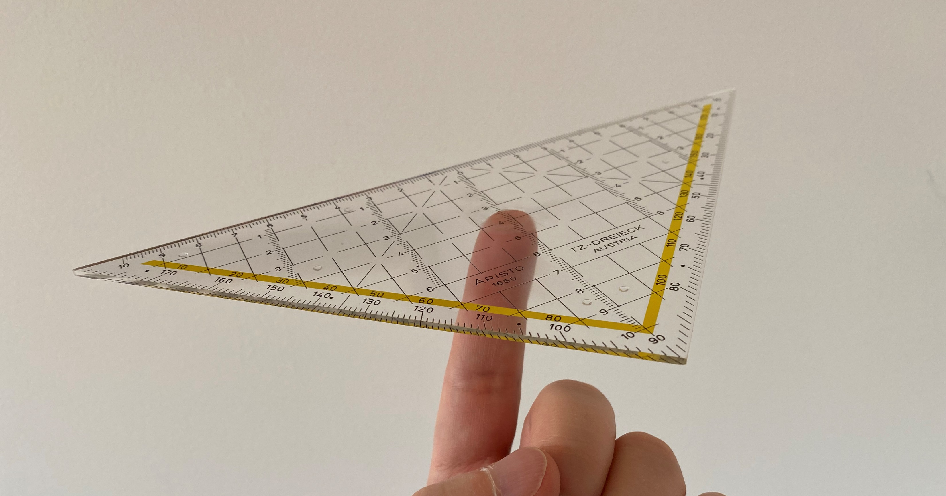
A balance of stakes
« Avoid-Reduce-Compensate » approach to iteratively develop a well-balanced scenario
Territorial impacts
= Societal acceptance
Performance of
the collider
= Scientific excellence
Technical feasibility and cost
= Acceptable risks

Slide 7
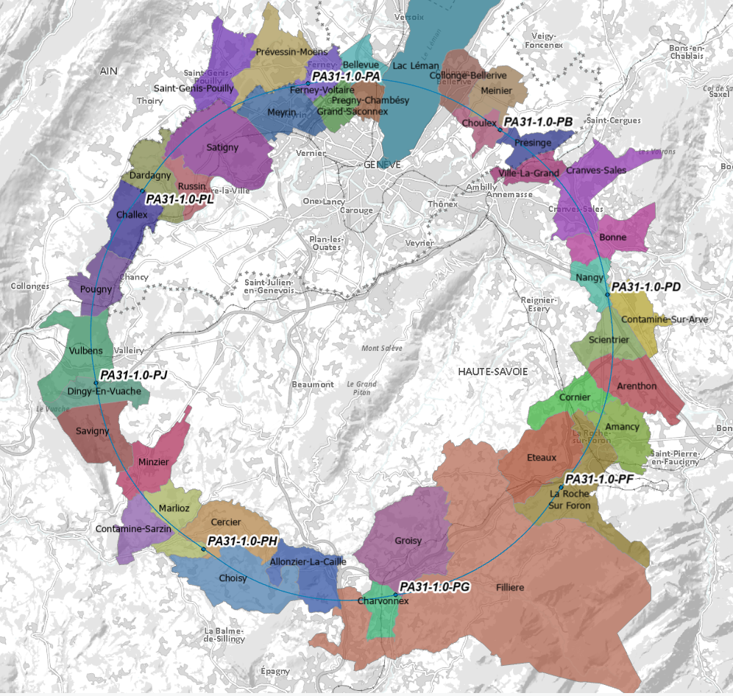
Reference scenario PA31
1. PA – Ferney Voltaire (FR, 01) – experiment
2. PB – Choulex (CH) – technical
3. PD – Nangy (FR, 74) – experiment
4. PF – Etaux (FR, 74) – technical
5. PG – Charvonnex/Groisy (FR, 74) - experiment
6. PH – Cercier/Marlioz (FR, 74) – technical
7. PJ – Vulbens/Dingy en Vuache (FR, 74) – experiment
8. PL – Challex (FR, 01) – technical
PA
PB
PL
PD
PJ
PF
PH
1 site in Switzerland
7 sites in France
PG

Slide 8


Single source of information for the implementation scenario
  Periodically updated via editorial process, about once per year
  V2.0 published in December 2023
  120 persons contributed to this work
https://doi.org/10.5281/zenodo.10369593
Ce projet a reçu, de l’Union Européenne, une subvention du programme d’aide de recherche et d’innovation Horizon 2020 sous le numéro d’agrément : 951754.

Slide 9
Our voluntary anticipating activities since 2021
Environment and sustainability studies
Not linked to the feasibility, which was confirmed earlier based on maps and databases. Complete and validate the knowledge, reduce the potential impacts, prepare the environmental assessment.
Called “état initial” or “état zero” analysis.
Identification of environmental aspects of the project as far as state of technoloy developments permits.
Road access and railway access as well as excavated materials disposal analysis completed.
Electricity access, initial renewable energy supply and waste heat supply analysis completed.
Excavated materials re-use field trials for agriculture and forestry on an open sky field laboratory at P5 in Cessy (1 ha) are being prepared and planned for at least four years.
Engagement of host state stakeholders
Regular information meetings and exchanges with cantonal services in Switzerland, prefecture of the region and the departments Haute-Savoie and Ain in France.
Periodic meetings with the mayors and municipal councils of the communes affected by the surface sites and the subsurface investigations
Targeted meetings with regional industries where a likelihood for synergy developments has been identified (e.g. water supply and treatment, cheese producers, farmers, fruit producers, service providers)

Slide 10
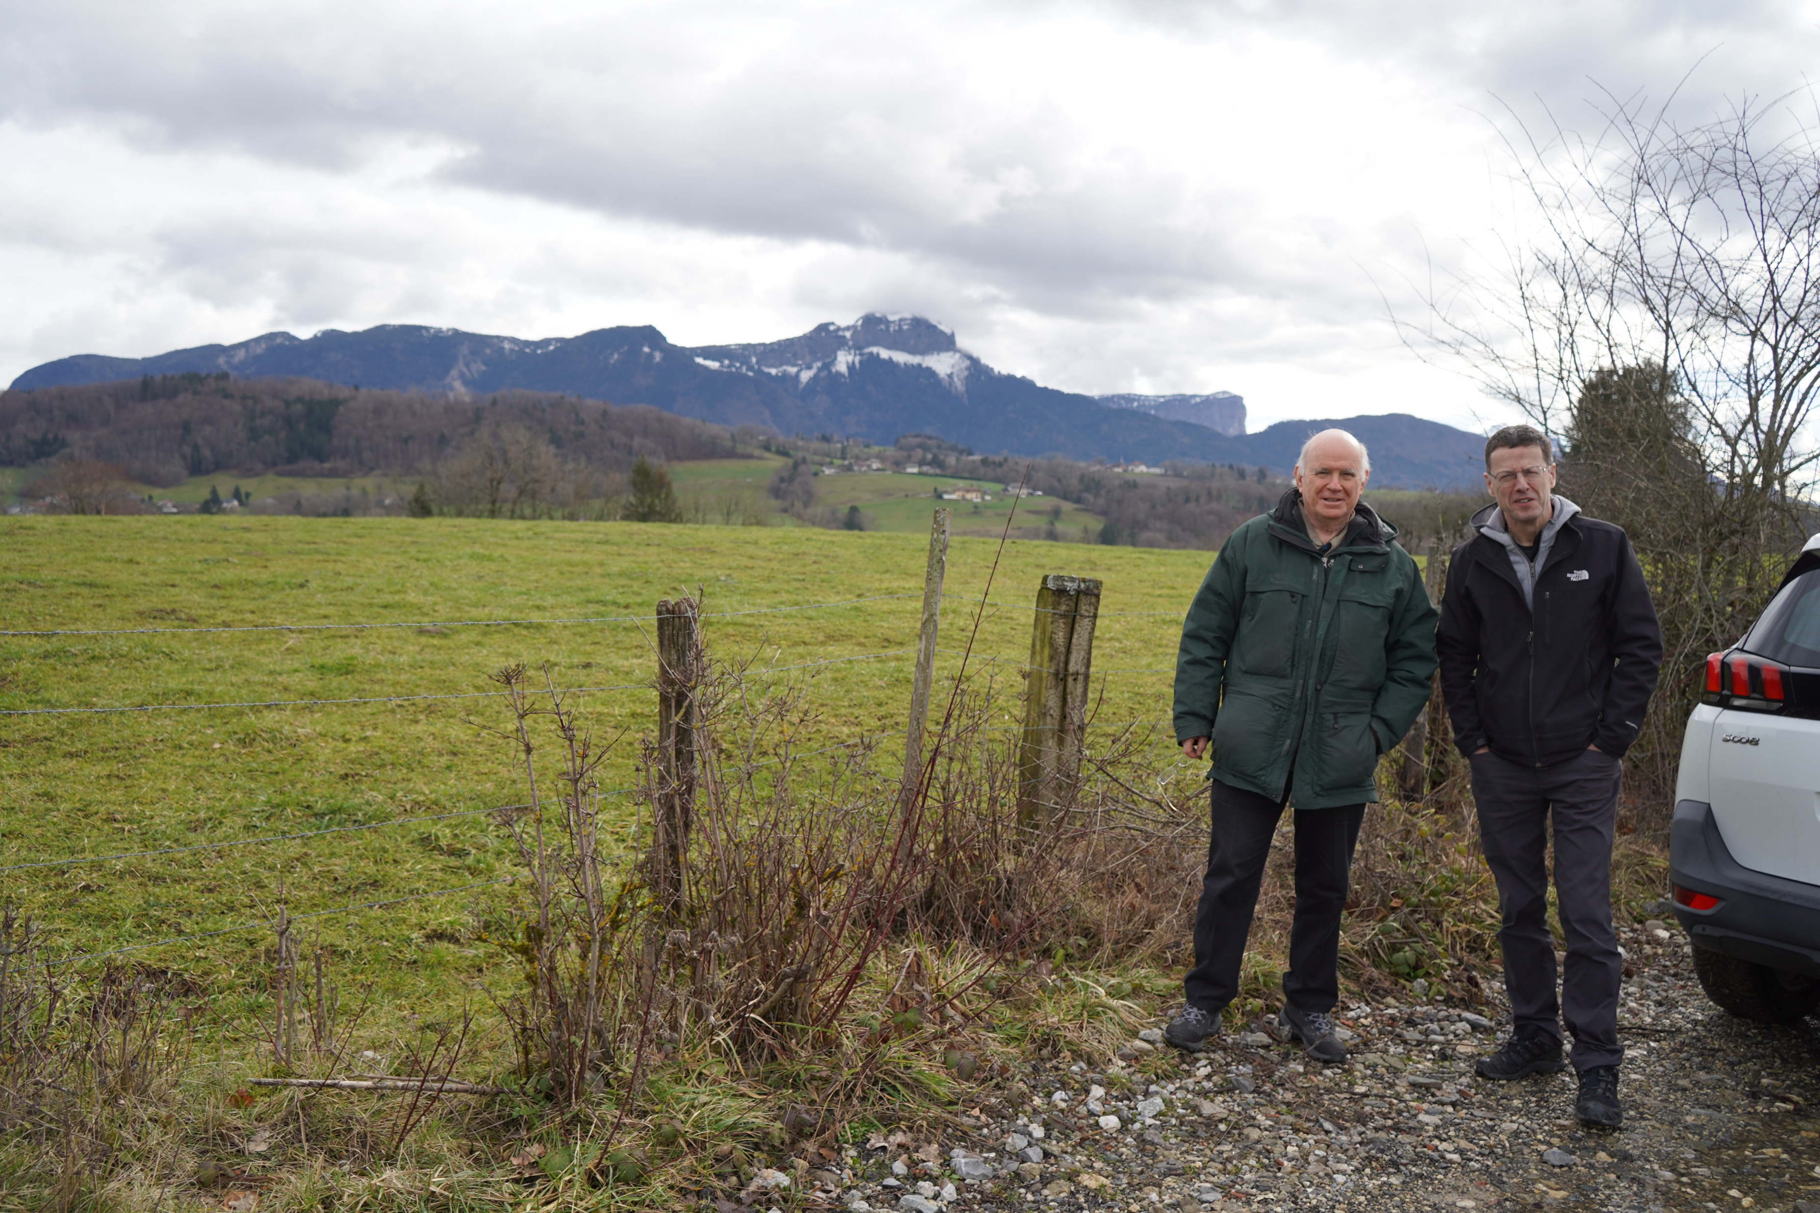
Example of nature analysis
~ 100 ha analysed at each site location during 4 seasons
Results of the field investigations guide the optimisation of the surface site exact locations, shapes and give guidelines for the layout, site design, improvement and compensation measures to be developed at a later stage.
Management is informed and engaged.

Slide 11
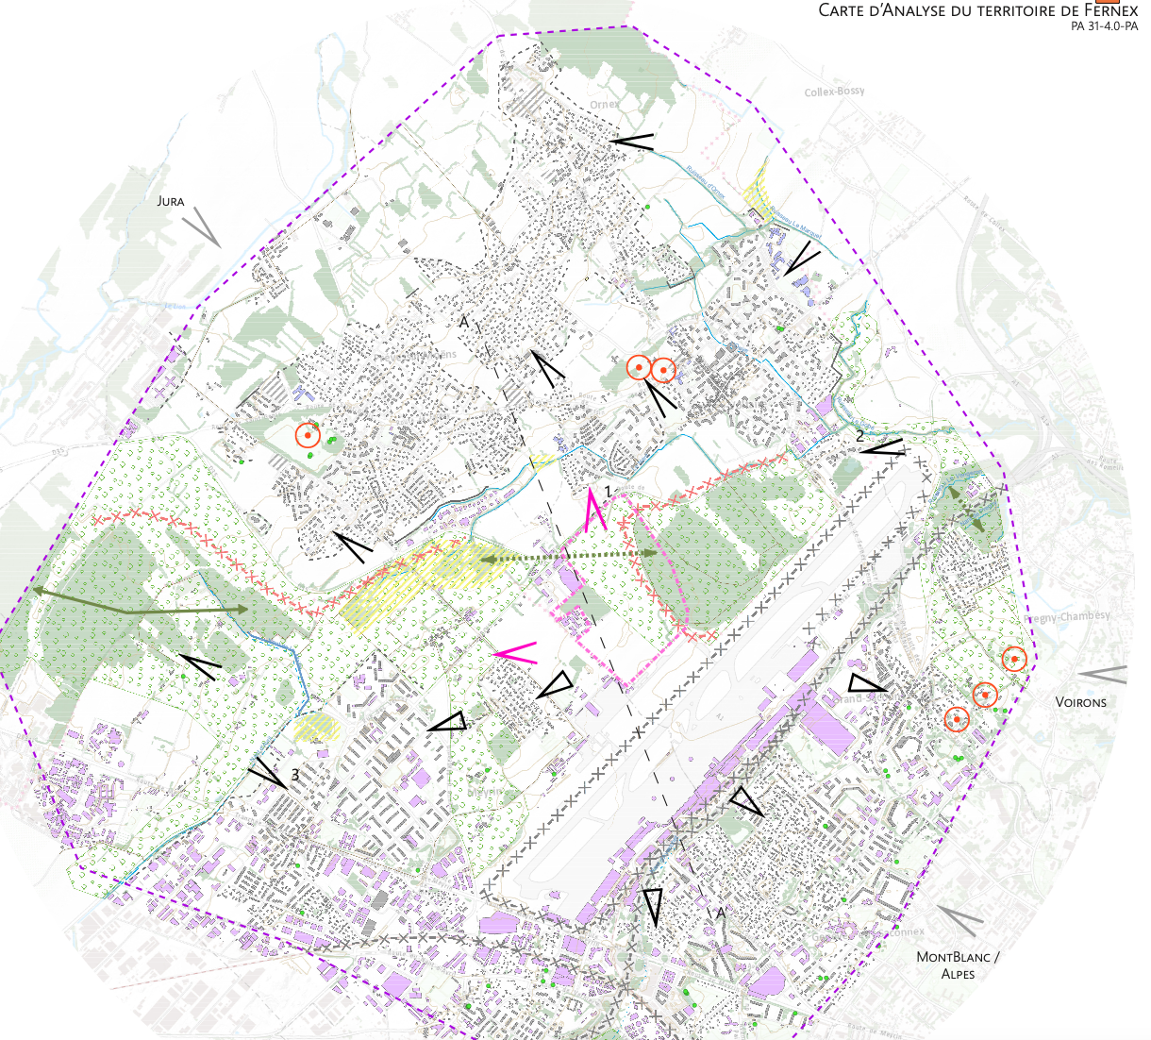
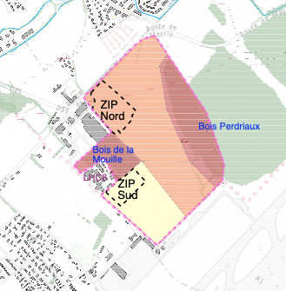

Example of landscape analysis
25/08/2023
Understand the challenges:
- views that would be obstructed
- visibility of the site from different directions
Develop guidelines for the surface site layout and implementation activities

Slide 12
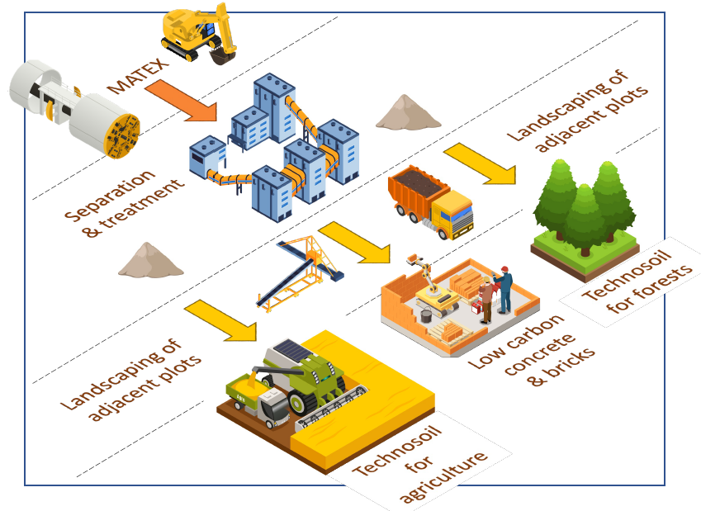
Management of the excavated materials: a key topic
Priority : reuse, minimize disposal
  Feasible disposal concept exists, but is very costly and comes with nuisances
Avoid and reduce transport
  In particular with trucks
Industrialisation of re-use pathways according to available resources
  Value creation for agriculture and reforestation
  Improvement of acid and polluted plots
  Recovery of wastelands
  Use as construction materials within the project
  (e.g. compressed blocks)

Slide 13
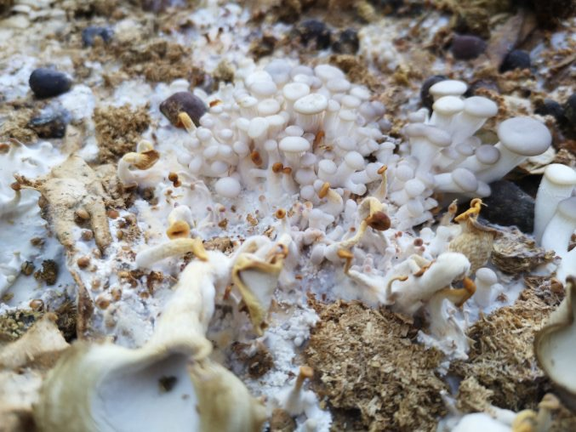
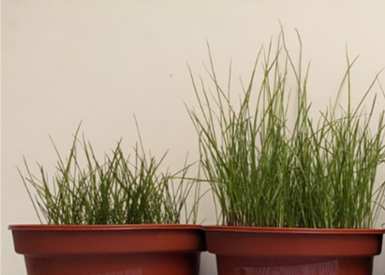
MATEX Open Innovation Example
”Mining the Future®” competition carried out
in the frame of the FCCIS H2020 project revealed a number of credible processes and technologies to
Develop approaches to manage the 8 million m³ of materials once excavated (foisonné) and
contribute in meaningful and relevant ways to the ever critical issue in Europe of disposing (waste) excavated materials from construction projects.
A consortium with academic & industrial partners is built to provide tangible evidence with a multi-year agricultural trial on 10’000 m² at LHC P5 in Cessy to
- convert molasse to arable soil,
- promote reforestation with climate fit trees and
- reduce the carbon footprint of construction projects
- bring quality assured processes to market
Accelerated soil transformation with funghi

Slide 14
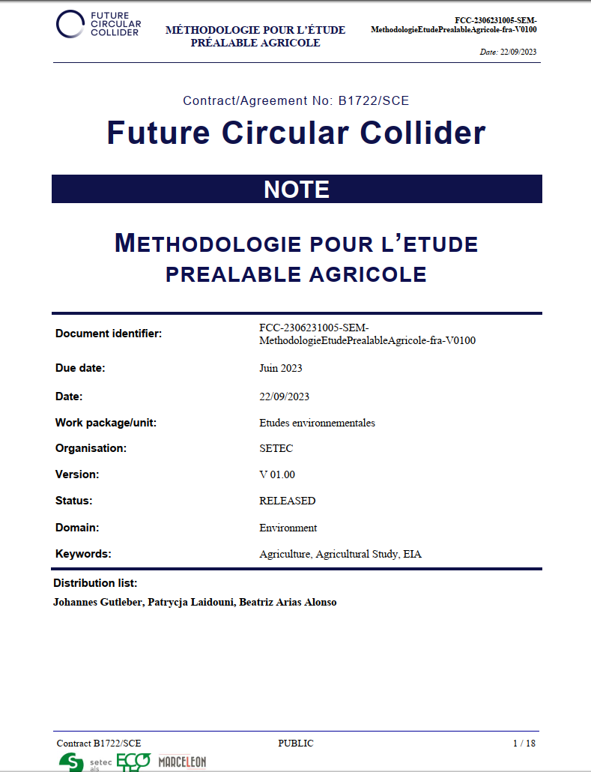
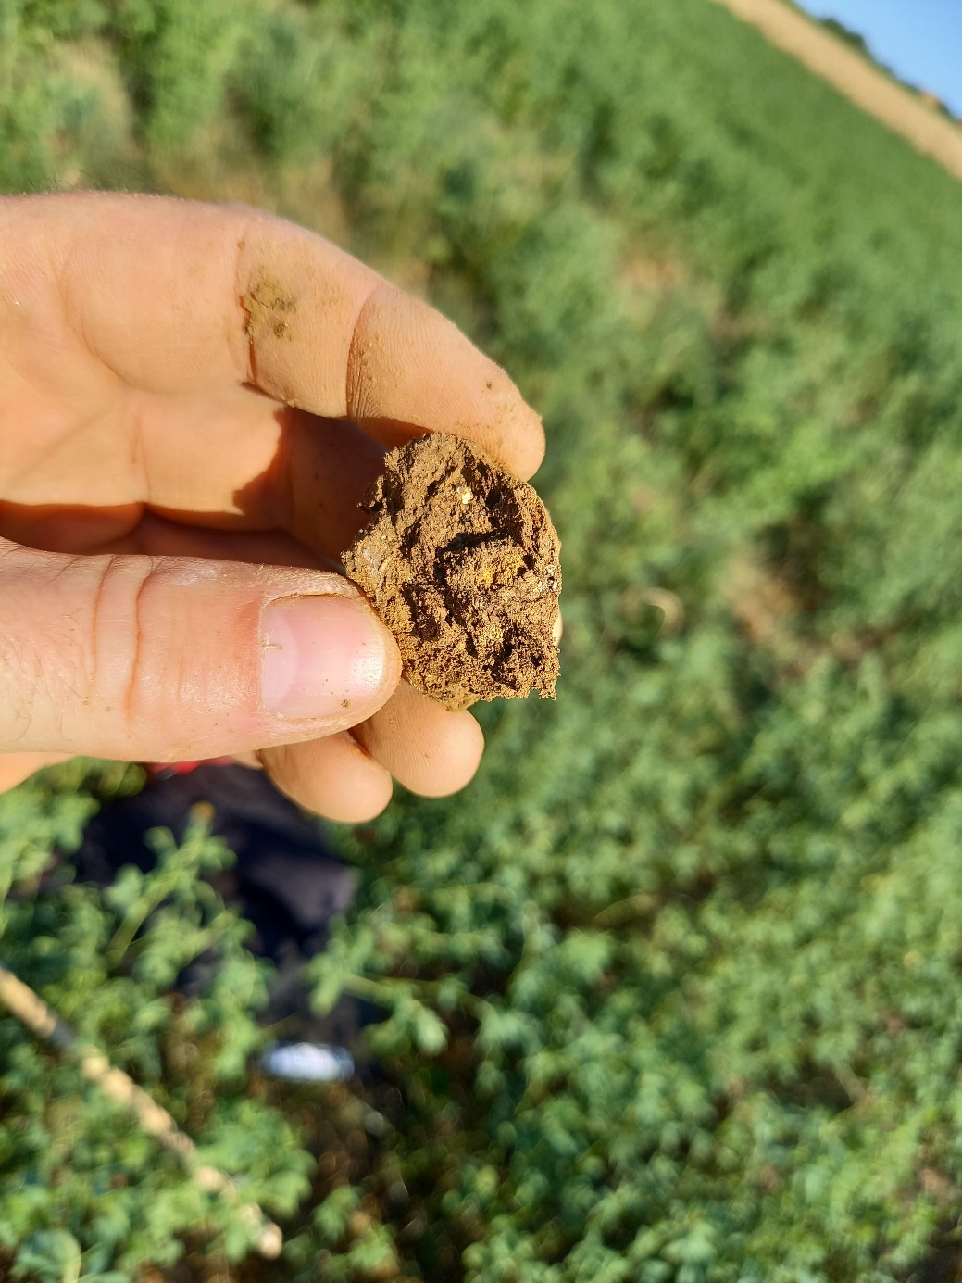
Agronomic studies
25/08/2023
Agricultural study considering the french regulatory framework
  « Pilot » carried out in Nangy
Soil quality analysis, wetland zone analysis
To determine
  Value of the plots consumed
  Quantification of economic loss
  Agricultural spaces that can
  be improved with treated
  excavated materials
  Work ongoing and
  to be completed this year
VIAN Jean-François, VALLEIX Thierry, STAGNARA Delphine, LAÏDOUNI Patrycja, & GUTLEBER Johannes. (2023). Méthodologie pour l'étude préalable agricole (Version V1.0). https://doi.org/10.5281/zenodo.8403158

Slide 15
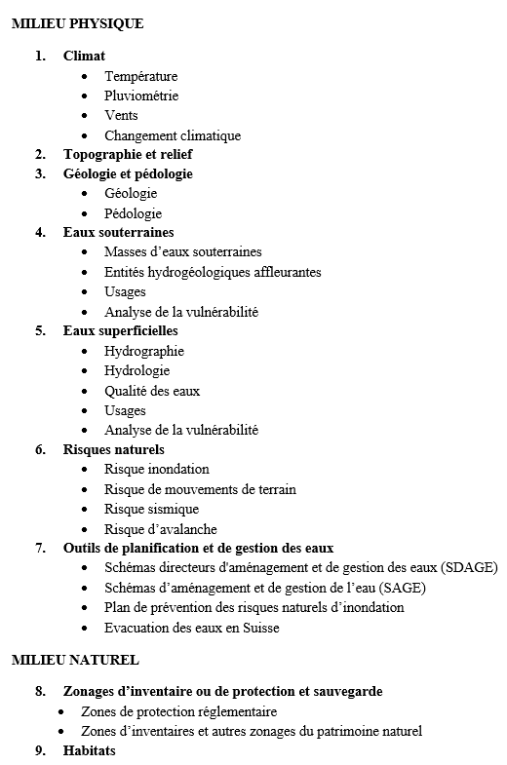
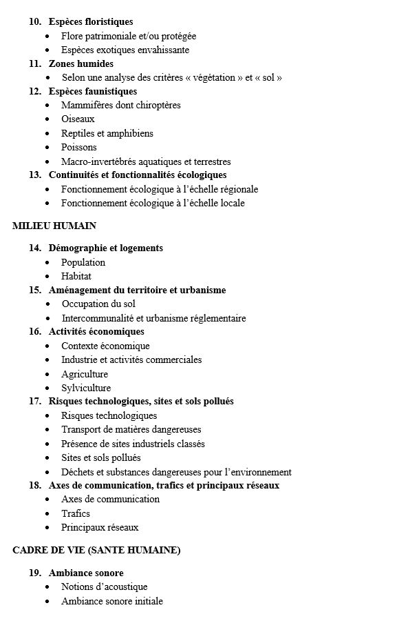
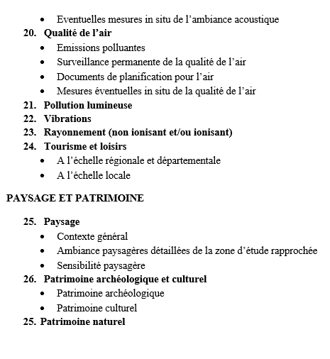
Topics included in the work until end 2025
Total personnel engagement:
35 persons from contractors
5 persons at CERN

Slide 16
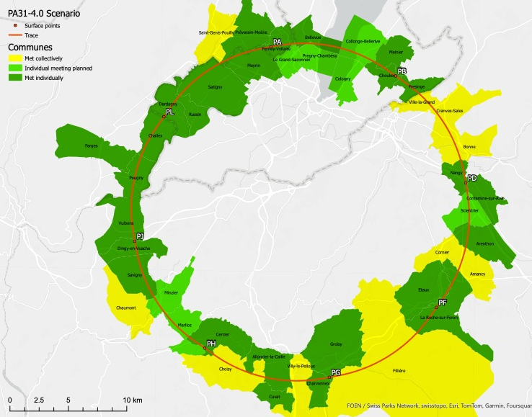
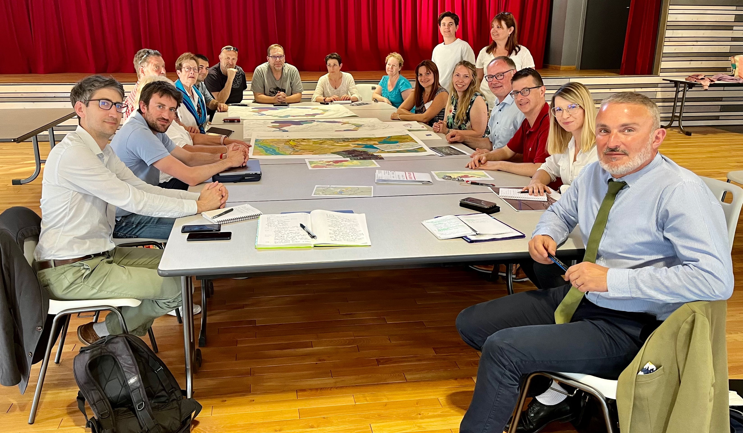
Working meetings with 42 municipalities
Meetings with the affected communes have
been carried out, sometimes more than once.
Focus is on very specific topics:
  surface site locations and sizes
  geotechnical and geophysical investigations
A host state representative is always
accompanying CERN (prefecture or canton)
Challex, Ain, France, 2023

Slide 17
Main concerns expressed by people met
Loss of agricultural space (1 ha is a lot for a municipality)
  Typical questions: what do you need the space for? Do you really need it? Where is the access? What can you put underground?
How will you manage the excavated materials? Where willt hey go? How?
What nuisances will the construction cause?
(noise, dust, traffic saturation due to trucks and workers)
Visibility and noise of evaporation towers and plume generation
Visibility of sites in general – size of buildings, construction style, fences
What are the adverse impacts concerning water supply and availability?
What are the adverse impacts on wetlands?
Visibility of electricity lines and electrical substations
Electrical energy consumption – will it affect other projects and development? How?
What about impacts on protected nature zones?
How will the influx of additional workers during construction period be managed in terms of housing, traffic, schooling, cultural integration?

Slide 18
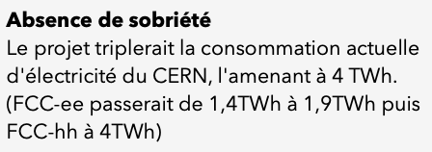

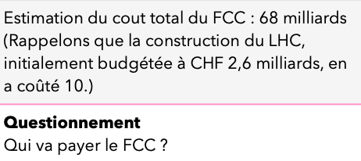

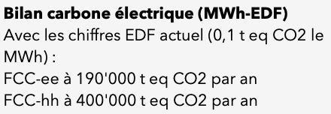


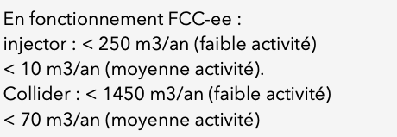



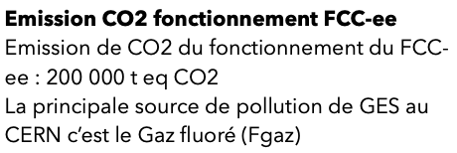

Concerns and “alternative” facts circulate online
We are analysing them and addressing them one-by-one with solid analysis and work.
We are convinved that transparency and professionalism is key to obtain the social license.

Slide 19
Principal general re-ocurring questions
What is the goal of the research you want to carry out concretely?
  Explicit request to be able to respond with less than 2 sentences
  and in half a minute without jargon terms. This is a challenge!
How will the surface site look like?
  A major challenge, since it is very hard for institutions and persons not involved in science and engineering to accept the iterative technical development process of a project that will operate in 20 years from now.
  It is a high risk to publish “block-style” surface site layouts, since people cannot detach from the drawings once they see them and keep interpreting them as the design-to-build. Not showing raises equal worries, incorrectly assuming the CERN hides information.
What is the site bringing in terms of added value
to my municipality and its immediate surrounding?
  Typically an iterative process in which the individual interests are identified.
  Subsequently we develop potential benefits jointly.
  A process that requires ample time and dedicated personnel resources.

Slide 20
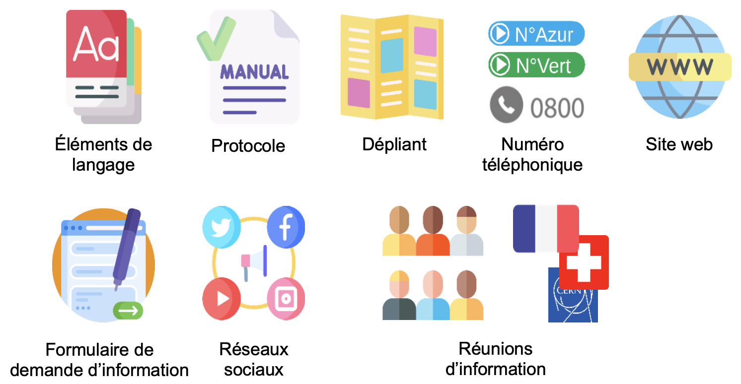
Information kit to accompany field investigations
Communication plan has been established in the frame of a “tripartie territorial dialogue group”
This body has been established to assure that CERN, France and Switzerland can proceed “in phase”.
Mid-term review revealed that web and in particular social-media presence needs netter planning and work. Consequently we will put a focus on this with a dedicated expert in “concertation publique”, leveraging existing experience of other large projects and platforms in place for such activities in France.

Slide 21
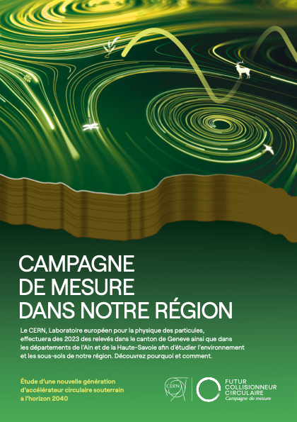
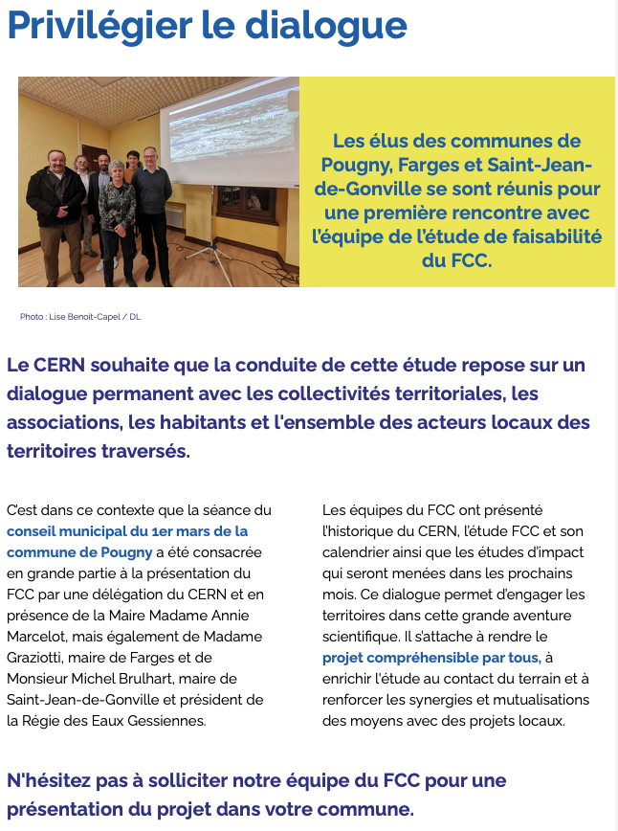
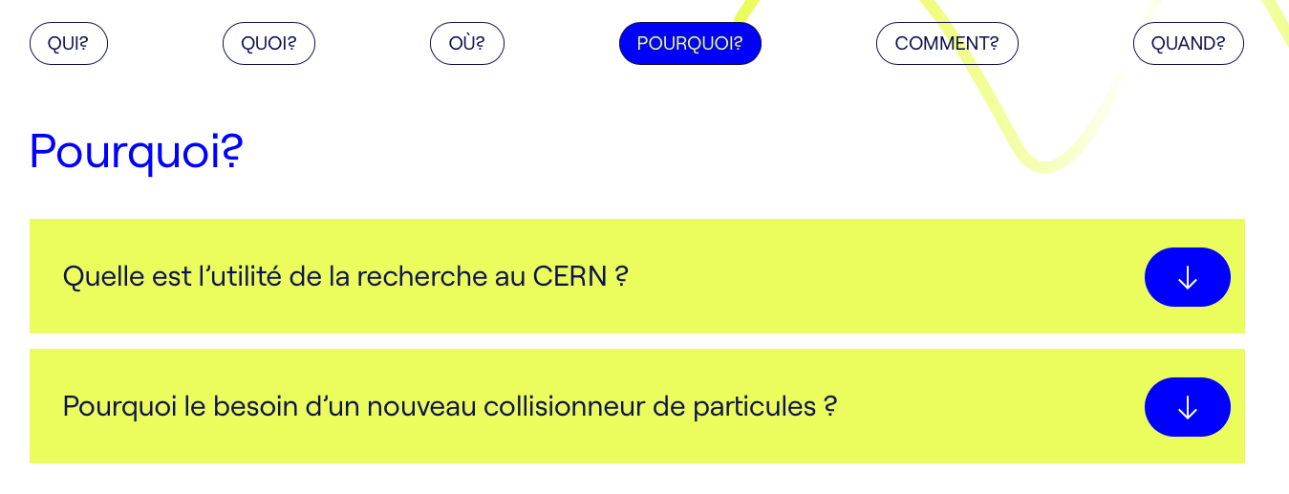
Web site:
fcc-faisabilite.eu

Slide 22
General summary
Reference scenario is established, communicated and reviewed by host states and with municipalities hosting sites.
Engagement is overall positive, but worries and concerns exist and are expressed.
Associations are teaming up against CERN and the situation leads to a “one-sided” painting of the project picture, e.g. https://www.change.org/p/le-cern-peut-il-tout-se-permettre
We are not able to answer to some of questions and worries exhaustively (yet).
If we knew it all, we would not need to study.
Development of synergy potentials with municipalities has started.
Environmental aspect analysis is ongoing.
Managed documentation exists
Environmental Information System rolled out.
The territory is continuously evolving. No obvious alternative feasible scenario has been identified.

Slide 23
Summary of work with instutions
A project scope and splitting has been proposed to the host states. It is currently under review.
An agreement between France, Switzerland and CERN on this proceeding is a pre-condition to
be able to advance on the preparatory tasks for a project.
Subsequently, targeted participation of host state services in both countries are required in the near future to be able to assure a timely preparation of a potential construction project, before a decision is taken and before a project authorisation is issued.
The development of the authorisation / permitting processes in the two host states has started.
Land plot reservation for study purposes has started in France and in Switzerland.

Slide 24
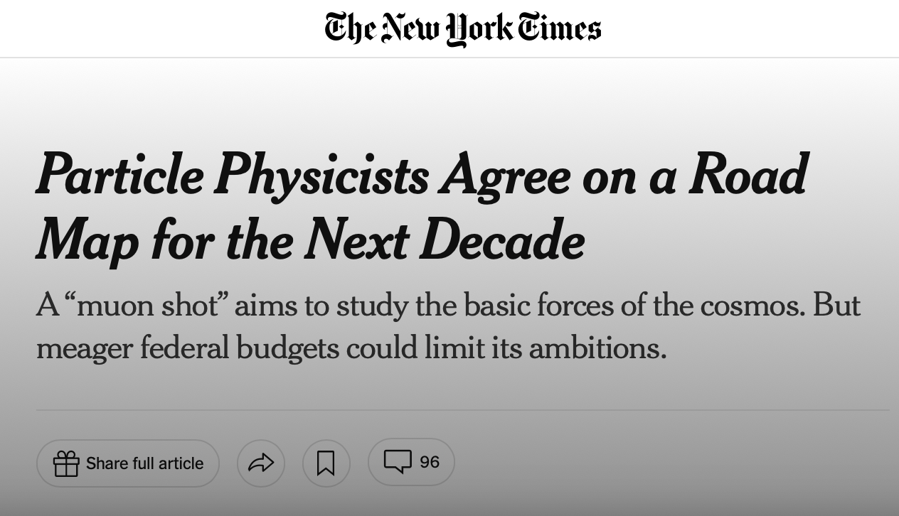
How can we make the FCC happen?
Unite as a community
Formalise collaborations
Be publicly visible as an entity with a vision
Explain to your partners, families, friends,companies you work with, people you meet in a bar, at the airport, at the train station, in the supermarket, on the bus, in the elevator, in the taxi, in the shops, on the beach, in the hotel, at school, at the kindergarten, ...
Please listen to the worries, the fears of the people.
Respect, accept and understand the criticism.
Sustainability of a Research Infrastructure relies on the long-term commitment of a sufficiently large and determined user community.
Opponents aim at dividing the community. Unity is a fundamental pre-requisite.

Slide 25






Your engagement counts!
The SM, as the renormalisable SU(3)SU(2)U(1) chiral gauge theory of three generations of quarks and leptons, is a consistent theory,
closed under radiative corrections, except maybe a hypercharge Landau pole at very high energy. But we know that it is not complete and it should be considered only as a low-energy EFT …
Help us to develop easy to understand and
short explanations
WHY do we want to carry out research with a future circular collider?
WHAT is the scientific research we want to do?
What will you do with this particle collider?
fcc-what@cern.ch
CAISSE

