Slide 1
Centre-of-mass energy shifts in Z pole run
Alain Blondel as member of EPOL group
Resonant depolarization frequency → < E⁺_{b} > , < E⁻_{b}> → E_{CM} (IP_{1,2,3,4})
-- Energy gains and losses in the ring
-- Beam Collision Offsets X Opposite Sign Vertical Dispersion (OSVD)
-- EM attraction between bunches
and their monitoring/measurement methods
Error budget on E_{CM} : << 100 keV absolute, ~<4keV point-to-point
PROGRESS_REPORT January 2024 Annecy based on June 2023 London

Slide 2

GO TO PAGE 5, 6-9

Slide 3
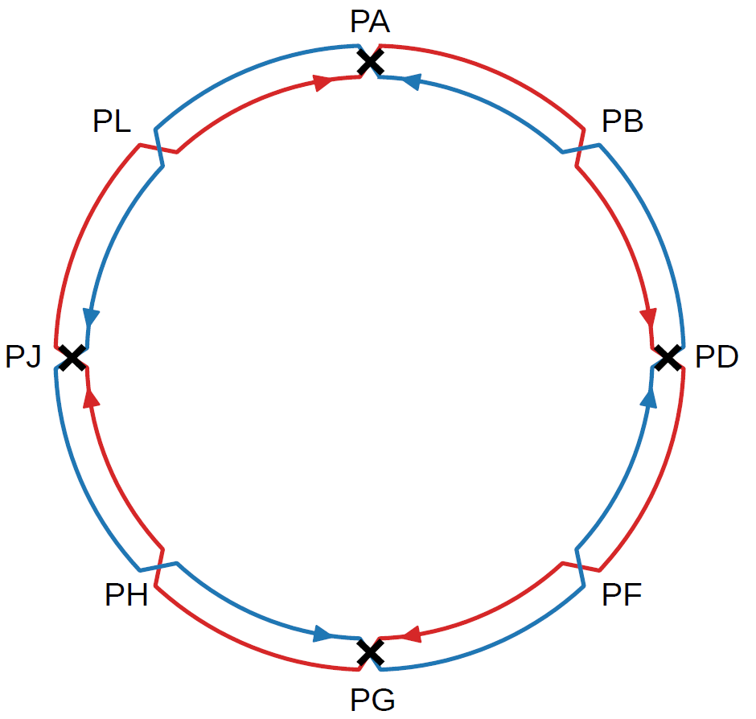
Orders of magnitude, basics
the average energies E₀ around the ring
are determined by the magnetic fields and RF frequency
➔same for colliding or non-colliding beams
-- measured by resonant depolarization
-- can be different for e⁺ and e⁻
ESSENTIAL TO HAVE ALL RF IN ONE POINT
Δ_{SRe}
Δ_{SRi}
RF

Slide 4
resistive wall
Orders of magnitude, Longitudinal Impedance
Emanuela Carideo, EPOL workshop 2
Uniformly distributed
depends on bunch length!
Bellows
The bunch lench increases for colliding beams ➔ energy losses decrease.

Slide 5
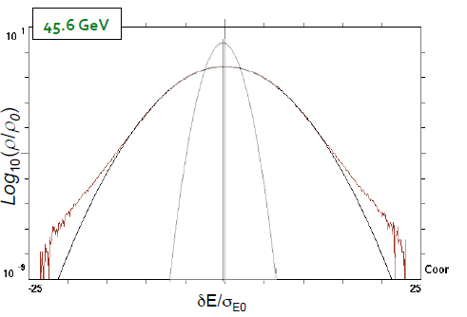
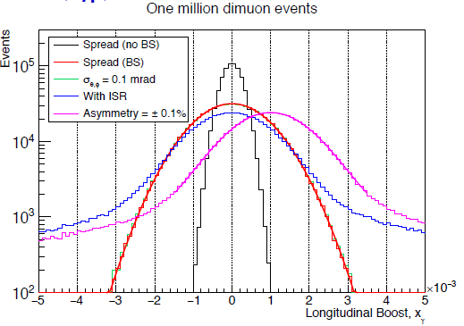

From EPOL Workshop I (2017)
3. From spin tune measurement to center-of-mass determination ν_{s} = $\frac{g−2}{2}\frac{Eb}{me }= \frac{Eb}{0.4406486(1)}$
  3.1 Synchrotron Radiation energy loss (10 MeV @Z in 4 ‘arcs’) calculable to < permil accuracy
  3.3 Beamstrahlung energy loss (0.62 MeV per beam at Z pole), compensated by RF (Shatilov)
  3.4 layout of accelerator with IPs between two arcs well separated from single RF section
3.5 E_{b}⁺ vs E_{b}⁻ asymmetries and energy spread can be measured/monitored in expt:
e+e- → μ+ μ- longitudinal momentum shift and spread (Janot)
D. Shatilov:
beam energy
spectrum
without/with
beamstrahlung
z boost
P. Janot: 5 min/exp @Z ➔ 10⁶ μ+ μ- /expt →
50 keV meast both on σ_{ECM} and E⁺ - E⁻
and beam crossing angle α (error negl.)
also monitor relative ECM (p-t-p!)

Slide 6
Orders of magnitude – ECM and Boosts
in this slide, many simplifying assumptions
-- ΔBS same for all IP
-- energy losses same for all arcs, include SR and Long. Impedance
-- γ⁴ effect ignored
-- E₀ measured by Resonant depolarization
e⁻
e⁺
Δ_{SRe}
Δ_{SRi}
Δ_{RF} = 4Δ_{SRi} + 4Δ_{SRe} + 4Δ_{BS}
-- ECM shift due to SR in ≠ ext
-- all Ecm are the same
-- boosts measure the energy losses
-- differences between the rings will show up.
-- assumes BS energy loss before collision is on average half of full beamstrahlung
E⁻_{J} = E₀⁻ + ΔRF/2 - Δ_{SRi} - Δ_{BS}/2
E⁺_{J} = E₀⁺ + ΔRF/2 - 4 Δ_{SRi} - 3 Δ_{SRe} -7Δ_{BS}/2
E⁺_{J} +E⁻_{J}= E₀⁺ + E₀⁻+ ΔRF - 5 Δ_{SRi} - 3 Δ_{SRe} -4Δ_{BS}
E⁺_{J}+E⁻_{J}= E₀⁺ + E₀⁻ +Δ_{SRe} - Δ_{SRi}
E⁻_{A} = E₀⁻ + ΔRF/2 - 2Δ_{SRi} - Δ_{SRe} - 3Δ_{BS}/2
E⁺_{A} = E₀⁺ + ΔRF/2 - 3 Δ_{SRi} - 2 Δ_{SRe} -5Δ_{BS}/2
E⁺_{A}+E⁻_{A}= E₀⁺ + E₀⁻+ ΔRF - 5 Δ_{SRi} - 3 Δ_{SRe} - 4Δ_{BS}
E⁺_{A}+E⁻_{A}= E₀⁺ + E₀⁻ +Δ_{SRe} - Δ_{SRi}
RF
Boost(J) = E⁻_{J} - E⁺_{J} = E₀⁻ - E₀⁺ + 3 ΔSRi + 3 ΔSRe + 3 ΔBS ➔ measures ¾ of E losses in J and G
Boost(A)= E⁻_{A}- E⁺_{A}= E₀⁻ - E₀⁺ + ΔSRi + ΔSRe + ΔBS ¼ in A and D
(other two ibid with reverse sign)
considerable information contained in the boosts measured by the experiments!

Slide 7
About the boost measurement using dimuons
refer to Patrick’s presentation in London, based on measurement of the acollinearity in Z→ μ μ events
This is a beautiful and potentially very powerful method. The statistical precision will be quickly sufficient.
A fundamental difficulty is that many sources of misalignment exist that affect the measurement of track angles.
Example of a difficulty:
the internal alignment of the detector leads to systematic uncertainties in the track angle measurements -- we are not measuring the angle directly, but basically from the position of a set of space points. A relative shift of the vertex detector assembly wrt the outer part (wrapper) of the tracker by only 30 microns ➔ acollinearity shift by 30microrad. This is very similar to a longitudinal shift in CM boost of 1.5 MeV!. The slight difference can be observed by analysis of the dilepton sample, but can also be mimicked by a small deformation of the outside detector, in which one encap has a slightly larger diameter than the other.
wrapper
In other words, the ‘global’ in-situ alignment require a ‘global’ fit to a great many sources of misalignment simultaneously, and it is not guaranteed that there will not remain blind directions.
vtx
vtx’
wrapper

Slide 8
The need of cosmic muons
wrapper
vtx
vtx’
wrapper
This type of misalignment cannot be eliminated using tracks originating from the vertex, traditionally this is constrained by using cosmic tracks that are going through all the detectors of concern.
The FCC caverns are far deeper (over 200m) than CMS (~70m), ATLAS (~57m) or even ALEPH (125m) (see next slide)
The smallness of the vertex detector and the depth of the caverns both reduce the number of useful cosmic muons.
Energy of the muons has to be >~5 GeV at entrance into detector. Each muon will provide an alignment constraint equivalent to ~3-5 microns on the relative longitudinal position of the vtx detector.
A few 100 cosmics will be sufficient to efficiently constrain the longitudinal boost below micron level.
In order to obtain a precision of 5keV on the longitudinal boost as desirable for the Z mass measurement
around O(>100’000) useful muons might be necessary. Is this possible? TO BE FOLLOWED!
Hope to improve also with the dimuon 3D boost measurement and constraints.
The availability of both, cosmics and in-situ alignment, is precious redundancy and should be pursued

Slide 9
From T. Watson’s talk

Slide 10
MAD-X simulation
No longitudinal impedance included yet

Slide 11
Exact numbers not final!
sum of |boosts| is indeed
2X energy losses! (41.48 MeV x 2)
-- The centre of mass energy is equal to the ’zero’ value with great precision, (8 keV) even with beamstrahlung included
-- to be checked: the average energy that is given by resonant depolarization is not exactly E₀ but close
-- this is due to the virtue of having only one RF section.
-- the boosts are large and not as symmetric as expected. 3B(A)=-3B(D) = B(J)=-B(G) ; ➔ to be understood in detail why.
Every 8 minutes the boosts are measured with a precision of 50 keV. 5keV per shift.... 0.5 keV for 30days of run.
Applying the constraints can fix the energy loss model effectively.
THE GRAND TEST IN FINE: ALL MEASURED Z MASSES SHOULD BE THE SAME

Slide 12
Jorg Wenninger
boosts, Qs and orbit differences will depend on beam intensity via both beamstrahlung and variation of impedance, which somewhat compensate eachother
Important to check, since pilot bunches will have different behaviour than colliding ones!
(of course on <average energy> this is all compensated by the RF!

Slide 13
Ivan Koop
Concludes that the energy losses can can be fit to extremely high accuracy. (and for instance the power law E⁴ verified by fitting the exponent)
Work in progress!..
e.g. need cosmics or some other method to constrain the boost measurements.

Slide 14
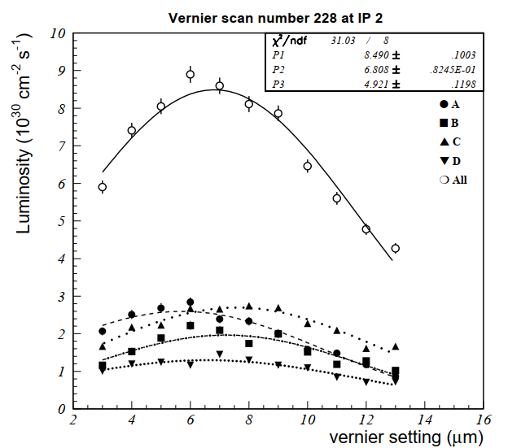





From beam energy to E_{CM}
opposite sign dispersion
$$E_{e^{−}}$$
Experience from LEP: Vernier scans
Relative position of beams measured to +- 80 nanometers from one scan
$$E_{e^{+}}$$
No effect on ECM if no offset
NB energy spread is reduced.
$$E_{e^{−}}$$
precision requires going
far from maximum
➔ loose beam?
$$E_{e^{+}}$$
Try beam-beam deflection?
ECM lowered:

Slide 15
GO TO PAGE 22 (23-25)

Slide 16
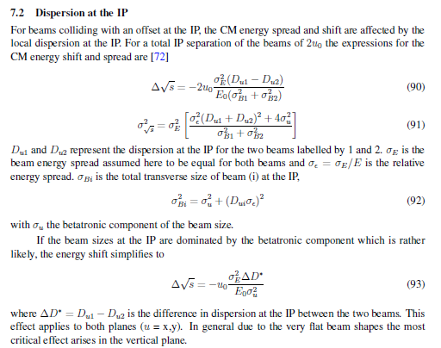
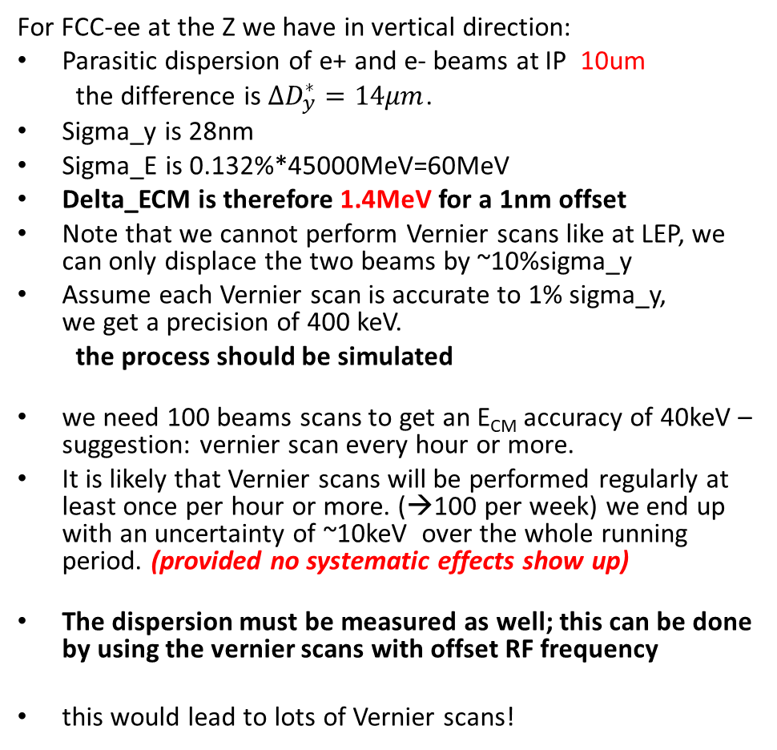
vernier scans
arXiv:1909.12245
For FCC-ee at the Z we have in vertical direction:
Parasitic dispersion of e+ and e- beams at IP 10um
the difference is $∆D_{y}^{∗}=14μm$.
Sigma_y is 28nm
Sigma_E is 0.132%*45000MeV=60MeV
Delta_ECM is therefore 1.4MeV for a 1nm offset
Note that we cannot perform Vernier scans like at LEP, we can only displace the two beams by ~10%sigma_y
Assume each Vernier scan is accurate to 1% sigma_y,
we get a precision of 400 keV.
the process should be simulated
we need 100 beams scans to get an E_{CM} accuracy of 40keV – suggestion: vernier scan every hour or more.
It is likely that Vernier scans will be performed regularly at least once per hour or more. (→100 per week) we end up with an uncertainty of ~10keV over the whole running period. (provided no systematic effects show up)
The dispersion must be measured as well; this can be done by using the vernier scans with offset RF frequency
this would lead to lots of Vernier scans!
critical effect is in the vertical plane, but horizontal plane should be investigated as well

Slide 17
CONJECTURE:
Because the beams are crossing each other at an angle in the horizontal plane,
horizontal dispersion or offsets are not relevant
every x slice of one beam crosses every x slice of the other
Check this is correct!

Slide 18
This is good news because effect (problem) is 10 times smaller than we thought.... 40keV→ 4 keV (stat!)
but we wont believe it until we measure it! (How do we measure vertical dispersion at IP?)

Slide 19
beam-beam deflection scans
already used at SLC, KEK and LEP, and now at SuperKEKb
CERN-SL-96-025
https://inspirehep.net/literature/420668
Uncertainty on Δy_{opt} = -5.6±0.1 μm
is 1/40 of the vertical beam size 3.8±0.2 μm
which was itself measured in the process

Slide 20
beam-beam deflection measurement at FCC-ee as if in « squished perspective » looking from behind detectors endcaps
e+
y axis
U-BPM
upstream electron
beam position monitor
located between
final focus quads and
compensating solenoid
D+BPM
downstream positron
beam position monitor
located between
final focus quads and
compensating solenoid
d=2.1m
IP
X
x axis
BPM in arc magnets
U+BPM
D-BPM
e-
BPM precision over 10⁸ bunch passages is ~1μm
detector z axis

Slide 21
REFERENCE
1. beams collide head on
-- or at low current
1’. pilot bunches (not colliding) all the time
1’’ can be calibrated with low current vernier scan
1’’’ or occasional vernier scan

Slide 22
COLLISION OFFSET
4.2 μm
2. offset by δ_{y} = 0.1σ_{y} (=3.5nm)
opposite kick by 4μrad
(Shatilov) in opposite directions for e+ and e-
movement in the BPMs by
± 2 μrad x 2.1m = ±4.2 μm
(x1000 demagnification due to optics)
with a very specific pattern of movements
4μrad
Vertical beam size at the IP: ∼35 nm (at Z pole). Vertical offset of 0.1σ_{y} leads to additional orbit angles about ±2 μrad for the nominal bunch population 2.5E+11. (D. Shatilov, simulation)

Slide 23
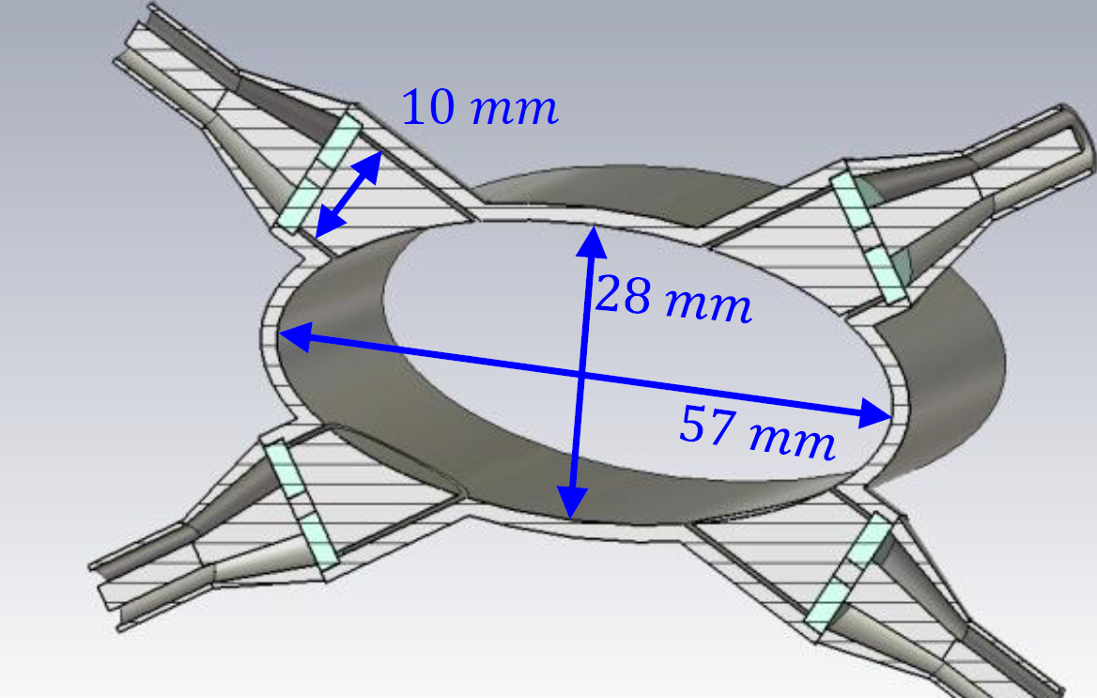
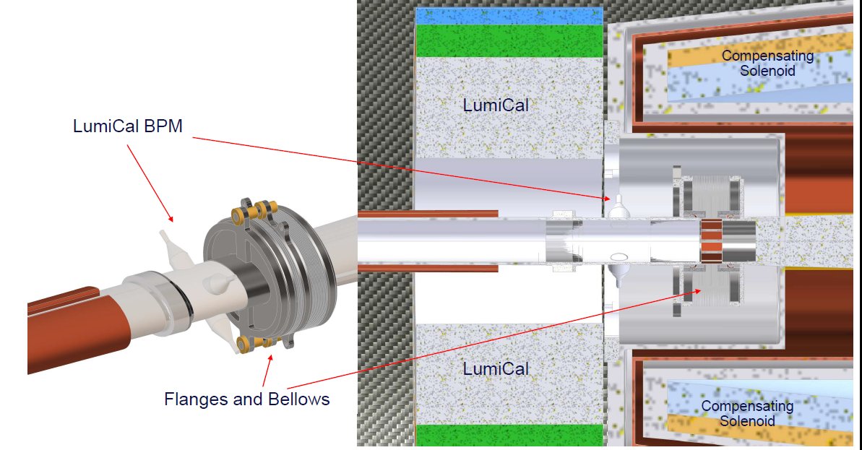
GOOD NEWS: THE LCAL BPM
M. Wendt proposed LumiCal BPM pickups Wendt@fccweek2023
-- 1.15 m away from the interaction point
-- both e+ and e- measured in the same device!
-- ideal place to measure relative beam-beam motion accurately.

Slide 24
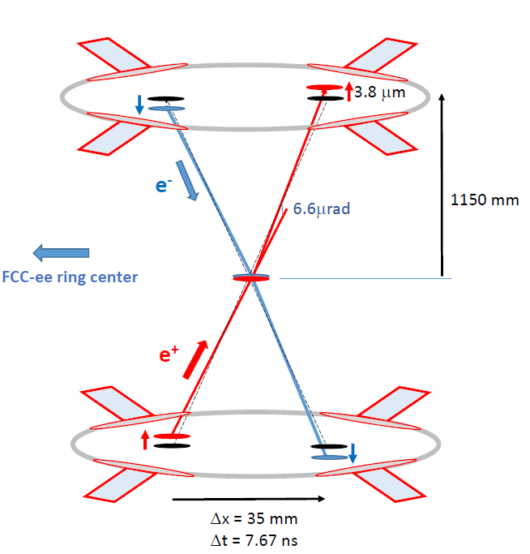
typical FCC-ee parameters of
beam-beam tune shift ξy = 0.14,
β∗y = 0.8 mm and
σy = 30 nm,
vertical collision offset of 3nm (0.1σ_{y} )
➔ beam-beam deflection of 6.6μrad,
or 3.8μm in each of the four BPMs
-- Assuming BPM resolution of 1μm for 10⁸ bunch passages, (3 seconds for 10⁴ bunches) of each beam,
the relative difference of 7.6 μm btw e+ and e- bunches can be measured with a precision of 1μm
precision of 0.4~nm on the collision offset
(1.3 % of σ_{y} )

Slide 25
Measurement of opposite sign vertical dispersion (OSVD) at the IP
to close the loop one needs to measure the OSVD at the IP for the colliding beams.
The OSVD can be directly estimated by varying both beam energies with a modification
of the revolution frequency.
However, although this method was successful at LEP, the feasibility of performing this procedure on colliding beams
remains to be demonstrated. Furthermore, this could lead to a cross-talk between the IPs, due to their
individual collision offsets and OSVD, which remains to be investigated.
-- Non-dispersive collision knobs need to be designed
-- procedure needs to be simulated
-- suggested that one could take advantage of tidal effect which is in fact a continuous
For a modification of the energy by 10−3, the above measurement of collision offsets with a precision of 0.4nm
corresponds to a measurement of the combined effect of collision offsets and OSVD on the centre-of-mass energy with an
accuracy of 20 keV every 30 minutes.
If a four times smaller relative excursion of energy of 2.5 × 10−4 is preferred, the same result will be obtained after
16 such measurements, providing a precision of 20 keV on the centre-of-mass energy every 8 hours, which would
constitute a perfectly acceptable solution.
It has recently been proposed to use the horizontal orbit correctors to modify the path length, as an alternative to adjusting
the RF frequency. This technique could only be performed on non-colliding pilot bunches. It would therefore be necessary
to assume that these pilots possess the same OSVD as the colliding bunches.

Slide 26
Measurements of offsets and Opposite Sign Vertical Dispersion (OSVD)
Purely statistical and preliminary arguments:
OFFSETS:
Four measurements of 4.2 micron displacement with 1 micron precision can be made with 10⁸ bunch passages
(assume 10000 bunches in each beam)
every 3 seconds
measurement of beam beam offset with precision of 0.1 * 35nm / 4.2 / √4 = 1/80 of beam size or ~0.4nm
NB no need of a scan in principle if a good and stable reference can be demonstrated. CAN WE USE THE PILOT BUNCHES?
LEP did not have pilot bunches, but maybe we can use them? (there is a debate on this)
Pilot bunches would provide 10^8 bunch measurements in 2 minutes (only 250 bunches of each beam)
Even better use a second set of (unpolarized) pilot bunches with full intensity. How many are needed?
Question is asked (to M. Wendt) about impact of bunch length which is different of pilot and colliding bunches
OSVD (this requires simulation of a 4IP machine because the beam beam effect will result in cross-talk between IPs)
we cannot really measure the dispersion at IP directly,
but the beams will move in opposite directions upon a change of RF frequency
we measure the opposite sign vertical dispersion (OSVD) this way!
Assuming that a relative momentum change of 10-3 is feasible, this measurement corresponds to a measurement of opposite sign vertical dispersion D*y(e+)-D*y(e-) with a precision of 0.4 micrometer.
Potential is great but the devil is in the details

Slide 27
OSVD and collision offsets -- status
THIS IS VERY PROMISING:
possible shift in energy (or absence thereof ) with a precision of ± 20 keV each time the dispersion measurement is done.
If the pilot bunches can be used as reference because it saves large scanning across the beams
from a combination of ‘beam-beam offset scans’ (Vernier or Van der Meer scans)
and direct beam-beam collision offset measurements
we have two methods providing potentially a large sample of measurements with a precision of O(20keV)
-- more simulations needed to ascertain feasibility of IP dispersion measurement

Slide 28
Energy shifts from EM interaction between the bunches
This was discussed already in the EPOl paper
Section 7.5.2 and 8.1.
The critical point is that
the EM forces being conservative, they do not
modify the centre-of-mass energy,
they modify both :
the beam energies and the crossing angle
net effect is about 60 keV correction
“The determination of the average centre-of-mass energy therefore requires
the average beam energy from pilot bunches with resonant depolarization
(+ correction for energy losses as above)
the measurement of the crossing angle in collision
the determination of the crossing angle increase due to beam-beam effects”

Slide 29
With 10⁶ dimuon events, expected to be recorded in ~10 minutes at the Z pole (exp)
the crossing angle (taken as the peak of the fitted Voigtian function) can be determined
with a sub-microrad statistical precision: α= 29.9998 0.0003 mrad
It is proposed is to perform in each filling a progressive mesurement of crossing angle with increasing beam charges
it is also shown that the
result can be obtained from
the natural variation of intensity
during each fill.
NB Issues of stability and systematics
are really crucial here
➔ more understanding/discussion
needed!

Slide 30
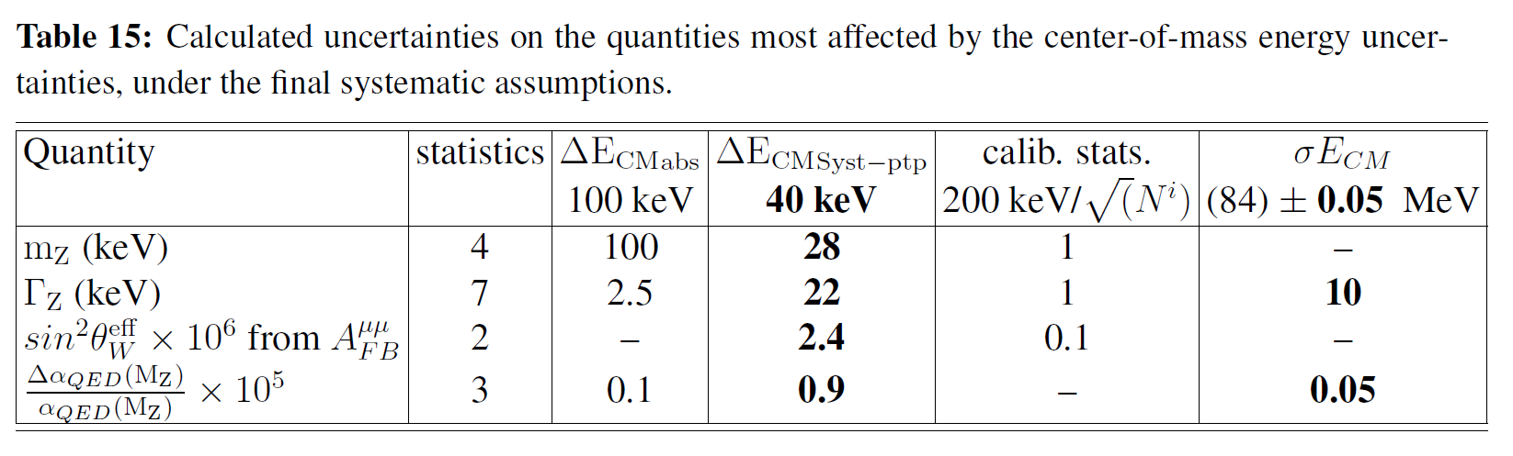
Assigning energy shift errors to absolute or point to point (recap from arXiv:1909.12245)
the point-to-point uncertainty dominates the physics output. It can be controlled in two ways
1. compare the momentum as measured with the polarimter spectrometer between different
energies (monitored constantly at each energy)
➔ Magnet must be very precisely monitored (<10-6) and dedicated monitoring of the main beam after the collision and magnet should be discussed.
this requires dedicated design of polarimeter
2. use the e+e- → μ+μ- events in the detectors to measure ECM for each of the energies.
➔ monitor experimental magnet to (<10-6) precision + QED issues etc..

Slide 31
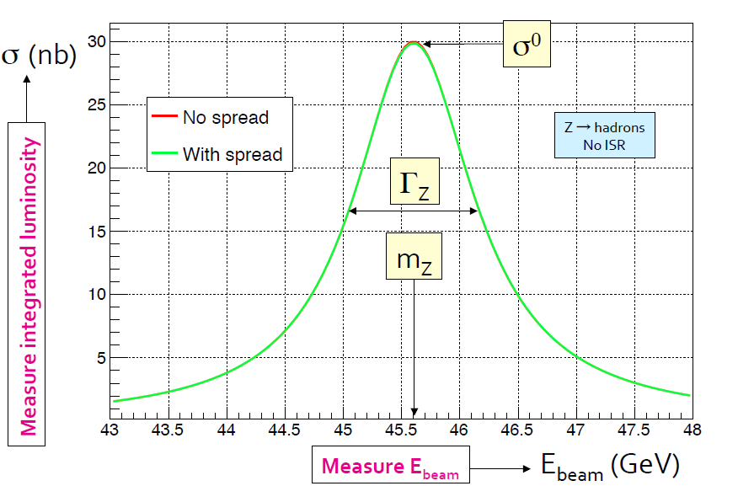
Assigning energy shift errors to absolute or point to point
For the Z line-shape measurement (and for asymmetries)
the point-to-point errors dominate.
The above error estimates O(20 keV) are really applicable for the Absolute Scale Uncertainty. (in addition to error in
RDP→ Ebeam, for which this analysis need to be done too)
The point to point errors are normally much smaller.
➔ keep the running conditions and calibration methods IDENTICAL (as much as possible)
for the (typically 3 or 3 groups) of data taken
below at and above the Z peak (88,91,94 GeV E_{cm})
Typically:
statistical errors → point-to-point
Method uncertainties → absolute scale

Slide 32
Conclusions : progress, and way forward
We have outlined the main methods and excellent potential precision for the control of energy shifts
It is too early to give new estimates but aim to give new values with significant improvements for the Feasibility Study report.
Progress is ongoing
ENERGY LOSSES
-- the boost measurements in the experiments basically provide measurements of the energy losses at keV levels on daily basis. Uncertainty anlysis to be made including impact of beamstrahlung.
Alignment of inner vs outer central detector to ±0.1 microns is required for 4 keV boost measurement. dimuons? Cosmics?
Collision offsets x OSVD
-- vernier scans and beam beam deflection measurements provide collision offsets and IP dispersion measurements
at 20 keV level every time a dispersion measurement is made.
-- new LCAL BPM is a real jewel
-- many questions remain e.g.
-- feasibility and reliability of full charge pilot bunches as reference (impossible, needs to reduce the current.
-- OSVD measurement on colliding beams? resulting beam beam collision offsets in all four experiments at once.
need to design method and knobs and simulate it!
Beam beam transverse attraction
-- beam-crossing angle measurement when bunch charges are increased measures what we need (stability issues?)
Point-to-point uncertainties
These effects will not generate large point-to-point errors provided running conditions are kept identical for the scan points
They will contribute to absolute energy scale error. All experiments should measure the same Z mass!

Slide 33
