Slide 1
Local chromatic correction Arc & Final Focus
7th FCC Physics Workshop
Annecy, January 31st, 2023
Kevin André, Pantaleo Raimondi
SLAC National Accelerator Laboratory

Slide 2
Local Chromatic Correction Optic
LCCO based on the development of optics solutions that allow/rely on chromatic and harmonic corrections as
local as possible. This has led to the development of:
HFD ARC lattice.
The lattice has been optimized by introducing a “beta&phase-modulation” and relies on 4 sextupole families
that results in a second-order achromat and nearly anharmonic lattice. The lattice is periodic over 5 Hybrid-FODO cells.
The optimized phase advance for ttbar operations is about 100/74.
A weaker lattice that utilizes all the ttbar magnets that has a phase advance of about 51/44 is achromatic and
anharmonic as well. It is considered to be used for Z operations and all modes that require a large
momentum compaction.
Both lattices have a MA in excess of +/-3%,
Long Straight Section (LSS) matching.
The insertion of the straight sections is performed by requiring the “Transparency Conditions”.
This allows the virtually transparent insertion of any SS in a Ring, without any significative degradation of
Its characteristics (DA/MA, detuning etc), neither requiring the introduction of sextupole families.
The TCs can be applied for any given SS, provided that 4 quadrupoles/side are available to match the conditions.
Final Focus (FF).
LCCO requirements are fulfilled by correcting the low-beta IP chromaticity in the FF in both planes and nearly entirely.
LCCO also results in the need of placing the Crab sextupoles in a nearly “chromatic-free” region: the FF outer ends.
This solution has been developed for the SuperB and has been adopted by CEPC as well.

Slide 3
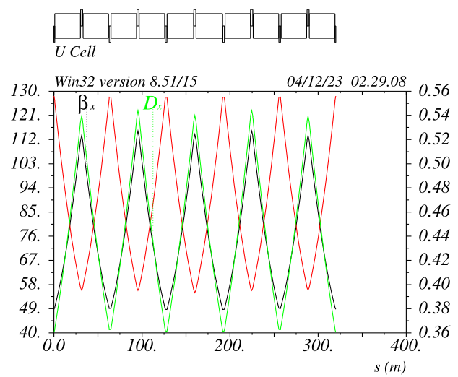
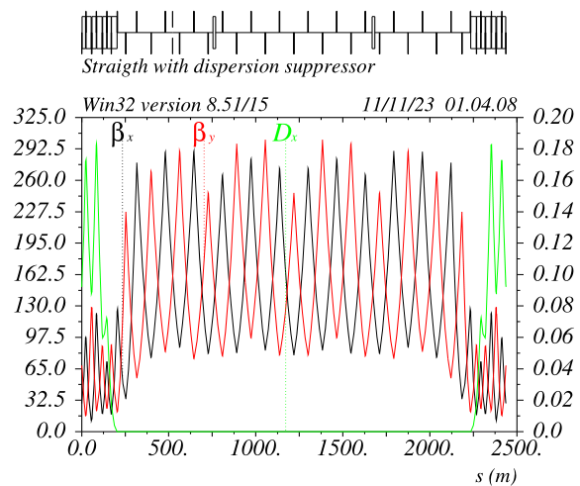
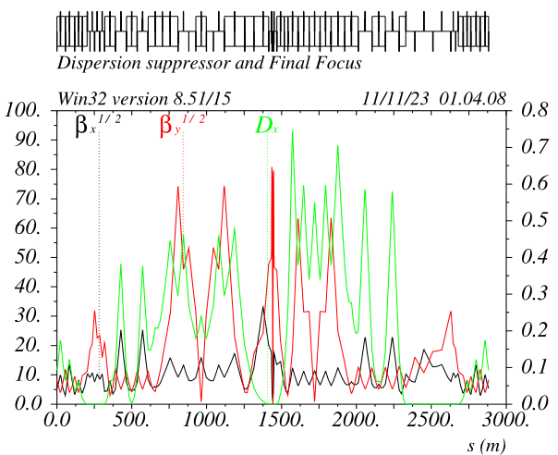
Ring layout v_74 ttbar
V_74 optic matches the baseline layout:
- LSS 2032m long as baseline
- ARCs bending radius as baseline
- FF section length set to match overall ring circumference: 90658.609m (tunnel length 90657.609)
Specialized LSS optics (injection, collimation, RF) presently not included.
30 cells/octant
4 Long Straight Sections
4 Final Focus systems
*In the following ttbar case only will be shown

Slide 4
HFD_51/44 Z mode
Given the additional degree of freedom from
the 2 additional sexts families, good tunes working points do exist almost continuously.
HFD_51/44 delivers:
Ex = 0.70nm Alphac =3.30e-5
(Ex = 0.69nm Alphac =2.94e-5 for full ring)
Muy has been chosen as best compromise between
chromaticities, detunings and sensitivitiy to collective effects.
Peak betas are very similar to the HFD100/74
(Long9090 FODO has twice larger betas wrt Short9090)
HFD100/74
HFD51/44

Slide 5
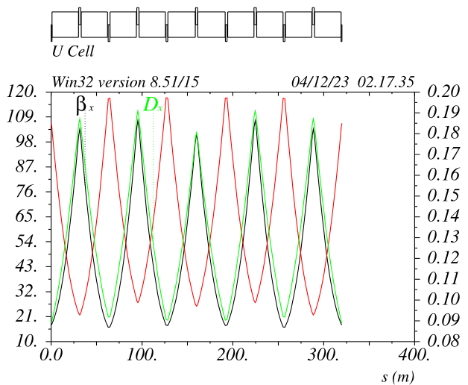
HFD_100/74 tt mode
Given the additional degree of freedom from
the 2 additional sexts families, good tunes working points do exist almost continuously.
HFD_51/44 delivers:
Ex = 0.70nm Alphac =3.30e-5
(Ex = 0.69nm Alphac =2.94e-5 for full ring)
Muy has been chosen as best compromise between
chromaticities, detunings and sensitivitiy to collective effects.
Peak betas are very similar to the HFD100/74
(Long9090 FODO has twice larger betas wrt Short9090)
HFD100/74

Slide 6
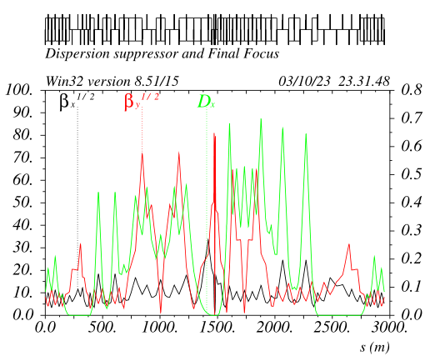
Local Chromatic Compensation FF asymmetric layout ttbar optics
The FF geometry is adjusted in order to recover entirely
the beams separation. Dipoles ARCs modification is not necessary.
Beams start to split @300m and are back @2300m
(Present separation in the ARCs is set to 40cm)
CCsX_Left section is short and has “strong bends”
CCsY_Left section is long and has “weak bend”
CCsY_Right section is short and has “strong bends”
CCsX_Right section is long and has “weak bend”
Details in next slides

Slide 7
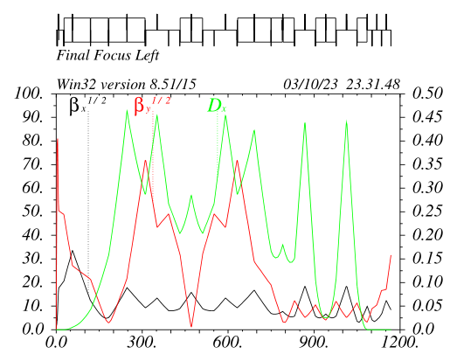
Left Final Focus ttbar optics
Last 3 dipoles EC~130KeV
CCsY optics has the largest dispersion (so far) for a given bend angle in the –I, presently Dx=0.303m@SDs
“Standard” non-linear optimization is performed as usual
Betas&Alfas at IP-phase sextupoles are optimized to reduce the DA reduction from Crab sextupoles
CCsY/X_L/R lengths and ratio between their total bend angles are optimized to have maximum dispersion on CCsY_Left and minimum overall emittance growth and radiation
CCsY sextupoles (0.6m long) are very weak Ks_madx~0.7 @ttbar, Ks~0.9 @Z. In fact ARCs sextupoles can be used in the FF as well

Slide 8
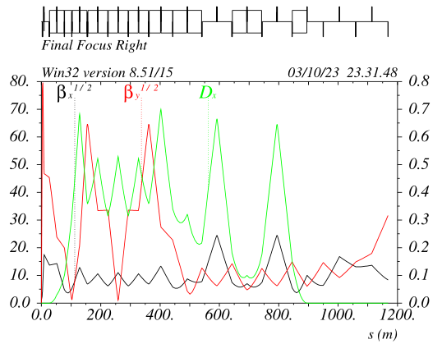
Right Final Focus v_67 ttbar optics
All dipoles in the CCsY have same field, best configuration to recover the beams separation
CCsY optics has the largest dispersion (so far) given the above requirement in the –I, presently Dx=0.370m@SDs
“Standard” non-linear optimization is performed as usual
CCsX has been shortened and pushed back, helping to recover the geometry. Incidentally this has originated a very long dispersion free straight section, ~400m when included the ARC DS part
Two drift sections about 100m long are also present in the CCsX “-I”
Alfay in the CCsX_LR is not zero to symmetrize the FF_LR nonlinear optics

Slide 9
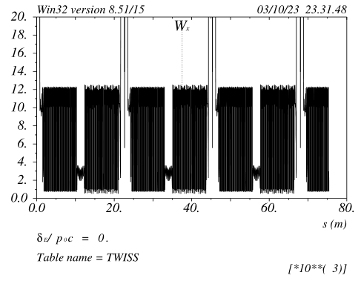
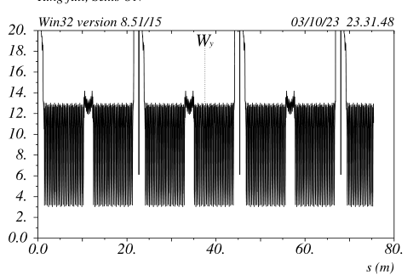
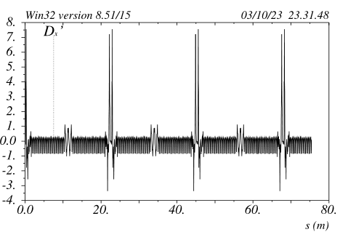
Full ring chromatic properties ttbar optics
Chromaticity in the ARCs is periodic and about 12 in both planes
This is extremely beneficial to reach and maintain top performances in a very short time
No sextupole families are needed.
Because the “Full Achromat” FF property, there is no need to change the ARCs&FF sextupoles (and CS) settings when the beta-squeeze is done with the beta-matching quads This is extremely beneficial to reach top performances, it will be extremely useful to level the luminosity on the 4 IPs as well.

Slide 10
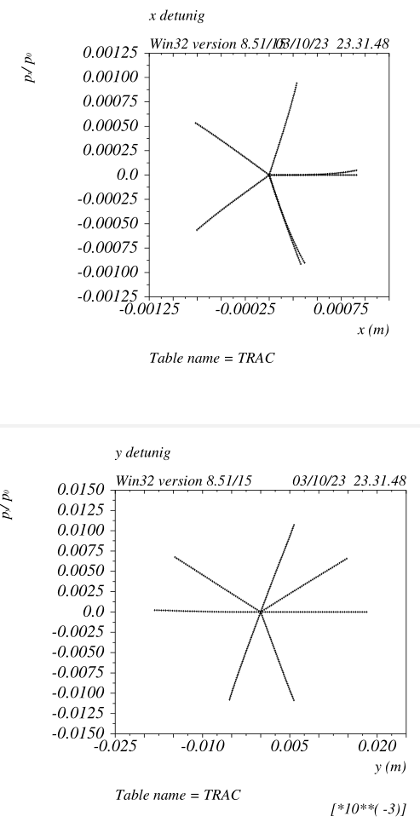
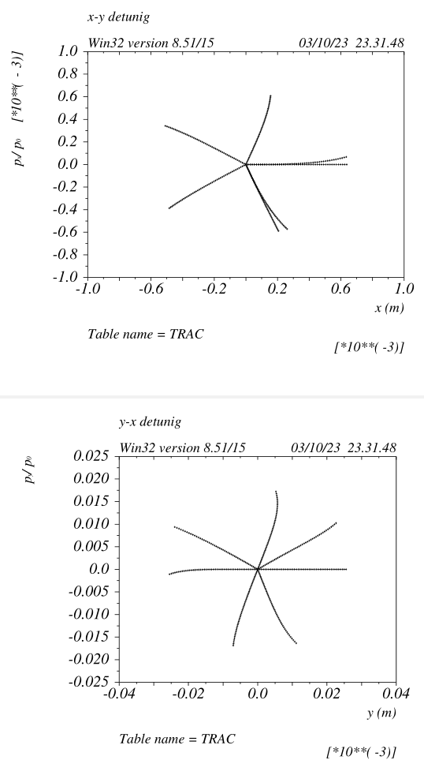
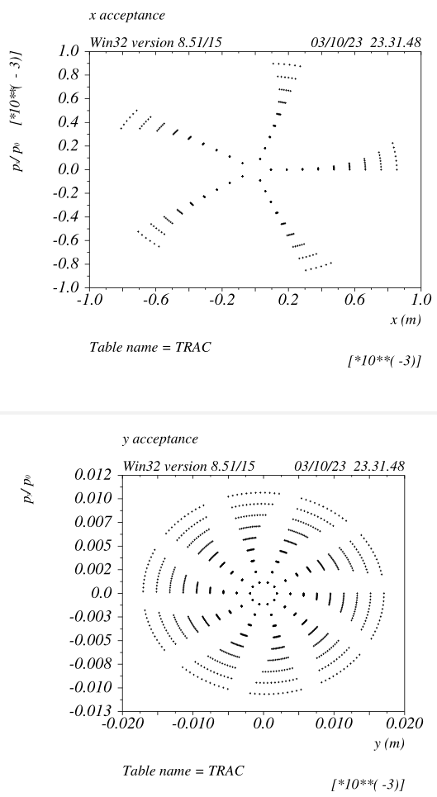
Full ring transverse DA v_67 ttbar optics
On-energy dynamic is linear.
“Resonances” are virtually not existing.
Extremely favorable dynamics to minimize beam-beam degradation (DS)
The quest/dream for a “quasi”
time-independent trajectory is
at reach!

Slide 11
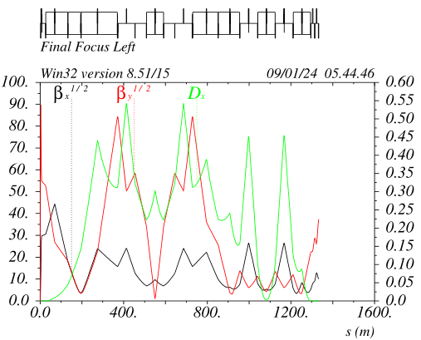
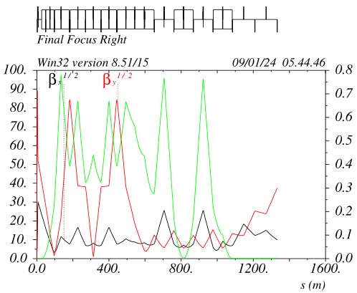
Cancelation of the Energy dependent Y & XY detuning with decapoles
The trick adopted is to use the Left and Right decapoles pairs to cancel “globally” the detuning:
FFL&R instead of FFL and FFR individually.
CCSy_Left decapoles are negative and cancel de_xy_detuning
CCSy_Right decapoles are positive and cancel de_y_detuning
CCSx_L&R decapoles are positive and cancel de_x_detuning
Betax/y@CCSyL/R are set to maximize the decapole effectiveness:
CCSy_L: betay=7100m, betax=250m dx=0.30m K4L_DECDL ~ -2200
CCSy_R: betay=7100m, betax=65m dx=0.40m K4L_DECDR ~ +3000
CCSx_L&R betay~30, betax~650 dx~0.60m K4L_DECFL&R ~ +500
Given the very high order of the aberration the decapoles pairs are very orthogonal
The transverse (mainly vertical) residual nonlinearities of the CCSy decapoles are
canceled altogether because the opposite sign of the Left/Right ones.
The are no side effects on the DA and on on_energy detunings
The third order chromaticity is weakly effected, this result in a small change in the
IP_phase sextupoles settings. Makes the x-IP_phase_sextupoles 10% weaker

Slide 12
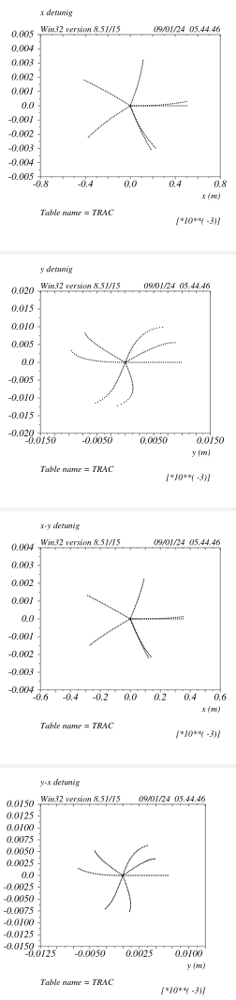
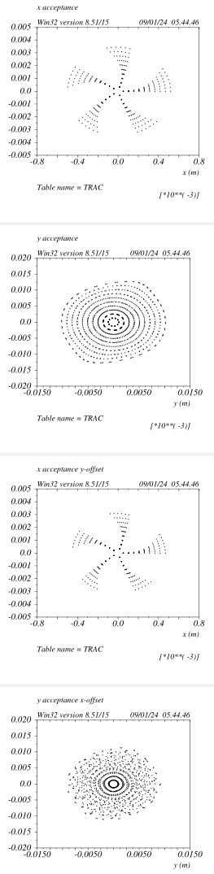
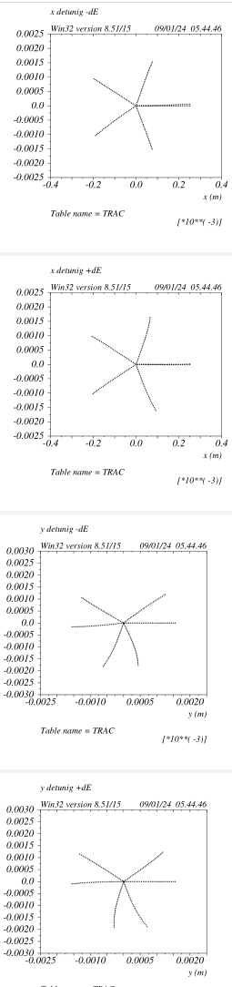
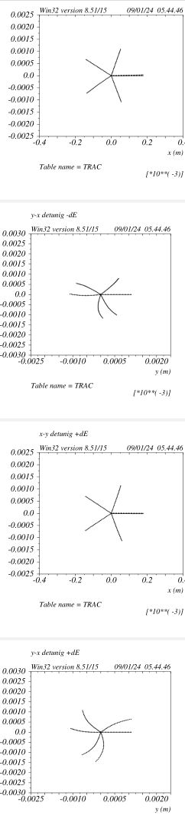
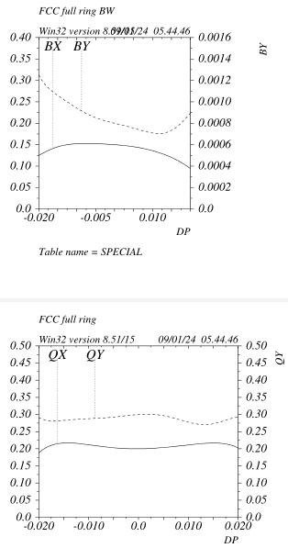
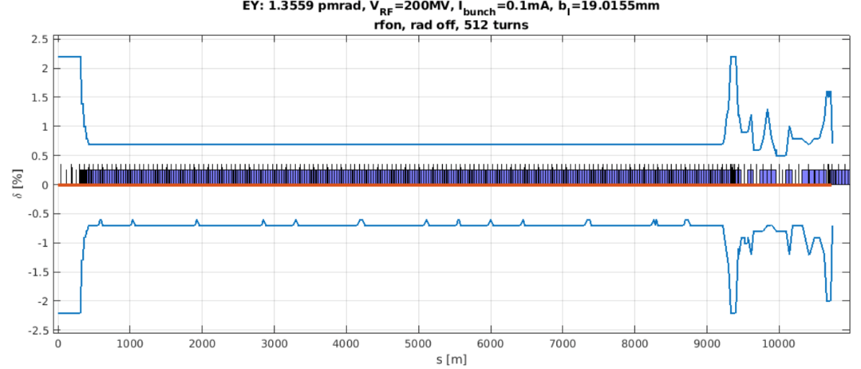
Beam dynamics: v_89
Vertical phase space deformation due
to the decapoles L/R asymmetry
On energy detuning 100 turns tracking
Off energy detuning de=+/-0.2%
Bandwidth around +/-2.2%
Local momentum acceptance

Slide 13
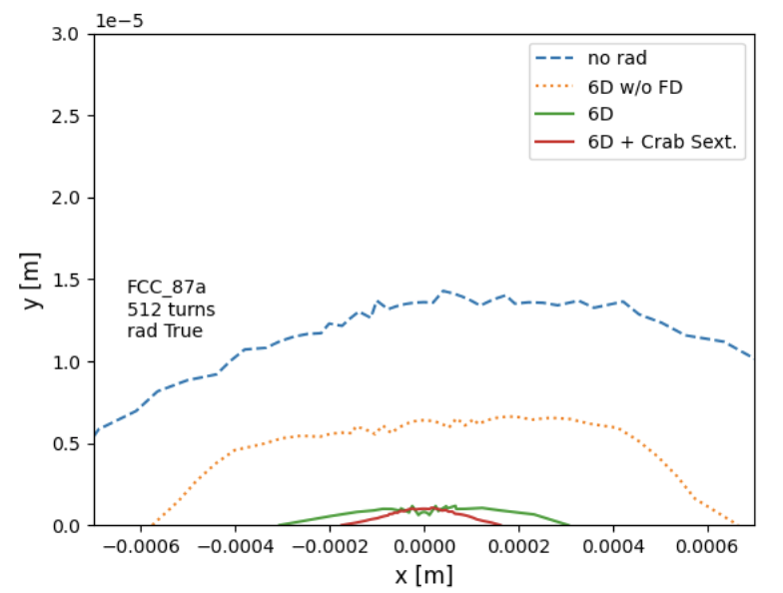
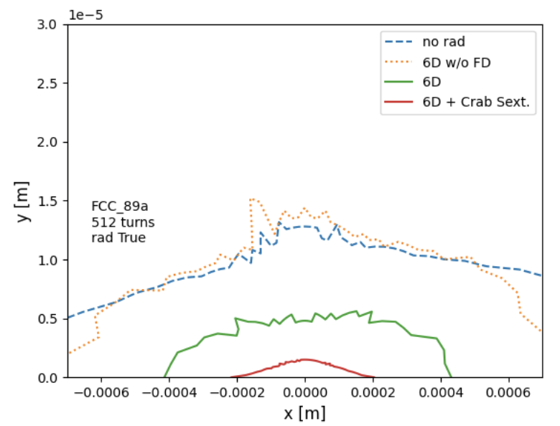
Dynamic aperture without and with SR
v_87 no decapoles
v_89 with decapoles
The effectiveness of the decapoles is evident.
This is probably the first time that the degradation due to the quadrupoles-SR and
FD-SR in particular is very effectively addressed.
S. Liuzzo

Slide 14
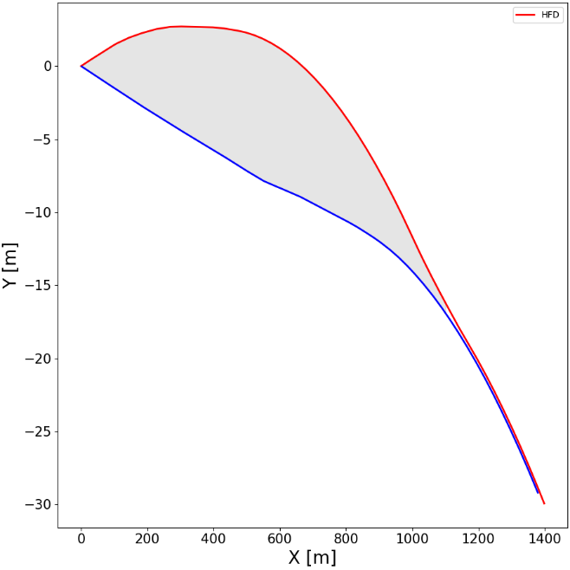
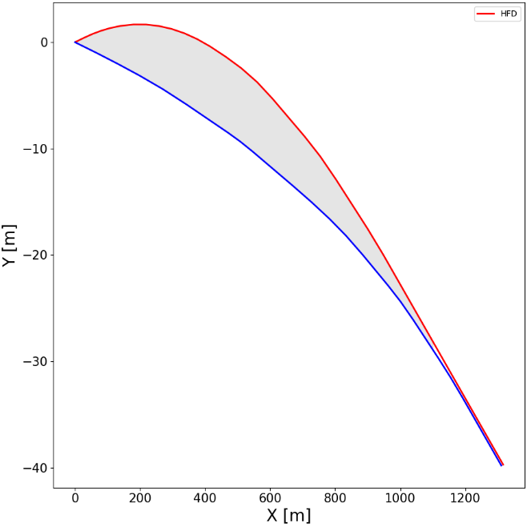
FF layout v_89
IP offset wrt to baseline is around 11m
There are no reverse bends thus simplifying the SR radiation handling for the distributed absorbers
The stronger dipoles are in the CCSy_R just downstream the IP, they are anyway about 10% weaker wrt the ARCs ones.
The “Soft bend” upstream the IP is about 230m long and has an Ec~130KeV @ttbar
Overall the ratio FF_Eloss/FF_bend_angle is
very similar to the ARC one.
There are no superconducting magnets required except the FD ones (this might change if some zero-leakage quadrupoles are needed). FF sextupoles@ttbar have k_values around 1 (1.5@Z) and are 60cm long.
FF quads are shorter and weaker wrt ARC’s
Baseline: area 6640m2
Max separation 9.6m
LCCO: area 4960m2
Max separation 7m

Slide 15
ARC layout Z and ttbar mode
The arc is a standard FODO sequence with two missing sextupole for every 10 quads.
BPMs are placed at each sextupole location (between sext and quad)
The sextupoles are the ones presently designed and the foreseen trimming coils are all what is needed for orbit and optic correction.
Sextupoles are 0.40/0.50m long, power consumption is < 5MW
Quads are 2.4/1.8m long and should consume about 5Kw each, 2240 per ring are needed => 23MW@ttbar
Dipoles are about 29.6m Long
In the case of HTS option the sextupoles are wrapped around the quadrupoles.
In principle by shifting the arc longitudinally by 30m, the QF will overlap with the QD, it then could
be possible to use a 1.8m twin quad + a 0.6m QF on one side only. I think that the cons of this
option greatly exceed the pros, nevertheless it should be mentioned.
Another option is to have an about gradient in the dipole (-0.4T/m 2/3 of the length, 0.4T/m 1/3)
In this case the QDs will be halved in length and the QF reduced by 25% => ~15MW power
Dipoles will be trickier to make and consume more power, a quick check should be done anyway.

Slide 16
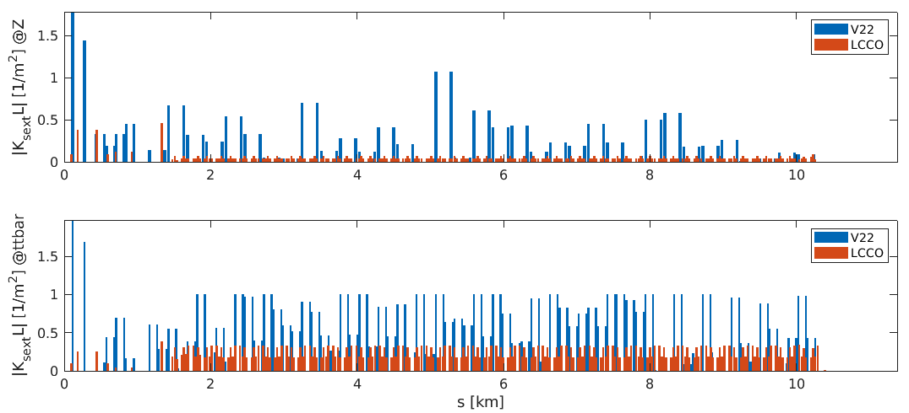
Sextupoles gradients (1 octant) Z and ttbar modes
904 m
773 m
Crab Sextupole
Outgoing FF CCSy sextupoles
3506 m
773 m
Smaller sextupole gradients ➔ Usually better performances.

Slide 17
Some LCCO highlights
ARC tuning nearly identical to the EBS one (highest energy ring with lowest horizontal emittance existing so far)
FF tuning knobs are very standard and can be built accordingly to the SLC/NLC/LEP ones
Large orthogonality of many fundamental quantities, that can be varied separately with no need to retune other quantities:
- ARC chromaticities
- Machine tunes
- FF chromaticities
- Individual IP betas
- Individual CS pairs
- Local FF tuning knobs
All requirements on tolerances and stabilities for LCCO are very relaxed (M. Hofer, S. Liuzzo).

Slide 18
Summary (1)
The LCCO beam dynamics is extremely well understood and optimized
The understanding of the quads SR on beam dynamics has lead to unprecedented means to mitigate the related DA deterioration. This will be potentially even more beneficial to the higher energies operation.
DA/MA exceeds the baseline.
There is only one very well identified aberrations that makes the CS detrimental to the DA. The reduction of this effect seems possible.
Hardware requirements for LCCO are much less demanding and are being assessed (as requested by G. Roy)

Slide 19
LCCO: Local Chromaticity Correction Optics
HFD: Hybrid FoDo
SS: Straight Section
FF: Final Focus
FD: Final Doublet
CCS: Chromaticity Correction Sextupole
CS: Crab Sextupole
DA: Dynamic Aperture
MA: Momentum Acceptance

Slide 20
Summary (2)
LCCO includes all the know-how and experience acquired in designing, building, commissioning and operating most of the high-energy and high-luminosity linear and circular colliders that have been operating in the past 30 years.
Many innovative solutions developed in the very active (and forefront) Synchrotron Radiation Accelerator community are utilized as well
LCCO hardware requirements are in line with standard (and cheap) solutions adopted for most of the colliders built so far
LCCO is an invaluable opportunity to further progress in Accelerator Physics and push forward the frontier of High Energy Science

