Slide 1

The CTA+ Italian Program to complement the Cherenkov Telescope Array Observatory South Site
C. Aramo¹ for the CTA+ Program, CTA-LST Project and CTA Consortium
¹ INFN – Sezione di Napoli email aramo@na.infn.it
XIII International Conference on New Frontiers in Physicsi
Missione 4 • Istruzione e Ricerca

Slide 2
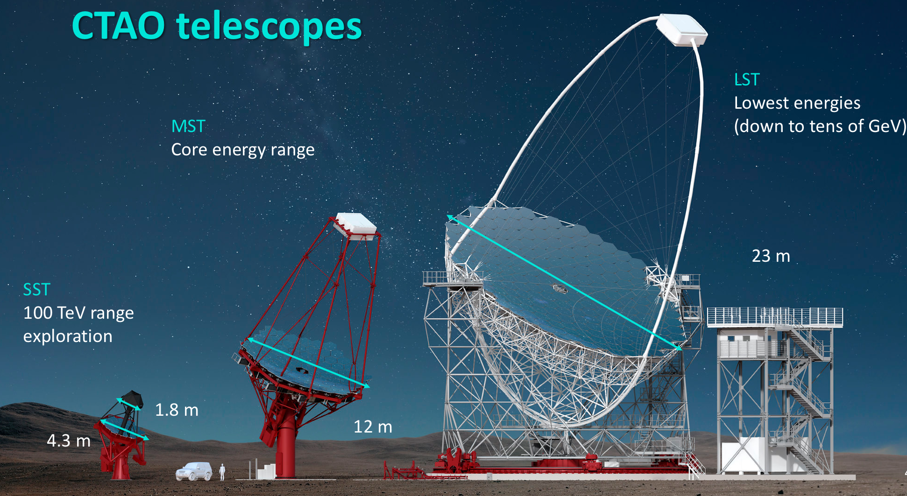
CTAO: next-generation Cherenkov Telescope Array facility
Originally envisioned: ~ 100 telescopes of 3 different sizes
Alpha configuration (defined 2022): 64 telescopes
Expected to improve sensitivity by ~ factor 10 compared to existing facilities (H.E.S.S., MAGIC, VERITAS)
Extend energy coverage:
~ 10 GeV - >100 TeV
Alpha configuration expected to be fully operational ~ 2028-29
Missione 4 • Istruzione e Ricerca
Missione 4 • Istruzione e Ricerca
Notes:
The CTAO is the world’s largest and most powerful ground-based observatory for gamma-ray astronomy at very-high energies.
Exploring the universe at the highest energies
To improve our ability to capture gamma rays and to have a full view of the night sky, the CTAO will host more than 60 telescopes on two sites – one in the northern hemisphere and the other in the southern hemisphere.
The CTAO will provide a very wide energy range and excellent angular resolution and sensitivity in comparison to any existing gamma-ray detector.
To make this possible, 3 classes of telescopes are being developed, covering CTAO’s broad energy range

Slide 3
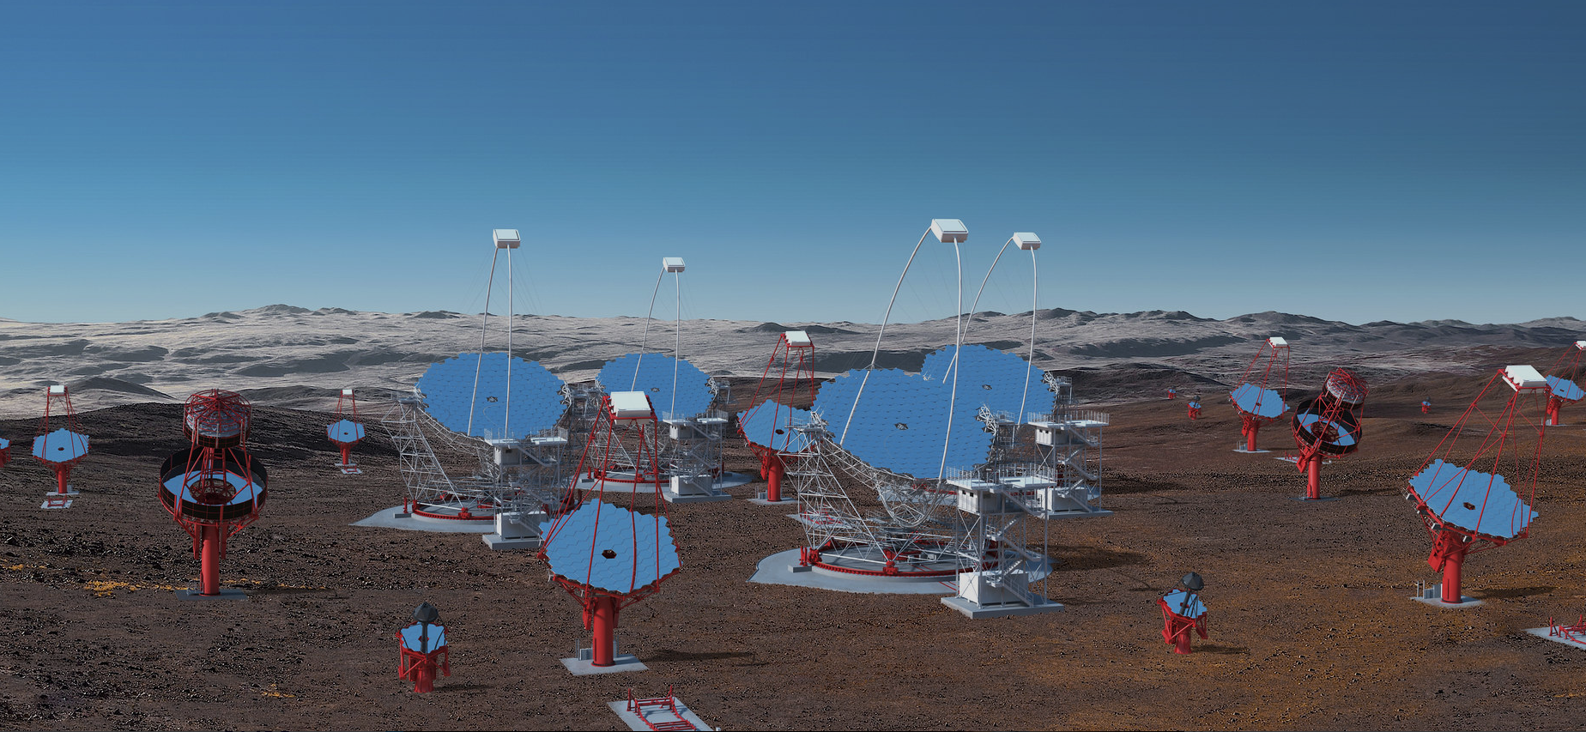
Large-Sized Telescopes (LSTs): 23 m Ø; PMT camera; 1855 pixels; 4.3° FoV
Mid-Sized Telescopes (MSTs): 11.5 m Ø
PMT camera with 2 designs
NectarCAM 1855 pixels
FlashCam 1764 pixels; 8° FoV
Small-Sized Telescopes (SSTs): 4.3 m Ø SiPM camera; 2048 pixels; 8.8° FoV
Missione 4 • Istruzione e Ricerca
Missione 4 • Istruzione e Ricerca

Slide 4
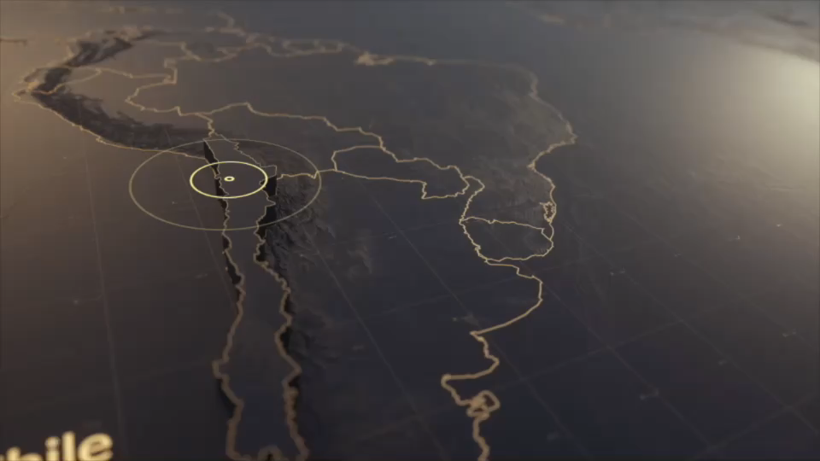
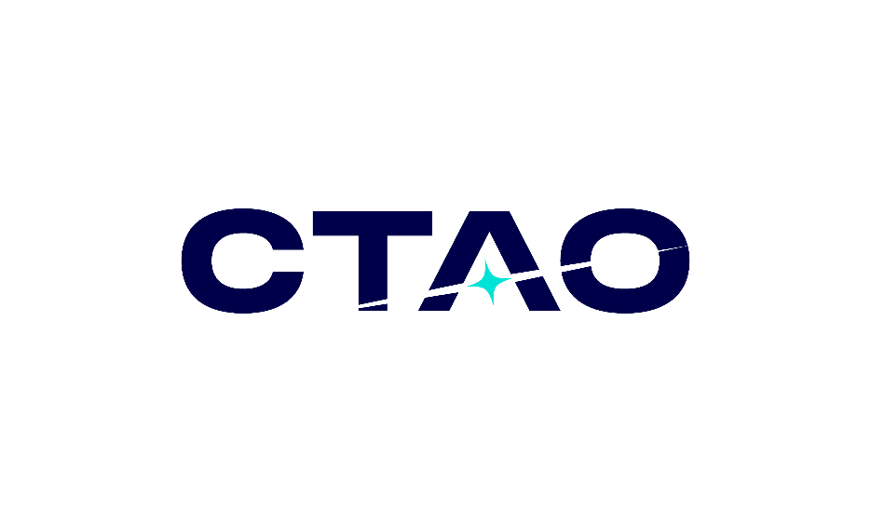
2 Sites
Missione 4 • Istruzione e Ricerca
Missione 4 • Istruzione e Ricerca

Slide 5
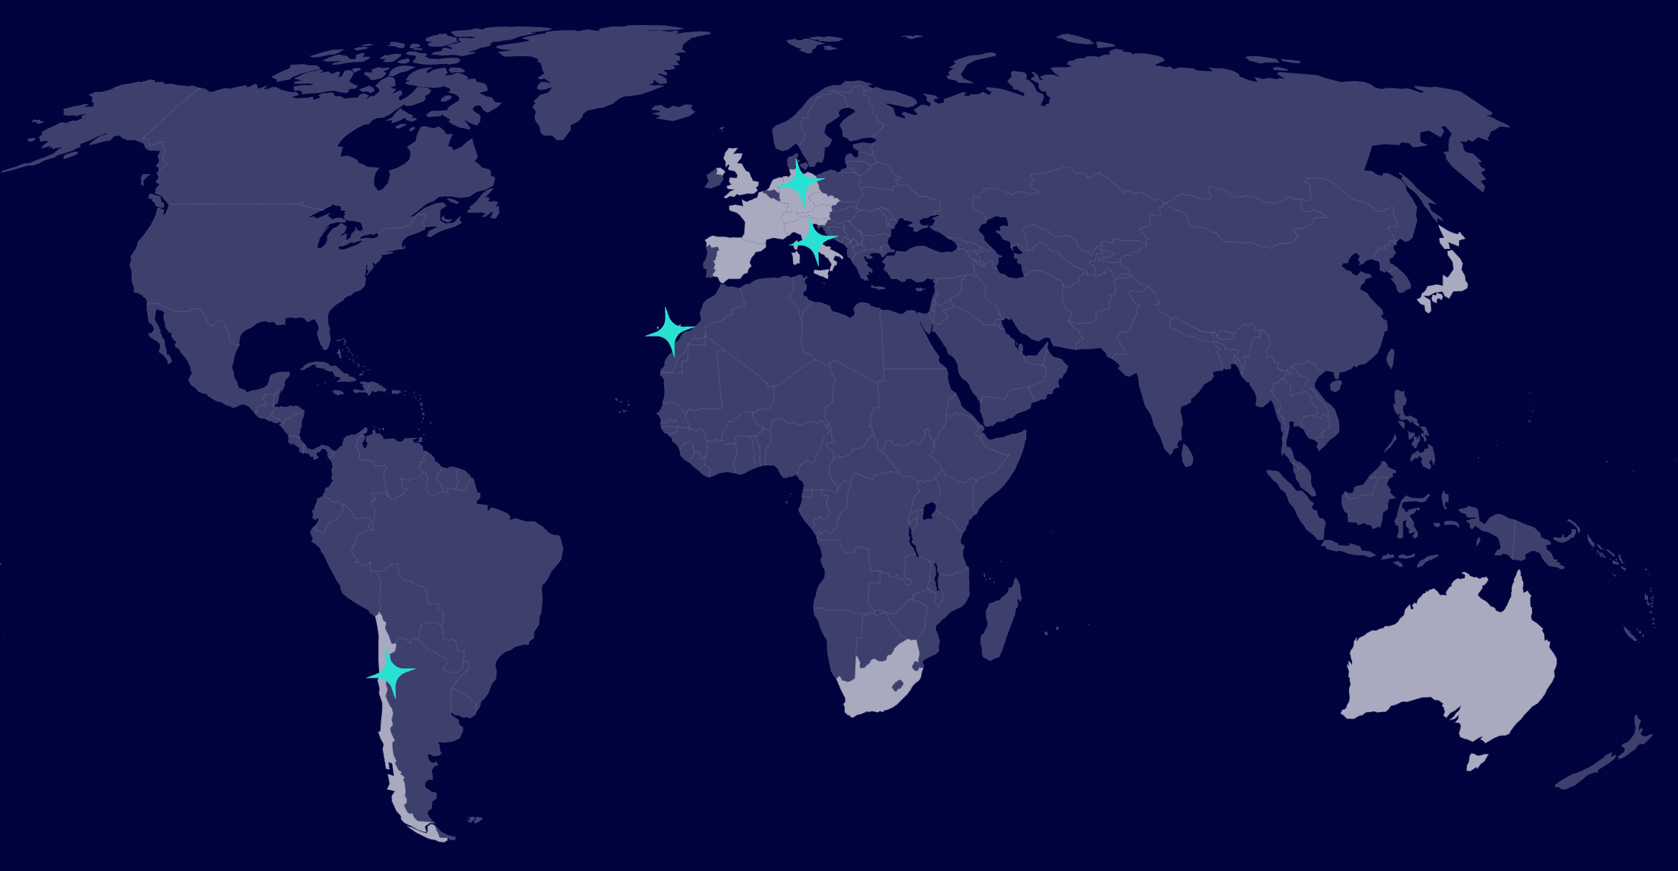
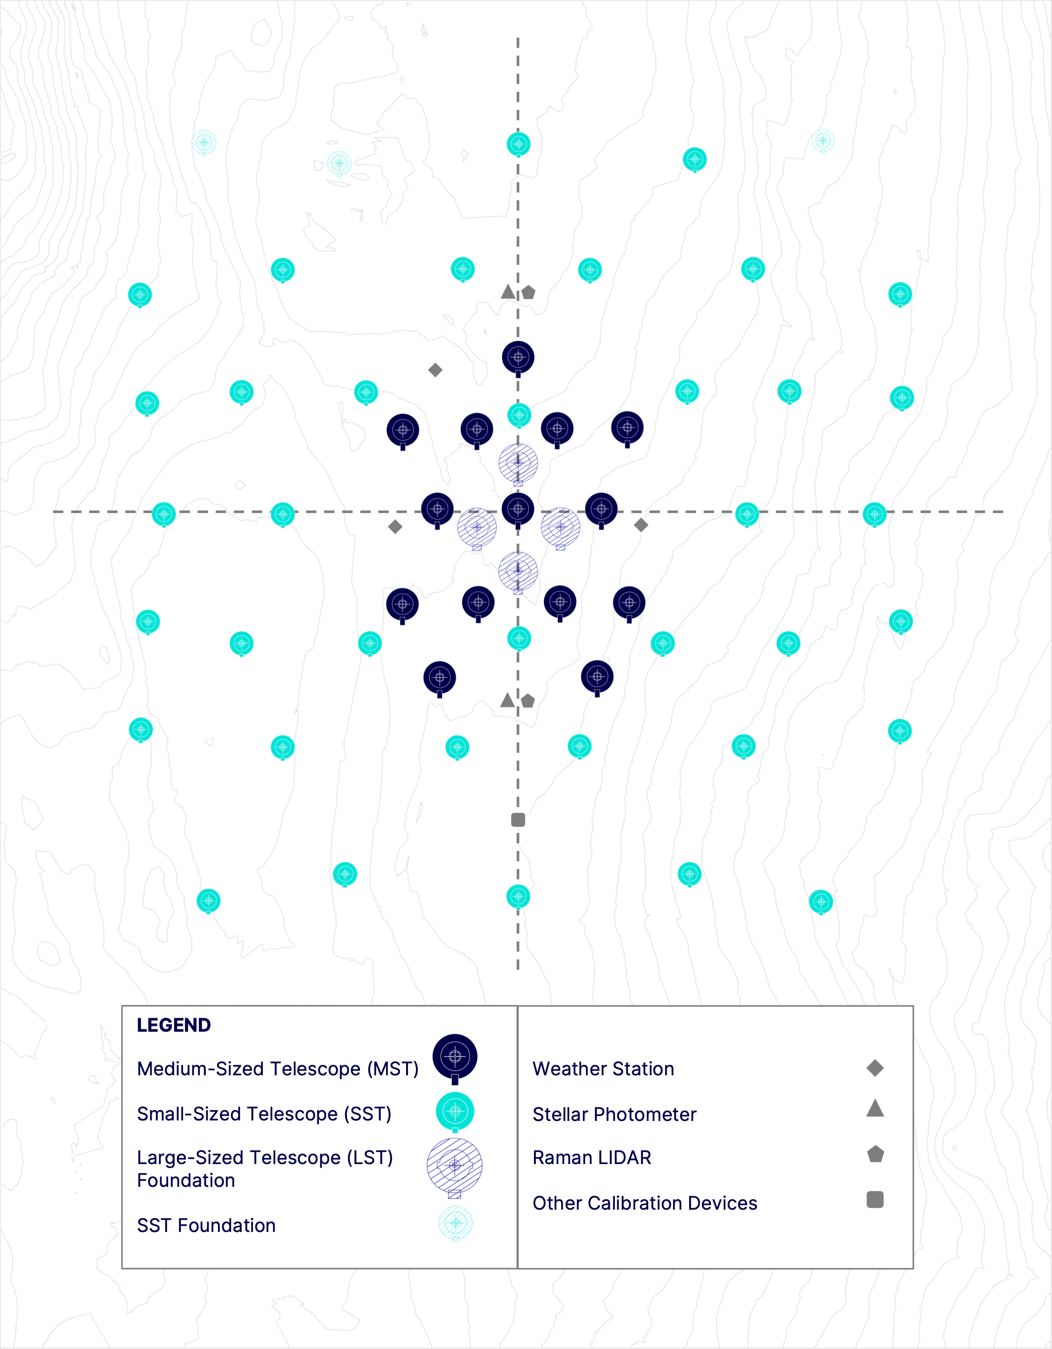
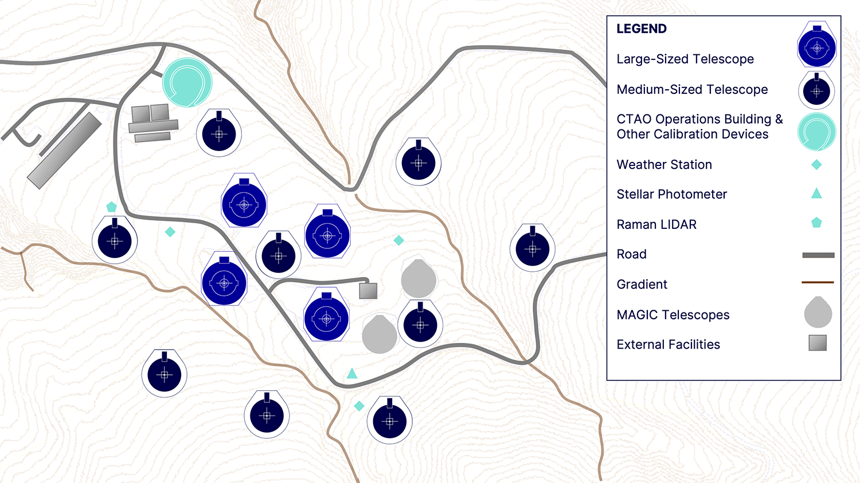
Science Data Management Centre
Zeuthen, Germany
Headquarters
Bologna, Italy
CTAO North
La Palma, Spain
CTAO South
Paranal, Chile
Missione 4 • Istruzione e Ricerca
Missione 4 • Istruzione e Ricerca
Notes:
Two a
CTAO Headquarters (HQ) is located in Bologna -> central office responsible for the overall direction of Observatory operations
Science Data Management Centre in Germany
coordinate operations , manage the CTAO’s computing and science operations coordination
array site locations

Slide 6
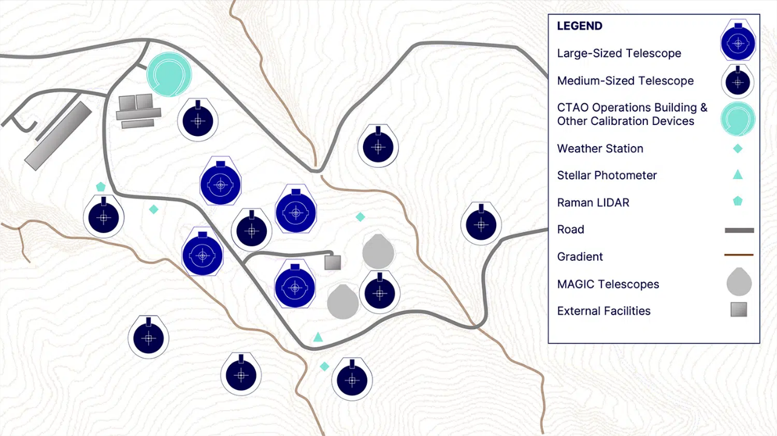
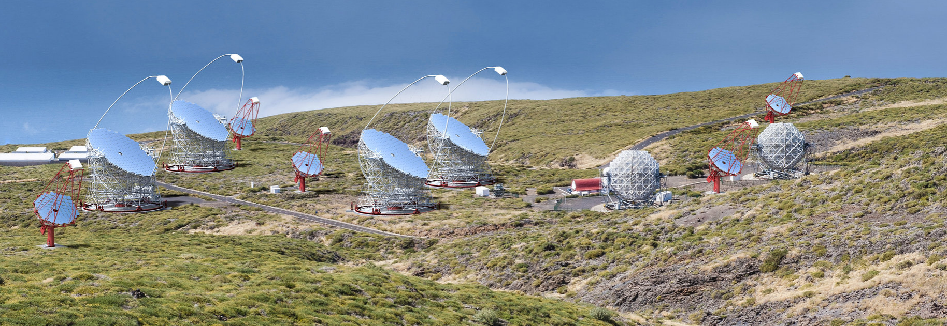
CTAO-North
La Palma, Canary Islands, Spain
Alpha Configuration:
  ~ 0.5 km²
  4 LSTs
  9 MSTs
Missione 4 • Istruzione e Ricerca
Missione 4 • Istruzione e Ricerca

Slide 7
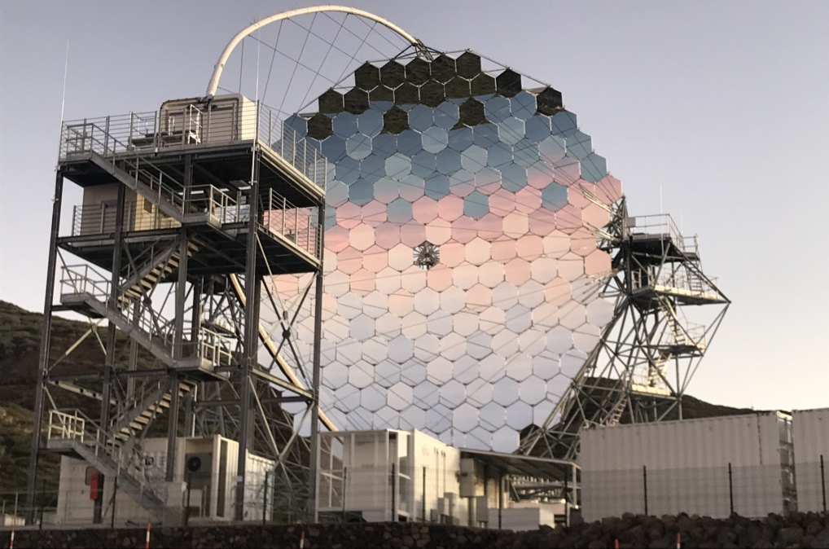
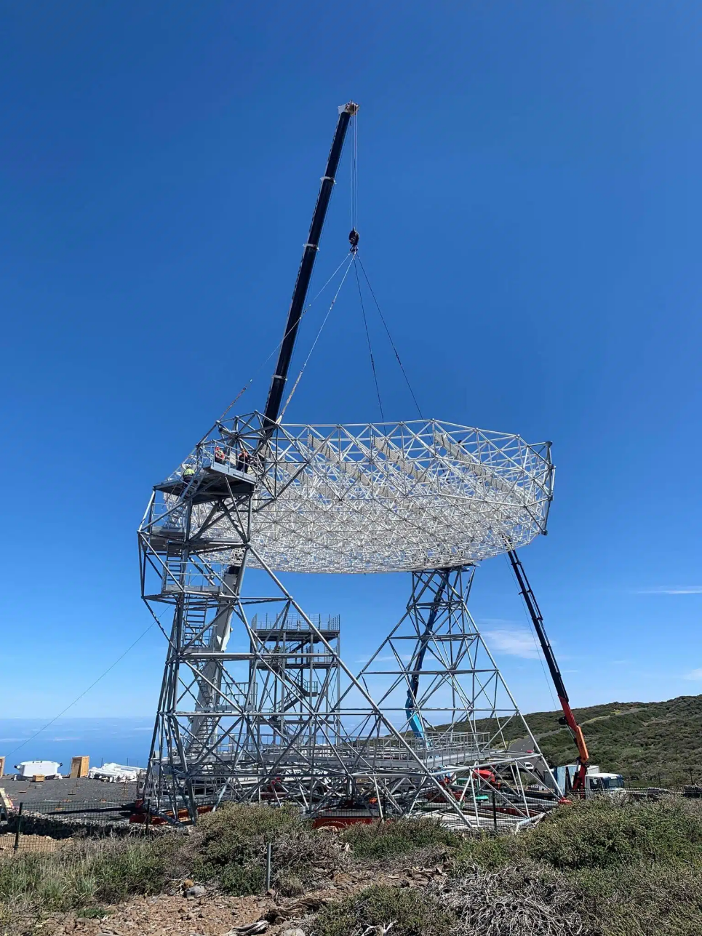
LST-4
CTAO-North
La Palma, Canary Islands, Spain
Prototype LST (LST-1) inaugurated in September 2018
Telescope mounts for LST 2 – 4 mostly completed
LST-4 dish structure lifted into mount in May 2024.
Missione 4 • Istruzione e Ricerca
Missione 4 • Istruzione e Ricerca

Slide 8

Alpha Configuration:
  ~ 3 km²
  14 MSTs
  37 SSTs – NO LST
CTAO-South
ESO (Paranal), Chile
Missione 4 • Istruzione e Ricerca
Missione 4 • Istruzione e Ricerca

Slide 9
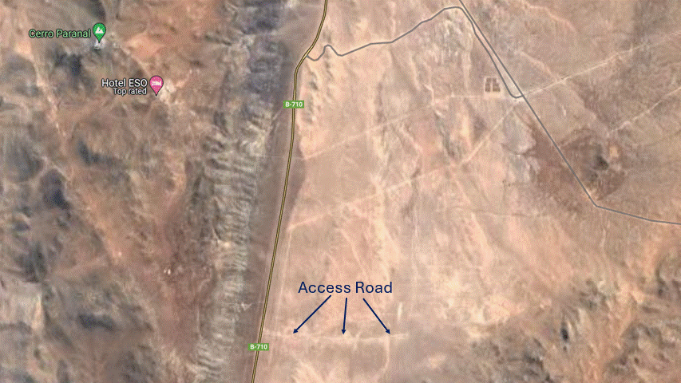
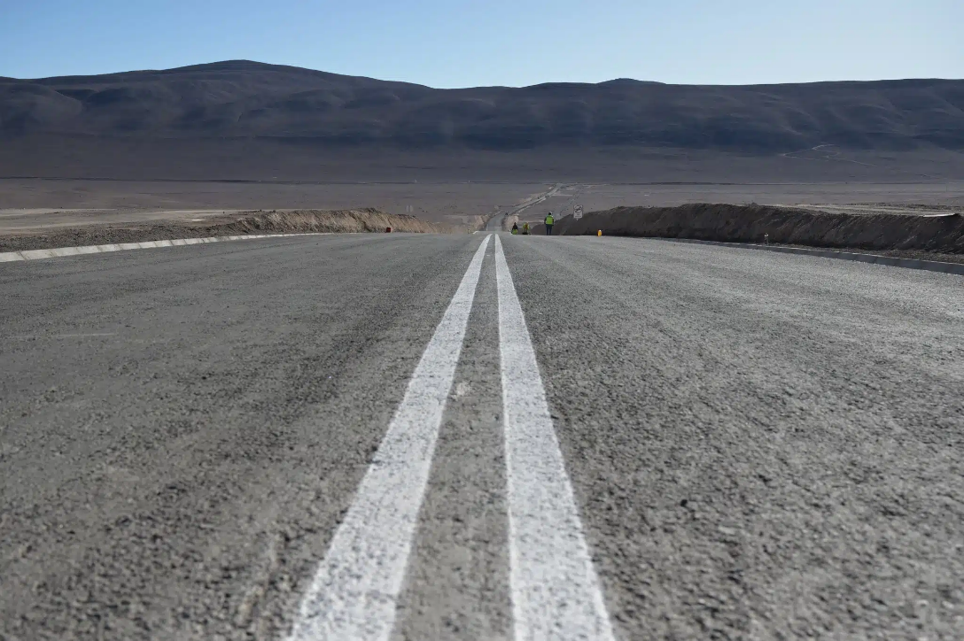
CTAO-South
ESO (Paranal), Chile
First infrastructure (access road, power infrastructure) construction started in March 2022.
Access road completed in 2024.
Missione 4 • Istruzione e Ricerca
Missione 4 • Istruzione e Ricerca

Slide 10
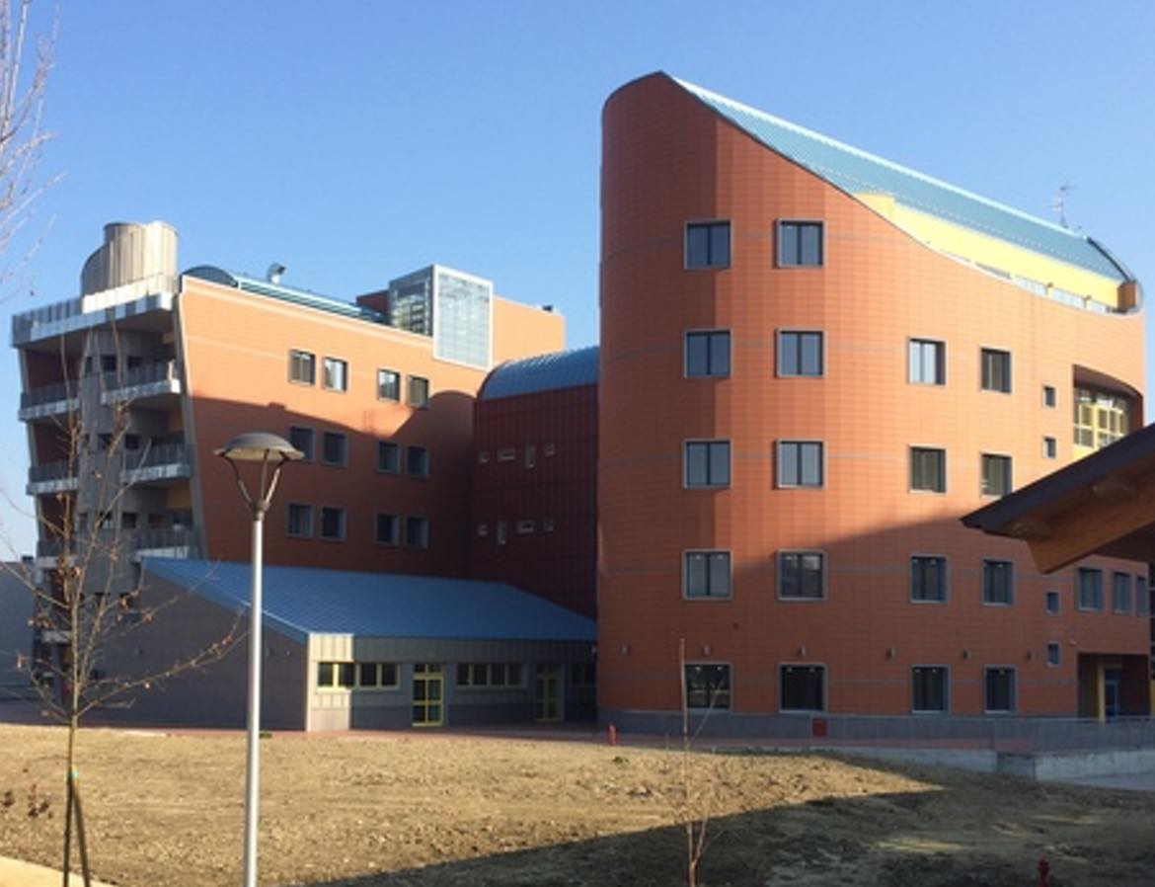
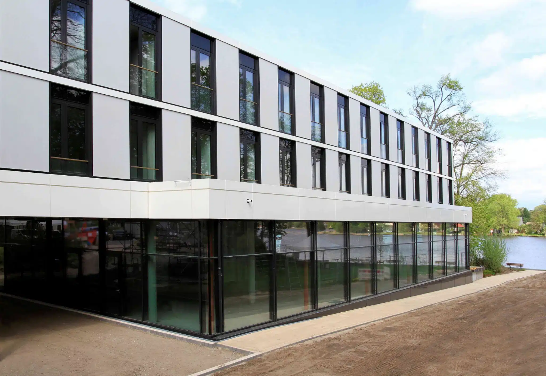
Science Data Management Centre
CTA Headquarters
At DESY Zeuthen (Berlin)
Start of construction: March 2022
Inauguration scheduled for October 2024
Bologna, Italy, completed 2019
Missione 4 • Istruzione e Ricerca
Missione 4 • Istruzione e Ricerca

Slide 11
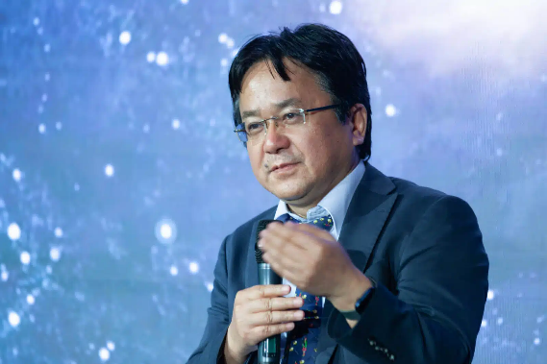
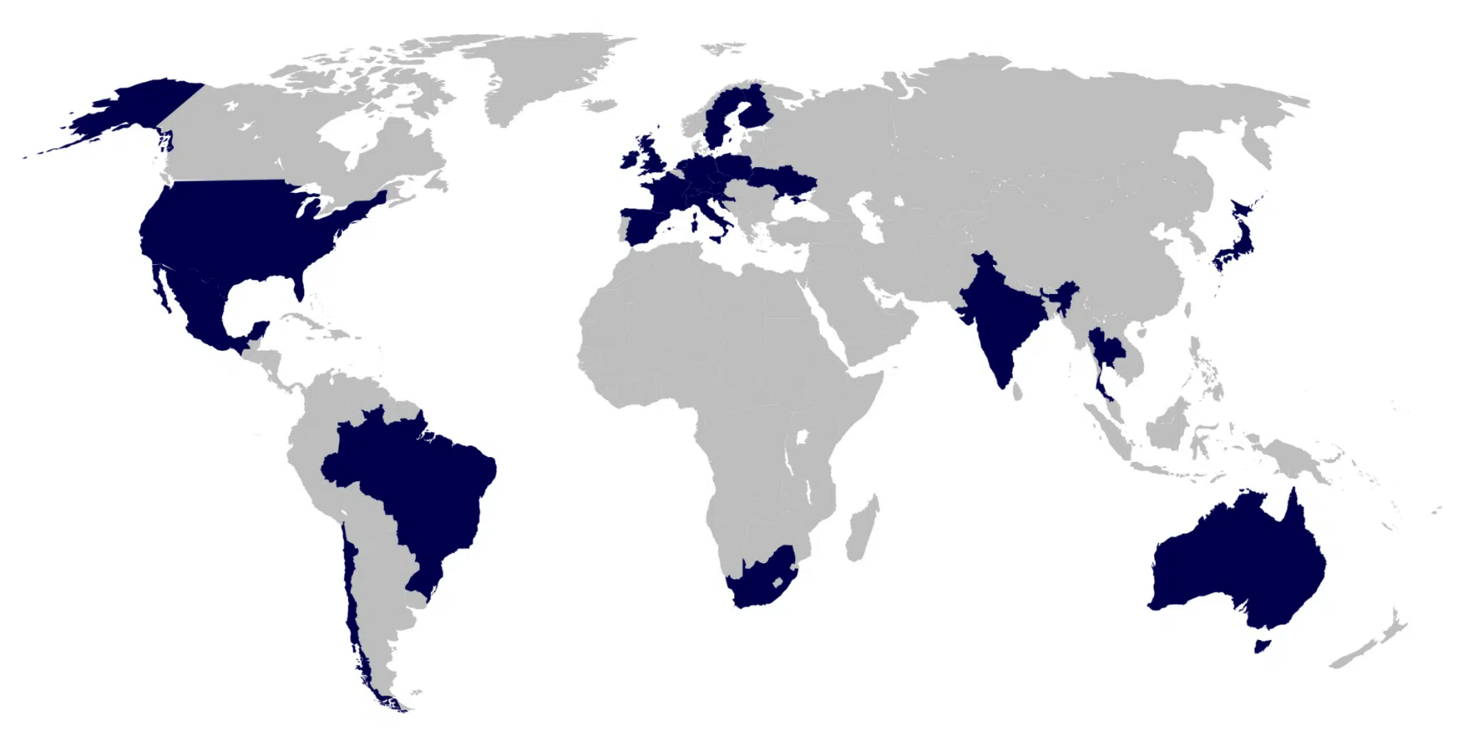
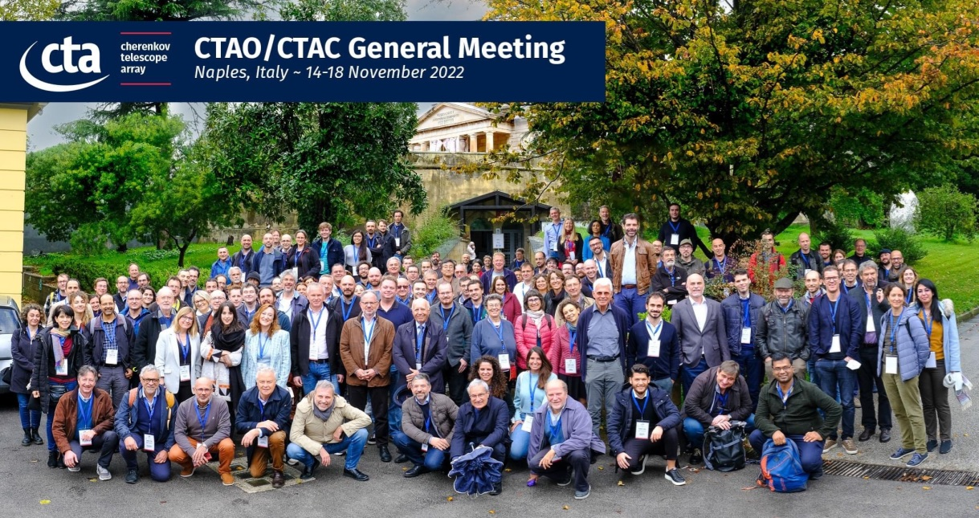
The CTAO Consortium
Masahiro Teshima (Tokyo) recently elected new spokesperson
More than 1400 scientists
~ 200 institutes
25 countries on 6 continents
Missione 4 • Istruzione e Ricerca
Missione 4 • Istruzione e Ricerca

Slide 12
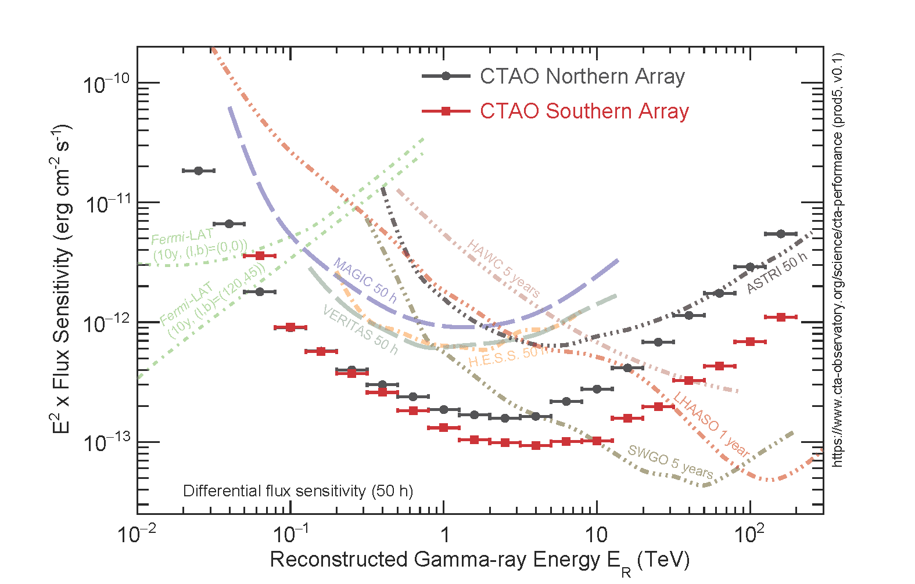
Expected Sensitivity
The first (open) Observatory in the TeV energy range
Missione 4 • Istruzione e Ricerca
Missione 4 • Istruzione e Ricerca
Notes:
The sources the CTAO will study, like supermassive black holes and supernova remnants, are the most energetic objects in the Universe. Thanks to the high number of telescopes and the extendend energy range, CTAO will provide a differential flux sensitivity orders of magnutide better than existing facilities, revolutioning TeV science

Slide 13
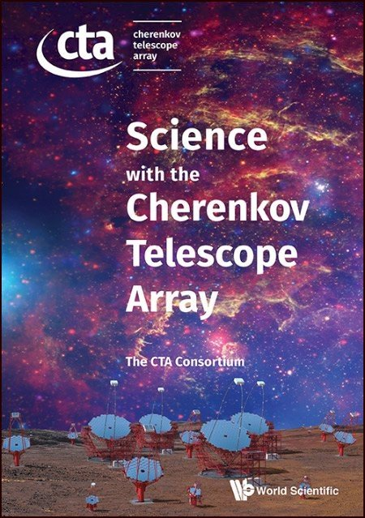
Key Science Projects
Indirect Dark Matter Searches
Deep observations of the Galactic Centre
Galactic Plane Survey
Large Magellanic Cloud Survey
Extragalactic Survey
Transients
Cosmic-Ray PeVatrons
Star Forming Systems
Active Galactic Nuclei
Clusters of Galaxies
See F. Longo Talk
This conference
(CTA Consortium 2019)
Missione 4 • Istruzione e Ricerca
Missione 4 • Istruzione e Ricerca

Slide 14

CTAO Alpha Configuration + CTA+
CTAO North
4 LSTs
9 MSTs
CTAO South
14 MSTs
37 SSTs
2 LSTs +
5 SSTs
Missione 4 • Istruzione e Ricerca
Missione 4 • Istruzione e Ricerca

Slide 15
The CTA+ program
CTA+ is an Italian program funded by National Program for Resilience and Resistance (PNRR in Italian), funded by the European Union – NextGenerationEU to enhance the CTAO infrastructure of the CTAO southern array
Total funding ~ 70 M€
INAF leadership with co-participation of INFN and several Universities
Main goals:
  Enhance CTAO southern array at the lowest (< 100 GeV) and highest (> tens TeV) energies
  Improve multi-messenger facilities for a better synergy with CTAO
  Science and outreach program with CTAO
  R&D activities: new detectors for Cherenkov telescopes or complementary
Missione 4 • Istruzione e Ricerca
Missione 4 • Istruzione e Ricerca

Slide 16
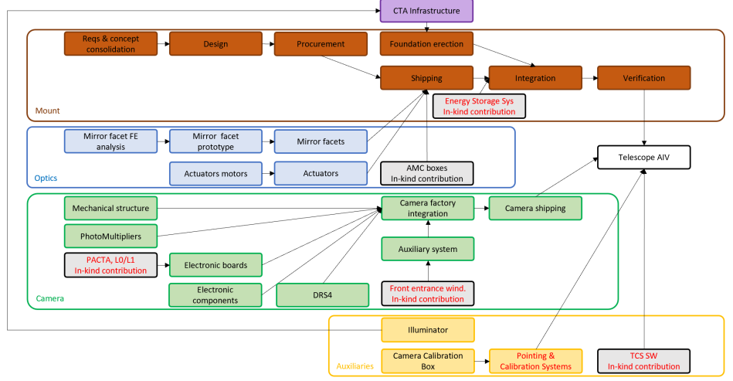
LST-South workflow
Mount to be adapted to
cope with CTAO-S site
conditions
Camera, optics and
auxiliaries will be as in
LST-North
Missione 4 • Istruzione e Ricerca
Missione 4 • Istruzione e Ricerca

Slide 17
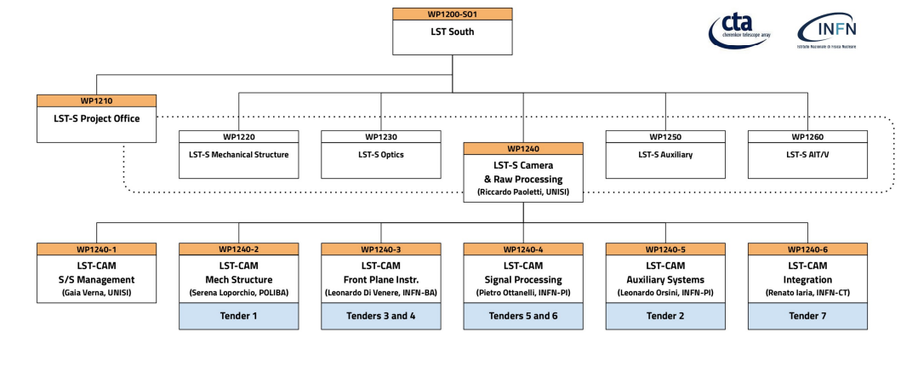
LST-South camera
Missione 4 • Istruzione e Ricerca
Missione 4 • Istruzione e Ricerca

Slide 18
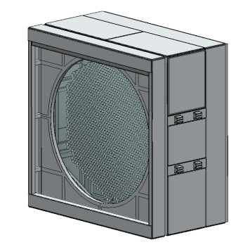
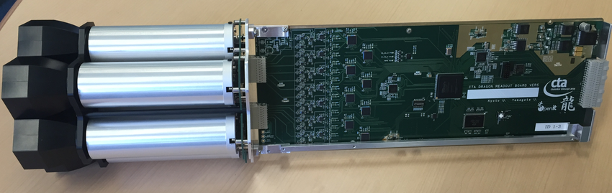
Tender 3: PMTs procurement
Tender 5: Active components
Tender 1: camera mechanics
Tender 6: DRS4
Tender 4: Cluster electronics production & assembly
Tender 2: auxiliary system
+ Tender 7: Integration facility in Catania
Outcome: 2 fully equipped LSTs + 470 spare modules (PMT + readout + backplane) + 1 spare cooling unit
Missione 4 • Istruzione e Ricerca
Missione 4 • Istruzione e Ricerca

Slide 19
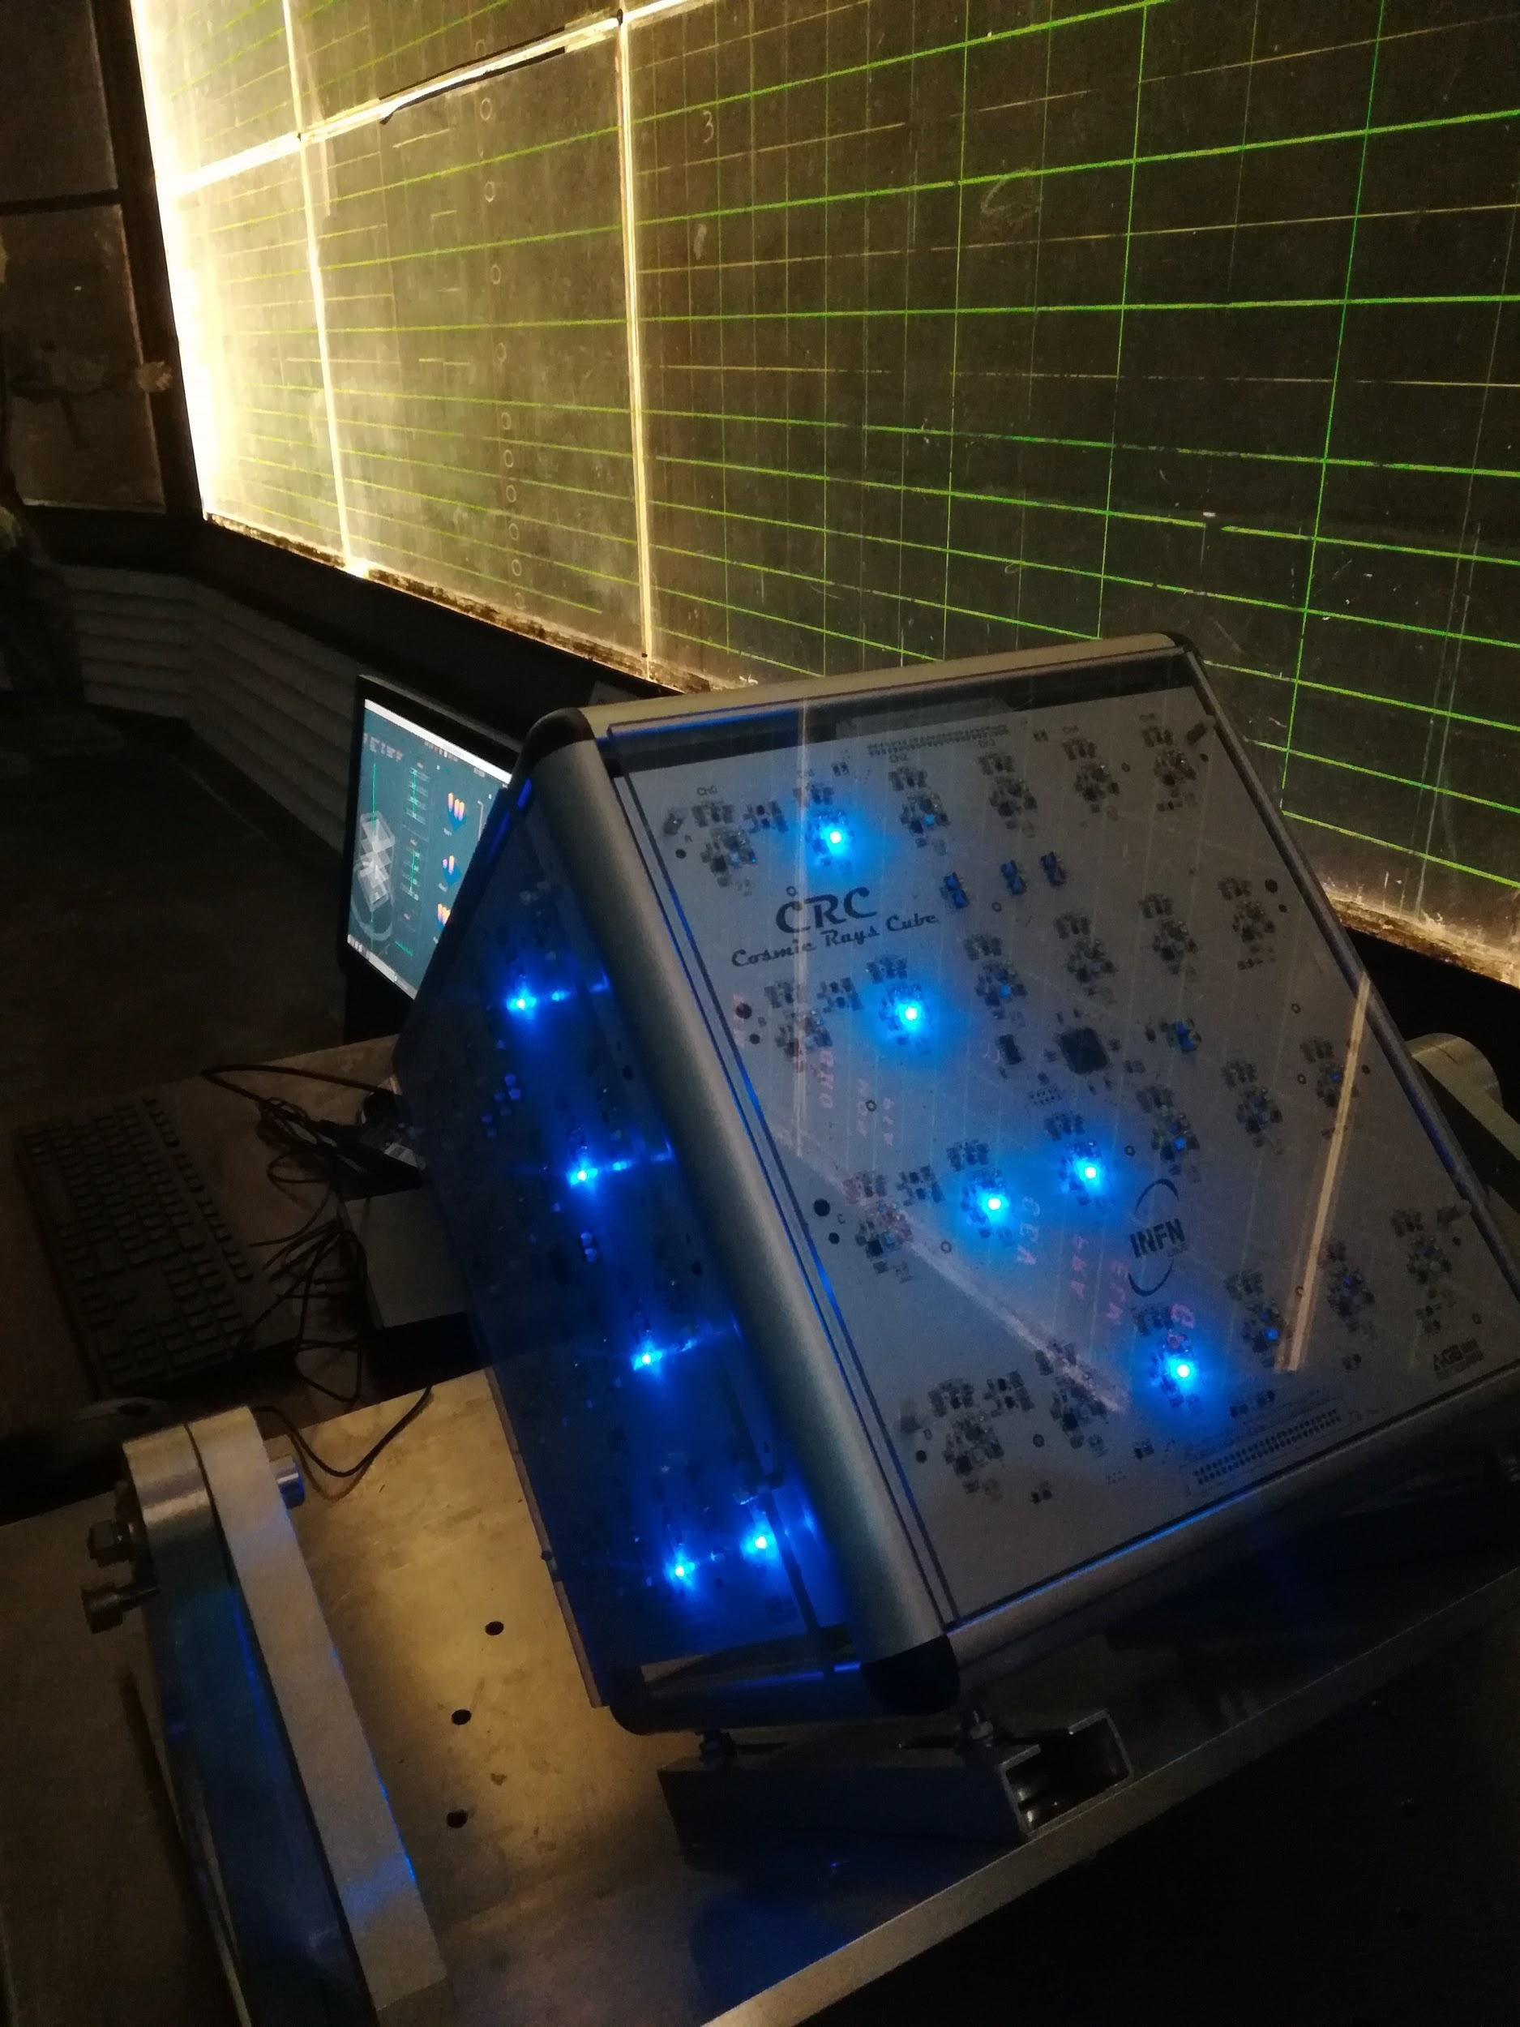
CTA+ outreach program
The CTA+ program also includes many outreach and science communication activities, with events for the general public, but above all with activities for students and training for teachers to bring them closer to the fascinating world of gamma rays and astroparticle physics.
Among all these activities, I will briefly describe two courses dedicated to Italian high school teachers, also using the Cosmic Ray Cube telescopes, founded by CTA+ program
Missione 4 • Istruzione e Ricerca
Missione 4 • Istruzione e Ricerca

Slide 20
Discovering cosmic rays for in-service
high school physics teachers
From 10 to 13 December 2023, 17 secondary school teachers from all over Italy attended the "Discovering Cosmic Rays" a course at the Gran Sasso National Laboratories.
The 2.5-days residential course was an opportunity to learn more about the fascinating topic of cosmic rays and gamma rays, the experiments that observe them and the messages they can bring us from space.
Missione 4 • Istruzione e Ricerca
Missione 4 • Istruzione e Ricerca

Slide 21
During the practical sessions, participants were actively involved in building a muon telescope, performing a muon flux measurement and analysing the data.
The aim of the course was to provide an overview of the subject matter, enabling participants to familiarise themselves with the activities, experience them first hand and build on their prior knowledge and skills, thus facilitating immediate implementation of the activities in the classroom.
Missione 4 • Istruzione e Ricerca
Missione 4 • Istruzione e Ricerca

Slide 22
Second Teachers' Course: 8-11 September 2024 - Department of Physics and Astronomy, University of Padua.
The 2.5-days residential course will give the 30 participants the opportunity to approach the fascinating topic of gamma rays, among the protagonists in the study of the high-energy universe, and to learn about the experiments that observe them and the astronomical sources that produce them, in particular active galactic nuclei.
During the practical sessions, participants will use astronomical portals available online to obtain data from the latest astronomical observatories (https://firmamento.hosting.nyu.edu/home).
Missione 4 • Istruzione e Ricerca
Missione 4 • Istruzione e Ricerca

Slide 23
Conclusions
CTA+ will improve the performance and scientific output of the CTA South Array
The larger and most ambitious goal of the CTA+ programme is to implement two LSTs and five SSTs at the CTA South site in about three years, using an end-to-end approach.
The two telescopes will be realised using the same basic design as the northern LSTs, with the exception of the modifications required to meet the environmental requirements of the southern site and to further reduce construction risks and costs.
The production of the auxiliary instruments, cameras, mirrors and mechanical structures will be realised through large industrial contracts overseen by the CTA+ management with the support of the LST Collaboration and the CTAO.
Some international partner countries of the LST Collaboration also provide in-kind contributions to the realisation of part of the telescopes.
CTA+ is carrying out an R&D programme for future CTAO detectors and ancillary instruments.
The science and outreach programme is well integrated and developed.
Missione 4 • Istruzione e Ricerca
Missione 4 • Istruzione e Ricerca

Slide 24
Acknowledgement
This work has been realized with the EU funding program "Next Generation EU" in the context
of the PNRR-IR "CTA+". The acknoledgements for CTA Consortium are listed here: https://www.
cta-observatory.org/consortium_acknowledgments/ . We gratefully acknowledge financial support from the following agencies and organisations listed here: https://www.lst1.iac.es/acknowledgements.
Questions?
Missione 4 • Istruzione e Ricerca
Missione 4 • Istruzione e Ricerca

