Slide 1

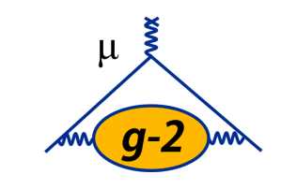

Latest Result and the Outlook of the Muon g-2 Experiment
Esra Barlas-Yucel (UIUC)
on behalf of the Muon g-2 Collaboration
ICNFP 2024
04/09/2024

Slide 2
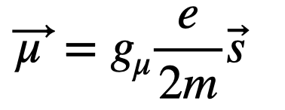
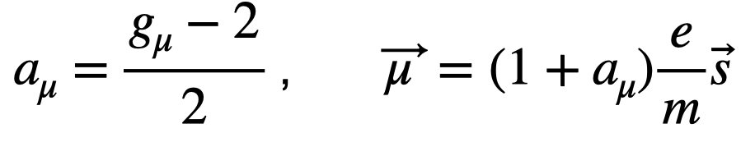
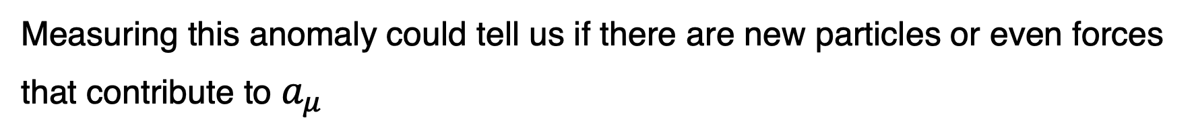
Muon Magnetic Moment and Defining the Anomaly
Magnetic Moment of Muon
A charged particle with spin generates its own magnetic moment:
g: Proportionality constant between spin and magnetic moment
Anomalous Magnetic Moment of Muon
Shows how much g differs fractionally from 2!
Measuring this anomaly could tell us if there are new particles or even forces that contribute to $a_{μ}$

Slide 3
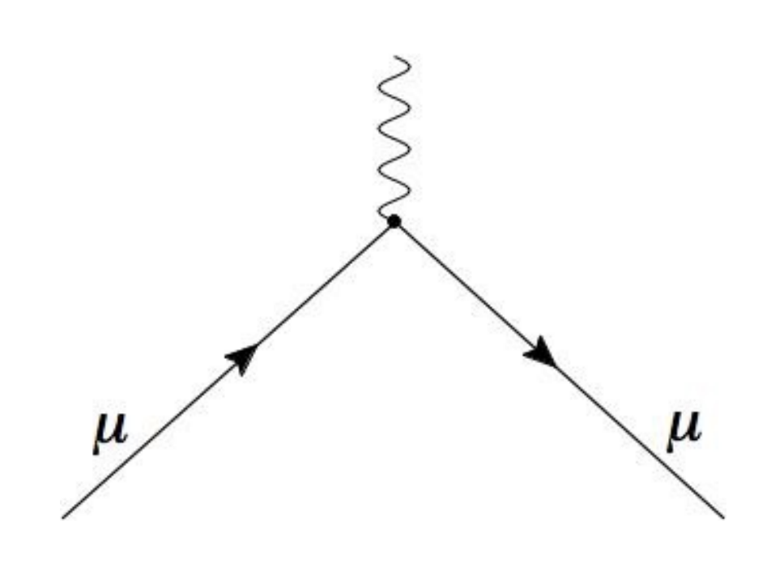
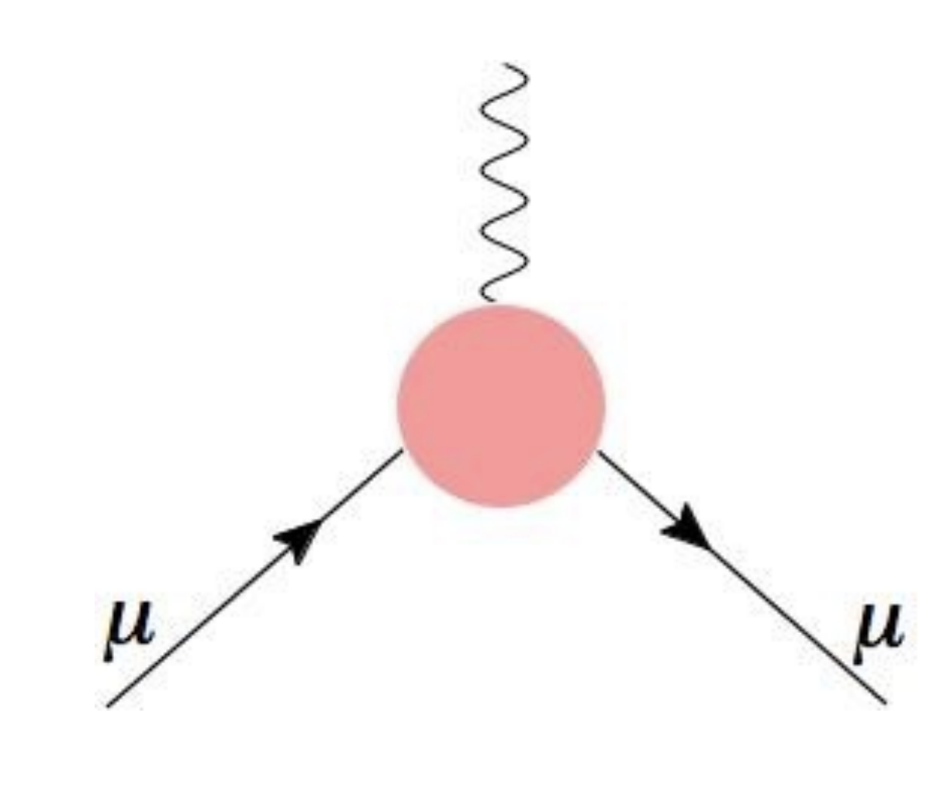
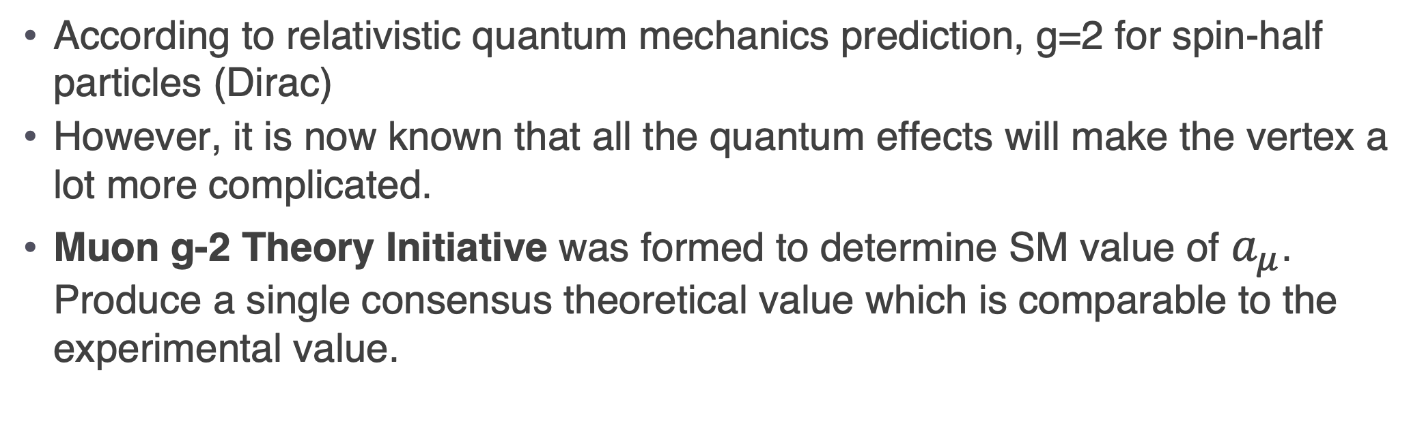
Standard Model Prediction of the Anomaly
Dirac: g=2
Quantum corrections: g>2
According to relativistic quantum mechanics prediction, g=2 for spin-half particles (Dirac)
However, it is now known that all the quantum effects will make the vertex a lot more complicated.
Muon g-2 Theory Initiative was formed to determine SM value of $a_{μ}$. Produce a single consensus theoretical value which is comparable to the experimental value.

Slide 4
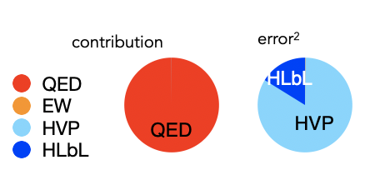
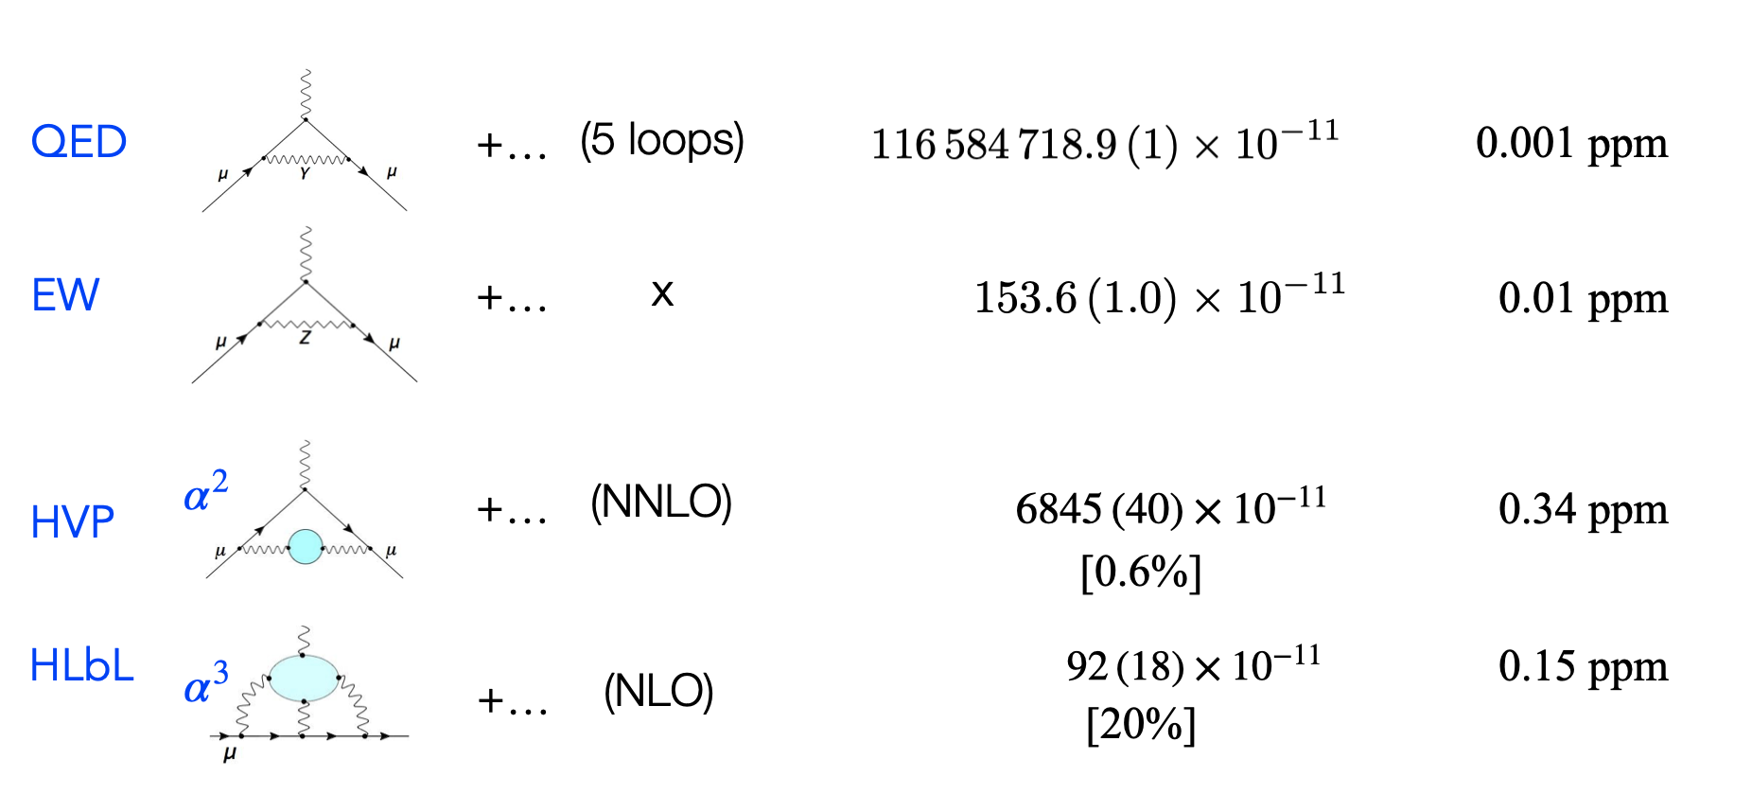
Standard Model Prediction of the Anomaly
$$a_{μ}=a_{μ}(QED)+a_{μ}(EW)+a_{μ}(hadronic)$$
Well-known
Non-perturbative
(Data-driven & lattice QCD)
QED and EW contributions are very well-known with small uncertainties
Hadronic contribution error dominates the uncertainty budget
Refining the SM calculations means refining the HVP calculation
Notes:
a_mu receives contributions from quantum electro dynamics, weak interactions and by the exchange of virtual photons with quarks from hadronic contributions.
First QED diagram is the schvinger diagram which is the leading contribution and it’s known very well known.
Weak contributions are also calculated very precisely and you can see that their contribution is very very small comparing to the QED contribution.
Hadronic is classified into Vacuum Polarization and light by light contributions. Vacuum polarization starts with square of fine-structure constant so it’s smaller than QED and EW. Muon emits a virtual photon which then creates a quark-antiquark pair which again immediately hadronizes into pions, Keons, etc… resulting in a very complicated structure inside (blue hadronic bubble).

Slide 5
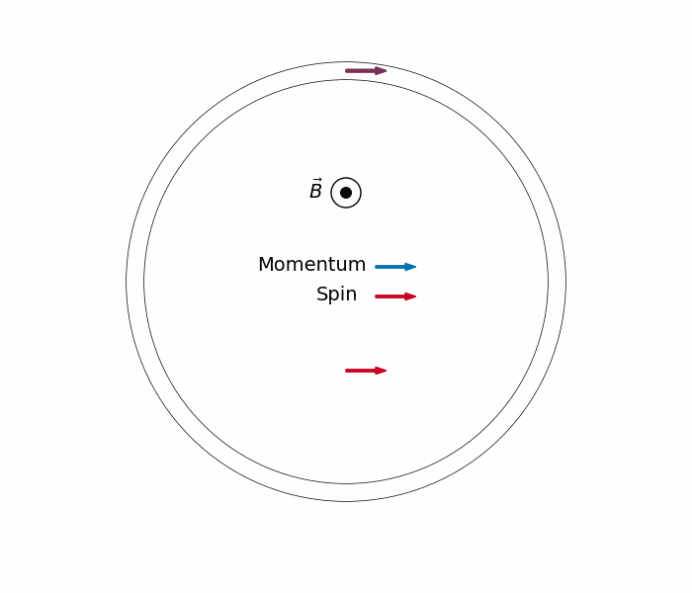
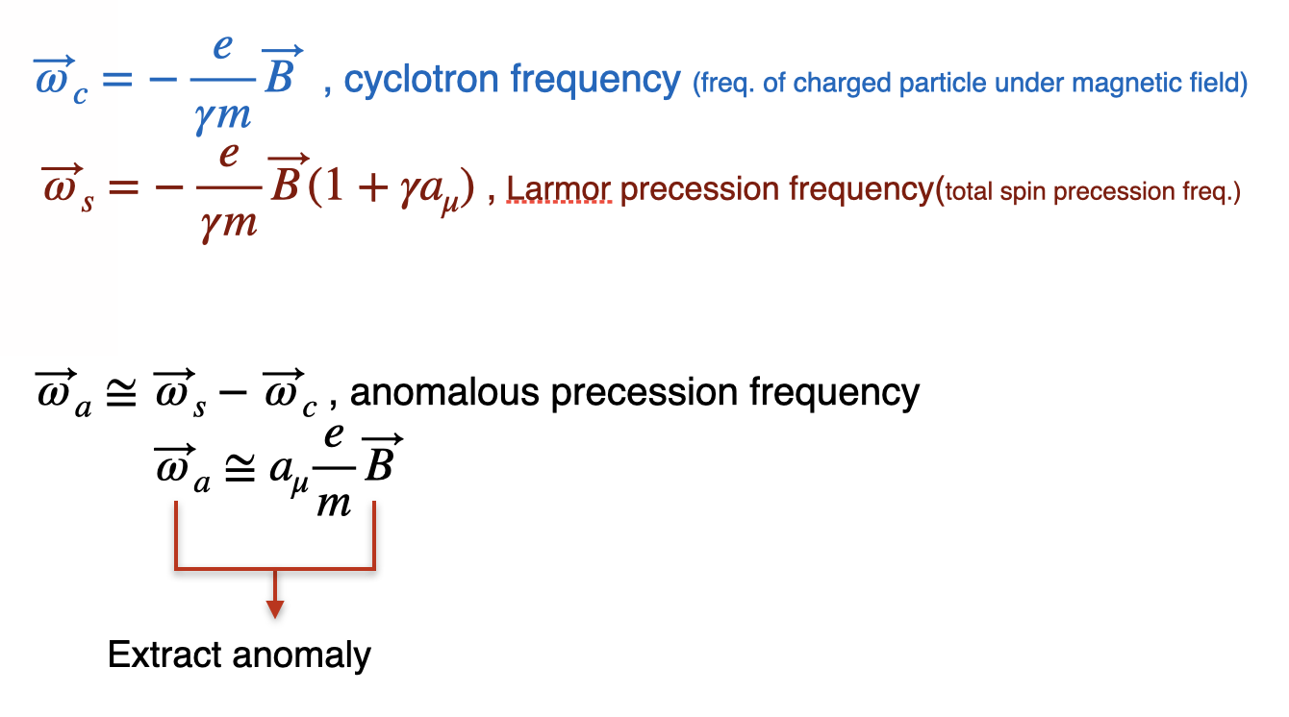
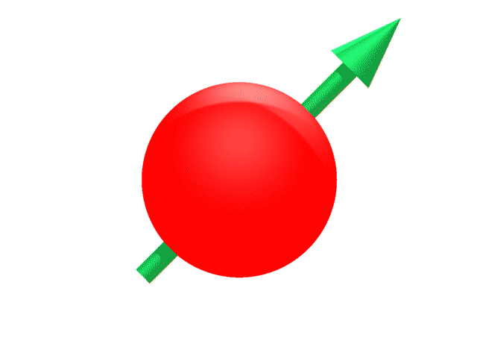
Measuring the Anomaly
g>2
B
polarized muons in a magnetic field
Notes:
Store polarized muons in a region of uniform magnetic field
‣Muon's spin precesses ( ) and its momentum rotates ( )
‣Difference frequency is proportional to magnetic anomaly ( )

Slide 6
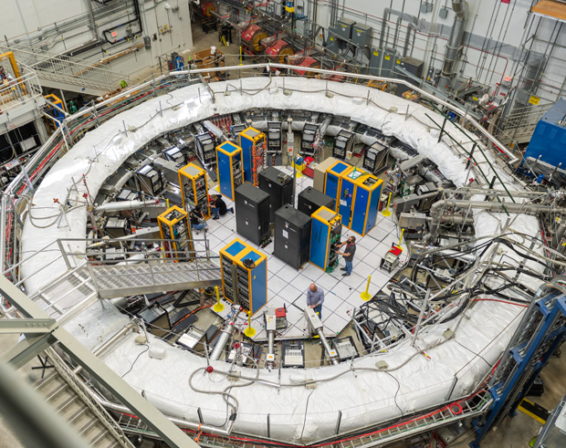
Muon g-2 Experiment at FNAL

Slide 7
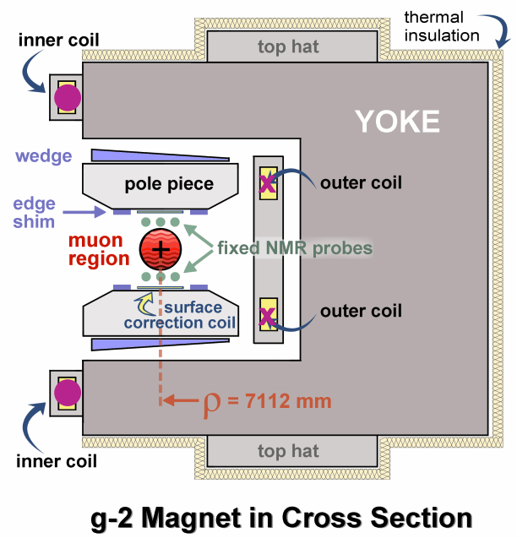

Storing the Muons: Magnet
B
Superconducting C shaped magnet
Provides 1.45T B field(vertical and uniform)
RMS of 2 ppm for Run-2 and 0.5 ppm for Run-3
Field uniformity is crucial
Notes:
12 Yokes:Open on the inside, allows the decay positrons to reach to the detectors.
72 poles:Low-carbon steel to minimize the impurity
144 Edge shims: Minimize the local sextupole field by changing edge shim thickness
864 Steel wedges: Angle adjustment (compensate quadrupole component), radial adjustment (shim local dipole field).
Surface correction coil: Reduces non-uniformities on higher moment of field.

Slide 8
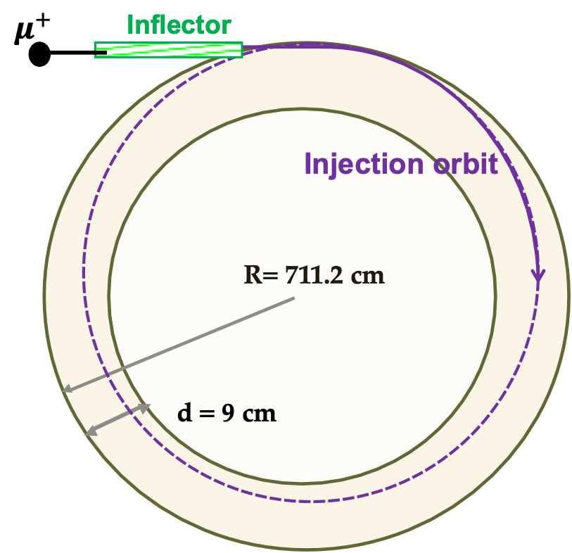
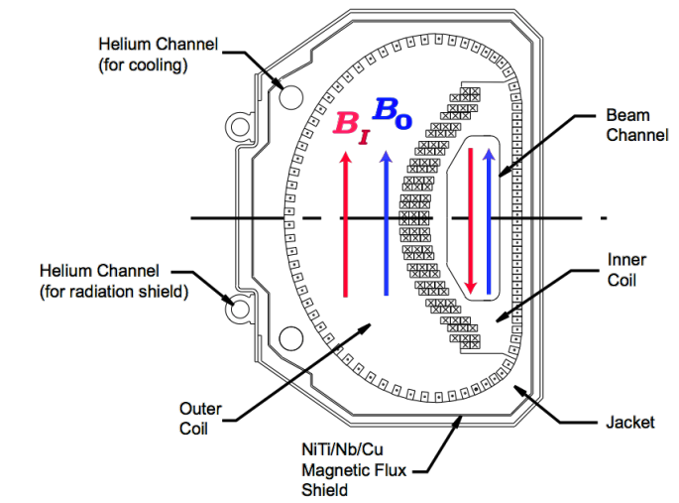
Storing the Muons : Inflector and Kickers
Inflector
  Super conducting magnet
  Cancels B field(1.45T) in the magnet gap and let the beam enter the storage ring without being deflected.
  They are at r=77mm outside central closed orbit

Slide 9
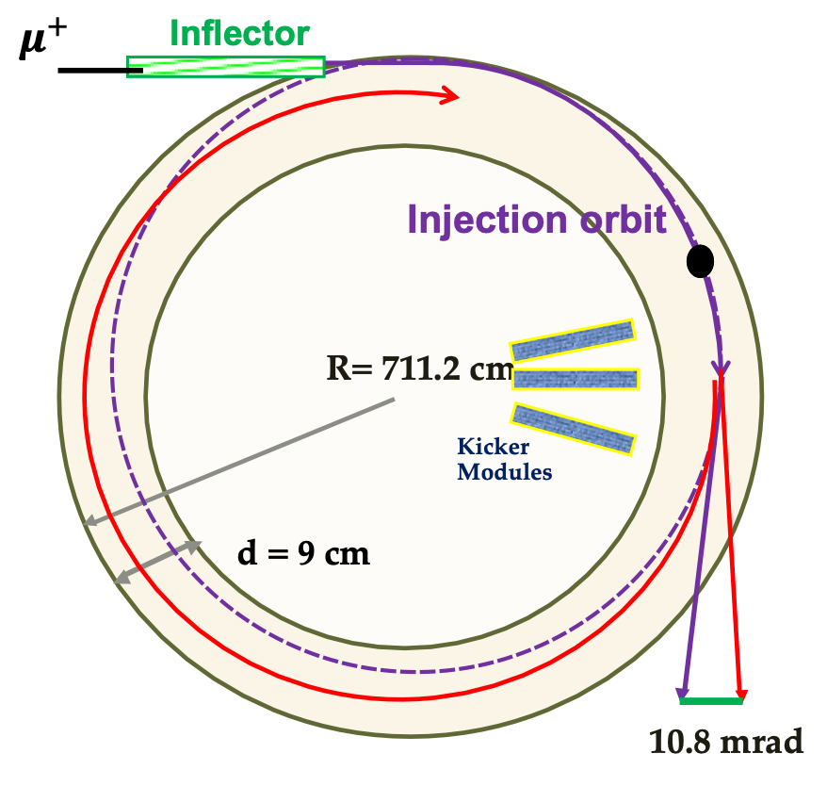
Storing the Muons : Inflector and Kickers
Magnetic Kickers
  Kick some more to direct the muons into ideal orbit.
  Use 10.8 mrad pulsed kicks (<149 ns)
Kickers

Slide 10
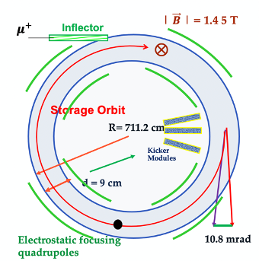
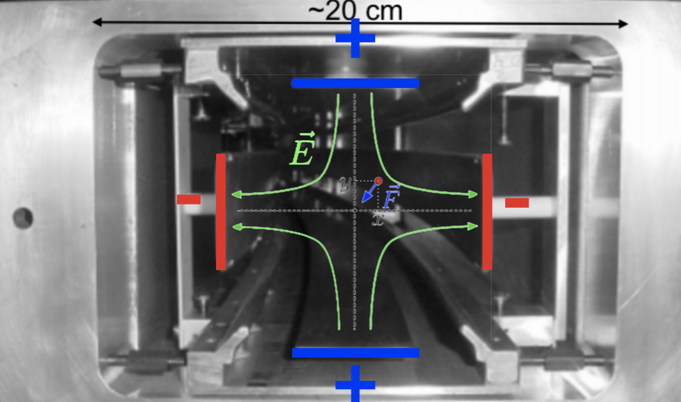
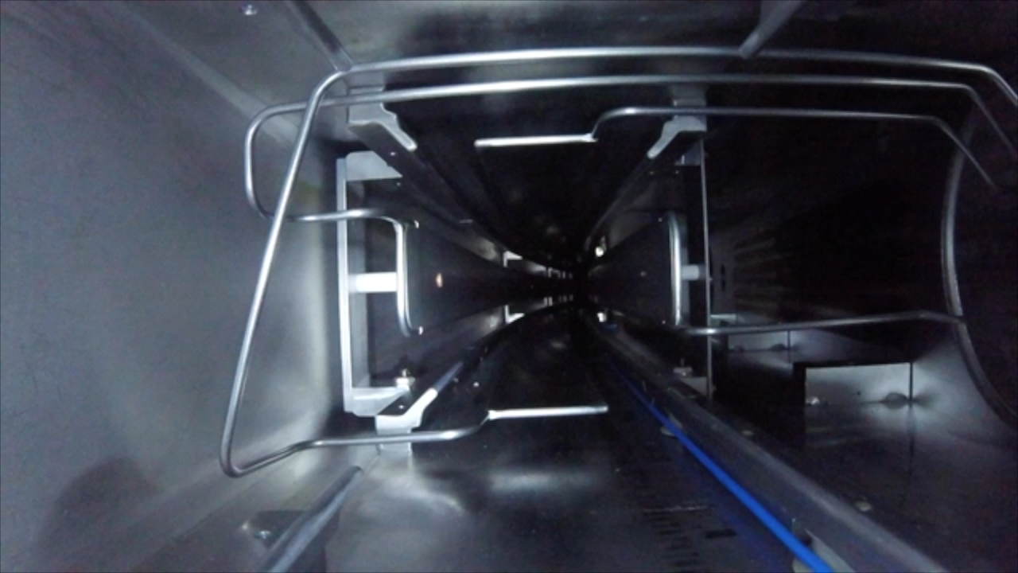
Storing the Muons: Electrostatic Quadrupoles
Electrostatic Quadrupoles
  4 sets of quads which cover 43% of the ring
  Electrostatic quadrupoles are used to focus the beam vertically while the storage ring field provides horizontal focusing

Slide 11
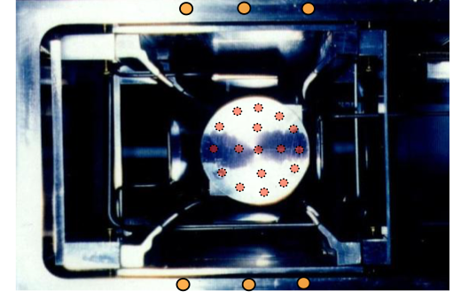
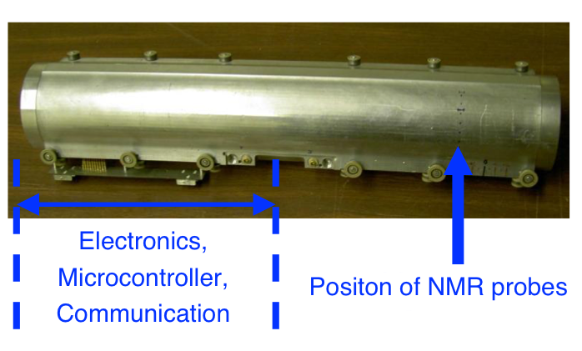
Monitoring and Measuring the Magnetic Field
Fixed probes:
  Proton Magnetic Resonance (NMR) Probes
  378 probes located on vacuum chamber
  Measure the magnetic field while muons are inside the storage ring
Trolley(Motorized cart):
  17 NMR probes
  Circles around the ring on periodically
  Measures the magnetic field in the storage region
  Used to calibrate FP measurements

Slide 12
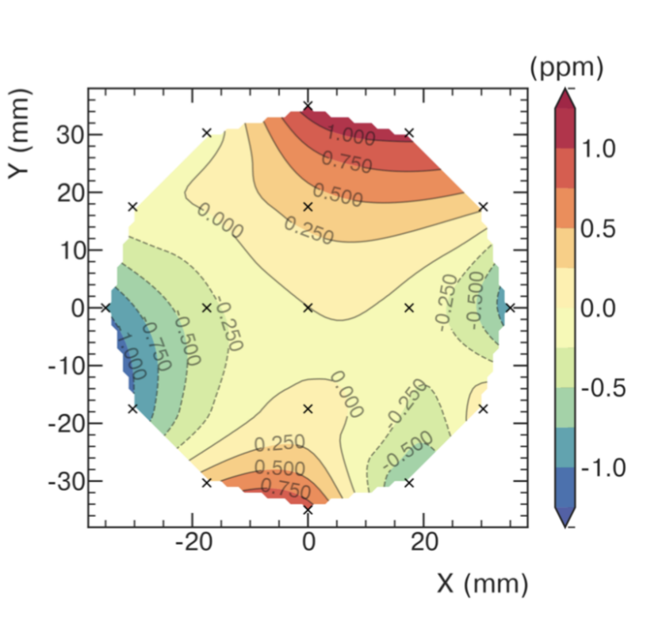
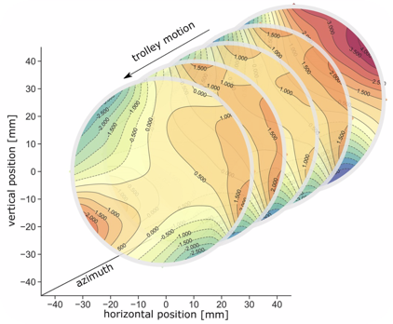
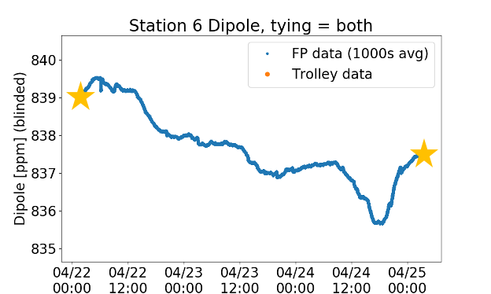
Monitoring and Measuring the Magnetic Field
azimuthally averaged field
To determine magnetic field at all times:
Map the magnetic field in the storage region with trolley runs every 3 days
Use fixed probes to interpolate the field between trolley runs

Slide 13
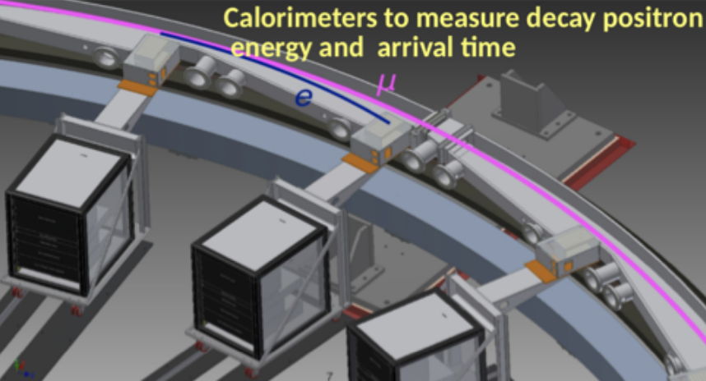
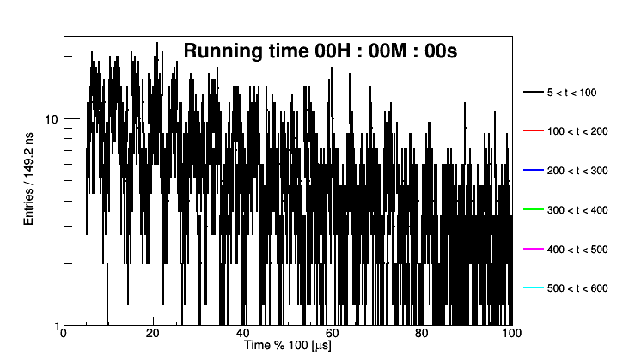
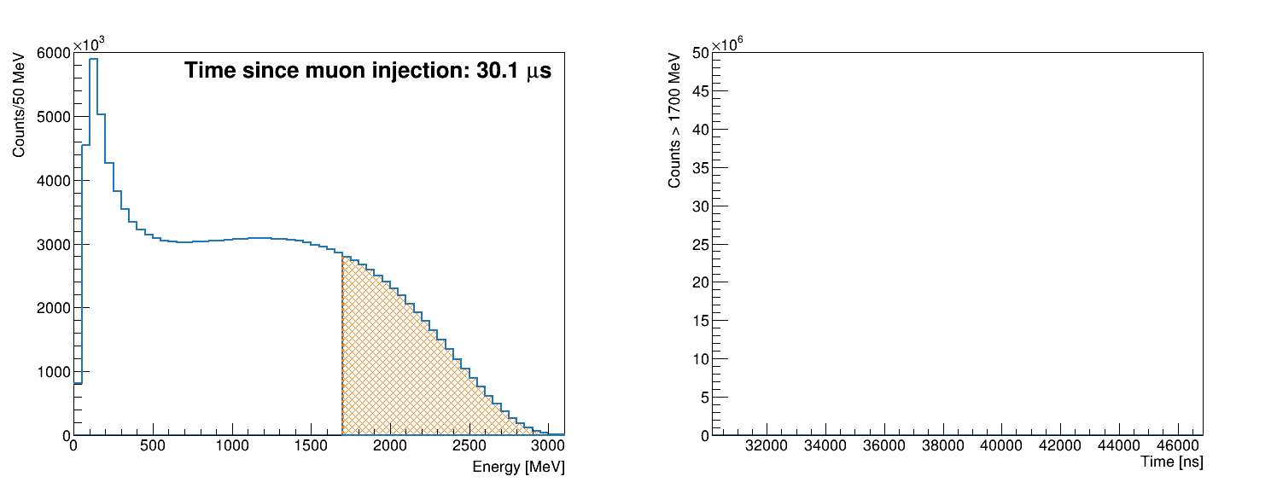
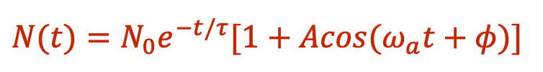
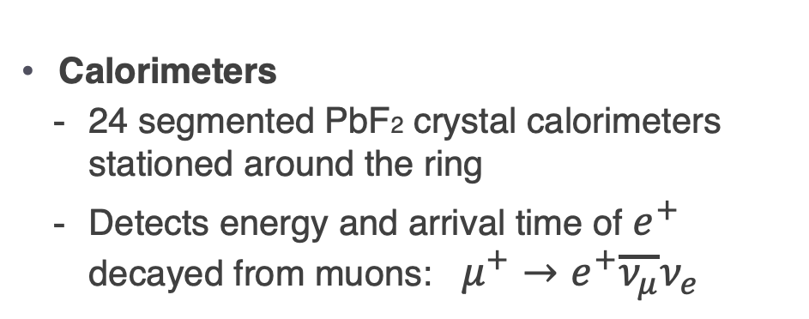
Detectors : Calorimeters
Calorimeters
  24 segmented PbF2 crystal calorimeters stationed around the ring
  Detects energy and arrival time of $e^{+}$ decayed from muons: $μ^{+}→e^{+}\overline{ν_{μ}}ν_{e}$
Due to parity violation, as the μ⁺ spin points towards & away from calorimeters the number of high energy e⁺ oscillates
$$N(t)=N_{0}e^{−t/τ}[1+Acos(ω_{a}t+φ)]$$

Slide 14
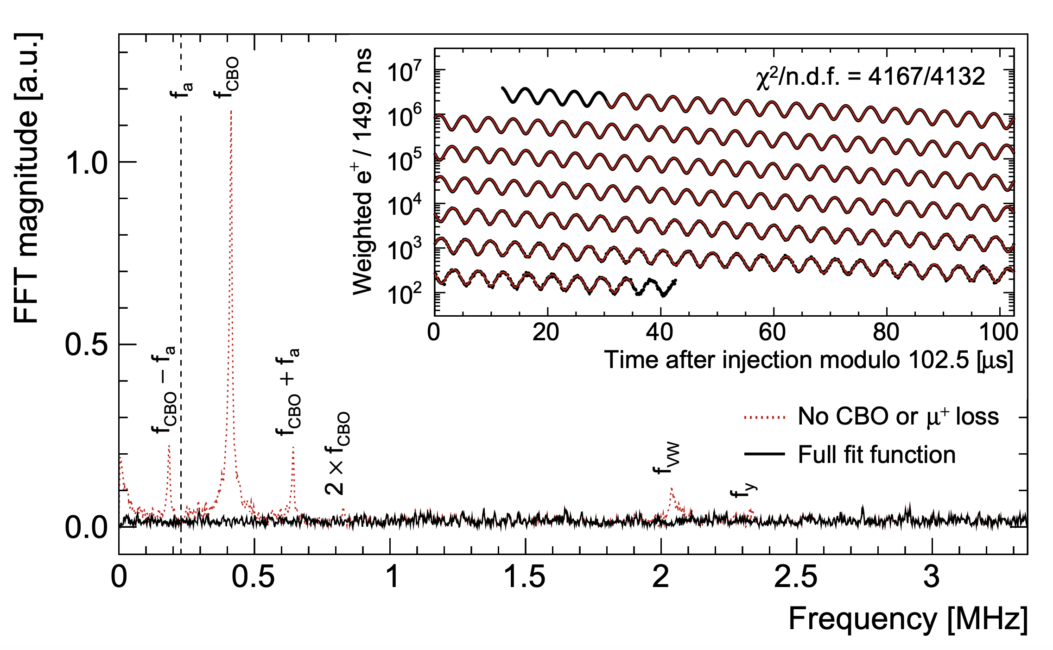
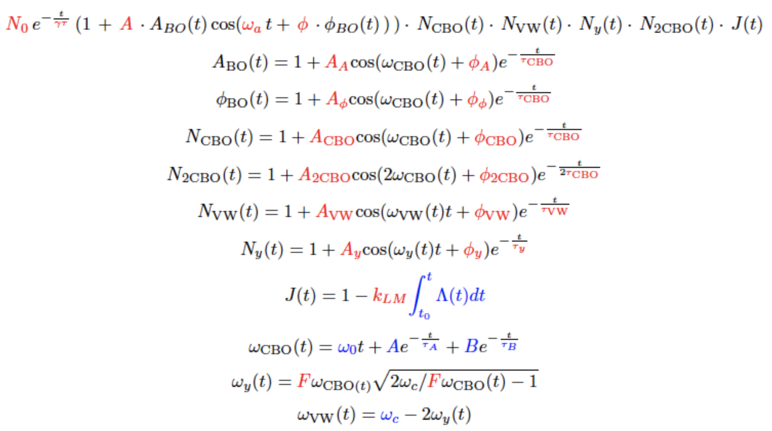
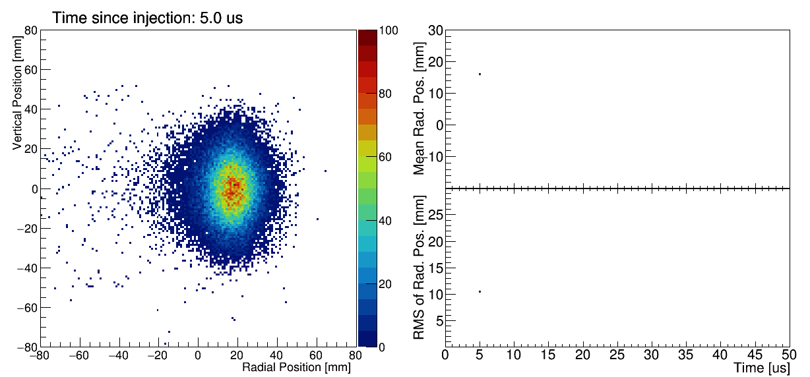
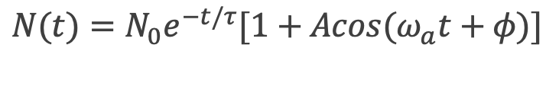
Measuring $ω_{a}$: Hidden information in the wiggle plot
Simple Fit
$$N(t)=N_{0}e^{−t/τ}[1+Acos(ω_{a}t+φ)]$$
FFT analysis of fit residuals
Systematic Effects
Including CBO, lost muon,
other beam dynamics related parameters
improve the fit results

Slide 15
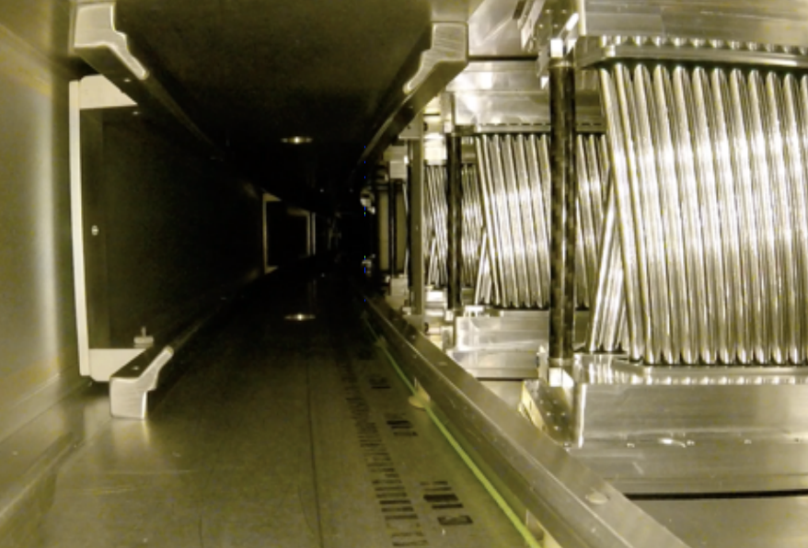
Detectors: Trackers for Reconstructing the Beam Profile
Trackers
  2 straw-tracker stations
  8 modules per station each with 128 straws
  Reconstruct muon beam profile from positron trajectories

Slide 16
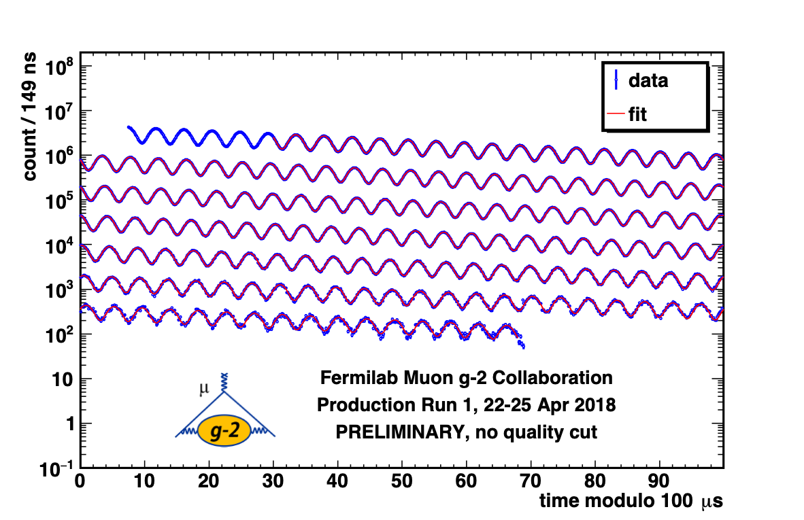
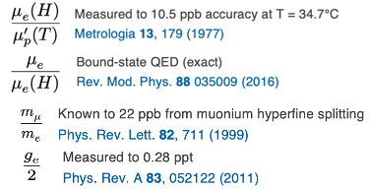
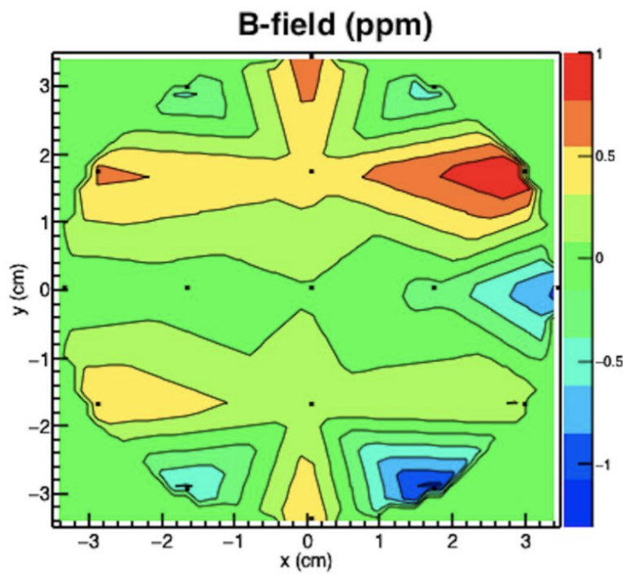
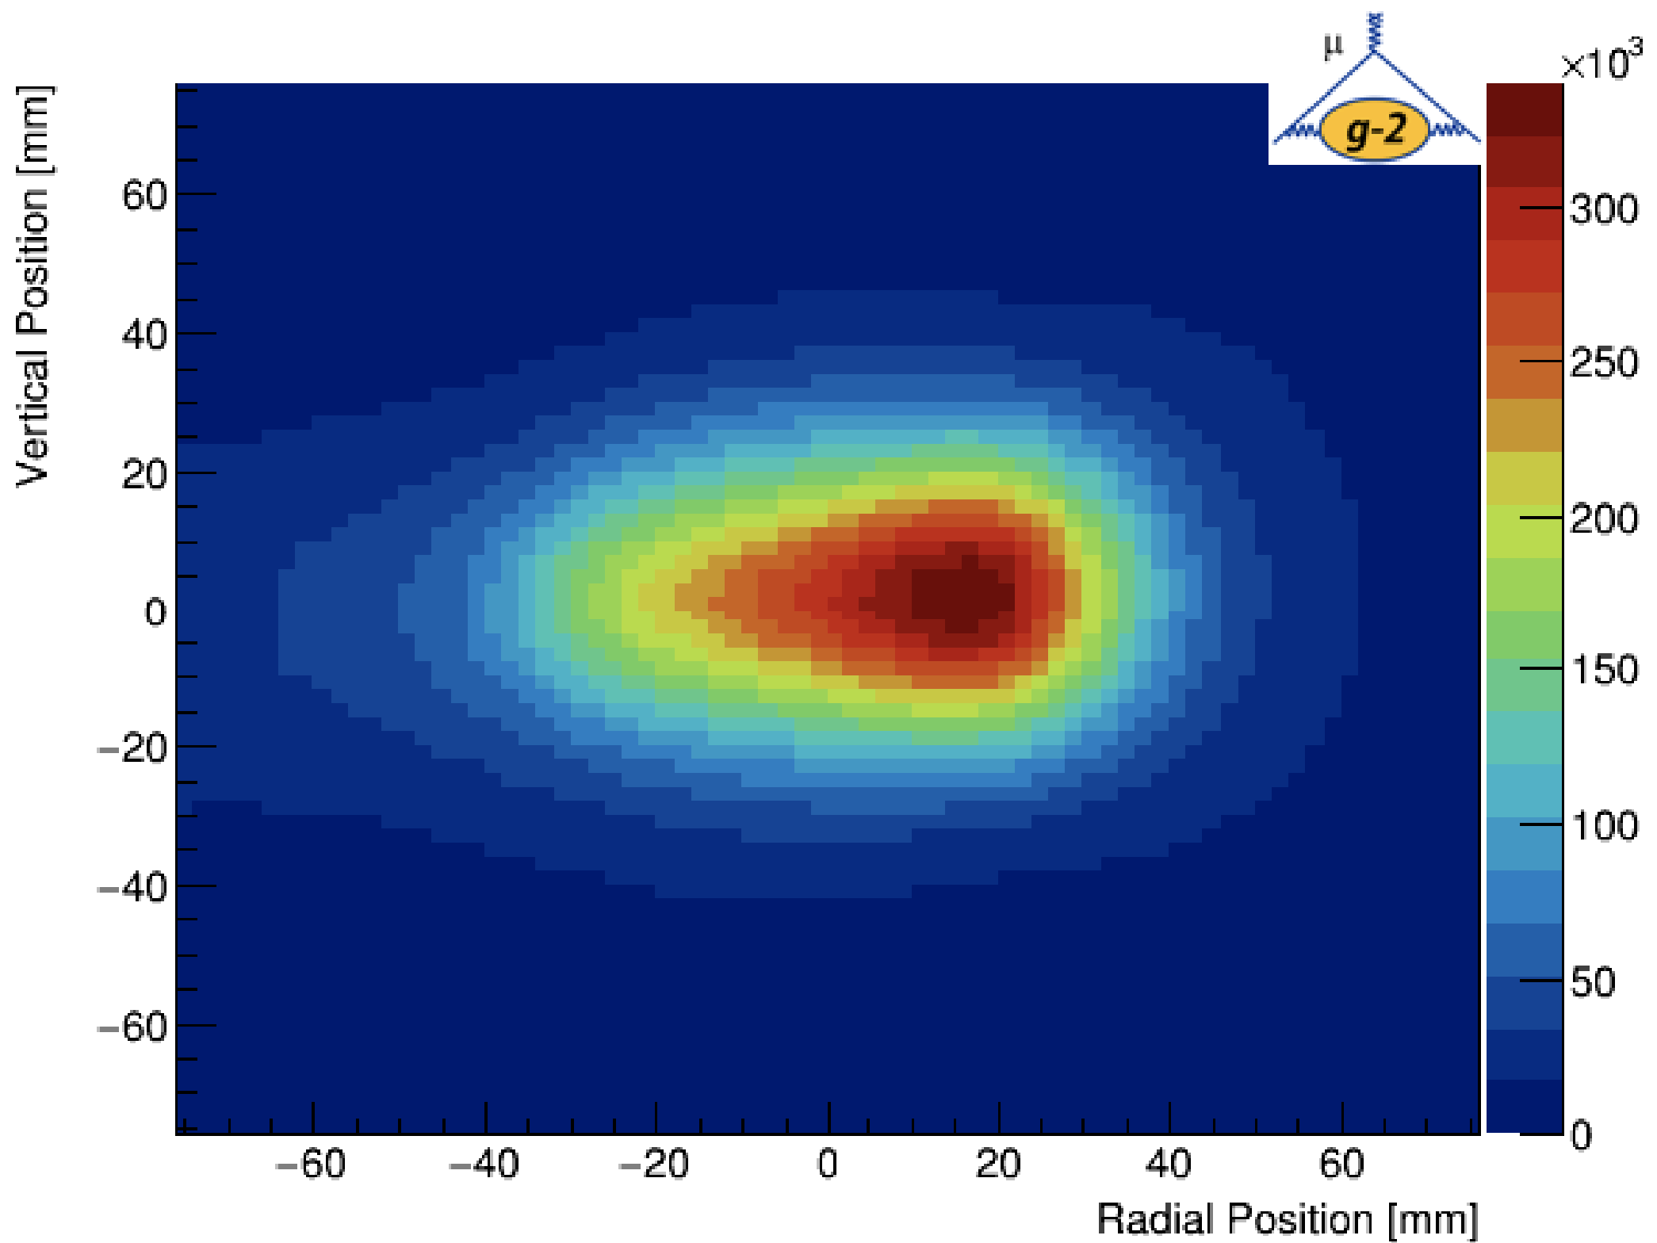


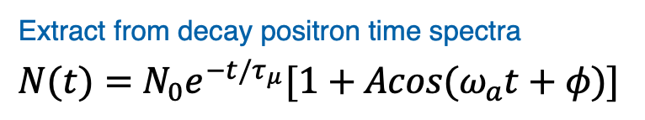
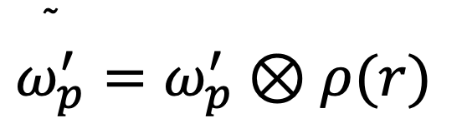
Measuring the Muon Anomaly
Extract from decay positron time spectra
$$N(t)=N_{0}e^{−t/τ_{μ}}[1+Acos(ω_{a}t+φ)]$$
Other measurements( known to ~ 24 ppb )
$$\overset{˜}{ω_{p}^{′}}=ω_{p}^{′}⊗ρ(r)$$
Vertical Position[mm]
y (cm)
Average magnetic field weighted by muon distribution
x (cm)
Radial Position[mm]
Map the magnetic field
Obtain muon distribution In the storage ring
Notes:
𝝎 ̃_𝒑^′ (𝑻_𝒓 ): proton Larmor precession frequency in water sample mapping the field and weighted by the muon distribution

Slide 17

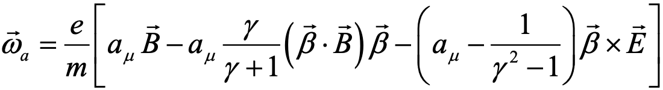
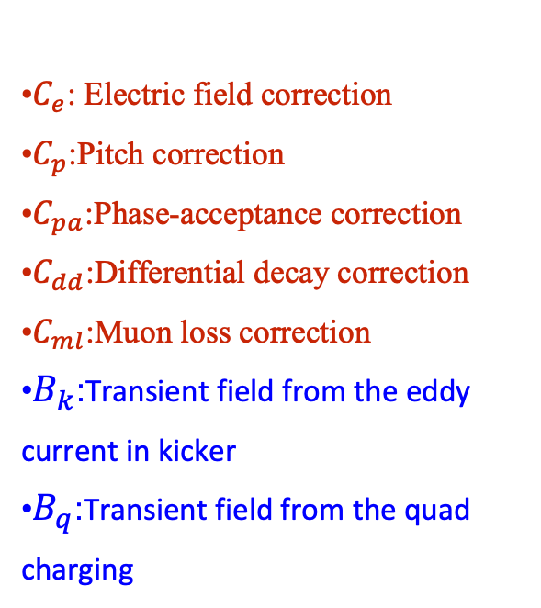
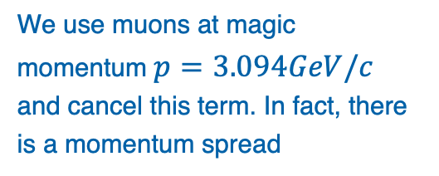
Actually…It’s not that straightforward, still need some corrections
Beam Dynamics Corrections
Transient Magnetic Field Corrections
Bargmann-Michel-Telegdi (BMT) Equation
•$C_{e}$: Electric field correction
•$C_{p}$:Pitch correction
•$C_{pa}$:Phase-acceptance correction
•$C_{dd}$:Differential decay correction
•$C_{ml}$:Muon loss correction
•$B_{k}$:Transient field from the eddy current in kicker
•$B_{q}$:Transient field from the quad charging
Small vertical beam oscillation
We use muons at magic momentum $p=3.094GeV/c$
and cancel this term. In fact, there is a momentum spread
(We used the condition where E=0 and
motion is planar to simplify the BMT
equation!)
Run-2/3 has a total of 622 ppb correction

Slide 18
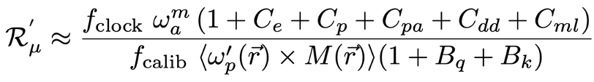
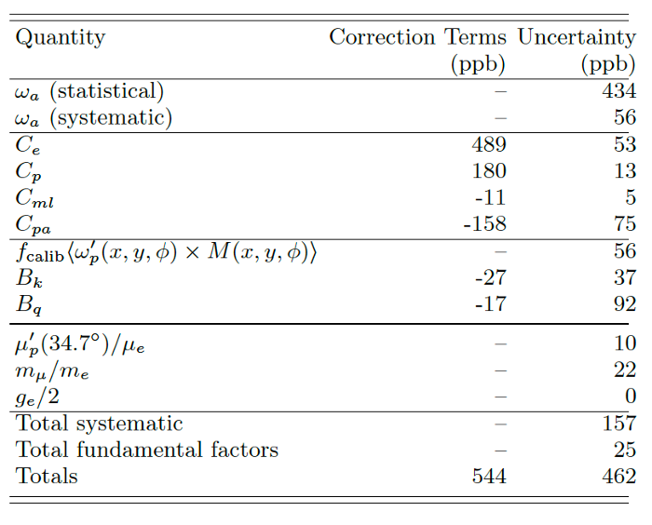
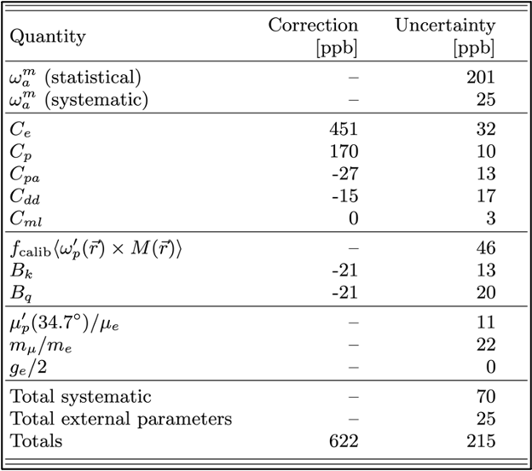
Systematics
Hardware
Blinded
Clock
Precession
Freq.
Beam Dynamics(Spatial and Temporal motion of the beam)
Field
Calibration
Convolution with beam
Transient Magnetic Field
Run-1
Run-2/3
Many improvements on the systematics:
-Running Conditions
-Analysis Improvements
-Methods for systematic measurements

Slide 19
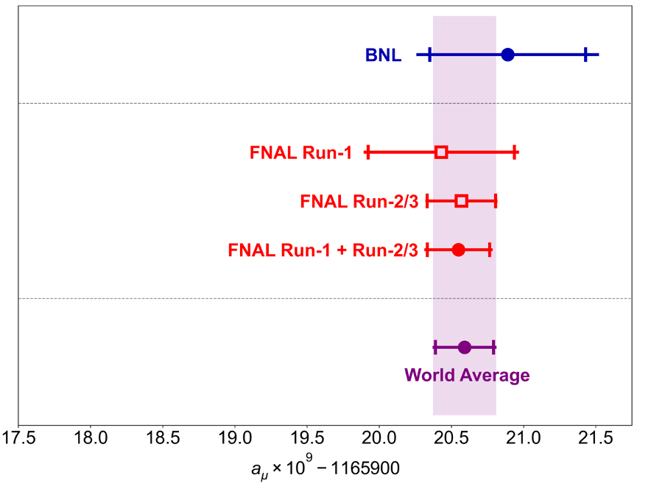
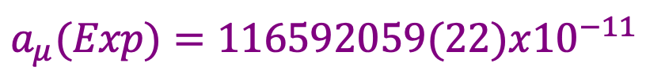
Latest FNAL result from 2023 summer
FNAL Run-2/3 is in agreement with both FNAL Run-1 and BNL
New result halved the uncertainty to 215 ppb
Systematic uncertainty went down to 70 ppb (surpasses our 100 ppb goal)
World average is dominated by FNAL values
Still dominated by statistical error
540 ppb
463 ppb
215 ppb
203 ppb
190 ppb
$$a_{μ}(Exp)=116592059(22)x{10}^{−11}$$
 | Run-1 | Run-2/3
Stat.[ppb] | 434 | 201
Syst.[ppb] | 157 | 70

Slide 20
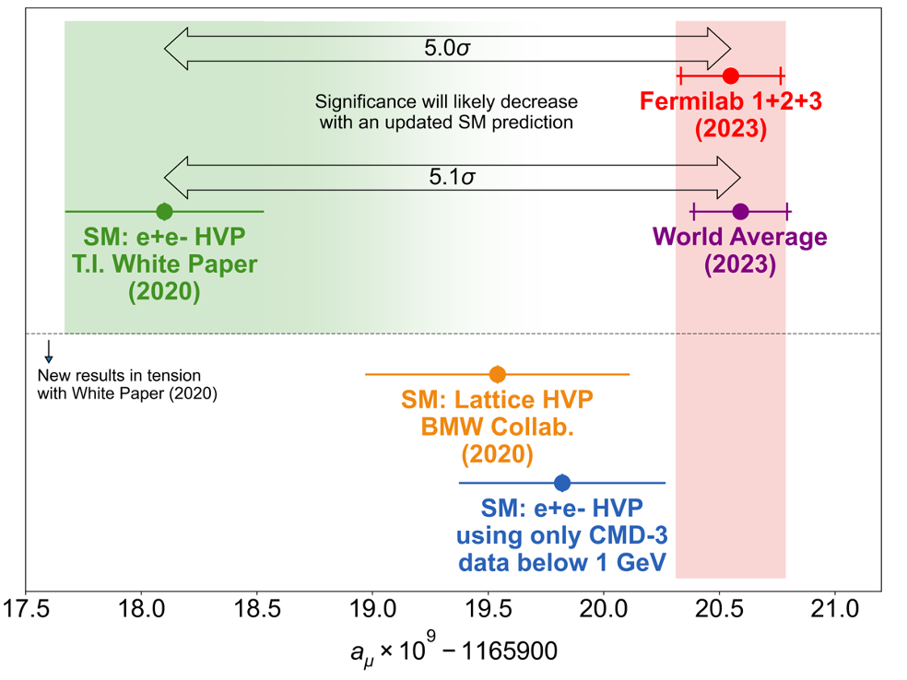

Standard Model Prediction and the Experiment Average
2020 Muon g-2 Theory Initiative
Net uncertainty is 368 ppb
HLbL incorporates both data-driven and lattice calculations, HVP is contribution is coming from only data-driven method
The discrepancy between SM and the experiment increased to 5.1$σ$

Slide 21

Standard Model Prediction and the Experiment Average
2020 Muon g-2 Theory Initiative
Net uncertainty is 368 ppb
HLbL incorporates both data-driven and lattice calculations, HVP is contribution is coming from only data-driven method
The discrepancy between SM and the experiment increased to 5.1$σ$
Lattice
Data-based Dispersive
New theory prediction will likely reduce the tension between the experiment and the theory!

Slide 22


CMD3 Result F. Ignatov et al, March 2023
  No plans for reanalysis of CMD2
  KLOE + KLOE-2: No new data( Finished in 2018) but new analysis to come
  No new data since 2008, but new analyses are still coming
  Still going, new data to be analyzed (BESIII)
  Still taking data, revising their analysis, working on reducing the corrections
  Plan to collect one year of systematics data
Measurement of $e^{+}e^{−}→π^{+}π^{−}$ cross section contributes to HVP
Tension with previous measurements ( >3 to 5 $σ$ )
New analyses to come from BaBar, KLOE, SND, BesIII, Belle II
  BaBar results (2x stats)
  KLOE results (7xstats), 2025
  SND/BES/Belle, 2026/2027

Slide 23


A New Lattice QCD Result (July 2024)
Lattice QCD groups published new results
Tension between experiment and the prediction is down to 0.9$σ$
New lattice number is close to CMD3 result
Lattice groups aims to finalize HVP calculations and provide SM results in 2025 ( multiple blinded analyses)
New Theory Initiative number is expected in 2025
Arxiv:2407.10913

Slide 24



Experiment Status
FNAL Muon g-2 experiment has reached the statistical TDR goal and stopped taking data as of last summer
Run4-5-6 is expected to be published in 2025
New type of physics analyses: EDM, Dark Matter, and CPT/LIV searches
FNAL experiment goal is to eventually reach 140 ppb precision
A different approach to measure $a_{μ}$ from J-PARC is set to start towards the end of 2020s

Slide 25

Outlook and Summary
Fermilab measured the $a_{μ}$ with 203 ppb precision so far
Design goal was reached with 70 ppb of systematic uncertainty
Run-4/5/6 analysis will be completed by 2025 which will conclude the FNAL measurements
Theory Initiative expects to update their prediction around the same time
  Working on figuring out the differences between LQCD and data-driven methods.
    Lattice HVP by 2025-> 0.5% ( if no tension)
    Dispersive+lattice LbL by 2025 -> 10%
    Data-driven HVP by 2025 -> 0.3% (if no tension)
    New results to come from BaBar, KLOE, SND, BesIII, Belle II (reduced uncertainty).
2025 is expected to be the year to resolve many puzzles…
540 ppb
463 ppb
215 ppb
203 ppb
190 ppb

Slide 26

Thank you
on behalf of the

Slide 27
Extras

Slide 28


Why the Muons?
Muons are useful!
$(m_{μ}/m_{e})^{2}=40000$ -> More sensitive to new physics
Easy to produce, muon beams from pion decays (99.9%)
Relatively long lifetime (2.2 $μs$) -> In the lab frame 64.4$μs$
Then, why measure the muon anomaly?
One of the most promising way to test SM
Possible to make high precision measurement
An accurate way to look for small differences from theory

Slide 29




Muon Delivery to g-2 Experiment
8 GeV protons are delivered to Recycler Ring from Booster
Split the proton bunch into four bunches with RF system.
Direct the proton punches to pion production target and obtain pions.
Muons produced by pion decays circulate in the delivery ring until proton contamination is removed.
Deliver muons to g-2 storage ring.

Slide 30


Independent Strategies to Evaluate Hadronic Contributions
Standard Model Prediction of the Anomaly
Dispersive + Data-driven
Lattice QCD
HVP: Use dispersion relations and re-write the integrals in terms of hadronic cross sections
  Many experiments have measured positron-electron cross sections for different channels over the needed energy range with a decent uncertainty
HLbL: A new dispersive approach
  Model Independent
  Significantly more complicated than HVP
Use the approximation of discrete space-time (a), finite spatial volume (L), time extent (T) to quantify the QCD effects
Integrals are evaluated numerically using MC methods
Already used to calculate simple hadronic quantities with high precision
Heavily depends on computation resources
Allows for the SM theory-based evaluations
Courtesy of A. El-Khadra

Slide 31



Close look at the SM calculations
Lattice
Data-based Dispersive
Lattice and Data
Official WP20
Theory Initiative HVP contribution
  Two independent data-driven compilations
  6 independent LQCD calculations with HVP average at 2.6% total uncertainty
  BMW20 is the first LQCD calculation with sub-percent error (in 2021)
    BMW20 reduced the tension with the experimental average
    BMW20 is also in tension with the data-based dispersive result (2.1$σ$)
    Needs to be confirmed by other lattice QCD groups
March 2023 P5 talk from A. El-Khadra

Slide 32



Measuring the Muon Anomaly: Modifying the Expression
$$B=\frac{ω_{p}^{′}}{2μ_{p}}$$
Express magnetic field in terms
of “proton precession frequency”
Notes:
𝝎 ̃_𝒑^′ (𝑻_𝒓 ): proton Larmor precession frequency in water sample mapping the field and weighted by the muon distribution

Slide 33


What is the beam doing after all these pulses and kicks :
Coherent Betatron Oscillation(CBO)
Kickers are used to put the muons into the ideal orbit
If the kick isn’t strong enough, it fails to reduce the horizontal oscillation around the ideal orbit
CBO motion as observed by the detector
$λ_{x}$ - radial wavelength
$λ_{C}$ - cyclotron wavelength
Frequency from detector point of view = $f_{c}−f_{x}$
Simple Harmonic Motion
Notes:
“The finite acceptance of the detector system couples with the beam motion resulting from CBO to introduce additional time modulation into the rate of detected positrons”

Slide 34


Pileup
Pileup is one of the systematics that modulated precession frequency.
When more than two positrons hit the detector at the same time and place, they could be treated as a single pulse.
That distorts the time and energy spectrum!

Slide 35



Muon Loss
Muons that were scattered from different materials before decaying and then punch through multiple calorimeters.
They have different phase than stored muons so they modulate $ω_{a}$, producing a systematic error.
We need to identify them in the data!

Slide 36


Phase Acceptance
3 of the quad resistors got damaged towards the end of Run-1 which caused:
  A time dependent phase
  Unstable beam motion (beam mean and width)
Convolution between beam motion and initial phase of the beam generated an early-to-late effect on $ω_{a}$
Fixing them improved transverse beam stability greatly
PA was second largest uncertainty in Run-1 result
Greatly reduced for Run-2/3 and beyond ( 75 ppb - 13ppb)

Slide 37




Measuring $ω_{p}$: Monitoring and Measuring the Magnetic Field
Absolute field calibration:
  Cylindrical $H_{2}O$ probes are used to calibrate NMR probes
  Spherical $H_{2}O$ and ${}^{3}He$ probes for cross-check
Notes:
. The probes are calibrated against a
retractable water-based cylindrical probe

Slide 38


Field Stability
  Magnet insulation was improved before Run-2
  Temperature control was improved before Run-3
  Better field stability
  Fewer muon loss
  Better detector stability
Magnet Temperature [C]

Slide 39


Quad Transient Systematic
Quads charging and discharging cause mechanical vibration —> Field Perturbation
Used special NMR probes to map the effect
Run-1 measurements were dominated by the spread of the effect
Run-2/3 mapping is more detailed
Run-2/3 uncertainty ($B_{q}$) is 4 times less than Run-1 (92 ppb—>20 ppb)
Notes:
In Run-1, the magnetic field transient due to vibrations caused by ESQ pulsing were only measured at a limited number of locations around the ring

Slide 40



Kicker Transient Systematic
Kickers pulsing created influence on the average field seen by beam
That created a field perturbation
Used a magnetometer to measure the transient
$B_{k}$ is reduced by 3 times beyond Run-2/3 (37ppb—>13ppb)
Run-1 Measurement
Run-2/3 Measurement

Slide 41


Blind Analysis !!!
Both hardware and software blinded analysis
Clocks are hardware blinded with a range of 25 ppm
The blinding factor is checked regularly by two people outside the collaboration
Unblinding is done after all of the analysis and the reviews are complete

Slide 42




E-field and Pitch Correction
Not all of the muons are at magic momentum!
There is a 0.5% momentum acceptance
Vertical betatron oscillations cause non-zero
average value for $\overset{⃗}{β}.\overset{⃗}{B}$

Slide 43

Improvements on the Muon g-2 Experiment Uncertainty:
Quad-RF System (during Run-5/6)
Apply RF dipole or quadrupole electric field; (by kicking the beam out of phase with CBO)
Reduce CBO Amplitude which is caused by an imperfect kicker system (factor of 5 reduction)
Reduce muon loss by scraping the beam (factor of 4 reduction)

Slide 44







Scans for consistency check
Per-energy Fits
Start time Fits
Per-calo Fits

Slide 45

Simple but Effective Consistency Check…
Datasets with different field settings

Slide 46

J-PARC Muon g-2
Muon g-2 at J-PARC
A new different approach to measure muon g-2 at J-PARC
Low emittance muon beam
No strong focusing, E=0
Positron tracking detector (silicon strip sensors)
Electric field will be eliminated by using reaccelerated thermal muon beam
Lower momentum muon beam + compact storage region with highly uniform magnetic field
Tracking detector for decay positrons —> reduced pile-up + able to measure the momentum direction of positrons.
Expects to start late 2020s

Slide 47
Most promising models to explain the discrepancy
Muon g-2 can indicate if there is a CP-conserving, lepton-flour conserving or BSM chirality-flipping interaction but can’t tell which one is the most promising.
Possible explanations:
  SUSY models (while evading LHC limits)
  Leptoquark models (if leptoquark masses are above all LHC limits)
  2-Higgs doublet models
Establishing a g-2 discrepancy from SM would place a strict limit on BSM scenarios

