Slide 1

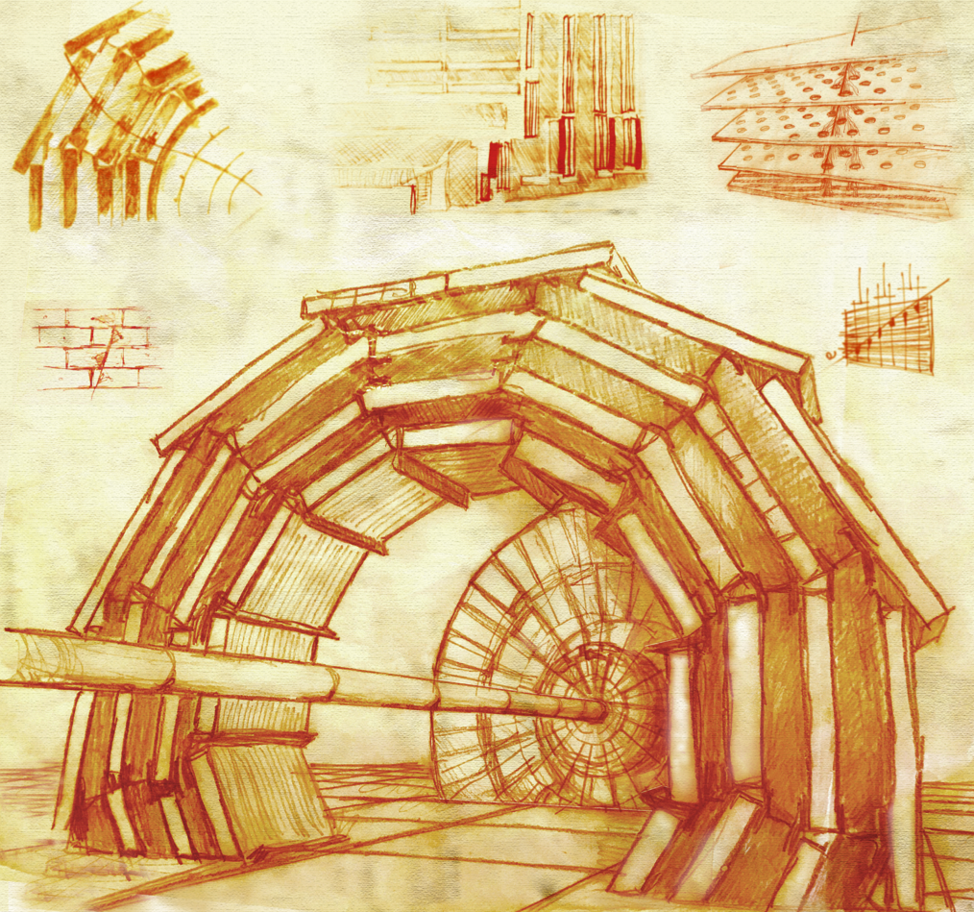
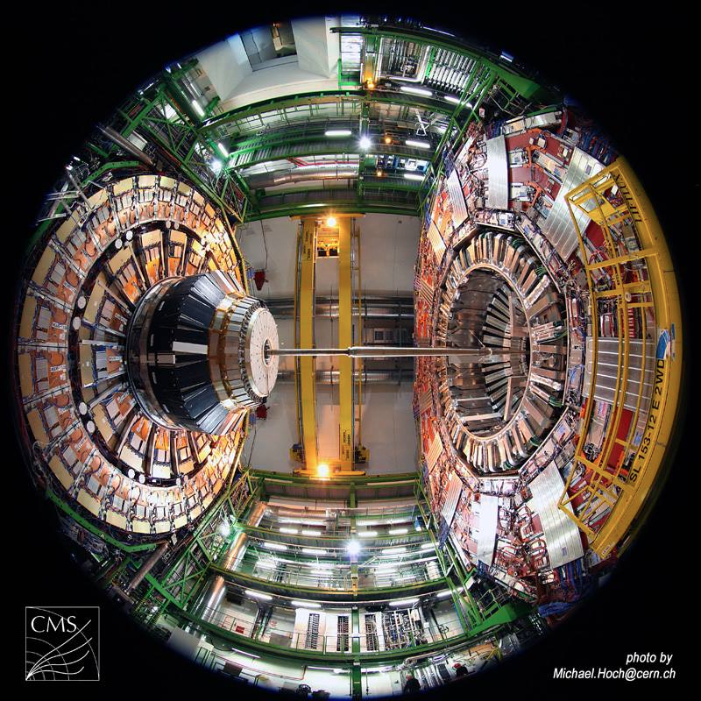
The Muon Detector at CMS
Gabriella Pugliese
INFN and Politecnico of Bari
on behalf of the CMS Experiment
XIII International Conference on New Frontiers in Physics, OAC, Kolymbari, Crete, Greece 26 Aug – 4 Sept 2024

Slide 2
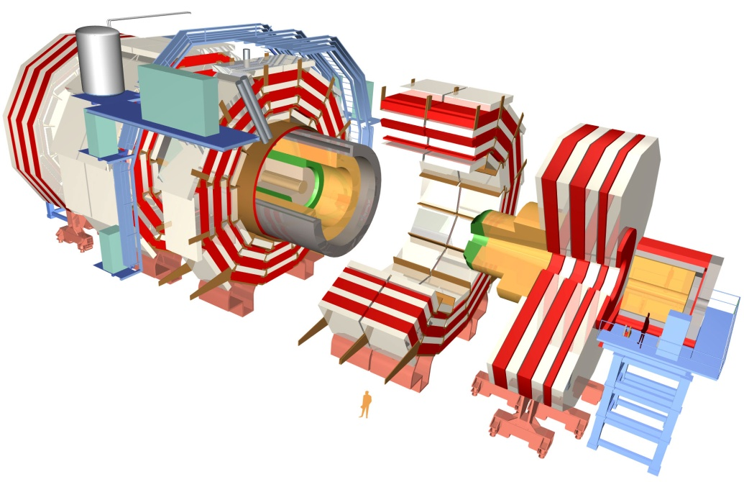
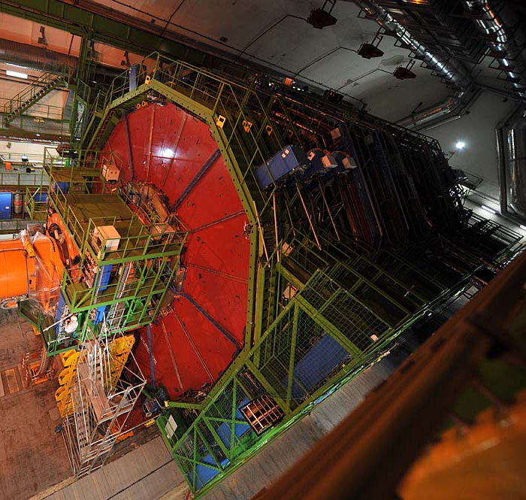
The CMS detector @ LHC
Endcap
Tracker
Barrel Region
Endcap
Electromagnetic calorimeter
Hadron calorimeter
Steel Return Yoke
Superconducting Solenoid
Niobium titanium coil carrying 18.000 A
Muon Spectrometer
Length: 28.7 m
Diameter: 15 m
Magnetic field: 3.8 T

Slide 3
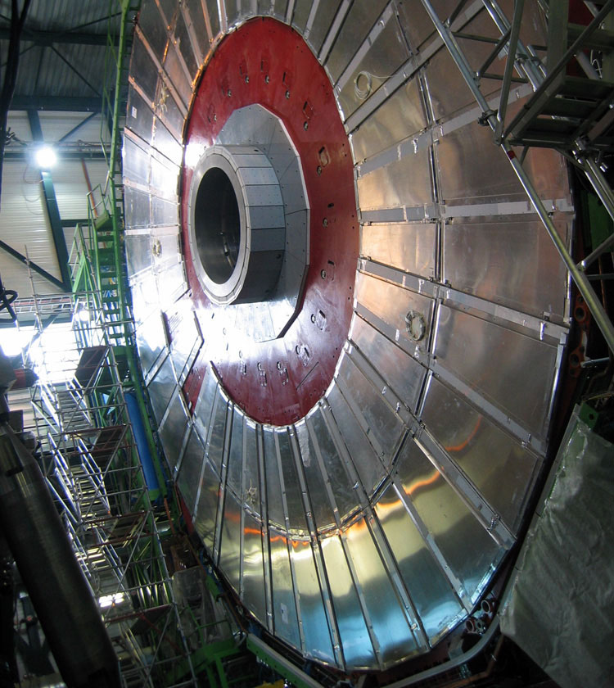
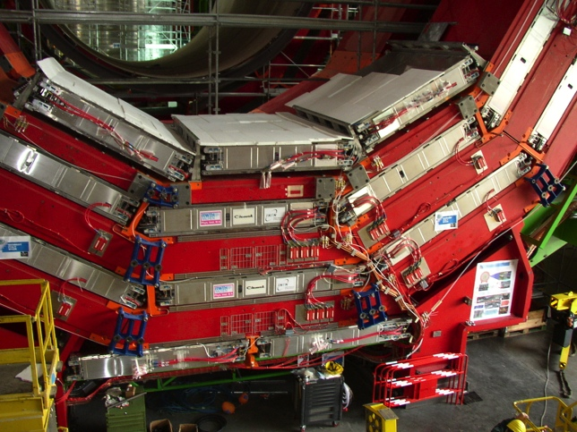
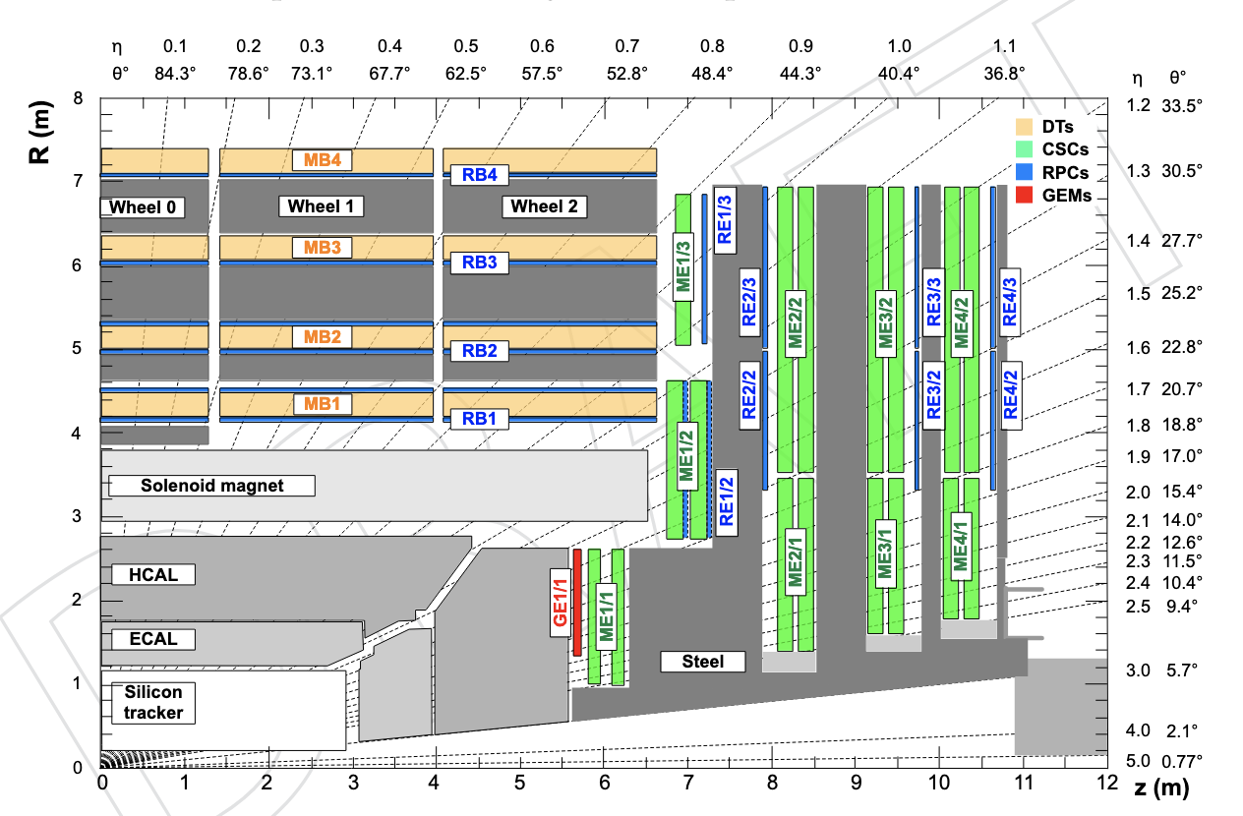
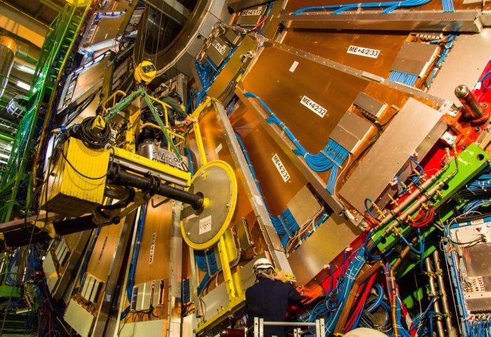
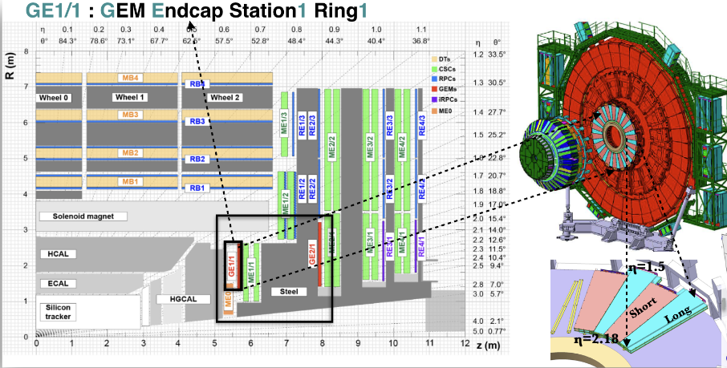
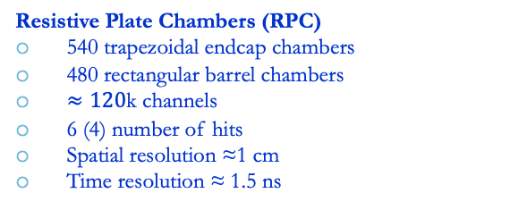
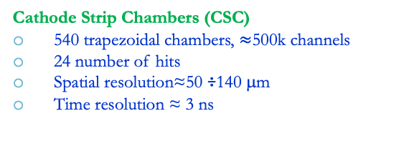
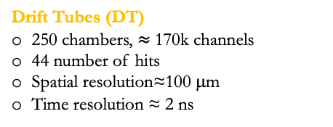
The CMS Muon Spectrometer
four
Muon system: three gaseous technologies for muon identification, timing and momentum measurement
Muon acceptance: |η| < 2.4
Drift Tubes (DT)
250 chambers, $≈$170k channels
44 number of hits
Spatial resolution≈100 μm
Time resolution ≈ 2 ns
Resistive Plate Chambers (RPC)
540 trapezoidal endcap chambers
480 rectangular barrel chambers
$≈120$k channels
6 (4) number of hits
Spatial resolution ≈1 cm
Time resolution ≈ 1.5 ns
Gas Electron Multiplier (GE1.1 installed in 2021):
72 Super-Chambers, consisting of two triple-GEM
2 number of hits
Spatial resolution≈100 mm
Time resolution ≈ 10 ns
Cathode Strip Chambers (CSC)
540 trapezoidal chambers, $≈$500k channels
24 number of hits
Spatial resolution≈50 ÷140 μm
Time resolution ≈ 3 ns

Slide 4
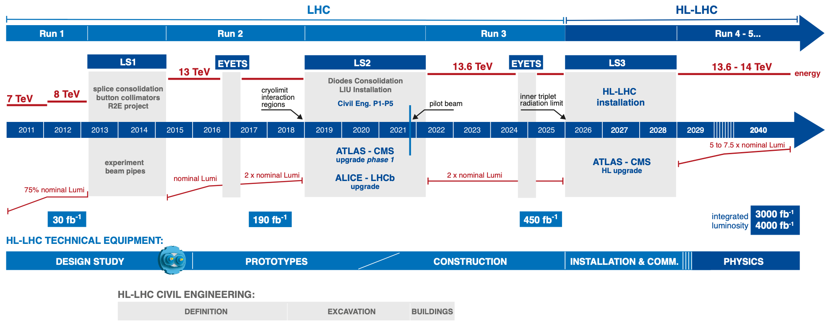
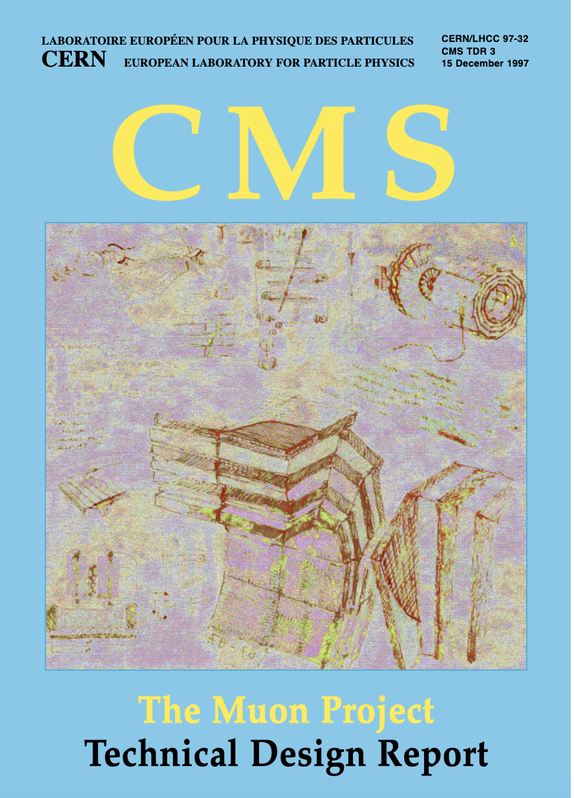
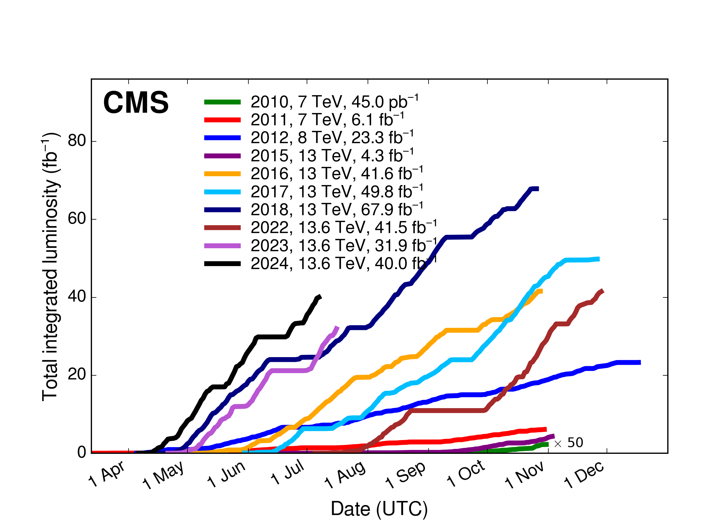
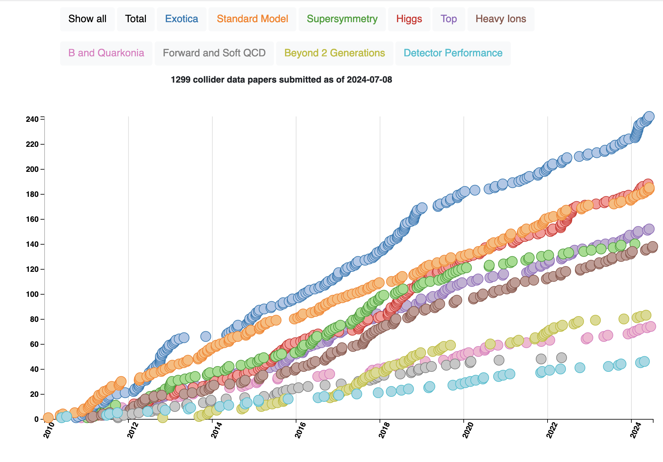
The CMS and LHC schedule
Today
Phase 1
Phase 2
R&D and production
Total integrated luminosity
Run 1 & Run 2
1299 papers published
1997 Muon Project TDR
2005-2008 Muons Chambers produced and installed
2010 Start of LHC
2013 The EU Strategy Report for High Energy Physics approved the HL-LHC as a priority project
2012 Higgs Discovery

Slide 5
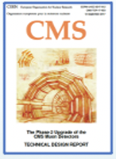
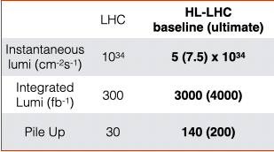
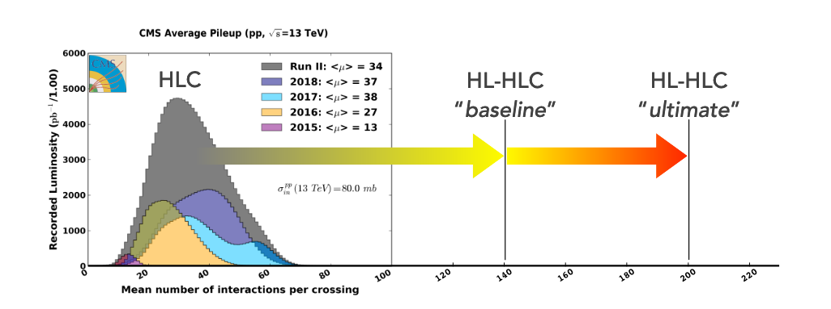
LHC and HL-LHC schedule
Today
Phase 2
Phase 1
Challenging conditions at High Luminosity LHC
2017 The Phase-2 Upgrade of the CMS Muon Detector TDR
CMS detector must be upgraded to cope with HL-LHC conditions (see R. Venditti’s talk)
Notes:
So far LHC has delivered 5% of the total planned integrated luminosity. By the end of RUN3, it will be double
Major HL – LHC challenges wrt. LHC:
The instantaneous luminosity will increase of a factor 3-4
The Pile-Up (PU) (interaction proton – proton collisions in each Bunch Crossing) up to 5 times
The integrated luminosity up to 10 times
higher rates and radiation doses (radiation damage of detector and electronics components)

Slide 6
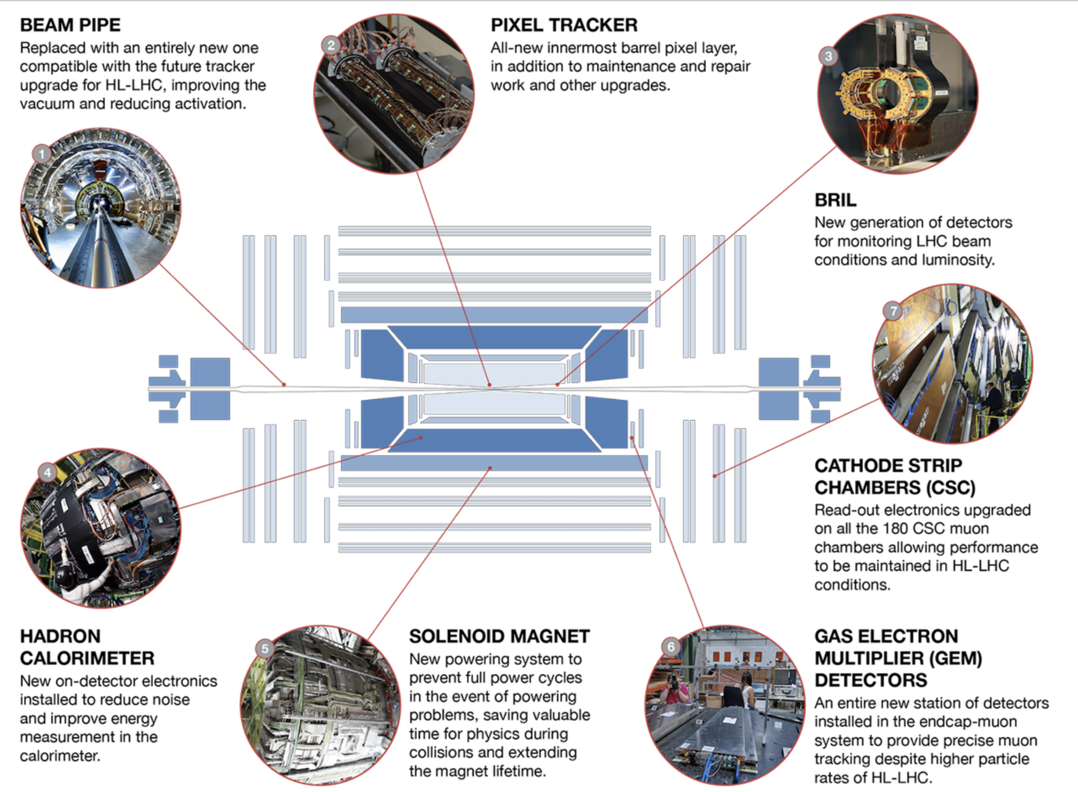
LHC and HL-LHC schedule
Today
Phase 1
Phase 2
Long Shutdown 2 (2019-2021):
Extensive work to upgrade the CMS detector because of the increase of energy and luminosity in Run 3 and beyond
New GEM chambers and CSC electronics in the Muon Spectrometer
https://home.cern/press/2022/CMS-upgrades-LS2
Notes:
Maintenance and repair activities
Hardware interventions to improve detector performance at HL-LHC (anticipating some work needed after LS3)
Installation of Muon and BRIL demonstrators
CMS detector re-commissioned with comic muons, pilot beam, splashes and collisions

Slide 7
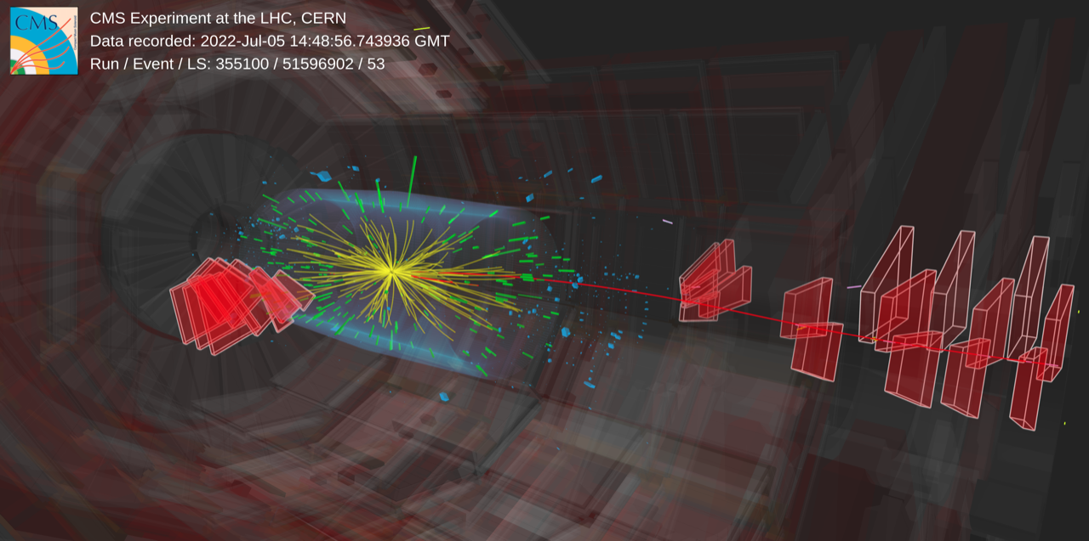
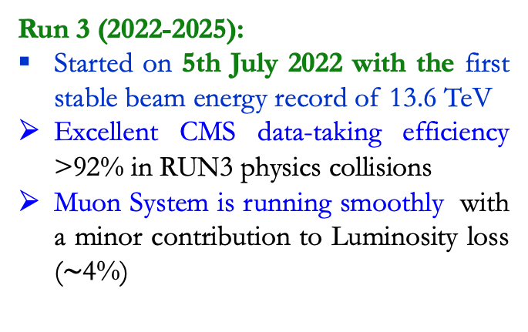
Run 3 operation
Today
Phase 1
Phase 2
Run 3 (2022-2025):
Started on 5th July 2022 with the first stable beam energy record of 13.6 TeV
Excellent CMS data-taking efficiency >92% in RUN3 physics collisions
Muon System is running smoothly with a minor contribution to Luminosity loss ($\sim$4%)
Run3
Notes:
Maintenance and repair activities
Hardware interventions to improve detector performance at HL-LHC (anticipating some work needed after LS3)
Installation of Muon and BRIL demonstrators
CMS detector re-commissioned with comic muons, pilot beam, splashes and collisions

Slide 8
Muon performance in RUN 3

Slide 9
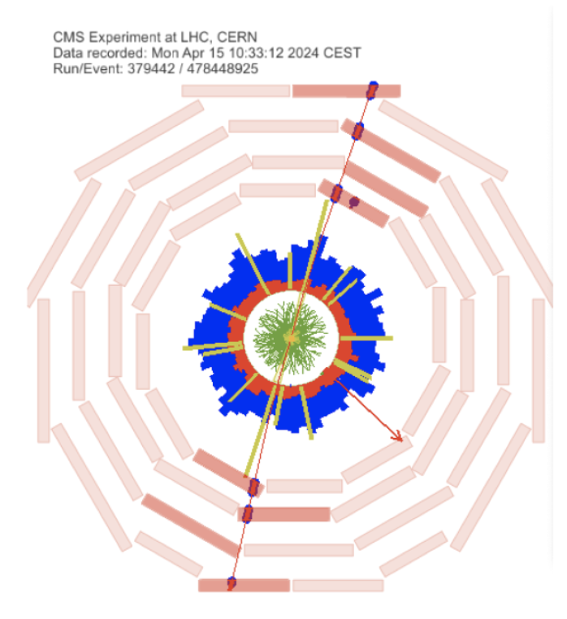
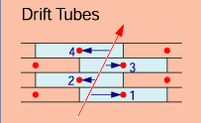
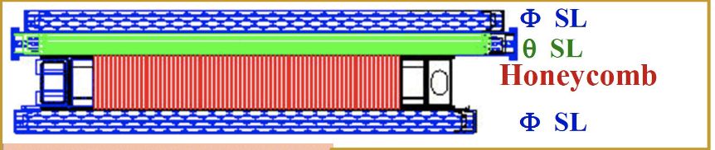
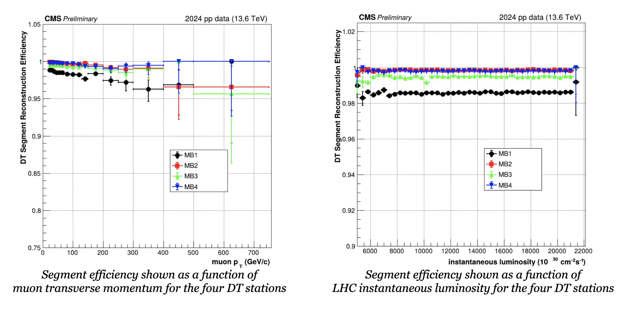
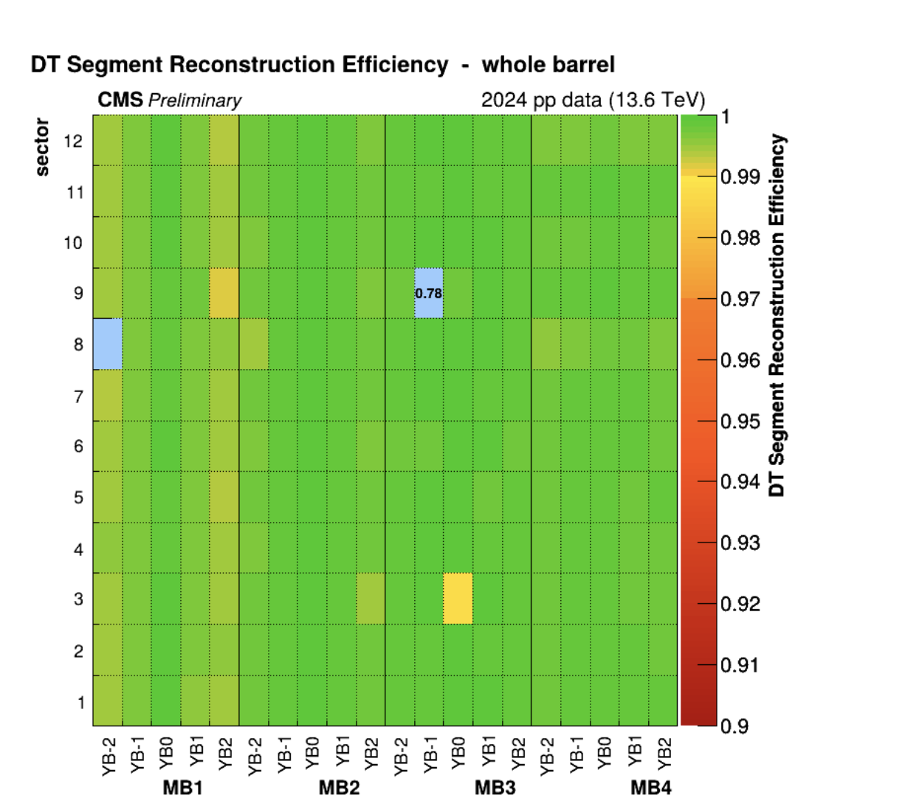
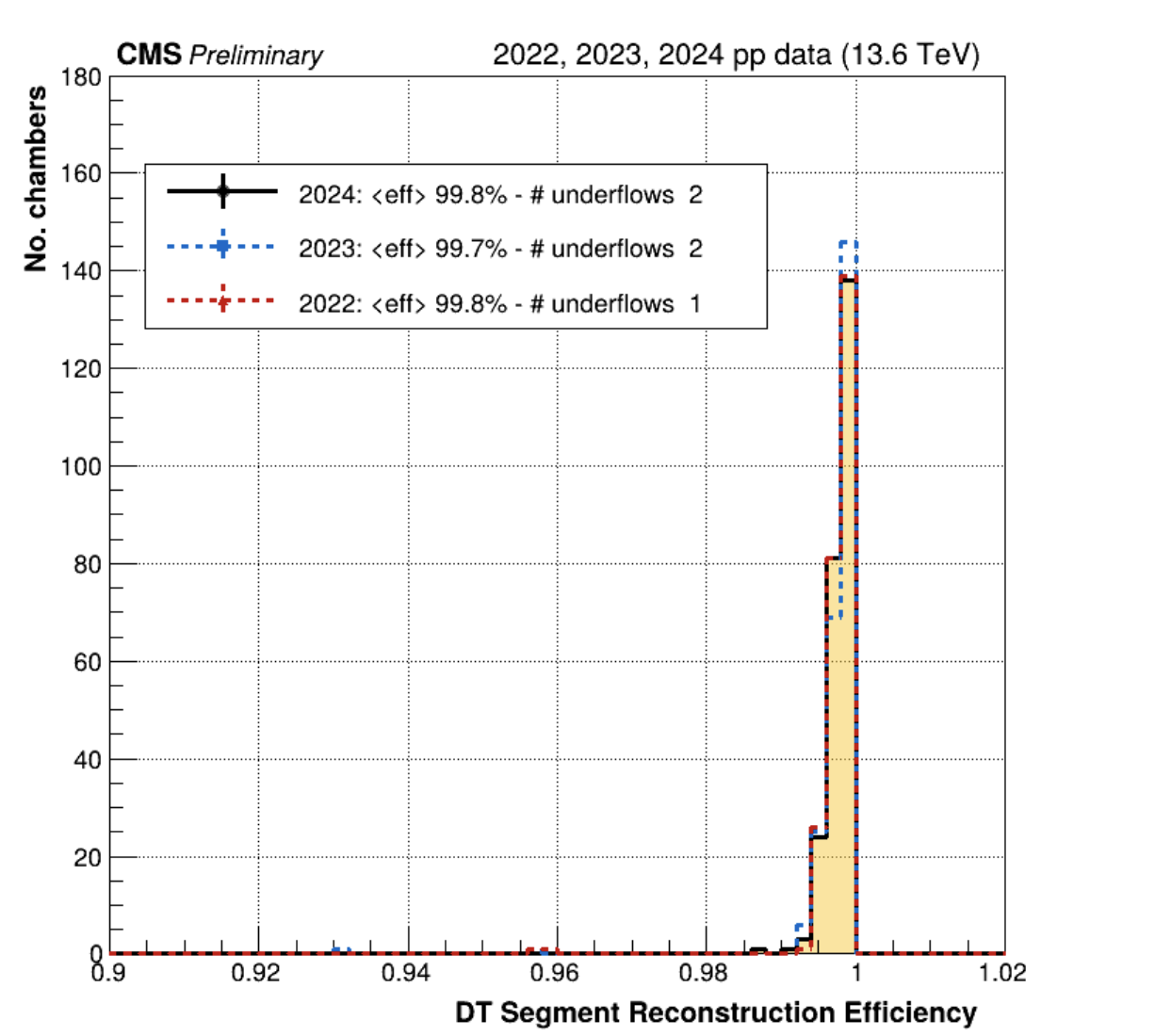
DT Segment Efficiencies in Run 3
Segment efficiency is studied with Tag &Probe method on di-muons
DT segment efficiency is more than 99% with few exceptions due to known hardware problems (one chamber in Wheel -2 Sector 8 MB1 is not working because of a gas connection problem and will be fixed over the coming YETS)
Stable in time and with luminosity

Slide 10
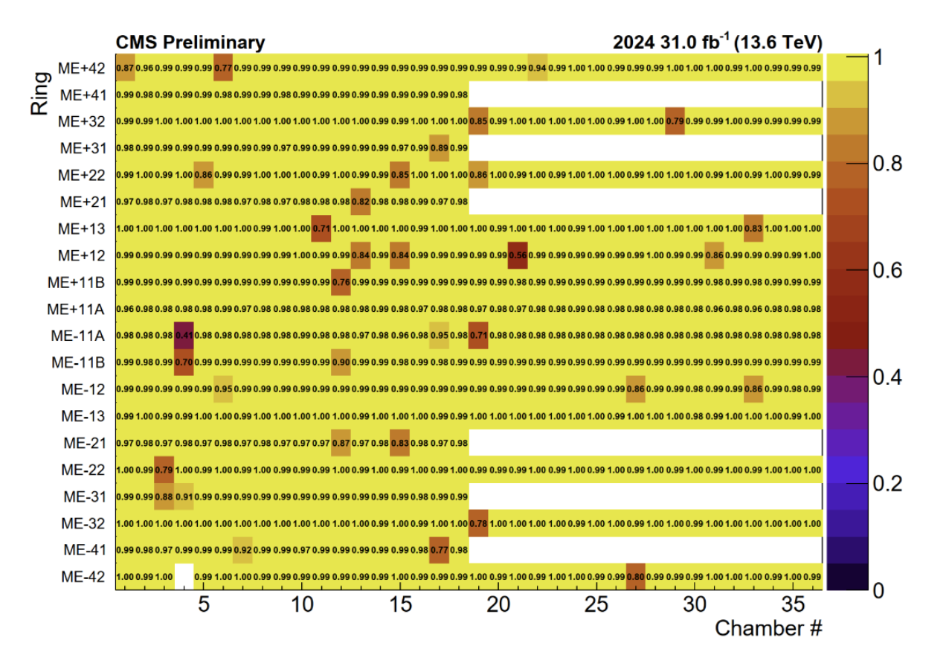
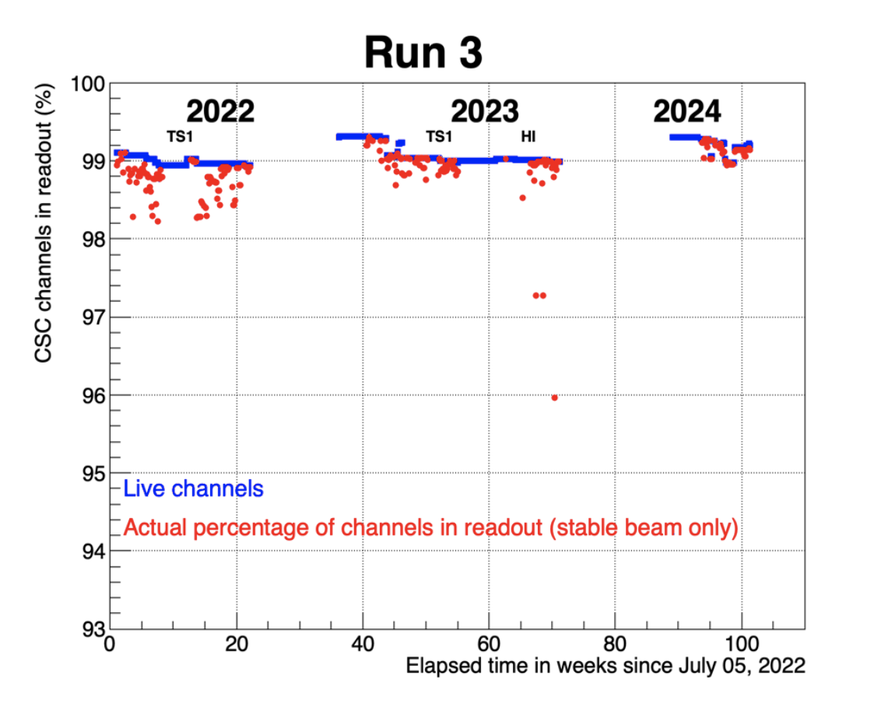
CSC performance in 2024
99%
CSC Segment efficiency: more than 98% of the CSCs is operating at close to 100% efficiency. Few chambers with lower efficiency are due to known reasons (electronics board failures, that cannot be fixed without access to the chambers, or accessional temporary failures
  Stable active channels fraction

Slide 11
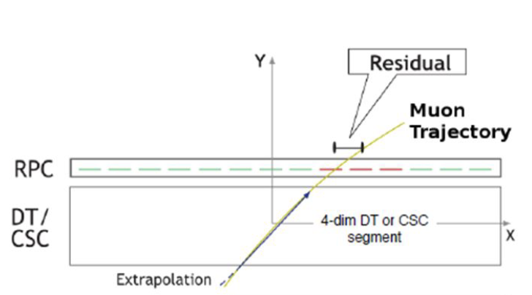
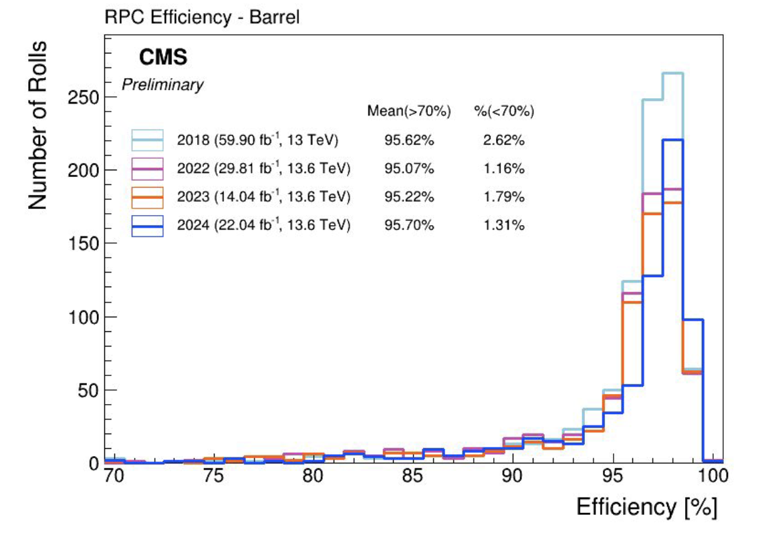
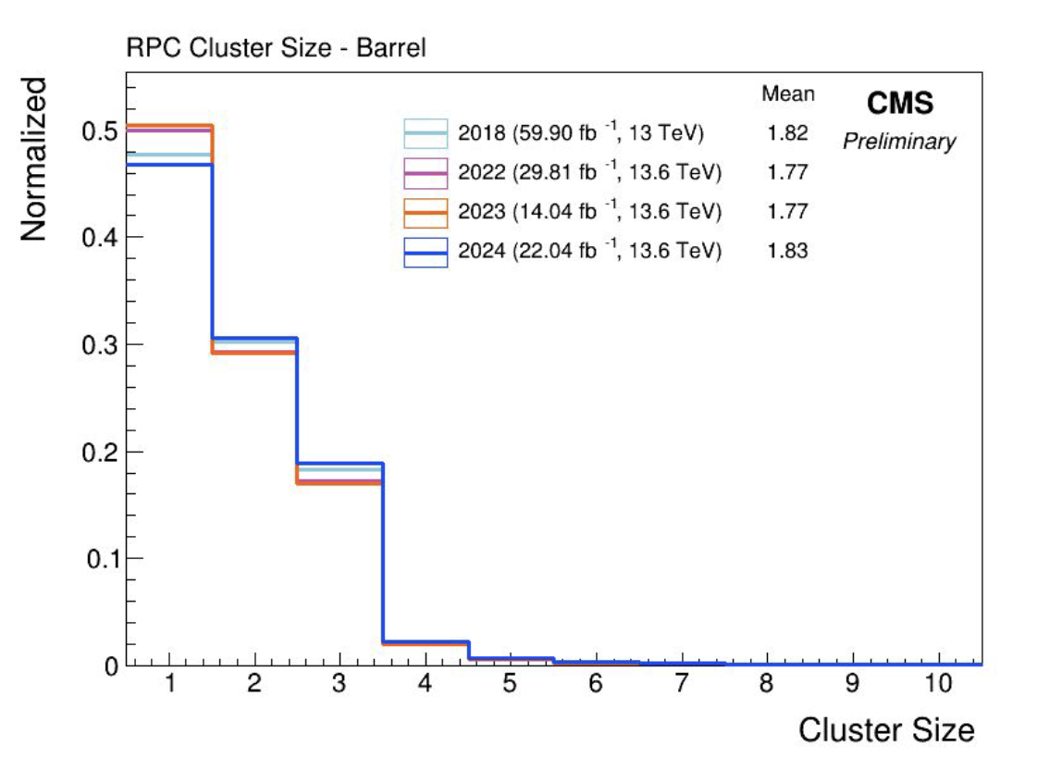
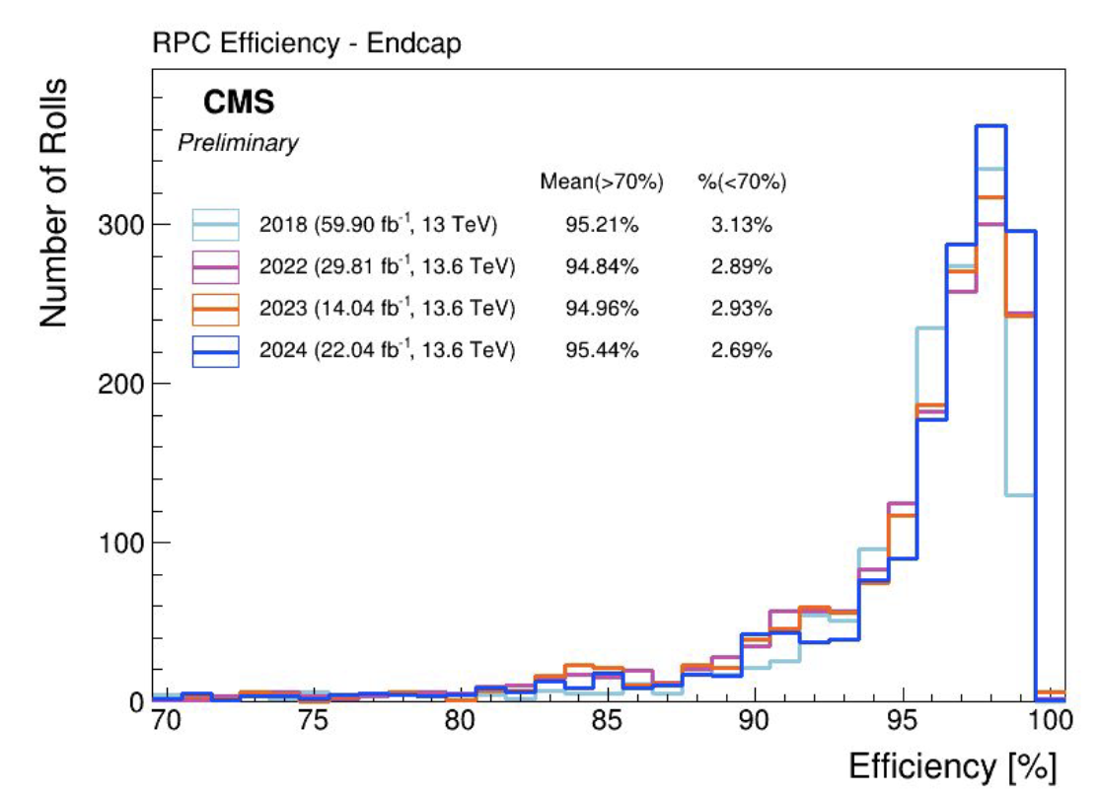
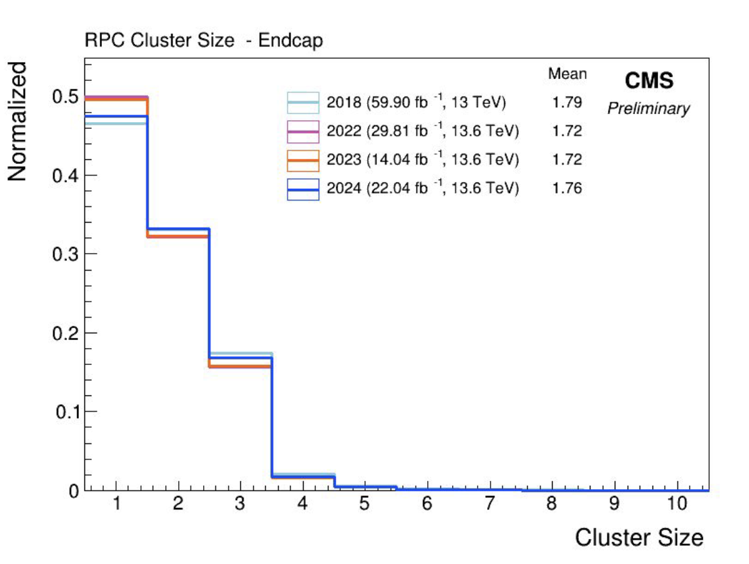
RPC performance in Run 3
(Barrel region)
RPC performance is measured using the Segment Extrapolation Method where DT/CSC Segments (in the Barrel/Endcap) that belong to a standalone muon track with timing corresponding to RPC readout BX windows are selected and extrapolated to the plane of a given RPC
Barrel
Barrel
Stable RPC performance in RUN 3 and RUN 2
Endcap
Endcap
RPC Efficiency distributions
RPC Cluster size distributions

Slide 12
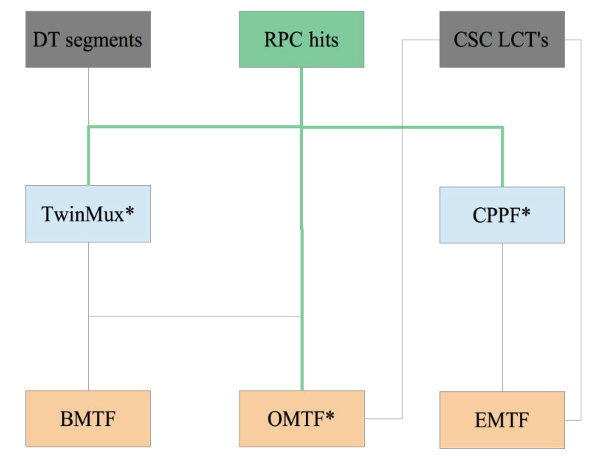
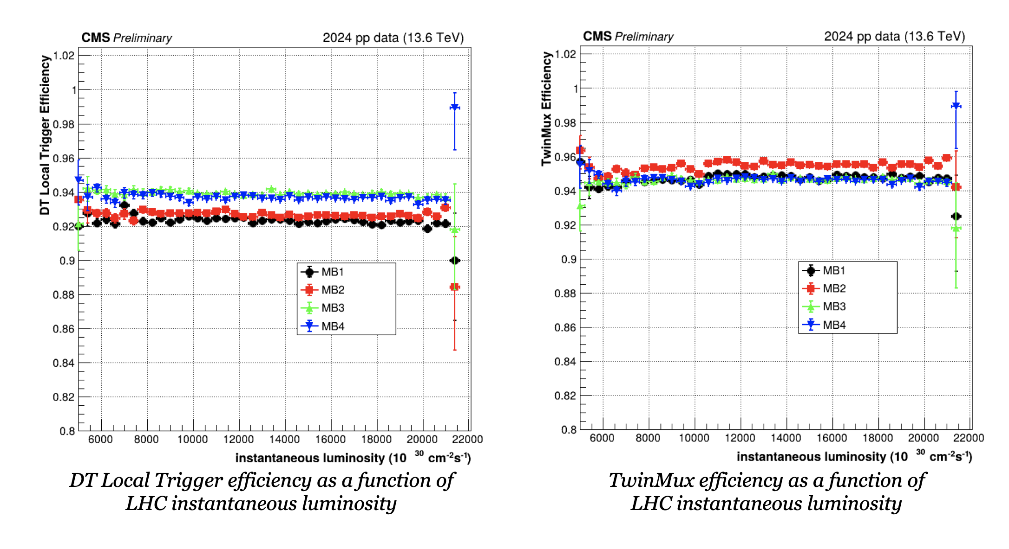
Local trigger and TwinMux performance
In the Barrel region, DT and RPC information is processed in two stages to provide optimal online reconstruction inputs to Level-1 Muon Trigger Track Finders.
In the first layer, TwinMux boards match RPC hit clusters with DT Local Trigger segments to:
  recover DT inefficiencies using RPC-only primitives (limited to MB1 and MB2 stations)
  improve BX identification efficiency by taking advantage of the RPC's excellent time resolution
DT local trigger and TwinMux efficiency are both stable as a function of LHC instantaneous luminosity
TwinMux efficiency is higher than the DT local trigger efficiency of:
  ~3% in the MB1 and MB2
  ~1.5% in the MB3 and MB4
Notes:
…. making the best out of DT spatial resolution and RPC time resolution
RPC timing used to assign the bunch-crossing of DT segments without 8 fired layers

Slide 13
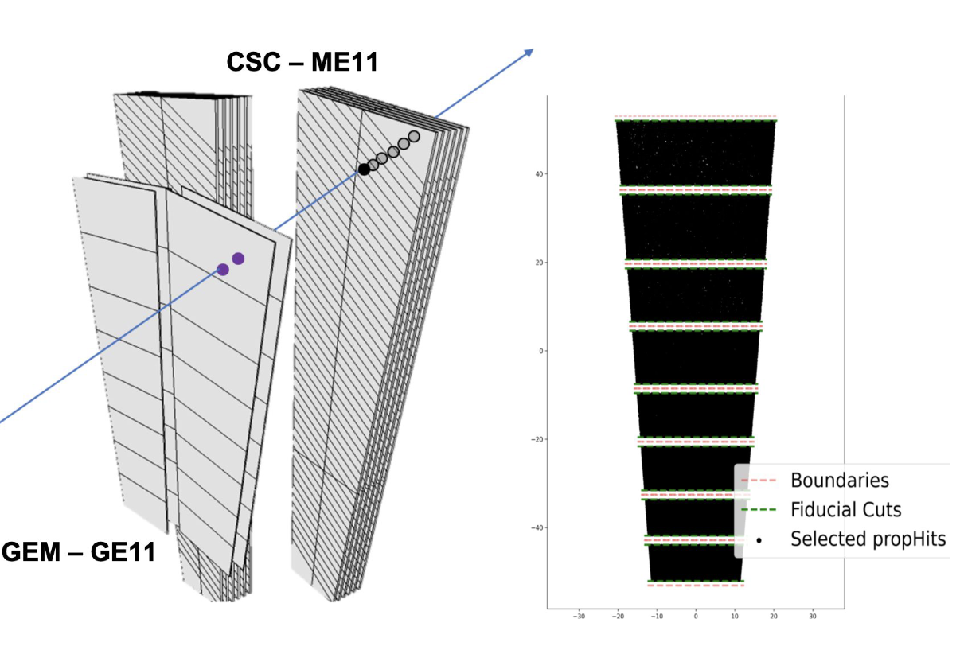
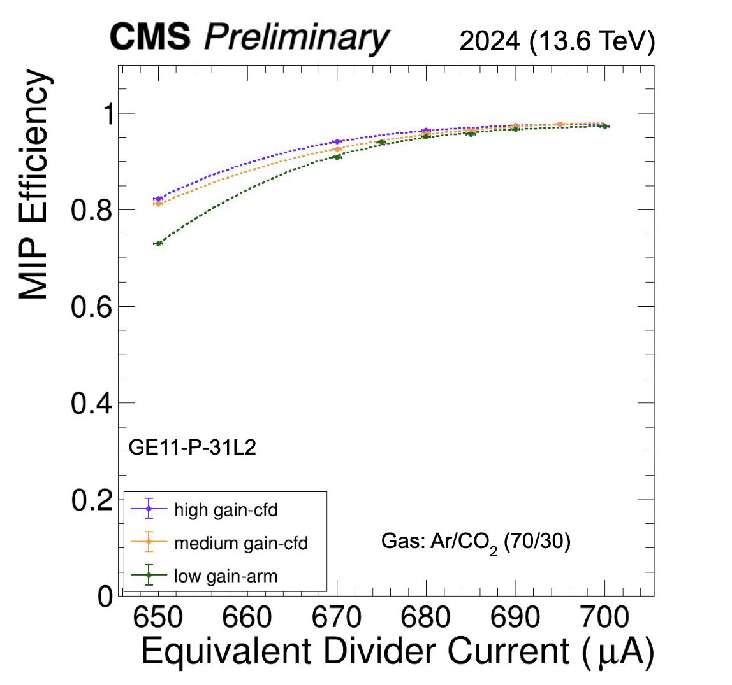
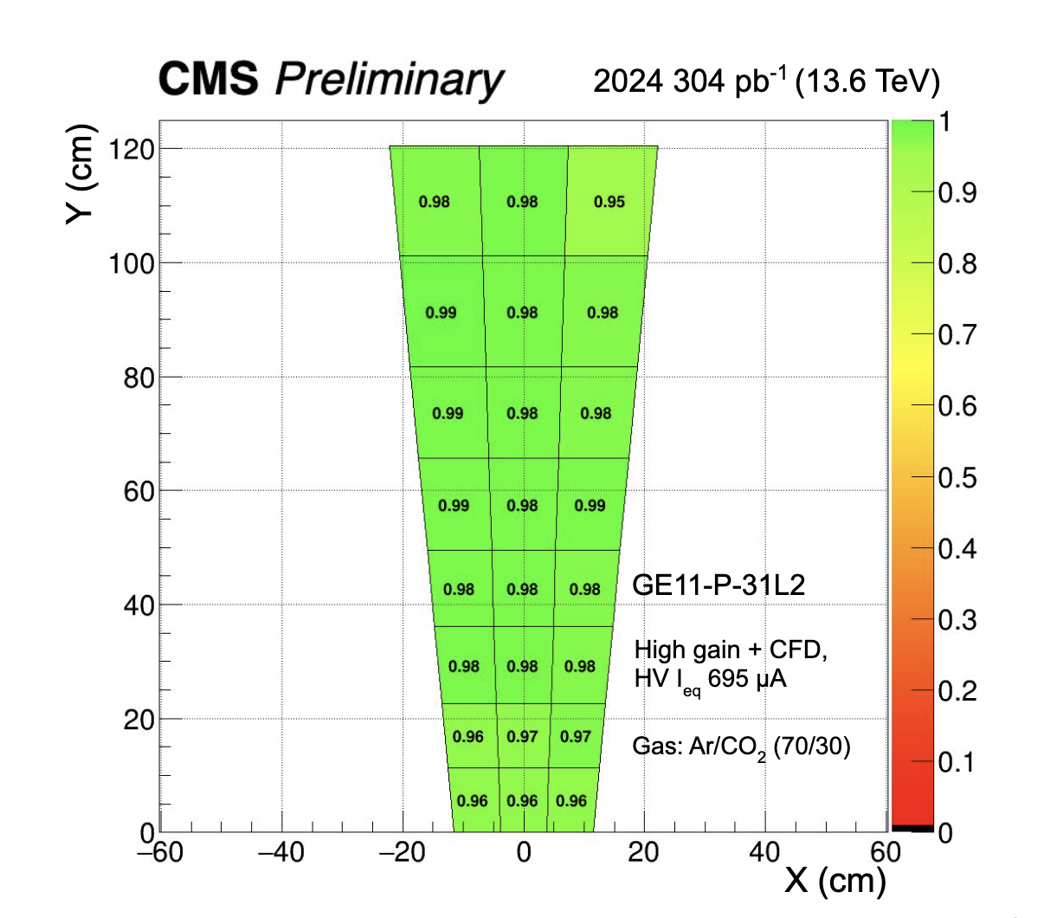
GE1/1 calibration in 2024
Calibration runs were taken in 2024 at different HV settings and Frontend chip (VFAT) configurations:
○ Pre-amplifier [low, medium, high] gain
○ Comparator mode [ARM, CFD].
GEM analysis done using events with standalone (STA) muons (p_{T} > 10 GeV, with at least 15 hits in the muon system, and χ₂ < 5) and with hits in the CSC companion station (i.e. accept a track through GE1/1 only if it contains ME1/1 hits)
GE1/1 efficiency vs. current
GE1/1 efficiency map

Slide 14
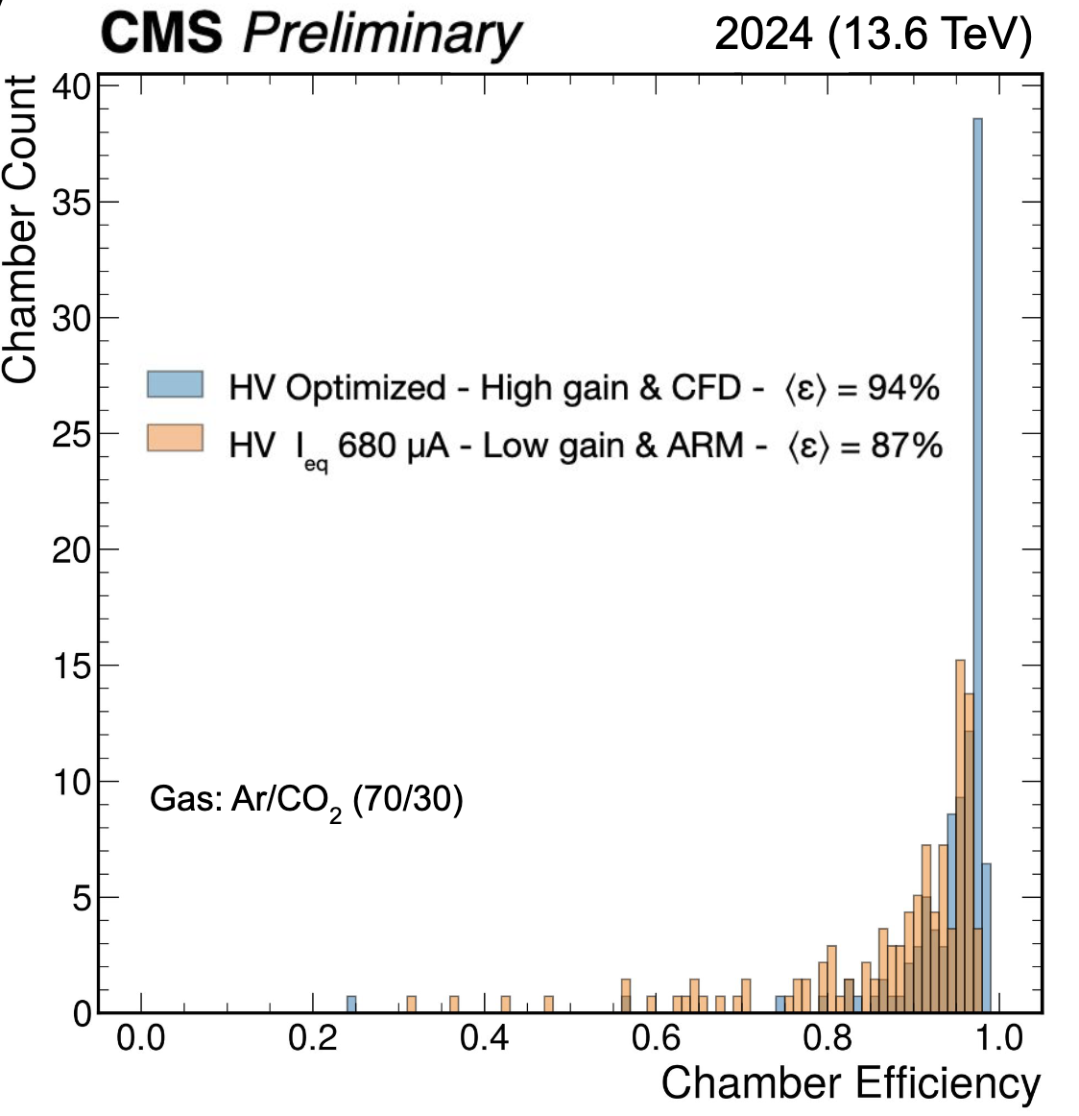
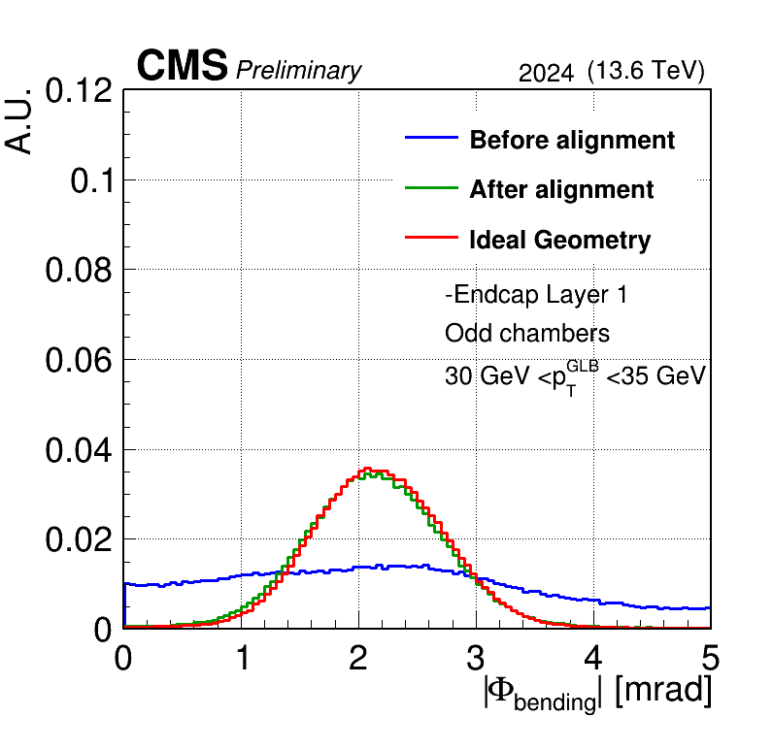
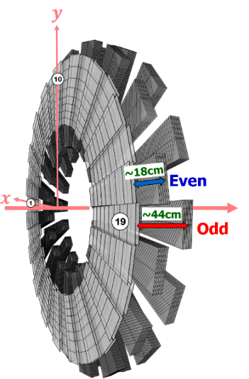
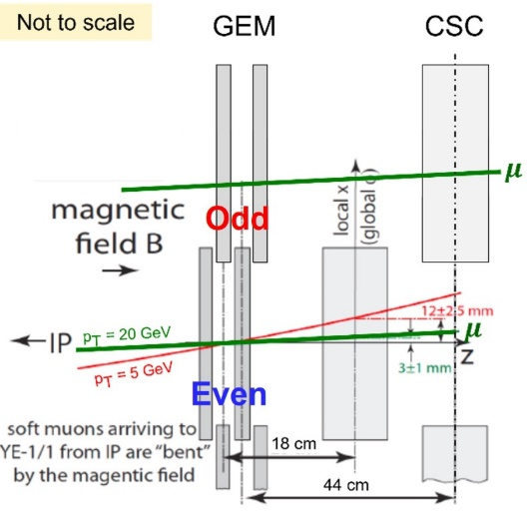
GEM performance in RUN3
Based on the 2024 calibration results, a new HV setting was applied in June, increasing significantly the GE1.1 efficiency to 94% (with an HV-optimized and High gain Constant Fraction Discriminator)
Fully validated the alignment for trigger capability: the Banding Angle distributions after the alignments are close to the ideal case

Slide 15
Muon Upgrade project for the HL-LHC period

Slide 16
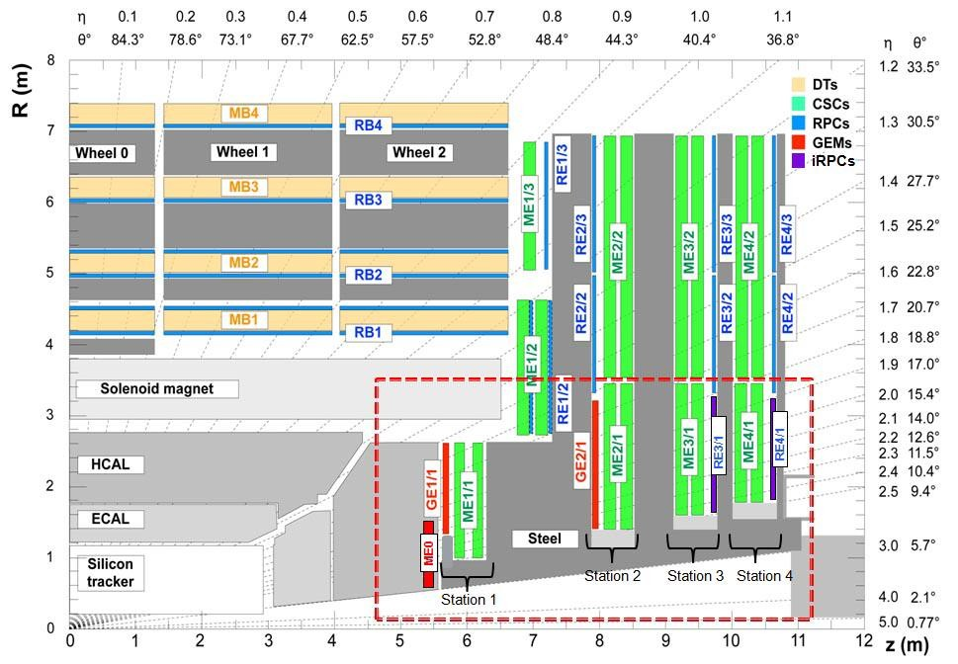
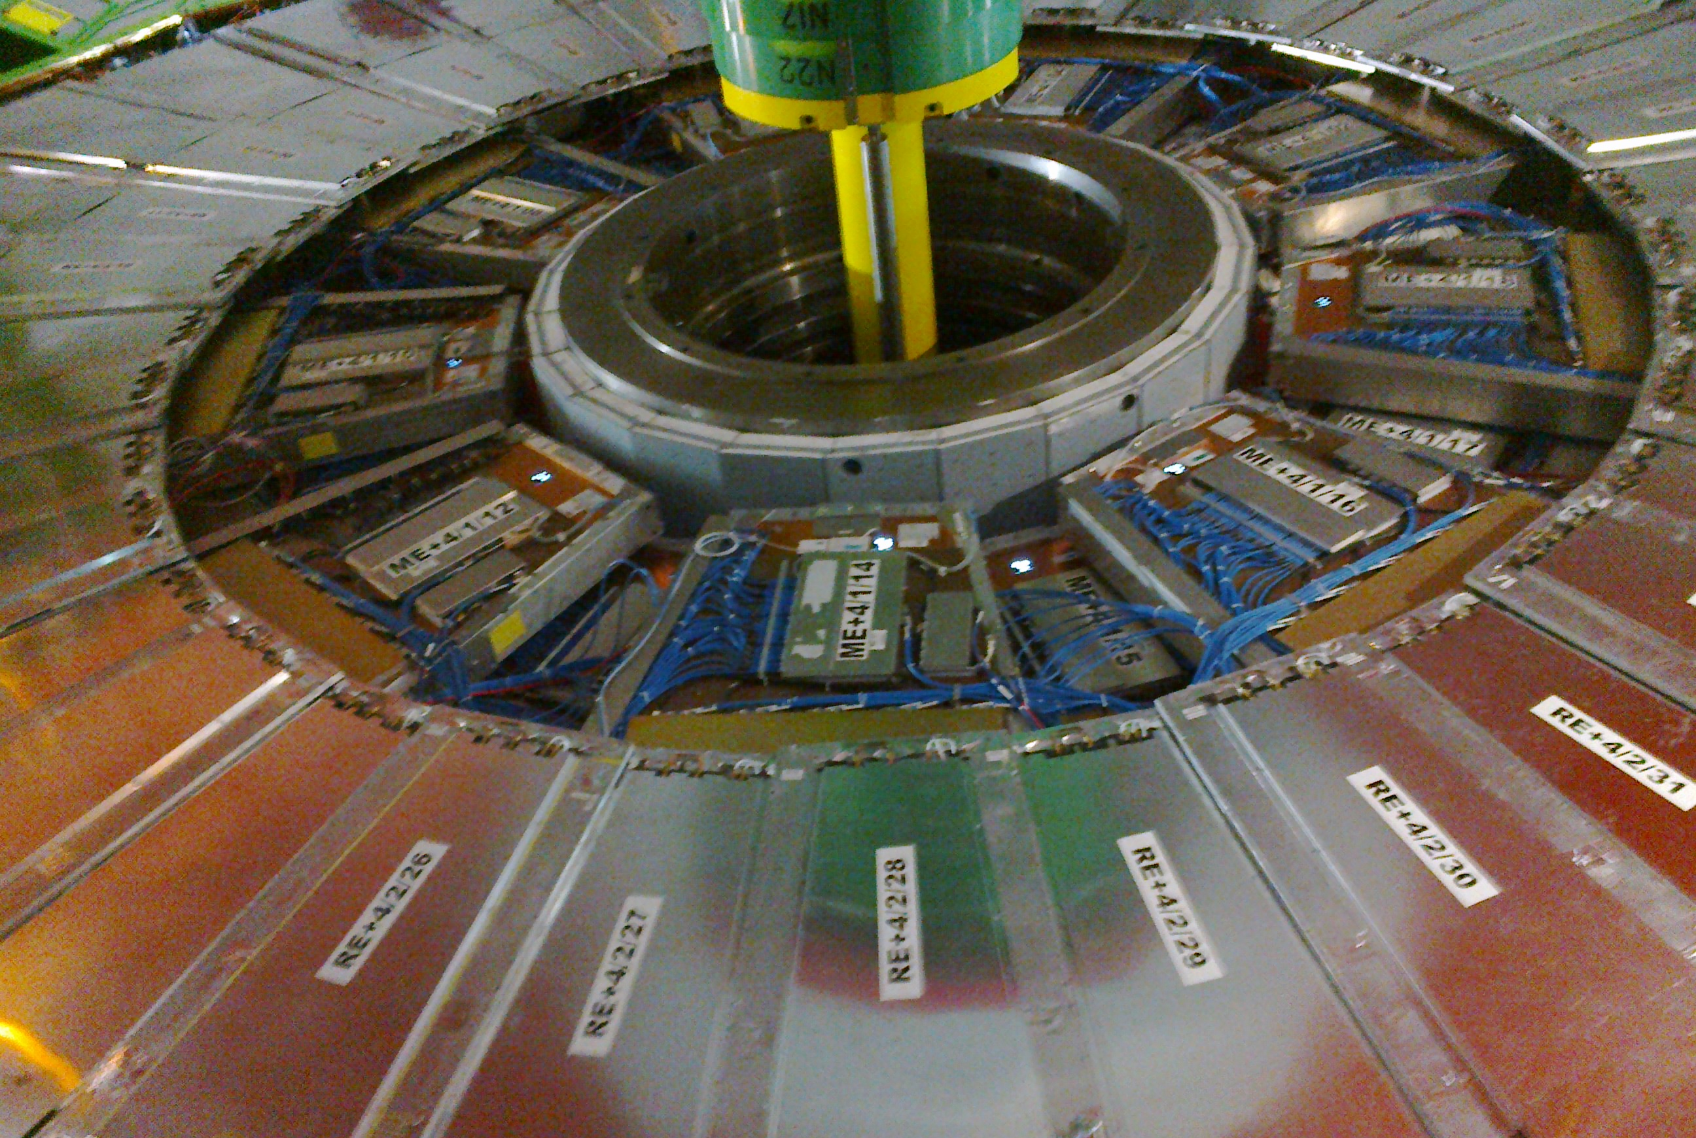
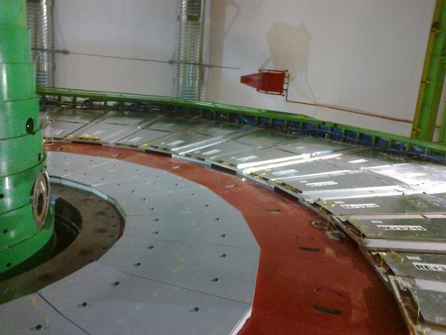
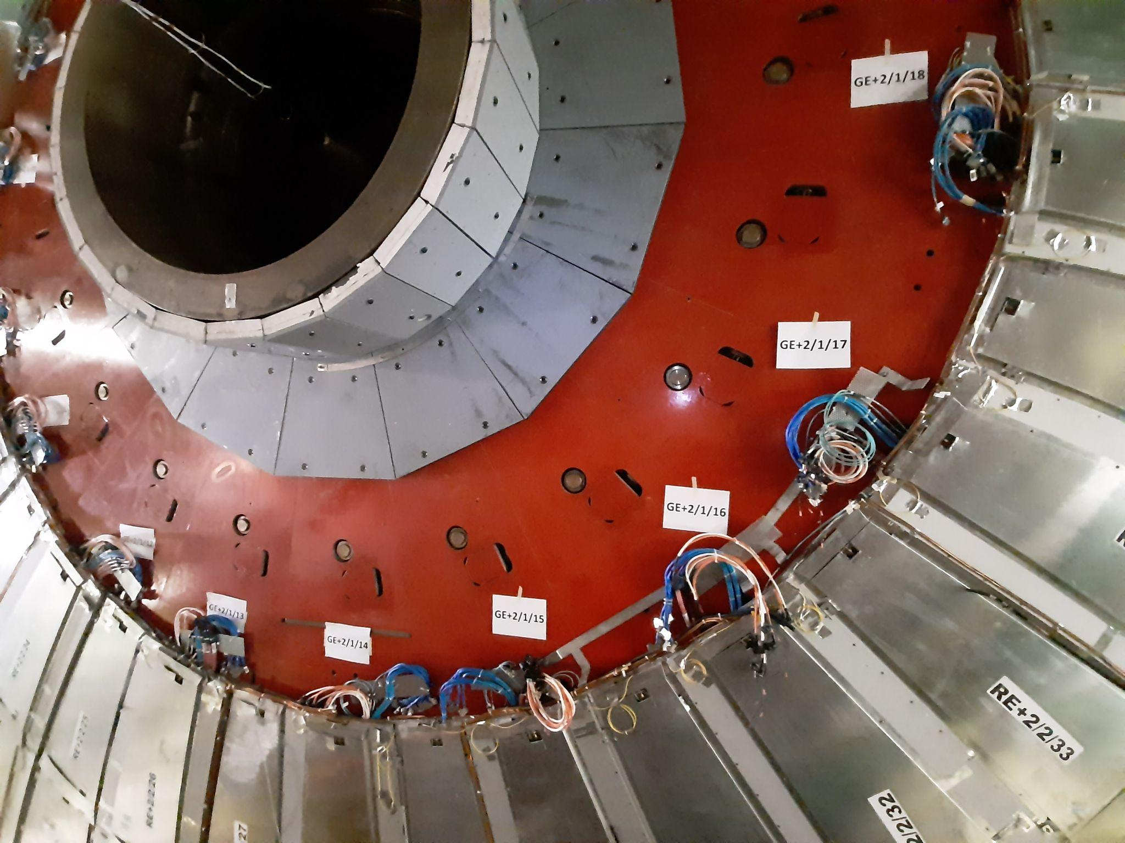
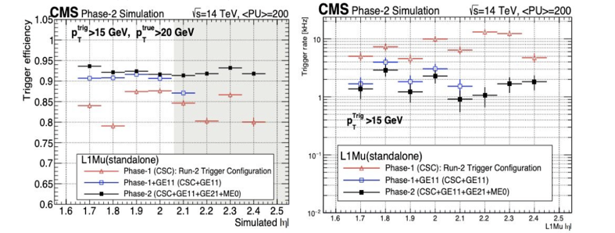
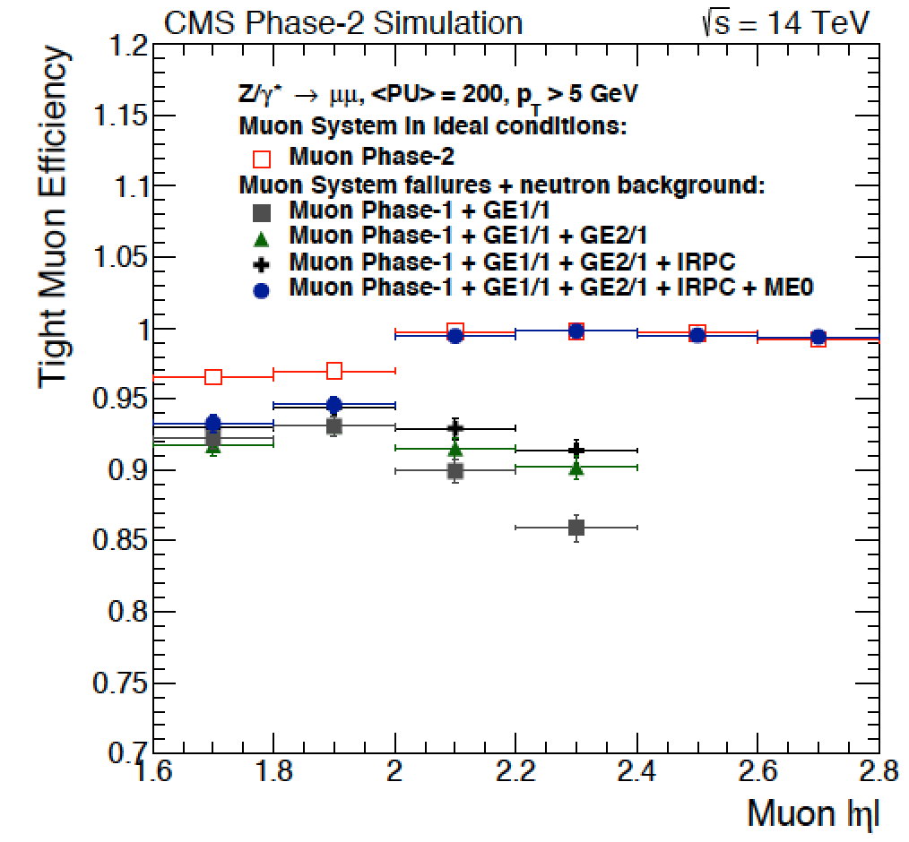

Muon Upgrade Project
  New detectors will be installed in the high-eta region to:
  Restore redundancy
  Extend the muon coverage up η = 2.8
  Improve Trigger efficiency without increasing the trigger rate
  Improve Muon reconstruction
RE4/1
ME0
GE2/1
RE3/1
New electronics for the legacy detectors:
DT: replace all on-board electronics (OBDT), BE
RPC: replace all off-chamber electronics, BE
CSC: replace selected FE boards, replace all BE
3. Longevity Studies (including the use of ecological gas mixtures, see L. Congedo’s talk)

Slide 17



The CSC Upgrade
The majority of the CSC upgrades was completed in LS2 (anticipating some activities originally scheduled for LS3)
In LS3, the CSC upgrade will focus on oﬀ-detector upgrade, including the replacement of the data Motherboard with new version boards (Optical DMB) and the upgrading of the BE
A total of 72 ODMB7 boards for ME1/1 & 108 ODMB5 boards for ME234/1 need to be produced
ODMB5/7 status:
  The pre-production boards were designed, produced, and tested
  The design was finalized after going through various irradiation tests on diﬀerent components
  Production is on schedule: the boards will be tested at UCSB (University of California) and are expected at CERN in early spring 2025

Slide 18



The DT Upgrade
In LS3, the DT upgrade will focus on:
New On-Board DT (OBDT) electronics for Theta/Phi chambers:
    TDCs implemented in FPGA
  Improved performance, radiation hardness, and simplified maintenance
  Comply with HL-LHC requirements
The new Trigger logic system moved to the back-end outside of the CMS cavern with the following improvements:
  Trigger Primitives are built by exploiting the ultimate DT cell resolution
  Increased flexibility in combining DT and RPC hits to form TPs
  Enhanced resilience to detector aging and failures
The OBDT prototypes have been fully validated (see the next slide)
The DT Upgrade production has started and is on schedule
OBDT Prototype v2.0

Slide 19




DT Upgrade: slice test
To test the new electronics under realistic conditions in the CMS environment, a DT slice-test demonstrator has been running since 2019. The data from two sectors have been split and read by both the legacy and new OBDT electronics (initially sector 12 was equipped with OBDTs v1, and later sector 1 with the OBDTs v2)
S1
Occupancy map for one chamber is as expected
S12
Time measurement distribution: it is visible the beam structure with 5 bunch trains of 12 colliding bunches each plus two single colliding bunches
The local trigger performance has a resolution comparable to the offline reconstruction

Slide 20



RPC Upgrade
New RPC Link system
New Improved RPCs for Ring 1 of end-cap discs 3/4 (RE3/1, RE4/1)
New Link System:
  Improve Trigger hit time resolution from 25 ns to 1.56 ns
  Data transmission speeds up to
10.24 Gbps
1 chamber =1.6x 1.2 m²
Total 72 iRPC (20⁰) chambers
- 1.8< |𝜂| <2.5

Slide 21



New RPC Link System Upgrade
In LS3 the current RPC Link system will be replaced with a new higher-performance Link System
Key Features of the new Link System
  14 Layer PCB, 40 × 28 cm2
  FPGAs are KINTEX-7, XC7K160T – Industrial Version
  Muon hit time, TDC timing Resolution: 1.56 ns
  Master Link board output data rate: 10.24 Gbps
  Control Board communication with RPC Backend electronics: 4.8 Gbps
Project status:
The irradiation tests of various components and FPGAs for the new boards are completed. The electronics meet the HL-LHC radiation requirements with high safety factors
A demonstrator was installed at the CMS in February 2024 to monitor system behavior under realistic conditions. The system has operated continuously and reliably for five months, with no change in performance or stability
Pre-production is expected to be delivered to CERN by the end of 2024
New Link System (left) and present Link System (right) at CMS experimental cavern (UXC)

Slide 22







iRPC Design & Performance
  New detector geometry, strip layout and Font-End Board electronics (2D readout)
  Requirements:
    Space resolution (cm): 1.5 in η and 0.3-0.6 in φ
    Time resolution (ns): 0.5 ns
    Rate capability: 2 kHz/cm²
iRPC Chamber
Two FEBs per chamber
New Strip PCB to allow the return line concept
To back-end board
FEB positioned external and @ lowest dose region
Prototype performance satisfies all requirements
Space resolution: 0.4 cm in φ and 1.6 cm in η
Timing resolution: 780ps/√2= 550 ps
Efficiency @ 2.3 kHz/cm² : 95 %
Working Point = 7.2 kV
Notes:
thinner gas gap and electrode thickness
Timing resolution performed with 2 identical chambers and a muon beam. Absolute timing resolution of the system after alignment by back-end:

Slide 23





GEM Overview Project
3 stations will be equipped with detectors based on Gas Electron Multiplier (GEM) Technology
  GE1/1, GE2/1 : complementing CSC in forward region (Station 1 & 2 for Ring 1 )
GE1/1 & GE2/1
Both GE1/1 & GE2/1 are based on the same mechanical design principle: 2 triple GEM detectors per Super-Chamber (SC)
GE1/1 : 72 SC (36 per endcap)
10° in φ from 1.6< |𝜂| <2.1
GE2/1 : 36 SC (18 per endcap)
20° in φ from 1.6< |𝜂| <2.4
ME0
  ME0: Extending muon system acceptance in the very forward region up to |𝜂| < 2.8
18 ME0 stack per endcap, each made of six layers of triple-GEM detector for efficient tagging of muon tracks
New Radial GEM foil segmentation w.r. to beamline to equalize the background rate (changed wrt original horizontal design)

Slide 24





ME0 Performance
Requirements :
  97% module efficiency
  < 500 𝜇rad resolution
  8-10 ns time resolution
  ≤ 15% gain uniformity
Rate capability: 150 kHz/cm²
Radiation hardness: 7.9 C/cm²
Detector prototype performance satisfies all requirements:
The First ME0 stack prototype was assembled and tested at CERN 904 laboratory and in several test beams
Spatial Resolution: 240 μrad
Efficiency locally > 99%
Rate capability: 2.5% efficiency loss with the highest background (loss in highest eta region) mitigated (1%) by the redundancy
Average time resolution of track segments as a function of the number of ME0 chambers (layers) used to reconstruct the segment.
The time resolution 5.4 ns for 6-layer segments
Notes:
ME0 design validated in test beams, also with high background (more details in T. Sheokand talk)
Preproduction started, installation schedules in early LS3

Slide 25




The first iRPC and GE2/1 installed in CMS
The first GE2/1 and iRPC chambers were installed in CMS during the last Extended Year End Technical Stop to gain operational experience and perform preliminary measurements of background, noise, performance
Preliminary results are satisfactory!
RPC Average noise ~ 0.2 Hz/cm²
GE2/1 efficiency map

Slide 26
Conclusions
The CMS Muon system is operating extremely well, delivering good triggers and data for physics. After 14 years of LHC running with increasing instantaneous luminosity and 20 years since construction, the Muon detector performance remains within specifications both as a triggering and as a reconstruction system.
To meet the HL-LHC challenges & maintain the high performance of the CMS Muon system, several upgrades were planned and some of them have already been successfully implemented for Run 3.
The prototypes of the new muon stations (GE2/1, ME0, RE3/1, RE4/1) have been fully validated satisfying the requirement, and production started
Present detectors (DT, CSC & RPC) which will continue operating until the end of LHC operations, are going for the electronics upgrade to sustain the challenging phase-2 conditions. Pre-production boars have been fully validated and production started
To address the challenges posed by the HL-LHC conditions & maintain high performance of the CMS Muon system, several upgrades have been planned and some have already been successfully implemented for Run 3 (GE1.1 and CSC electronics)
The present detectors (DT, CSC & RPC), which will continue operating until the end of LHC operations, are undergoing an electronics upgrade to withstand the demanding conditions. The pre-production boars have been fully validated, and production started
The prototypes of the new muon stations for the high eta region are fully satisfying the requirements, and production has started

Slide 27


Thanks!
Credits
to CMS People

Slide 28
Backup slides

Slide 29

RPC performance in Run 3 (Endcap region)
Endcap RPC efficiency and cluster size distribution in Run2 (2018) and Run3 (2022, 2023, and 2024)
Stable Endcap RPC performance in RUN 3 and in agreement with previous runs

Slide 30




Background reduction in 2024
A New Forward Shielding (NFS) was designed to reduce background in the cavern detected by the muon detectors. In the last shutdown, it was installed only on the negative side
Significant reduction of the currents and hit rates observed mostly in the outermost layer of the Muon System (MB4 and ME4)
52 % reduction
56 % reduction
DT Background currents and rates versus instantaneous luminosity in one MB4 sector of W-2 as measured in 2024 and 2023
Notes:
which will receive from now
on a much lower dose than before.
240 tons of additional shielding material:
90% Concrete
10% Steel

Slide 31

Background in 2024
The effect gradually decreases going negative side (where the shielding is installed) to the opposite side
No effect in the internal stations (MB1, MB2 and MB3)
The effect will be fully symmetric after the installation of the NFS on the positive side, thus dramatically reducing the detector aging process
NFS position
Notes:
which will receive from now
on a much lower dose than before.

Slide 32

CMS Upgrade Project
The CMS detector has to be upgraded to cope with expected HL-LHC conditions (highest rate, fluence and pileup ever achieved) for new measurements and new physics searches

Slide 33
DT Segment Efficiencies in Run 3
Excellent DT segment performance up to the maximum LHC instantaneous luminosity (~2.1*10³³ cm⁻²s⁻¹)

Slide 34



Muon Operation in Run3
Excellent CMS data-taking efficiency >92% in RUN3 physics collisions
Muon System:
  Smooth operation with a minor contribution to Luminosity loss (4%, due to CSC readout)
  Stable active channels fraction:
DT
~98.6%
CSC
~99%
GEM: ~92%
GEM dead channels are mainly due an electronics issue (VTRx outgassing is causing damage in the optical connection) that will be fixed in LS3
Year | 2018 | 2022 | 2023 | 2024
% of RPC active channel | 96.5 | 89.6 | 87.7 | 82.6
Since 2022, all RPC leaky chambers (located only in the Barrel region) have been disconnected to reduce GHG emissions and to use the new RPC recuperation system efficiently
Key to success: prompt intervention of the experts during all beam-off and Technical Access time in case of failure
Notes:
•DT : 98.57 %
•CSC : ~ 99 %
•RPC : ~ 83%
- Barrel : ~ 69%
- Endcap : ~ 99%
•GEM : ~92%
For 2024
Lumi loss
CSC 3.9 % rest negligible
For Run3
CSC 1.7%
GEM 1.0%
DT and RPC negligible
The VTRx photodiode outgassing is causing damage in the optical connection so these channels are dead and we will not be able to fix until LS3
There is a nice explanation of the VTRX problem/solution in the May 2022 EP seminar by Brendan Regnery: https://indico.cern.ch/event/1108957/

Slide 35


RUN3 DT Hits Efficiencies
DT hits efficiency exceeds 96.9 % (few exceptions are due to known hardware problems) and it is stable
In 2024, one chamber only in Wheel -2 Sector 8 MB1 is not working because of a gas connection problem: this problem is reported as a light blue bin in the plot and will be fixed over the coming YETS.

Slide 36

Muon Reconstruction
Tracker track reconstruction
Standalone Muon reconstruction
Performed using DT/CSC segments & RPC hits
Local reconstruction
Performed within single chamber
Global muon reconstruction (out side –in): a standalone muon is propagated to match a tracker track. If matching is positive a global fitting is performed.
Tracker Muon (inside – outside): a tracker track is propagated to muon system and qualified as muon if matching with standalone or one segment.

Slide 37



CSC Electronics Upgrade motivation
On-chamber and off-chamber electronics to be replaced in order to handle the CMS trigger requirements at HL-HC

Slide 38


LS2 CSC Upgrade activity
The on-detector Refurbishment of Electronics in LS2

Slide 39


Muon Upgrade
New GEM and RPC detectors needed to improve efficiency reconstruction and trigger performance at HL_LHC
NEW

