Slide 1

Cosmic Rays Introduction and Detectors
By: Dr. Dmitriy Beznosko
Clayton State University
For: Almaty School on High-Energy Physics and Accelerator Technology
10/9-10/13 2023

Slide 2
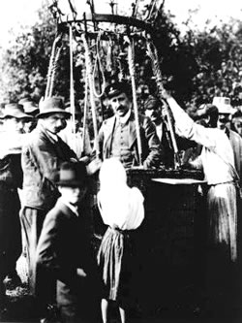

What is cosmic rays physics - intro
Cosmic rays (CR) first shown to come from space in 7/8/1912 by Victor Hess
CR are high energy particles and nuclei coming from space
Local source (The Sun) and galactic/extra galactic (?) sources
CR physics – part of HEP (high energy physics) studies CR using their interactions with Earth atmosphere to infer properties and origins of CR
https://www.aps.org/publications/apsnews/201004/physicshistory.cfm

Slide 3
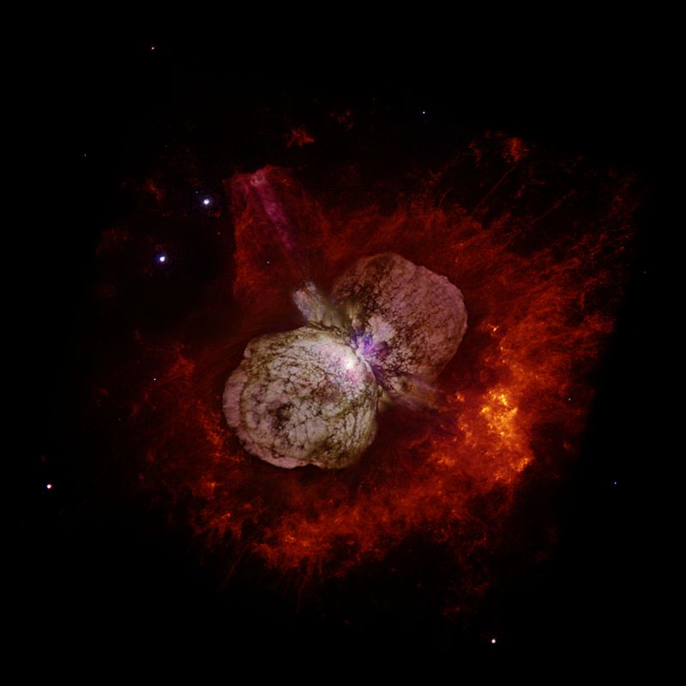
Cosmic rays and astrophysics:
Sources of Ultra-high energy (UHE) CR
http://en.wikipedia.org/wiki/Hypernova
Energy of UHECR from ~10¹⁵ up to 10²¹ eV and above
The large mystery today is the origin and the nature of UHECR
Possible sources:
  Neutron Stars
  Active Galactic Cores
  (converting dark matter into high energy protons?)
  Hypernova Explosions (Fermi acceleration mechanism?)
  Decay of unknown massive particles or dark matter
Approximate composition of the primary cosmic ray at the energy of 10¹⁵eV
protons | 40 %
α-particles (He nucleus) | 20 %
Group of nucleus of CNO | 20 %
Group of nucleus of Al | 10 %
Group of nucleus of Fe | 10 %

Slide 4
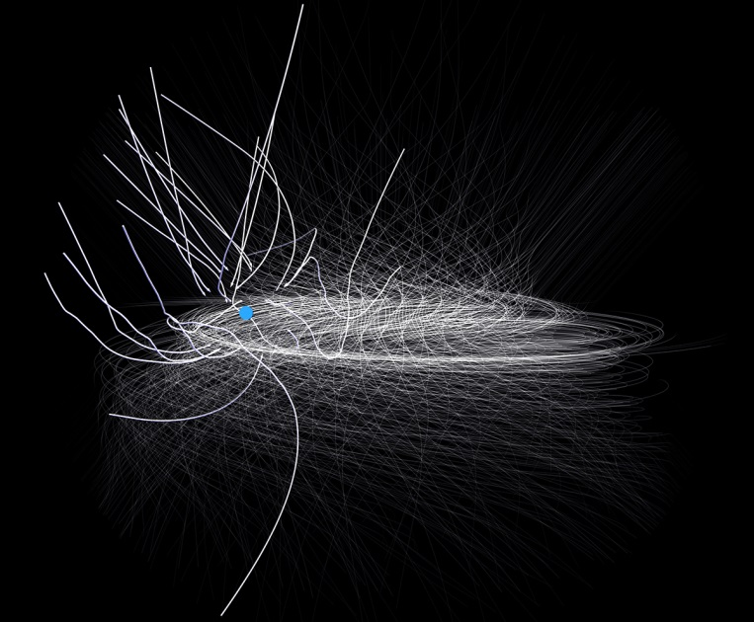
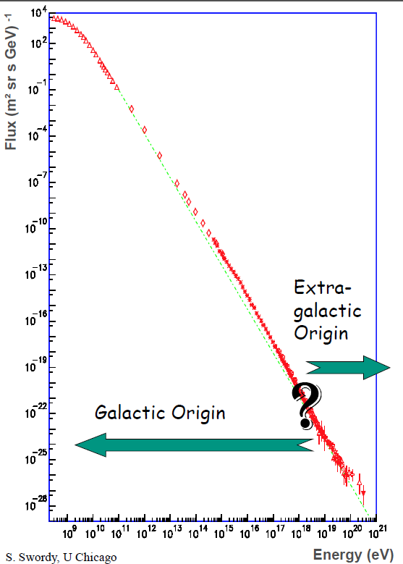
Mystery of UHECR
https://www.nas.nasa.gov/SC14/demos/demo4.html
Due to galactic magnetic field, charged particles loose direction to origin
Trapped in galaxy for E<10¹⁵ eV for protons
For E>10¹⁷ eV, all extra-galactic?
If so then anisotropy should be present but not found

Slide 5
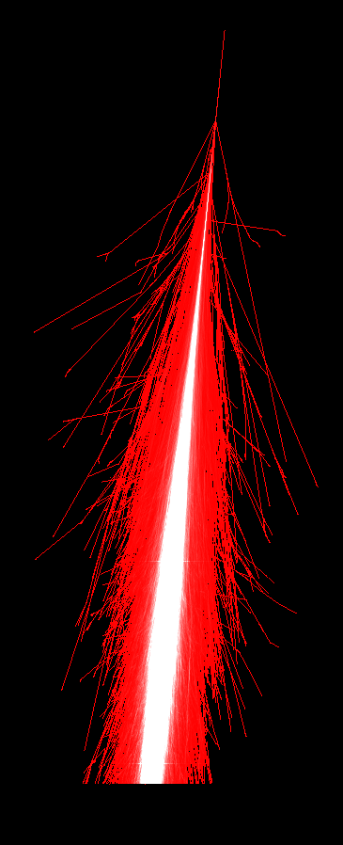
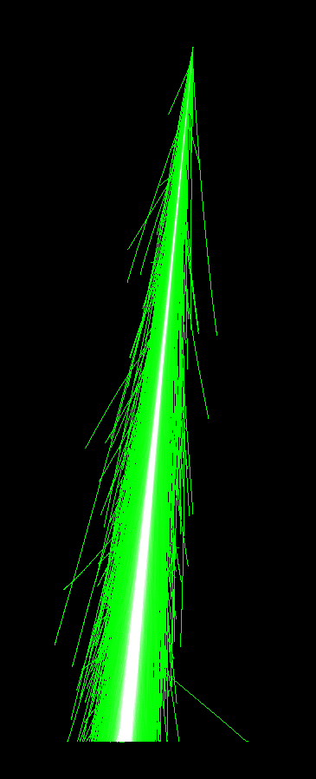
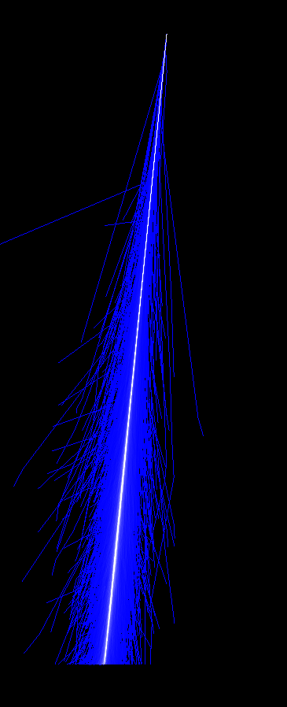
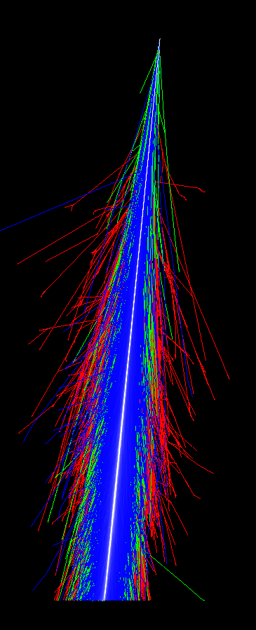
EXTENSIVE AIR SHOWER
Discovery by Bruno Rossi in early 1930s, attributed to Pierre Auger (1938)
A phenomenon that allows to study cosmic rays
Extensive shower of particles born in hadronic and electromagnetic interactions in the atmosphere resulting from interactions between a primary particle from cosmic ray and air nuclei
Electromagnetic component
Muon component
Hadron component
All shower components
All components together form a shower disk that can be up to few km in diameter

Slide 6
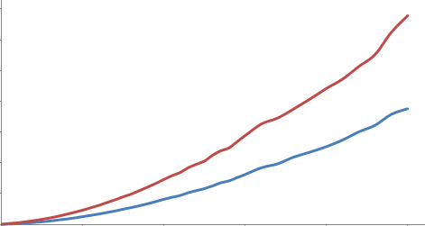
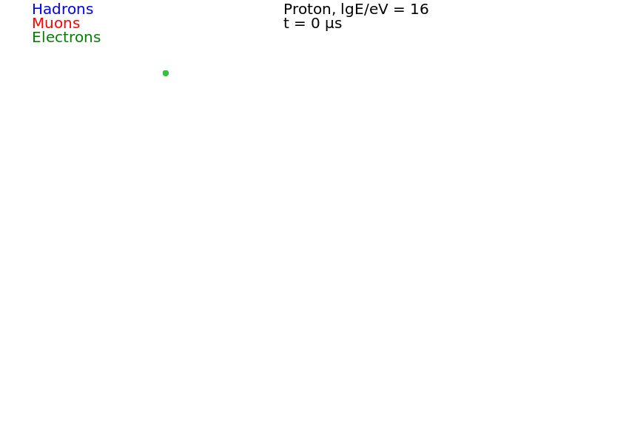
Typical methods of CR physics
Time, ns
Can reconstruct using particle density distribution
Need to calibrate detection points to obtain equivalent MIP number
If know time and width, additional methods can be used (CORSIKA)
Distance from core, m
Observation level with detectors
Notes:
The Extensive Air Shower (EAS) disk has a curved shape with width increasing with distance from the axis and density decreasing. With each detector calibrated, can get particle density in MIP equivalents and reconstruct using particle density distribution. However, if can measure width (as HT does), can also use it for reconstruction. Parameter dependencies are studied using CORSIKA (shown on next slide)
//note that the animation on this slide will not work in pdf file!

Slide 7
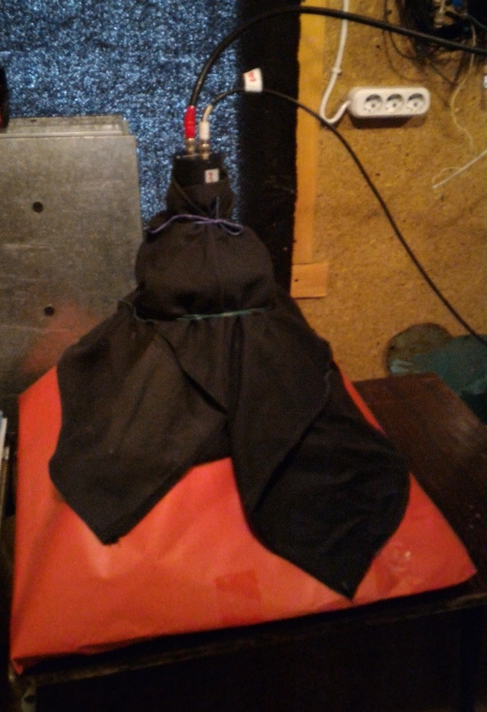
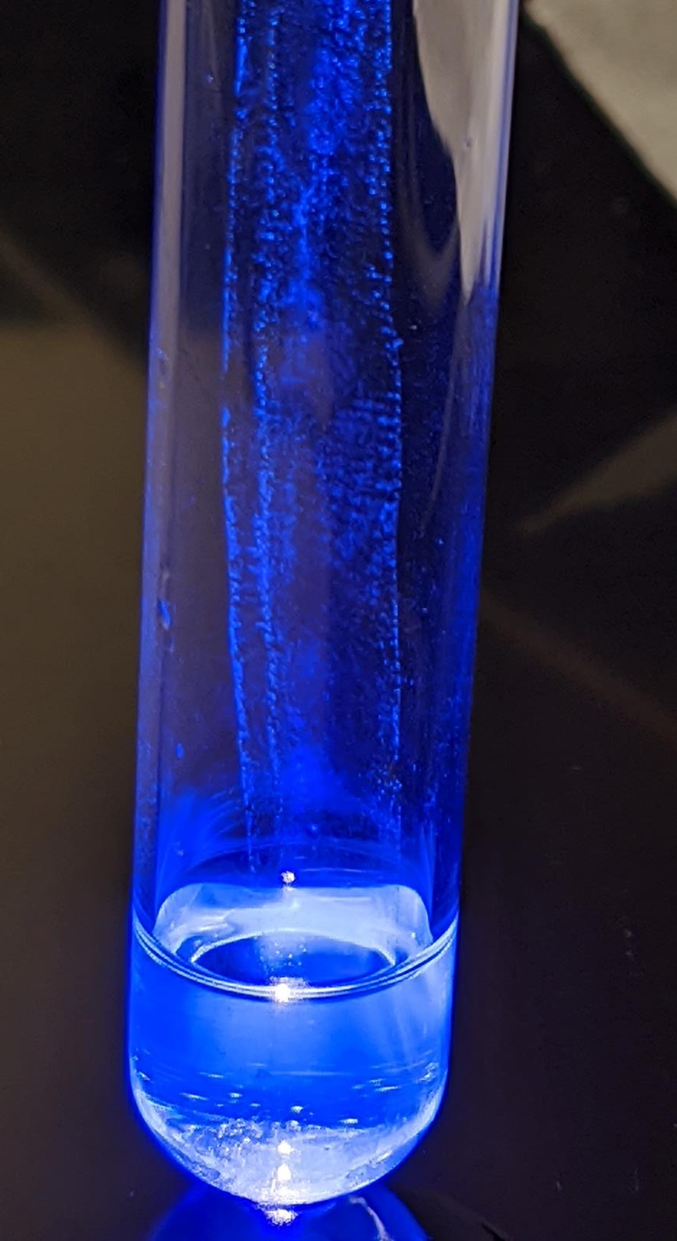
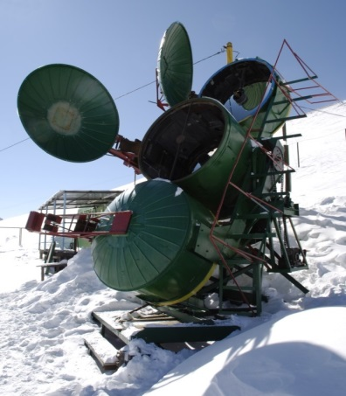
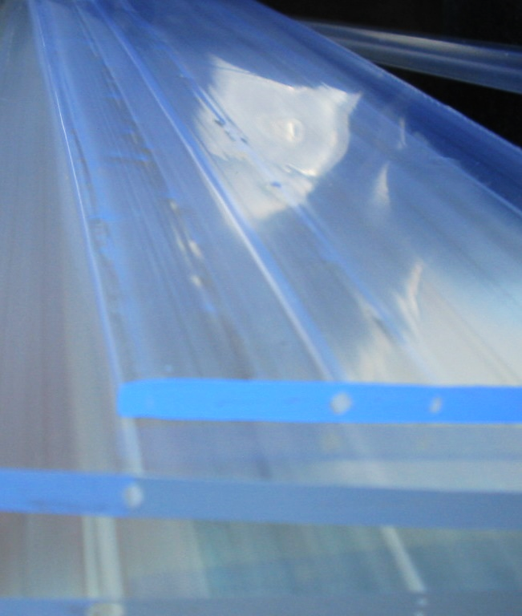
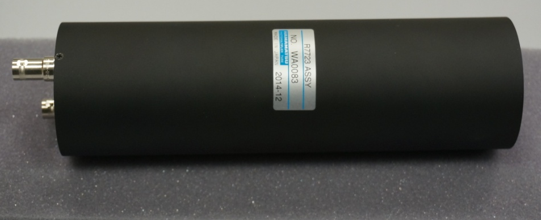
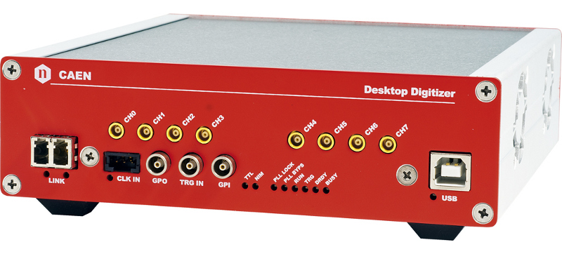
Typical Detector System Components
A sample of liquid organic scintillator under the UV light.
Composition:
Toluene (methylbenzene)
PPO (2,5-diphenyloxazole)
POPOP (1,4-di-(5-phenyl-2-oxazolyl)-benzene)
1 m² polysterene-based scintillators & scintillating glass with PMT 1 m above
R7723 (H11284-30) Hamamatsu PMT (52 mm diameter)
  2kV max voltage
  1.7 ns pulse rise time
  1.1 ns time spread
500 MHz digitization CAEN DT5730B ADC
Cherenkov-Vavilov light detector
All channels MIP/cable/linear range calibrated
  Photos from Horizon-T and D.U.C.K. detector systems
A sample of organic plastic scintillator under the sunlight.
Composition:
Polyurethane
PPO (2,5-diphenyloxazole)
POPOP (1,4-di-(5-phenyl-2-oxazolyl)-benzene)

Slide 8
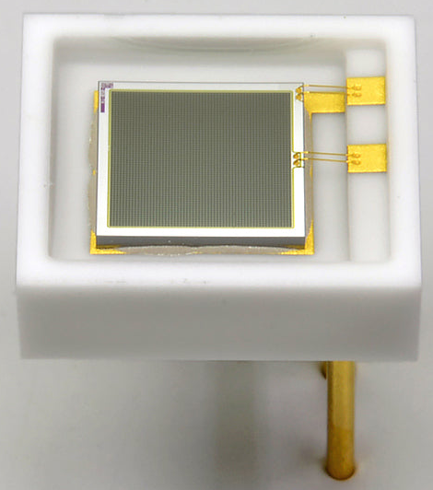
Detector design Considerations
HV power supply
Features:
  PMT gain monitoring
  MIP calibration monitoring (MPPC)
Low-latency and high-speed time resolution
  ns level
  Waveform recording
PMT
ADC
Function generator
MPPC from Hamamatsu
LV power supply
LED
MPPC
Scintillator

Slide 9
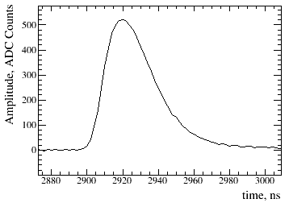
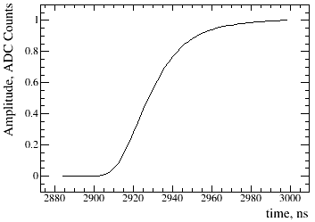
Data analysis
A typical pulse from the MIP is used for detector characterization
The pulse front - between 10% and 50% of pulse CDF
The total duration is 10%-90% of the pulse CDF
SD with R7723 PMT characteristics:
  pulse front: 7.16 ± 0.40 ns
  total duration: 21.6 ± 1.48 ns
GD characteristics
  pulse front: 2.17 ± 0.13 ns
  total duration: 5.10 ± 0.67
  [corresponds to the technical characteristics of the PMT]
SD contribution:
pulse front: ~ 5 ns
total duration: ~ 15 ns
Example of a typical inverted PMT pulse (left) and its normalized cumulative distribution(CDF) (right)

Slide 10
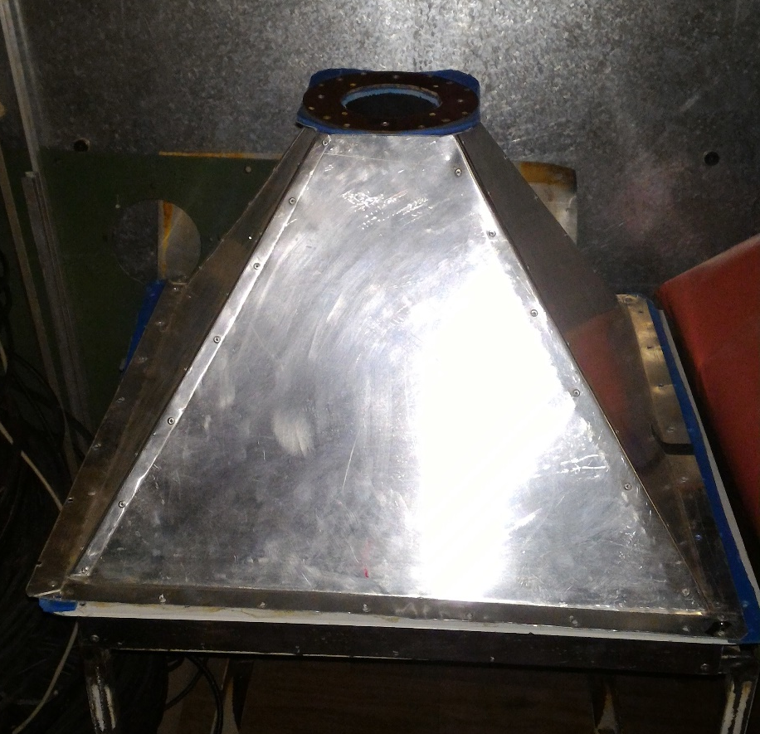
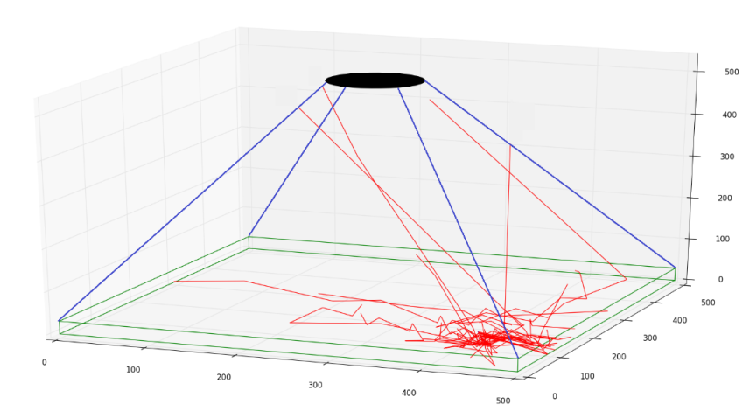
Detector design and simulation
Various designs were checked
  Different PMT positions
  Different medium shapes
  Scintillator and glass
PMT from the top results in better uniformity
  Even with Cherenkov light in glass
Calibration tests are for single MIP detection
Bottom of the medium is painted in order to increase reflectivity

Slide 11


Glass detector simulation
Relativistic charged particles emit only Cherenkov light while passing through optical glass. Cherenkov photons are emitted in a cone at fixed opening angle w.r.t. progenitor particle's trajectory (zenith angles of emitted photons):
Anisotropy of the emitted lights is confirmed in simulation
Due to the anisotropy, it is necessary to use a transformation from particle's coordinate system to medium's coordinate system:
$$θ=\cos^{−1}{\frac{1}{n_{m}β}}$$
  $\left(\begin{aligned}x′′ \\ y′′ \\ z′′\end{aligned}\right)=\left(\begin{matrix}\cos{θ}\cos{φ} & \cos{θ}\sin{φ} & \sin{θ} \\ −\sin{φ} & \cos{φ} & 0 \\ −\sin{θ}\cos{φ} & −\sin{θ}\sin{φ} & \cos{θ}\end{matrix}\right)\left(\begin{aligned}x \\ y \\ z\end{aligned}\right)$
where $\left(\begin{aligned}x′′ \\ y′′ \\ z′′\end{aligned}\right)$ - unit vectors in a particle's coordinate system, $\left(\begin{aligned}x \\ y \\ z\end{aligned}\right)$ - unit vectors in medium's coordinate system, θ, φ – progenitor particle’s angles.

Slide 12
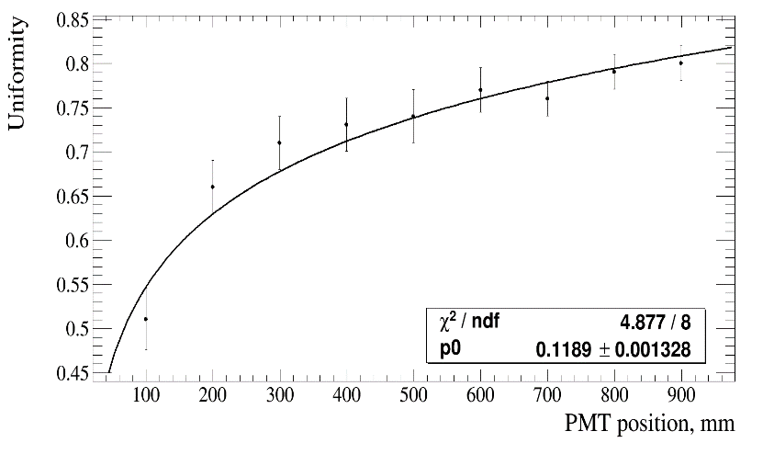
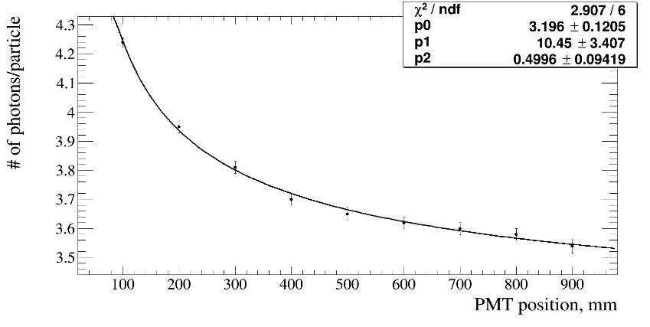
Detector design and simulation
PMT position above glass results in statistically significantly higher light yield:
  3.65 ± 0.04 detected photon per MIP for ‘above’
  3.19 ± 0.03 for ‘below’
Uniformity increases / saturates depending on position
Detected photon number decreases

Slide 13
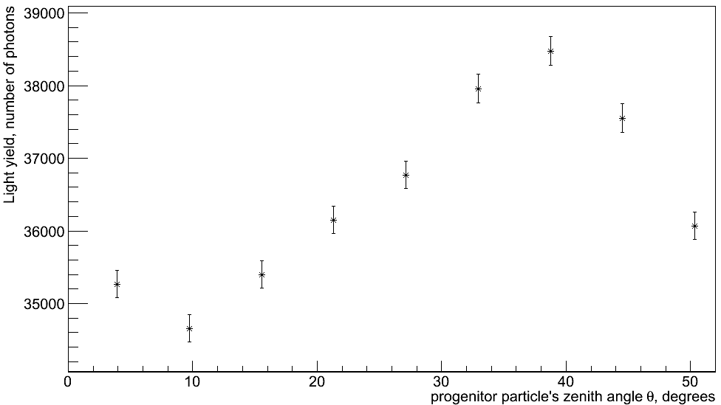
Glass detector simulation (cont’d)
Light yield vs. zenith angle θ

Slide 14
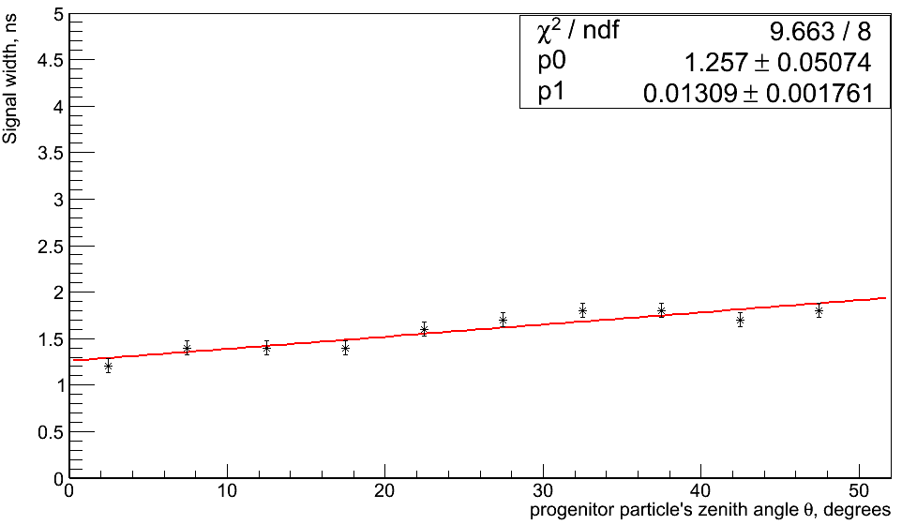
Glass detector simulation (cont’d)
Signal width vs. zenith angle θ

Slide 15
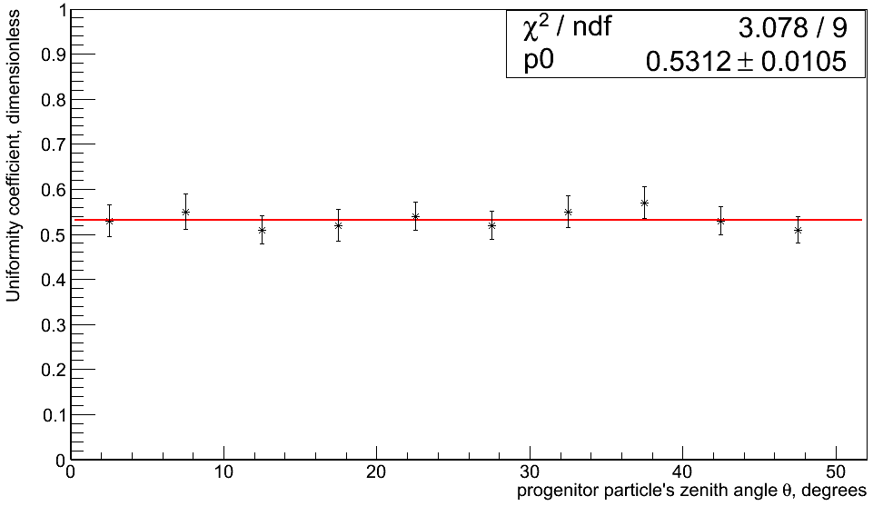
Glass detector simulation (cont’d)
Uniformity vs. zenith angle θ

Slide 16
Comparison of 4 detector models
Medium Type | Light Yield, number of detected photons | Average signal width, ns | Uniformity
Glass, black edges | 181062±426 | 1.8±0.1 | 0.74±0.07
Glass, white edges | 230610±480 | 2.1±0.1 | 0.77±0.06
Scint, black edges | 1609049±1269 | 7.5±0.1 | 0.68±0.12
Scint, white edges | 1892122±1376 | 9.2±0.1 | 0.70±0.11
Parameters of 4 geometries obtained from the simulation

Slide 17
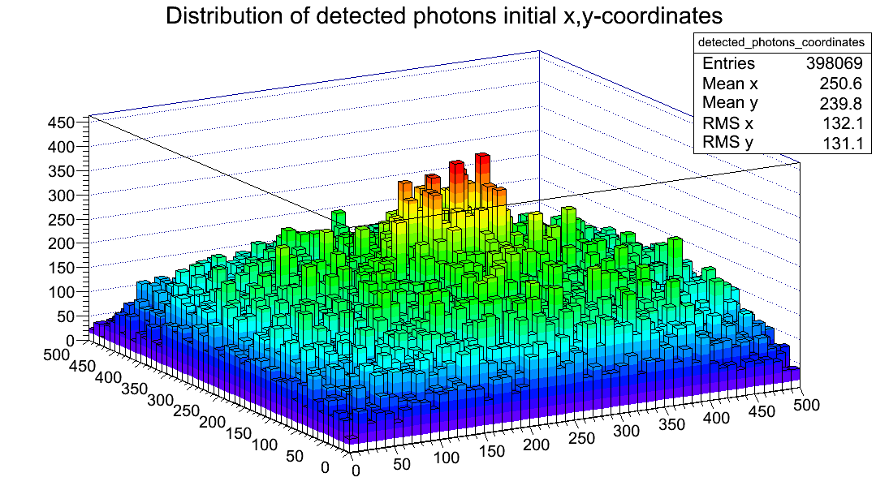
Uniformity across the Scintillator
Progenitor particles’ initial x,y-coordinates are distributed uniformly
Zenith θ and polar φ angles are distributed uniformly in corresponding ranges as well
Isotropic light yield (implemented physics for scintillator detector is correct)
Distribution of detected photons' progenitor particles' initial x,y-coordinates for scintillator detector with PMT above

Slide 18
SD detector response uniformity
The MIP signal calibration is done at the center of SD/GD, however, particles arrive randomly
SD is scanned across using ⁶⁰Co radioactive source along the lines x = 20 cm, x = 80 cm and two diagonals
PMT dark current is subtracted
Average weight value(measure of non-uniformity) for several SDs is 0.7 ± 0.1
Light yield of scintillator itself is uniform across its volume; the rest is the effect of the detector shape (e.g. geometry).
SD Detector Response Uniformity
The size of error bars is due to the low intensity of the rad. source that was available.

Slide 19
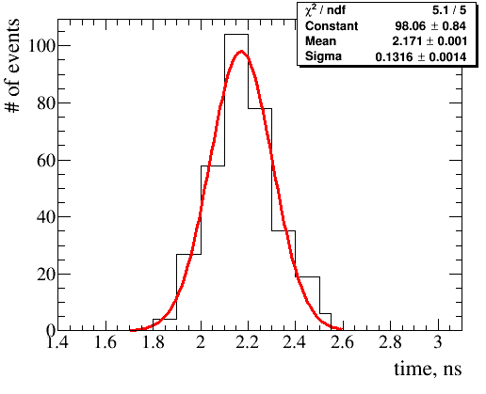
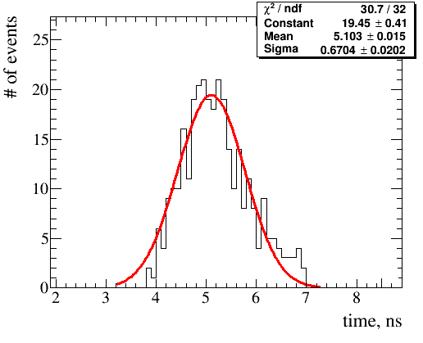
Time response measurements
~ 2.2 ns rise time response (10-50% of the pulse area) of the PMT+glass
~ 1.7 ns pulse width is limited by PMT, ADC characteristics and geometry
~ 5.1 ns total time response (10-90% of pulse area) of the PMT+glass

Slide 20
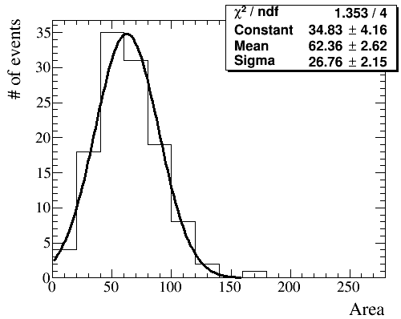
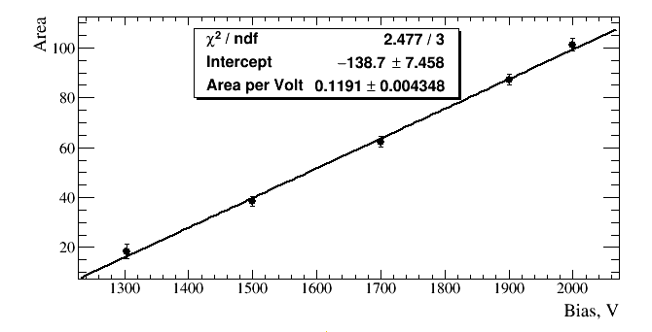
PMT Calibration: PE calibration
PE calibration is needed to calculate number of incident photons in PMT pulse signal during detector operations
Low light LED pulse is fed to PMT that is connected to DAQ via short cable (<1m)
Care is taken to ensure that pedestal has ~ 80% of all events in order for single photon detection assurance
R7723 PMT single PE response pulse area at 1700V
Single PE pulse area vs. bias voltage for R7723 PMT

Slide 21
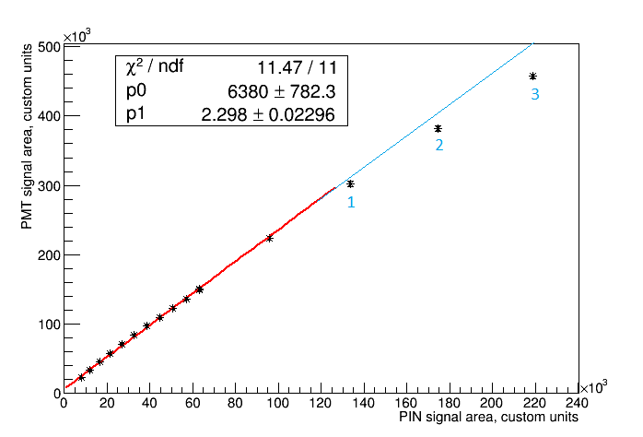
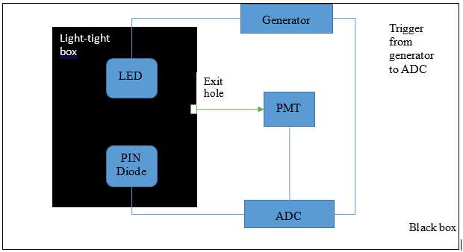
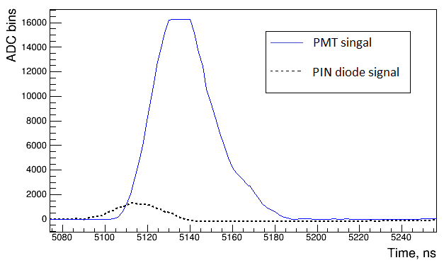
PMT non-linearity
PMT response saturates for large input signals
PMT and Hamamatsu S3883Si PIN diode responses are measured for small signals with several photons detected
Intensity of incident light is gradually increased
PIN diode response is known to be linear up to 10¹⁰ photons
PMT signal is starts to be nonlinear with deviation ~ 7% near the ADC upped range limit
PIN signal area vs PMT signal area
 | Deviation, %
Point 1 | 3.7 ± 0.3
Point 2 | 6.6 ± 0.2
Point 3 | 11.3 ± 0.2
Deviation of points from linearity
Linearity holds from 1 MIP and up to 3000 MIP for glass medium
Schematic of PMT linearity measurement experiment
PMT and PIN diode pulse at point 3

Slide 22
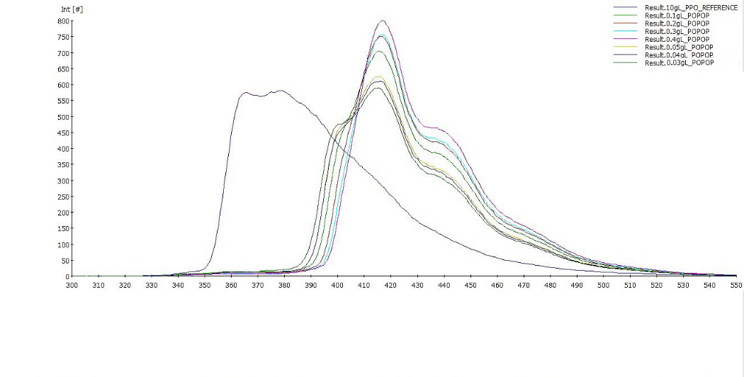
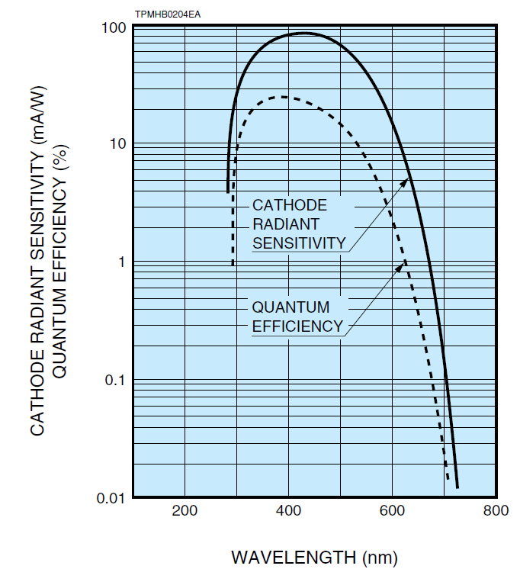
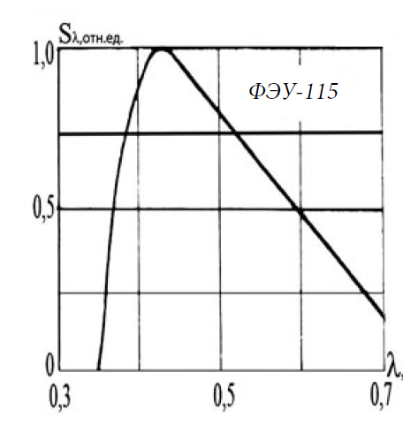
Scintillator testing
POPOP 0.4 g/L
Amplitude, custom units
POPOP concentration is increasing
The light yield and light emission time were tested vs. PPO and POPOP concentration.
The scintillator light output spectrum vs POPOP concentration was accessed
Signal gain depends on the PMT used.
POPOP 0.0 g/L
Wavelength, nm
FEU-115 is not UV sensitive
The R580 PMT is partially UV sensitive,
Normalized efficiency
Wavelength, μm
Spectral sensitivity for R580 (left) and FEU-115 (right)

Slide 23
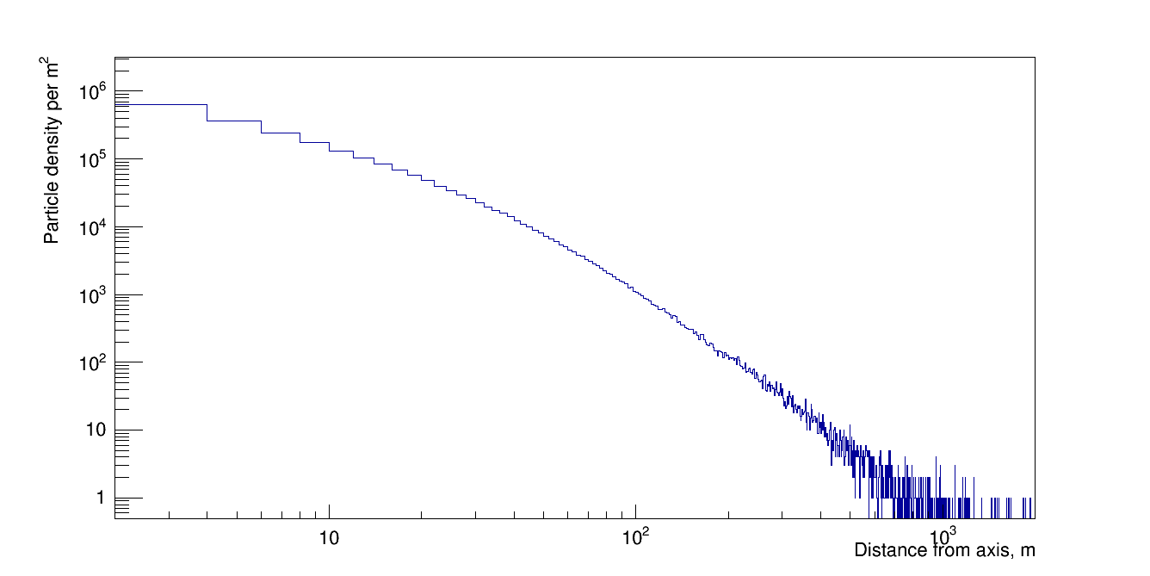
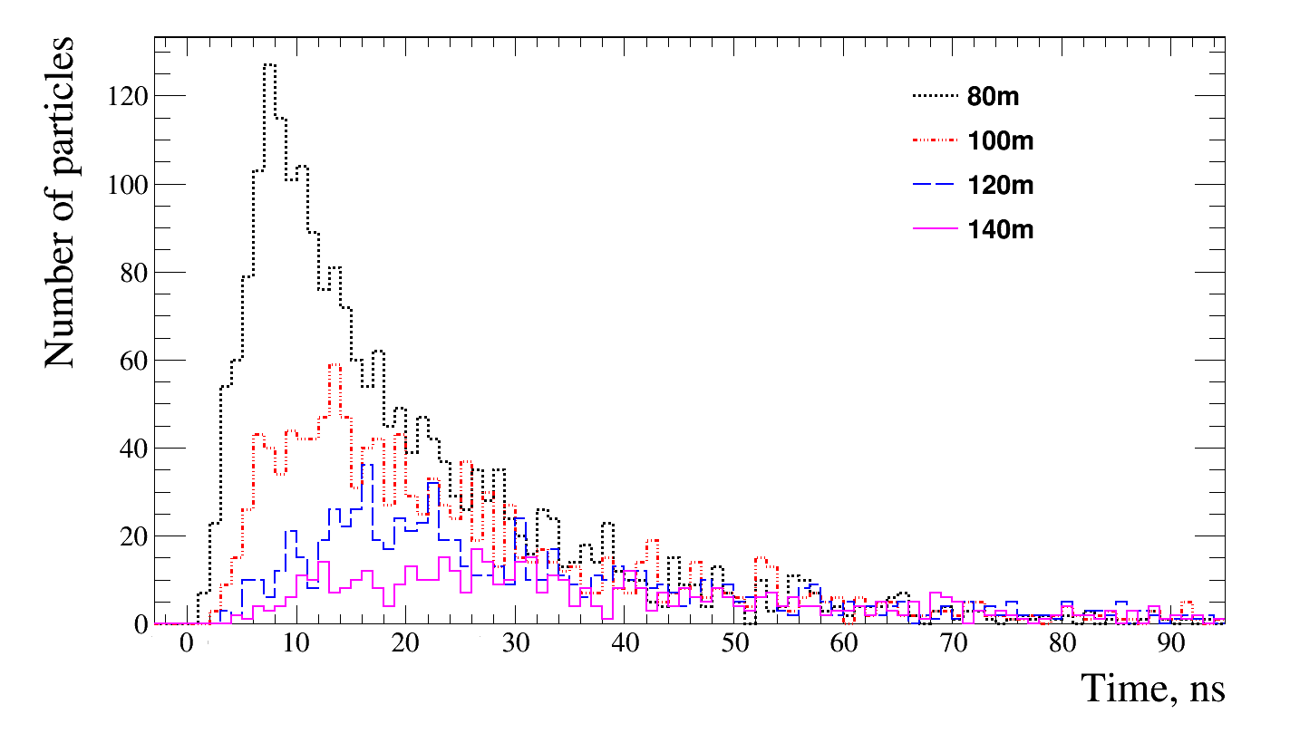
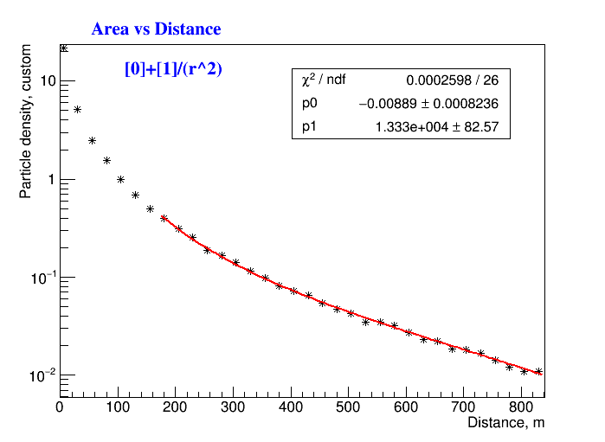
CORSIKA Simulation for Standard EAS Definition
Particle density vs. distance from EAS axis
Number of particles arrival in time at different distances from EAS axis.
CORSIKA* simulation software is based on our understanding of HEP, thus simulating a ‘standard’ shower.
  Plots are for E=10¹⁷ eV proton.
At observation level, such EAS has a single disk with particle density decreasing as ~1/r² (far) from the axis
* D. Heck, J. Knapp, J.N. Capdevielle, G. Schatz, T. Thouw. CORSIKA: A Monte Carlo Code to Simulate Extensive Air Showers, Forschungszentrum Karlsruhe Report FZKA (6019)
Notes:
From CORSIKA, we can see that particle density drops rapidly with distance from EAS axis. For the most of the disk, the dependence is ~1/(r^2) and is more rapid near to the axis.
//top left figure is log-log plot of particle density in the EAS disk, top right is particle distribution in time at different distances, bottom right – fitted 1 over r_squared dependence.

Slide 24
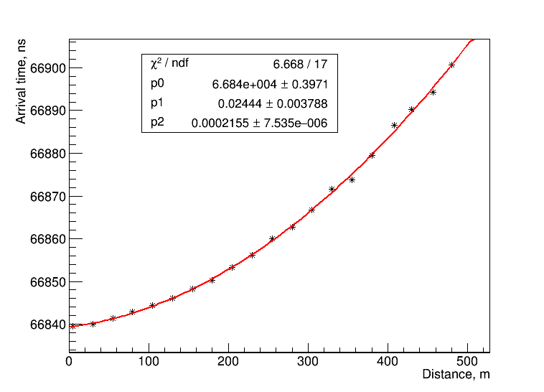
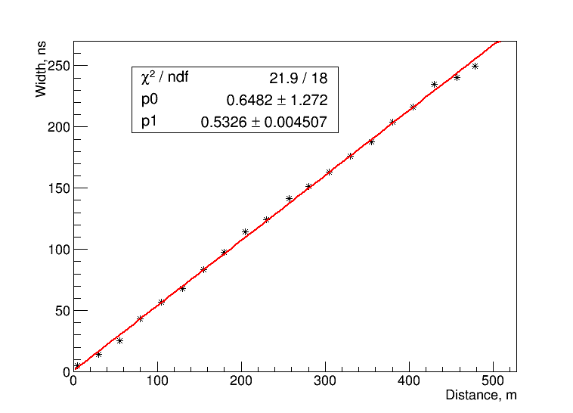
Standard EAS characteristics
Disk arrival time ~r² (used for arrival direction determination)
Disk passage time (e.g. width) is growing with ~r
Can use particle density and pulse width additional information from each detection point
  Need time resolution <10ns
Notes:
The arrival time of the disk (taken as time of the 10% of total particles at each detector location) is parabolic but this parameter can not be measured in the experiment directly. However, disk width at each detector location can be recorded, and this width grows ~linearly with distance from the axis. Note that at far distances particle density is very low and is not possible to assess disk width accurately.
//this is all from simulation
//how we define start, center and pulse end: total pulse area is integrated, center is the median (50%), the start is taken as 10% of the area and end as 90%
//top plot: this is the time of 10% of simulated pulse at each virtual ‘detector’, fitted with 2nd order polynomial
/bottom plot: disk width at each virtual detector distance from axis as time between 10% and 50%. Grows linearly with distance.

Slide 25
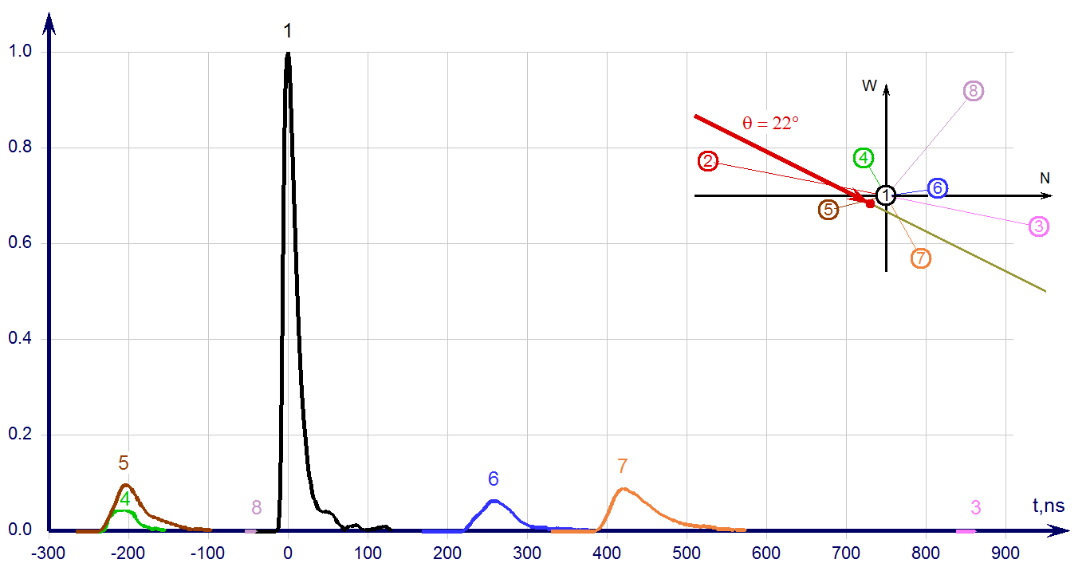
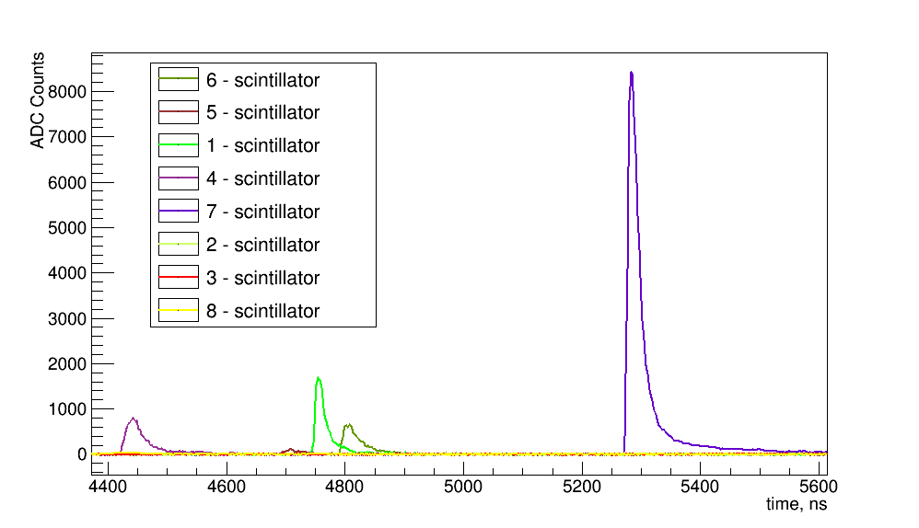
Data examples for Standard EAS
Standard EAS signal from each HT detector
Corresponds to simulation
Estimated Energy:
  ~10¹⁶ eV (top) at low angle
  ~2·10¹⁶ eV (left) high zenith angle
Notes:
So we establish ‘standard’ EAS as simulated on average by CORSIKA. This slide shows two examples from HT data of standard events.
//plots are self evident from description

Slide 26
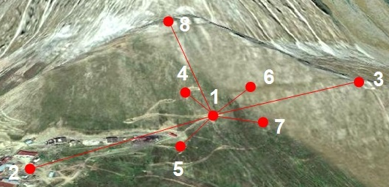
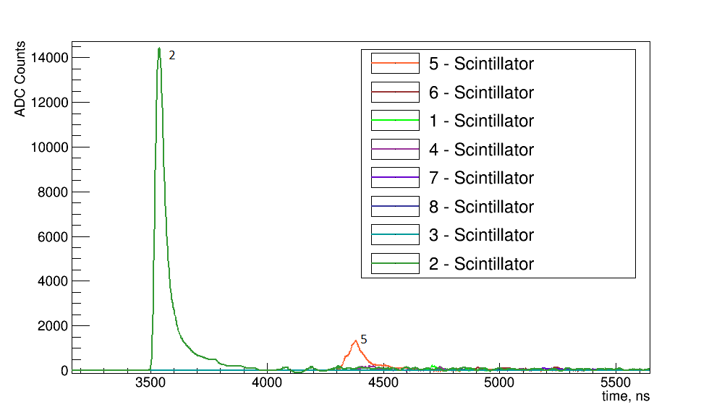
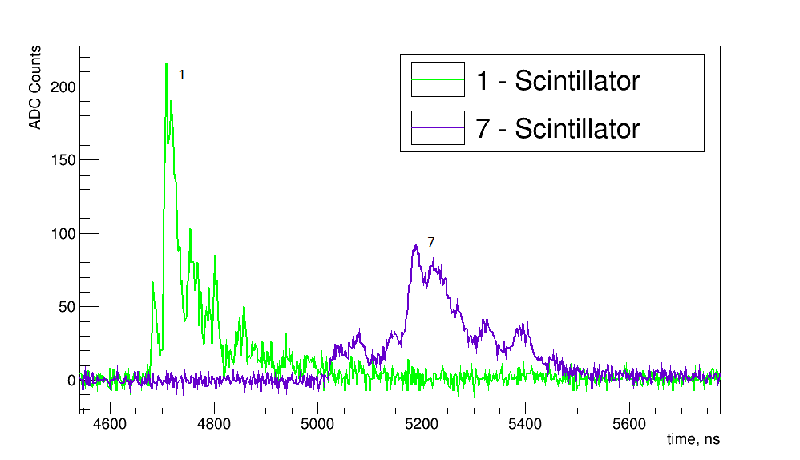
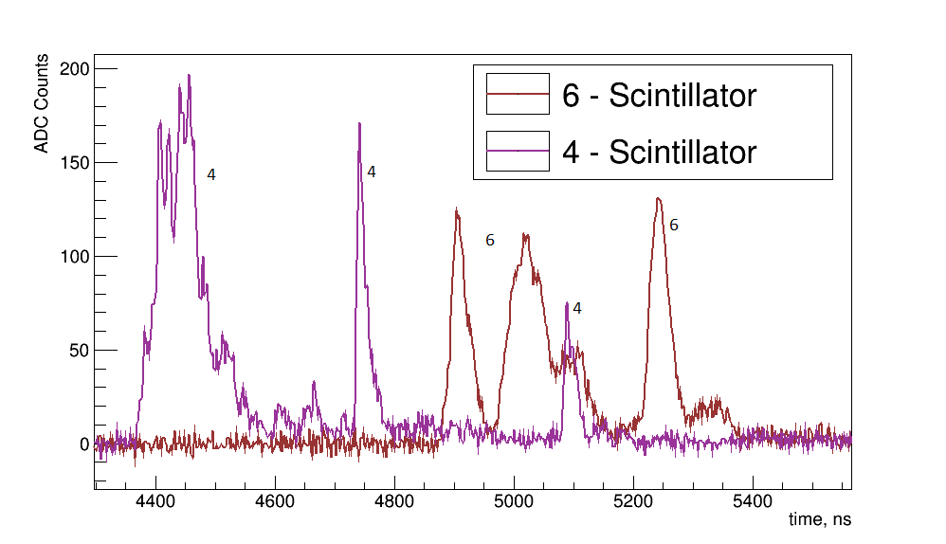
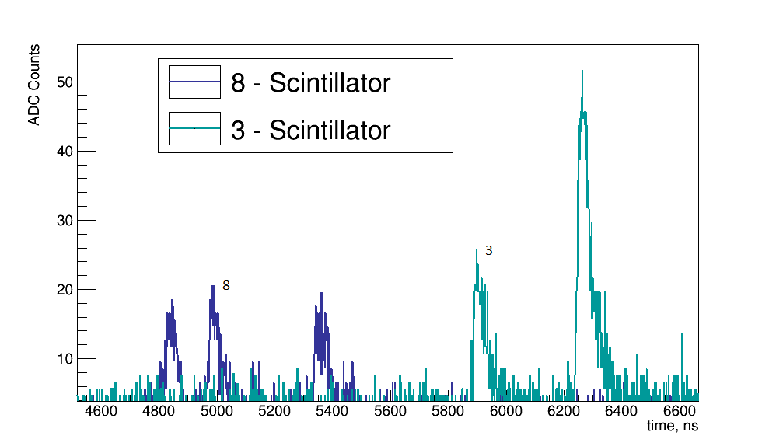
Unusual EAS example
Event of Jan26 ’16 at Horizon-T. Typical behavior: separation between peaks increases with distance from axis
Notes:
This slide shows clear example of the unusual event from HT detector. Note that closer to the axis (top left) the smaller peak has a shape with steps, then farther from axis peaks (top right) appear to be composed of many smaller peaks, and farther from the axis (bottom left) peaks separate completely. This separation increases at even further distances (bottom right plot). Also please note the width of these peaks separated in both bottom plots – they are each much narrower then the expected width at such distances (~350m in the left plot and about 400m and 600m in the right one). This is a typical appearance for the ‘unusual’ event – peaks overlapping near the axis, increasing separation with distance.
//plots are different zoom views of the same event . HT had only 8 detector. at the time
//if anyone asks – this can not be poisson noise. In bottom left plot – each peak has at least 12-15 MIP particle equivalent from calibration data.

Slide 27
Modeling attempt at unusual events by Combining Simulated disks
To approximate response of a detector from arrival of two disks separated in time and space, two simulated disks are overlaid.
Following cases were simulated:
  Two disks of the same energy falling with delay at the same distance from their centers (time delay)
  Two disks of the same energy falling at the same time at different distances from their centers (spatial separation)
  Two disks of different energies falling at the same time at different distances from their centers
Notes:
CORSIKA gives us a simulated disk. We can try to use this disk to form simple combinations to try and re-create the unusual event structure.
Simple ways to combine: one disk is delayed in time behind another-or time delay, one disk axis is displaced with respect to another – spatial separation; two disks can be either of same energy or different (scaled)

Slide 28
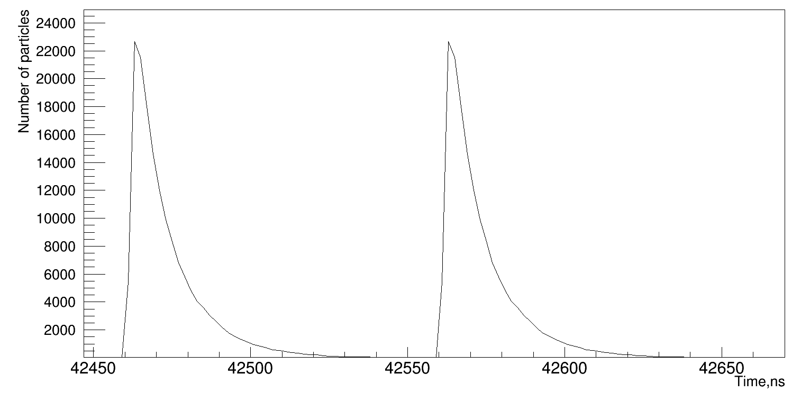


Combining Simulated disks: Time delay
50 m
30 m
Time delay between disks centers - 100 ns.
Energy of each primary – 10¹⁷ eV
Farther from the EAS axis the disks become wider, so combining two pulses results in overlapping of the shower fronts.
170 m
Close to the center, each disk signal could be differentiated easily. However, hardly distinguishable multipeak event can occur far from the center
Notes:
Results from the time delay (both disks are the same): disk centers are separated by 100ns. Note the overall picture: near the axis, where disk is narrow, two high amplitude pulses (corresponding to high particle density) are clearly separated. As we go further from the axis, pulses become wider and shallow – separation becomes less and less apparent (continued on next slide)

Slide 29


Combining Simulated disks: Time delay 2
170 m
290 m
Although at even larger distances from the center of the shower (>300 meters) signals become separated clearer, it happens because of low density of particles in the shower disk. Still, wide particle distributions are observed as expected from disk width.
350 m
Notes:
At even farther distances (170m) separation is barely there, then it comes back mostly due to the lack to particles in that region – we see only most dense parts of the disk.
So delayed disk gives the following event: two clearly separated pulses in detectors near the axis with high amplitude pulses, and much shallower separation at larger distances and small wide! pulses. However, there are no events in data that have the same appearance.

Slide 30


Combining Simulated disks: spatial separation
Number of particles
30 m + 50 m
Energy – 10^16 eV
The particle density so much higher closer to the axis that contribution of the second disk is not clearly visible
Each figure shows distances from the disk axis on the left then from the axis on the right
30 m + 110 m
Number of particles

Slide 31


Combining Simulated disks: spatial separation
Number of particles
130 m + 150 m
Energy – 10^17 eV
Even far from the center of the shower combination does not give any distinguishable peaks
Thus, no multi-peak behavior can be seen in this case
Number of particles
130 m + 170 m

Slide 32


Horizon-T unusual events initial analysis
ADC Bins
Multipeak signals at distances far from the axis of EAS noticeably separated in time.
For such events, pulses’ widths and separation between pulses can be measured.
Shown are clear separation at 600m detection point of Horizon-T (in magenta). Analysis showed that typical width of pulses is ~30-50 ns with expected >500s at such distance from axis.
Moreover, separation time between disks increases with distance to the shower axis.
Time, ns
ADC Bins
Time, ns

Slide 33
Conclusion
Cosmic ray detectors need to be fast, simple and with high dynamic range
Detector of Unusual Cosmic casKades (DUCK) is in construction stage
Unusual events show common features:
  narrow multiple pulses far from expected axis
  Multy-peaked pulses near axis with peaks overlap
  Time separation between pulses increases with distance from axis
Simple combination of simulated disks doesn’t give similar picture
Possible explanation: multiple showers originating from primary fragmentation with high transverse momentum
  This mechanism can not be explained within current particle physics

