Slide 1
INTERNATIONAL SCHOOL
ON HIGH ENERGYPHYSICS, ACCELERATOR TECHNOLOGY AND NUCLEAR MEDICINE
Almaty, Kazakhstan 9-13 October 2023
PRODUCTION OF RADIOPHARMACEUTICALS AT THE INSTITUTE OF NUCLEAR PHYSICS
E. Chakrova,
e.chakrova@inp.kz

Slide 2
What is nuclear medicine?
Nuclear medicine is a specialized area of radiology that uses very small amounts of radioactive materials, or radiopharmaceuticals, to check organ function and structure (for diagnosis) or to treat diseased organs or tissue (for treatment).

Slide 3
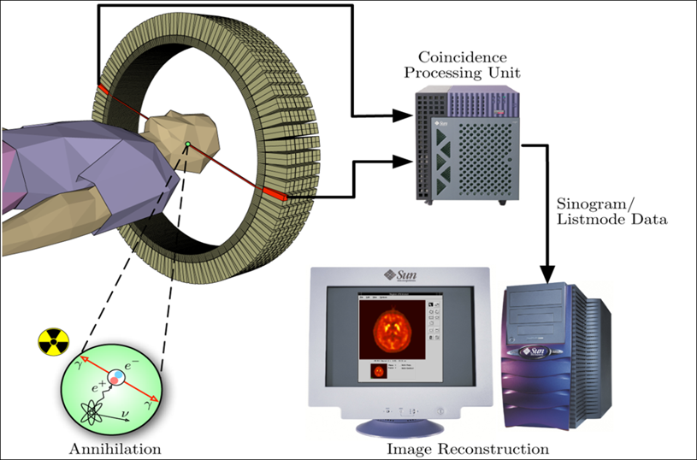
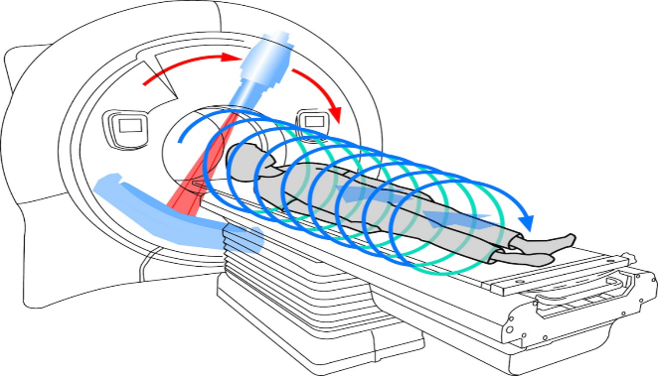
Nuclear medicine methods:
Radionuclide diagnostics or imaging
SPECT, SPECT-CT, SPECT-MRI ^{99m}Тс, ¹²³I , ⁶⁷Ga, ²⁰¹Tl …
PET, PET-CT, PET-MRI ¹⁸F, ⁶⁸Ga, ¹¹C, ⁶⁴Cu …
Radionuclide therapy ¹³¹I, ¹⁵³Sm, ¹⁷⁷Lu, ²²³Ra, ²²⁵Ac …
Theranostic ⁶⁸Ga-PSMA or ¹⁸F-PSMA ¹⁷⁷Lu-PSMA or ²²⁵Ac-PSMA, ^{99m}Tc-PSMA ¹⁷⁷Lu-PSMA, ⁶⁴ Cu…

Slide 4
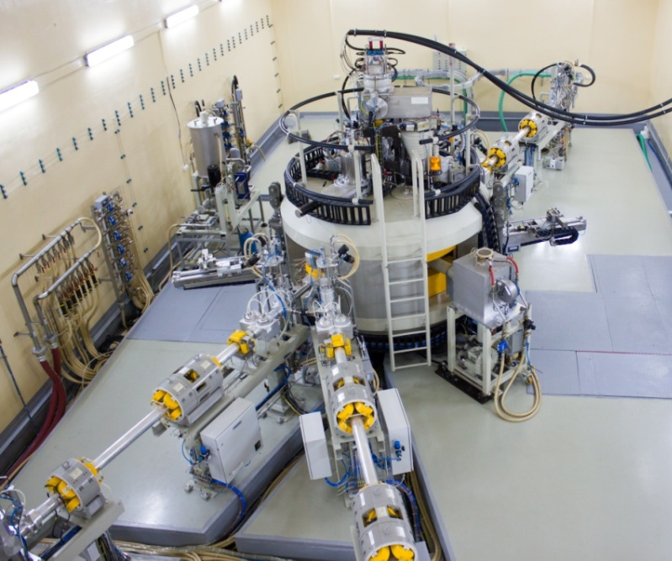
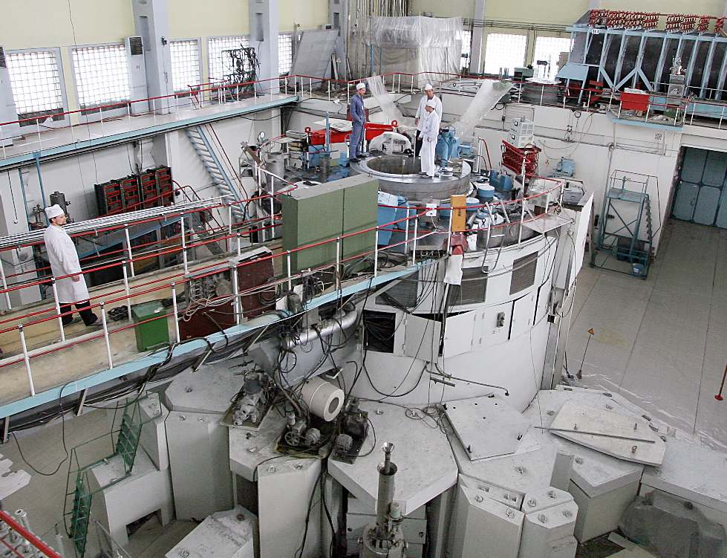
Isotope production
WWR-К, 6 МW
Max thermal neutron flux: 2.2⋅10¹⁴ n∙cm⁻²s⁻¹
С-30:
Proton: max. 30 MeV,
3 solid targets, 2 liquid targets
⁹⁹Mo/^{99m}Tc, ¹³¹I, ¹⁵³Sm, ¹⁷⁷Lu, ¹⁹²Ir, ⁶⁰Co, ¹²⁴Sb, ²⁰⁴Tl, ⁸⁵Sr, ¹³⁴Cs
¹⁸F, ⁵⁷Со, ¹⁰⁹Cd

Slide 5
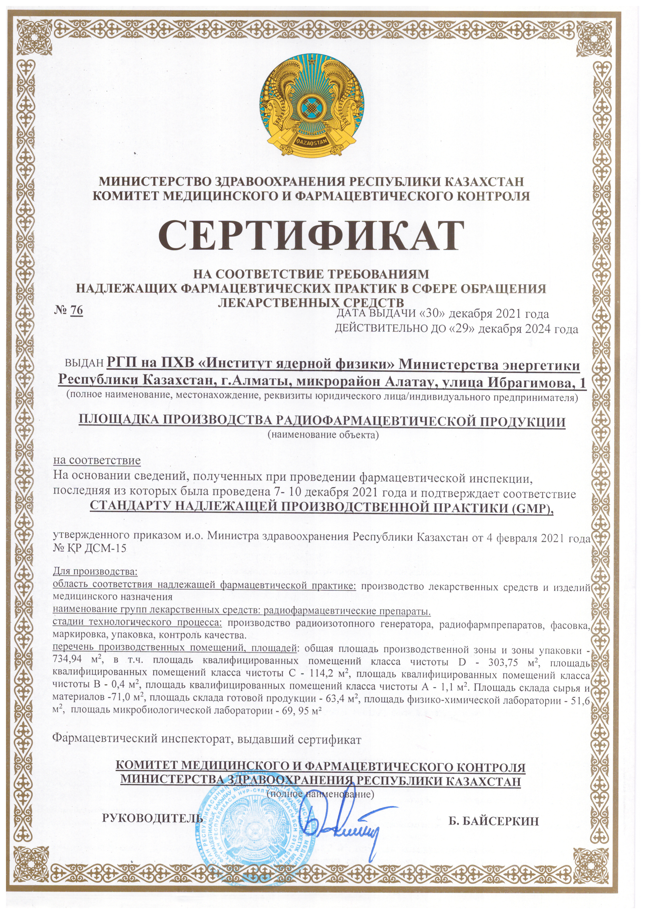
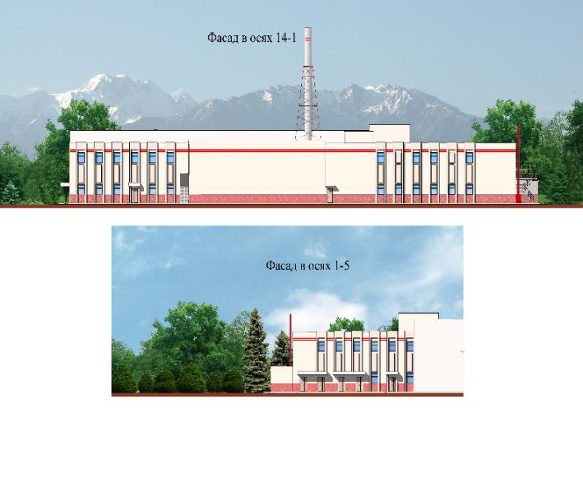
Radiopharmaceutical production facility
Radiochemical building:
R&D laboratories
Hot cells
Microbiological laboratory, Class A, B, C and D
Clean rooms, class C and D
Radiopharmaceutical building:
Clean rooms, Class C and D
Hot cells, Class A, B, C and D
QC laboratory, Class D
~800 м²
~ 730 м²

Slide 6
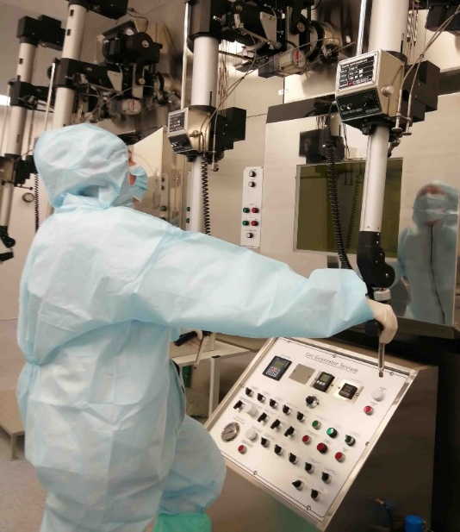
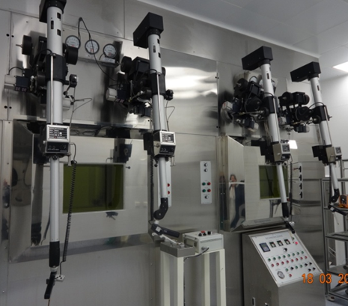
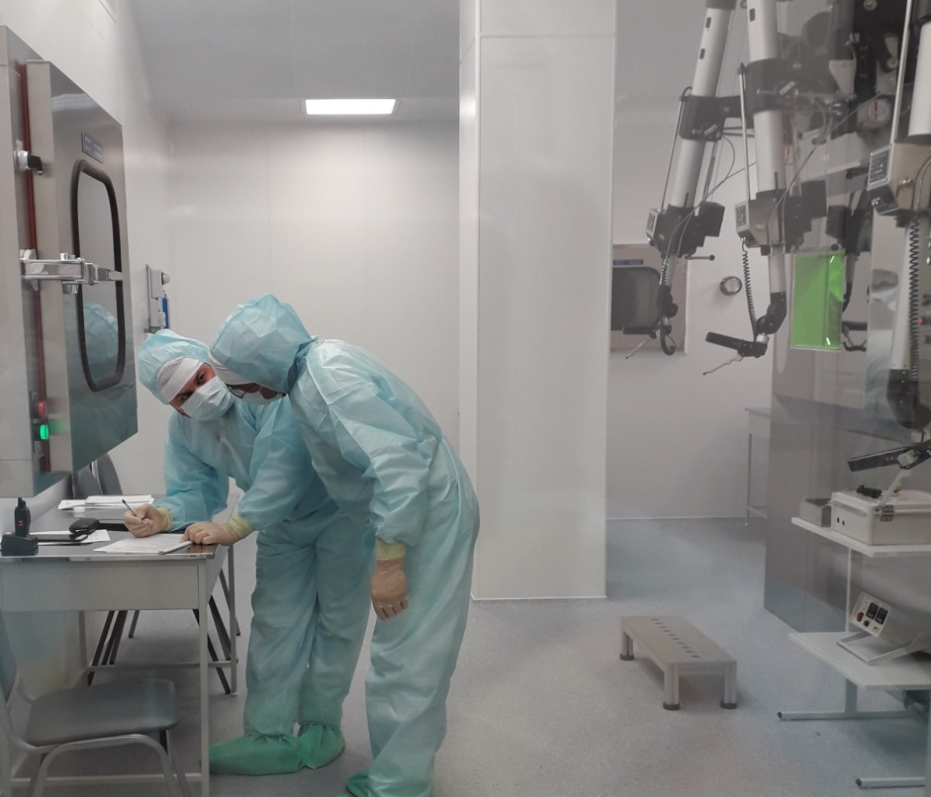
Sodium pertechnetate ^{99m}Tc, injection from ⁹⁹Mo/^{99m}Tc gel-generator
^{99m}Tc
Irradiation: reactor WWR-K, 1∙10¹⁴, n∙s⁻¹∙см², ⁹⁸Mo (n γ) ⁹⁹Mo (β⁻)→^{99m}Tc,
molybdenum oxide, 15 g., 120 h.
⁹⁹Мо bulk solution production- alkaline dissolution
Premises: class C
⁹⁹Mo/^{99m} gel-generator production/assembling: hot cells class C
Production: 2 times/month, 18 GBq

Slide 7
“Gel” method concept
^{99m}Tc
Direct conversion of (n, gamma) ⁹⁹Mo into insoluble zirconium polymolybdate “gel” that contains 25-40 wt.% of molybdenum.
The gel is a cation exchanger with an open structure which allows free diffusion of pertechnetate anion under simple elution by saline.
Additional Al₂O₃ column is needed to prevent molybdenum break-through
x(ZrO)²⁺·y(⁹⁹MoO₄)²⁻·z(H₂O)
24 hours
x(ZrO)²⁺ ·y
(⁹⁹MoO₄)²⁻
(^{99m}TcO₄)⁻
·z(H₂O)
NaCl
x(ZrO)²⁺ ·y
(⁹⁹MoO₄)²⁻ Cl⁻
·z(H₂O)
P.W.Moore, M.E.Shying, J.M.Soeau, J.V.Evans, D.J.Maddalena and K.H.Farrington. Zirconium molybdate gel as a generator for 99mTc – II. High activity generators//Appl.Radiat.Isot. – 1987. – Vol.38, № 1. – P.25-29.
R.E.Boyd. The gel generator: a viable alternative source of 99mTc for nuclear medicine//Appl.Radiat.Isot. – 1997. – Vol.48, № 2.
+
Na⁺(^{99m}TcO₄)⁻

Slide 8
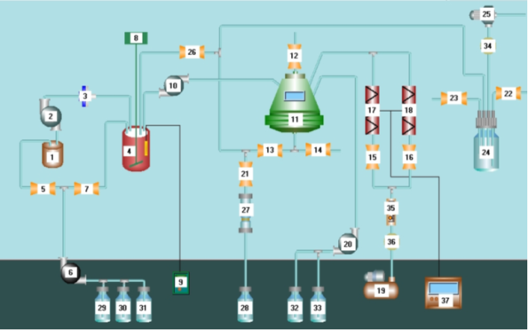
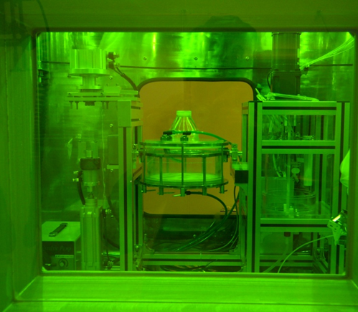
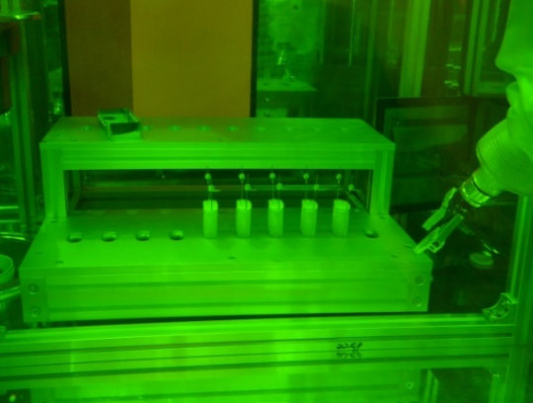
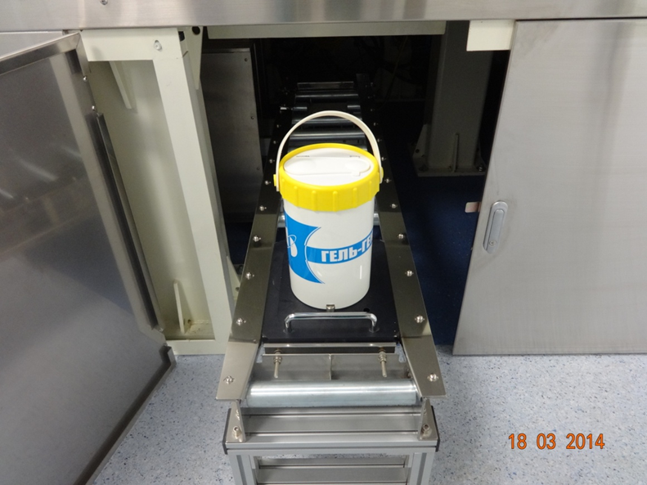
Production of ⁹⁹Mo/^{99m}Tc gel generators
^{99m}Tc
Premises – class C
Hot cell 1- for synthesis of ⁹⁹Mo-Zr gel and filling of generator’s columns - class C
Hot cell 2 - for steam sterilization of cartridges and assembling of generators - class C
Design and production of hot cell equipment for ⁹⁹Mo-Zr gel preparation, Pat. 27786 RK
Design of ⁹⁹Mo/^{99m}Tc gel generator, Pat. 28157 RK
IAEA-CN310-329
Slide 7/n
Speaker name: Yelena Chakrova
17-21 April 2023
#ISTR2023

Slide 9
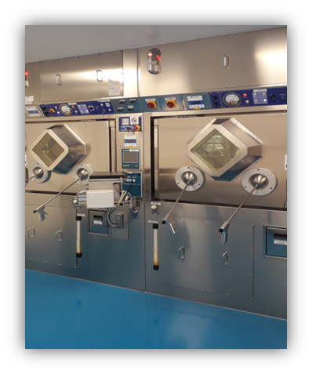
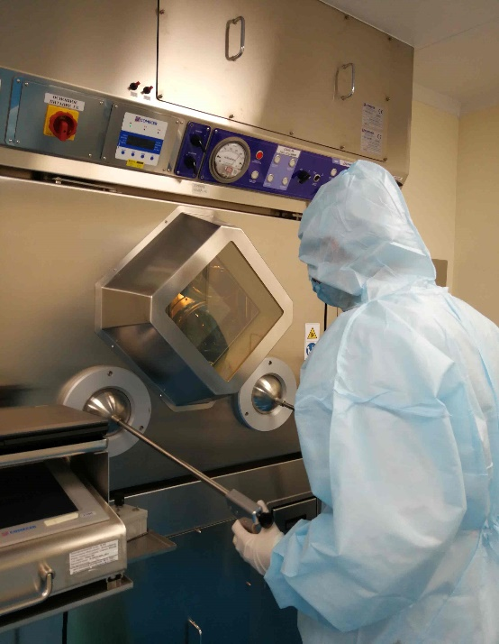
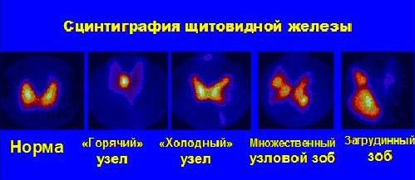
Sodium iodide ¹³¹I for therapy
¹³¹I
Irradiation: reactor WWR-K, 1∙10¹⁴, n∙s⁻¹∙см², ¹³⁰Te (n γ)¹³¹Te (β⁻)→¹³¹I,
tellurium oxide, 20 g., 72-120 h.
¹³¹I bulk solution production: reactor radiochemichal hot cells, dry distillation process, 700°C
Premises: class D
Production/dispensing/sterilization: hot cells class C

Slide 10
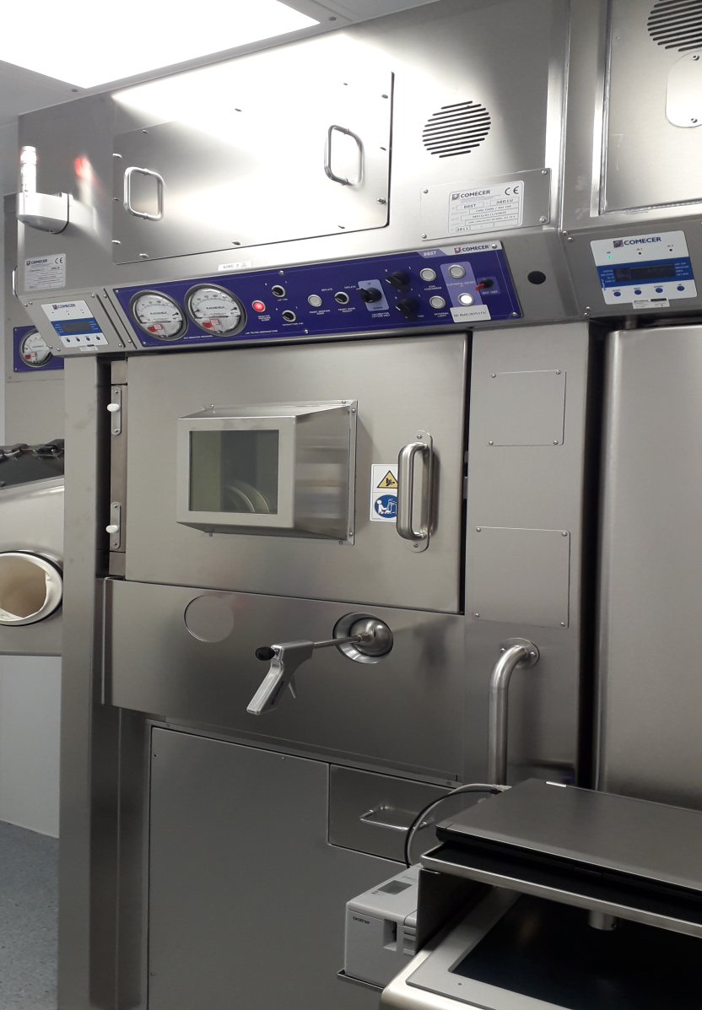
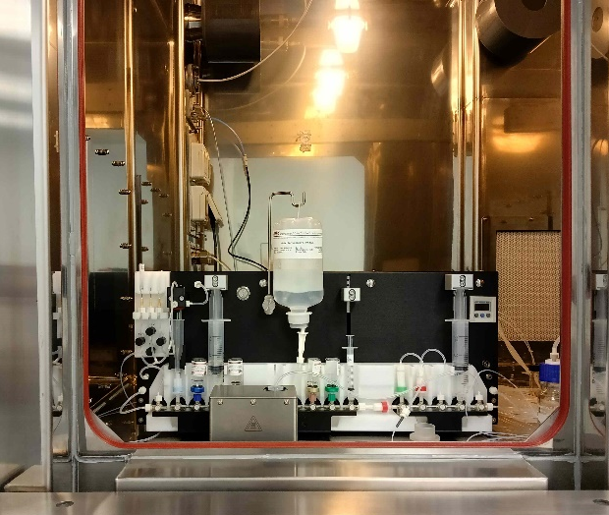
Fluordeoxiglucouse ¹⁸F injection
¹⁸F
Irradiation: cyclotron C-30, 18 MeV, ¹⁸O(p,n)¹⁸F
2 ml enriched water, 2- 3 h.
Syntheses modules: Synthera, Neptis, dispensing - Thymotheo LT
Premises: class C
Production: hot cells class C
Dispensing/membrane sterilization: hot cells class A
Production: 3 times/day
Transportation: 1- 7 h

Slide 11
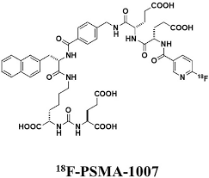
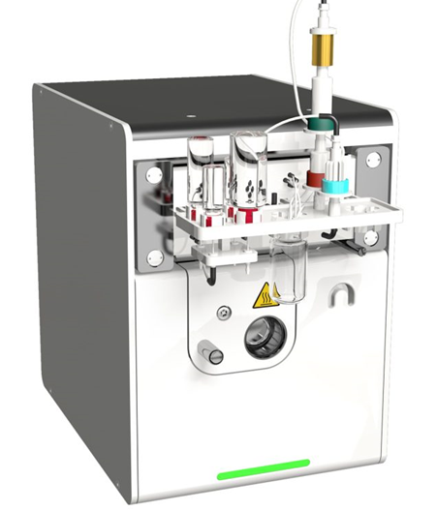
¹⁸F-PSMA-1007 injection
¹⁸F
Irradiation: cyclotron C-30, 18 MeV, 2 ml enriched water, 2- 3 h.
Syntheses modules: Synthera, dispensing: Thymotheo LT
Premises: class C
Production hot cells- class C
Dispensing/membrane sterilization:
hot cells class A
Production: 1 time/week

Slide 12
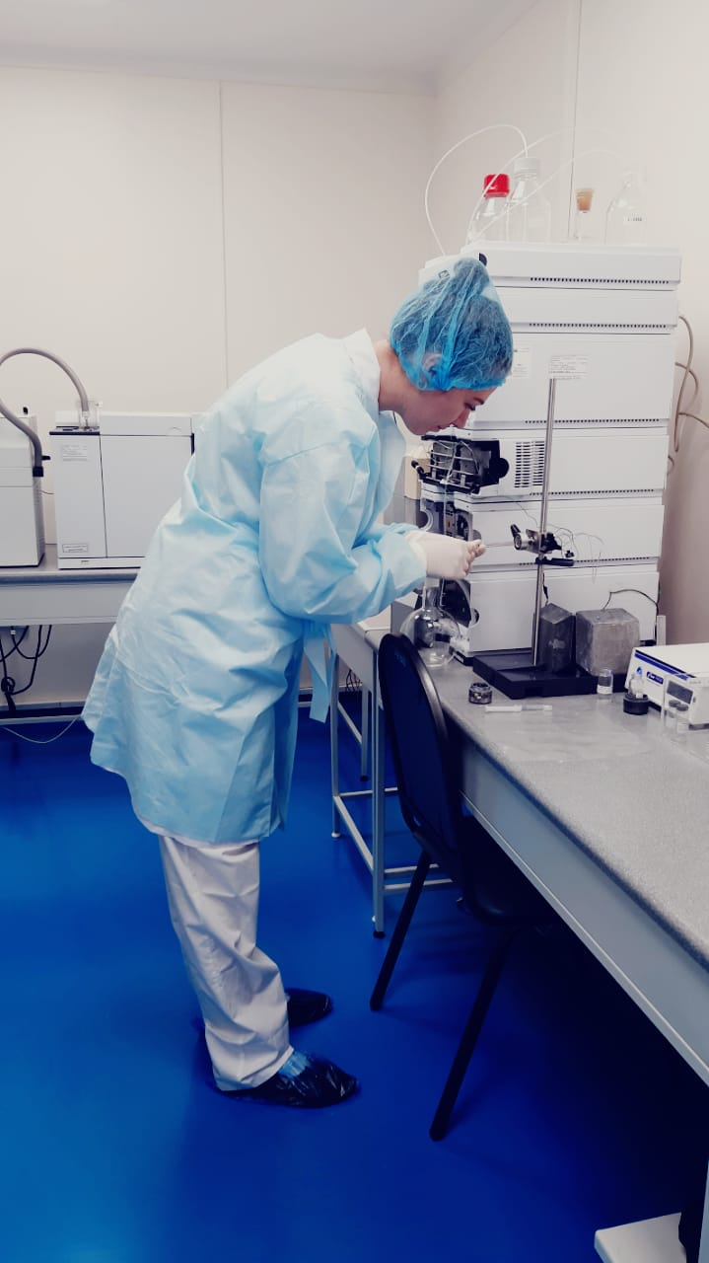
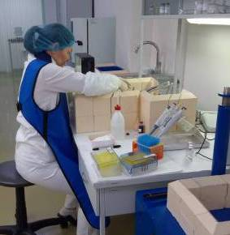
Lutetium chloride ¹⁷⁷Lu, solution for labeling
¹⁷⁷Lu
¹⁷⁶Lu (n γ)¹⁷⁷Lu
¹⁷⁶ Yb (n γ)¹⁷⁷ Yb (β⁻)→¹⁷⁷Lu
Irradiation: reactor WWR-K, 1∙10¹⁴, n∙s⁻¹∙см², 18 days
Lutetium oxide, 20 mg
Premises: class D
Production/dispensing/sterilization: hot cells class C

Slide 13
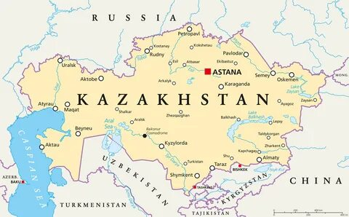
Status of Nuclear Medicine in Kazakhstan
9 working Centers of Nuclear Medicine
3 Centers of Nuclear Medicine is in process of building
Radiopharmaceuticals:
⁹⁹Mo/^{99m}Tc gel generator, from 2001
“Sodium iodide ¹³¹I, oral solution” for therapy, from 2002
“Fludeoxyglukose ¹⁸F, injection”, from 2021
1
2
1
1
1
5
1
INP fully covers local demand in radiopharmaceuticals with ^{99m}Тс and ¹³¹I and 70% of local demand in radiopharmaceuticals with ¹⁸F
Speaker name: Yelena Chakrova
17-21 April 2023
IAEA-CN310-329
Slide 2/n
#ISTR2023

