Slide 1

Electrical safety for EXSOs
James Devine, Electrical Safety
EP Safety Office
EDMS 2966369

Slide 2
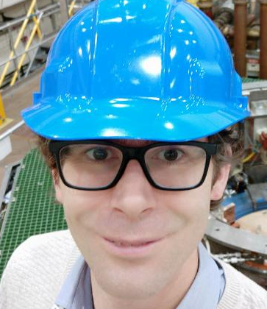
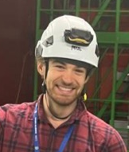
Introduction
Electricity is a big danger in all of your experiments!
A brief overview of what we will cover today:
AUG/AUL/AUE testing during YETS
Safety Messages
Important electrical safety messages.
Electrical Safety Training
James Devine – Electrical Safety Officer
Review of available training courses
Electrical Rules
Lock-outs and cable rules
Latest news:
Site lighting at night
Alex Schouten – Deputy ESO
EDMS 2966369

Slide 3
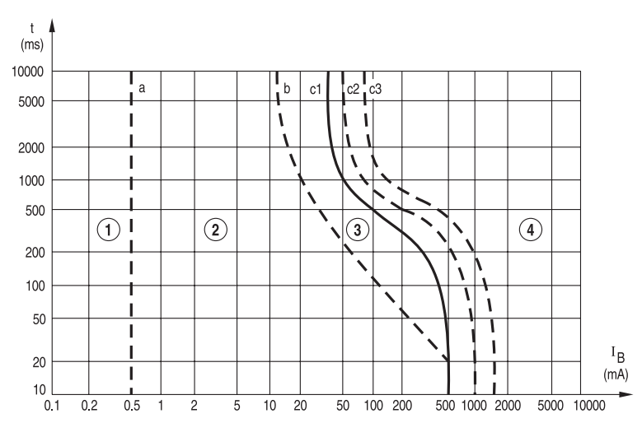
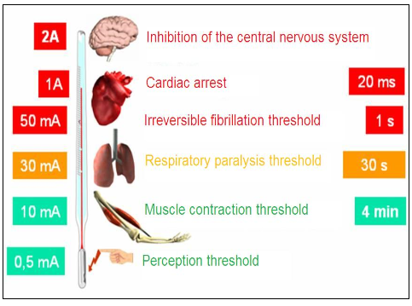



The dangers of electricity
Safety Messages
Time / current zones of effect of AC current (15 Hz to 100 Hz) on human body
Protection from a
30 mA Differential
Check up !
74444
+41 22 767 4444
“Safe”
zone
EDMS 2966369

Slide 4
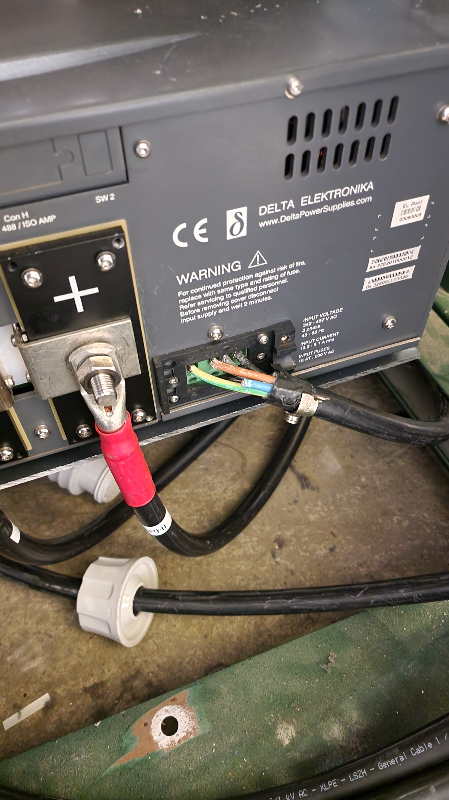
Recent accidents
Safety Messages
Direct Contact with 400V AC
The victim was re-locating a power supply in an equipment rack.
The mains supply cable was plugged in and powered on, but not secured to the power supply module.
Their hand came into contact with a phase conductor.
They received an electrical shock.
The circuit turned off rapidly thanks to a 30mA RCD operating.
Medical checkup performed, no health consequences.
EDMS 2966369

Slide 5
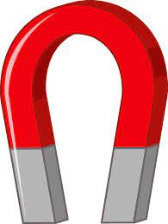
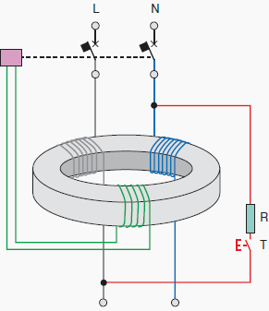
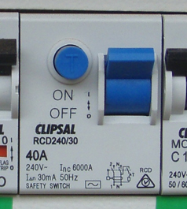

30mA Differential Protection
Safety Messages
This is what saved the persons life…
All experimental areas are equipped with them. They should be tested every 6 months (manufacturers recommendation).
If it fails to operate, it must be replaced.
Push to TEST
Push to TEST
See EDMS 2684145 for the tests performed in a magnetic field.
EDMS 2966369

Slide 6
Electrical Safety Training: The Menu
Electrical Safety Awareness
15 minutes: Electrical safety awareness: Online only; mandatory.
½ Day: Electrical Safety - Working in EP experiments – recommended for everyone working on experiments in the EP Department. Mandatory only for ISOLDE hall access.
3 Days: Habilitation Electrique - Person making Tests in Labs or on Test Bench - Recommended for 1 person from each small/medium experiment. Mandatory for the performance of live electrical measurements. Course is now 80% online; only a short practical session is needed at the safety training centre.
Working in EP Experiments
Habilitation
Electrique
Add summary matrix what training/is/are
The EP safety office is checking with all small/medium experiments to ensure that one person in each has a habilitation electrique, so they can be the point of contact for electrical safety. There will also be an e-group for communication of any electrical safety messages.
EDMS 2966369

Slide 7
Electrical Safety Training: Summary
Course/ Activity | Electrical Safety Awareness (online) | Working in EP Experiments (classroom) | Habilitation Electrique (hybrid)
Access to CERN site, plug & unplug equipment | Mandatory | N/A | N/A
Design experiment distribution | ❌ | ✔️ | ✔️
Secure plugs for work on modular equipment | ❌ | ✔️ | ✔️
Measurements based on written procedure | ❌ | ✔️ | ✔️
Measurements without a written procedure | ❌ | ❌ | ✔️
Lock-out, other tasks | ❌ | ❌ | ✔️
EDMS 2966369

Slide 8
Electrical Safety – Working in EP experiments
Authorises certain tasks which are common for physicists working at CERN:
Connection, disconnection and operation of equipment connected via standardised plug sockets (IEC/CEE/T13/T23) up to 63A does not require authorization.
Working in EP Experiments
Revised and updated!
Roll out by Jan 2024
EDMS 2966369

Slide 9
Electrical Safety – Working in EP experiments
Electrical tasks
The installation and operation of standardised rack mounted electrical equipment in relation to experimental apparatus at CERN within existing racks and the connection of modules and modular power supplies with standardised connectors.
Performance of localised disconnection and locking of plugs for your own work and for equipment under your responsibility, where the point of isolation is a plug and socket.
The entirety of cable installation, cable connection and disconnection at terminals, and measurement activities shall be preceded by the turning off, locking out and identification of the power supply circuit(s) at the appropriate plug and socket. Before commencing the activity, the absence of voltage shall be verified.
Working in EP Experiments
EDMS 2966369

Slide 10
Electrical Safety – Working in EP experiments
The construction and assembly of electrical cables in a workshop environment, up to 6 mm² for signal cabling and power distribution, and up to 16 mm² for earthing. During the assembly operation the cables may not be installed on any cable tray or electrical containment containing existing (live) circuits.
Cable connections are permitted when the following criteria are satisfied:
The equipment shall be IP2X compliant, including connection terminals.
Connections may be made with modular plugs/sockets which are shielded and do not allow direct contact with conductors (to IP2X or IP3X depending upon rated voltage), in accordance with manufacturers recommendations.
Connections may be made at terminals which are enclosed, i.e. without any exposed live parts and IP2X compliant, when the equipment is powered off and secured.
Working in EP Experiments
EDMS 2966369

Slide 11
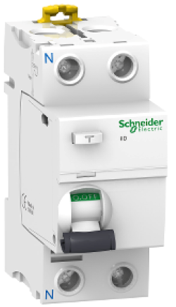
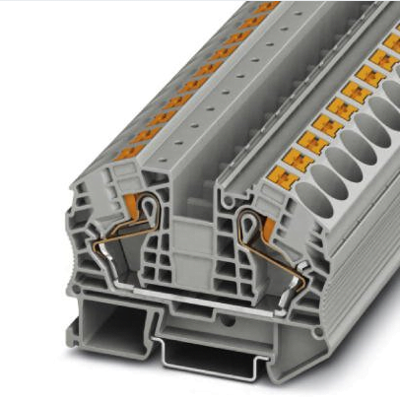
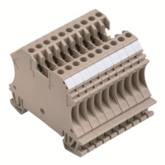
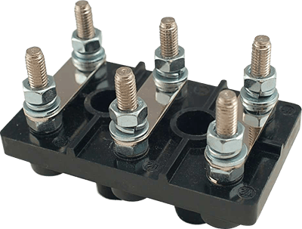
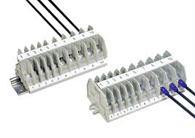
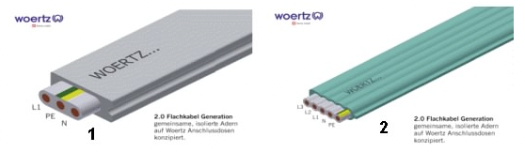
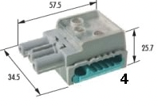
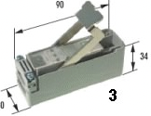
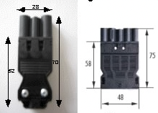
Connector Types
IP2X protected at all times
Exposed (live) parts
Working in EP Experiments
Contact with live parts when connecting!
30/10/23
J. Devine – Electrical Safety for EXSOs
EDMS 2966369
Good example - shielded twisted pair cable – grounded at one end
+
-
+
-
Rack
Equipment
External Fields -> induced voltage -> grounded.
Grounding of the
shield at only one end
Notes:
This is a new slide; we are tightening up the requirements for what we consider ‘safe’ without a habilitation.
Exposed terminals = Danger! Only permitted if covered (Makrolon/plexi shields – ideally provided by manufacturer).
If you can touch the terminal, then it’s not going to pass inspection.
If you cannot alter the equipment/installation with protection, you will need a habilitation electrique to intervene.
This also applies to semi-shielded terminals (right middle), which you can still touch with a finger.
For flat cables, the installation of screw-on junctions (right bottom) is reserved for electricians. This is because the screws are in contact with the live cable beneath, and can only be installed during a power cut (lock-out).
Modular plugs connecting to flat cables (bottom left) do not require any habilitation and this course permits you to plug and unplug them, and put them in a plug safe if necessary.

Slide 12
Electrical Safety – Working in EP experiments
The use of threaded studs for connections is permitted only for earthing cables, where there is no IP rating requirement. All other connections to threaded studs require a habilitation électrique.
The repair and removal operations on experimental apparatus, when the equipment is disconnected and unplugged. If the operation requires the removal of any housing or protective screens these must be replaced before the equipment is re-powered.
The measurement of live equipment is only permitted on fixed installations, where both the equipment being measured and the equipment used for the measurement are mechanically secured, IP2X rated and subject to a written procedure and risk assessment.
The design, construction and modification of experimental equipment, which must be subject to an “electrical safety inspection” before it is energised.
Working in EP Experiments
EDMS 2966369

Slide 13
Electrical Safety – Working in EP experiments
Mechanical tasks
The execution of mechanical work for the installation of cables and cable containment systems, where the routes employed are not shared with existing cables. Interconnection with existing infrastructure (existing cable trays, filled with cables) is not permitted.
The installation and termination of cables in a non-electrical environment, up to 6 mm² for signal cabling and power distribution, and up to 16 mm² for earthing.
Working in EP Experiments
Included for anyone coming to CERN just to perform mechanical/technician tasks
EDMS 2966369

Slide 14
Habilitation Electrique
What can you do with a habilitation electrique?
B0/H0 – presence and observation only (no activity).
B1 - Electrician tasks, B2 – Electrician supervisor tasks
BC – Lock-out authorisation, must be acompanied by a ‘Convention d’exploitation’ with EN/EL for your experiment.
BE Test/HE Test – Recommended for all EP experiments with HV equipment (>1000V). Wording for the habilitation: “Limited to labs and test facilities at HV supplied by LV installations.”
Habilitation
Electrique
This one!
EDMS 2966369

Slide 15
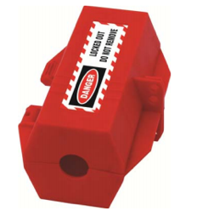
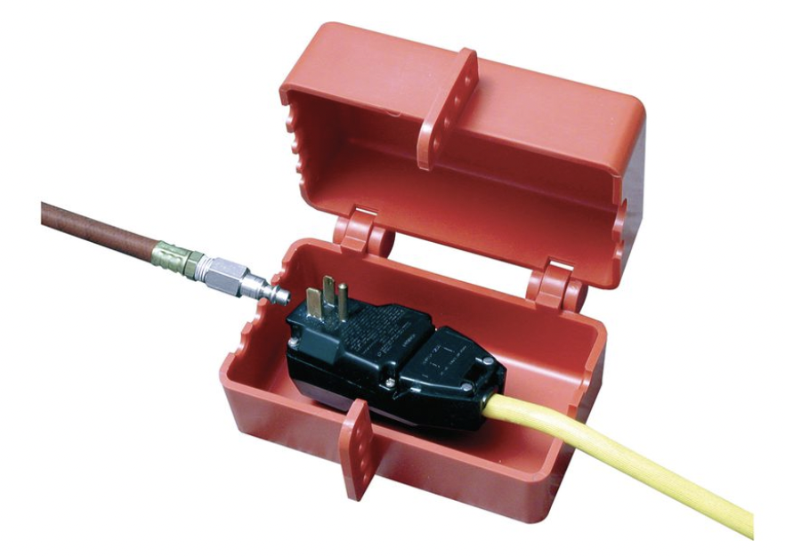
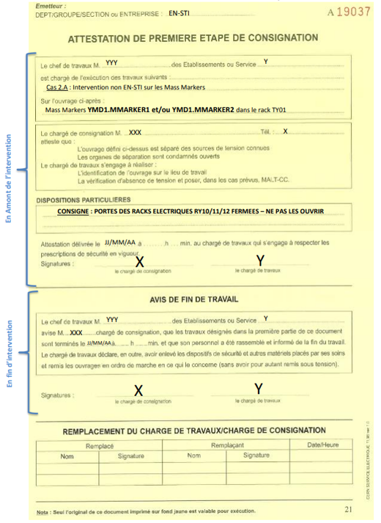
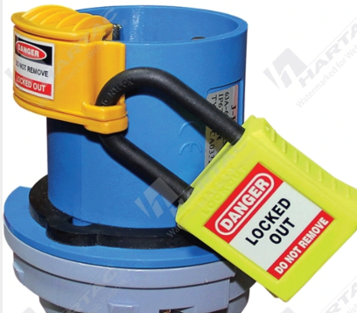
Rules for working on electrical equipment
Can the system be unplugged?
YES
NO
Unplug and secure the plug.
Lock-out
/
Tag-out
Training:
Electrical Safety - Working in EP experiments
Training: Habilitation Electrique
Electrical Rules
Not a ”lockout”…
A ”lockout”…
EDMS 2966369

Slide 16
Lock-Out/Tag-Out and securing power supplies
Four key documents to help you:
Working with electricity in EP: An overview of procedures EDMS 2492708
Electrical lock-outs in EP: Procedures EDMS 2689353
Work on modular electrical equipment in EP: Procedures EDMS 2689354
Guidance for non-electrical works EDMS 2378250
Electrical Rules
If in doubt ask!
EDMS 2966369

Slide 17

New cable rules: SSI-FS-2-1
This standard replaces CERN IS 23 which is now obsolete.
The new rules are an implementation of EU Regulation 305/2011 (CPR).
Two classes of CPR qualified cables are permitted:
  For High Risk (experiments): Cca-s2,d1,a2.
  For Low Risk (tertiary areas): Dca-s2,d1,a2
In theory these are standard classes available on the EU market, practical experience to date (large experiments) shows this isn’t always the case.
Electrical Rules
SSI-FS-2-1: EDMS 2669584
EDMS 2966369

Slide 18
Implementing the new cable rules
Purchase cables via CERN stores; automatic compliance (also derogation granted for IS23 cables until stocks are exhausted).
Procure from the EU market with Cca-s2,d1,a2 criteria.
‘Standing’ derogations are included in the new code which apply to the following cases:
  Halogens or Sulphur acceptable in short distance equipment cables, laptop power supplies, VGA cables, optical patch cords. Small quantities, non-permanent installations in radiation areas.
  Low temperature cryogenic installations, RF connections and amplifier cabling. PTFE, PEF/Teflon acceptable, only if no halogen free options exist.
  A good definition for patch cables: two pre-terminated ends & relatively short.
Electrical Rules
HSE guidance document: EDMS 2669629
EDMS 2966369

Slide 19
AUG, AUL and AUE testing
Complex | Electrical test & Maintenance | Date
all CERN sites | Auto-transfert | 5th, 6th, 7th December 2023 (W49)
 | Normal Secours (N/S) | 19th December 2023 (6 a.m. to 6.10 am) (W51)
Meyrin site | AUG Adm. Zone Meyrin | 6th January 2024 (W1)
 | AUG PS & PSB | 16th & 17th December 2023 (W50)
 | AUG West area | 13th January 2024 (W2)
Prévessin site | AUG Adm. Zone Prevessin | 10th February 2024 (W6)
 | AUG North area (BA80-BA81-BA82) | 29th & 30th January 2024 (W5)
SPS | AUG SPS1 | 18th December 2023 (W51)
 | AUG SPS2 | 11th December 2023 (W50)
 | AUG SPS3 | 27th November 2023 (W48)
 | AUG SPS4 + AWAKE | 28th November 2023 (W48)
 | AUG SPS5 | 9th January 2024 (W2)
 | AUG SPS6 | 4th December 2023 (W49)
 | AUG SPS7 | 12th December 2023 (W50)
LHC | AUG LHC1 (including HL) + ATLAS | 14th November 2023 (W46)
 | AUG & Maintenance LHC18 + P18 | 12th, 13th, 14th, 15th January 2024 (W2&3)
 | AUG & Maintenance LHC2 + ALICE | 22nd & 23rd November 2023 (W47)
 | AUG LHC3 + LHC3Z | 25th January 2024 (W4)
 | AUG & Maintenance LHC4 | 20th & 21st November 2023 (W47)
 | AUG & Maintenance LHC5 (including HL) + CMS | 10th & 11th January 2024 (W2)
 | AUG & Maintenance LHC6 | 20th & 21st December 2023 (W51)
 | AUG LHC7 | 31st January 2024 (W5)
 | AUG & Maintenance LHC8 + LHCb | 16th & 17th January 2024 (W3)
AUL testing:
I will contact the experiments concerned to schedule it at a convenient time for you!
AUE testing:
This is the responsibility of the equipment owner.
EN/EL Planning document: ACC-E-TP-0001 v.0.3
EDMS 2966369

Slide 20
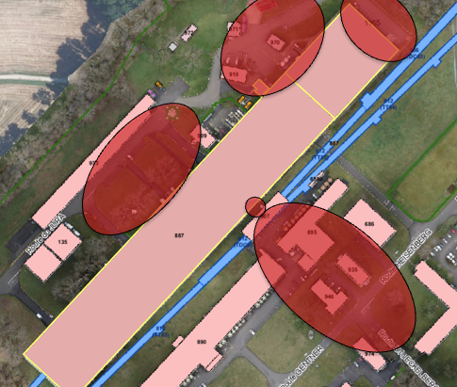
Site lighting at night
Since October 2022, CERN lighting has been turned off between 11pm and 5am.
This is a known issue for experiments, being addressed on a zone by zone basis with EN/EL for urgent needs.
Also being addressed with SCE for the whole site, for longer term evolution.
All of the critical zones identified should be lit now, however if you notice a problem contact me!
SCE consultation with all departments is ongoing; there may be a change in the schedule (11:30pm or 12am) if there is enough support.
EP lighting needs, all experiments: EDMS 2910905
EDMS 2966369

